Slide 1
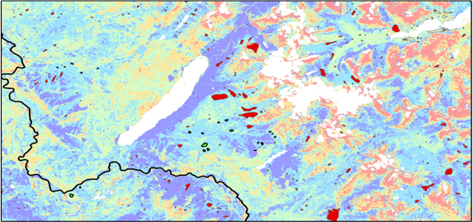
Charlotte Mays (Team Lead)
GLACIER NATIONAL PARK CLIMATE II
Antonio Alvarado
Ryan Avery
A Threshold-Based Decision Tree Approach to Mapping Landscape Disturbance in Glacier National Park
Jemiris Gonzalez-de Jesus
Suzannah Richards
NASA Langley Research Center
2017 Spring
Notes:
We are the Glacier National Park Climate Team *Introduce yourself (name, degree/field, school)*

Slide 2
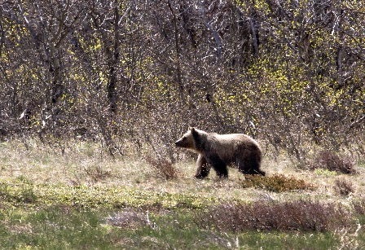
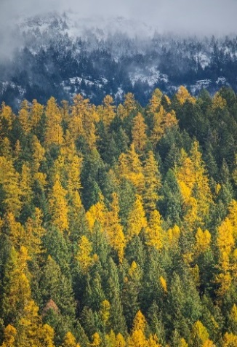
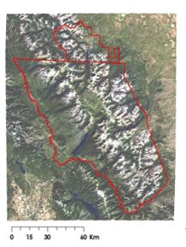
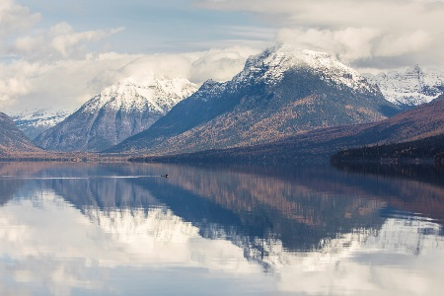
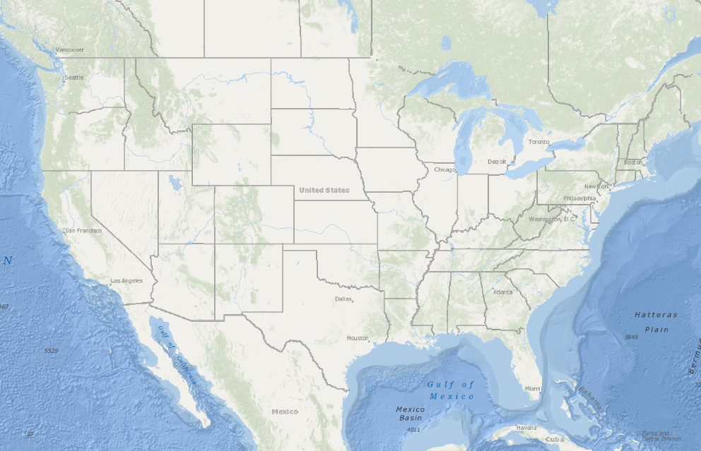
Glacier National Park (GNP)
Study Area: GNP and Waterton National Park (Canada)
Study Period: 2000 - 2016
Part of the Crown of the Continent ecosystem
International biosphere reserve
4 major floristic provinces = diversity
Image Credits: (Top Right Images) Glacier National Park’s Jacob W. Frank, (Top Left/Bottom Right) ArcGIS Online, (Bottom Left), NPS
1
Notes:
Roughly encompassing over 1,500 square miles, Glacier National Park is part of the larger Crown of the Continent ecosystem
Source: (https://www.nps.gov/glac/learn/news/fact-sheet.htm)
Source: Waldt, R., (2004). Crown of the Continent. Helena, Montana: Riverbend Publishing
GNP’s unique landscape and ecosystem has established it among the US’s most popular national parks.
Floristic Provinces: (Source: https://www.nps.gov/glac/learn/nature/plants.htm)
Cordilleran [49%], including the southern and central Rocky Mountains as well as the Cascade Mountains of the Pacific Northwest
Boreal [39%], sub arctic forest
Arctic-Alpine [10%],
Great Plains [1%], prairie, steppe and grassland
pine image: https://www.flickr.com/photos/glaciernps/30058012794/
Lake image: https://www.flickr.com/photos/glaciernps/30601537111/
Bear image: https://www.flickr.com/photos/glaciernps/24868375952/in/album-72157623549884756/

Slide 3
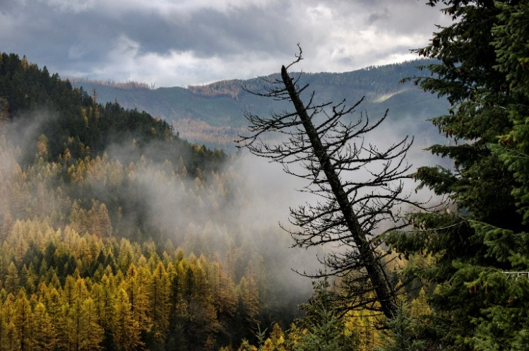
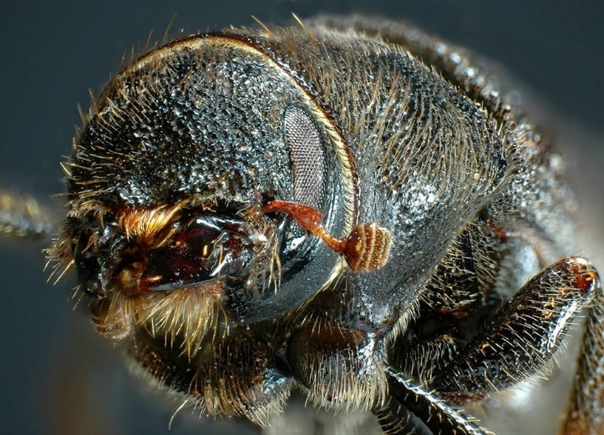
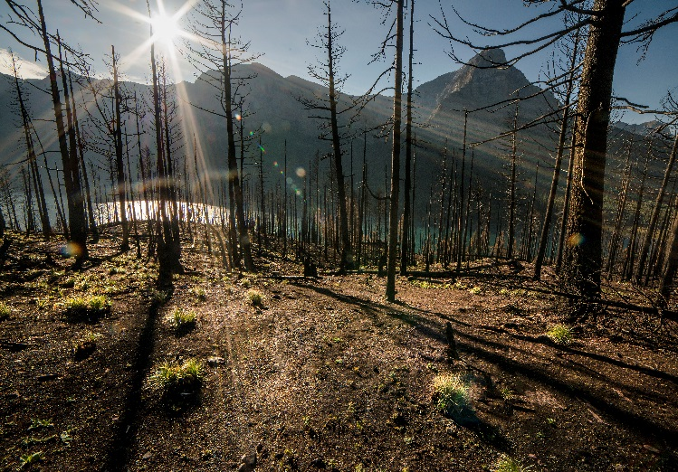
Community Concerns
Outbreaks from bark beetles cause extensive damage to pine forests
Severe outbreaks can impact timber industry
Insect disturbance compromises aesthetic value of park
Dead trees are safety hazards
Image Credits: NPS, Glacier National Park’s Jacob W. Frank, Scienceline
2
Notes:
Over the past decade insects such as the bark beetle have caused intensifying disturbance.
Intensifying landscape disturbances have been observed in recent decades due in part to a changing climate (“Montana Insect and Disease Conditions,” 2001).
Parasitic insects have caused extensive damage to the park’s pristine pine forests since 1999.
The timber industry must account for the impact that bark beetle outbreaks may have on timber production and optimal harvesting period (Goodwin et al., 2008).
Outbreaks may also compromise the aesthetic value of the park. The park service must consider this in managing bark beetle in order to preserve the pristine and primitive nature of Glacier National Park.
Image Credits: Glacier National Park Service’s Frank W. Jacobs
Upper photo: https://www.flickr.com/photos/glaciernps/30284703360/
Right photo: http://scienceline.org/2014/11/a-portrait-of-the-artist-as-a-mountain-pine-beetle/
Lower photo: https://www.flickr.com/photos/glaciernps/24619954129/
Formal Citations:
Bullet 1: “Montana Insect and Disease Conditions and Program Highlights 2001 - stelprdb5196901.pdf.” Accessed February 16, 2017. https://www.fs.usda.gov/Internet/FSE_DOCUMENTS/stelprdb5196901.pdf.
Bullet 3: Goodwin, Nicholas R., Nicholas C. Coops, Michael A. Wulder, Steve Gillanders, Todd A. Schroeder, and Trisalyn Nelson. “Estimation of Insect Infestation Dynamics Using a Temporal Sequence of Landsat Data.” Remote Sensing of Environment 112, no. 9 (September 15, 2008): 3680–89. doi:10.1016/j.rse.2008.05.005.

Slide 4
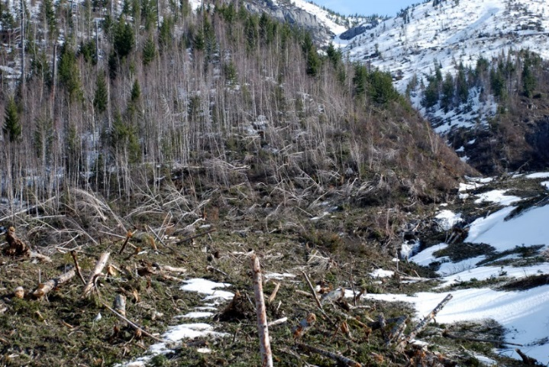
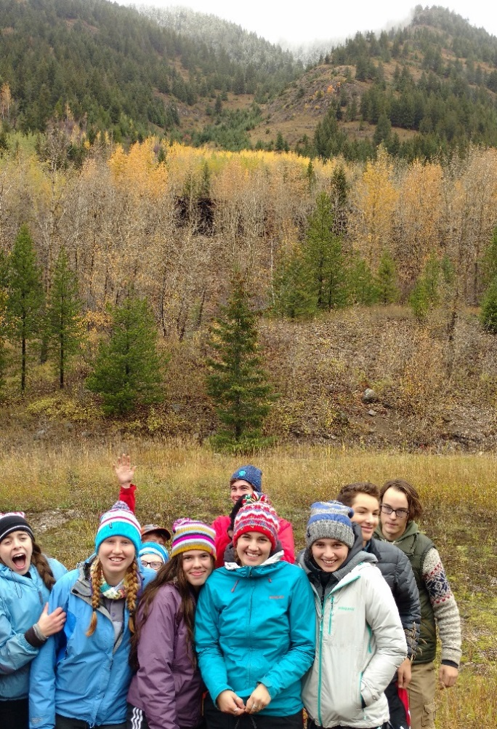
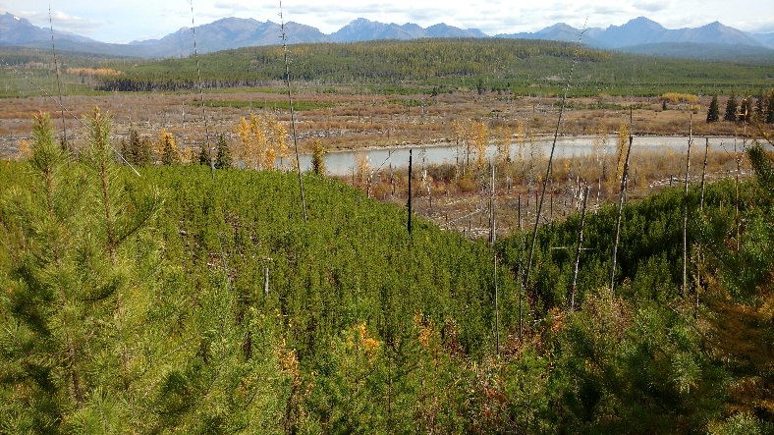
Project Objectives
Classify landscape disturbance using threshold-based, decision tree approach
Develop automated Python program that expedites mapping of disturbances
Create educational tutorial for high school students
Image Credits: Richard Menicke
3
Notes:
The primary objectives for the project are composed of:
Classifying landscape disturbance within Glacier National Park utilizing a threshold- based decision tree approach
Developing an automated Python program utilizing NASA Earth observations that expedites mapping disturbance within GNP.
Educating students in Whitefish and Columbia Falls High School through interactions with NASA Earth observation tools.
Image Credits: Richard Menicke

Slide 5
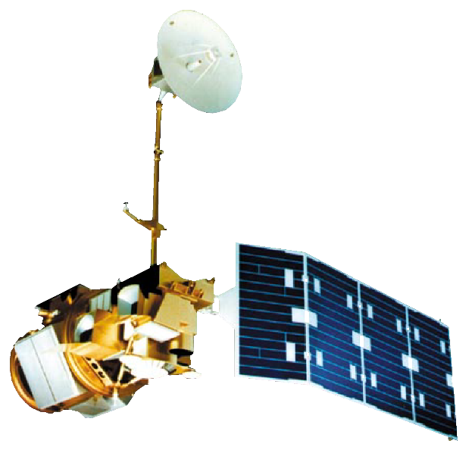
NASA Earth Observations
Landsat 7 ETM+
Landsat 8 OLI
Landsat 5 TM
Image Credit: NASA
4
Notes:
Images from Landsat 5, 7, 8 were composited for the months of June to August of every year within Glacier National Park form 1999-2016.

Slide 6
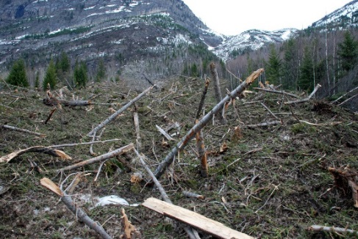
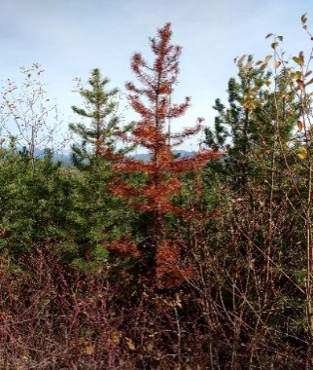
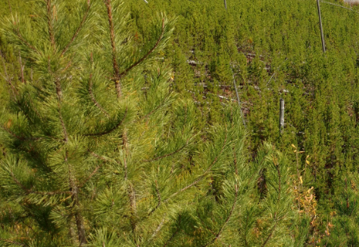
Decision Tree Methodology
Abrupt Disturbance
High Disturbance
Establish ∆NDMI Thresholds
Calculate ∆NDMI
Cloud Mask/Target Date Mosaics
Moderate Disturbance (Potentially Insect)
Healthy Vegetation
Regenerating Vegetation
Image Credits: Richard Menicke
5
Notes:
We hypothesized that disturbance from bark beetle causes decreases in canopy moisture, up until tree mortality.
Because of this, a normalized difference moisture index was computed from Landsat to track changes in moisture for our time series.
Thresholds for categorizing disturbance were established to map interannual changes in NDMI.
We used five categories; Abrupt, High, Moderate, Healthy, and Regenerating Vegetation. The moderate disturbance category was the class most closely associated with insect disturbance.
Because of this, a Red Green Index was then used to further separate Moderate disturbance.

Slide 7
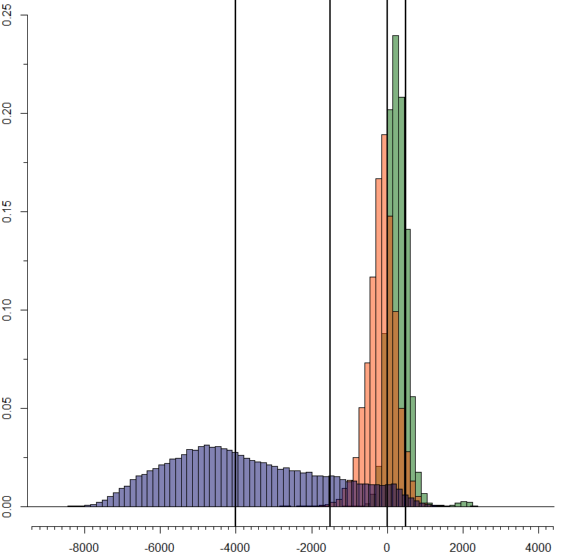
Results: Threshold Reclassification
Comparison of ∆NDMI Subset to Bark Beetle, Healthy Forest, and Fire Polygons
Fire Polygons (2015 – 2016)
Bark Beetle Polygons
(2013 – 2014)
Healthy Forest Polygons
(2013 – 2014)
Thresholds:
Abrupt Disturbance: ∆NDMI < -4000
High Disturbance: -4000 ≤ ∆NDMI < -1500
Moderate Disturbance: -1500 ≤ ∆NDMI < 0
Healthy Vegetation: 0 ≤ ∆NDMI < 500
Regenerating Vegetation: ∆NDMI ≥ 500
Frequency of ∆NDMI
∆NDMI
6
Notes:
Here are the thresholds that the team determined by overlaying changes in NDMI subset to the following categories; bark beetle (outlined here, point to the orange histogram), healthy forest (Outlined here, point to the green), and fire (outlined here, point to the blue/purple). The black lines represent the thresholds that we visually interpreted for each class.

Slide 8
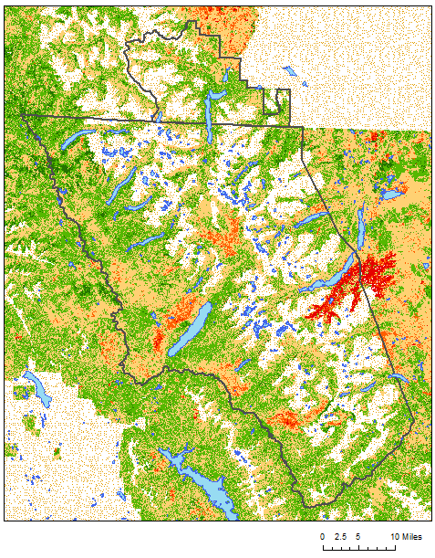
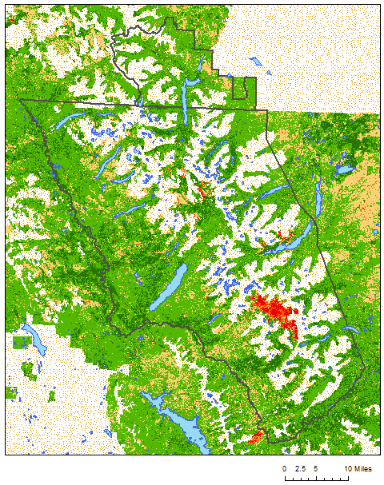
Results: Interannual Classification Maps
Landscape Disturbance
Glacier National Park (2005 – 2006)
Landscape Disturbance
Glacier National Park (2015 – 2016)
Landcover Classification
Cardston
Cardston
Abrupt Disturbance
High Disturbance
Moderate Disturbance
Healthy Vegetation
Regenerating Vegetation
Water Bodies
Park Boundaries
Masked Areas
WhiteFish
WhiteFish
Columbia Falls
Columbia Falls
7
Notes:
With the thresholds established, we reclassified dNDMI to create classification maps. As you can see these maps do a good job of mapping fire or abrupt disturbance in red. There is also a varied amount of moderate disturbance in yellow between the two years.

Slide 9
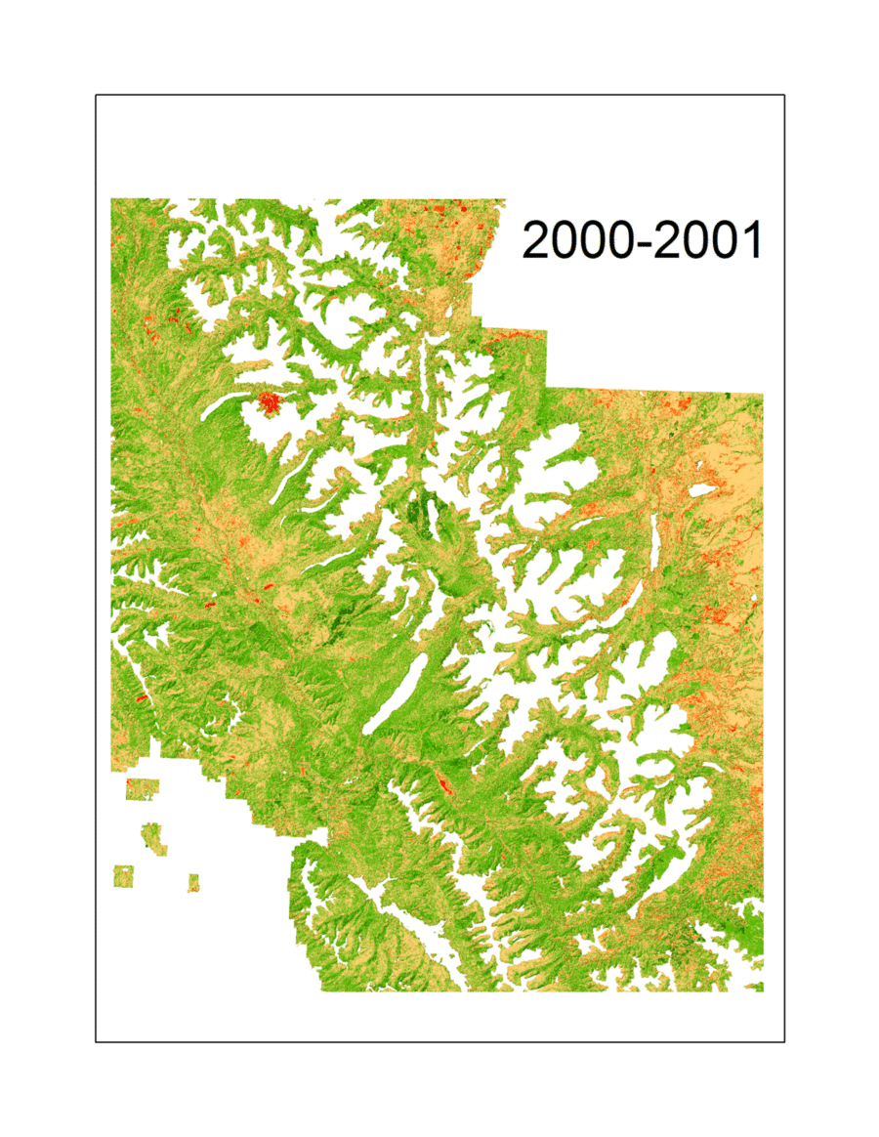
Landscape Disturbance within
Glacier National Park (2000-2016)
Landcover Classification
Abrupt Disturbance
High Disturbance
Moderate Disturbance
Healthy Vegetation
Regenerating Vegetation
Water Bodies
Park Boundaries
Masked Areas
8
Notes:
We can see in this time series that when fires appear in red, the next year there is regeneration in dark green. We can again see how varied the moderate disturbance is from year to year.

Slide 10
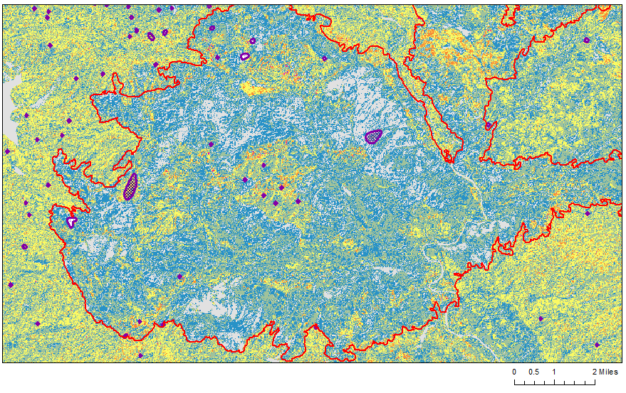
Results: Disturbance Frequency Maps
Number of Interannual Periods Showing Persistence
1
2
3
4
5
2001 Fire Outline
ADS Top 15% DTPA 2004, 2005, and 2006
ADS = Aerial Detection Survey
DTPA = Dead Trees Per Acre
Persistence of Moderate Disturbance from Interannual Periods
2001- 2002 to 2005-2006
9
Notes:
This persistence map was created through separating out moderate disturbance from the rest of the classes and then grouping them into five year periods. This map shows persistence of moderate disturbance from 1 – 5 interannual periods. A fire polygon from a fire in 2001 was added as well as bark beetle polygons from 3 – 5 years after the fire. We can see that after the fire occurred there is not much moderate disturbance in the polygon because it would be mostly abrupt and regenerating vegetation. However, in looking at the bark beetle polygons outside of the fire perimeter, we see that a lot of moderate disturbance is occurring near the perimeter.

Slide 11
Results: Bark Beetle Accuracy
2013 - 2014 Classification within Bark Beetle Polygons (Top 15%)
Tabulated Area Results:
Classification maps using three sets of validation polygons:
ADS
Fire
Healthy Forest
Percentage of pixels by disturbance category for each set of polygons.
10
Notes:
After making classification maps, we did an accuracy assessment using three different sets of polygons. This graph shows the number of pixels either correctly classified as moderate disturbance or misclassified. Here, over 60% of pixels in bark beetle polygons are correctly classified as moderate disturbance

Slide 12
Results: HV and Fire Accuracy
2013 - 2014 Classified within Healthy Vegetation Polygons
2015 - 2016 Classified within Fire Polygons
11
Notes:
This first graph shows that over 70% of pixels were correctly classified as healthy vegetation. The next graph shows that just under 50% of pixels were correctly classified as abrupt disturbance and 35% were misclassified as high disturbance. This could be due to how we drew our thresholds on the histograms.

Slide 13
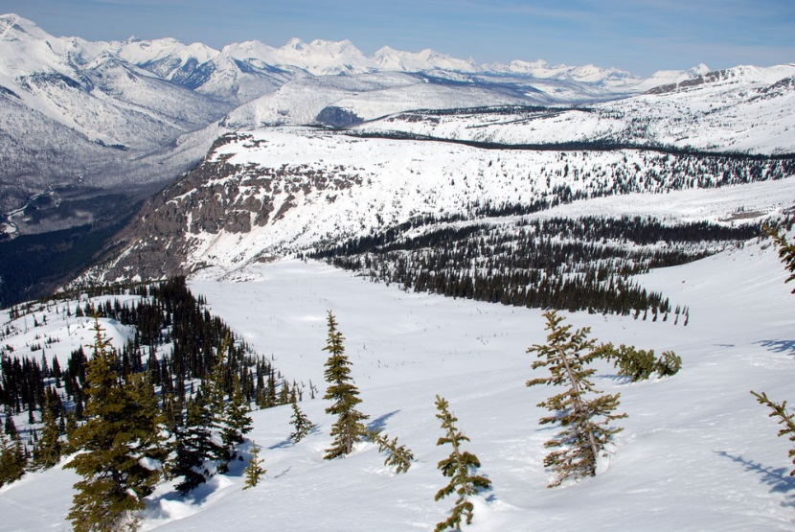
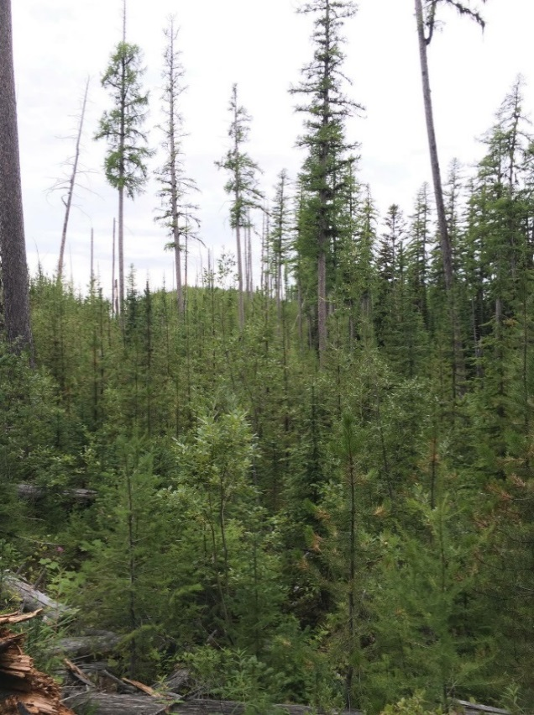
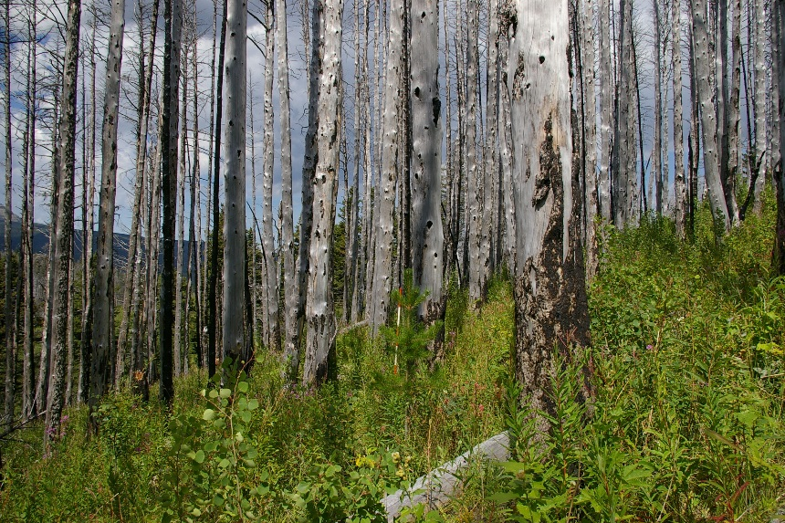
Conclusions
Higher activity of bark beetle disturbance 3-5 years after forest fire encounters
Landsat multi-spectral indices valuable with locating moderate disturbances in GNP
Threshold-based classification schemes provide an efficient approach for identification of stressed canopies
Image Credit: (Top and Bottom Left) Richard Menicke, (Center Right) Jordan Lubbers
12
Notes:
Persistence of interannual moderate disturbance coincide with higher activity of bark beetle disturbance 3-5 years after forest fire encounters.
Multi-spectral indices from Landsat can be valuable in locating areas that are at risk or currently impacted by drought, insect, and other moderate disturbances in GNP.
While it is not possible to exclusively detect bark beetle disturbance, the use of threshold-based classification schemes can provide an efficient and accurate approach for identifying and mapping canopies experiencing significant stress.
Image Credits:
Top and Bottom Left: Richard Menicke
Center Right: Jordan Lubbers

Slide 14
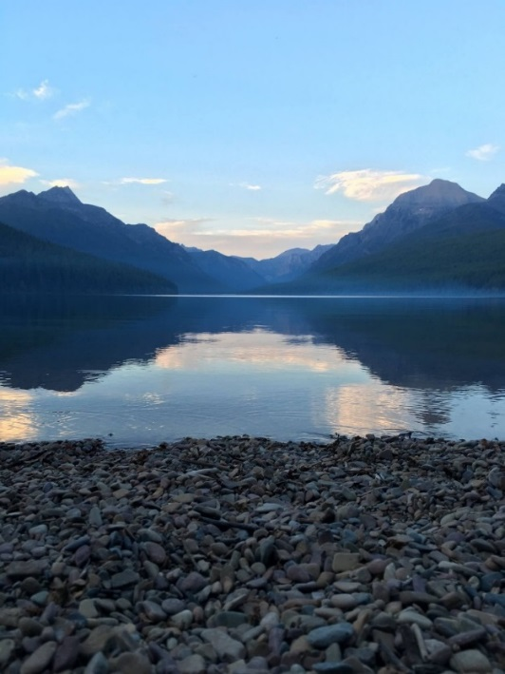
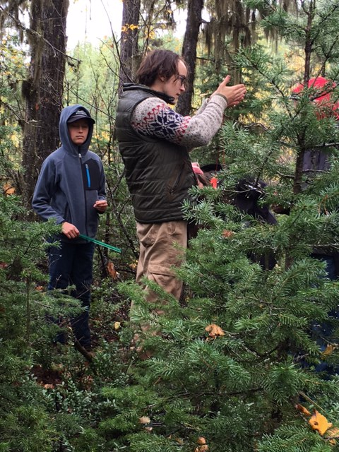
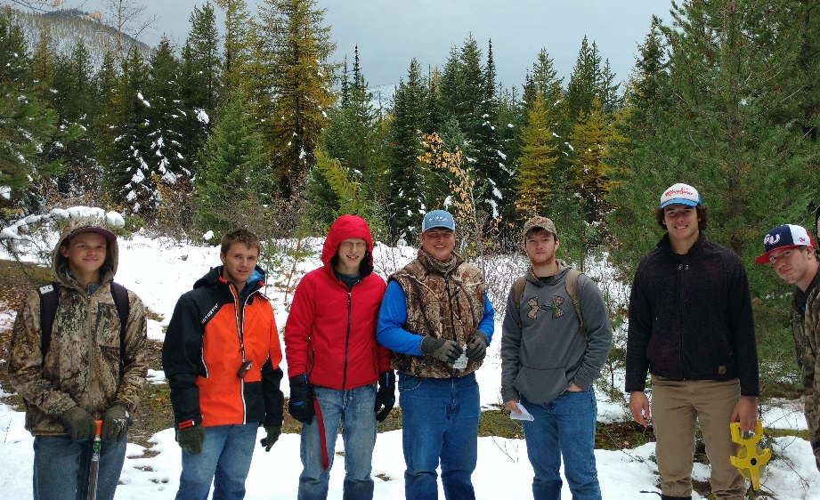
Future Work
Explore other methods to examine red attack
Analyze maps and look for trends
Refine automation process
Image Credits: (Left) Jordan Lubbers, (Center) Eric Sawtelle, (Right) Richard Menicke
13
Notes:
Expand the study area to include sister park, Waterton.
Explore a better methodology for analyzing red attack.
Actually spend time analyzing the classification and frequency maps and look for trends.
Refine previous code to obtain a more abstract and versatile script that allows user to access with more ease.
Image credits:
Left photo: Jordan Lubbers
Right photo: Eric Sawtelle

Slide 15
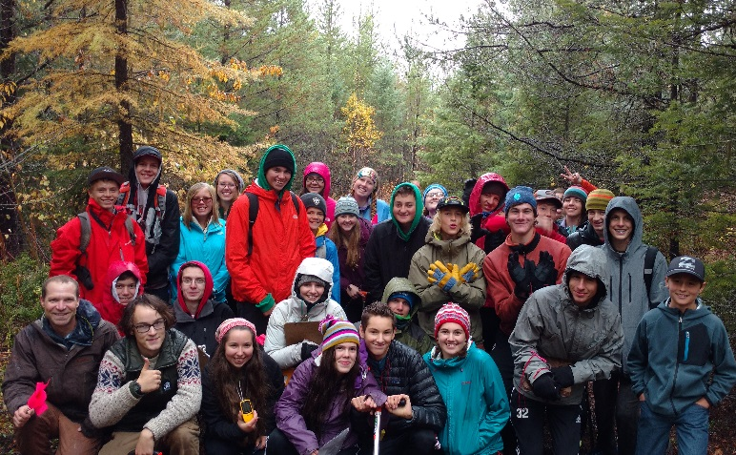
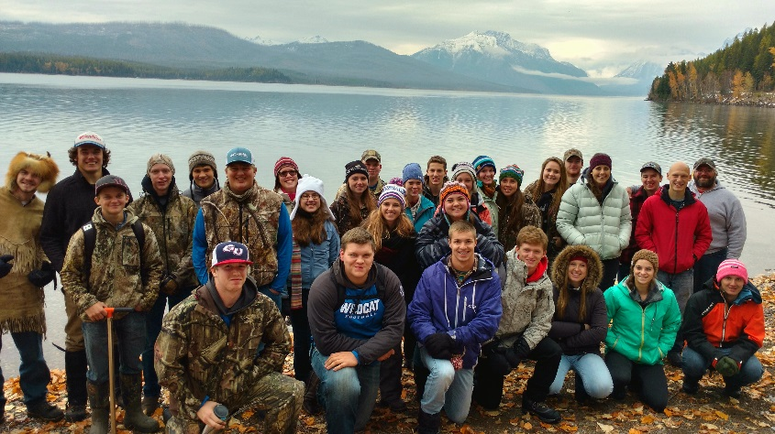
Advisor
NASA Langley Research Center:
Dr. Kenton Ross
Partners
National Park Service, Glacier National Park:
Richard Menicke
NASA Ames Research Center:
Dr. Chris Potter
University of Idaho:
Dr. Jeffrey Hicke
NASA DEVELOP
Center Lead: Emily Gotschalk
Previous Term Affiliates: Jordan Lubbers, Dr. Sunita Yadav-Pauletti, Joe Harris, Zachary Wardle
Special Thanks
Whitefish High School, MT
Columbia Falls High School, MT
Image Credit: Richard Menicke
Notes:
We would like to thank the following individuals for their assistance on this project. Without them, this work would not have been possible.

