Slide 1
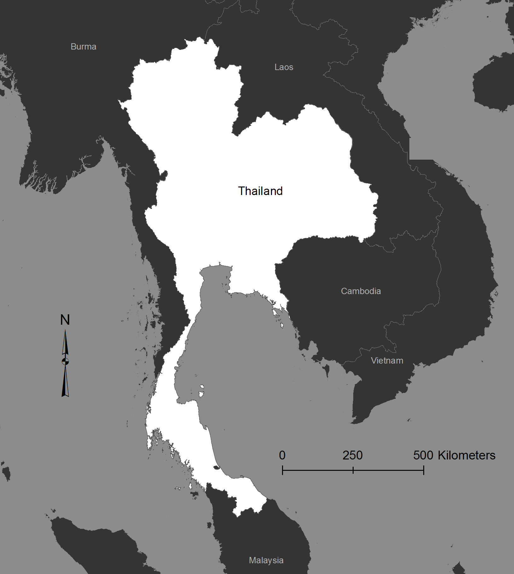
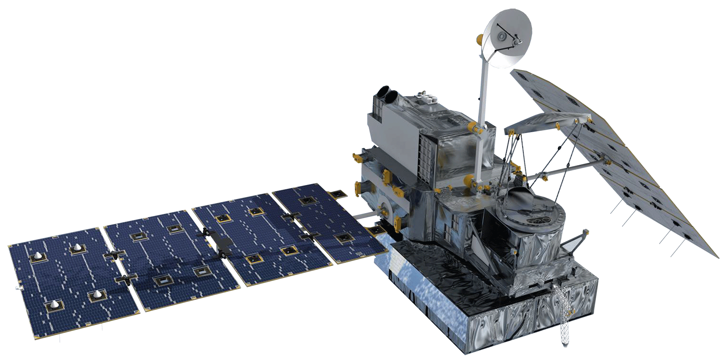
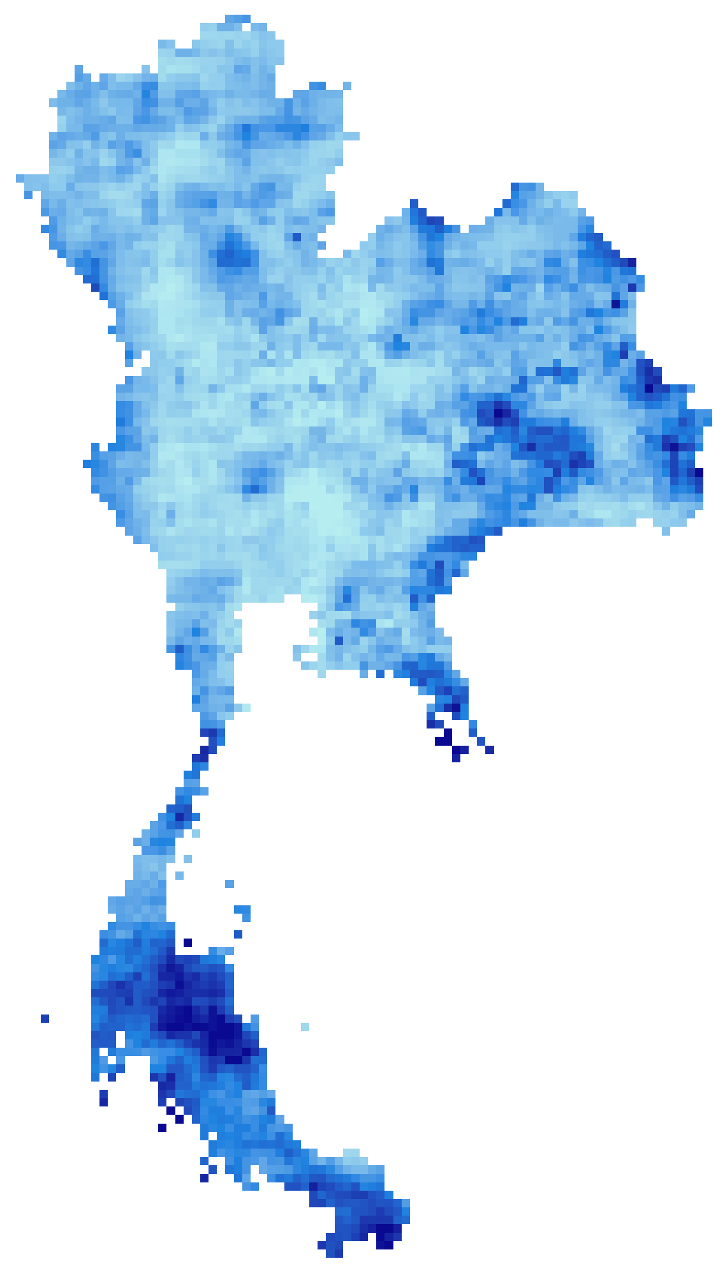
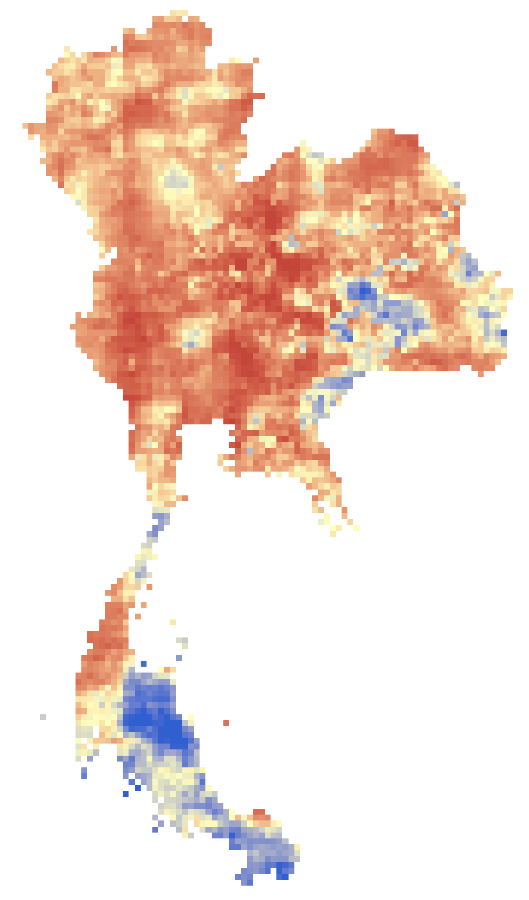
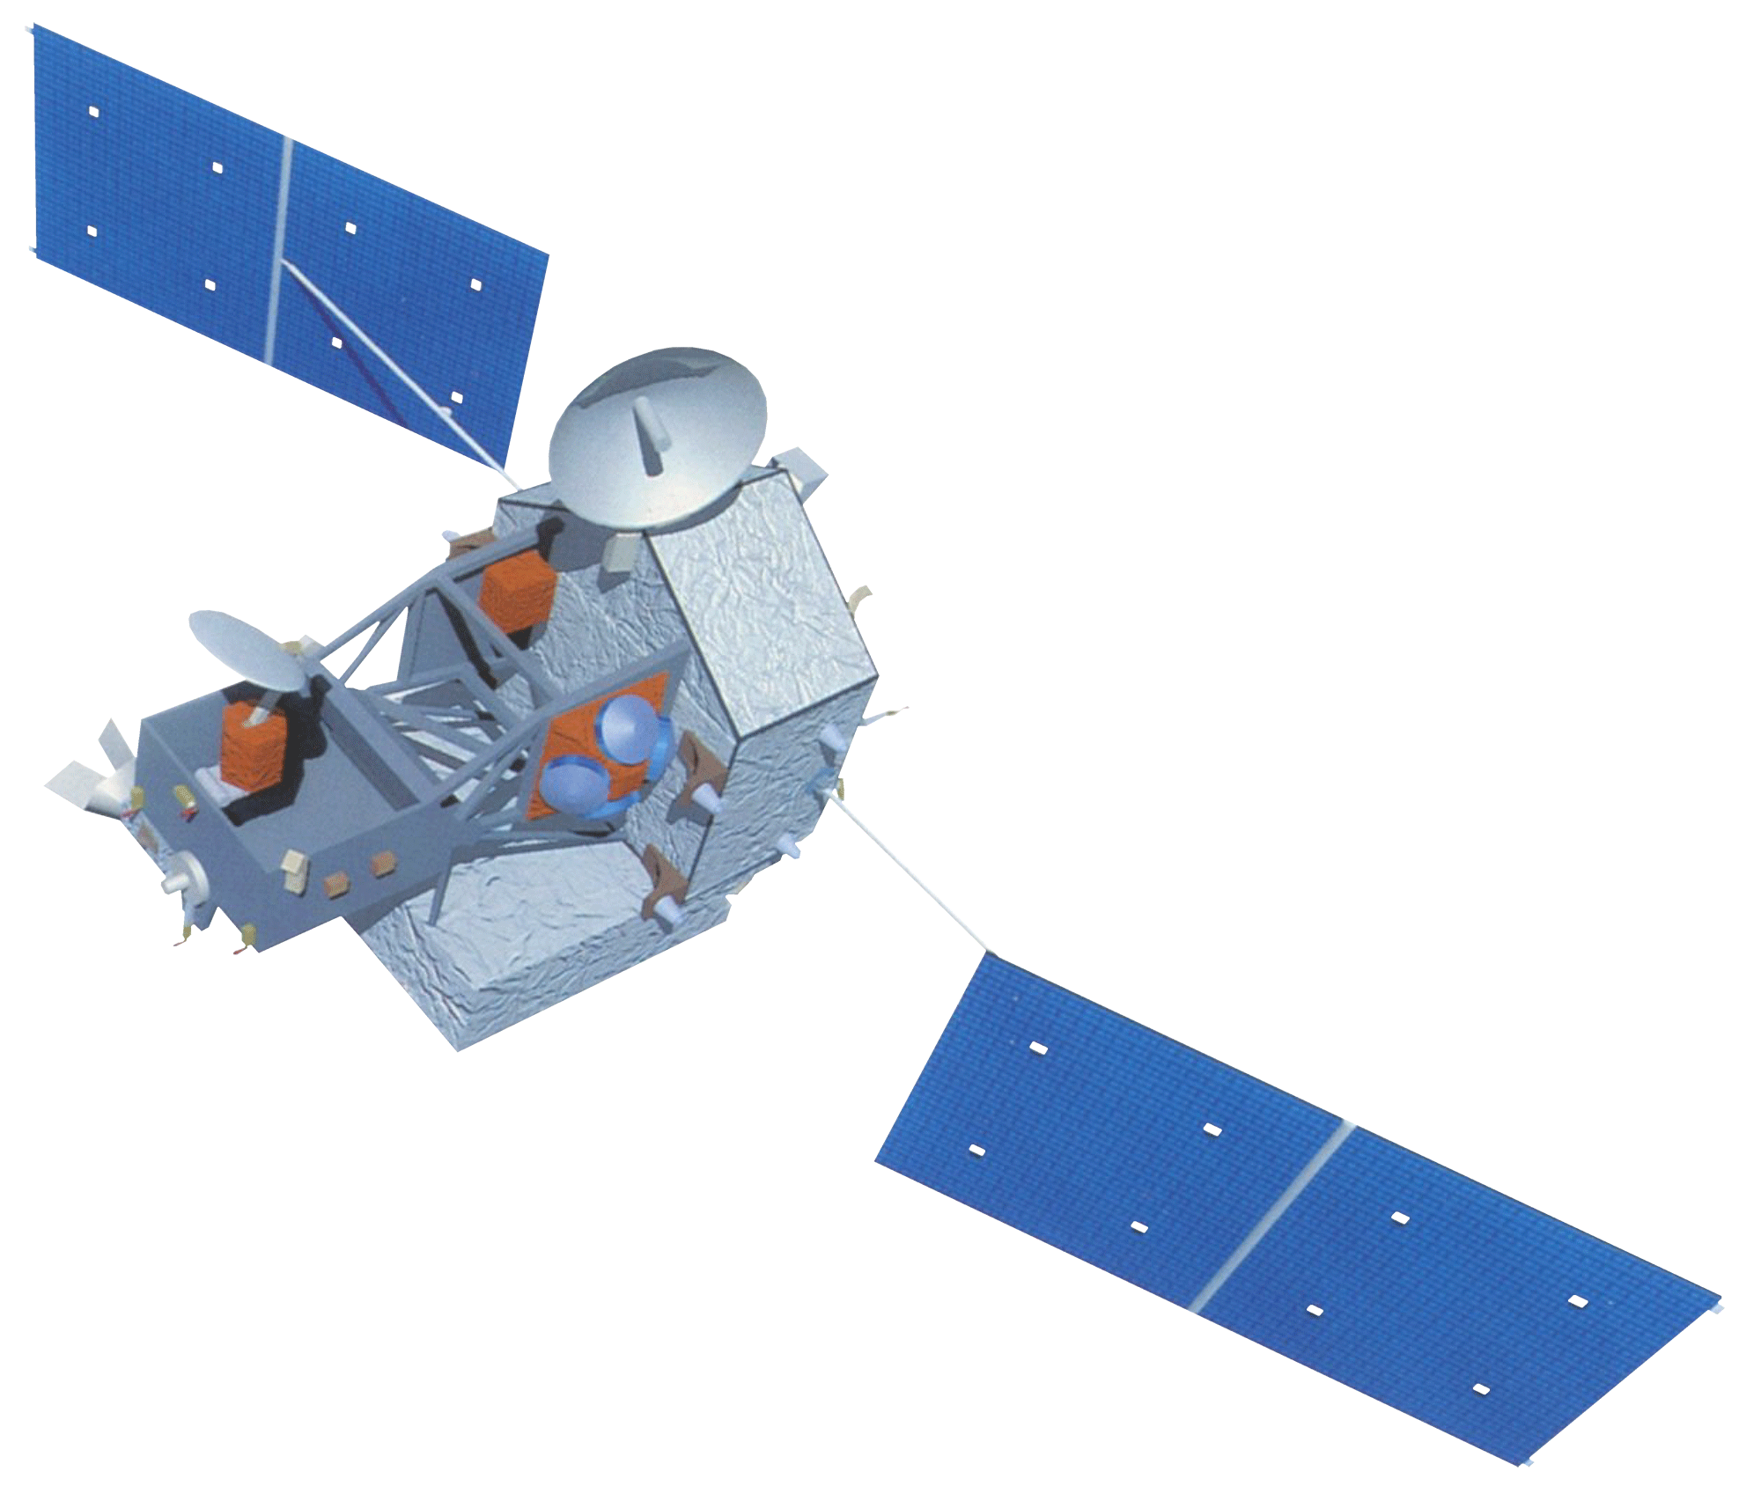
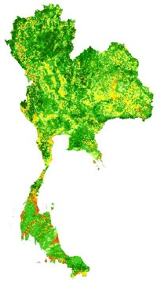
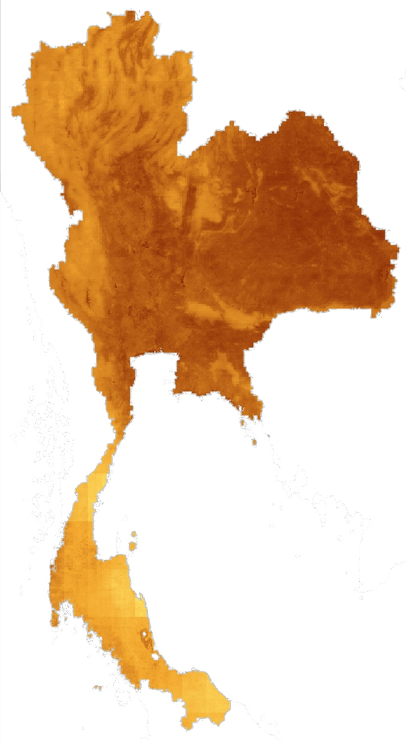


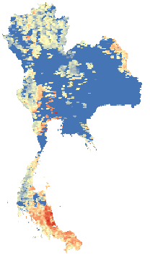
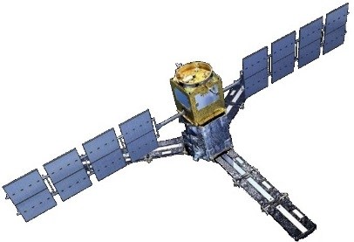
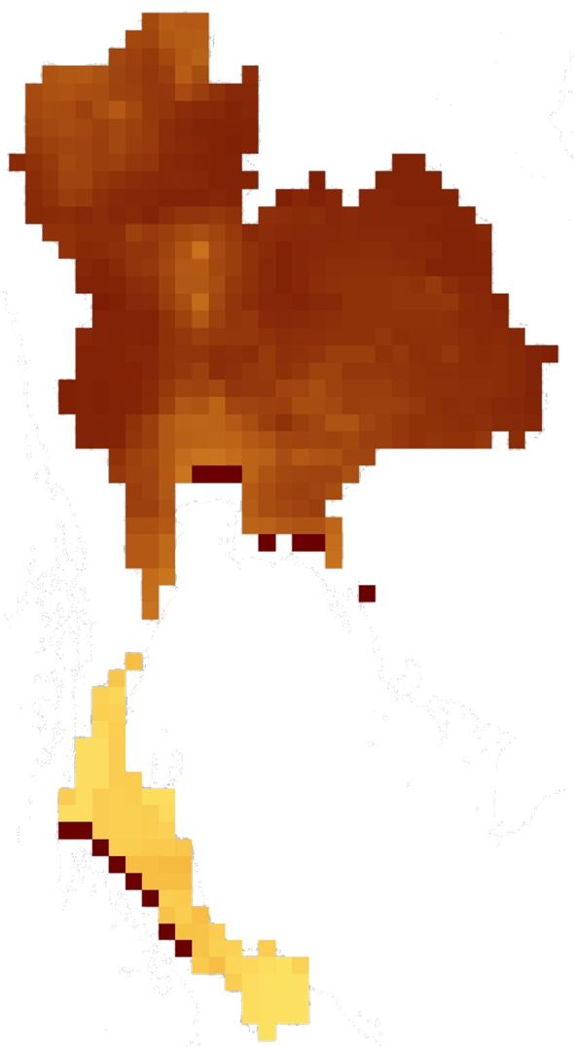
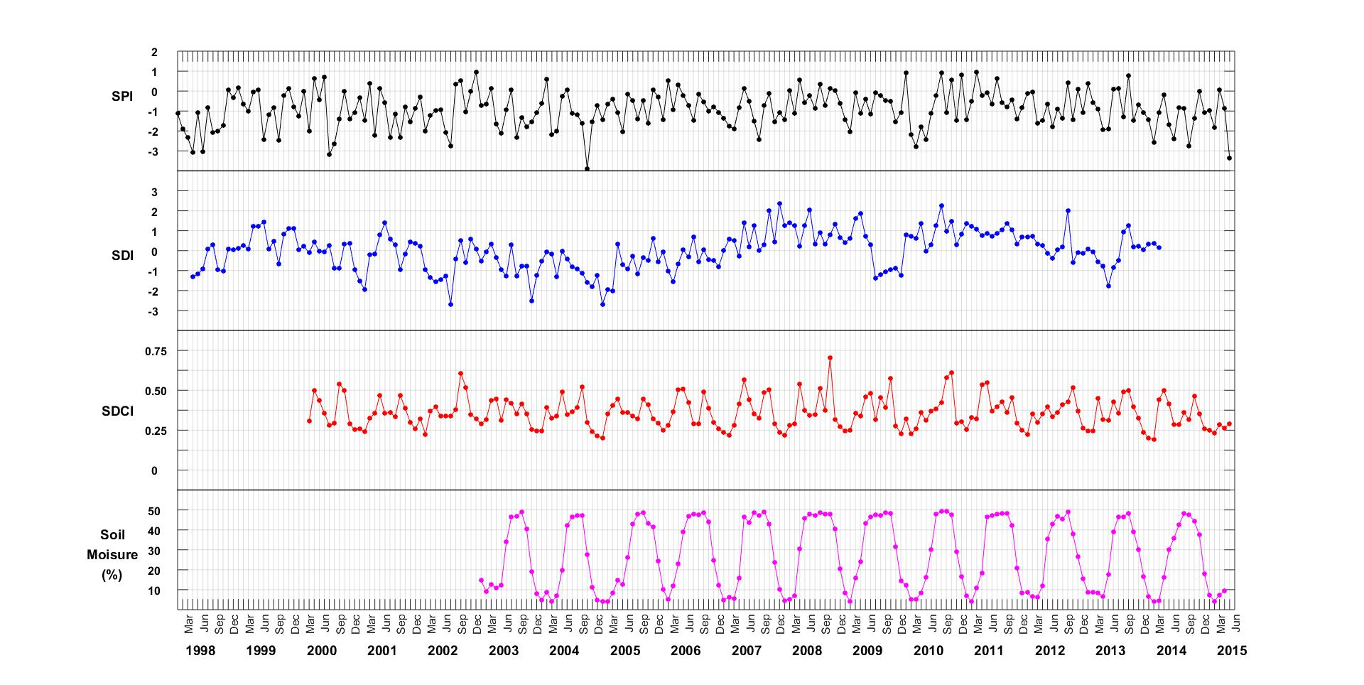
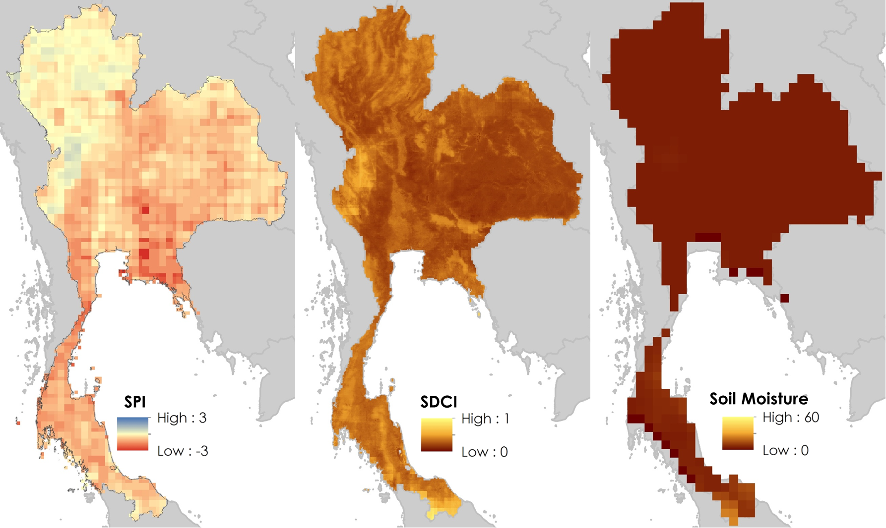
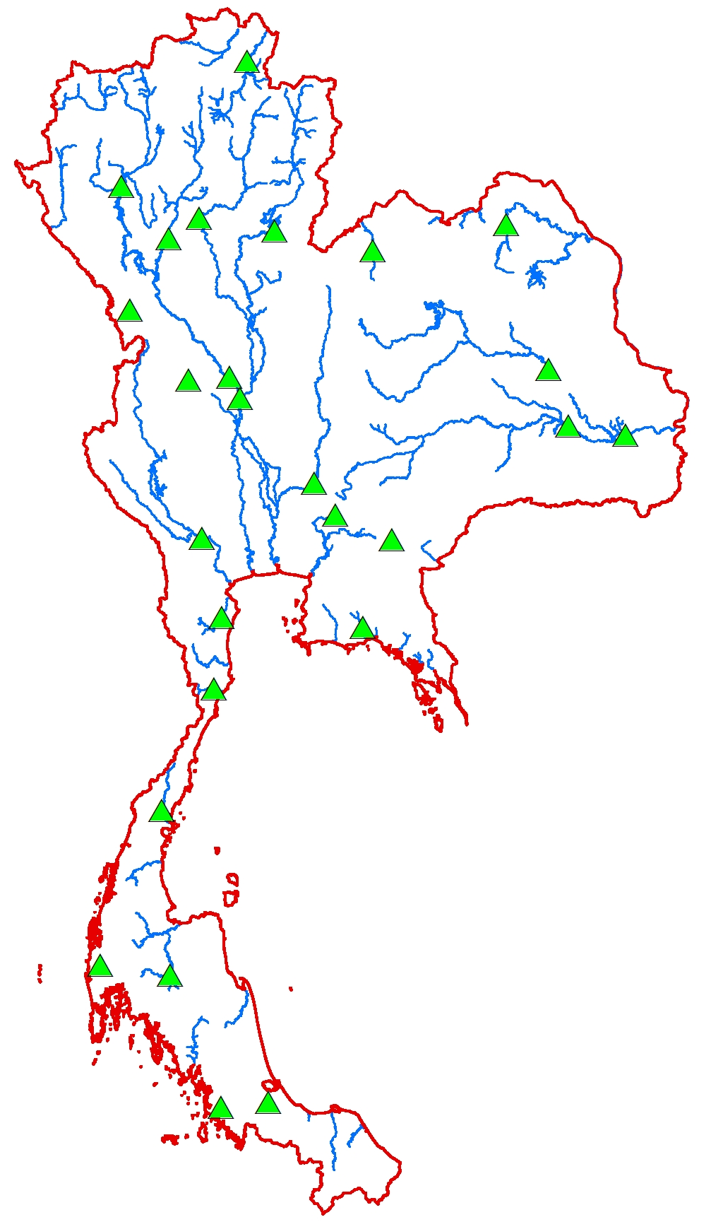
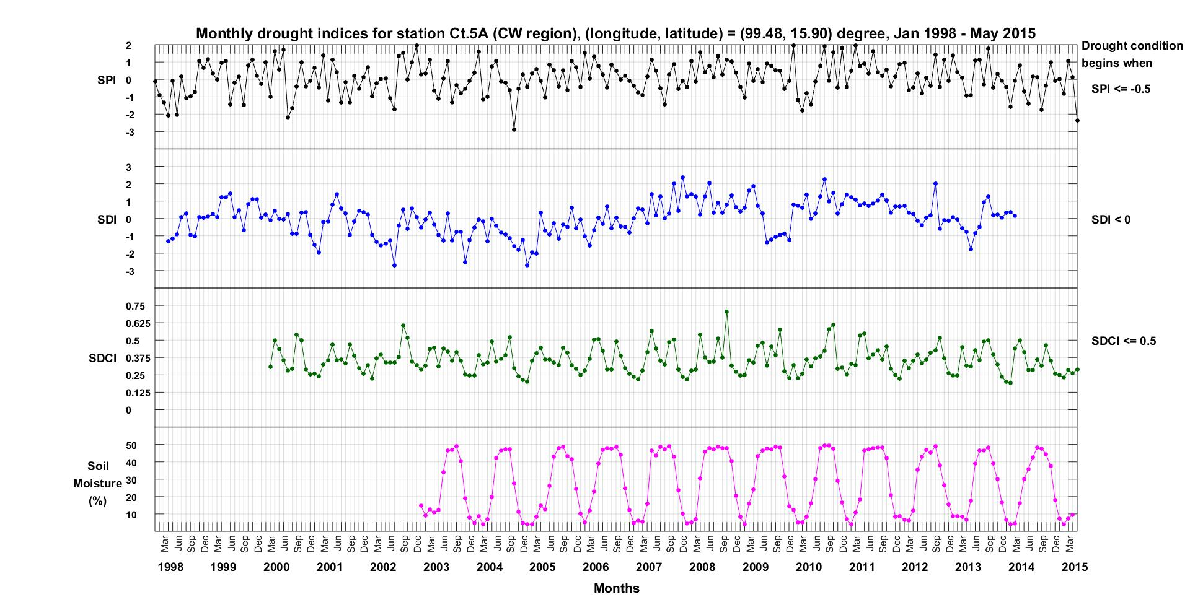
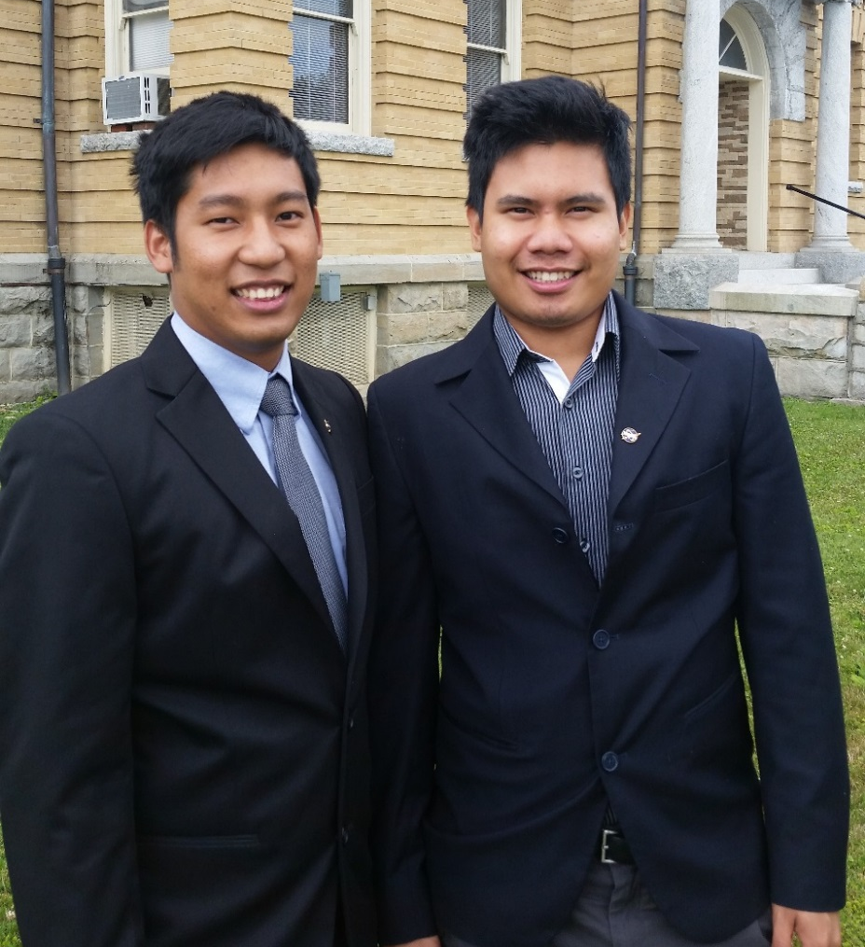
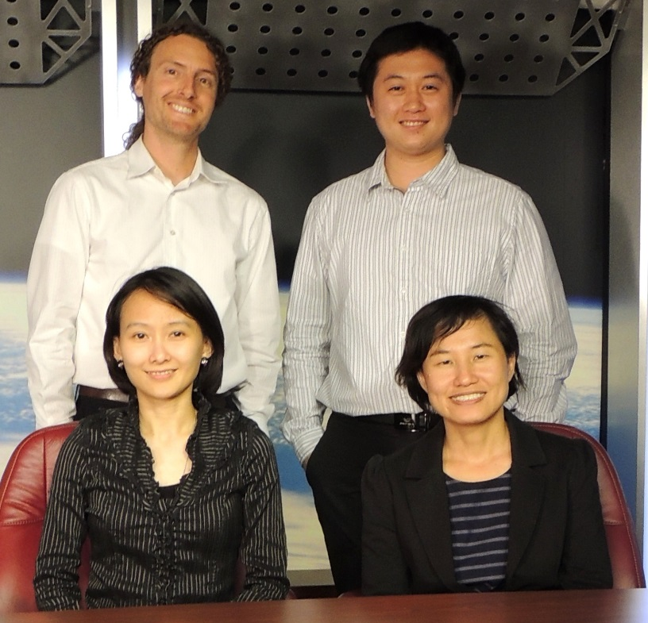
Thailand Disasters
Monitoring risk and extent of drought for enhanced decision making and resource allocation in the Kingdom of Thailand
Sean McCartney (Project Lead), Nobphadon Suksangpanya, Chisaphat Supunyachotsakul, Srisunee Wuthiwongyothin, Sahakait Benyasut, Thanapat Vichienlux
NASA DEVELOP National Program at NASA Goddard Space Flight Center and Wise County and City of Norton Clerk of Court’s Office
Abstract
Objectives
Drought is a natural disaster impacting agricultural production and economic livelihoods. The Kingdom of Thailand is impacted by drought due to the variability of monsoon rains as well as other unfavorable meteorological conditions. The drought of 2015 was the worst drought to impact Thailand in over 15 years. As one of the biggest exporters of rice in the world, drought has the ability to impact the economy of Thailand by reducing agricultural yield and shrinking Thailand’s gross domestic product. The available drought monitoring system in Thailand looked at only agricultural drought. This was insufficient for analyzing accurate risk management and decision-making. Using data from various Earth-observing satellites, including Terra and Aqua (MODIS), TRMM (MI), and GPM (MI), as well in situ data from streamflow stations, this study utilized four indices to analyze and monitor the current state of meteorological, hydrological and agricultural drought across Thailand. The Standardized Precipitation Index was used in monitoring meteorological drought, the Streamflow Drought Index was used in monitoring hydrological drought, and the Scaled Drought Condition Index and Soil Moisture Index were used in monitoring agricultural drought. All indices were based on a monthly temporal resolution. The study demonstrated how a combination of various indices can offer better understanding of drought conditions, with data derived from Earth-observing satellites offering the ability to monitor drought across the entire country and in near-real time.
Use four different drought indices to monitor meteorological, hydrological and agricultural drought in Thailand
Identify drought anomalies based on a climatological baseline
Create a near-real time drought monitoring tool to assist in drought management and mitigation
Study Area
Methodology
GPM – GMI
30-min precipitation rate (mm/hr)
0.1°-spatial resolution
IMERG Level 3 product
Monthly Precipitation
Resampled to
0.1°-spatial resolution
Standardized Precipitation Index (SPI)
TRMM – TMI
Daily precipitation (mm)
0.25°-spatial resolution
3B42 Level 3 product
NDVI
0.01°-spatial resolution
MOD13A3 and
MYD13A3 products
Scaled Drought Condition Index
(SDCI)
0.01°-spatial resolution
Terra & Aqua
– MODIS
LST
0.05°-spatial resolution
MOD11C2 and
MYD11C2 products
SMOS – MIRAS
0.25°-spatial resolution
Palmer Model
Soil Moisture
Index
(SMI)
(%)
Earth Observations
Streamflow Drought Index
(SDI)
TRMM
Streamflow Records
26 ground-based stations on the main streams and rivers
Monthly Streamflow (m³)
SDI
Aqua
Terra
GPM
SMOS
Results
Conclusions
Four indices were utilized to monitor drought by two methods: first being spatial extent and second as a time series.
First, the index map was analyzed at a monthly scale so we can see the spatial extent of drought in Thailand.
Drought anomaly in February 2005
A drought monitoring system was developed based on meteorological, hydrological, and agricultural drought which improves upon the current system in Thailand.
SPI is an indicator of meteorological drought based on precipitation amounts in the study area.
SDI provided the effect of hydrological drought based on the streamflow from streams and rivers in Thailand.
Agricultural drought was monitored by SDCI and SMI. SDCI incorporates three factors: LST, NDVI, and precipitation. SMI measures the water content in the soil.
This drought monitoring system allows end users to access and characterize regional drought in Thailand. This leads to better decision making processes that are necessary in mitigating the impact of regional drought.
SPI
SDI
SDCI
Second, the time series plots at any region were analyzed to compare all indices. This approach allowed us to derive anomalies and identify drought.
In February 2005, all indices show extreme drought in the central region of Thailand. The index map at this time also substantiates the extreme drought conditions.
Soil Moisture (%)
Team Members
Project Partners
Acknowledgements
Royal Thai Embassy
Asian Disaster Preparedness Center (ADPC)
SERVIR Mekong
Colin Doyle (NASA GSFC - USRA)
Dr. John Bolten (DEVELOP National Science Advisor)
Dr. Kenton Ross (DEVELOP National Science Advisor)
Dr. Dalia Kirschbaum (DEVELOP National Science Advisor)
Lance Watkins (NASA DEVELOP)
Summer 2013 Great Plains Agriculture Team (NASA DEVELOP)
Dr. Peter Cutter (ADPC)
L to R: Thanapat Vichienlux, Sahakait Benyasut
(Wise node)
Back L to R: Sean McCartney, Nobphadon Suksangpanya
Front L to R: Chisaphat Supunyachotsakul,
Srisunee Wuthiwongyothin (Goddard node)
NASA Goddard Space Flight Center, Wise County and City of Norton Clerk of Court's Office

