Slide 1
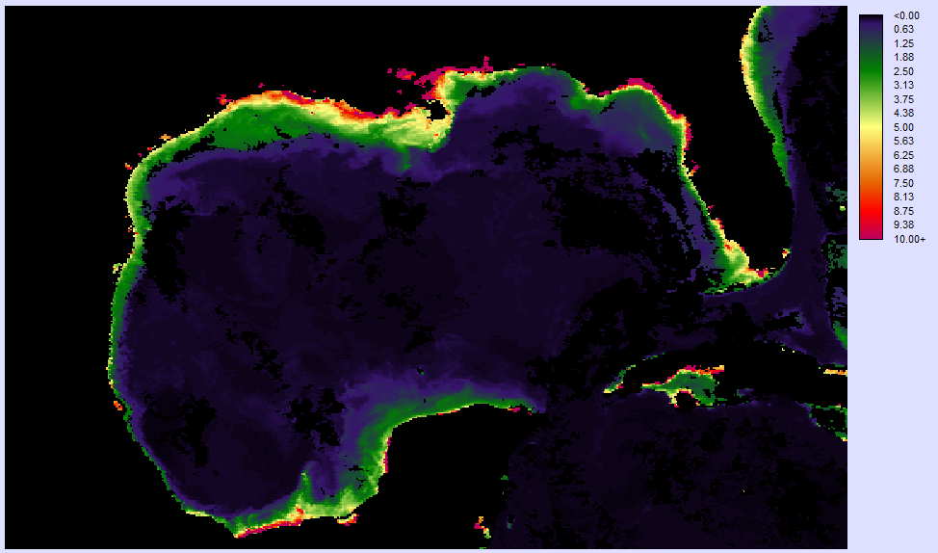
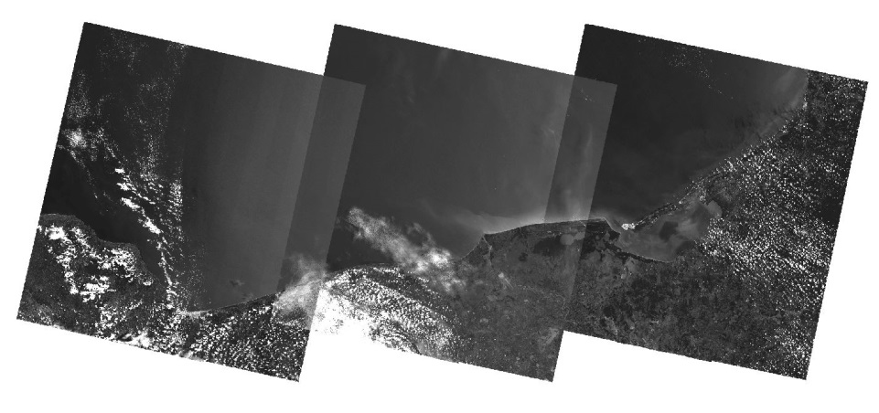
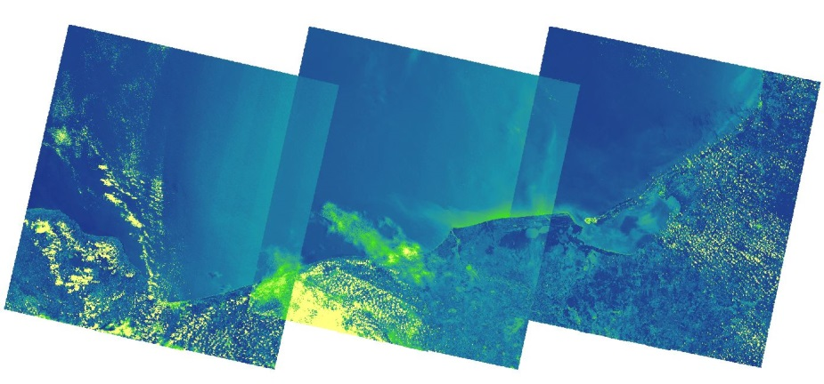
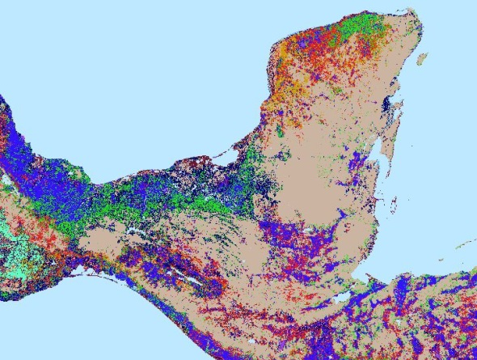
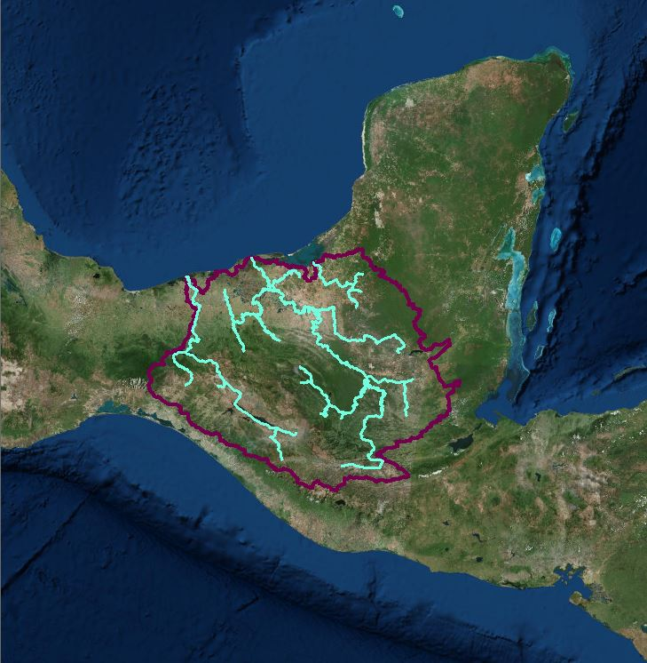
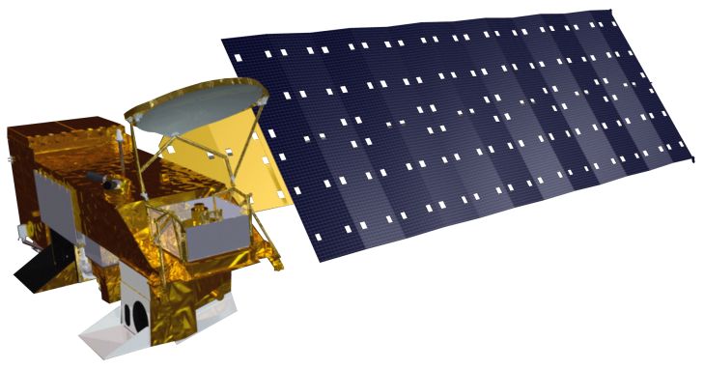
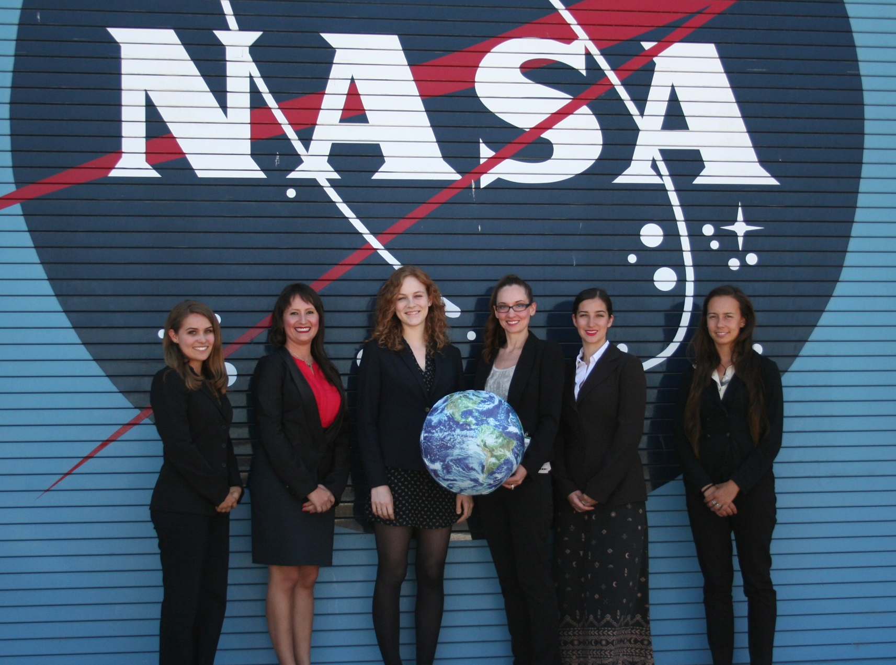
Gulf of Mexico Water Resources
Utilizing Nasa Earth Observations to detect factors contributing to hypoxic events in the southern Gulf of Mexico
Rebecca Chapman(Project Lead)¹, Irma Caraballo Álvarez^{1,2}, Alannah Johansen¹, Åse Mitchell¹, Bridget Smith¹, Mackenzie Taggart^{1,3}
NASA Ames DEVELOP Program, University of Puerto Rico, Rio Piedras, California Polytechnic State University, San Luis Obispo)
Abstract
Study Area
Keep this blank for now.
Body text point size should be at least 24.
Caption text point size should be at least 16.
Feel free to rename, move, and resize sections as needed.
Methodology
Run TerrSet Earth
Trends Modeler
Chl
SST
CDOM
PAR
Objectives
Output Time
Series Analysis
Utilize NASA Earth observations to identify indicators of hypoxic events and HABs in the southern Gulf of Mexico and connect their occurrences to nutrient and sediment loading from the Grijalva – Usumacinta river basin.
Conduct time series analysis on MODIS Level III 8-day SMI products of chlorophyll a (Chl), sea surface temperature (SST), colored dissolved organic matter (CDOM) and photosynthetically available radiation (PAR).
Apply both the Floating Algal Index (FAI) and Normalized Difference Turbidity Index (NDTI) to Landsat 8 OLI data
Run the Soil Water Assessment Tool (SWAT) to model nutrient and sediment loading for the entire Grijalava-Usumacinta river basin.
1) Download Aqua Modis Data: 2002 - 2014
Apply FAI
& NDTI
Analyze Trends
2) Download Landsat 8 OLI Data: 2013 - 2014
Run SWAT
Output Nutrient &
Sediment loading
SWAT Results Image Placeholder
3) Acquire SWAT inputs: DEM, weather, soil & hydrologic data
Earth Observations
Landsat 8 OLI Aqua MODIS
Results
Results Placeholder
Conclusions
Satellite measurements of Chl-a anomalies and SST can provide many important indicators of HAB’s.
Identifying specific blooms species remains a challenge in remote sensing and may be mitigated with the availability of hyperspectral missions.
More conclusions placeholder.
Team Members
Project Partners
Left to Right: Mackenzie Taggart, Irma Caraballo Álvarez, Bridget Smith, Rebecca Chapman, Alannah Johansen, Åse Mitchell
Consorcio de Instituciones de Investigación Marina del Golfo de México y del Caribe (CiiMar-GoMC)
Centro del Cambio Global y la Sustentabilidad en el Sureste (CCGSS)
Comisión Nacional para el Conocimiento y Uso de la Biodiversidad (CONABIO)
Centro Nacional de Datos Oceanográficos (CENDO)
Universidad Autónoma de Baja California (UABC)
Universidad Juárez Autónoma De Tabasco (UJAT)
Secretaría de Marina (SEMAR)
The Federal Ministry of Health
Acknowledgements
Special thanks to our science advisors Dr. Juan L. Torres-Pérez, Dr. Sherry L. Palacios, and Chase Mueller from the Bay Area Environmental Research Institute for assistance with the project and creation of the ArcPy Reflectance to Index script.
The authors also wish to thank the Ames DEVELOP management team for their overall support and help with this project
NASA Ames Research Center

