Slide 1
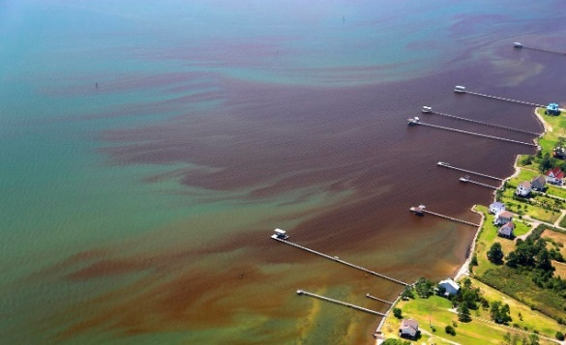
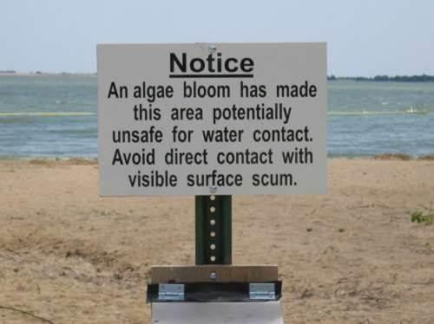
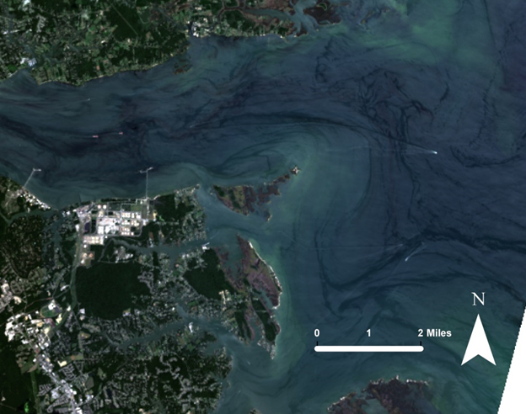
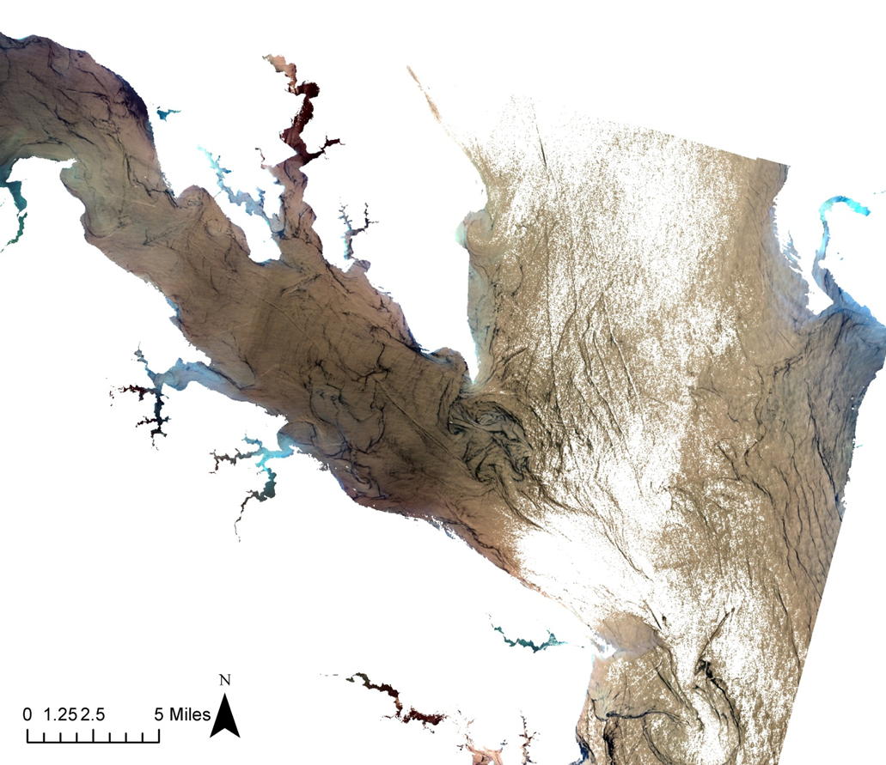
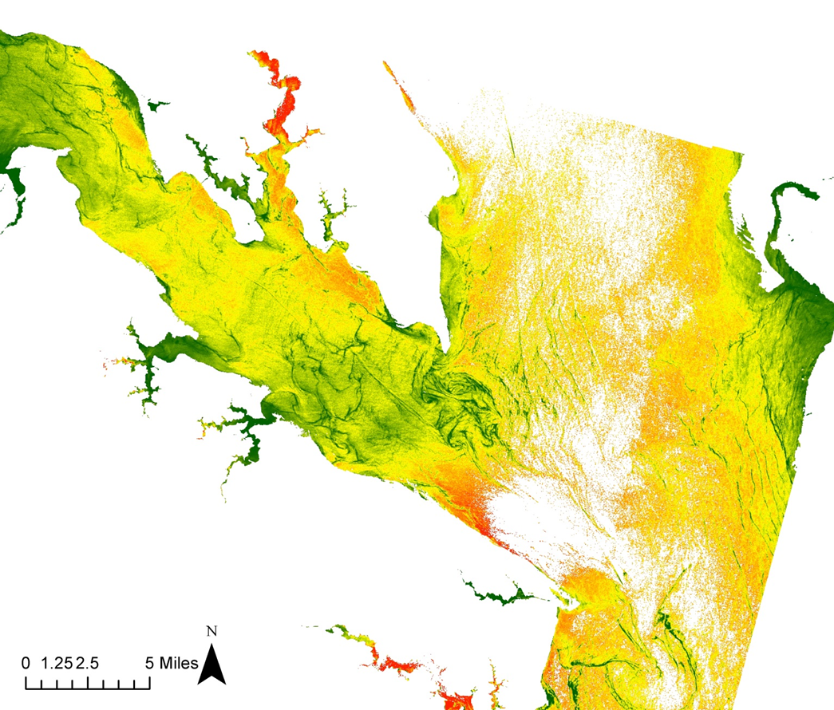
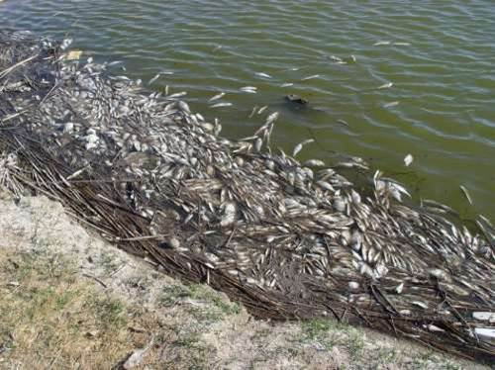
Overview
Concerns
Results
Wolfgang Vogelbein, York River, 8-17-2015
The population of the Chesapeake Bay Watershed is currently approaching 18 million people. As a result, increases in urban and agricultural land use have led to higher concentrations of nutrient runoff into the Chesapeake Bay and its estuaries. High concentrations of nitrogen and phosphorus in the water trigger the excessive growth of algae, known as Harmful Algal Blooms, or HABs.
Harmful Algal Blooms degrade water quality and negatively affect human and marine life by:
Blocking Sunlight
Depleting Oxygen
Producing Toxins
Since the total area of the Bay is too large to continuously monitor and current methods do not allow for the desired real-time monitoring of the area, a more efficient and cost-effective method of identifying HABs is necessary to protect the Chesapeake Bay.
Jennifer Graham. Harmful Algal Blooms. 10/19/2015
Harmful Algal Blooms may:
Produce unpleasant-smelling toxins
Mutate and contaminate organisms
Require beach closures to ensure safety
Cause massive fish mortality events
As fishing, oyster harvesting, and tourism are three major economic industries for Virginia’s coastal communities, HABs pose serious threats to the economic security of the area.
The Virginia Water Resources II NASA DEVELOP team created a tool which takes raw Landsat 8 data and produces two image composites used to identify chlorophyll.
The data is taken in by the python code. Two final images are created with chlorophyll concentration gradients. The green areas show lower concentrations of chlorophyll whereas the red areas show higher concentrations of chlorophyll, and higher probability of a HAB hotspot.
Mike Hooper. Dead Fish Washed Ashore during Golden Alga Toxic Bloom. 10/19/15
Notes:
Front (left, centre, right inside)

Slide 2
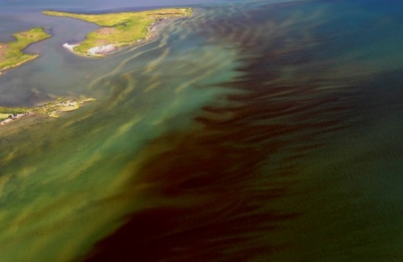
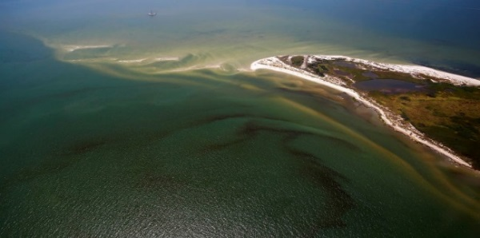
What Can Be Done to Help?
Virginia
Water Resources
Utilizing NASA Earth Observations to Identify Algal Hotspots in the Chesapeake Bay
Acknowledgements
DEVELOP Location
NASA DEVELOP Wise,
NASA Langley Research Centre
NASA Earth Observations
Landsat 8 OLI
Partners
Dr. Kim Reece, Virginia Institute of Marine Science
Russ Baxter, Virginia Deputy Secretary of Natural Resources for the Chesapeake Bay
Will Hunley, Hampton Roads Sanitation Department
Todd Egerton, Old Dominion University
Advisors
Dr. Kenton Ross [NASA DEVELOP National Program],
Dr. DeWayne Cecil [Global Science and Technology Inc.],
Melanie Salyer [NASA DEVELOP Wise]
Wolfgang Vogelbein, York River, 8-17-2015
A 24 hour HAB Hotline has been established and community members are asked to report suspicious colors, smells, or fish kills in their areas. When HABs are detected or reported, the response team can collect samples that are analyzed at different institutions depending on the nature of the report. The VA Health Department is then able to determine future actions based on guidelines set by the Clean Water Act and State of Virginia Water Quality Standards.
To report any suspicious phenomena in the Chesapeake Bay area, contact the HAB Hotline:
1-888-238-6154
Virginia Department of Health Website:
https://www.vdh.virginia.gov/epidemiology/DEE/HABS/
Authors:
Arika Egan (Project Lead), Zachary Tate, Jakub Blach, Jessica Jozwik, Tyler Rhodes.
Cover photo credit: Wolfgang Vogelbein, York River, 8-17-2015
Notes:
Back (second cover, backside, main cover) Figure 3. A true color composition of the Lower York River, created from Landsat bands 4, 3, and 2. Circled in red are three boats that were traveling in the river at the time the Landsat 8 OLI captured the image. The movement of boats like these in the water may have shifted the location of algae in the water, and thus affected the locations of detected chlorophyll in the Landsat 8 OLI data and the VIMS data cruise data.

