Slide 1
Coastal California
Water Resources II
Utilizing NASA Earth Observations to Detect and Assess the Impacts of Estuarine Breach Events for Improved Coastal Wetland Monitoring and Management
Karina Alvarez, Rachel Darling, Alexander Gunnerson, Sarah Payne, & Sophia Stonebrook
California – JPL

Slide 2
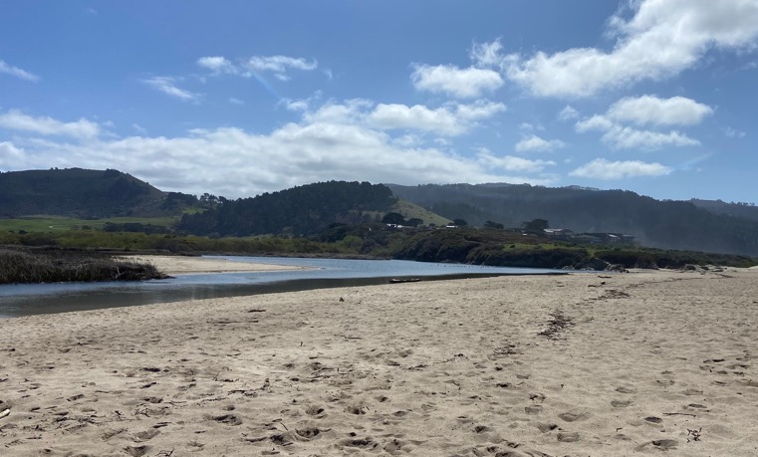
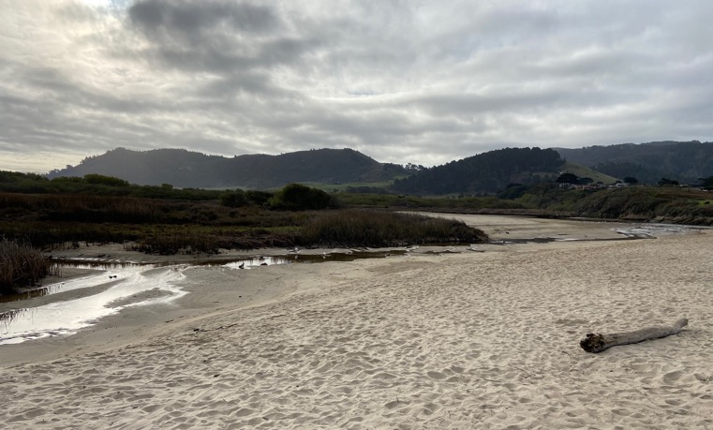
Estuarine Ecosystems
Partially-enclosed spaces where rivers and oceans/seas converge
Brackish
Extremely productive ecosystems
Extremely delicate ecosystems
Numerous anthropogenic stressors (development, pollution)
Image Credit: Kevin O’Connor, Central Coast Wetlands Group, Moss Landing Marine Labs
Notes:
Speaker:
Estuarine Ecosystems are…
Partially closed meaning they're partially protected from the open ocean and aren't subject to full-force wave dynamics, storms, etc.
Distinguish from wetlands (a more encompassing term...estuaries are always wetlands but wetlands aren't always estuaries)
They're brackish; they are a mix of freshwater from a river/water body feeding the system from inland and saltwater from the ocean/sea
Important breeding grounds/habitat, water filtration, storm buffering, flood prevention, carbon sequestration...TONS of ecosystem services
Degraded by pollution, coastal squeeze issues and development, rising sea levels, overfishing, etc.
Additionally, these systems are highly dynamic. Bar-built estuaries, which we focused on in this project, are particularly dynamic. In the images on the right of Carmel River Lagoon, you can see the drastic changes that an estuary experiences. These images are taken one day apart following a breach event. In this case, the lagoon lost 4 feet of water overnight.
------------------------------Image Information Below ------------------------------
Image Credit: Kevin O’Connor, Central Coast Wetlands Group, Moss Landing Marine Labs
Image Source: Provided by Kevin O’Connor (project partner) with permission

Slide 3
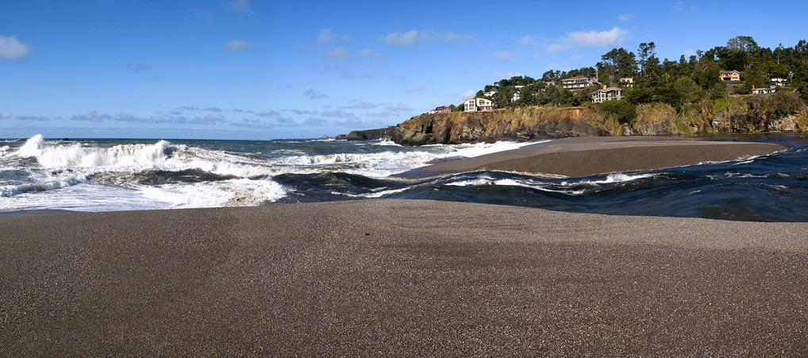
What is a Breach?
Ocean
Estuary Mouth
Estuary
Gualala Estuary. Image Credit: ianmacd
Notes:
Speaker:
A breach event occurs when…
When an estuary that was closed is connected to the ocean
Specifically, this is from erosion of the sand barrier at the estuary mouth
Either the water inside the estuary overflows and a channel is created through the barrier
And/or repeated waves create erode the barrier and a channel is formed
Natural breaches are difficult to predict, but important to monitor as they influence estuary water extent and quality
------------------------------Image Information Below ------------------------------
Image Credit: ianmacd
Image Source: https://search.creativecommons.org/photos/265bcf03-379a-4102-b3f4-0a9ca36904f1 (CC BY-NC-ND 2.0)

Slide 4
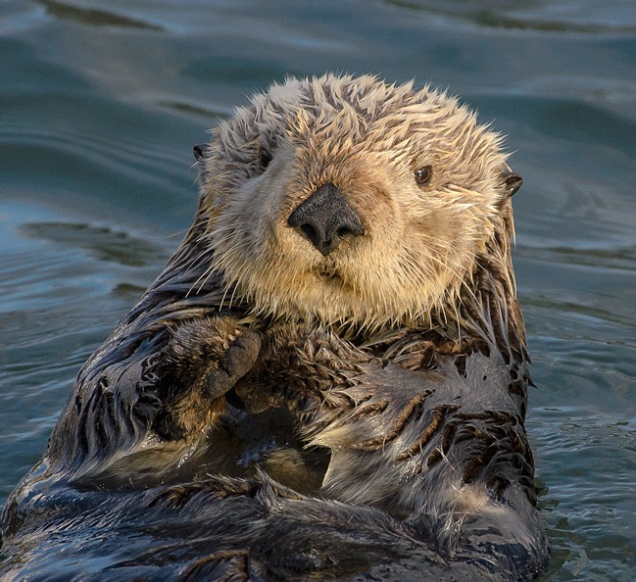
Community Concerns
Estuaries in California serve as essential habitat for endangered species such as salmon and sea otter
Breaching events result in changes to levels of salinity, inundation extent, and water quality metrics
These factors affect health and productivity for estuarine and coastal ecosystems
Image Credit: Marshal Hedin
Notes:
Speaker:
The health of estuaries is important because they provide habitat to endangered species such as sea otters and salmon
Breach events significantly impact levels of salinity, inundation, chlorophyll-a, and turbidity which affects productivity in the estuarine ecosystem, but also ecosystems off the coast
Frequency or infrequency of estuary breaching can lead to events that can negatively impact estuarine systems permanently
Increasing data of estuary conditions is essential for detecting patterns of breaching and assessing the impacts of breaching to the ecosystem.
It also allows land conservation managers and decision makers to make well-informed policy regarding conservation
------------------------------Image Information Below ------------------------------
Image Credit: Marshal Hedin
Image Source: https://search.creativecommons.org/photos/8317b0a7-8382-4448-bd6f-26d64bd522d3 (CC BY-SA 2.0)

Slide 5
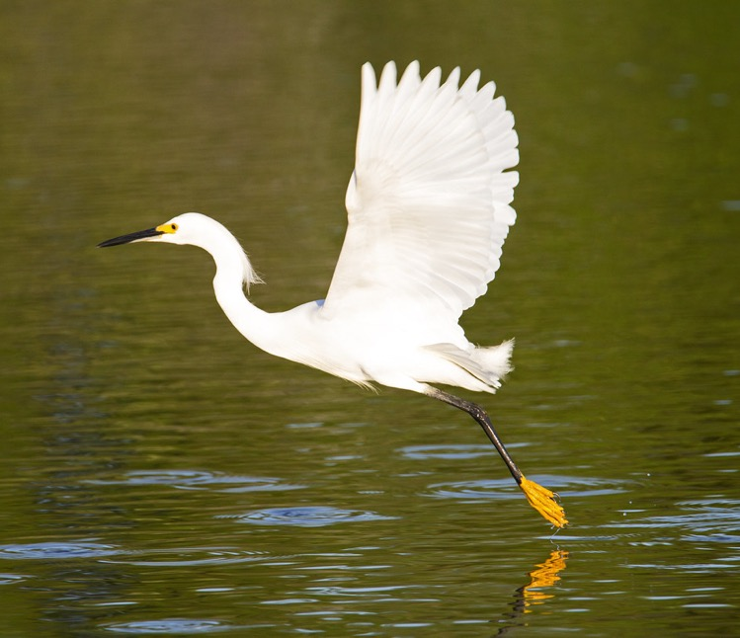
Partners
End User
Ocean Protection Council
Collaborators
Moss Landing Marine Laboratories, Central Coast Wetlands Group
Southern California Coastal Water Resource Project
University of California, Los Angeles
University of California, Davis
Image Credit: Ian Morton
Notes:
Speaker:
Our partner organizations are involved in the monitoring of California estuaries, especially those that are in Marine Protected Areas. These areas are known as EMPAs.
Our end user for our project deliverables is the Ocean Protection Council, which is one of the regulatory agencies tasked with collecting data on EMPAs and reporting to the government of the State of California.
Our collaborators include:
Moss Landing Marine Laboratories Central Coast Wetlands Group, which is funded by the OPC
Southern California Coastal Water Resource Project, whose governing board includes the OPC
And UCLA, and UCD whose expertise lies in coastal ecology and remote sensing
Our goal for this project was to provide an efficient workflow for state-agencies and partners interested in EMPA monitoring using remote sensing.
------------------------------Image Information Below ------------------------------
Image Credit: Dis da fi we (Ian Morton)
Image Source: https://search.creativecommons.org/photos/9656420c-87b3-4663-9f01-6f7589329ed8 (CC BY-NC-SA 2.0)

Slide 6
Objectives
1.
2.
3.
Refine
Compare
Design
Improve California Estuary Assessment (CEA) Tool in Google Earth Engine (GEE)
Investigate outputs, visual inspection, in-situ data, and other estuary assessment tools
Test a graphical user interface for end users of all experience levels
Notes:
Speaker:
With partner input, we also defined our project objectives…
the primary aims of our project are to… Overall- assist project partners in EMPA monitoring using remotely sensed imagery.
Refine the CEA tool- the previous term worked to create functioning code of estuary mouth state, inundation, and water quality which we aimed to refine by adjusting thresholds
Validate with available data– used visual inspection of imagery, in-situ water level data, and comparison among different outputs within the tool itself and other estuary assessment tools to ensure the CEA tool
Design a GUI that links all the different functions in a user friendly interface and output With these objectives in mind, we are now going to talk more specifically about water quality metrics

Slide 7
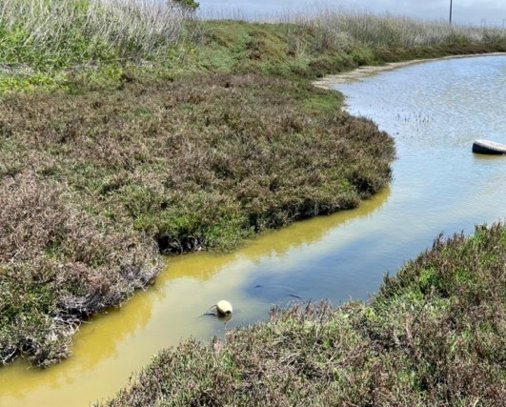
Background Information: Water Quality Metrics
Turbidity: Amount of suspended matter in water causes water to be hazy
Higher turbidity: limits light penetration
Sea Surface Temperature (SST): The temperature on the surface of the water
Higher SST: limits nutrients
Image Credit: Kevin O’Connor, Central Coast Wetlands Group, Moss Landing Marine Labs
Notes:
Speaker:
Some important background on water quality metrics…
Mouth state heavily influences what is going on inside/ right outside the estuary
These water quality metrics that we studied along with others influence the organisms which live in the estuary.
The water quality metrics that we studies were:
Turbidity:
Is the amount of suspended matter in water.
Higher turbidity means that the water is more hazy, limiting light penetration into the water.
Sea surface temperature
Is the temperature on the surface of the water.
Warmer sea surface temperatures limit the ability for cooler nutrient rich water to be brought up to the surface.
------------------------------Image Information Below ------------------------------
Image Credit: Kevin O’Connor
Image Source: provided by Kevin O’Connor

Slide 8
Potential Trends
Impacts of Mouth State
 | Inundation | SST | Turbidity
Mouth-State Closed
Mouth-State Open
Notes:
Speaker:
With our GEE tool using remotely sensed data, here are some potential trends we hope to capture….
On the left we have estuary mouth-state as closed (not connected to the ocean) and mouth-state as open (connected to the ocean)
With the mouth state as closed we may have
Higher levels of inundation (as the water builds in the estuary)
Higher sea surface temperature (no influence by the ocean)
Lower levels of turbidity (without the ocean’s influence)
With mouth state as open, we may have
Lower levels of inundation (water leaving to ocean)
Lower sea surface temperature (cooler ocean water mixing into the estuary)
Higher levels of turbidity (waves influence, water flow)
As we move forward with methods and out results, these are trends to keep in mind of how mouth-state might influence inundation and water quality

Slide 9
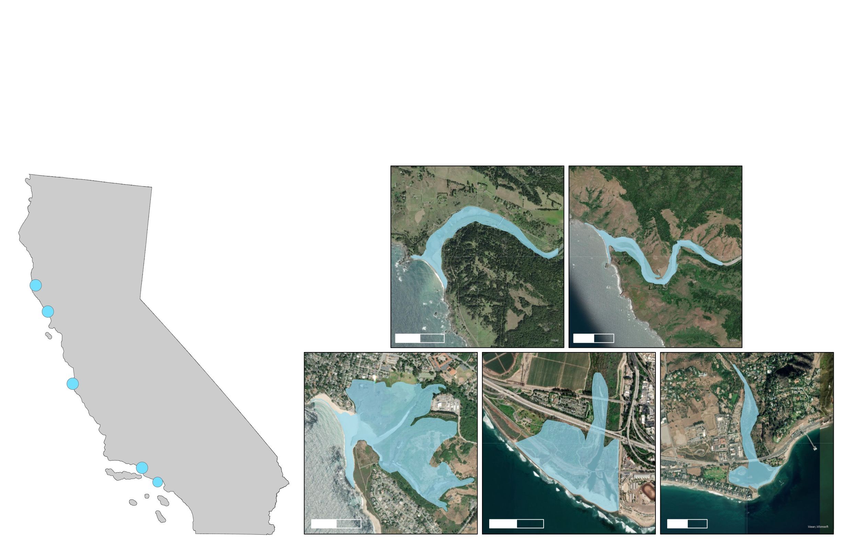
Study Area
A. Navarro
B. Russian River
A.
B.
0
1
0
2
Km
Km
C. Carmel
D. Ventura
E. Malibu
C.
D.
E.
N
0
0.5
0
0.5
0
0.5
Km
Km
Km
Notes:
Speaker:
Our five study sites are spread across the coast of California and include: Navarro, Russian River, Carmel, Ventura, and Malibu
When selecting our study sites we took into consideration:
Dynamic Estuary Mouths- some that opened and closed and some that were always open
Spatial Resolution- ensure visible with satellite imagery
Location- we wanted sites in Northern, Central, and Southern California
With our study sites selected, we then determined which satellites and sensors would properly capture estuary mouth opening and associated health metrics
ESRI World Imagery Base Source: Esri, Maxar, GeoEye, Earthstar Geographics, CNES/Airbus DS, USDA, USGS, AeroGRID, IGN, and the GIS User Community

Slide 10
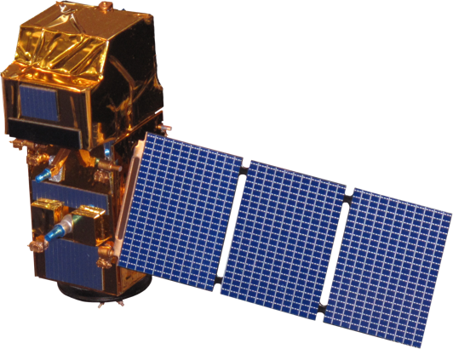
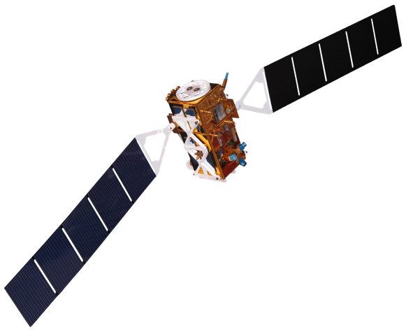
Satellites and Sensors
Landsat 8 Operational Land Imager & Thermal Infrared Sensor
Level 2 Surface Reflectance Tier 1
Sentinel-2 Multispectral Instrument
Level 2A Surface Reflectance
Sentinel-1 C-Band Synthetic Aperture Radar
Level 1 Single Look Complex
~5 days, 10-20m, 2018 +
16 days, 30 m, 2013 +
12 days, 10 m, 2016 +
+
+
Image Credit: NASA (Landsat 8), ESA (Sentinel-2 & Sentinel-1)
Notes:
Speaker:
To best capture estuarine dynamics, we used 3 different satellites and their associated sensors
We used….
Landsat 8 OLI provided more flexibility in image selection and was an important component in turbidity analysis
Sentinel-2 MSI was essential in getting high resolution imagery for mouth state and health assessments
Sentinel-1 C-band was used to capture estuary inundation extent without cloud coverage
With these satellites and data availability in mind, we set the study period to
December 2018 to July 2021
------------------------------Image Information Below ------------------------------
Image Credit: NASA, ESA
Image Source: https://www.devpedia.developexchange.com/dp/index.php?title=List_of_Satellite_Pictures

Slide 11
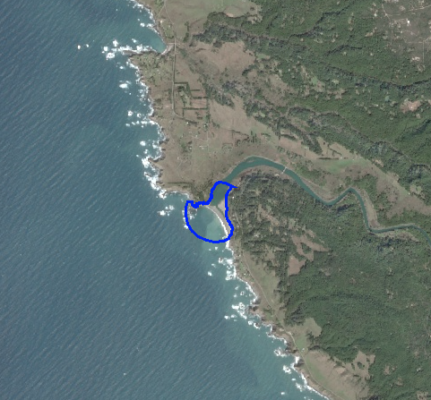
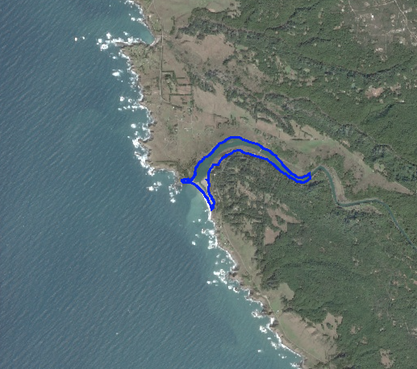
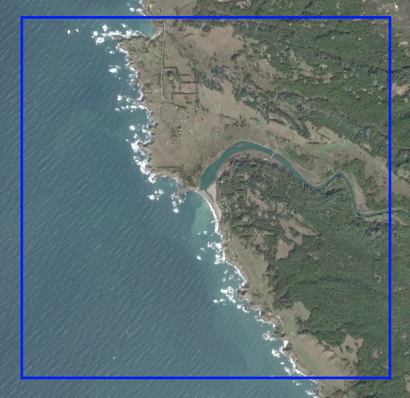
Methodology
Creation of Study Area Boundaries
1.
2.
3.
Mouth State
Inundation
Water Quality
0
2 km
0
2 km
0
2 km
Notes:
Speaker:
3 Different shapefiles were used for different analyses....
Estuary mouth state analysis used a 5m buffer around a point in the estuary mouth, excluding land in order to examine pixel connectivity
Inundation analysis focused on areas of potential inundation in the estuary body, - Created using US Fish and Wildlife Wetlands Mapper and USGS 3DEP 1 m DEMs to find areas of potential inundation
Water quality used a larger area of analysis of a 4 km box to potentially examine sediment plumes

Slide 12
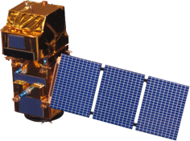
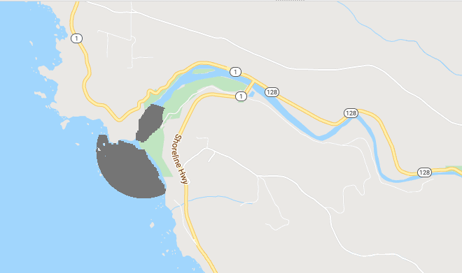
Methodology
Refinement - Estuary Mouth State
Data Source:
Steps:
Outputs:
1. Applied cloud filter
on AOI
2. Calculated NDWI
3. Applied NDWI
threshold
4. Determined pixel
connectivity
Refinement this term:
Iterated through different thresholds
Adjusted chart output
Time Series
Sentinel-2 MSI
Pixel Connectivity
Image Credit: ESA
Notes:
Speaker:
Last term set the foundation for this analysis
filtering clouds based on the estuary mouth shapefile,
calculating NDWI and creating a water non-water threshold (in other words, an image in which every pixel is identified as either water or not water)
using a pixel connectivity analysis to determine if an estuary mouth is open (1) or closed (2)
This term refined this analysis by
Adding an additional cloud filter, excluding images with low inundation levels (most likely indicating a cloud) from the estuary mouth state analysis
Determining the ideal NDWI threshold to create the water/non-water binary for each site
Adjusting the chart output to only produced open (1) or closed (2) results
------------------------------Image Information Below ------------------------------
Image Credit: NASA, ESA
Image Source: https://www.devpedia.developexchange.com/dp/index.php?title=List_of_Satellite_Pictures
ESRI Base Source: Esri, Maxar, GeoEye, Earthstar Geographics, CNES/Airbus DS, USDA, USGS, AeroGRID, IGN, and the GIS User Community

Slide 13
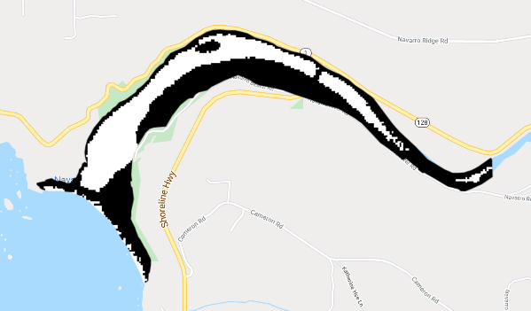
Methodology
Refinement - NDWI Inundation
Data Source:
Steps:
Outputs:
1. Applied Cloud filter
on AOI
2. Calculated NDWI
3. Applied NDWI
threshold
4. Counted water
pixels
Refinement this term:
Used a new shapefile
Graphed relative to maximum inundation and area inundated
Time Series
Sentinel-2 MSI
Binary
Image Credit: ESA
Notes:
Speaker:
First method implemented for looking at inundation extent was using Sentinel-2 MSI imagery.
The steps for finding inundation extent are as followed:
Applying 2 cloud filters
Calculate NDWI (normalized difference water index) for every image in the image collection (using green and near infrared bands)
NDWI threshold is applied and land/ water binary created based off of where the NDWI values fall
Number of water pixels are counted and divided by the total number of pixels to get the percent inundation
Refinements made this term:
A new shapefile was used this term that did not extend out into the ocean, only the interior of the estuary
Iterated through multiple different threshold across our 5 different study sites to select which threshold captures inundation extents the best
The time series graph of inundation over time was plotted relative to the maximum inundation. The maximum inundation was found and every inundation was divided by the maximum and then multiplied by 100 to get the new relative inundation.
------------------------------Image Information Below ------------------------------
Image Credit: ESA
Image Source: https://www.devpedia.developexchange.com/dp/index.php?title=List_of_Satellite_Pictures
ESRI Base Source: Esri, Maxar, GeoEye, Earthstar Geographics, CNES/Airbus DS, USDA, USGS, AeroGRID, IGN, and the GIS User Community

Slide 14
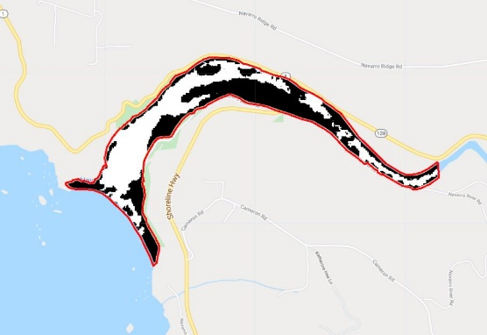
Methodology
Refinement - SAR Inundation
Data Source:
Steps:
Outputs:
Filtered by near and far range
Applied Lee filter
Calculated percent and area inundated
Refinement this term:
Used a new shapefile
Refined thresholds based on range and sensor
Compared trends to NDWI
Time Series
Sentinel-1 C-SAR
Binary
Image Credit: ESA
Notes:
Speaker:
We also determined levels of inundation using Sentinel-1 C-SAR
S1 is a good addition to S2 NDWI since it is not affected by cloud coverage, allowing for a higher temporal resolution
Last Term:
- Provided the design of a Lee and VV+2VH filter, thresholding the SAR imagery, and charting the percent inundation
This Term:
- Utilized the new shapefile of only the interior of the estuary
Added additional noise reductions by filtering by near and far ranges using an incidence angle of 36 degrees as the boundary
Created new thresholds to improve designations of water non-water for VV and VH, S1A and S1B
Compared percent and area inundated for NDWI and SAR to improve the CEA tool
Outputs:
The time series was generated with a smoothing line
In the water/non-water binary, the white represents water
------------------------------Image Information Below ------------------------------
Image Credit: ESA
Image Source: https://www.devpedia.developexchange.com/dp/index.php?title=List_of_Satellite_Pictures
ESRI Base Source: Esri, Maxar, GeoEye, Earthstar Geographics, CNES/Airbus DS, USDA, USGS, AeroGRID, IGN, and the GIS User Community

Slide 15
Methodology
Refinement - Water Quality - Turbidity
Data Source:
Steps:
Outputs:
1. Applied MAIN algorithm for atmospheric correction
2. Applied turbidity algorithm in GEE
3. Graphed average values in the interior of the estuary
Time Series
Sentinel-2 MSI
Images
Image Credit: ESA
Notes:
Speaker:
Landsat 8 OLI and Sentinel-2 MSI were used to generate turbidity data and imagery.
The MAIN algorithm was applied this term in GEE as a form of atmospheric correction that is applicable for water quality analyses
To create our turbidity product, we utilized an algorithm take utilizes the red band on Landsat 8 and Sentinel-2 to create a turbidity layer in Google Earth Engine showing turbidity Formazin Nephelometric Unit (FNU)
This algorithm was developed during a previous effort from graduate students Sol Kim, Rafael Grillo Avila, and Xiaowei Wang from UC Berkeley under the guidance of our science advisor Christine Lee
It has been utilized effectively in previous DEVELOP projects that looked at monitoring water quality off the coasts of Belize and Honduras
------------------------------Image Information Below ------------------------------
Image Credit: NASA, ESA,
Image Source: https://www.devpedia.developexchange.com/dp/index.php?title=List_of_Satellite_Pictures

Slide 16
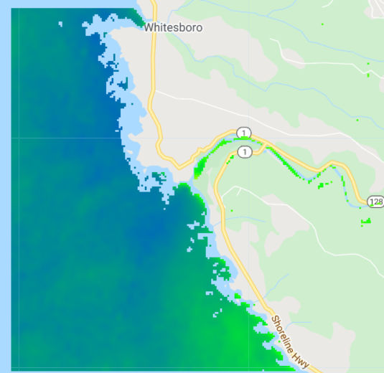
Methodology
Refinement - Water Quality - Temperature
Data Source:
Steps:
Outputs:
1. Converted sea surface temperature (SST) from Kelvin to Celsius
2. Graphed average values in the interior of the estuary
Time Series
Landsat 8 OLI/TIRS
Images
Image Credit: NASA
Notes:
Speaker:
Landsat 8 TIRS was used to generate temperature data and imagery.
The Landsat 8 OLI/TIRS Collection 2 data conveniently includes a temperature band in Kelvin. This value was converted into Celsius.
Mean temperature values for the interior of the estuary were then calculated.
A time series and images for the study period were then generated.
------------------------------Image Information Below ------------------------------
Image Credit: NASA, ESA
Image Source: https://www.devpedia.developexchange.com/dp/index.php?title=List_of_Satellite_Pictures

Slide 17
Results: Comparison of NDWI thresholds
 | Number of Images | NDWI Threshold | Accuracy of CEA Tool to Visual Inspection
Navarro | 185 | 0.05 | 80%
Russian | 370 | 0.10 | 76%
Carmel | 185 | 0.00 | 63%
Malibu | 183 | 0.10 | 70%
Ventura | 372 | 0.05 | 65%
Notes:
Speaker:
For every site every image in the image collection was inspected to determined if the estuary was open or closed or if the image should be skipped due to clouds.
With the visual inspection as a reference, we found the best NDWI threshold for every site which resulted in accuracy of the CEA tool estuary mouth state analysis from 63 to 80 percent
Ventura and Carmel are smaller estuaries and this may be a potential tool limitation that will be discussed in later slides

Slide 18
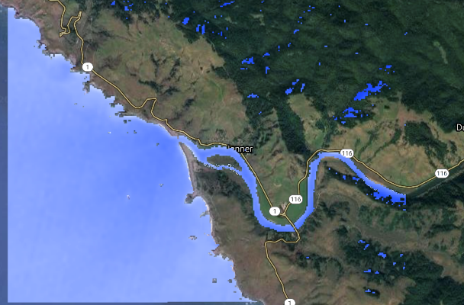
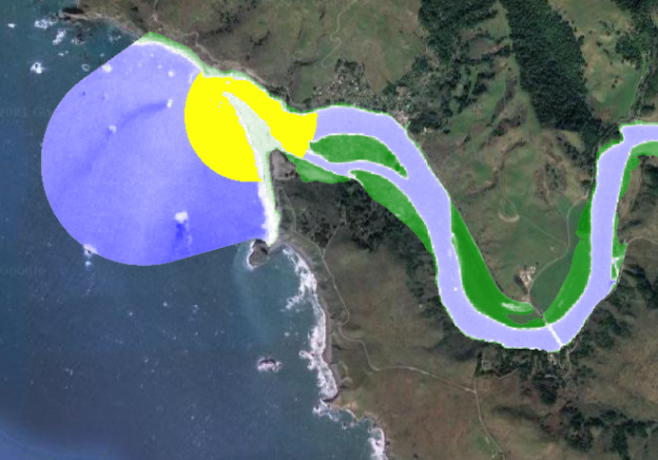
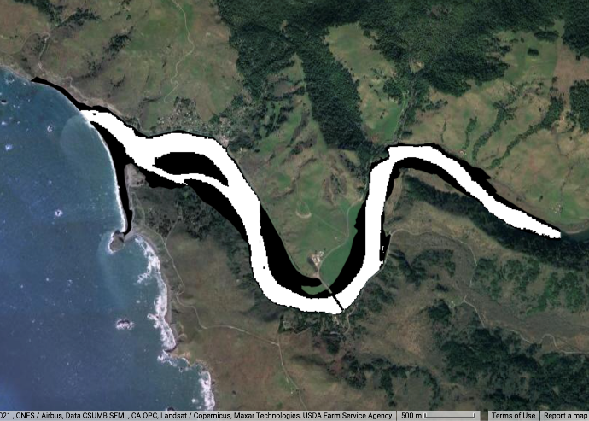
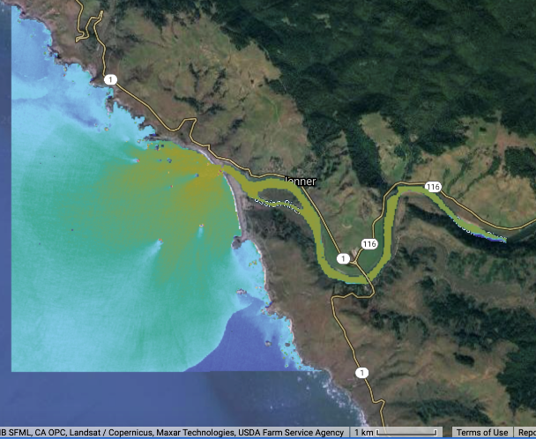
Results
Russian River
1.
2.
3.
Mouth State
Inundation
Water Quality
SST (C)
0
30
0
1.0 km
NDWI
-0.8
0.8
Water
Estuary Mouth
0
450 m
Non-water
0
500 m
Turbidity (FNU)
0
35
0
1.0 km
Notes:
Speaker:
Images obtained from the month of February for our study site Russian River
Potential Trends Identified
Mouth state is open
Would expect to see lower levels of inundation, cooler waters inside the estuary, and high levels of turbidity
Inundation levels are still relatively high when this image was obtained, but there could be additional factors influencing this such as increased stream flow or increased precipitation during this time of year
Observe a large turbidity plume as well as cooler temperatures inside the estuary
These are the outlines of what an analysis of our CEA tool would produce
The CEA tool created in this project provide increased spatial and temporal coverage of estuaries compared to field-based surveys and supplement resource-intensive in-situ data collection

Slide 19
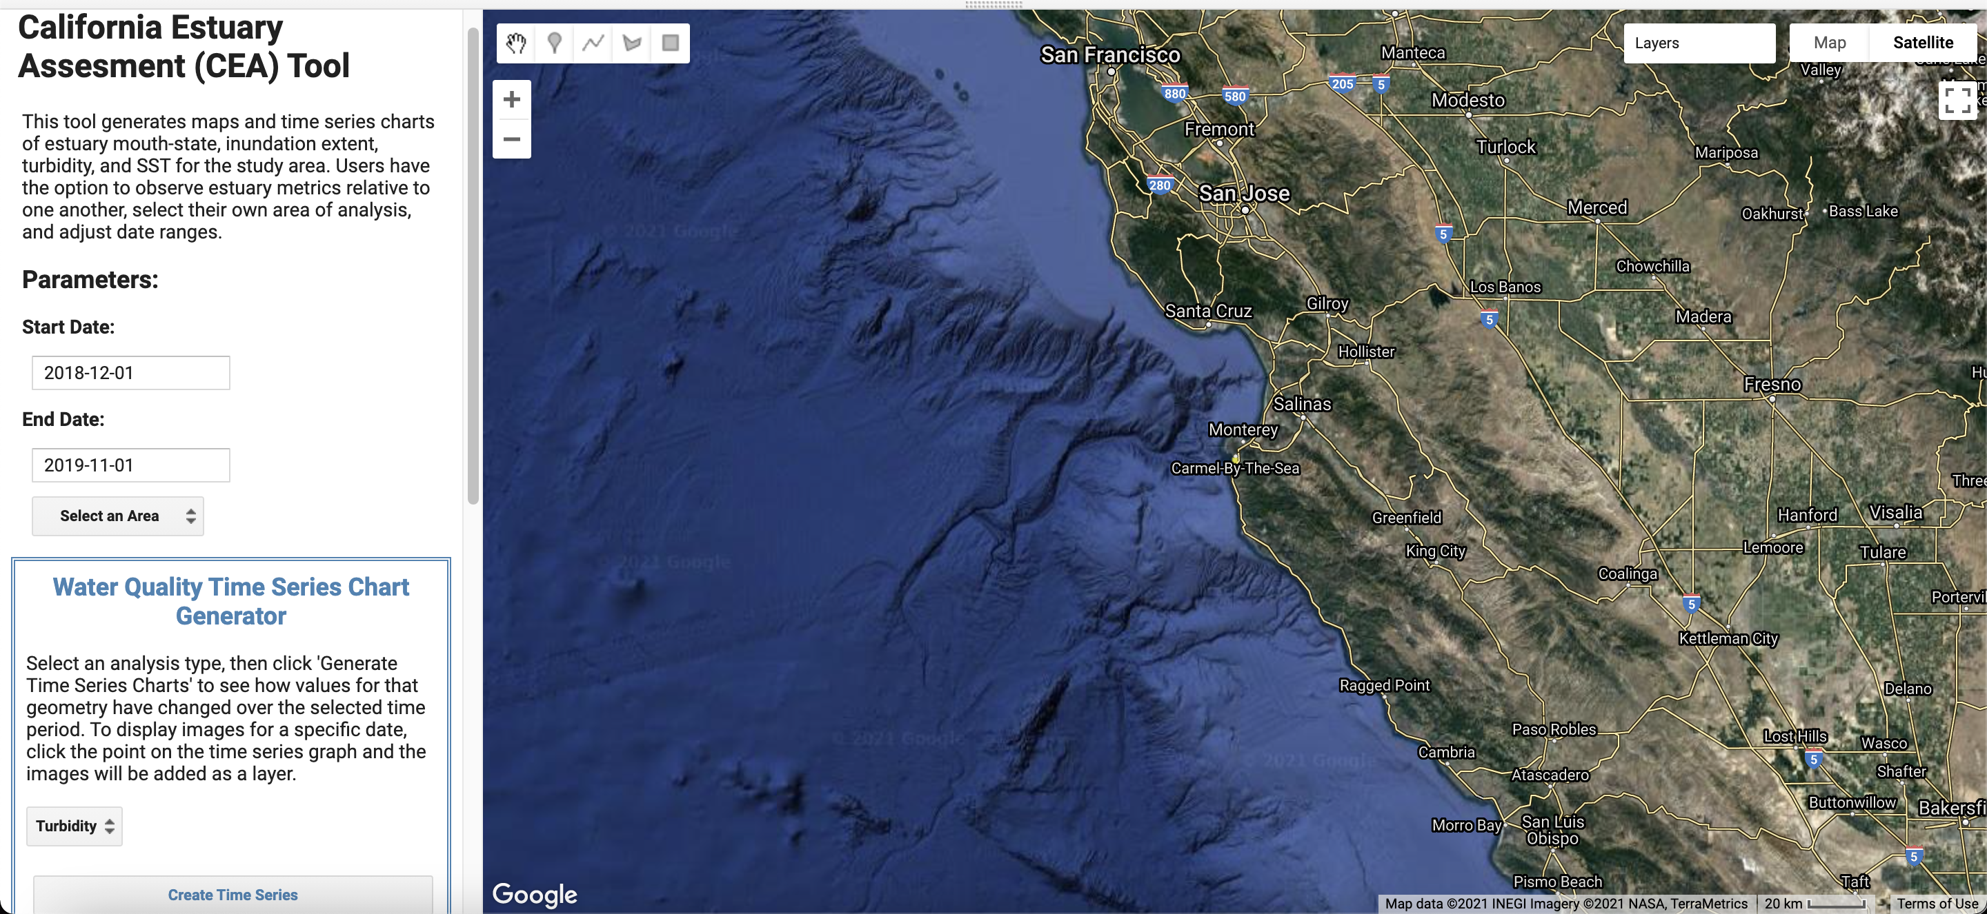
GUI
Notes:
Speaker:
Creation of a graphic user interphase for ease of use by our partners.
Condensed our four separate scripts into one tool that would allow the user to do the following things:
Select the desired dates to study
Select one of the pre-set locations, or upload their own asset of a specific study site
Select the parameters that you want to display the time series of (mouth state, inundation (optical + SAR), water quality (SST or turbidity)
On click function allows for images from selected parameter and day selected to be added to the map
Users will have the option to export images to google drive

Slide 20
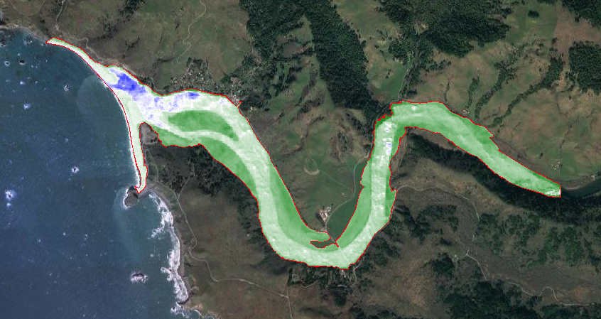
Limitations
Sentinel-2 images bypassed cloud filter
NDWI Binary
Temporal Resolution
Spatial Resolution
NDWI
0
500 m
-0.8
0.8
Notes:
Speaker:
There are a few limitations that we encountered during our future refinement this term:
Clouds continued to get through the cloud mask and filter that we used, which would throw off our analysis at time
There were times that the NDWI binary was incorrectly identifying areas as water, or water areas as non-water. This term we investigated using a supervised classification, which could help reducing these misclassifications The image displayed is NDWI of Russian River on November 20th 2020, it is an image that made it through the cloud filter and therefore does not properly identify water pixels Blue here is meant to indicate water while green is meant to indicate non-water, yet since water is not properly identified due to clouds most of the image is green
We were limited by spatial and temporal resolution. There are instances where there is a month long period of not having an image, due to the return time and clouds in the area. Spatial resolution limited our ability to capturing smaller mouth openings, and would limit the feasibility of expanding this tool to certain sites that may only have smaller mouth openings.

Slide 21
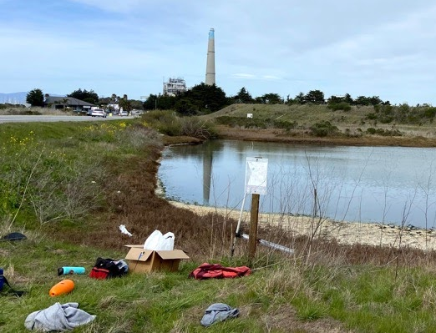
Partner Application
Integrate their own supplemental in-situ data
Upload their own asset into the GUI
Monitor to the present day with updated GEE imagery
Integrate NASA EO in future studies
Image Credit: Kevin O’Connor, Central Coast Wetlands Group, Moss Landing Marine Labs
Notes:
Speaker:
Ways that the partners can expand and improve the use of this tool:
Utilize supplemental in-situ data if available to verify what the tool is saying (ie. Using water level data to understand whether the mouth was actually open at a time, or to see if there was actually a drop in the inundation levels)
Partners expanding to additional study sites by drawing their own shapefiles for desired study sites
As data continues to be collected by Sentinel-1, Sentinel-2, and Landsat-8 the partners will have the ability to continue to use this tool in the future as the datasets expand
Hope that this inspired partners to utilize other NASA EO’s in their research and studies
------------------------------Image Information Below ------------------------------
Image Credit: Kevin O’Connor
Image Source: provided by Kevin O’Connor

Slide 22
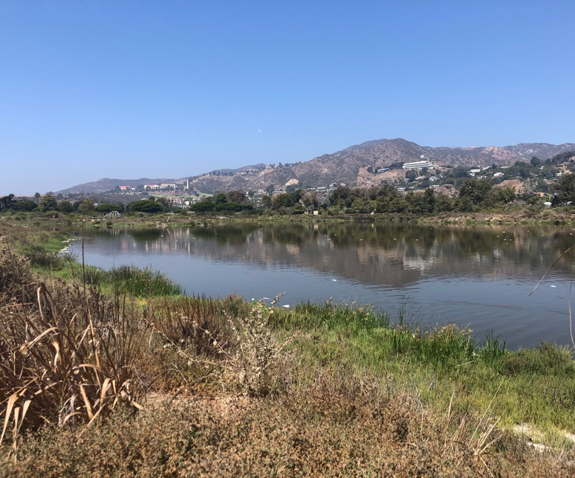
Conclusion
CEA tool successfully analyzes estuary health
Potential trend of open mouth, low inundation, low temperature and high turbidity
Tool most effective when:
Breach events are larger than the 10 m resolution
Water does not have algae or glint
Water surface is smooth
Image Credit: Karina Alvarez
Notes:
Speaker:
The CEA tool provides increased spatial and temporal coverage of estuaries when compared to field-based surveys and time and resource intensive in-situ data collection
Our tool will help project partners investigate potential trends of an open estuary mouth leading to lower levels of inundation, decreased water temperature, and increased turbidity
The GUI improves ease of use for our partners to investigate these trends
Our tool was found to be most effective for
Estuary mouth state analysis when breach events were larger (swath of stream connecting estuary to the ocean), as S2 resolution is 10 m
Inundation when water did not have algae or glint that misidentified water and non-water
Water quality when the water’s surface was smooth and not choppy due to strong wind events, particularly for exterior of the estuary.
Overall our CEA tool will assist project partners in the understanding of estuarine marine ecosystems by improving monitoring and management
------------------------------Image Information Below
Image Credit: Karina Alvarez
Image Source: Provided by Karina Alvarez

Slide 23
Science Advisors
Benjamin Holt (NASA Jet Propulsion Laboratory, California Institute of Technology)
Dr. Christine Lee (NASA Jet Propulsion Laboratory, California Institute of Technology)
Dr. Bruce Chapman (NASA Jet Propulsion Laboratory, California Institute of Technology)
Erica Carcelén (NASA DEVELOP, JPL Node Fellow)
Partners
Michael Esgro (Ocean Protection Council)
Dr. Eric Stein (Southern California Coastal Water Resource Project)
Dr. Kris Tanaguchi-Quan (Southern California Coastal Water Resource Project)
Ross Clark (Moss Landing Laboratories, Central Coast Wetlands Group)
Kevin O’Connor (Moss Landing Laboratories, Central Coast Wetlands Group)
Dr. Kyle Cavanaugh (University of California, Los Angeles)
Dr. John Largier (University of California, Davis)
This material contains modified Copernicus Sentinel data (2018-2021), processed by ESA.
Notes:
Speaker:
We wanted to send a big thank you to our amazing science advisors and partners!
We greatly appreciate your time, guidance, and support!
:D

Slide 24
Backup Slides

Slide 25
Estuarine Ecosystems
Partially-enclosed spaces where rivers and oceans converge
Productive + delicate ecosystems
Objectives
Improve the California Estuary Assessment Tool in Google Earth Engine
Compare outputs of CEA tool to visual inspection and in-situ data
Design a graphical user interphase
Image Credit: John Largier, UC Davis
Notes:
Speaker:
Estuarine Ecosystems are…
Partially closed meaning they're partially protected from the open ocean and aren't subject to full-force wave dynamics, storms, etc.
Distinguish from wetlands (a more encompassing term...estuaries are always wetlands but wetlands aren't always estuaries) Important breeding grounds/habitat, water filtration, storm buffering, flood prevention, carbon sequestration...TONS of ecosystem services
The primary aims of our project are to…
Overall- assist project partners in EMPA monitoring using remotely sensed imagery.
Refine the CEA tool- the previous term worked to create functioning code of estuary mouth state, inundation, and water quality which we aimed to refine by adjusting thresholds
Validate with available data– used visual inspection of imagery, in-situ water level data, and comparison among different outputs within the tool itself and other estuary assessment tools to ensure the CEA tool
Design a GUI that links all the different functions in a user friendly interface and output
------------------------------Image Information Below------------------------------
Image Credit: John Largier, UC Davis
Image Source: Partner Image

Slide 26
Study Area
A. Navarro
B. Russian River
A.
B.
0
1
0
2
Km
Km
C.
C. Carmel
D. Ventura
E. Malibu
D.
E.
N
0
0.5
0
0.5
0
0.5
Km
Km
Km
Notes:
Speaker:
Our five study sites are spread across the coast of California and include: Navarro, Russian River, Carmel, Ventura, and Malibu
When selecting our study sites we took into consideration:
Dynamic Estuary Mouths- some that opened and closed and some that were always open
Spatial Resolution- ensure visible with satellite imagery
Location- we wanted sites in Northern, Central, and Southern California
With our study sites selected, we then determined which satellites and sensors would properly capture estuary mouth opening and associated health metrics
ESRI World Imagery Base Source: Esri, Maxar, GeoEye, Earthstar Geographics, CNES/Airbus DS, USDA, USGS, AeroGRID, IGN, and the GIS User Community

Slide 27
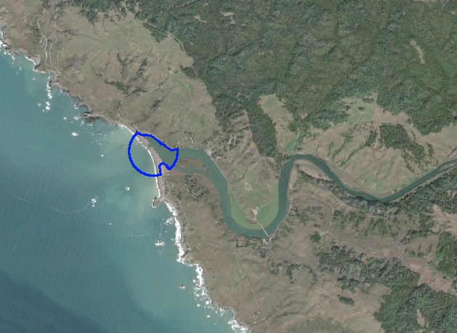
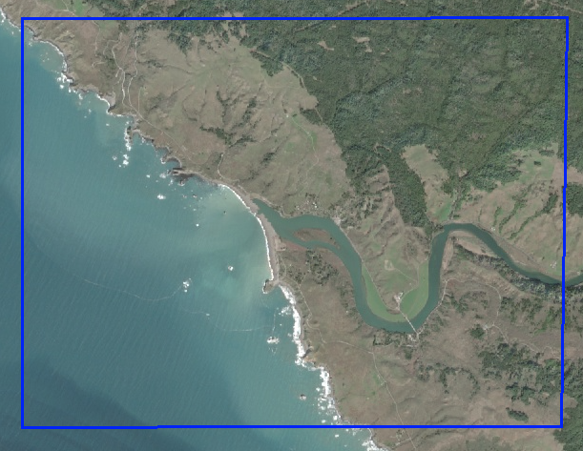
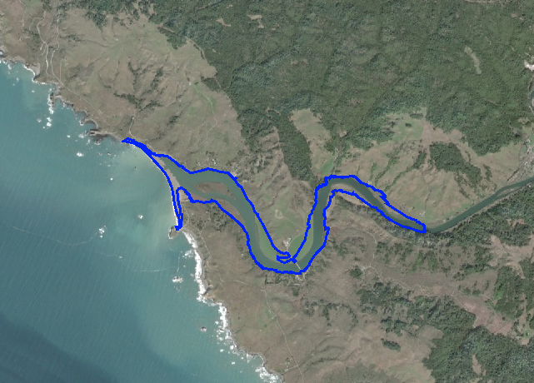
Methodology
Russian River
1.
2.
3.
Mouth State
Inundation
Water Quality
0
2 km
0
2 km
0
2 km
Pixel Connectivity
Water Binary
Temperature, Turbidity
Notes:
Speaker:
*Keeping the structure of three columns for methodology*
Speaker:
3 Different shapefiles were used for different analyses....
Estuary mouth state analysis used a 5m buffer around a point in the estuary mouth, excluding land in order to examine pixel connectivity
Inundation analysis focused on areas of potential inundation in the estuary body, - Created using US Fish and Wildlife Wetlands Mapper and USGS 3DEP 1 m DEMs to find areas of potential inundation
Water quality used a larger area of analysis of a 4 km box to potentially examine sediment plumes
Mouth State:
We used a water non-water binary using an NDWI threshold
We then saw if the water pixels were connected as one object- this would suggest an open mouth state
If the water pixels were not connected (due to sand separating the water) two objects would be returned and this would suggest a closed mouth state
Inundation:
NDWI:
Used Sentinel-2 imagery to create a water non-water binary using the same NDWI threshold that were found to be most suitable from the mouth state analysis. Graphed the inundation relative to the maximum inundation at every site for the desired time period.
SAR:
Used Sentinel-1 C-SAR to create a water non-water binary. Chose to use VV near at a threshold of ____ (might vary among sites) to discern water from non-water. Graphed the inundation relative to the maximum inundation at every site for the desired time period.
Water Quality:
Landsat 8 OLI and Sentinel-2 MSI were used to generate temperature and turbidity data and imagery in Google Earth Engine

Slide 28
Results + Conclusion
Russian River
1.
2.
3.
Mouth State
Inundation
Water Quality
SST (C)
0
1.0 km
0
30
NDWI
Water
0
450 m
-0.8
0.8
0
500 m
Non-water
Turbidity (FNU)
0
1.0 km
0
35
Notes:
Speaker:
Images obtained from the month of February
Mouth state is open
Would expect to see lower levels of inundation, cooler waters inside the estuary, and high levels of turbidity
Inundation levels are still relatively high when this image was obtained, but there could be additional factors influencing this such as increased stream flow or increased precipitation during this time of year
Observe a large turbidity plume as well as cooler temperatures inside the estuary
These are the outlines of what an analysis of our CEA tool would produce
The CEA tool created in this project provide increased spatial and temporal coverage of estuaries compared to field-based surveys and supplement resource-intensive in-situ data collection

