Slide 1
Bhutan
Water Resources
Comparing and Investigating Climate Variable Datasets and Trends in Bhutan to Assist the Himalayan Environmental Rhythm Observation and Evaluation System (HEROES) Project
Kinley Dorji, Tashi Kaneko, Tenzin Wangmo, & Deki Namgyal
Alabama – Marshall
Notes:
Kinley:
Hello! We’re the Bhutan Water Resources team. I’m Kinley Dorji (the project lead).
Tashi:
My name is Tashi Kaneko.
Tenzin:
I’m Tenzin Wangmo.
Deki:
And I’m Deki Namgyal

Slide 2
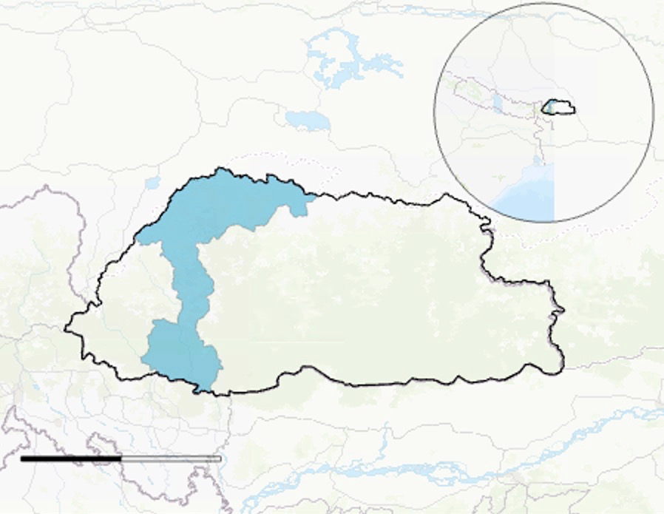
PROJECT OVERVIEW
Study Area
Country: Bhutan
Focus districts: Gasa, Thimphu, and Chhukha
Population: 754,388
Study Period
1981 — 2019
June 1st — August 31st
China
Nepal
India
Gasa
Thimphu
Chhukha
0
200
Kilometres
N
Notes:
Tenzin:
The study area of the project is the country of Bhutan which is landlocked in between the countries of China, India and Nepal in Southeast Asia. Our main focus is on the three districts located in the western part of country namely, Gasa, Thimphu and Chhukha. We decided to focus on the three districts as it divides the country into three parts: Gasa the Northern part, Thimphu the central and Chhukha the Southern foothills. Bhutan experiences all four seasons, however, we decided to focus on the monsoon season that is June, July and August as rainfall is heavy and common in these particular months which will help us with finding the relation between precipitation and temperature, that is, if they are directly proportional. The period of the study is from 1981-2019 which is about 4 decades.

Slide 3
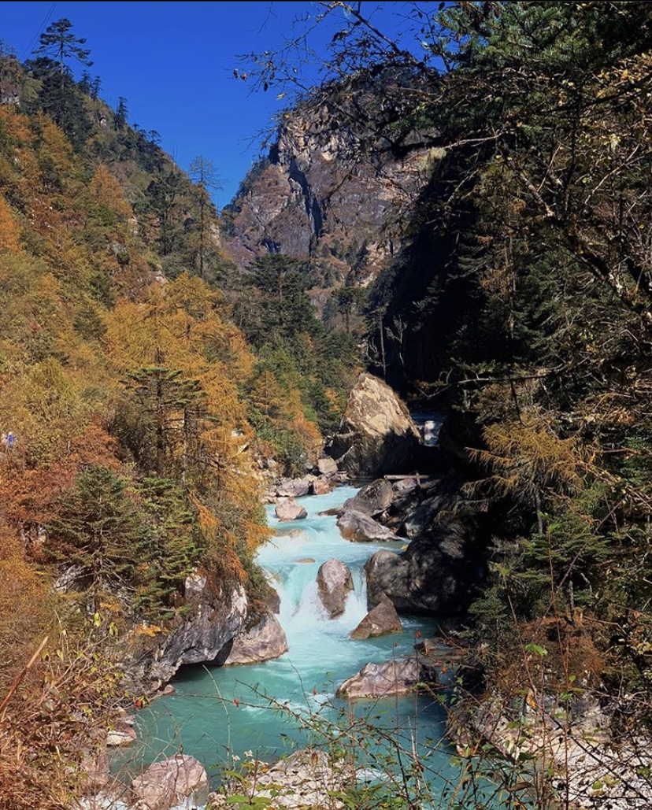
OBJECTIVES
Provide a trend analysis for temperature and precipitation from 1981-2019
Compare modelled satellite and in situ data
Precipitation
Temperature
Phenology
Prepare a foundation for future research on assessing trends for climate variables
Image credit: Karma Dema
Notes:
Tenzin:
The objectives of the project were to analyze data using Earth observation platforms and ancillary datasets like CHIPRS, MODIS and FLDAS model required in attempt to get data and visual representation of the rate at which climate variabilities like precipitation, temperature and phenology have been changing over the past four decades. We also wanted to compare the ground data obtained from the Hydrology and Meteorological datasets with the satellite data in order to lay down foundation for future research. - - - - - -
Image credit: Karma Dema
Image source: Karma Dema
Image license: Public domain

Slide 4
PARTNER ORGANIZATIONS
Himalayan Environmental Rhythm Observation and Evaluation System (HEROES)
BHUTAN FOUNDATION
Ugyen Wangchuk Institute for Conservation and Environmental Research (UWICER)
Notes:
Tenzin:
Our partners for the project are the Bhutan foundation, The Himalayan Environmental Rhythms Observation and Evaluation System also known as (HEROES) and Ugyen Wangchuk Institute for Conservation and Environmental Research (UWICER). Bhutan Foundation bases its project support decisions and priorities outlined in the Bhutan 12th Five Year Plan (FYP). The (HEROES) program is a citizen science initiative project that supports schools and communities to monitor any changes in the climatic conditions and the impacts of the changes on the Himalayan regions. Being born and brought up in Bhutan until high school, we are concerned about how climate variability can affect Bhutan in the long run and that’s why it’s essential to be more informed and take preventive measures to keep our country safe.

Slide 5
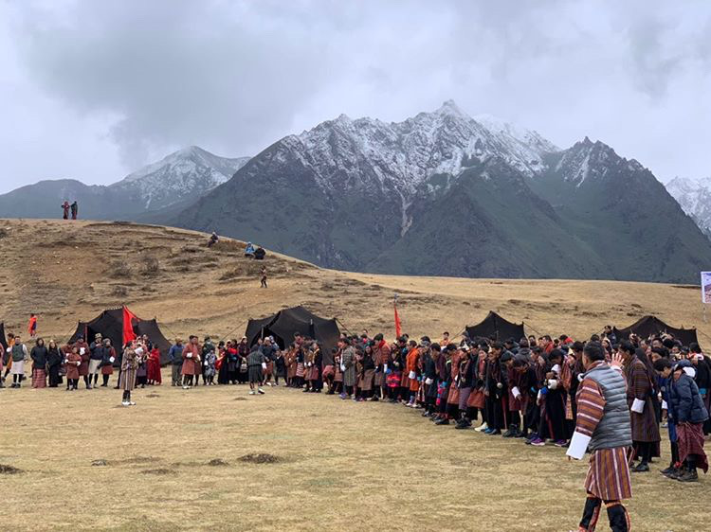
COMMUNITY CONCERNS
Increasing potential melt and decreasing likelihood of precipitation falling as snow
Glacial lake outbursts as a result of warming climate
Local farmers expressed concerns over growing/delayed seasons
Image credit: Karma Dema
Notes:
Deki:
Despite its relative isolation from the rest of the world until the early twenty-first century, Bhutan is no exception when it comes to experiencing effects of climate variability. 1. Bhutan has experienced increased warming and this has resulted in severe change to its local climate with the decrease in the annual rainfall and snowfall over the past decade. It is crucial to know about the changes in the precipitation patterns as it helps one know more about the rainfall and snow pattern which in turn helps people with the knowledge of agricultural trends and land cover. 2. Bhutan already faces the risk from glacial lake outburst floods and this threat could increase through a warming climate (UNDP, 2012). 3.Bhutan is also a non-industrialized country, it is more agriculture-based and many communities within the country are still actively involved in the field of farming so they depend heavily on agricultural work for living and to conserve the environment.
--- credit ---
Image credit: Karma Dema
Image source: Karma Dema Image license: Public domain

Slide 6
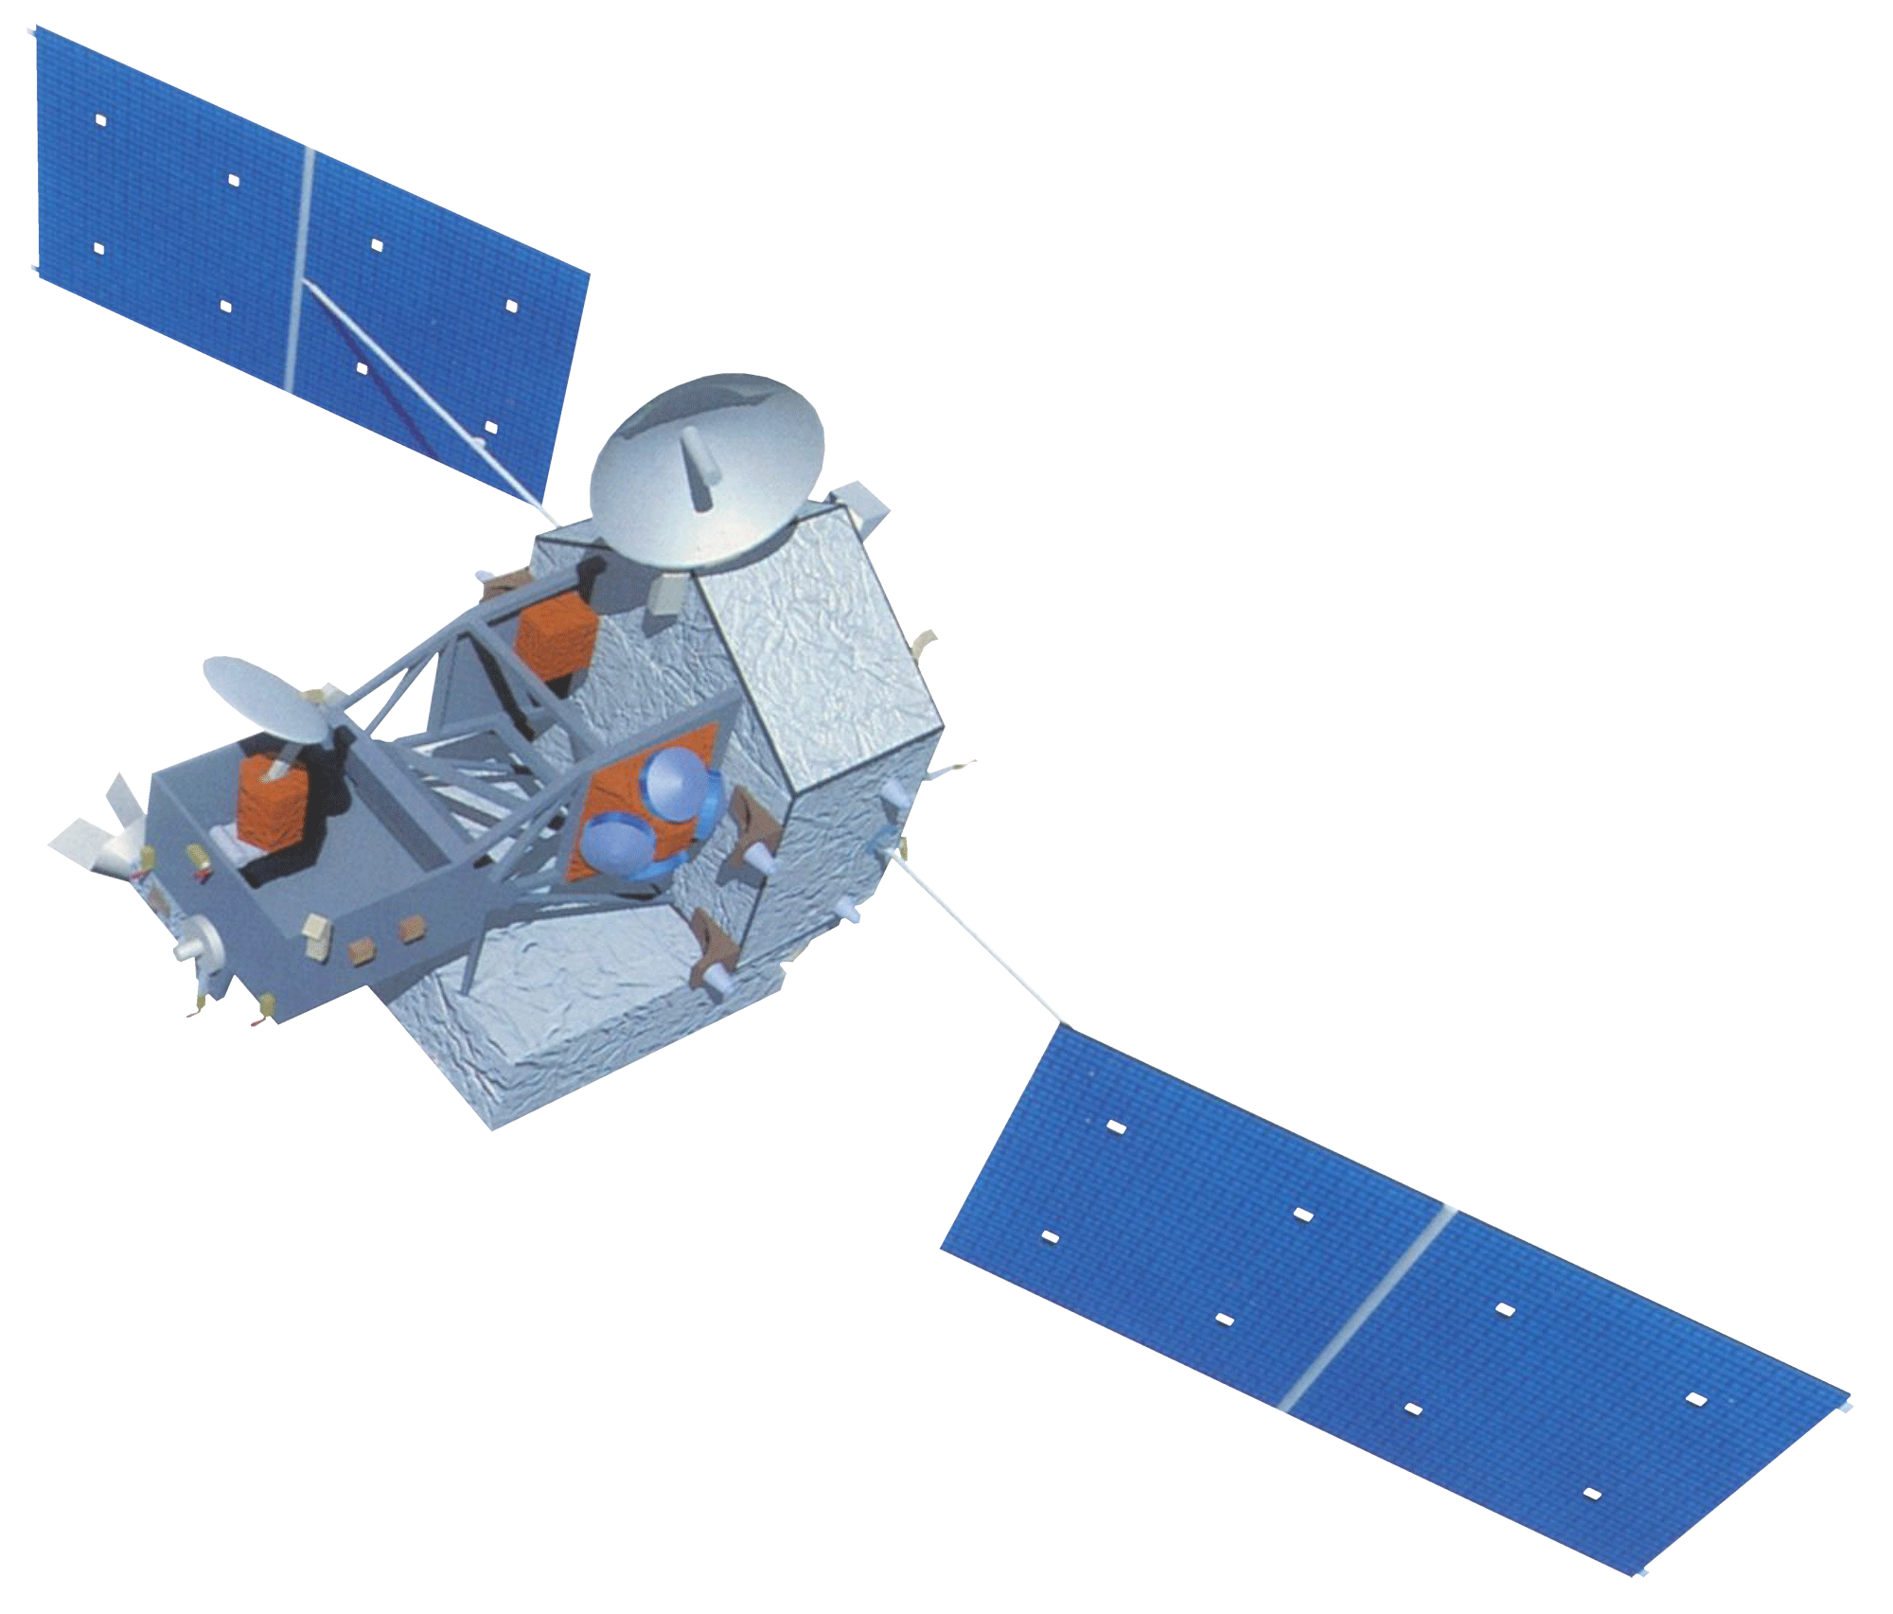
NASA SATELLITES
Terra Moderate Resolution Imaging Spectroradiometer (MODIS)
Tropical Rainfall Measuring Mission (TRMM)
Image credit: NASA
Image credit: NASA
Notes:
Deki: TRMM monitors and studies tropical rainfall. CHIRPS uses TRMM data to assess trends in precipitation. CHIRPS provide complete reliable, up-to-date datasets for a number of early warning objectives, like trend analysis and seasonal drought monitoring. Its dataset goes back as far as 1981 and incorporates 0.05° resolution satellite imagery with in situ data to create gridded rainfall time series to identify climate variability.
Terra MODIS provided the estimates of the timing for vegetation and phenology. It provides global land surface phenology metrics at yearly intervals from 2001-2017
Image Credit 1: NASA
Image Source: http://www.devpedia.developexchange.com/dp/index.php?title=List_of_Satellite_Pictures
Image License: Public Domain
Image Credit 2: NASA
Image Source: http://www.devpedia.developexchange.com/dp/index.php?title=List_of_Satellite_Pictures
Image License: Public Domain

Slide 7
ANCILLARY DATASETS
Platforms | Uses
Climate Hazards Group InfraRed Precipitation with Station (CHIRPS) | Seasonal drought monitoring and trend analysis
Famine Early Warning Systems Network (FEWS NET) Land Data Assimilation System (FLDAS) | Assess trends in temperature
Moderate Resolution Imaging Spectroradiometer (MODIS) | Provide estimates of the timing of vegetation phenology at global scales
Notes:
Deki:
CHIRPS was used to analyze trends in precipitation while FLDAS was used to measure surface air temperature of our focus districts. This dataset contains a series of land surface parameters simulated from the Noah 3.6.1 model in the Famine Early Warning Systems Network (FEWS NET) Land Data Assimilation System (FLDAS). FLDAS data is in 0.10 degree resolution and ranges from January of 1982 to present.
MODIS as mentioned earlier , provides the estimates of the timing for vegetation and phenology.

Slide 8
METHODOLOGY
In situ data
Modelled data
Bhutan National Center for Hydrology and Meteorology
(Temp. & precip.)
HEROES
(phenology)
CHIRPS (rainfall)
MODIS (phenology)
FLDAS (temperature)
Sum
Mean
Mean
Compiling and organizing data
Google Earth Engine
Excel
Box and whisker plots
Trend analysis
Notes:
Tashi:​
In this section will explain how we used the data from the ground and the satellite to investigate temperature, precipitation and phenology. The in situ data was acquired from Bhutan Hydrology and meteorology for temperature and rainfall and the HEROES project for the phenology. These data were then plotted into an excel sheet. ​
​
For the satellite data, adjustments had to be made to ensure that the data was one to one with the ground data. The ground data was acquired from a point station and the satellite data had to be filtered down to those regions of interest using elevation.
To do so we filtered down the data to a certain elevation which contained the ground station of the in situ data. This was done as Bhutan has various difference in elevation throughout each district which would lead to improper comparison of data with the ground data. As temperature and precipitation can change with the change of elevation. ​
​
CHIRPS: here we took the sum of total precipitation in the monsoon (June – August) season for each year from (1996 – 2017)​
FLDAS: Here we plotted the mean temperature across each district for each year for the monsoon season (June - August) and specifying the elevation of the region of interest (which included the ground stations).​
MODIS: [Placeholder: the data has yet to be finalized].​
​
These data were then plotted into excel to create a trend analysis and used to compare and analyze the in situ & satellite data.​

Slide 9
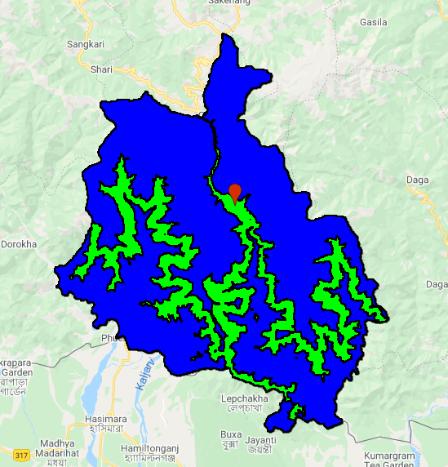
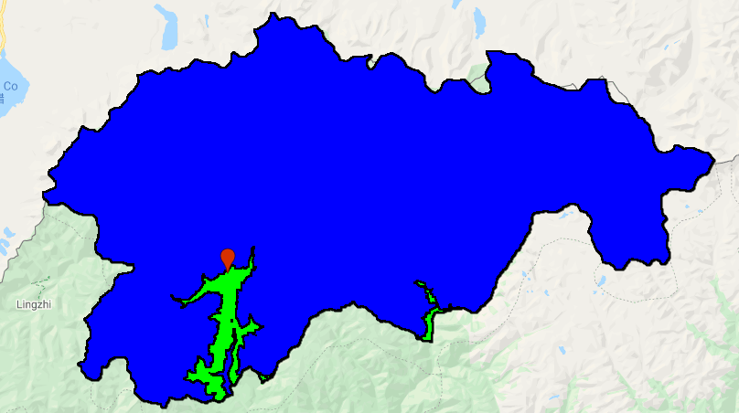
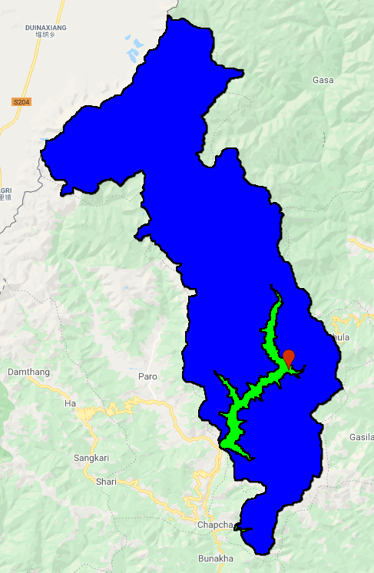
METHODOLOGY
ELEVATION THRESHOLDS FOR REGION OF INTEREST
CHHUKHA
GASA
THIMPHU
Elevation: 2000 – 2800m
Elevation: 1300 – 2000m
Ground station
Region of interest
Region not used
Elevation: 2000 – 2500m
Image credit: Google Earth Engine
Notes:
Tashi:
Firstly we would like to explain that satellite data collected the entire district’s data and gave us an averaged-out value for the entire year for that district, and that the in situ data collected data from a point location within each district. The districts focused on are Chhukha, Gasa and Thimphu respectively from the images shown. So in order to have a one on one comparison between the two types of data, an adjustment had to be made on how we collected the satellite data. The satellite data had to be filtered down to a region of interest within each district by an elevation threshold. The threshold elevation were coded in such a way that it contains the ground stations from where the in situ data were collected to maintain consistency.
This elevation threshold had to be made as Bhutan is a very mountainous region with varying topography. This topography makes it hard to find a mean temperature or precipitation within each district of Bhutan.

Slide 10
RAINFALL RESULTS: THIMPHU
Ground station
Region of interest
Region not used
Notes:
Based on the data collected from Bhutan’s in situ data and the CHIRPS.modelled data from 1996-2017 for the monsoon season (from June to August). The Thimphu district has the least precipitation from the three districts, ranging from 200 to 600 mm. On observing the in situ data, there is a slight decreasing trend in total rainfall over the years during the monsoon period, but the CHRIPS data for the region of interest shows that the total amount of precipitation within the region has remained consistent. Overall, both the data are very close to each other. Another observation that can be made is that the mean total precipitation for the in situ is lower then the CHIRPS data. This is due to the fact that a wider region and elevation is investigated for the CHIRPS data as compared to the point location for the in situ data.

Slide 11
RAINFALL RESULTS: CHHUKHA
Ground station
Region of interest
Region not used
Notes:
Tashi:​
Chhukha district is the district with the highest amounts of rainfall among the three districts. When investigating the two data, it was found that the in situ data is lower as compared to the CHIRPS data. This is also because of the fact that the CHIRPS data set looks into a wider region. Another explanation to this difference is due to the CHIRPS dataset covering the southern region of Bhutan. In this region, the moisture carrying monsoon winds from India meets the mountains of Bhutan. When these monsoon winds hits the mountains the elevation of the mountains causes the winds to cool down and precipitate. Leading to large amount of rainfall in the southern regions of Bhutan. As for the ground station, it is located more inland in the mountains experiencing less rainfall compared to the southern region of Chhukha. An interesting find is that both CHIRPS and in situ data indicate that there is a gradual increasing trend in the amount of rainfall each year in the Chhukha district.

Slide 12
RAINFALL RESULTS: GASA
Ground station
Region of interest
Region not used
Notes:
Tashi:​
Firstly, we would like to explain that the Gasa district was the district with the more topographic changes with the highest elevation as compared to Thimphu and Chukkha. As seen on the map, the region of interest for the CHIRPS data is very small as the ground station for the in situ data was located at a very low elevation in comparison to the rest of Gasa. Another note is that the in situ data on precipitation was only collected from 2003 and no earlier records could be found from the Bhutan’s National Center for Hydrology and Meteorology.
This region shows a huge difference between the CHIRPS data and the in situ data even though the elevation threshold had been adjusted as close as it can be with the ground station. As you can see, the in situ data shows high amounts of precipitation in the region but the CHRIPS data completely contradicts it.
This district is an anomaly with its precipitation data and it maybe due to the topography or due to human error in data collection. This district shows the limitations and difficulties in data collection in highly topographic regions.

Slide 13
TEMPERATURE RESULTS: Thimphu
Ground station
Region of interest
Region not used
Notes:
Tashi:
Now we will look into the temperature dataset.
When investigating temperature data within Thimphu, it can be seen that the in situ data is slightly higher as compared to the FLDAS data. This is also due to the FLDAS like the CHIRPS data looks at a wider region with various elevation. It should be noted that temperature is susceptible to the change in altitude and Bhutan is a highly mountainous country.

Slide 14
TEMPERATURE RESULTS: Chhukha
Ground station
Region of interest
Region not used
Notes:
Tashi:
In the case of Chhukha, the temperature data for both the FLDAS and the CHIRPS data stay within the same range to a certain degree. An interesting observation is that according to the in situ dataset, there has been an increasing trend in temperature over the year for the district.

Slide 15
TEMPERATURE RESULTS: Gasa
Ground station
Region of interest
Region not used
Notes:
Tashi:
The Gasa temperature for both datasets also stay with the same range but one interesting find is that the in situ data indicates that there is a decreasing trend in temperature over the years but the FLDAS data shows a very slight increase in temperature trend over the past 14 years.

Slide 16
PHENOLOGY RESULTS: Thimphu
Notes:
When looking into the phenology data for Thimphu obtained from MODIS, Thimphu seems relatively stable. From the graph, we can observe that there is a slight increase in the trend line indicating that spring is starting late as compared to previous years in Thimphu. But then again looking at individual point on the graph, it can be also seen that there is an alternating pattern where spring starts early one year and in the next year it starts a little late.

Slide 17
PHENOLOGY RESULTS: Chhukha
Notes:
Like Thimphu, Chhukha district shows a slightly steeper increasing trend indicating that spring is also starting to start late in this district. However, there was an anomaly in the Spring of 2004 for Chhukha where it started very early.

Slide 18
PHENOLOGY RESULTS: Gasa
Notes:
In the case of Gasa too there is a slight increasing tend meaning that spring is starting to start late with each year. There are a few individual points that contain anomalies where spring starts very early like in the years 2002, 2010 and 2017.
But an overall conclusion can be made that spring has been starting late over the past year for all three districts.

Slide 19
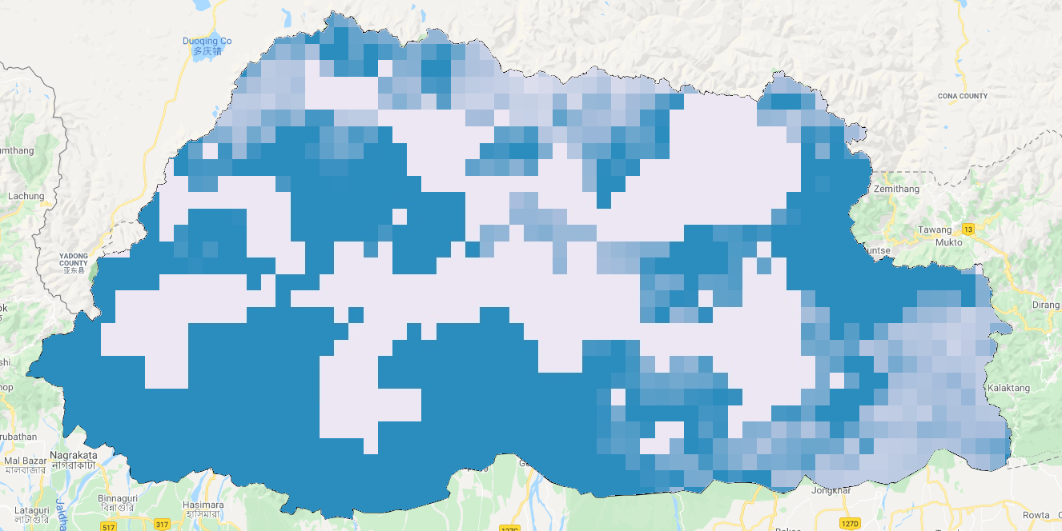
MAP: PRECIPITATION
Bhutan's 2019 Total Monsoon Precipitation (mm)
TOTAL PRECIPITATION
(June 1st – August 31st)
High
Low
Precipitation (mm)
0
200
N
Kilometres
Notes:
Moving on, here we have an example of a visual representation of Bhutan's total precipitation for 2019 from June-August for the monsoon period. As observed on the map, the darker shade of blue represents higher concentration of rainfall, while the lighter shades of blue represent the lower concentration of rainfall.

Slide 20
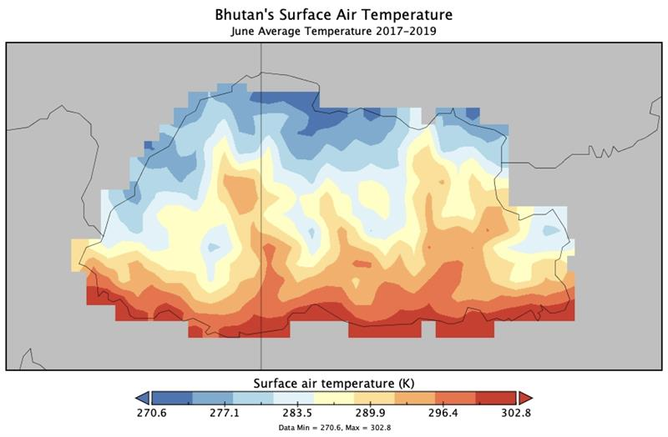
MAP: TEMPERATURE
Bhutan’s Surface Air Temperature
June Average Temperature 2017 to 2019
0
200
Kilometres
Surface air temperature (K)
N
270.6
277.1
283.5
289.9
296.4
302.8
Notes:
Kinley:
As for temperature, here we have a visual representation of Bhutan's monthly average temperature for the month of June from 2017-2019.
Based on the map, the darker shades of red represent hotter regions within the country, while the darker shades of blue indicate areas with temperate weather for June.

Slide 21
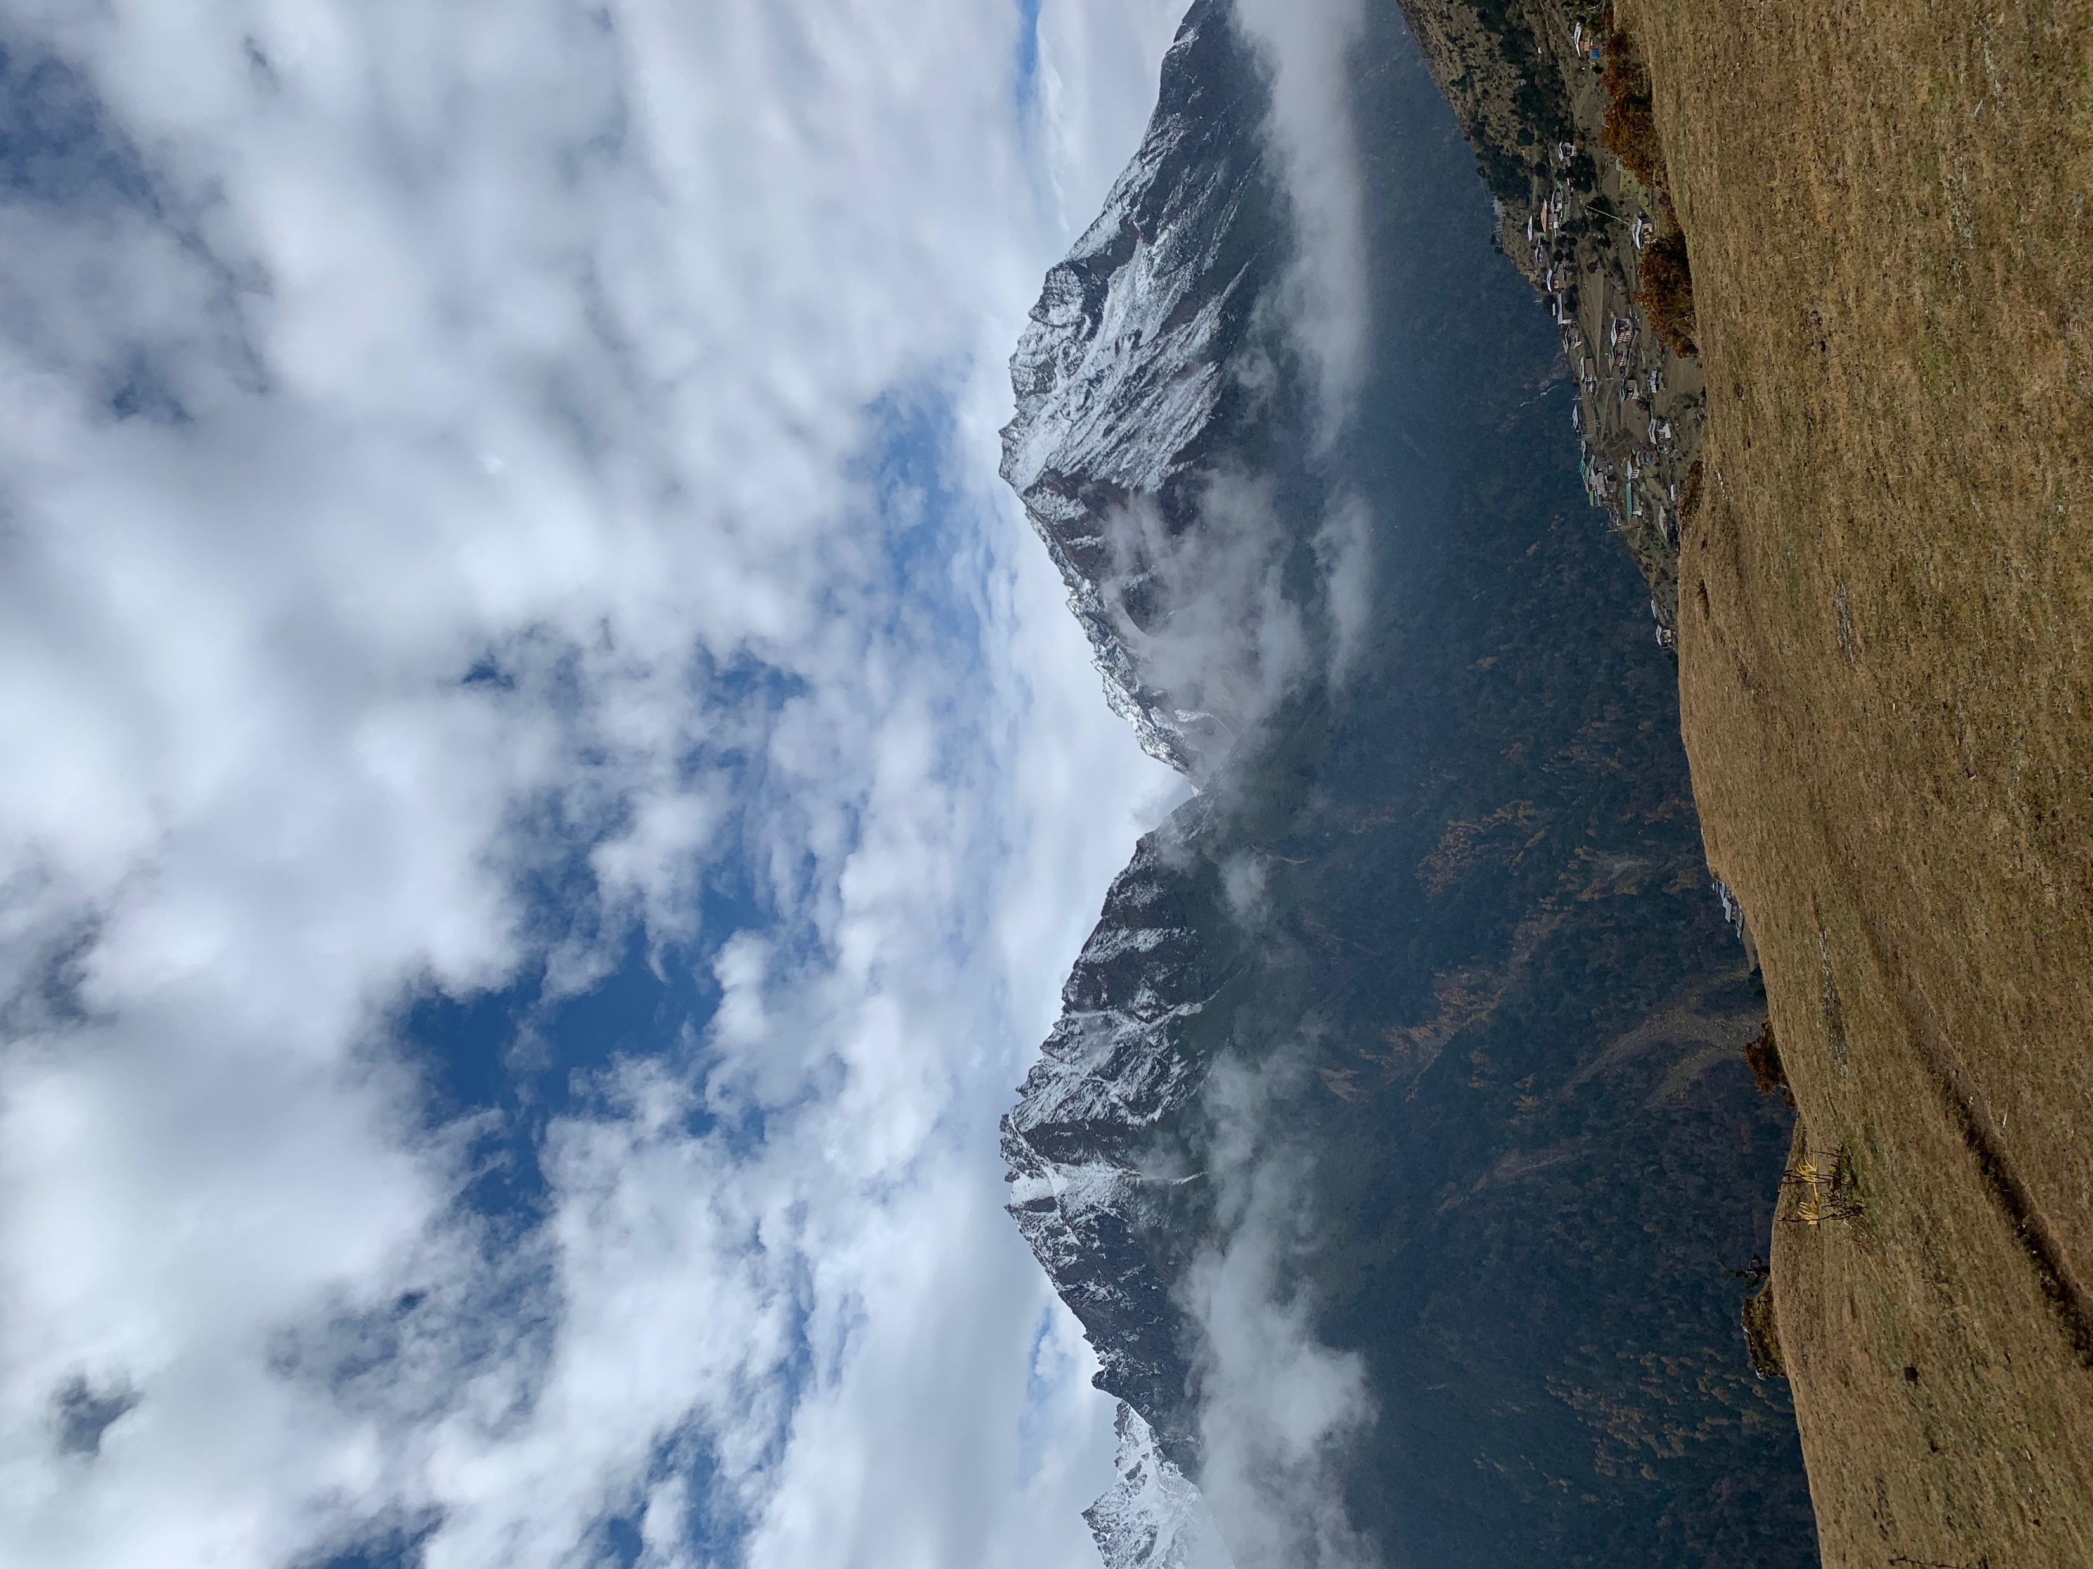
CONCLUSION
CHIRPS, FLDAS and MODIS were used to assess trends in precipitation, temperature and phenology
The trend analysis remained consistent for both modelled and in situ data, with slight variations in all climate variables for each focus district
Satellite precipitation data are challenged in the Himalayas
The satellite data suggests spring is arriving later
Image credit: Karma Dema
Notes:
Kinley:
In a nutshell, Bhutan has been affected by seasonal and climatic variability. This is not only a major concern for the local farmers, but also the people of Bhutan (Wangchuk et al., 2013). Satellite platforms and sensors like CHIRPS, FLDAS, and MODIS were used to assess trends in precipitation, temperature and phenology. Three focus districts on the western region were chosen based on their location as our prototype, with Gasa in the north; Thimphu- central, Chhukha- south. Our partners can use this prototype to do the same for other districts of Bhutan.
The in situ data can be used to validate and evaluate satellite data. The trend analysis was pretty consistent for both modelled and in situ data. The modelled data did not account for heights which explains the variation in trends. Satellite precipitation data are challenged in the Himalayas and it's hard to measure rainfall above mountains and dense forests.
Based on the results acquired from analyzing the datasets, there were variations in trends for both temperature and precipitation for each district. Carefully designed studies have found similar studies that its hard to match up satellite and in situ data. Regardless, this suggests that our partners (Bhutan Foundation or HEROES) can use the satellite data to make up for any missing in situ data

Slide 22
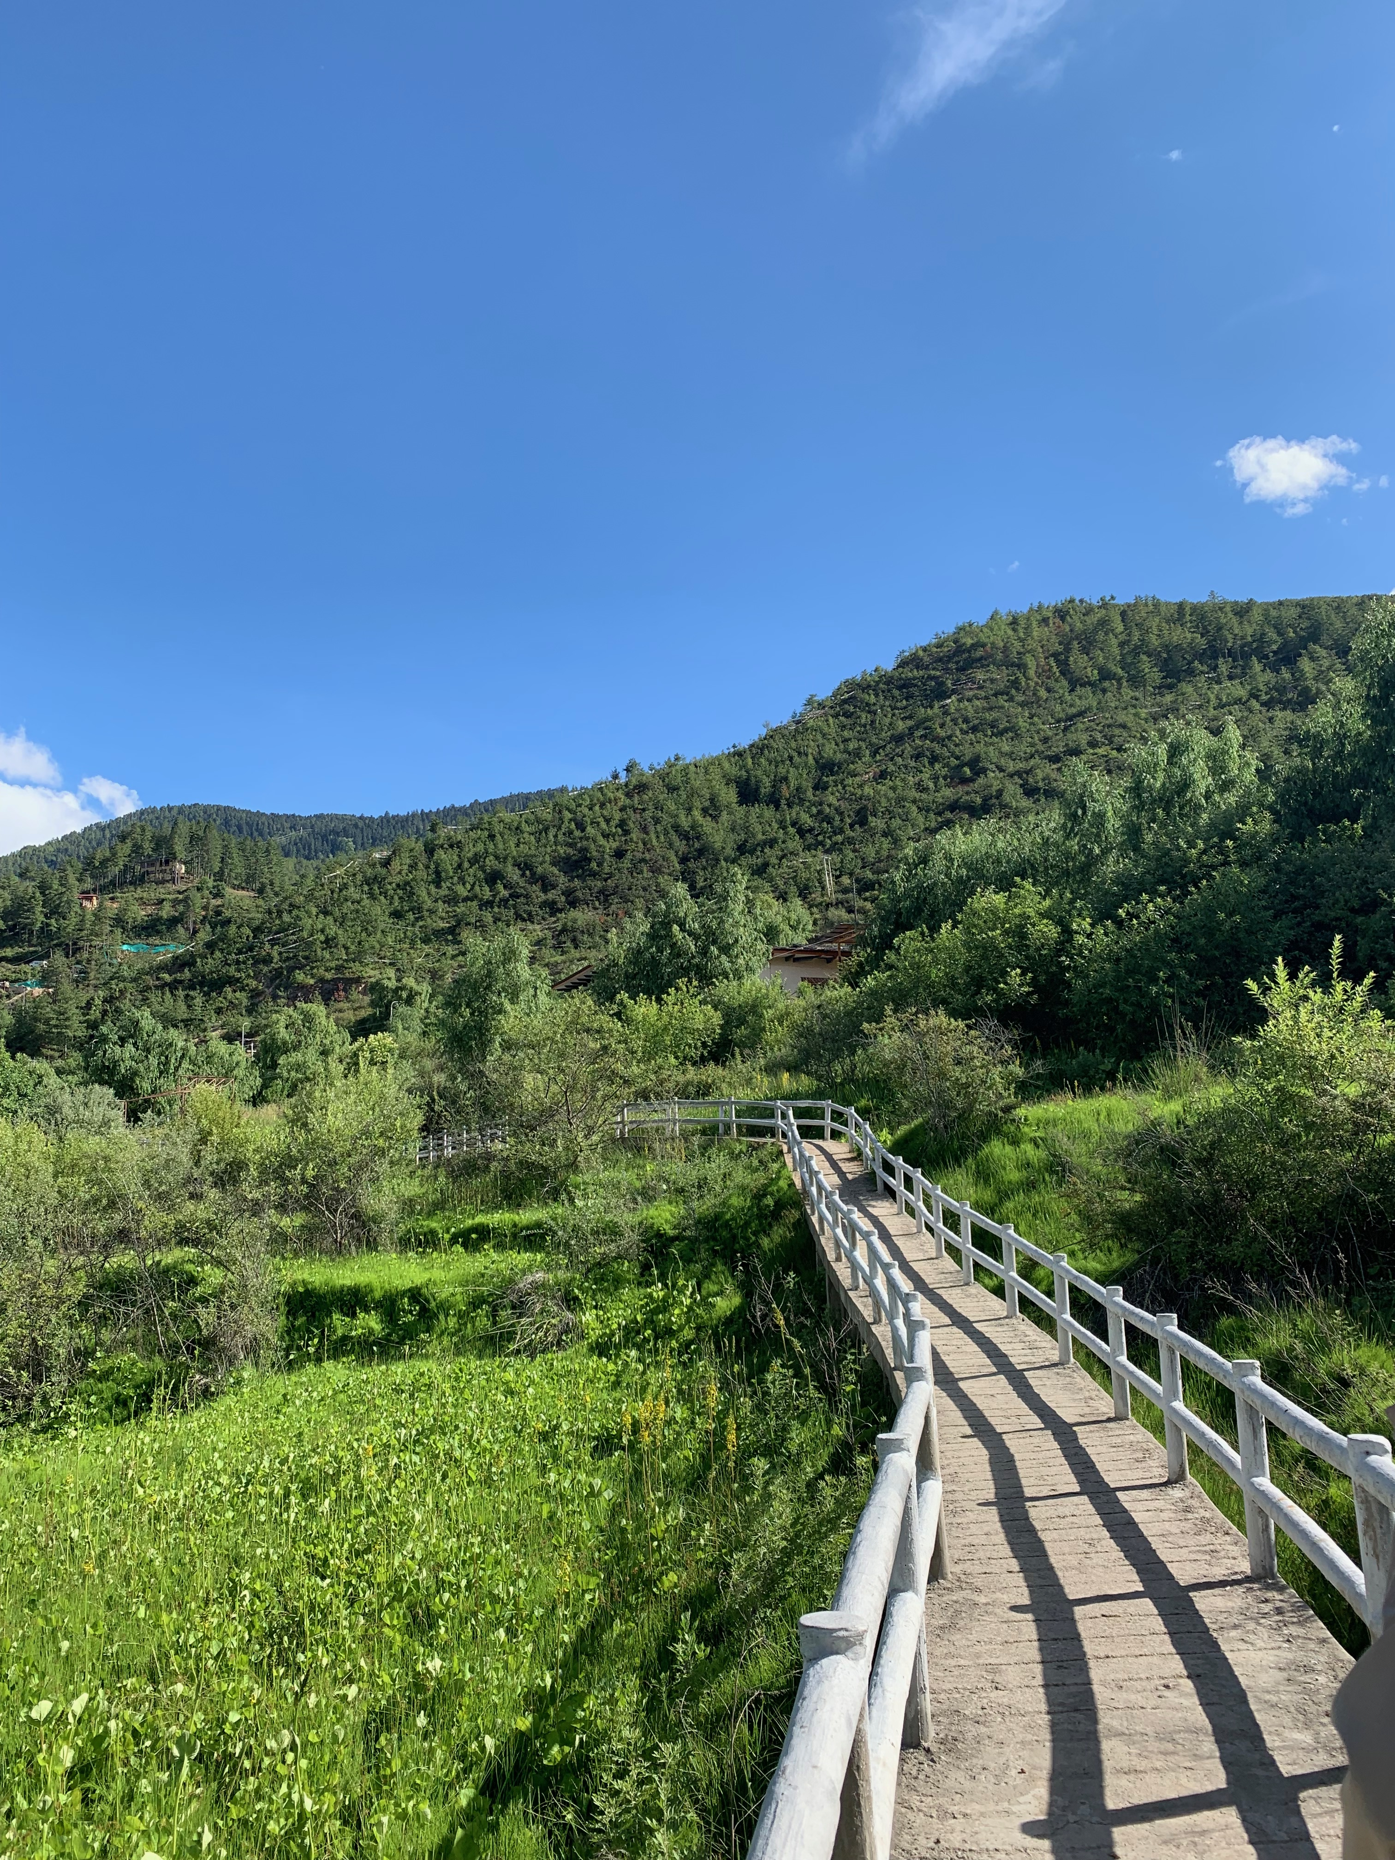
LIMITATIONS AND UNCERTAINTIES
Variation in elevations and slopes influence how the satellite and ground data are measured
Potential human error (bias and random error) while collecting in situ data
Limited availability of in situ data (1996 – 2017), making it difficult to perform a comparative analysis
Image credit: Bhutan WR Team
Notes:
Kinley:
No satellite is perfect, and both CHIRPS and FLDAS have issues assessing data from highly mountainous ranges. Variations in elevations and slopes influence how the satellite and ground data are being measured. There were differences between the in situ data being point data and modelled data being a mean over the whole district.
Another limitation our project had encountered were the small variations we had found while doing the comparative analysis for the modelled and in situ data. It's highly possible that there were potential human error while collecting in situ data, such as biasness or random error. There was also limited availability of in situ data, making it difficult to match with the modelled satellite data to perform a comparative analysis
- - - - - -
Image Credit: Bhutan WR Team
Image Source: Bhutan WR Team
Image license: Permission to use

Slide 23
FUTURE WORK
Analyze how variability in climate trends affect local farmers in Bhutan
Examine the role precipitation and temperature play in influencing phenological trends
Use NOAA Advanced Very High-Resolution Radiometer (AVHRR) to look at phenology data over past 40 years
Image credit: Jamyang Dema
Notes:
Kinley:
Since Bhutan is more of an agriculture-based nation, it would be beneficial to understand how an increase or decrease in rainfall trends could affect crop plantations and farming in general. It's also crucial to place more emphasis on how these climate trends had impacted Bhutan's agricultural lifestyle and affected local farmers in the country. More research can be also be done to further examine the role precipitation and temperature play and how these factors influence phenological trends
Since we're using MODIS for phenology which only goes back as far as 2000, it would be advisable to look into NOAA AVHRR for long-term phenology dataset
--- credit ---
Image credit: Jamyang Dema
Image source: Jamyang Dema
Image license: Permission to use

Slide 24
The team would like to acknowledge the following individuals for their influence in our work:
Timothy Mayer (NASA SERVIR Science Coordination Office)
Helen Baldwin (NASA SERVIR Science Coordination Office)
Sean McCartney (Science Systems & Applications, Inc., NASA Goddard Space Flight Center)
Dr. Robert Griffin (The University of Alabama in Huntsville)
Dr. Jeffrey Luvall (NASA Marshall Space Flight Center)
Dr. Patrick Taylor (NASA Langley Research Center)
Dr. Kenton Ross (NASA Langley Research Center)
Caily Schwartz (NASA SERVIR Science Coordination Office)
Christine Evans (The University of Alabama in Huntsville)
Madison Murphy (Optimal GEO)
A.R. Williams (NASA DEVELOP)
Sabine Nix (NASA DEVELOP)
Thomas Quintero (NASA DEVELOP)
This material contains modified Copernicus Sentinel data (2014), processed by ESA. ​
Notes:
We would like to thank the following individuals for their influence in our work

Slide 25
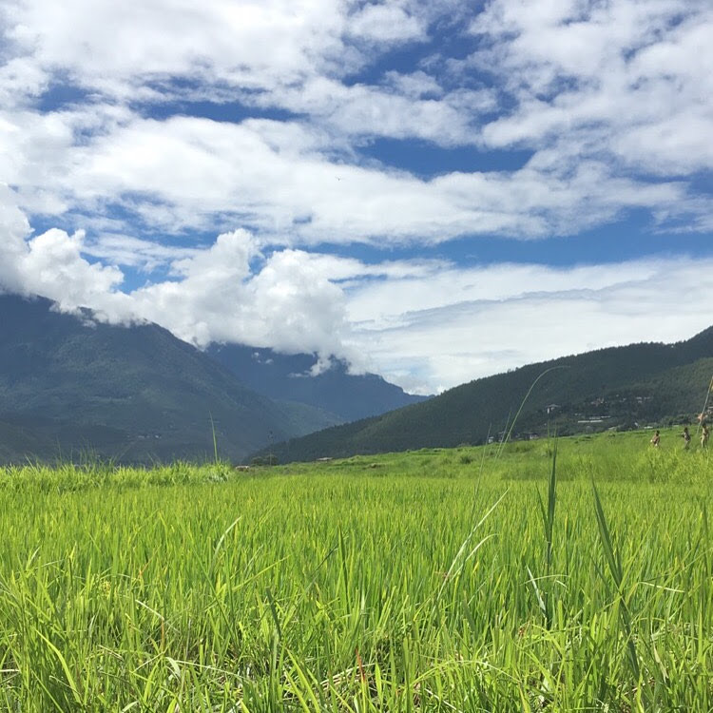
QUESTIONS
Image credit: Bhutan WR Team
Notes:
Any questions?
- - - - - -
Image Credit: Bhutan WR Team
Image Source: Bhutan WR Team
Image license: Permission to use

Slide 26
REFERENCES
Funk, C., Peterson, P., Landsfeld, M., Pedreros, D., Verdin, J., Shukla, S., Husak, G., Rowland, J., Harrison, L., Hoell, A., & Michaelsen, J. (2015). The climate hazards infrared precipitation with stations—a new environmental record for monitoring extremes. Scientific Data, 2, 150066. https://0-doi-org.lib.utep.edu/10.1038/sdata.2015.66
Khandu, Awange, J.L., L., Kuhn, M., Anyah, R., & Forootan, E. (2017). Changes and variability of precipitation and temperature in the Ganges-Brahmaputra-Meghna River Basin based on global high-resolution reanalyses. International Journal of Climatology, 37(4), 2141–2159. https://doi.org/10.1002/joc.4842
Lamchin, M., Lee, W., Jeon, S., Wang, S, K., Lim, H., Song, C & Sung, M. (2018). Long-term trend of and correlation between vegetation greenness and climate variables in Asia based on satellite data. MethodsX, 5(803–807), 803–807. https://doi.org/10.1016/j.mex.2018.07.006
Liu, J., Wang, Z., Gong, T., & Uygen, T. (2012). Comparative analysis of hydroclimatic changes in glacier-fed rivers in the Tibet- and Bhutan-Himalayas. Quaternary International, 282, 104–112. https://0-doi-org.lib.utep.edu/10.1016/j.quaint.2012.06.008
UNDP (United Nations Development Programme). 2012. Technical review and social impact assessment. Reducing climate change-induced risks and vulnerabilities from glacial lake outburst floods in the Punakha, Wangdue and Chamkhar Valleys.
Wangchuk, S., & Siebert, S. F. (2013). Agricultural change in Bumthang, Bhutan: Market ppportunities, government policies, and climate change. Society & Natural Resources, 26(12), 1375–1389. https://doi.org/10.1080/08941920.2013.789575
Wangdi, N., Om, K., Thinley, C., Drukpa, D., Dorji, T., Darabant, A., Chhetri, P., B., Ahmed, I, U., Staudhammer, C, L., Jandl, R., Schindlbacher, A., Hietz, P., Katzensteiner, K., Godbold, D., & Gratzer, G. (2017). Climate change in remote mountain regions: A through fall-exclusion experiment to simulate monsoon failure in the Himalayas. Mountain Research and Development, 37(3), 294–309. https://doi.org/10.1659/MRD-JOURNAL-D-16-00097.1
Wiltshire, A. J. (2014). Climate change implications for the glaciers of the Hindu Kush, Karakoram and Himalayan region. The Cryosphere, 3. http://doi.org/10.5194/tc-8-941-2014

