Slide 1
GEORGIA
Energy III
Identifying Habitat and Solar Site Conflict in Georgia by Developing an Environmental Sensitivity Public Mapping Tool
Samantha Trust, Alexander Burke, Jannatul Ferdush, Vineeth Jason Putti
Georgia – Athens
Notes:
Hello Everyone! We are the Georgia Energy III team of Samantha Trust, Alexander Burke, Jannatul Ferdush, and Vineeth Jason Putti.
This 10-week NASA DEVELOP project worked to map environmental sensitivity and solar suitability in the state of Georgia and create a web application to share this information with solar developers and the general public. Over the course of this presentation we will introduce you to our study area and partners and discuss our data uses and results.

Slide 2
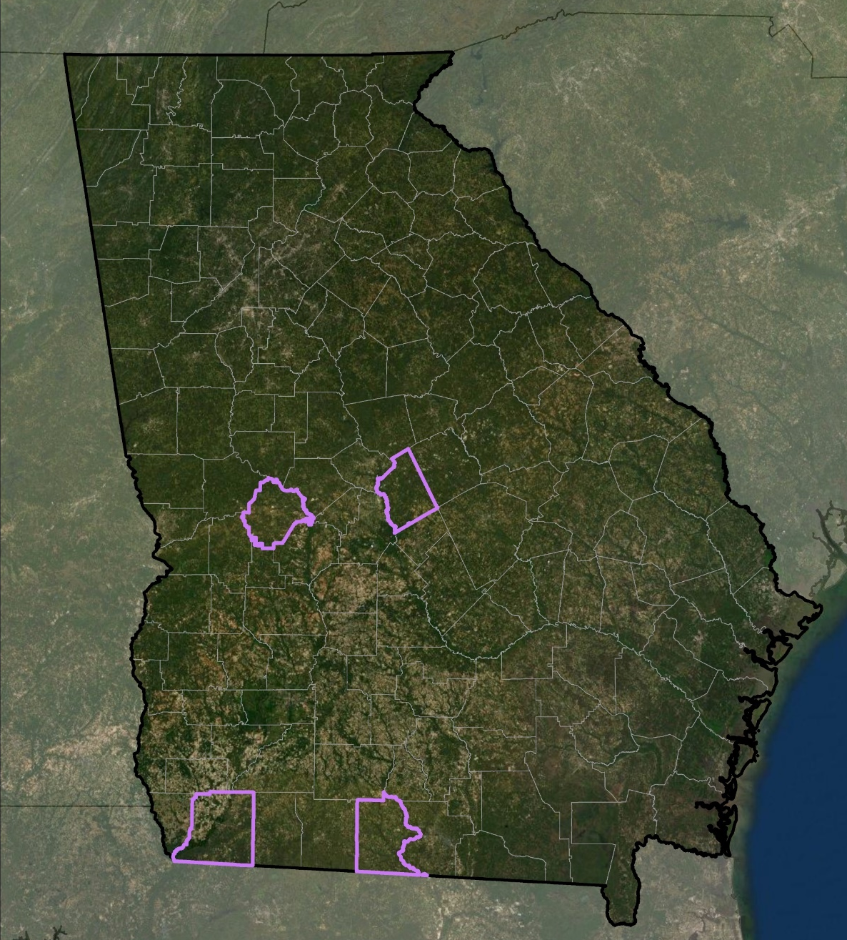
STUDY AREA & PERIOD
Tennessee
Counties of Interest
Georgia (Study Area)
Study Area
Entire State of Georgia
Four counties of interest
  Brooks County
  Decatur County
  Taylor County
  Twiggs County
Study Period
July 2017 to June 2020
South
Carolina
Georgia
Twiggs
Taylor
Alabama
Decatur
Brooks
N
0
25
50
100
Florida
Km
Notes:
The team used the entire state of Georgia as our primary study area and based on discussions with our partner organizations, we also focused Brooks, Decatur, Taylor, and Twiggs county for in-depth analysis since these locations have a rapid pace of solar development with critical environmental threats.
Our study period continues from the previous term in 2017 and created updated analyses for the years 2017, 2018, and 2019.
Image Created by Team Member Alexander Burke

Slide 3
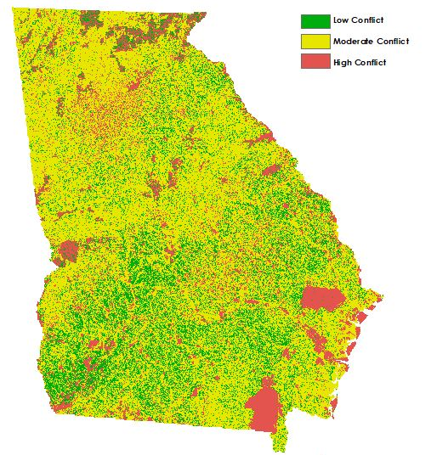
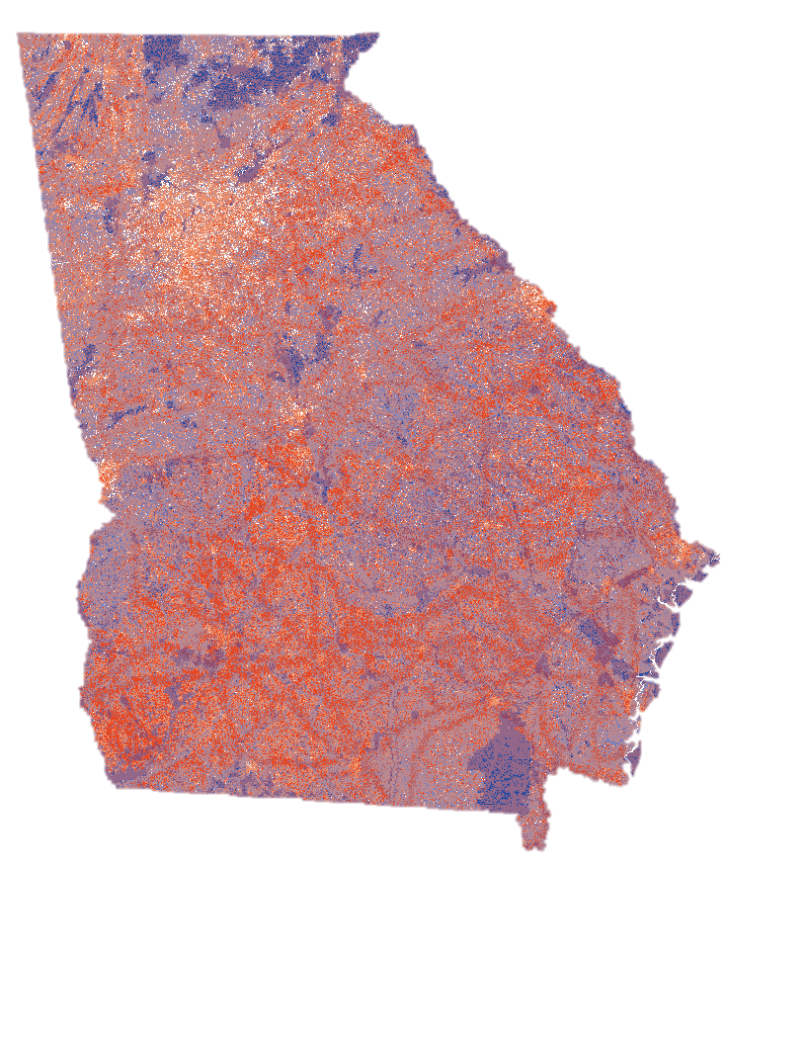
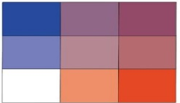

Georgia Energy I & II
Georgia Energy I (2016)
Georgia Energy II (2017)
Low Conflict
Moderate Conflict
Environmental Sensitivity
High Conflict
Solar Farm
Development Potential
N
0
80
160
200
Kilometers
Notes:
The Georgia Energy I and II teams focused on the effects of solar development on gopher tortoise habitats by conducting solar suitability and Land-use Conflict Identification Strategy (LUCIS) Model analyses across the state of Georgia for the year 2016, as well as, in Taylor County.
They concluded that the distribution of most suitable areas is mostly concentrated in the southern areas of Georgia, with some areas in the northern part of the state.
The Georgia Energy II team continued to examine the effects and conflicts between critical species habitats and utility-scale development in the entire state, Taylor and Decatur Counties for 2017.
The second term was able to conclude that Decatur county contained more highly suitable areas than Taylor county (Shrestha, Ahmed, Aragón, Bouffard, et al., 2017).
The Georgia Energy III team has expanded the two previous terms by including opinions and feedback from Georgia solar developers and black bear habitats in our LUCIS model.
Additionally , we included two more counties (Brooks and Twiggs) for in-depth analysis.
Citations:
Abdouni, L., Amed, E., Bhattacharee,N., Bledsoe, R., Cameron, C., Shrestha, S., & Stone, A. (2017). Georgia Energy Identifying Sensitive Habitats and Wildlife and Populations in Areas with High Solar Power Potential [Unpublished Manuscript]. NASA DEELOP National Program.
Shrestha, S., Amed, E., Aragon, A., Bouffard, M., Clermont, F., Hawman, P., Morgan, N., Remillard, C., & Stone, A. (2017). Georgia Energy II: Reducing Conflicts in Siting Solar Power Facilities by Identifying Sensitive Habitats and Wildlife and Populations in Areas with High Generation Potential [Unpublished Manuscript]. NASA DEVLOP National Program

Slide 4
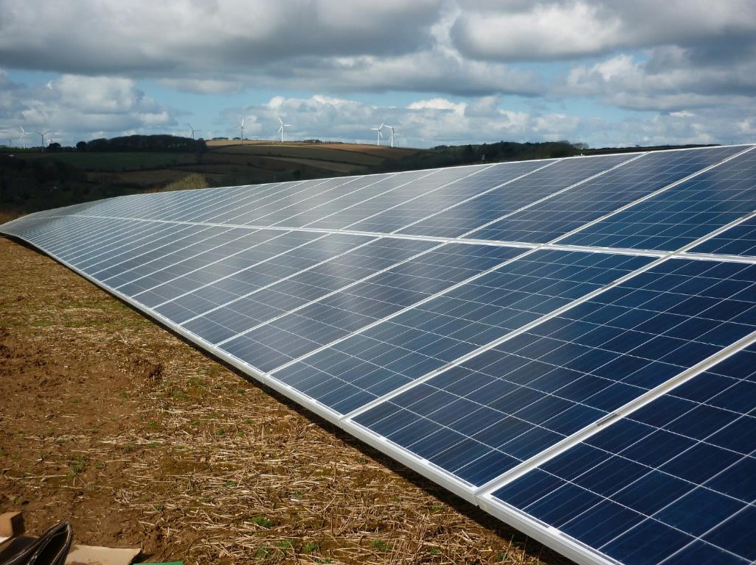
Why is this research necessary?
A decade of rapid development in the solar energy market in Georgia
Large overlap between sites that are suitable for solar development and the habitats of critical species
Need to provide decision support to solar developers on the potential impacts of utility-scale solar farms
Credit: Jaidee
Notes:
Before and after the previous projects, the geography and economics of Georgia have assisted in driving solar energy market. Over the past decade the market has rapidly expanded by up to 30-45% each year and in 2019, Georgia was ranked as the 5th largest solar energy producer in the US. Unfortunately there is a large overlap between ideal areas for utility scale solar farms and critical habitats of species like the Gopher Tortoise and American Black Bear. Without accurate information on where the key habitats lie developers can potentially alter the environmental status of the state.
Image Credit: Jaidee from Pixabay (Free for commercial use, No attribution required)
https://pixabay.com/photos/solar-solar-panels-solar-farm-2796471/

Slide 5
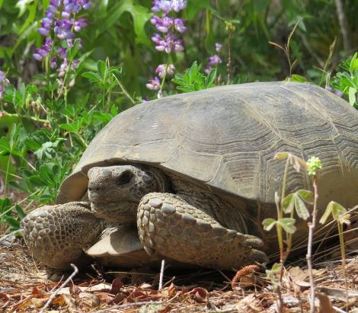
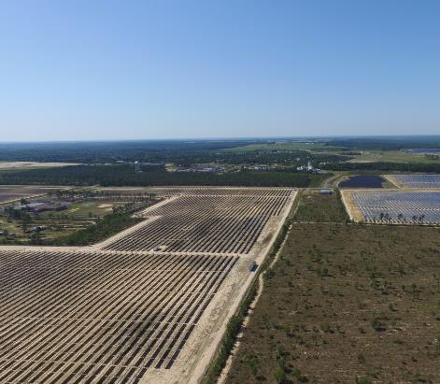
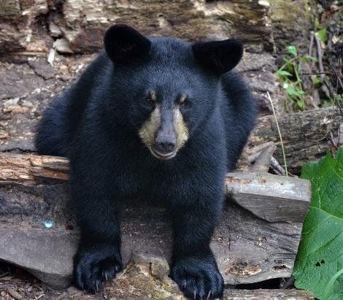
COMMUNITY CONCERNS
Credit: Georgia Dept. of Natural Resources
Solar development threatens keystone species and critical habitats
Biodiversity and ecological imbalances due to land use changes
Credit: Georgia Dept. of Natural Resources
Credit: Tina Shaw/USFWS
Notes:
As previously mentioned, development of solar farms can significantly alter the environment and pose threats to biodiversity that could lead to a negative trophic cascade of the surrounding ecosystem.
The Gopher Tortoise is a key stone species of Georgia that has been increasingly disturbed by urbanization and deforestation. The recent construction of a solar farm in Twiggs County has also put black bears at risk of decreased habitat and therefore decreased population.
Additionally, solar developers prefer to use already cleared land which is often in close proximity to agricultural lands. The
Image credit for Gopher Tortoise and Solar Farm
Georgia Department of Natural Resources
Image source: Provided by project partners at the Georgia Department of Natural Resources (Matt Elliott)
Image Credit for Black Bear Cub:
Tina Shaw/USFWS via Flickr (Public Domain)
https://www.flickr.com/photos/usfwsmidwest/20254986474/in/photolist-wRS6NJ-jqAAw5-7X5F9j-21YnRM-HVA3Y2-PmchSR-2iNjfba-7Un3ax-GGTLCM-okF7wM-nYaZ6Z-pv4LmX-6X6dGa-kwG6kc-kwJuiw-k2FmXE-pvYSir-ni3di6-tyogTv-tQWD5R-tQU1MV-RHD9r4-vW9suW-GZwNwb-NEszon-GTHr13-2b2ZXmn-2cqLaz8-2cqL9LK-2b2ZZBK-2b2ZV8p-67cowr-2b2ZZbp-2b311jB-2b2ZYFM-2cqLabT-2cqLbkr-NHrr3q-2iP24c4-29E9V4J-2b2ZXTK-2cqLbCF-2cqLa1x-2htTedW-4fAD75-YHjYfF-XtigBD-2cqLvCz-2cmj8LL-QZvywE

Slide 6
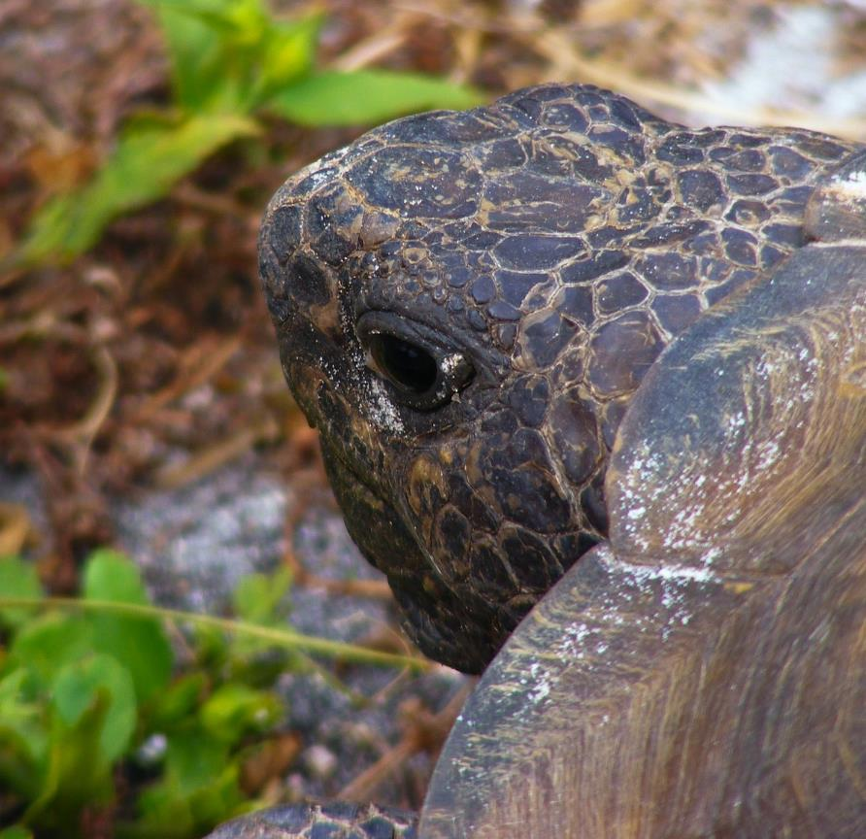
PARTNERS
The Nature Conservancy –
Georgia Chapter
Amy Gutierrez, Climate and Lands Coordinator
Georgia Department of
Natural Resources
Matt Elliott, Assistant Chief of Wildlife Conservation
Credit: Jody Davis
Notes:
The team had opportunity to work with two organizations that work with decision makers and planners to conserve natural resources, the environment, and ecology.
The Georgia Chapter of the Nature and Conservancy is a non-profit organization that is working with solar developers towards a common goal to create the best and highest land use for any parcel, whether that be for conservation or for development. They were looking for a proactive tool for developers and conservationists to recognize benefits of low impact siting of renewable energy deployment (A. Gutierrez, personal communication, June 8, 2020).
Our other partner, the Georgia Department of Natural Resources, helped us to understand the availability of land that would not be consequential on the environment. They work closely with Georgia Power, who is concerned about generating more renewable energy sources, but are aware of the potential conflict. They want to be more cognizant of their siting choices as to avoid any detrimental effects which could be achieved through a visual tool of our results (M. Elliott, personal communication, June 8, 2020).
Image by Jody Davis from Pixabay https://pixabay.com/photos/gopher-tortoise-gopherus-polyphemus-201528/
(Free for commercial use, No attribution required)

Slide 7
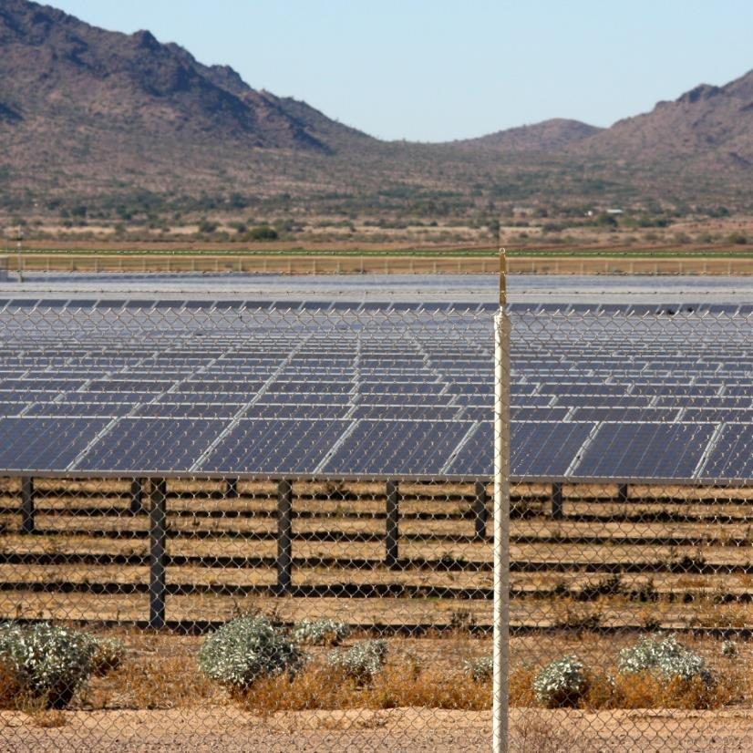
OBJECTIVES
Compare solar suitability and environmental sensitivity analyses for the state of Georgia between 2017 and 2019
Perform in-depth analysis of Brooks, Decatur, Taylor, and Twiggs counties
Utilize the Land-Use Conflict Identification Strategy to find areas of conflict between solar suitability and environmentally sensitive areas in 2017, 2018, and 2019
Provide a user-friendly application for decision makers
Credit: Kevin Dooley
Notes:
The objectives during the term were to compare solar suitability and environmental sensitivity across the state for 2017 and 2019 to see any changes between the last project and now.
Then, we performed in-depth solar suitability and environmental sensitivity analyses for Taylor, Twiggs, Decatur, and Brooks counties. The results of these two objectives were used as inputs for the Land-Use Conflict Identification Strategy to find areas of conflict between solar suitability and environmentally sensitive areas.
Finally, we provided decision-makers with a user-friendly web application to assist in visualizing conflict and selecting sustainable solar development sites.
Image Credit: Kevin Dooley
Image Source: flickr.com/photos/pagedooley/23791566693/in/photolist-CfnZTK-2jirrQd-2iDVvn7-2iR3wRU-PnELTn-2geuHCu-YovcUU-2hzqB2o-2gtL2B4-YnV3ic-27JWJRe-skkMn4-2gNpNfa-Uhko6V-PGJ91r-2hpeYrY-CUVV32-CPna4h-xVwiyL-BMKmuW-2etpoww-2h9uHWX-WkJjGL-2idsiYH-RkpZzu-2iUABu4-2duy3fU-2io2aJc-2iMNVHc-2gapcAt-XcP1tb-aSBuji-DktzGv-BV94bA-Cwm6X5-CMPFYy-EErD6c-2icyXEy-YJZtJV-EErB7c-FpBQ3a-6C4RpN-2hs4keP-2ihUqHQ-LcWRfe-2iTRt29-CNKL6g-Pcf45-2bRD6Bv-273WdTh
CC BY 2.0

Slide 8



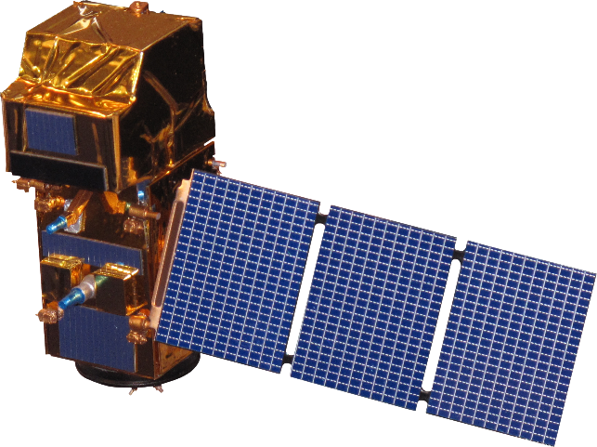
EARTH OBSERVATIONS
Aqua
Terra
Direct Source
Aqua CERES
Solar Insolation
Terra CERES
Indirect Source
Landsat 8
Sentinel-2
Landsat 8 OLI
Land Use Land Cover
Sentinel-2 MSI
Notes:
For our analyses, we utilized four NASA Earth observations. The Cloud and Earth’s Radiant Energy System Instrument on the Aqua and Terra Satellites and processed by the NASA Prediction Of Worldwide Energy Resources team to give us our solar Insolation data for 2017, 2018, and 2019.
Additionally, imagery from Landsat 8 Operational Land Imager and Sentinel-2 Multi-Spectral Instrument was used for by the United States Department of Agriculture’s CropScape dataset for years 2017, 2018, and 2019 to provide Land Use and Land Cover.

Slide 9
METHODOLOGY
Needs
Understanding Environmental Needs + Solar Developer Needs
Develop Goals + Objectives for Land-Use Conflict Identification Strategy (LUCIS) Model
Inputs
Acquire Data for Suitability Models
Solar Suitability Parameters:
Floodplains
Land Use and Land Cover (LULC)
Parcels
Proximity to Roads
Proximity to Transmission Lines
Slope and Aspect
Solar Insolation
Environmental Parameters:
Gopher Tortoise Habitats
Prime Agricultural Land
Protected/Conservation Lands
Land Use and Land Cover
Landscape Connectivity
Raster Calculator
Outputs
Statewide and County Level Conflict Bivariate Maps for 2017, 2018, and 2019
Notes:
The first step in our process was to understand the needs of solar developers and criteria for environmental sensitivity. This was done through multiple discussions with our partners, as well as, through a survey conducted by the Georgia Chapter of the Nature Conservancy that asked developers within the state what the most important factors were that led to their decisions of solar farm siting and how they would weight each parameter in a suitability model. These discussions and the results from the survey became the basis of our solar suitability and environmental sensitivity analyses.
After identifying the parameters, we collected the necessary GIS data to complete each analysis, conferring with our partners to assign suitability scores and weights. Then the resulting analyses were used as inputs for the Land Use Conflict Identification Strategy, LUCIS, to create our final outputs of the statewide bivariate maps for 2017 and 2019, and county level bivariate maps for 2017, 2018, 2019.

Slide 10
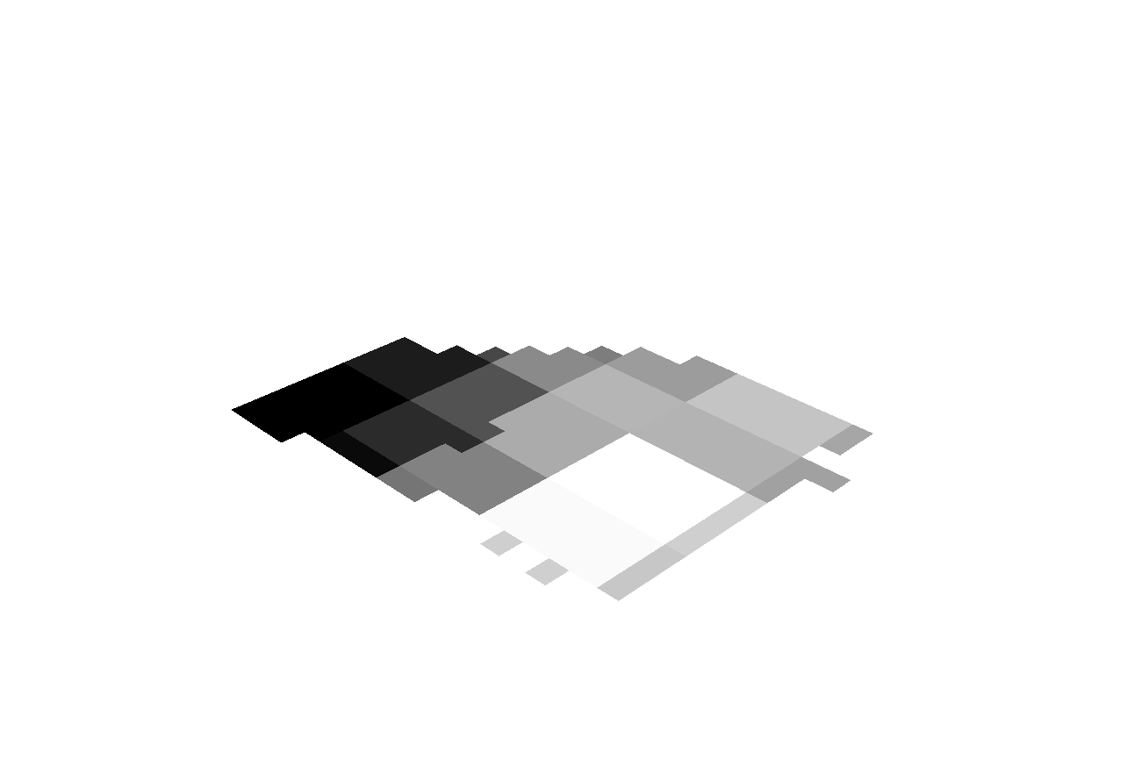
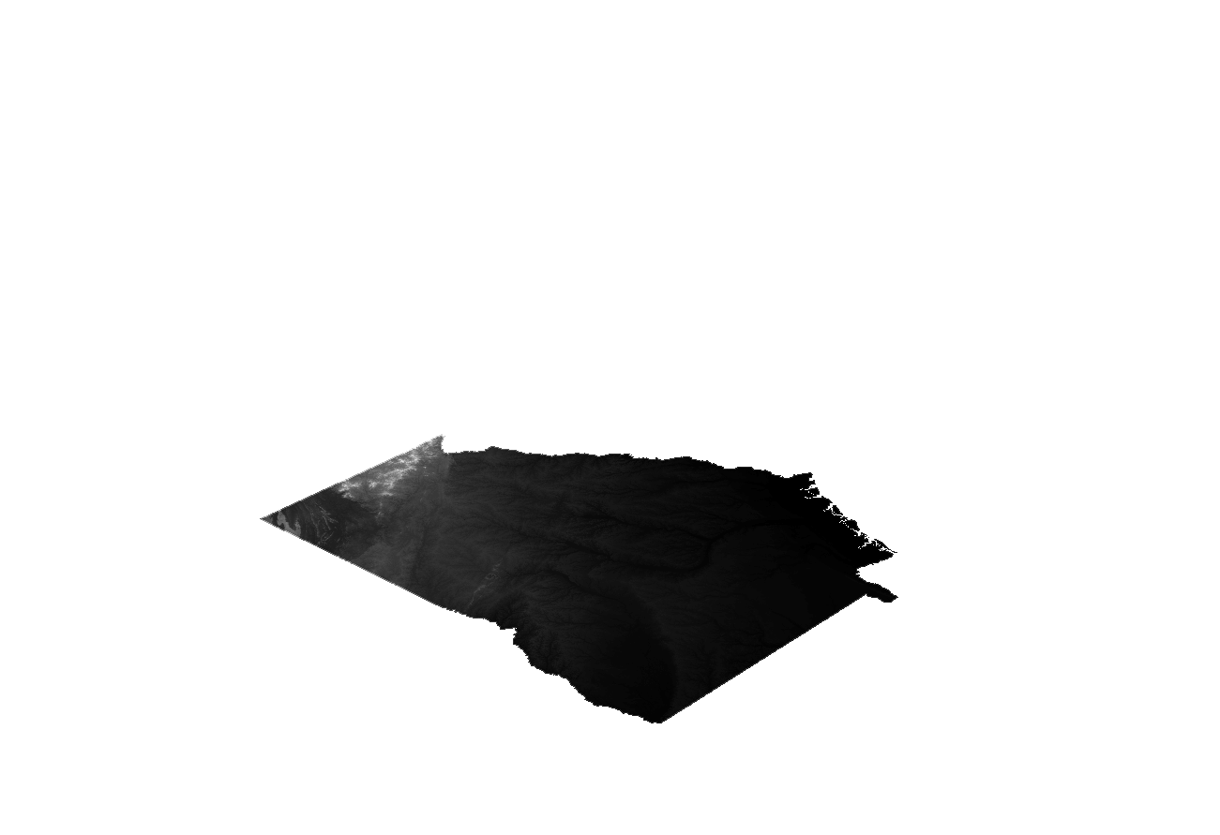
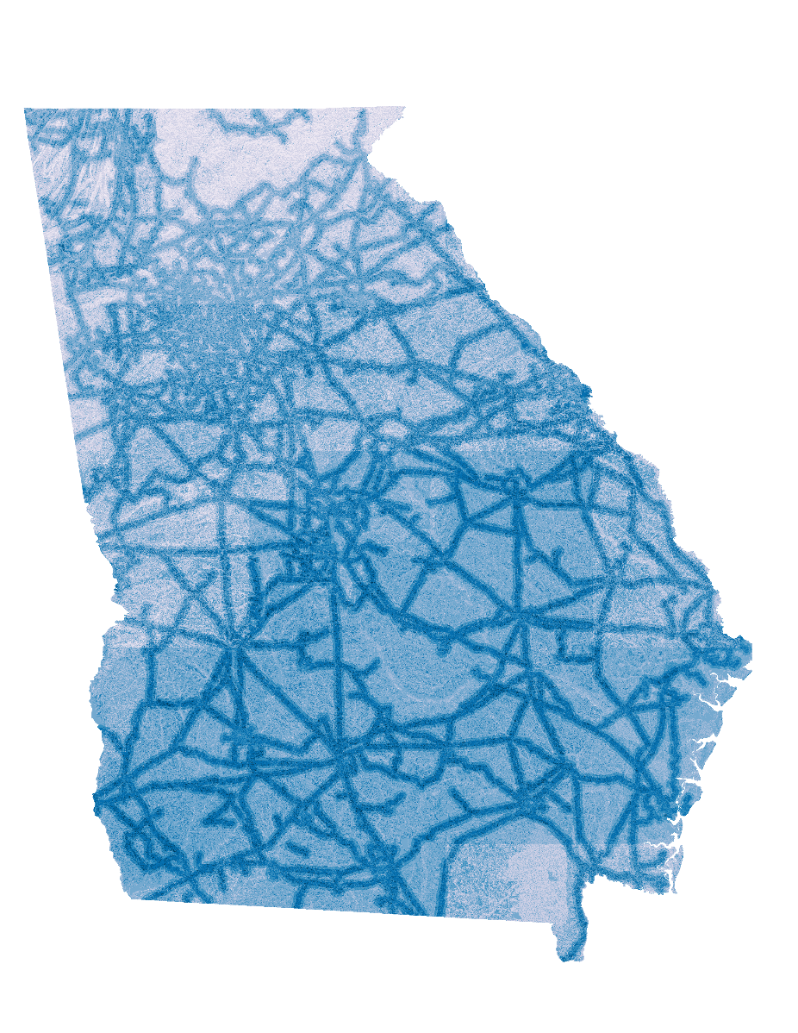
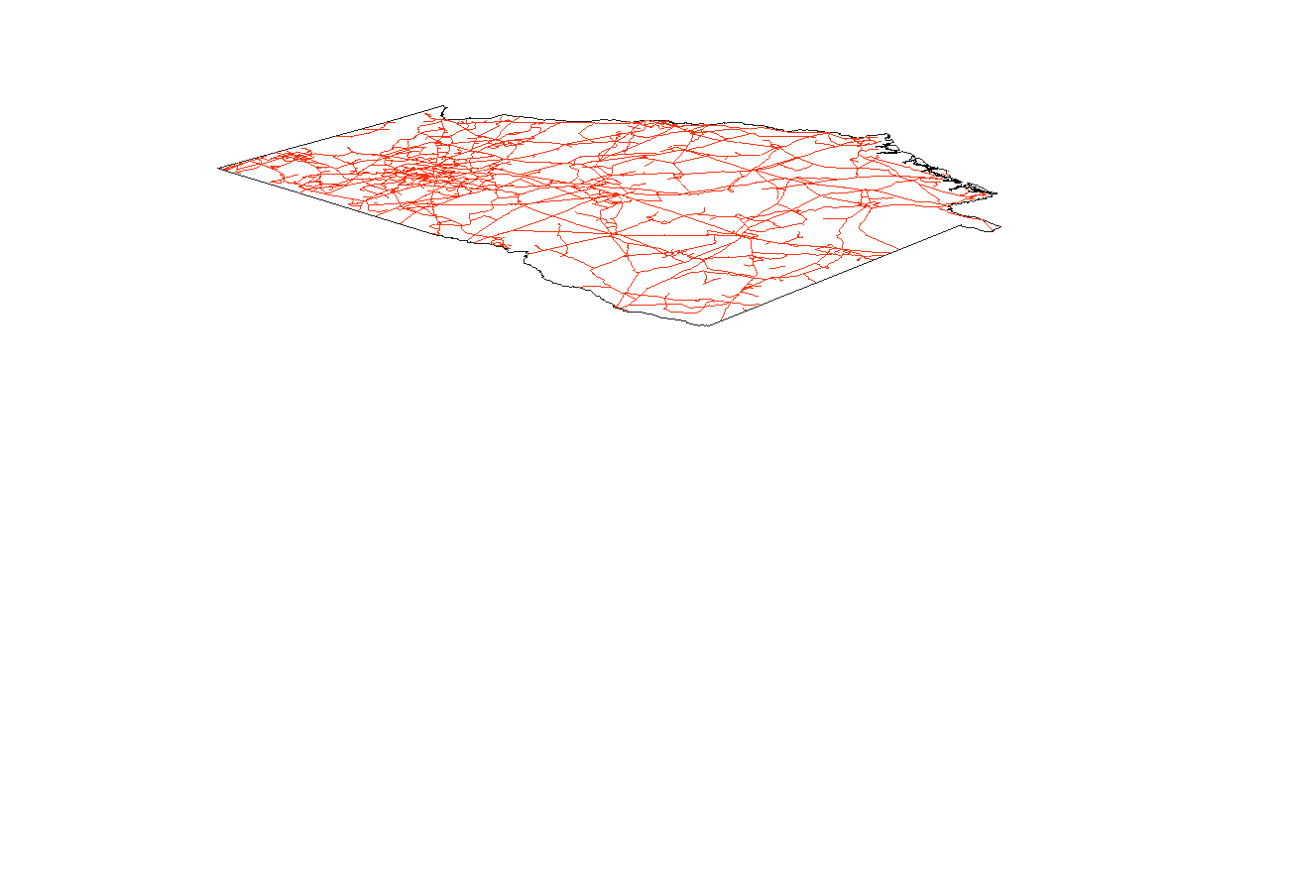
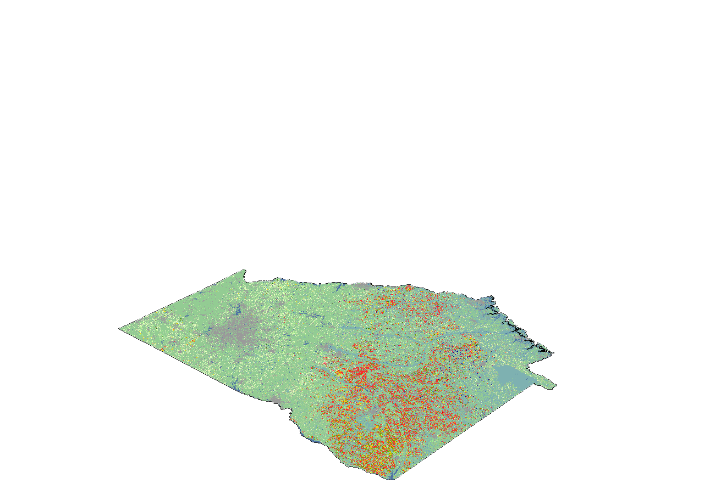
SOLAR SUITABILITY ANALYSIS
Input Raster
Weighting
Factor
Proximity to Transmission Lines
25%
Solar Insolation
15%
Aspect
20%
Slope
20%
LULC
20%
Notes:
For our statewide solar suitability assessment, we utilized land use and land cover, slope and aspect derived from the United States Geological Survey digital elevation model, solar insolation and proximity to transmission lines. For the county level analysis, we also included additional data, like parcels, floodplains, and roads for a more in-depth look.
Each raster was then reclassified on a scale of 1-3, 3 being most suitable for utility scale solar development. Using the weighted overlay tool, these layers were assigned weights of influence based on the results from the survey sent to solar developers by TNC. Solar insolation was weighted the lowest because there is not much variability in scores across the state, while proximity to transmission lines was weighted higher because access to transmission lines is crucial to new solar farm development since that is how power is transported.
All images and figures created by the DEVELOP team

Slide 11
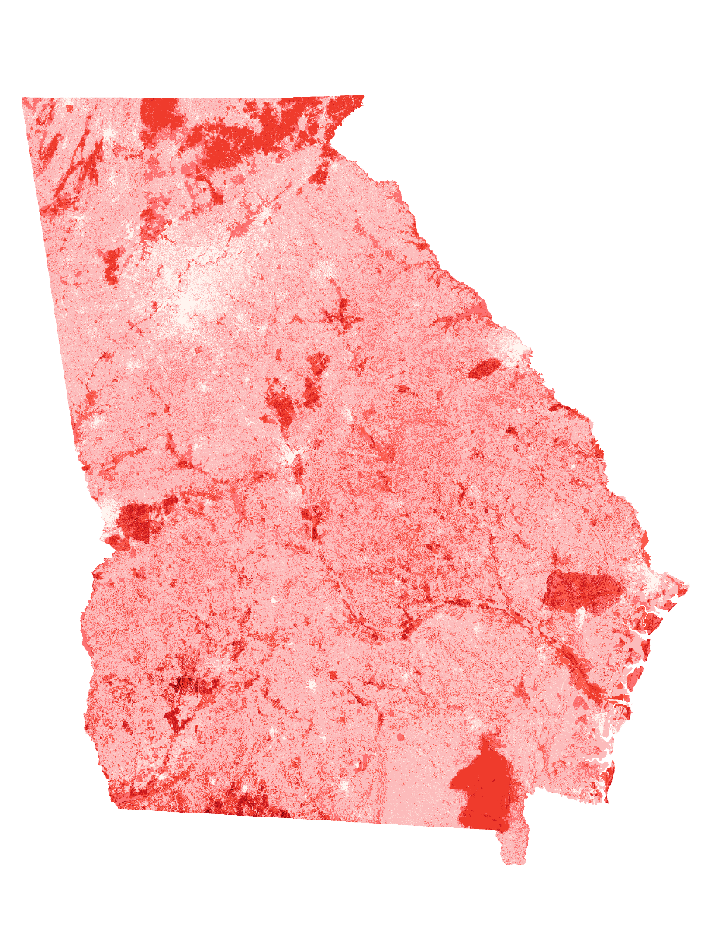
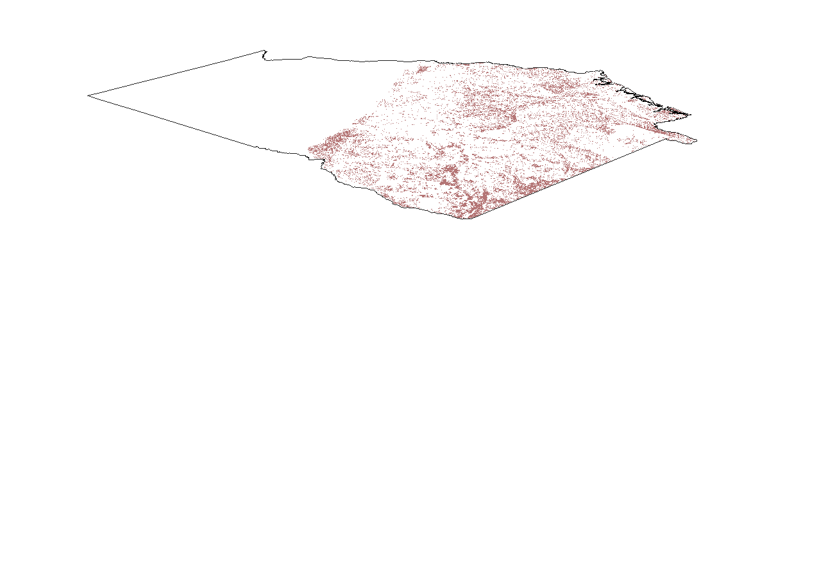
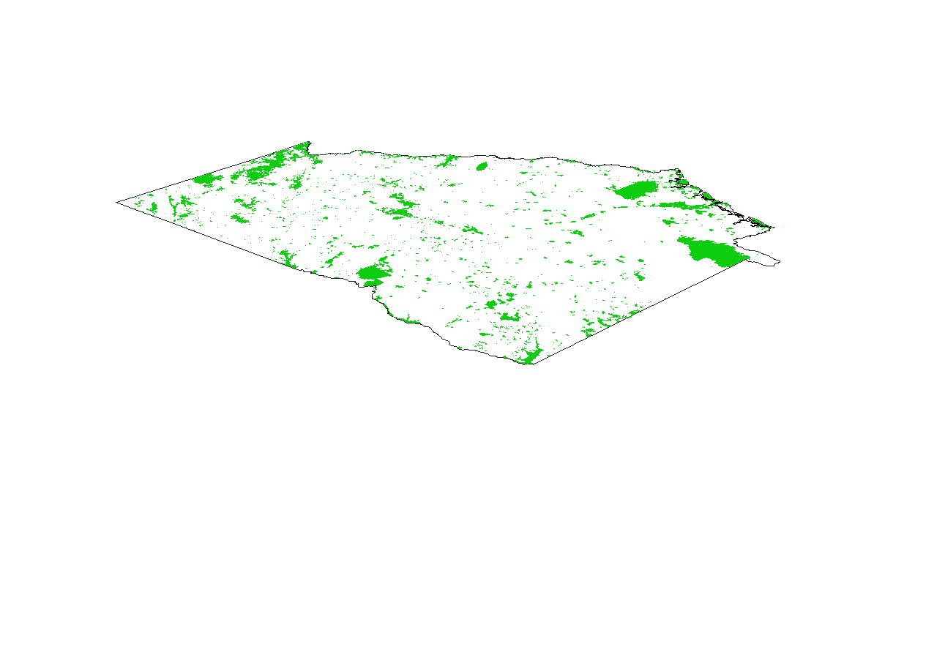
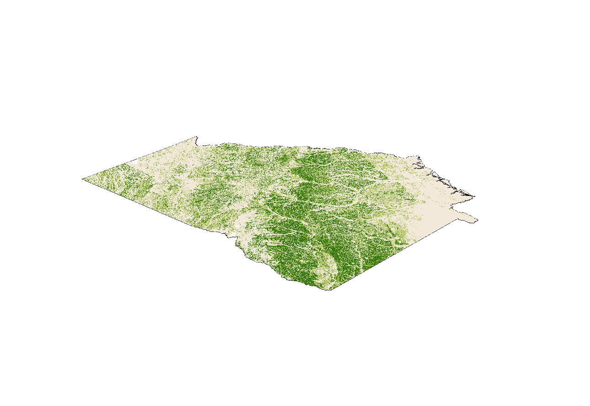
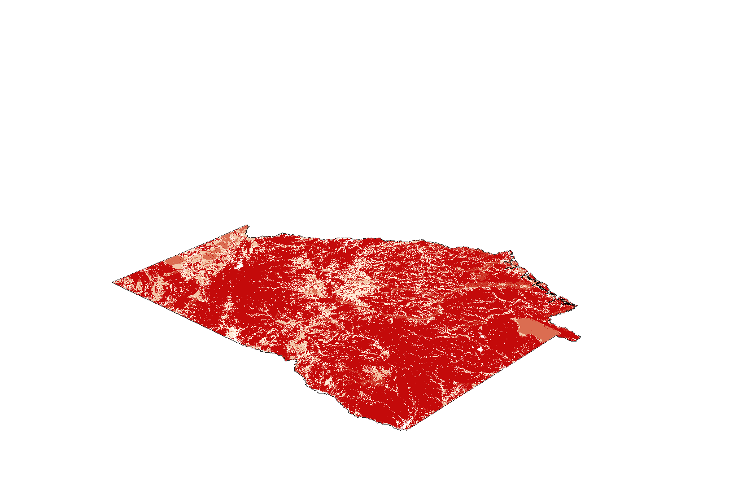
ENVIRONMENTAL SENSITIVITY ANALYSIS
Input Raster
Weighting
Factor
Gopher Tortoise Habitats
20%
GADNR Protected/ Conservation Lands
20%
Prime Farmland
20%
Landscape Connectivity
20%
LULC
20%
Notes:
For our environmental sensitivity analysis, we utilized the CropScape land use and land cover data, in addition to data for landscape connectivity, prime farmlands, protected areas from the GA Dept. of Natural Resources, and Gopher Tortoise habitats.
We used a similar methodology as the solar suitability analysis by reclassifying values and assigning weights according to the partners interest and ecological impacts of each layers. Ultimately, each layer was given equal influence, because we found it did not have much effect on the results.
All images and figures created by the DEVELOP team

Slide 12

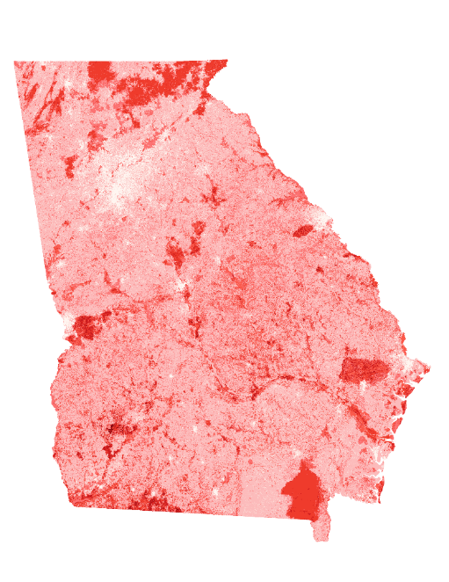
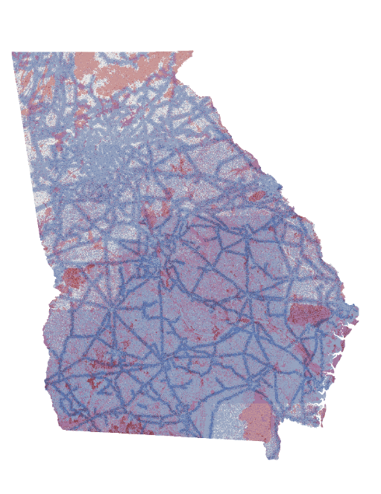
LUCIS MODEL
31
32
33
21
22
23
Solar Suitability
Low
Med.
High
1
1
11
12
13
2
+
2
=
3
3
Low
Med.
High
4
4
Environmental Sensitivity
5
5
6
6
7
7
N
8
8
9
9
0
50
100
150
Km
Bivariate Conflict Map
Solar Suitability
10
+
Environmental Sensitivity
=
X
Value = 1 2
Environmental Score
Solar Score
Notes:
The LUCIS Model uses the raster calculator to combine the results from the weighted overlay and create a new two-digit conflict value. The solar suitability score is multiplied by 10, then added to the environmental sensitivity score to create the Bivariate Conflict Map. By multiplying the solar raster by 10, that creates a second digit place that represents the level of suitability. This is only to get the conflict value and does not affect the weight of the layer. Conflict values that have the same number in both places, 33, 22, and 11 indicate high levels of conflict. While numbers like 31, indicate high solar suitability and low sensitivity, making it the most ideal location for development.
All images and figures created by the DEVELOP team

Slide 13
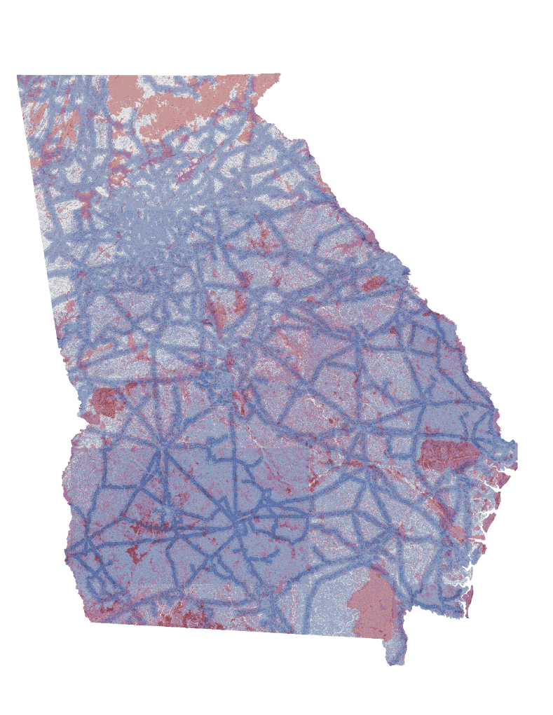
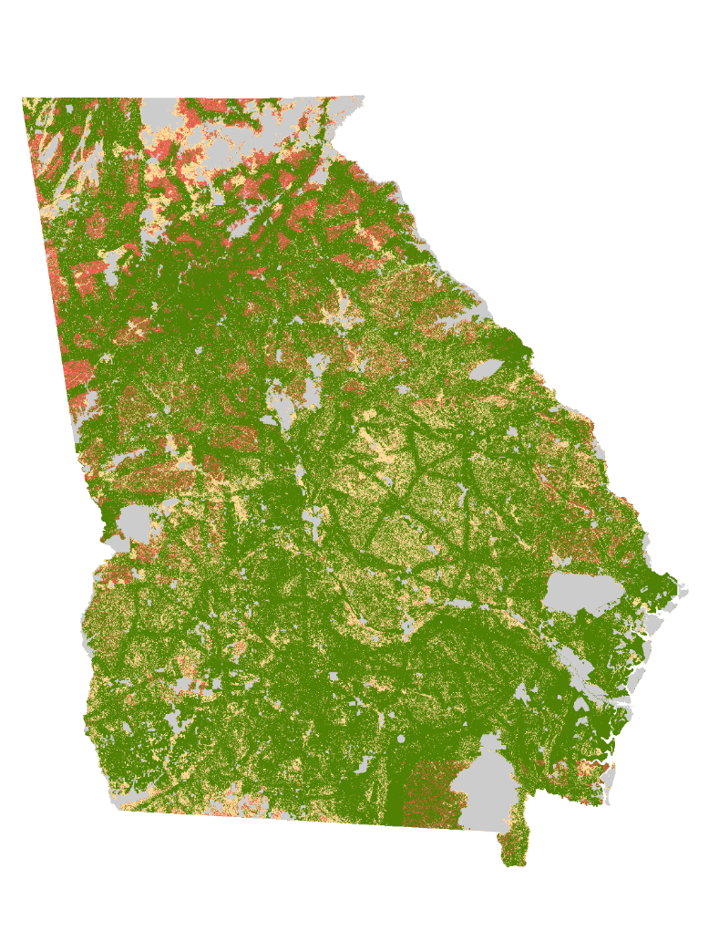
RESULTS
31
32
33
31
32
33
Med.
21
22
23
21
22
23
Low
High
Solar Suitability
Low
Med.
High
Solar Suitability
11
12
13
11
12
13
Low
Med.
High
Low
Med.
High
Environmental Sensitivity
Environmental Sensitivity
Restricted
Low
Preference
Moderate
Preference
High
Preference
N
0
25
50
100
Km
Notes:
The resulting bivariate conflict map for 2019 is on the left. Shades of blue represent levels of solar suitability, shades of red represent levels of environmental sensitivity and shades of purple represent conflict. The color grey represents conservation lands, land trusts, or lands protected by the Georgia Department of Natural Resources. However, at a quick glance it is not easy to digest the results of our analyses. To make these results more comprehendible, we reclassified the conflict values into levels of preference for solar development, shown on the right. Areas of high sensitivity were reclassified as low preference despite their solar suitability because we want to prioritize conservation of areas of environmental importance. The score 31 represents the highest level of solar suitability and the lowest level of environmental sensitivity, therefore it would be the most ideal place for new utility scale solar farms and received a high preference for solar development due to the minimal environmental impact and maximum benefits for solar development.
All images and figures created by the DEVELOP team

Slide 14
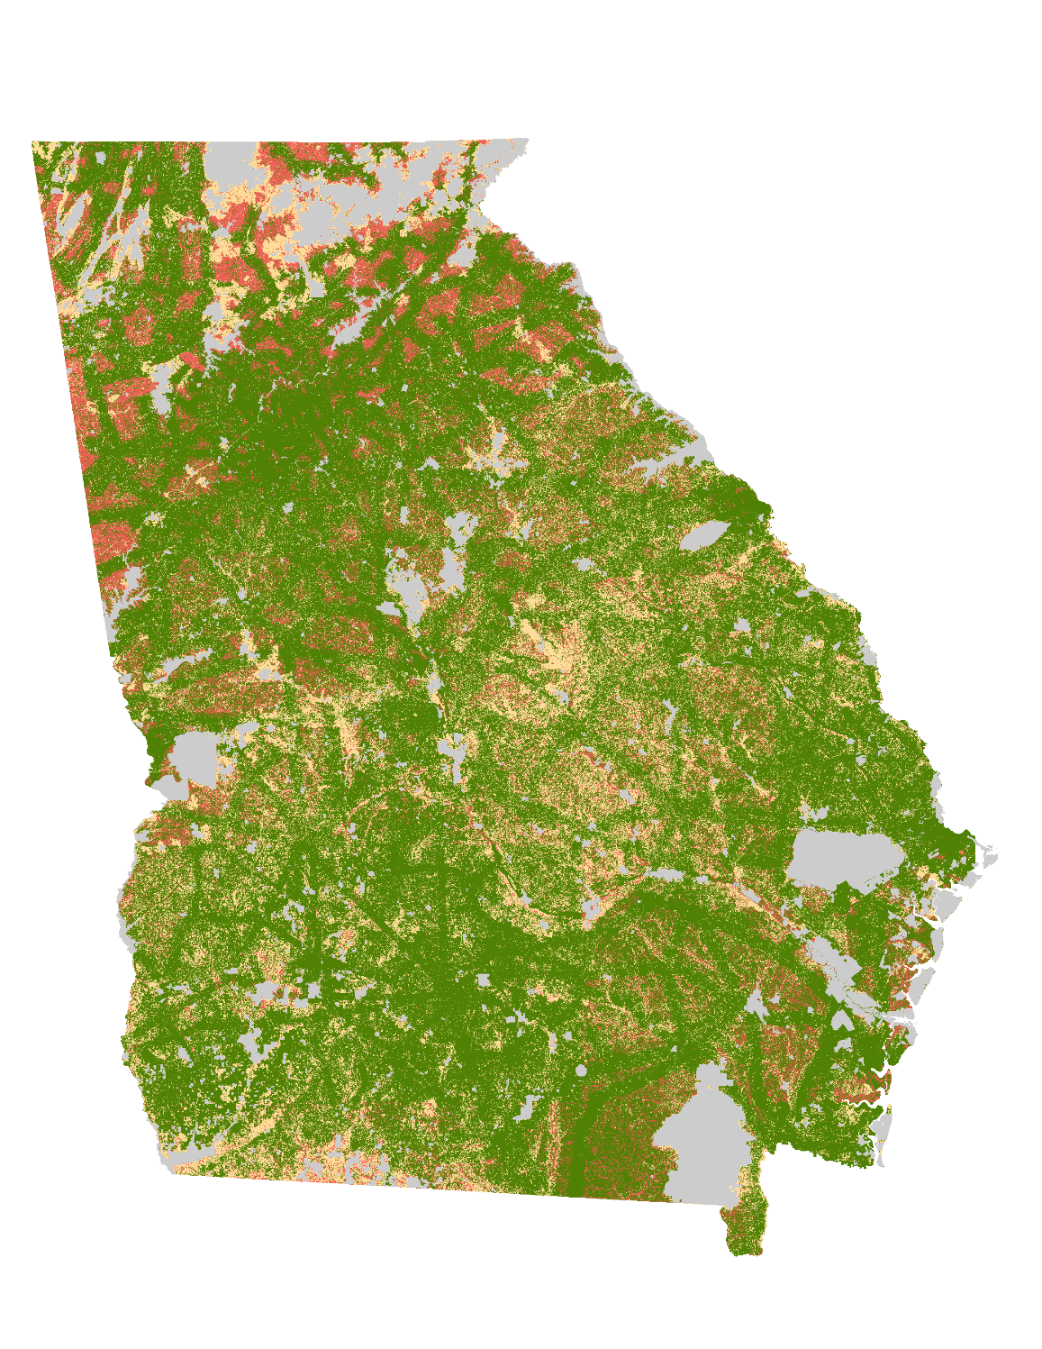

RESULTS
Restricted
Low
Preference
Moderate
Preference
High
Preference
N
0
25
50
100
Km
2017
2019
Notes:
This slide shows a side by side comparison of results from 2017 and 2019. Green indicates high preference for development, while red indicates low preference. The color grey represents conservation lands, land trusts, or lands protected by the Georgia Department of Natural Resources. While you may not see much change with the naked eye, the state became more suitable and preferable for utility scale solar development between 2017 and 2019, especially in the southern half of the state.
The overall area under the restricted regions remained constant between the two years. There was an approximate decrease of 17% (17.069%) in area under the regions of low preference while there was an approximate increase of 3% (2.92%) in area under the regions of high preference. The regions of moderate preference saw a negligible increase in area of 0.07% (0.069%).
All images and figures created by the DEVELOP team

Slide 15
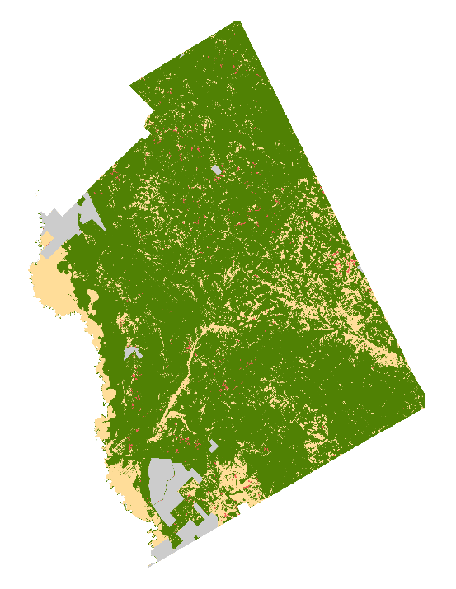
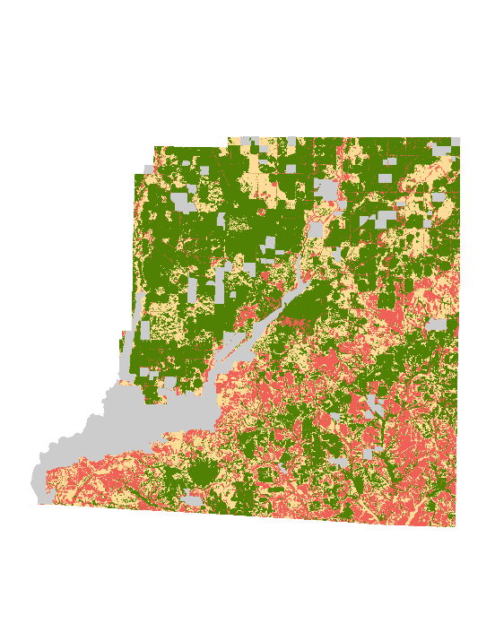
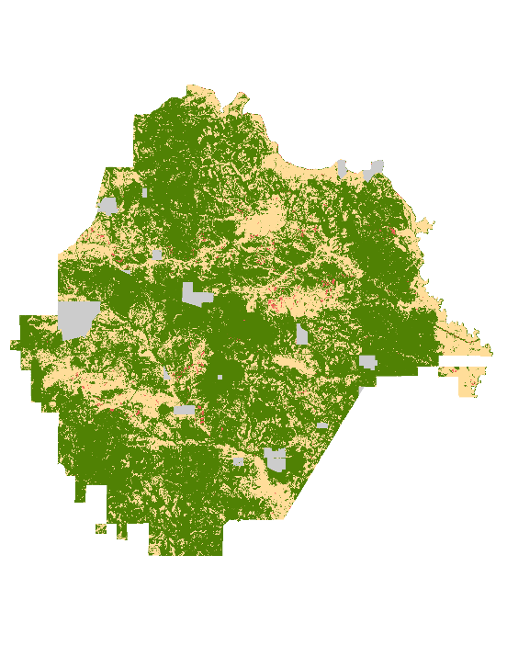
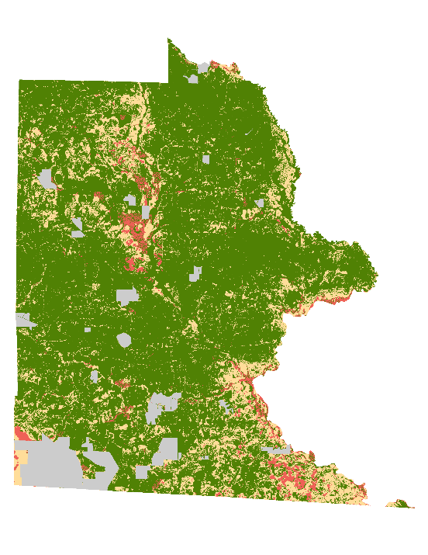
CONCLUSIONS
From 2017 to 2019, areas of low preference for solar development decreased by 17% and high preference areas increased by 3%.
Higher suitable areas were distributed across south Georgia.
Solar suitability is the highest in Twiggs County, followed by Decatur, Taylor, then Brooks.
2019 LUCIS Results
Restricted
Low
Preference
Moderate
Preference
High
Preference
Taylor County
Brooks County
N
Twiggs
County
Decatur County
0
3
6
9
0
4
8
12
0
3.25
6.5
9.75
0
3.25
6.5
9.75
Miles
Miles
Miles
Miles
Notes:
The overall area under the restricted regions remained constant between the two years. We have estimated that the overall solar suitability of the entire state of Georgia has increased in 2019 by more than double from 2017. There was an approximate decrease of 17% (17.069%) in area under the regions of low preference for solar development, while there was an approximate increase of 3% (2.92%) in area under the regions of high preference for solar development. We have estimated that the overall solar suitability of the entire state of Georgia has increased in 2019 by more than double from 2017. Most of the higher scores of suitable areas were located at the southern part of the state, closer to transmission lines. Twiggs County, located at the far left of this slide, experienced highest solar suitability in 2019, while Decatur county (second from left) experienced highest solar suitability in 2018 and 2017. Overall, the counties rank Twiggs, Decatur, Taylor (third from left) then Brooks in terms of suitability.
All images and figures created by the DEVELOP team

Slide 16
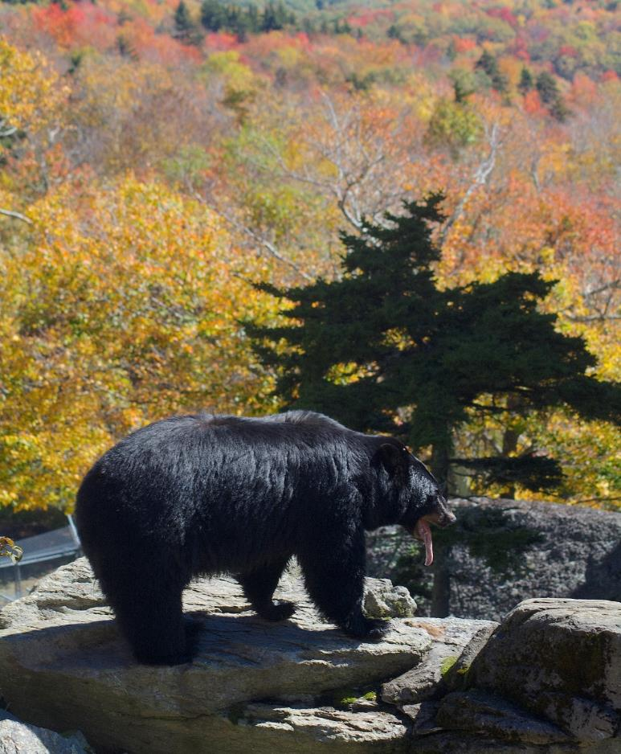
LIMITATIONS
Varying resolutions of raster input data can affect accuracy of data
Availability of up-to-date black bear habitat data
Future weather and atmospheric variations may impact availability of sufficient sunlight in Georgia
Credit: Ucumari Photography
Notes:
Through the entire term, the team faced a few limitations and uncertainties.
When downloading raster data, it is common for it to coming varying cell sizes, so it is expected that this variability can affect the positional accuracy of the data and therefore the results.
For including black bear habitats in our model, we could only locate a thesis from 2007 that created a habitat model based on camera traps and tracking of the individual animals. It was outside of the scope of our project to try and recreate it their model and ultimately, since a lot of parameters that were used in that model, like LULC, river corridors, and agriculture, were already included in by other data we located. So we felt that it was at least a consideration in our model. Ideally, we would like to find either existing data or rerun the analyses with an updated and reconstructed model.
Lastly, several of our input layers for both solar and environmental analyses rely on the geography and consistent weather pattens in Georgia so our products do not reflect any thing significant for the long term.
Image Credit: Ucumari Photography from Flickr
https://www.flickr.com/photos/ucumari/22153916925/in/photolist-zKEBEV-RHD9r4-2fJHPLJ-2hadRxu-2fPwjEu-29JRxB1-M5X5v4-8Nv4t9-2jg1RJi-sWLcZN-BzaEfw-2gC67NR-2b1wuHE-s35A6S-2c1WNNV-79tjEX-t9witZ-sGw4Ty-2jfdDfH-zonFXd-eNW9jM-GHCSgk-67cowr-YHjYfF-r7e8kF-XtigBD-NHrr3q-29FcnzR-2iP24c4-btnhYk-F6kBa4-2cndGHX-fgLPLb-Y797Af-2fxvBSc-vxCCiN-BUtbAZ-5LDsTX-2cKWx3f-289jLiX-Y798A1-ecBqJ-5oCsqW-k2FmXE-pvYSir-5YvEiA-z4RCBc-yMkEsr-9V7Faq-ni3di6
Attribution-NonCommercial-NoDerivs 2.0 Generic (CC BY-NC-ND 2.0)

Slide 17
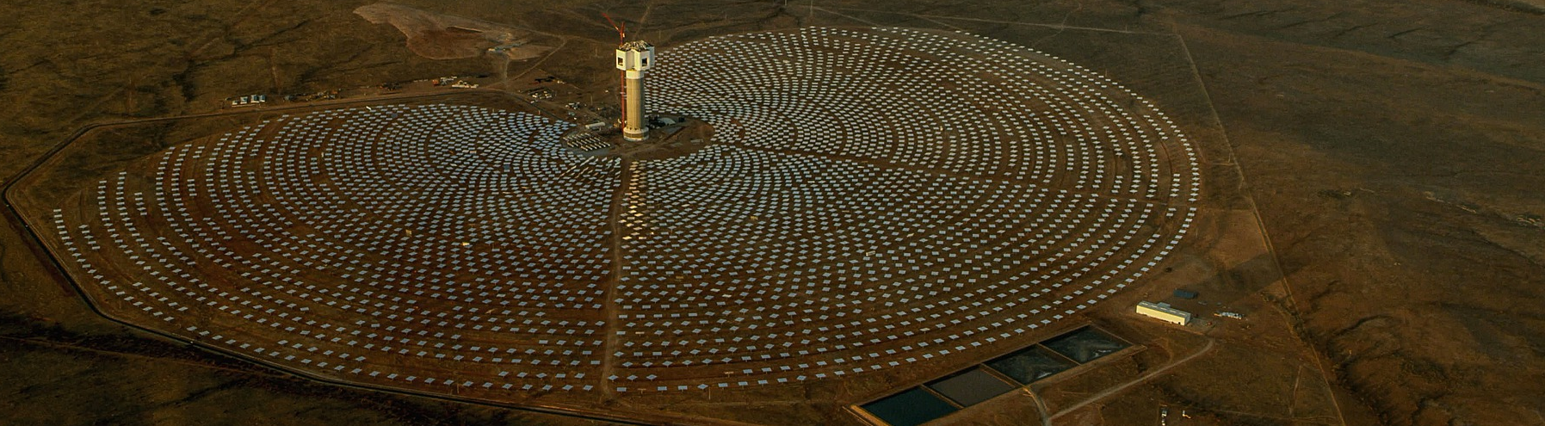
FUTURE WORK
Consider additional counties in Georgia for in-depth suitability analysis
Find out additional potential parameters
Compare the accuracy of LUCIS analysis with other suitability analyses
Implement the LUCIS model in other regions of the US
Credit: Christo Ras
Notes:
As a part of concluding the Georgia Energy projects with NASA DEVELOP, the team produced a suitability and LUCIS tutorial for our partners. Using this the partners can conduct the analysis for more counties as well as locate any additional parameters that we did not include.
We also believe that there is room for more analyses of the results to be compared between the county and statewide level results. This will provide details for the conflicts in two different scales.
Finally, this is a project that we believe can be modified and replicated in any state or county, so we would love to see this project continued for other leading states in the solar industry like Texas, North Carolina, or California.
Image Credit: Christo Ras from Pixabay
Image Source: https://pixabay.com/photos/solar-farm-solar-photovoltaic-4683339/
Free for Commercial Use, No attribution required

Slide 18
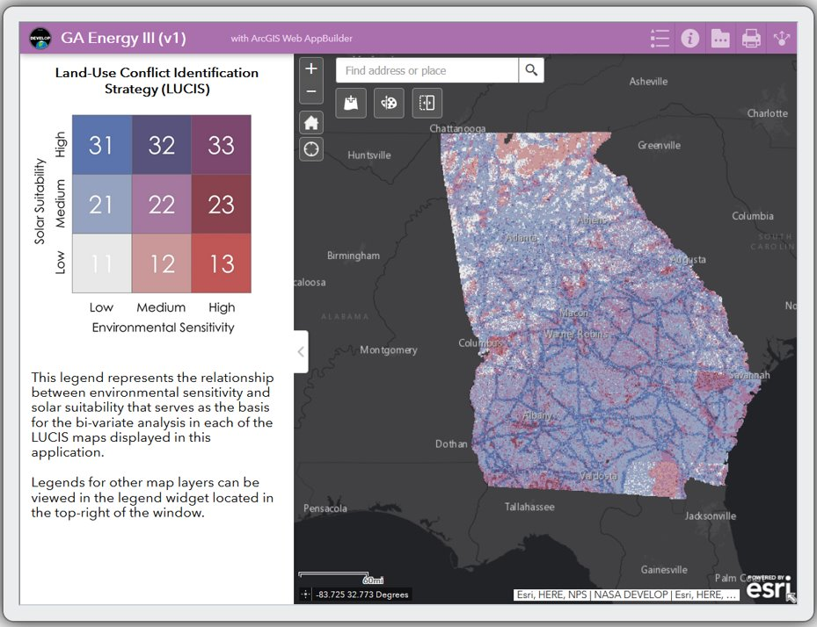
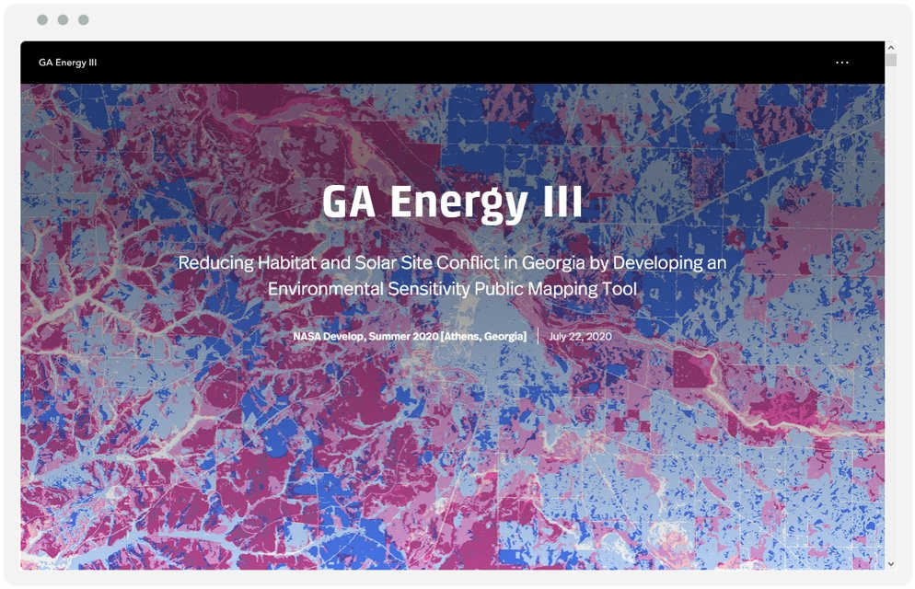
SCIENCE COMMUNICATION
Story Map
Web App
Notes:
The results from our analyses were used as the basis for a web application on ArcGIS Online that will be distributed by our partners and to be used when working with solar developers to plan environmentally conscious utility scale solar development across Georgia. They will have access to add their own data and layers in the Web app to visualize and compare the suitability and conflict of solar sites. TNC will have access to continue updating LUCIS model with new data as available.
In addition, our partners can use the Story map that we provided as a part of their communications with stakeholders and as an education tool for the general public.

Slide 19
Partners
Amy Gutierrez, The Nature Conservancy
Matt Elliott, The Georgia Department of Natural Resources
Special Thanks
Dr. Sergio Bernardes, CGR, UGA
Dr. Paul Stackhouse, NASA POWER
Bradley Macpherson, NASA POWER
SouthFace
Past DEVELOP contributors
Lynn Abdouni
Emad Ahmed
Amanda Aragón
Natalia Bhattacharjee
Roger Bledsoe
Marie Bouffard
Christopher Cameron
Fabiola Clermont
Peter Hawman
Nick Morgan
Caren Remillard
Suravi Shrestha
Austin Stone
Science Advisors
Dr. Marguerite Madden, CGR, University of Georgia (UGA)
NASA DEVELOP
Shelby Ingram, NASA DEVELOP GA Lead/Fellow
This material contains modified Copernicus Sentinel data (2017, 2018, and 2019), processed by ESA.
Notes:
The Georgia Energy Team III would like to their advisors, partners, and Fellow for their continuous support and time.
Special thanks to Dr. Sergio Bernardes at UGA’s Center for Geospatial Research, Paul Stackhouse and Bradley Macpherson at NASA POWER,
Past contributors from NASA DEVELOP, specially to Amanda Aragon (Georgia Energy I ) and Austin Stone (Georgia Energy I and II participant) for their assistance with data and software.
This material contains modified Copernicus Sentinel data (2017, 2018, and 2019), processed by ESA.

Slide 20
APPENDIX
Data for solar suitability analyses for 2017 and 2019
Layer Name | Data Source | Scale | Years Acquired
Solar Insolation | NASA Prediction Of Worldwide Energy Resources (POWER) | Global | 2017 2019
Slope | Digital Elevation Model from United States Geological Survey | Degree Block | 2019
Aspect | Digital Elevation Model from United States Geological Survey | Degree Block | 2019
Transmission Lines | Homeland Infrastructure Foundation Level Data (HIFLD) | Nationwide | 2017 2019
Land Cover/Land Use | United States Department. of Agriculture CropScape | Nationwide | 2017 2019
Floodplains | Federal Emergency Management Agency National Flood Hazard Layer | County Level | 2010
Parcels | ParcelPoint via The Nature Conservancy | County Level | 2020
Roads | United States Census Bureau TIGER Database | County Level | 2017 2018 2019
Notes:
Appendix slides will only be shown if parties are interested in hearing more about data input details or specific analysis results.

Slide 21
APPENDIX
Data sources statewide and county level environmental sensitivity analyses for 2017, 2018, and 2019
Layer Name | Data Source | Scale | Years Acquired
Gopher Tortoise Habitat | United States Geological Survey | Southeastern Region | 2019
Protected Lands | Georgia Department of Natural Resources | Statewide | 2020
Conservation Lands | Georgia Department of Natural Resources | Statewide | 2020
Land Trusts | Georgia Department of Natural Resources | Statewide | 2020
Prime Farmland | ESRI USA Soils Farmland | Nationwide | 2019
Sensitive Land Use Classifications | United States Department. of Agriculture (USDA) CropScape | Nationwide | 2017 2018 2019
Resilient Lands | The Nature Conservancy Resilient Landscape Dataset | Eastern Coast | 2016

Slide 22



APPENDIX
Statewide Environmental Sensitivity
0
35
70
105
1
Miles
N
2
3
4
5
6
7
8
9
2017
2019

Slide 23
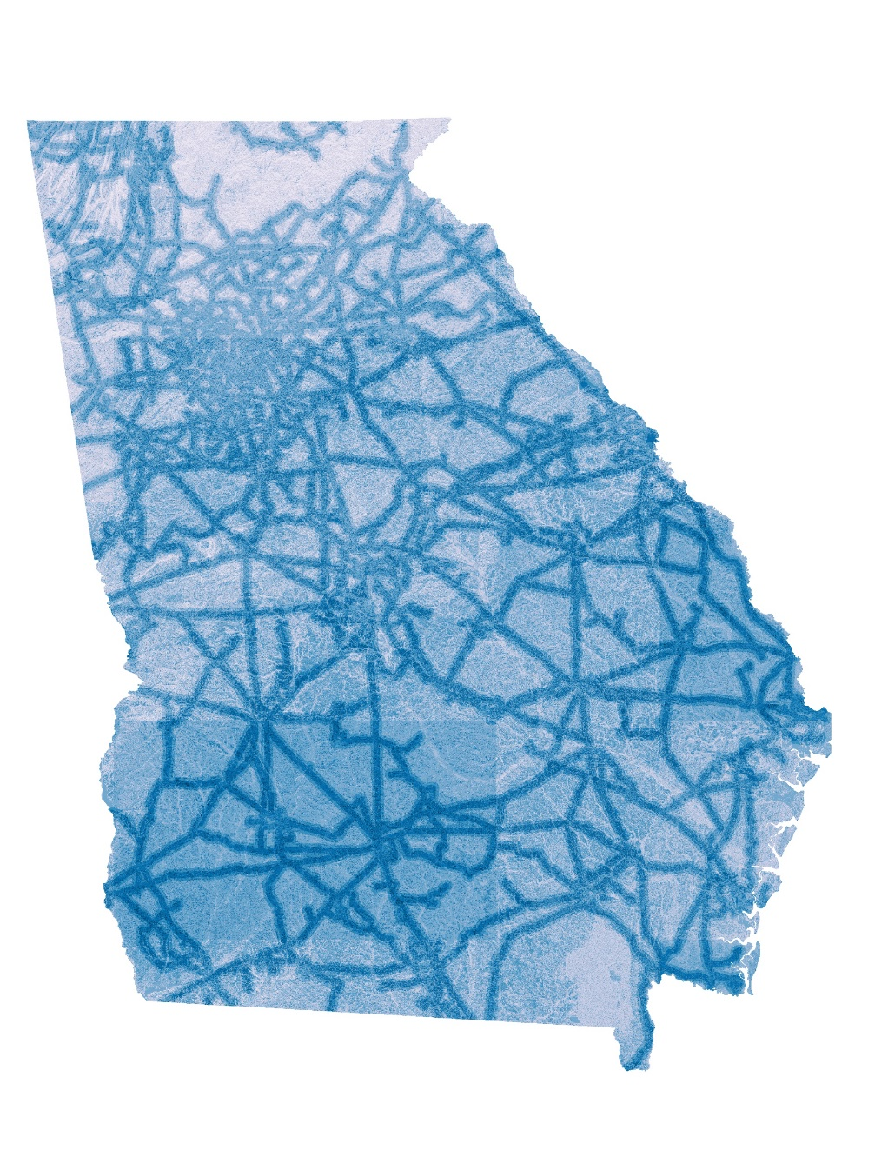

APPENDIX
Statewide Solar Suitability
0
35
70
105
1
Miles
N
2
3
4
5
6
7
8
9
2017
2019

Slide 24
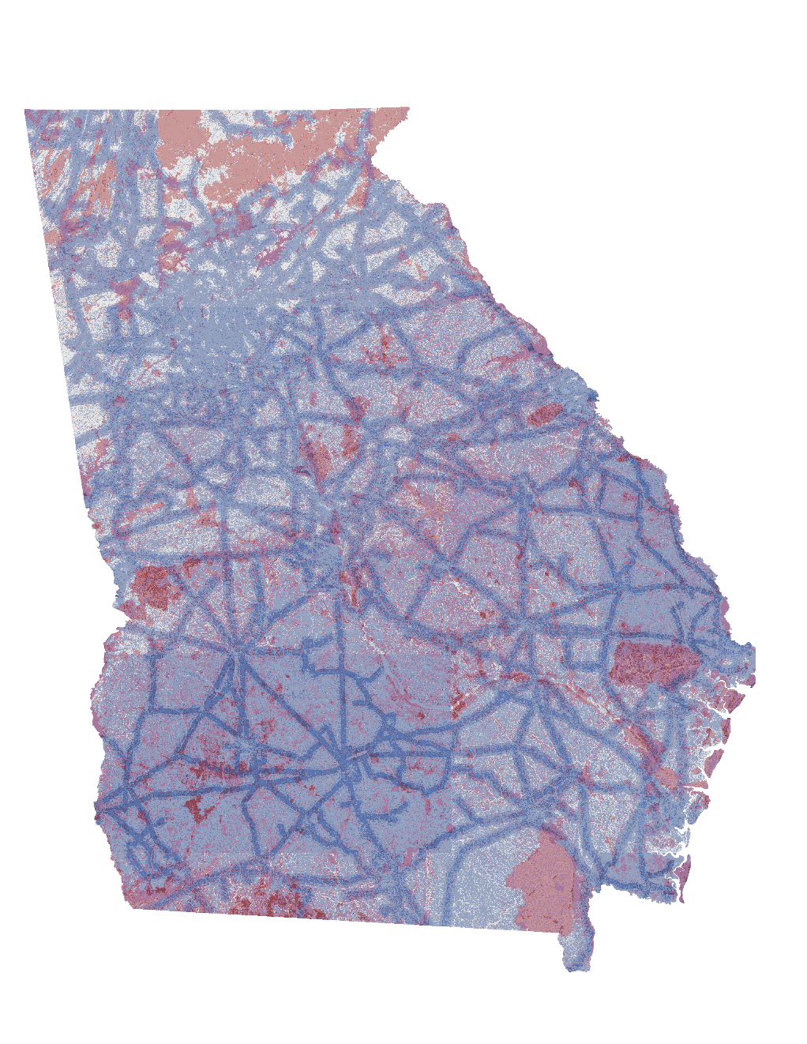
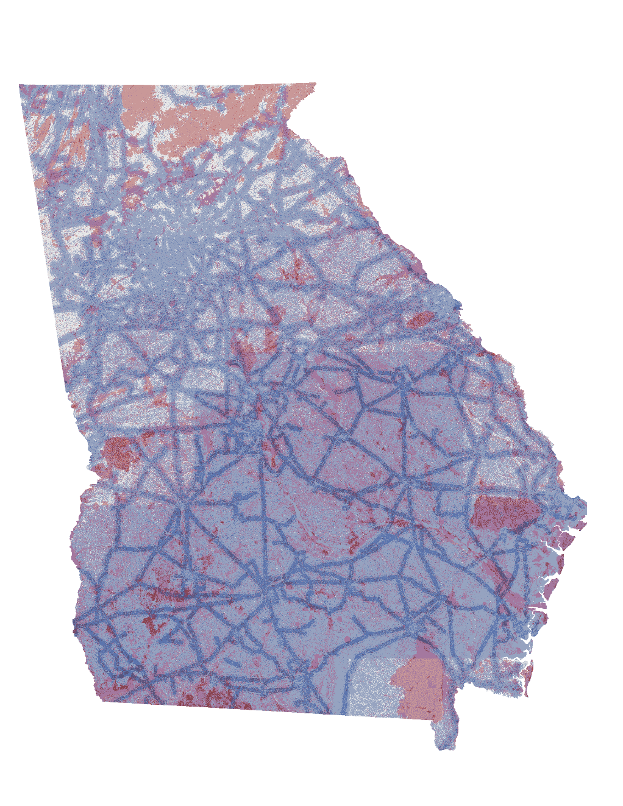
APPENDIX
Statewide Solar Suitability
N
0
35
70
105
Miles
31
32
33
Med.
21
22
23
Low
High
Solar Suitability
11
12
13
Low
Med.
High
Environmental Sensitivity
2017
2019

Slide 25
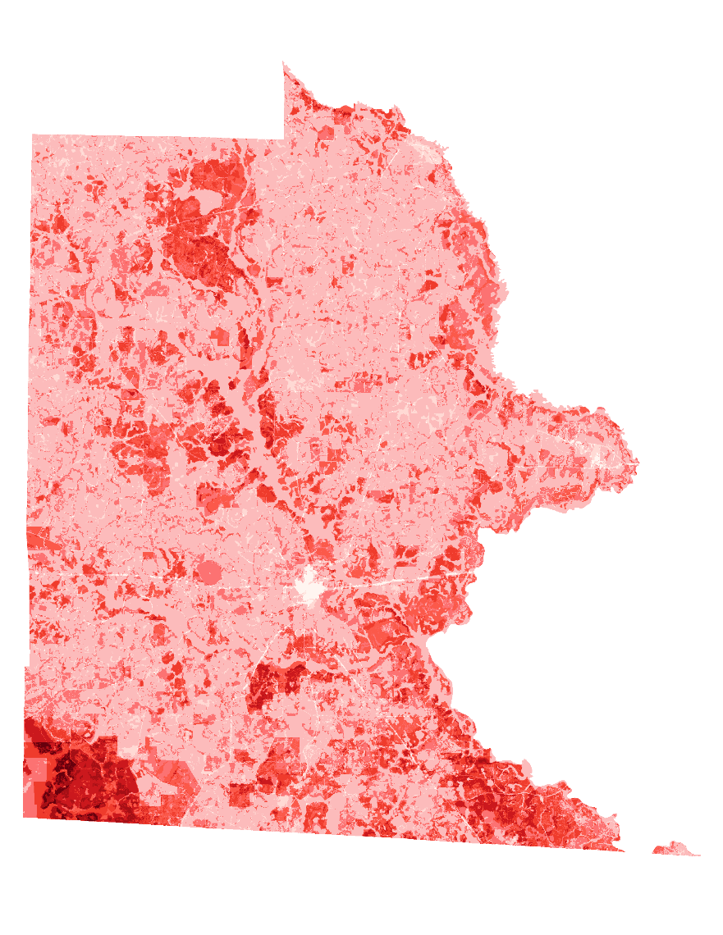

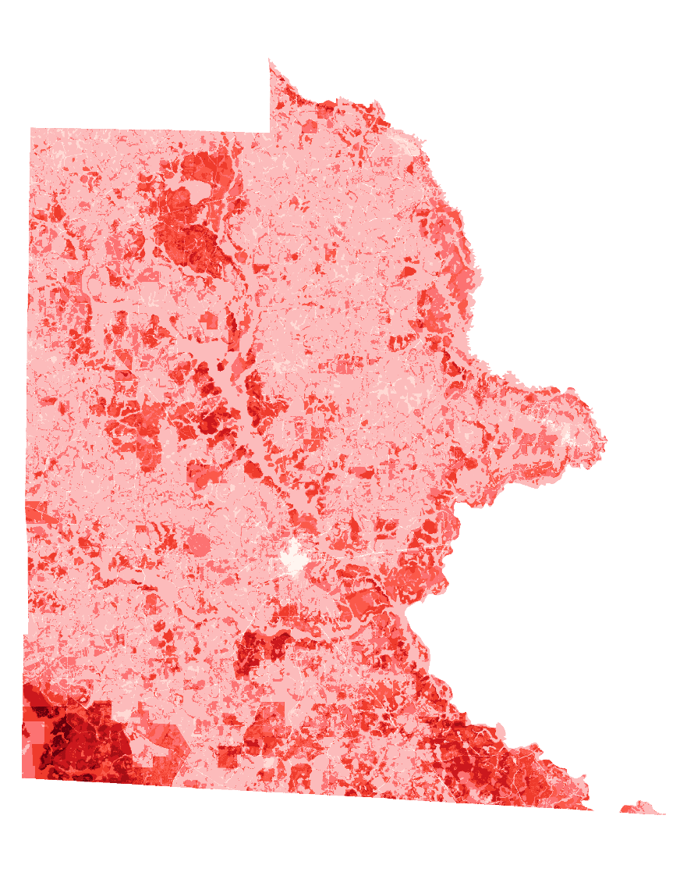
APPENDIX
Brooks County Environmental Sensitivity
1
2
3
4
5
6
7
N
8
9
2017
2018
2019
0
3.25
6.5
9.75
Miles

Slide 26
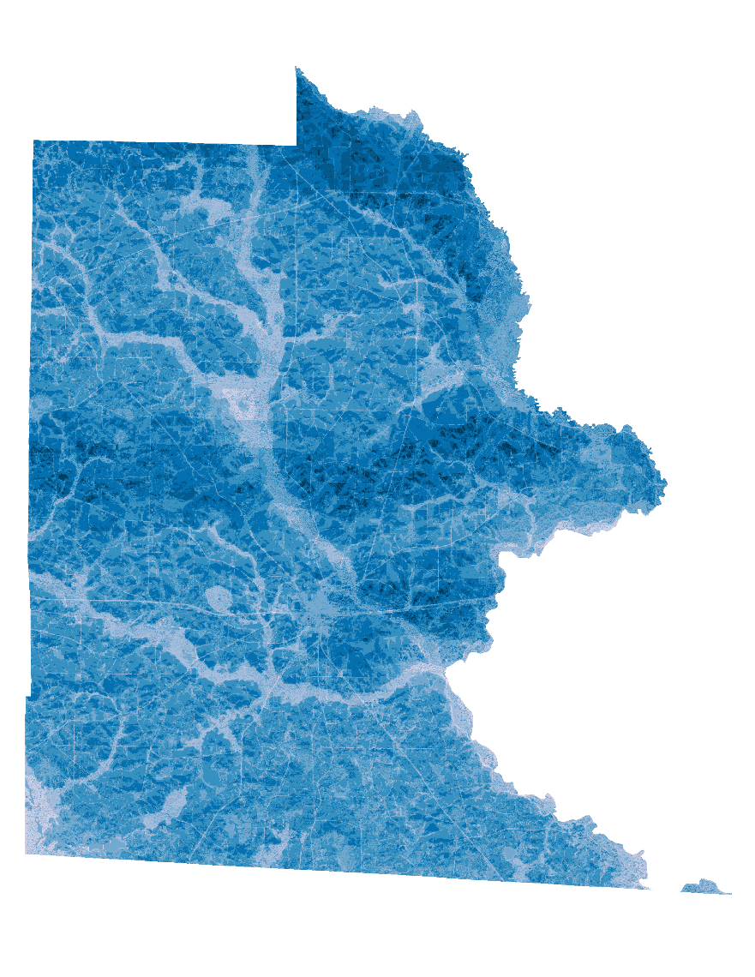
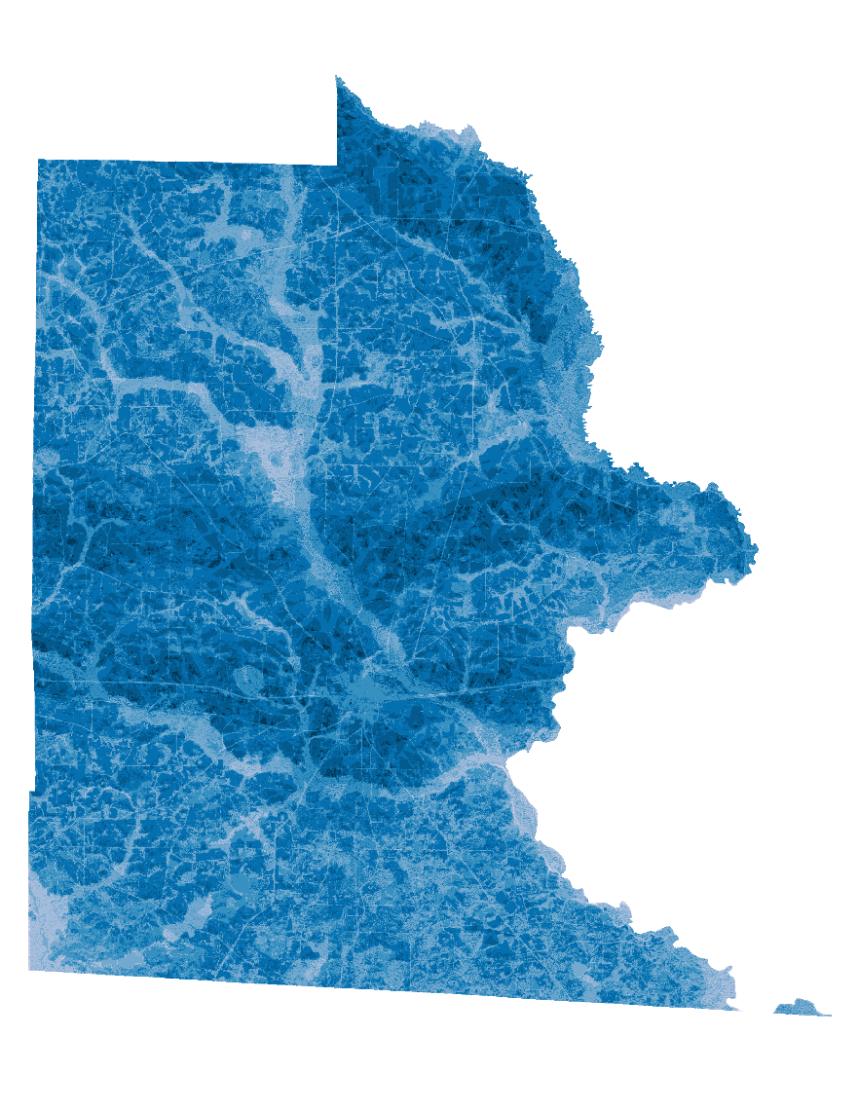

APPENDIX
Brooks County Solar Suitabiilty
1
2
3
4
5
6
7
N
8
9
2017
2018
2019
0
3.25
6.5
9.75
Miles

Slide 27
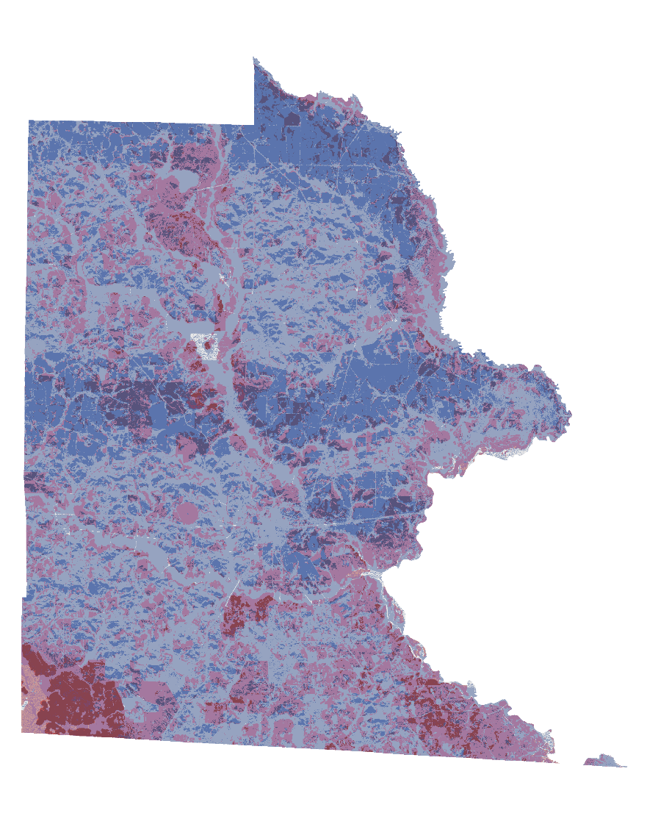
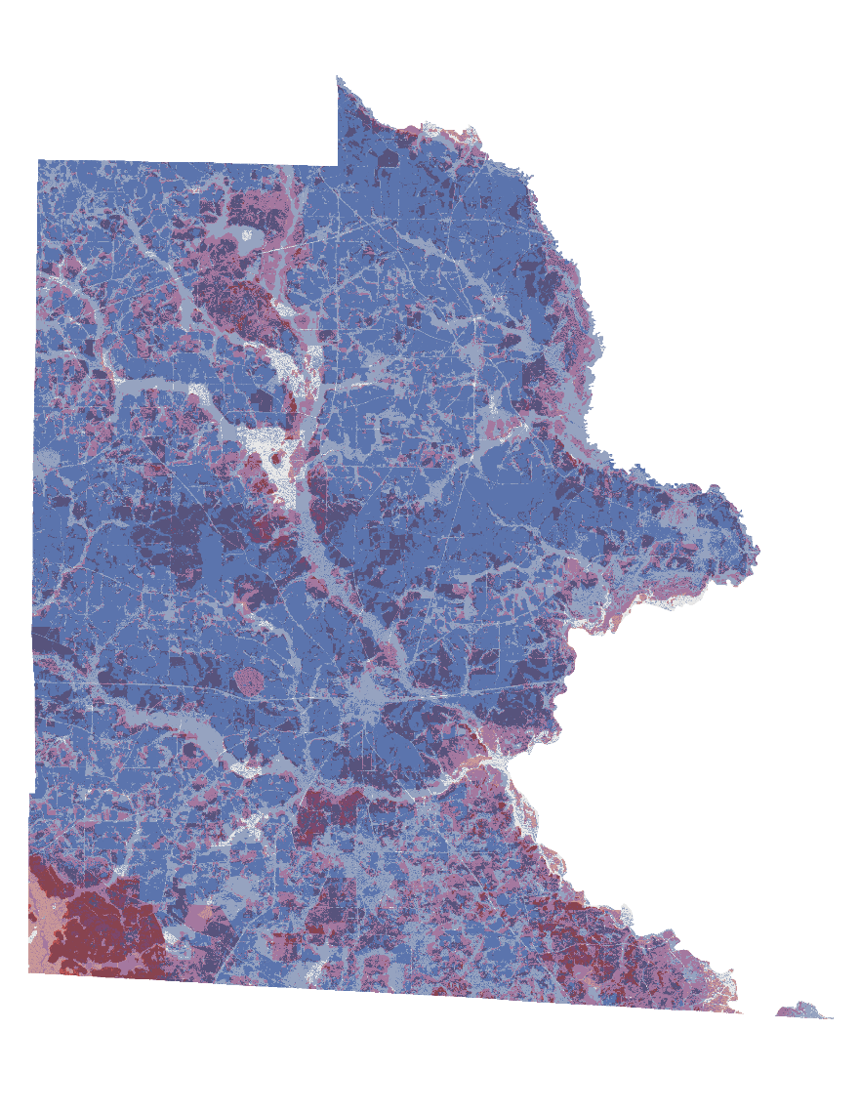

APPENDIX
Brooks County LUCIS Results
31
32
33
Med.
21
22
23
Low
High
Solar Suitability
11
12
13
Low
Med.
High
Environmental Sensitivity
N
2017
2018
2019
0
3.25
6.5
9.75
Miles

Slide 28
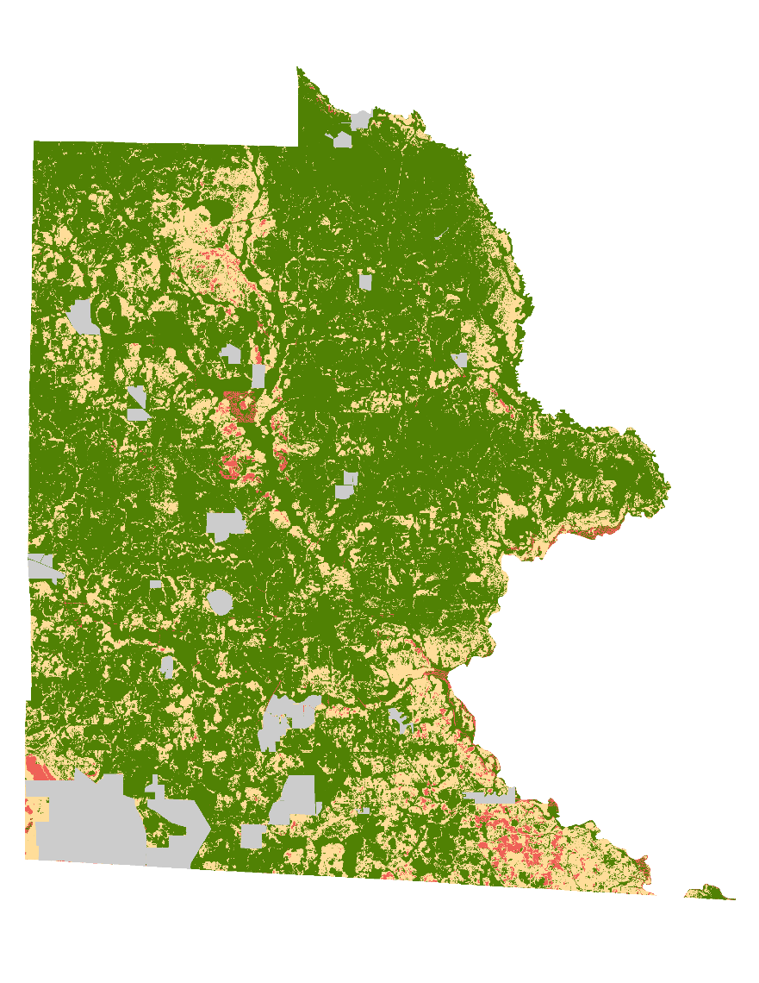
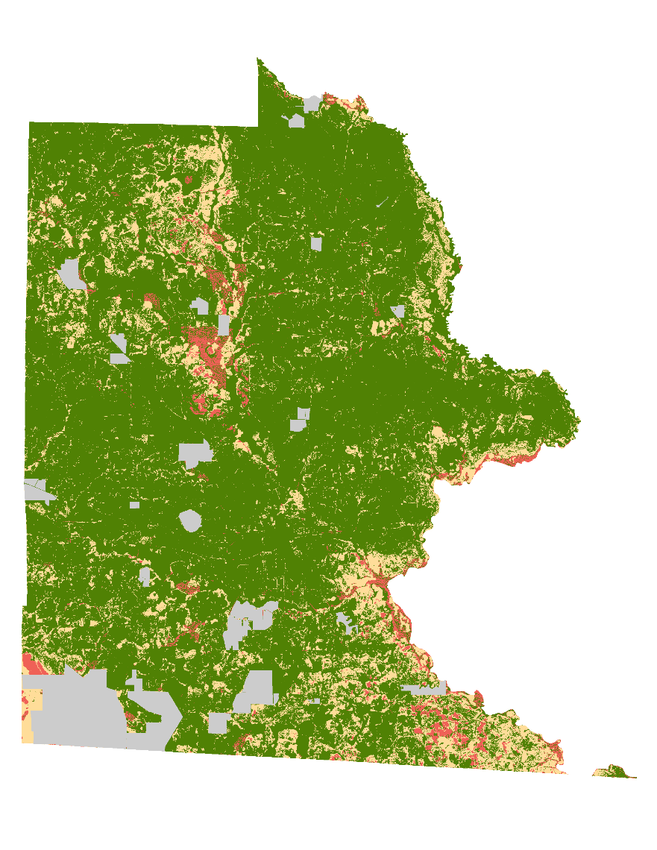

APPENDIX
Brooks County LUCIS Results
31
32
33
Med.
21
22
23
Low
High
Solar Suitability
11
12
13
Low
Med.
High
Environmental Sensitivity
N
2017
2018
2019
0
3.25
6.5
9.75
Miles

Slide 29
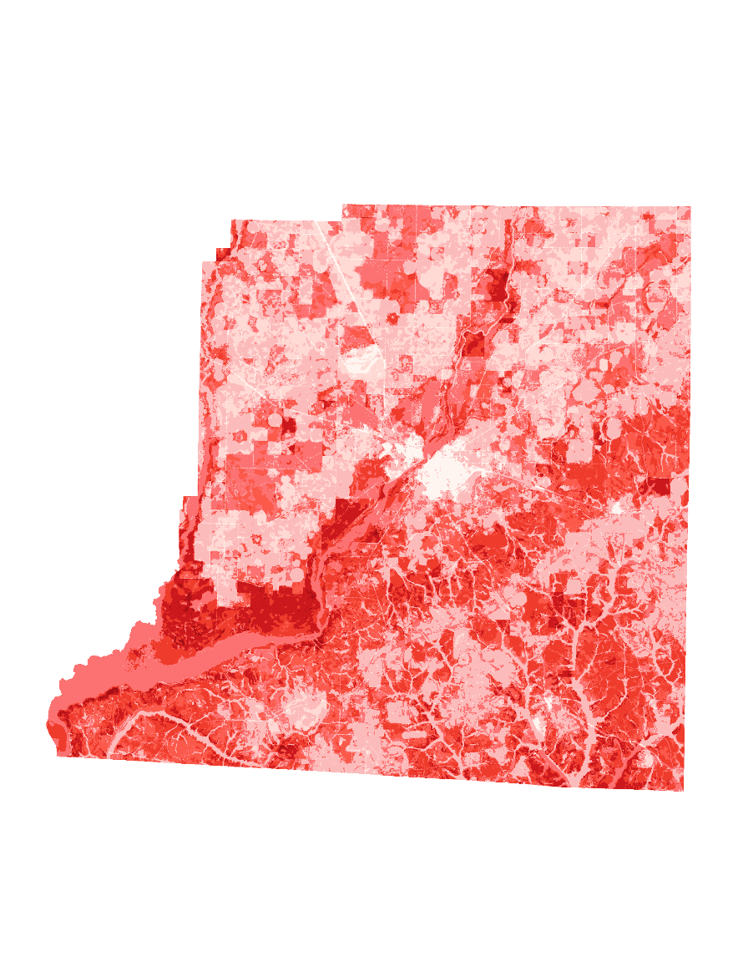
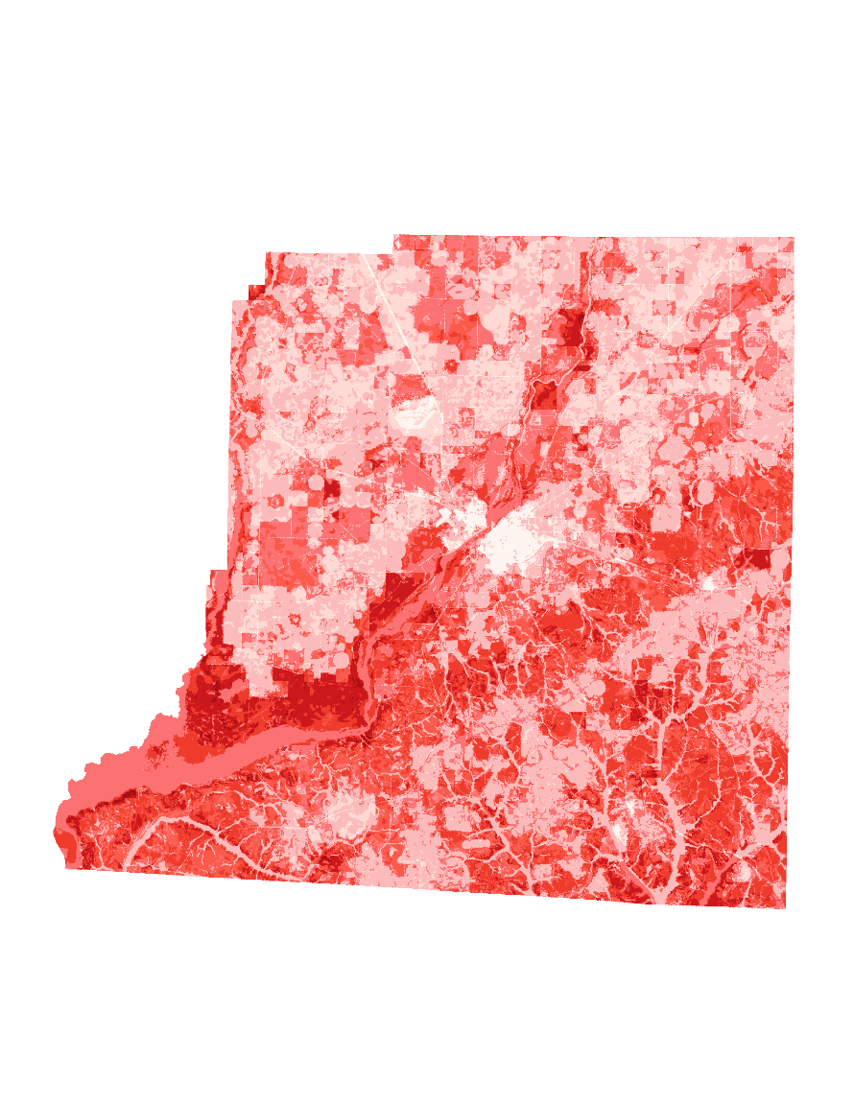
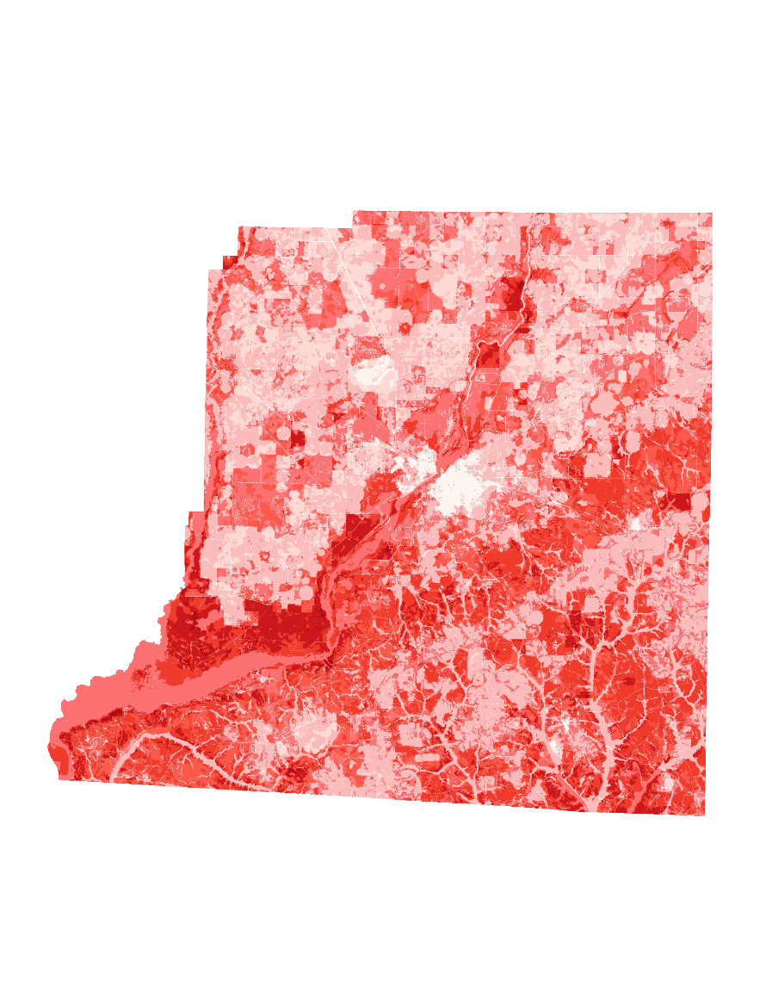
APPENDIX
Decatur County Environmental Sensitivity
1
2
3
4
5
6
7
N
8
9
2017
2018
2019
0
4
8
12
Miles

Slide 30
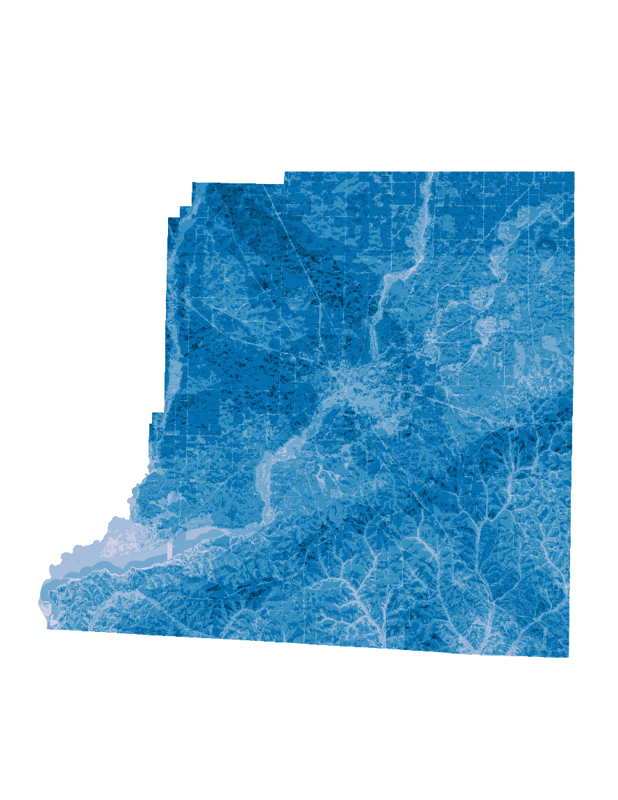
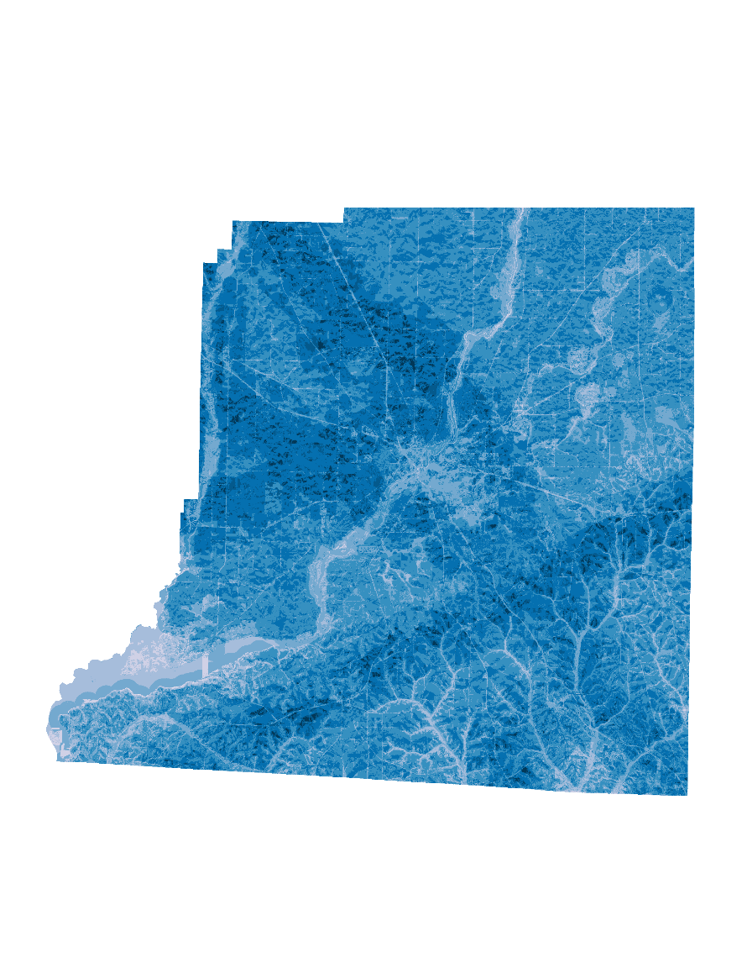

APPENDIX
Decatur County Solar Suitability
1
2
3
4
5
6
7
N
8
9
2017
2018
2019
0
4
8
12
Miles

Slide 31



APPENDIX
Decatur County LUCIS Results
31
32
33
Med.
21
22
23
Low
High
Solar Suitability
11
12
13
Low
Med.
High
Environmental Sensitivity
N
0
4
8
12
Miles
2017
2018
2019

Slide 32



APPENDIX
Decatur County LUCIS Results
31
32
33
Med.
21
22
23
Low
High
Solar Suitability
11
12
13
Low
Med.
High
Environmental Sensitivity
N
0
4
8
12
Miles
2017
2018
2019

Slide 33



APPENDIX
Taylor County Environmental Sensitivity
1
2
3
4
5
6
7
N
8
9
2017
2018
2019
0
3.25
6.5
9.75
Miles

Slide 34



APPENDIX
Taylor County Solar Suitability
1
2
3
4
5
6
7
N
8
9
2017
2018
2019
0
3.25
6.5
9.75
Miles

Slide 35



APPENDIX
Taylor County LUCIS Results
31
32
33
Med.
21
22
23
Low
High
Solar Suitability
11
12
13
Low
Med.
High
Environmental Sensitivity
N
2017
2018
2019
0
3.25
6.5
9.75
Miles

Slide 36



APPENDIX
Taylor County LUCIS Results
31
32
33
Med.
21
22
23
Low
High
Solar Suitability
11
12
13
Low
Med.
High
Environmental Sensitivity
N
2017
2018
2019
0
3.25
6.5
9.75
Miles

Slide 37



APPENDIX
Twiggs County Environmental Sensitivity
0
3
6
9
1
Miles
N
2
3
4
5
6
7
8
9
2017
2018
2019

Slide 38



APPENDIX
Twiggs County Solar Suitability
0
3
6
9
1
Miles
N
2
3
4
5
6
7
8
9
2017
2018
2019

Slide 39



APPENDIX
Twiggs County LUCIS Results
31
32
33
Med.
21
22
23
Low
High
Solar Suitability
11
12
13
Low
Med.
High
Environmental Sensitivity
N
2017
2018
2019
0
3
6
9
Miles

Slide 40



APPENDIX
Twiggs County LUCIS Results
31
32
33
Med.
21
22
23
Low
High
Solar Suitability
11
12
13
Low
Med.
High
Environmental Sensitivity
N
2017
2018
2019
0
3
6
9
Miles

