Slide 1
Gila National Forest
Water Resources III
Modelling the Impacts of Post-fire Restoration Methods on Vegetation Recovery in the Gila National Forest
Henry Grover, Ebony Williams, Darby Levin, Tyler Pantle
Maryland – Goddard
Notes:
Welcome everyone to the Gila Water Resources III Presentation. Today we will be discussing our project background, methodology, model architecture, model results, analysis, and our conclusions.

Slide 2
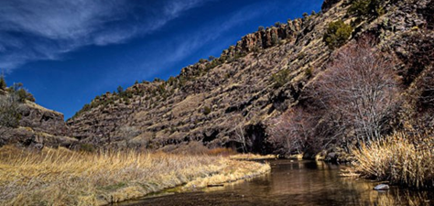
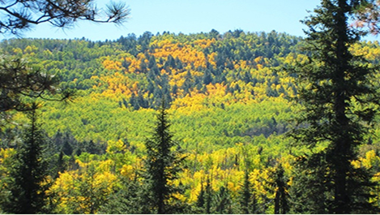
The Gila National Forest
Located in southwestern New Mexico
Covers 3.3 million acres of land including ~793,000 acres of wilderness
Elevation ranges from 4,200 to 10,900 feet
Image Credits: NPS Photo by Bruce Bloy (top) , USDA-FS (bottom)
Notes:
Speaker:
The Gila National forest in Southwestern New Mexico has a diverse landscape that covers more than 3 million acres of land. The Gila NF has a semi-arid climate and is subject to the seasonal North American Monsoon which typically lasts from July to September each year. The Gila NF has diverse landcover environments such as mixed conifer forests, oak shrublands, grasslands and is also host to several endangered terrestrial and aquatic species. The Gila National forest is also home to the headwaters of the San Francisco and Gila Rivers, which are important water sources for communities and habitats downstream in New Mexico and Arizona.
------------------------------Image Information Below ------------------------------
Top Image: NPS Photo by Bruce Bloy (Public Domain)
https://www.nps.gov/gicl/planyourvisit/gila-wilderness.htm
Bottom Image: USFS Gila National Forest (Public Domain)
https://www.fs.usda.gov/main/gila/home

Slide 3
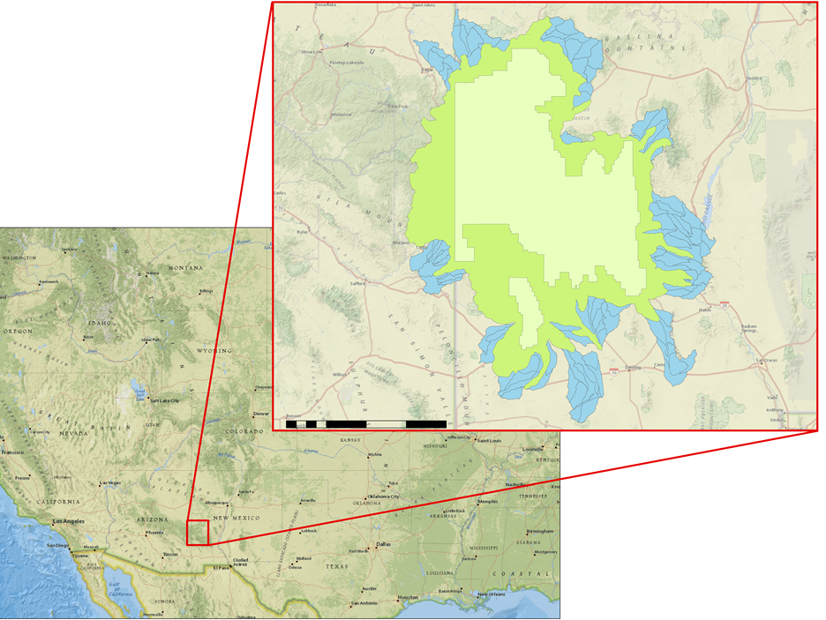
The Gila National Forest
Gila National Forest contains the headwaters of the Gila and San Francisco rivers.
Arizona
New Mexico
0
20
40
80 miles
Gila National Forest Study Area
Watershed Boundary
Gila National Forest Study Area
Administrative Forest
Notes:
Speaker:
The Gila National forest in southwestern New Mexico has a diverse landscape that covers more than 3 million acres of land. The Gila NF has a semi-arid climate and is subject to the seasonal North American Monsoon which typically lasts from July to September each year. The Gila NF has diverse landcover environments such as mixed conifer forests, oak shrublands, grasslands and is also host to several endangered terrestrial and aquatic species. The Gila National forest is also home to the headwaters of the San Francisco and Gila Rivers, which are important water sources for communities and habitats downstream in New Mexico and Arizona.

Slide 4
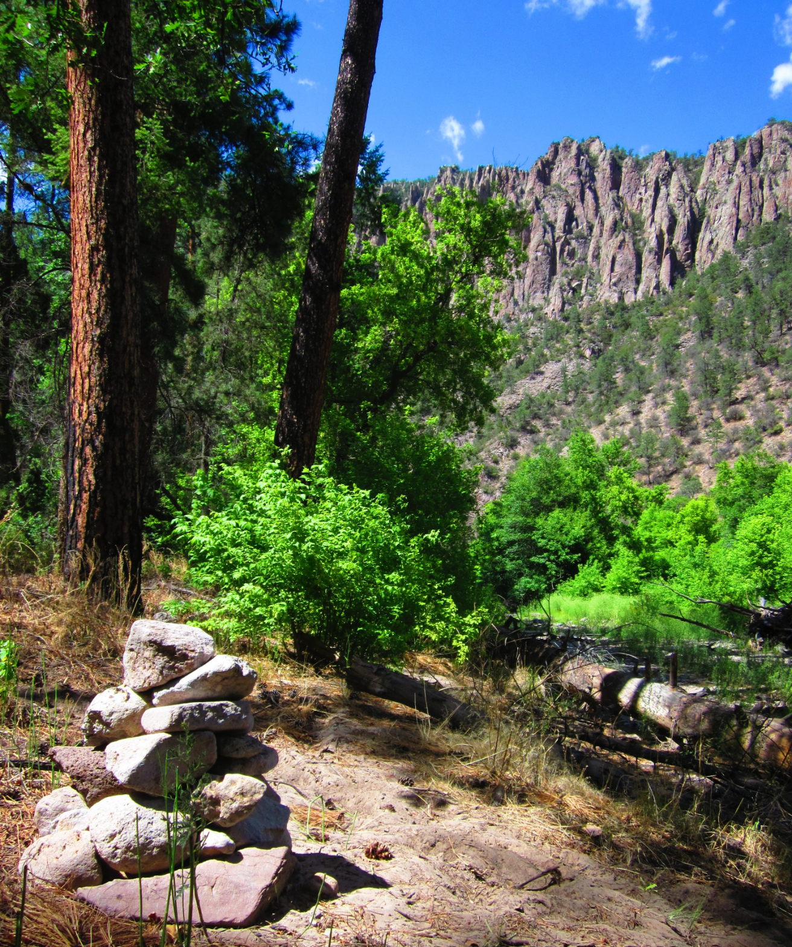
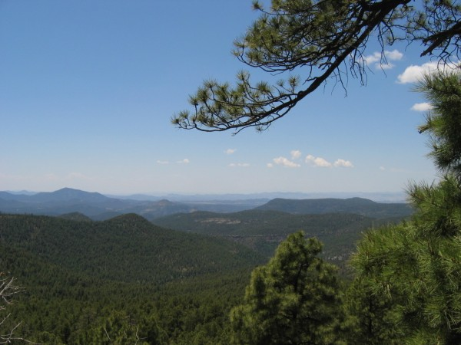
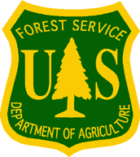
Project Partners
USDA Forest Service, Gila National Forest
USDA Forest Service, Region 3
Image Credits: USDA Forest Service Gila National Forest
Notes:
Speaker:
For this project, we partnered with the Gila National Forest and Region 3 teams from the United States Forest Service. Over the course of the term, they indicated the concerns which were most pressing to them, advised on the specific questions we sought to answer, and provided data. Most importantly, they provided invaluable on-the-ground knowledge which helped to guide the decision-making throughout the project.
The culmination of this partnership is a product which offers both results and a proof-of-concept. The product, once handed off to the partners, can then continue to be developed by the Forest Service with the end goals of adding data to increase accuracy and scaling up the product to be used over larger areas.
------------------------------Image Information Below ------------------------------
Left Image: USFS (Public Domain)
https://www.fs.usda.gov/recmain/gila/recreation
Middle Image: Wikipedia (Public Domain)
https://en.wikipedia.org/wiki/United_States_Forest_Service#/media/File:Logo_of_the_United_States_Forest_Service.svg
Right Image: USFS (public domain)
https://www.fs.usda.gov/Internet/FSE_MEDIA/fseprd598929.jpg

Slide 5
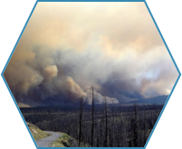
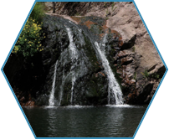
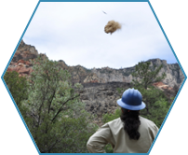
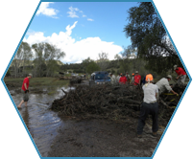
Community Concerns
Recovery Efforts
Post-fire Flooding
Fire Response
Water Quality and Streamflow
Image Credits (left to right) : US Forest Service, Gila National Forest; US Forest Service, Coconino National Forest
Notes:
Speaker:
The record breaking fires that Gila NF has faced in the past decade degraded large tracts of land and raised major concerns over flooding and water quality. Our partners have observed severe flooding 1-2 years post-wildfire, causing even more damage to the land and the human property downstream.
Currently, Gila National Forest responds to wildfire by either managing the fire or by actively suppressing. For more serious blazes, the National Forest also assembles a Burned Area Emergency Response (BAER) Team. BAER teams include specialists in various fields who conduct field surveys to assess post-fire emergency conditions, potential effects to the natural resources, and threats to human health, safety, and property. Recently, active restoration efforts are being made to help mitigate cumulative degradation of the landscape through initiatives such as aerial re-seeding and mulching areas that have been subject to intense burns. A main concern of this project is that efforts to restore land and streams after severe burns, such as seeding, mulching, and bank reconstruction are being washed away by post-fire flooding.
------------------------------Image Information Below ------------------------------
Fire Response Image: US Forest Service Gila National Forest (Public Domain)
https://commons.wikimedia.org/wiki/File:Gila_National_Forest_(7282037236).jpg
Recovery Efforts Image: US Forest Service, Coconino National Forest (Public Domain)
https://commons.wikimedia.org/wiki/File:Heli-mulching_Slide_Fire_BAER_Work_C4_(14329711807).jpg
Water Quality Image: Gila NF (Public Domain)
https://www.flickr.com/photos/gilaforest/8727134762/in/album-72157627866288425/
Post-Fire Flooding Image: Gila National Forest (Public Domain)
https://commons.wikimedia.org/wiki/File:Gila_River_flooding_in_Gila_Hot_Springs_area_(9776418862).jpg

Slide 6
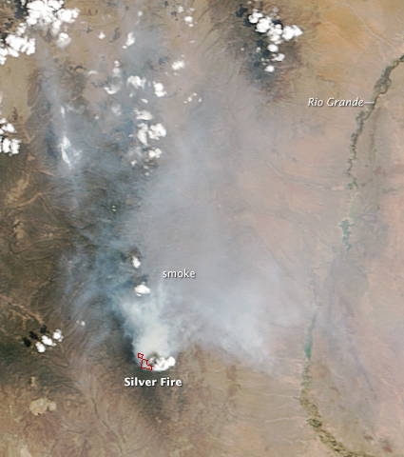
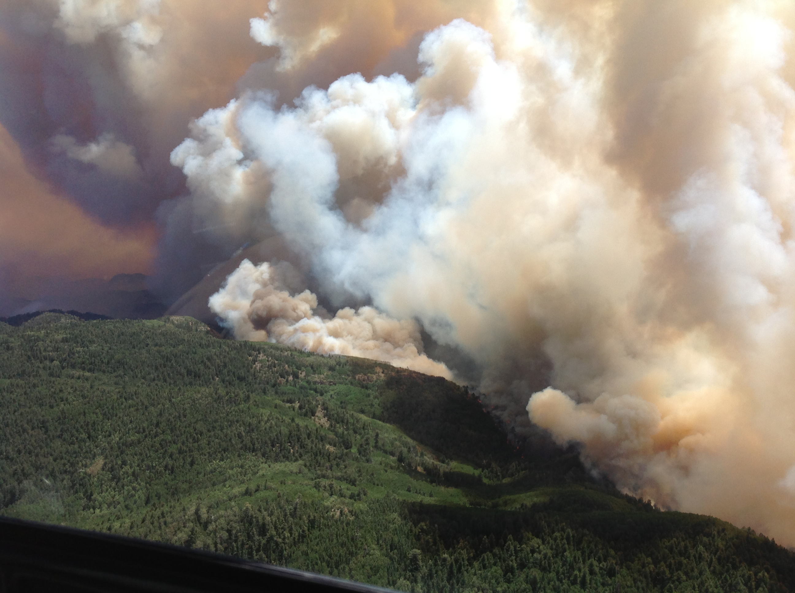
The Silver Fire
Image Credit: NASA Earth Observatory and the USFS GILA NF
Notes:
Speaker: The Silver Fire began on June 7th, 2013 due to a lightning strike and was 80% contained a month later on July 7th. The photo shown on the left was taken by Terra MODIS on June 10th, three days after the fire began. The photo shown on the right shows the Silver fire still burning on June 24th.
------------------------------Image Information Below ------------------------------
Silver fire satellite image (left): NASA
https://earthobservatory.nasa.gov/images/81362/silver-fire-new-mexico
Silver fire aerial image (right): USFS Gila NF
https://www.flickr.com/photos/gilaforest/9135114667/ (CC BY-SA 2.0)

Slide 7
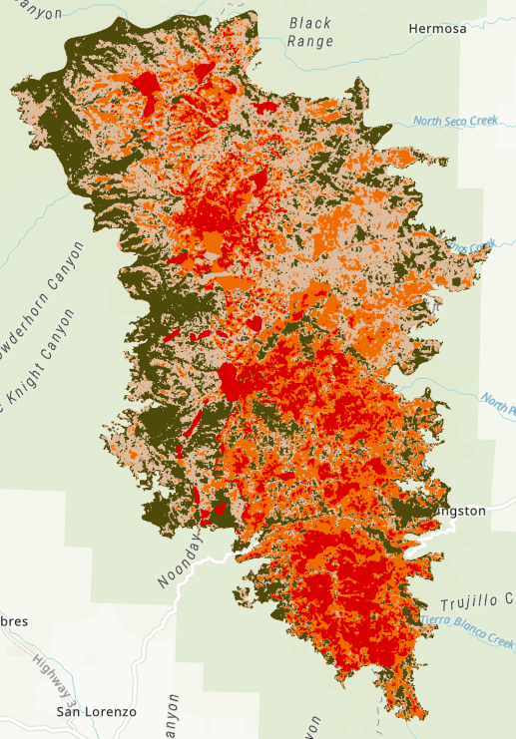
The Silver Fire
138,698 acres burned including 788 acres of private land
Burn Severity Class | Acres | % of Fire Area
High | 20,793 | 15
Moderate | 36,931 | 27
Low & Unburned | 80,292 | 58
Unknown | 683 | <1
Total | 138,698 | 100
5 km
Notes:
Speaker:
Over the course of the month-long period, the fire burned over 138 thousand acres, nearly 800 of which were private land. Across these acres, the fire caused various degrees of soil burn severity from high to low/unburned, as seen in the image.

Slide 8
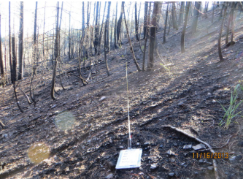
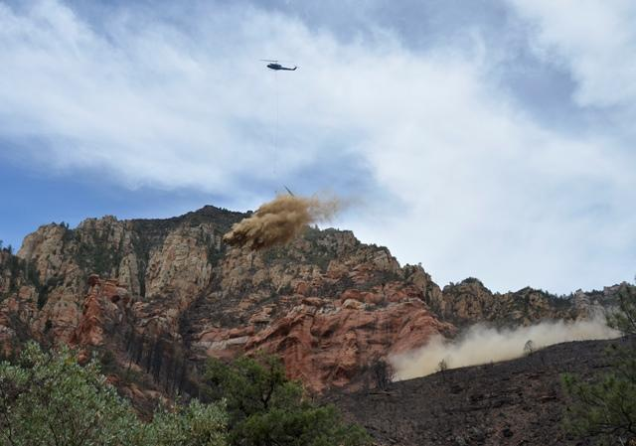
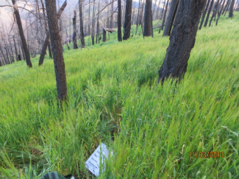
Post-fire Rehabilitation
Both aerial mulching and grass seeding were applied to reduce runoff and erosion after the Silver Fire.
Image Credits (left to right): Robichaud et al. 2009, Coconino NF, Gila NF, Gila NF
Notes:
Speaker:
After the fire was contained, post-fire treatment methods were applied immediately to mitigate runoff and erosion, both of which increase post-fire due to the lack of vegetation. These methods included seeding and a combination of seeding and mulching. Treatment needs to be implemented quickly post-fire, but it is expensive and takes time. Therefore treatment was targeted in the moderate and high burn severity areas.
Grass seeding continued until July 26 and was successful, providing 30% more canopy cover than on untreated plots by November 2013. Mulching and seeding treatments provided 30% more litter cover in the same time period. Monitoring of these treatment plots by a BAER team continued through 2016.
------------------------------Image Information Below ------------------------------
From left to right
Image 1: Robichaud et al. (2009). Emergency post-fire rehabilitation treatment effects on burned area ecology and long-term restoration. (Public Domain) https://www.fs.fed.us/rm/pubs_other/rmrs_2009_robichaud_p002.pdf
Image 2: USFS (Public Domain)
https://www.flickr.com/photos/coconinonationalforest/14329467710/in/photostream/
Images 3 and 4: Natharius, M. (2015). BAER level II monitoring report year two Silver Fire Gila National Forest. (Public Domain) https://www.fs.usda.gov/Internet/FSE_DOCUMENTS/fseprd559324.pdf

Slide 9
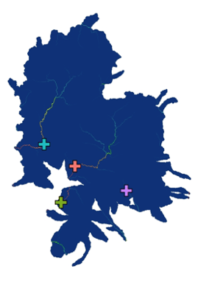
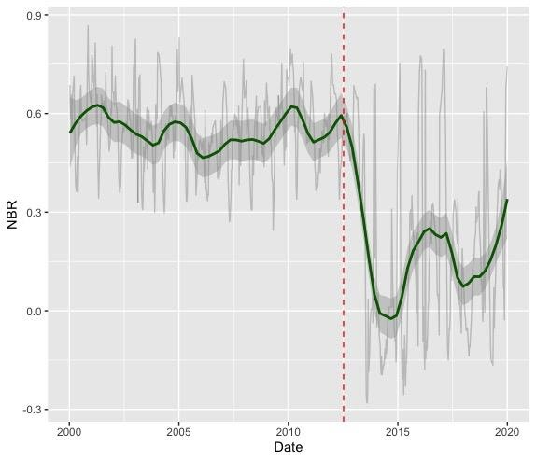
Three-Term Project
Gila I:
Gila II:
Gila III:
Post-fire watershed recovery
Post-fire flooding & vegetation restoration
Vegetation regrowth prediction model
900
600
300
0
-300
Training Points
Training Points
RF
Model
RF
Model
NBR
Data
Data
2000
2010
2020
Year
Prediction
Smoothed NBR Data
Raw NBR Data
Notes:
Speaker:
The model developed during this term builds on the work conducted by two prior DEVELOP teams.
The Gila Water Resources 1 team produced a database of environmental variables while exploring post-fire watershed recovery trends. In doing so, they sought to inform land management decisions and planning.
The Gila Water Resources 2 team analyzed the relationship between precipitation and streamflow to investigate the impacts that wildfires have on hydrology. Additionally, they identified burned areas that received treatment and compared Normalized Burn Ratio, or NBR, for different land cover types.
This term, the team developed a model to predict vegetation growth. The development of this model was made possible by data produced in the past two terms and thus offers insight into the hydrologic ramifications of our model results.

Slide 10
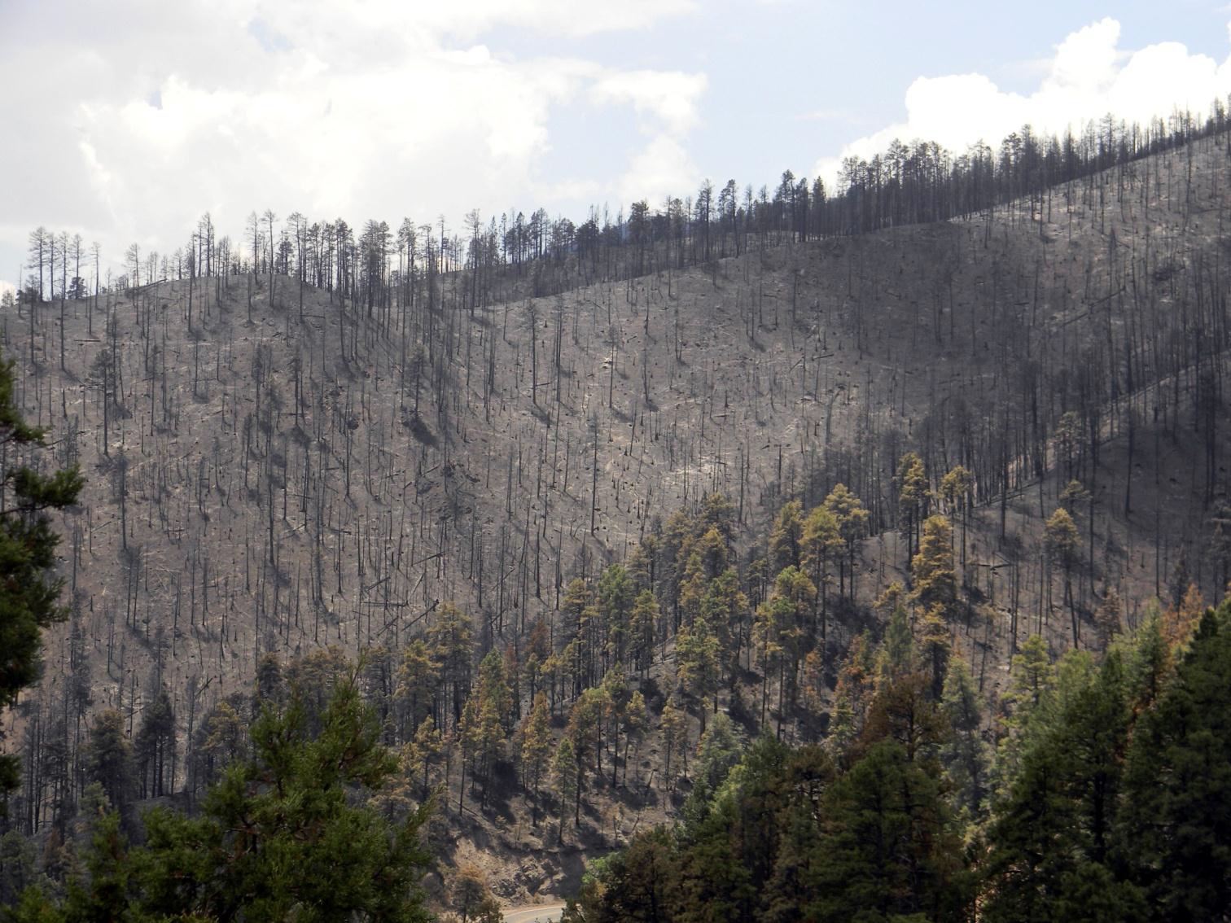
Objectives
Quantify recovery trends over time using NASA Earth observations
Evaluate the correlation between environmental factors after the fire
Explore the impact of seeding and seeding/mulching on post-fire recovery
Predict the impact of post-fire treatments on future wildfire recovery
Image Credit: Silver Fire BAER team
Notes:
Speaker:
To meet our project’s goals, we identified four primary objectives:
First, we wanted to quantify vegetation recovery trends using NASA Earth observations in order to demonstrate their capabilities. Second, we gathered extensive data within the Silver Fire burn perimeter up to four years post-fire to study correlations between environmental factors within the perimeter and recovery. Third, we stratified our data by treatment types to produce results explaining the effects that seeding, seeding/mulching, and withholding treatment had on post-fire recovery. Lastly, we compiled all of our data and results into a recovery prediction model which we will describe in greater detail later on in the presentation.
------------------------------Image Information Below ------------------------------
Image: USFS (public domain)
https://www.fs.usda.gov/Internet/FSE_DOCUMENTS/stelprdb5430883.pdf

Slide 11
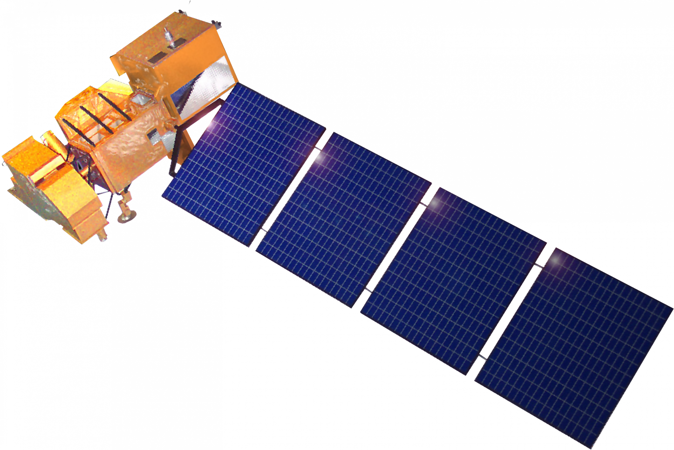
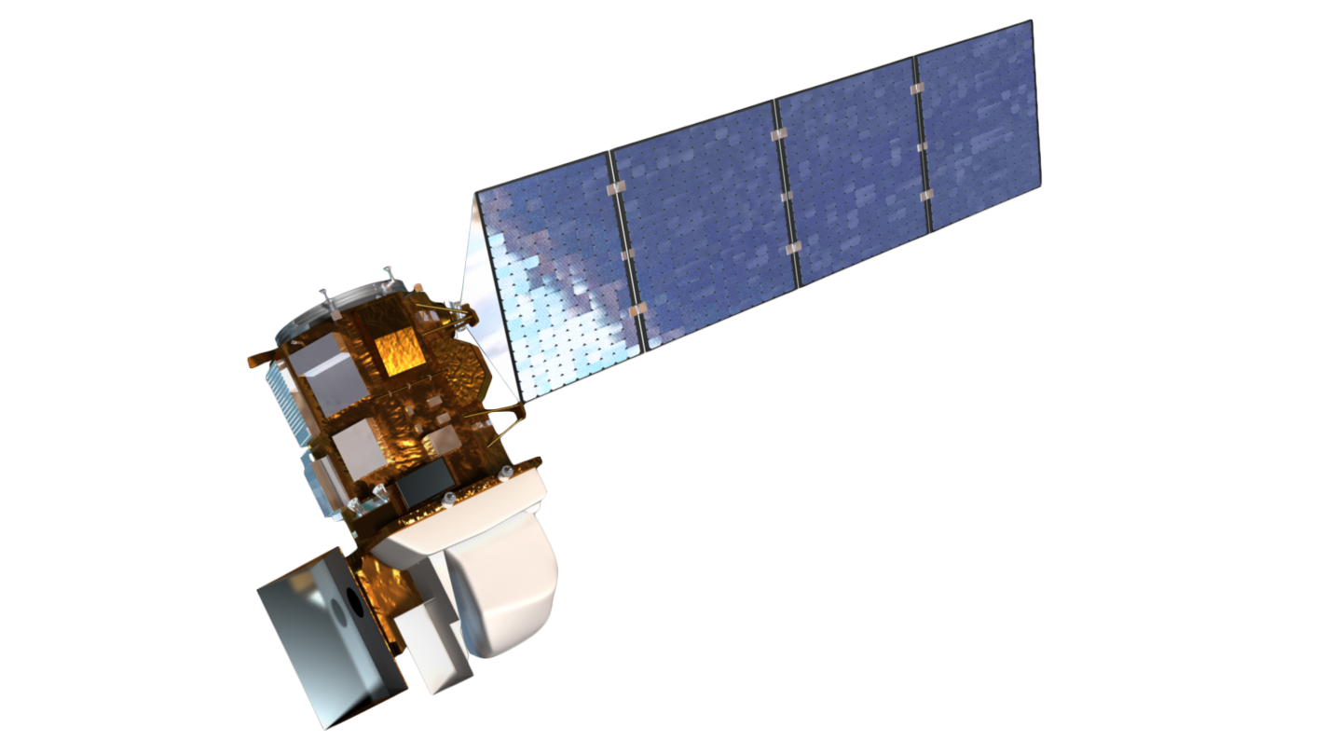
Data: NASA Satellites & Sensors
Landsat 7 Enhanced Thematic Mapper Plus (ETM+)
2013 post-fire mosaic
NBR measurements
Landsat 8 Operational Land Imager (OLI)
Pre-fire NDVI mosaic
2013 post-fire mosaic
2014-2017 post-fire mosaics
NBR measurements
Image Credits: NASA
Notes:
Speaker:
The team used NASA Earth observation data from the Landsat 7 and 8 missions to produce mosaic images over which Normalized Burn Ratio, or NBR, and change in NBR, or dNBR, were calculated. A mosaic of Landsat 8 images was also used to acquire pre-fire NDVI data. An image mosaic is made by temporally combining multiple images from the same scene to produce a single cloud-free image. We used the near-infrared and shortwave infrared band data collected from each satellite to calculate NBR and measure vegetation recovery.
------------------------------Image Information Below ------------------------------
Landsat 7 Image: NASA GSFC (Public domain)
https://espd.gsfc.nasa.gov/projects.html
Landsat 8 Image: NASA GSFC (Public domain)
https://landsat.gsfc.nasa.gov/wp-content/uploads/2013/01/ldcm_2012_COL.png

Slide 12
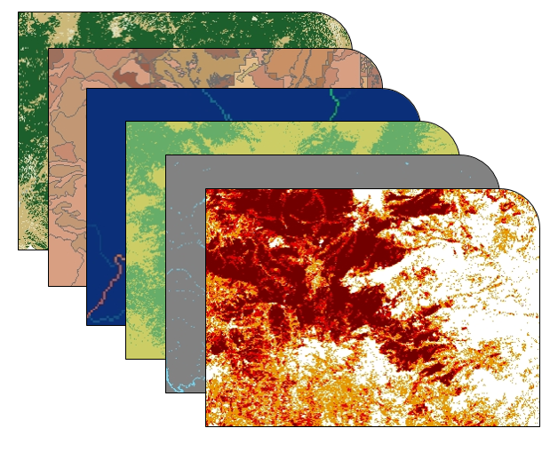
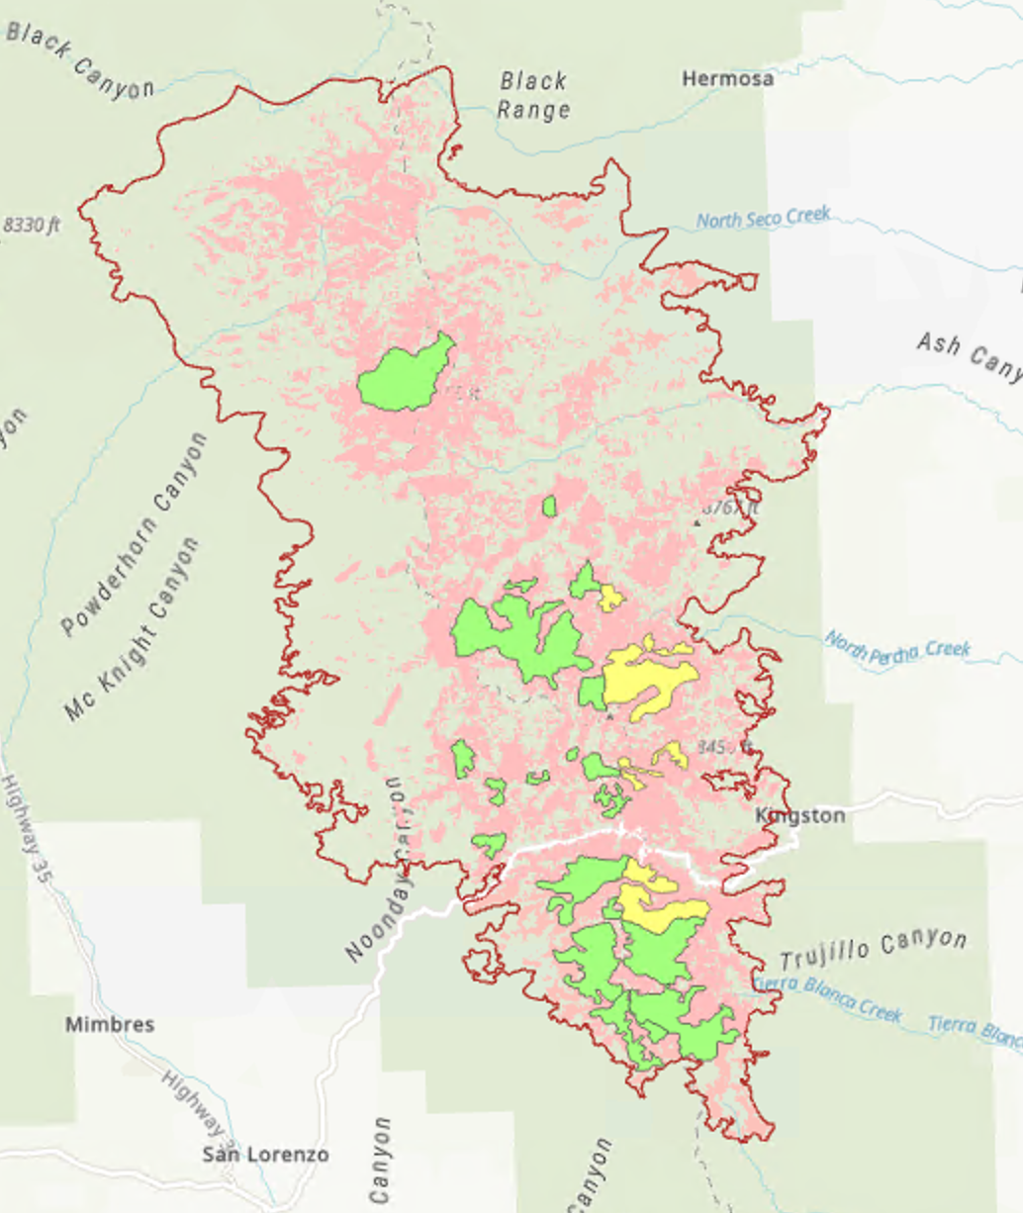
Methodology: Predictor Variables
Acquire and process necessary Landsat and ancillary data
Identify predictor variables
Identify training points for all treatment types across moderate and high burn severities
Treatment
Soil Burn Severity
Pre-fire NDVI
Elevation
Slope
Insolation
Soil Order
Resprouting Vegetation
Canopy Cover
Mod/High Burn Severity
Mulch/Seed
Areas
Seed Areas
Silver Fire Perimeter
Notes:
Speaker:
Our choice of predictor variables was influenced by literature, existing research, and expert opinions. We acquired early-2013 data on our predictor variables to ensure that our data was as accurate as possible when describing pre-fire conditions. In instances where 2013 data was not available, we chose the next earliest pre-fire dataset.
All data was compiled in Google Earth Engine and datasets that were not native to Earth Engine were uploaded via the Asset Manager. The Asset Manager was also used to upload necessary shapefiles and rasters of burn perimeter, burn severity, and treatment areas.
------------------------------Image Information Below ------------------------------
Stack of Images (middle): Gila Water Resources I (Public Domain)
http://www.devpedia.developexchange.com/dp/images/d/d8/2019Fall_GSFC_GilaWater_Presentation_FD-final.pptx

Slide 13
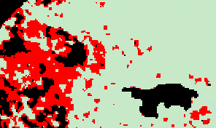
Methodology: Predictor Variables
Identify training points for all treatment types across moderate and high burn severities
Found min and max values of elevation and insolation for each level of treatment/burn severity
Removed regions outside min and max
Randomly generated 245 points in each masked treatment/burn severity strata
450 m
Removed
Kept
Notes:
Speaker:
Since our goal was to predict vegetation recovery across seeded, seeded/mulched, and untreated areas, as well as moderate and high burn severity, we had six sub-regions representing six unique combinations of treatment and burn severity. To create comparable datasets we needed to remove untreated areas that did not have the same environmental diversity as the treated areas. To achieve this we removed pixels in control areas that fell outside the ranges of elevation and insolation in the treated areas.
For each unique sub-region, we randomly selected a set of 245 of training points locations at which data for each variable was extracted.

Slide 14
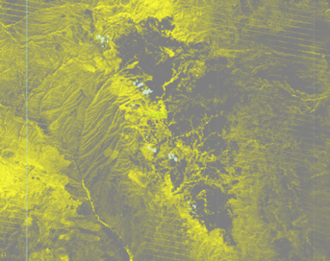
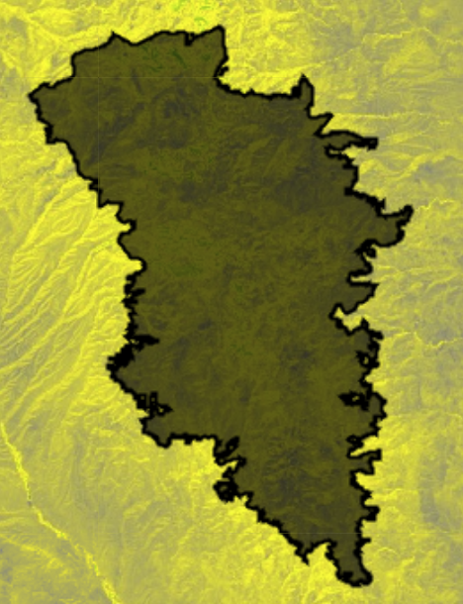
Methodology: dNBR Response Variable
2013 Minimum NBR
2017 Maximum NBR
NBR
Healthy Vegetation
Unhealthy/ burned
Notes:
Speaker:
Before discussing the next steps of the training point datasets, we must first highlight the response variable that our model is predicting. Our response variable is the difference normalized burn ratio, or dNBR. This index represents the change in NBR from a pre-fire image to a post-fire image. dNBR was selected as the response variable because it is a good proxy for vegetation recovery. The more vegetation recovers, the less the effects of erosion and flooding will be, according to the past Gila project terms. Therefore, dNBR is the best metric for addressing the community concern of flooding mentioned earlier.
We chose to model the vegetation recovery at two times after the fire - 2013 (capturing the immediate green-up post-fire) and 2017 (four years post-fire). We calculated a dNBR value for each time period, which measures the change in each 30m pixel’s NBR values between the pre-fire and post-fire image.
In the above maps, we see two maps of NBR, one from before the fire in 2013 on the left and one from 2017 on the right. As mentioned previously, these images are temporal mosaics. The 2013 mosaic is made up of images from July 7, when the fire was 80% contained, to the end of August when the seed-treated canopy was well-established. These images were mosaiced based on minimum NBR in order to capture the worst that each pixel was burned.
The 2017 mosaic is made up of images from June through November in order to capture the anniversary date of the fire as well as the months over which the BAER team has monitored in previous years, which were generally September-November. These images were mosaiced based on maximum NBR in order to capture the most that each pixel had recovered.

Slide 15
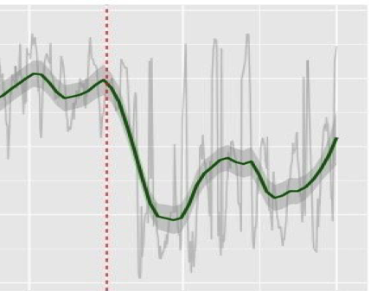
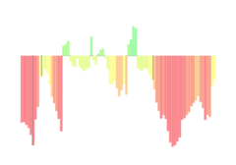
NBR & Post-fire Drought Conditions
900
600
300
0
-300
NBR
Palmer Drought Severity Index
2010
2015
2020
Year
Date of Silver Fire
Smoothed NBR Data
Raw NBR Data
2013 2014 2015 2016 2017 2018 2019 2020
Year
Notes:
Speaker:
We chose 2017 rather than another post-monitoring year, because of the implications that weather has on post-fire recovery. For example, following the Silver Fire treatment application, 14.7 inches of precipitation facilitated grass establishment (Natharius 2015). Knowing the impact of weather, we didn't want to predict regrowth in a year of severe drought, so we turned to the Palmer Drought Severity Index. The index captures both temperature and rainfall and, as shown in the graph, revealed a severe drought after 2017.
The influence of weather is further exemplified when we overlay the Drought index on top of the graph of NBR, which is shown on the left.
*CLICK*
Notice that when we align the years of the Drought index and NBR, we see NBR fall during the 2018-2020 drought years. For this reason, we confirmed our selection of 2017 as our post-BAER monitoring prediction year.

Slide 16
Methodology: Random Forest Modeling
Interpretive model structure
Two Random Forest Models
Interpretive model to compare treatment effects
Predictive models to make the best prediction at each treatment level
Training Dataset:
With all treatments and burn severities
Random Forest Regression Model
Variable Selection
Variable importance plots
Plots of important predictors influence on response
Notes:
Speaker:
We created two types of models: one, our interpretive model, is meant to aid in interpretation of drivers of post-fire recovery and recovery monitoring. The other, our predictive model, is designed to make the best predictions of post-fire dNBR at each treatment level.
We developed random forest models by identifying the ranges of values of our predictor variables. We masked out any area within the burn perimeter which fell outside of these ranges because any predictions made in those areas would be an extrapolation.
We created one model that included a predictors of soil burn severity and treatment to better understand how they might be impacting dNBR. Variable selection was implemented to include only the important variables.
This allowed us to create variable importance plots and plots of each important variable's influence on the response

Slide 17
Random Forest Interpretation
dNBR Fall 2013
dNBR Fall 2017
Treatment
Soil Burn Severity
Soil Burn Severity
Treatment
Insolation
Elevation
Elevation
Resprouting
Veg Cover
Predictor
Predictor
Pre-fire NDVI
Resprouting
Veg Cover
Soil Order
Slope
Pre-fire NDVI
Soil Order
Pseudo R² = 0.43
Insolation
Pseudo R² = 0.31
Canopy Cover
Canopy Cover
Importance: Low High
Importance: Low High
Notes:
Speaker:
These figures show the random forest variable importance when predicting dNBR for both 2013 and 2017. Both models performed quite well with Pseudo R^2's of more than .3.
When interpreting variable importance one should focus on rank order.
The most important variables for both timepoints were Treatment and Soil Burn Severity which is unsurprising given the results that the USFS GILA NF found in their monitoring. Data for the top four predictors in each model will be shown in more detail on the following slides.

Slide 18
Random Forest Interpretation
1000
1000
800
800
600
600
400
400
200
200
0
0
dNBR Fall 2013
Seed/Mulch
Seed
Untreated
High
Moderate
Treatment
Soil Burn Severity
1000
1000
800
800
600
600
400
400
200
200
0
0
50
100
150
200
250
2100
2300
2500
2700
2900
3100
Insolation
Elevation (m)
Notes:
Speaker:
In late 2013 after the fire, we see the first signs of post-treatment vegetation regrowth. These graphs show dNBR on the y axis and the most important predictors on the x axes, they are designed to visualize the relationship between each predictor and the response while accounting for the effects of the other variables in the random forest model.
The top left graph indicates the greatest positive change in NBR in seed/mulched areas, and the lowest positive change in untreated areas. This confirms the short-term positive treatment impacts seen by the partners.
The top right graph shows a slightly larger positive change in NBR within high burn severity areas compared to moderate burn severity areas.
For these top two graphs, note that average dNBR is between 400-200 for all variables.
The bottom two graphs detail the relationship between dNBR and insolation and elevation. Both graphs show slight decreases in magnitude of dNBR as insolation and elevation value increase. This makes sense for insolation as higher insolation values mean locations that receive more sunlight which can implead recovery.

Slide 19
Random Forest Interpretation
1000
1000
800
800
600
600
400
400
200
200
0
0
-200
-200
dNBR Fall 2017
Untreated
Seed/Mulch
Seed
High
Moderate
Treatment
Soil Burn Severity
1000
1000
800
800
600
600
400
400
200
200
0
0
-200
-200
0
25
50
75
2100
2300
2500
2700
2900
3100
Insolation
Elevation (m)
Notes:
Speaker:
Turning to 2017, we see that differences in dNBR across treatment types have leveled out to be relatively similar, with untreated areas holding a slightly higher dNBR than seeding and seeding/mulching. However, dNBR across burn severity has remained the same with high burn severity continuing to have a higher dNBR average.
Importantly, we see that the dNBR values across all variables has increased from the 200-400 range in 2013, to the 400-600 range in 2017.
Additionally, in 2017, we see that elevation remains an important predictor variable, but insolation has been replaced by resprouting vegetation. Resprouting vegetation data is measured using 5% buckets, leading to the vertical lines shown in the graph.

Slide 20
Random Forest Model: Predictive
Training Dataset:
Seeding
Training Dataset:
Mulching
Training Dataset:
Untreated
Random Forest Regression Model
Random Forest Regression Model
Random Forest Regression Model
Variable Selection
Variable Selection
Variable Selection
Predictor Variable Rasters
Predictor Variable Rasters
Predictor Variable Rasters
Seeding dNBR: 428
Mulching dNBR: 480
Untreated dNBR: 156
Notes:
Speaker:
Our project sought to create a tool to help BAER teams predict how well the landscape will recover after fire depending on what restoration treatment is applied. To do this, we created a multi-part random forest regression model using Google Earth Engine and R.
A model was created to predict recovery for each treatment type (seeded, mulched/seeded, and untreated) at both the moderate and high burn severity level for a total of six mini-models. We decided to create separate models for moderate & high burn severity areas, because, as we found with our interpretive model, burn severity is an extremely important factor in how the landscape recovers.
An example workflow is as follows. The training dataset for seeded, moderate burn severity areas was used to train a random forest regression model. We used the VSURF package in R to determine which predictor variables were most important for each model. Each model was optimized to make the best possible prediction for that treatment type and burn severity.
We then analyzed the overall Silver Fire burn perimeter and isolated our “predictable area” – all areas with similar topographic profile to our training data. This is the area over which our model can predict without extrapolating. We used the model to make a prediction of dNBR (or vegetation recovery) across our predictable area.
We repeated this process for each of our six models: Seeded moderate & high burn severity, mulched moderate/high burn severity, and untreated moderate/high burn severity. In the end, partners will be able to click on any given point and see its projected dNBR (or recovery) if the area was seeded, mulched, or left alone to recover naturally. In this example, we can see that the pixel achieves the highest dNBR value if it is mulched.

Slide 21
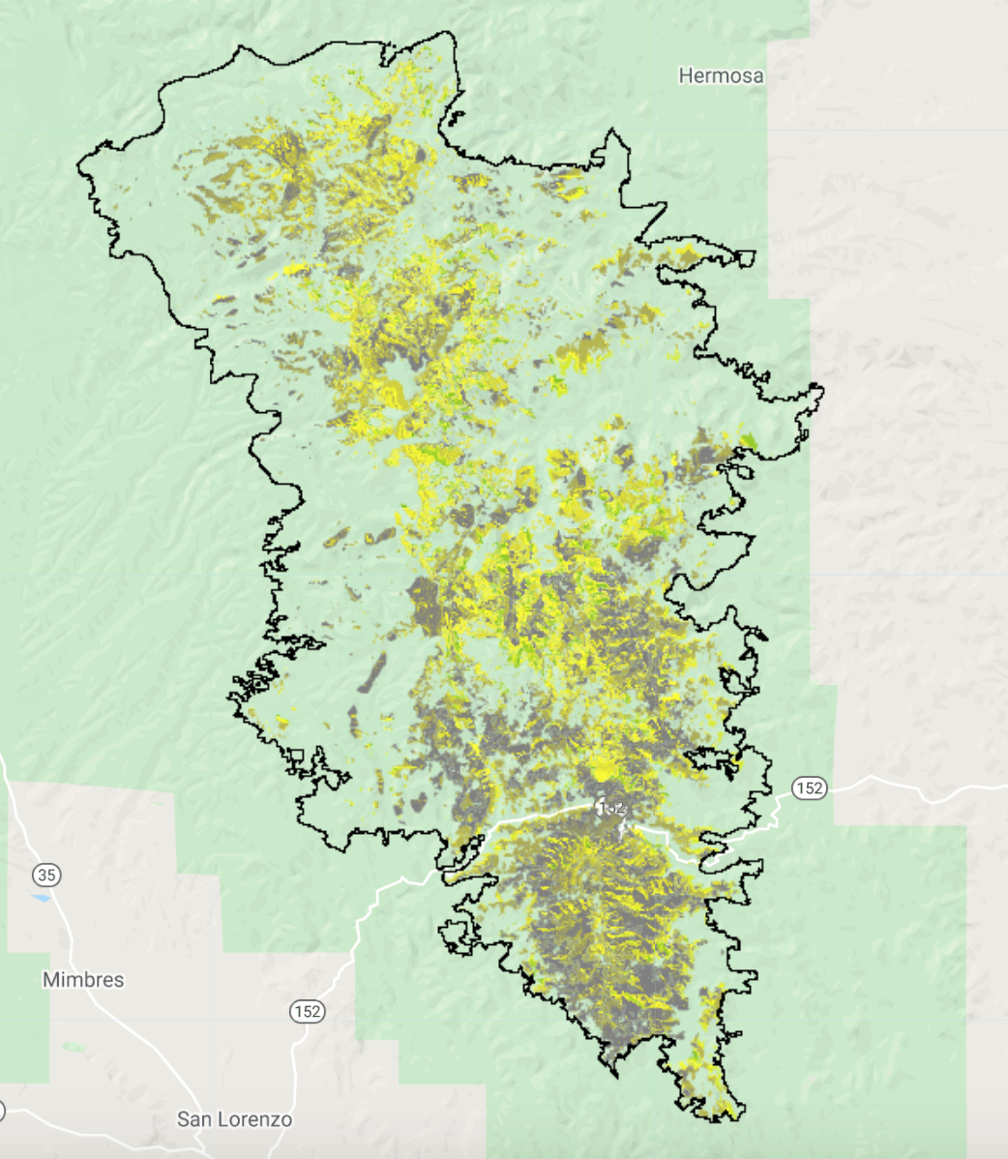
Results: Seed Treatment
2013 dNBR Prediction
2017 dNBR
Prediction
High recovery
Low recovery
Mod Burn Severity Model R² = 0.28
High Burn Severity Model R² = 0.19
Mod Burn Severity Model R² = 0.24
High Burn Severity Model R² = 0.14
Notes:
The image on the left shows the output of our seeding model for 2013, several months after the fire. Here we see the results of our models for moderate and high burn severity as though the entire landscape was seeded. Lower recovery levels are shown in gray, and higher recovery levels are in green. We’ve made a projection for 2013 – several months after the fire, and a projection for 2017 – four years after the fire. On the right are the results of the same model run for 2017 – four years post-fire. We can see higher dNBR values in many areas, reflecting vegetation recovery over time.
Our model for moderately burned seeded areas in 2013 had an R^2 of 0.28, which means that our model captures roughly 28% of the variance in the landscape. Our high burn severity 2013 model had an R^2 value of 0.19. In 2017, the moderate burn severity model had an R^2 of 0.24 and the high severity burn model had an R^2 of 0.14.

Slide 22
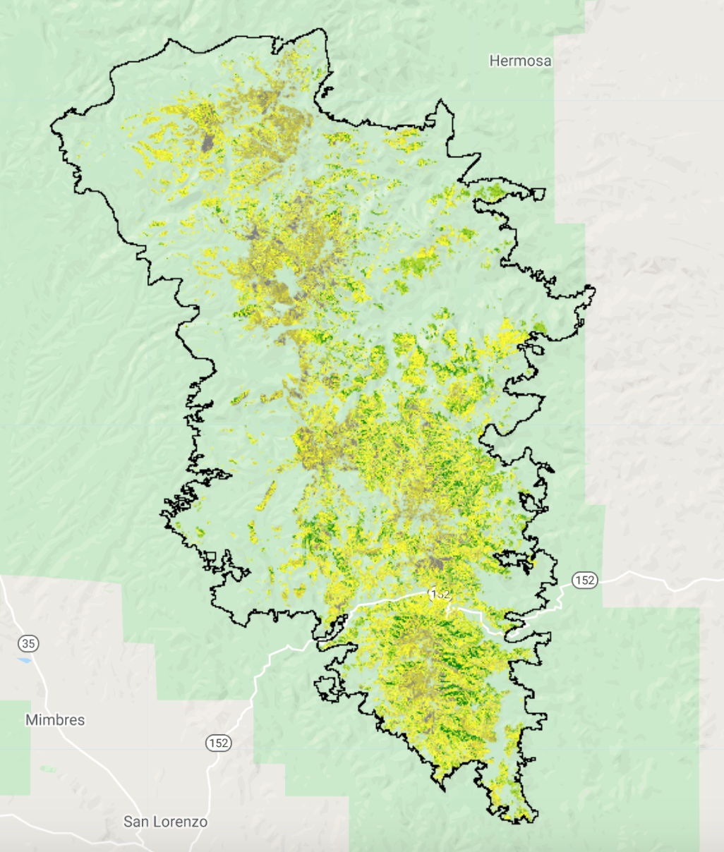
Results: Seed/Mulch Treatment
2013 dNBR Prediction
2017 dNBR
Prediction
High recovery
Low recovery
Mod Burn Severity Model R² = 0.39
High Burn Severity Model R² = 0.22
Mod Burn Severity Model R² = 0.38
High Burn Severity Model R² = 0.11
Notes:
The image on the left shows the output of our mulching/seeding model for 2013, several months after the fire. Here we see the results of our models for moderate and high burn severity as though the entire landscape was mulched and seeded. Lower recovery levels are shown in gray, and higher recovery levels are in green. We’ve made a projection for 2013 – several months after the fire, and a projection for 2017 – four years after the fire. On the right are the results of the same model run for 2017 – four years post-fire. We can see higher dNBR values in many areas, reflecting vegetation recovery over time.
Our model for moderately burned mulched/seeded areas in 2013 had an R^2 of 0.39, which means that our model captures roughly 39% of the variance in the landscape. Our high burn severity 2013 model had an R^2 value of 0.22. In 2017, the moderate burn severity model had an R^2 of 0.38 and the high severity burn model had an R^2 of 0.11.

Slide 23
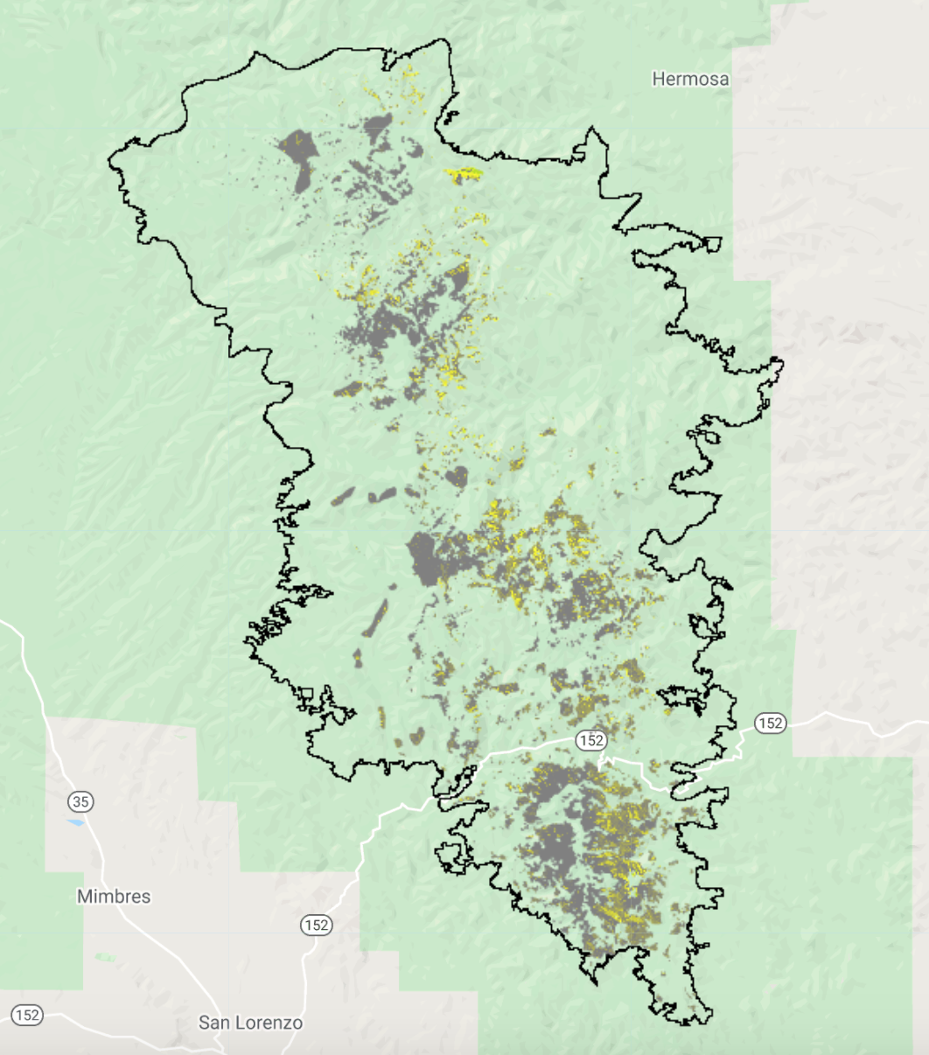
Results: No Treatment
2013 dNBR Prediction
2017 dNBR
Prediction
High recovery
Low recovery
High Burn Severity Model R² = 0.26
High Burn Severity Model R² = 0.20
Notes:
The image on the left shows the output of our untreated model for 2013, several months after the fire. Here we see the results of our models for moderate and high burn severity as though the entire landscape was left to recover naturally. Lower recovery levels are shown in gray, and higher recovery levels are in green. We’ve made a projection for 2013 – several months after the fire, and a projection for 2017 – four years after the fire. On the right are the results of the same model run for 2017 – four years post-fire. We can see higher dNBR values in many areas, reflecting vegetation recovery over time.
Our model for severely burned untreated areas in 2013 had an R^2 of 0.26, which means that our model captures roughly 26% of the variance in the landscape. In 2017, the high burn severity model had an R^2 of 0.20.

Slide 24
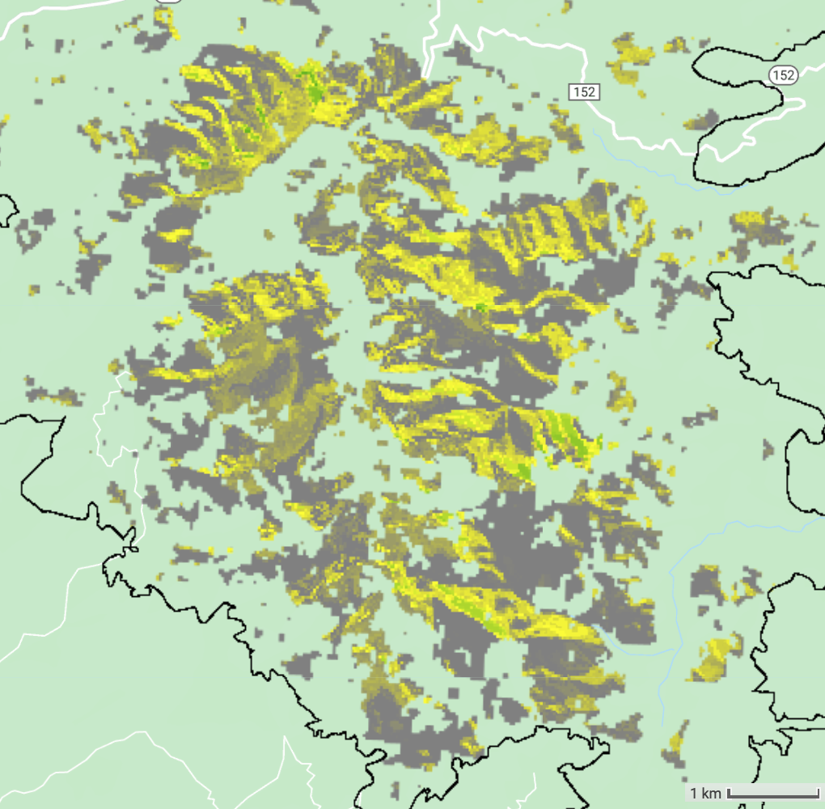
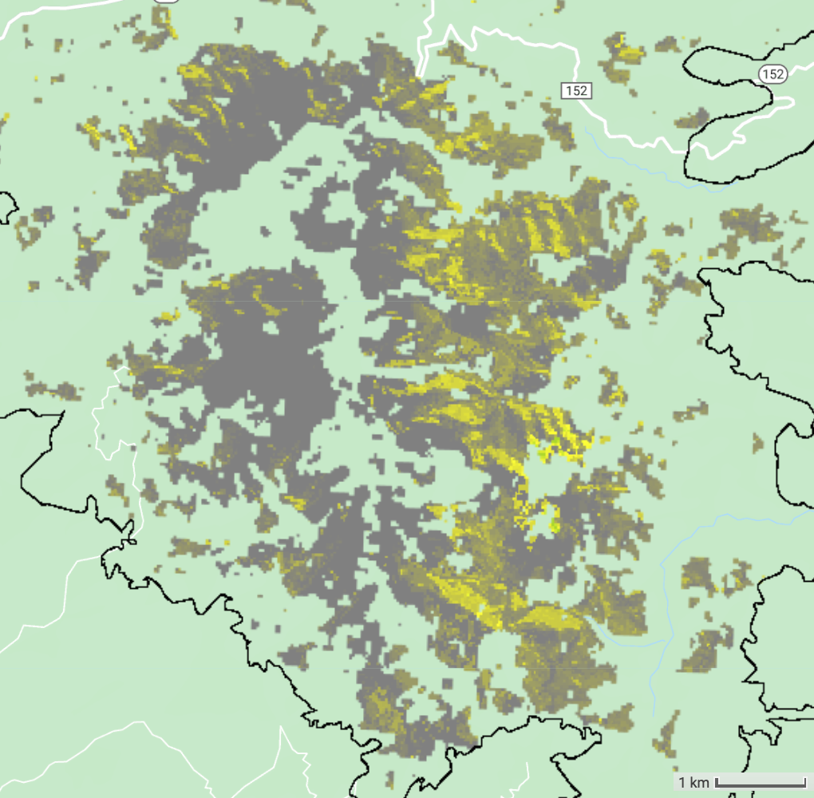
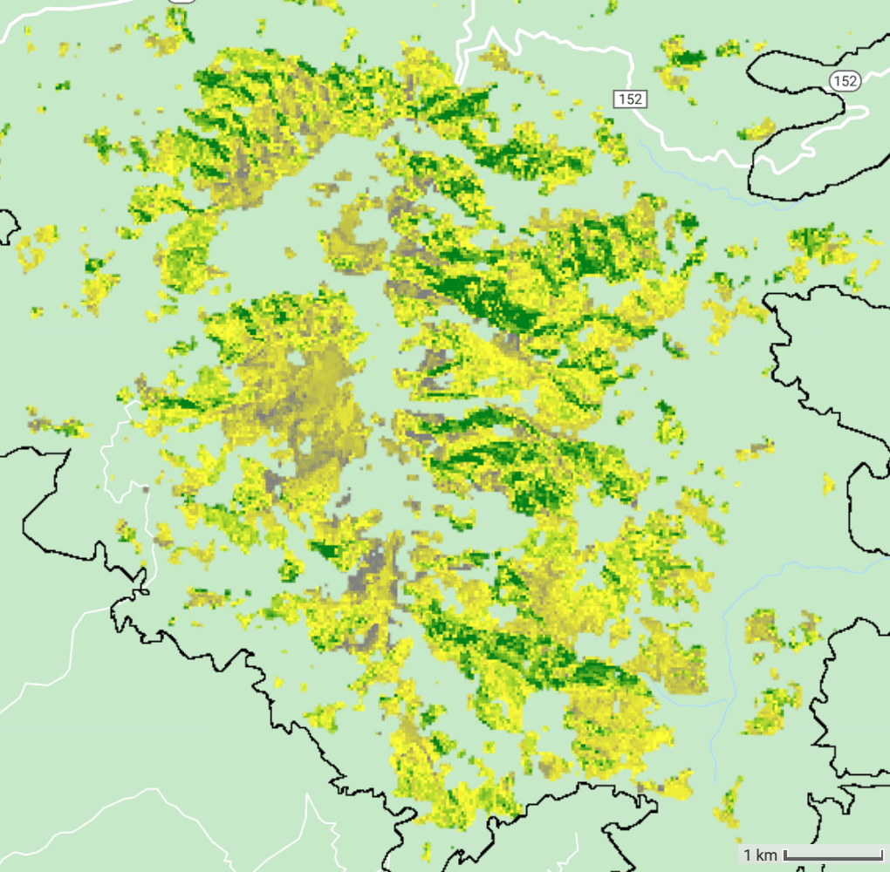
Results: 2013 dNBR Predictions
Mulched
Seeded
Untreated
High recovery
Low recovery
1 km
Notes:
Here is an example of how partners might use the decision-support tool to examine vegetation recovery based on restoration treatment type. We're looking at a zoomed-in portion of the Silver Fire burn area. The image shows the dNBR prediction across the area of interest roughly four months post-fire as though the whole landscape was left untreated to recover naturally. Next, we see the same area's predicted vegetation recovery if the entire landscape were seeded. Finally, we see a prediction of vegetation recovery if the entire landscape were mulched.
We can see that in most places, vegetation recovery is maximized by mulching, or in some areas, seeding. However BAER teams must weigh the costs of using expensive treatment methods like mulching against the risks of erosion or flooding posed by specific areas. In lower-risk areas, it may be more cost effective to close off sections of the forest and let it recover naturally. However in areas where the risk of flooding or erosion is high, more intensive treatments like seeding or mulching may be necessary. This model is a proof-of-concept tool that BAER teams could use to understand how vegetation would recover under different treatment methods, and to help make decisions about how to manage the landscape after a fire.

Slide 25
Assumptions and Errors
Assumptions:
Post-fire weather must be similar to the Silver Fire which helped grasses establish and grow
Sources of error:
No independent cross validation of model uncertainty
Ability to extrapolate results beyond the Silver Fire not well known
Some models had low predictive power
Notes:
Speaker:
We did not include post-fire weather into our modeling technique which is a very important driver of recovery
There was no independent cross validation of model uncertainty on a different fire which would improve our understanding of how well we could predict recovery after different treatments
Including more fires in this effort could improve predictive power and model flexibility beyond the silver fire
Some of the models we created have relatively low predictive power

Slide 26
Conclusions
dNBR is a good response variable for assessing vegetation recovery
Seed/Mulch and Seed treatments increased recovery in the short term, but effects diminished by 4 years post-fire
Treatment, Soil Burn Severity, and Elevation were consistently the most important drivers of dNBR recovery
This tool could be used to make predictions of how treatments could influence recovery to augment monitoring of recovery after a wildfire
Notes:
Speaker:
In conclusion, we found dNBR from directly post-fire to the timepoint of interest to be a good response variable for monitoring post-fire recovery
Post-fire treatments had an immediate effect on vegetative cover, but recovery of untreated areas had caught up by 4 years after the fire
Treatment, Soil Burn Severity, and Elevation were the most important drivers of dNBR recovery both in 2013 and in 2017

Slide 27
Gila National Forest
Carolyn Koury, Hydrologist
Mike Natharius, Soil Scientist
Advisors
Dr. John Bolten
Dr. Raha Hakimdavar
Keith Weber
Past contributors
Abigail Barenblitt
Ariege Besson
Terra Edenhart-Pepe
Carli Merrick
Alia Giolitti
Carli Merrick
Madeline Allen
Sarah Hafer
USDA Forest Service, Region 3
Jack Triepke, Regional Ecologist
Bart Matthews, Photogrammetry Program Specialist
Anna Jaramillo, Regional Watershed Improvement Program
Kathleen Hawkos, GIS Specialist
Center Fellow
Darcy Gray
Notes:
Speaker:
Thank you to our advisors, collaborators and past contributors on this project. And thank you all for joining us!

Slide 28
Backup Slide

Slide 29
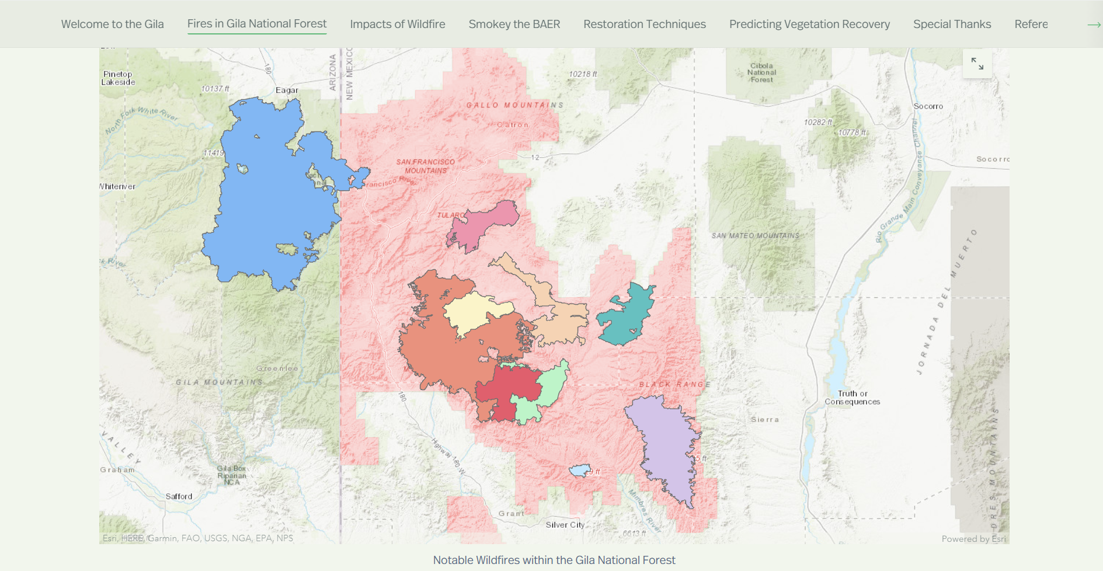
AGOL Story Map
Notes:
To communicate the results of this project, the team produced a creative communication tool via the public facing StoryMap in ArcGIS Online.

