Slide 1
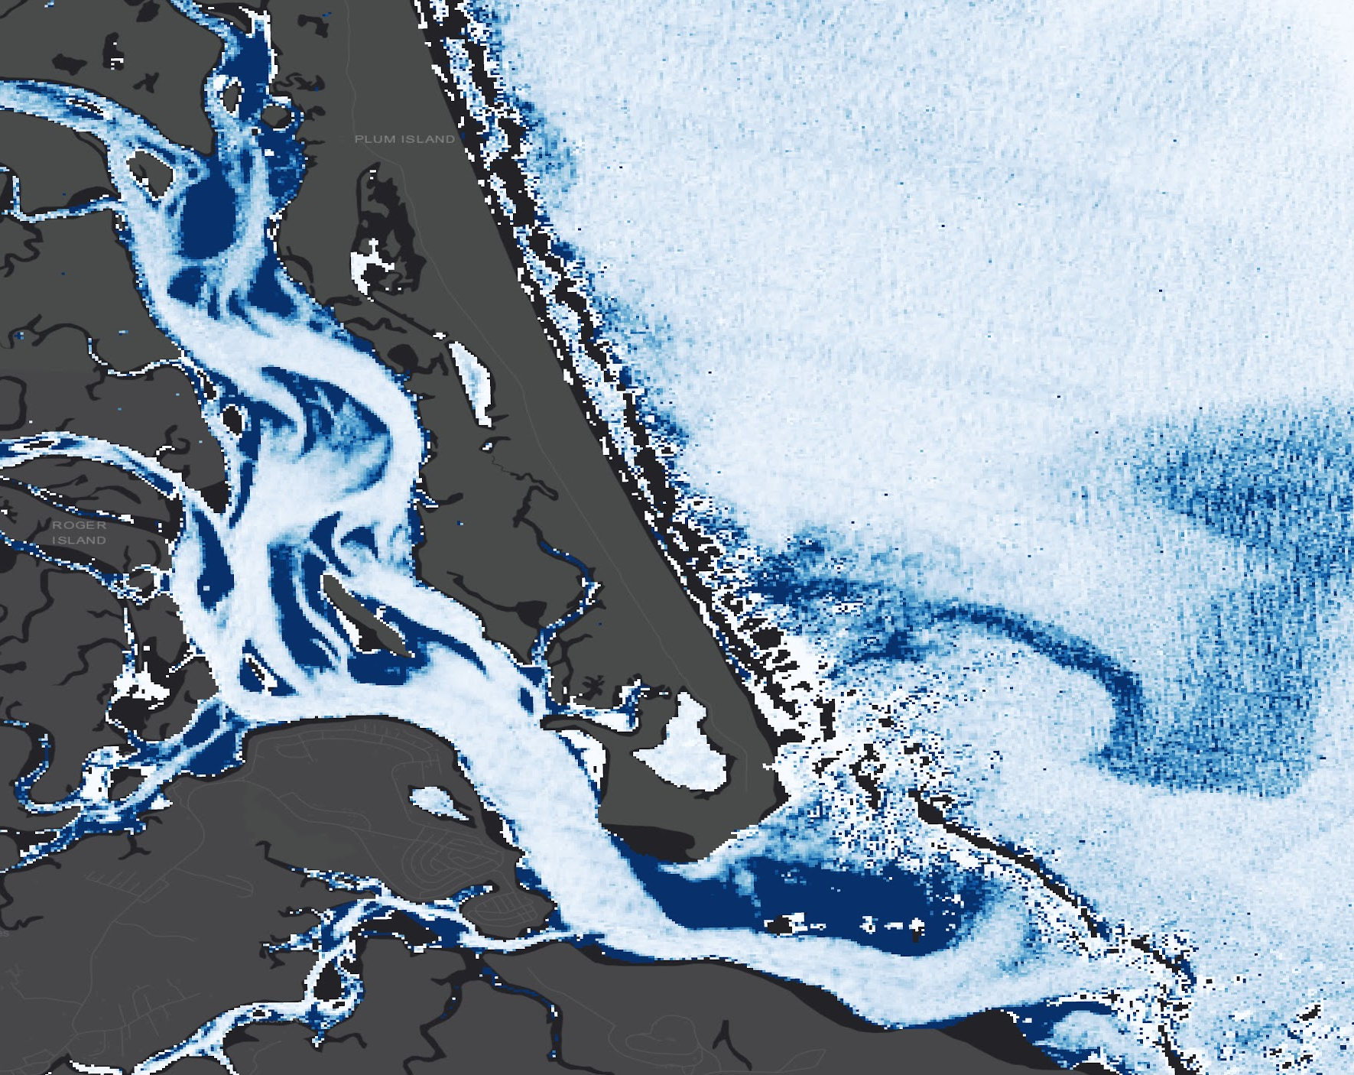
2018 Summer | Massachusetts – Boston
PLUM ISLAND ESTUARY WATER RESOURCES II
Employing Remote Sensing Techniques to Quantify Sediment Supply and Evaluate Marsh Vulnerability in the Plum Island Estuary
Henrik Westerkam
Ruizhe Guo
Sydney Neugebauer
Linnea Smith
Notes:
Hello! My name is ___. The 2018 summer team at the Massachusetts node of NASA DEVELOP continued work from the spring term in the Plum Island Estuary. The team used NASA earth observations to quantify sediment supply in the estuary in order to better assess the marsh’s vulnerability to sea level rise.
Image: Landsat 8 OLI

Slide 2
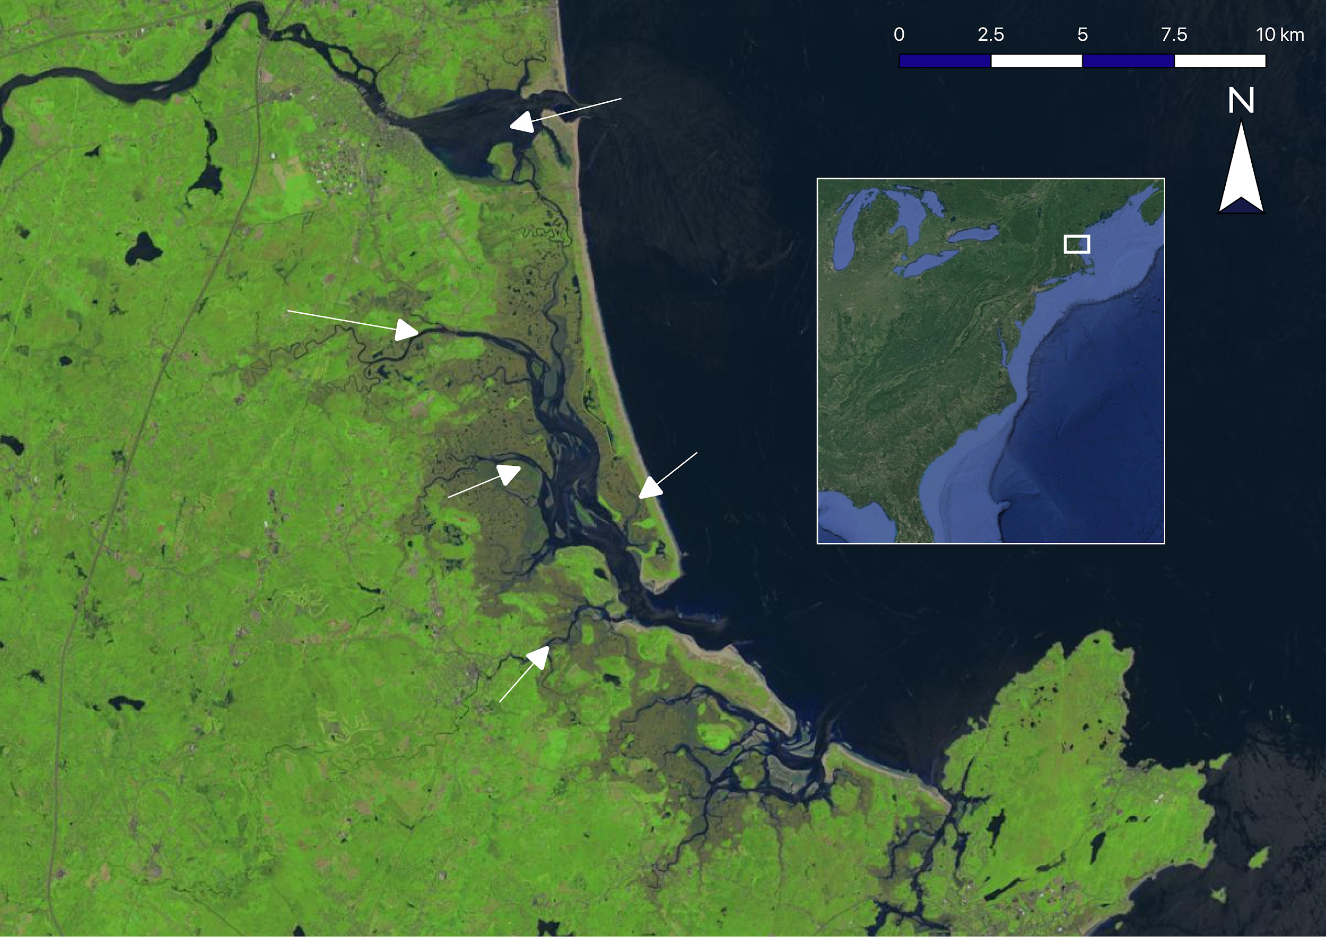
Study Area
Merrimack River
Study Area
Parker River
Plum Island
Atlantic Ocean
Rowley River
Ipswich River
Image source: Landsat 8 OLI
Inset source: Google, Landsat/Copernicus
Merrimack River
Study Area
Parker River
Plum Island
Atlantic Ocean
Rowley River
Ipswich River
Notes:
The Plum Island Estuary is located in Northeastern Massachusetts, about 45 km north of Boston. The estuary is fed by the Ipswich, Rowley, and Parker rivers, and is bordered by the Merrimack River in the north. The estuary is open to the Gulf of Maine. PIE is a protected area under the 1972 Wetlands Protection Act, and is located within the Great Marsh Area of Critical Environmental Concern, a status which recognizes the area’s unique ecological value.
Image source: Landsat 8 OLI from June 17th, 2018. Inset source: Google, Landsat/Copernicus.

Slide 3
Study Period
Image source: DEVELOP participant
Image Credit: Monet
Remote sensing data | April 2013 – July 2018
In situ data | November 2017; May – July 2018
Notes:
This study includes remote sensing data from April 2013 to April 2018. In situ data was acquired in November 2017 and from May to July 2018.
Image: View from LTER Rowley house
Image source: Linnea Smith, DEVELOP participant

Slide 4
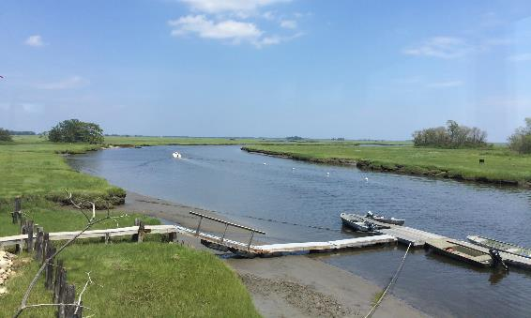
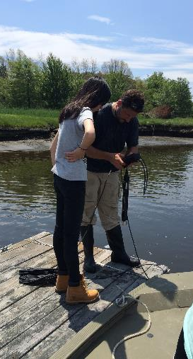
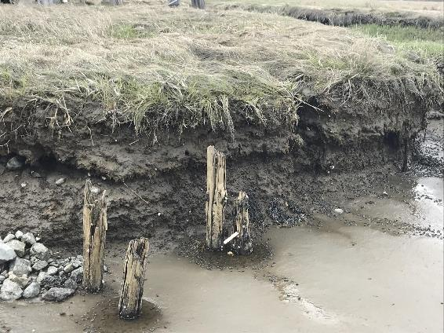
Community Concerns
Ecosystem Services
Education and Outreach
Vulnerability Assessments
Image sources: DEVELOP participants
Image Credit: ??
Notes:
Salt marshes are critical for resilience in coastal communities; they provide ecosystem services such as water purification, erosion control, protection from storm surge, and carbon sequestration. Plum Island Estuary is also a popular destination for research, education, and environmental outreach activities, making it a valuable social resource for nearby communities. Producing a sediment budget will help decision-makers in the area perform vulnerability assessments that identify high-risk areas of the marsh that could benefit the most from limited conservation funds.
Images: (top left) View from LTER Rowley house; (bottom left) scarp; (right) science advisor Cedric Fichot and DEVELOP participant Ruizhe Guo
Image source: Linnea Smith, DEVELOP participant; and Zachary Bengtsson, Center Lead

Slide 5
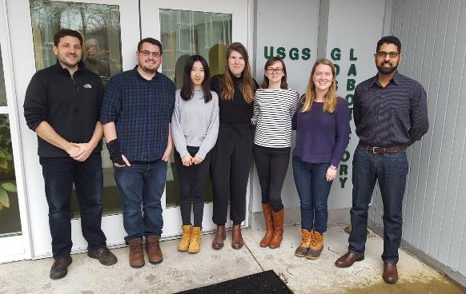
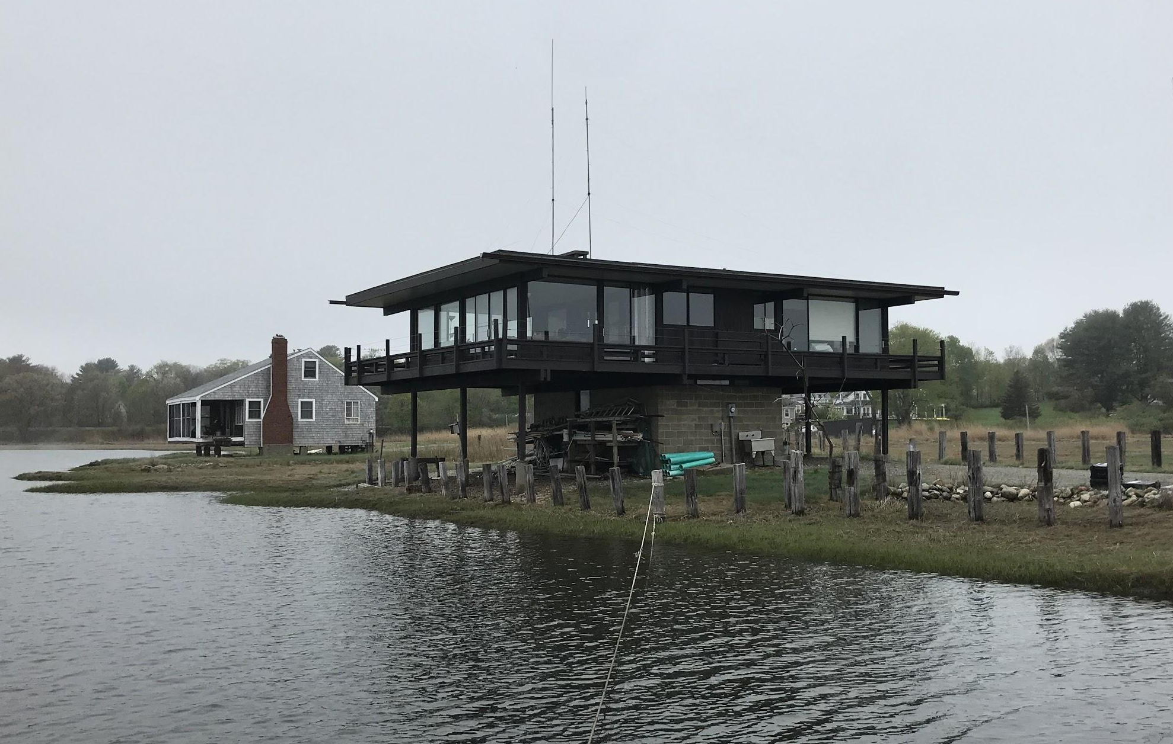
Partners
US Geological Survey Woods Hole Coastal and Marine Science Center
Long Term Ecological Research Network Plum Island Ecosystems
US Fish and Wildlife Service Parker River National Wildlife Refuge
Image sources: DEVELOP participants
Notes:
We partnered with the USGS Wood Hole Coastal and Marine Science Center, PIE LTER, and the USFWS Parker River National Wildlife Refuge. The USGS, in collaboration with Dr. Sergio Fagerhazzi at Boston University and Nancy Pau at the USFWS, currently measure SSC at point locations in the estuary. Dr. Neil Ganju from the USGS uses this information in vulnerability assessments of the marsh, which are used to determine management procedures, allocate funds judiciously, and guide future research. PIE LTER conducts extensive research on Plum Island ecosystems, and is interested in the estuary’s long term viability and health.
Images: (top) Spring 2018 DEVELOP team at USGS Woods Hole; (bottom) LTER Rowley house
Image source: Sydney Neugebauer, DEVELOP participant

Slide 6
Objectives
Improve atmospheric correction
Develop an algorithm to derive SSC from Rrs
Create time series of sediment concentrations 2013-2018
Evaluate the Merrimack River as a source of sediment
Model suspended sediment flux
Estimate SSC
Quantify Flux
Assess the estuary’s vulnerability to sea level rise
Notes:
This term, we sought to improve our atmospheric correction methods. We refined the algorithm created last term, for deriving suspended sediment concentration from remote sensing reflectance, by incorporating more in situ data. We also created a time series of sediment concentration in the estuary from 2013 to 2018. Finally, we attempted to evaluate the Merrimack River as a possible source of sediment and quantified suspended sediment flux in the estuary using a hydrodynamic model. The ultimate goal of these efforts was to help our end user estimate the vulnerability of the estuary to sea level rise.

Slide 7
Methods
Atmospheric correction
Algorithm development
Sediment flux estimation
Time Series analysis
Improved atmospheric correction with gains in SeaDAS
Developed an empirical algorithm in R and validated it with in situ data
Estimated sediment flux using Delft3D model
Conducted time series analysis to study what factors affect SSC
Notes:
This is an overview of the team’s methods. We improved our atmospheric correction using gains in SeaDAS, developed an empirical algorithm in R and validated it with in situ data, estimated sediment flux using the Delft3D model, and conducted time series analysis to analyze change in SSC over time.

Slide 8
Earth Observations
Spatial Resolution | Temporal Resolution | Spectral Resolution | Dates of Imagery
30 m | 16 days | 9 spectral bands | April 2013 – July 2018
Image Credit: Monet
Landsat 8
Operational Land Imager
Image source: NASA
Notes:
The team used level 1 data from Landsat 8 OLI and Sentinel-2 MSI for this study. The high spatial resolution of these sensors was necessary to analyze the estuary’s narrow channel. Landsat 8 has a spatial resolution of 30 m, and captures a new image every 16 days. The team was able to coordinate in situ data collection with a Landsat overpass.
Image: Landsat 8 satellite
Image source: Developedia

Slide 9
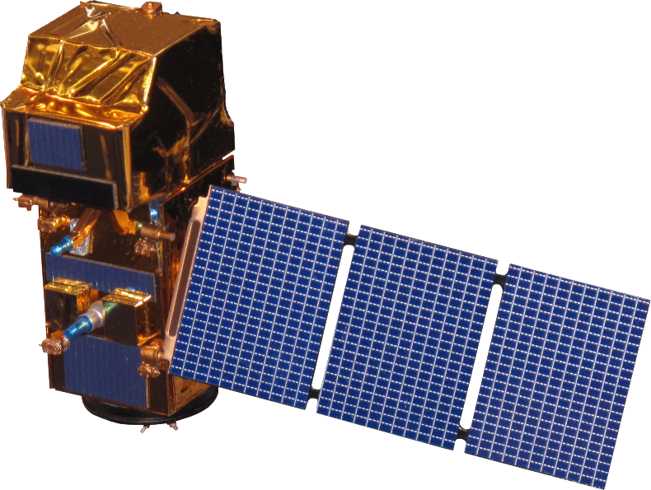
Earth Observations
Spatial Resolution | Temporal Resolution | Spectral Resolution | Dates of Imagery
10-20 m | 10 days | 13 spectral bands | October 2017 – April 2018
Image Credit: Monet
Sentinel-2
Multispectral Instrument
Image source: NASA
Notes:
The ESA’s Sentinel-2 has a spatial resolution between 10 and 20 m, and passes over Plum Island every 10 days.
Image: Sentinel-2 satellite
Image source: Developedia

Slide 10
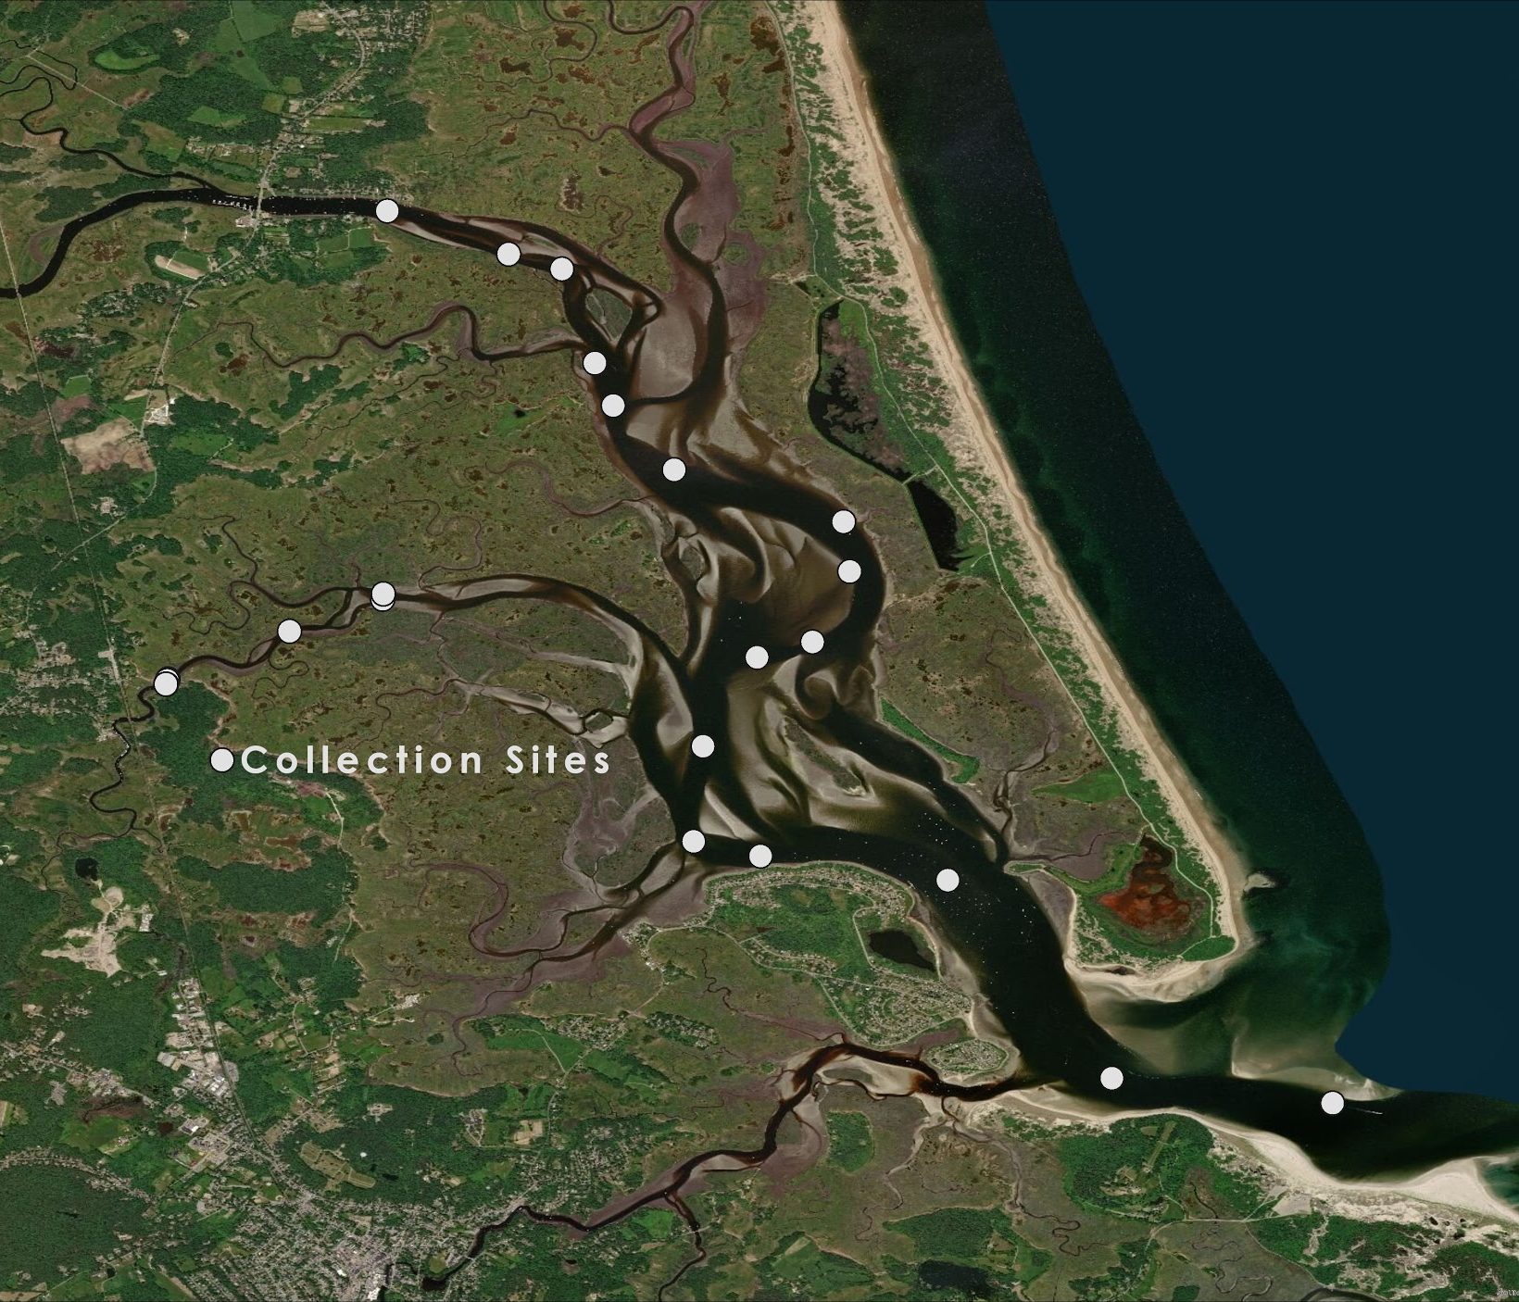
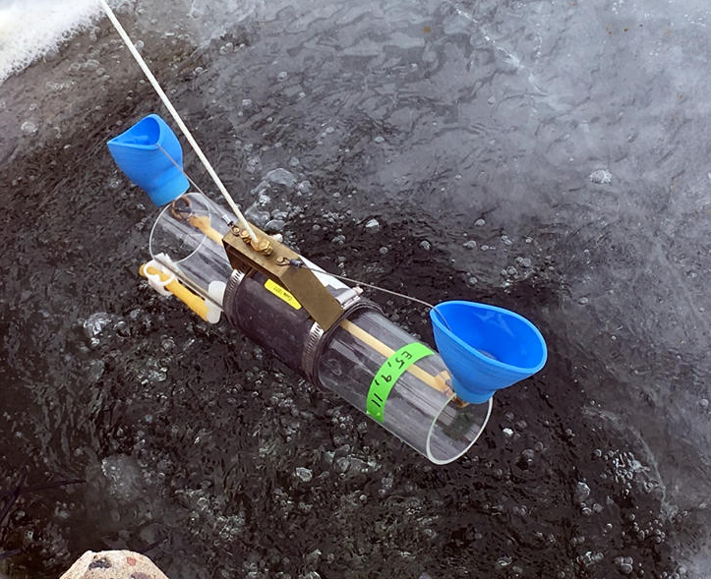
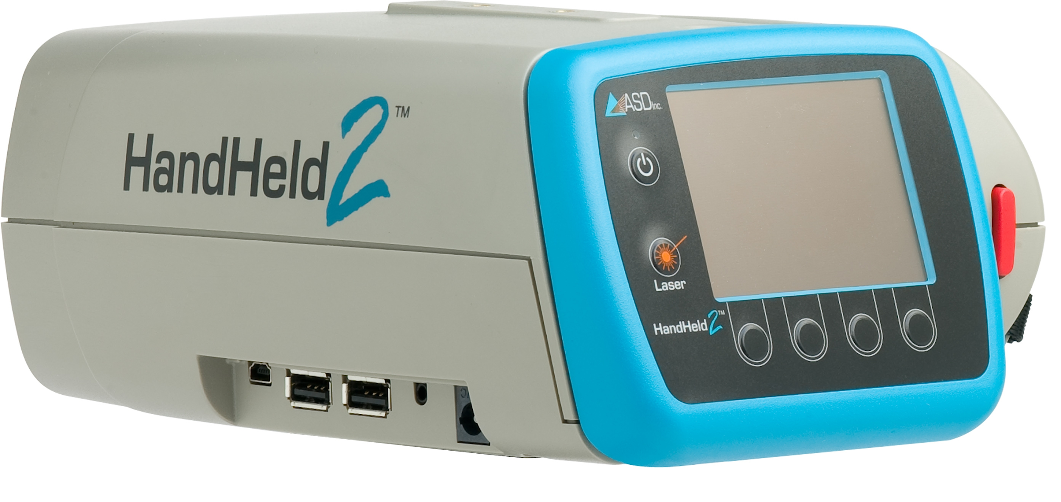
Methodology
In situ data collection
Van Dorn Sampler
Image source: Chris Merkes, Upper Midwest Environmental Science Center
Spectroradiometer
Image source: ESRI, DigitalGlobe, GeoEye, Earthstar Geographics, CNES/Airbus DS, USDA, USGS, AeroGRID, IGN, and the GIS User Community
Image source: Malvern Panalytical
Notes:
Thanks to the team’s proximity to the study area, participants were able to visit Plum Island and collect in situ data. The team used a Van Dorn sampler to collect water samples, which they later filtered in BU’s photobiogeochemistry lab to get measurements of SSC. The team also used a handheld radiometer and a profiling spectroradiometer to gather reflectance measurements at the time of sample collection. This map shows the locations where we collected in situ data.
Images: (top) Van Dorn sampler; (bottom) ASD Fieldspec HandHeld 2 Pro
Image source: Chris Merkes, Upper Midwest Environmental Science Center and Malvern Panalytical; (right) ESRI, DigitalGlobe, GeoEye, Earthstar Geographics, CNES/Airbus DS, USDA, USGS, AeroGRID, IGN, and the GIS User Community

Slide 11
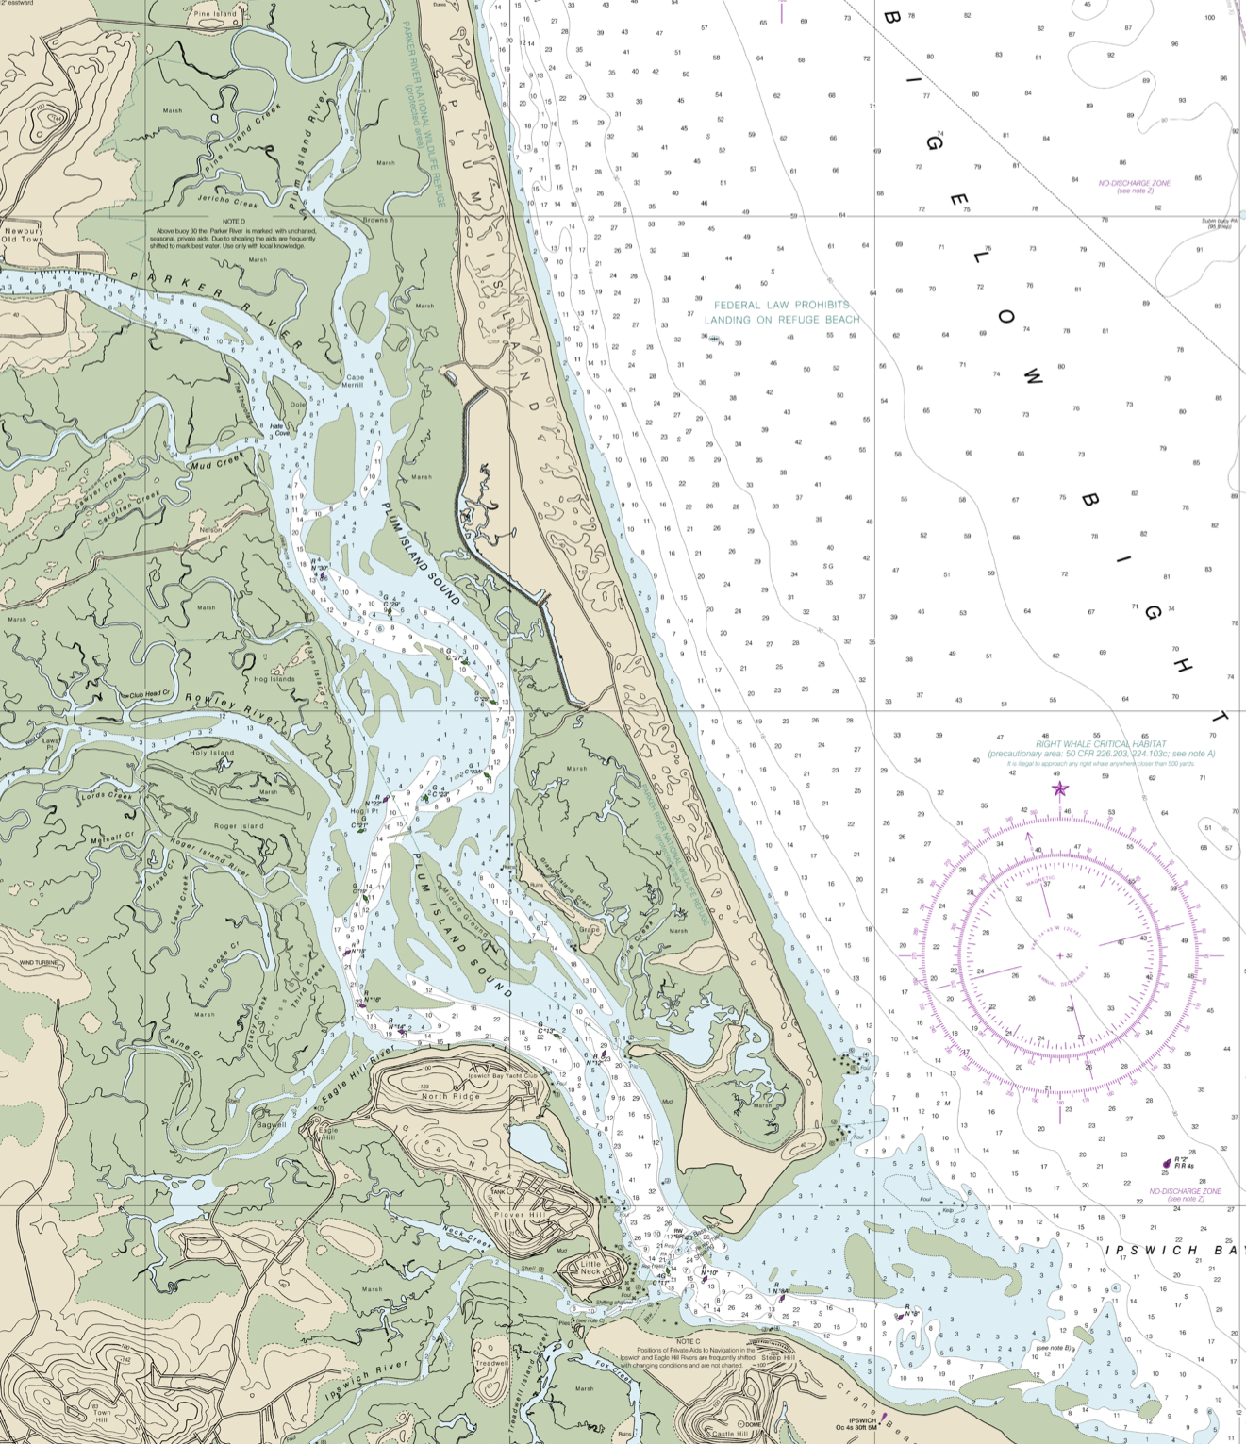
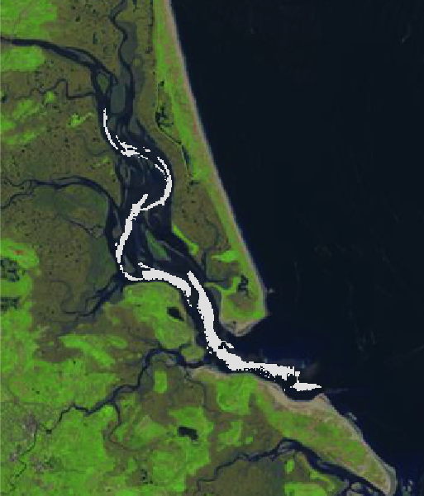
Methodology
Mask creation
Image source: NOAA
Image source: Landsat 8 OLI
Notes:
The previous term of this project recognized bottom reflectance as a potential source of error in gathering SSC information from reflectance data. The team therefore decided to exclude shallow parts of the estuary from their analysis to limit the influence of bottom reflectance on SSC measurements. They used data from NOAA and images from Google Earth Pro and Landsat 8 OLI to mask all areas of the channel shallower than six feet.
Images: (left) NOAA Nautical Chart 13274, with deep areas in white; (right) screenshot of mask, area that is deep enough in grey
Image source: NOAA, Landsat 8 OLI

Slide 12
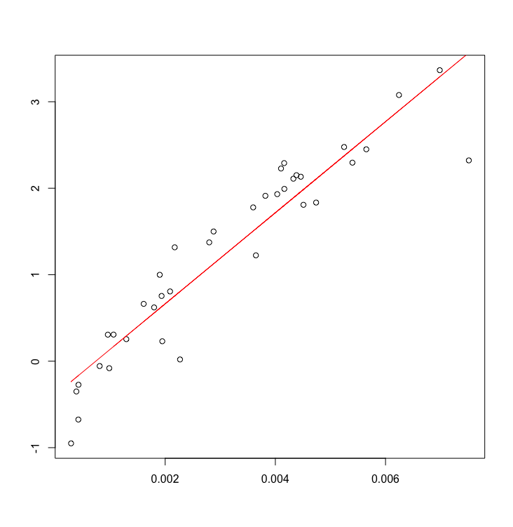
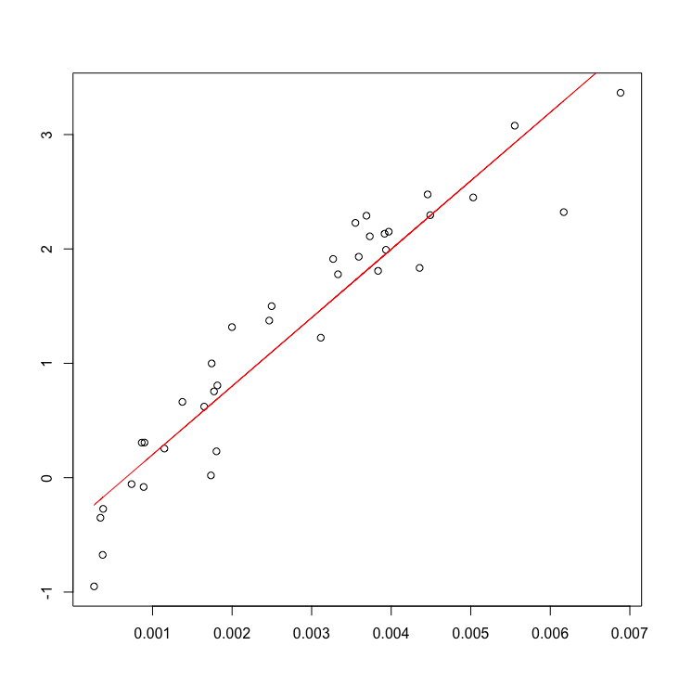
Methodology
Algorithm Development
Landsat 8
Sentinel-2
SSC=e^(526.6598*Rrs_655-0.3902)
SSC=e^(598.4910*Rrs_665-0.3967)
log(SSC) (mg/L)
log(SSC) (mg/L)
R² = 0.8785
R² = 0.8953
Rrs_655 (sr^-1)
Rrs_665 (sr^-1)
Intercept | Slope
[-0.6322,-0.1482] | [460.5304,592.7892]
Intercept | Slope
[-0.6205,-0.1728] | [529.3454,667.6367]
95% CI:
Notes:
The team developed an empirical algorithm to derive SSC from remote sensing reflectance at two wavelengths, corresponding with the sensors onboard each satellite.
Images: Preliminary algorithm for deriving SSC from Rrs, generated in R by DEVELOP participants

Slide 13
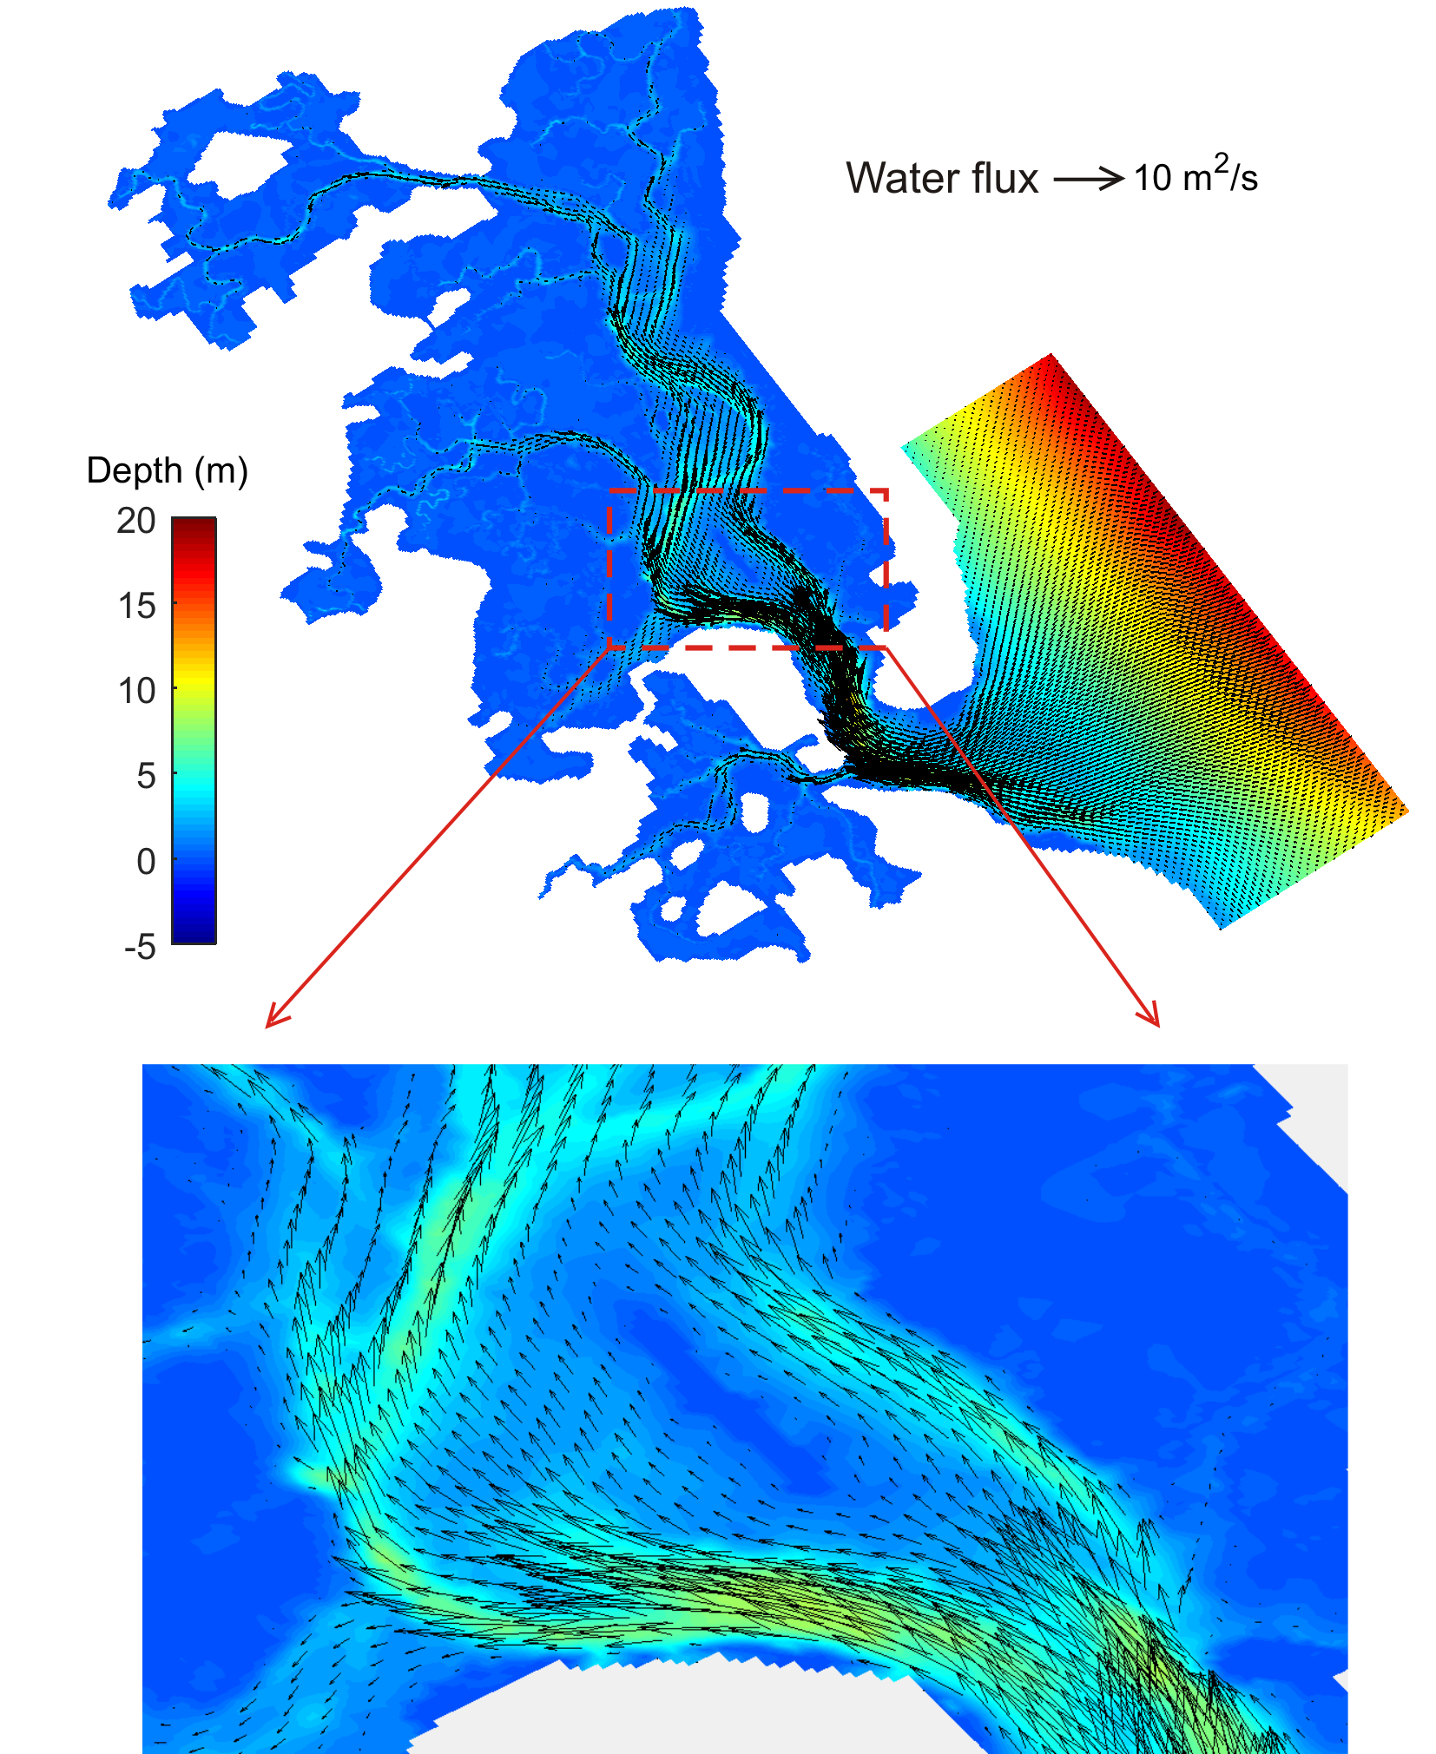
Methodology
Flux Modeling
Landsat 8 OLI
February 6, 2017
Notes:
To evaluate sediment flux throughout the estuary, the team provided SSC data produced by the algorithm as an input to the Delft3D hydrodynamic model. This model was then used to produce a map of sediment flux into and out of the estuary.
Images: SSC on February 6, 2017 derived from Landsat 8 OLI, generated in ArcGIS Pro by DEVELOP participants (left); dh/dt modeled for all dates with a Landsat 8 or Sentinel-2 overpass, generated with Delft3D hydrodynamic model by Xiaohe Zhang

Slide 14
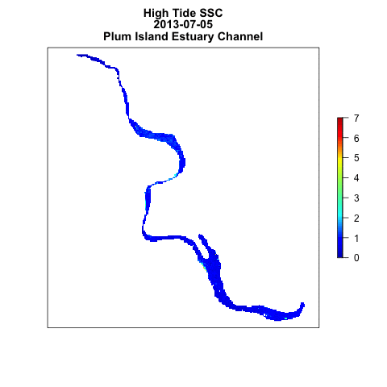
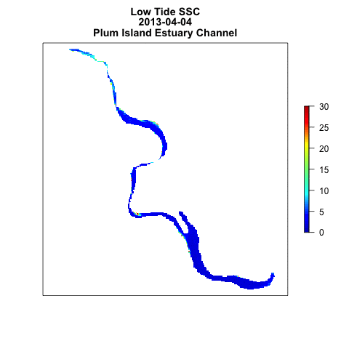
Results
Time Series of SSC
High Tide SSC
Plum Island Estuary Channel
Low Tide SSC
Plum Island Estuary Channel
mg/L
mg/L
mg/L
Notes:
We generated a few time series products to visualize how SSC changes over time throughout the estuary. These time series gifs depicts SSC in the channel on 46 dates from 2013 to 2018, with 24 images from high tide and 22 images from low tide. Low tide has much higher SSC compared to high tide, which could be partly due to bottom reflectance and not necessarily a true measurement. However, the inconsistency of areas with extremely high SSC indicates that our mask effectively excluded virtually all areas of bottom reflectance, meaning these are accurate measurements.
Image: SSC on various dates from 2013-2018, generated in R by DEVELOP participants

Slide 15
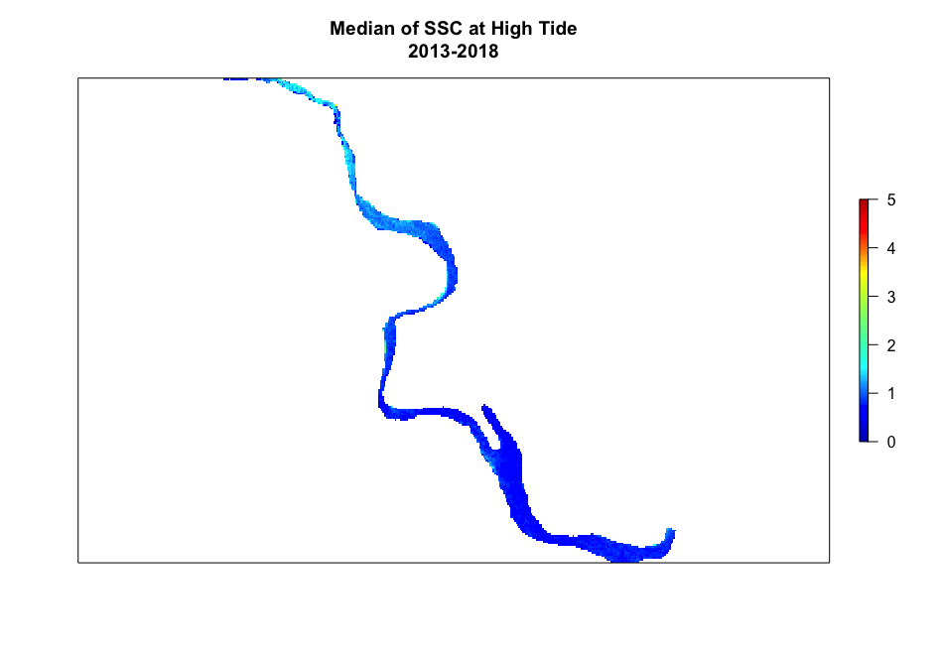
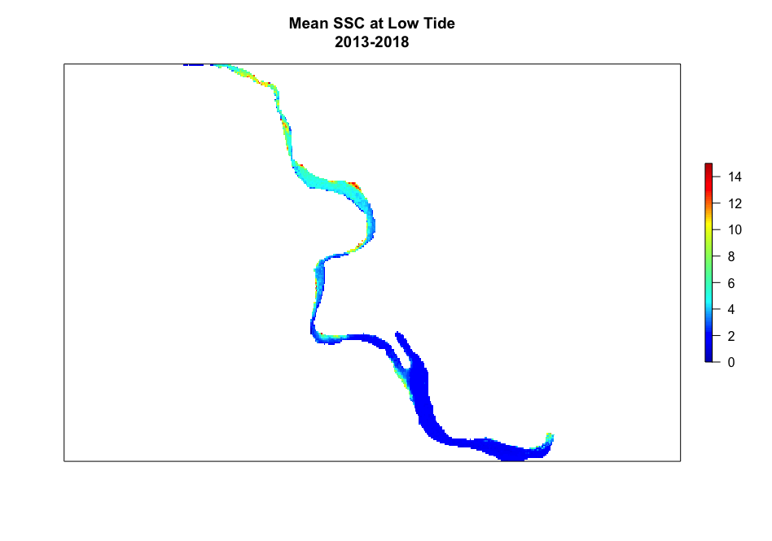
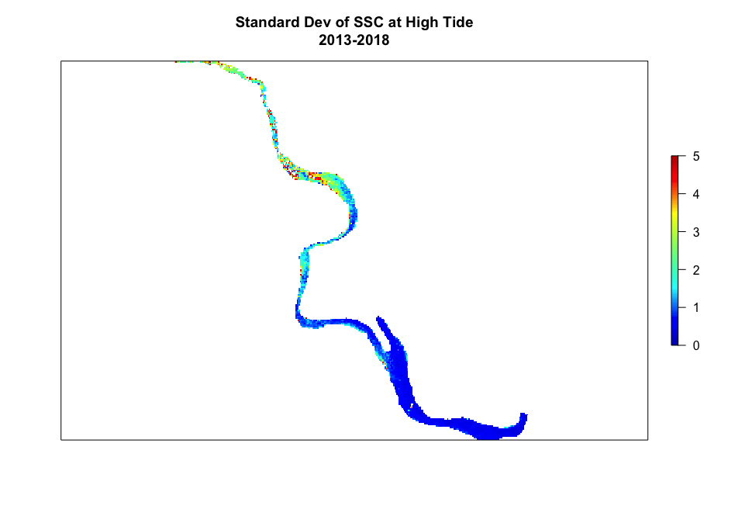
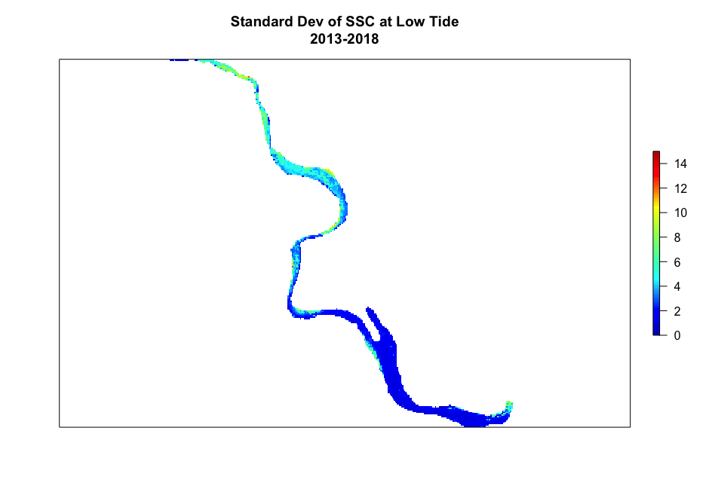
Results
Mean and Standard Deviation of SSC Landsat 8 and Sentinel-2
High Tide
Low Tide
Mean SSC
Mean SSC
Standard Deviation
Standard Deviation
Notes:
These maps show the mean SSC from the 22 low tide and 24 high tide images from 2013 - 2018, along with the standard deviation. You can again see how high tide has much lower SSC than low tide does. Firstly, these show that SSC is consistently higher towards the top of the estuary, where the Parker River feeds into it. This could indicate that the Parker River is a main source of sediment for the estuary, more so than input from the ocean at the mouth of the estuary. Variation in SSC is also higher near the top of the estuary, as shown by the maps of standard deviation. Possible sources of variability are wind speed, water level, and river discharge.
Image: Mean and standard deviation of SSC same set of dates from 2013-2018, generated in R by DEVELOP participants

Slide 16
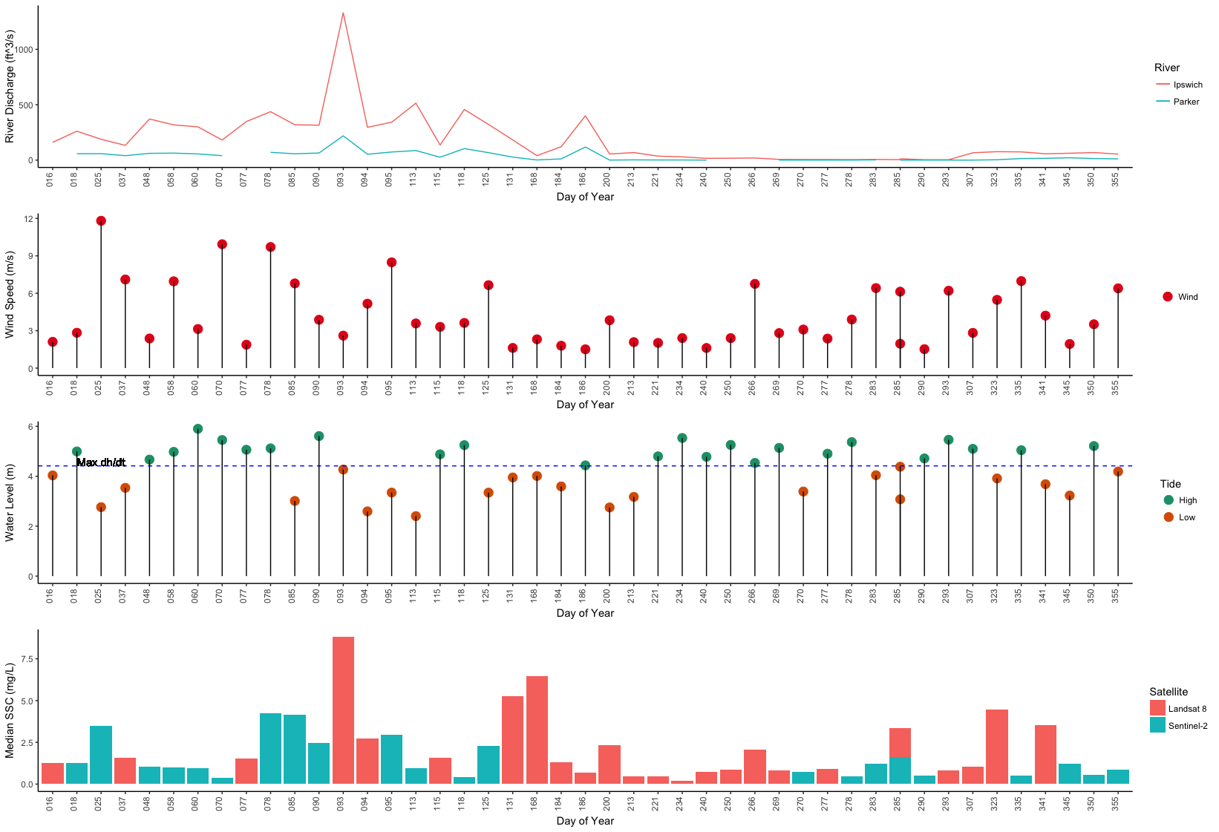
Results
Linear Regression SSC ~ variable
Ipswich p < 0.001 R² = 0.267 Parker p < 0.005 R² = 0.181
Wind Speed p = 0.35 R² = -0.002
Water Level p = 0.04 R² = 0.075 dh/dt p = 0.005 R² = 0.144
River Discharge (ft³/s)
Wind Speed (m/s)
6
4
2
0
Water Level (m)
Median SSC (mg/L)
Notes:
This plot shows the relationships of our hypothesized explanatory variables to SSC. We used the median SSC for each image as the metric to compare explanatory variables to. Median SS, water level, wind speed, and river discharge are shown here for each image we analyzed, in order of Julian day of year without regard for the year the image was taken, in order to evaluate seasonal trends. We found that water level and dh/dt, or the amount the water level changed in fifteen minutes around the time the satellite image was taken, had significant relationships with SSC, as well as discharge from the Ipswich and Parker rivers. However, wind speed did not have much of an effect on SSC.

Slide 17
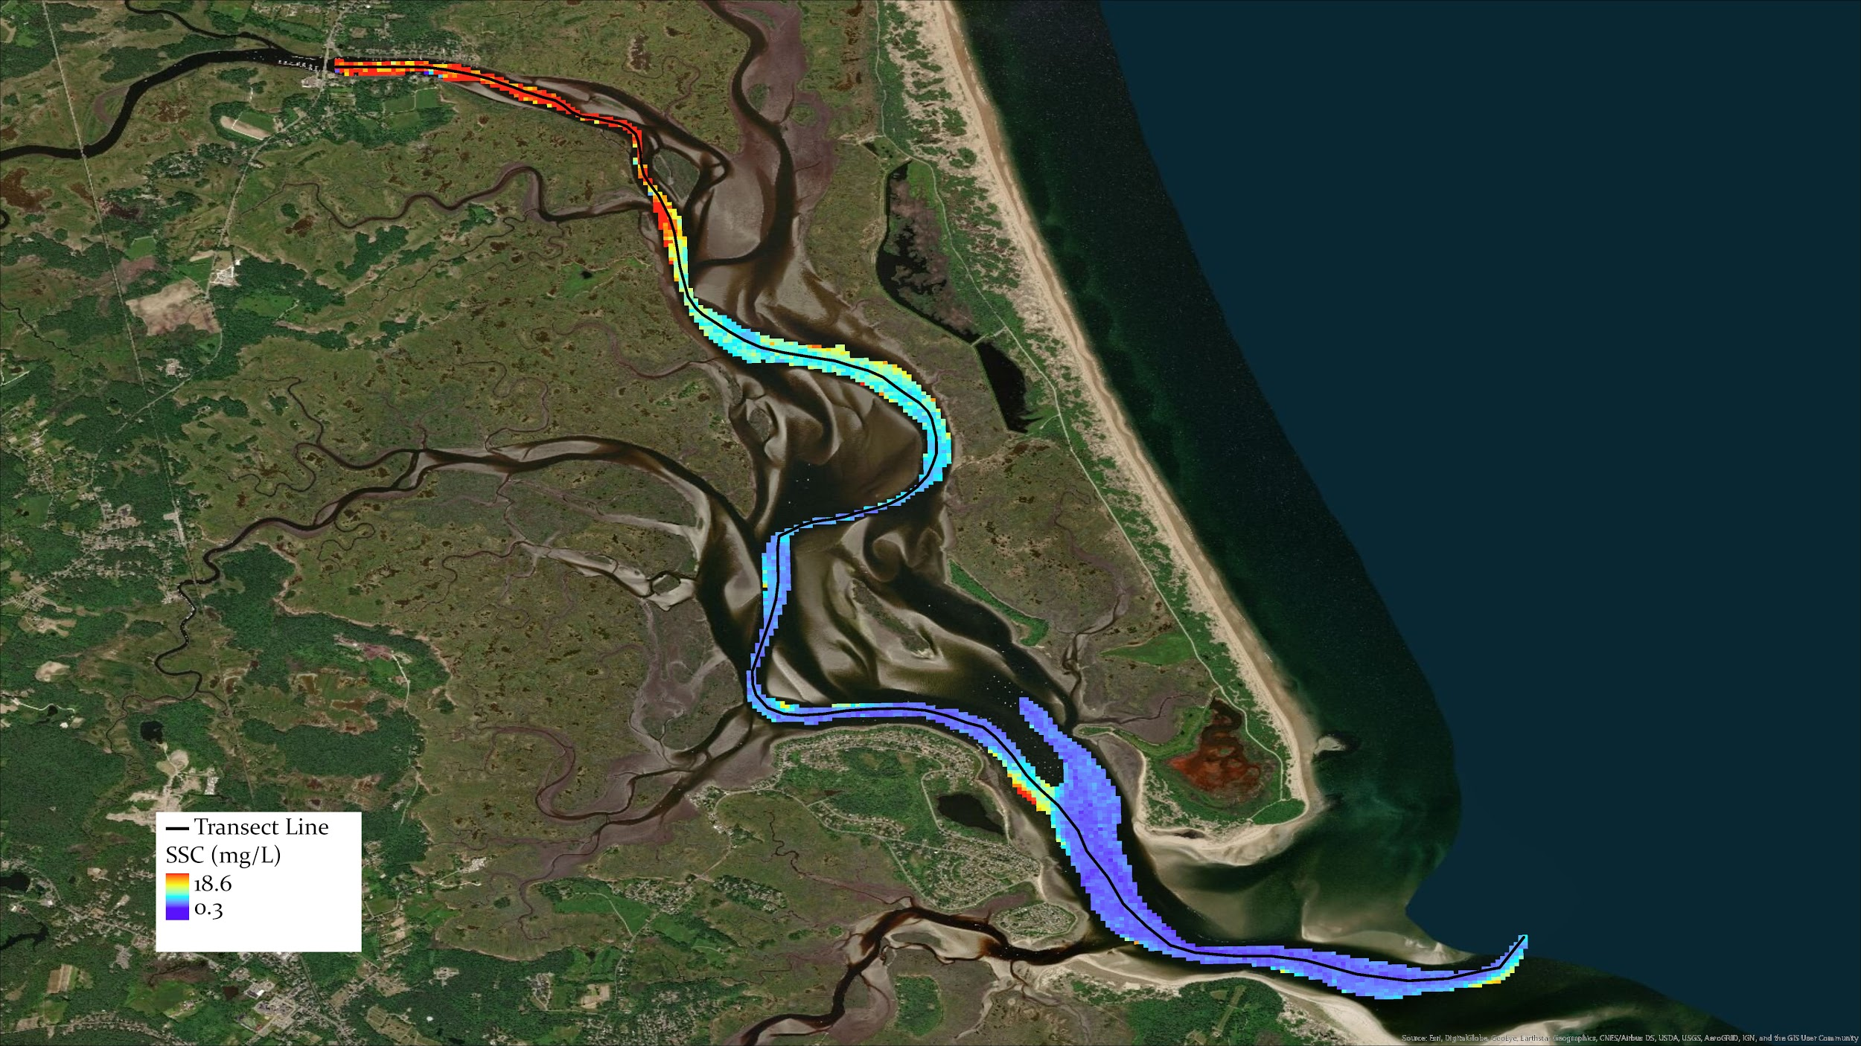
Results
Transect
Notes:
We drew a transect line from the top of estuary to the ocean. The transect cuts through the center of our mask.

Slide 18
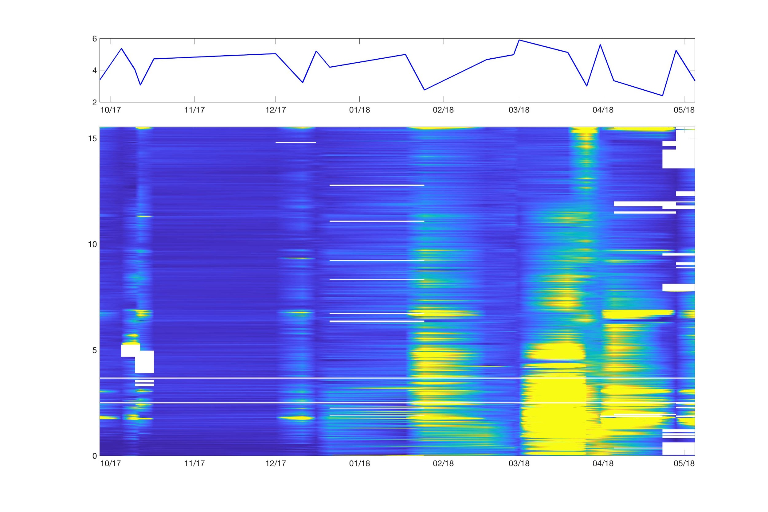
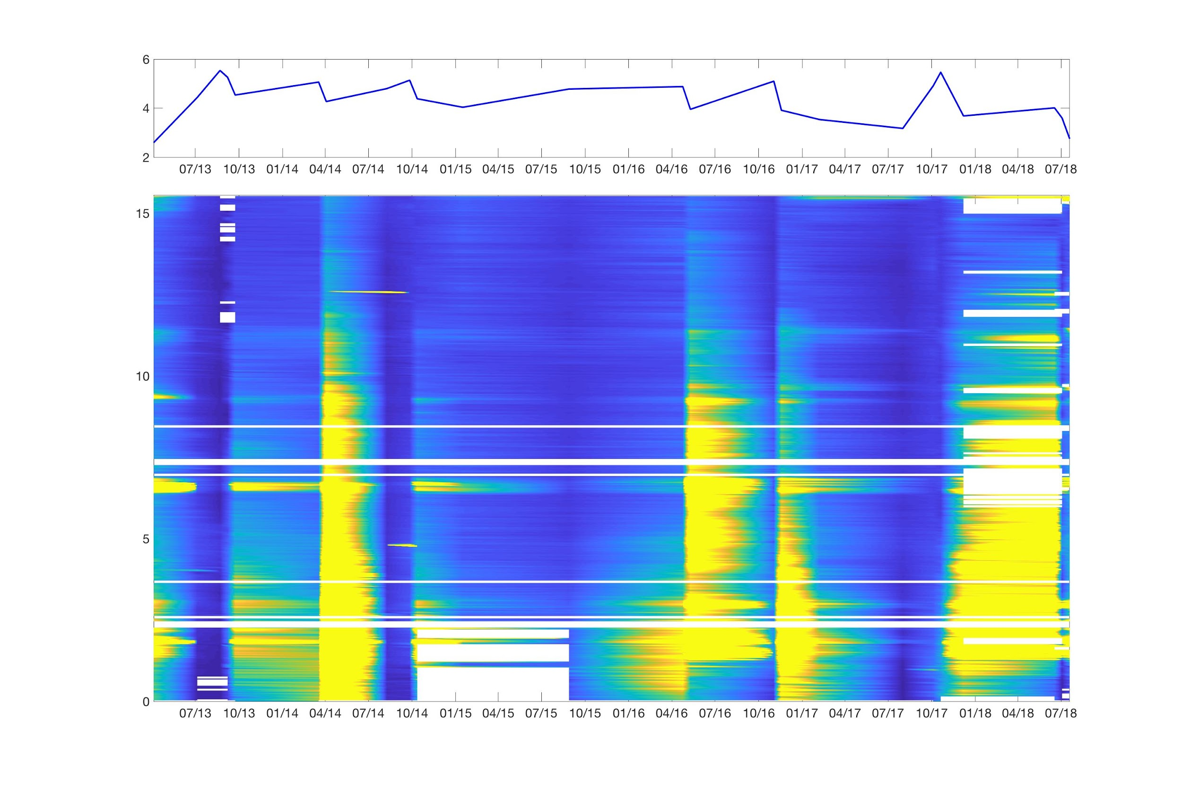
Results
Transect
Water Depth(m)
Water Depth(m)
Sentinel-2 MSI
Landsat 8 OLI
Water Depth (m)
Water Depth (m)
Distance (km)
Distance (km)
SSC (mg/L)
Notes:
We plotted SSC along the transect line for each of the imagery, as well as the water depth, to see how SSC changes along the line spatially and temporally. As you can see, in general the concentration is higher at the top of estuary for some of the dates, and when the water level is low, SSC tends to be higher.

Slide 19
Results
Validation of Turbidity Algorithm
Landsat 8
 | Plum Island Estuary (July 3, 2018) | Merrimack River (July 19, 2018)
Bias | 0.8347 | 2.048
RMSE | 0.9375 mg/L | 2.131 mg/L
Notes:
In addition to the algorithm for SSC, we also developed an algorithm to estimate turbidity from remote sensing data, and validated this with in situ data. The algorithm was based on in situ data from PIE, since we don’t have enough data from the Merrimack for algorithm development. The in situ data used for validation are from two Landsat overpass dates, 7.19 for the Merrimack river and 7.3 for Plum Island Estuary. Both the bias and RMSE are relatively low for PIE, and combined with our other results, we can say our algorithm performs well in this area, but it doesn’t work well for the Merrimack. This indicates that there is a different relationship between turbidity and Rrs in that area, because it has a different type of particles.

Slide 20
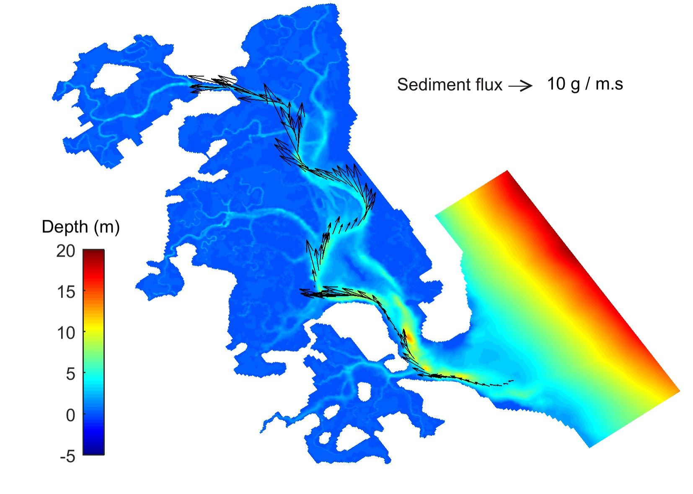
Results
Flux modeling
Notes:
This graph shows the relationship between dh/dt and SSC based at two different tidal stations. Generally, the higher the flow, the higher the SSC.
Image: dh/dt vs SSC, data were generated using Delft3d hydrodynamic model by Xiaohe Zhang

Slide 21
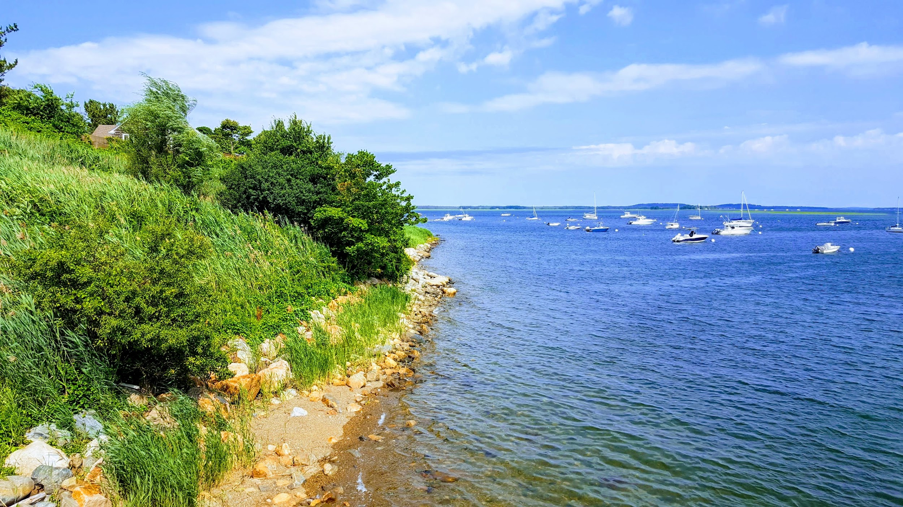
Conclusions
Details/Imagery pending
SSC is higher and more variable towards the top of the estuary
SSC is heavily influenced by tidal level and river discharge. Wind speed may also have an effect close to the mouth of the estuary, but was not significant overall.
A higher number of in situ data points and a more refined mask allowed for more consistent retrieval of SSC
Local algorithm relating turbidity to Rrs outperformed established general turbidity algorithm for this area
Relationship between SSC and Rrs is different in the Merrimack River compared to PIE
Image source: DEVELOP participant
Notes:
Based on comparisons between our SSC results with other environmental factors, we were able to reach several conclusions. SSC is higher and more variable towards the top of the estuary. SSC is heavily influenced by tidal level and discharge rate from source rivers, though not much by wind speed. A higher number of in situ data points and a more refined mask allowed for more consistent retrieval of SSC. Our local algorithm relating turbidity to Rrs outperformed established general turbidity algorithm for this area. The relationship between SSC and Rrs was different between the Merrimack River system and the PIE system. A unique algorithm must be developed for the Merrimack River to investigate the area further. Based on the flux modeling, we were able to determine that there was a positive relationship between dh/dt and SSC.
Image source: DEVELOP participant

Slide 22
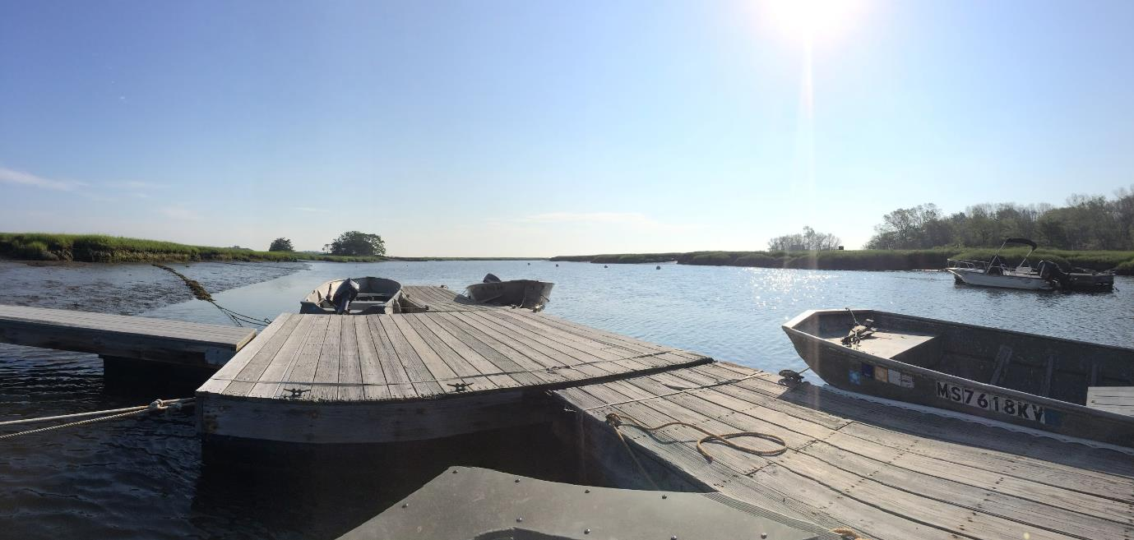
Errors and Uncertainties
Potential sources of error:
Errors in in situ data
Vicarious calibration
Aerosol correction
Algorithm bias/uncertainty
Image source: DEVELOP participant
Notes:
Potential sources for error included errors in the in situ data collected and processed by the team, as well as uncertainty regarding the effectiveness of atmospheric corrections and the preliminary gains offered by Pahlevan et al.
Image: LTER Rowley house dock
Image source: Linnea Smith, DEVELOP participant

Slide 23
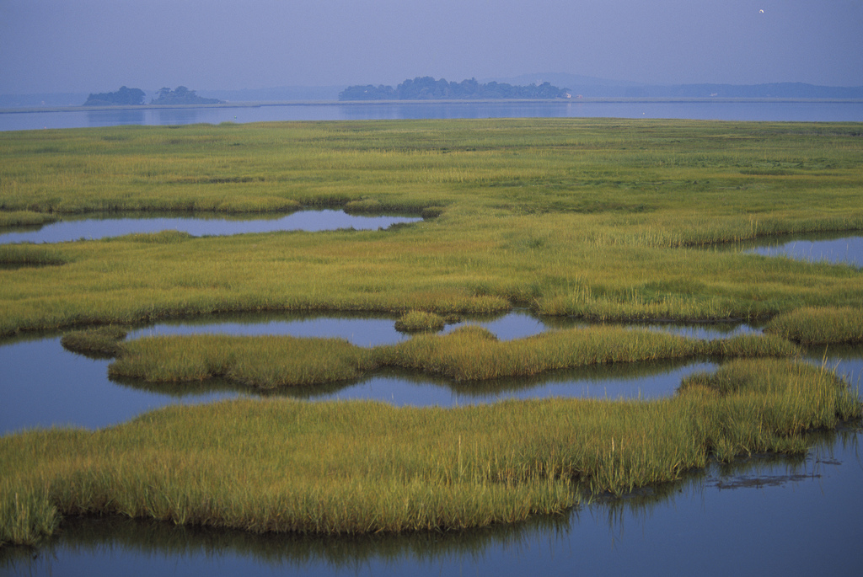
Future Work
Future Ipswich Mills Dam removal
Study seasonal and tidal trends with additional in situ data
Combine data sets from different sensors using data fusion
Model SSC in shallows with radiative transfer model
Image source: Botteville
Image source: Kelly Fike/USFWS
Notes:
A dam in the Ipswich River will be removed in coming years; though this is beyond the DEVELOP term, it would be interesting to return during and after dam removal to study how this affects sediment dynamics in the estuary. The majority of in situ data used to generate the algorithm came from the summer months. It would be interesting to continue gathering data in the fall, winter, and spring to better study seasonal trends in sediment supply. It would also be beneficial to combine the Landsat 8 and Sentinel-2 algorithms using data fusion, to create a single algorithm that could be used on all imagery collected. Finally, It is possible to bypass the problems with bottom reflectance by using a radiative transfer model; however, this will require more extensive collection of in situ data. Once this data is collected, though, it could be used to model sediment concentration throughout the entire estuary.
Image: Parker River National Wildlife Refuge
Image source: Kelly Fike, USFWS Flickr

Slide 24
Acknowledgements
We would like to thank our partners, advisors, and past participants for their contributions to this project:
Dr. Neil Ganju, USGS Woods Hole Coastal and Marine Science Center
Dr. Anne Giblin, PIE LTER
Nancy Pau, USFWS Parker River National Wildlife Refuge
Dr. Cedric Fichot, Boston University
Dr. Sergio Fagherazzi, Boston University
Dr. Michael Dietze, Boston University
Kimberly Johnson, past participant
Zachary Bengtsson, past participant
Bogumila Backiel, past participant
John Macone, Merrimack River Watershed Council
Robert Russell, Merrimack River Watershed Council
Carly Baracco, Undergraduate Researcher
Xiaohe Zhang, Graduate Researcher
Notes:
This project could not have been completed without the generous efforts of our partners, science advisors, and past participants.

Slide 25
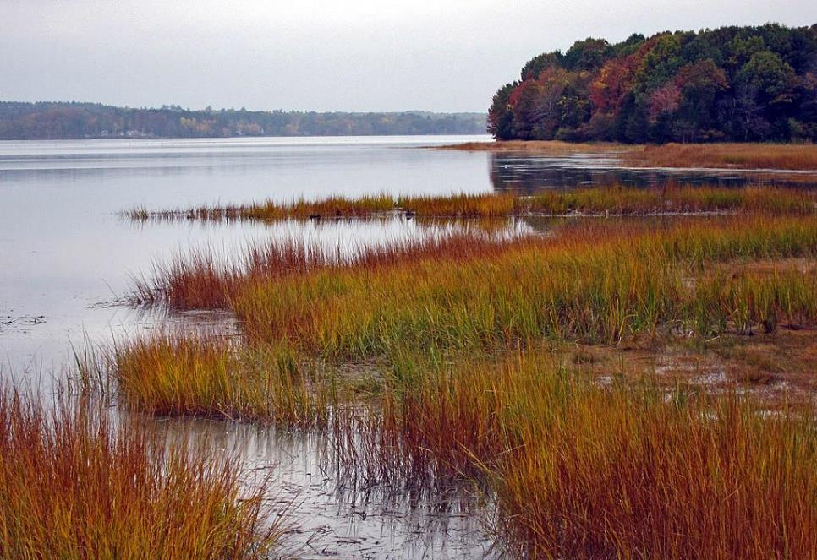
Questions?
Image source: USFWS
Notes:
We would now like to open up the floor to questions or comments.
Image: Great Bay National Wildlife Refuge, New Hampshire
Image source: USFWS

