Slide 1
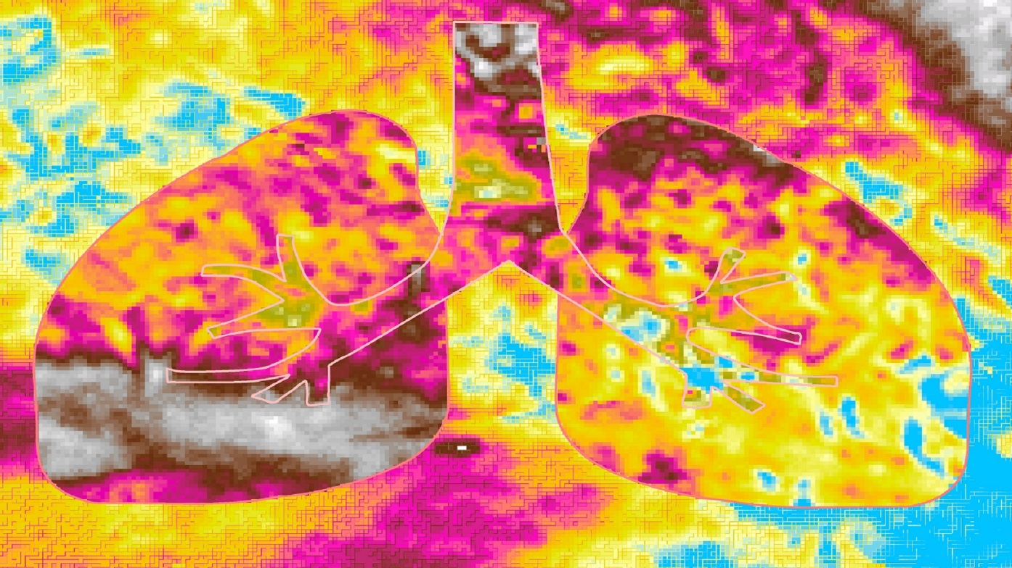
CALIFORNIA HEALTH AND AIR QUALITY
Measuring California Air Quality through the Use of NASA Earth Observations to Identify Spatial, Temporal, and Social Disparities in Particulate Matter Pollution
Amanda Wasserman
Ariana Nickmeyer
Megs Seeley
Notes:
Hi everyone. Thank you so much for joining us today. My name is Amanda Wasserman, and I graduated from California State University, Monterey Bay, with a Masters degree in Applied Marine Science.
Hi, my name is Ariana Nickmeyer, and I graduated from University of California, Los Angeles, with a Bachelor’s in Geography and Environmental Studies.
Hi, my name is Megs Seeley, and I graduated from the University of Wisconsin, Madison, with a dual major in Forestry and Botany.
We are the ladies of the California Health and Air Quality Team, and our project examines spatial, temporal, and social differences in particulate matter pollution in California.

Slide 2
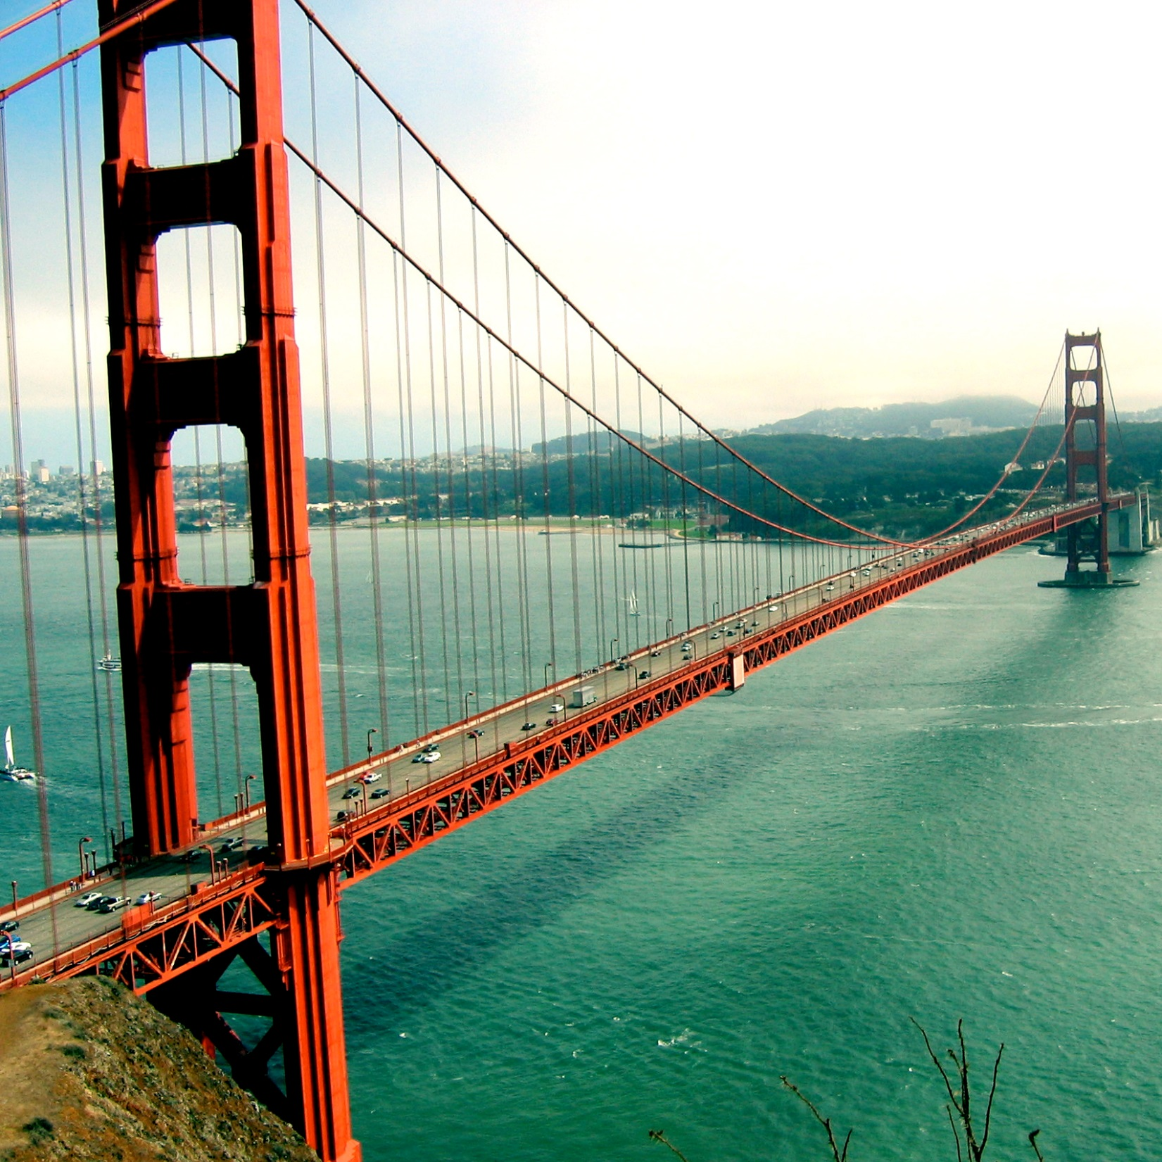
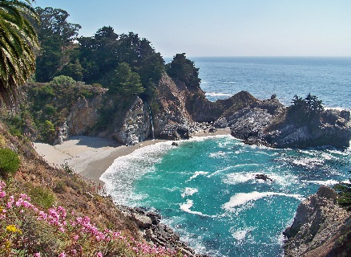
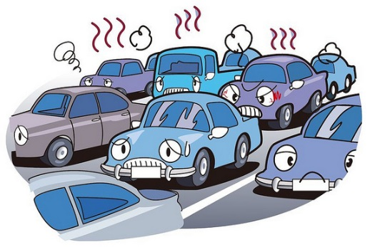
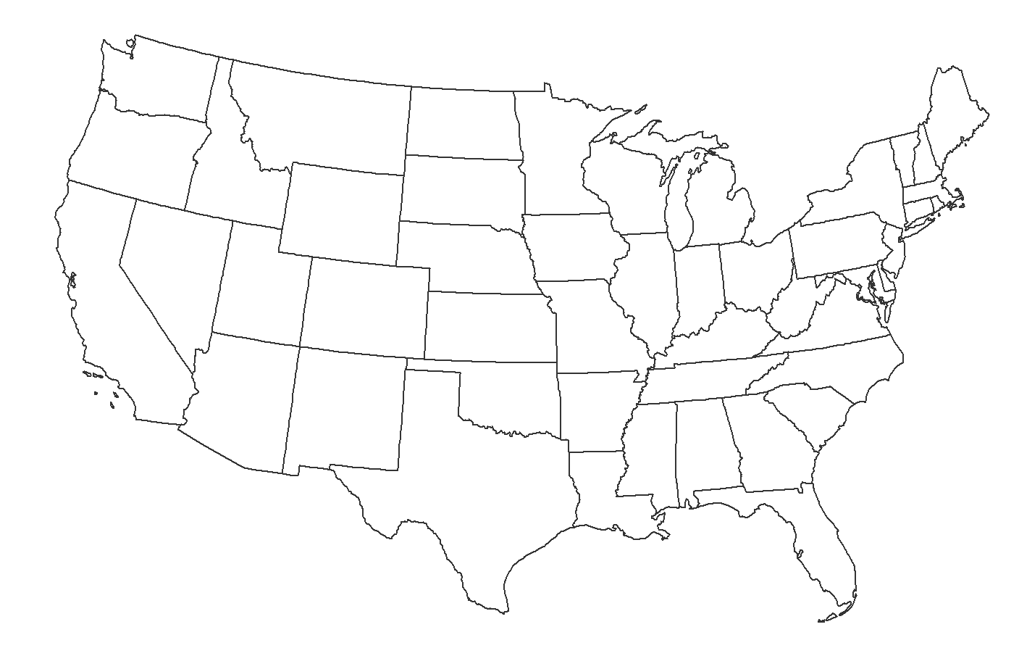
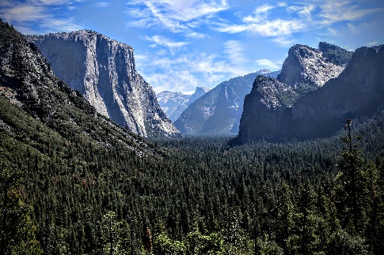
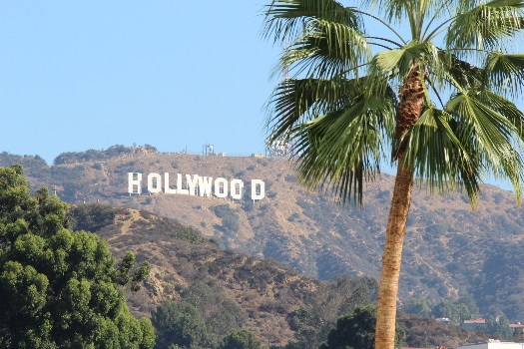
California
Image Credit: Don Graham
Image Credit: accidentalocelot (flickr)
Image Credit: Shinya Suzuki
Image Credit: Tony Iannuzzi
Notes:
Our study area, the state of California, is well known for its spectacular scenery, bustling show business industry, and of course its phenomenal weather.
But did you know that California is also home to some of the poorest air quality in the country? This is a result of sources such as industry and agriculture, population growth, and of course all of that traffic congestion.
~~~~~~~~~~~~~~~
Image Source (Golden Gate): https://flic.kr/p/5kCTfu
Image Credit (Golden Gate): Tony Iannuzzi, “Golden Gate Bridge”
License: https://creativecommons.org/licenses/by-nc-sa/2.0/legalcode
No changes were made to this image.
Image Source (McWay Falls): https://flic.kr/p/iMA8hY
Image Credit (McWay Falls): Don Graham, “McWay Falls, Big Sur, CA”
License: https://creativecommons.org/licenses/by-sa/2.0/legalcode
No changes were made to this image.
Image Source (Yosemite): https://flic.kr/p/wzTWCv
Image Credit (Yosemite): accidentalocelot (flickr), “Yosemite”
License: https://creativecommons.org/licenses/by-nc-nd/2.0/legalcode
No changes were made to this image.
Image Source (Hollywood): https://flic.kr/p/phWZhA
Image Credit (Hollywood): Shinya Suzuki, “Hollywood”
License: https://creativecommons.org/licenses/by-nd/2.0/
No changes were made to this image.

Slide 3
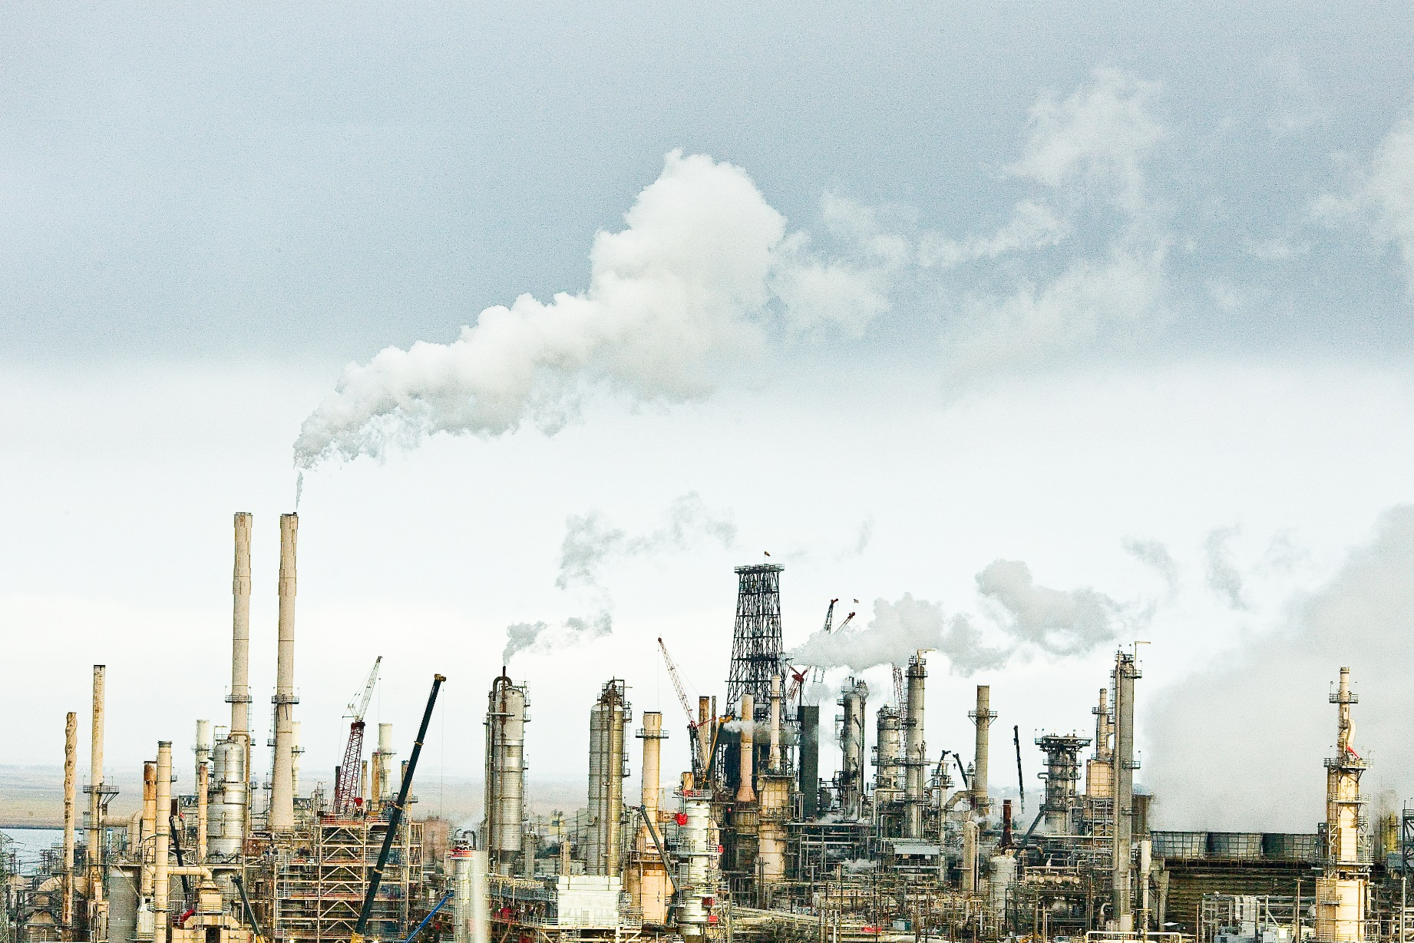
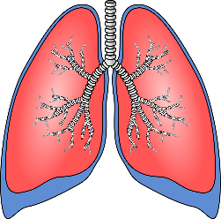
Concern
Particulate Matter
Dust
Sea spray
Ash
Combustion of fuels
2.5 μm
PM_{2.5}
Heart disease
Autism
Asthma
Mortality
Image Credit: Thomas Hawk
Notes:
Air quality affects our health, the climate, and many other living organisms. Solid and liquid particles, or particulate matter, become suspended in the atmosphere through natural sources like dust, sea spray, and volcanic ash, as well as anthropogenic sources, primarily the combustion of fuels.
Particulate matter is classified based on size – when less than 2.5 micrometers PM can enter the lungs AND the circulatory system, consequently endangered human health. Known as PM2.5, this pollutant is associated with a heightened risk of health disorders like cardiovascular disease, autism, and asthma, as well as early mortality.
~~~~~~~~~~~~~~~
Image Source: https://flic.kr/p/7Avvmx
Image Credit: Thomas Hawk, “Remaining”
License: https://creativecommons.org/licenses/by-nc/2.0/legalcode
No changes were made to this image.

Slide 4
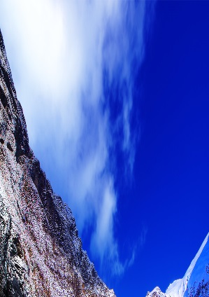
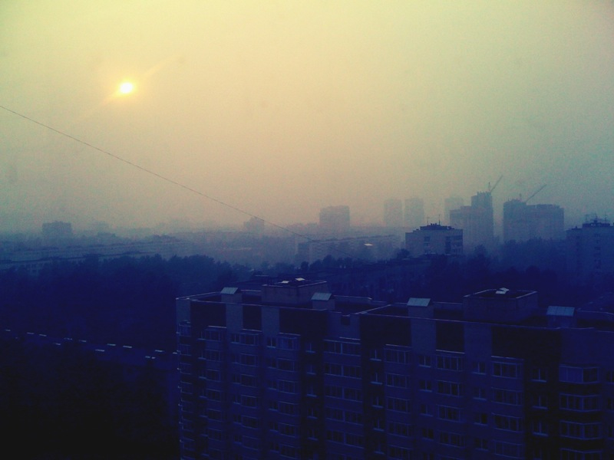
Environmental Justice
“…the fair treatment and meaningful involvement of all people regardless of race, color, national origin, or income, with respect to the development, implementation, and enforcement of environmental laws, regulations, and policies.”
-US Environmental Protection Agency
Image Credit (left): Paul Bica
Image Credit (right): praegerr (flickr)
Notes:
Unfortunately, communities of low socioeconomic status tend to be disproportionately burdened by air pollution and its associated health risks, making air pollution an issue of environmental justice. According to the US Environmental Protection Agency, environmental justice is “the fair treatment…of all people regardless of race, color, national origin, or income, with respect to the development…and enforcement of environmental laws and regulations.”
Environmental justice issues are pervasive across the United States, but are of particular concern with regards to air quality in California, as the state is ranked both high in racial diversity and low in air quality relative to the rest of the country.
~~~~~~~~~~~~~~~
Image Source (left): https://flic.kr/p/dxXMBi
Image Credit (left): Paul Bica, “Homer Tunnel”
License: https://creativecommons.org/licenses/by/2.0/legalcode
This image was cropped.
Image Source (right): https://flic.kr/p/8qypYb
Image Credit (right): praegerr (flickr user), “Smog”
License: https://creativecommons.org/licenses/by/2.0/legalcode
This image was cropped.

Slide 5
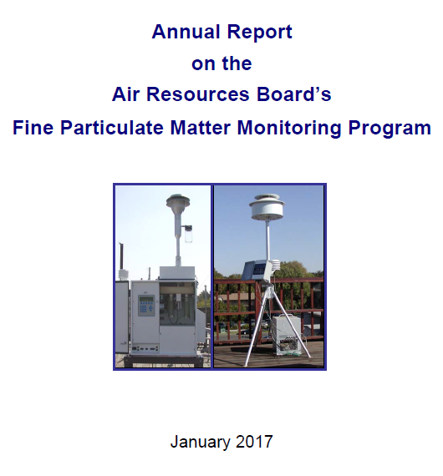
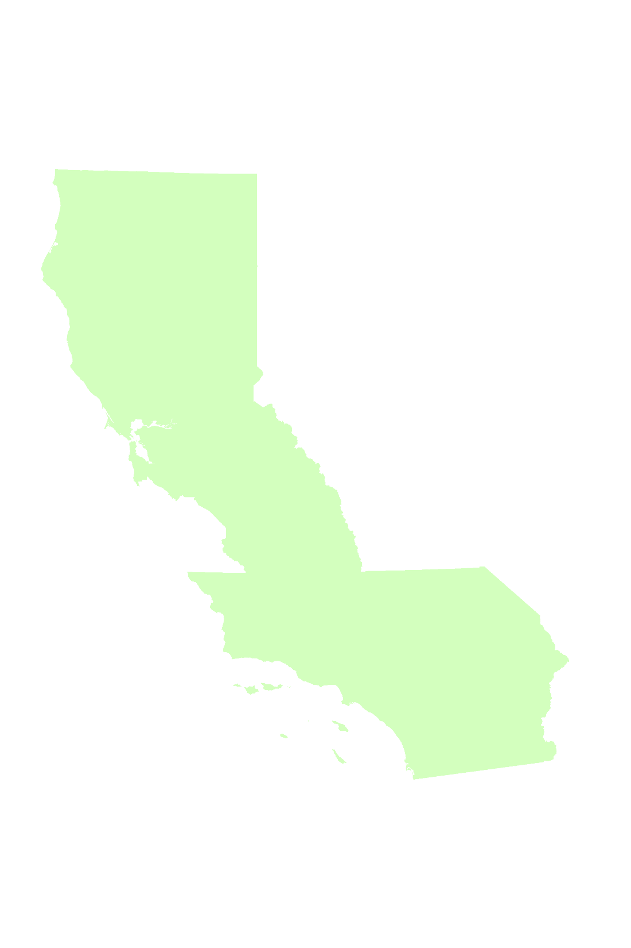
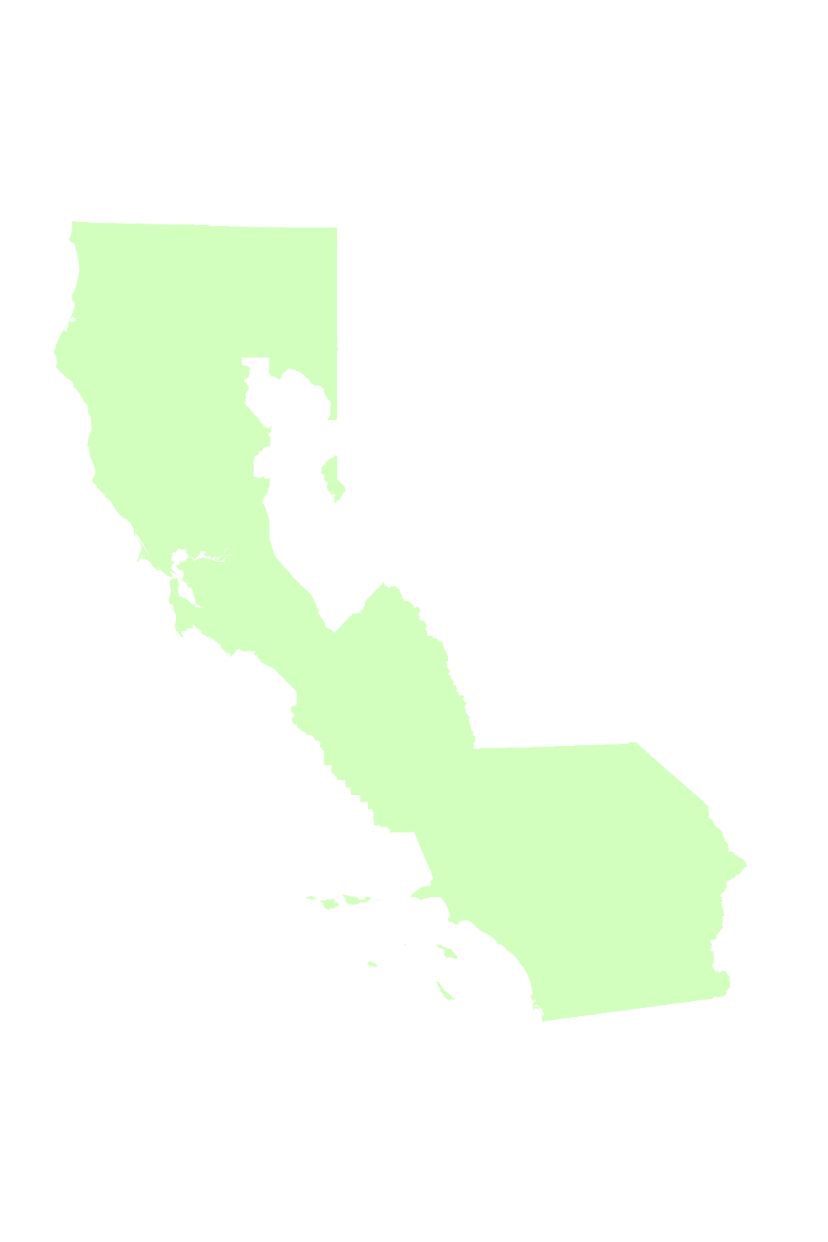
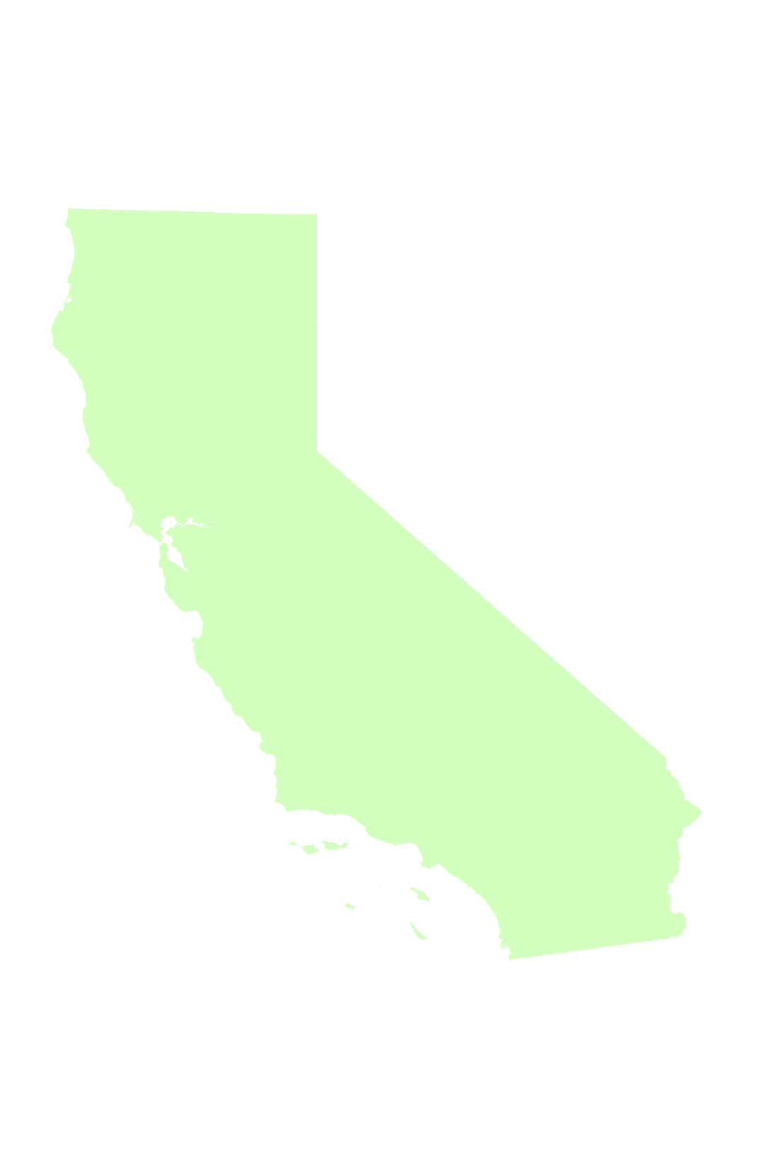
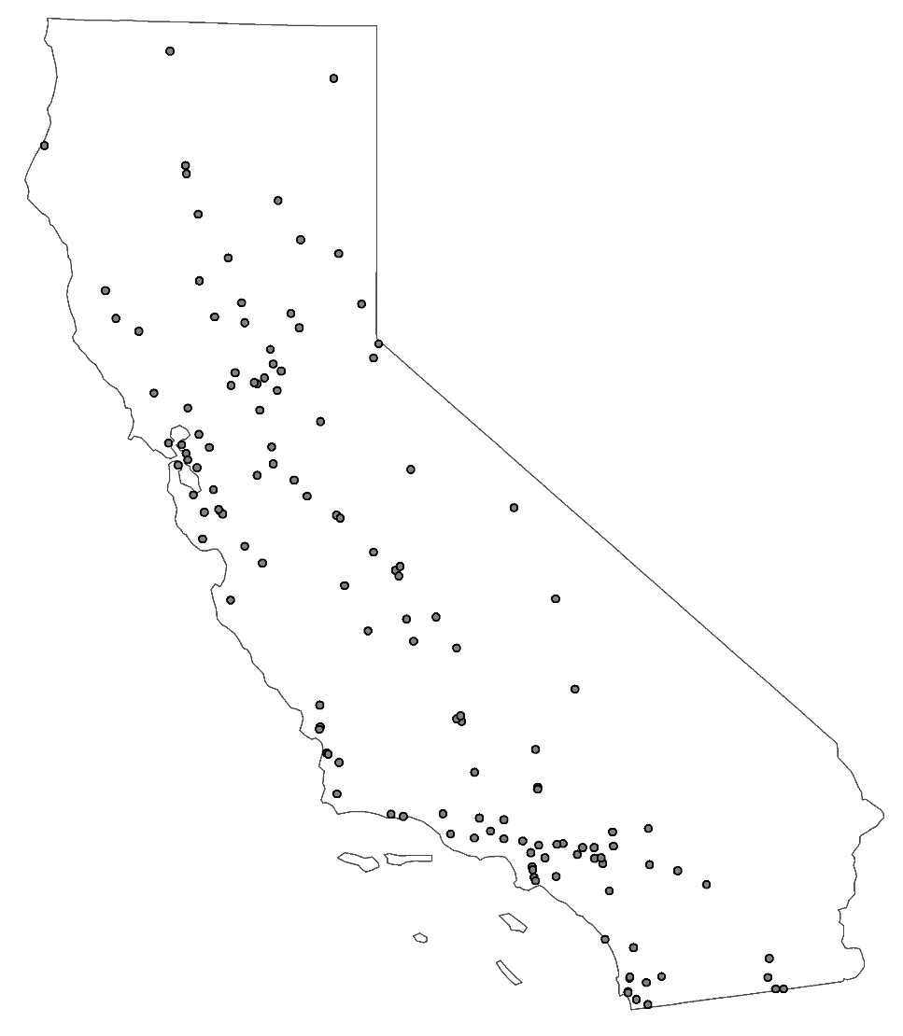
PM Monitoring
California Air Resources Board (CARB)
CARB monitor sites (1999-2016)
Remote sensing data
https://www.arb.ca.gov/research/apr/reports/pm25-monitoring-2017.pdf
Notes:
The main organization in California monitoring air quality, including particulate matter, and how it relates to environmental justice is the California Air Resources Board, or CARB.
CARB is a California state agency, which conducts monitoring and research and enforces regulations related to air quality in the state. It is important for CARB to conduct air quality monitoring to ensure that standards are being met and that all of its residents have clean air to breathe.
Currently, CARB monitors PM2.5 with a number of different types of ground monitors. As you can see, the placement of these monitors already leave us with substantial gaps in data throughout the state. Further, every monitor is not always collecting data, due to maintenance and technical issues, which leads to even greater uncertainty and unreliability in the monitoring of particulate matter.
Conversely, by incorporating remote sensing into air quality monitoring, the idea is that we can begin to fill in those gaps and create a more complete picture.
~~~~~~~~~~~~
Report screengrab: https://www.arb.ca.gov/research/apr/reports/pm25-monitoring-2017.pdf

Slide 6
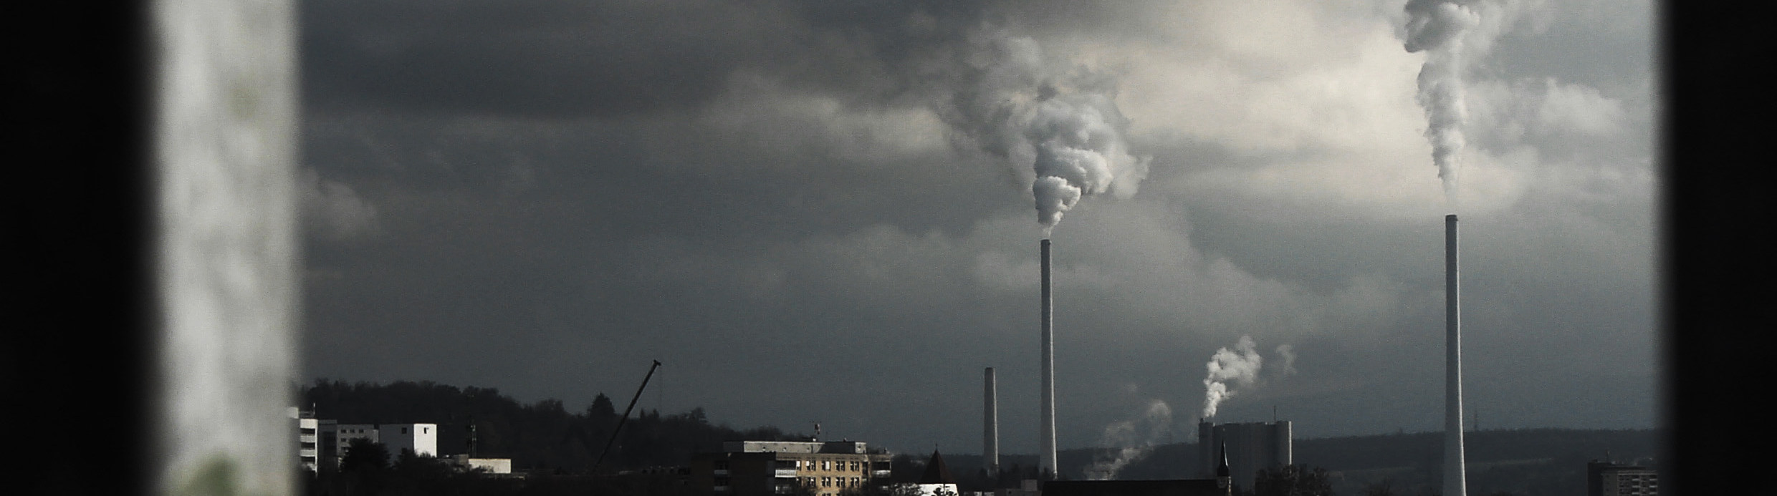
Objectives
Image Credit: Isengardt (flickr)
Determine the feasibility of using a satellite-derived dataset to represent PM_{2.5} in California
Examine statewide spatial and temporal trends in PM_{2.5} concentration
Evaluate the correlation between satellite-derived PM_{2.5} and socioeconomic factors
Notes:
With all of this in mind, our objectives were to, first, determine the feasibility of using a satellite-derived dataset to represent PM2.5 in California; second, examine statewide spatial and temporal trends in PM2.5 concentration; and third, evaluate the correlation between satellite-derived PM2.5 and socioeconomic factors.
Image Source: https://flic.kr/p/7XAjDH
Image Credit: Isengardt (flickr), “Smog”
License: https://creativecommons.org/licenses/by/2.0/legalcode
Image was cropped.

Slide 7
Methodology
Notes:
And this is how we attempted to accomplish these goals…

Slide 8
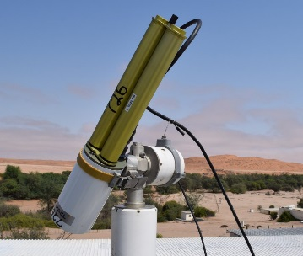
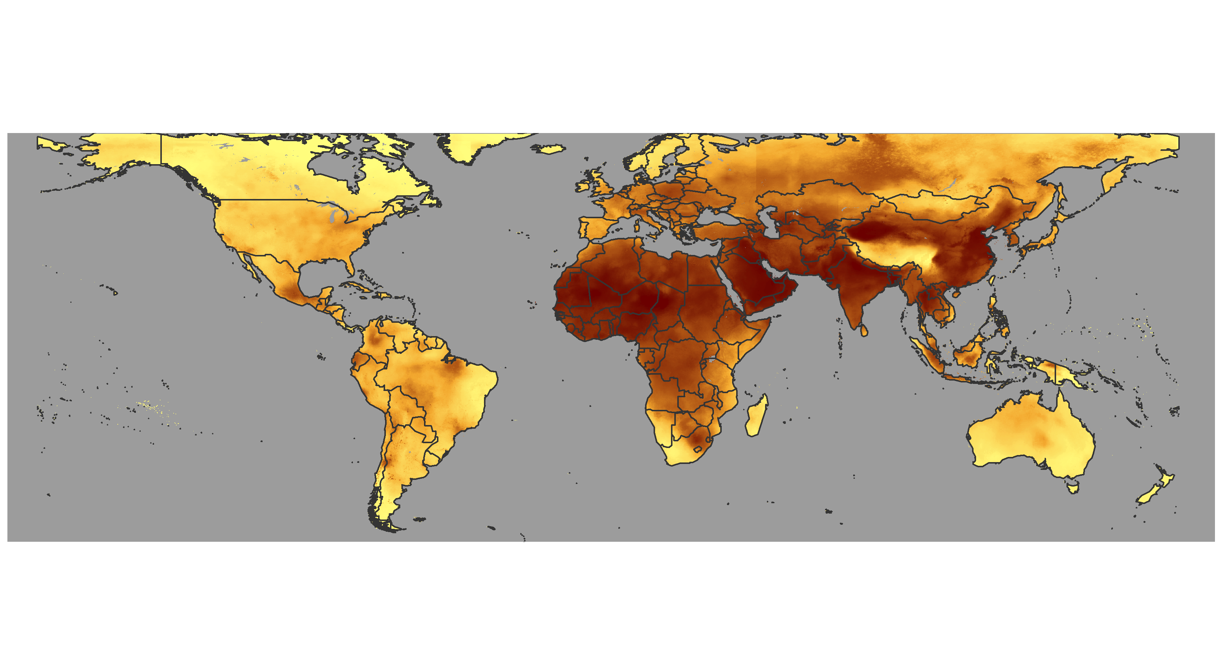
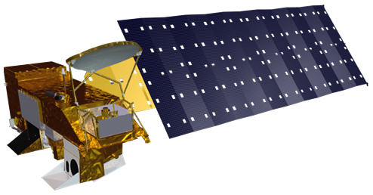
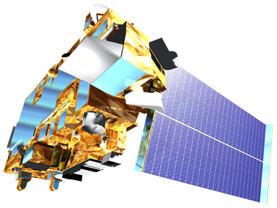
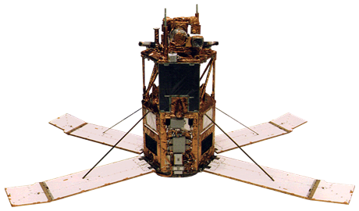
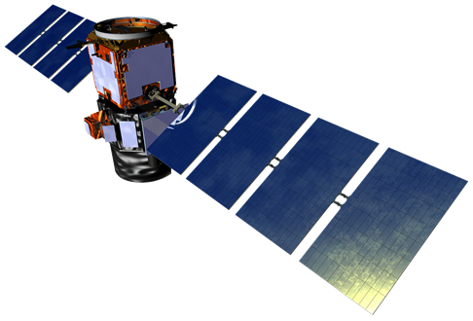
Data
AERONET
Surface PM_{2.5}, Dalhousie University Atmospheric Composition Analysis Group (ACAG)
GEOS-Chem Chemical Transport Model
Aqua MODIS
PM_{2.5}
Terra MODIS/MISR
SeaStar SeaWiFS
CALIPSO CALIOP
Notes:
We used a dataset of global PM2.5 concentrations, created by the Atmospheric Composition Analysis Group, or ACAG, in all of our analyses.
Researchers from this group estimated global PM2.5 concentration by using a combination of data from passive satellite instruments, including the MODIS instruments onboard the NASA Terra and Aqua satellites, the MISR instrument also onboard the Terra satellite, and the SeaWIFS sensor onboard the NASA SeaStar satellite—along with multiple retrieval algorithms including both dark target and deep blue algorithms; the “active” CALIOP instrument onboard the CALIPSO; model simulation; and data from surface monitors, including the Aerosol Robotic Network (AERONET).
We used their data in multiple analyses to look at air quality and environmental justice in California.
PM2.5 Dataset: Atmospheric Composition Analysis Group, http://fizz.phys.dal.ca/~atmos/martin/?page_id=140
World Borders Shapefile: Bjorn Sandvik, http://thematicmapping.org/downloads/world_borders.php
CC License: https://creativecommons.org/licenses/by-sa/3.0/legalcode

Slide 9
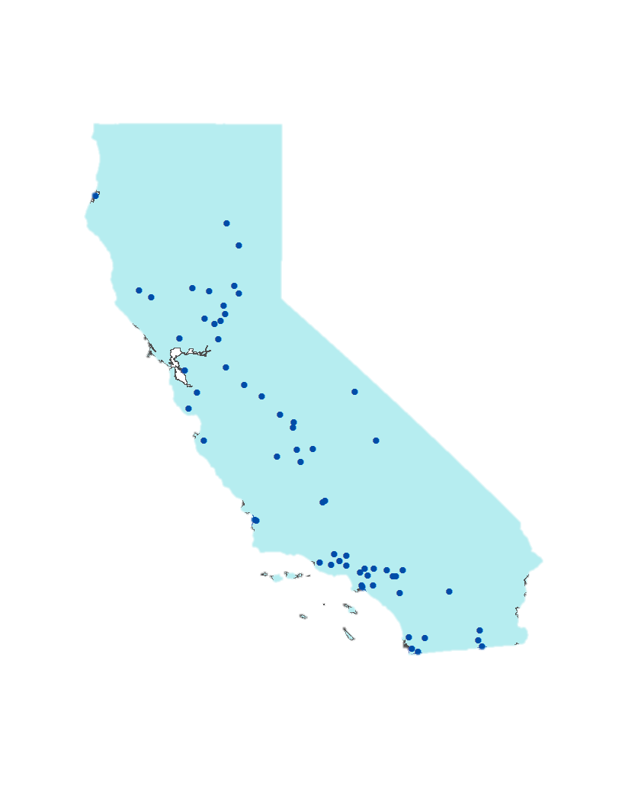
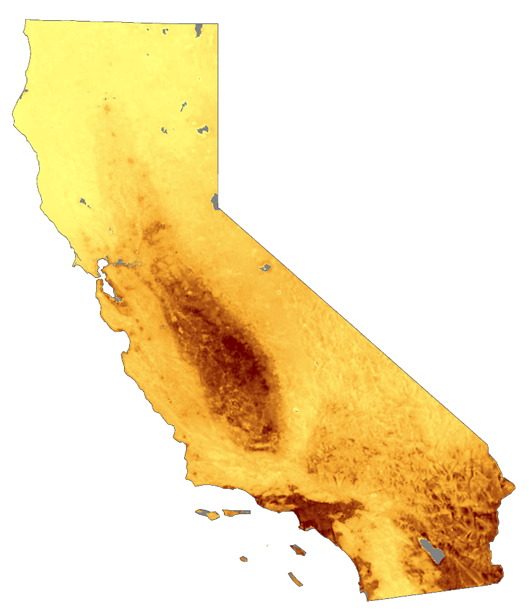
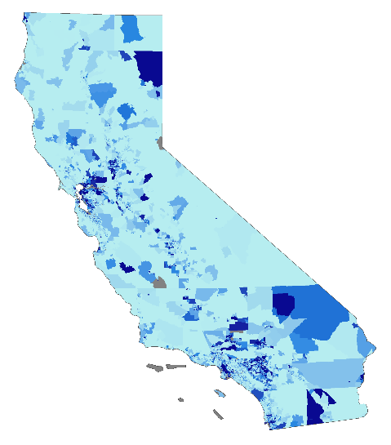
Analyses
CARB Ground Monitor PM2.5 Data
Determine Feasibility
Linear Regression
PM_{2.5}
1km
1999–2016
Examine Spatial and Temporal Trends
Mann-Kendall Test
Change Detection
1998–2014
Socioeconomic Data (IPUMS)
Evaluate Correlation
Linear Regression
2000 & 2010
Notes:
Our analyses were geared toward our three objectives. To assess how well this ACAG dataset represents PM2.5 in California, we performed a ground-truthing assessment using annual mean PM2.5 data from CARB ground monitors, pulled from CARB’s iADAM statistics. We extracted ACAG PM2.5 values within 1-km buffers around each geolocated monitor for every year, and the regressed these data against the ground monitor values.
Our second objective was again to characterize spatial and temporal PM2.5 trends. For this presentation, we will discuss the results of our Mann-Kendall Test -- which assesses monotonic trends across the study period -- and visualizations of interannual PM2.5 trends.
Lastly, we wanted to look at the correlation between PM2.5 in California and socioeconomic variables representing race, ethnicity, income, education, and housing value. These data were acquired from IPUMS (/eye-puhms/) and projected onto the same 1-km grid as the ACAG data. We regressed each socioeconomic variable against the PM2.5 data to determine the significance and slope of the relationship. The data was divided into quartiles and displayed as boxplots for visualization.
---Notes---
IPUMS stands for Integrated Public Use Microdata Series

Slide 10
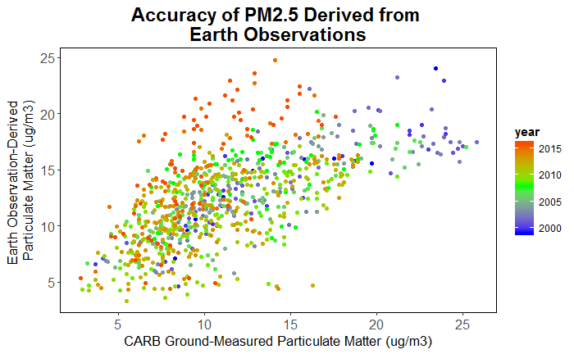
Results – Determine Feasibility
PM_{2.5} as Measured by CARB Monitors vs. PM_{2.5} Derived from ACAG Data Product
25
20
Year
2016
1999
ACAG Data Product Particulate Matter (µg/m³)
15
R² 0.40
10
5
5
10
15
20
25
CARB Ground-Measured Particulate Matter (µg/m³)
Notes:
The ground-truth assessment revealed that the R-squared of ACAG-derived PM2.5 versus CARB ground monitor PM2.5 for all CARB sites across all years was 0.4. This plot separates data points by year, and if we look at where the scatter is the greatest, or where the residuals seem to be the highest, we can see that these points represent more recent years—the orange/red end of the spectrum. When we looked into how the correlation between the ACAG product and CARB data varied across time, we see that the R-squared decreased over the years. Upon discovering this we wanted to know if the increase in scatter over the years affected the slope of the regression.

Slide 11
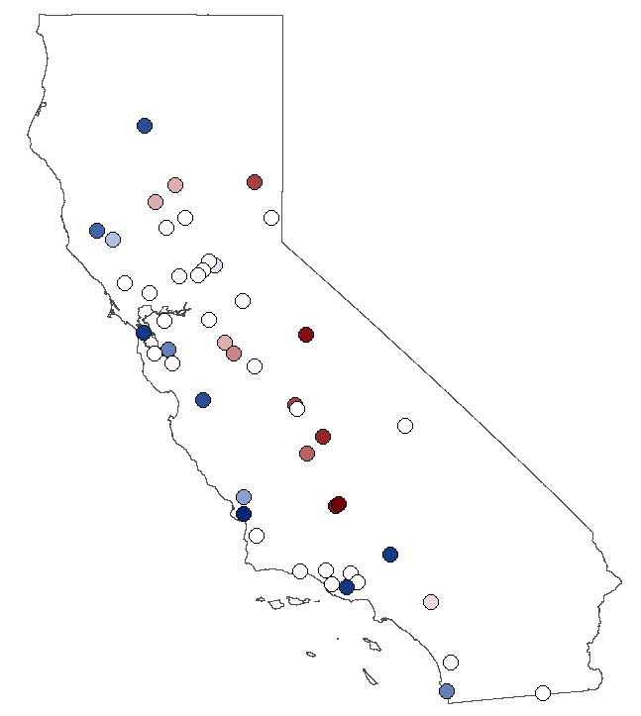
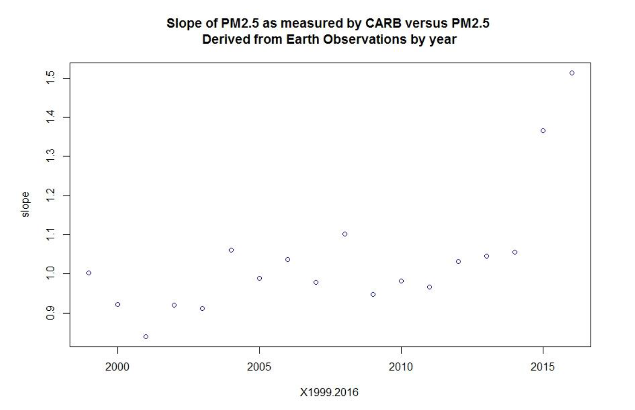
Spatial Distribution of PM_{2.5} Over and Under Predictions
Results – Determine Feasibility
Slope of PM_{2.5} as Measured by CARB Monitors vs.
PM_{2.5} Derived from Earth Observations
PM_{2.5} (Satellite – CARB)
8.2
-8.2
1.5
1.4
2007
1.3
Slope
1.2
1.1
1.0
PM_{2.5} (Satellite – CARB)
11.80
-5.7
0.9
2000
2005
2010
2015
2016
Year
Notes:
This graph shows the slope of the regression between the ACAG data product and the CARB Monitor data, controlling for the intercept. From 1999 to 2014, the slope hovers around 1, which is the expected result. In 2015 and 2016, we can see a deviation from a slope of 1 to a slope of around 1.5.
Here we mapped the over and underprediction of PM2.5 by satellites for 2007, a relatively normal year with an R-squared of X and slope of X, and 2016, one of the anomalous years, to see if there was a spatial trend. In these maps blue is an over prediction and red is underprediction, and we can see that the ACAG data tends to overpredict Southern California and underpredict Northern California. The scale bars also reveal that the overprediction is greater in 2016. Further analyses may shed light onto these anomalies, but until we have more insight, we determined that these years should be excluded from our other analyses.

Slide 12
Notes:
This animation shows mean annual PM2.5 values changing across the state from 1998 to 2016, with air basins delineated in both the map and the line graph to show how different regions vary in their trends. There are 15 air basins within California but the three we focused on in this study were chosen based on our partners’ interest. They are the San Francisco, San Joaquin Valley, and South Coast air basins. Air basin boundaries are determined through many factors, including similar geographical and meteorological features as well as political boundaries. The San Joaquin Valley and South Coast air basins (blue and green respectively) are consistently higher than the San Francisco air basin (which is purple). When we excluded 2015 and 2016 for the reasons mentioned earlier, we found statistical significance for decreasing PM2.5 trends in our three air basins, but not for California as a whole.

Slide 13
Results – Spatial and Temporal Trends
1,600,000
1000
1,400,000
800
1,200,000
1,000,000
600
800,000
Acres Burned By Fire
400
600,000
400,000
200
200,000
0
0
PM_{2.5} anomaly
Fire acres
Mean cumul.
precip/1km pixel
Notes:
This graph shows the mean PM2.5 anomaly for the state of California, deviation from the average across all years. What’s interesting about this graph is that we wanted to look at the year to year variation in PM2.5, and when we plotted the mean cumulative precipitation per pixel and the total acreage burned by fire in each year, we did see that they tended to track. Smoke from fire is a form of particulate matter, so we expect PM levels to respond to the acres burned. At the same time, precipitation influences fires /and/ years with lower precipitation tend to increase how much dust is suspended in the air (another form of particulate matter). So for precipitation, we expect to see an opposite trend, and that can indeed be seen on this graph.

Slide 14
Results – Evaluate Correlation
% Population White
% Population Latino/Hispanic
% Population Black
2000
2010
2000
2010
2000
2010
25
CA
CA
CA
20
15
10
5
0
25
SJV
SJV
SJV
20
15
10
PM_{2.5} (μg/m³)
5
Q1&Q2
Q3
Q4
Q1&Q2
Q3
Q4
SF
SF
SF
15
10
5
25
SC
SC
SC
20
15
10
5
Q1
Q2
Q3
Q4
Q1
Q2
Q3
Q4
Q1
Q2
Q3
Q4
Q1
Q2
Q3
Q4
Q1
Q2
Q3
Q4
Q1
Q2
Q3
Q4
Notes:
Our final set of analyses examined the correlation between PM2.5 and the socioeconomic variables. We considered variables representing Education, Housing Value, Income, Race, and Ethnicity. This slide displays the results from the race and ethnicity evaluations. When we performed a linear regression between PM2.5 and each variable, we found that each variable was significantly correlated to PM2.5 except percent of the population that is Latino or Hispanic in the San Francisco Air Basin in 2010, outlined in purple.
These graphs group the socioeconomic variable into quartiles for the census years 2000 and 2010. Each quartile is represented by a boxplot, and the y-axis is PM2.5 in ug/m3. Lighter shades represent data from 2000, and darker shades represent 2010. Each row represents a different geographic region; from top to bottom, we can see the trends across the entire state of California, the San Francisco air basin, the San Joaquin Valley air basin, and the South Coast air basin. Across all spatial extents, there are similar trends depicting differences in PM2.5 based on the racial and ethnic makeup of communities. As the percentage of population that is white increases, PM2.5 in that area decreases. Generally, as the percentage of the population that is Latino or Hispanic and percentage of population that is black increases, PM2.5 in that region also increases.
We do notice, however, a smaller slope for this relationship across the board in 2010, and in San Francisco as previously mentioned, this group (indicate purple box) correlation is not statistically significant. Therefore, there tends to be a change in the strength of the relationship between race and ethnicity and PM2.5, though in most cases, PM2.5 was disproportionately distributed across communities based on race.

Slide 15
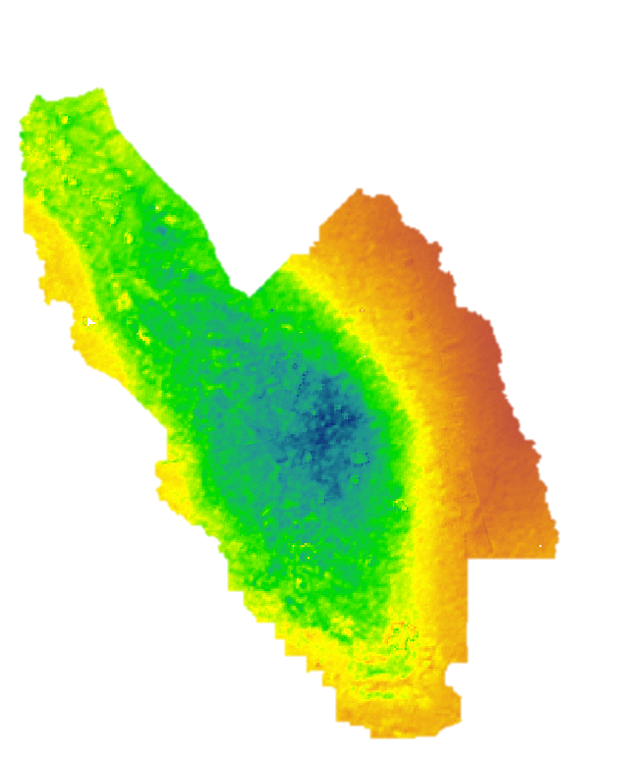
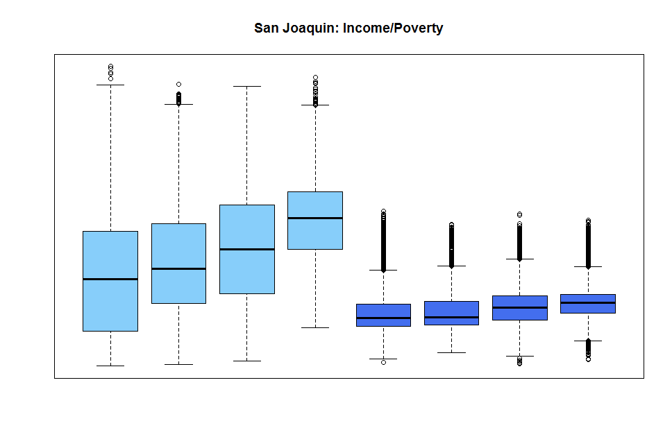
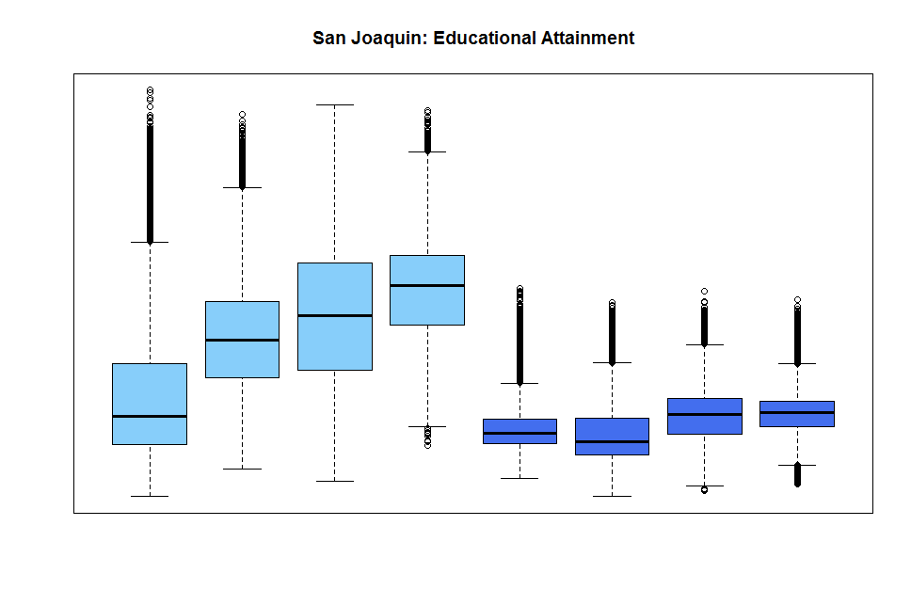
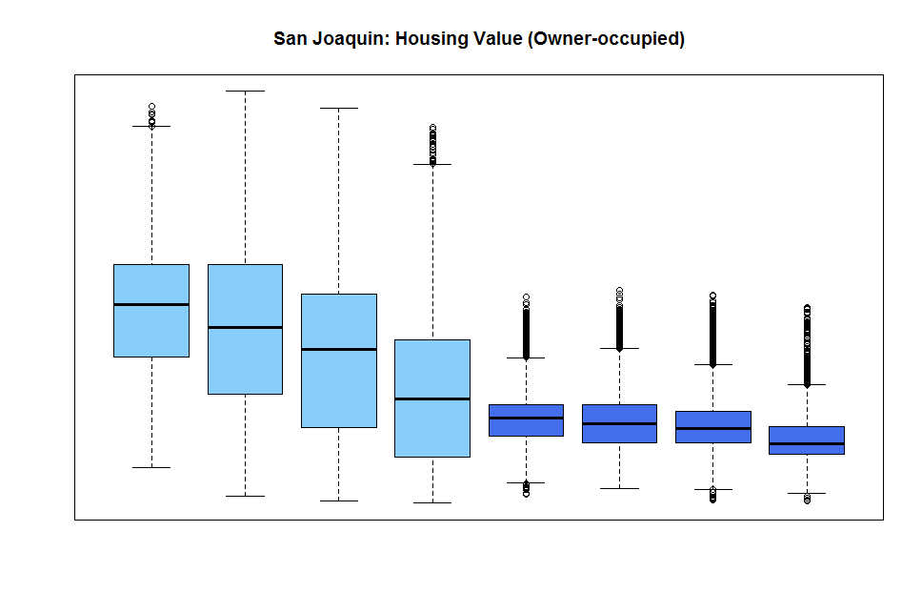
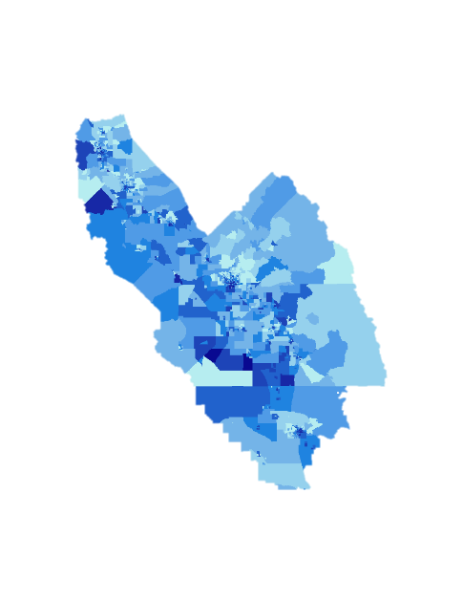
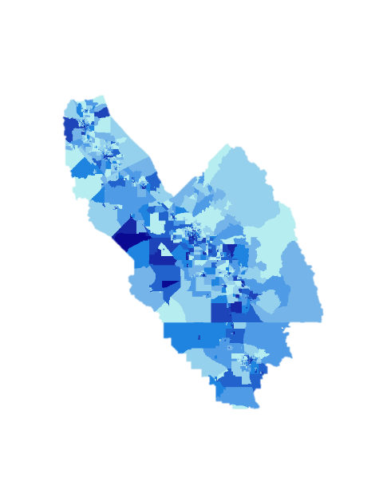
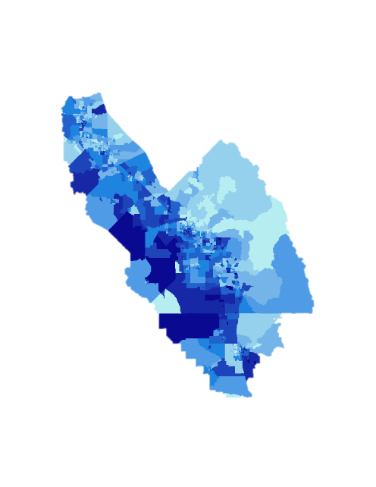
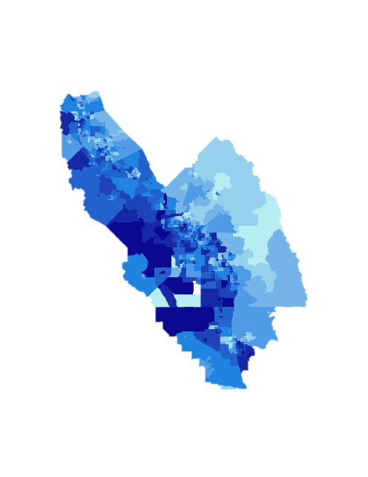
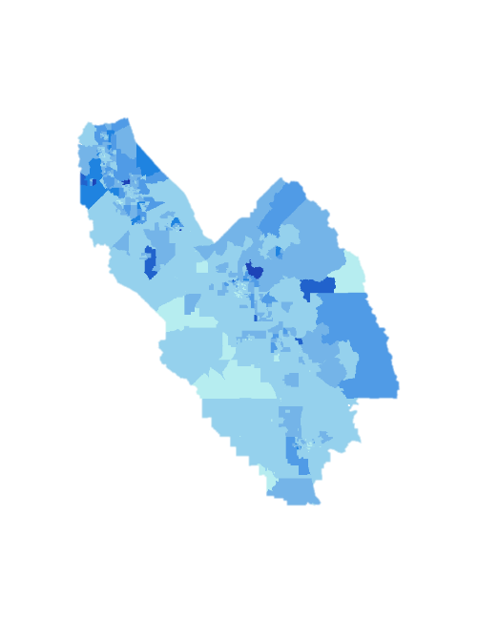
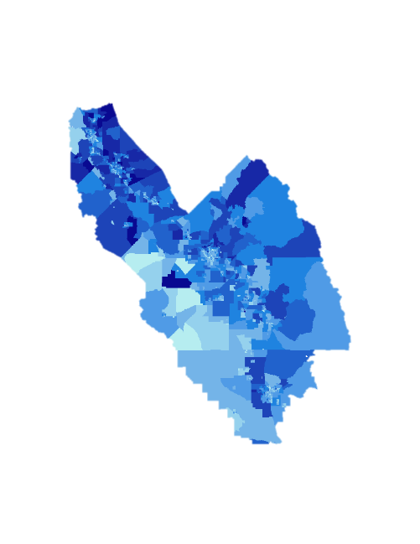
PM_{2.5} Change from 2000 to 2010
Results – San Joaquin Valley
2.5
-13
Income: Under Poverty Line
Education: No High School Degree
Median Housing Value
2000
2010
2000
2010
2000
2010
25
20
PM_{2.5} (μg/m³)
15
10
5
Q1 Q2 Q3 Q4
Q1 Q2 Q3 Q4
Q1 Q2 Q3 Q4
Q1 Q2 Q3 Q4
Q1 Q2 Q3 Q4
Q1 Q2 Q3 Q4
Population Under Poverty Line (%)
Population with No High School Degree (%)
Median Housing Value ($)
100
0
100
0
1,000,000
0
Notes:
This slide highlights income, education, and housing value within the San Joaquin Valley air basin. Race and ethnicity display the same trends we saw on the previous slide in that the inequalities across communities of different socioeconomic status are reduced in 2010 compared to 2000. While significant relationships between each socioeconomic variable and PM2.5 still exist in 2010, the slope is closer to zero. We can see, by the change in PM2.5 graph in the upper right-hand corner, that there is a strong association between location and change in PM2.5. The radial pattern in PM2.5 decrease may drive the changes in the relationship between socioeconomic status and PM2.5.

Slide 16
Conclusions
While the ACAG PM_{2.5} data product adequately represents long-term exposure and large-scale spatial processes, the dataset’s coarse annual average temporal resolution may fail to capture all PM_{2.5}-related health risks.
Recent California air quality policies and regulations may be factors contributing to overall declines in PM_{2.5}, while precipitation, fire, and transportation patterns likely contribute to the inter-annual variability in the San Francisco, San Joaquin Valley, and South Coast air basins.
Low income communities, especially those with higher percentages of minority populations, are more likely to experience greater annual mean PM_{2.5} concentrations.
Notes:
So to sum everything up, our major conclusions for this project are that while the ACAG dataset does a good job representing long-term and large-scale PM2.5 spatial processes within California, it may fail to capture all PM2.5-related health risks since its temporal resolution is limited to an annual lens.
In addition, the overall declines in PM2.5 we see across the entire state may be due in part to recent air quality policies and regulations put into place by California. In smaller geographical areas like our three air basins, precipitation, fire, and transportation patterns likely contribute to the inter-annual variability we saw.
Finally, air quality is indeed an environmental justice issue and low income communities and those with a larger proportion of people of color are more likely to experience greater annual mean PM2.5 concentrations than more affluent, less-diverse communities.

Slide 17
Acknowledgements
Advisors
Dr. Juan Torres-Pérez, Bay Area Environmental Research Institute
Dr. Cindy Schmidt, Bay Area Environmental Research Institute
Dr. Robert Chatfield, NASA Ames Research Center
Dr. Anthony Strawa, NASA Ames Research Center
Dr. Meytar Sorek-Hamer, Universities Space Research Association
Dr. Caroline Parworth, Universities Space Research Association
Partners
California Air Resources Board
Dr. Hyung Joo Lee
University of California, Los Angeles, Institute of Transportation Studies
Madeline Brozen
NASA DEVELOP National Program Staff
Jenna Williams· John Dilger· Nick Rousseau· Amanda Clayton· Jonathan O’Brien
Notes:
We’d like to thank and acknowledge all of our advisors, partners, and members of the DEVELOP National Program Staff. Your time and input are greatly appreciated.

Slide 18
THANK YOU!
Questions?
Notes:
That concludes our presentation! Thank you again for your time and attention; we would be happy to accept any questions.

Slide 19
Notes:
(Extra slide just in case / for questions)
This map shows the by-pixel PM2.5 anomalies for California and our three air basins each year. The mean pixel values from 1998 to 2016 are used as the normal. The line graph points are regional mean anomalies, so for example the average difference between a 1 km pixel in the San Joaquin Valley in the year 2002 compared to the mean of the entire state across all years, was about 2 ug/m3. The San Joaquin Valley air basin (blue) appears to have the greatest fluctuation around the mean for our study period, falling especially precipitously from 2008 to about 2011, but then rising steadily and surpassing the other two air basins and the state as a whole by 2016. You can see how clearly the trends are contained within the air basin boundaries, especially within the San Joaquin Valley air basin in the more anomalous years.

Slide 20
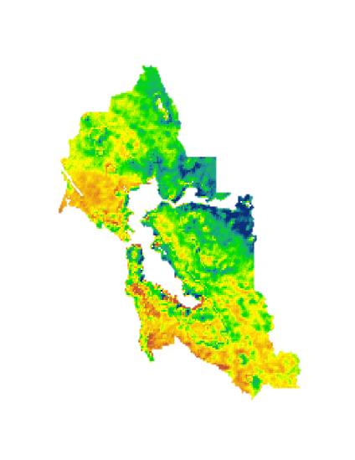
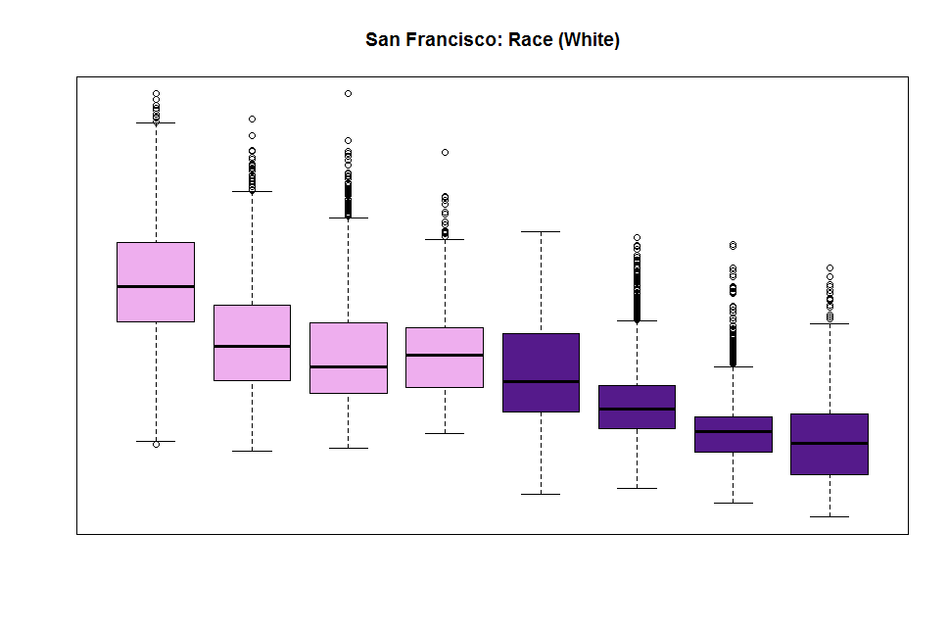
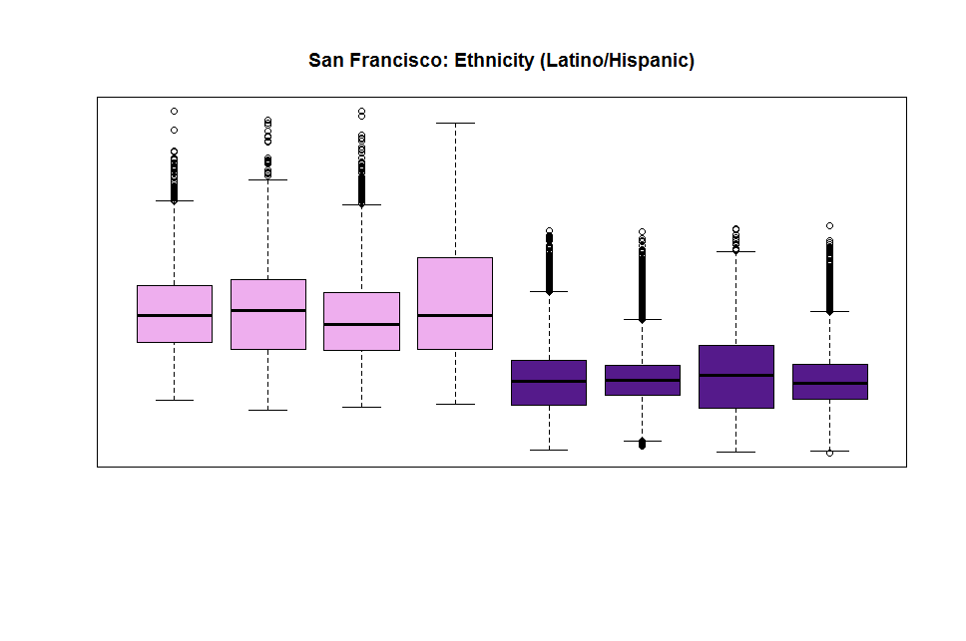
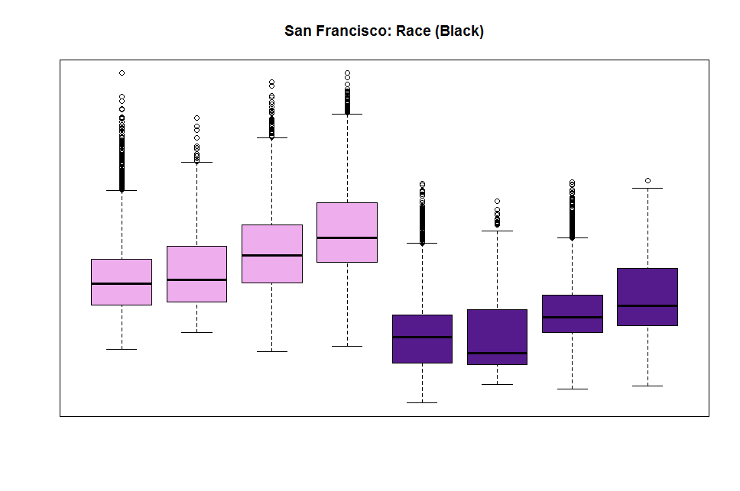
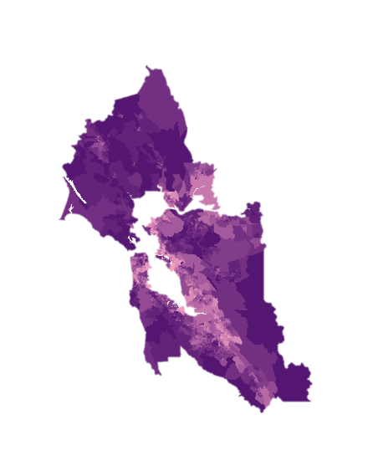
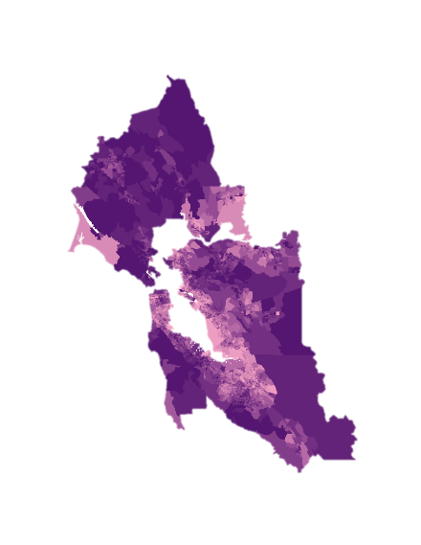
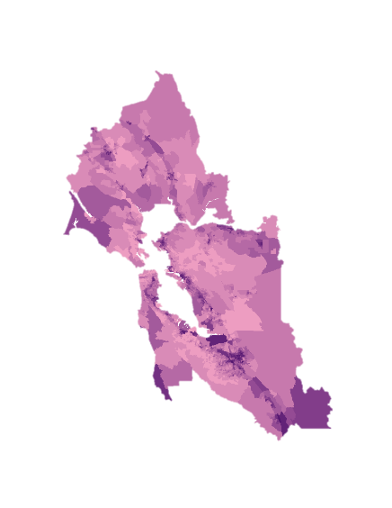
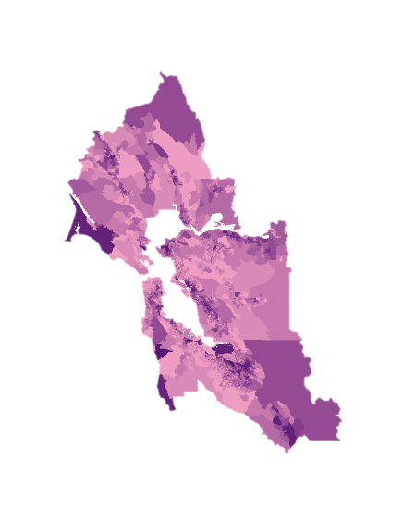
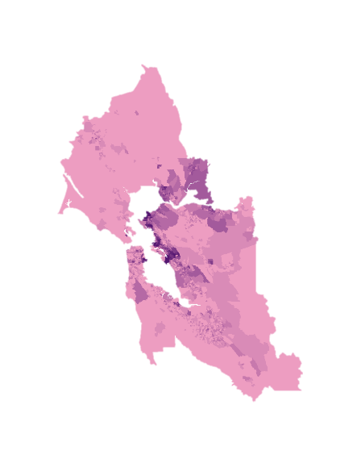
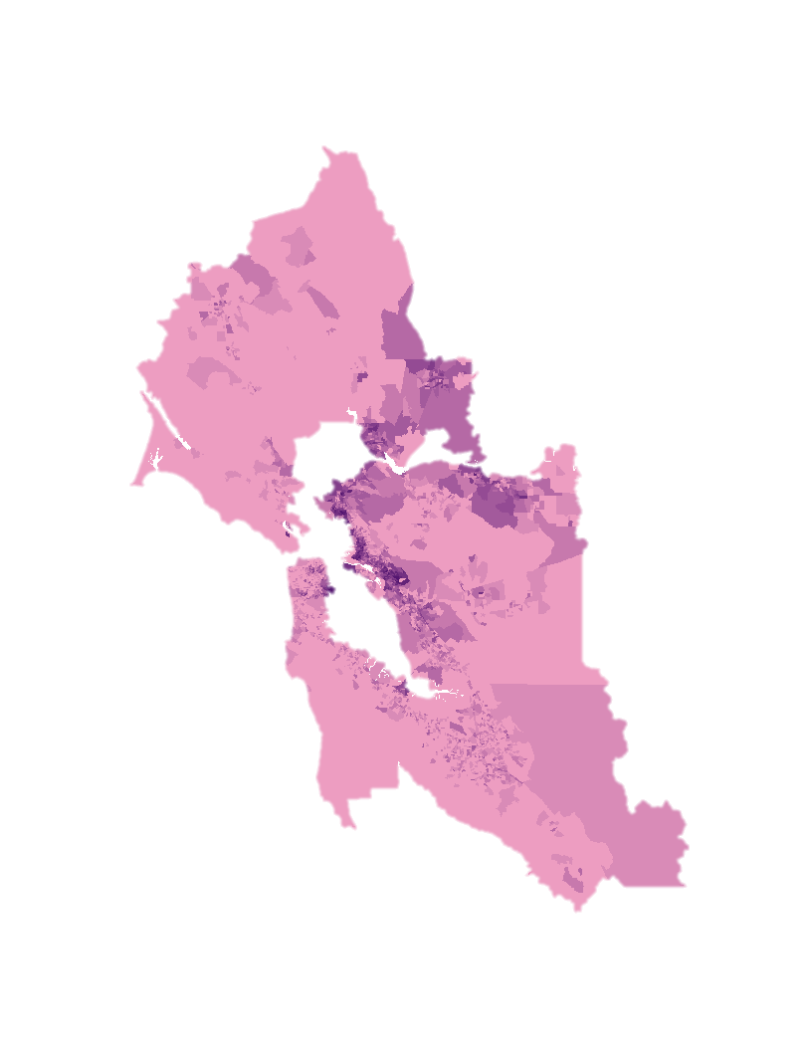
PM_{2.5} Change from 2000 to 2010
Results – San Francisco
1.5
-7
Race: White
Ethnicity: Latino/Hispanic
Race: Black
2000
2010
2000
2010
2000
2010
15
PM_{2.5} (μg/m³)
10
5
Q1 Q2 Q3 Q4
Q1 Q2 Q3 Q4
Q1 Q2 Q3 Q4
Q1 Q2 Q3 Q4
Q1 Q2 Q3 Q4
Q1 Q2 Q3 Q4
Population that is White (%)
Population that is Latino/Hispanic (%)
Population that is Black (%)
100
0
100
0
100
0
Notes:
(Extra slide just in case / for questions)
This slide zooms into the San Francisco air basin. Along the bottom, we can see the spatial distribution of each socioeconomic factor. While there were changes in racial and ethnic community composition across the 10 years, the distribution remains relatively static. In the upper right corner, we can see the change in PM2.5 from 200 to 2010. Cooler colors represent decreases in PM2.5 and warmer colors represent increases. Overall PM2.5 decreased in this area, but changes in PM2.5 were not uniform across space. We wanted to know if these non-uniform changes exacerbated or reduced PM2.5 inequalities in communities of different socioeconomic status. In San Francisco, we can see that PM2.5 inequalities were reduced with regards to ethnicity and remained relatively static with regards to race. The patterns in the South Coast air basin also remained relatively static.

Slide 21
Notes:
(Extra slide just in case / for questions)
This map shows CARB ground monitors over time, with yellow points representing monitors added within a specific year, and red monitors representing monitors already present in that year. Coastal areas and especially urban areas like San Francisco, Los Angeles, and San Diego, experience the most increase, but especially into the 2010s there are more monitors being added in central California especially along major highways, and even up Eureka or out in Death Valley monitors are being put up by CARB.

