Slide 1

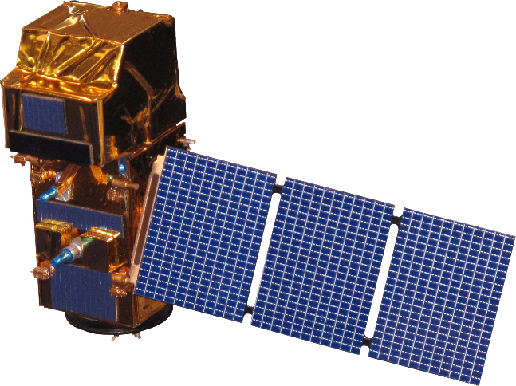
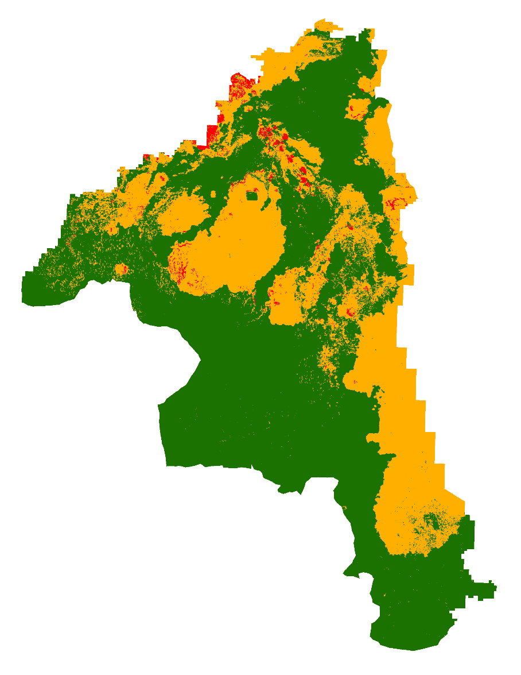
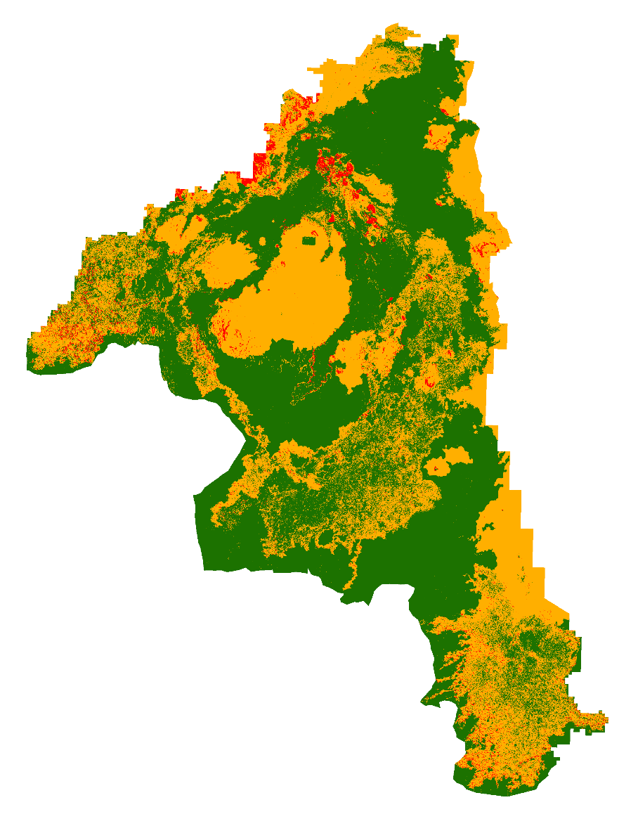
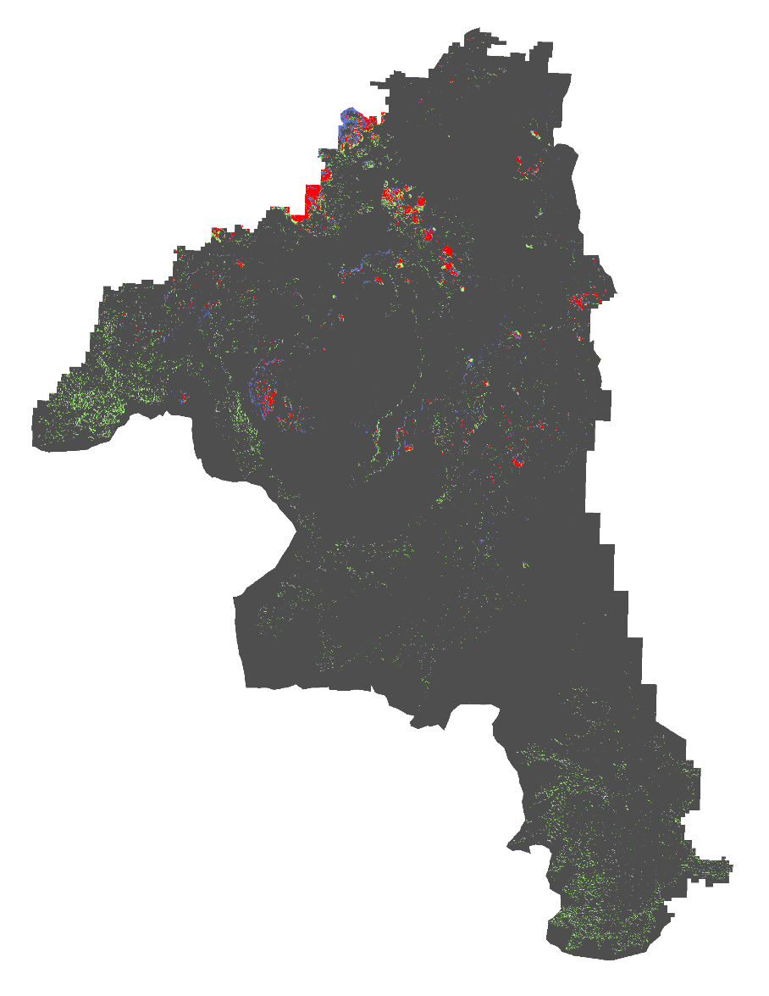
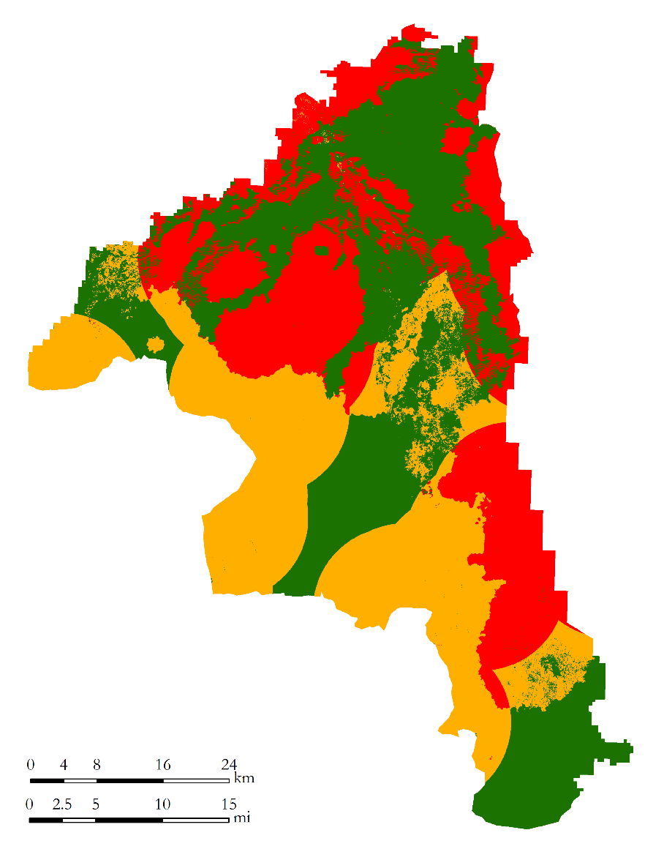
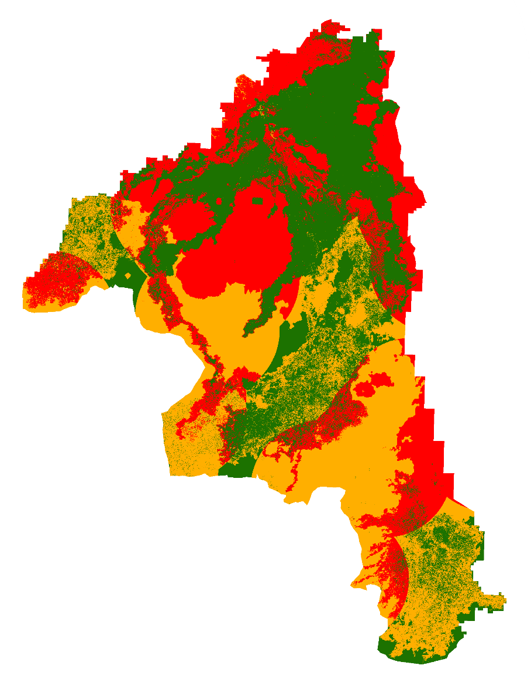
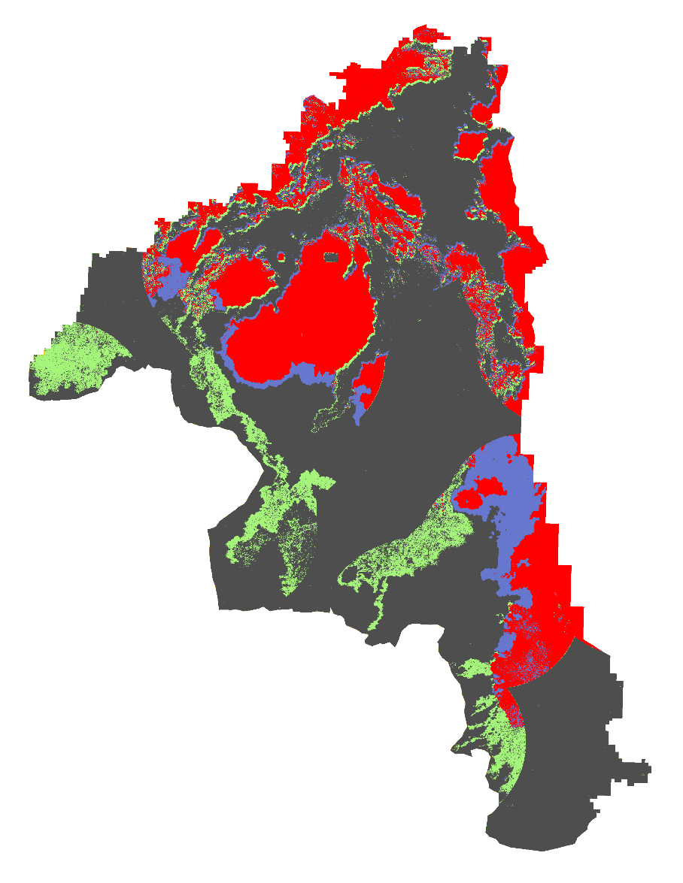


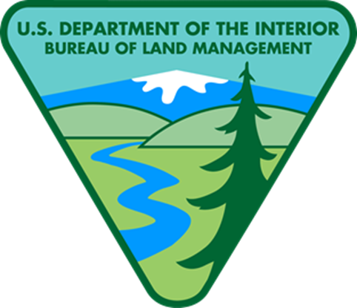



Utilizing NASA Earth Observations to Identify Critical Wildlife Habitat Areas Threatened by Heightened Wildfire Susceptibility for Improved Conservation and Management Practices
Abstract
Objectives
Wildfires can be disastrous for declining, threatened, or endangered wildlife species. Encroachment of non-native annual grasses such as cheatgrass or woody-vegetation such as juniper have increased fuel loads, intensified wildfire severity, and altered fire regimes throughout the Great Basin and Intermountain West. This project partnered with Craters of the Moon National Monument and Preserve (CRMO) and the Bureau of Land Management (BLM) in Idaho to identify wildlife habitats with increased susceptibility to wildfires due to fuel loads. This project is unique in its inclusion of kipukas, islands of wildlife habitats found throughout lava formations. Wildlife habitats of the diminished Greater Sage-grouse (GRSG) (Centrocercus uraphasignus) and declining mule deer (Odocoileus hemionus) were included in the study. Sagebrush-steppe is a resilient ecosystem and is able to handle many different environmental extremes, but wildfires can be disastrous to the flora, and as a result, the fauna, because it takes so long to re-establish. This project leveraged Landsat 8 Operational Land Imagery (OLI) data from June 2015, Sentinel-2 data from June 2016, fuel loads measured in tons per acre, and topographic variables to produce an at-risk habitat wildfire susceptibility model. Weightings from expert opinion and industry standards were applied to model variables to discern fire behavior and habitat vulnerability. Methods developed provided decision makers with new and effective ways to monitor remote areas and threatened habitats.
Identify critical mule deer and the Greater sage-grouse habitats that have an increased susceptibility to wildfires based upon surrounding vegetation.
Compare performance of wildfire susceptibility models using 10 meter Sentinel-2 imagery versus 30 meter Landsat-8 imagery.
Study Area
Eastern Idaho
Landsat WRS-2 Path 39 and 40 Row 30 (June 2015)
Sentinel-2 R127 (June 2016)
Methodology
Case Study
Sun Effect
Mule Deer Habitat Fire Susceptibility 30 m
Craters of the Moon National Monument and Preserve
Established May 2, 1924
Craters
of the
Moon
Wyoming
DEM
10m & 30m
Aspect
Rate of Spread (Slope)
Idaho
Slope
Sage-grouse Habitat Fire Susceptibility 30 m
Nevada
Utah
Fire Suppression
Earth Observations
Veg. Moisture
Sentinel - 2
Intrinsic Factors
CTA
Classification
Expert Weightings
Landsat 8 Operational Land Imager (OLI)
Rate of Spread
(Fuel Load)
Sage-grouse Habitat Fire Susceptibility 10 m
Conclusions
Fuel Loads
Fire Intensity
Initial validation with Google Earth shows highly vegetative areas correlate to those identified as highly susceptible to wildfires.
Resulting habitat models for mule deer identified high susceptibility in a well documented migration path through Craters.
Generally, Sentinel-2 was seen to pick up more vegetation in the basalt flows, likely result of increased spatial resolution.
Landsat 8 performed satisfactorily and is a recommended choice for a compromise between speed and accuracy.
Recommendation is for land/park managers to focus resources toward areas where both satellites agree there is high fire susceptibility.
Eastern Idaho Disasters
Habitat Data
Mule Deer Winter Habitat
Habitat suitability
Mule Deer Habitat Fire Susceptibility 10 m
Sage-grouse Lek & Nesting Grounds
Habitat suitability
Figure 1: Processes to develop habitat fire susceptibility
Results
Mule Deer High Fire Susceptibility
Landsat 8
Sentinel-2
High Fire
Susceptibility Analysis
Sensors | Acres Classified | Percent Classified
None | 726,839 | 96.6%
Landsat 8 | 4,750 | 0.63%
Sentinel-2 | 15,069 | 2%
Both | 5,591 | 0.74%
Mule Deer
High Fire Susceptibility
High Fire Susceptibility
Low
None
Moderate
Landsat 8
Red
Sentinel-2
Greater Sage-grouse High Fire Susceptibility
Both
Sensors | Acres Classified | Percent Classified
None | 459,584 | 61%
Landsat 8 | 55,685 | 7.4%
Sentinel-2 | 72,250 | 9.6%
Both | 164,719 | 21.8%
Greater Sage-grouse
Team Members
Project Partners
Total Acres = 752,249
Acknowledgements
Craters of the Moon National Monument and Preserve
Bureau of Land Management
Idaho Department of Fish and Game
Keith Weber¹, Mike Kuyper², Shelly Mavor², Karen Kraus², Todd Stefanic³, Georgina Pearson³, Scott Bergen⁴, Kindra Serr¹
1. Idaho State University 2. Bureau of Land Management 3. National Park Service 4. Idaho Department of Fish and Game
Any opinions, findings, and conclusions or recommendations expressed in this material are those of the author(s) and do not necessarily reflect the views of the National Aeronautics and Space Administration. This material is based upon work supported by NASA through contract NNL11AA00B and cooperative agreement NNX14AB60A.
Courtney Ohr
Project Lead
Priscilla Addison
Jenna Williams
BLM at Idaho State University GIS TReC – Summer 2016

