Slide 1
Indonesia Agriculture
Identifying Current Areas of Palm Oil Production and Modeling a Risk Map for Future Expansion in Central Kalimantan, Indonesia
Kyle Peterson (Project Lead)
Michael Riedman
Abigail Childs
Notes:
Hello! Thank you for attending our presentation today.
My name is Kyle Peterson, and I’m the Project Lead on the Indonesia Agriculture project. I have a XX in XX from XXX
Hi, my name is Michael Riedman, I have a Master’s in GIS from University of Maryland, Baltimore County, and a B.S. from University of Maryland, College Park
Hi, my name is Abby Childs, I have a Masters in International Affairs from Columbia University’s School of International and Public Affairs.
Our project couples NASA earth observations with in situ data to predict locations of current palm oil production and model a risk map for future expansion of palm oil plantations in Central Kalimantan, Indonesia.

Slide 2
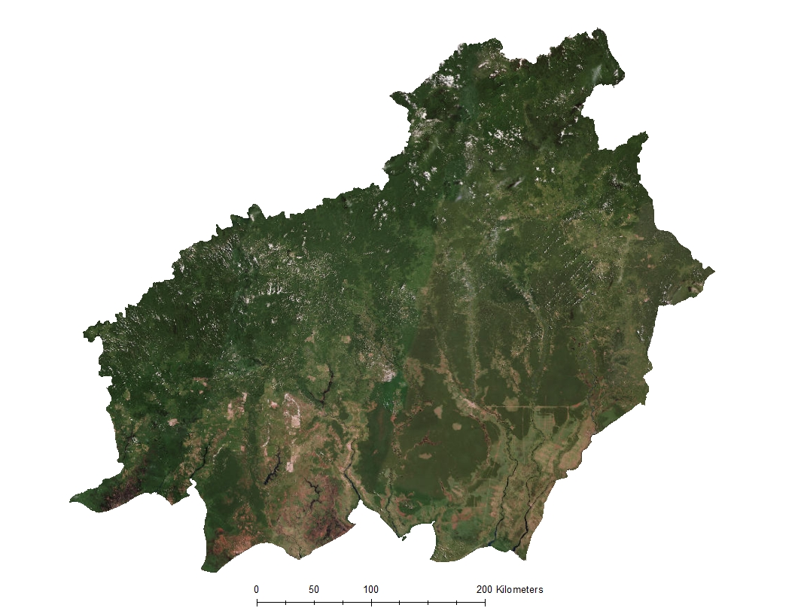
Study Area
Central Kalimantan, Indonesia
Notes:
Located in Southeast Asia, on the island of Bornea, Central Kalimantan is a remote province and that is home to natural rainforests, peatland, and many endangered species, such as Sumatran tigers, orangutans, pygmy elephants, and Sumatran rhinoceros.
Central Kalimantan has been marked as a region for the government-backed expansion of palm oil due to its underdevelopment and availability of large plots of land that can be converted into palm oil plantations.
Also existing in Central Kalimantan are areas that have been designated by the government of Indonesia as land to be protected; these protected areas are on rainforest, peatlands, and areas that contain endangered species.
Citation:
ESRI Basemap: World Imagery provides one meter or better satellite and aerial imagery in many parts of the world and lower resolution satellite imagery worldwide. The map includes 15m TerraColor imagery at small and mid-scales (591M down to 72k) and 2.5m SPOT Imagery (288k to 72k) for the world, and USGS 15m Landsat imagery for Antarctica. The map features 0.3m resolution imagery in the continental United States and 0.6m resolution imagery in parts of Western Europe from Digital Globe. Recent 1m USDA NAIP imagery is available in select states of the US. In other parts of the world, 1 meter resolution imagery is available from GeoEye IKONOS, Getmapping, AeroGRID, IGN Spain, and IGP Portugal. Additionally, imagery at different resolutions has been contributed by the GIS User Community. For more information on this map, including the terms of use, visit us online at http://goto.arcgisonline.com/maps/World_Imagery

Slide 3
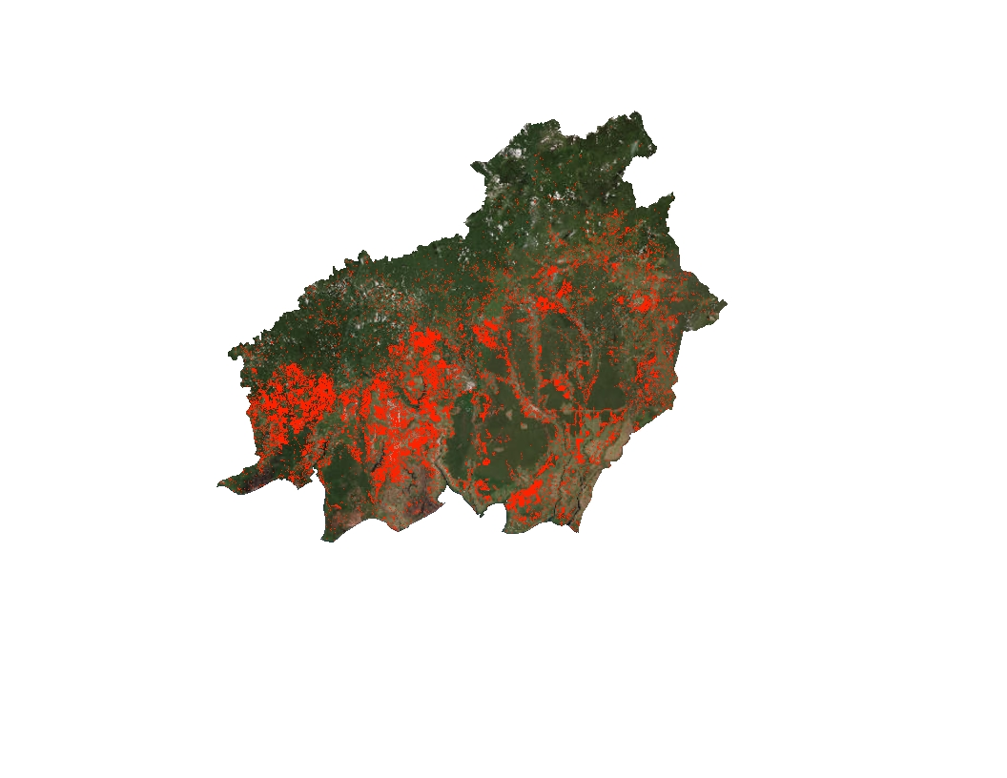
Study Period
January 2000 – January 2016
Loss of Forest, 2000-2014
Image Credit: Hansen Global Forest Loss Data
Notes:
Our project had a 16 year study period from January 2000 – January 2016.
This image shows areas of forest loss in Central Kalimantan between 2000-2014.
There was considerable forest loss in this region over that 14 year period, particularly in the southwest portion of the province.
Citation:
Matthew Hansen
ESRI Basemap :World Imagery provides one meter or better satellite and aerial imagery in many parts of the world and lower resolution satellite imagery worldwide. The map includes 15m TerraColor imagery at small and mid-scales (591M down to 72k) and 2.5m SPOT Imagery (288k to 72k) for the world, and USGS 15m Landsat imagery for Antarctica. The map features 0.3m resolution imagery in the continental United States and 0.6m resolution imagery in parts of Western Europe from Digital Globe. Recent 1m USDA NAIP imagery is available in select states of the US. In other parts of the world, 1 meter resolution imagery is available from GeoEye IKONOS, Getmapping, AeroGRID, IGN Spain, and IGP Portugal. Additionally, imagery at different resolutions has been contributed by the GIS User Community. For more information on this map, including the terms of use, visit us online at http://goto.arcgisonline.com/maps/World_Imagery

Slide 4
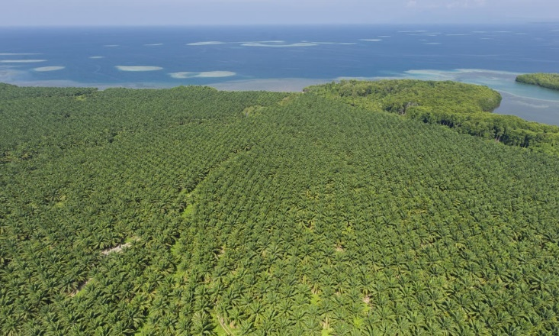

Objectives
Identify current palm oil plantations in Central Kalimantan, Indonesia using Maxent
Generate a risk assessment map of future palm oil plantations based on identified plantations
Enhance World Wildlife Fund’s ability to combat deforestation using NASA Earth observations
Image Credit: World Wildlife Fund
Don’t destroy my home!!!
Image Credit: Flickr (Restless Mind)
Notes:
There were two primary objectives in this project
The first objective was to identify the location of current palm oil plantations in Central Kalimantan, based on in situ data provided by WWF and data obtained from NASA satellites.
*CLICK
2. The second objective was to create a risk assessment map of potential future palm oil plantations based on the output of palm oil plantations from the first objective
Both objectives used Maxent to model the presence of palm oil plantations in Central Kalimantan
*CLICK
Both outcomes will be used by WWF to combat deforestation in the province and protect rainforest, peatland, and biodiversity.
Image Link:
https://www.flickr.com/photos/restless_mind/2318914518/sizes/l

Slide 5
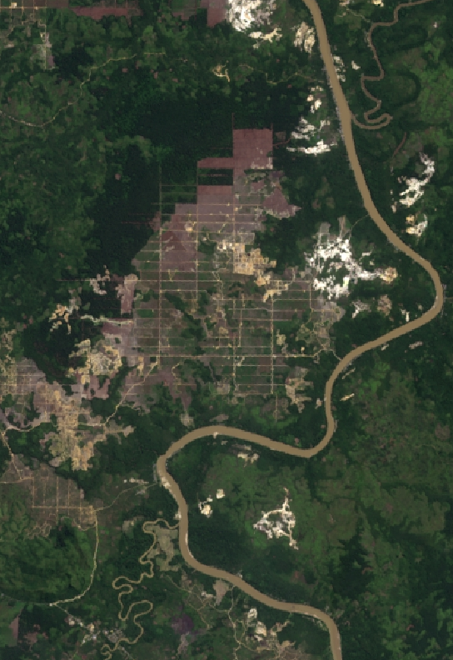
Community Concerns
Illegal deforestation
CO₂ emissions
Rainforest and biodiversity loss
Image Credit: Landsat 8
Notes:
Illegal deforestation of conservation areas in Central Kalimantan for the purpose of palm oil plantations is against the expressed purpose of conserving areas. Moreover, reduction of natural forests and peatlands causes a significant release of CO₂ emissions, making Indonesia one of the largest contributors to climate change in the world.
Rainforest and biodiversity loss caused by the creation of palm oil plantations will have a long and continuing impact of the species that rely on natural forests for their survival and can push these species to the brink of extinction in the near future.

Slide 6
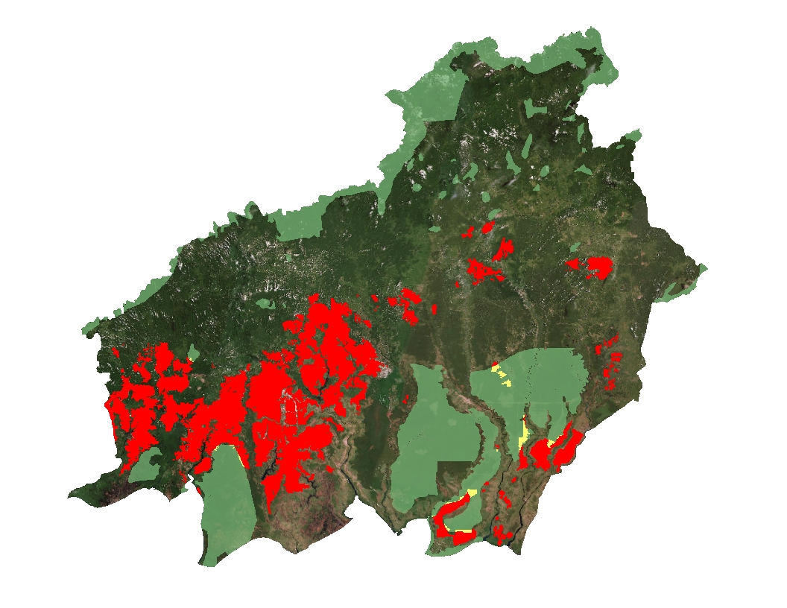
Current Plantations
Palm oil plantations exist in both conserved and non-conserved areas
Indonesia has set the goal of expanding palm oil plantations by 2 million hectares by 2020
Most plantations are located in the southwestern lowland portion of the region
Conservation Areas
Plantation Locations
Plantations inside conservation areas
Notes:
Data we have gathered indicate that the presence of palm oil plantations in Central Kalimantan, Indonesia occurs in both conserved and non-conserved areas.
Global demand for palm oil has doubled over the last decade and is expected to double again before 2050. (http://wwf.panda.org/what_we_do/footprint/agriculture/palm_oil/)
Indonesia has the goal of becoming the worlds biggest palm oil exported and will need to convert two million hectares of land in order to achieve this. (Ramdhani/Taufik 2006) - Land Suitability Analysis for Sustainable Oil-palm Plantations in Kalimantan using Fuzzy Weighted Linear Combination on Multi Criteria- Spatial Decision Support System
Areas with roads and existing plantations are likely increase their plantation sizes since these areas have existing infrastructure making the relative cost of growth and expansion inexpensive.
Citations: Data layers obtained from Global Forest Watch (http://data.globalforestwatch.org/datasets/baae47df61ed4a73a6f54f00cb4207e0_5) and provided by World Wildlife Fund
ESRI Basemap: World Imagery provides one meter or better satellite and aerial imagery in many parts of the world and lower resolution satellite imagery worldwide. The map includes 15m TerraColor imagery at small and mid-scales (591M down to 72k) and 2.5m SPOT Imagery (288k to 72k) for the world, and USGS 15m Landsat imagery for Antarctica. The map features 0.3m resolution imagery in the continental United States and 0.6m resolution imagery in parts of Western Europe from Digital Globe. Recent 1m USDA NAIP imagery is available in select states of the US. In other parts of the world, 1 meter resolution imagery is available from GeoEye IKONOS, Getmapping, AeroGRID, IGN Spain, and IGP Portugal. Additionally, imagery at different resolutions has been contributed by the GIS User Community. For more information on this map, including the terms of use, visit us online at http://goto.arcgisonline.com/maps/World_Imagery

Slide 7
Methodology
Known Palm Oil Plantations
NASA Earth Observations
Relative Humidity
EVI
Maxent
Max Ave. Temp
NDVI
Environmental Variables
Min Ave. Temp
Elevation
Precipitation
Slope
Ancillary Data
Distance to Mills
Population
Protected Areas
Distance to Cities
Peat Lands
Accessibility
Distance to Roads
Soil Type
Pre-existing plantations
Distance to Water
Palm Oil Concessions
Notes:
Using a combination of NASA Earth Observations and ancillary data, we processed the data to run in the Maxent model.
Maxent requires that all raster data are uniform; meaning that rasters must have the same projection, cell size, and extent to be entered into the model. A combination of geoprocessing procedures in arcpy and ArcGIS were used to make all input rasters uniform.
*CLICK
We then combined our environmental variables, from both NASA Earth Observation and Ancilliary datasets to create a set of environmental variables
*CLICK
We combined the environmental variables with the data of known palm oil plantations, provided by WWF,
*CLICK
and ran the data in TerrSet using Maxent

Slide 8
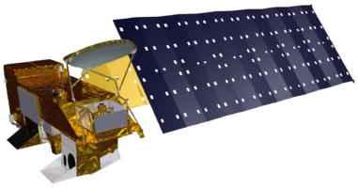
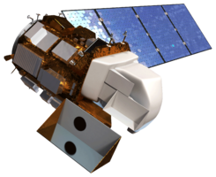
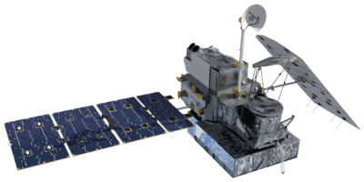
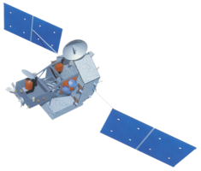
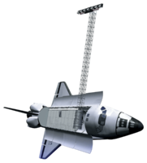
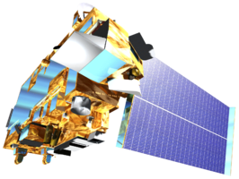
NASA satellites and sensors
Aqua: Relative Humidity
Landsat 8 OLI: Imagery
GPM: Precipitation
TRMM: Precipitation
SRTM: Elevation
Terra: Land surface temperature
Aqua
Landsat 8 OLI
GPM
TRMM
SRTM
Terra
Images: NASA
Notes:
We used several of NASA’s satellites and sensors to serve as inputs into the Maxent model of palm oil plantations.

Slide 9
Risk Map
Future growth of palm oil plantations will likely occur in XXX areas
Notes:
Using the results of modeling known palm oil plantations, we modeled areas most at risk for future palm oil plantations in Central Kalimantan.
The results show that the areas most at risk for palm oil plantations are those located in I DON’T KNOW WHERE.
This map is helpful since it shows expected future palm oil plantations in both conserved areas and areas that are marked for development.
(Image 1: highlight plantations in conserved areas)
(Image 2: highlight plantations in areas not marked for conservation)
WWF can use this map to show local government officials the conserved areas most at risk for future deforestation and help to better target resources.
This map can also be used by the government to better direct palm growers to prime palm oil plantation land that is not in conserved areas

Slide 10
Analysis
Statistics on robustness of results
Notes:
Compare training data to actual data
Use image classification in ENVI to check against our results

Slide 11
Conclusions

Slide 12
Errors & Uncertainties

Slide 13
Future Work
Notes:
Future work can expand on our project and extrapolate our findings to the entire island of Kalimantan, Indonesia. By using our results to model current locations of palm oil plantations in Kalimantan, WWF and other NGOs can better target their resources over a wider range, thus curbing deforestation of conserved areas and reducing biodiversity loss.

Slide 14
Advisors
Dr. Naikoa Aguilar-Amuchastegui, WWF (Science Advisor)
Aakash Ahamed, USRA/GSFC (Science Advisor)
Partners
World Wildlife Fund
DEVELOP Staff
Sean McCartney, SSAI/GSFC (DEVELOP Center Lead)
Notes:
We would like to acknowledge both Dr. Naikoa Aguilar-Amuchastegui and Aakash Ahamed for their advice and guidance over the course of this project

