Slide 1
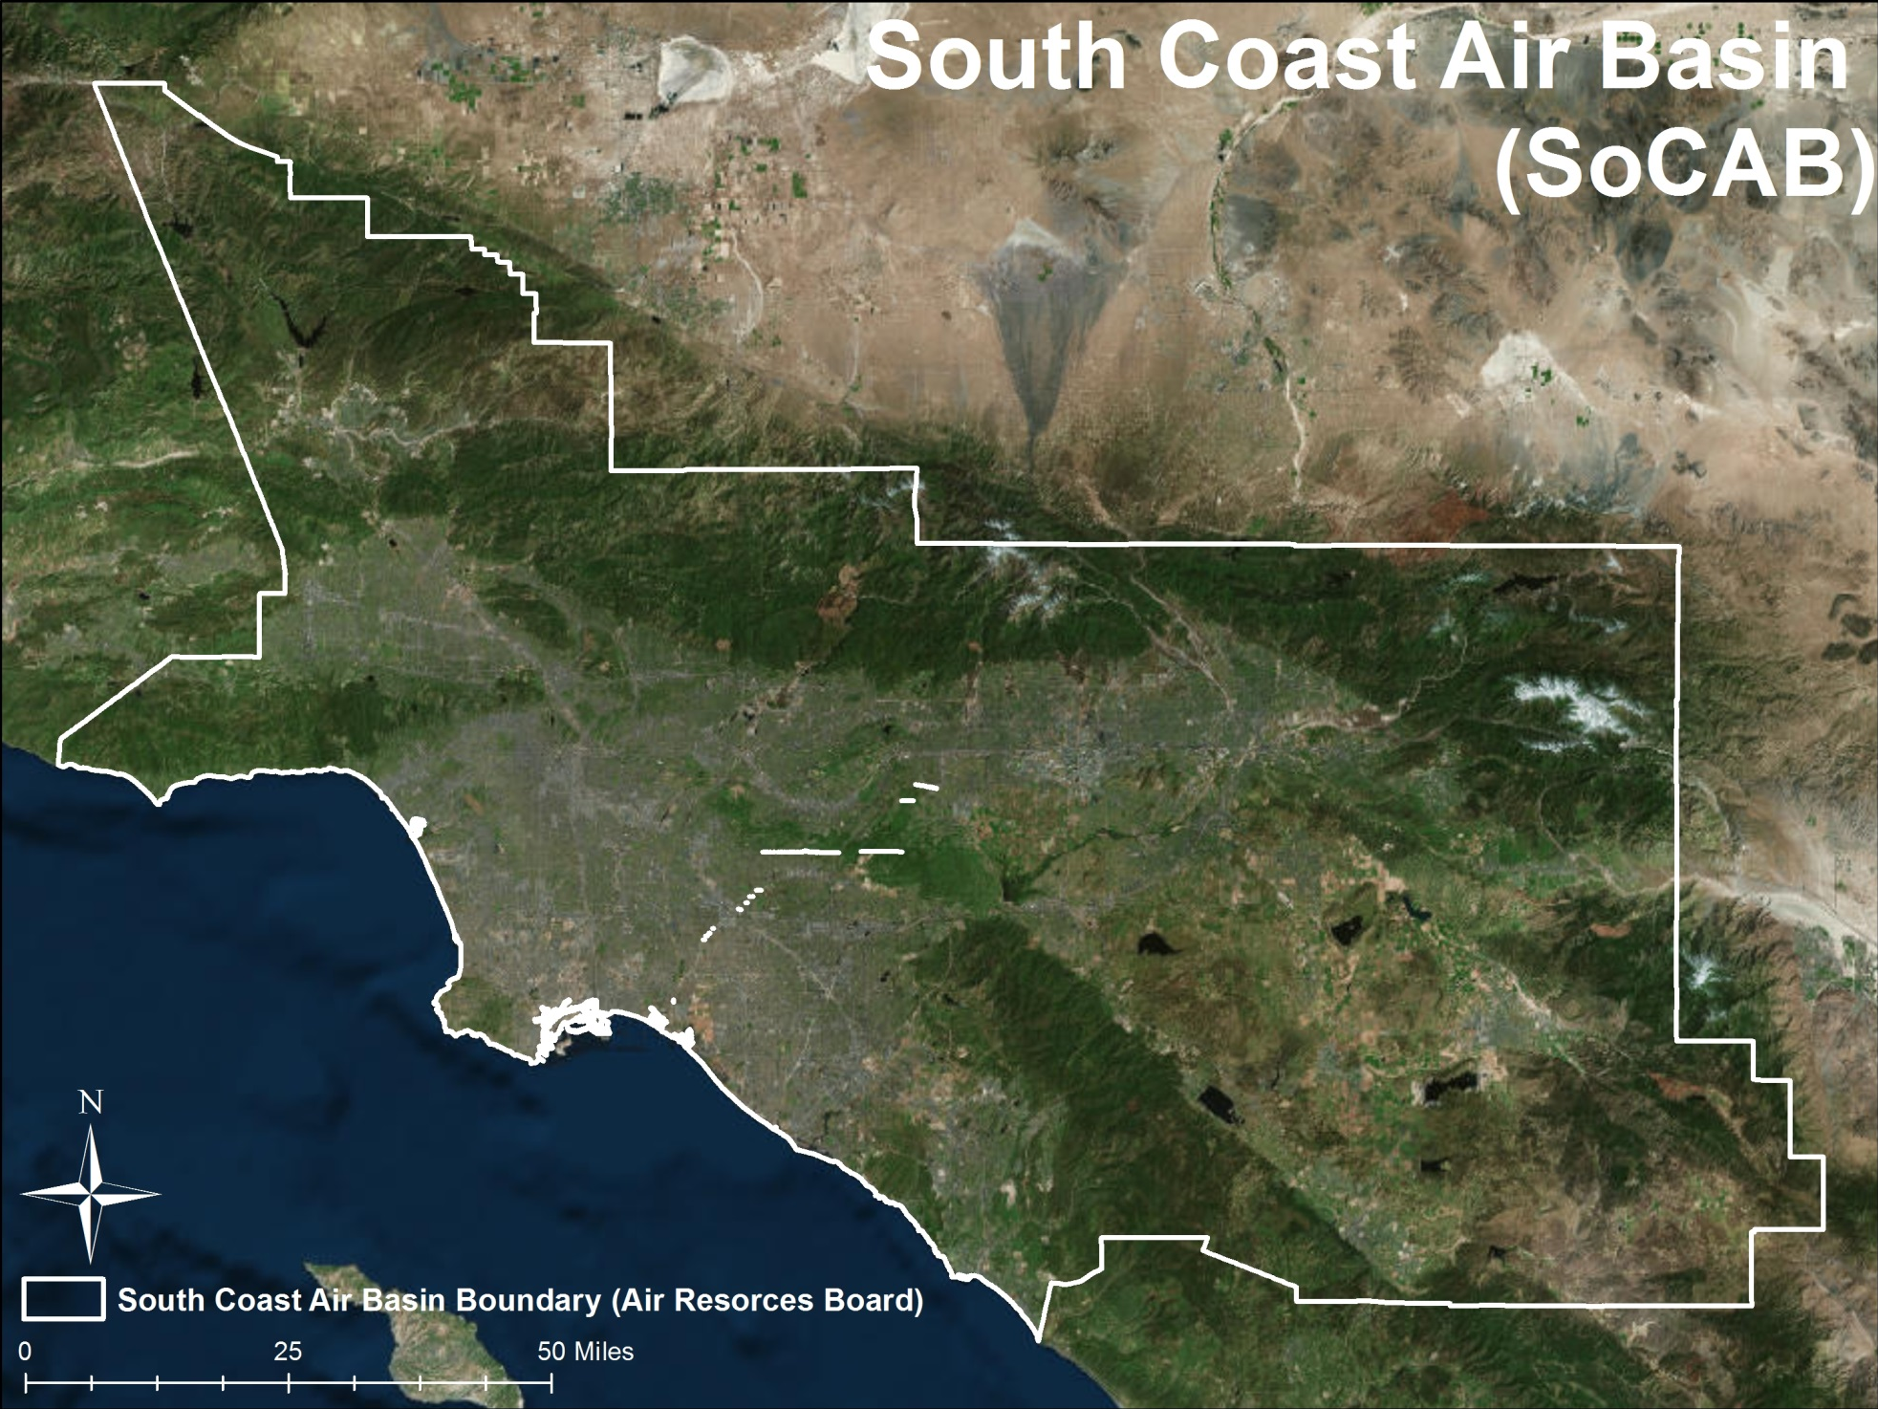
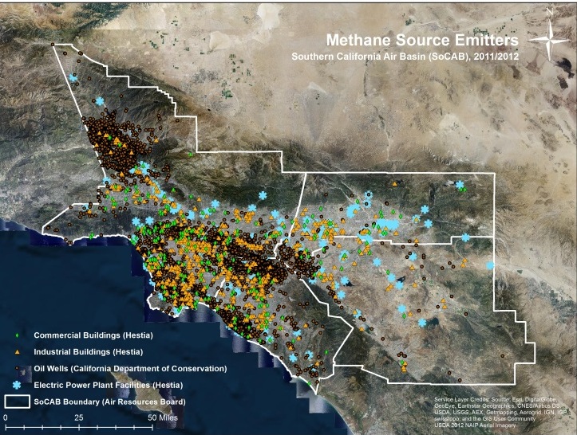
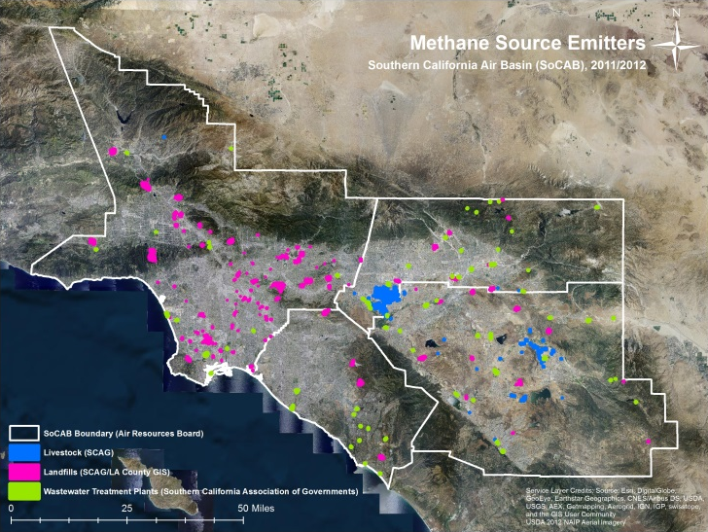
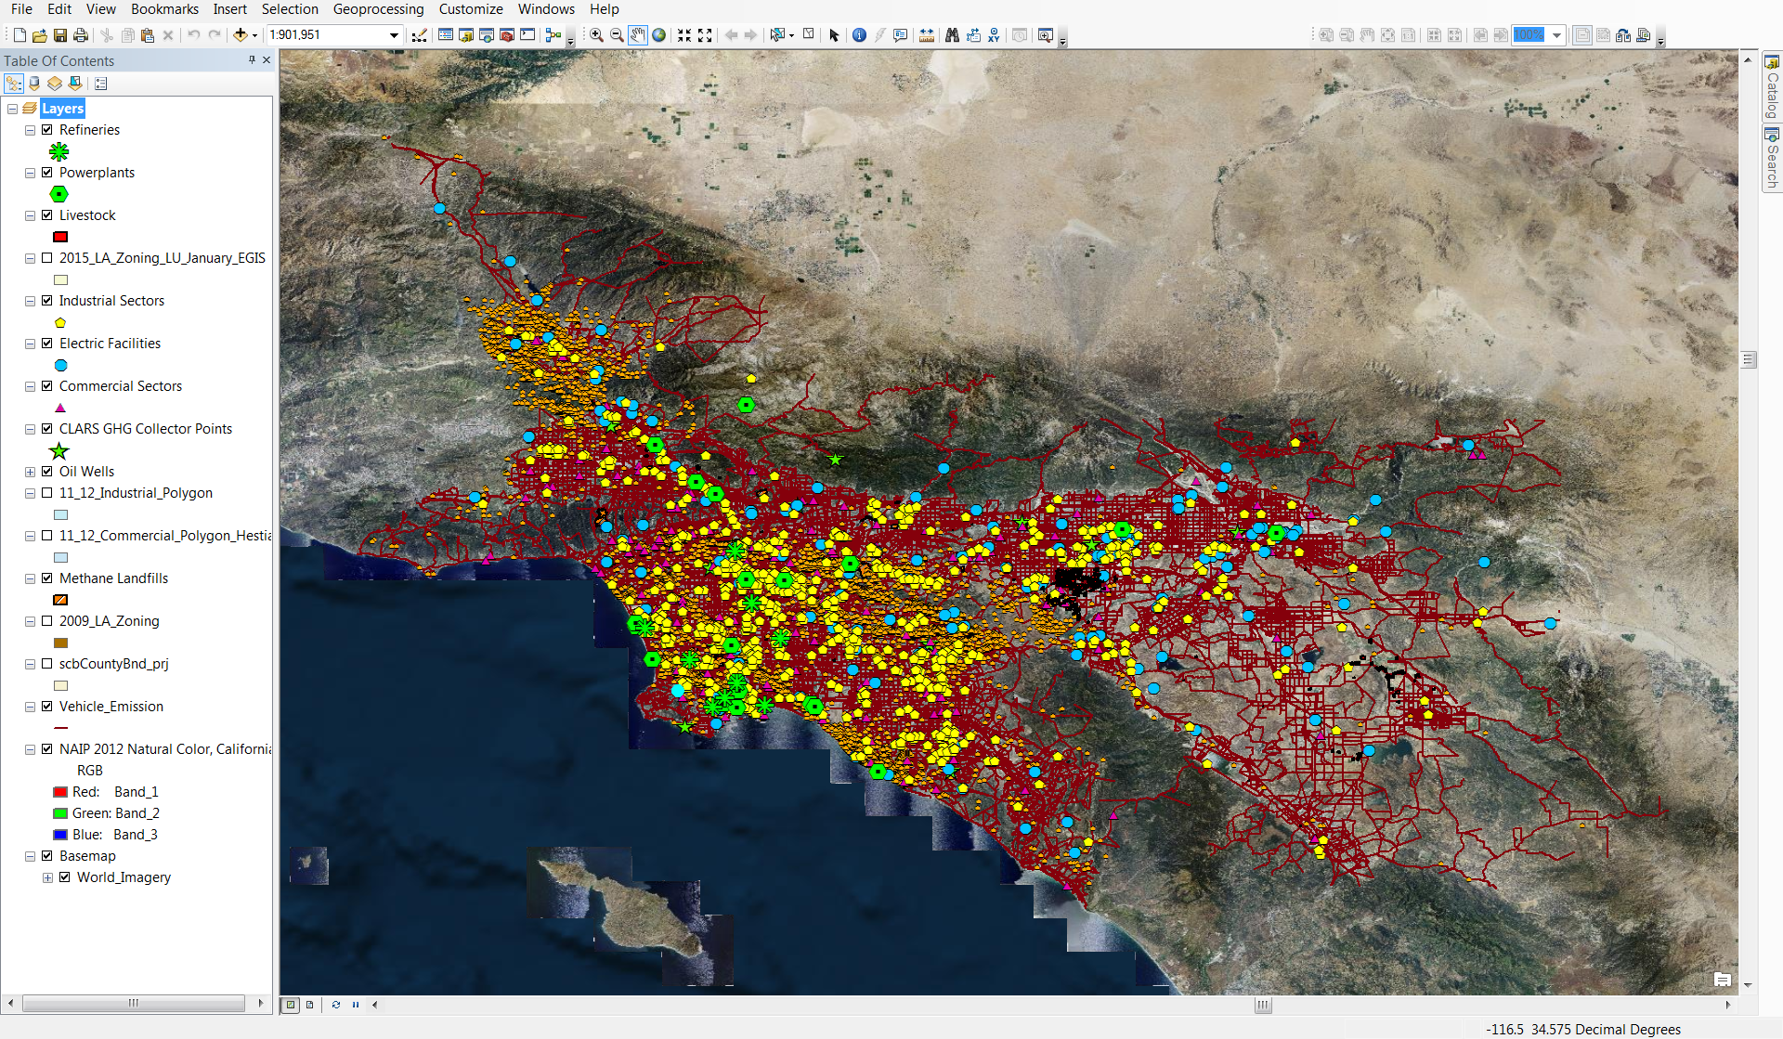
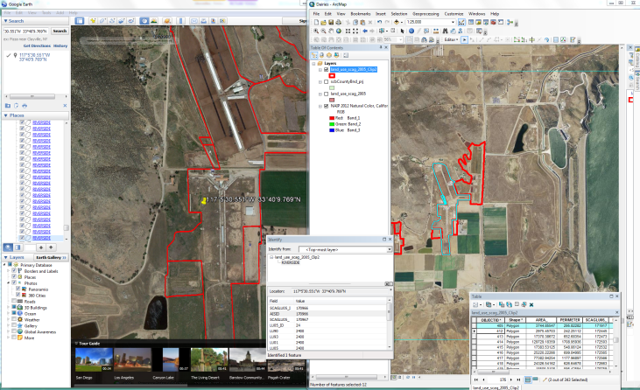
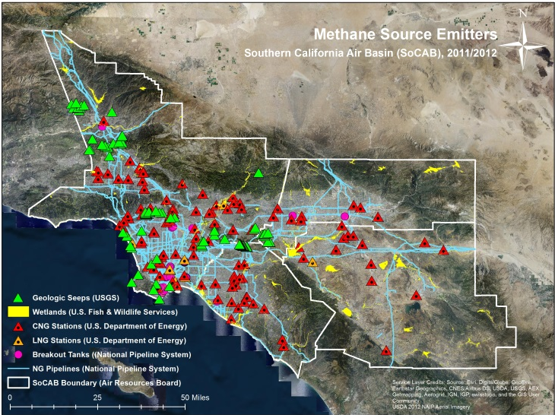

Los Angeles Health & Air Quality
Identifying Urban Emission Patterns in the Los Angeles Megacity
Talha Rafiq (Project Lead), Isis Frausto-Vicencio, Valerie Carranza
NASA DEVELOP National Program
Abstract
Study Area
Objectives
Combining greenhouse gas (GHG) datasets with GIS spatial modeling is a viable method for analyzing the distribution of GHG emissions. Understanding the spatial dynamics of GHG emissions is important for global climate modeling and forecasting, especially as it relates to predicting the effects of global warming and the development of state and federal policies.
Our research presents a spatial model of methane (CH₄) emissions in the Southern California Air Basin. Point sources of CH₄ emissions are established through the development of a geospatial database. We estimated CH₄ emission factors using a combination of the GHG inventory developed by the California Air Resources Board (CARB) and other statistical methods derived from previous GHG studies to tabulate these spatial datasets in order to create a raster-based visualization of CH₄ emissions.
Our spatial map of CH₄ emissions illustrates the potential of spatial modeling for accurately depicting GHG emissions in a megacity, such as greater Los Angeles. This data provides a baseline against which measurements collected by NASA Jet Propulsion Laboratory’s Climate & Science Department, chiefly the Megacities Carbon Project, can be evaluated.
Collect, process, standardize, and validate different sources of GIS spatial layers that symbolize CH₄ emission sectors
Review and rank CH₄ emission sectors to determine significance
Use the expertise from the JPL climate & science advisors and CARB partners to formulate estimated emission factors for the top 4 CH₄ producing sectors
Develop a raster-based spatial representation of CH₄ emissions in the SoCAB region
Evaluate results with CLARS, in Situ measurements, and TCCON maps
Earth Observations
Results (IN PROGRESS)
NASA JPL Mt. Wilson Observatory – California Laboratory for Atmospheric Remote Sensing (CLARS)
California Institute of Technology Total Carbon Column Observing Network (TCCON)
Methodology (IN PROGRESS)
1
GIS data collection of CH₄ Emission Sectors
2
Data Processing & Validation of GIS Layers
3
Research & Rank of CH₄ Emission Sectors
4
Formulate CH₄ Emission Factors for Sectors
CARB 2012 | Statewide
CALGEM 2012 | SoCAB
Rank | Source | Statewide Total (Gg CH₄/year)
1 | Livestock-Dairy | 73,175
2 | Landfills | 7,973
3 | Natural Gas | 2,354
4 | Wastewater Treatment Plants | 1,665
5 | Oil wells | 1,037
Rank | Source | SoCAB total (Gg CH₄/year)
1 | Landfills | 171.3
2 | Natural Gas | 87.4
3 | Wastewater Treatment Plants | 56.3
4 | Livestock-Dairy | 77.3
5 | Petroleum | 7.9
Team Members
Conclusions (IN PROGRESS)
IN PROGRESS.
Project Partners
Acknowledgements
California Air Resources Board (CARB)
NASA JPL Megacities Carbon Project
We want to thank our NASA JPL Climate & Science Advisors Francesca Hopkins, Kristal Verhulst, & Preeti Rao, for their time and support. We also want to thank the DEVELOP National Program especially Benjamin Holt and Gwen Miller for giving us this valuable opportunity to learn and research at NASA JPL.
LA Health & Air Quality Team (from left): Valerie Carranza, Isis Frausto-Vicencio, and Talha Rafiq (Project Lead)
NASA Jet Propulsion Laboratory

