Slide 1
DEVELOP National Program
Texas & Arizona Ecological forecasting
NASA Marshall Space Flight Center
Summer 2015
Final Imagery

Slide 2
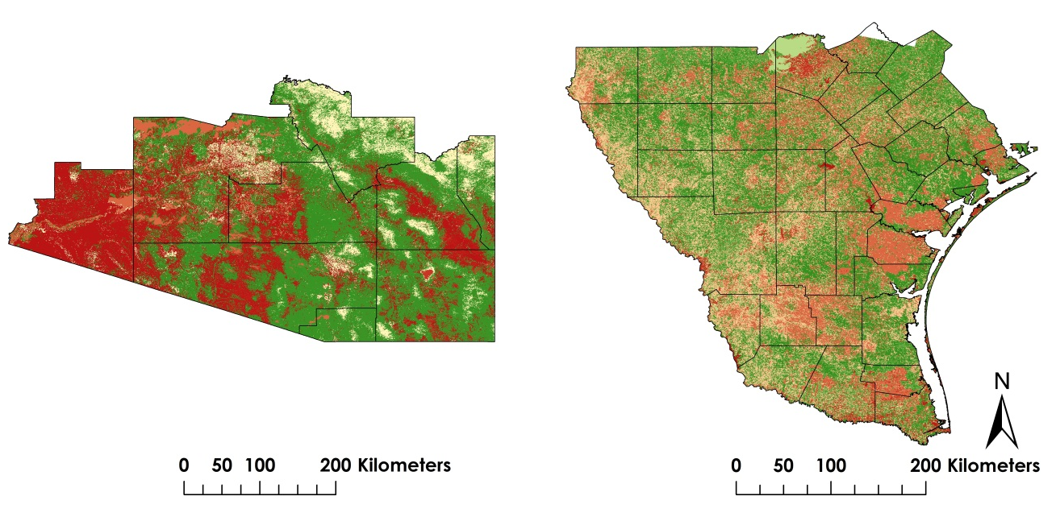
NASA Marshall Space Flight Center
Texas & Arizona Ecological Forecasting Team
Suitable Habitat Map -
Landsat 8 OLI/TIRS 2014 data were used to derive the land cover classification. Terra MODIS 2014 data were used to create the Normalized Difference in Vegetation Index (NDVI). Both layers were scaled using the Fuzzy Membership Tool and then combined using the Fuzzy Overlay Tool in ArcMap 10.2.1.
Most Suitable : 1
Least Suitable : 0

Slide 3
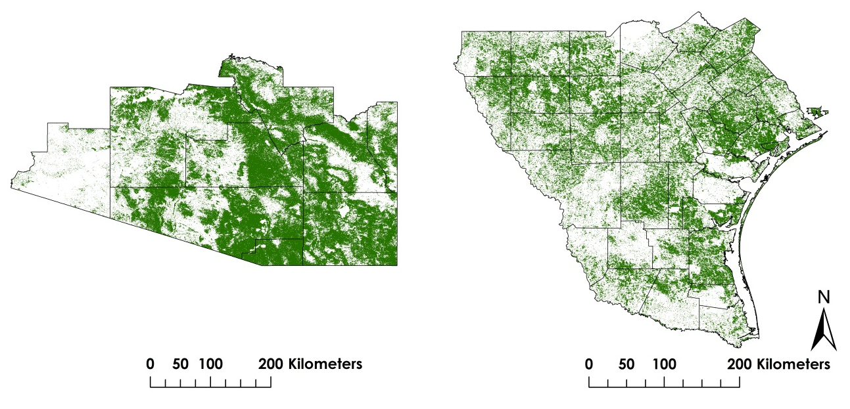
NASA Marshall Space Flight Center
Texas & Arizona Ecological Forecasting Team
Habitat Percent Cover Map -
The suitable habitat layer was reclassified to show only the areas with most suitable habitat. From that layer, the percent cover was assessed using the Geometry Tool in ArcMap 10.2.1.
Most Suitable Habitat

Slide 4
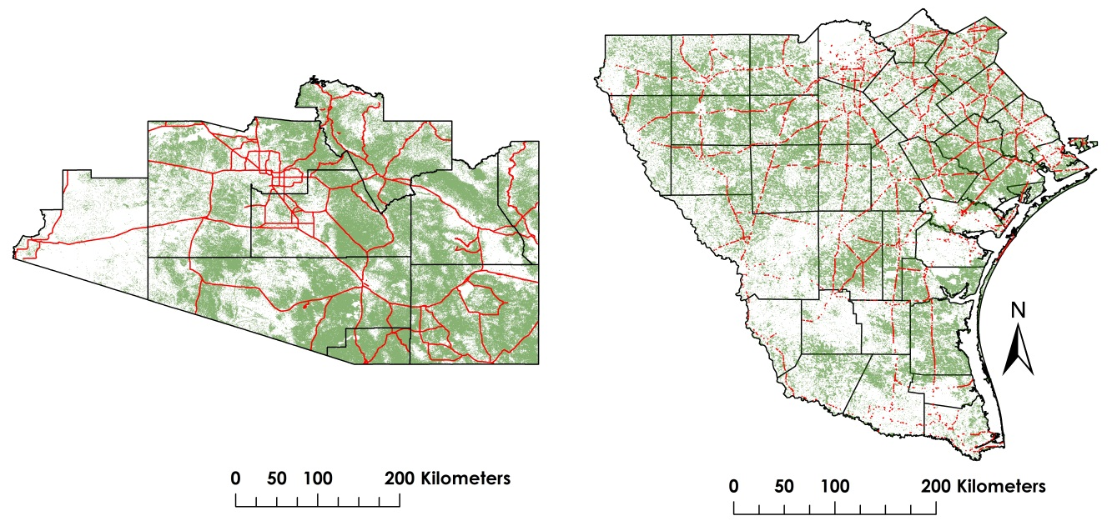
NASA Marshall Space Flight Center
Texas & Arizona Ecological Forecasting Team
Proximity Risk Map -
This map was created using the Intersect Tool in ArcMap 10.2.1. The two layers used were road networks and most suitable habitat.
High Risk Roads
Most Suitable Habitat

