Slide 1
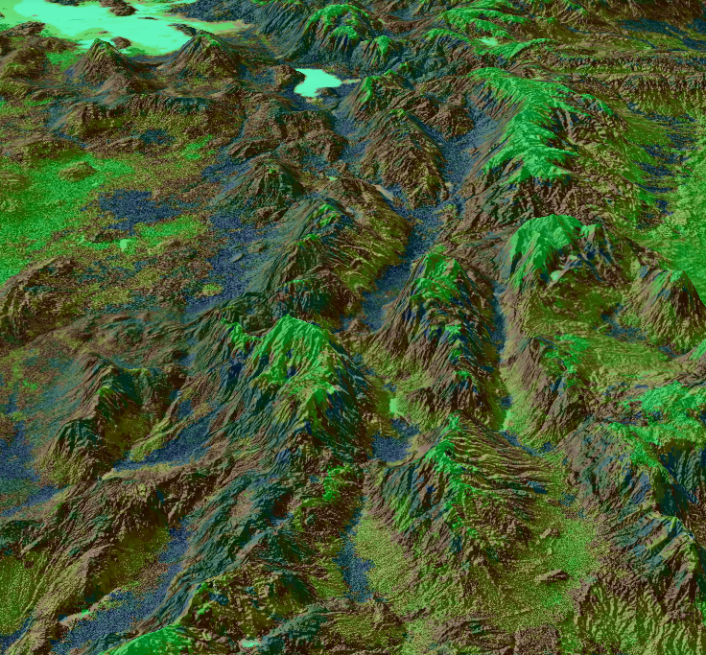
GREAT BASIN ECOLOGICAL FORECASTING
Integrating NASA Earth Observations into Live Fuel Moisture Models to Improve Wildfire Timing and Severity Forecasting in the Eastern Great Basin
Lauren Lad
Helena Bierly
Amber Hobbs
Gavin Pirrie
Idaho - Pocatello | Fall 2019
Notes:
Lauren-Introduce team
------Image Information Below------
Image made by the NASA DEVELOP team using Suomi-NPP VIIRS NDVI for May 1st of 2019. (doi: 10.5067/VIIRS/VNP13A1.001)
Image viewpoint is of the mountain range south of Great Salt Lake

Slide 2
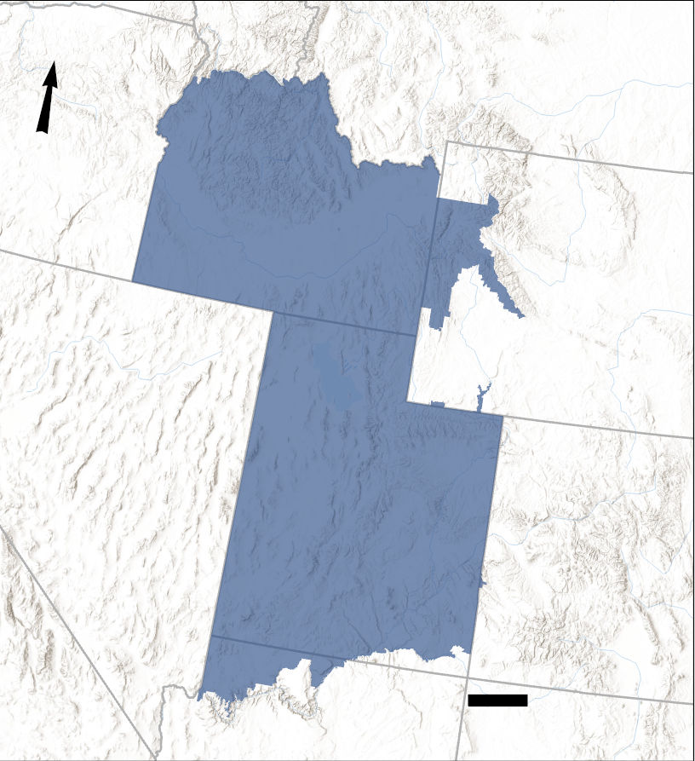
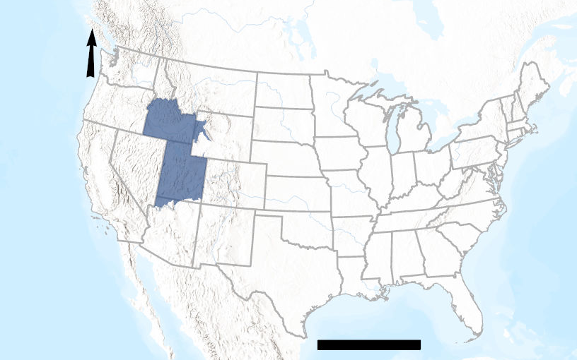
Study Area – Eastern Great Basin
 Location: Western United States
 Total Area: 411,759 km²
 States: Arizona, Colorado, Idaho, Utah, and Wyoming
N
N
100
1,000
Kilometers
Kilometers
Eastern Great Basin Study Area
Notes:
Lauren
The study area includes most of Utah and Idaho, while also including portions of Arizona, Colorado, and Wyoming. The eastern Great Basin is a semi-arid ecosystem that is subject to destructive wildfires. These wildfires affect the vegetation and contribute to other natural disasters occurring within the area, such as flooding and erosion.
------Image Information Below------
Image made the NASA DEVELOP team
Sources: Esri, Airbus DS, USGS, NGA, CGIAR, N Robinson, NCEAS, NLS, OS, NMA, Geodatastyrelsen, Rijkswaterstaat, GSA, Geoland, FEMA, Intermap and the GIS user community, Sources: Esri, HERE, Garmin, FAO, NOAA, USGS, © OpenStreetMap contributors, and the GIS User Community

Slide 3
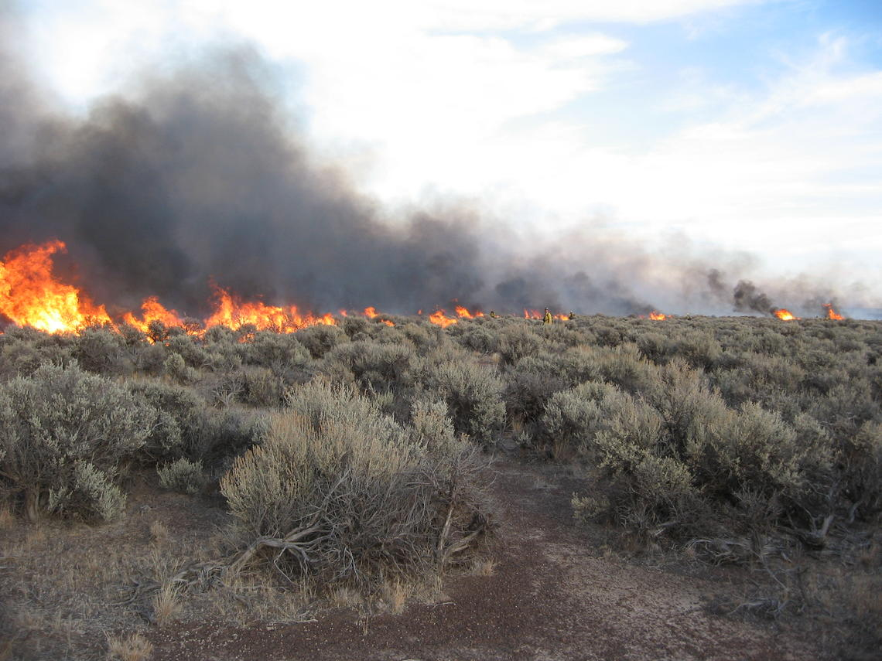
Why a live fuel moisture (LFM) model?
Our study period.
Why wildfires?
 April to September
(2016 & 2017)
 Twice monthly sampling: 1st to 15th of each month, 16th to the end of the month
 Not all are harmful, however increasing frequency can lead to greater risk.
 Vegetation, human life, urban areas
 In situ measurements
 Help predict the likelihood of wildfires at a higher spatiotemporal resolution
Image credit: Scott Shaff, USGS
Notes:
Amber
Wildfires can benefit ecosystems by aiding in plant succession regulation. However, as their frequency has increased since the 1950s, wildfires are becoming a growing threat to human life, property, and urban development. Additionally, wildfires can harm a region’s ecology by impacting water quality and susceptibility to erosion. In order to aid project partners in their prediction of and response to wildfires, the NASA DEVELOP team examined live fuel moisture (LFM) content during wildfire season. Using the in situ data provided by our partners, our team developed a LFM model that will enhance ability in predicting the severity of wildfires in the eastern Great Basin study area.
------Image Information Below------
Image Source: https://www.usgs.gov/media/images/sagebrush-fire-a-controlled-burn (Public Domain)

Slide 4
Fire Frequency
Notes:
Amber
This histogram shows wildfire frequency, collected by the ISU GIS TReC, in the eastern Great Basin from 1950 to 2018. Our project examined the factors contributing to wildfires during the years of 2016 and 2017. The number of wildfires has exponentially grown since 1950 with the highest frequency of wildfires being between 1996 and 2018.
------Source for Statistics------
http://giscenter.isu.edu/research/Techpg/HFD/index.htm
Fire Frequency data acquired from the Historic Fires Database from the Idaho State University GIS Training and Research Center.

Slide 5
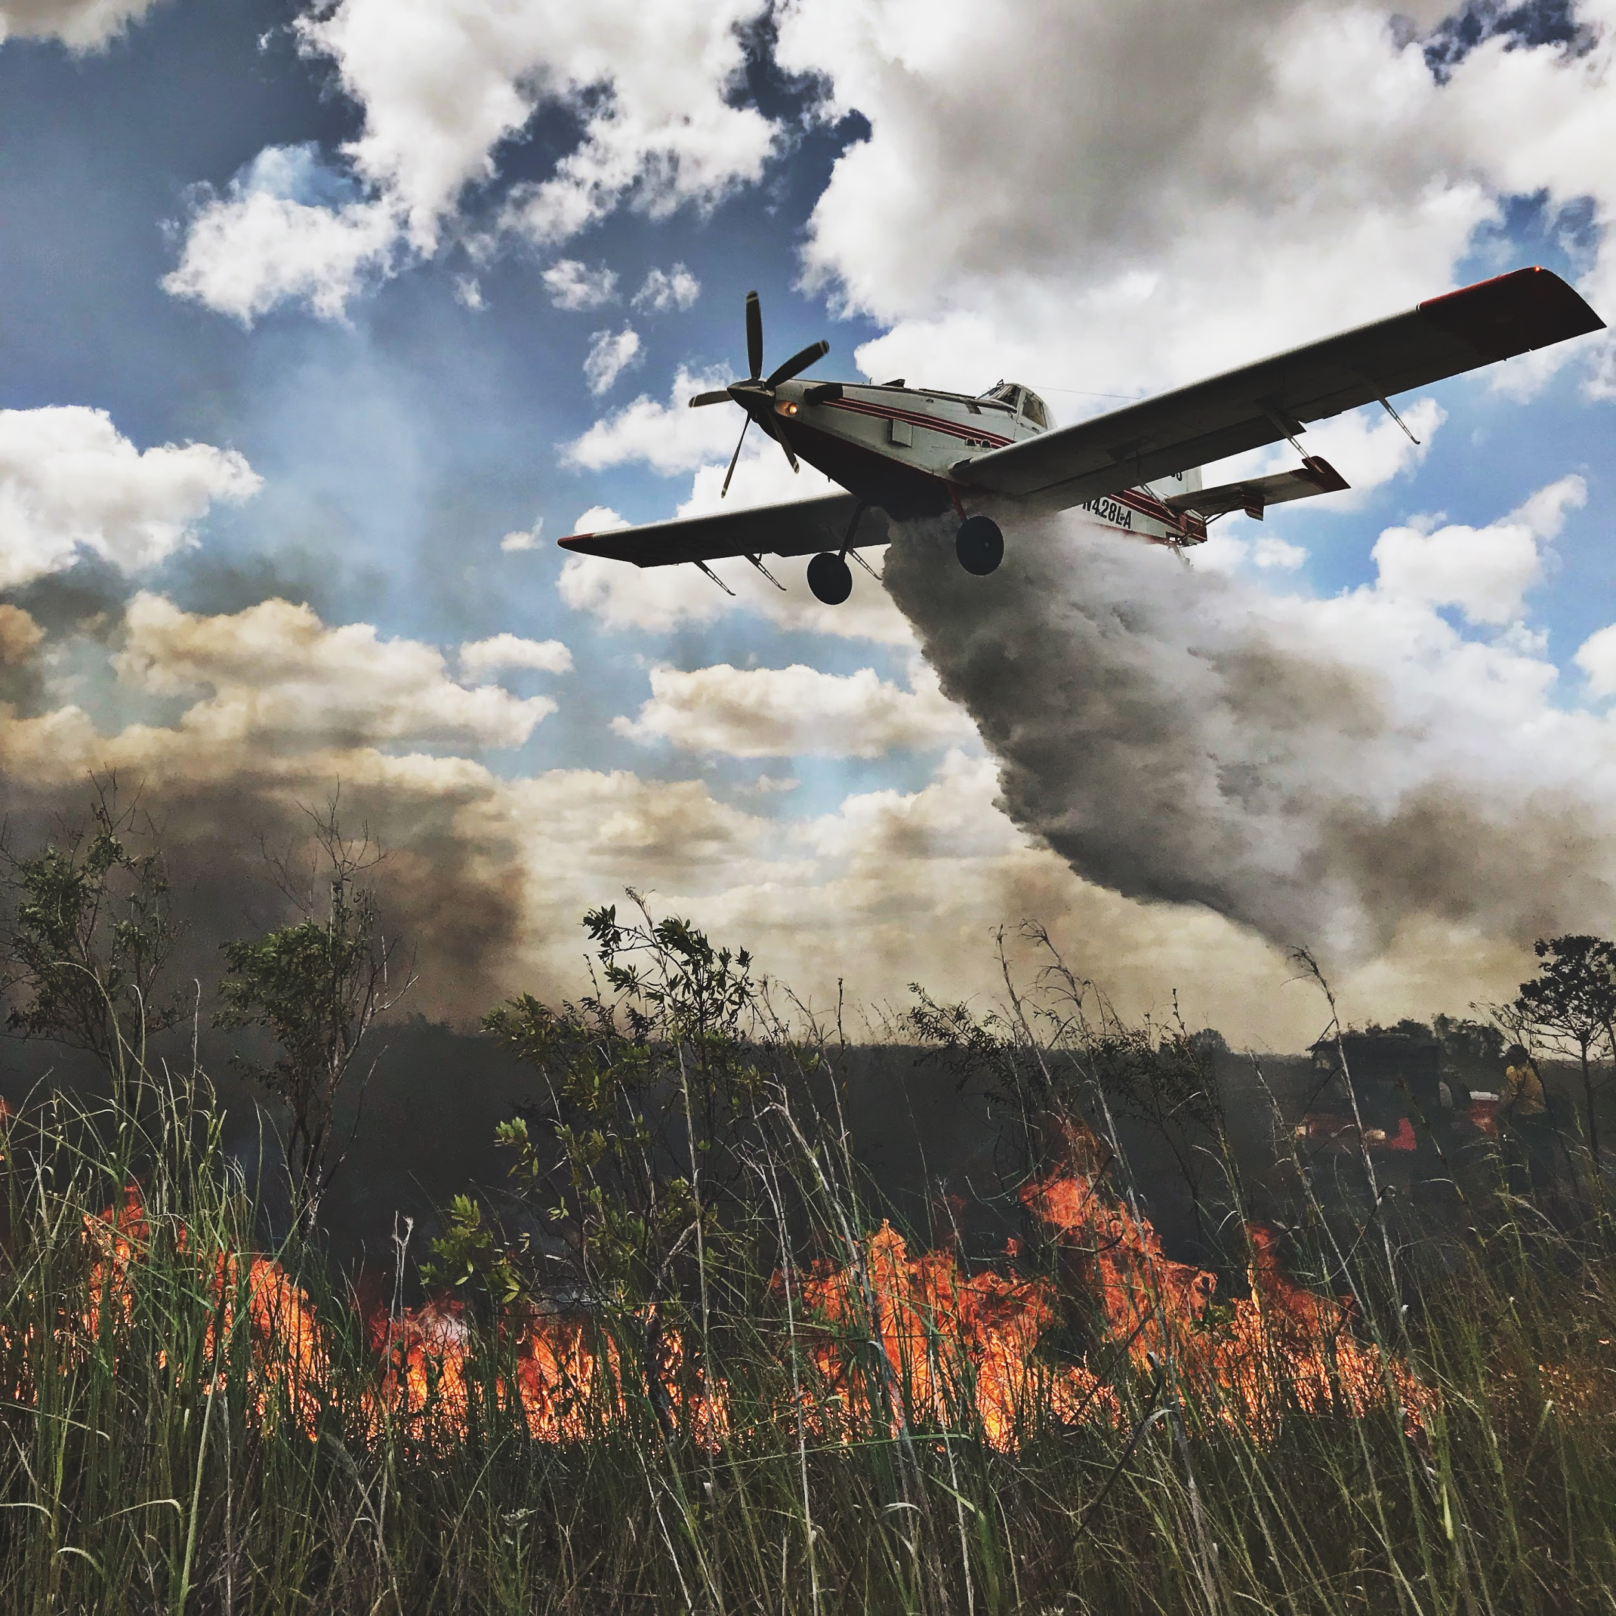
Community Concerns
 Economic Loss where wildfires can potentially cost billions of dollars in suppression and recovery.
 Ecological Loss where wildfires can impact environmental factors such as water quality, erosion, and flooding.
 Response Timing as untimely response efforts toward wildfires can affect resource allocation and risk the loss of life.
Image credit: National Interagency Fire Center
Notes:
Helena
The implementation of a predictive model for live fuel moisture estimates in the eastern Great Basin Region will improve response timing, resource allocation, and prevent economic and ecological loss.
------Image Information Below------
Image Source: https://flickr.com/photos/165415395@N07/43443733124/in/album-72157698026084534/
Image consent received on 11/6/2019 from the NIFC

Slide 6


Partners
Bureau of Land Management (BLM), Upper Snake Field Office
NOAA, National Weather Service
Idaho Department of Fish and Game, Southeast Regional Office
Great Basin Coordination Center (GBCC)
Notes:
Helena
Our project partners included the Bureau of Land Management Upper Snake Field Office, the National Oceanic Atmospheric Administration National Weather Service Pocatello Office, the Great Basin Coordination Center, and the Southeast Regional Office of the Idaho Department of Fish and Game.

Slide 7
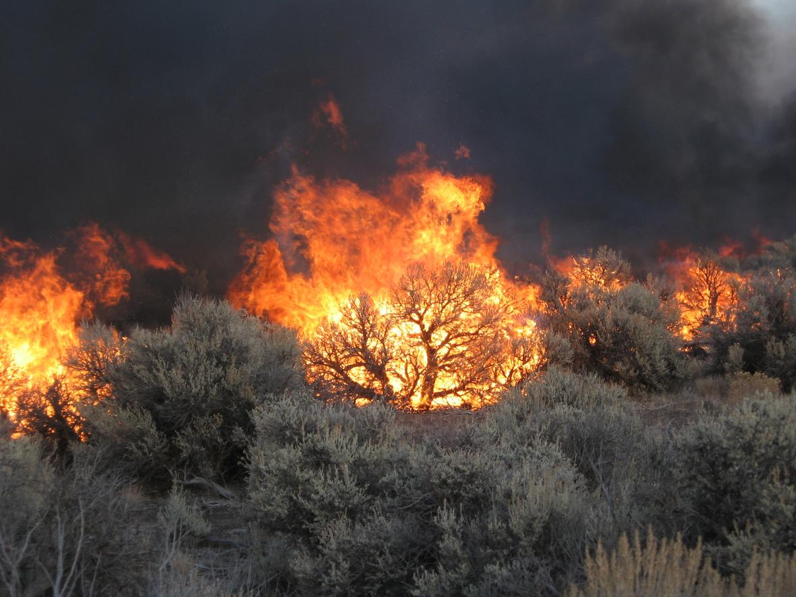
Objectives
 Evaluate the feasibility of using existing spatial datasets to determine LFM
 Determine which data inputs have the highest correlation strength with in situ datasets from the BLM and GBCC
 Generate a LFM model to predict wildfire risk and severity
 Produce a tutorial describing the model for partners to replicate processes
Image credit: Scott Shaff, USGS
Notes:
Lauren
There were four main objectives of the project. First, we wanted to evaluate the feasibility of using existing spatial datasets from our partners in the determination of live fuel moisture. Secondly, we aimed to determine which data inputs best matched the in situ data from the BLM and GBCC. We found these data to be: elevation, Aqua MODIS ET, VIIRS LST & NDVI, Terra MODIS ET, and aspect. Thirdly, we targeted creating a live fuel moisture model to forecast wildfire risk and severity based on the LFM percentage of sagebrush. Finally, we wished to design a tutorial of our model for our partners to reproduce the processes that we used. The overarching goal of this project was to improve the spatiotemporal resolution of LFM measurements throughout the EGB so that project partners have an improved knowledge of potential wildfire risk.
------Image Information Below------
Image Source: Scott Shaff/USGS, https://www.usgs.gov/media/images/burning-sagebrush , Public Domain

Slide 8
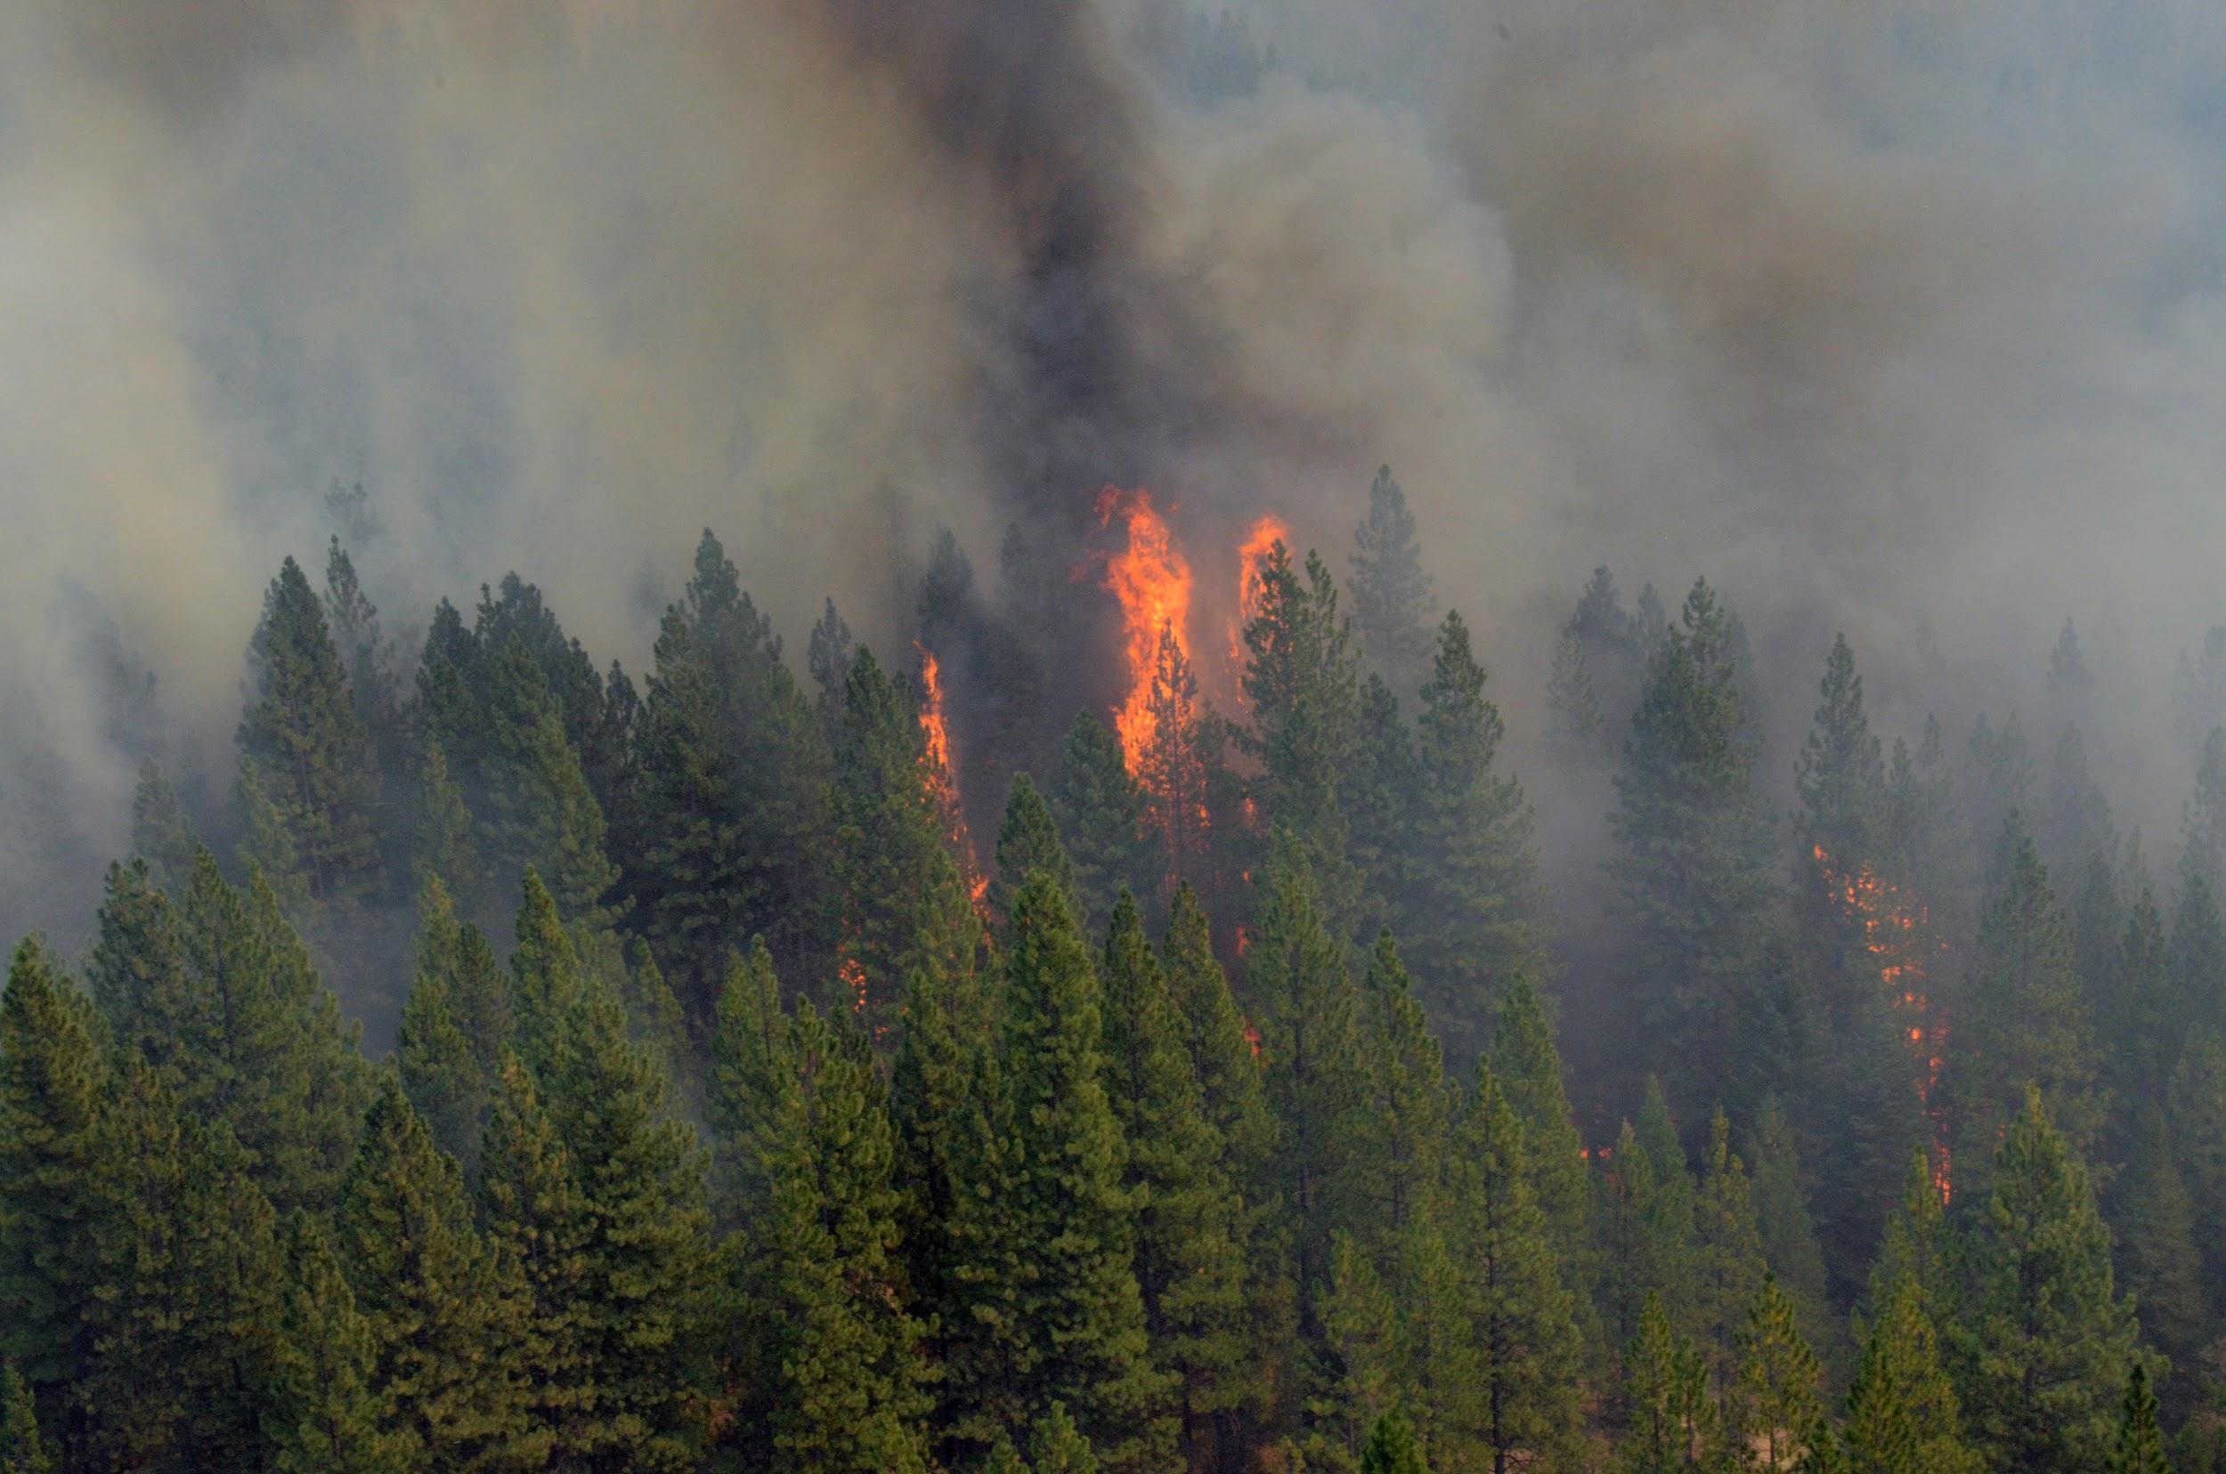
Ancillary Datasets
In situ measurements of LFM from the BLM for the years 1995 to 2018
LANDFIRE Land cover Data to mask out nonburnable areas and isolate sagebrush for LFM classification
National Elevation Dataset (NED) for aspect and elevation layers
BLM Fuel Moisture Sampling Guide as guidelines for LFM classes
Image credit: Master Sgt. Paul Wade/ U.S. Army National Guard
Notes:
Lauren
We classified sagebrush into 6 LFM classes: (1) 0-74%, (2) 75-99%, (3) 100-124%, (4) 125-149%, (5) 150-199%, (6) 200% and above.
------Image Information Below------
Image Source: Master Sgt Paul Wade/US Army National Guard, https://flickr.com/photos/caguard/9686077215/, CC by 2.0

Slide 9
Partner Data
Class | Live Fuel Moisture Range (Percent)
1 | 0-74
2 | 75-99
3 | 100-124
4 | 125-149
5 | 150-199
6 | 200 & above
Image credit: Master Sgt. Paul Wade, U.S. Army National Guard
Notes:
Lauren
We classified sagebrush into 6 LFM classes: (1) 0-74%, (2) 75-99%, (3) 100-124%, (4) 125-149%, (5) 150-199%, (6) 200% and above.
------Image Information Below------
Image Source: Master Sgt Paul Wade/US Army National Guard, https://flickr.com/photos/caguard/9686077215/, CC by 2.0

Slide 10

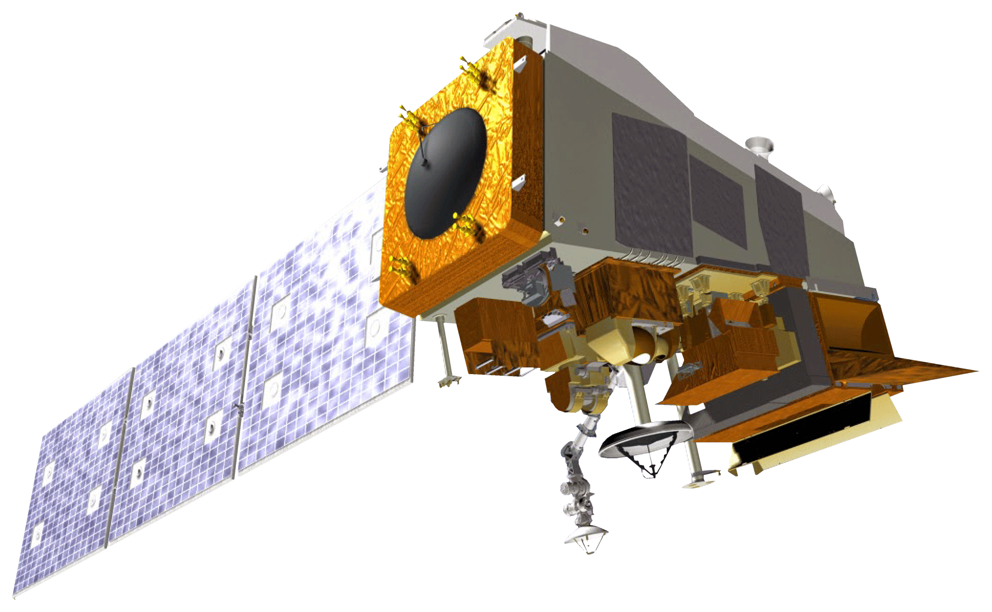


Model Satellites and Sensors
Image Credit: NASA JPL
Suomi National Polar-orbiting Partnership
Visible Infrared Imaging Radiometer Suite
Aqua
Moderate Resolution Imaging Spectroradiometer
Terra
Moderate Resolution Imaging
Spectroradiometer
Notes:
Gavin
The team used Aqua and Terra MODIS for Evapotranspiration and Suomi-NPP VIIRS for Land Surface Temperature and Normalized Difference Vegetation Index
------Image Information Below------
Image Source: https://images.nasa.gov/details-PIA00232

Slide 11
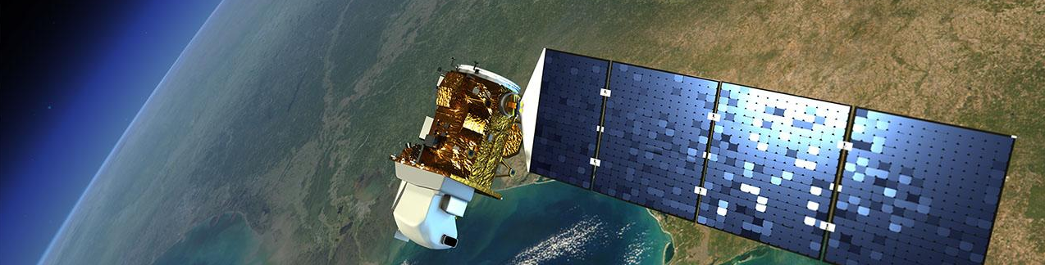
Visualization Tool – GreBAT
 GreBAT: Great Basin Analysis Tool
 Google Earth Engine tool, used with Landsat 5, Landsat 8, and SRTM
 Visualize NDVI, NDWI, true color, and false color
 Longer temporal trends in the eastern Great Basin
Image credit: NASA, Near Earth Network, Space Network
Notes:
Gavin
Our team’s visualization tool is titled GreBAT, or the Great Basin Analysis Tool. The tool is used through Google Earth Engine in order to process and then visualize sizable data derived from Landsat 5, Landsat 8, and the Shuttle Radar Topography Mission (SRTM). The tool allows inputs from Normalized Difference Vegetation Index (NDVI), Normalized Difference Water Index (NDWI), true color, and false color. The tool will be used by our partners in order to interpret information and longer scale temporal trends from the eastern Great Basin study area.
------Image Information Below------
Image Source: NASA, https://www.nasa.gov/directorates/heo/scan/services/missions/earth/LDCM.html, Public Domain

Slide 12
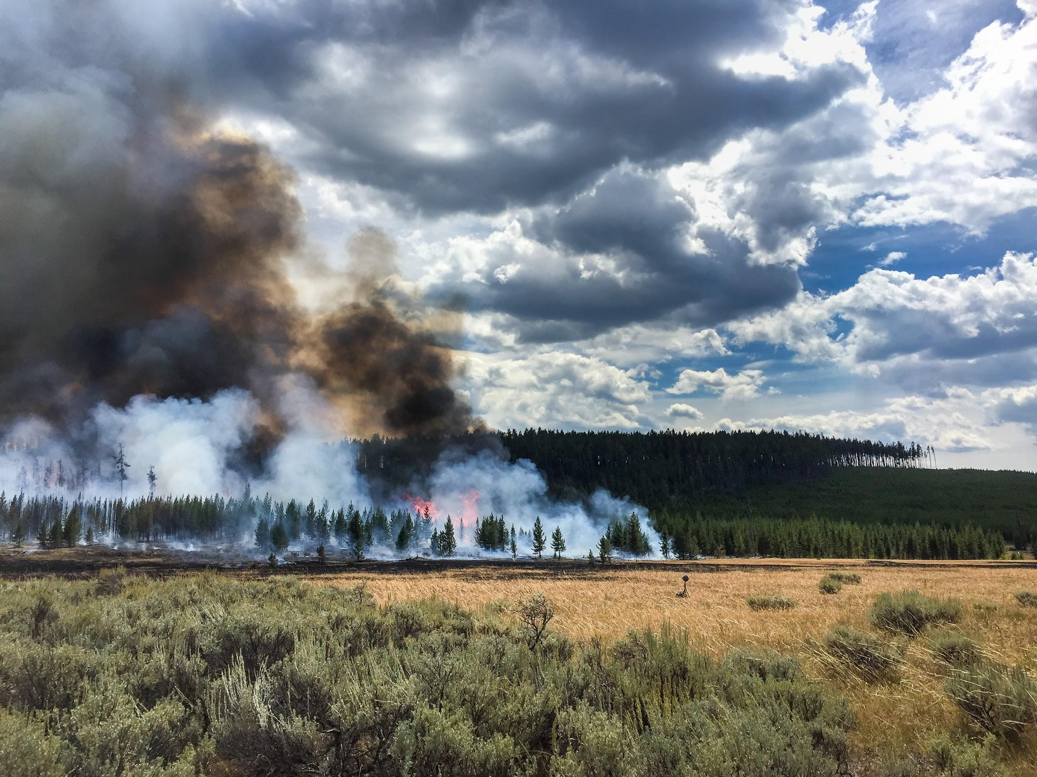
Data Acquisition
Data Processing
Data Analysis
 Reclassification of in situ data
 Earth observation data download
 Ancillary data download
 Create Composite images
 Convert layers into integer values
 Project rasters
 Random Trees Classifier
Confusion Matrix
Zonal Statistics
Image credit: National Interagency Fire Center
Notes:
Gavin
This graphic illustrates our interpretation and analysis of the in situ data measurements. After all data were downloaded, our team began by reclassifying the in situ sagebrush data into the 6 LFM percentage classes. For data processing, we created composite images and converted each layer to integer values to preserve data while decreasing file size. We also projected each raster to the same projected coordinate system for consistency. The in situ data were separated into training and testing points. For model development, we used a 60% training and 40% testing point split. This equated to approximately 28 training points and 19 validation points per term. Once the training points had trained the Random Trees Classifier to identify LFM based on the composite images, the testing points were used to evaluate the model output accuracy with a confusion matrix. Zonal statistics were then calculated for 3 polygons within the study area in order to conduct LFM trend analysis throughout peak fire season.
------Image Information Below------
Image Source: https://www.flickr.com/photos/165415395@N07/43443931674/in/album-72157695703320492/
Image consent received on 11/6/2019 from the NIFC

Slide 13
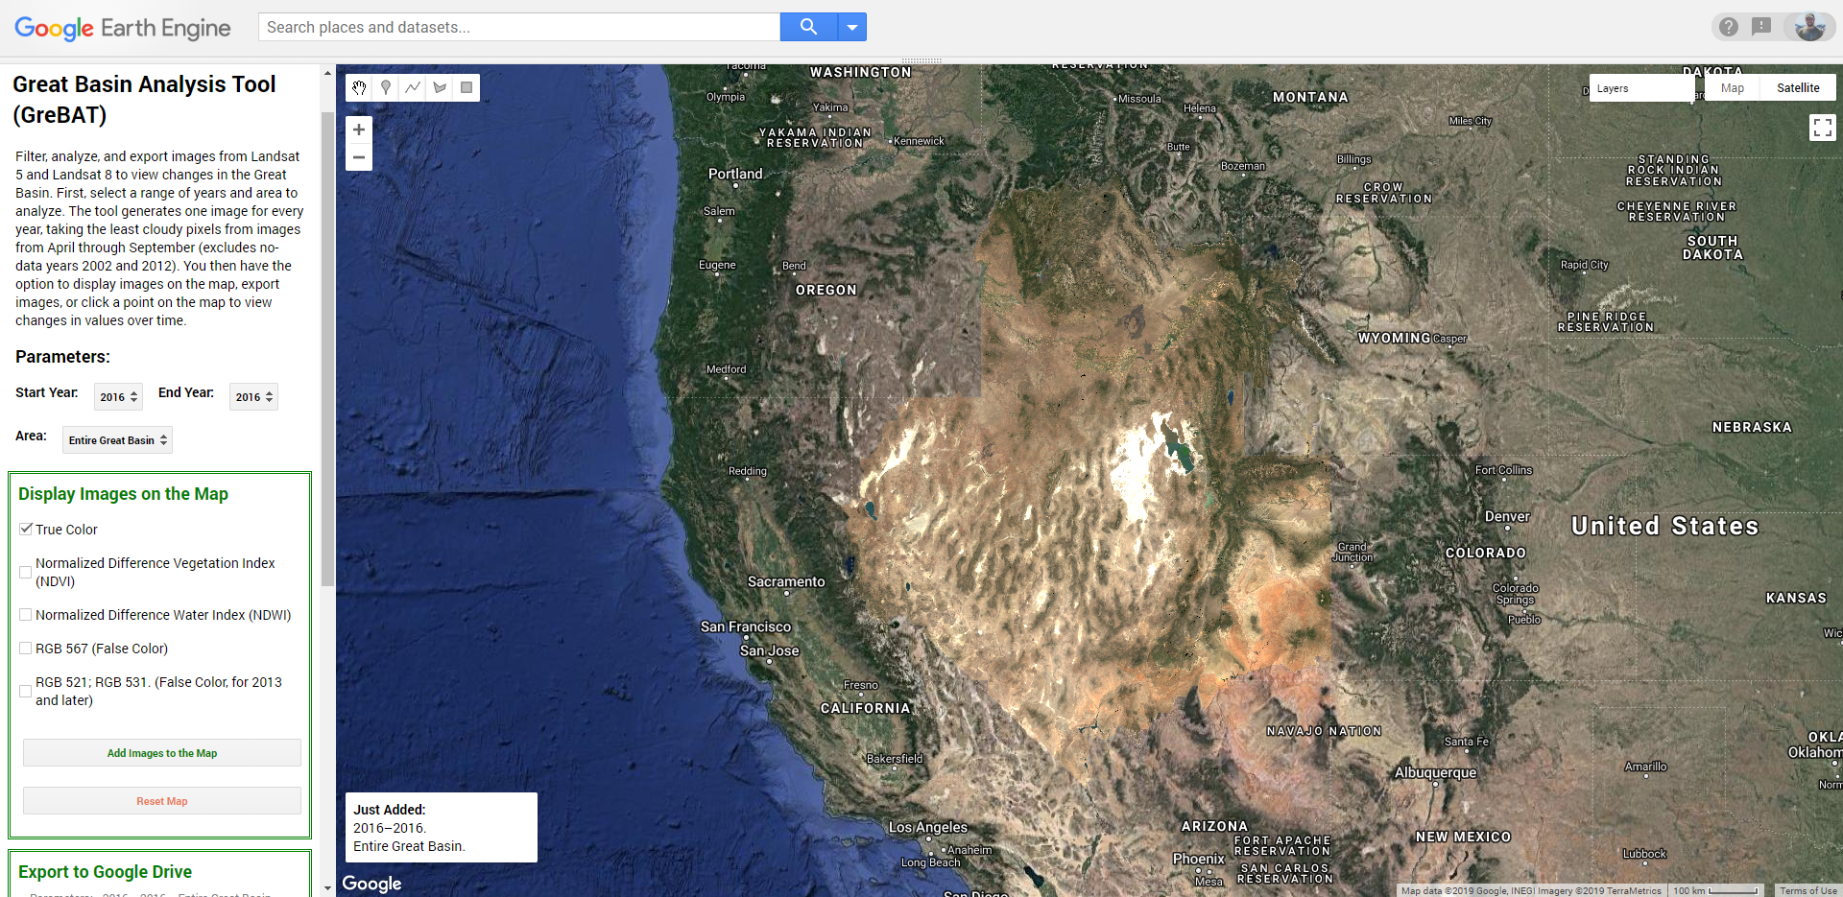
Software
Notes:
Gavin
GreBAT shows NDVI, NDWI, false color, and true color. True color is shown for the entire Great Basin in this screenshot of GreBAT for 2016.
------Image Information Below------
GreBAT Screenshot created by ID Fall 2019 DEVELOP Team

Slide 14
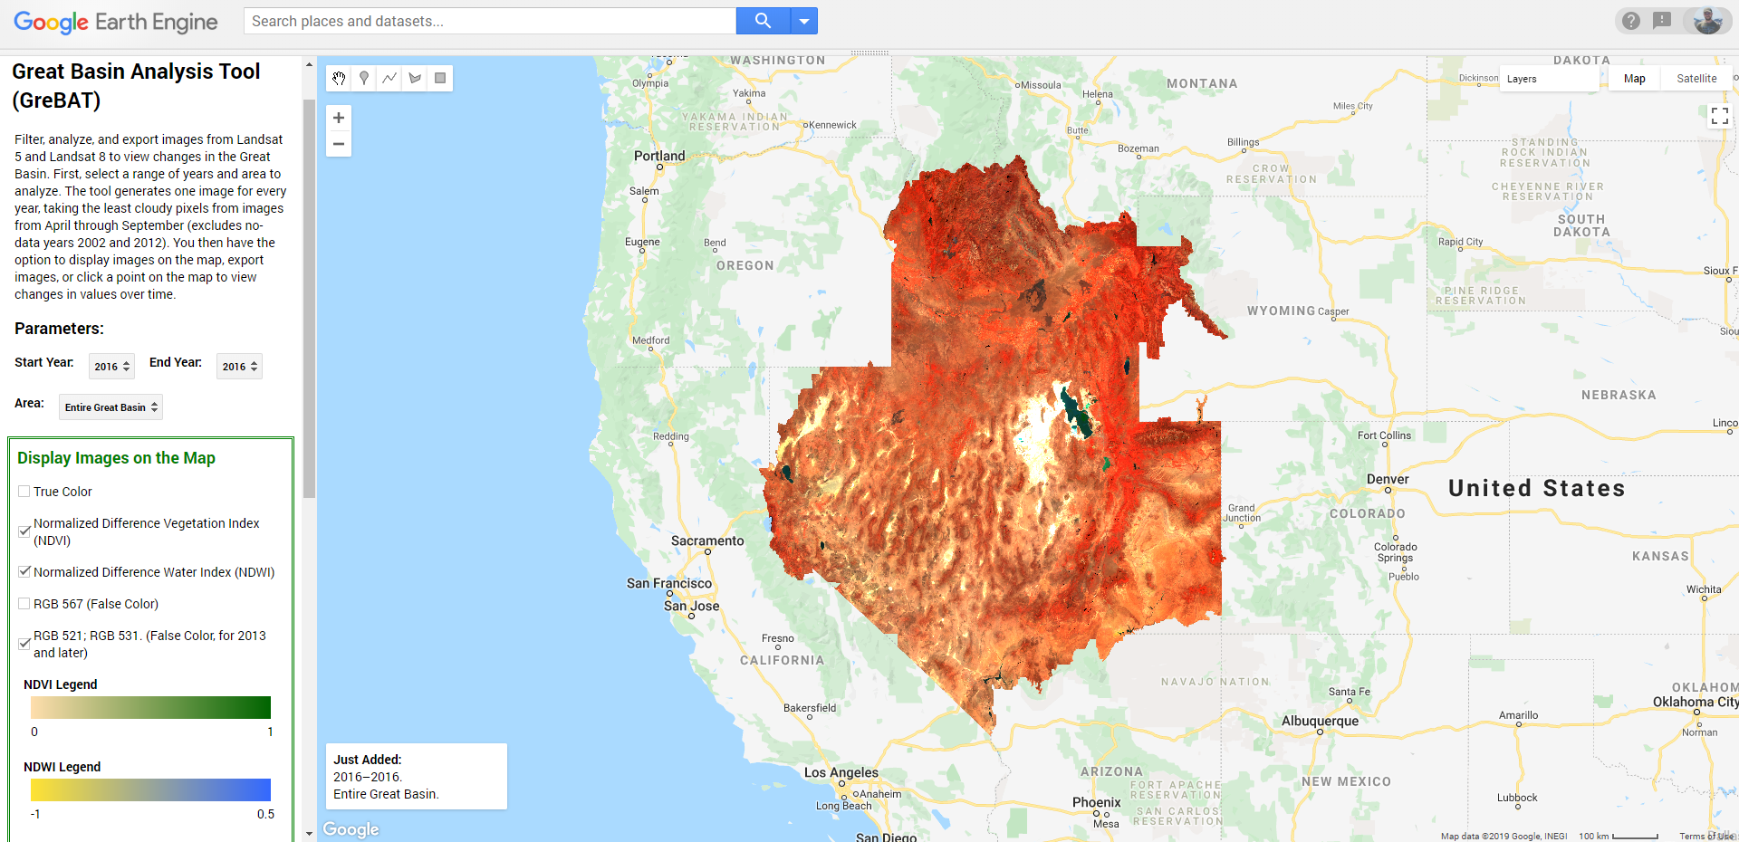
Software
Notes:
Gavin
False color is shown in this screenshot of GreBAT for 2016.
------Image Information Below------
GreBAT Screenshot created by ID Fall 2019 DEVELOP Team

Slide 15
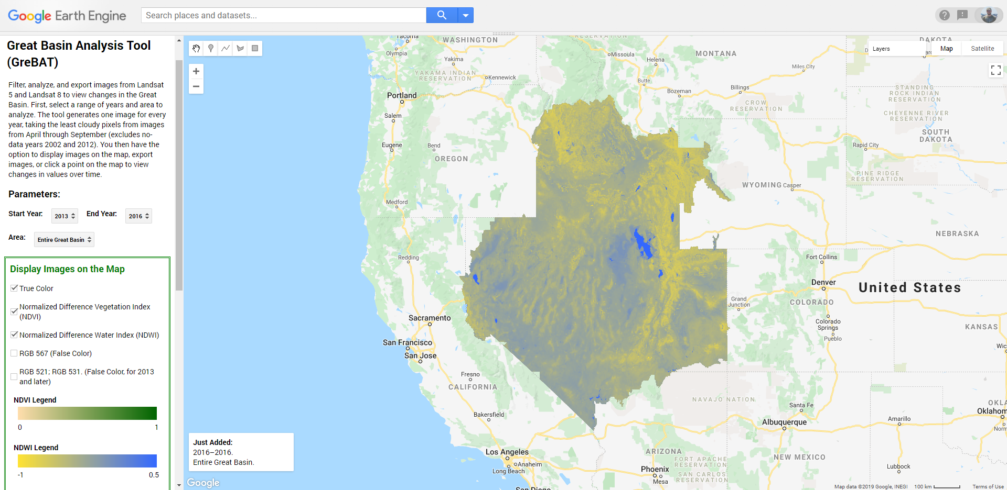
Software
Notes:
Gavin
NDWI is shown in this screenshot of GreBAT for 2016.
------Image Information Below------
GreBAT Screenshot created by ID Fall 2019 DEVELOP Team

Slide 16
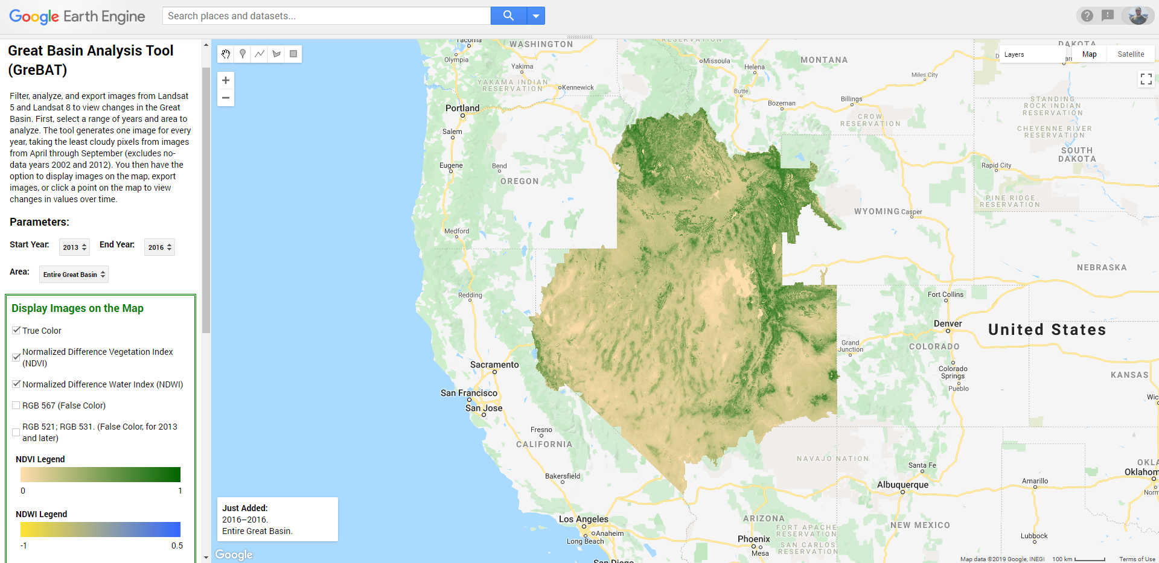
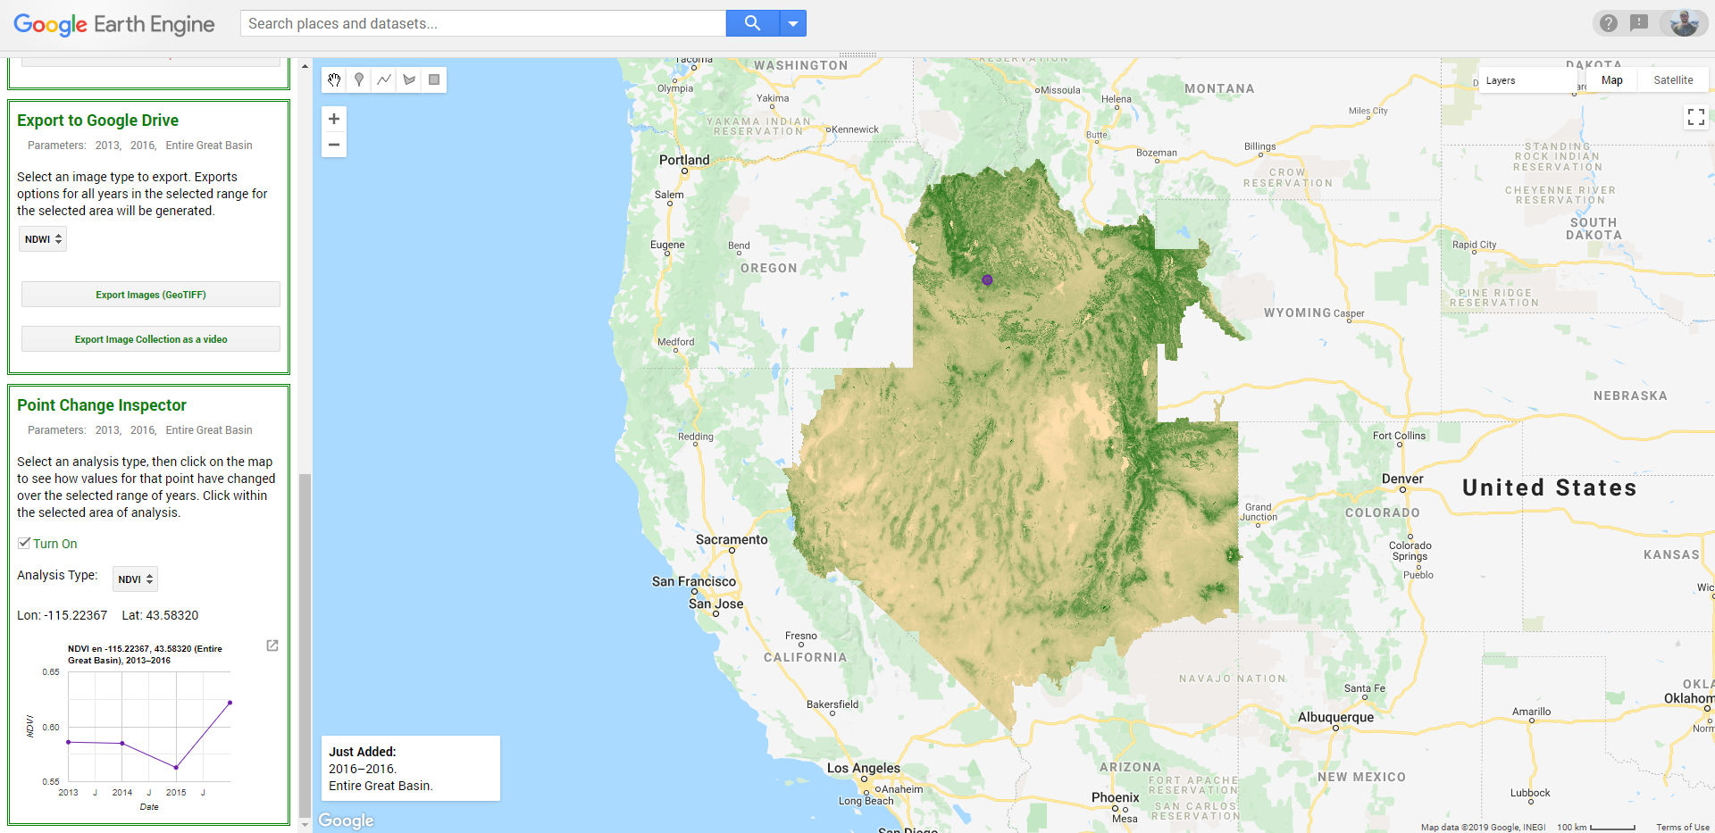
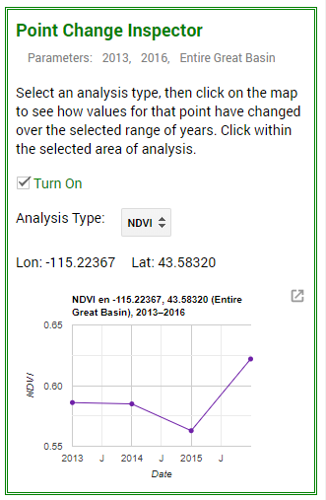
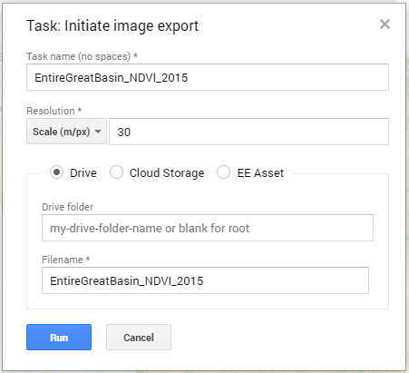
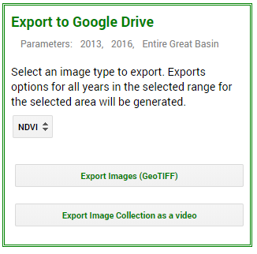
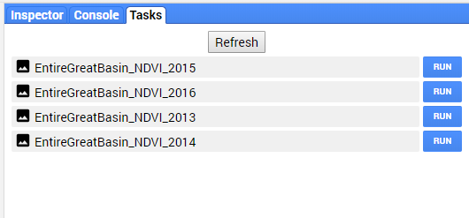
Software
Notes:
Gavin
NDVI is shown in this screenshot of GreBAT for 2016 as well as point change inspector and export.
------Image Information Below------
GreBAT Screenshot created by ID Fall 2019 DEVELOP Team

Slide 17
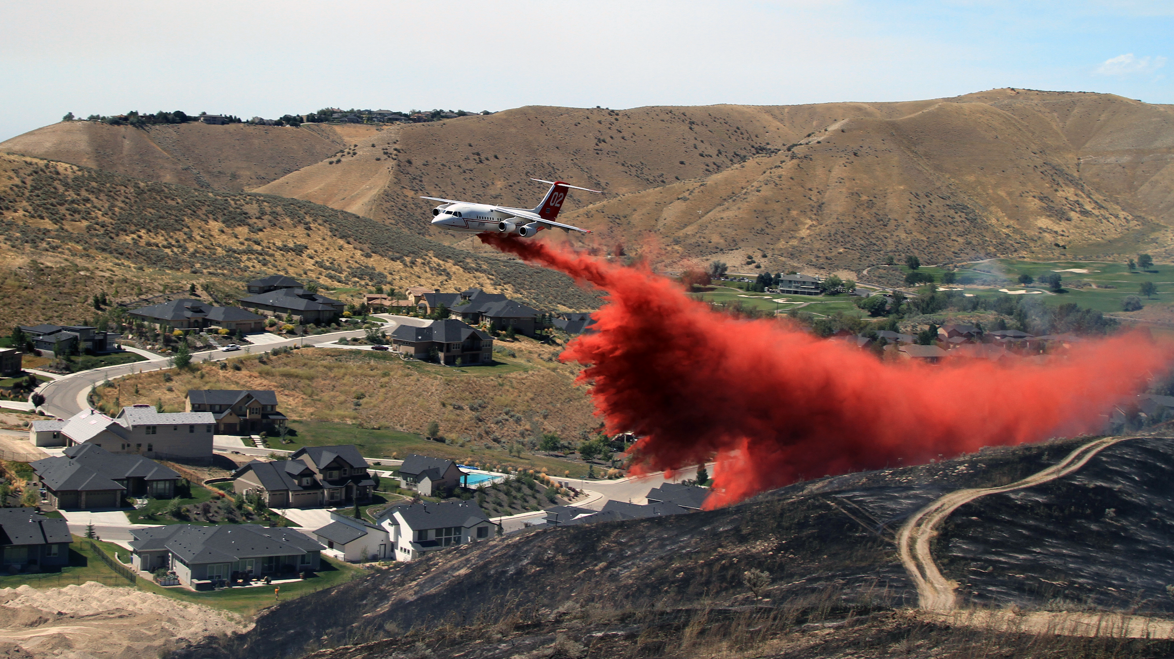
Software
 ESRI ArcGIS Pro for data processing, image compositing, and image classifications
 Google Earth Engine API for data download and processing for the GreBAT Tool
 Python for automation of raster analysis
Image credit: National Interagency Fire Center
Notes:
Amber
The DEVELOP team used ESRI ArcGIS Pro, Google Earth Engine API, and Python to create the Live Fuel Moisture model for our partners.
------Image Information Below------
Image Source: https://flickr.com/photos/165415395@N07/30608405718/in/album-72157698026084534/
Image consent received on 11/6/2019 from the NIFC

Slide 18
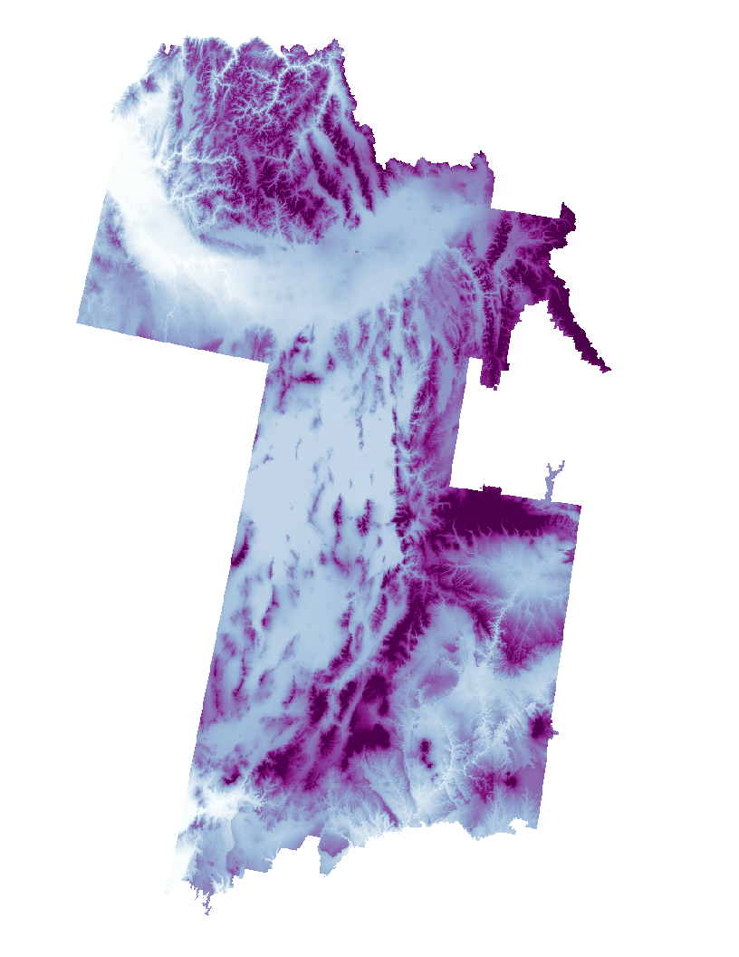
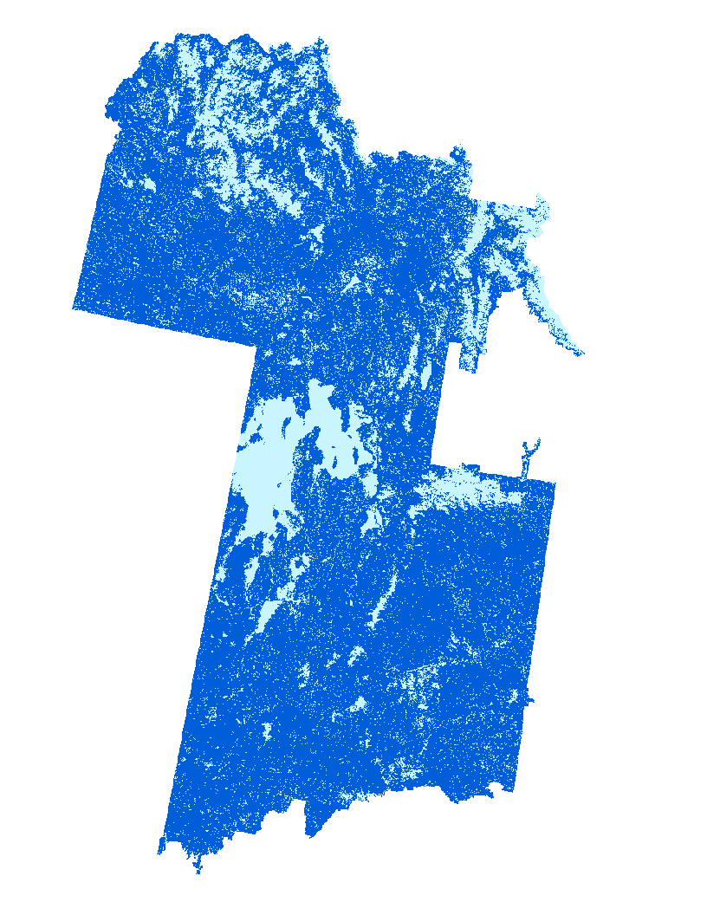
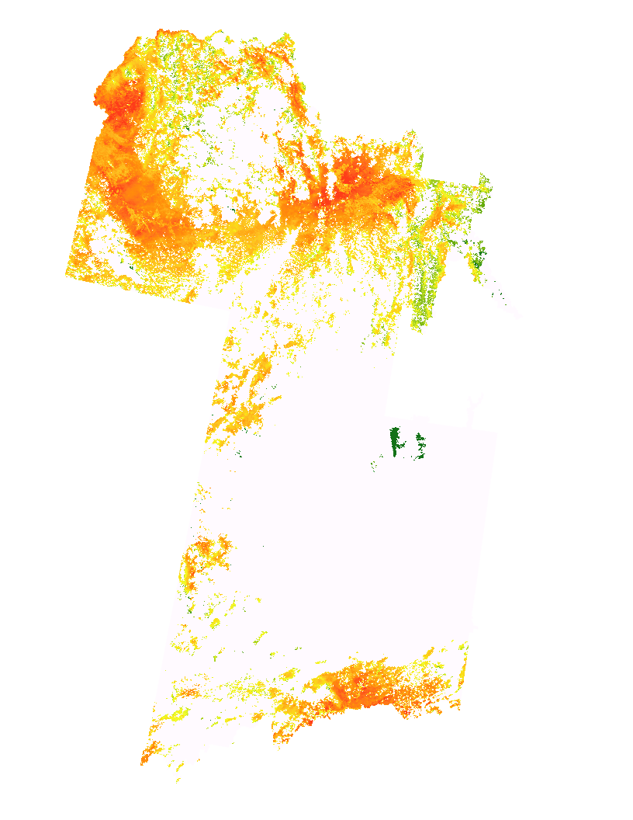
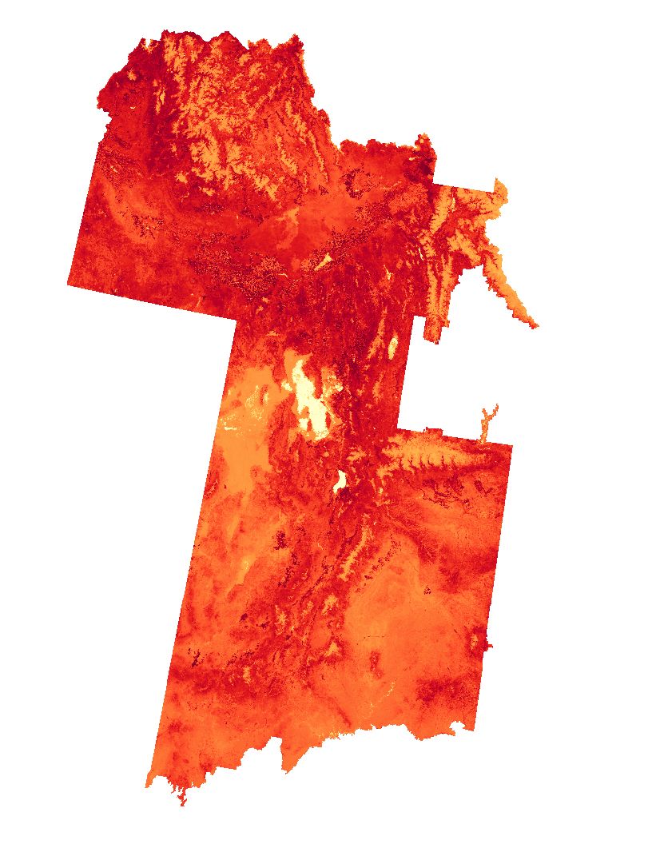
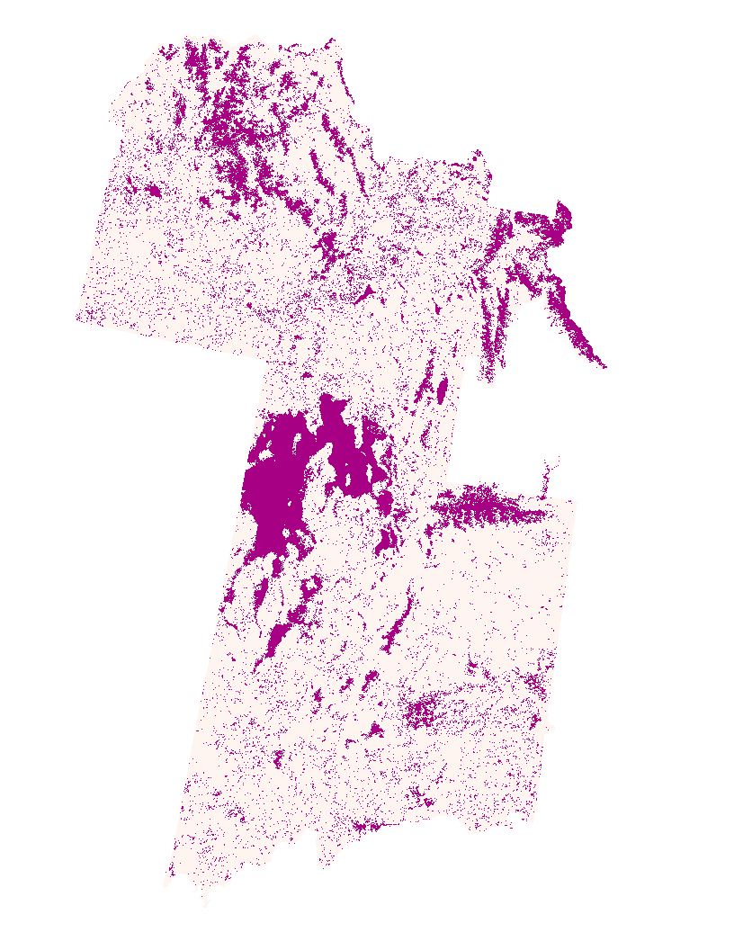
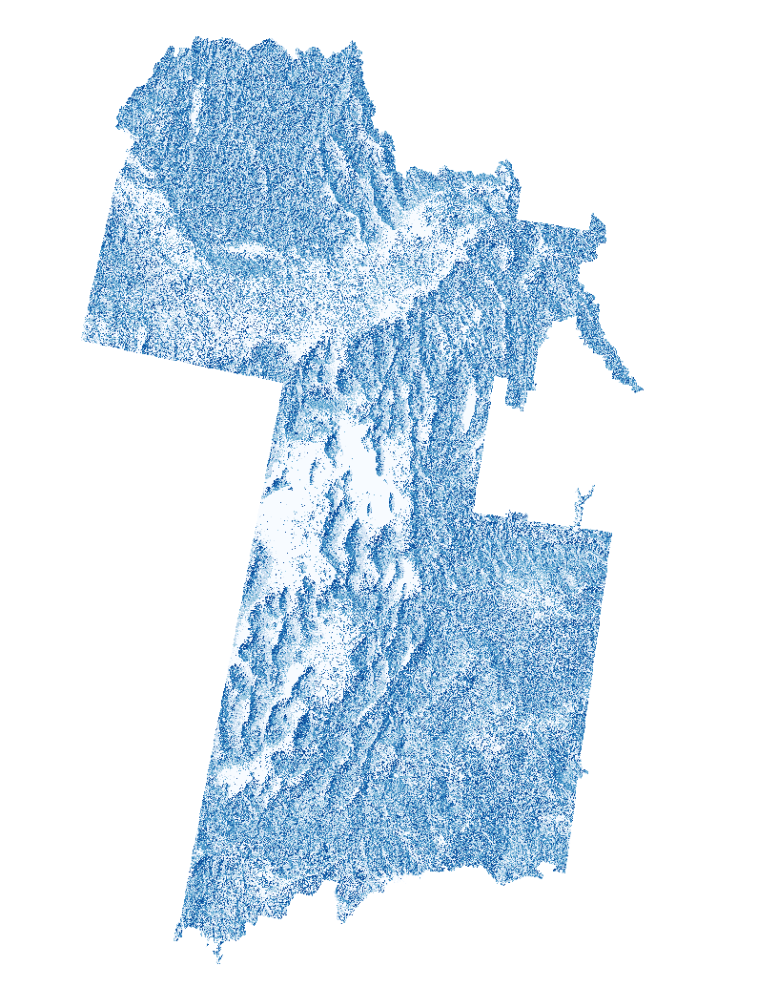
Model Composition
1. Elevation
2. Aqua ET
3. VIIRS LST
4. VIIRS NDVI
5. Terra ET
6. Aspect
2. 3. 4. 5. 6.
Notes:
Amber
In order to develop the model, composite rasters were made for each two week time period using ArcGIS Pro. The composite images were comprised of the following layers: elevation, Aqua MODIS ET, Suomi-NPP VIIRS LST and NDVI, Terra MODIS ET, and aspect. These composite rasters were used in combination with subset data to train the Random Trees Classifier in ArcGIS Pro to identify LFM classes.
------Image Information Below------
Image source of layer by number:
1: 2005 data layer acquired from BLM
2, 3, and 4 DOI: 10.5067/MEaSUREs/SRTM/SRTMGL1.003
5 DOI: 10.5066/P937PN4Z
6 DOI: 10.5067/MODIS/MYD16A2.006
7 DOI: 10.5067/VIIRS/VNP21A1D.001
8 DOI: 10.5067/VIIRS/VNP13A1.001
9 DOI: 10.5067/MODIS/MOD16A2.006
10 DOI: 10.5067/KE1CSVXMI95Y
11: 2016 & 2017 GRIDMET acquired from GEE API

Slide 19
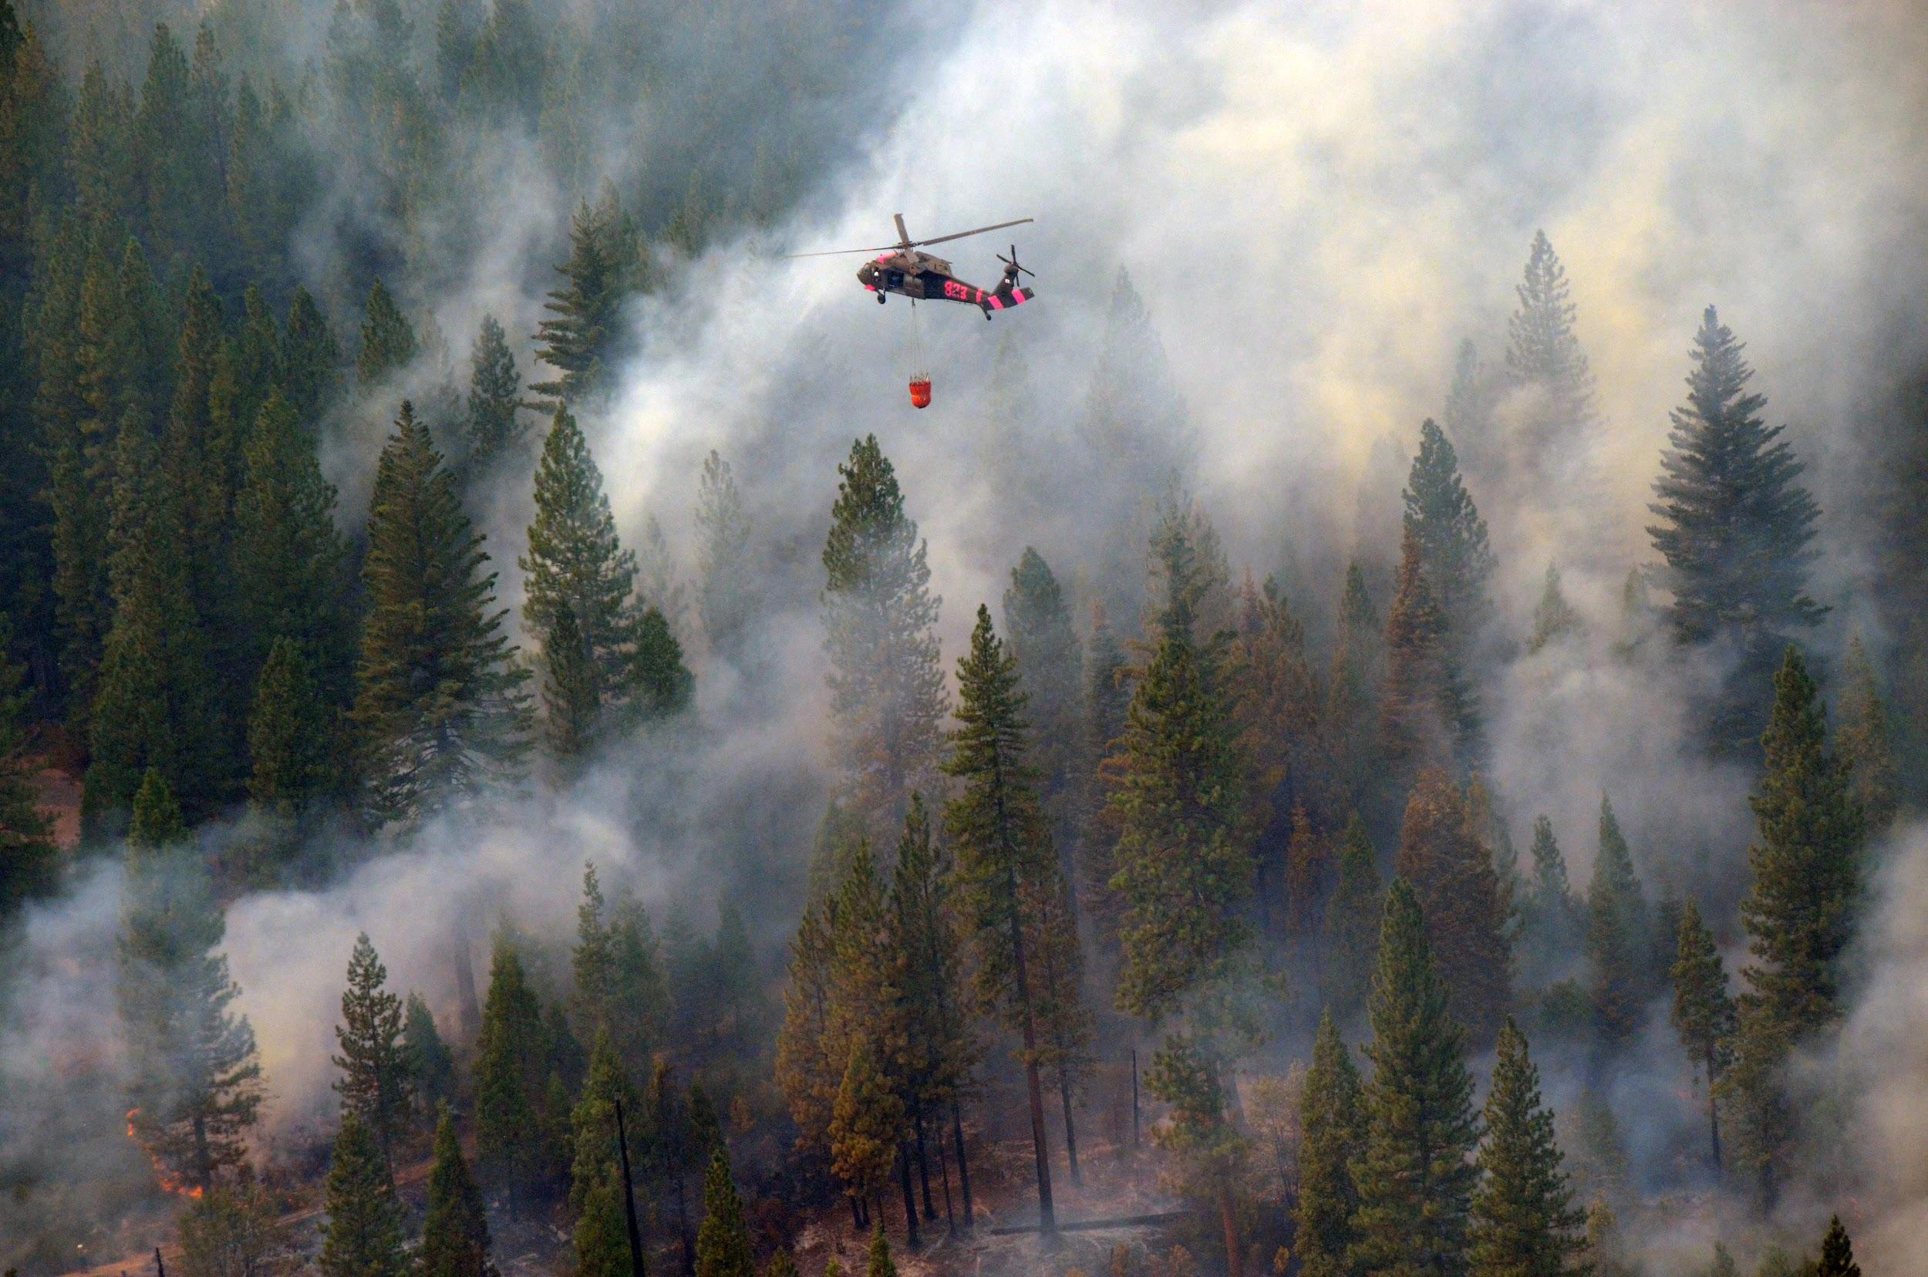
Model Errors and Uncertainties
 Temporal Resolution has been limited to the years 2016 and 2017 due to incomplete satellite and in situ data
 Spatial Resolution could be affected by resampling elevation and aspect
 Data Removal of all non-sagebrush measurements removed 77% of our in situ data
 Data Gaps for VIIRS Land Surface Temperature Data
Image credit: Master Sgt. Paul Wade, U.S. Army National Guard
Notes:
Helena
Temporal resolution was limited to 2016 and 2017 because there was incomplete in situ data for 2018 and 2019. In order to develop the most comprehensive model in the most recent years, we decided to conduct the training of our model in the years 2016 and 2017. This allowed for the elimination of gaps in satellite and in situ data, but means that a forecasting model for 2020 will rely on a model trained on data from 3 years prior. This could result in an unknown amount of error in the model. All model layers were resampled to 250 m, which could have introduced an unknown amount of error. Additionally, partner in situ data included LFM measurements for 1, 10, 100, and 1000 hour dead fuels. In order to train our model to identify exclusively live fuels, these data were removed, resulting in a loss of 77% of in situ data. Finally, VIIRS LST data had varying gaps in data due to cloud cover. This resulted in some terms having little to no LST data, while some terms relied heavily on this data for model training.
------Image Information Below------
Image Source: https://flickr.com/photos/caguard/9685947041/in/photolist-fKV1AV-hps45W-kvDm-iPs4xK-7RdWa8-9R1hJT-9p4Rkt-6KtdKi-suTZiN-gLH9K-7M7Uht-231ZqeP-M2KnTe-8EpNKP-Rg5P3-5328gB-92xXVu-bAKZcW-6bLhNm-Fg8SUC-L1W5ji-6EyWG5-fEWjom-2b7Ev-6KqwLt-oc7fdo-mw9vPZ-UQFqBZ-PCLDTj-omeUzA-eoxAtd-S63khv-fJ57No-h1dRzx-b3j4UX-oZPLW9-pyxE3S-hgL9LY-cpQPaQ-fKVkt2-9U1soA-2a3Fsxe-Z3PyVt-seZ9cu-7N5jC6-azcY7X-gsMQ1N-29gkBwk-cWFQTo-4r7vfJ ; CC by 2.0

Slide 20
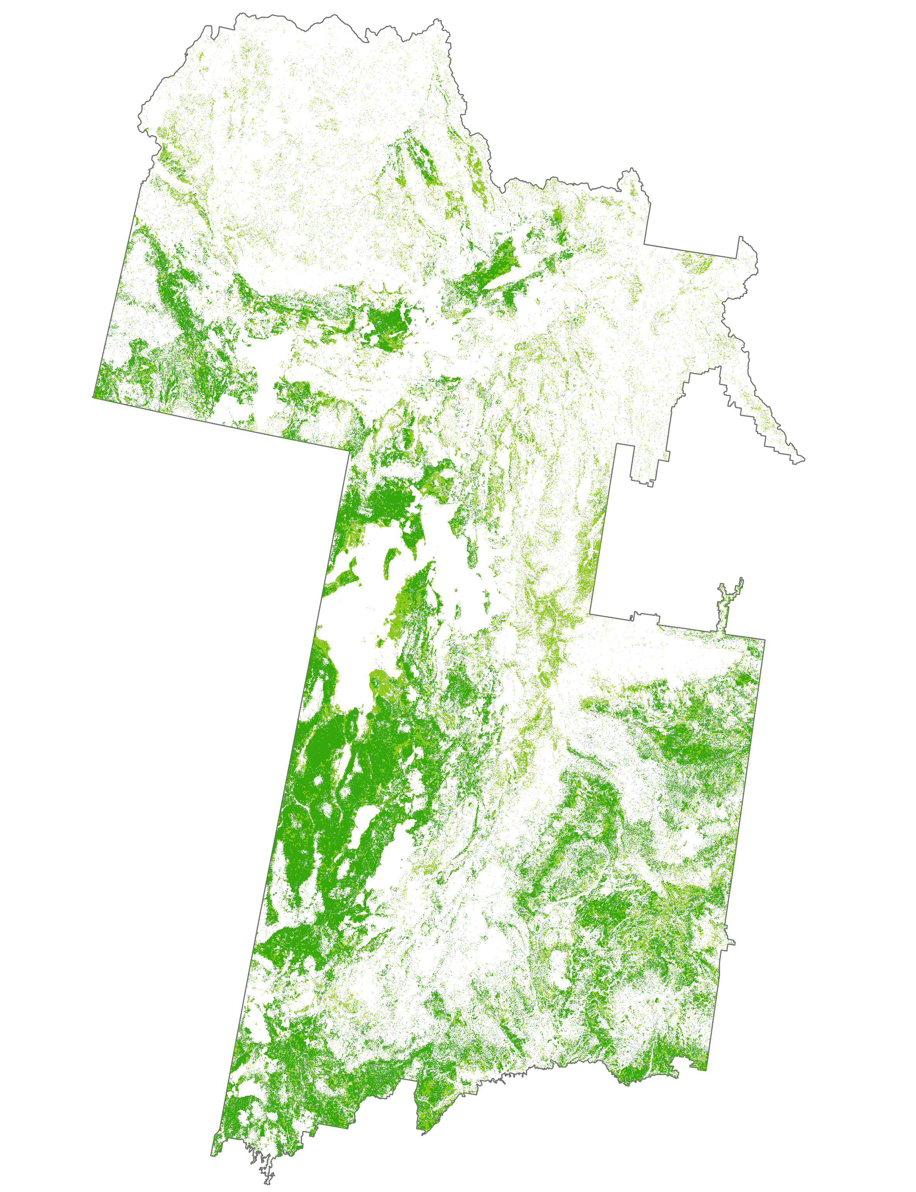
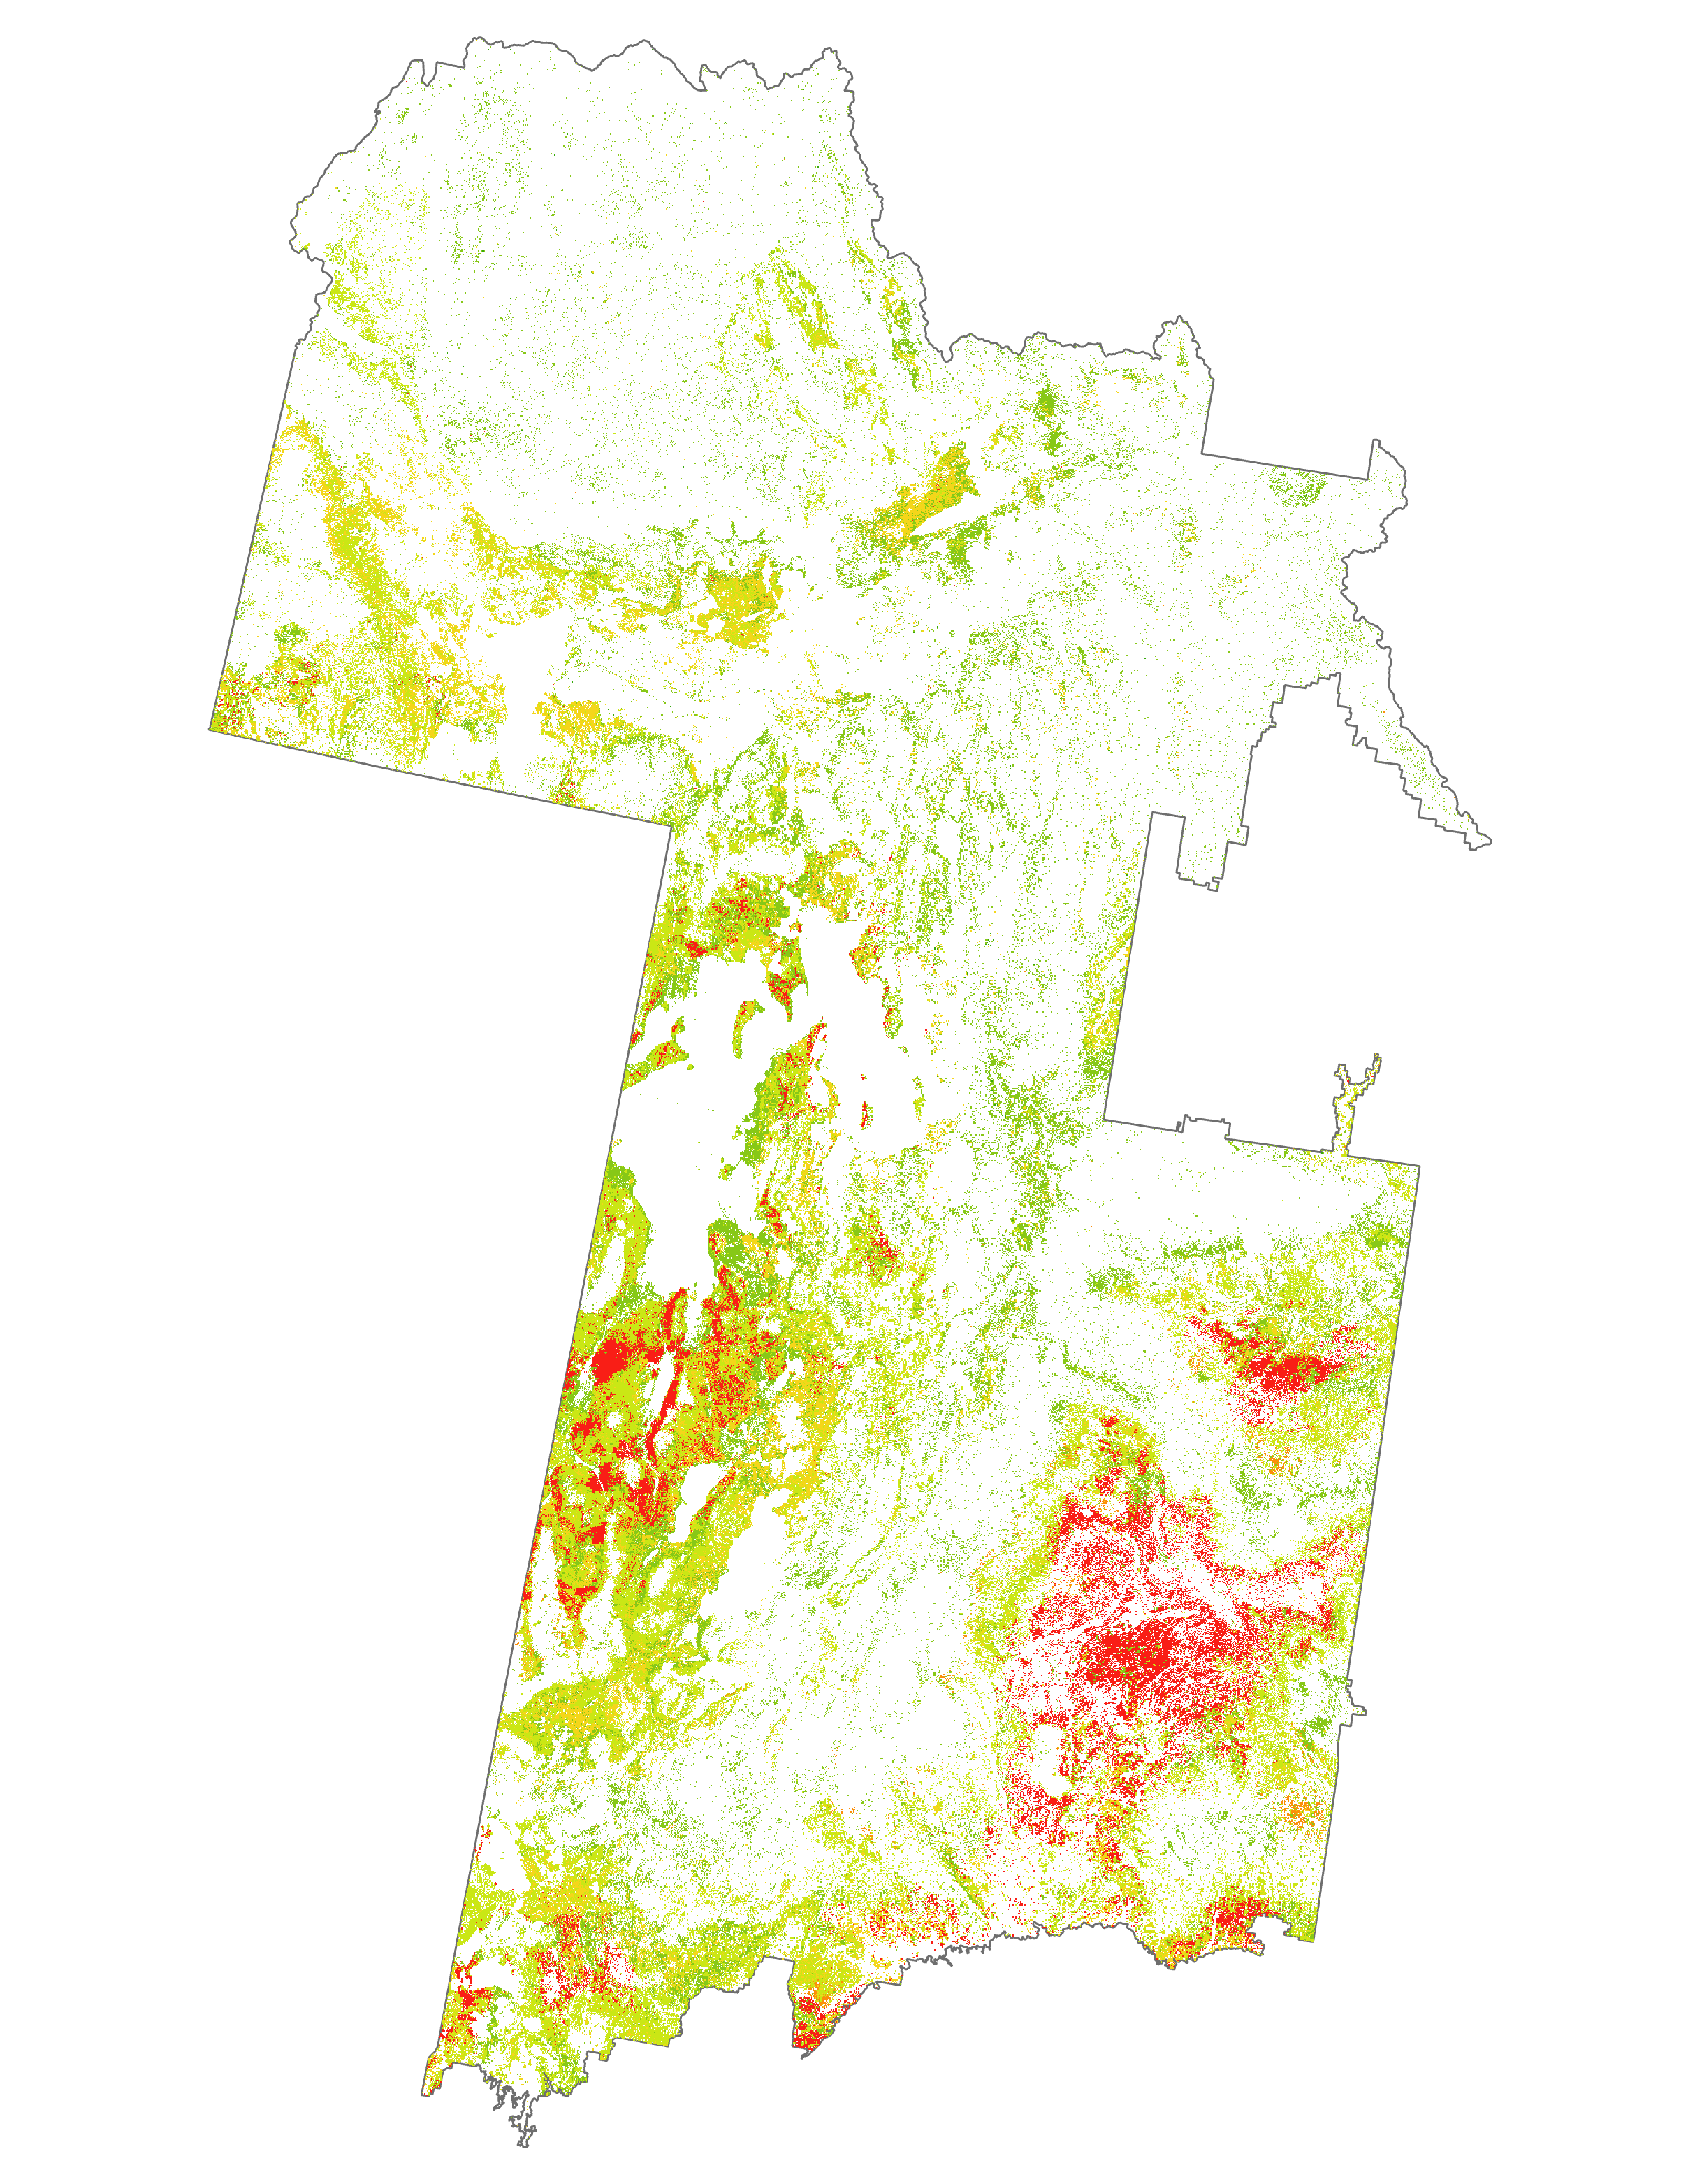
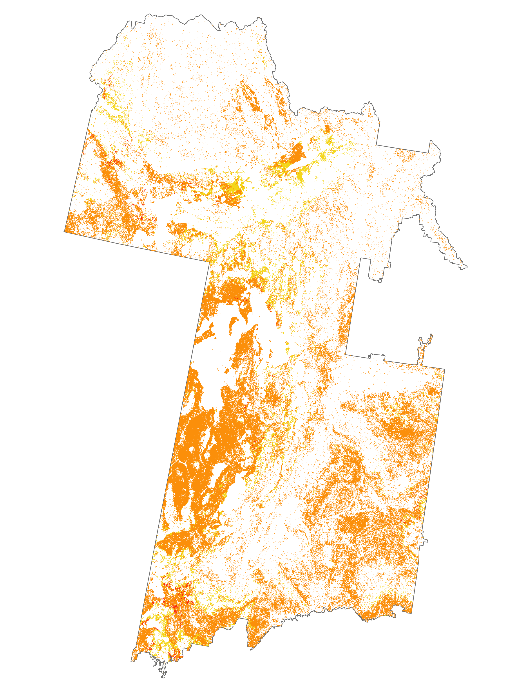

Image Classification Results
N
Live Fuel Moisture Percentages
≤ 74
75 - 99
100 - 124
125 - 149
150 - 199
≥ 200
May 2017
July 2017
September 2017
Notes:
Helena
These images were derived using Random Tree Classifier through ArcGIS Pro. The May 2017 image displays live fuel moisture percentages for the first two weeks of May in 2017, the July 2017 image displays the live fuel moisture percentages for the first half of July in 2017, and the September 2017 image displays the live fuel moisture percentages for the second half of September in 2017.
------Image Information Below------
Images created by the ID Fall 2019 NASA DEVELOP team.

Slide 21
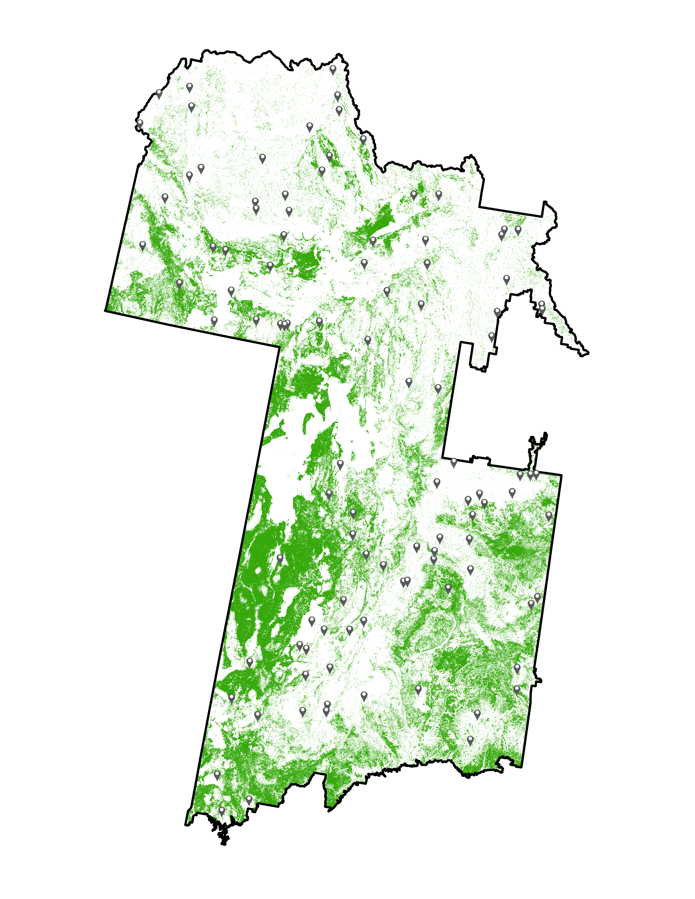
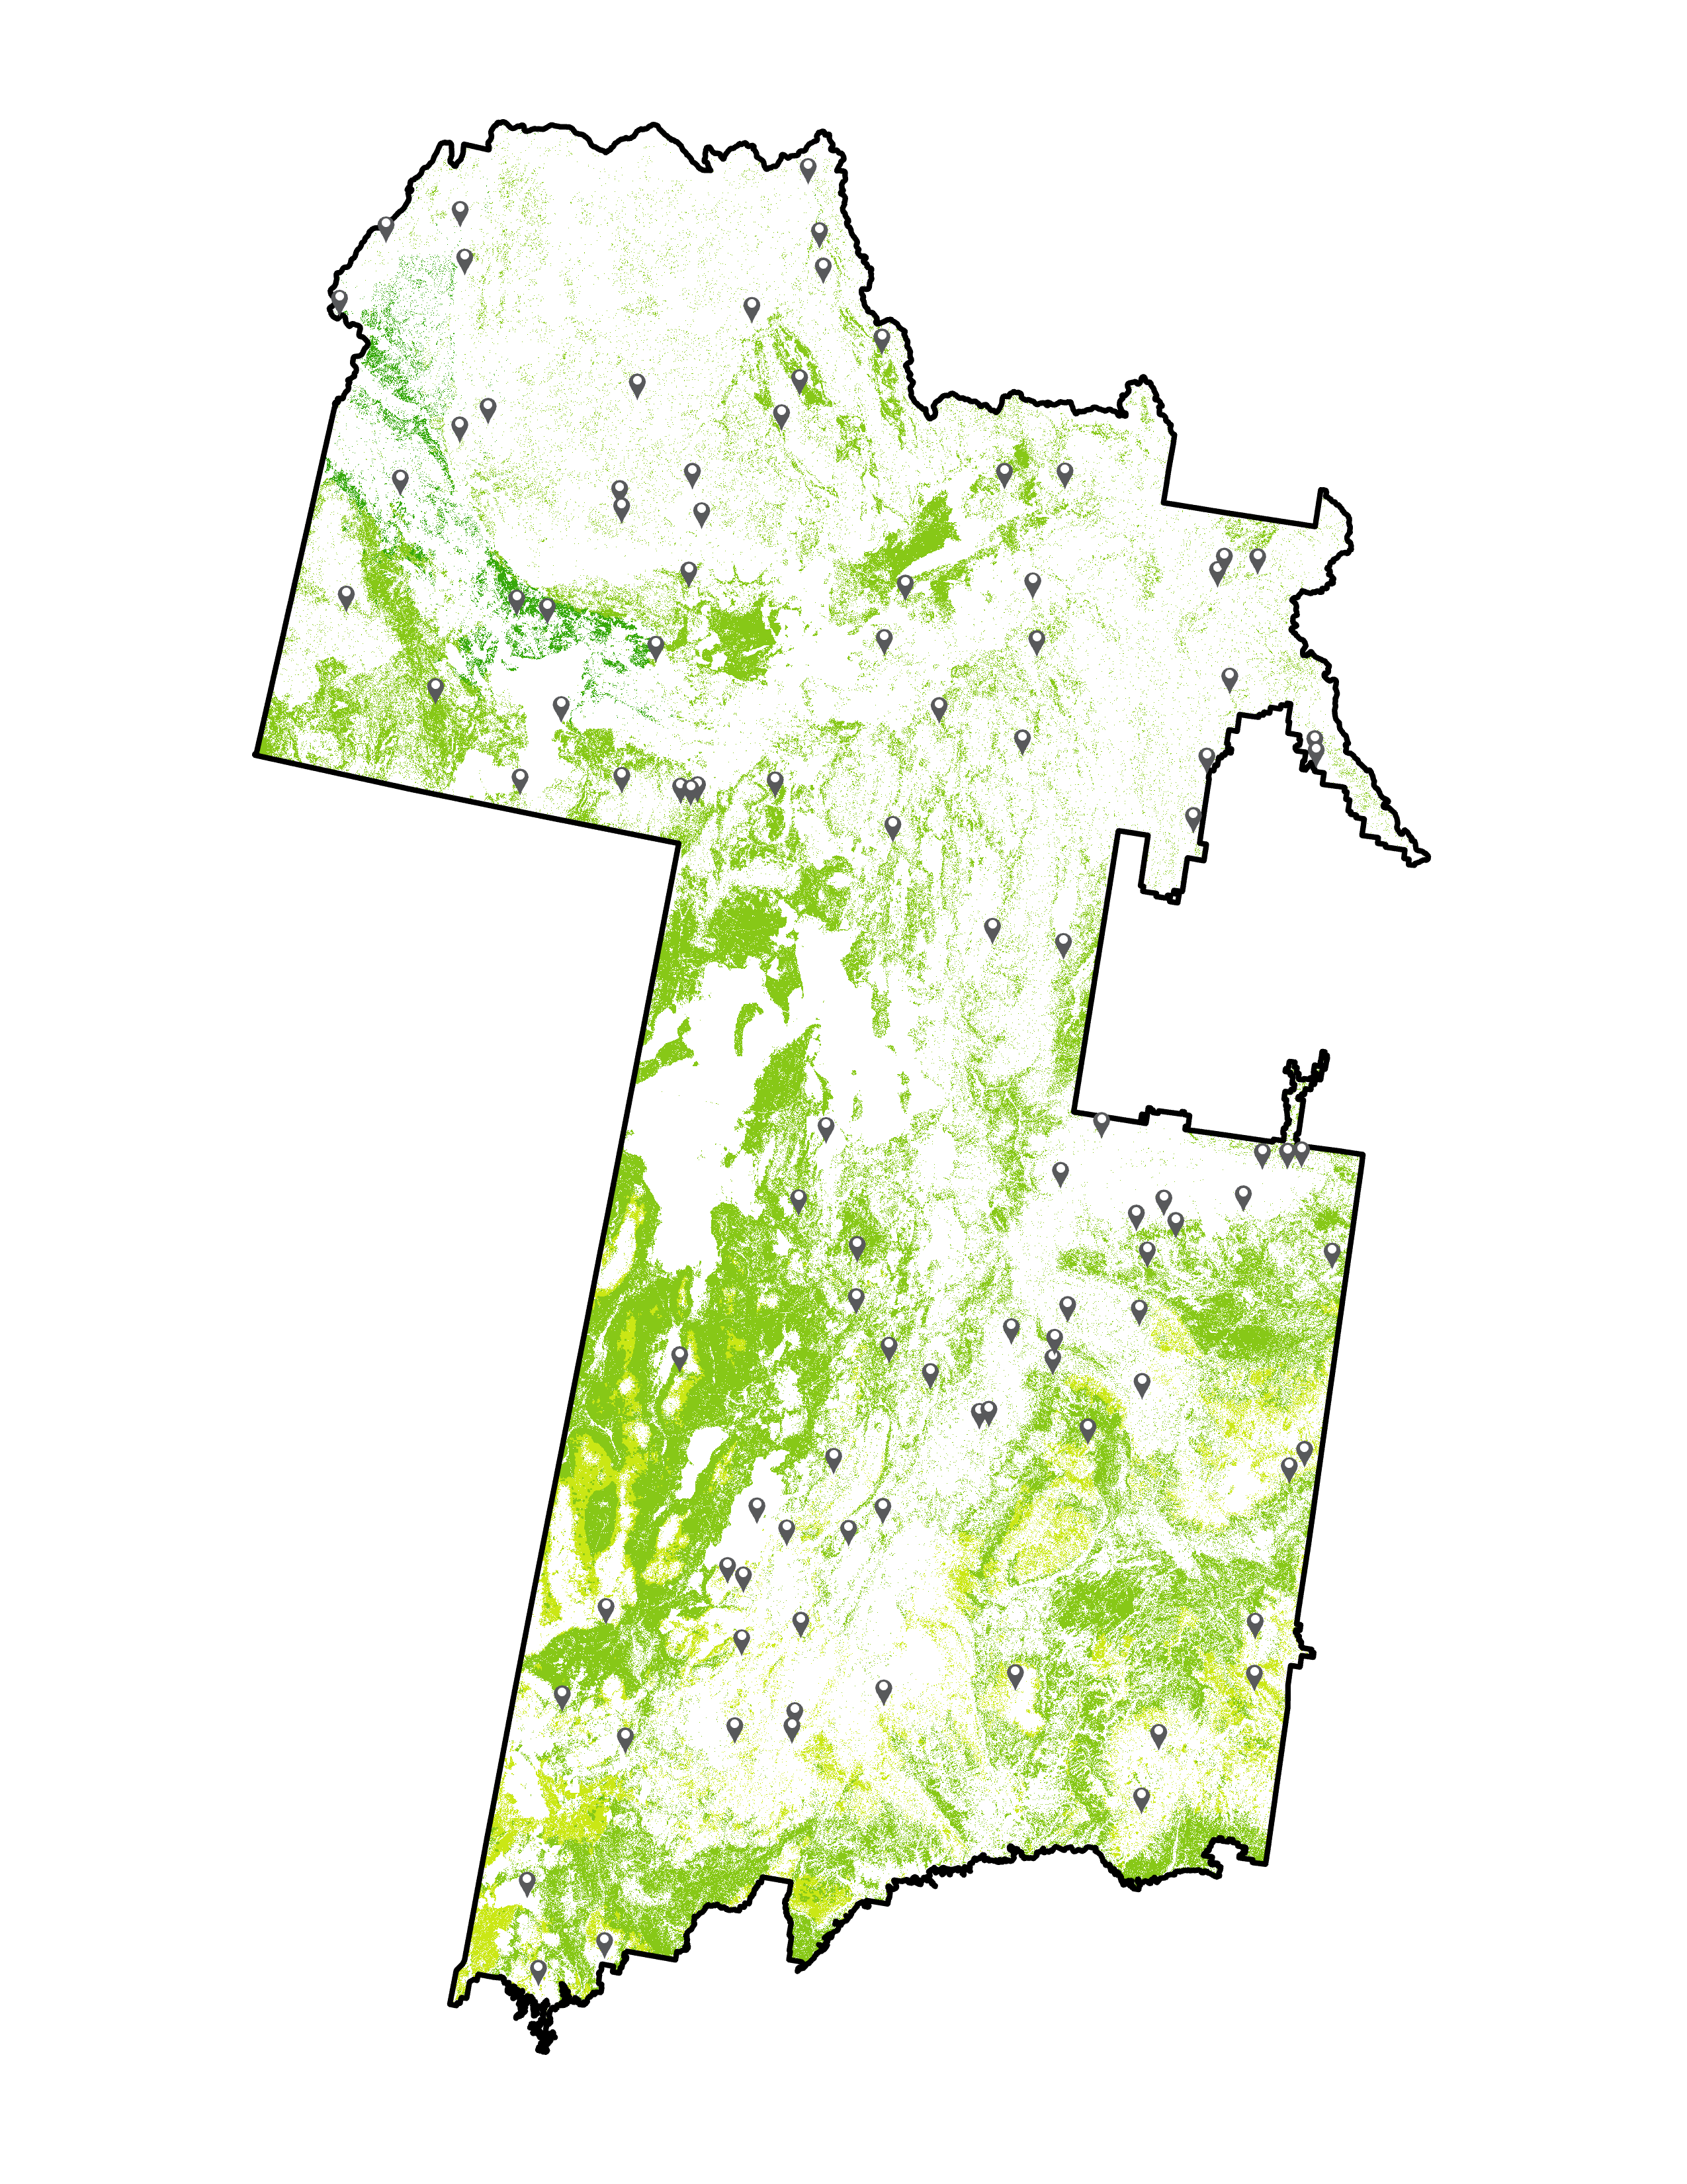
2016 to 2017 Live Fuel Moisture Progression
N
Live Fuel Moisture Percentages
≤ 74
75 - 99
100 - 124
125 - 149
150 - 199
≥ 200
2016
2017
Notes:
Helena
These GIFs created by the NASA DEVELOP team visually display the change in live fuel moisture content from the years 2016 to 2017, from April to September. The first GIF is of 2016, while the second GIF is of 2017, reading left to right. The second image does not include the month of April, which had very little data to display.
------Image Information Below------
GIFS made by the NASA DEVELOP team using the classification imagery from data obtained from Aqua MODIS, Terra MODIS, and Suomi-NPP VIIRS.

Slide 22
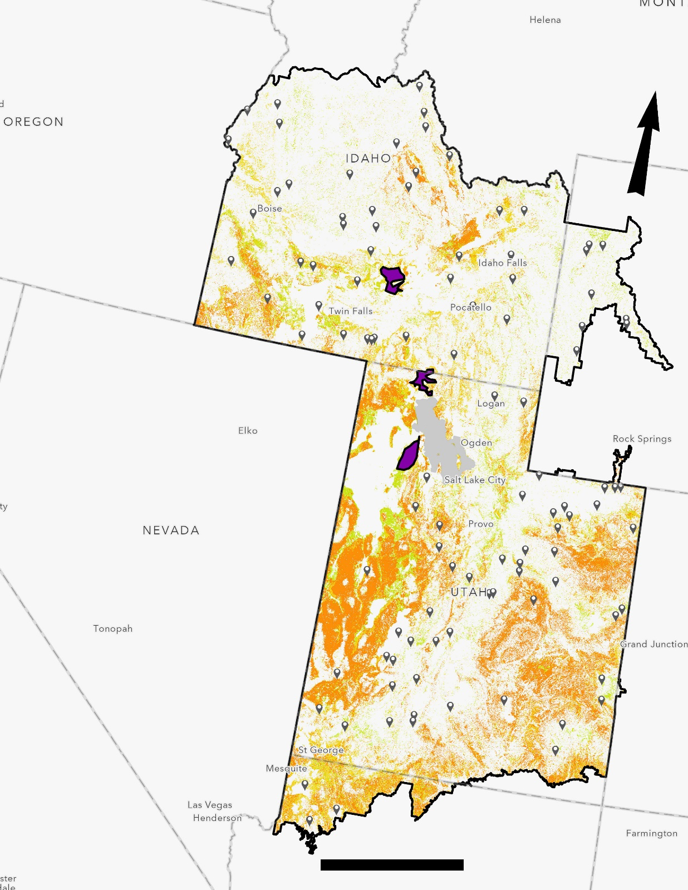
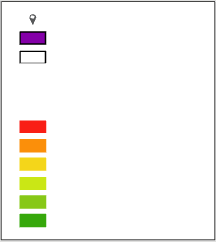
Classification Trend Analysis
Live Fuel Moisture for July 2017 Term 2
Second term of July 2017
Three polygons in sagebrush dominated areas
          On border between ID and UT, also in ID, and in UT
LFM trends (mean and median) were calculated using Zonal statistics
N
In situ sites
Polygons
Eastern Great Basin
Live Fuel Moisture (LFM)
LFM < 75 %
75% < LFM < 100%
100% < LFM < 125%
125% < LFM < 150%
150% < LFM < 200%
200% < LFM
200
Kilometers
Notes:
Gavin
The team made three polygons: one incorporating the border between Idaho and Utah, one exclusively in Idaho, and one exclusively in Utah. These polygons covered the primary areas of interest for project partners, but did not include any LFM in situ measurement sites, in order to avoid a bias. We then calculated zonal statistics for each time period, and in each of the three polygons, in order to understand the annual trends of LFM during peak fire season.
------Image Information Below------
Image created by the ID Fall 2019 NASA DEVELOP team
Map basemap: Esri, HERE, Garmin, FAO, NOAA, USGS, © OpenStreetMap contributors, and the GIS User Community

Slide 23
Statistical Results
Live Fuel Moisture Percentages
≥ 200
150 - 199
125 - 149
100 - 124
75 - 99
≤ 74
Notes:
Gavin
These statistical results were obtained by using Zonal Statistics through ArcGIS Pro. Three separate polygons on the map were drawn where high concentrations of sagebrush were in Idaho, Utah, and the border in between Idaho and Utah. This shows the lowest mean LFM occurring between July and September of 2016 and features a trend line that follows predicted wildfire risk throughout the peak season.
------Image Information Below------
Graph developed by the Fall 2019 ID DEVELOP team.

Slide 24
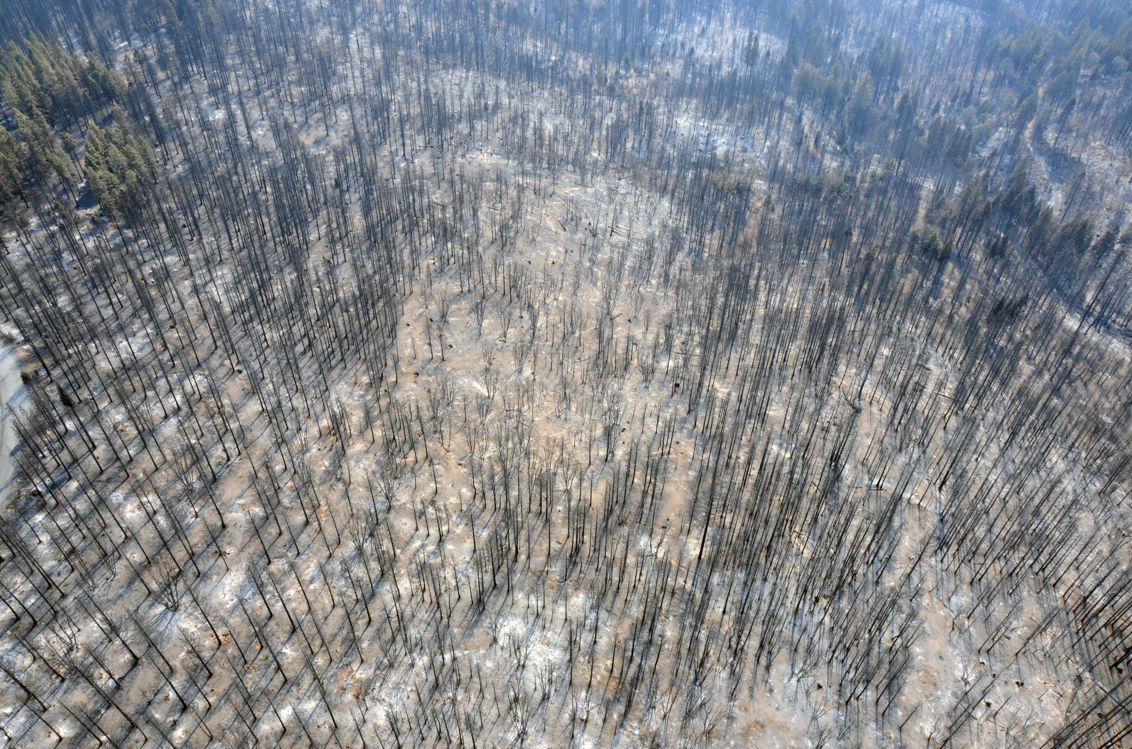
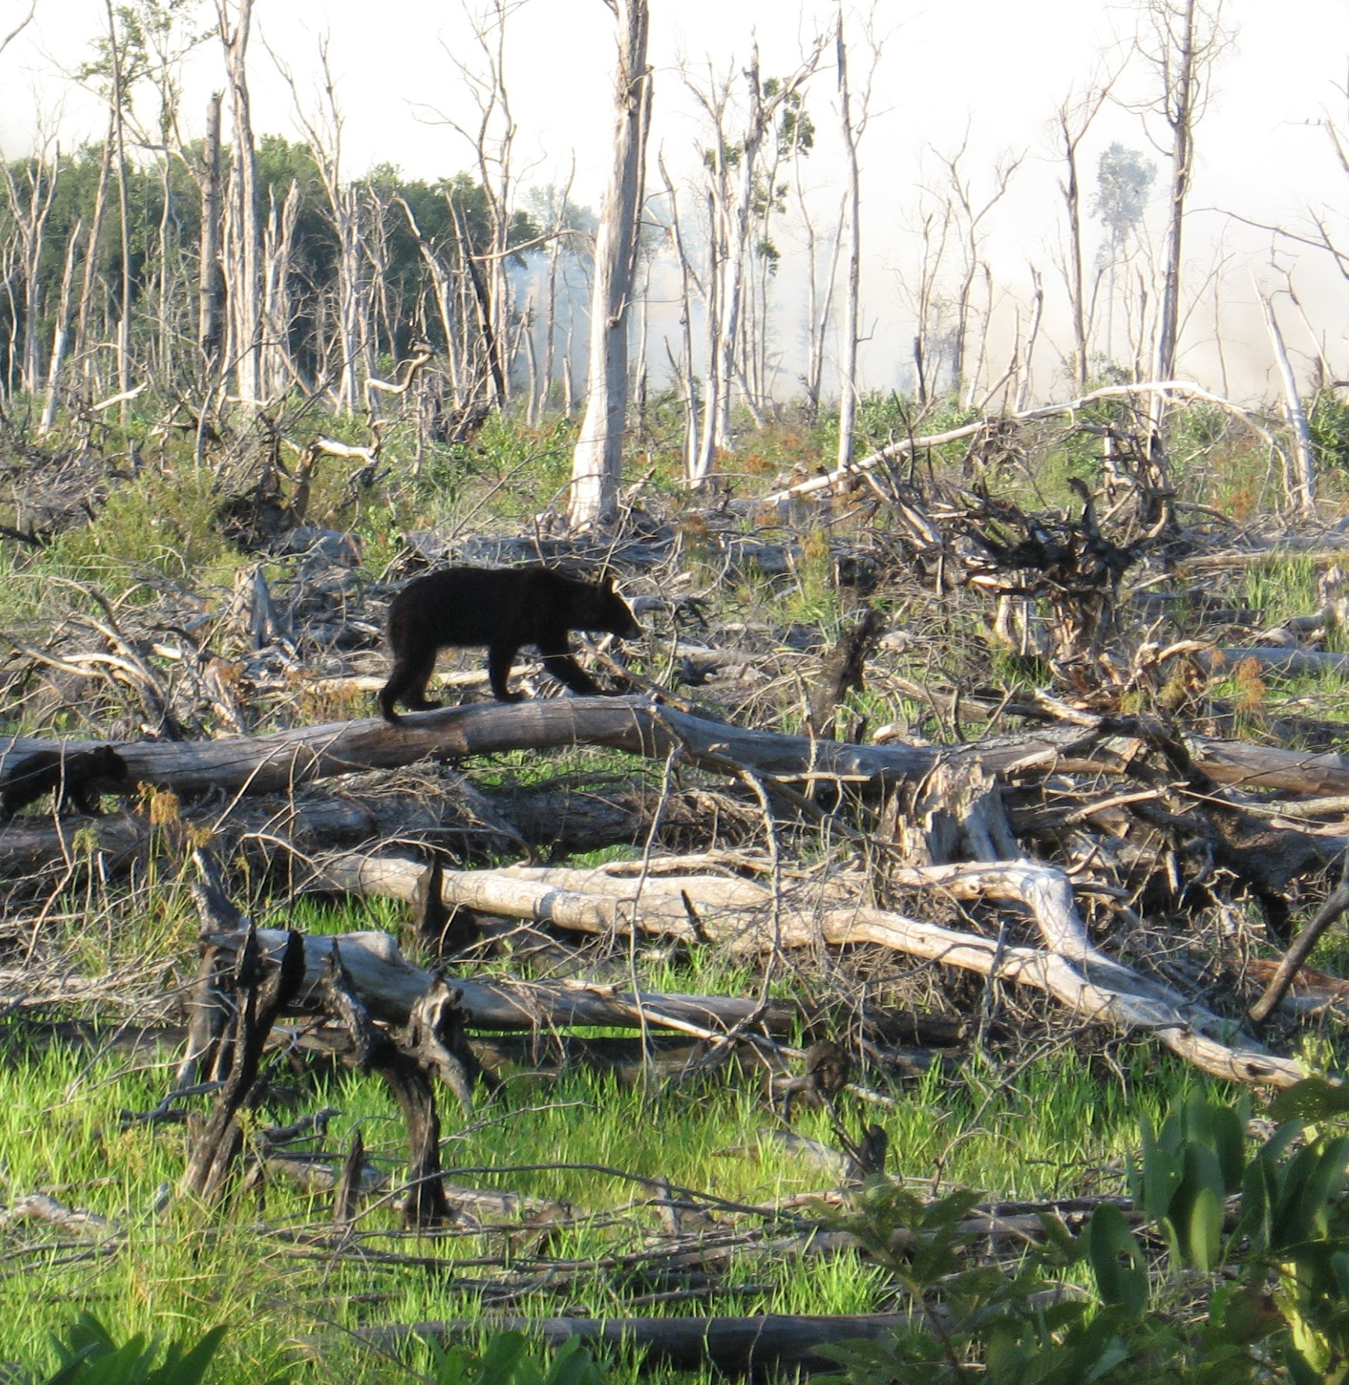
Overall Results
Graphs display intuitive trends of live fuel moisture percentages for the eastern Great Basin
Highest model accuracy achieved was 34.6% with the average accuracy being 8.2%
Mean number of training points = 28.3
Mean number of testing points = 18.9
Grid cell size = 250 meters
Image credit (left to right): Master Sgt. Paul Wade, U.S. Army National Guard, Rob Wood, U.S. Fish and Wildlife Service
Notes:
Lauren
The LFM trendlines developed for the three polygons demonstrate trends similar to those that are expected during fire season in the EGB. Model training was done using 60% training points and 40% testing points. However, with means around 30 and 20 of training and testing points, respectively, there were very few points training a model to classify for 411,000 km², around 1 training point for every 13,000 km². Additionally, training was done using only sagebrush values, and sagebrush was not collected at every site during every training period.
------Image Information Below------
Image Sources (left to right): https://flickr.com/photos/caguard/9685867073/in/album-72157635264185234/; CC by 2.0, https://www.flickr.com/photos/usfwsnortheast/6049557320/in/set-72157626003661941 (Public Domain)

Slide 25
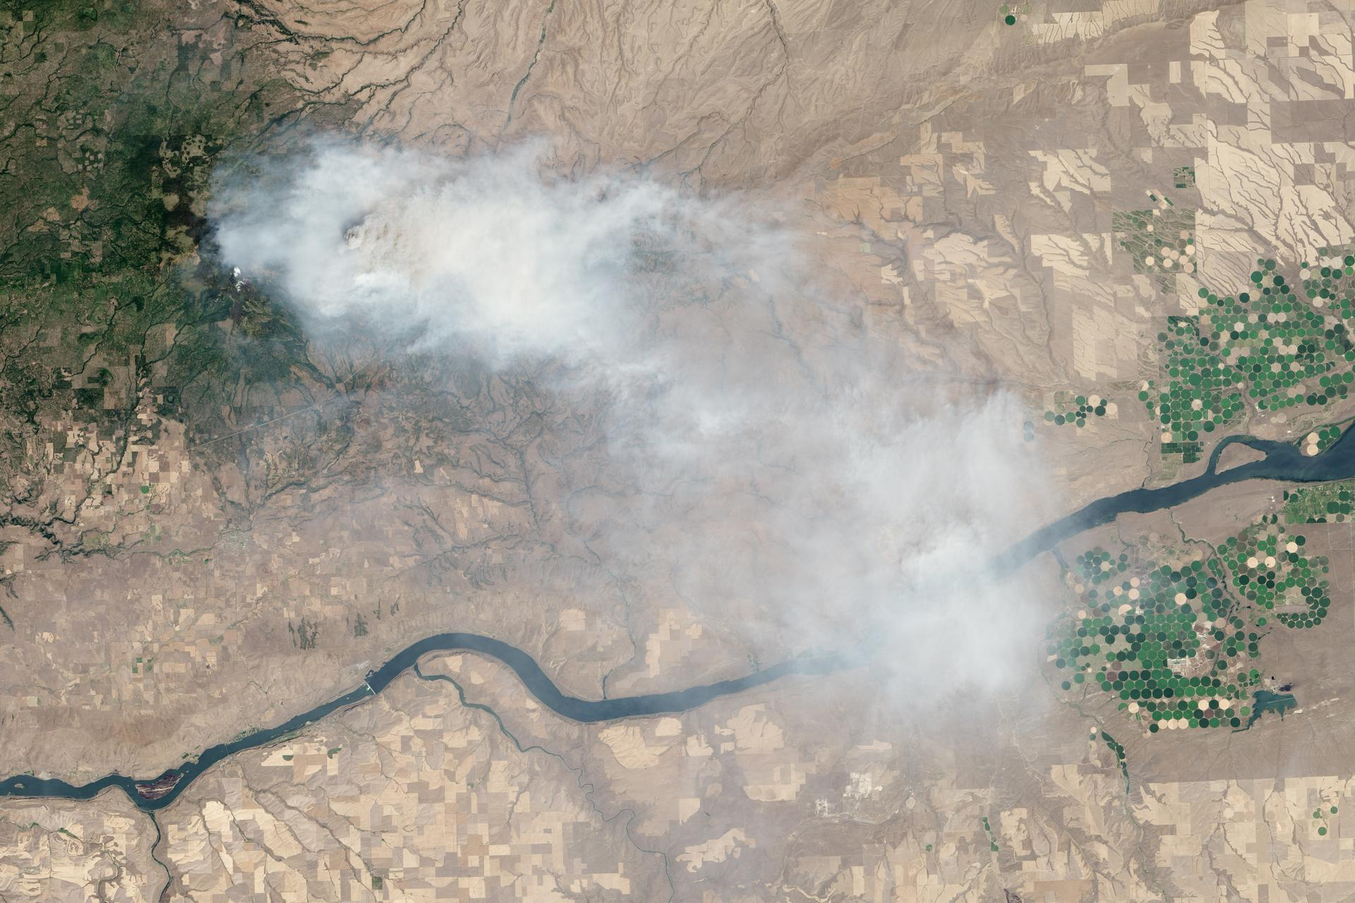
Conclusions
The development of a predictive model
is feasible
 A predictive model would be greatly benefitted by more in situ measurements to increase classification accuracy
Spatial resolution for model was 10x higher than in situ measurements
Classification trend is in agreement with expected LFM seasonal trends
Image credit: Jesse Allen and Robert Simmon, NASA Goddard
Notes:
Amber
This project found that the development of a predictive LFM model using NASA EOs is feasible, but would be greatly benefitted by more in situ measurements. This would allow for a larger number of training, as well as testing, points and hopefully increase model accuracy. The spatial resolution of model outputs was 250m, which is around 10 times higher than the spatial resolution of in situ measurements. Finally, the classified trends are in agreement with the expected LFM seasonal trends.
------Image Information Below------
Image Source: https://images.nasa.gov/details-GSFC_20171208_Archive_e001423 (Public Domain)

Slide 26
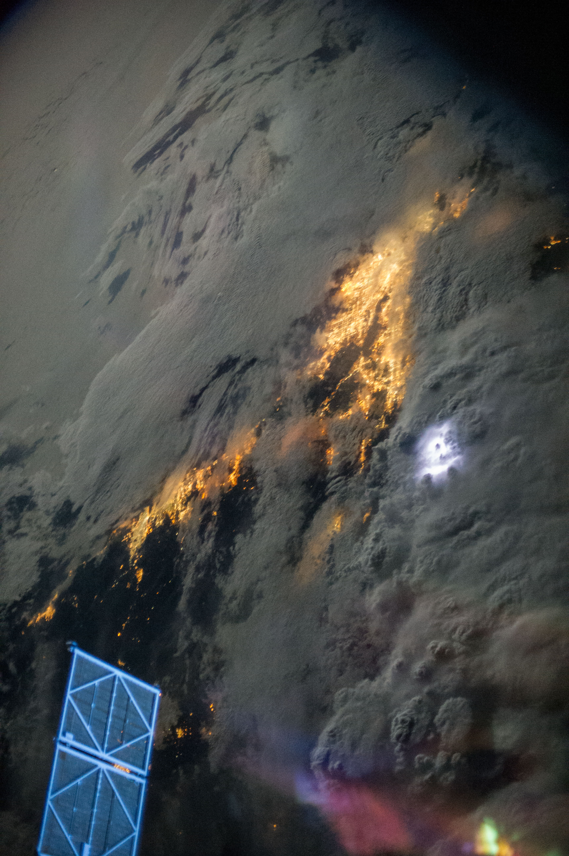
Future Work
 Extrapolation of LFM model to forecasting model to be used for the 2020 fire season
 Lightning strike data from the Geostationary Lightning Mapper (GLM) as a variable to compare with wildfire frequency and LFM data correlations
 Incorporation of ENSO and PDO cycles into forecasting model
Image credit: NASA JSC
Notes:
Helena
A forecasting model for the next NASA DEVELOP term could incorporate El Niño Southern Oscillation (ENSO), Pacific Decadal Oscillation (PDO), and lightning strike variables from the Geostationary Lightning Mapper (GLM), in order to draw correlations between fire patterns and frequencies on longer temporal scales. The forecasting model will be used by project partners for the 2020 fire season.
-------Image Information Below------
Image Source: https://images.nasa.gov/details-iss036e022863 )Public Domain

Slide 27

Idaho Department of Fish and Game, Southeast Regional Office
 Scott Bergen, Senior Wildlife Research Biologist
Bureau of Land Management, Upper Snake Field Office
 Ben Dyer, Fire Ecologist
 Michelle Mavor, Fire Ecologist
NOAA, National Weather Service
 Kurt Buffalo, Meteorologist, Science and Operations
 Mike Hutson, Meteorologist
Great Basin Coordination Center
 Nanette Hosenfeld, Predictive Services Meteorologist
Special thank you to our Idaho node mentors:
 Keith T. Weber, GIS Director at Idaho State University, GIS Training and Research Center
 Mason Bull, NASA DEVELOP National Program Fellow
Notes:
Gavin
Scott Bergen – Idaho Dept. Fish and Game
Ben Dyer and Shelli Mavor – BLM
Kurt Buffalo and Mike Hutson – NWS
Nanette Hosenfeld and Shelby Law – GBCC
Keith Weber – GIS TReC
Mason Bull – NASA DEVELOP
---------Image information below---------
Image locations: https://en.wikipedia.org/wiki/File:Logo_of_the_United_States_Bureau_of_Land_Management.svg , https://www.swpc.noaa.gov/news/swpc-dissemination-service-modernization-0

Slide 28
Questions/Comments

