Slide 1

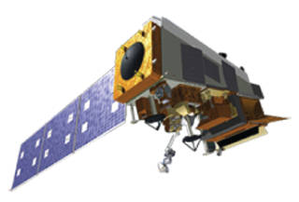
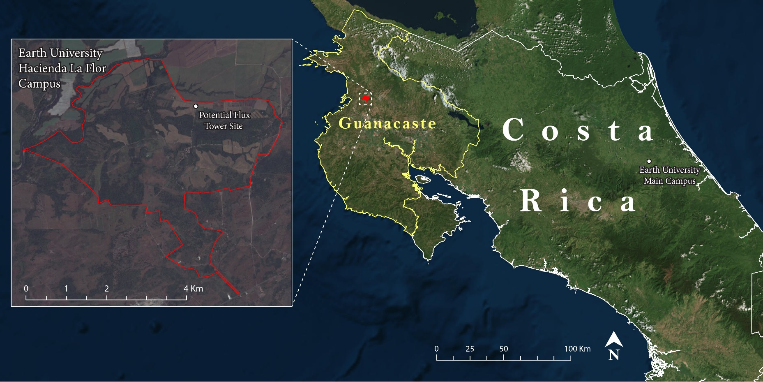
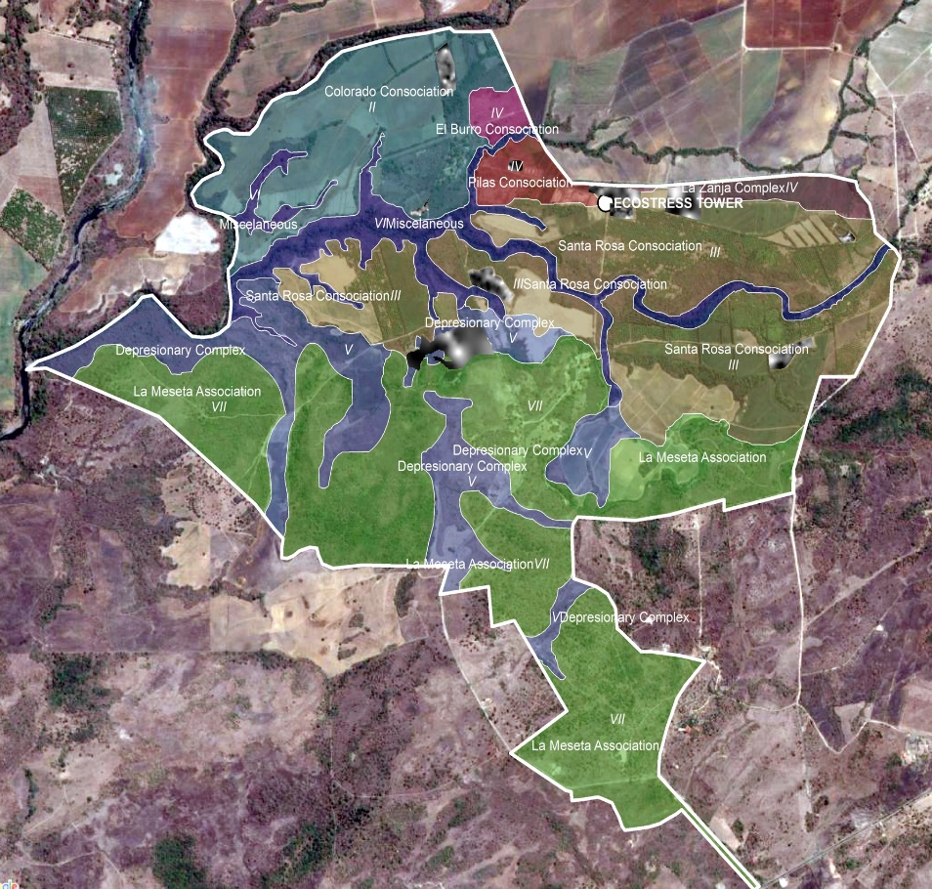
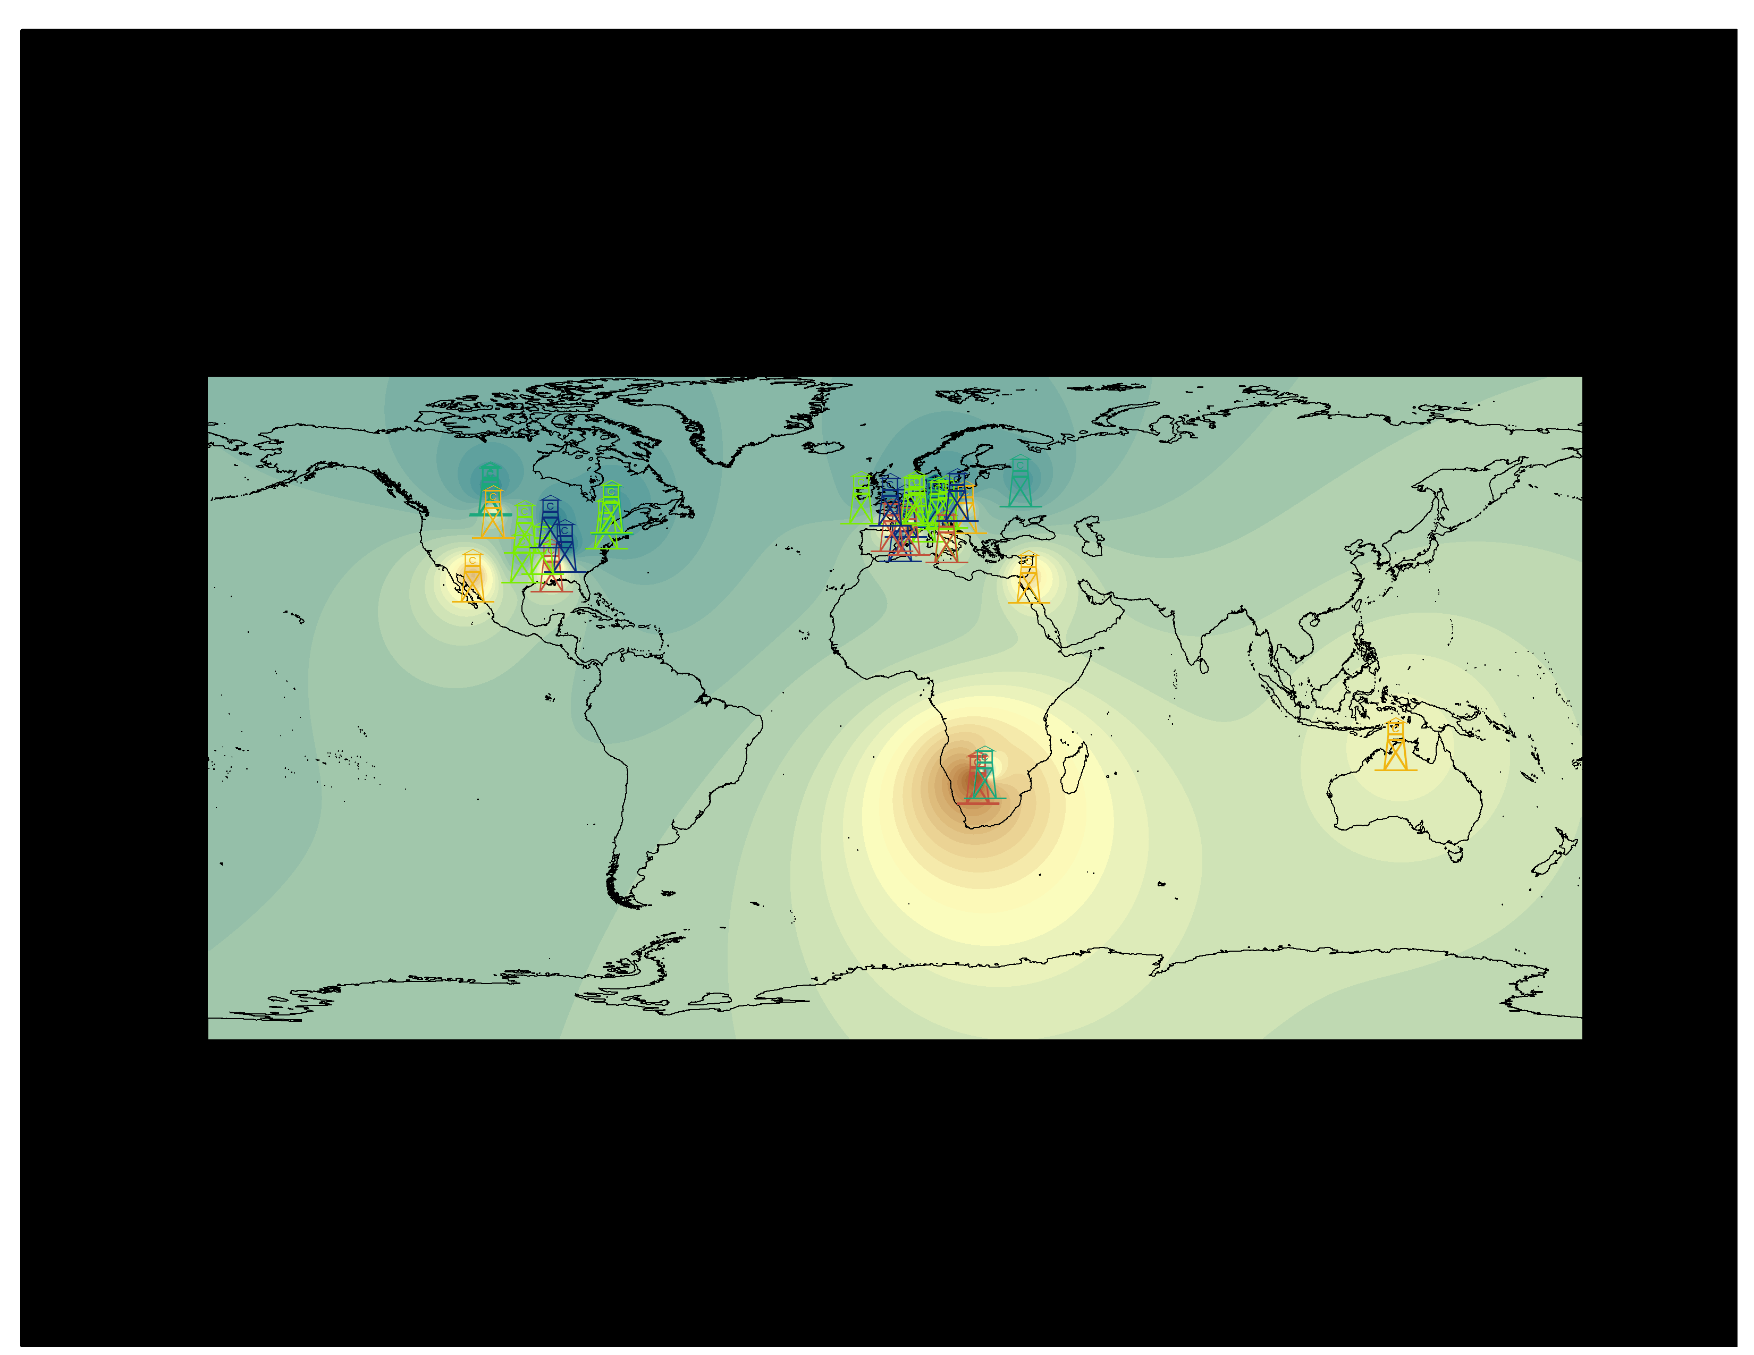
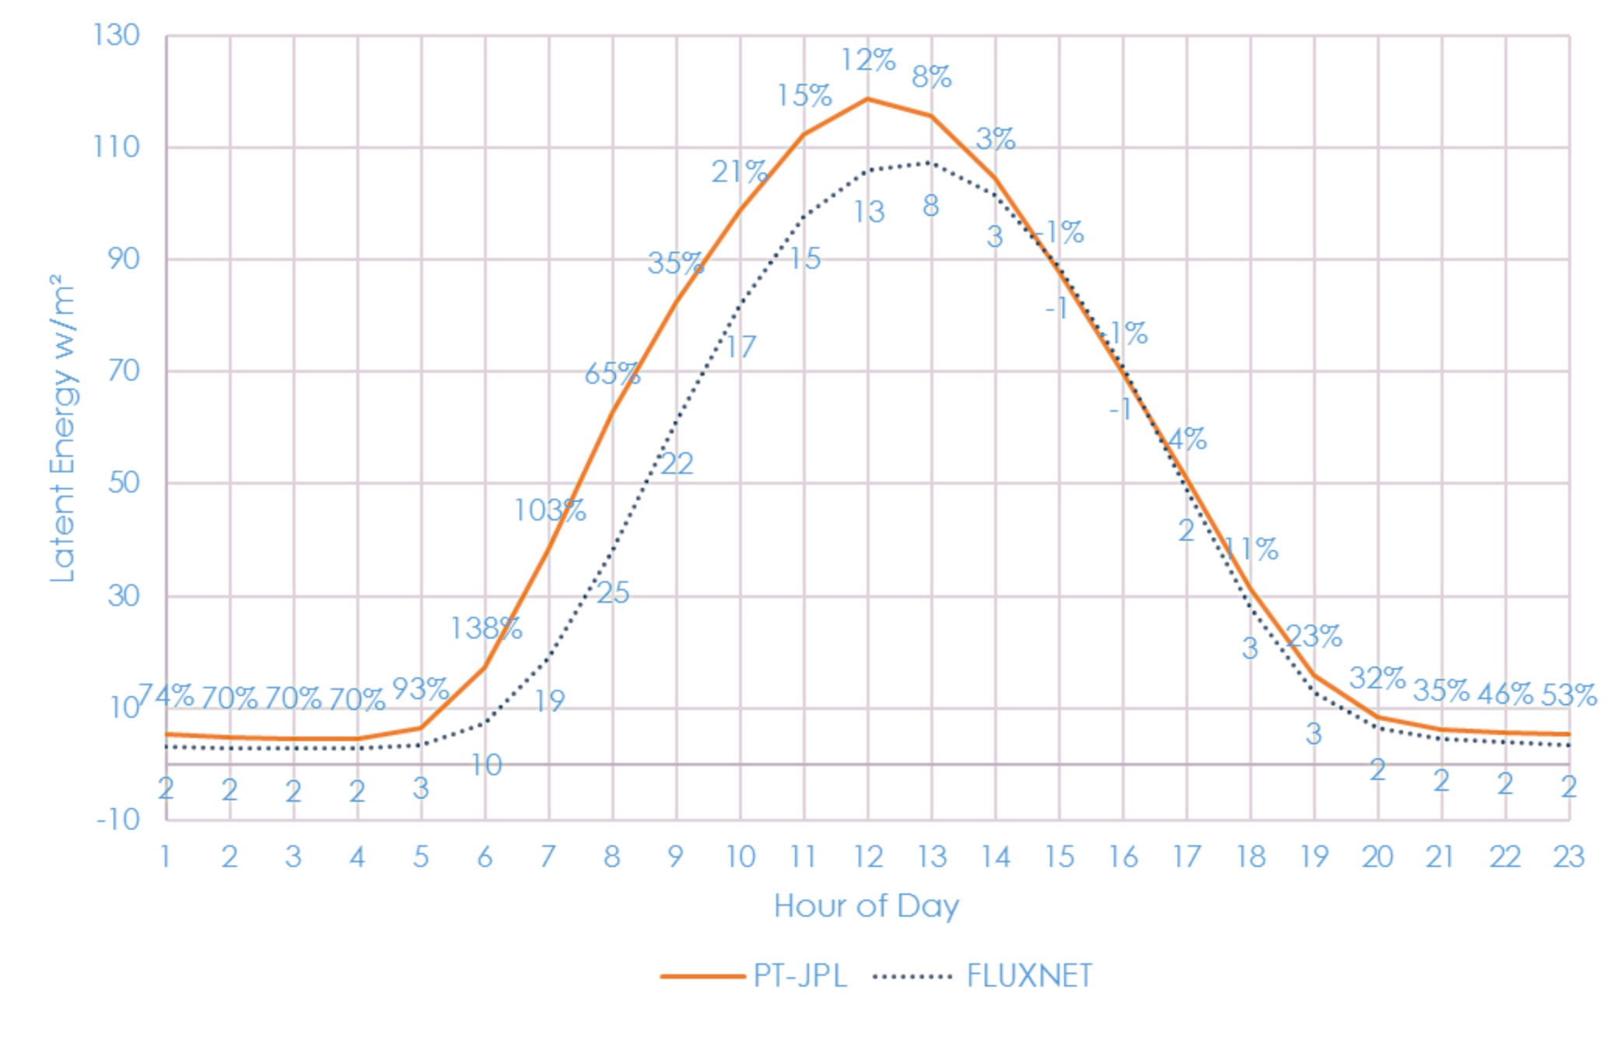
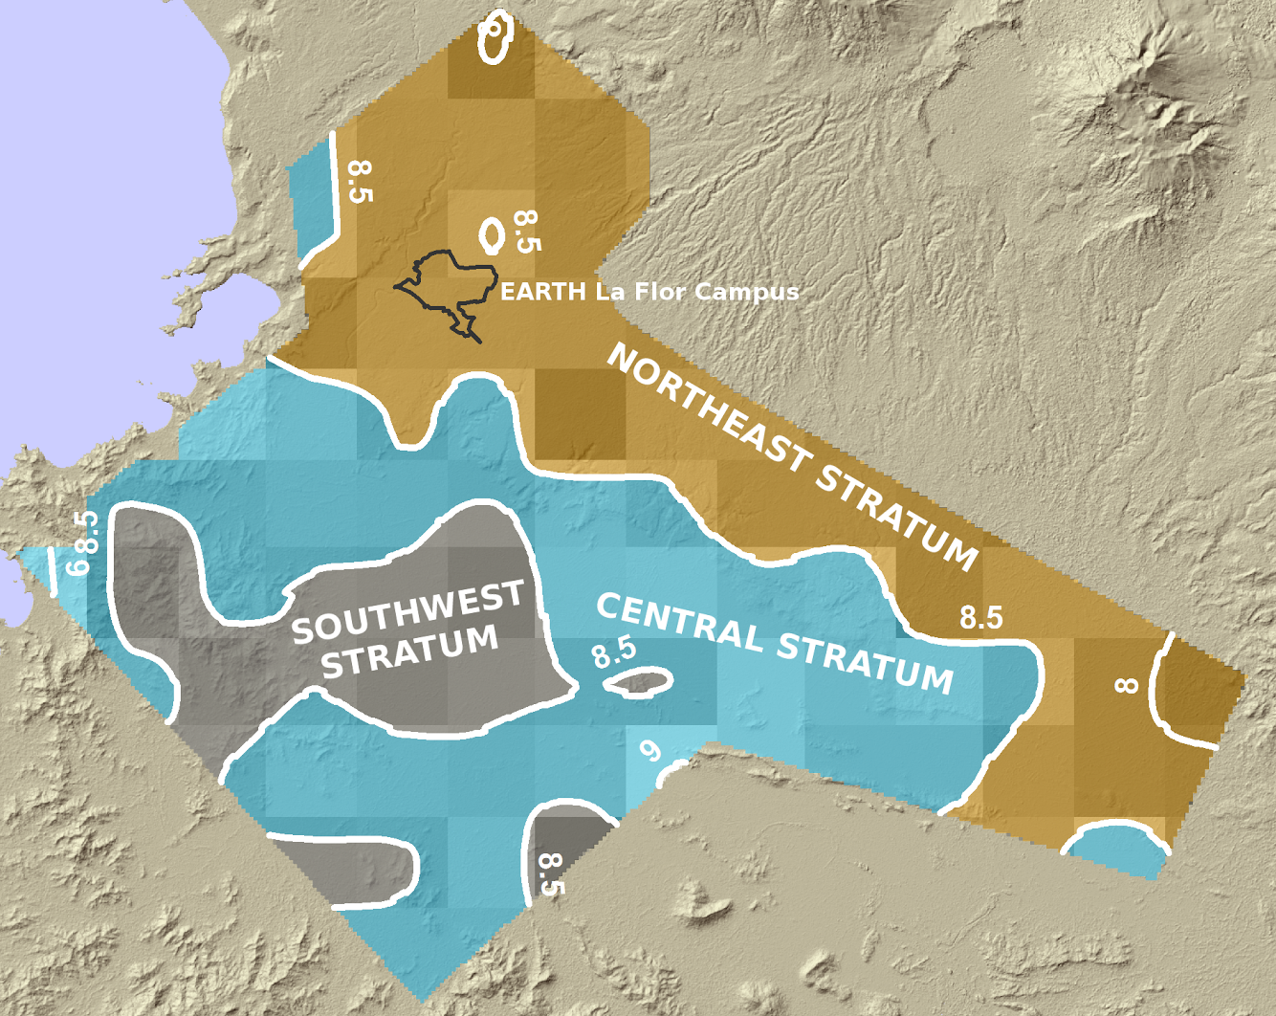
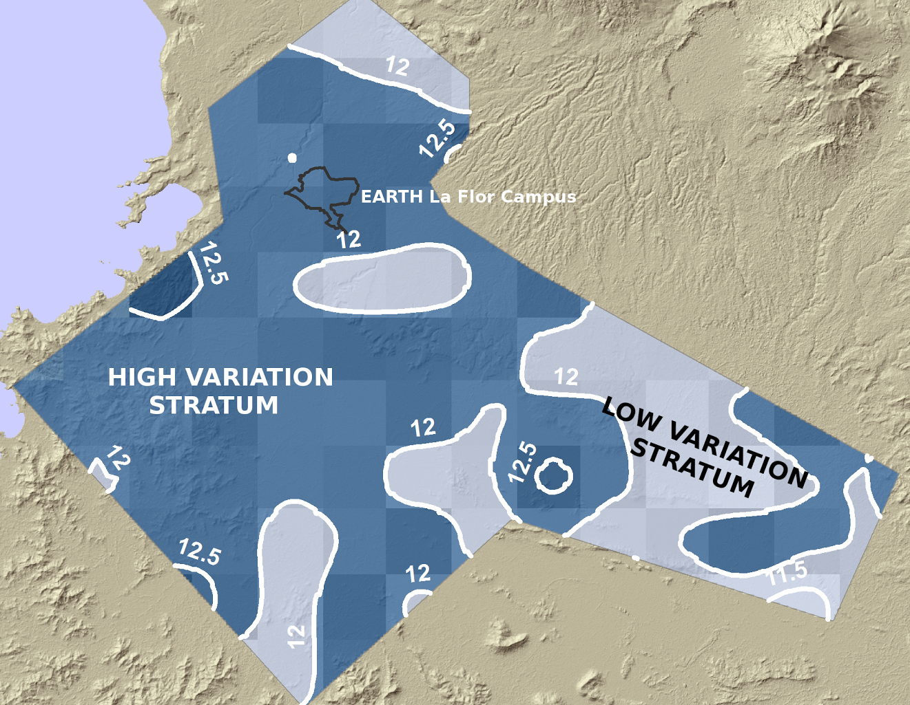
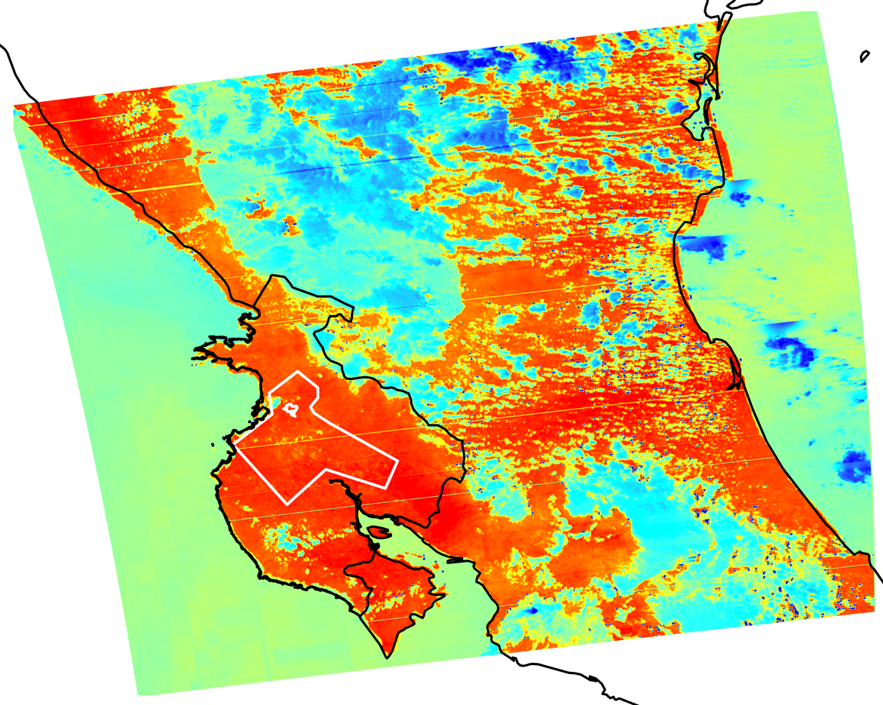

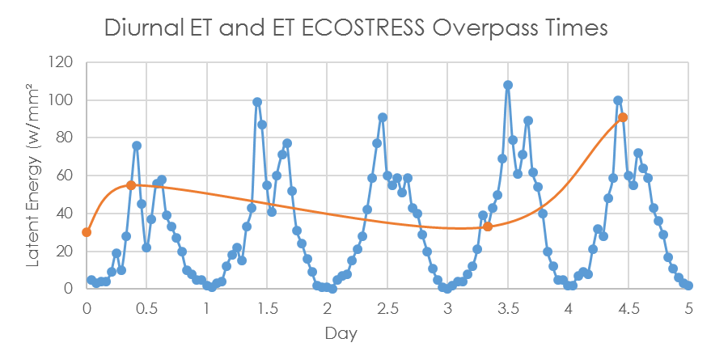
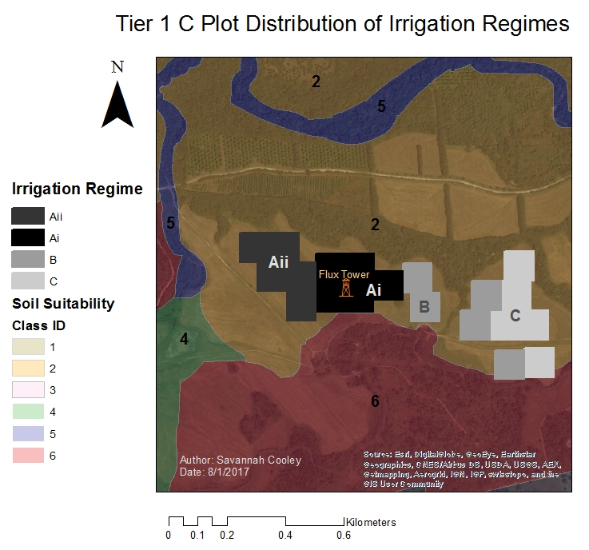



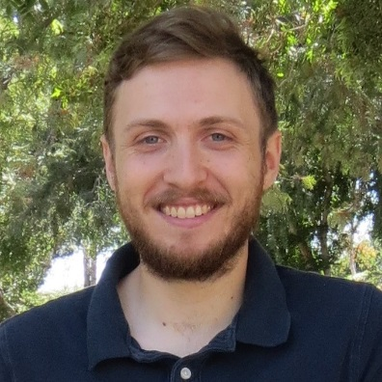
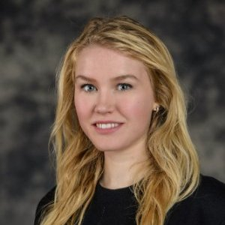
Applying ECOSTRESS Diurnal Cycle Land Surface Temperature and Evapotranspiration to Agricultural Soil and Water Management
Abstract
Objectives
Increased demand for agricultural products and limited water supplies in Guanacaste, Costa Rica have encouraged the improvement of water management practices to increase resource use efficiency. Remotely sensed evapotranspiration (ET) data can contribute by providing insights into variables like crop health and water loss, as well as better inform the use of various irrigation techniques. EARTH University currently collects data in the region that are limited to costly and time-intensive in situ observations and will greatly benefit from the expanded spatial and temporal resolution of remote sensing measurements from the ECOsystem Spaceborne Thermal Radiometer Experiment on Space Station (ECOSTRESS).
In this project, Moderate Resolution Imaging Spectroradiometer (MODIS) Priestly-Taylor Jet Propulsion Laboratory (PT-JPL) data, with a resolution of 5 km per pixel, were used to demonstrate to our partners at EARTH University the application of remotely sensed ET measurements. An experimental design was developed to provide a method of applying future ECOSTRESS data, at the higher resolution of 70 m per pixel, to research in managing and implementing sustainable farm practices. Our investigation of the diurnal cycle of land surface temperature, net radiation, and evapotranspiration will advance the model science for ECOSTRESS, which will be launched in 2018 and installed on the International Space Station.
Model Evapotranspiration (ET) Diurnal Cycle to advance the ECOSTRESS L3 data product
Apply PT-JPL with MODIS 5 km data to demonstrate the use of NASA remote sensing data to the project partner
Create experimental design to investigate how ET informed irrigation practices impact water use efficiency and crop yield
Promote the use of the future ECOSTRESS PT-JPL 70 m product through media development and educational outreach
Earth Observations
Project Partner
EARTH University
San Jose, Costa Rica
Terra MODIS
Suomi NPP VIIRS
Study Area
Methodology
 | ET Diurnal Cycle | Applying PT-JPL | Experimental Design
Data Acquisition | La Thuile FLUXNET dataset provided by Adam Purdy MERRA2 Net Radiation (Rn) 5 km product provided by Dr. Greg Moore | MODIS PT-JPL 5 km product provided by Munish Sikka for 2008-09 VIIRS, ASTER GED, MERRA2 | Flux tower site and crop locations provided by EARTH
Data Processing | Convert half-hourly FLUXNET data to hourly Sample MODIS NDVI, albedo, and optimum temperature to table Calculate maximum fraction of photo-synthetically active radiation Sample MERRA2 air temperature, dew-point temperature, incoming shortwave, and incoming longwave to table Run PT-JPL on tabled values | Aggregate maps of mean ET and net temporal ET variation over two-year dataset Convert LE in units of W/m2 to ET in mm/day Stratification scheme via interpolation and contours Simulate L2 product | Select crop: Digitaria decumbens Assign min/max thresholds for plot size and number Create plot distribution table
Data Analysis | Compare hourly aggregate of latent energy at all flux sites | Apply Neyman optimal allocation technique to identify sample size scenarios | Specify plot locations with stratified sampling design Define method to measure crop yield and water use
Results – ET Diurnal Cycle
Costa Rica Agriculture
Diurnal PT-JPL Latent Energy
Weekly Average Correlation with FLUXNET
PT-JPL Latent Energy Using MODIS Land Data and MERRA2 Surface Meteorology Compared to La Thuile FLUXNET Aggregated by Hour at All Sites with Absolute and Percentage Bias
Conclusions
Diurnal Cycle: Diurnal cycle evapotranspiration can be accurately predicted using PT-JPL using MODIS NDVI and albedo and MERRA2 air temperature, dew-point temperature, incoming shortwave radiation, and incoming longwave radiation.
Applying PT-JPL: MODIS derived PT-JPL evapotranspiration data at 5 km/pixel proved useful for EARTH University in a regional-scale sample design. There is a clear need for higher spatial resolution ET data to apply towards precision agriculture studies. Simulated ECOSTRESS L2 data demonstrated this need and clarified how it can be applied by EARTH University.
Experimental design: EARTH University demonstrates that it has the interest and resources necessary to investigate how ET informed irrigation practices impact water use efficiency and crop yield. The next step involves conducting the experiment.
$ρ$ = 0.65, R² = 0.42, RMSE = 26.68 W/m²
$ρ$ = 0.98, R² = 0.97, RMSE = 6.65 W/m²
Results – Applying PT-JPL
Simulated ECOSTRESS L2 Data
Input data from Suomi NPP VIIRS, ASTER GED, MERRA-2, and Radiative Transfer Model (RTTOV) were used to create a simulated ECOSTRESS Land Surface Temperature data product.
Acknowledgements
10 km
Dr. Christine Lee (JPL, California Institute of Technology)
Dr. Joshua Fisher (JPL, California Institute of Technology)
Dr. Johan Perret (EARTH University, Costa Rica)
Dr. Simon Hook (JPL, California Institute of Technology)
Dr. Glynn Hulley (JPL, California Institute of Technology)
Dr. Greg Moore (JPL, California Institute of Technology)
Adam J. Purdy (University of California, Irvine)
Munish Sikka (JPL, California Institute of Technology)
Any opinions, findings, and conclusions or recommendations expressed in this material are those of the author(s) and do not necessarily reflect the views of the National Aeronautics and Space Administration. This material is based upon work supported by NASA through contract NNL11AA00B and cooperative agreement NNX14AB60A.
Optimal Sample Sizes (n_{h}) | SW | Central | NE
 | 10, 5, 1 | 41, 20, 4 | 49, 25, 5
High Δ | Low Δ | Total Sample (n)
74, 37, 7 | 26, 13, 3 | 100, 50, 10
Average ET (mm/day) stratification scheme with three strata. The NE stratum has the lowest average values of ET and contains EARTH University’s La Flor campus.
Variation of ET (Δ mm/day) stratification scheme with two strata. La Flor is within the stratum with a net temporal variation of ET from 2008-09 of over 12 mm.
High
Low
100 km
Results – Experimental Design
Research Question: Can diurnal ET improve water use efficiency?
Team Members
Study Groups:
Full diurnal cycle ET data,
ET data based on ECOSTRESS overpass times
Traditional
“Business as usual” precision agriculture
Plot Distribution:
5 plots per irrigation regime, 1 ha per plot (Tier 1 C)
Gregory Halverson
Project Lead
Mark Barker
Steven Pestana
Savannah Cooley
Jet Propulsion Laboratory – Summer 2016

