Slide 1
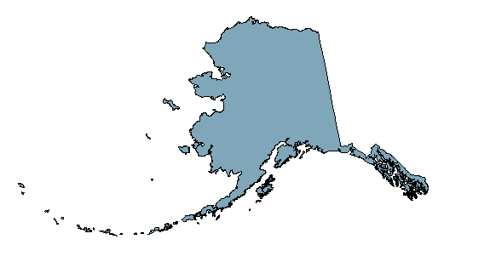
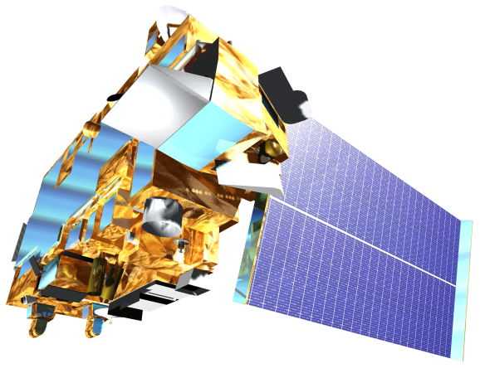
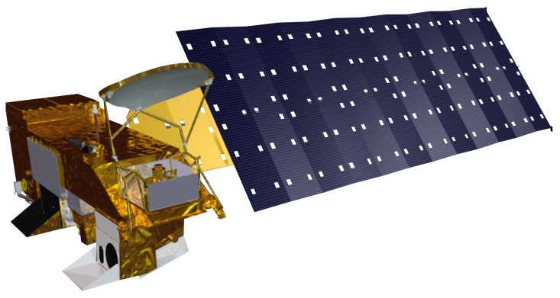
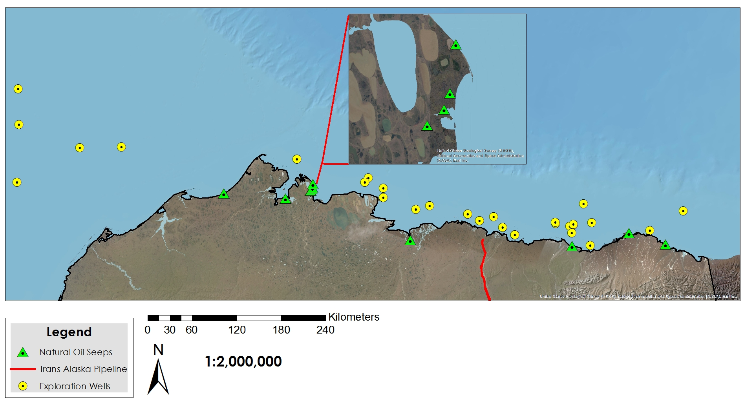
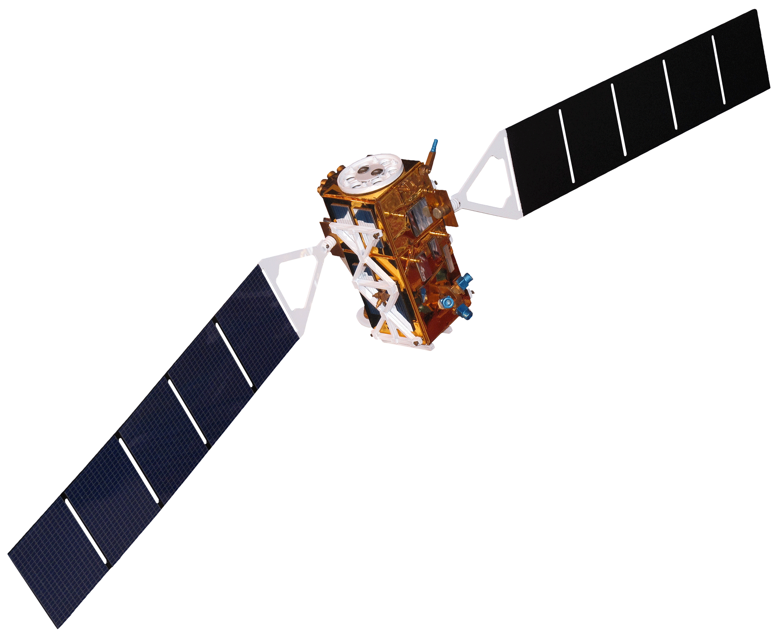
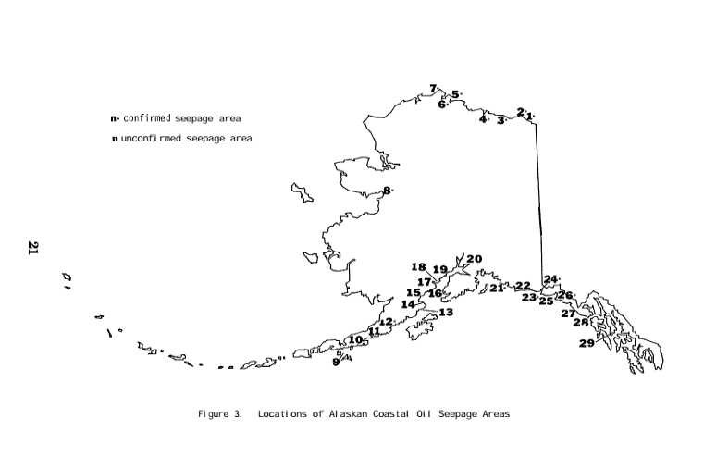
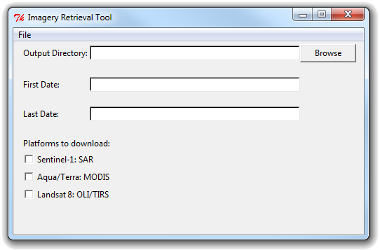
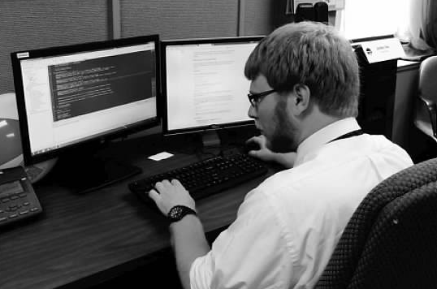
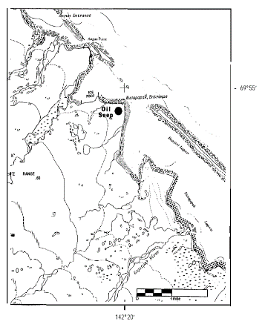
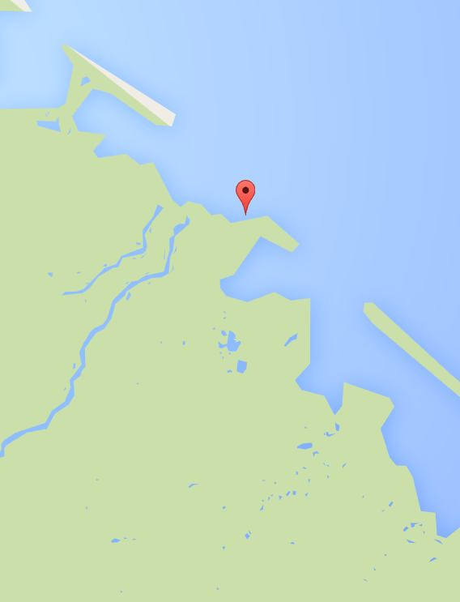
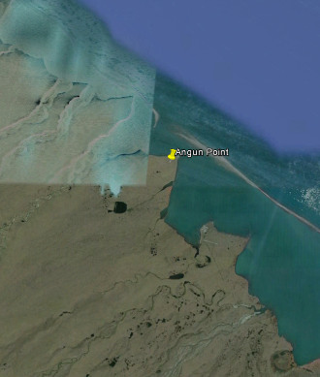
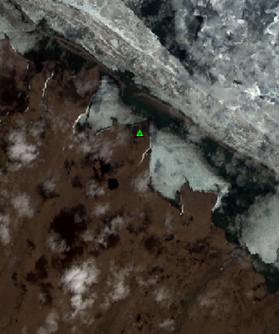
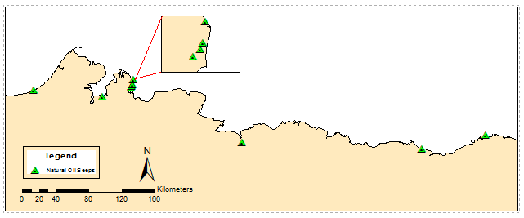
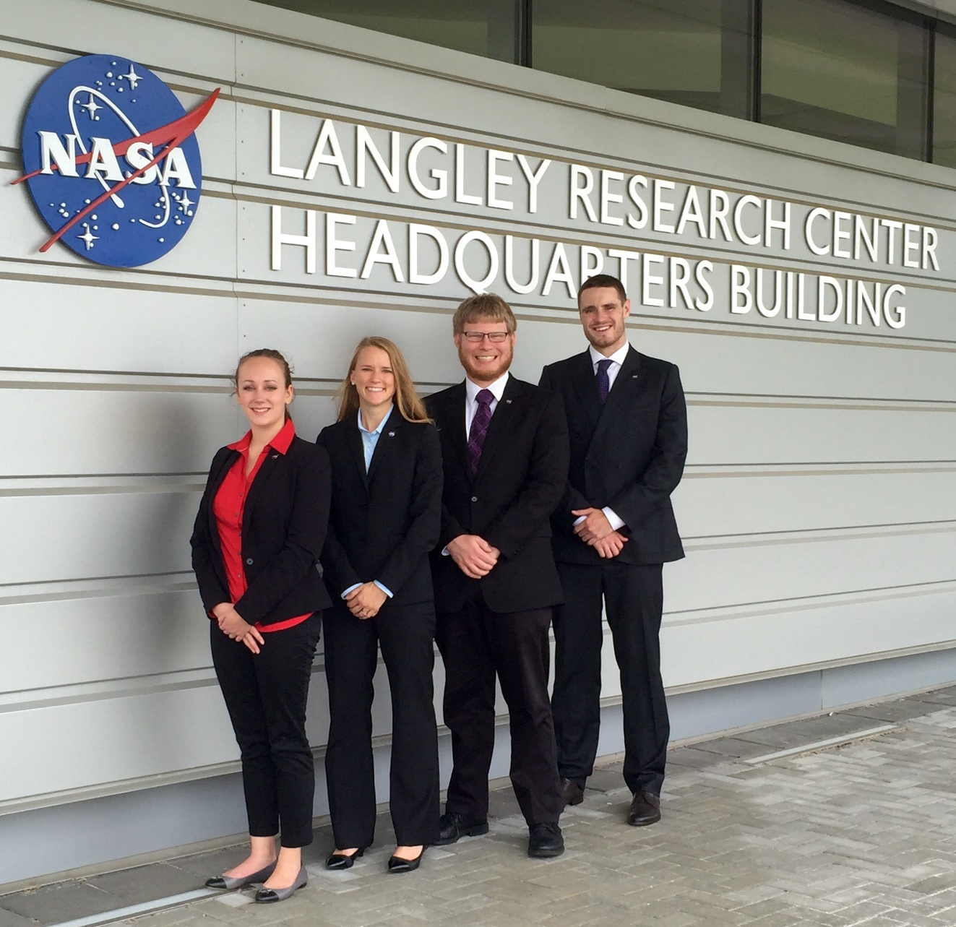
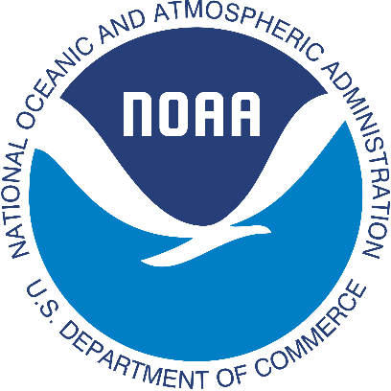
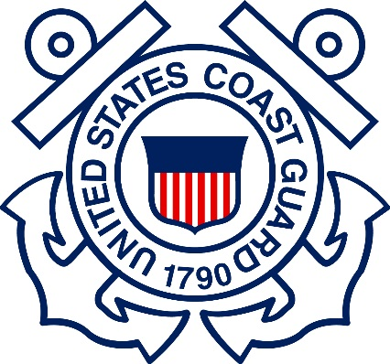
Alaska Disasters
Utilizing NASA Earth Observations to identify oil spills and natural oil seeps off the Northern coast of Alaska
Will Manion (Project Lead), Amy Ferguson, Jordan Vaa, Kristen Noviello, Nicole MacDonald, Katelynn Quinn
NASA DEVELOP National Program NASA Langley Research Center
Abstract
Study Area
Objectives
Sea ice is rapidly decreasing in the Arctic, encouraging a surge in maritime transportation and energy exploration in the region. This increase in traffic, combined with challenges unique to an Arctic environment, escalates the risk of an oil spill. In addition to human activity, oil enters the marine environment through natural oil seeps. The United States Coast Guard (USCG) is the lead response agency for oil spills in U.S. coastal waters. Ancillary responsibilities of the USCG include monitoring natural oil seeps in order to rule out anthropogenic sources. Complexities inherent to an Arctic oil spill, ice-infested waters, strong currents, cloud cover, and extended darkness, require a combination of sensors operating across the electromagnetic spectrum to accurately portray an incident. NASA DEVELOP partnered with the USCG Auxiliary University Program to create a Python-based tool that automates access to optical and radar imagery. The project incorporated near real-time optical data from the NASA’s Aqua, Terra and Landsat 8, and radar data from the European Space Agency platform, Sentinel-1. Additionally, the study constructed a natural oil seeps map using ArcGIS 10.3 by georeferencing data discovered in historical literature. The resultant dataset was incorporated into the interactive Arctic Emergency Response Management Application to facilitate fast visualization and coordination for emergency responders. These products will be used by the USCG to improve strategic oil spill response planning for the northern coast of Alaska.
Identify natural oil seeps along the northern shore of Alaska
Create a graphical user interface to facilitate fast visualization of an oil spill incident through quick access to NASA EOS spectral imagery and ESA EO radar imagery
Inject spatial data into Arctic ERMA in order to assist USCG response communication and coordination efforts
Northern shore of Alaska
Earth Observations
Results
Natural oil seeps on the Northern shore of Alaska
Aqua-MODIS Terra-MODIS
Landsat 8 OLI/TIRS Sentinel-1
Methodology
Imagery Retrieval Tool
Natural Oil Seeps Map
Data Repositories
Software
Python 2.7
Product
GUI
Historical Data
Becker and Manen (1988)
Geo-
referencing
Product
ArcMap 10.3.1
Web-based GIS
Google Maps, Google Earth, Landsat 8 OLI/TIRS
Sentinel-1 Scientific Data Hub
Georeferenced natural oil seeps identified by Becker and Manen (1988).
Imagery Retrieval Tool Graphical User Interface
Imagery Retrieval Tool facilitates quick access to spectral data.
Conclusions
Team Members
Aqua/Terra MODIS, Landsat 8 OLI/TIRS, and Sentinel-1 data offer a promising suite of spectral data for USCG strategic oil response planning.
Injection of natural oil seeps data into Arctic ERMA facilitates rapid visualization and may improve strategic, operational and tactical coordination efforts.
Future work on this project can incorporate optical and radar parameters into GUI code to better refine oil detection methodology.
Nicole MacDonald
Project Partners
Acknowledgements
National Oceanic and Atmospheric Administration (NOAA)
United States Coast Guard (USCG)
We would like to thank our Science Advisor, Dr. Kenton Ross (National Science Advisor), for his guidance on this project.
We would also like to thank Dr. Amy Merten of the NOAA Spatial Data for her help in assimilating our data into the Arctic Emergency Response Management Application.
Katelynn Quinn
Kristen Noviello, Amy Ferguson, Jordan Vaa, Will Manion
NASA Langley Research Center

