Slide 1
U.S.
DISASTERS II
Using GRACE-Derived Water and Moisture Products as a Predictive Tool for Wildfire Potential in the Contiguous United States
Brittany Zajic (Project Lead)
Daniel Jensen
Nick Rousseau
Notes:
Our project involves using GRACE-Derived Water and Moisture Products as a Predictive Tool for Wildfire Potential in the Contiguous United States
US Disasters II is a carry-over project from the Spring 2015 term, where our preliminary results incorporated both a correlation coefficient map and a linear regression model to where you will see a more refined data set.

Slide 2
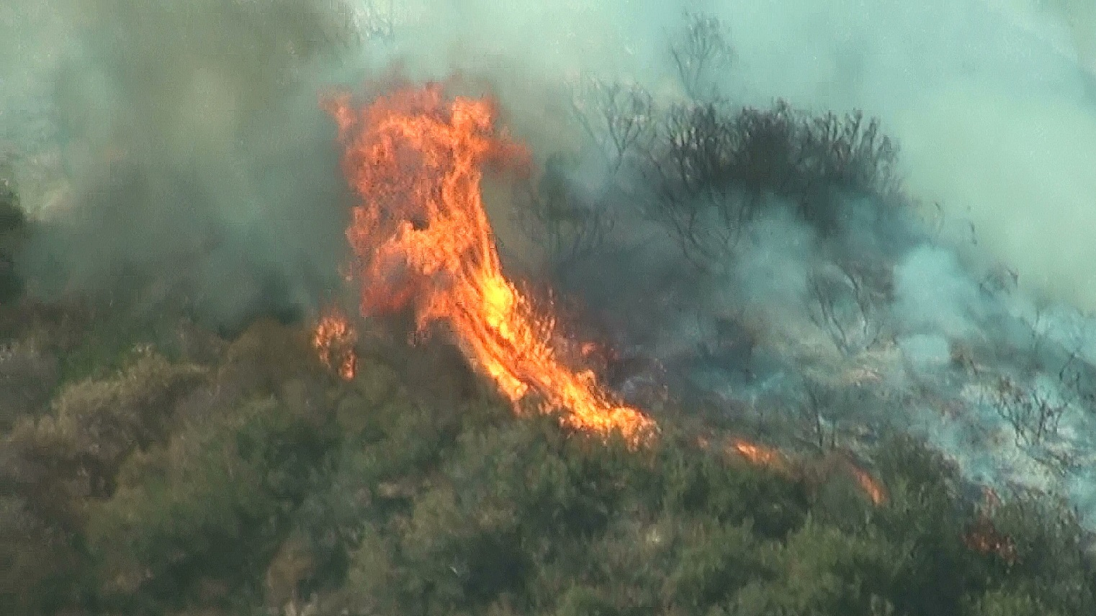
Introduction
Wildfires in the contiguous United States have become more frequent in the last several decades
Recent drought conditions have escalated wildfires causing:
Economic Loss
Environmental
Degradation
Property Damage
Credit: Nick Rousseau
Notes:
Wildfires across the contiguous United States have increasingly become larger and more frequent in the last several decades. In turn, this has caused an increase in fire suppression costs, a higher rate of natural resource degradation and an increase in property damage in the form of structures burned.
Trends contributing to both an increase in the number of wildfires as well as large fire area correlate with a decrease in terrestrial water supply (Dennison et al. 2014).
Image: 2015 Santa Clarita Fire off of 5 Freeway (Source: Nick Rousseau)

Slide 3
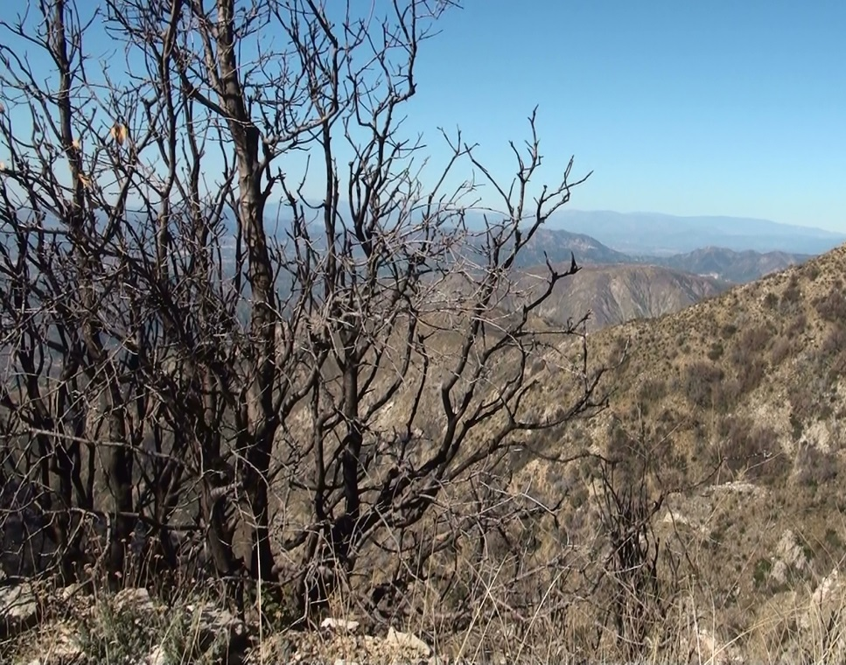
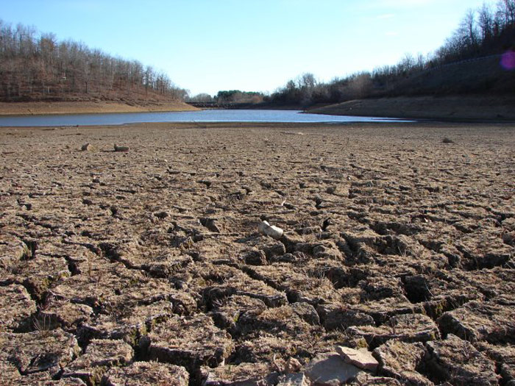
Introduction
Rising wildfire trends can be correlated with the increase of drought
Understanding the relationship between wildfire activity and soil moisture in the U.S. has faced limited ability
Credit: Nick Rousseau
Credit: NOAA
Notes:
Fire season in the western United States has historically occurred from the months of June through October which also is the driest time of the year in the western U.S., but over the past decade fire season has increasingly lengthened due to the drought.
2003-2012: 71.7 million acres burned, 2006 record for most acres burned at 9.8 million acres (National Interagency Fire Center.)
If we can understand how regional climate conditions effect terrestrial water supply we can better understand and possibly predict potential wildfires.
Higher precipitation rates during the wet season generally lead to higher rates of vegetation growth or “fire fuel”, which can lead to greater potential for fire in the dry season.
Image 1: Post wildfire burn areas near Mt. Lukens, San Gabriel Mountains, California (Source: Nick Rousseau)
Image 2: River basin in the Western United States (source: http://www.noaa.gov/features/monitoring_0209/watersupply.html)

Slide 4
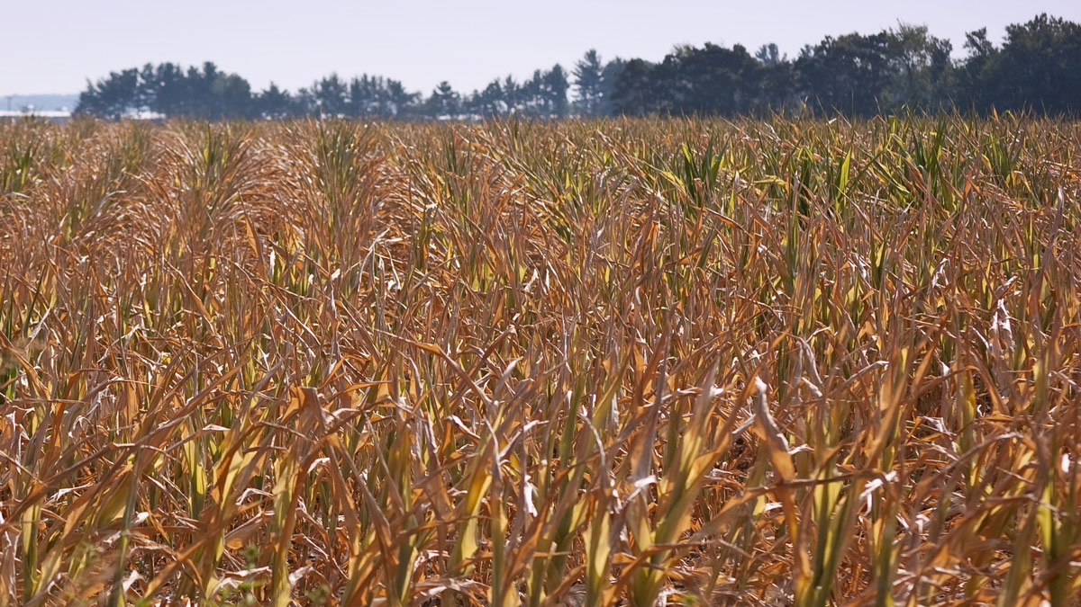
Introduction
A major contributing factor to wildfires is fuel moisture content (FMC)
Low FMC means higher fire risk as wells as a potentially higher fire severity
No accurate remotely-sensed FMC product available
Credit: Wikimedia Commons
Notes:
Fuel moisture content (FMC) is a measure of the amount of water in a fuel (vegetation) available to a fire.
The moisture content and distribution of fuels determine how quickly a fire can spread and how intense or hot a fire may become. The burning speeds in vegetation with a higher FMC will be slower than vegetation with a lower FMC because the heat from the fire must first eliminate the moisture within that higher FMC vegetation type.
Low FMC means higher fire risk as well as higher potential fire severity, thus increasing the degree of environmental degradation caused by a fire.
There is currently no accurate remotely-sensed fuel moisture content product in use. A remotely-sensed FMC proxy, combined with an analysis of yearly wet and dry patterns, could provide fire managers and responders with a powerful predictive tool for understanding fire risk and response.
Image: http://www.jpl.nasa.gov/news/news.php?release=2014-376

Slide 5
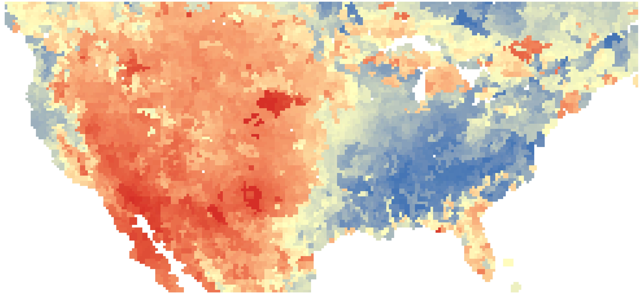
Objectives
Quantify relationships between assimilated GRACE data and wildfire data by land cover type on a national scale
Create an algorithm in Python that will serve as a tool for fire predictive services
Determine if assimilated GRACE data is a promising tool for predicting wildfire potential across the contiguous United States
Notes:
1) Quantify relationships between assimilated GRACE data and wildfire data by land cover type on a national scale.
2) Create an algorithm in Python that will serve as a tool for fire predictive services, which would quantify wildfire probability
and predict burned area by year.
3) Determine if assimilated GRACE data is a promising tool for predicting wildfire potential across (next slide) our study area of the contiguous United States

Slide 6
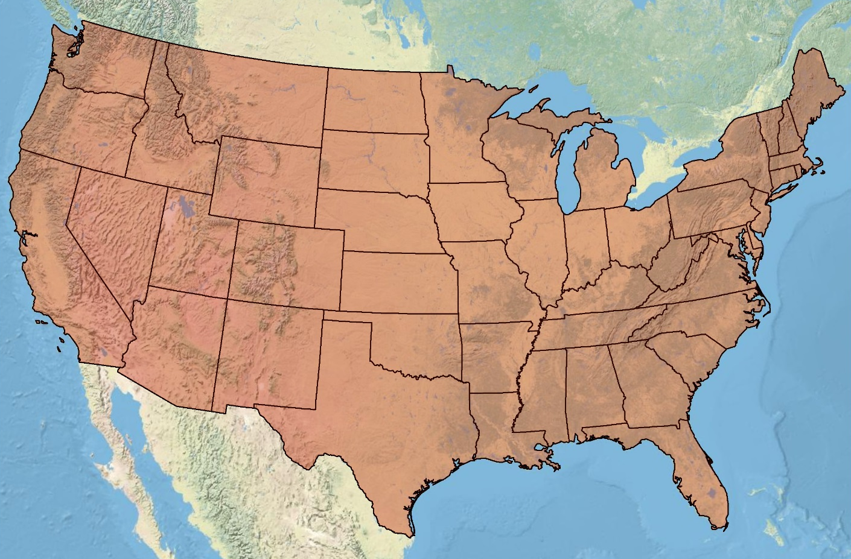
Study Area and Period
Study Period: January 2003 to December 2013
Location: Contiguous United States
Notes:
Our focus is on the contiguous United States, mainly areas that are most affected by wildfires using data from a ten-year period: January 2003 to December 2013. This period was used to determine the extent to which dry years following wet years correlate with fire potential. These existing trends contribute to both an increase in the number of wildfires as well as large fire area and correlate with decreased soil moisture (Dennison et al. 2014).

Slide 7
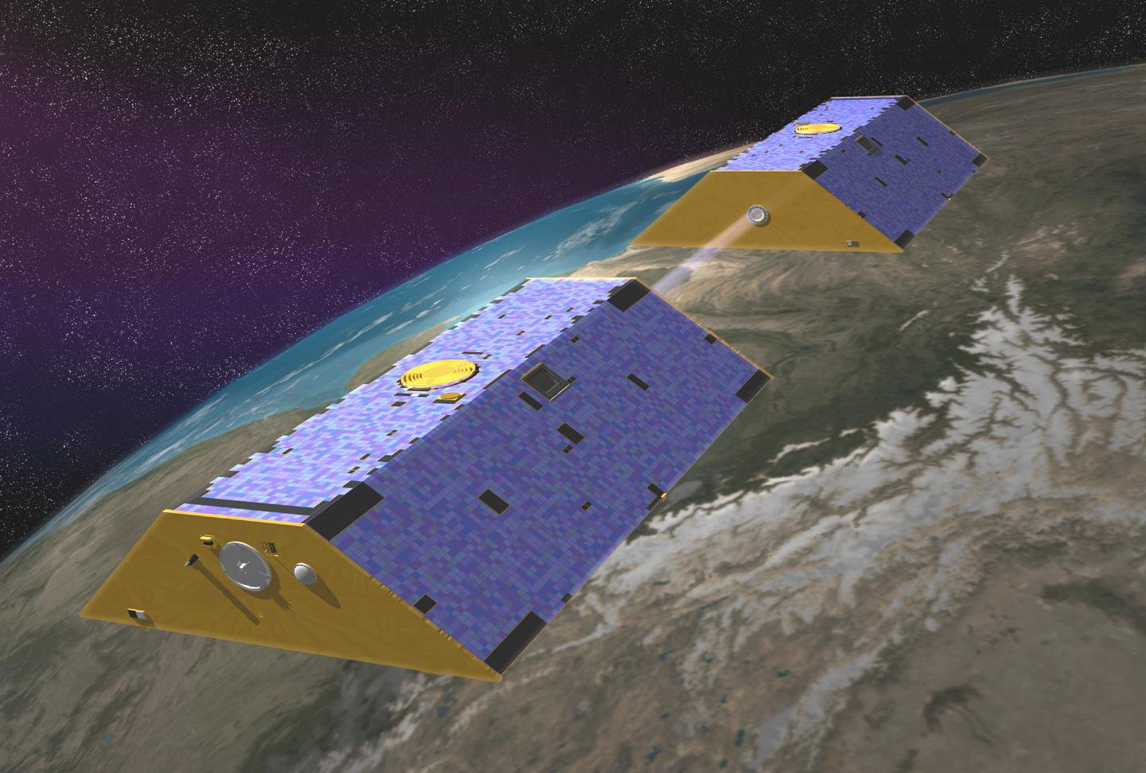
Gravity Recovery and Climate Experiment (GRACE)
Credit: NASA/JPL-Cal Tech
Notes:
Launched in 2002, NASA’s Gravity Recovery and Climate Experiment (GRACE) is made up of a pair of Earth-observing satellites that measure Earth’s gravity field.
GRACE maps Earth’s gravity field by making accurate measurements of the distance between the two satellites and from that we can measure how Earth’s gravity field changes over time. The only thing that moves around at this time scale is water, so GRACE is unique in its ability to measure total water storage variations, stored at all levels above and within the Earth’s surface.
Image source: http://www.nasa.gov/topics/earth/features/Grace_OBP.html

Slide 8
Project Methodology
Surface Soil Moisture
Assimilated GRACE Data
(NASA GSFC Terrestrial Hydrology Program)
Annual Average
Soil Moisture January – April
(Python)
Annual Total Burned Area
(ArcGIS, Python)
Predictive Algorithm
(Python)
Wildfire Probability and Predicted Burned Area
Wildfires
Fire Program Analysis Fire-Occurrence Database
(USDA Forest Service)
Annual Total Number of Wildfires
(ArcGIS, Python)
Land Cover
National Land Cover Database 2011
(USGS)
Resample and Reclassify
(ArcGIS)
Notes:
For our methodology I will now go through each dataset and how it was processed.
First is the surface soil moisture assimilated GRACE data.

Slide 9
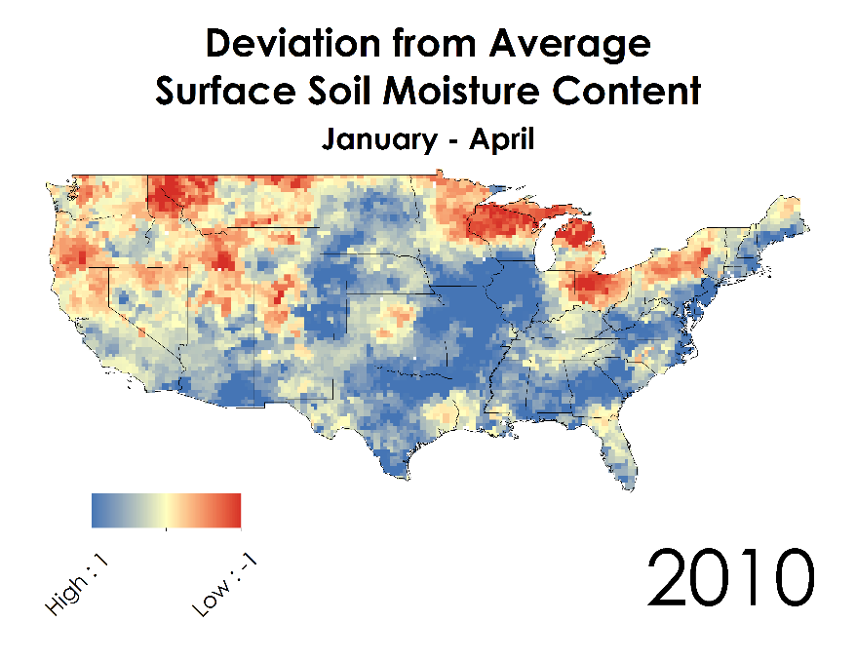
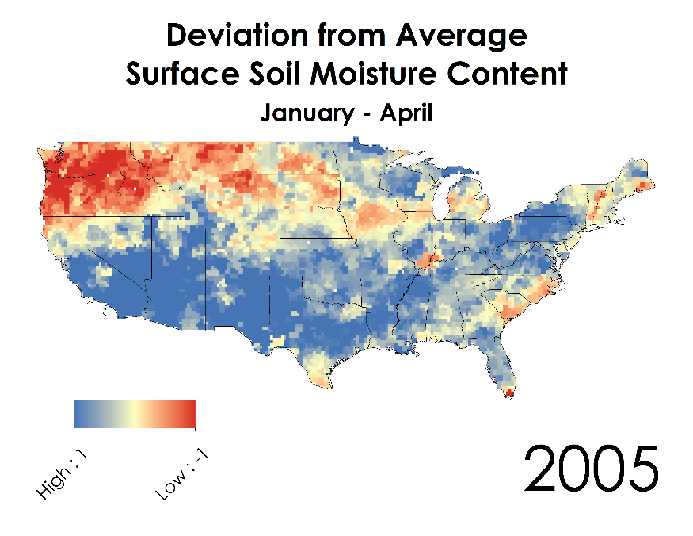
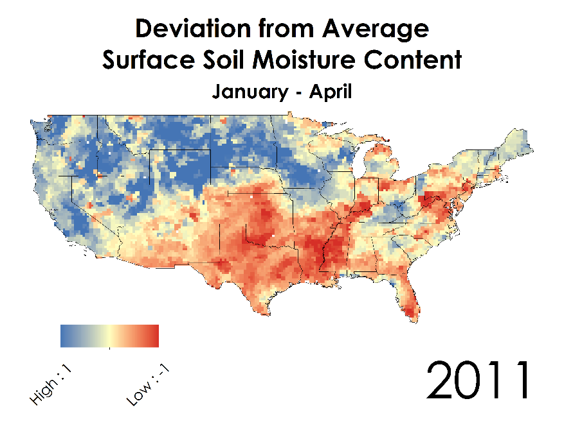
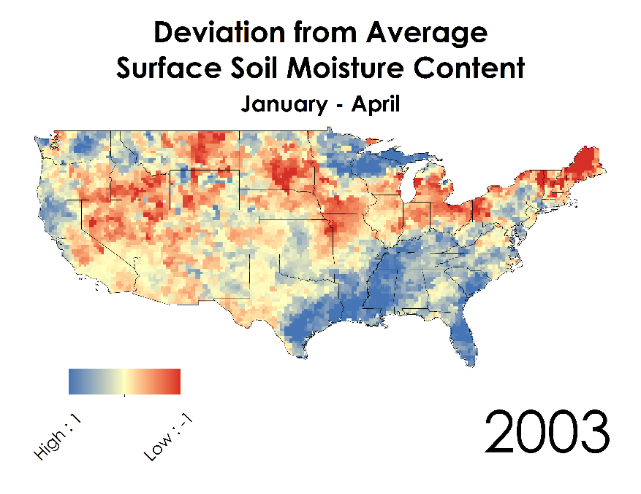
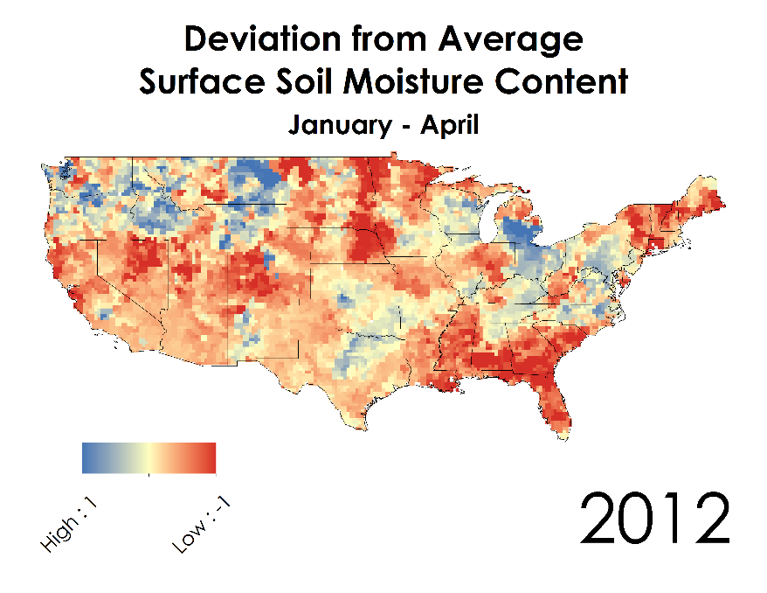
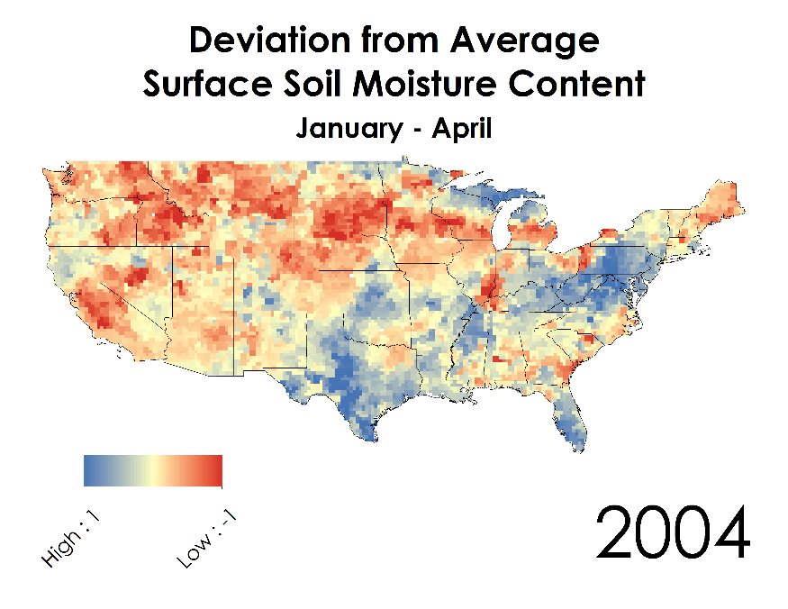
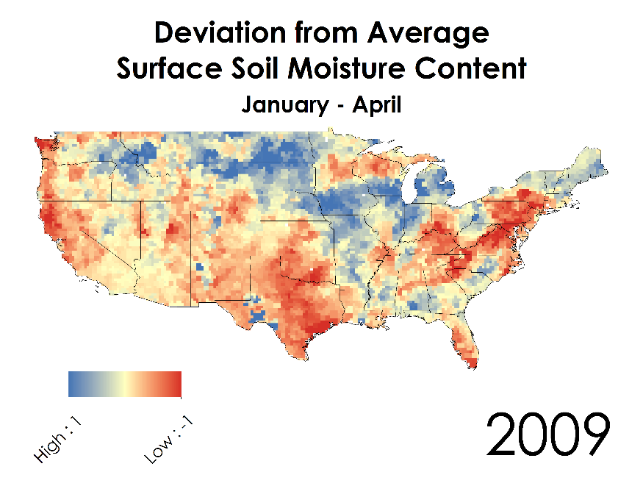
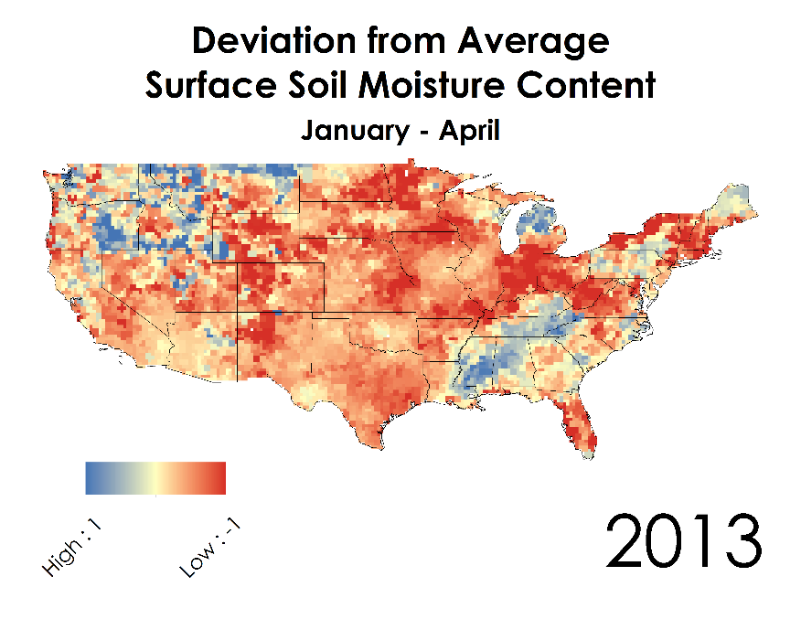
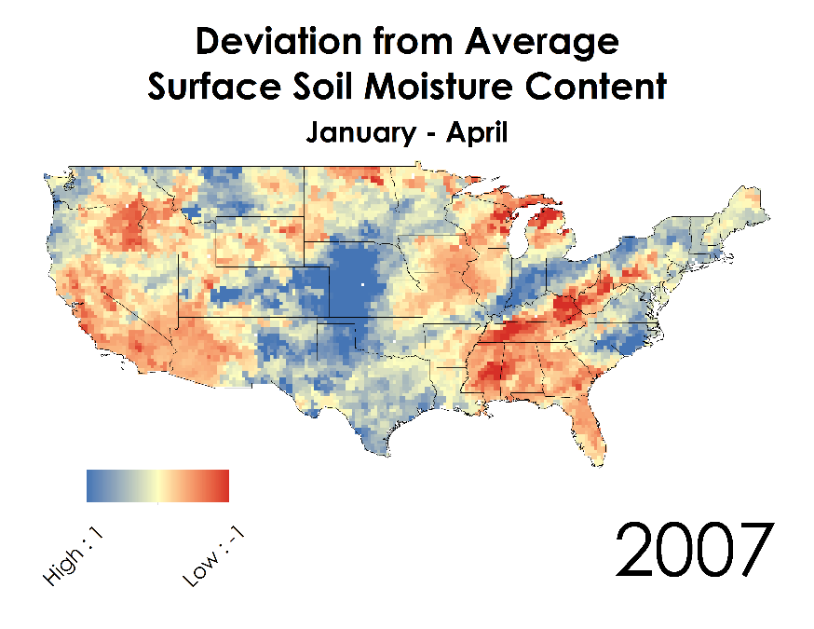
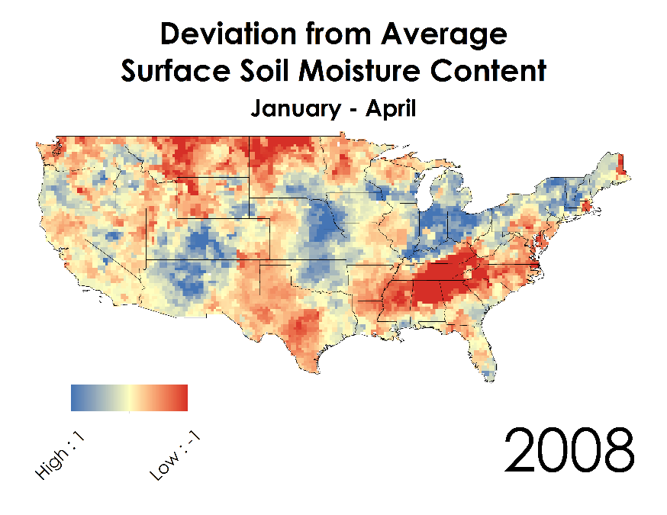
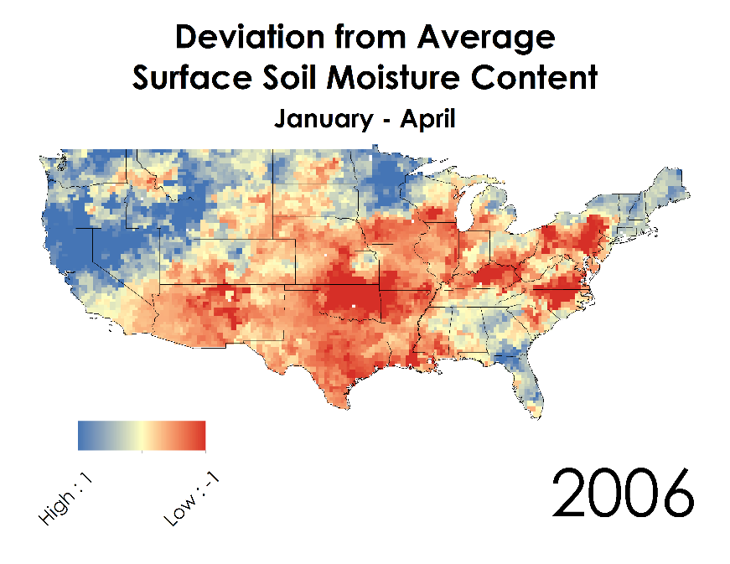
GRACE Assimilated Data
  GRACE assimilated data measures terrestrial water storage (TWS), root zone moisture content (RZMC), and surface soil moisture content (SFMC)
Notes:
NASA scientists at Goddard Space Flight Center integrated GRACE data into the Catchment Land Surface Model to create assimilated data of terrestrial water storage, root zone moisture content, surface soil moisture content and more. This is how we acquired our soil moisture data, and the following figures show how drastically each year’s January-April SFMC deviates from its average value. We chose these months because they are the months that lead into the western portion of the United States’ fire season. For our methodology, the surface soil moisture content was first processed into annual average arrays for January through April of that year.

Slide 10
Project Methodology
Surface Soil Moisture
Assimilated GRACE Data
(NASA GSFC Terrestrial Hydrology Program)
Annual Average
Soil Moisture January – April
(Python)
Annual Total Burned Area
(ArcGIS, Python)
Predictive Algorithm
(Python)
Wildfire Probability and Predicted Burned Area
Wildfires
Fire Program Analysis Fire-Occurrence Database
(USDA Forest Service)
Annual Total Number of Wildfires
(ArcGIS, Python)
Land Cover
National Land Cover Database 2011
(USGS)
Resample and Reclassify
(ArcGIS)
Notes:
Second is the USDA Forest Service wildfire data

Slide 11
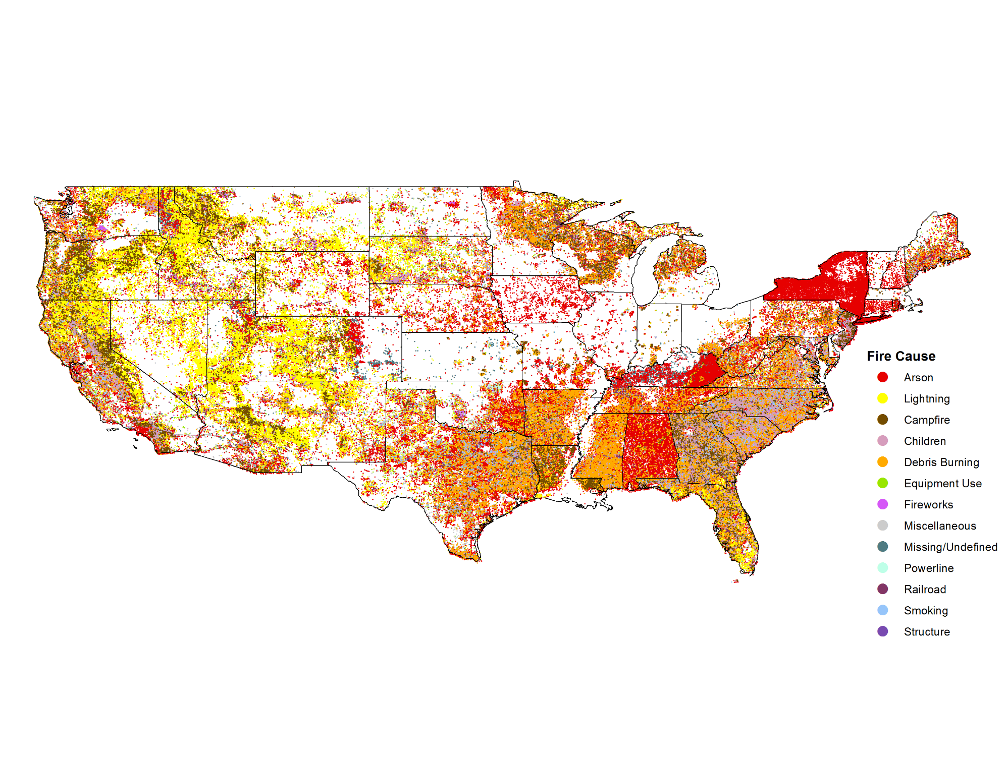
Fire Program Analysis Fire-Occurrence Database (FPA FOD)
Notes:
The USDA Forest Service’s Fire Program Analysis Fire-Occurrence database is a comprehensive geospatial database of wildfires in the US from 1992 to 2013. It includes 1.73 million geo-referenced wildfire records, representing a total of 126 million acres burned during the 22-year period. It also contains vital information for each of these fires, including date, cause, fire size, fire class, burned area, and coordinates. This data was imported into a geospatial information system and processed into two separate raster datasets that matched the spatial and temporal resolution of the GRACE derived soil moisture data.
http://www.fs.usda.gov/rds/archive/Product/RDS-2013-0009.3/
Short, Karen C. 2015. Spatial wildfire occurrence data for the United States, 1992-2013 [FPA_FOD_20150323]. 3rd Edition. Fort Collins, CO: Forest Service Research Data Archive. http://dx.doi.org/10.2737/RDS-2013-0009.3

Slide 12
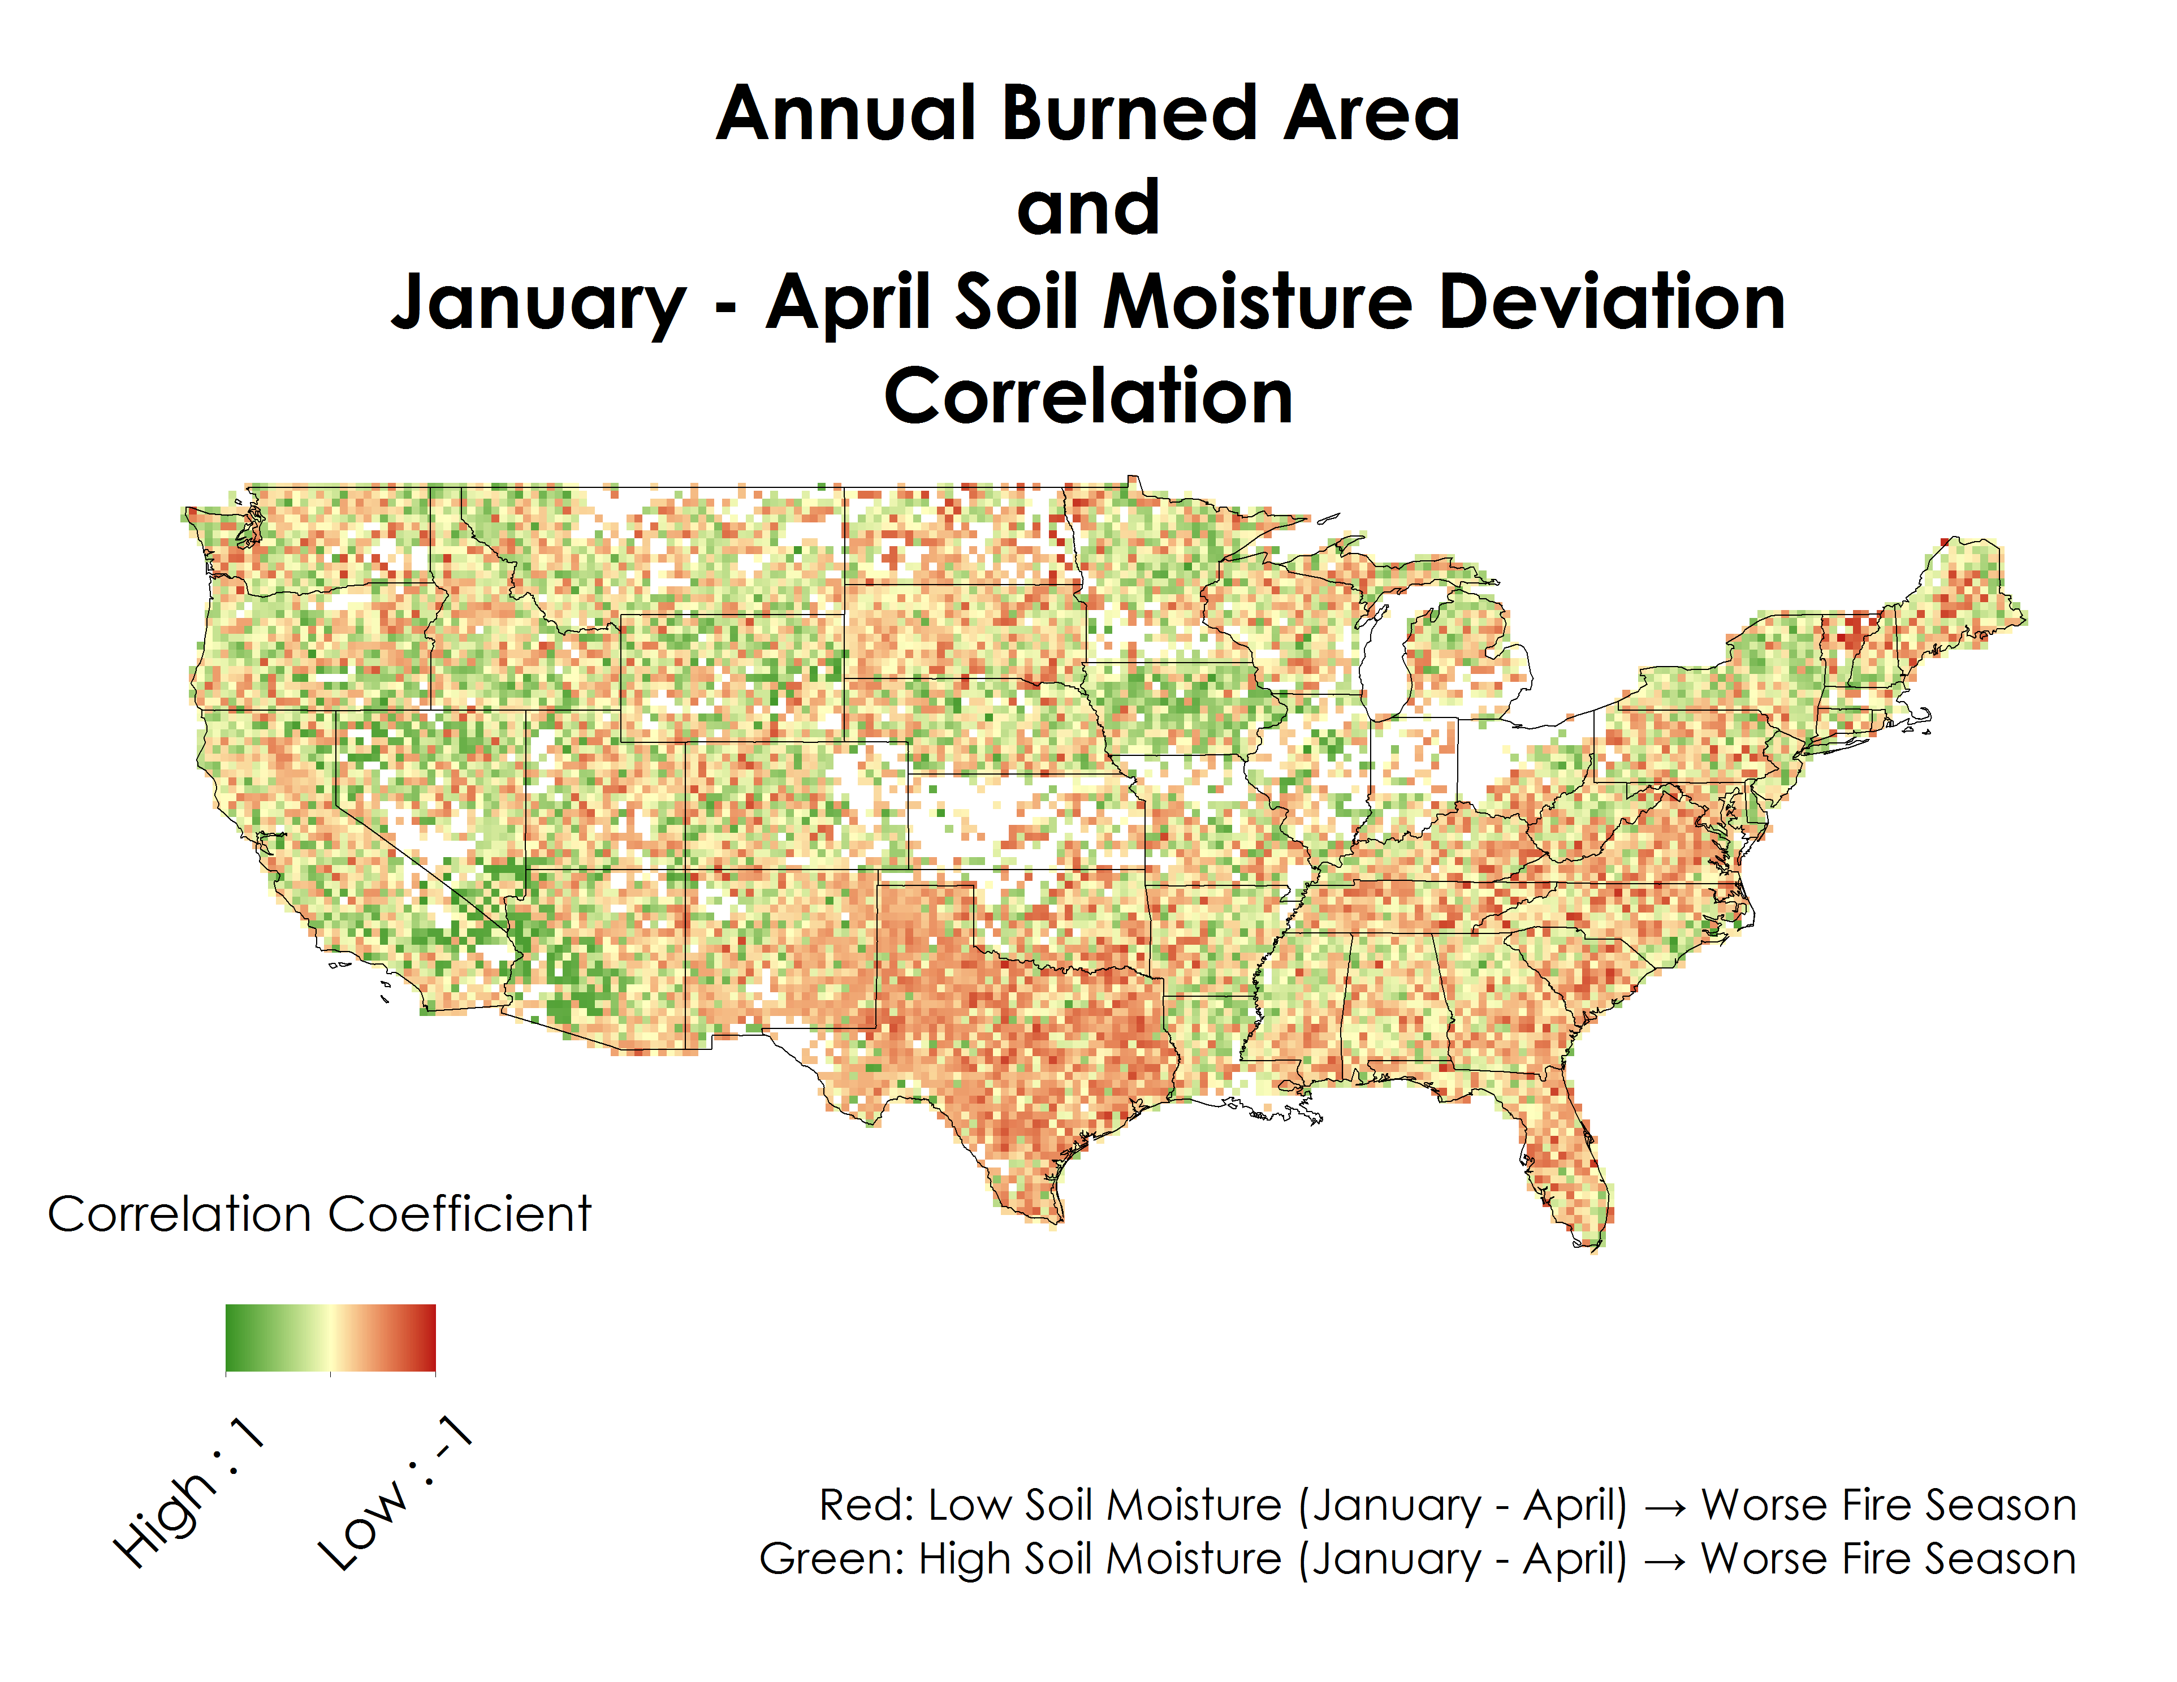
Preliminary Evaluation
-0.98 < p < 0.94
Notes:
We did not acquire this wildfire dataset until our second (current) term and thus we first wanted to evaluate the relationship of this new wildfire dataset with the soil moisture data. We performed a Pearson Correlation Coefficient and received high correlation values of -0.98 to 0.94, suggesting a strong linear relationship between the two datasets. This allowed us to move forward with more complex statistical computations in the algorithm development stage.

Slide 13
Project Methodology
Surface Soil Moisture
Assimilated GRACE Data
(NASA GSFC Terrestrial Hydrology Program)
Annual Average
Soil Moisture January – April
(Python)
Annual Total Burned Area
(ArcGIS, Python)
Predictive Algorithm
(Python)
Wildfire Probability and Predicted Burned Area
Wildfires
Fire Program Analysis Fire-Occurrence Database
(USDA Forest Service)
Annual Total Number of Wildfires
(ArcGIS, Python)
Land Cover
National Land Cover Database 2011
(USGS)
Resample and Reclassify
(ArcGIS)
Notes:
Third is the USGS National Land Cover data

Slide 14
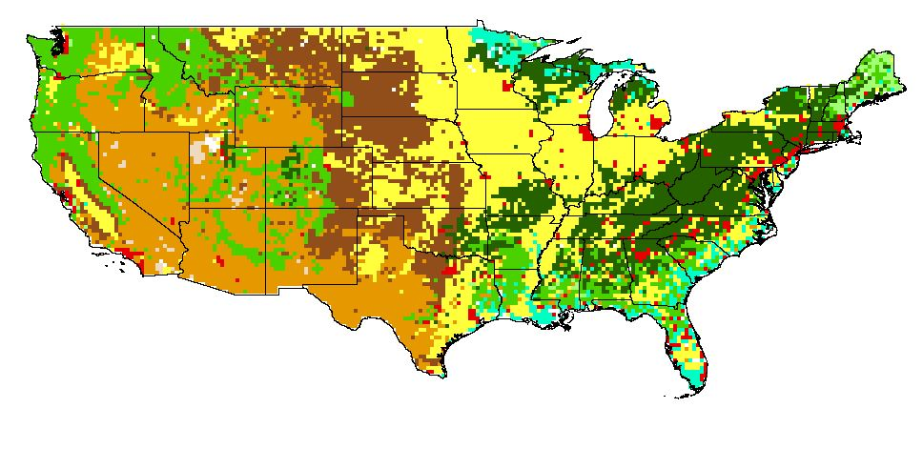
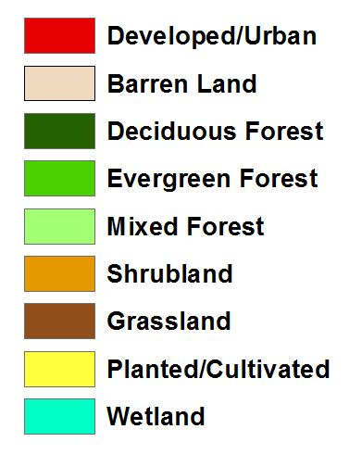
USGS 2011 NLCD Land Cover Product
Notes:
The 2011 USGS National Land Cover Data Product was resampled to the same spatial extent and resolution as our two other datasets. This allowed each grid cell to have a unique land cover classifier, which could then be programmatically used to extract values and characterize each relevant vegetation type’s relationship between soil moisture and wildfire

Slide 15
Project Methodology
Surface Soil Moisture
Assimilated GRACE Data
(NASA GSFC Terrestrial Hydrology Program)
Annual Average
Soil Moisture January – April
(Python)
Annual Total Burned Area
(ArcGIS, Python)
Predictive Algorithm
(Python)
Wildfire Probability and Predicted Burned Area
Wildfires
Fire Program Analysis Fire-Occurrence Database
(USDA Forest Service)
Annual Total Number of Wildfires
(ArcGIS, Python)
Land Cover
National Land Cover Database 2011
(USGS)
Resample and Reclassify
(ArcGIS)
Notes:
With these datasets all processed in spatially matching arrays, the predictive algorithm could be developed in Python to assess wildfire probability and predicted burned area.

Slide 16
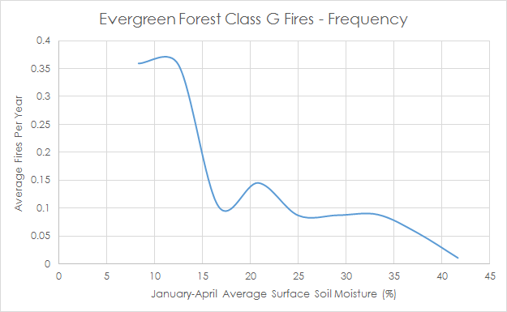
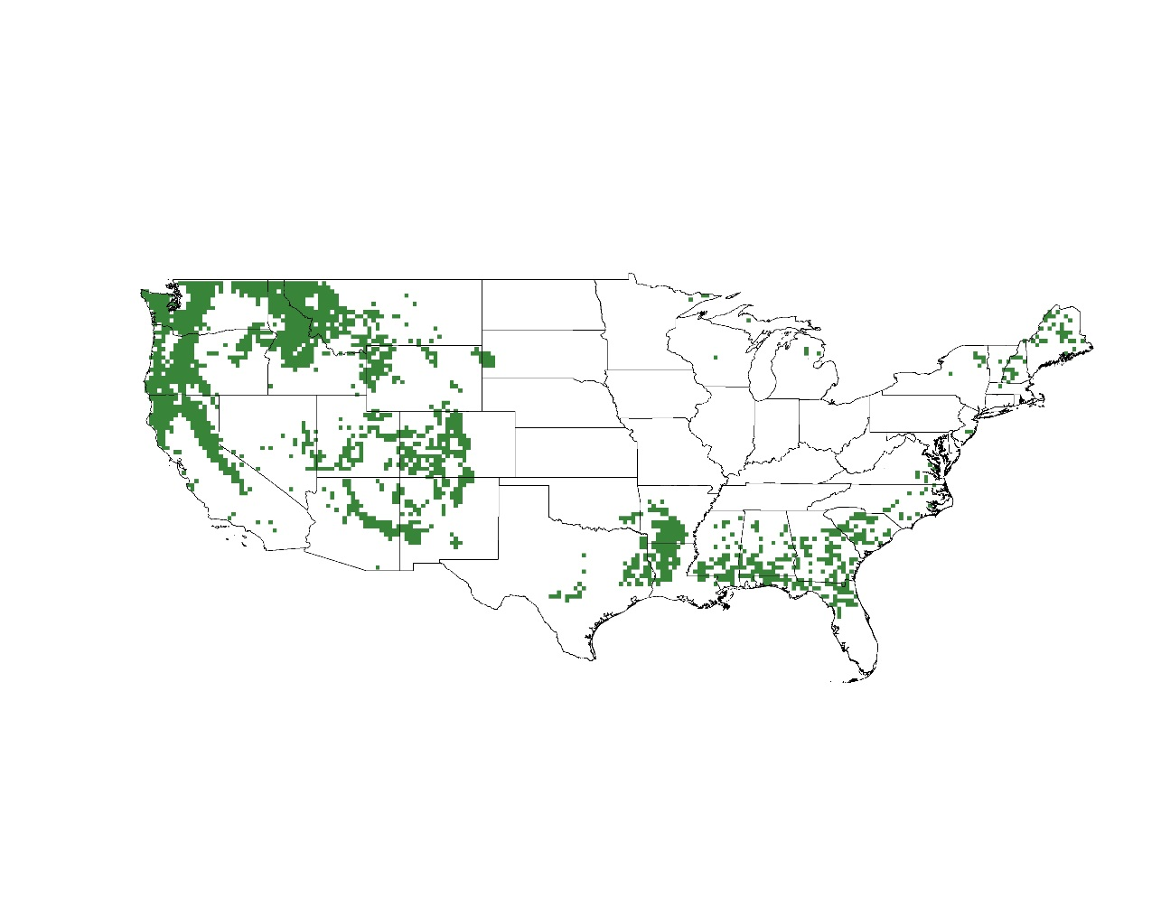
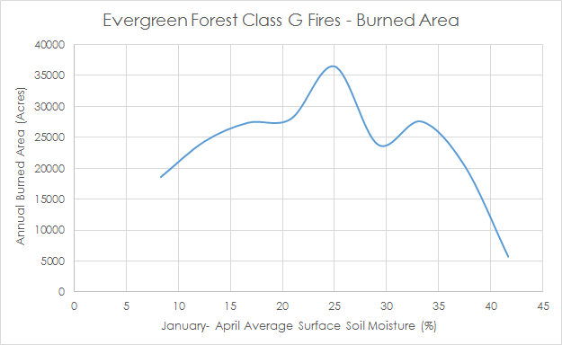
Algorithm Work Flow
Notes:
The first step in algorithm development was to disaggregate the fire data by size class. We are most interested in Class G fires, the largest classification at over 5000 acres burned, as they give us the clearest indication of high fire severity and potential. Then, with annual January – April soil moisture and both annual class G fire number and burned area 3D arrays processed, each burned area and fire frequency value was plotted against its corresponding soil moisture value. The land cover array could be used to disaggregate these plots for each relevant land cover type. The last step in this process was to bin the data by soil moisture ranges, giving us average burned area and number of fires by soil moisture value. These data, then, revealed the unique relationship in each land cover class between wildfire and soil moisture, such as this example for Class G fires in evergreen forest land. These were compiled as look-up tables to be referenced for mapping fire probability and predicted burned area.

Slide 17
Results
May 2003 – 2004 Predicted Fire Season
*Class G Fire = Over 5000 Acres Burned
Notes:
These maps are examples of our results, which retrodict the May 2003 – April 2004 fire year. The first map shows the probability of a Class G fire occurring by multiplying the relevant binned average frequency value by that cell’s soil moisture value. The map on the right, then, shows predicted burned area by Class G fire as a result of multiplying the probability in the left map by the relevant binned average burned area value. It should be noted that these maps are not intended to offer hard predictions of fire severity, but rather an assessment of fire risk and potential based on seasonal soil moisture.

Slide 18
Validation
Notes:
To validate these results then, we created summary statistics for each land cover class, summing up the total number of fires predicted by the algorithm for that fire season (left) and the total predicted burned area (right). We found that in our 2003 – 2004 example data, shown above, that the predictive algorithm performed very well. The values for both predicted fire frequency and burned area line up well with the actual data for this period in the evergreen, deciduous, and wetland classes. Meanwhile, grassland and shrubland appear to be overly sensitive in our model, likely due in part to their widespread classification in actual desert land where fires are infrequent. Despite these promising results for the earlier times in our study period, we also find that as time progresses towards the present the actual fire frequency and burned area data grows much greater than the predicted data.

Slide 19
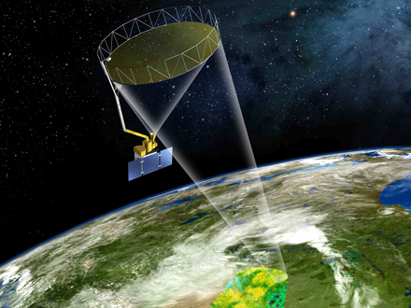
Discussion & Future Work
Validation – more environmental variables addressed for a more accurate model
Seasonal → Monthly
SMAP – more robust results/data
SMAP
Soil Moisture Active Passive
Notes:
However, the same overall patterns hold true through the study period, so these maps are still valid as qualitative indicators of fire risk and potential throughout rather than hard predictors of fire occurrence and severity. Looking forward, then, there are several ways we can refine our algorithm. We do see clear relationships overall between soil moisture and fire frequency/burned area, so incorporating more environmental variables that may account for the increase in fire frequency and severity through time would result in a more accurate modeling process. We could also transition from assessing fire risk on a seasonal level to a monthly time scale. Lastly, SMAP data, despite its recent radar malfunction, can still offer more robust soil moisture data and pick up where GRACE leaves off as the GRACE satellites approach the end of their lives.

Slide 20
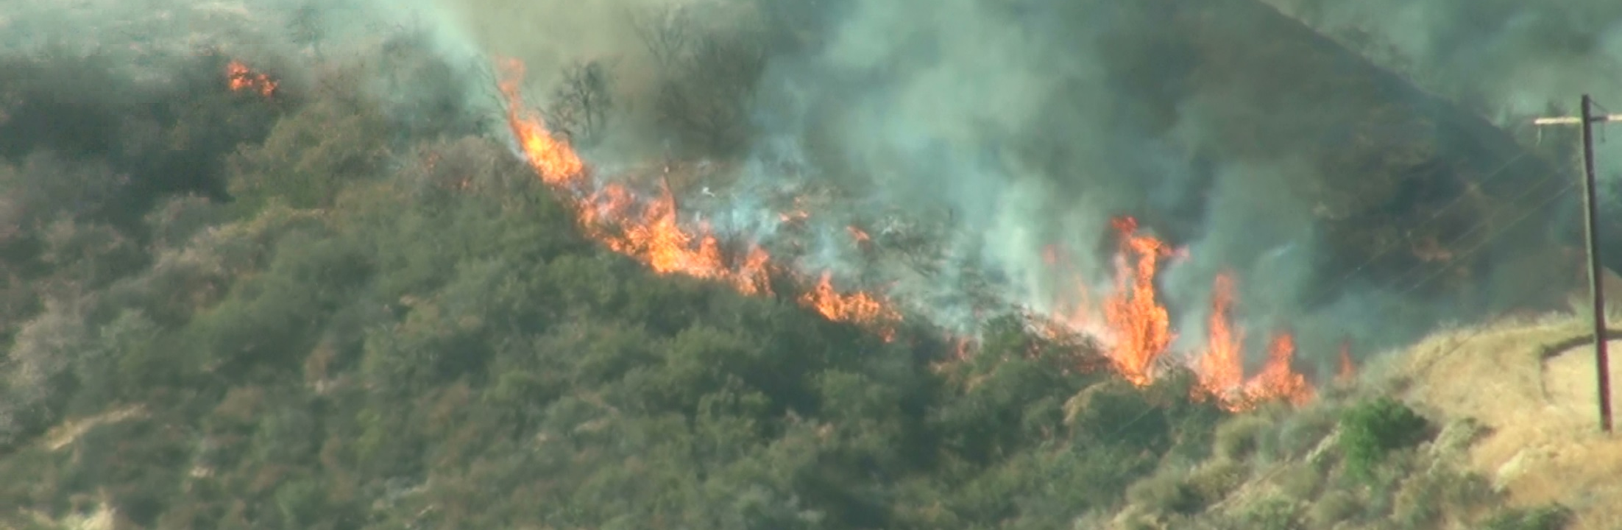
Conclusion
High coefficient of determination values across many fire size classes and land cover types indicate a strong relationship between soil moisture and wildfire
Predictive wildfire potential maps will help better serve the USDA Forest Service as they look to integrate this tool into their predictive capabilities
GRACE can be considered a useful tool for assessing wildfire probability and predicting wildfire
Credit: Nick Rousseau

Slide 21


Partners
Dr. Matt Rodell, NASA Terrestrial Hydrology Program at Goddard Space Flight Center
Mark Finney, Chuck McHugh, and Everett Hinkley, USDA Forest Service
Advisor
Dr. John T Reager, NASA Jet Propulsion Laboratory
Past Contributors
Max Baldridge, NASA DEVELOP
Notes:
Image Source: http://commons.wikimedia.org/wiki/File:Claude_Monet_-_The_Magpie_-_Google_Art_Project.jpg

Slide 22

Questions?
Brittany Zajic, Nick Rousseau, Daniel Jensen
U.S. Disasters II Team, Summer 2015

