Slide 1
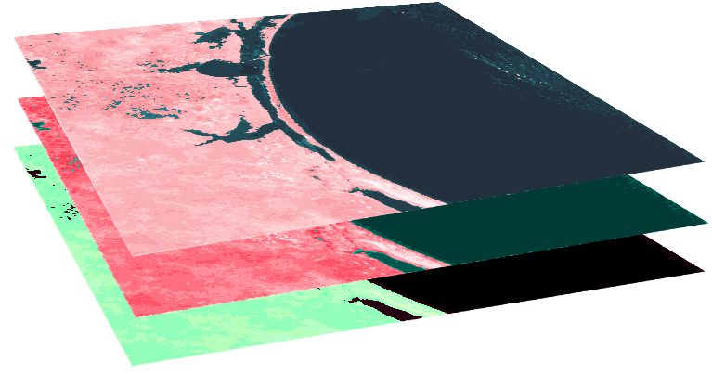
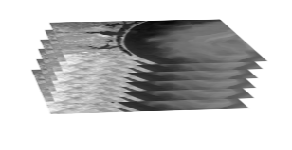
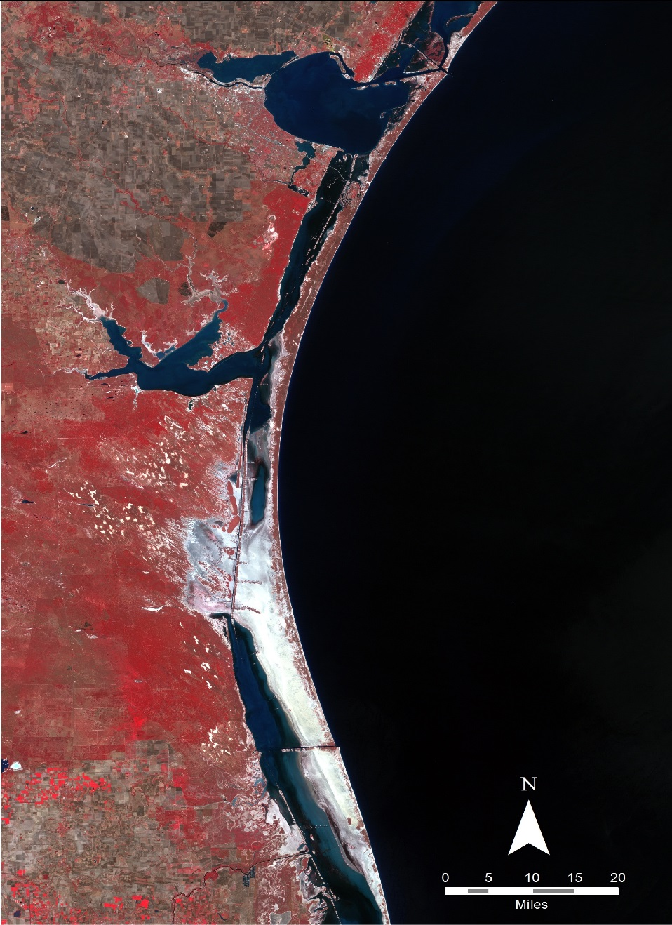
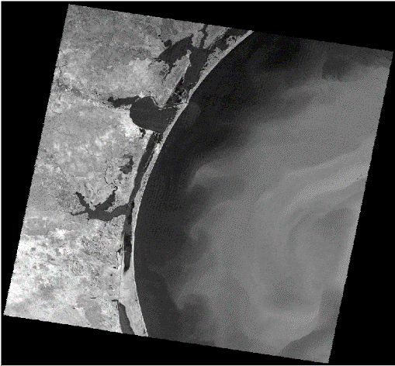
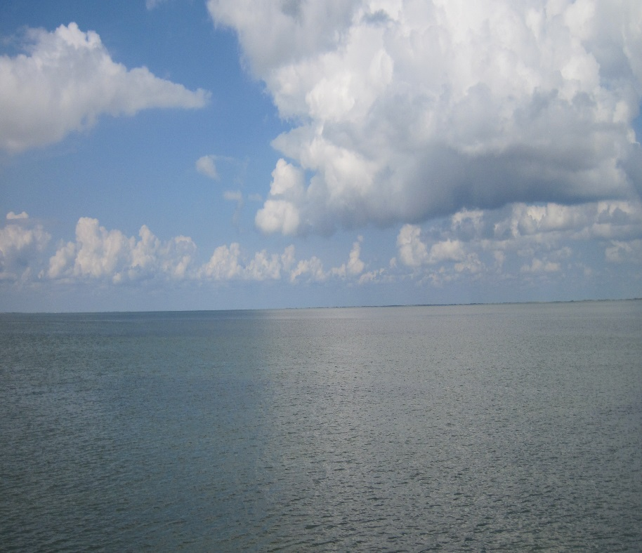
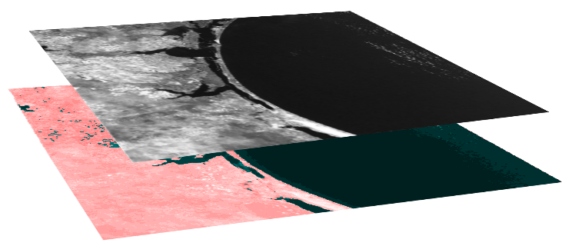
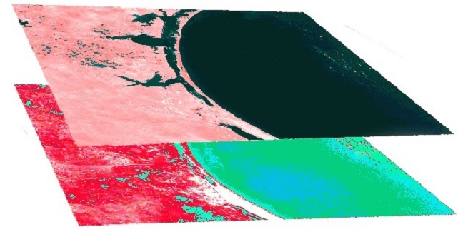
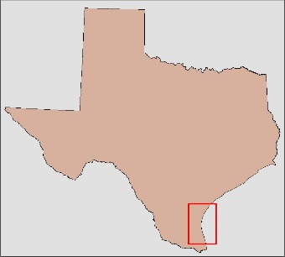
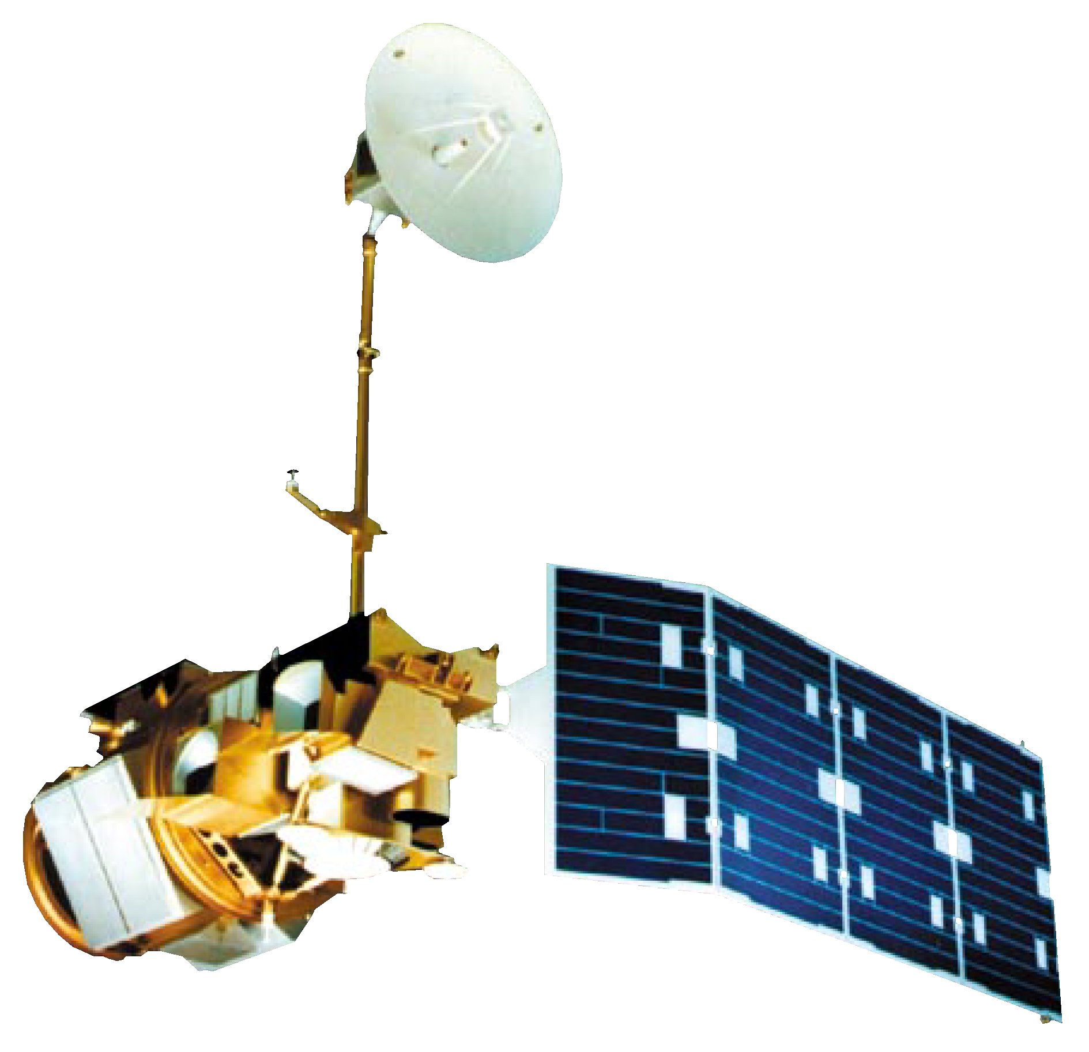
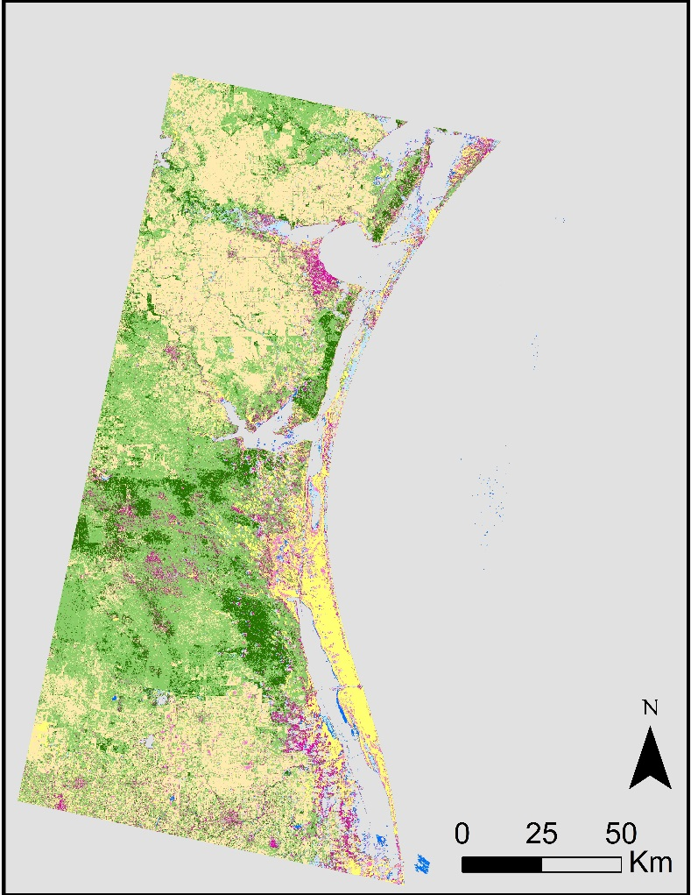
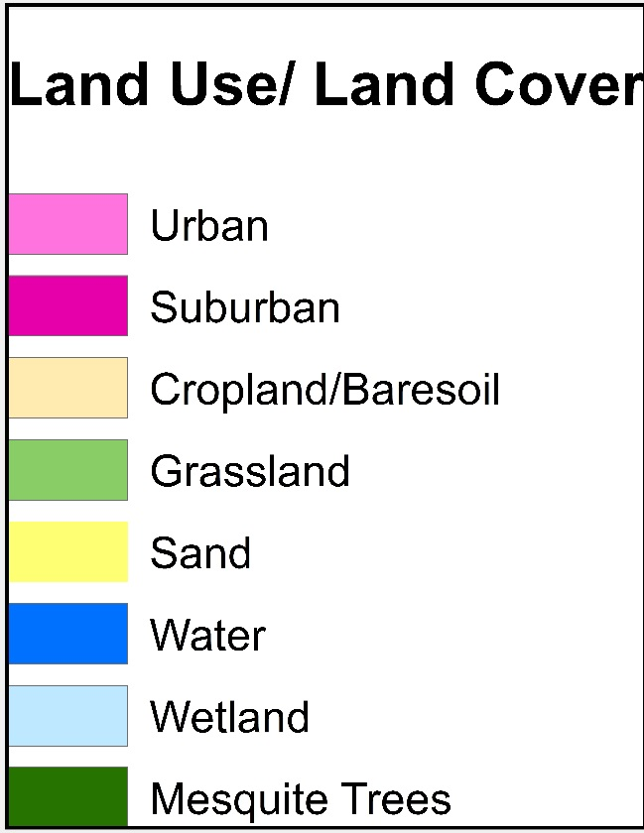
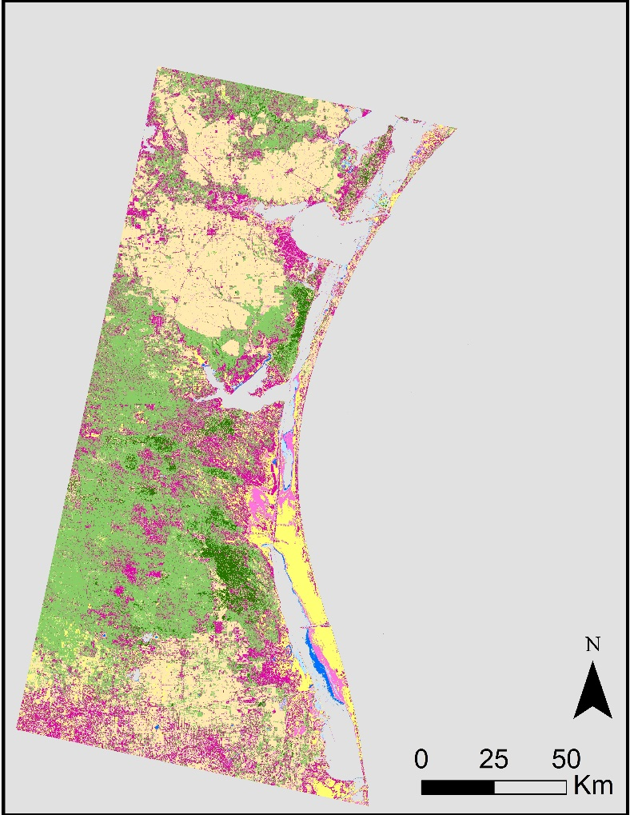
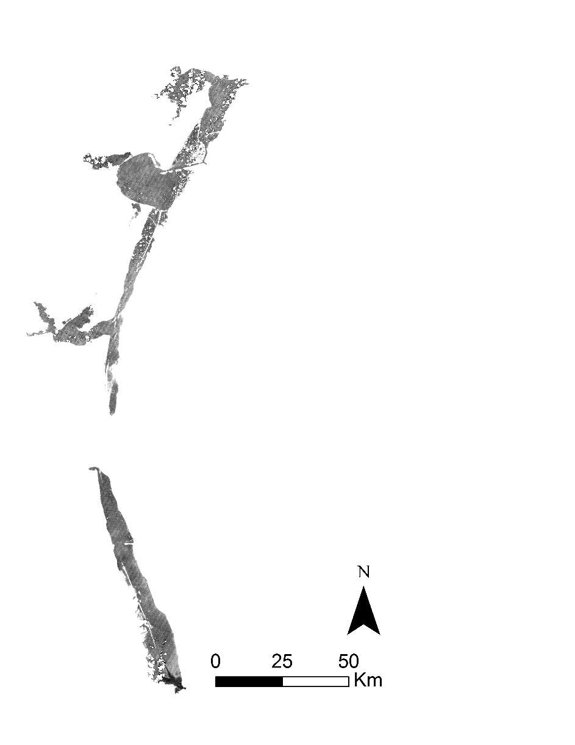
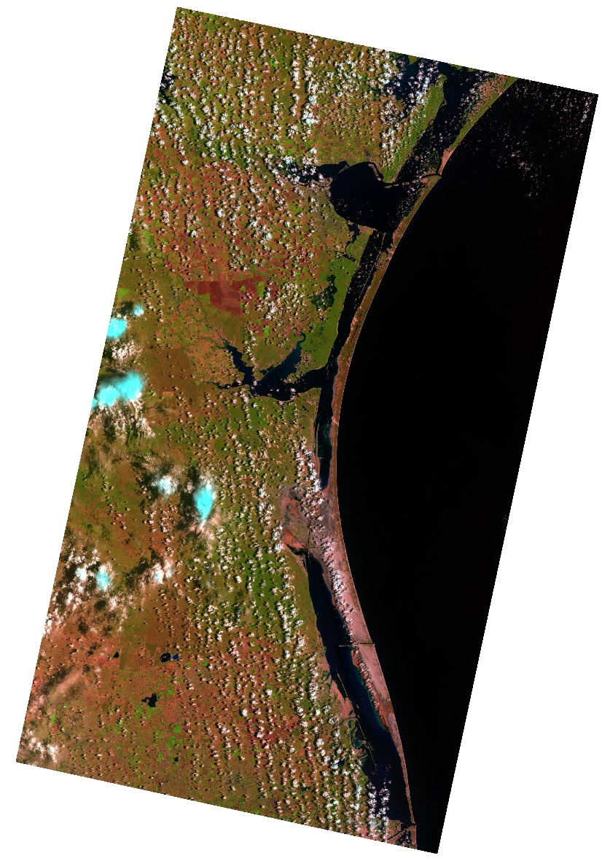
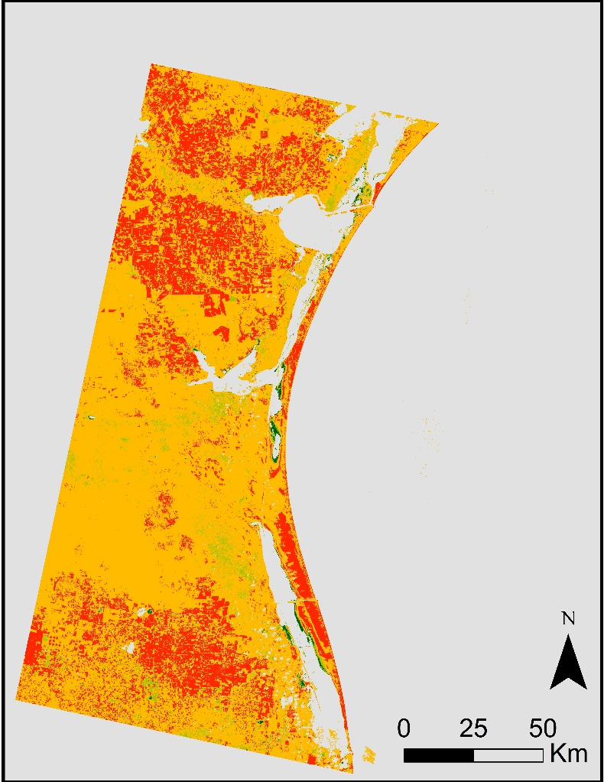
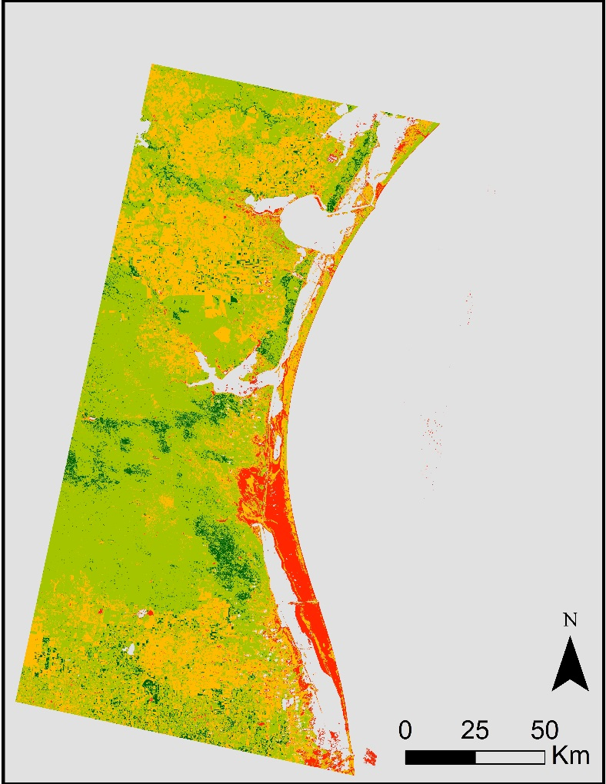
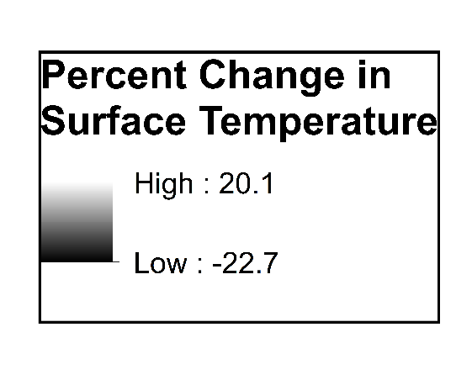
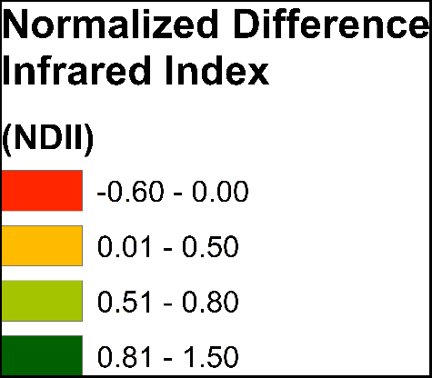
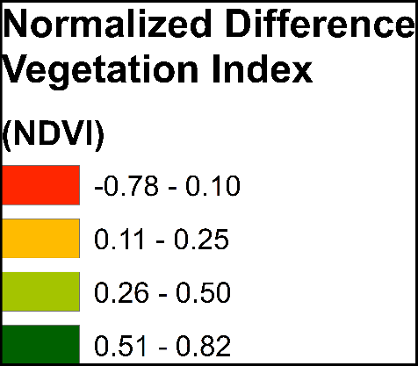
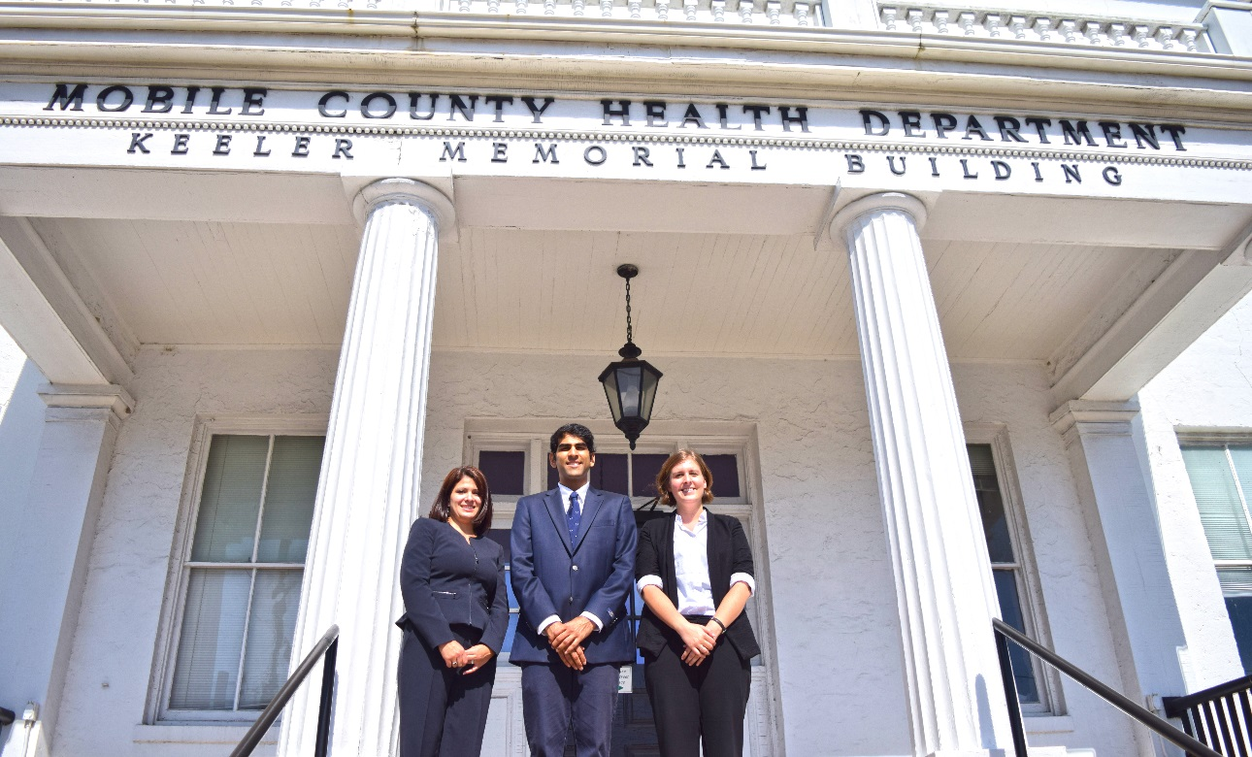
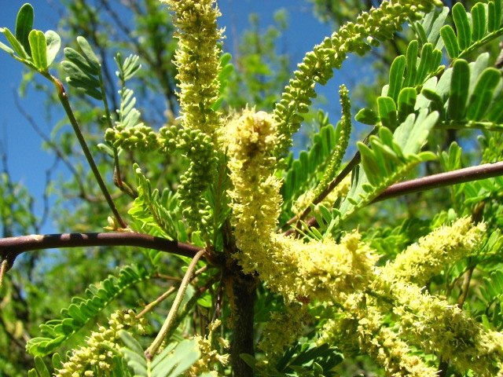
Coastal Texas Water Resources II
Using NASA Earth Observations to Assess Laguna Madre Water Conditions Through Land Cover Mapping and Thermal Analysis
Elaina Gonsoroski (Project Lead), Vishal Arya, Jennifer Boyd
DEVELOP National Program at the Mobile County Health Department
Abstract
Objectives
This project was conducted to aid the National Park Service (NPS) in assessing the historical hydrology of the Laguna Madre located within Padre Island National Seashore. While the lagoon is now hypersaline, there is historical evidence indicating this was not always the case. It is hypothesized that the proliferation of the honey mesquite tree (Prosopis glandulosa) has contributed to the Laguna Madre’s increased salinity by tapping into groundwater, thereby reducing the amount of freshwater flow into the lagoon. The project team partnered with the NPS to analyze the suspected correlation between the occurrence of the mesquite trees and the salinity of the lagoon. NASA Earth observations were used in ArcGIS software and ERDAS IMAGINE to create time series maps and conduct data analyses. Landsat 5 data were used to create Land Use/Land Cover (LULC) maps to analyze the change in mesquite tree coverage compared to various soil types and underlying geology as well as to calculate the Normalized Difference Vegetation Index (NDVI) and the Normalized Difference Infrared Index (NDII). Thermal maps of the lagoon were also created using Landsat 5 data to identify thermal anomalies in surface water temperature. These anomalies could indicate possible inflow locations of groundwater to the lagoon. In situ and PRISM (Parameter elevation Regression on Independent Slopes Model) precipitation data were used to target months and years for analysis. Through these analyses, the NPS can improve future land management practices.
Keep this blank for now.
Body text point size should be at least 24.
Caption text point size should be at least 16.
Feel free to rename, move, and resize sections as needed.
Investigate the relationship between the salinity of the Laguna Madre and the increase in honey mesquite trees using remote sensing technologies
Identify potential areas of fresh groundwater inflow to the Laguna Madre using thermal imagery
Compare the coverage of mesquite trees over time
Develop a systematic method to study the relationships between environmental factors to assist the NPS in studying Laguna Madre hydrology
Methodology
Study Area
Land Use/Land Cover (LULC)
Vegetation Indices
Thermal Analysis
Laguna Madre
Padre Island National Seashore
Study Period:
1984-2000
Bands 4,3,2 stack and TOA Reflectance
Landsat 5 (TM) Bands
Landsat 5 (TM) Band 6
LULC Map
DN to TOA Radiance to Celsius
Laguna Madre (Image Credit: Joe Meiman, National Park Service)
NDII = $\frac{NIR −SWIR}{NIR+SWIR}$
NDII = $\frac{NIR −Red}{NIR+Red}$
Earth Observations
Accuracy Assessment
NDII Map
NDVI Map
Extract the Lagoon
Results
Landsat 5
July 1986 LULC
September 2000 LULC
 | Mesquite Producer’s Accuracy | Mesquite User’s Accuracy
1986 | 80.8% | 84.0%
2000 | 48.7% | 86.4%
July 1991 Thermal Imagery
Conclusions
July 1986 NDII
July 1986 NDVI
Growing
Season
Mesquite tree areas decreased from 1986 to 2000.
Areas of high photosynthetic activity (NDVI) and low stress (NDII) correlated with areas of mesquite tree coverage
Lagoon thermal anomalies were identified but not correlated with a source
Future work will focus on the direction of groundwater flow in the area and the effects of evapotranspiration and precipitation on the lagoon
Team Members
Project Partners
Acknowledgements
Dr. Bernard Eichold, M.D., Dr. PH - Mobile County Health Department
Joe Spruce - CSC, NASA Stennis Space Center
Dr. Kenton Ross - NASA Langley Research Center
Joe Meiman - National Park Service
Dr. Dorina Murgulet - Texas A&M, Corpus Christi, Texas
Georgina Crepps, Tyler Lynn, Rodrigo Pereira da Silva, and Ryan Schick - Previous Project Participants of the DEVELOP National Program at the Mobile County Health Department
(L to R) Jennifer Boyd, Vishal Arya,
Elaina Gonsoroski
Honey Mesquite Tree (Image Credit: National Park Service)
Mobile County Health Department

