Slide 1
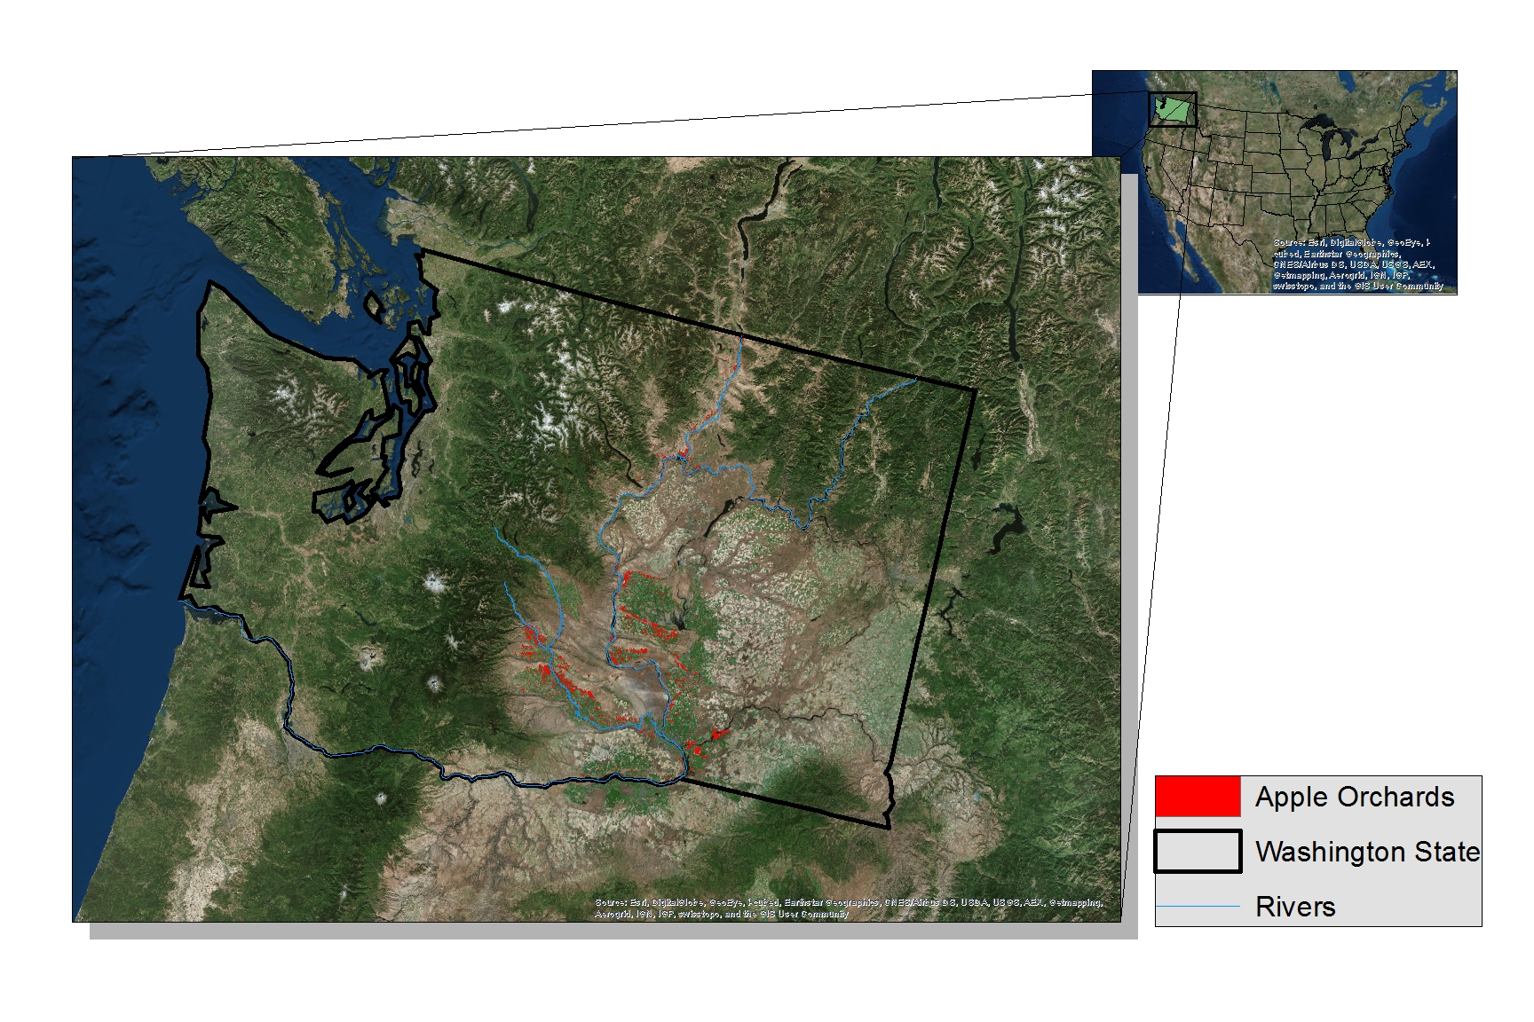
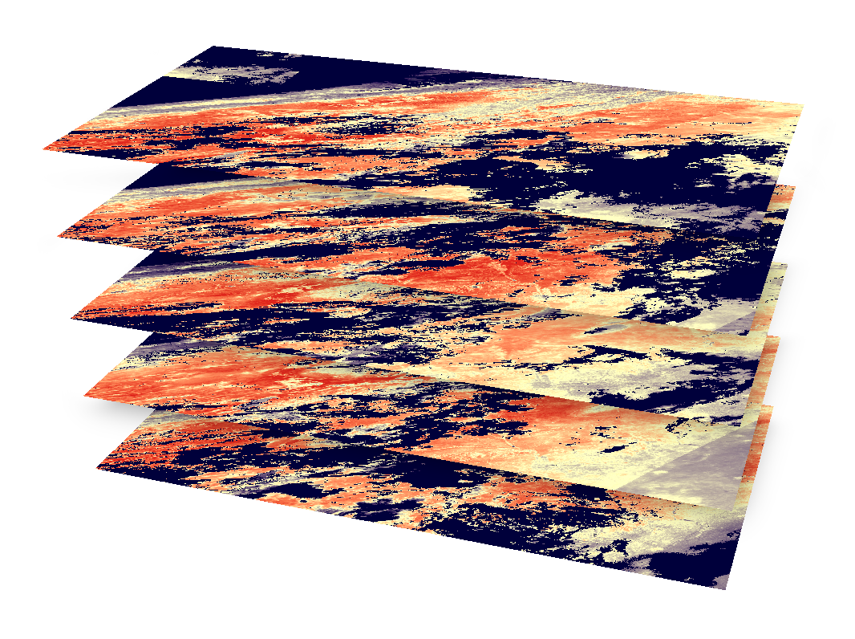
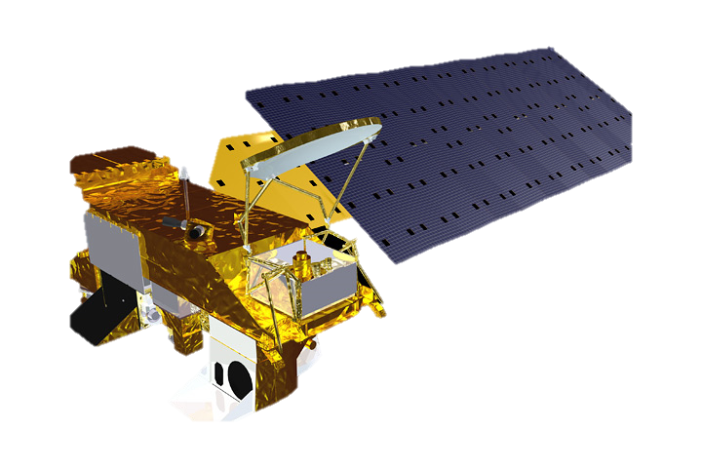
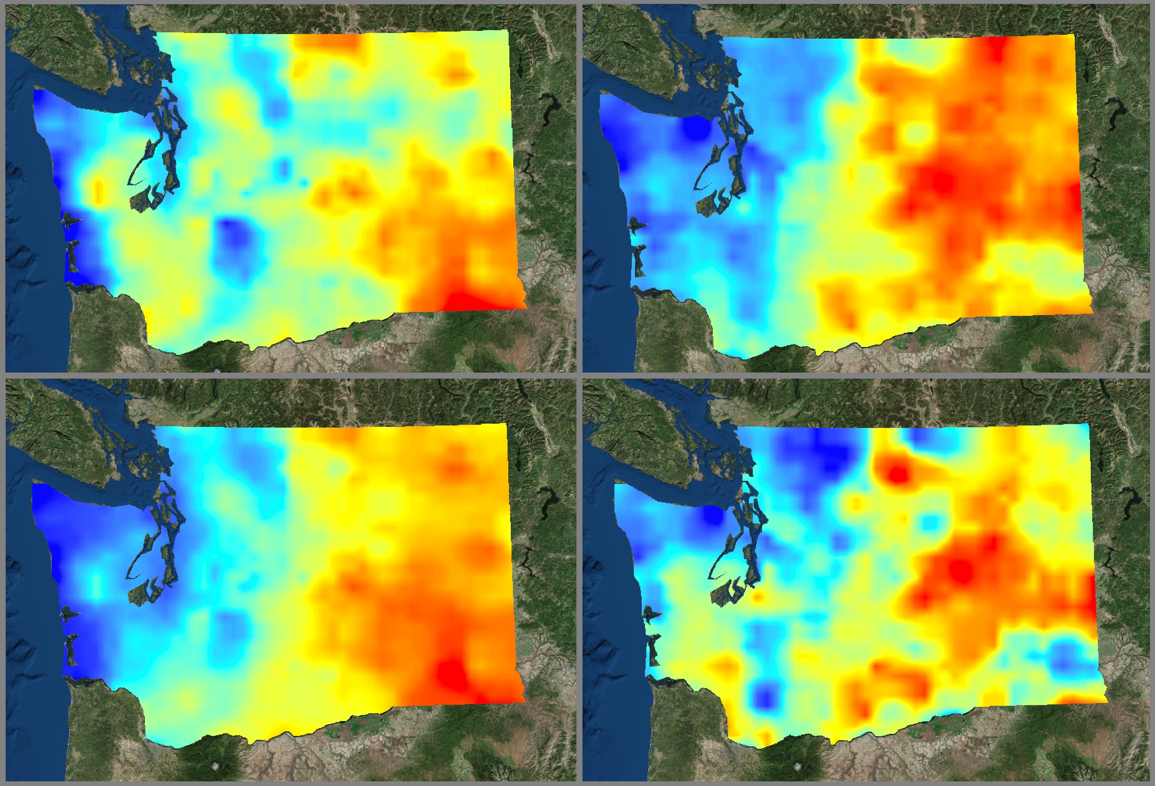
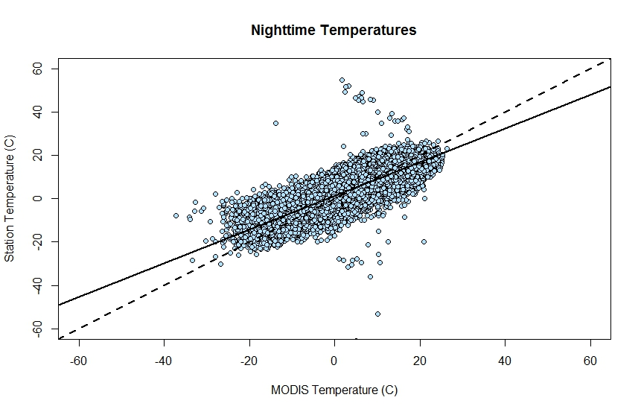
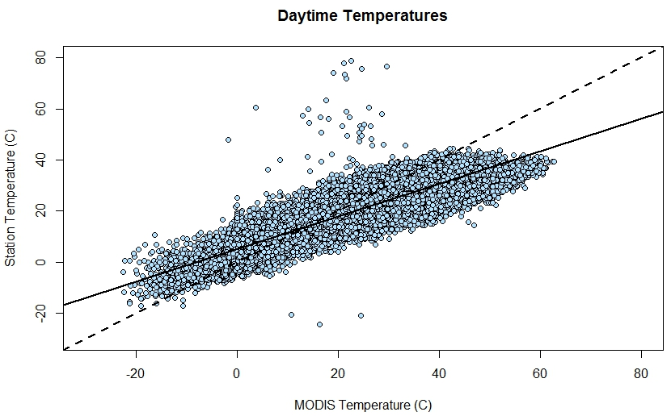
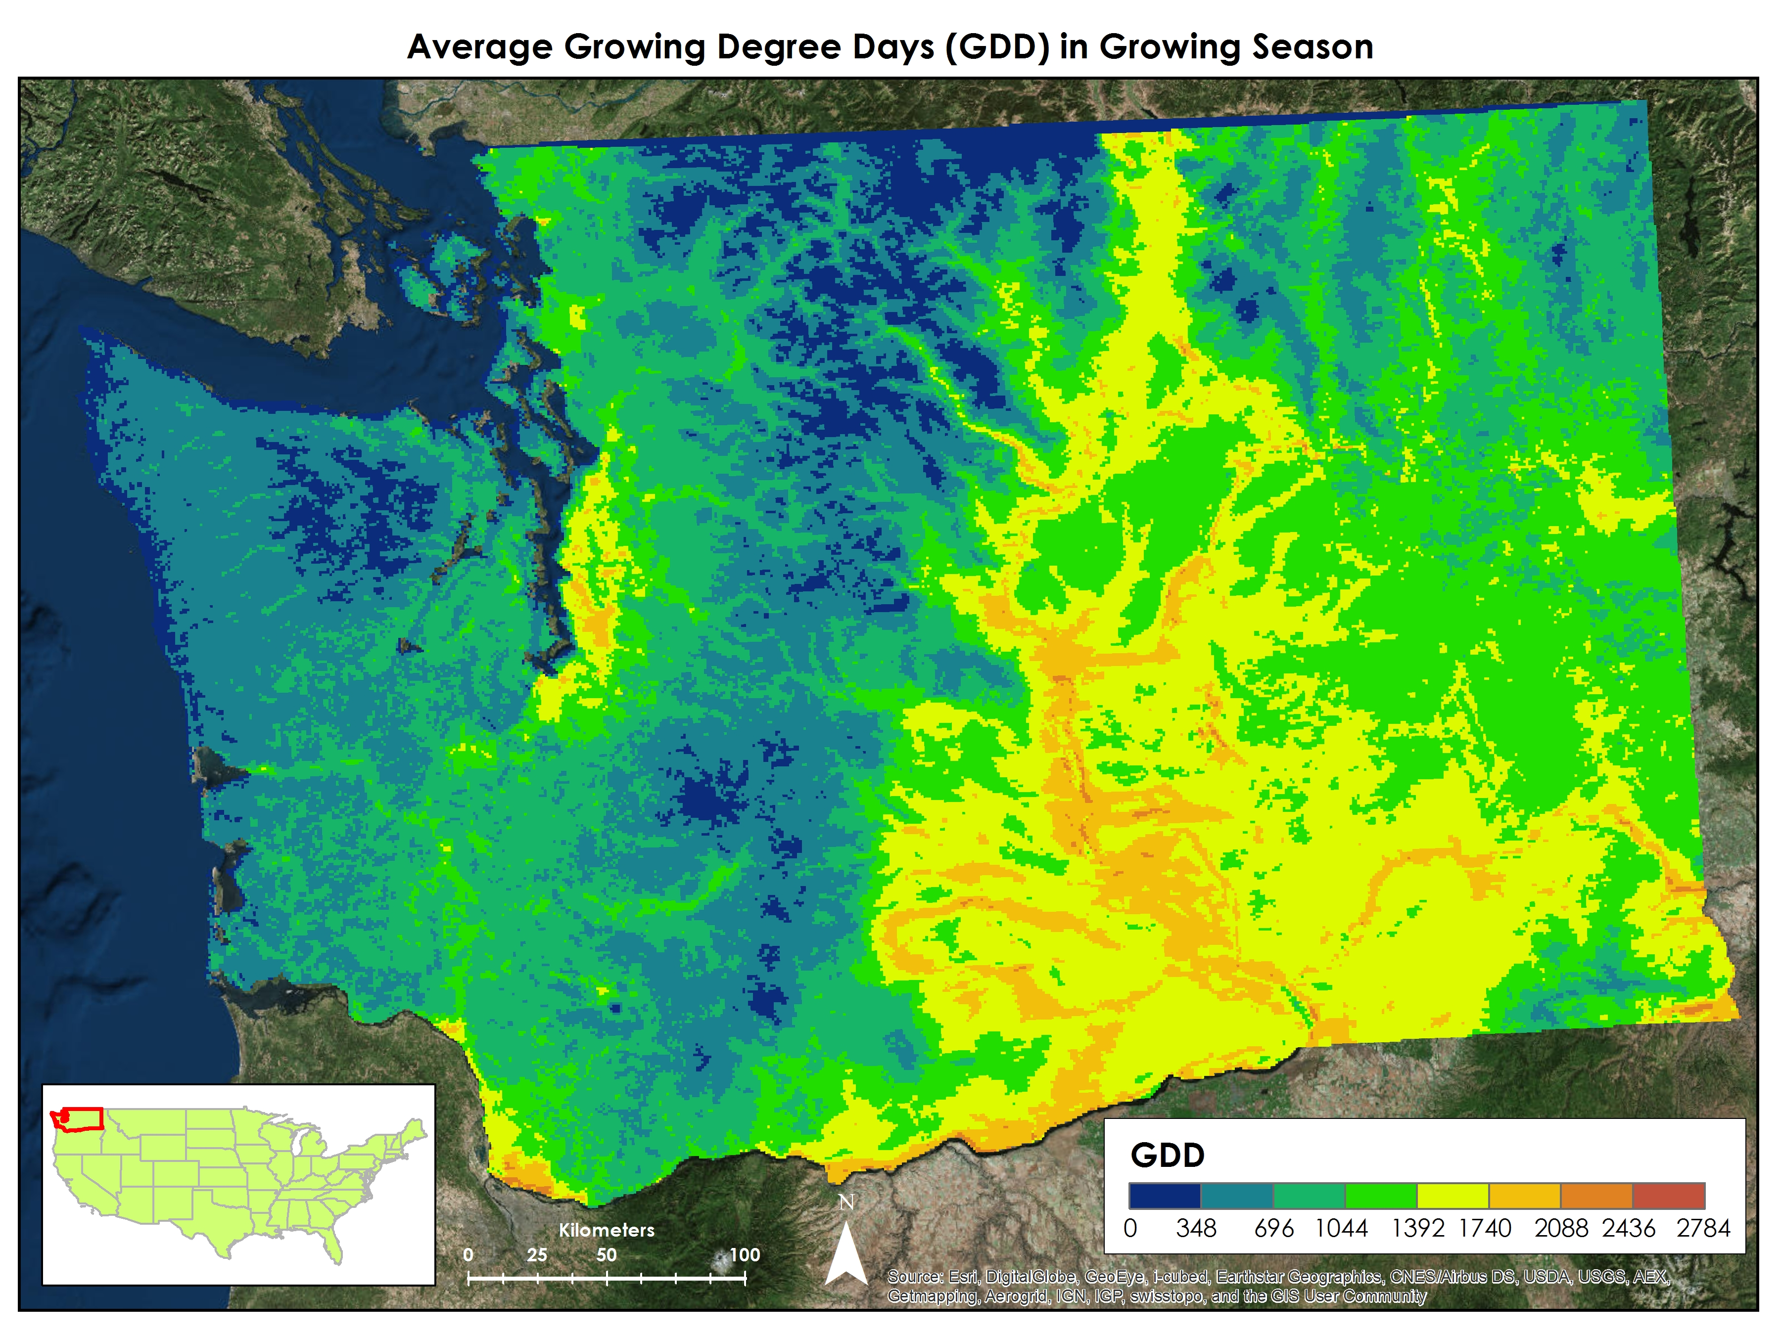
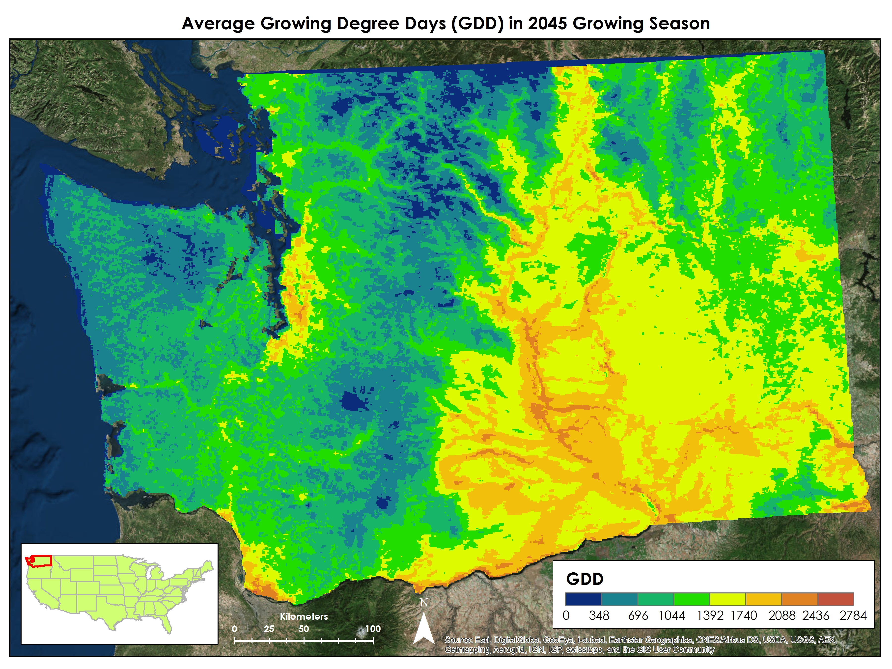
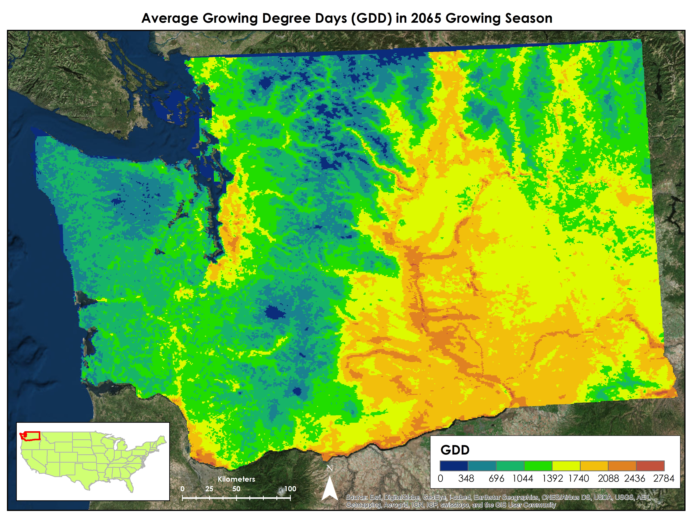
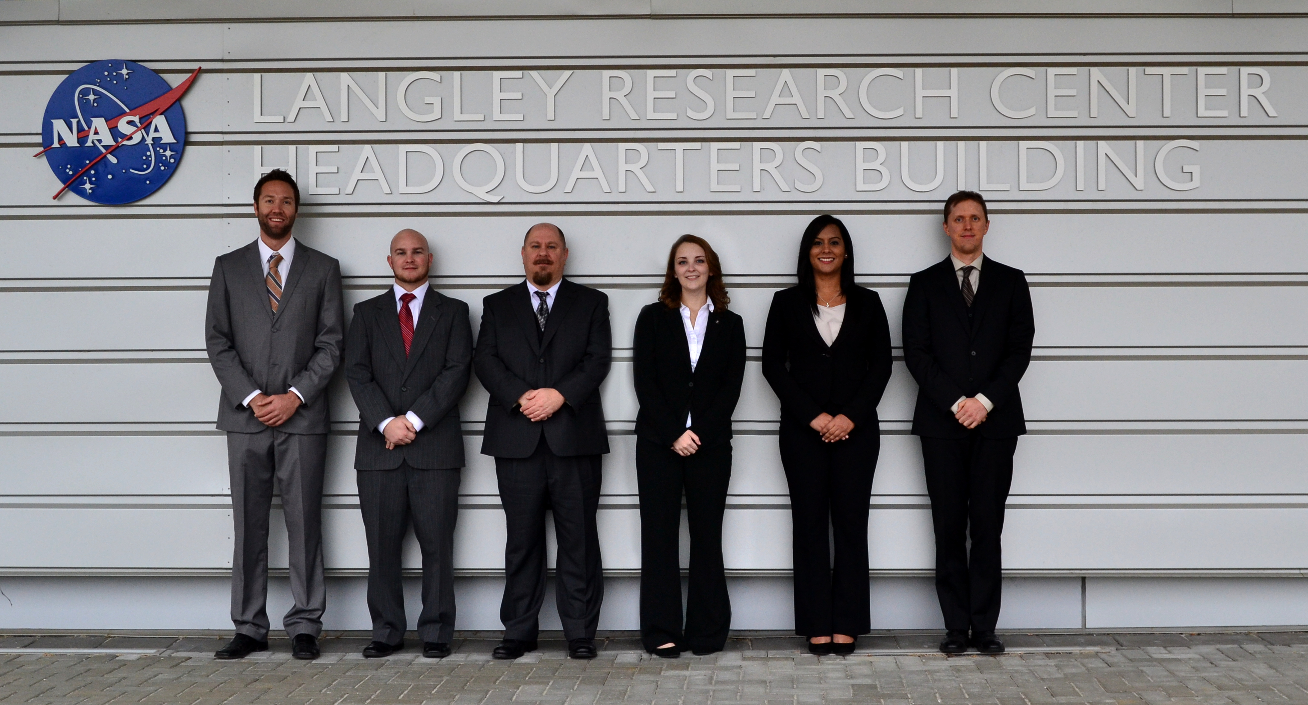
Northwest United States Agriculture
Evaluating Habitat Suitability of Cydia pomonella in Washington State from 2003 to 2065
Lauren Makely, Idamis Del Valle Martínez, Clarence Kimbrell, Zachariah Long, Chad Smith, Matthew Smith
Langley Research Center
Washington State is the number one apple producer in the United States, providing 70% of the nation’s apples. The current climate in Washington is favorable for apple production; however, as temperatures rise it also becomes more suitable for many apple pests. The codling moth (Cydia pomonella)’s suitable habitat is likely to expand its range in Washington with rising temperatures, placing more orchards at risk of infestation. The United States Department of Agriculture (USDA) Agricultural Research Service (ARS) has shown interest in codling moth distribution because the moth has a well-defined temperature range for development, between 10° C to 31° C. An analysis comparing satellite derived land surface temperatures (LST) and air temperatures measured from 36 weather stations revealed that LST is a suitable alternative to calculate growing degree days (GDD). Using Aqua Moderate Resolution Imaging Spectroradiometer (MODIS) LST from 2003 to 2013, GDD for insect development were calculated for the codling moth to show current at-risk areas. Furthermore, inclusion of the Coupled Model Intercomparison Project phase 5 (CMIP5) multi-model ensemble forecasted climate changes for 2045 and 2065 were used to determine future pest ranges. Final products show that rising temperatures will allow codling moth ranges to move closer to the Cascade mountain range and increase around the Columbia river valley. Additionally, a rise in temperature will allow more growth time for the moth each growing season, ultimately leading to larger pest populations. The current and long-range forecast risk maps benefit orchard managers by improving pest management and better handling of current orchards.
Calculate growing degree days (GDD) for insect development
Create a pest risk map to identify low and high risk areas for the codling moth in Washington State for the years 2002-2013
Generate forecasted pest risk maps to identify the potential geographical range of the codling moth for the years 2045 and 2065
Washington State
Data Output
Data Acquisition
Data Analysis
MODIS LST
Heat Accumulation (GDD)
Pest Risk Map from GDDs
$$\frac{\left[Tmax + Tmin\right]}{2} − 10° C$$
CMIP5
ΔT for
2045 & 2065
Forecasted Pest Risk Map
Aqua MODIS
The plots to the right show correlations between daytime and nighttime temperatures for MODIS LST data and NOAA weather station air temperatures. 36 different stations within the top three apple producing counties in Washington state were included in this portion of the analysis.
Time series plots were created to show variability between air temperatures and LST for different times of the year. The plots above are for the Quincy weather station.
r = 0.84
r = 0.90
Average GDD for 2013
Average GDD for 2045
Average GDD for 2065
MODIS LST are a good proxy measurement for calculating GDD
Greatest risk areas from 2003-2013 for generational growth of the codling moth are located east of the Cascades
Climate projections suggest an northward extension of the codling moth’s distribution
Future work should include precipitation in the analysis to determine influence on insect development
Dr. Kenton Ross
NASA DEVELOP National Science Advisor
Jeffry Ely
NASA DEVELOP Geoinformation Scientist
Dr. Michael Glenn
USDA ARS
Diane Kearns
Fruit Hill Orchard
Spring 2014 US Agriculture Team
Dr. Michael Glenn
USDA Agricultural Research Service
(L to R) Matthew Smith, Chad Smith, Clarence Kimbrell, Lauren Makely, Idamis Del Valle-Martinez, and Zachariah Long

