Slide 1



2020 Spring
NATIONAL
ORIENTATION
MODULE 1. About NASA

Slide 2
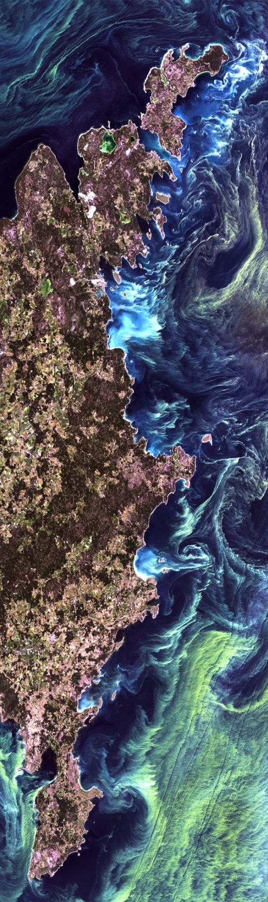

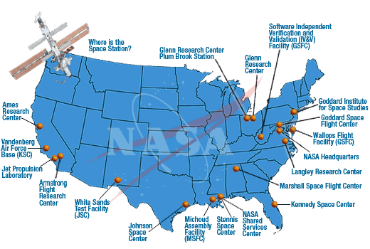

NASA History
"An Act to provide for research into the problems of flight within and outside the Earth's atmosphere, and for other purposes."
With this simple preamble, the US Congress and President Dwight D. Eisenhower established the National Aeronautics and Space Administration on July 29, 1958.
NASA began operations on October 1, 1958.
It absorbed into itself the earlier National Advisory Committee for Aeronautics (NACA).
Today, NASA has 10 Centers and multiple facilities around the country.
By The Way
NASA celebrated its 60th birthday in 2018!

Slide 3
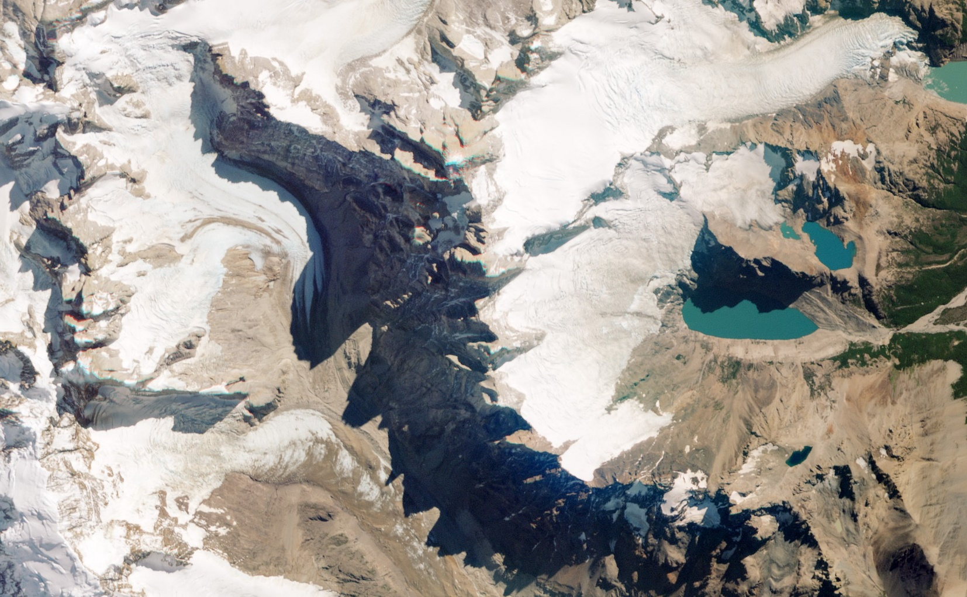
NASA Organization
NASA Administrator
Associate Administrator
Mission Directorates
Human Exploration and Operations
Space Technology
Science
Mission Support
Aeronautics Research
Joint Agency Satellite Div.
Heliophysics Division
Earth Science Division
Planetary Science Div.
Astrophysics Division
Applied Sciences Program
Capacity Building Program
ARSET
DEVELOP
SERVIR
You Are Here!

Slide 4
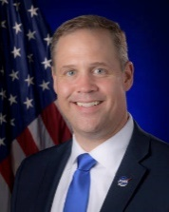
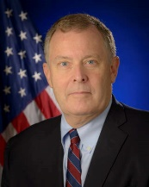




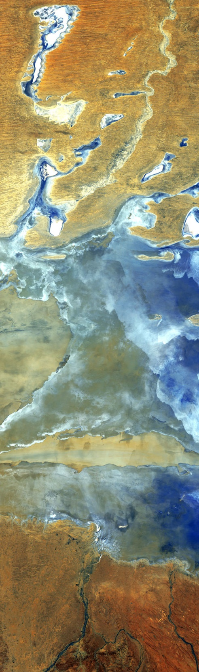

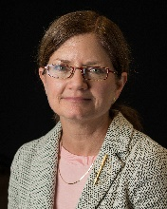

NASA Leadership
NASA Administrator
Jim Bridenstine
Jim Bridenstine
Jim Morhard
Steve Jurczyk
Deputy Administrator
Jim Morhard
Associate Administrator
Steve Jurczyk
Deputy Associate Administrator
Melanie Saunders
Melanie Saunders
Dr. Thomas Zurbuchen
Sandra Cauffman
Science Mission Directorate
Thomas Zurbuchen, Ph.D.
Earth Science Division
Sandra Cauffman*
* Acting Division Director
Applied Sciences Program
Lawrence Friedl
Lawrence Friedl
Dr. Nancy Searby
Mike
Ruiz
Capacity Building Program
Nancy Searby, Ph.D.
By The Way
Knowing key NASA leaders is important because you will see these people at conferences and events!
DEVELOP National Program
Mike Ruiz
NASA Organization Chart: http://www.nasa.gov/about/org_index.html#.VBNBWvldWbM

Slide 5

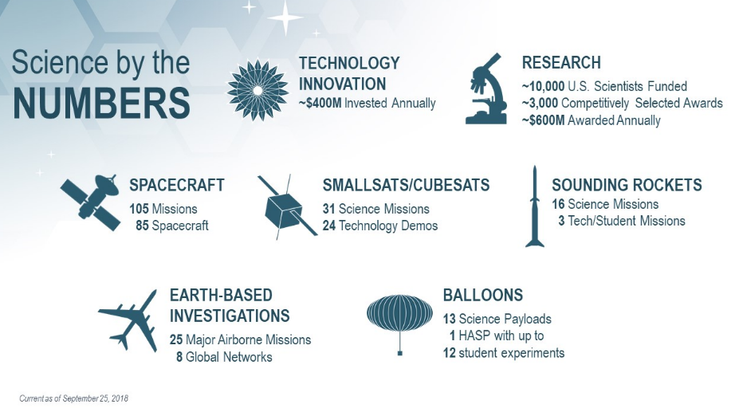

Science Mission Directorate
Science is interconnected; no important question stands alone.
The Science Mission Directorate (SMD) is an organization where discoveries in one scientific discipline have a direct route to other areas of study. This flow is something extremely valuable and is rare in the scientific world.
SMD engages the Nation’s science community, sponsors scientific research, and develops and deploys satellites and probes in collaboration with NASA’s partners around the world to answer fundamental questions requiring the view from and into space.
SMD seeks to understand the origins, evolution, and destiny of the universe and to understand the nature of the strange phenomena that shape it.
By The Way
Dr. Thomas Zurbuchen, Associate Administrator for SMD and aka Dr. Z, is often seen at conferences and visiting NASA Centers! Follow him on Twitter!

Slide 6





Earth Science Division
The Earth Science Division (ESD), conducts scientific studies to understand the Earth as a system and on all time scales.
ESD utilizes NASA’s ability to view the Earth from the unique vantage point of space.
ESD provides uniformly high-quality data covering the planet to support the pursuit of answers to fundamental science questions.
There are four lines of business:
Flight
Develops, launches, and operates NASA’s fleet of Earth-observing satellites, instruments, and aircraft. Manages data systems to make the data freely and openly available.
Technology
Tests and demonstrates scientific technologies for future satellite and airborne missions:
Instruments, Information Systems, Components, In-Space Validation.
Research & Analysis
Supports research that advances knowledge of the Earth as a system. Six focus areas plus field campaigns, modeling, and scientific computing.
Applied Sciences
Supports innovative and practical uses of Earth observations and scientific knowledge by private and public sectors to inform their planning, decisions, and actions.

Slide 7

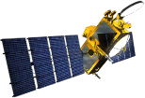



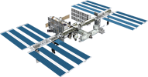

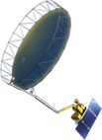


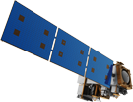

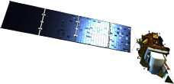
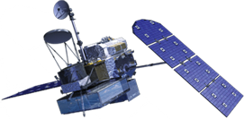


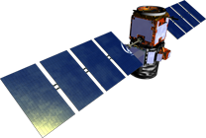
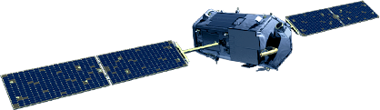

NASA Earth Observations
NASA Earth observations include a coordinated series of 17 polar-orbiting and low inclination satellites and 6 instruments on the ISS for long-term global observations.
OSTM/Jason-2
(NOAA)
ICESat-2
Terra
GRACE-FO (2)
ISS: LIS, SAGE III, TSIS-1, ECOSTRESS, GEDI, OCO-3
InVEST/CubeSats
RAVAN
RainCube
TEMPEST-D
CubeRRT
CSIM
CYGNSS (8)
Landsat 7
(USGS)
SMAP
Aqua
Suomi NPP (NOAA)
NISTAR, EPIC
(DSCOVR / NOAA)
SORCE (NOAA)
Landsat 8
(USGS)
Aura
CALIPSO
GPM
CloudSat
OCO-2
01.13.20
Notes:
Jan. 16, 2018: Reformatted with entire set, operating missions only
OPERATING MISSIONS ONLY 06/16/2017
12/20/17: Reformatted to 16:9 ratio only.
12/01/17: edited to remove CATS from ISS
10/27/17: DGH updated to remove Grace after end of mission

Slide 8
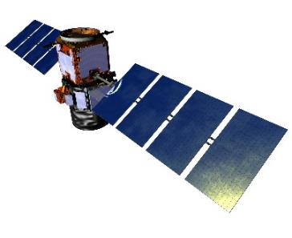
EO vs EOS
NASA Earth observations (EO): Umbrella term used that includes all airborne and flight missions that study the Earth.
Current NASA Spaceborne EO Missions:
NASA’s Earth Observing System (EOS): EOS is a specific program within NASA and EOS refers to a specific subset of the NASA Earth observing missions that are focused on long-term global observations of the land surface, biosphere, solid Earth, atmosphere, and oceans to improve understanding of the Earth as an integrated system.
Only use this term when speaking exclusively to the below missions:
Current EOS Missions:
Aqua
Aura
Landsat 7
Landsat 8
OSTM/Jason-2
QuikSCAT
SORCE
SAGE III-ISS
Terra
Aqua
Aura
CALIPSO
CloudSat
CYGNSS
DISCOVR
ECOSTRESS (on ISS)
GEDI (on ISS)
GPM
GRACE-FO
ICESat-2
Landsat 7
Landsat 8
LIS (on ISS)
OSTM/Jason-2
OCO-2
OCO-3 (on ISS)
SAGE III (on ISS)
SMAP
SORCE
Suomi NPP
Terra
TSIS-1 (on ISS)
Future EOS Mission:
Landsat 9
By The Way
NASA pursues airborne campaigns in addition to its spaceborne missions. Some DEVELOP projects explore use of airborne data as well!

Slide 9
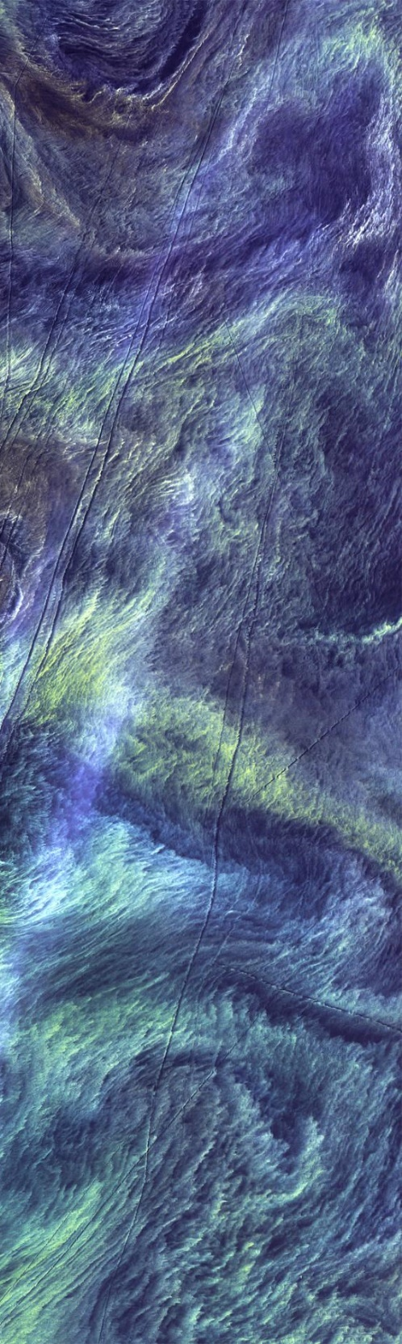
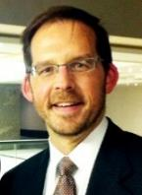
By The Way
Lawrence Friedl, ASP Director, once worked at NASA Mission Control!
Applied Sciences
The Applied Sciences Program (ASP) supports innovative and practical uses of Earth observations and scientific knowledge by private and public sectors to inform their planning, decisions, and actions.
ASP pursues:
  Partnerships with public and private organizations
  Discovery of innovative NASA Earth Science applications
  Support of environmental decision-making activities
  Demonstration of practical benefits of NASA Earth Science
  Help to improve the quality of life and strengthen the economy
Three lines of business:
Thematically-Organized Applications
Capacity Building
Program
Mission
Planning

Slide 10



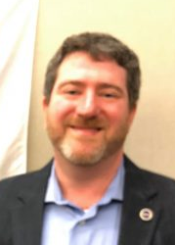





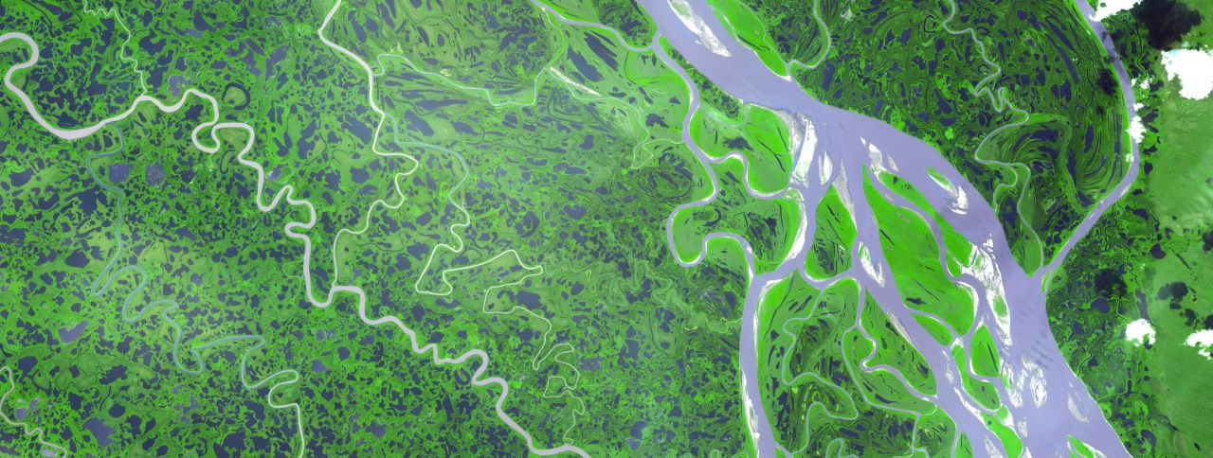
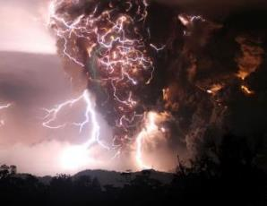
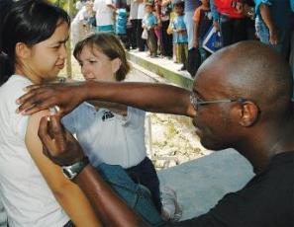

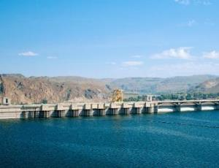




ASP Application Areas
The Applied Sciences Program is structured around eight application areas
Only five have full programs that routinely hold solicitations and have active investment portfolios at NASA Headquarters:
Health &
Air Quality
Ecological Forecasting
Food Security & Agriculture
Disasters
Dr. David Green
John Haynes
Woody Turner
Water Resources
Dr. Brad Doorn
Dr. Brad Doorn
Additional three thematic areas of applications:
Energy
Urban Development
Transportation & Infrastructure

Slide 11
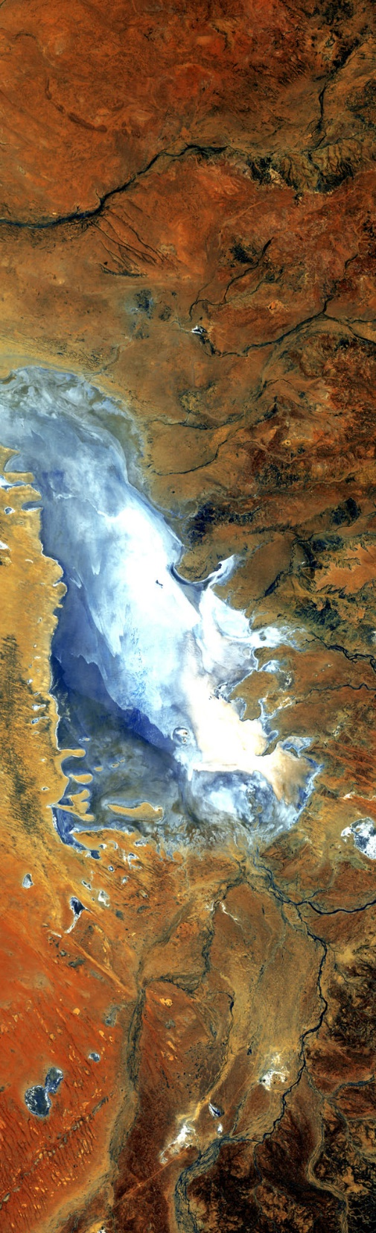


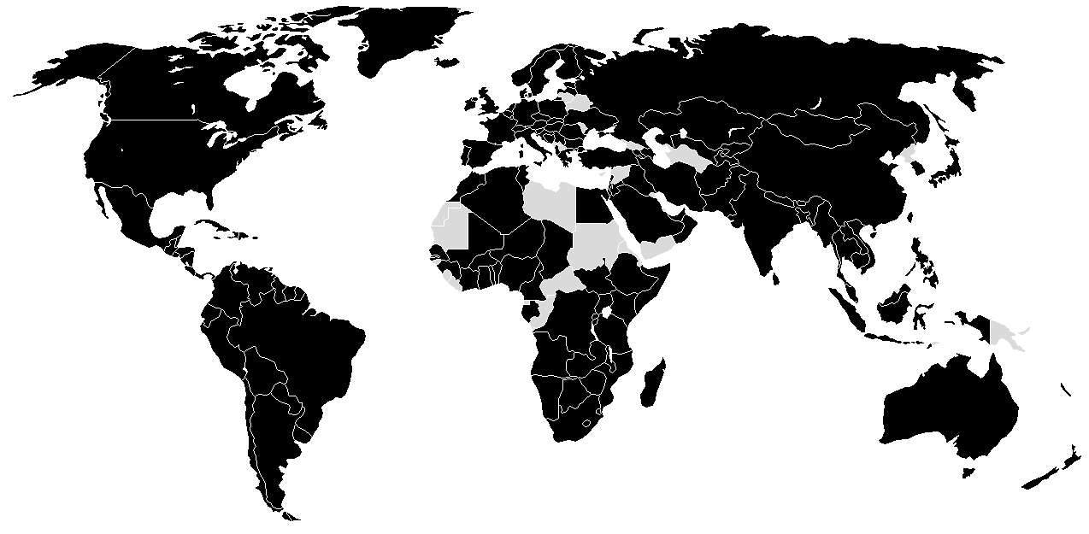
Capacity Building Program
Engages current and future decision makers
Improves skills and capabilities to access and apply NASA Earth Science
Three lines of business: trainings, product co-development, relationship brokering
Works through both program and element activities
Identifies partnership opportunities to reach new end users
Participates in both domestic and international capacity building groups, such as GEO and CEOS
Supports three Elements (ARSET, DEVELOP, and SERVIR) and initiatives focused on indigenous peoples in North America and an interactive mapper
2018 Achievements
Programmatic Engagement:
8,600
2,944
Individuals
Institutions
Impacted
Not Impacted

Slide 12
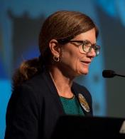
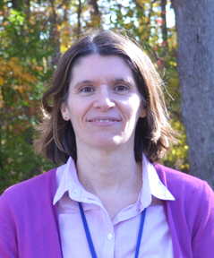
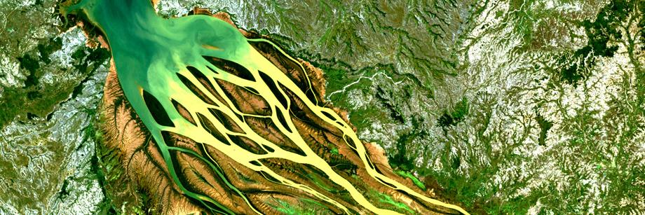
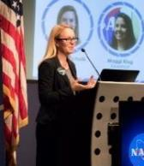

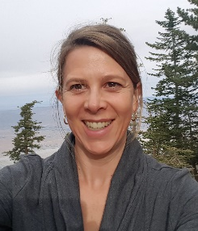

Capacity Building Program
Dr. Nancy Searby
CBP Program Manager
Element Leads
Ana Prados
ARSET
Project Manager
NASA Goddard Greenbelt, MD
Lauren Childs-Gleason
CBP Analysis & Coordination Lead
Mike Ruiz
DEVELOP
Program Manager
NASA Langley Hampton, VA
Christine Mataya
CBP Program Support Specialist
Dan Irwin
SERVIR
Program Manager
NASA Marshall Huntsville, AL
By The Way
Lauren Childs-Gleason spent 12 years with DEVELOP! Feel free to reach out to her if you have questions about or interest in CBP.

Slide 13
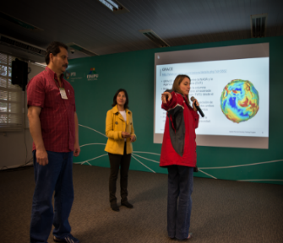
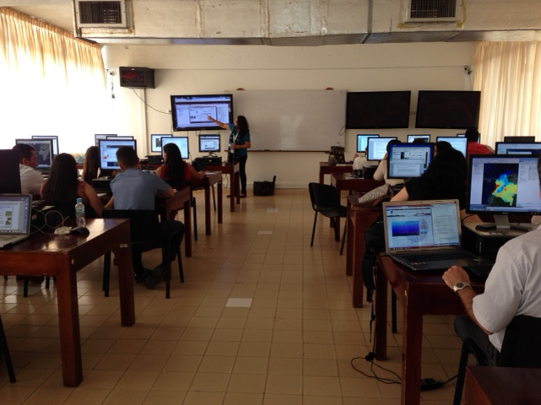

By The Way
ARSET’s archive of trainings is available on its website for free!
ARSET
Applied Remote Sensing Training Program
Provides online and in-person trainings for:
  Policy makers
  Regulatory agencies
  Applied environmental professionals
  Students
  General public
Increases the use of NASA Earth Science models and data for environmental applications
https://arset.gsfc.nasa.gov

Slide 14
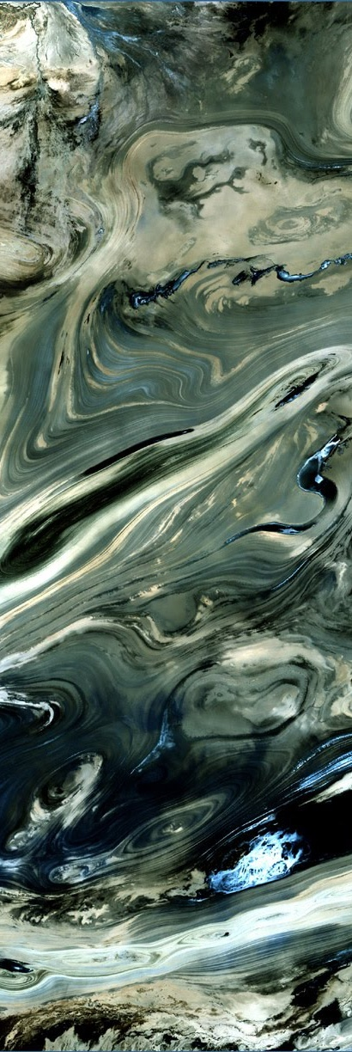
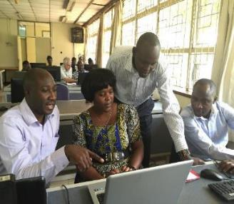
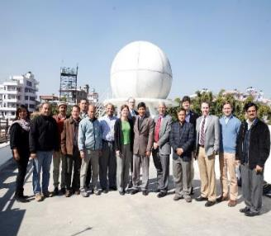
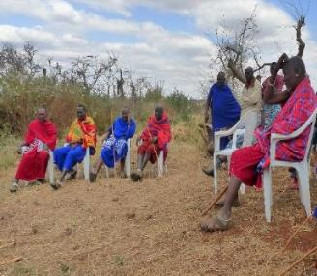

SERVIR
Joint development initiative of NASA & USAID
Works in partnership with leading regional organizations world-wide to host five hubs:
  Eastern & Southern Africa – Nairobi, Kenya
  West Africa – Niamey, Niger
  Hindu-Kush Himalayas – Kathmandu, Nepal
  Mekong – Bangkok, Thailand
  Amazonia – Valle del Cauca, Colombia
Helps developing countries use information provided by Earth observing satellites and geospatial technologies for managing climate risks and land use
Empowers decision makers with tools, products, and services to act locally on climate-sensitive issues
https://www.servirglobal.net/
By The Way
SERVIR recently announced the location of its 5th hub in Colombia!

Slide 15
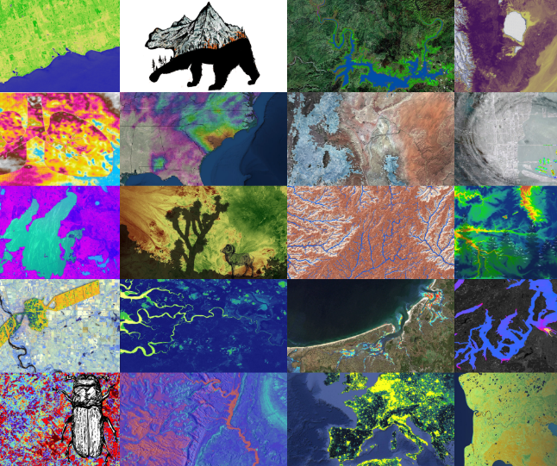

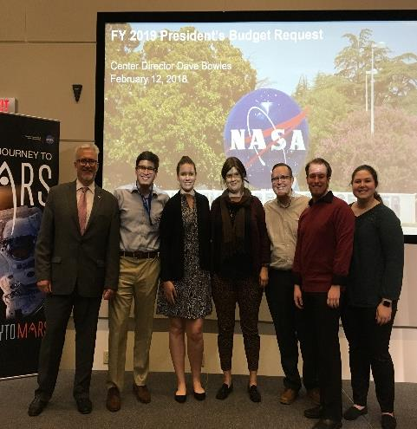

DEVELOP
Bridges the gap between NASA Earth Science and society
Addresses environmental and public policy issues around the globe
Conducts 10-week long interdisciplinary feasibility studies during 3 terms per year
Builds capacity to use Earth observations in both participants (students, recent grads & transitioning career professionals) and partner organizations
11 Nodes throughout the US
https://develop.larc.nasa.gov

Slide 16
Quiz Time!
What birthday did NASA celebrate in 2018?
Dr. Zurbuchen is the Associate Administrator of what Mission Directorate?
What’s the difference between EO and EOS?
Who is the Director of the Applied Sciences Program?
How many Applied Sciences Program application areas are there?
Which of DEVELOP’s “sister” programs is focused on providing trainings?

Slide 17
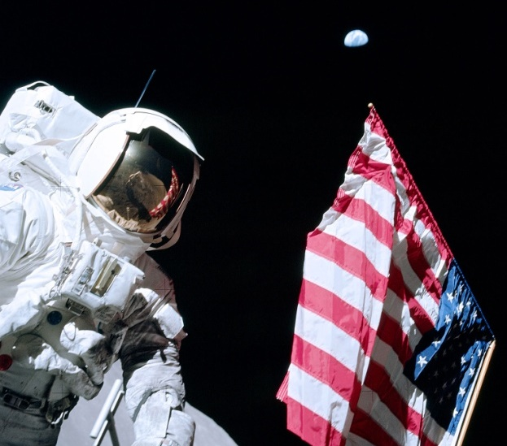
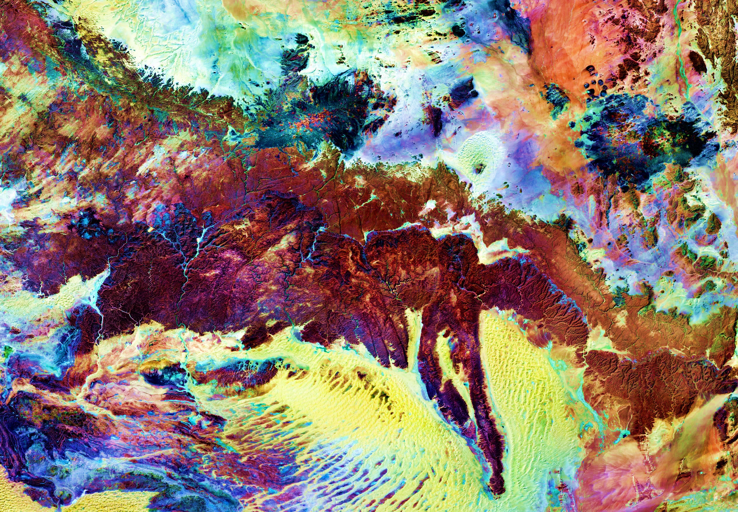

THANK YOU!
Joining the DEVELOP family means being part of NASA’s Legacy.
Learn it. Know it. Live it.

