Slide 1
Mobile Bay Ecological Forecasting
Monitoring Marsh Conditions in Coastal Alabama Using NASA Earth Observations to Support the Alabama Coastal Foundation’s Restoration and Conservation Initiatives
Saranee Dutta (Project Lead)
Jeanett Bosarge
Courtney Kirkham
Tyler Lynn
Notes:
Methodology
Results
Conclusions
Errors & uncertainties
Future work
Acknowledgements
Backup slides
Required Statement

Slide 2
Background
Marshes are complex ecosystems, which form transitions between terrestrial and aquatic habitats.
Mobile Bay is an estuary - an area where freshwater and saltwater mix due to tidal fluctuations.
Coastal areas of Alabama have seen dramatic decreases in marshlands over the last 200 years due to a variety of natural and anthropogenic stressors ^{(1,2,3)}.
Recent trend analyses reveal that marsh habitats are diminishing at lower rates than in previous years due to the advent of environmental laws and interest groups.
Notes:
1.Handely et al. 2007
2.Craft et al. 2009
3. NEP 2008

Slide 3
Partners
Alabama Coastal Foundation Mark Berte
Dauphin Island Sea Lab Dr. Just Cebrain
Notes:
1.Handely et al. 2007
2.Craft et al. 2009
3. NEP 2008

Slide 4
Community Concerns
Coastal marshes are unique and extremely productive ecosystems.
They are also highly sensitive to environmental stressors such as expanding urban development, sea level rise, invasive species etc.
Alabama coastal marshes are important locations for a variety of local businesses, researchers, and recreational activities.
Image Credit: Monet
Notes:
Image Source: http://commons.wikimedia.org/wiki/File:Claude_Monet_-_The_Magpie_-_Google_Art_Project.jpg

Slide 5
Objectives
Apply NASA satellite data to assess historical and current marsh conditions.
Predict future marsh extent using land change models and trend data.
Assist the Alabama Coastal Foundation by providing data that will help focus funding and efforts in appropriate areas.
Provide project partners with a cost-effective methodology to improve monitoring and restoration efforts.
Notes:
These notes should be thorough enough for someone not familiar with the project to clearly present the material.
Image Source: http://commons.wikimedia.org/wiki/File:Claude_Monet_-_The_Magpie_-_Google_Art_Project.jpg

Slide 6
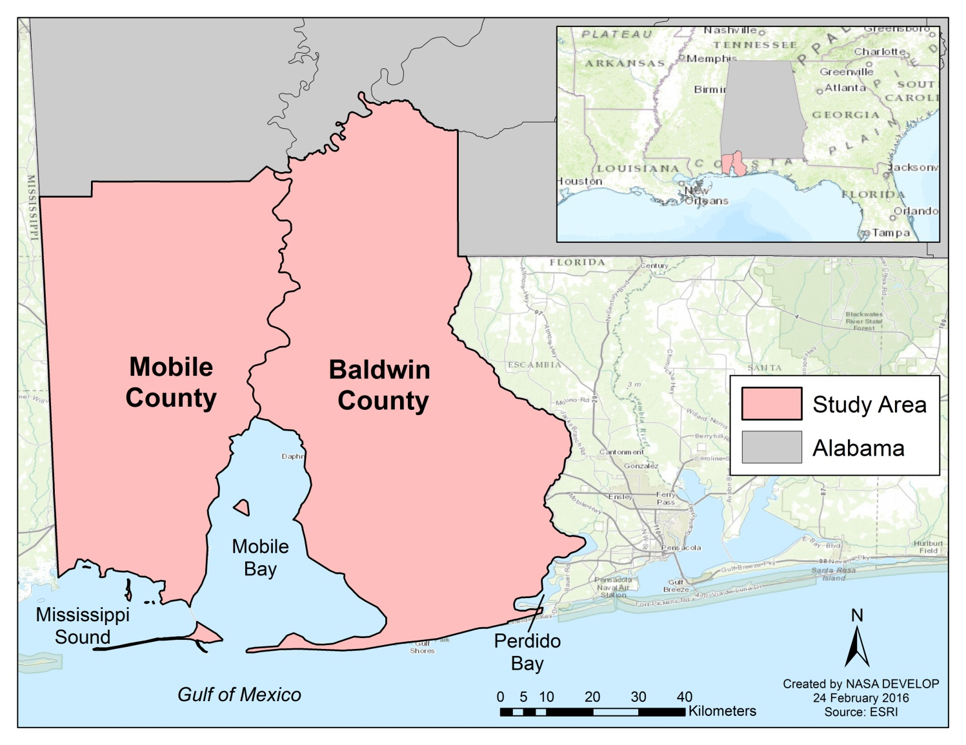
Study Area and Study Period
January 2000 – January 2016
Coastal Alabama, Mobile and Baldwin counties
Notes:
This timeframe is influenced by available Landsat 5 data, which dates back to 1984. However, not all data will be able to cover the entire timeframe. For example, MODIS data is only available beginning in 2000, and is used to gain a better understanding of temporal changes rather than spatial distribution.

Slide 7
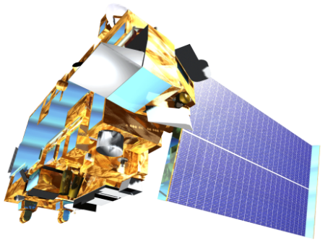
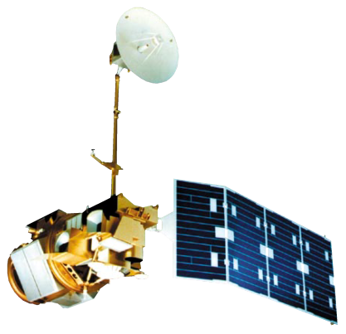
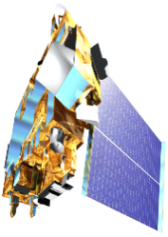
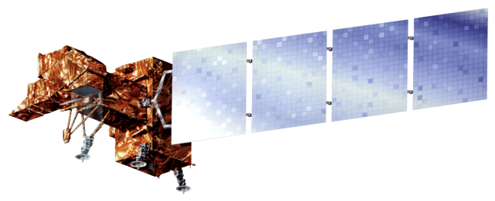
NASA Satellites and Sensors
Terra, MODIS
Landsat 5 ( TM)
Landsat 7 ( ETM +)
Landsat 8 (OLI)
Terra, MODIS

Slide 8
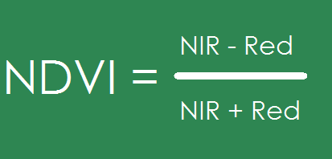
Methods
MODIS / Terra (Surface Reflectance)
Subset Creation
NDVI Map
Marsh Health Trend Map

Slide 9
Advisors
Bernard Eichold, M.D., Dr. PH, Mobile County Health Department
Kenton Ross, Ph. D., NASA Langley Research Center
Partners
Mark Berte, Alabama Coastal Foundation
Just Cebrian, Ph. D., Dauphin Island Sea Lab

