Slide 1
DEVELOP National Program
Ethiopia Eco-Forecasting
USGS at Colorado State University
Summer 2015
Final Imagery

Slide 2
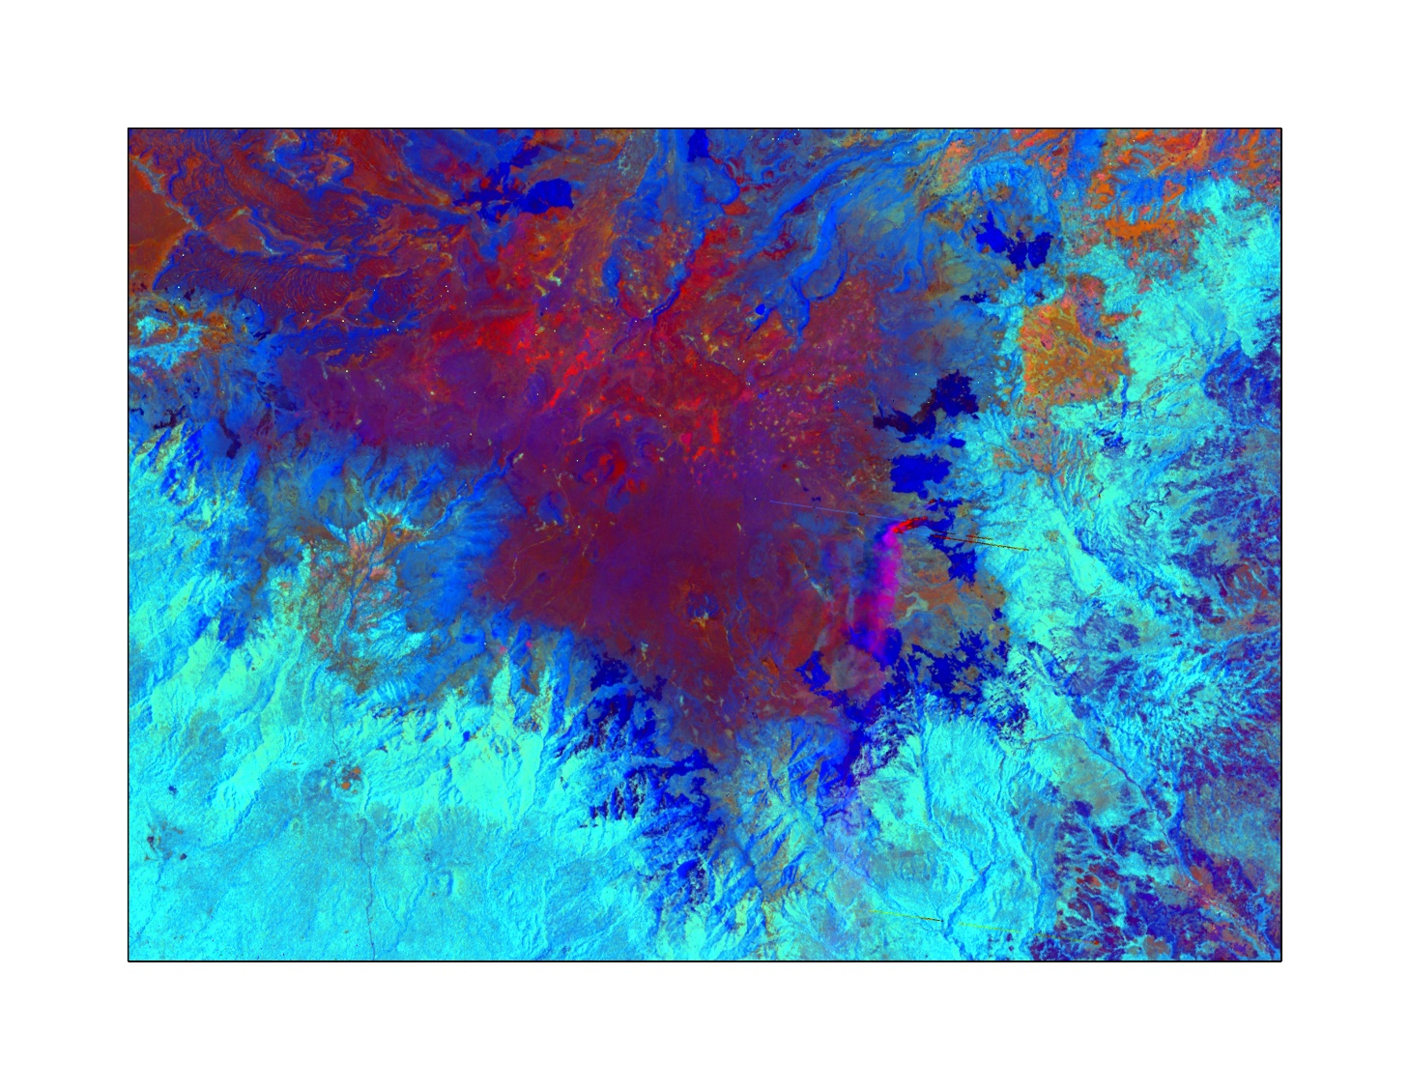
USGS Colorado State University
Ethiopia Eco-Forecasting
A composited tasseled cap (brightness, greenness, wetness) image of the Bale Mountains, Ethiopia, The image was derived from a scene captured by NASA’s Landsat 5 Thematic Mapper sensor on March 9, 2000 and processed using the LandsatLinkr R package. In this image, the Harenna Forest on the southern side of the Bale escarpment is shown in turquoise, the Afro-alpine soil and vegetation on the escarpment is shown in red tones, and burned areas can be seen as dark blue patches in the blue shrubland zone between the forest and alpine areas. Smoke from an active fire is visible in pink near the center of the image. This image, in conjunction with data from prior and subsequent years, can be used to examine historical fire patterns and to help develop environmental management strategies for anthropogenic burning in the Bale Mountains.

