Slide 1
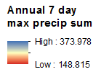
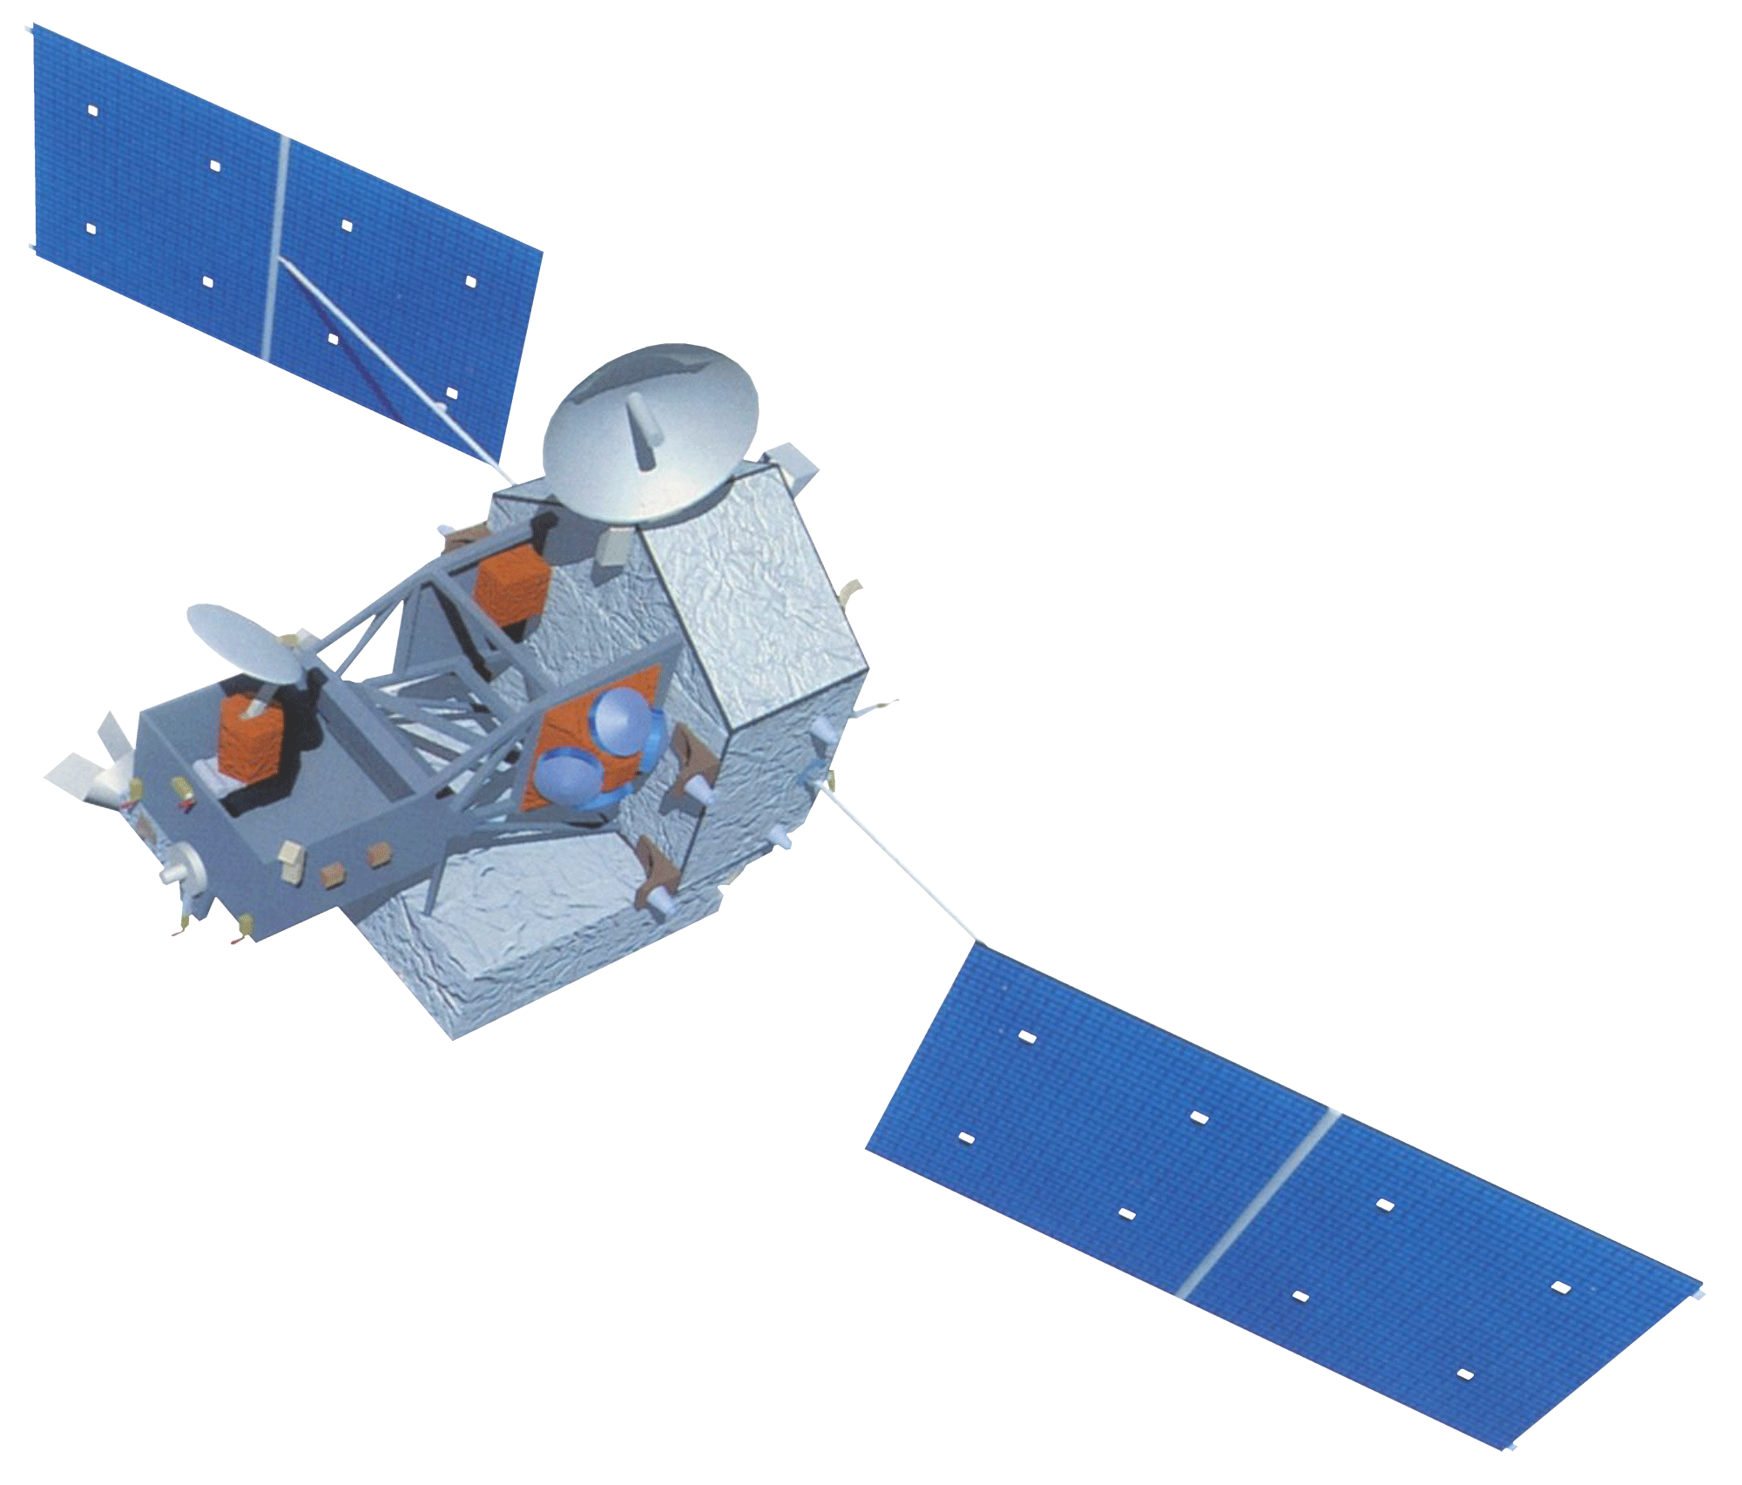
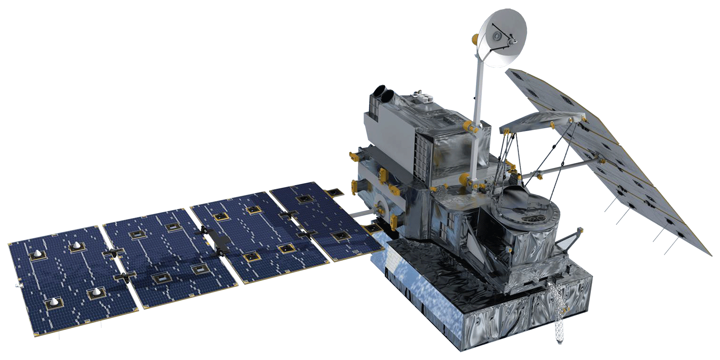
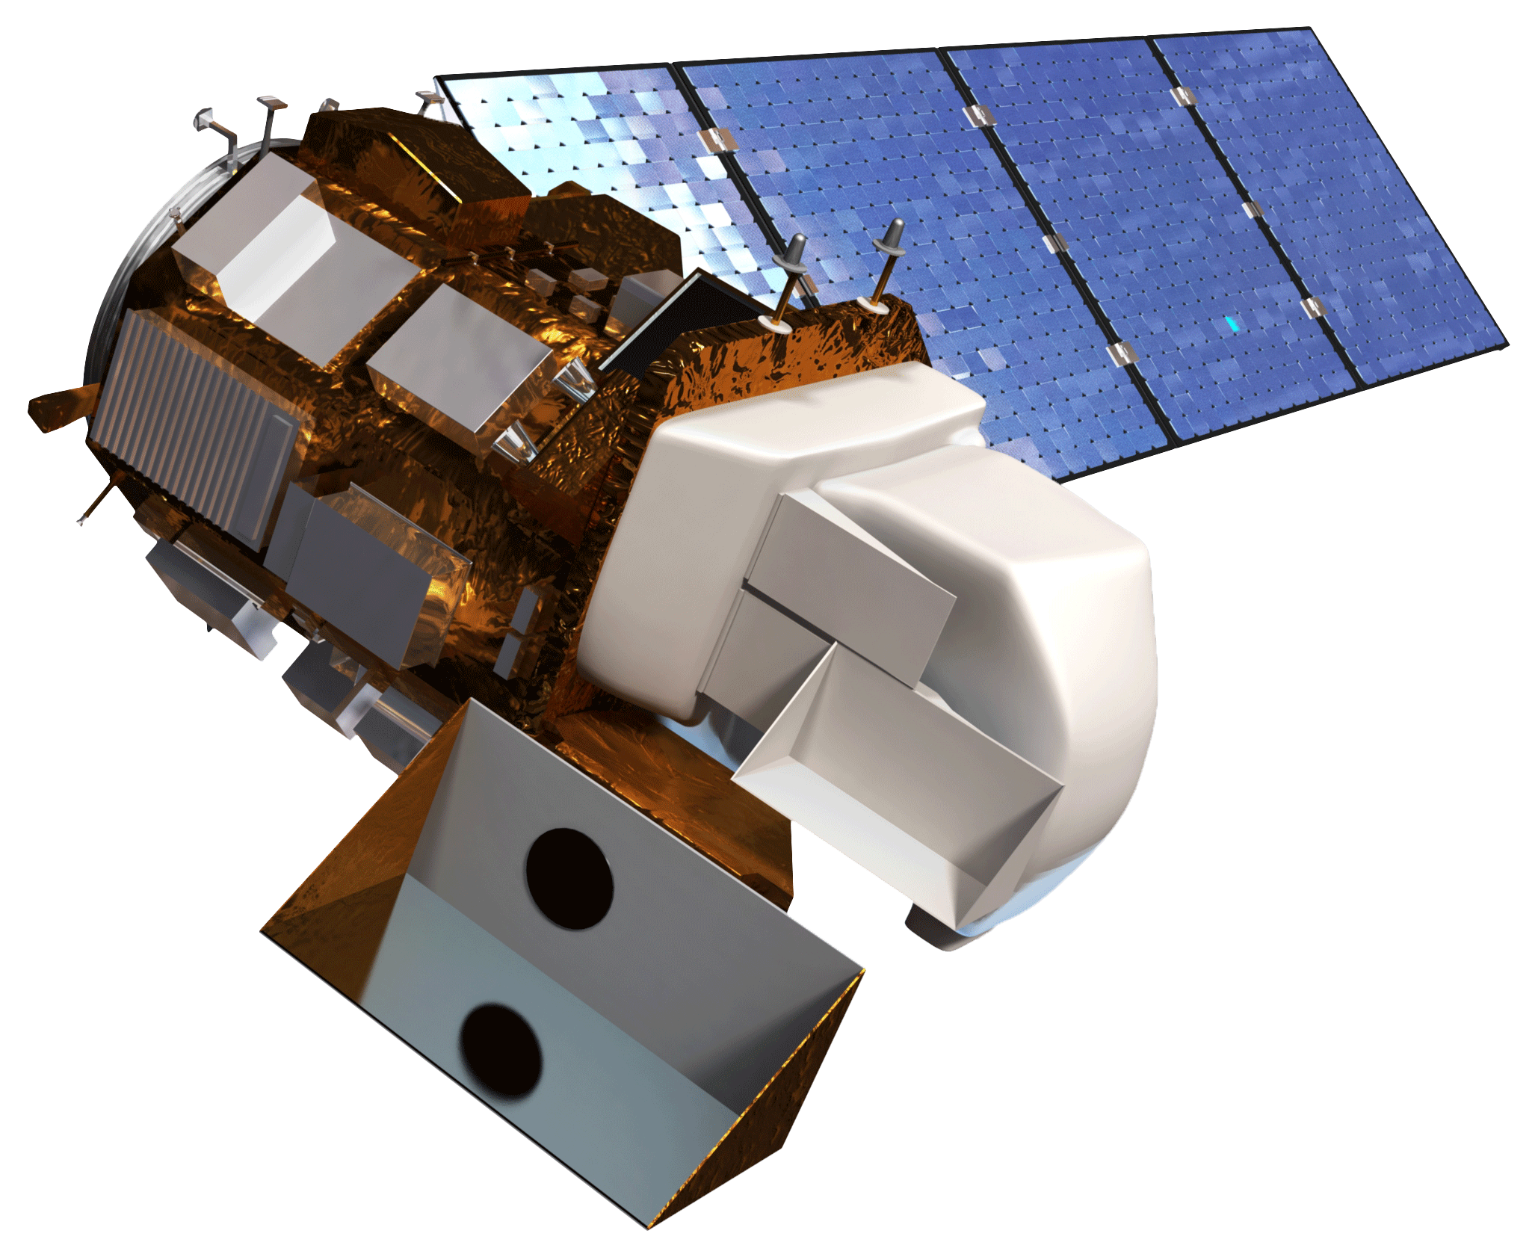
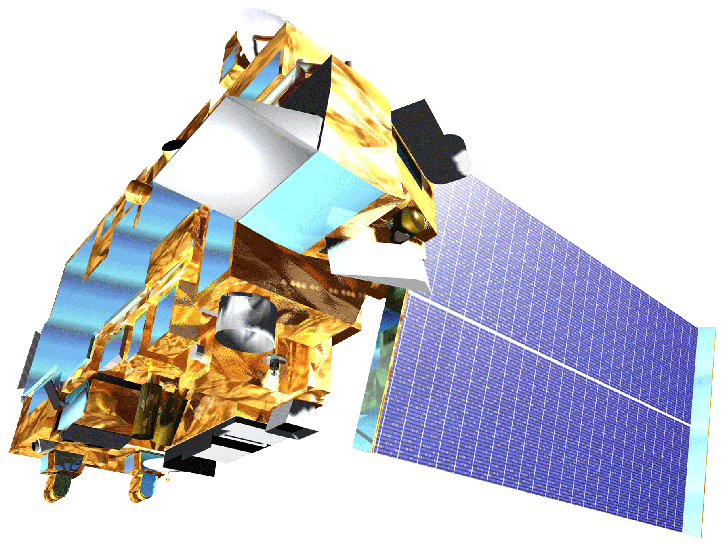
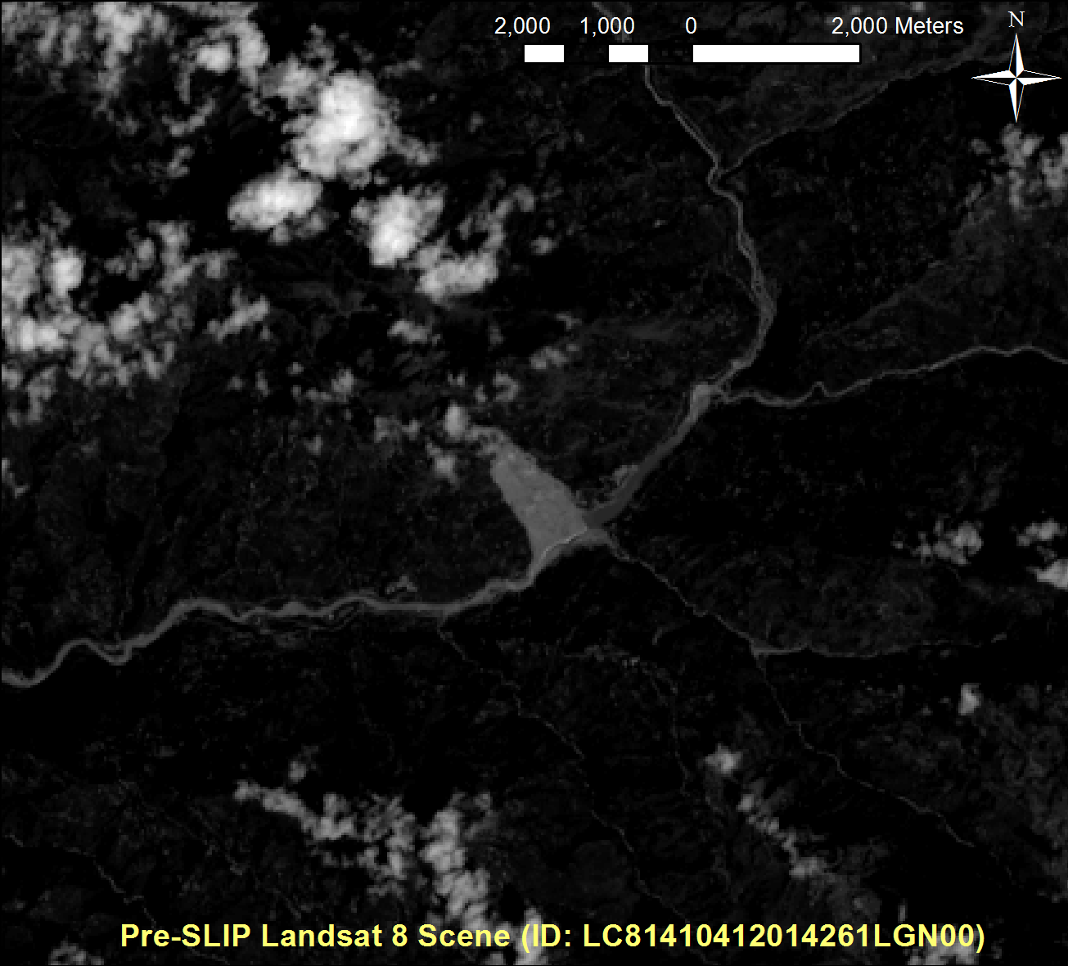
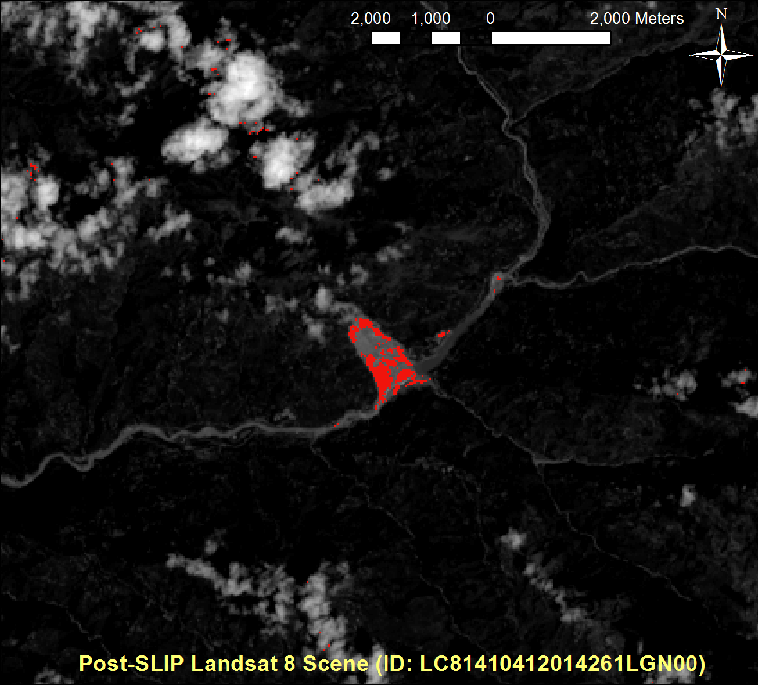
Himalaya Disasters III
Utilizing a Landslide Identification Product and a Real-time Rainfall Detection Tool for Enhanced landslide Detection in Nepal
Amanda Rumsey (Project Lead), Jordan Scheffler, Jessica Fayne
DEVELOP National Program at Goddard Space Flight Center
Abstract
Objectives
Keep this blank for now.
Body text point size should be at least 24.
Caption text point size should be at least 16.
Feel free to rename, move, and resize sections as needed.
Validate the results of SLIP using digitized landslide event information collected using Landsat 8 imagery
Develop a web-based platform to display the results of the SLIP and DRIP products
Package SLIP and DRIP into a usable program for ICIMOD
Perform rainfall threshold analysis and comparative rain gauge and TRMM analysis for Nepal
Methodology
Study Area
SLIP and DRIP
Validation
GPM
Historical TRMM data was used to calculate monthly mean thresholds used to detect anomalies in near real-time with GPM
Monitors GPM IMERG data every 30 minutes looking for anomalies compared with calculated threshold values
Precipitation monitoring by DRIP
SLIP
DRIP
IMERG 30-Minute
Data Collection
TRMM
Thresholds
Comparison
Landsat 8
TMPA-RT 3B42
Landsat 8
Cloud Mask
QA band from Landsat 8 is used to remove clouds from the other bands
landslide detection by SLIP (Yellow)
IR
SWIR
Red Increase
Calculate percent change between two Red band images
Data Comparison
Earth Observations
SLIP
QA
Red
Data Collection
TRMM
GPM
Landsat 8
Terra
SRTM
Moisture Index
Compare two images’ moisture using IR and SWIR bands
Accuracy Assessment
ASTER
Slope Analysis
Remove pixels with slopes lower than 15%
Alert!
If current rainfall levels are higher than thresholds, an alert is created
Conclusions
Results
Use bullets.
Use complete sentences with periods.
Location of Landslide Event | % Accuracy
Team Members
Acknowledgements
Dr. Dalia Kirschbaum (GSFC)
Thomas Stanley (GSFC)
Sebastian Wesselman (ICIMOD)
Justin Roberts-Pierel (GSFC)
Aakash Ahamed (GSFC)
Jamie Shiplet (Towson University)
Project Partners
ICIMOD
Amanda Rumsey, Jessica Fayne, Jordan Scheffler

