Slide 1
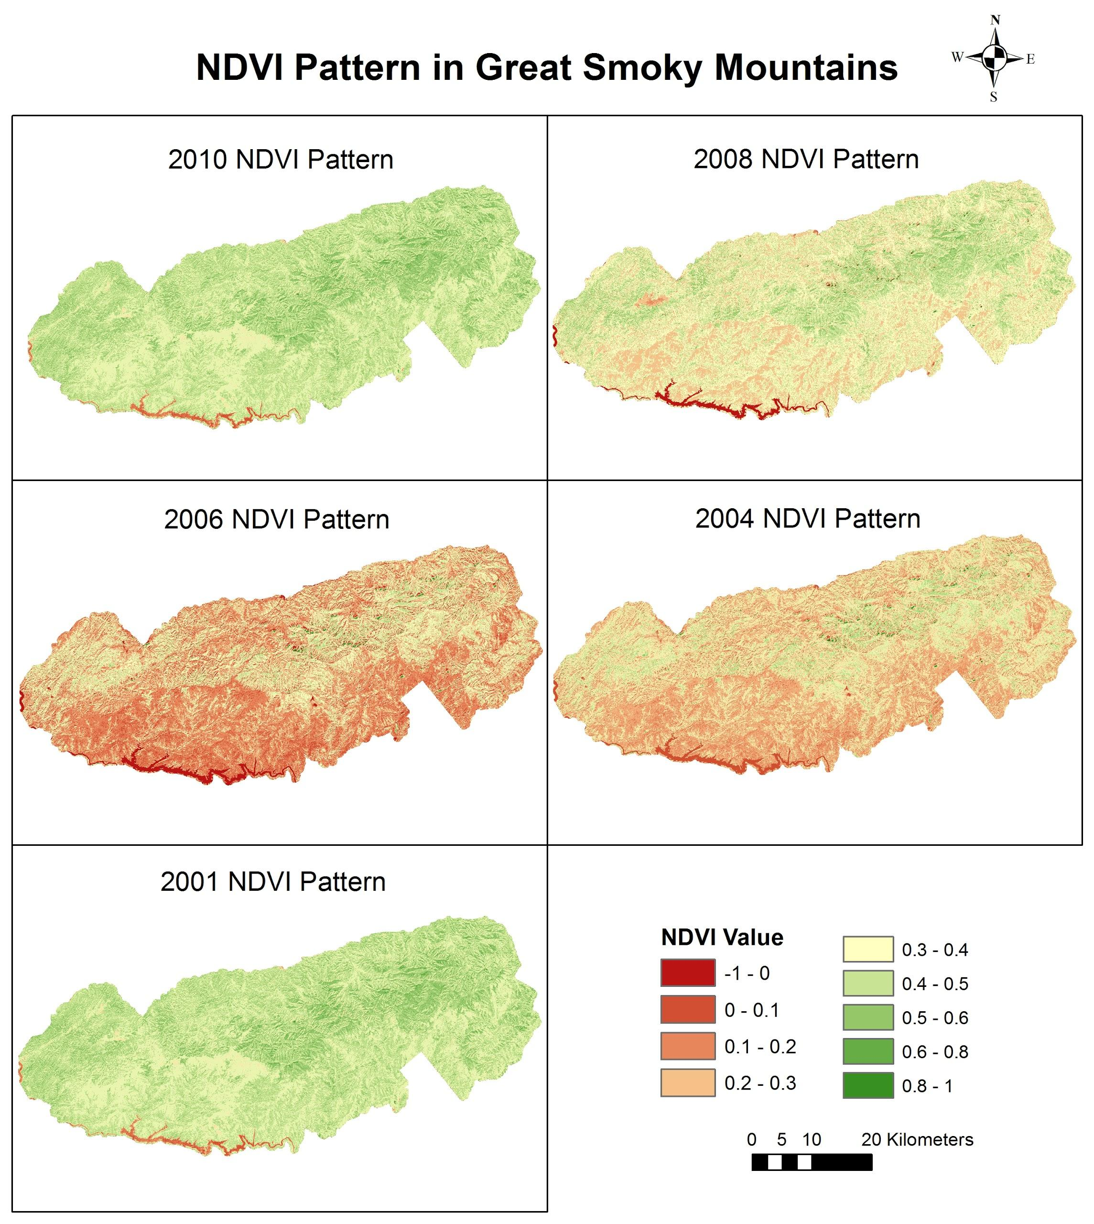
UGA
Great Smoky Mountains Ecological Forecasting
NDVI pattern calculated using leaf-off Landsat 5 Thematic Mapper images from 2001 to 2010 for the Great Smoky Mountains National Park.
This is an example of how NDVI products extracted from NASA Earth Observation data can be used to monitor the spatiotemporal trend of forest health condition.

