Slide 1
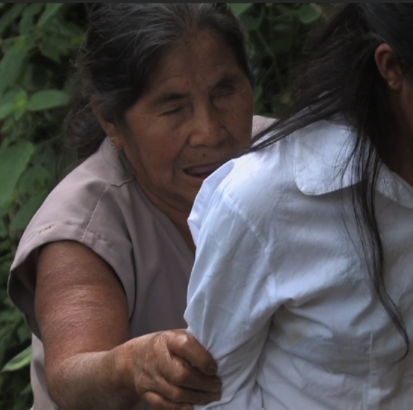
Alto Orinoco Health and Air Quality
Background Information
Utilizing NASA Earth Observations to Locate Remote Yanomami Villages in the Alto Orinoco Municipality for Targeted Elimination of River Blindness Disease
What is Onchocerciasis or River Blindness Disease?
Neglected tropical disease
Caused by a parasitic worm known as Onchocerca volvulus
Onchocerca volvulus is transmitted through the bite of a black fly
Source: Flickr User Gleilson Miranda
Source: The Carter Center
Sara Amirazodi
Rajkishan Rajappan
Zachary Tate
Symptoms of river blindness disease include itching, rash, skin discoloration, visual impairment, and blindness
Timothy Larson
Amanda Rumsey
Annabel White
Kyle Sowder
Notes:
The Alto Orinoco Health and Air Quality Project utilized satellite imagery to locate remote Yanomami Villages in the Alto Orinoco Municipality of Venezuela for the Elimination of Onchocerciasis.

Slide 2
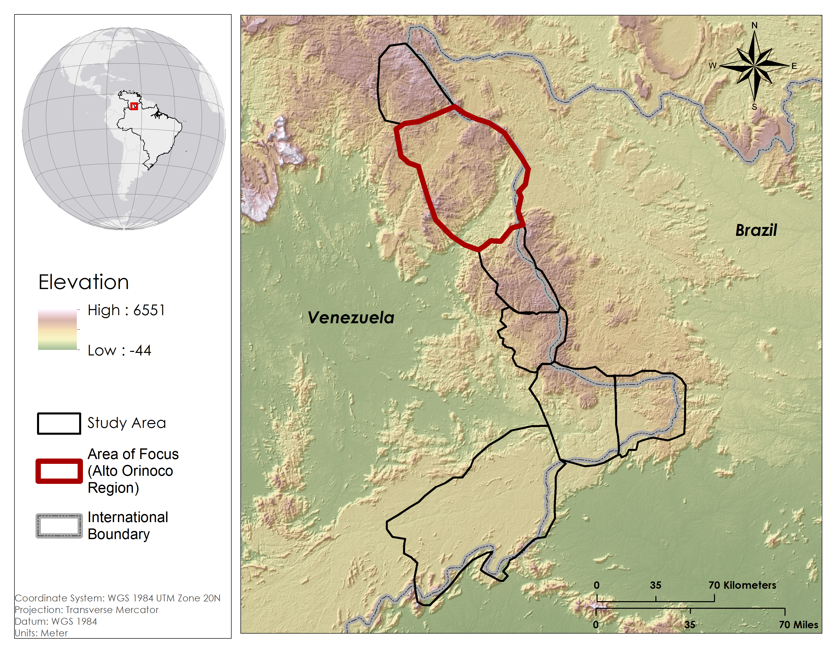
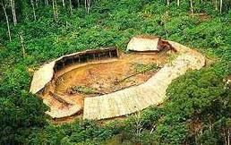
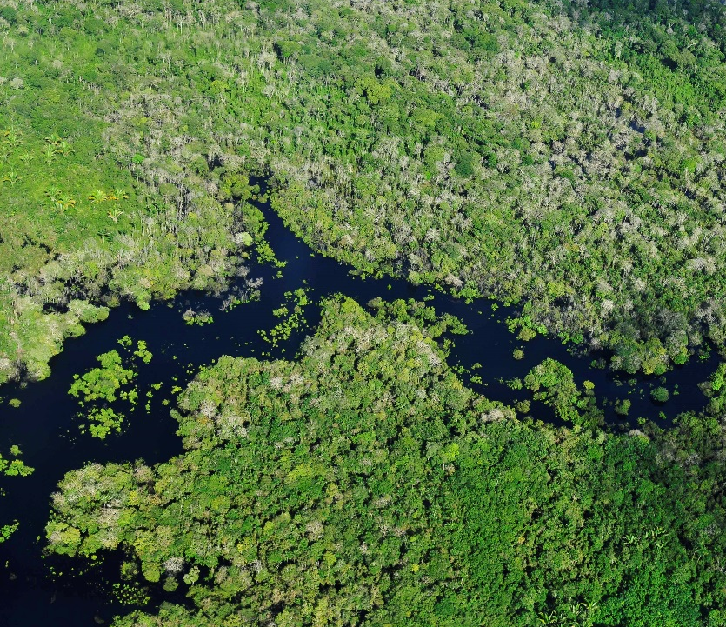
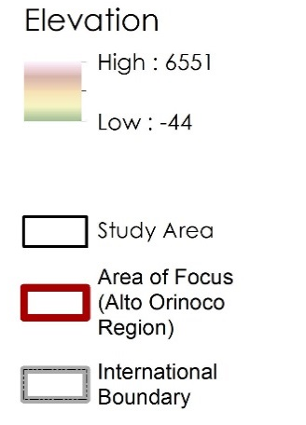
Background Information
Who is at Risk?
What are the Current Limitations to Providing Treatment?
13 sub regions of Brazil, Ecuador, Guatemala, Mexico, Venezuela, and Colombia
The Alto Orinoco Municipality is one of the last active transmission zones
122,282 people within the Alto Orinoco region are at risk
20,500 people within the Alto Orinoco region need treatment
Densely forested terrain
Political boundaries
Government policies
Remote locations of Yanomami villages
Migratory nature of Yanomami people
Source: Wikipedia User Zeljko
Elevation
High: 6551
Low: -44
Alto Orinoco
Municipality
Area of Focus
Coordinate System: WGS 1984 UTM Zone 20N
Projection: Transverse Mercator
Datum: WGS 1984
International
Boundary
Source: Flickr User CIAT
Notes:
Onchocerciasis or otherwise known as river blindness disease is a neglected tropical disease that is caused by a parasitic worm and is transmitted through the bite of a black fly. Some symptoms of river blindness disease include itching, skin discoloration, and blindness.
The Alto Orinoco municipality in Venezuela is one of the last remaining active transmission zone for river blindness. Within this region, over 122,000 people are at risk for the disease and 20,500 people are currently seeking treatment for the disease.
The Carter Center has been working to provide treatment to the Yanomami tribes in this region, but densely forested terrain, remote village locations, and migratory patterns of the Yanomami tribe make it difficult for The Carter Center to identify active villages.

Slide 3
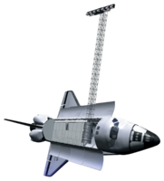
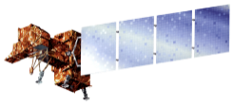
Objectives
Utilize NASA Earth observations and DigitalGlobe data to locate remote Yanomami villages
Convey the locations and physical characteristics of the villages to The Carter Center so that they can provide medical treatment
Develop a suitability model to assist The Carter Center in future village identification efforts
Source: NASA
Notes:
The goals of this study were to utilize NASA earth observations and high resolution digital globe information to locate remote Yanomami villages, convey the locations and physical characteristics of these villages to The Cater Center, and to develop a suitability model to assist The Carter Center in future village identification efforts.

Slide 4
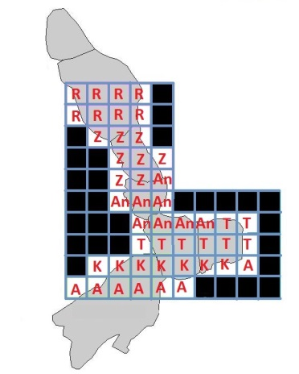
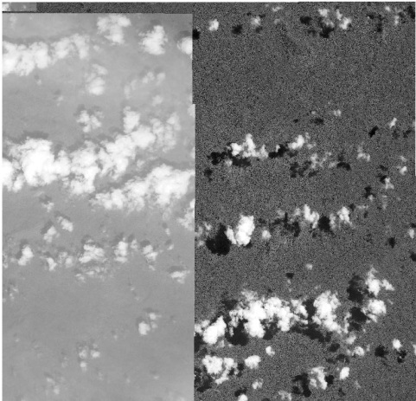
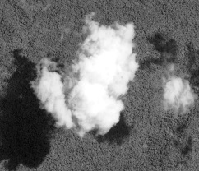
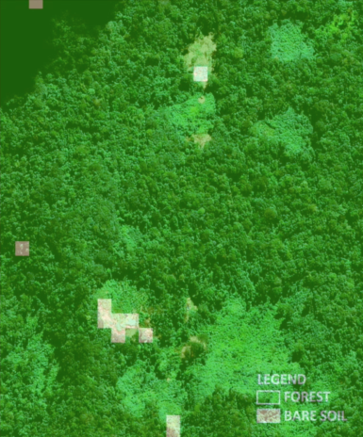
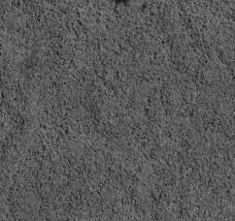
Project Methodology
Data Sources
1. DigitalGlobe
WorldView -1,2,3
GeoEye -1
Quickbird -2
NASA Earth Observations
Landsat 8 OLI and TIRS
Village Identification Methodology
The study area was dissected into 46 grids
Each team member was assigned 7-8 grids to visually inspect
Each grid was inspected on a pixel-by-pixel basis using a cloud-free DigitalGlobe mosaic and a yearly DigitalGlobe mosaic
If a cloud was present in the mosaics, raw imagery from another date was substituted in
A “soil - vegetation” k-means unsupervised classification was used to focus on at risk regions
Steps 1 and 2
Step 3
Step 4
Step 5
Notes:
To locate the villages, the study area was dissected into 46 grids and each team member was assigned 7 to 8 grids to visually inspect using cloud free and yearly digitalglobe mosiacs. If a cloud was present in either of the mosaics, raw digital globe data from another date was substituted in. Soil data derived from an unsupervised classification performed on a Landsat 8 composite was also used to check for villages using the mosaics.

Slide 5
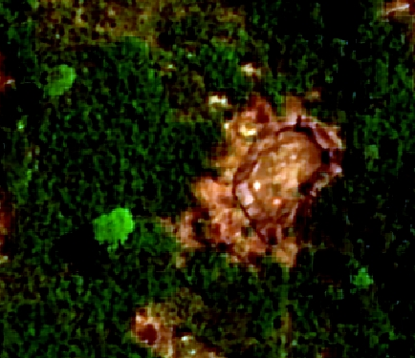
Project Methodology
Village Identification
Village ID
Diameter of village
Number of huts
Temporal Information
Sensor Information
Population Estimate
Notes:
When a village was identified, the village was marked with a point vector, and the village diameter, number of huts, temporal history, sensor history, and current population estimates were recorded.

Slide 6
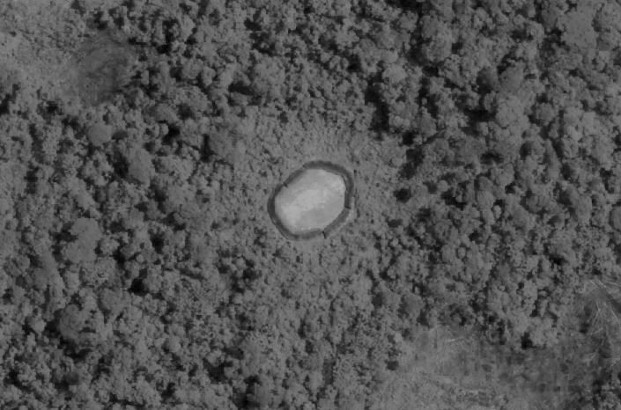
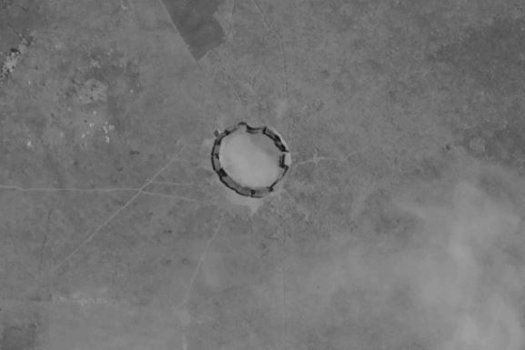
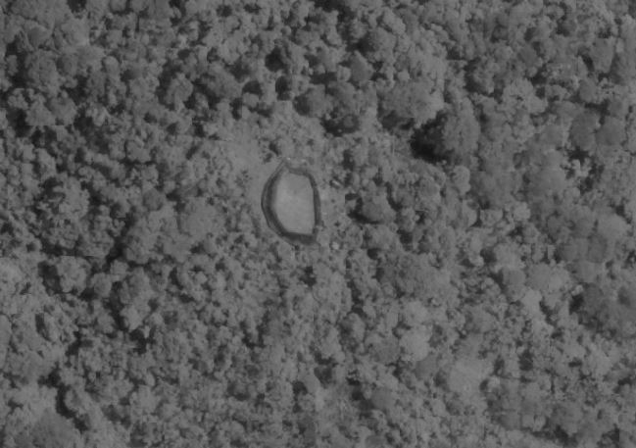
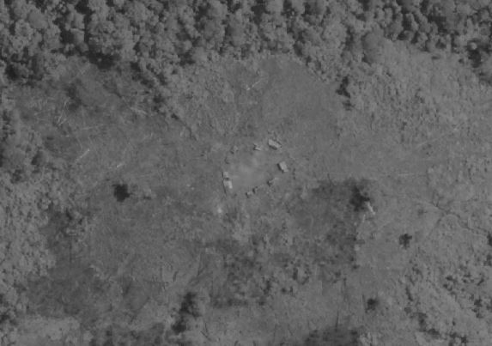
Village Identification Results
Active Villages
137 active villages
Abandoned Villages
26 abandoned villages
Population Estimate
3125 people in the 137 active villages
Carter Center Deliverables
Village shapefile with an attribute table
KML file
Notes:
Through visual inspection of the high resolution data, 133 active villages and 26 abandoned villages were identified. We estimate the total population for these active villages is 2763. The geospatial and attribute data will be provided in a kml, shapefile, and excel format.

Slide 7
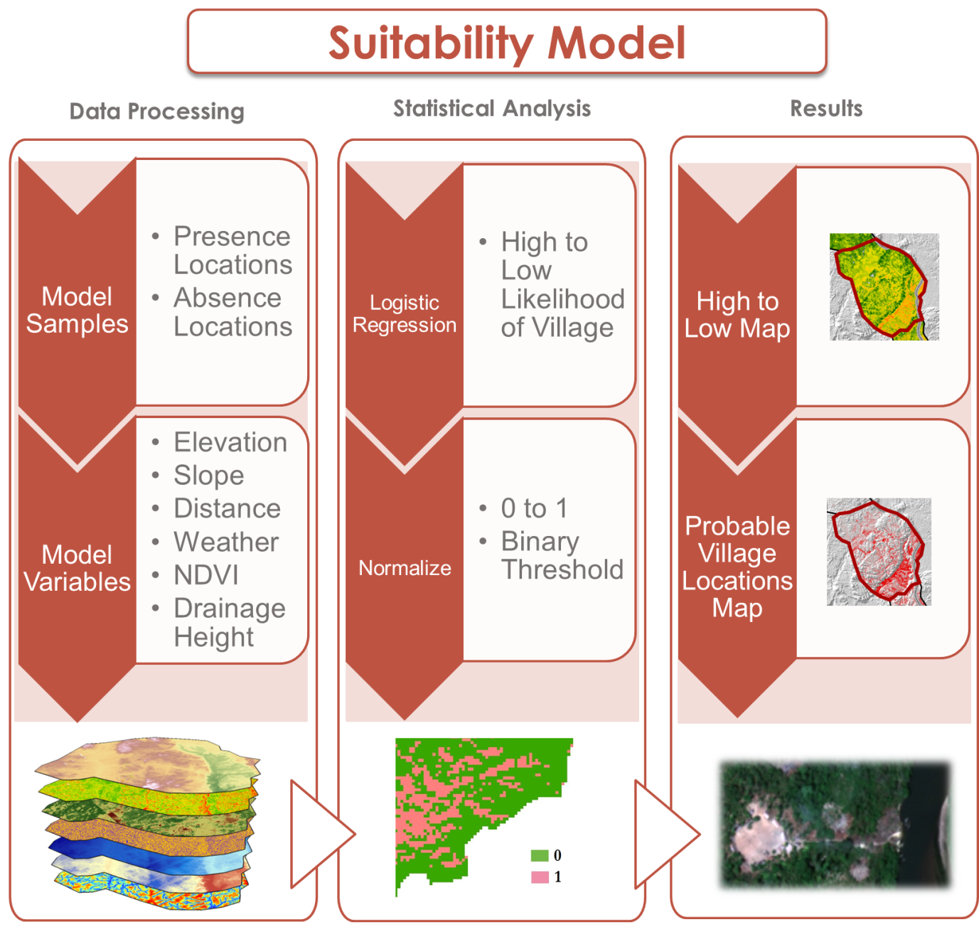
Project Methodology
Data Sources: Landsat 8 OLI/TIRS, SRTM
Notes:
A suitability model was then developed using a logistic regression technique. The coordinates of the identified villages in relation to 6 environment variables were used to calibrate the model.
Variables included: elevation, slope, distance to streams, ndvi, height above nearest drainage, temperature, and precipitation.

Slide 8
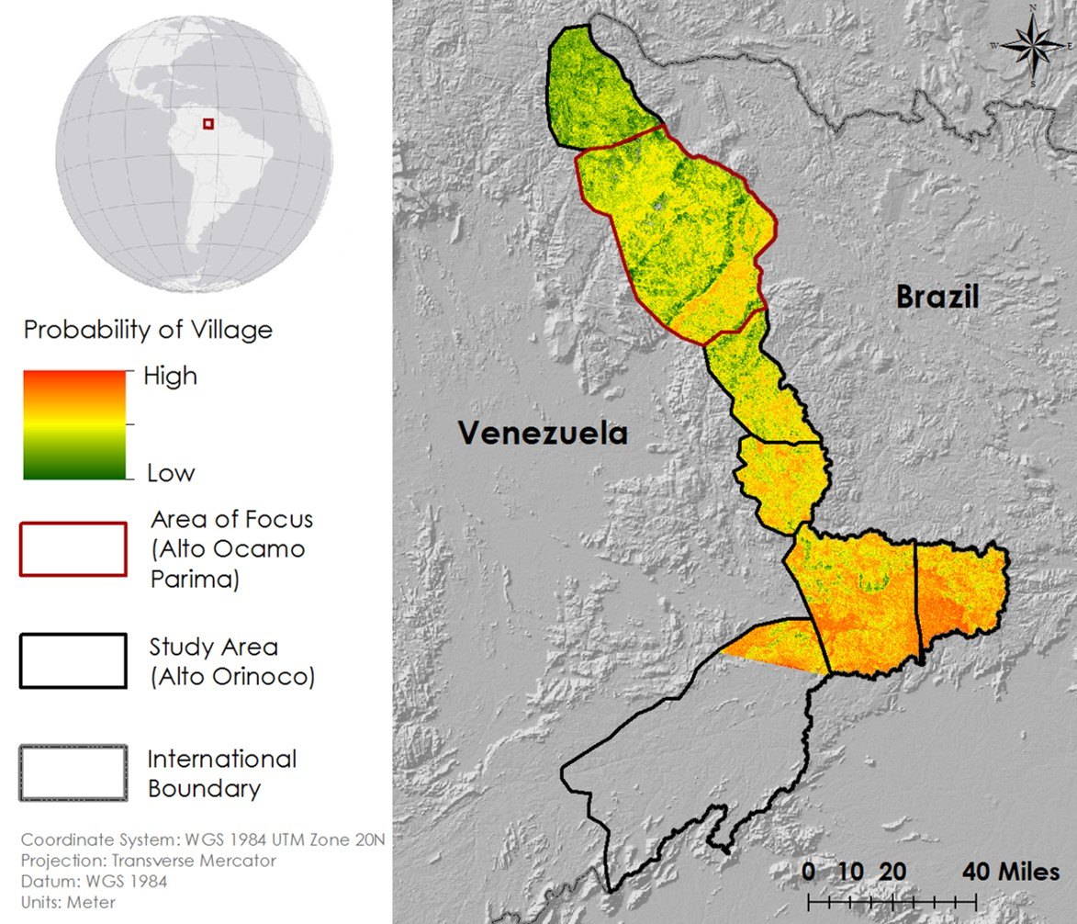
Suitability Model Results
Notes:
The logistic regression model resulted in a probability map as shown above. Areas in red have a high probability of village occurrence.

Slide 9
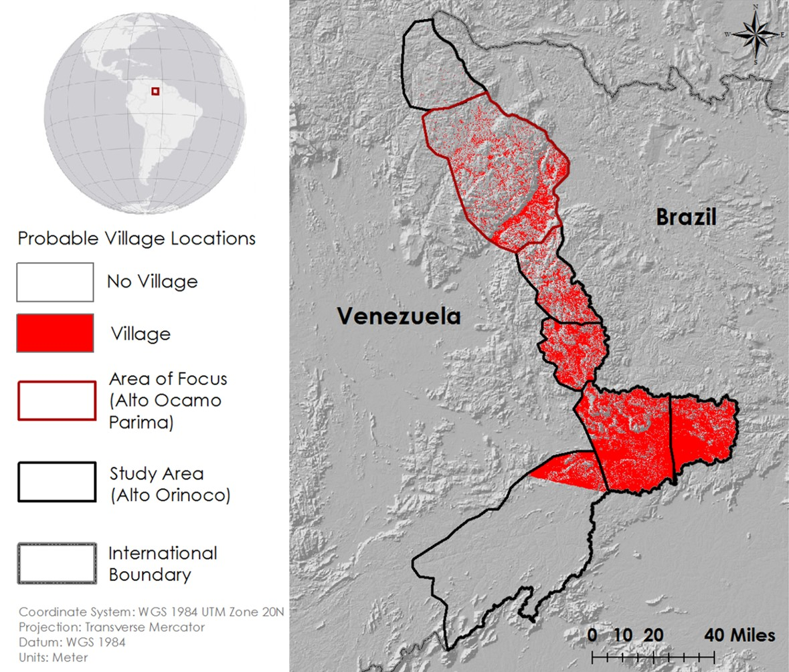
Suitability Model Results
Notes:
A binary threshold was applide to identify and extract new probable village locations.
These steps yielded a cross validation accuracy of 76% (predictions vs outcomes),
a cross validation correlation of .6 (alignment of values when changes occur),
and a significance of less than .01 (significant).
This model will help The Carter Center not only identify villages for initial treatment, but also identify villages for follow-up treatment once they’ve migrated to new locations.

Slide 10
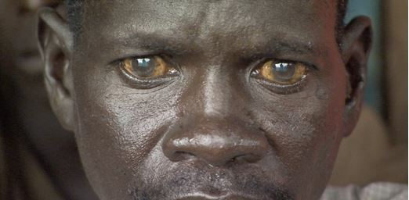
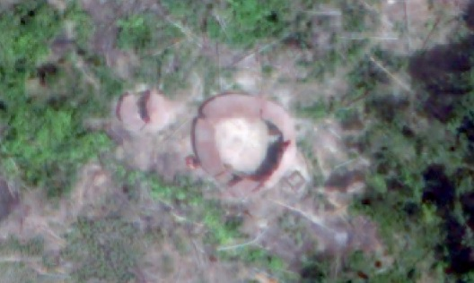
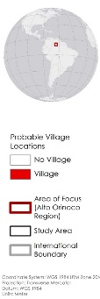
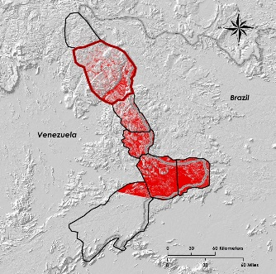
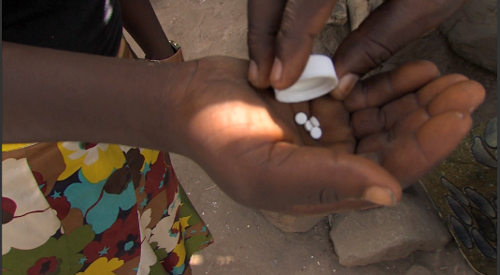
Acknowledgments
Conclusion
Advisors
Dr. Jim Tucker (NASA Goddard Space Flight Center)
Kel Markert (University of Alabama in Huntsville)
Dr. Kenton Ross (NASA DEVELOP)
Dan Irwin (SERVIR Program Director)
Dr. Jeff Luvall (NASA at National Space Science and Technology Center)
Dr. Robert Griffin (University of Alabama in Huntsville)
Katie Melocik (NASA Goddard Space Flight Center)
Dr. Thomas Unnasch (University of South Florida)
Melanie Salyer, Mentor (Wise County)
River Blindness Disease effects:
Reinforces poverty cycle
Impacts ones quality of life
Influences ones ability to work and learn survival skills
About 160 remote villages were identified in the Alto Orinoco Region
The suitability and probable village location maps have an 76% accuracy rating
Partners
The Carter Center
Dr. Frank Richards, The Carter Center
Lindsay Rakers, The Carter Center
The Carter Center will apply this intelligence to provide treatment and continue their eradication efforts
This material is based upon work supported by NASA through contract NNL11AA00B and cooperative agreement NNX14AB60A
Source: The Carter Center
Notes:
In conclusion, the village locations and probability maps will be used by The Carter Center to aid in their efforts to deliver treatment and eradicate onchocerciasis.
These efforts are crucial because river blindness reinforces the poverty cycle by reducing an individual’s ability to visually learn survival skills and impacts their quality of life.
And lastly, we would like to thank our science advisors and partners. For without which, this unique project which stemmed from communication between President Cater and Charles Bolden, would not have been possible.

