Slide 1
Kankakee River Water Resources
Monitoring Temperature and Vegetation to Detect River Flow Impediments at Energy Intake Structures
Marisa Smedsrud • Hayden Hoffmeister • Oluwatosin Orimolade • Barira Rashid
Pop-Up Project | Summer 2023
Notes:
<greeting>. Thank you everyone for being here for this presentation. We can start with some introductions.
I'm <name>
***HAVE ALL PRESENTERS INTRODUCE THEMSELVES BY NAME***
Today we will be talking about the NASA DEVELOP Kankakee River Water Resources project.

Slide 2
Presentation Outline
METHODS
How we collected and analyzed our data, and how we determined results.
Introduction
Introduction
Results
The problem, our partners, and their concerns.
Methods
Conclusion
RESULTS
OBJECTIVES
The key takeaways, limitations, and next steps.
What we are trying to accomplish with the project.
Icon Credit: Microsoft Office
Notes:
For this presentation, we will start by introducing the problem, our partners, and their concerns.
Then we'll establish the objectives of the project and discuss what we are trying to accomplish.
We'll review our methods; how we collected, processed, and analyzed our data. And how we took those outcomes and determined results.
Finally, we'll discuss some key takeaways, limitations we faced, and next steps for this particular topic.
------------------------------Image Information Below ------------------------------
•Icons: Microsoft

Slide 3
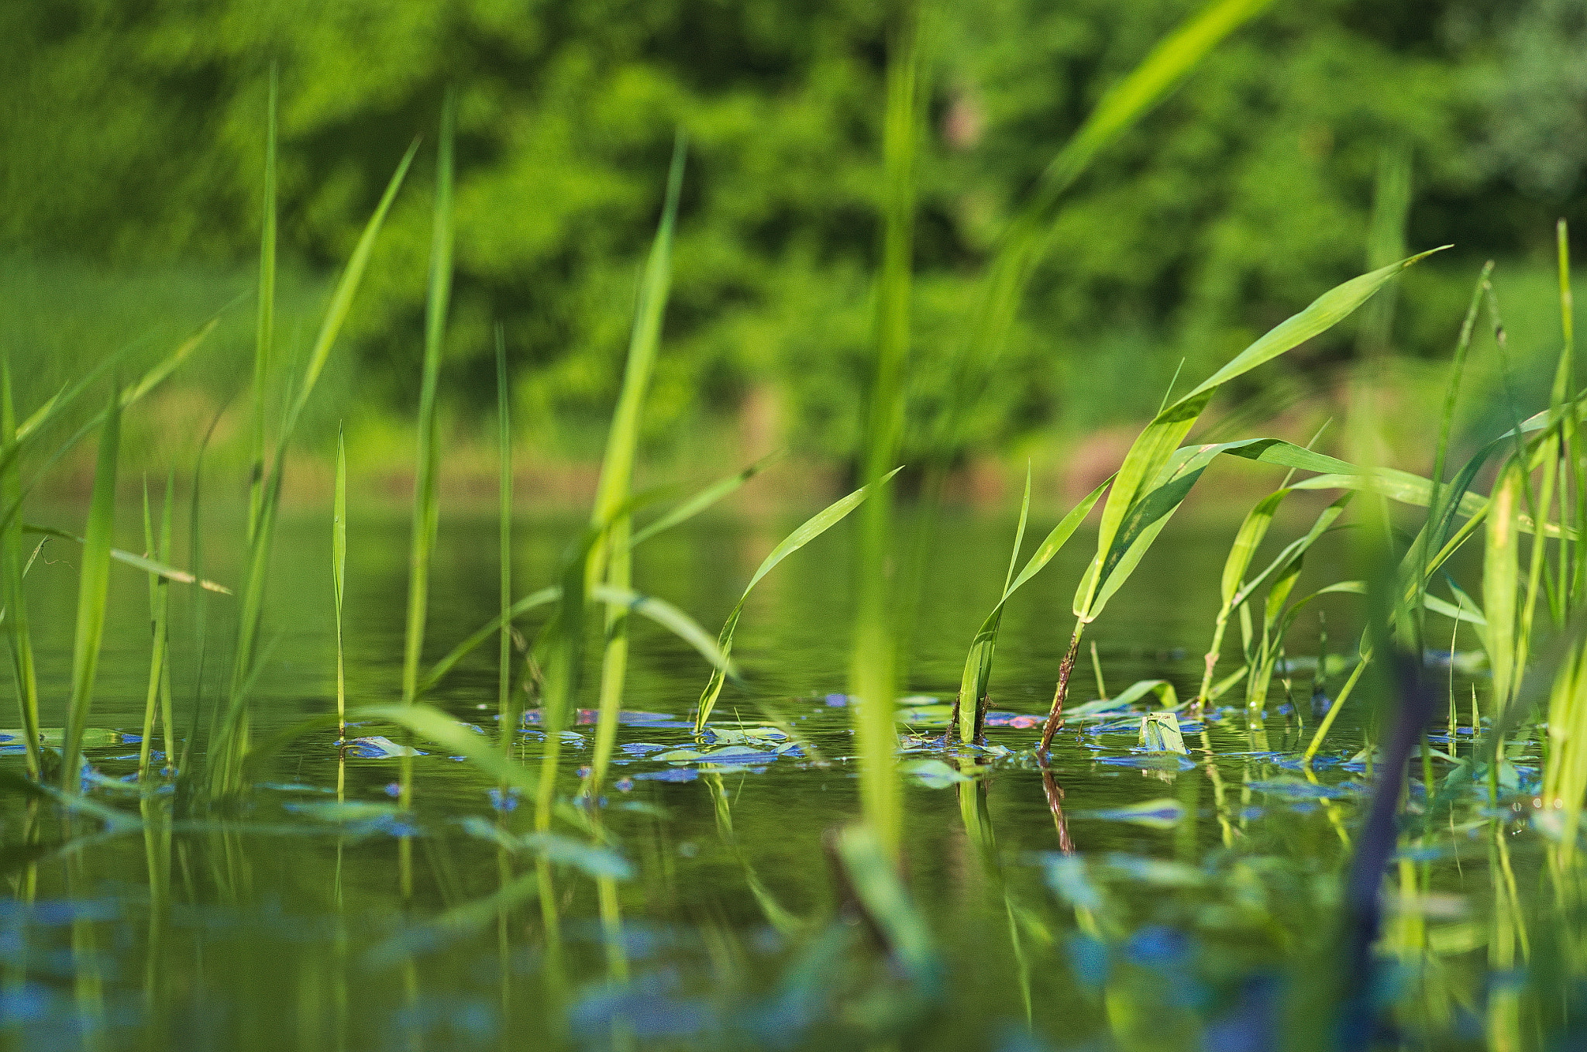
What is a grassing event?
Perennial aquatic grasses in rivers are released at the end of each growing season
Changes in environmental conditions can cause these grasses to release earlier and in large quantities
Poses an issue to infrastructure that utilizes water intakes
Credit: Aleksander Kwiatkowski
Notes:
Before we begin, let us answer the question: "What is a grassing event?". There are many different species of aquatic vegetation, called macrophytes, that grow from riverbeds. Typically, these aquatic grasses grow perennially from a rhizome buried in river sediment; growing grass leaves during a growing season, then releasing those leaves slowly, over time, after the growing season. A grassing event occurs when there is some environmental factor that causes these grasses to grow rapidly and release their leaves earlier and in large quantities. This rapid release of biomass can pose a threat to man-made infrastructure that relies on the intake of water from a river where grasses and other types of macrophytes grow.
------------------------------Image Information Below ------------------------------
•Image Credit: Aleksander Kwiatkowski
•Image Source: https://commons.wikimedia.org/wiki/File:Warta_River_Plants_%28157963939%29.jpeg licensed under CC-1.0 Public Domain Dedication

Slide 4
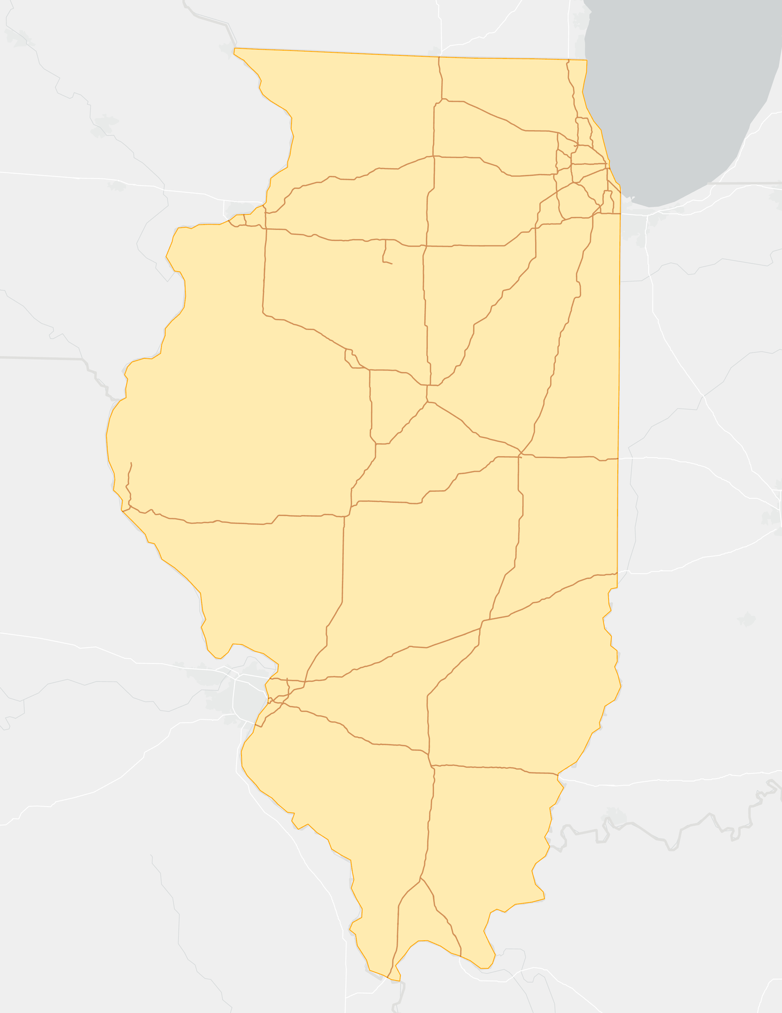
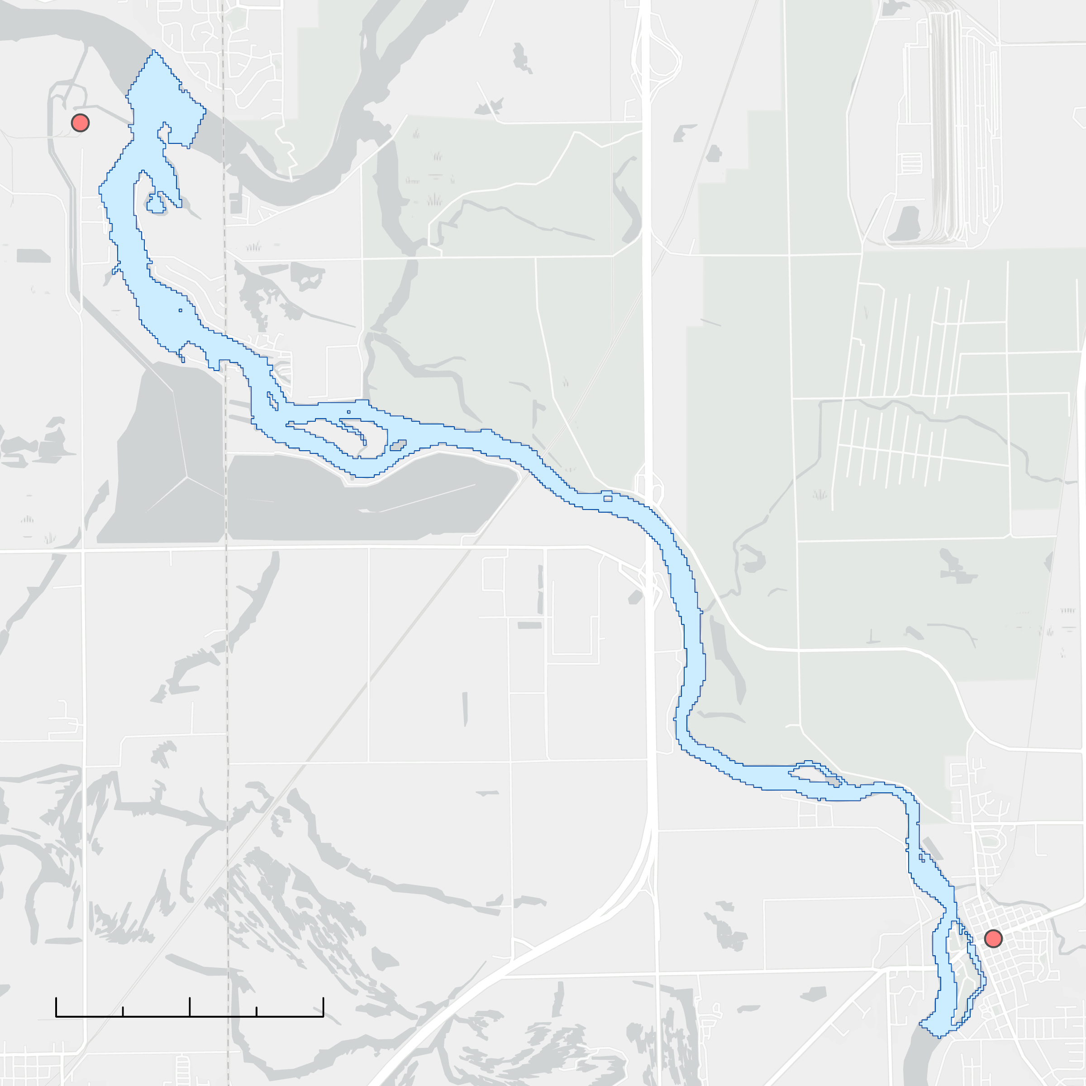
Study Area
N
Chicago
Dresden Generating Station
Study Area Extent Along the Kankakee River
Point of Reference
Illinois
Missouri DNR, Esri, HERE, Garmin, FAO, NOAA, USGS, NPS
Wilmington, IL
0
1.5
3 Kilometers
Grassing event occurred on July 29th, 2022.
County of Will, Esri, HERE, Garmin, SafeGraph, GeoTechnologies, Inc, METI/NASA, USGS, EPA, NPS, USDA
Notes:
On July 29th, 2022, a major grassing event occurred on the Kankakee River near the Dresden Generating Station that sits at the confluence between the Des Plaines, the Illinois, and the Kankakee Rivers. The plant uses a cold-water cooling system that intakes water from the Kankakee river. Grassing events, such as one which occurred in July of 2022, have been known to clog the intake and impede operation at the station. For the study area of this project, we are looking at a section of the lower Kankakee River that stretches from the confluence of the Kankakee and Des Plaines upstream to a small check dam in Wilmington, IL. The initial study period consisted of a case study for the summer of 2022, when the most recent event (at the time) had occurred (there has since been another event this summer).
------------------------------Image Information Below ------------------------------
•Image Credit: DEVELOPer
•Image Source: DEVELOPer
•Icons: Microsoft
- Basemap credit: Missouri DNR, Esri, HERE, Garmin, FAO, NOAA, USGS, NPS

Slide 5
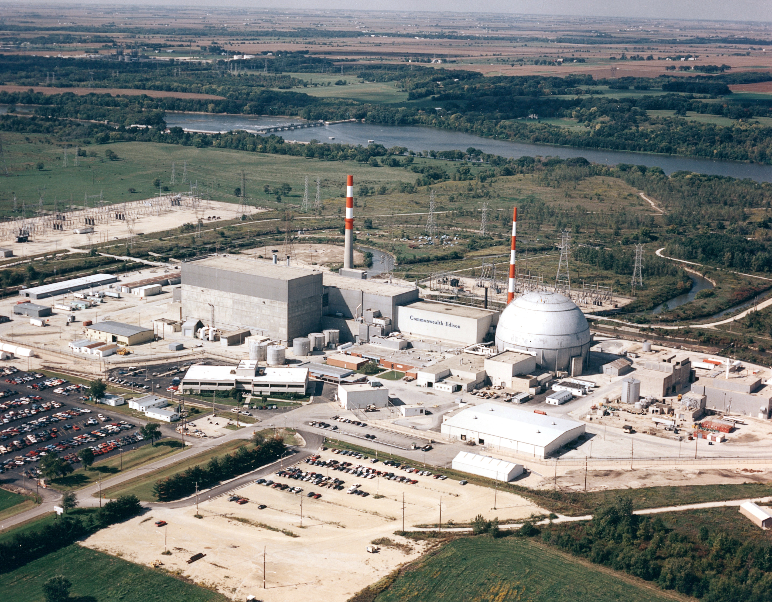
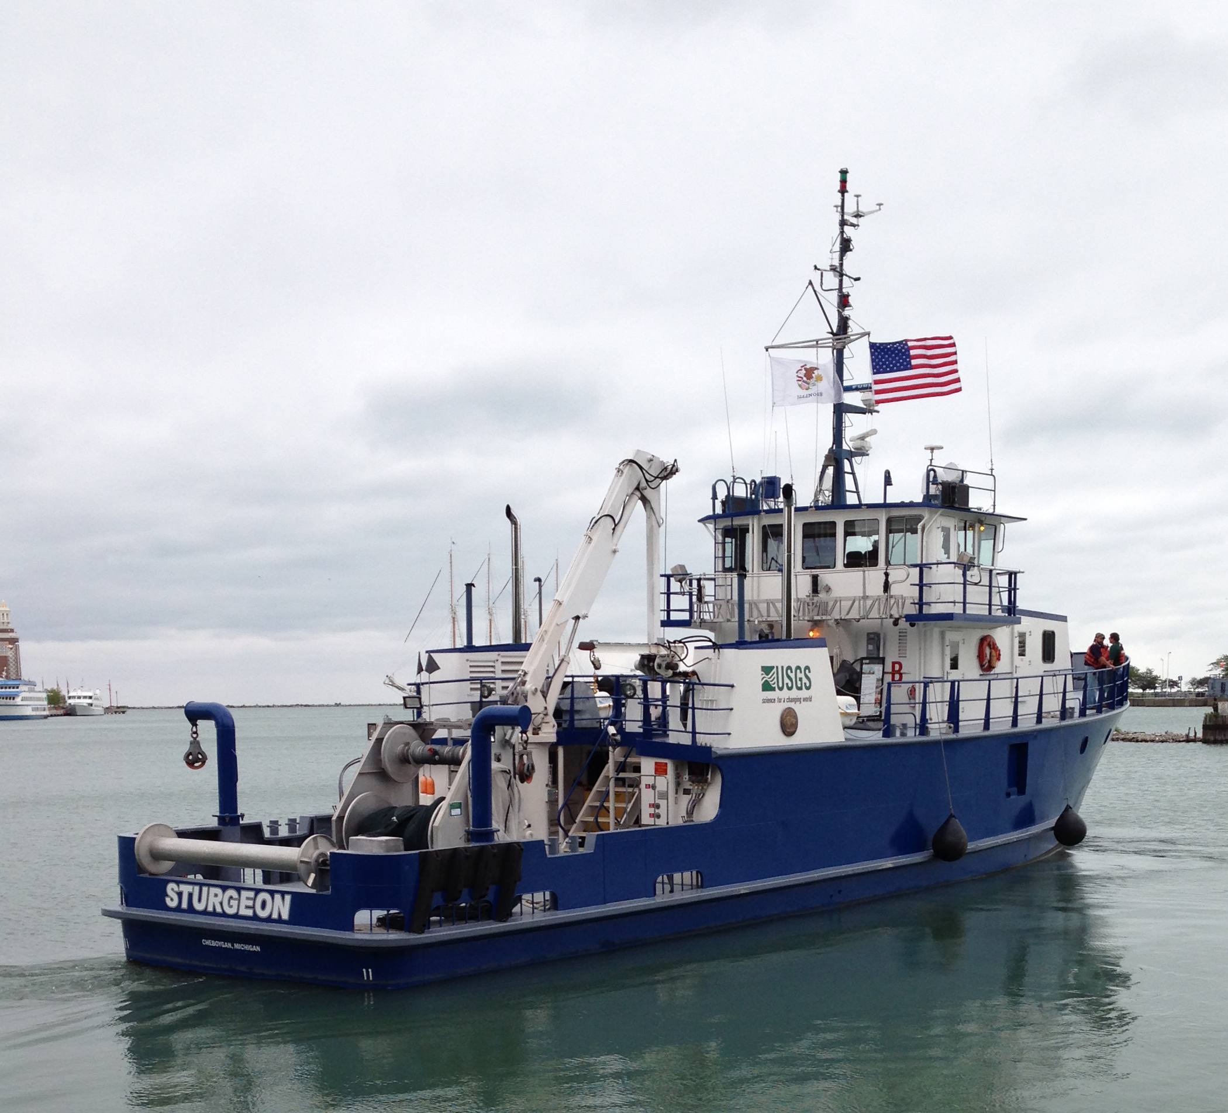
Project Partners
Constellation Nuclear
End User
Point of Contact: Becki Maddox
Senior Environmental Specialist
Credit: USNRC
USGS Central Midwest Water Science Center
Collaborator
Point of Contact: Allison Atkinson
Civil Engineer
Credit: USGS CMWSC
Notes:
Our two partners that we consulted for this project were the Dresden Generating Station which is owned and operated by Constellation Nuclear—they were our primary end user—and the USGS Central Midwest Water Science Center who were a collaborating organization. Beckie Maddox is the Senior Environmental Specialist at Constellation Nuclear and our main point of contact there. Allison Atkinsons is a Civil Engineer with the USGS and our main point of contact with CMWSC.
------------------------------Image Information Below ------------------------------
Image (left)
•Image Credit: U.S. Nuclear Regulatory Commission
•Image Source: https://www.flickr.com/photos/69383258@N08/17859259621/ licensed under Creative Commons CC-BY-2.0 (no changes made)
Image (right)
•Image Credit: USGS Central Midwest Water Science Center
•Image Source: https://www.usgs.gov/media/images/rv-sturgeon-leaving-dock-navy-pier-chicago-il licensed under Public Domain

Slide 6
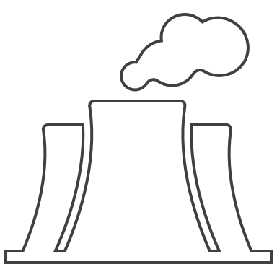
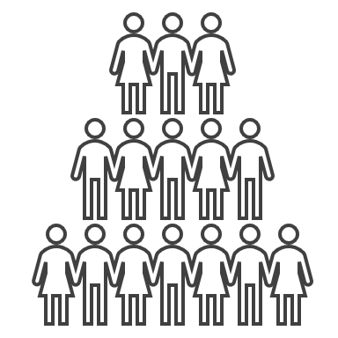
Community Concerns
Dresden Generating Station:
1,845 MW
15 million MWh
1.4 million
657
Generation Capacity
Net Generation in 2022
Equivalent Homes Served
Locals Employed
Energy Reliability & Consistency is a Critical Concern
Notes:
The main community concern that was identified through discussions with our partners is reliability. The Dresden Generating Station generates power through two nuclear reactors. Due to the nature of nuclear energy, the Dresden Generating Station is considered a highly reliable source of energy. That means maintaining consistency in energy production is crucial for the organization's model as well as the surrounding community that relies on the plant for power. Here you can see some facts about the Dresden Generating Station including that it generates enough energy to power the equivalent of 1.4 million houses. Additionally, the station also has a significant impact on the local economy, employing over 600 people. The reliable operation of the station is paramount to the local community.
------------------------------Image Information Below ------------------------------
•Icons: Microsoft

Slide 7
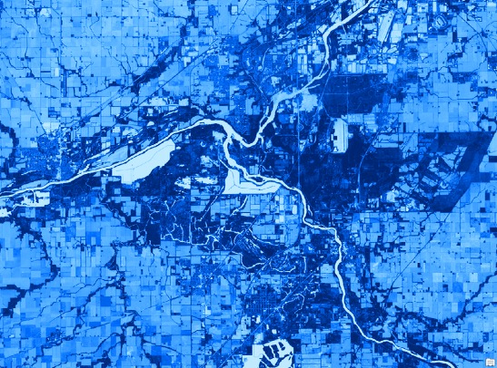
Objectives
Detect floating aquatic vegetation with Earth observations
Predict future events using environmental metrics
Develop a reproducible workflow for future partner use
Notes:
Based on our partners' needs, we derived three main objectives for this project. First, we wanted to assess the feasibility of using Earth observations to detect floating aquatic vegetation. Second, we wanted to analyze environmental trends in relation to remote sensing data aid in predicting future grassing events. Finally, we wanted to evaluate that process, and develop a reproducible workflow for our partners to utilize in the future.
------------------------------Image Information Below ------------------------------
•Image Credit: DEVELOPer
•Image Source: DEVELOPer
•Icons: Microsoft

Slide 8
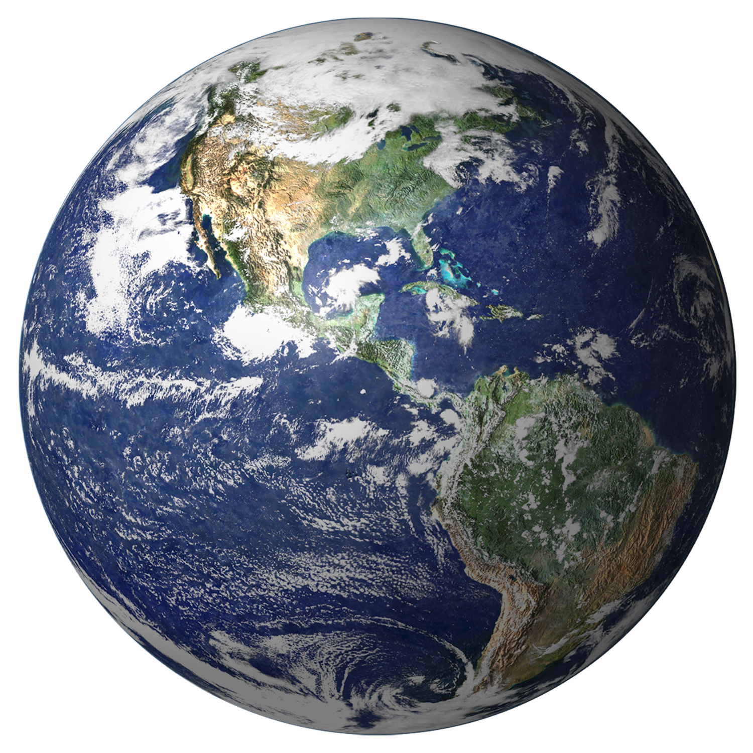
Intro to Remote Sensing
Images
Image Credit: gahag.net & NASA GSFC
Notes:
In order to understand how we can detect floating aquatic vegetation, one must first understand the fundamental concepts of remote sensing. As shown in this diagram, the sun emits waves of electromagnetic energy, which then make contact with the Earth. Some of this energy is absorbed, but some of it is reflected off the surface of the Earth. This reflected energy can be detected by satellites using sensors. The detected electromagnetic values can then be turned into images that can be analyzed to determine the electromagnetic properties of the surface of the Earth.
------------------------------Image Information Below ------------------------------
Sun
•Image Credit: Creazilla
•Image Source: https://creazilla.com/nodes/7816581-sun-clipart licensed under Public Domain
Earth
•Image Credit: NASA GSFC
•Image Source: https://earthobservatory.nasa.gov/images/885/earth-from-space licensed under CC-BY-2.0 Generic (no changes made)
•Icons: Microsoft

Slide 9
How can satellites detect FAV?
Infrared
Blue Visible
Green Visible
Bare Water
Aquatic Vegetation
Image Credit: gahag.net
Notes:
This diagram shows how the remote sensing process can be used to detect floating aquatic vegetation. When electromagnetic waves hit the surface of the water, many of the waves are absorbed by the water due to water's electromagnetic property, but some waves, such as blue visible light, and green visible light, are reflected. When the same waves hit a patch of FAV, different waves will be reflected and absorbed. For example, green visible light will still be reflected, which is why vegetation looks green to our eye. However, when FAV is present in the water, infrared energy will primarily be reflected instead of absorbed, which can be detected by satellite sensors. Therefore, by using infrared light detected from EOs, we are theoretically able to distinguish areas of bare water and areas of water that contain FAV.
By analyzing the readings produced by the sensor through mathematic formulas known as "remote sensing indices", conclusions can be drawn about the Earth's surface and the presence of FAV.
------------------------------Image Information Below ------------------------------
•Image Credit: Creazilla
•Image Source: https://creazilla.com/nodes/7816581-sun-clipart licensed under Public Domain
•Icons: Microsoft

Slide 10
Project Methods
Notes:
Now we will discuss our methodology for this project.

Slide 11
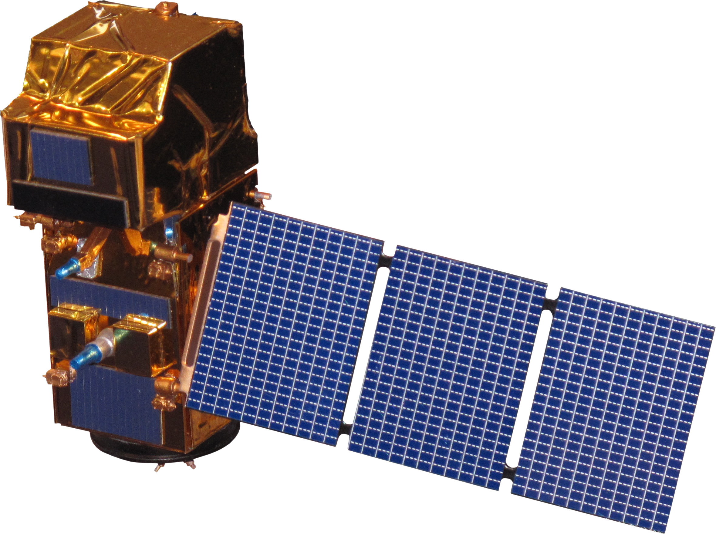
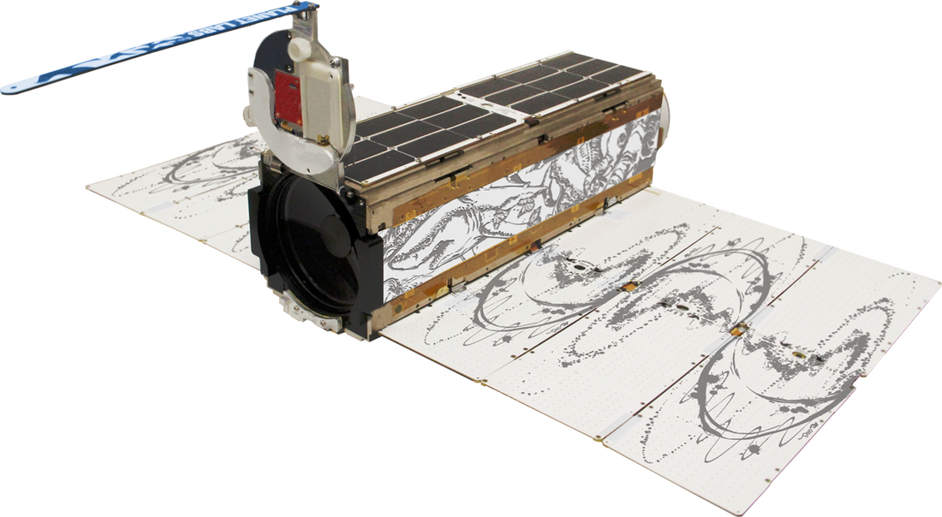
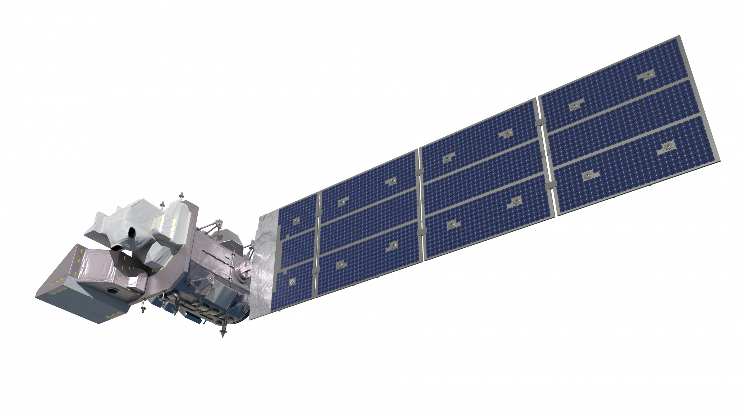
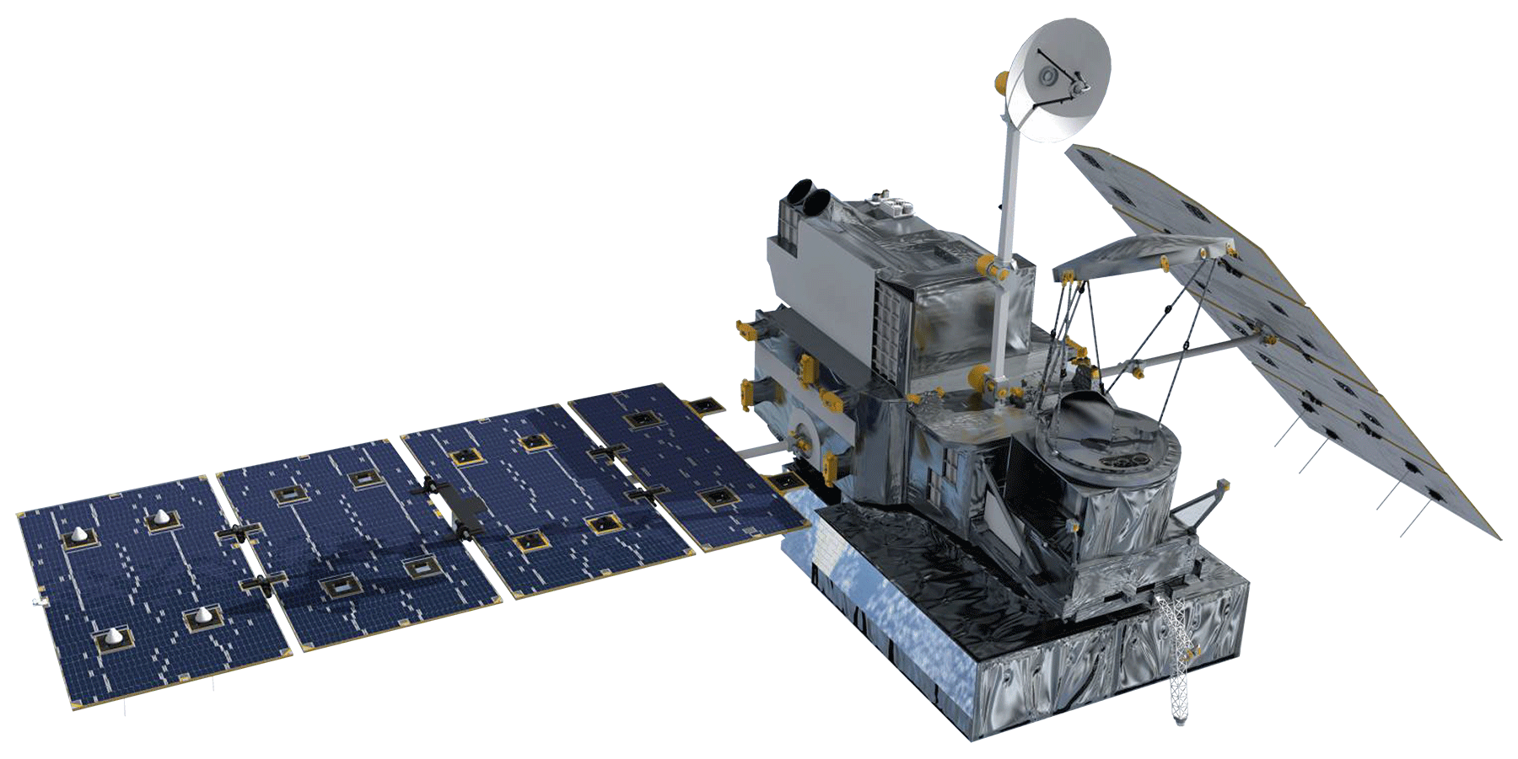
Earth Observations
Surface Reflectance
Surface Reflectance
Sentinel-2 MSI
PlanetScope Dove
Precipitation
Landsat 8 OLI
Landsat 9 OLI-2
GPM IMERG
Image Credit: NASA , PlanetLabs PBC
Icon Credit: Microsoft Office
Notes:
To obtain satellite imagery, we acquired data from six different Earth observation platforms. We acquired imagery scenes from NASA's Landsat 8 and Landsat 9 platforms; ESA's Sentinel-2 platform. We also acquired scenes from two commercial satellites: Planet's PlanetScope DOVE platform; and Maxar's WorldView-3 platform. We utilized NASA's IMERG algorithm to acquire precipitation data from the GPM Earth observation platform. Specifically, we picked the days May 1st to September 30th for the initial case study and then expanded this data out to 2017 when conducting the environmental trends analysis.
------------------------------Image Information Below ------------------------------
Image 1-3
•Image Credit: NASA
•Image Source: https://science.nasa.gov/get-involved/toolkits/spacecraft-icons licensed under Public Domain
Image 4
-Image Credit: PlanetLabs PBC
-Image Source: https://www.earthdata.nasa.gov/esds/csda/csda-vendor-planet
Image 5
•Image Credit: Wikimedia
•Image Source: https://commons.wikimedia.org/wiki/File:Earth_-_Illustration_%285679642883%29.jpg licensed under CC-BY-2.0 Generic (no changes made)
Image 6
•Image Credit: ESA
•Image Source: https://docs.charter.uat.esaportal.eu/missions/opt/worldview-3/ licensed under Public Domain

Slide 12
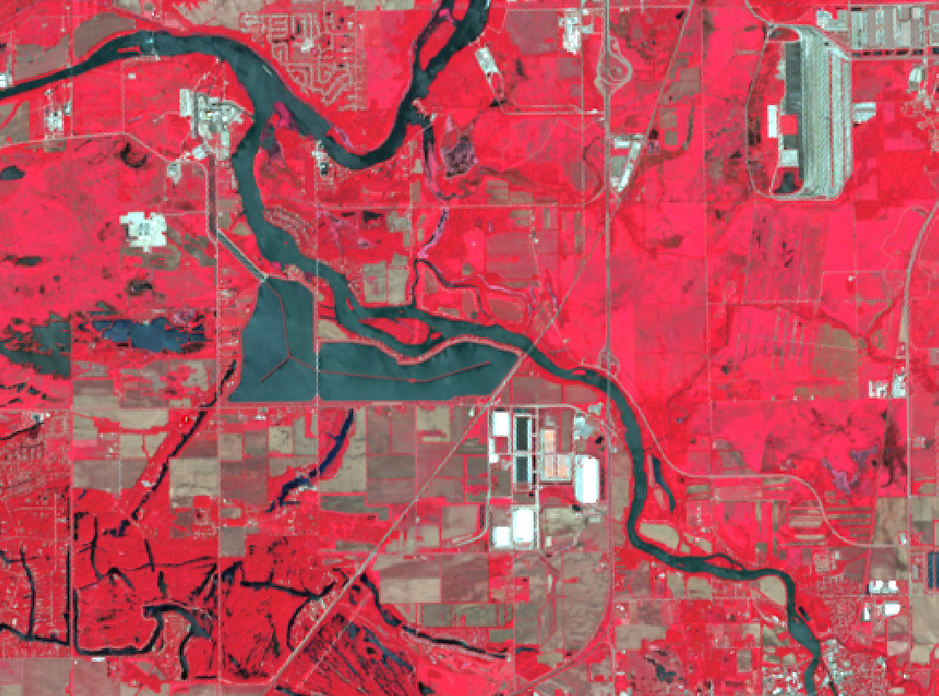
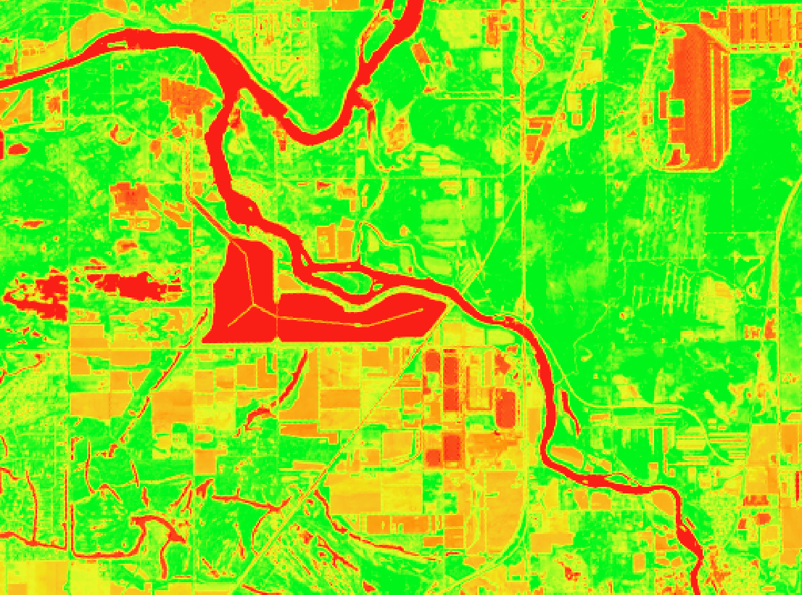
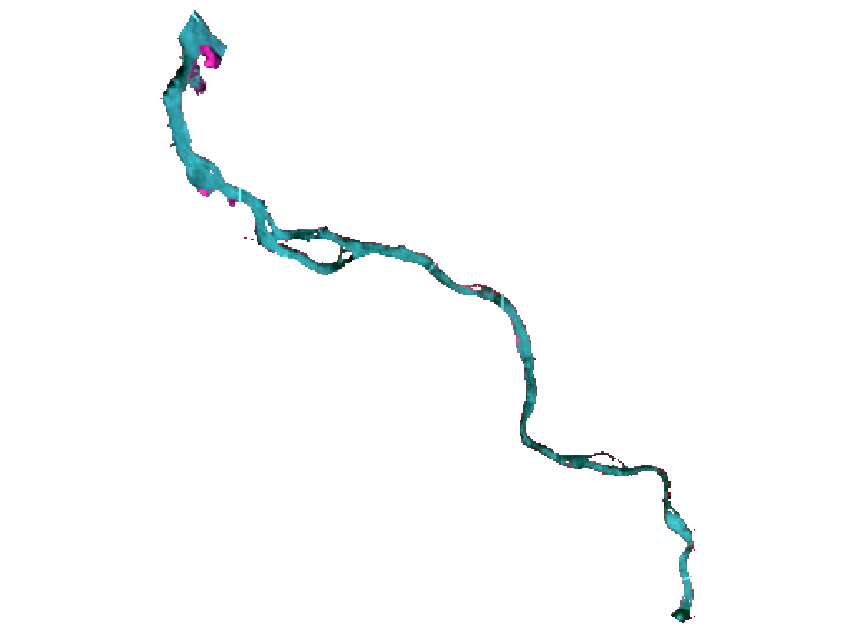
Data Preprocessing
Acquire Raw Data
Surface reflectance ​
Visual assessment for low cloud cover
Calculate NDVI
Compare all dates to identify consistent areas of land to create a land mask
Clip to River Extent
Apply a land mask to all dates
Calculate Vegetation Indices
Within the river extent
Used to pair FAV with environmental trends
EVI
NDVI
GCI
SAVI
Notes:
For each EO, we acquired all the data within the study area and period. For each EO, we only wanted scenes with surface reflectance, which means atmospheric correction had already been applied. We also wanted little to no cloud cover directly over the Kankakee River (we filtered this characteristic through qualitative assessment). Then, we wrote a land masking algorithm to highlight just the river. This was somewhat tricky, as patches of aquatic vegetation that we had qualitatively assessed as being present in the scenes was initially getting masked out as land due to having similar reflectance values. In order to address this issue, we wrote an algorithm that produced a mask by iterating through each scene and picking out areas of aquatic vegetation that were misidentified. This novel approach worked well for us because we could create a unique mask for each EO instead of relying on a singular, potentially inconsistent mask across all EOs. Finally, we calculated various vegetation indices for each scene clipped to the delineated river to be used for our analysis.
------------------------------Image Information Below ------------------------------
•Image Credit: DEVELOPer
•Image Source: DEVELOPer

Slide 13
Methods Overview
Case Study of Summer 2022 Grassing Event
Environmental Trends Analysis from 2017-2022
Notes:
The subsequent methods utilized in this project can be separated into two major categories. First, we wanted to conduct an initial case study of the grassing event that took place on July 29th of 2022 to determine which EO was the most feasible to use for detecting FAV, and which index produced the most accurate result at illustrating FAV presence.
Then, we wanted to conduct an environmental trend analysis to determine what environmental factors could lead to grassing events. For this analysis, we incorporated data from our case study (Summer of 2022), as well as data from previous summers (2017 to 2021).
------------------------------Image Information Below ------------------------------
•Image Credit: DEVELOPer
•Image Source: DEVELOPer

Slide 14
Methods Overview
Case Study of Summer 2022 Grassing Event
Environmental Trends Analysis from 2017-2022
Compare imagery from each Earth observation
Compare the use of different vegetation indices
Assess the feasibility of using EO to detect aquatic vegetation
Identify Earth observations and indices of interest to identify environmental trends
Notes:
For the case study portion, we outlined four main steps. First, we wanted to compare imagery from each EO to determine which one would be feasible to use. Then, we wanted to compare the use of different vegetation indices, deciding on an index that detects FAV with the highest accuracy. After that, we could assess the feasibility of using EOs for aquatic vegetation detection. Finally, we would be able to identify EOs and indices of interest to use in our environmental trends analysis.
------------------------------Image Information Below ------------------------------
•Image Credit: DEVELOPer
•Image Source: DEVELOPer

Slide 15
Methods Overview
Case Study of Summer 2022 Grassing Event
Environmental Trends Analysis from 2017-2022
Compare imagery from each Earth observation
Compare the use of different vegetation indices
Assess the feasibility of using EO to detect aquatic vegetation
Identify Earth observations and indices of interest to identify environmental trends
Visualize trends in environmental data and presence of floating aquatic vegetation
Determine high correlations between aquatic vegetation & environmental metrics
Identify initial quantitative relationships
Notes:
For the environmental trends analysis, we determined three steps for our methods. First, we would visualize trends in the environmental data and visually compare it to the presence of detected aquatic vegetation. Then, we would use statistical metrics to determine quantitative correlation coefficients that suggest the strength of the relationship between aquatic vegetation detection and each environmental metric. Finally, we would use th​e resulting correlation coefficients to identify speculate on potential quantitative relationships.
------------------------------Image Information Below ------------------------------
•Image Credit: DEVELOPer
•Image Source: DEVELOPer

Slide 16
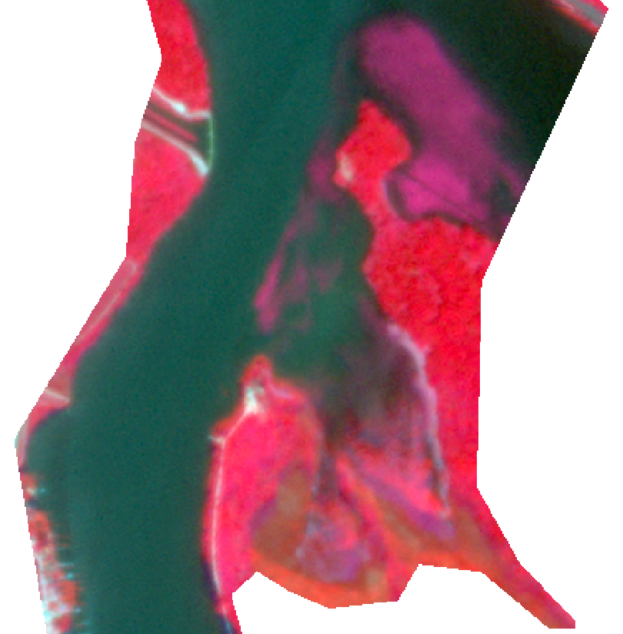
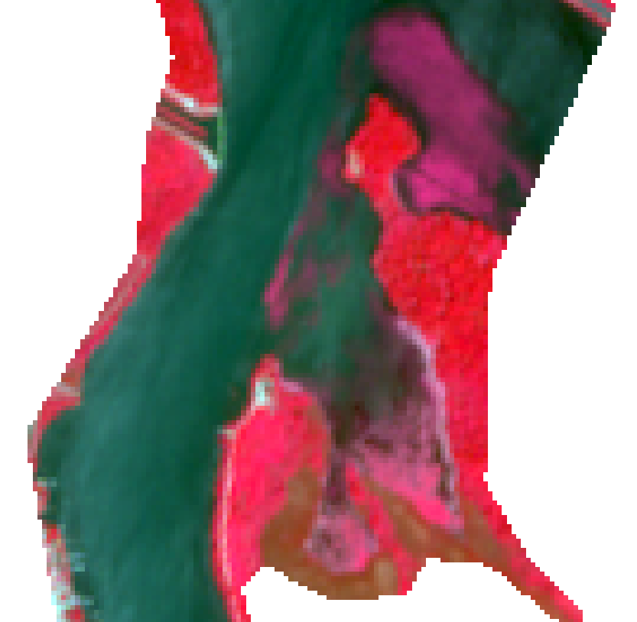
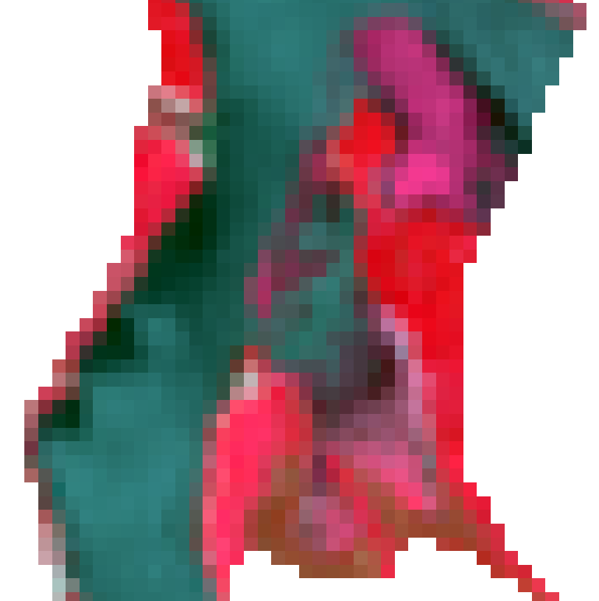
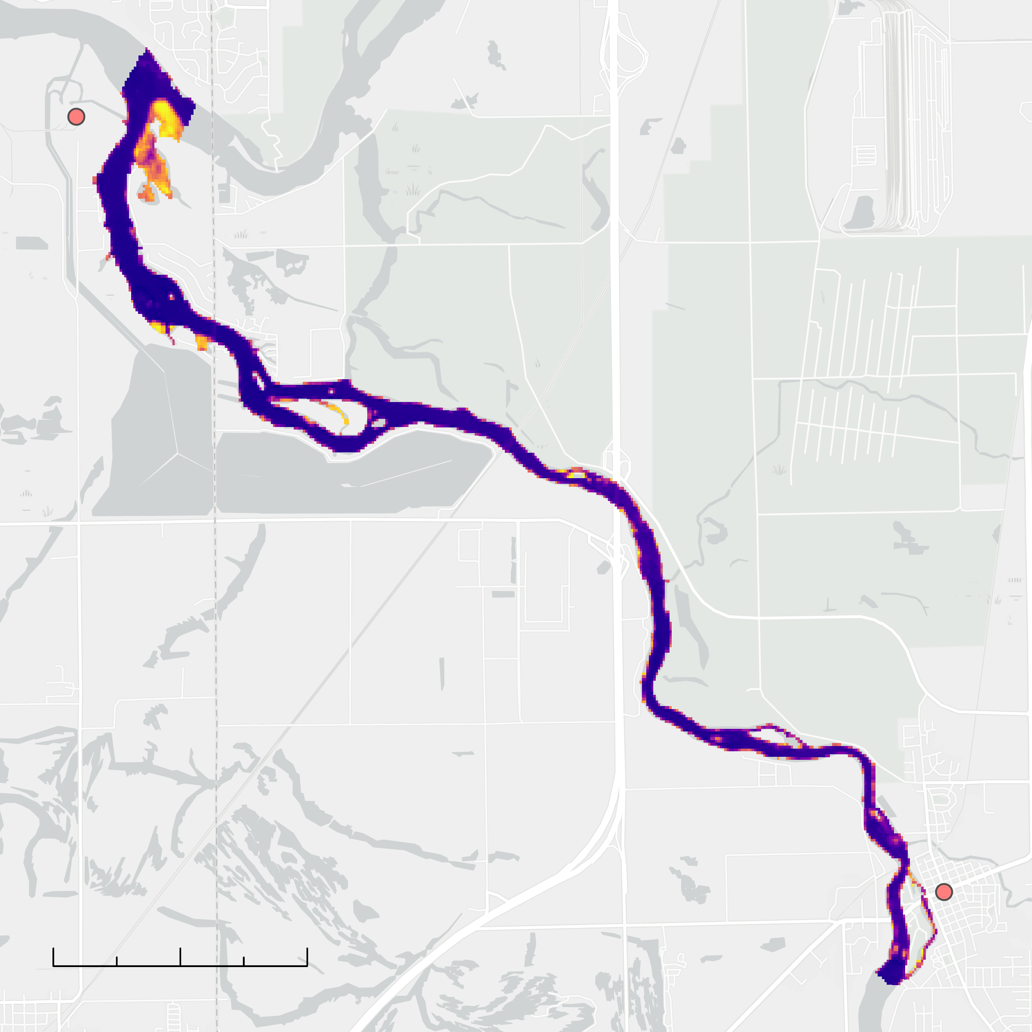
Methods: Case Study Analysis
1
Compare similar areas of aquatic vegetation
2
Compare the pros & cons for each Earth observation & vegetation index
3
Proceed with the optimal Earth observation & Index
Notes:
During the case study analysis, once we acquired all our EO scenes, we began comparing the EOs to each other, specifically looking at areas of aquatic vegetation. We then utilized Python scripts and the land mask we had designed during preprocessing to test the feasibility of each EO and index for detecting aquatic vegetation. Finally, we moved forward with further analysis of the EO we found most optimal for addressing the problem.
------------------------------Image Information Below ------------------------------
•Image Credit: DEVELOPer
•Image Source: DEVELOPer
•Icons: Microsoft

Slide 17
Methods: Environmental Trends Analysis
?
~
Discharge
Water Temperature
Floating Aquatic Vegetation
Precipitation
Cloud Cover
Correlation Analysis
Notes:
For the environmental trends analysis, we took the preliminary cell count measurement, and ran it through another Python script with each environmental factor we identified to produce a correlation coefficient for the relationship between detected vegetation and each factor. The factor with the highest correlation was then further analyzed by assessing the relationship between detected vegetation and the factor in summers prior to the initial study period.
------------------------------Image Information Below ------------------------------
•Icons: Microsoft

Slide 18
Case Study Analysis Results
Notes:
Now, we will move onto discussing our results.

Slide 19
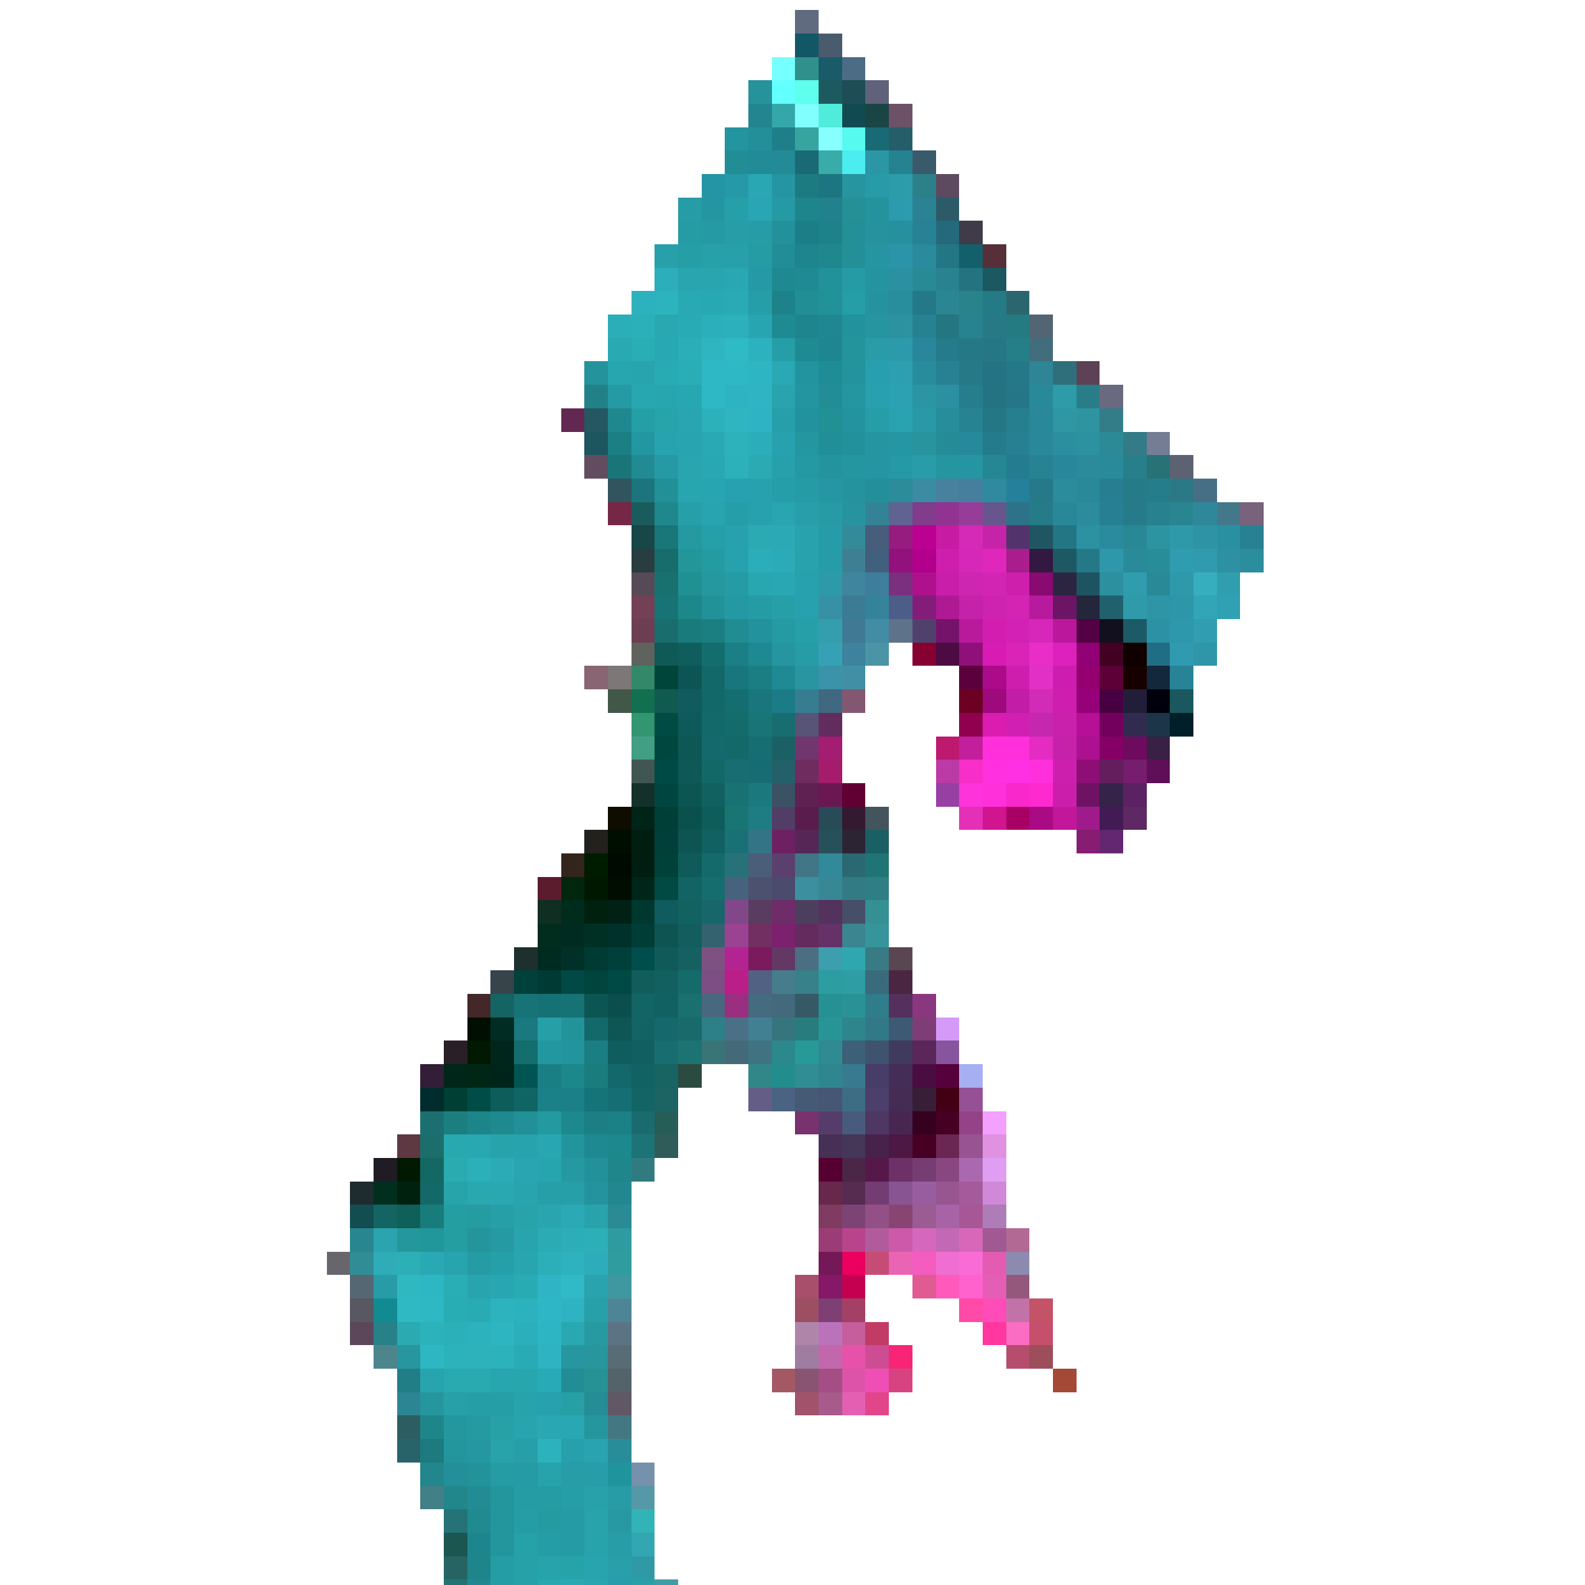
Results: Case Study Analysis
Vegetation patches can be resolved at this resolution
N
Long historical data archive
Data acquisition at no cost
Landsat 8/9
Moderate temporal resolution
Aquatic Vegetation
Bare Water
Inaccuracies at the river boundary
0
1.5
3 Kilometers
County of Will, Esri, HERE, Garmin, SafeGraph, GeoTechnologies, Inc, METI/NASA, USGS, EPA, NPS, USDA
Image Credit: NASA
Notes:
After our preliminary analysis of the EOs, we determined some positives and negatives of each one based on a visual assessment of the False Color Infrared composites compiled for each EO. In the middle of the slide, you can see the Landsat 8 and 9 False color infrared composite. When looking at these types of images, one should note that the pink areas denote the presence of FAV whereas blue-green areas can be denoted as bare water.
Landsat 8 and 9 were the most immediately appealing satellites for multiple reasons. First, despite concerns about the lower spatial resolution, vegetation patches were still resolved. Second, the Landsat program has a long historical archive, allowing for expanded study in the future, and finally, Landsat data is free and easy to acquire using Earth Explorer. Some negative aspects of using Landsat included the less than ideal temporal resolution resulting in only a few scenes to work with, and inaccuracies at the river boundary due to the lower spatial resolution.
------------------------------Image Information Below ------------------------------
Maps
•Image Credit: DEVELOPer
•Image Source: DEVELOPer
Satellites
•Image Credit: NASA
•Image Source: https://science.nasa.gov/get-involved/toolkits/spacecraft-icons licensed under Public Domain
•Icons: Microsoft

Slide 20
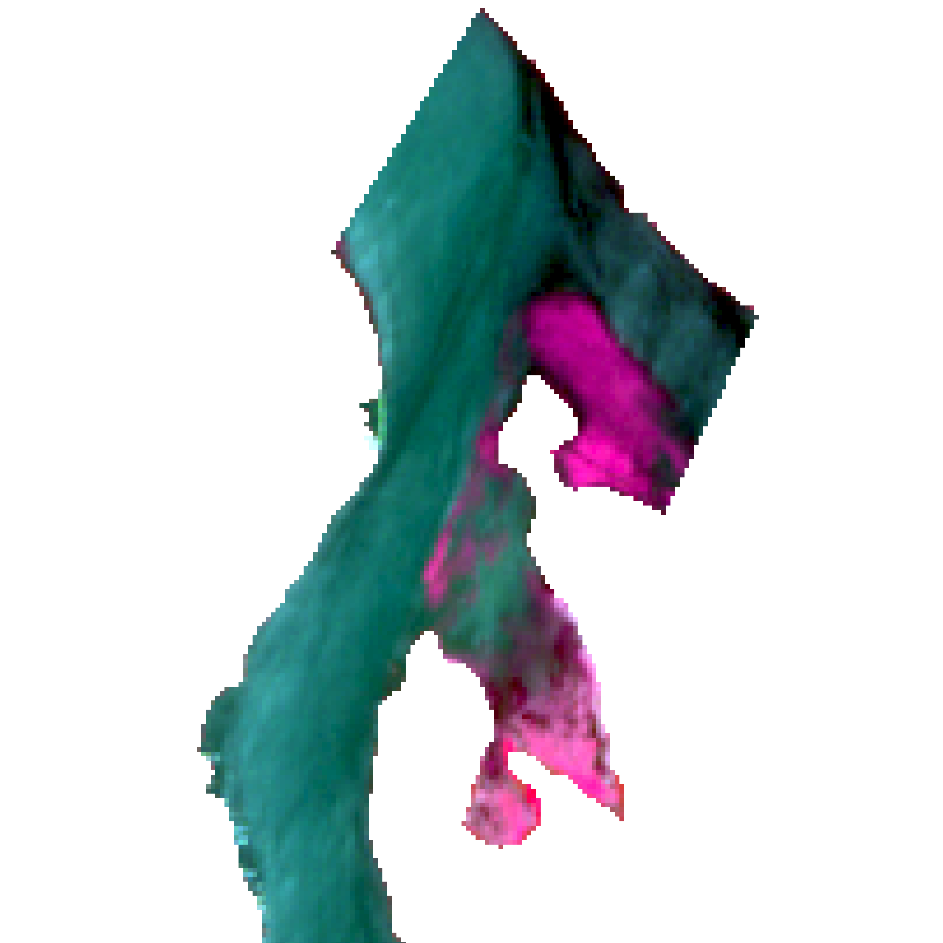
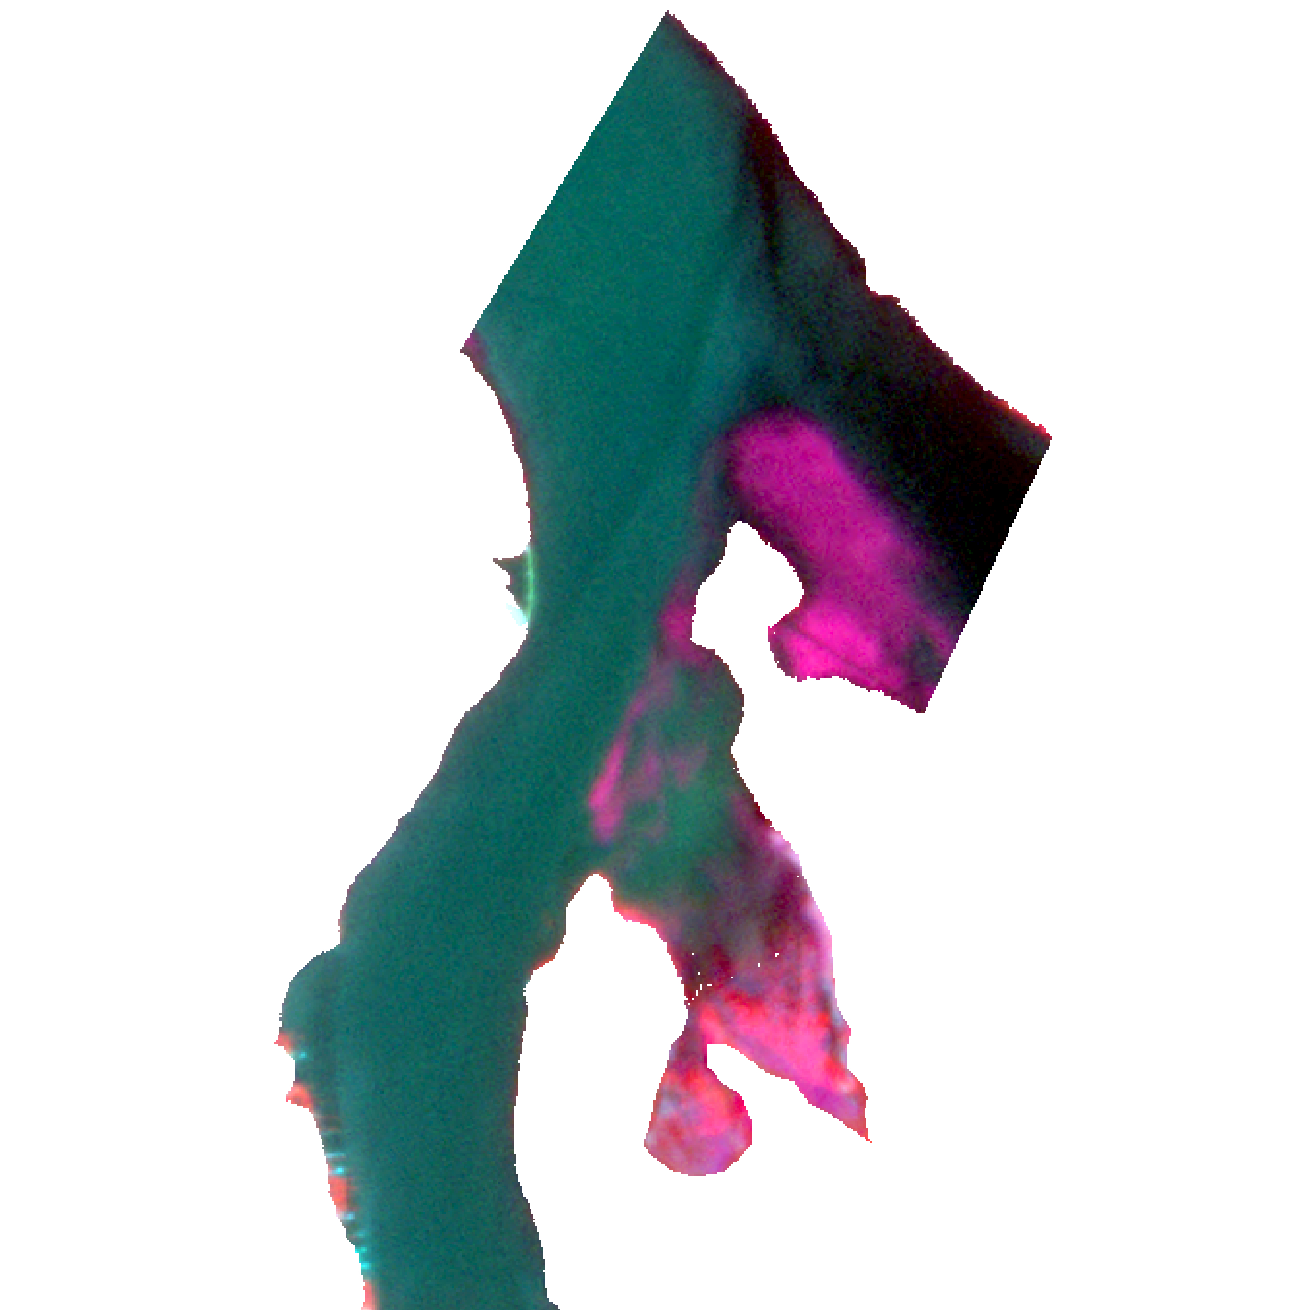
Results: Case Study Analysis
Spatial resolution comparable to PlanetScope
N
Data acquisition at no cost
Low data availability
Sentinel-2
High spatial and temporal resolution
Costly data acquisition
0
1.5
3 Kilometers
Low spectral availability
County of Will, Esri, HERE, Garmin, SafeGraph, GeoTechnologies, Inc, METI/NASA, USGS, EPA, NPS, USDA
PlanetScope
Image Credit: NASA
Includes copyrighted material of Planet Labs PBC. All rights reserved.
Notes:
For Sentinel-2 and PlanetScope, the list of pros and cons was a little different. For Sentinel-2, the spatial resolution is higher than Landsat and comparable to PlanetScope, which was a big pro, and the data is also available at no cost. Despite that, we found the data availability for Sentinel-2 to be poor for this specific project. As for PlanetScope, the high spatial and temporal resolution was a major draw, but PlanetScope data is costly to acquire, and only contains visible bands and the near infrared band, giving it exceedingly low spectral resolution.
------------------------------Image Information Below ------------------------------
Maps
•Image Credit: DEVELOPer
•Image Source: DEVELOPer
Satellite 1
•Image Credit: ESA
•Image Source: https://docs.charter.uat.esaportal.eu/missions/opt/worldview-3/ licensed under Public Domain
Satellite 2
•Image Credit: NASA
•Image Source: https://science.nasa.gov/get-involved/toolkits/spacecraft-icons licensed under Public Domain
•Icons: Microsoft

Slide 21
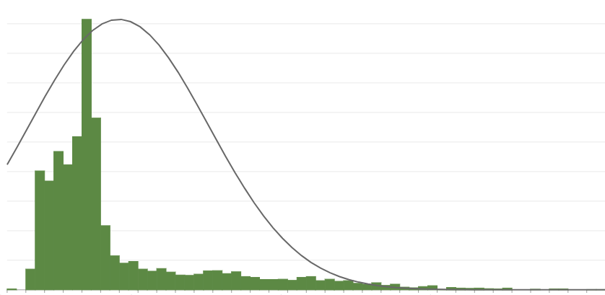
Results: Case Study Analysis
Landsat NDVI Histogram (June 9, 2022)
NDVI had the most normally distributed histogram
SAVI and EVI had histograms similar to NDVI
GCI histogram was heavily left skewed
900
800
700
600
500
Cell Count
400
300
200
100
-0.077
-0.061
-0.045
-0.029
-0.012
0.004
0.020
0.037
0.053
0.069
0.085
0.102
0.118
0.134
0.151
0.167
0.183
0.199
0.216
0.232
0.248
0.265
0.281
0.297
0.314
0.330
0.346
0.362
0.379
0.395
0.411
0.428
NDVI Value
Notes:
After going through the first round of analysis, we utilized the histograms, as well as imagery analysis, to assess how well each index performed. Out of the four, NDVI had the most normally distributed histogram of cell values, with a strong ability to distinguish water from aquatic vegetation based on qualitative assessment. SAVI and EVI had histograms very similar to NDVI with similar results when assessing the images. The GCI histogram was heavily left skewed, meaning it over classified water and tended to detect a very low amount of aquatic vegetation. With that being said, all of the indices that were tested performed relatively similarly to one another.
------------------------------Image Information Below ------------------------------
•Image Credit: DEVELOPer
•Image Source: DEVELOPer

Slide 22
Results: Case Study Analysis
N
Detected Aquatic Vegetation
Large amount of vegetation buildup in the pool across from the intake and at the Des Plaines confluence.
Smaller mats detected in various spots:
Pools north of the cooling pound
Chute through Bardwell Island
Around the island west of the I-55 bridge
Buildup occurs in the stretch of river that runs through Wilmington, IL
Aquatic Vegetation
Water
0
1.5
3 Kilometers
County of Will, Esri, HERE, Garmin, SafeGraph, GeoTechnologies, Inc, METI/NASA, USGS, EPA, NPS, USDA
Notes:
Ultimately, we determined that Landsat 8 and 9 as well as the NDVI index were most ideal to move forward with for this project. The map on this slide shows a raster image of the average NDVI cell values of the Landsat scenes in the study area over the study period. This map gives a good idea of where, geographically, we were able to detect aquatic vegetation. If you look in the top left of the image you can see there is a large amount of vegetation detected in the pool across from the intake as well as the pool directly at the confluence of the Kankakee and Des Plaines. Small mats of aquatic vegetation were detected in various spots. As we move upstream from the confluence, we see hotspots in the pools north of the cooling pond, the chute through Bardwell Island that also sits north of the cooling pond, and around the island west of the I-55 bridge in the middle of the image. Significant buildup also occurs in the stretch of river that runs through Wilmington, as well as just downstream of that stretch..
------------------------------Image Information Below ------------------------------
•Image Credit: DEVELOPer
•Image Source: DEVELOPer
•Icons: Microsoft

Slide 23
Results: Case Study Analysis
Notes:
Here is an animation of the NDVI Landsat images of the study area over the study period. Here, the images have been classified using the predetermined threshold to distinguish water from aquatic vegetation.
***PLAY VIDEO***
Blue represents water, and green represents aquatic vegetation.
As you can see, there is a noticeable growth of detected aquatic vegetation over time (especially within the pond near the river confluence), and a recession in the final frame.

Slide 24
Environmental Trends Results
Notes:
Now we will discuss the results of the environmental trends analysis

Slide 25
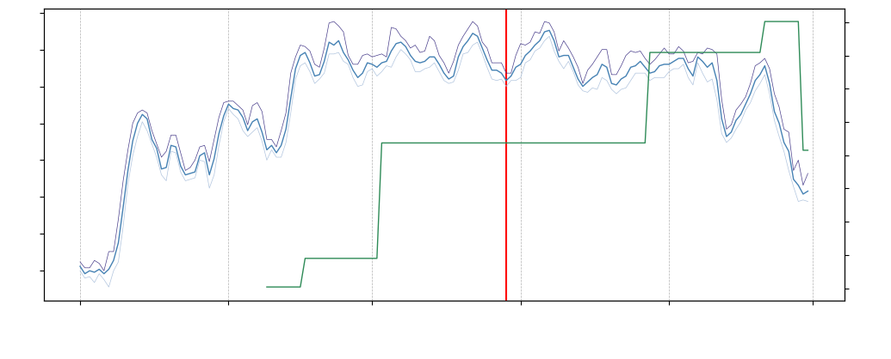
Results: Environmental Trends Analysis
Kankakee River Water Temperature Compared to Detected Aquatic Vegetation
30.0
1800
27.5
1700
25.0
1600
22.5
1500
Water Temperature [Degrees Celsius]
(Lorenzo Guage)
Daily Aquatic Vegetation Cell Count
(Landsat, NDVI)
20.0
1400
17.5
1300
1200
15.0
1100
12.5
1000
May
Jun.
Jul.
Aug.
Sep.
Oct.
Mean Water Temperature
Vegetation Cell Count
Grassing Event
Notes:
This slide shows a time series of the water temperature over the study period and the detected aquatic vegetation over the same period. The blue line represents the mean daily water temperature with the lines on either side representing maximum and minimum respectively. The green line represents a forward-filled cell count value of detected aquatic vegetation, and the red line is the day of the grassing event. Visually, there seems to be no correlation between water temperature and the presence of aquatic vegetation.
------------------------------Image Information Below ------------------------------
•Image Credit: DEVELOPer
•Image Source: DEVELOPer

Slide 26
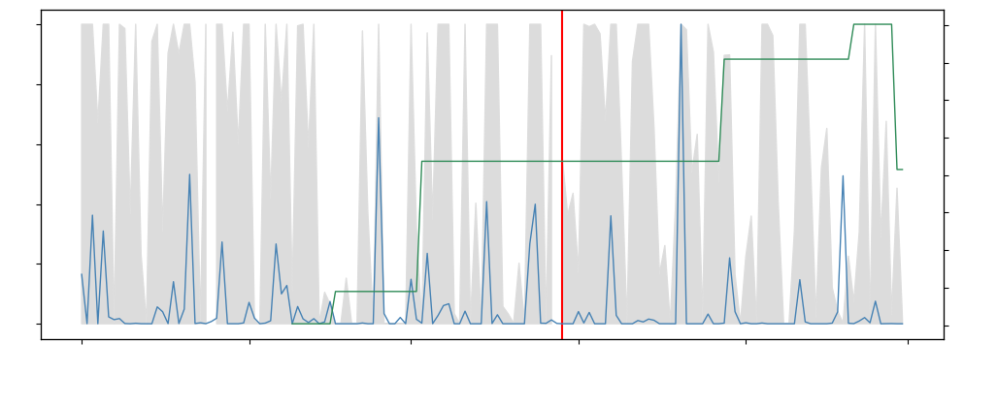
Results: Environmental Trends Analysis
Daily Precipitation Accumulation and Cloud Cover Compared to Detected Vegetation
100
60
1800
1700
48
1600
36
1500
Daily Precipitation Accumulation [MM]
(Study Area Mean)
Aquatic Vegetation Cell Count
(Landsat, NDVI)
Cloud Cover Percentage
1400
24
1300
1200
12
1100
0
0
1000
May
Jun.
Jul.
Aug.
Sep.
Oct.
Precipitation Accumulation
Vegetation Cell Count
Grassing Event
Cloud Fraction
Notes:
This slide shows the same timeseries with the detected vegetation and grassing event lines, but compares them to precipitation and cloud cover instead—with precipitation being the blue line and cloud cover being the gray fill in the background. There is a lot going on in this figure, but the key takeaway is that there is likely a correlation between precipitation and cloud cover, but it is difficult to determine any preliminary qualitative correlations between the detected aquatic vegetation and either of these variables.
------------------------------Image Information Below ------------------------------
•Image Credit: DEVELOPer
•Image Source: DEVELOPer

Slide 27
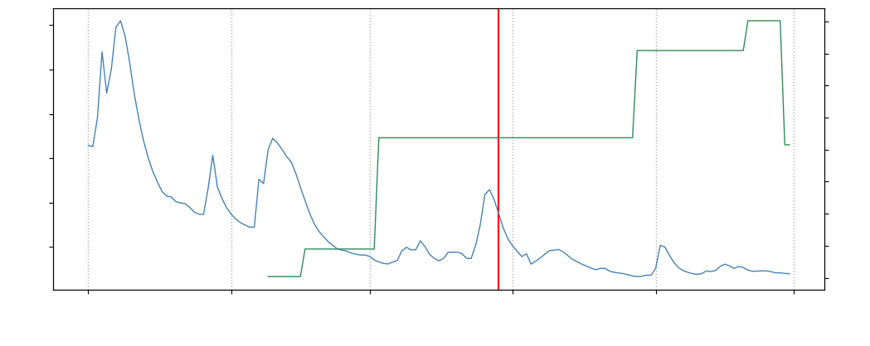
Results: Environmental Trends Analysis
Kankakee River Discharge Rate Compared to Detected Aquatic Vegetation
12000
1800
1700
10000
1600
8000
1500
Kankakee River Flowrate [Cubic Feet/Second]
(Wilmington Gauge)
Daily Aquatic Vegetation Cell Count
(Landsat, NDVI)
6000
1400
1300
4000
1200
2000
1100
1000
May
Jun.
Jul.
Aug.
Sep.
Oct.
Discharge Rate
Vegetation Cell Count
Grassing Event
Notes:
The final timeseries here depicts detected aquatic vegetation and discharge rate. As we will discuss, these two variables had the strongest correlation coefficient, which can be visually seen here. Furthermore, this graph shows that prior to the event there was a prolonged period of low flow rate which could have played a role in the event.
------------------------------Image Information Below ------------------------------
•Image Credit: DEVELOPer
•Image Source: DEVELOPer

Slide 28
Results: Environmental Trends Analysis
Correlation Table
 | NDVI | EVI | GCI | SAVI
Discharge | -0.875 | -0.881 | -0.855 | -0.876
Water Temperature | 0.291 | 0.287 | 0.272 | 0.291
Cloud Cover | 0.449 | 0.403 | 0.374 | 0.443
Precipitation | 0.513 | 0.493 | 0.445 | 0.514
Gauge Height | -0.276 | -0.224 | -0.175 | -0.270
*Closer to 1 means more positive correlation;
Closer to –1 means more negative correlation
Notes:
This table shows all the correlation coefficients between the environmental factors and each index we tested. NDVI, EVI, and SAVI all had similar results which supports our conclusion that these three indices performed very similarly within this context. Furthermore, GCI has the weakest coefficient for each factor. If you look at the NDVI column, you can see a strong negative correlation between detected aquatic vegetation, and discharge rate. You can also see a moderate positive correlation between cloud cover and precipitation.

Slide 29
Discussion & Conclusion
Notes:
Finally, we will present the discussion of our results and concluding thoughts.

Slide 30
Key Takeaways
The environmental trend that was found to have the strongest correlation with the increase in detected vegetation is discharge.
Environmental Trends
Analysis
NDVI, SAVI, and EVI perform similarly in detecting aquatic vegetation.
We also found a moderate positive correlation between detected vegetation cloud cover, and precipitation.
Case Study Analysis
It is feasible to use Earth observations to detect aquatic vegetation.
Notes:
In terms of key takeaways, there are a few. From the case study analysis, the key takeaways were; NDVI, SAVI, and EVI performed similarly for the task of detecting aquatic vegetation in a river, and GCI did not perform well for this task. And it is feasible to use NDVI and Earth observations in general to detect aquatic vegetation. From the environmental trends analysis the key takeaways were; we found a strong negative correlation between detected vegetation and discharge rate, meaning the lower the discharge, the more vegetation was detected, and there is a moderate positive correlation between detected vegetation and cloud cover/precipitation.
------------------------------Image Information Below ------------------------------
•Icons: Microsoft

Slide 31
Discussion: Discharge Correlation Hypotheses
The presence of aquatic vegetation is negatively correlated with discharge through time.
Potential Hypotheses:
1
Vegetation accumulation to the intake occurs through a mechanism of premature die-off triggered by sub-2,000 cfs flows in the Kankakee River
2
Low discharge exposes submerged aquatic vegetation, leading to higher detections when low water levels allow for less infrared light absorption
Notes:
We would also like to expand on the correlation between vegetation detection and river discharge. We found this correlation to be negative, meaning low values of discharge are associated with high vegetation detection. We have come up with two potential hypothesis for why we are seeing this result. First, it could be that grassing events are caused by an extended period of discharge that is sub-2,000 cfs, leading to grasses dying off earlier than they should be and accumulating at the Dresden Generating Station's intake. Alternatively, on days that see low discharge in the Kankakee River, this could simply be exposing more submerged vegetation that is stationary with respect to the riverbed. If this is the case, it could be that there is no systematic cause of large scale grassing events and they are likely occurring on a localized scale.

Slide 32
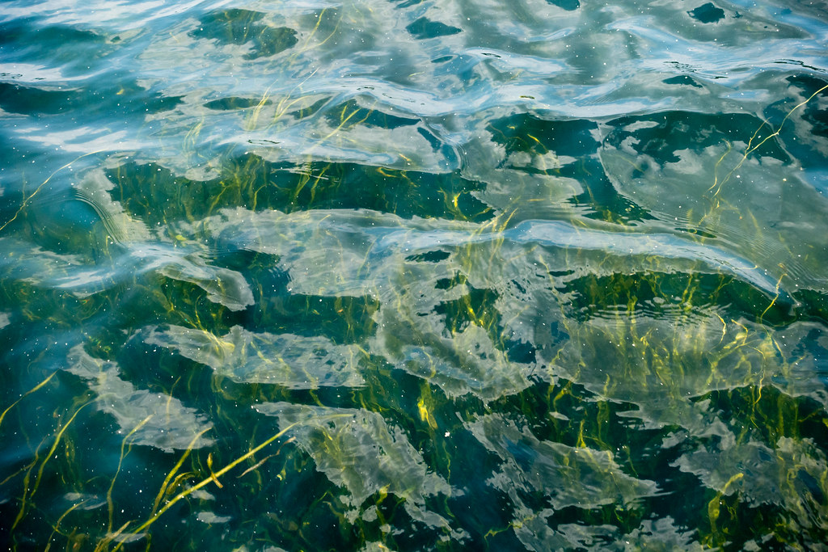
Limitations
Lack of ground truth for river delineation & vegetation detection
Limited ability for EO to distinguish between floating and submerged aquatic vegetation
Tracking movement in FAV requires high temporal resolution
Image Credit: Chesapeake Bay Program
Notes:
There were a few limitations we identified in this project. The lack of ground truthing for river delineation and vegetation detection means that the results can't be physically verified. This limitation is fundamental to the remote nature of the project. We were also limited by our methods not being able to distinguish between "floating aquatic vegetation" and "submerged aquatic vegetation". This means that it's difficult for us to say whether or not the vegetation we detected was directly contributing to the grasses that clogged the Dresden Generating Station. This limitation is a product of the limited scope of the project, as well as inherent limitations in what can be accomplished with Earth observations. Finally, we were limited by our temporal resolution, and this could not track the precise movement of the detected aquatic vegetation. This also adds to the difficulty of being able to truly resolve the nature of the vegetation that disrupted operation at the generating station.
------------------------------Image Information Below ------------------------------
•Image Credit: Chesapeake Bay Program on flikr
•Image Source: https://www.flickr.com/photos/chesbayprogram/28653921820 licensed under CC-BY-NC-2.0

Slide 33
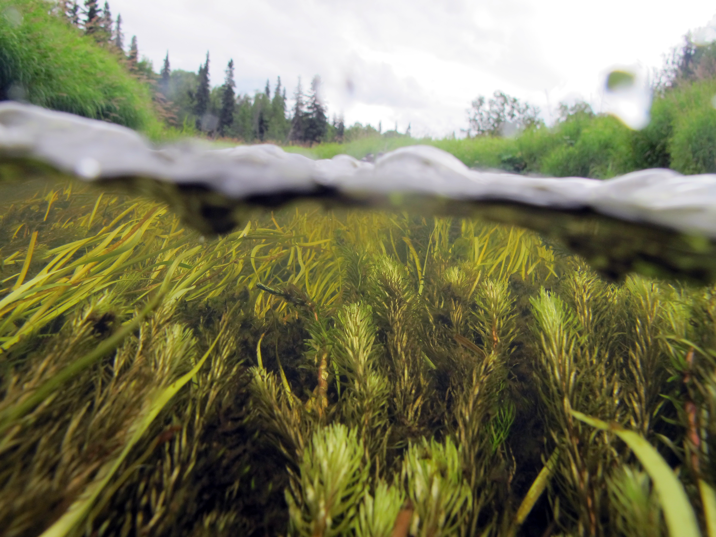
Future Directions
Conduct analysis with increased temporal resolution
Combine EOs or use an EO with a high revisit period
Implement an algorithm for tracking FAV movement
Locate FAV using localized tools
UAVs, field surveys, etc.
Image Credit: USFWS, Alaska Region
Notes:
Considering our results here, we determined some future directions for this specific topic. Recreating the analysis with similar parameters and methods, but higher temporal resolution could provide more concrete results. This could be achieved by combining EOs or using an EO with a high revisit period. Implementing an algorithm to track the movement of detected aquatic vegetation could also be useful for generating a solution to the problem faced by Dresden Generating Station. Using localized tools such as UAVs and field surveys to locate floating aquatic vegetation for further assessment could also be beneficial and provide more answers.
------------------------------Image Information Below ------------------------------
•Image Credit: U.S. Fish and Wildlife Service, Alaska Region, photostream on Flickr
•Image Source: https://www.flickr.com/photos/54775250@N07/9471754299/ licensed under Public Domain

Slide 34
Partners
Beckie Maddox, Constellation Nuclear
Jake Murphy, Constellation Nuclear
Allison Atkinson, USGS Central Midwest Water Science Center
David Heimann, USGS Central Midwest Water Science Center
Fellow
Caroline Williams, NASA DEVELOP
Science Advisor
Dr. Austin Madson, University of Wyoming
This material contains modified Copernicus Sentinel data (2022), processed by ESA.
This work utilized data made available through the NASA Commercial Smallsat Data Acquisition (CSDA) Program.
Notes:
Thank you all for listening. We would like to acknowledge a few people for their contributions to this project. Caroline Williams, our Fellow with DEVELOP has been a massive help throughout this whole project, Dr. Austin Madson from the University of Wyoming who was the science advisor on this project and was also a huge help, and our partners that worked with us; Beckie Maddox and Jake Murphy with Constellation Nuclear, as well as Allison Atkinson and David Heimann with the USGS Central Midwest Water Science Cetner. Thank you all very much!

