Slide 1
Los Angeles Oceans II
Validating Satellite Observations of Wastewater Plumes and their Biological Impacts in Santa Monica Bay, California
Rebecca Trinh(Project Lead)
Lindsay Almaleh
Notes:
Hello I am Rebecca… UC Berekely….
Hello I am Lindsay… UCLA….
And we are the Los Angeles Oceans II Team

Slide 2
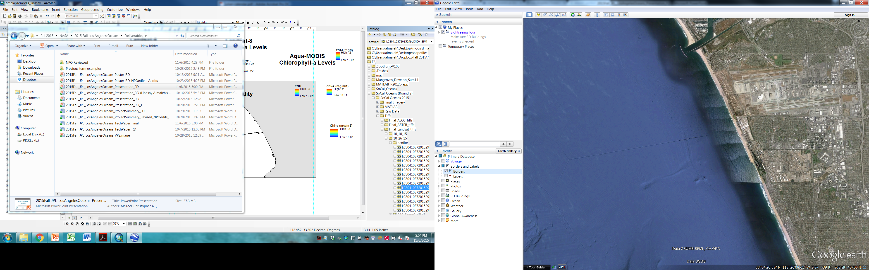

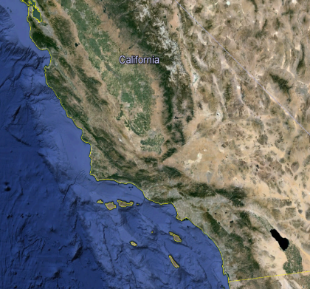
Study Area
Marina Del Rey
Santa
Monica
Bay
LAX
Hyperion
5-Mile Outfall
1-Mile Outfall
California
Los Angeles
Notes:
Our projects impact region was Los Angeles, California, and specifically focused on the waters of Santa Monica Bay. Santa Monica Bay stretches from Malibu to the Palos Verdes Peninsula. The bay is an ecologically important marine habitat and a valuable resource in terms of commercial or recreational fishing and tourism.
The Hyperion water Reclamation Plant is a wastewater treatment facility located on the coast, just south of Los Angeles’s major airport, LAX. Hyperion is one of the largest treatment plants on the west coast of the United States. They release an average of 362 million gallons of treated sewage per day into the Santa Monica Bay. In normal operation, they release treated wastewater, also called effluent, into the ocean through a 5-mile-long outfall pipe where it is pumped 57m down into the head of the marine canyon. The effluent typically mixes with the seawater, which dilutes it before it can reach the surface.

Slide 3
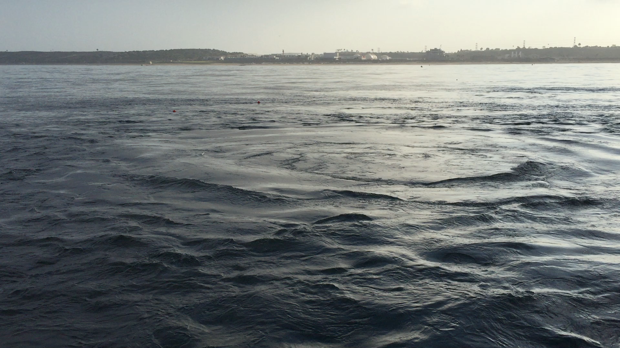
The Effluent Plume
Image Credit: Ben Holt, JPL
Notes:
They found significant amounts of corrosion and rust at the initial portion of the 5 mile pipe and they diverted treated sewage to the 1 mile pipe to make repairs to their 5 mile pipeline.
The wastewater during the diversion was pumped only 1 mile out and 15m deep instead of 5miles out and 57 m deep.
The wastewater is freshwaster and colder than the surrounding seawater

Slide 4
Study Period
DIVERSION
Before
After
9/16/15
9/21/15
11/2/15
11/19/15
Image Credit: Ben Holt, JPL
Notes:
We processed satellite imagery from September 16th to September 20th to get a pre-diversion baseline of what the ocean signatures around Hyperion’s outfall looked like. On September 21st Hyperion’s diversion was under way, and from then until November 2nd, we analyzed all the signatures from the effluent that was being emitted from the 1 mile outfall. After Nov 2nd until the 19th, we analyzed imagery post-diversion to monitor ocean restoration and detect any long-term effects.
Pre-Diversion: Aug 30-Sept 20, 2015
Diversion: Sept 21-Nov 2, 2015 (12:01 am)
Post-Diversion: Nov 2-Nov 15, 2015

Slide 5
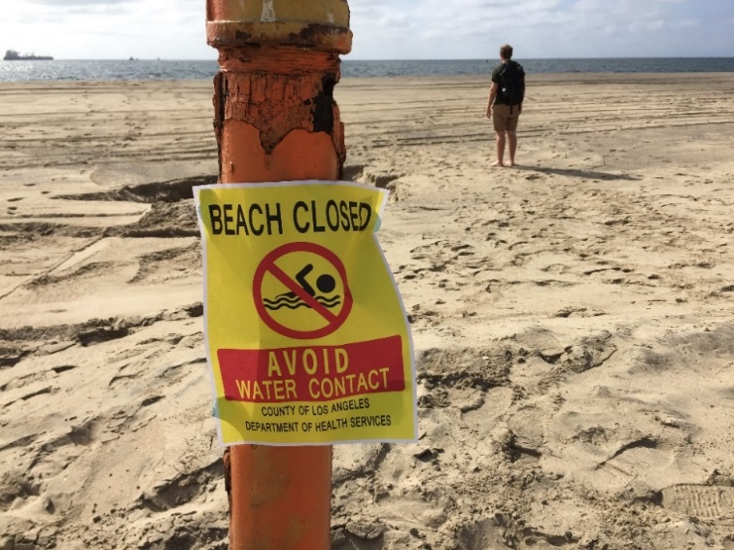
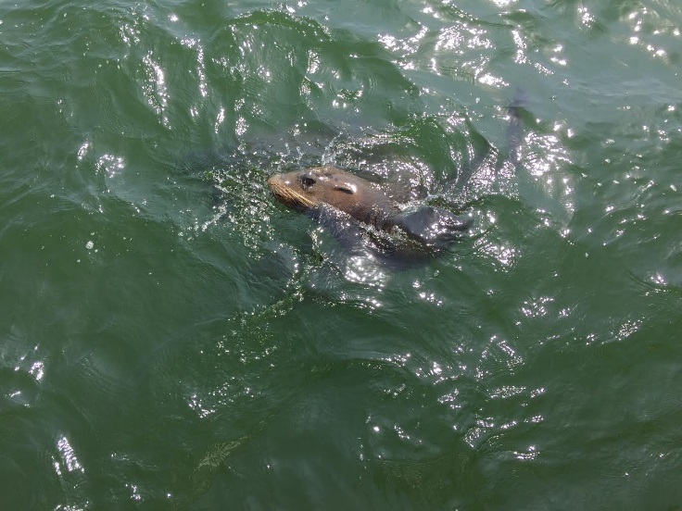
Community Concerns
Humans
Ecosystem
Polluted water for beachgoers
Negative impact on tourism/recreation
Bacterial contamination
Materials of sewage origin washing on shore
Nutrient loading
Harmful Algal Blooms
Depleted oxygen levels
Disrupted food web
Notes:
This event has raised public concerns.
In terms of human impacts; tourists may be discouraged from visiting the beaches, and beachgoers may be exposed to harmful contaminants like ecoli and enterococcus. The news media has taken a strong hold of this issue after a large amount of (MOSO) or Materials of sewage origin washed onto the beach after a storm a week before the planned diversion.
In terms of ecosystem health; Excess nutrients from the secondary treated sewage may enter the ocean and cause harmful effects including algal blooms, or increased presence of oils and organics. All these factors may disrupt the local food web in Santa Monica Bay.

Slide 6
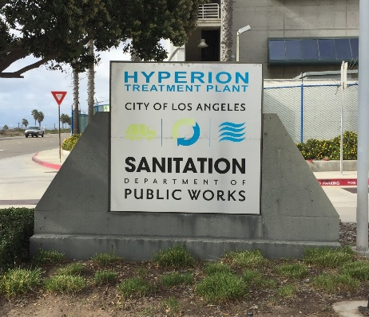
Objectives
Coordinate
with the Hyperion Water Reclamation Plant research team in obtaining in situ readings taken in the LA Basin.
Validate
NASA Earth observations with in situ readings taken during the diversion event.
Determine
whether the expelled effluent has negatively impacted the local ecosystem or washed ashore to potentially contaminate beaches.
Publish
results in a peer reviewed scientific journal,
and Hyperion’s technical report.
Image Credit: Ben Holt, JPL
Notes:
This is a continuation of the work we began last term at DEVELOP. Last term we obtained and processed all satellite imagery. This term our objectives were to coordinate with Hyperion and other scientists on the Diversion research team. With their raw data, we have the ability to validate our satellite data from last term. With a side by side comparison of in situ and remote sensed data, we can better determine if this diversion event had a siginifcant impact on the local ecosystem and beaches. Finally, we plan to publish our findings in a peer reviewed scientific journal, and submit our findings to Hyperions comprehensive technical report.

Slide 7
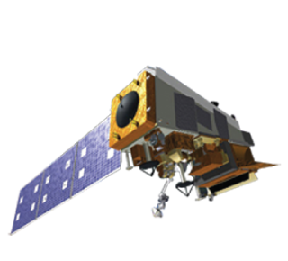
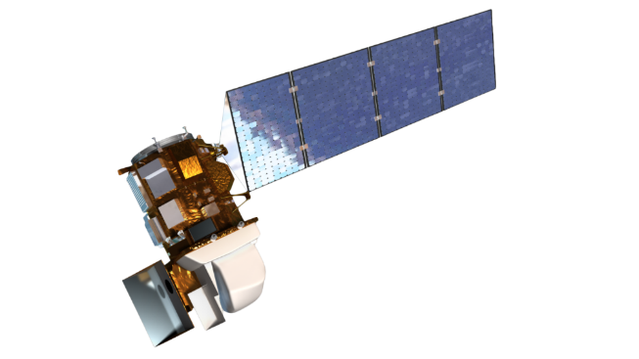


Instruments Utilized
Remote Sensing
Satellite | Landat-8 | Terra | Aqua | SUOMI-NPP
Instrument | OLI, TIRS | ASTER | MODIS | VIIRS
Resolution (m) | 30 | 90 | 250 | 375
Acquisition (days) | 16 | 16 | Daily | Daily
Detection | Sea surface temperature Chlorophyll-a Particulate reflectance Turbidity | Sea surface temperature | Chlorophyll-a Particulate reflectance | Chlorophyll-a Particulate reflectance
Notes:
The earth observations used were
While using the landsat 8 satellite Landsat-8 both Operational Land Imager (OLI) and Thermal Infrared Sensor (TIRS)

Slide 8
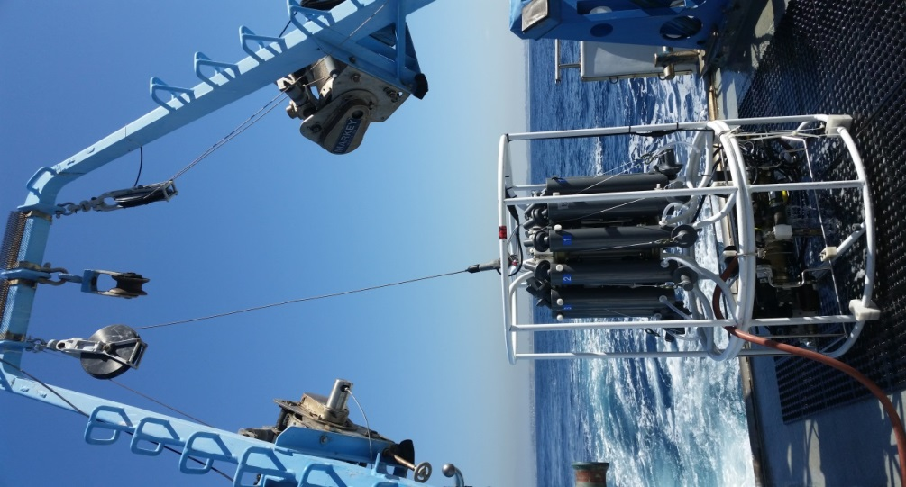
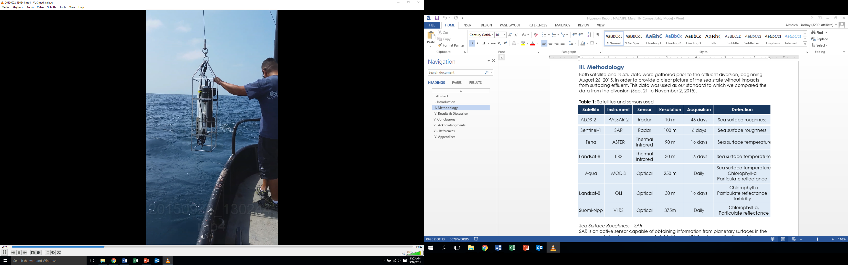
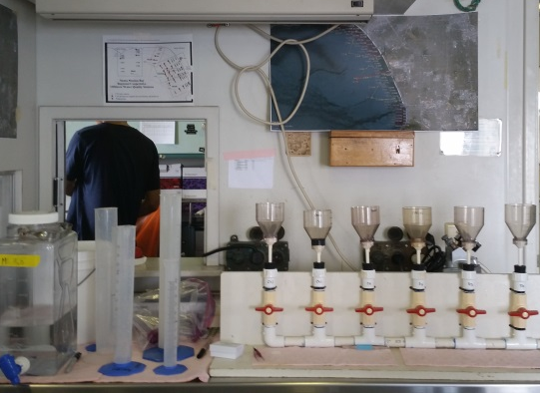
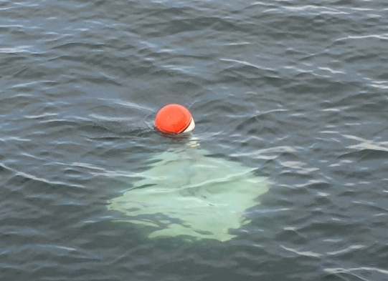
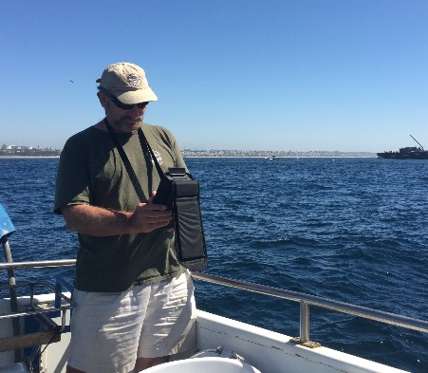
Instruments Utilized
In Situ Data Verification
CTD Sensor
UCSB
CTD Sensor
City of LA
Phytoplankton Chemistry
USC
Lagrangian Drifters
UCSB
Microtops
NASA/JPL
Notes:
Many collaborators went out into the Santa Monica Bay several times a week to take in situ measurements of the diversion plume.
Both hyperion and UCSB had CTD instruments. CTD stands for conductivity temperature depth. The useful measurements for us from the CTD are temp and salinity.
University of Southern California uses laboratory methods to test the sea water for phytoplankton species and concentrations.
University of California Santa Barbra has installed GPS drifters in the ocean to track the plume’s surface movement over time.
A collaborator at JPL uses his Micritops to obtain aerosol optical thickness values on specific days during the diversion.
By obtaining, processing, and manipulating data obtained from these in situ instruments, we can compare their in situ results to our remote sensing results to validate our conclusions.

Slide 9
Project Methodology
NASA Earth Observations:
Terra, ASTER
Sea surface temperature
Landsat-8, OLI, TIRS
Chlorophyll-a
Surface sediment
Turbidity
Aqua, MODIS
Suomi NPP, VIIRS
Spatiotemporal
analysis of combined
datasets
Atmospheric correction
In Situ Measurements
Microtops, JPL
Atmospheric aerosols
Drifters, USCB
Local current direction
Phytoplankton, USC
Algal blooms
Salinity, temperature, chlorophyll-a
CTD, HWRP/UCSB
Notes:
The general signatures we are looking for in our processed satellite imagery are 1) chlorophyll-a , 2) Sea surface temperature
ASTER and Landat can sense SST. MODIS Lansdat and VIIRs can sense chlorophyll-a
We used the atmospheric optical thickness readings from the microtops to atmospherically correct the satellite data.
We used data from the drifters to determine local current of the plume to see if it matches with the algeal bloom patterns.
We used both the phytoplankton chemistry and CDT data to validate the location of algeal blooms
Finally, we used the salinity and temperature CTD data from 2 different CTDs to determine if the cold temperature signature that we saw at the immediate location surround the 1 mile outfall is valid.

Slide 10
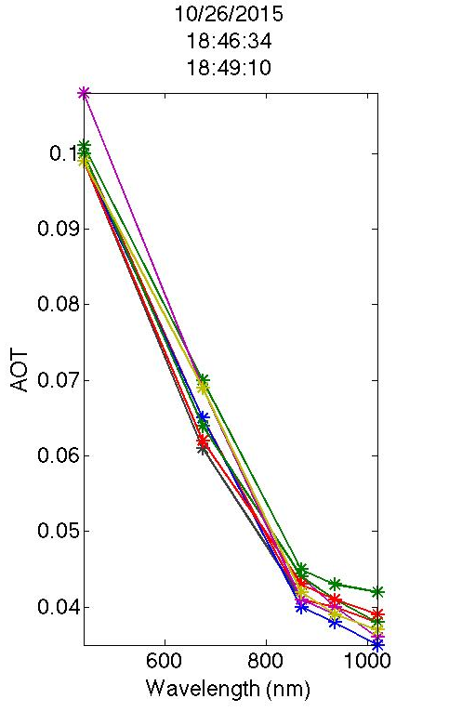
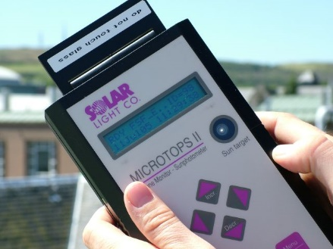
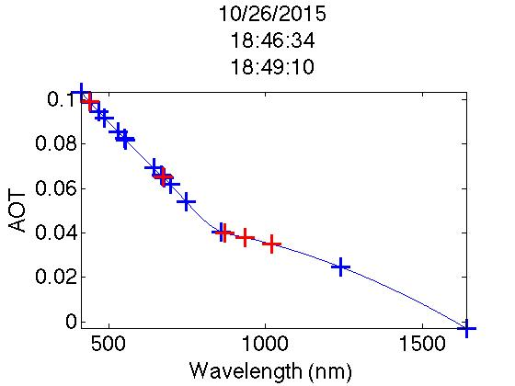
Atmospheric Correction
10/26/15
18:46:34 -18:49:10
Microtops Sensor
Field Measurement Dates
9-16-15
9-24-15
9-30-15
10-21-15
10-26-15
11-5-15
11-11-15
AOT
10/26/15
18:46:34 -18:49:10
AOT (Tau)
Wavelength (nm)
Aerosol Optical Thickness measurements from Microtops sensor
Wavelength (nm)
Interpolated Aerosol Optical Thickness values at different wavelengths
Notes:
The microtops instrument must be aimed at the sun to obtain aerosol optical thickness values. Values vary day by day and by location.
We had 7 days where we had this data to work with.
The best light samples were chosen and tau values were extrapolated for each wavelength, depending on the satellite.
With these values, we were able to enter it in a algorithm that allowed for atmospheric correction of our images.
Image: http://fsf.nerc.ac.uk/instruments/ozonemonitor.shtml

Slide 11
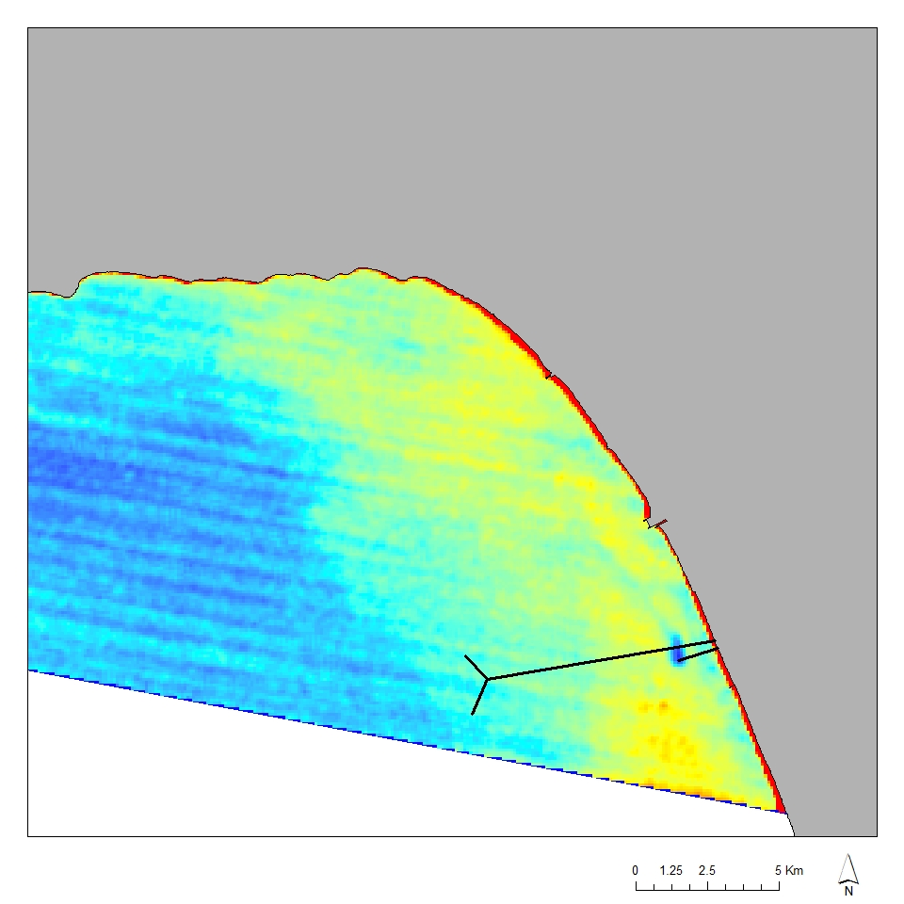
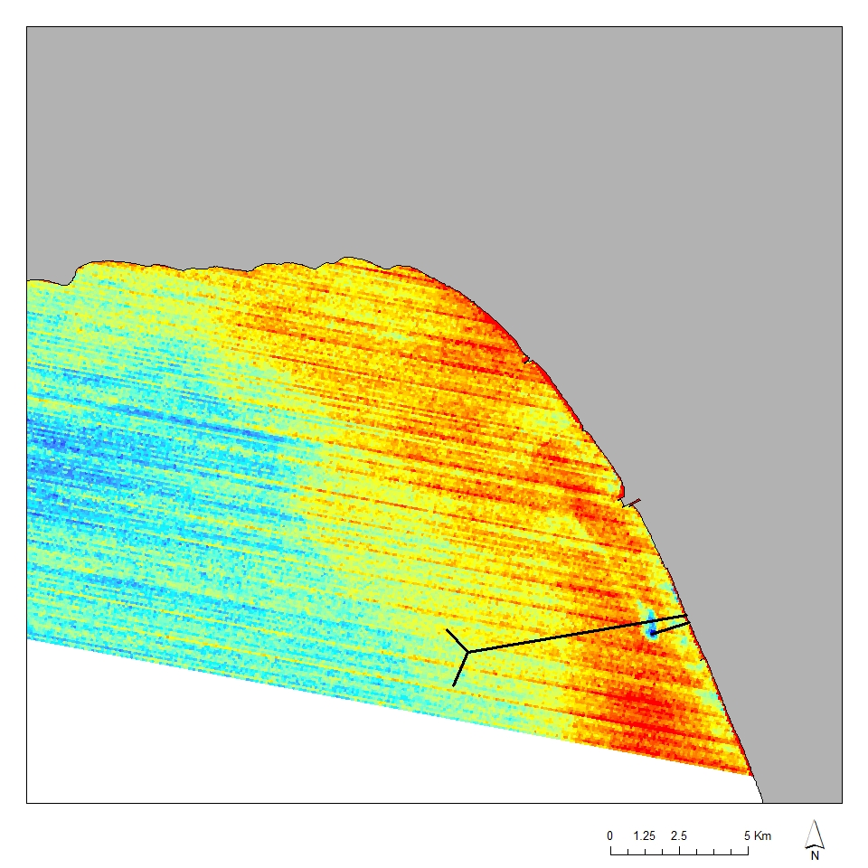
ASTER Atmospheric Correction
Terra, ASTER
Oct. 2, 2015
BEFORE
Notes:
Here is what an ASTER SST image looks like before it is atmospherically corrected…
And here is after
You can see that many of the scan lines have disappeared and the image is a lot smoother
The cold SST at the terminus of the pipe is visible in both images

Slide 12
ASTER Atmospheric Correction
Terra, ASTER
Oct. 2, 2015
AFTER

Slide 13
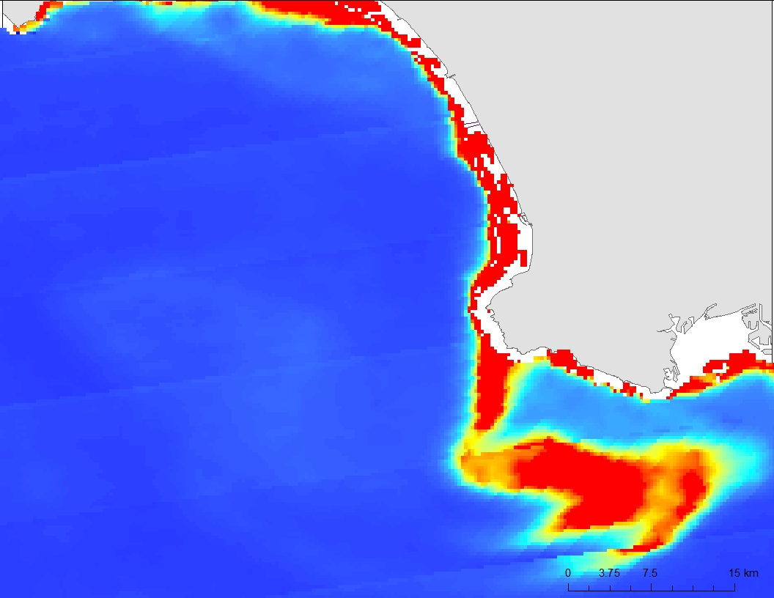
MODIS Atmospheric Correction
Aqua-MODIS
October 26, 2015
BEFORE
Notes:
Here is what a MODIS chla image looks like before it is atmospherically corrected…
And here is after
You can see that the algal bloom and the coastline become more subtle

Slide 14
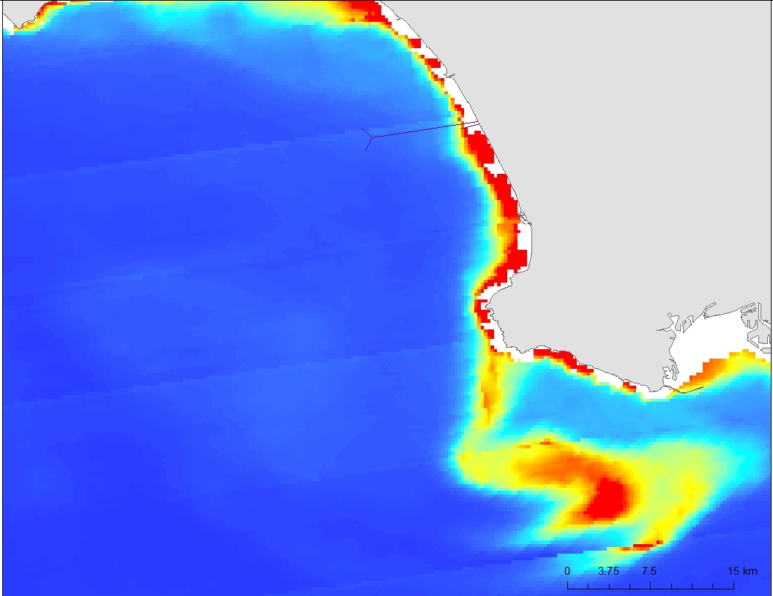
MODIS Atmospheric Correction
Aqua-MODIS
October 26, 2015
AFTER

Slide 15
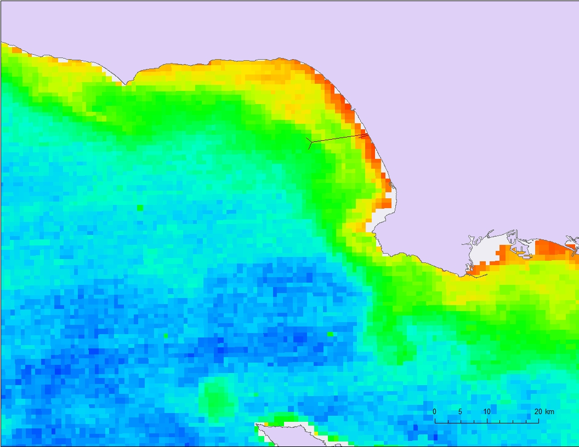
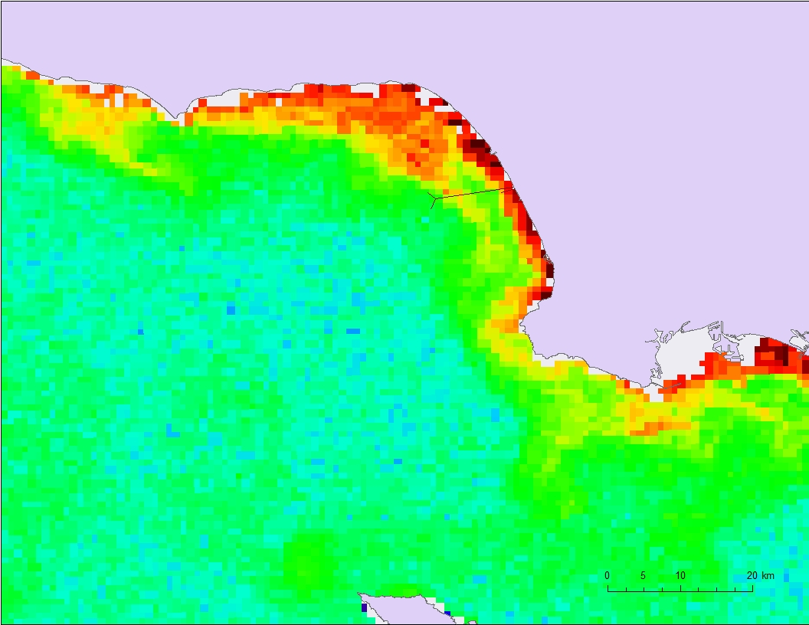
VIIRS Atmospheric Correction
Suomi-NPP VIIRS
November 11, 2015
BEFORE
Notes:
Here is what a VIIRS chla image looks like before it is atmospherically corrected…
And here is after
You can see that many of the pixilation is removed, and the true chlorophyll concentrations are revealed

Slide 16
VIIRS Atmospheric Correction
Suomi-NPP VIIRS
November 11, 2015
AFTER

Slide 17
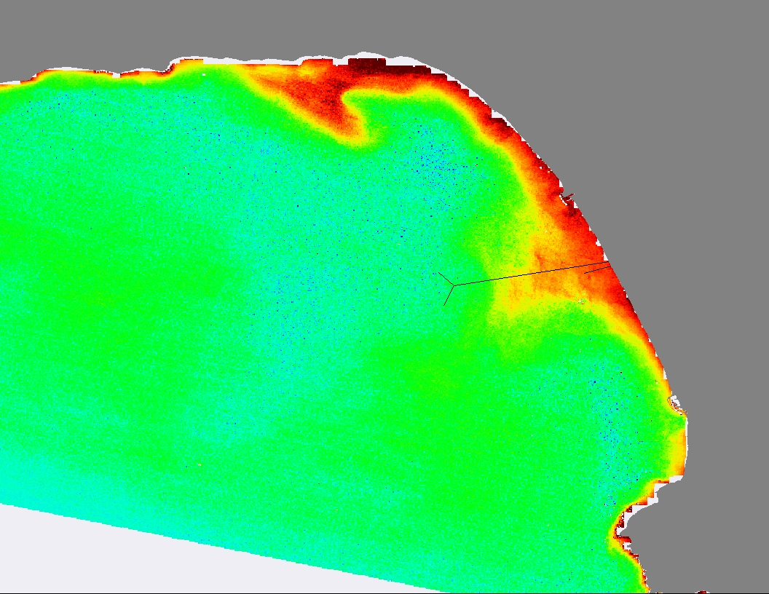
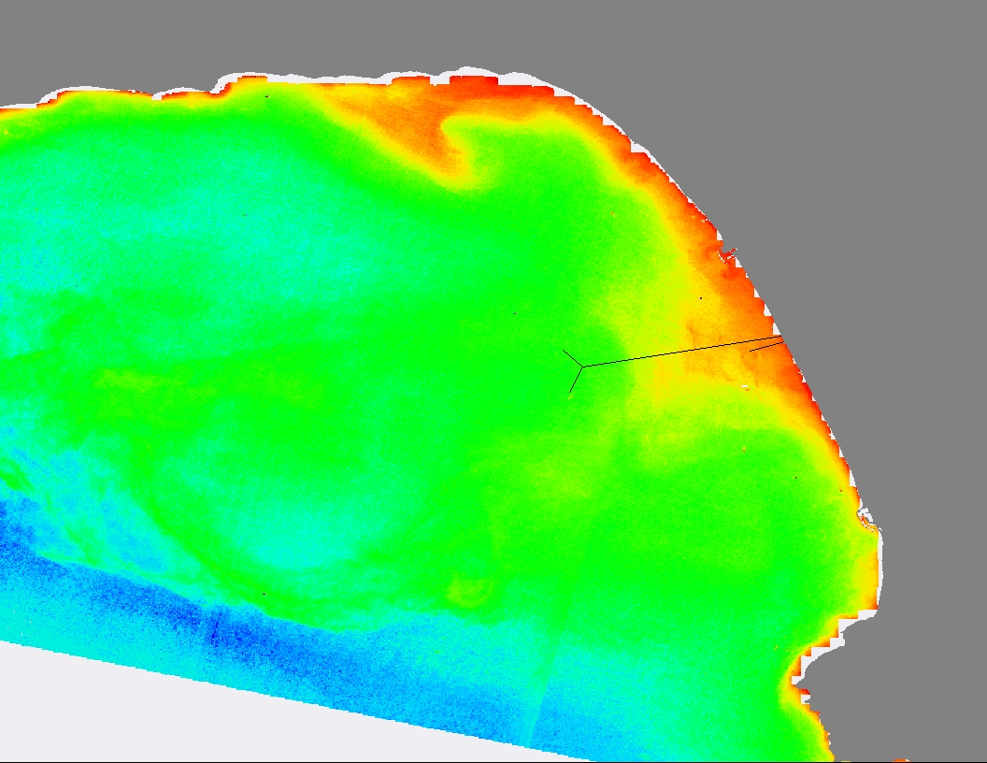
Landsat-8 Atmospheric Correction
Landsat-8
Sept. 24, 2015
BEFORE
Notes:
Finally, here is a Here is what a landsat chl image looks like before it is atmospherically corrected…
And here is after
You can see that much of the graininess is removed, the coastline becomes more subtle, and eddies are revealed

Slide 18
Landsat-8 Atmospheric Correction
Landsat-8
Sept. 24, 2015
AFTER

Slide 19
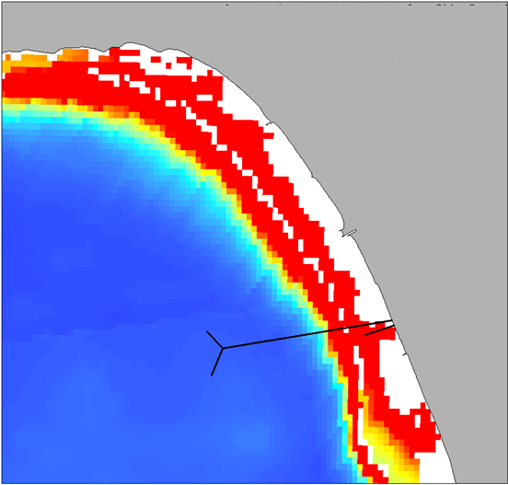
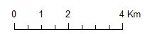
MODIS Chlorophyll-a
Aqua, MODIS
Oct. 17, 2015
Notes:
Here is a chlorophyll image from MODIS on October 17, 2015.
You can see elevated levels along the coast

Slide 20
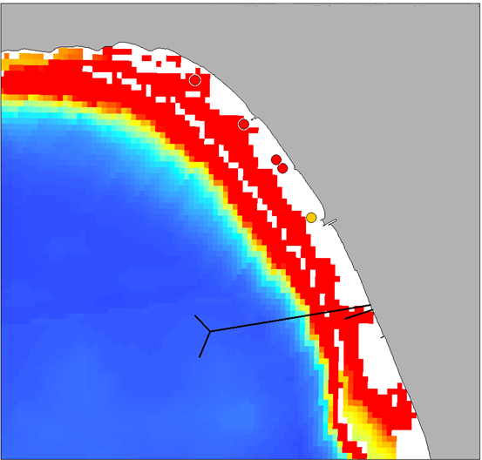
MODIS Chlorophyll-a
Aqua, MODIS
Oct. 17, 2015
Surface
Notes:
Plotted on top of the chlorophyll MODIS image now is chlorophyll concentrations from discrete surface water samples taken by a phytoplankton lab at USC.
You can see that the measured values are higher than those detected by MODIS, but the general trend holds true

Slide 21
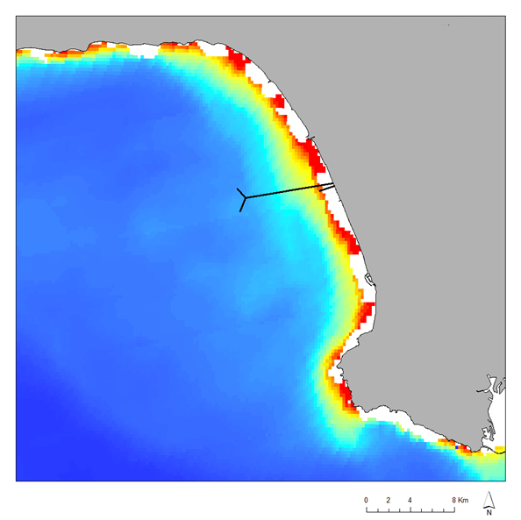
MODIS Chlorophyll-a
Aqua, MODIS
Oct. 22, 2015
Notes:
Here is chlorophyll data from MODIS on October 22, 2015

Slide 22
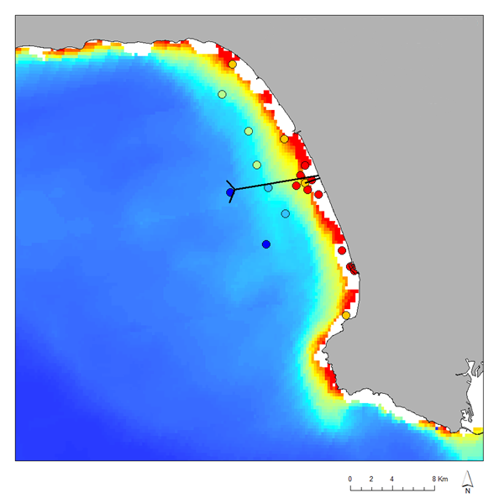
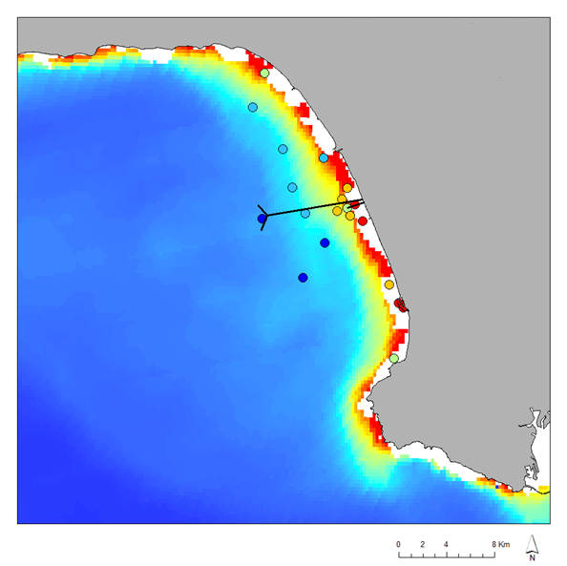
MODIS Chlorophyll-a
Aqua, MODIS
Oct. 22, 2015
CTD
Notes:
Here it is again with CTD chlorophyll data plotted on top.
Here, the values match more readily to the values measured by MODIS than the discrete water chlorophyll samples.
You can see that levels are higher closer to the coast and decrease as you move off shore.
There is a low concentration of chlorophyll at the mouth of the pipe, we think this may be due to the effluent bubbling up to the surface and pushing the phytoplankton away.

Slide 23
MODIS Chlorophyll-a
Aqua, MODIS
Oct. 22, 2015
Adjusted CTD
Notes:
Here is the same MODIS chlorophyll image, but this time adjusted chlorophyll values from the CTD are plotted.
We used the discrete surface chlorophyll data to adjust the chlorophyll data seen in the previous plot, by performing a regression between the two data sets.

Slide 24
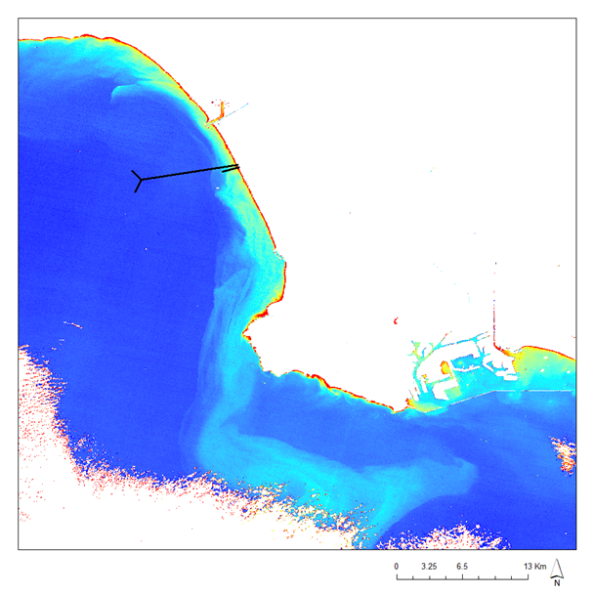
Landsat-8 Chlorophyll-a
Landsat-8
Oct. 26, 2015
Notes:
Here is a Landsat-8 chlorophyll image from October 26.
You can see a large bloom heading south from the 1-mile outfall pipe and wrapping around the peninsula

Slide 25

Landsat-8 Chlorophyll-a
Landsat-8
Oct. 26, 2015
CTD
Notes:
Now you can see the CTD chlorophyll data from the same day overlaid on top.
The increased levels of chlorophyll are measured by the CTD

Slide 26
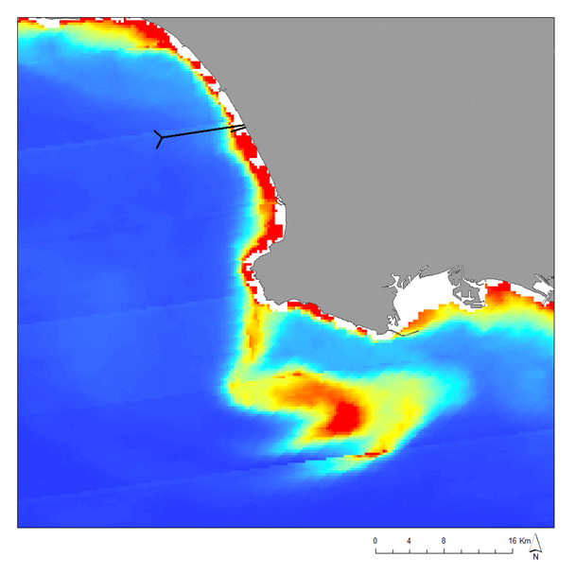
MODIS Plankton Bloom
Aqua MODIS
Oct. 26, 2015
Notes:
Here is a MODIS image from the same day. The chlorophyll signature is also detected by MODIS

Slide 27

MODIS Plankton Bloom
Aqua MODIS
Oct. 26, 2015
CTD
Notes:
And here is the same image with the CTD data overlaid.
As you can see, the CTD and satellite measurements tend to match up pretty well

Slide 28
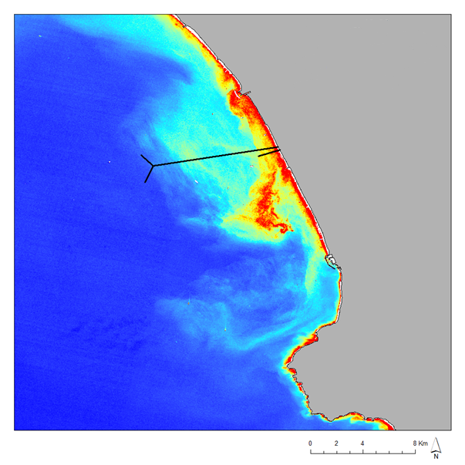
Landsat-8 Algal Bloom with Drifters
Landsat-8
Oct. 10, 2015
Notes:
Another way we validated the information we were seeing in the satellite images was by comparing it to drifter data.
Surface drifters were released near the mouth of the 1-mile outfall by a group at UCSB, and were allowed to drift with prevailing currents for extended amounts of time.
Here you can see a landsat-8 image from October 10, showing higher amounts of chlorophyll heading south from the 1-mile pipe.

Slide 29
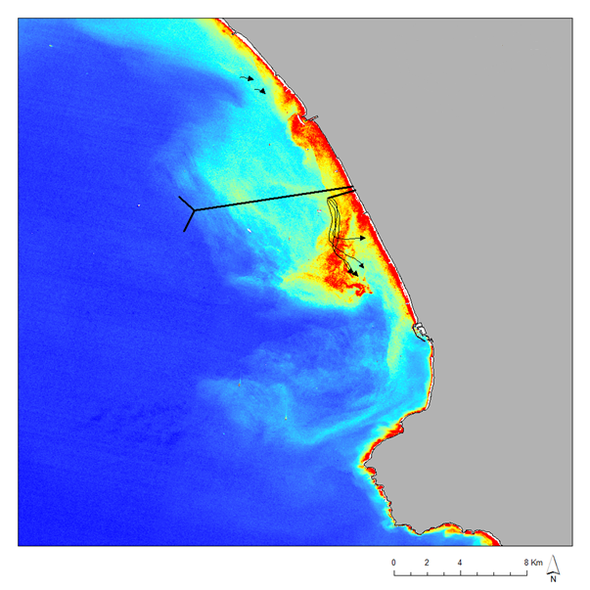
Landsat-8 Algal Bloom with Drifters
Landsat-8
Oct. 10, 2015
Drifter Direction
Notes:
And when we place the drifter tracks on top, we see a strong correlation between where we are see the blooms and where the current is heading, bringing with it, excess nutrients from the effluent

Slide 30
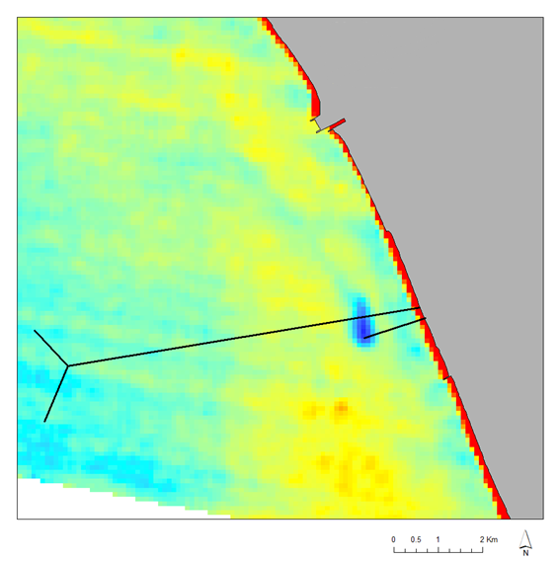
ASTER Sea Surface Temperature
Terra, ASTER
Oct. 2, 2015
Notes:
And here is an example of sea surface temperature data from during the diversion.
You can see in this ASTER image, a cold signature at the mouth of the 1-mile pipe, evidence of the surfacing effluent, bringing with it, colder bottom water

Slide 31

ASTER Sea Surface Temperature
Terra, ASTER
Oct. 2, 2015
CTD
Notes:
This is validated by the CTD temperature data. The top 5 meters of measurements were averaged to show something similar to what the satellites would measure.
As you can see, there is a distinct cold area at the mouth of the 1-mile pipe

Slide 32

ASTER Sea Surface Temperature
Terra, ASTER
Oct. 2, 2015
CTD
Notes:
We also compared the data near the 1-mile pipe to salinity measurements taken by the CTD.
The effluent coming from the pipe is composed of freshwater.
The CTD data picks this up, as you can see from the blue low salinity dot at the end of the 1-mile pipe.
The effluent then mixes with surrounding water and dilutes.

Slide 33
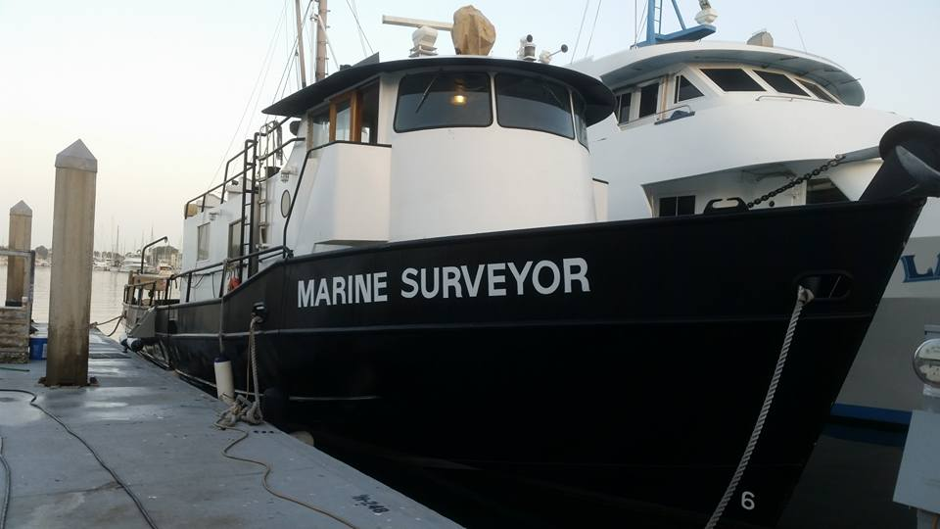

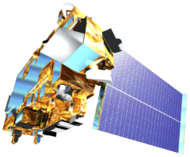
Conclusions
In situ AOT can be used to atmospherically correct satellite images
Freshwater and cold SST signatures from the effluent is validated via temperature and salinity from CTD
Algal blooms seen on remote sensed images are validated by in situ chlorophyll-a data from CTD and water chemistry
Obtaining data using multiple methods can help validate all measurements
Notes:
The results obtained from this project reveal that Aerosol optical thickness values obtained in the field can help atmospherically correct satellite images, removing graininess, and revealing true patterns
Observed Freshwater and cold surface signatures due to the effluent bubbling up from the 1 mile pipe to the surface are validated by obtaining matching salinity and SST values from CTD
Algeal blooms seen on our remote sensed images are validated by the in situ chlirophyll data from both the CTD and via phytoplankton water chemistry
The more measurements taken the better. We have the luxury of obtaining an extensive range of data via satellites, but they are not always accurate to true life measurements. By obtaining in situ data, we were able to validate the satallite data

Slide 34
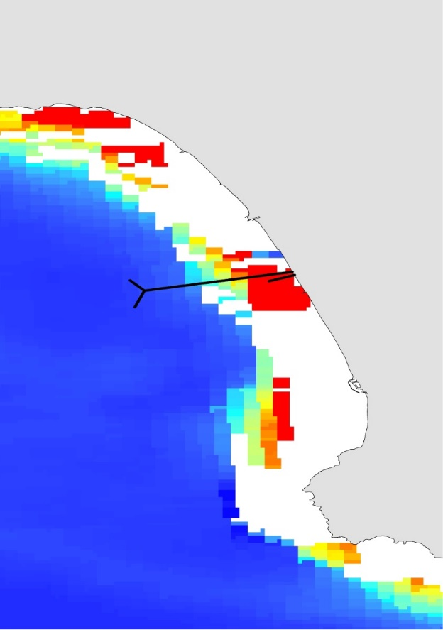
Errors & Uncertainties
More frequent Atmospheric Aerosol Thickness (AOT) values
Not all satellite and in situ data overlaps
MODIS data cannot be acquired on cloudy days
Possible human error in in situ data
Difficult to determine if blooms detected were due solely to the diversion event or underlying background conditions, or both
Resolution of VIIRS and MODIS is very course, occasionally missing the terminus of the outfall pipe
Satellites can only take surface readings
Notes:
We would have liked AOT for more days so we could atm correct more satallite images.
We had soprratic data due to satallite acquisition times and various instruments on boat trips, so not all days and parameters were able to overlap.
MODIS cannot aquire data through clouds, so we were not aboe to obtain satallite data for several days during the study period
We must take into account human error in collecting in situ data
It is Hard to validate if the large southward curving algal blooms are directly related to the effluent, or if they are due to natural occurrences
The resolution of VIIRs and MODIS is very poor and coarse, so sometimes it missed our outfall pipe
Finally, satellites can only take surface data, and cannot read at depth like some of the in situ instruments can. So we are missing part of the story under water

Slide 35
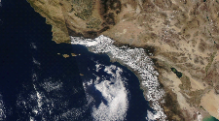
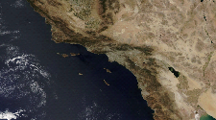
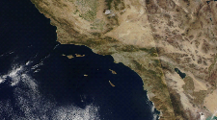
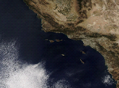
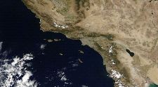
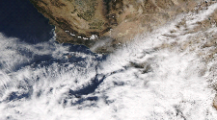
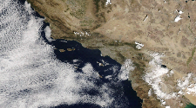
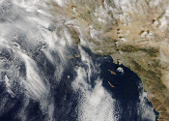
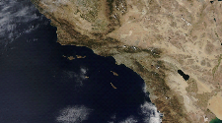
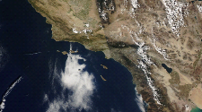
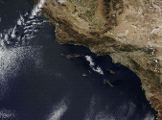
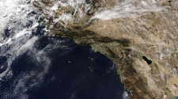



















































Daily Cloud Cover
Aqua-MODIS cannot detect Earth’s surface covered by clouds.
9/16/15
9/17/15
9/18/15
9/19/15
9/20/15
9/21/15
9/22/15
9/23/15
9/24/15
9/25/15
9/26/15
9/27/15
9/28/15
9/29/15
9/30/15
10/1/15
10/2/15
10/3/15
10/4/15
10/5/15
10/6/15
10/7/15
10/8/15
10/9/15
10/10/15
10/11/15
10/12/15
10/13/15
10/14/15
10/15/15
10/16/15
10/17/15
10/18/15
10/19/15
10/20/15
10/21/15
10/22/15
10/23/15
10/24/15
10/25/15
10/26/15
10/27/15
10/28/15
10/29/15
10/30/15
10/31/15
11/1/15
11/2/15
11/3/15
11/4/15
11/5/15
11/6/15
11/7/15
11/8/15
11/9/15
11/10/15
11/11/15
11/12/15
11/13/15
11/14/15
11/15/15
11/16/15
11/17/15
11/18/15
11/19/15
Notes:
Here are the days that we were not able to obtain MODIS data due to clouds

Slide 36

Future Work
Continued collaboration with City of LA and other institutions
Further analysis of in situ data
  YSI- Water quality parameters
  Wirewalker- Tidal data
  Hyperpro- Light attenuation
Final Diversion Report
Published paper
NASA DEVELOP Los Angeles Oceans II Team, JPL: Lindsay Almaleh and Rebecca Trinh
Notes:
We will Continue to collaborate with City of LA and other institutes
We plan to continue this project after the DEVELOP term to process more complicated in situ data.
YSI- Water quality parameters
Wirewalker- Tidal data
Hyperpro- Light attenuation
We plan to send a Final Report of our results to Hyperion
We plan to write a manuscript and hope to publish our findings in a published in a peer reviewed journa;

Slide 37
Advisors
Ben Holt & Michelle Gierach
NASA Jet Propulsion Laboratory
Partners
Curtis Cash, Ashley Booth, & Mas Dojiri
Los Angeles City Hyperion Water Reclamation Plant
Past Contributors
Mark Barker, Christine Rains & Jack Pan
NASA DEVELOP, NASA Jet Propulsion Laboratory
Others
Cedric Fichot, NASA Jet Propulsion Laboratory
Jayme Smith, University of Southern California
Carter Ohlmann, UC Santa Barbara

Slide 38

QUESTIONS?

