Slide 1
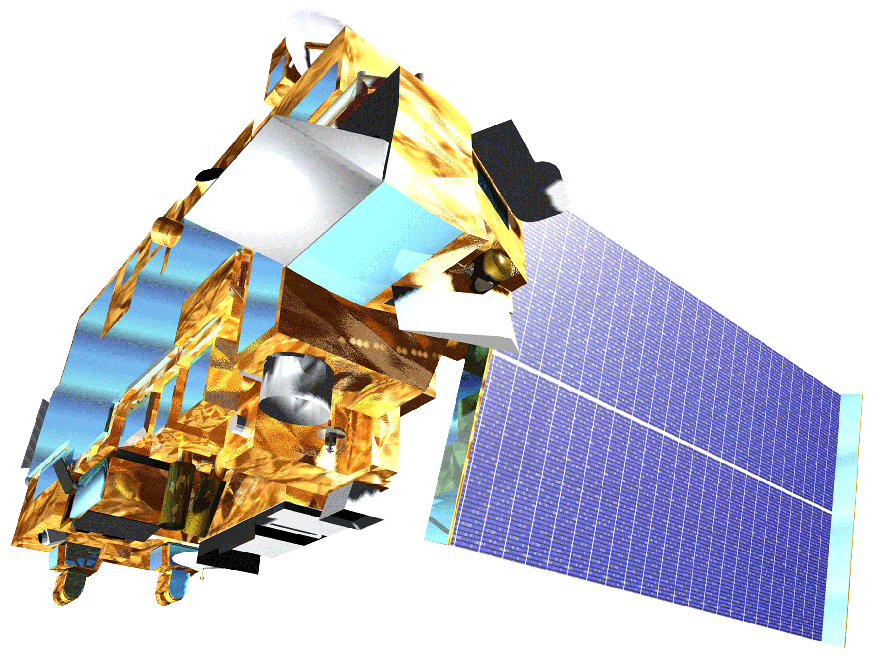
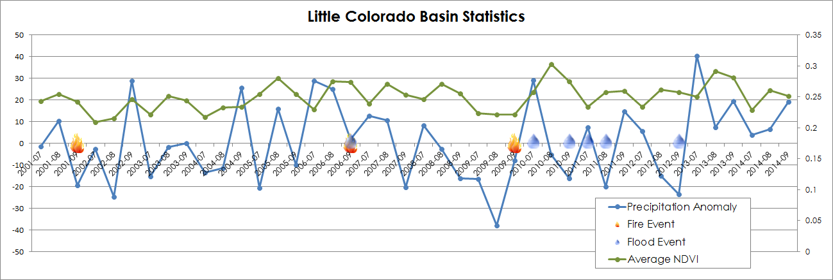
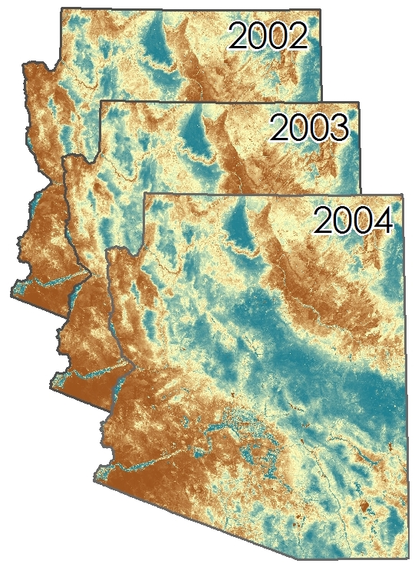
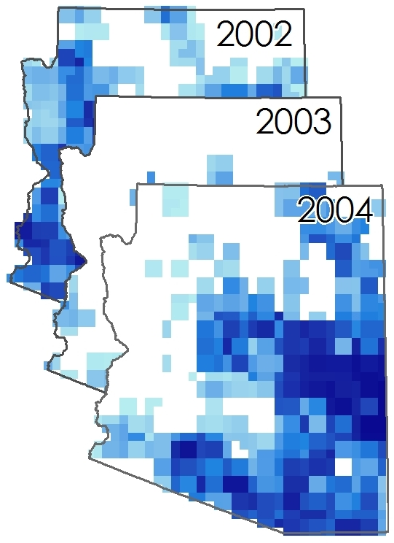
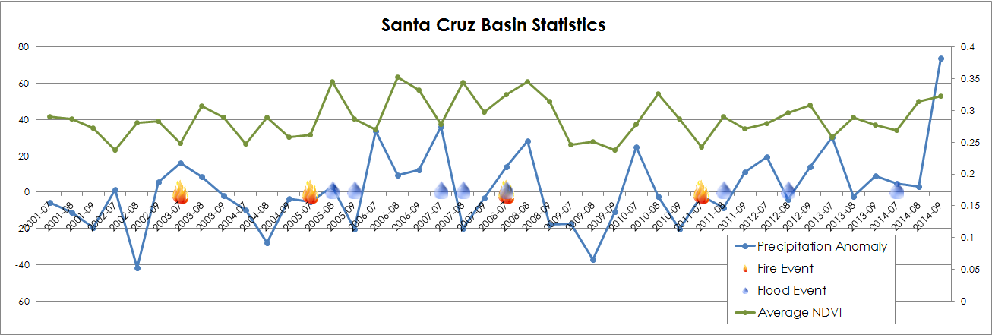
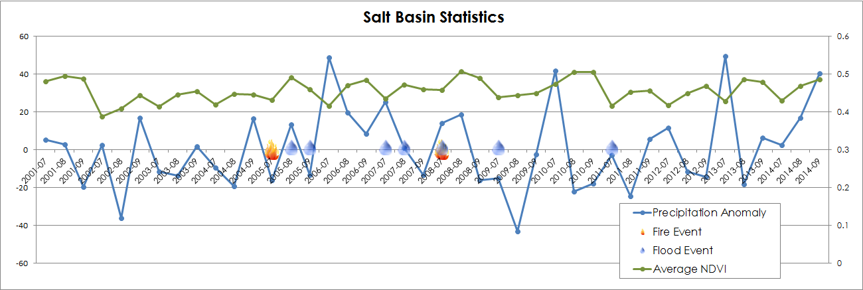
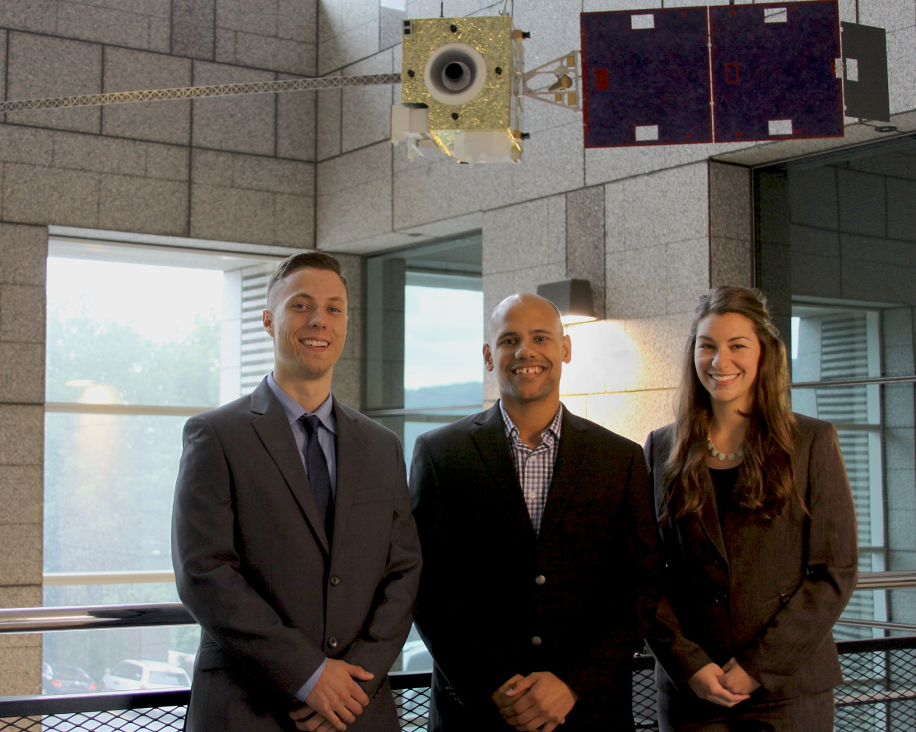
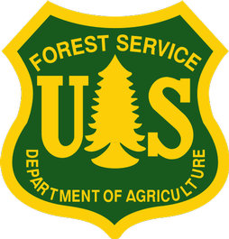
Southwest United States Disasters
Incorporating CDRs and MODIS to create a predictive model of post-burnout vegetation regrowth in relation to flood risk
Jason Zylberman (Project Lead), Jennifer Holder, Lance Watkins
NASA DEVELOP National Program at NCEI
Abstract
Objectives
This study investigated the relationship between the vegetation regrowth process and flooding following wildfire events in Arizona within the Lower Colorado River Basin. Extensive studies have been conducted on post-burnout rainfall-run-off relationships or post-burnout vegetation regeneration, but few establish a relationship between both processes. In this study, MODIS-NDVI Earth Observations were first used to create a surface indicating vegetation regrowth rate on a per-pixel basis following historical wildfire events. Next, historical flood events were identified in the NOAA PERSIANN precipitation Climate Data Records to establish return intervals associated with increased post-wildfire flooding risk. The relationships between recurrence intervals, time since the fire, and vegetation regrowth were then used to identify watershed recovery and supplement the post-fire warning systems of local management. By utilizing remotely-sensed vegetation and precipitation data in a study area with limited in situ data, this analysis developed an additional long-term predictive tool for managing future post-fire hazards.
Establish a spatio-temporal relationship between vegetation regrowth as a function of NDVI and post-fire runoff hazard for three watersheds in the Arizona area within the Lower Colorado River Basin
Generate a raster surface indicating vegetation regrowth rate after historical wildfires on a per-pixel basis
Identify precipitation rates associated with increased post-wildfire flooding risk based on historical runoff events
Study Area
Methodology
Pre-process MODIS NDVI data
Clip NDVI layers to study area
Calculate average NDVI for each summer month
Pre-process BARC burn severity maps
Associate floods to fire events
Clip floods to study area
Identify relationships in a multivariate statistical regression
Pre-process PERSIANN precipitation data
Clip precipitation layers to study area
Calculate sum of precipitation for each summer month
Calculate monthly normals and anomolies
Earth Observations
Results
The analysis resulted in a series of relationships between variables across time and space. Both flooding and regrowth are most strongly affected by precipitation.
TERRA
Average yearly NDVI based on MODIS
Average yearly precipitation based on PERSIANN-CRD
Image similar to the one below, comparing NDVI and precipitation products over time
GOES N-P
Conclusions
Conclusions will be added in complete sentences once conclusions have been reached.
CDRs are awesome! Everything is awesome!
Team Members
Project Partners
Jason Zylberman, Lance Watkins, & Jennifer Holder
Acknowledgements
DeWayne Cecil (Chief Climatologist and Program Manager, Global Science & Technology (GST) National Centers for Environmental Information (NCEI))
Gregg Garfin (Investigator, Climate Assessment for the Southwest (CLIMAS))
Tim Brown (Director, Western Regional Climate Center (WRCC))
Dennis Staley (Research Physical Scientist, USGS Landslide Hazards Program)
Jason Kean (Research Hydrologist, USGS Landslide Hazards Program)
NOAA National Centers for Environmental Information

