Slide 1
Africa
Agriculture & Food Security II
Predicting the Likelihood of Human-elephant Conflict and Assessing Patterns in Elephant Movements Over Varying Habitat Conditions in the Kavango-Zambezi Area
Madison Bradley, Ariel Calle, Michael Corley, Erica Kriner
Georgia - Athens
Notes:
Speaker: Madi
Hello everyone! We are the Africa Food Security and Agriculture II Team and we are really excited to tell you about the work we've done over the past 10 weeks exploring how NASA Earth observations can be used to identify areas of human-elephant conflict in the Kavango-Zambezi area of southern Africa. My name is Madison Bradley, and these are my teammates Ariel Calle, Michael Corley, and Erica Kriner.

Slide 2
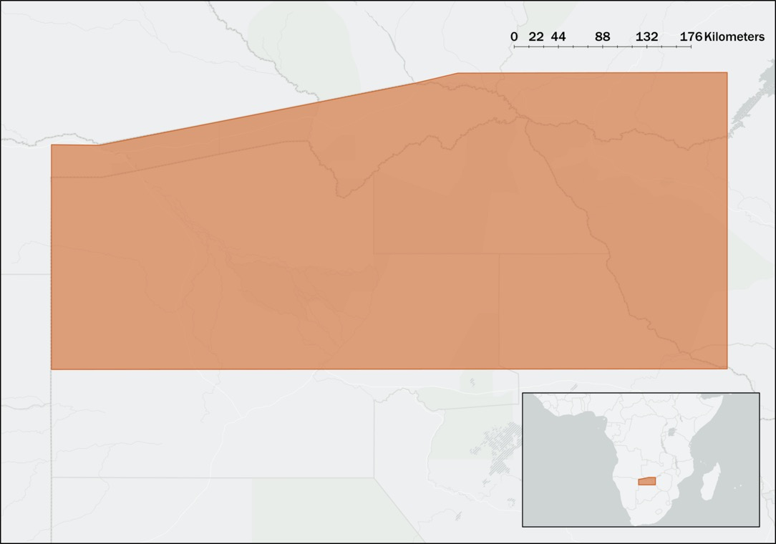
Study Area and Period
Kavango-Zambezi Area, 1990-2020
ZAMBIA
Conservation lands in 5 African countries
ANGOLA
NAMIBIA
ZIMBABWE
Home to 75% of the African elephant population and over 3 million people
BOTSWANA
Subsistence farming dependent on seasonal rainfall
Country Outline
Study Area
Notes:
Speaker:
The Kavango-Zambezi, located in Sub-Saharan Africa, are conservation lands that span across five African Continents. Specifically; Angola, Botswana, Namibia, Zambia and Zimbabwe.
More than three million people live in close proximity to 75% of Africa's free ranging elephant population. Many of those living within the region rely on subsistence agriculture that is heavily dependent on seasonal rainfall. Increasingly frequent human elephant encounters have increased the risk of decreased crop yields, financial losses, infrastructural damage and physical injury. Furthermore, elephants are increasingly at risk of waste consumption borne illnesses and injury or death from direct human conflicts.
Local conservation groups and NGOs must be informed on mitigation strategies in order to best promote coexistence. Using satellite imagery from 1990 and partner provided elephant GPS data, the team has worked to develop end products that can help inform those actively involved in mitigation efforts.
Image Credits:
-------------------
1. Basemap source: ESRI, FAO, NOAA, HERE, GARMIN, USGS

Slide 3
Objectives
Conduct Coincidence Analysis
Classify Land Use Land Cover Changes from 1990-2020
Create Human-elephant Conflict (HEC) Heat Maps
Notes:
Speaker:
The team will generate LULC maps to identify areas of agricultural and urban expansion into elephant habitats. Three Land Use Land Cover maps will be generated for the years 1990, 2005 and 2020. The classifications were conducted in Google Earth Engine and were compiled into a Time Series.
Partner provided GPS elephant tracking and HEC data was used to create Kernel Density heatmaps in QGIS. In turn, coincidence analysis will be conducted between the LULC maps and elephant kernel density heat maps to determine and visualize areas of high HEC risk.
Phenological impact on HEC risk throughout the wet and dry season will be assessed

Slide 4
Community Concerns
Human-Induced Habitat Fragmentation
Variable Dry Season Temporal Span
Elephant Presence in Residential and Agricultural Areas
Image Credits: Graham McCulloch
Notes:
Speaker:
Habitat Fragmentation
Elephants are highly intelligent and travel across the landscape using distinct pathways that are remembered and followed by elephants for generations. As human population has increased in the Kavango-Zambezi area, human settlements and agricultural lands have expanded into free-ranging elephant movement pathways leading to habitat fragmentation.
(http://www.ecoexistproject.org/challenge/area/)
Variable Dry Season
As the duration and intensity of wet season months continue to become more variable in relation to precipitation and temporal span, seasonal water sources dry out sooner. This pushes elephants into contact with human settlements as they migrate towards permanent water sources.
Is it an earlier dry season can we assume that it’s a normal year, and the next is not, varying in one direction (reference start time of the dry season, and when rains start)
Notice that the wet and dry season are binary, and go hand in hand so the temporal span of one affects the temporal span of another
How does this affect the community, crops growing season etc
Human Elephant Conflict
As elephants pass through agricultural fields and human settlements, they trample and raid crops, destroy property, and threaten residents. Crop-raiding by elephants can mean the loss of an entire years worth of income and food security for farmers. Even though elephants may demonstrate a preference for movement pathways away from human settlements, human-elephant encounters are inevitable due to high elephant population density in the Kavango-Zambezi Area. These encounters may result in the loss of both human and elephant lives.
Transition to partners:
Image Credits:
-------------------
1. Elephants on Road; Graham McCulloch (Ecoexist Project)
2. Elephants drinking water; Graham McCulloch (Ecoexist Project)
3. Elephant in a field; Graham McCulloch (Ecoexist Project)
Source: Provided by partners

Slide 5
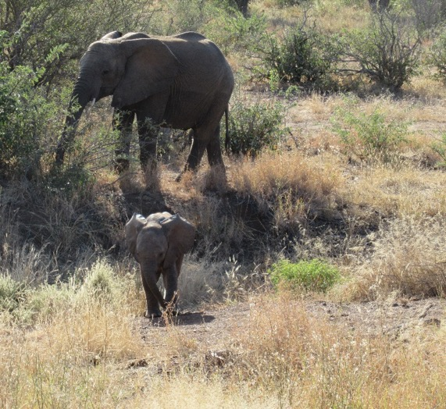
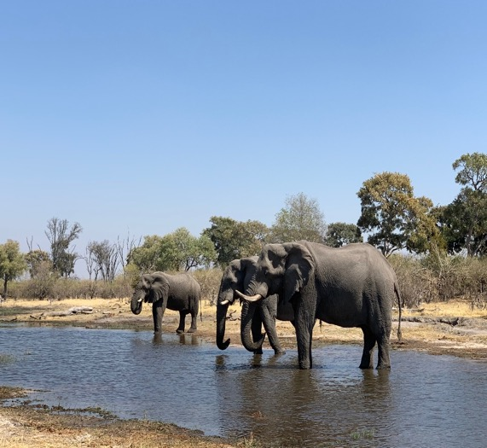
Project Partners
Connected Conservation
The Ecoexist Project
“Assist communities in conflict with wildlife through data driven solutions”
“Reducing conflict and fostering coexistence between elephants and people”
Region of Focus: Victoria Falls, Zimbabwe
Region of Focus: Okavango Delta, Botswana
Image Credits: Erica Kriner (left), Madison Bradley (right)
Notes:
Speaker:
The team partnered with two local NGOS, Connected Conservation and The Ecoexist Project.
Both organizations are actively involved in elephant monitoring and HEC mitigation efforts.
Connected Conservation focuses specifically on the region surrounding Victoria Falls, Zimbabwe. The team had the pleasure of communicating extensively with Director Dr. Ferrell Osborn and Senior Researcher Malvern Karidozo while working on this project.
The Ecoexist project focuses their efforts on the Okavango Delta in Botswana. The team also operated with Directors Dr Anna Songhurst and Dr Graham McCulloch while working on this project.
Image Credits:
-------------------
1. Mom and daughter elephants; Erica Kriner (DEVELOP Team Member)
2. Female elephants in Moremi Wildlife Reserve, Botswana; Madison Bradley (DEVELOP Team Member)

Slide 6
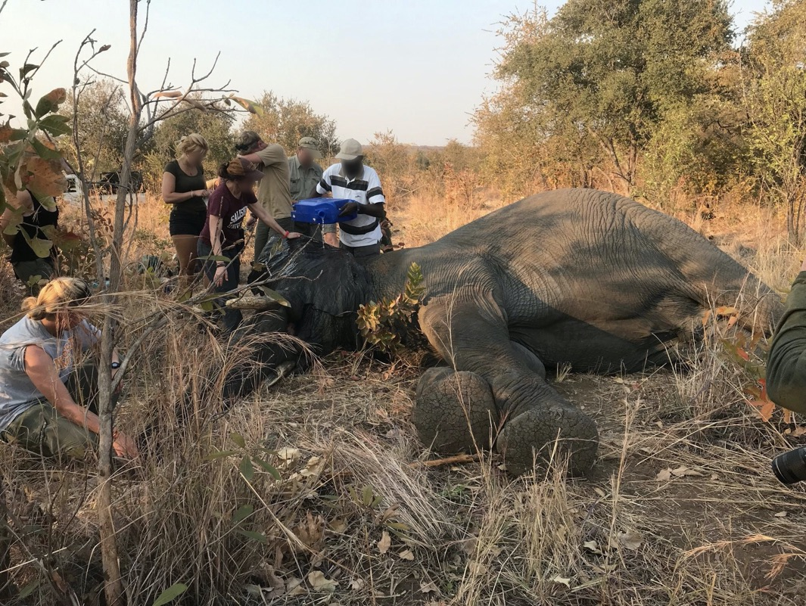
Victoria Falls, Zimbabwe
Deciduous savanna woodland
Annual rainfall: ~668 mm
13 elephants collared between 2017-2020
HEC data collected from 2012-2020
Victoria Falls
Zimbabwe
Image Credits: Marguerite Madden
Notes:
Speaker:
The first region of focus for our project was Victoria Falls and the surrounding areas in Eastern Zimbabwe which are characterized by deciduous and dry deciduous savanna woodland and receive approximately 668mm of rainfall per year (Osborn, 2003).
Since 2017, researchers from Connected Conservation have fitted 13 bull elephants in the region with GPS tracking collars. The bull elephants that were collared are estimated to be between 20 and 30 years old. At this age, bulls are more likely to demonstrate aggressive behaviors such as raiding crops and attacking locals or tourists. Connected Conservation has also collected HEC records in the Victoria Falls area since 2012.
Image Credits:
-------------------
1. Elephants being collared in Zimbabwe; Marguerite Madden (DEVELOP science advisor, provided with permission to use)

Slide 7
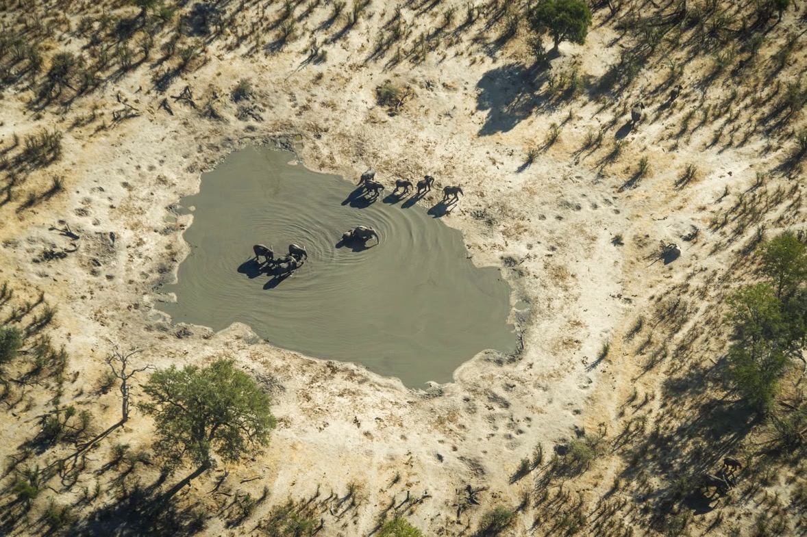
Okavango Delta, Botswana
Semi-arid savanna
Annual rainfall: ~500 mm
40 elephants collared between 2014-2020
HEC data collected from 2008-2020
Okavango Delta
Botswana
Image Credits: Graham McCulloch
Notes:
Speaker:
The second region of focus for our project was the Eastern Panhandle of the Okavango Delta in Northern Botswana, which is a semi-arid savanna region that receives approximately 500mm of rainfall per year during the wet season (Buccholtz, 2019). On the east side of the delta, approximately 18,000 African elephants and 16,000 people compete for resources, making this a human-elephant conflict 'hot-spot' (Pozo, 2017). Researchers at the Ecoexist Project have been recording human-elephant conflict events since 2008 and have fitted more than 40 elephants with GPS collars since 2014.
Image Credits:
---------------
1. Okavango Delta; Graham McCulloch (Ecoexist Project)

Slide 8
Earth Observations
Landsat 5 Thematic Mapper (TM)
1990-2012
Landsat 8 Operational Land Imager (OLI)
2013-2021
Shuttle Radar Topography Mission (SRTM)
2000
30 m
Applications: Vegetation Indices, LULC Classification
30 m
16 days
Applications: Vegetation Indices, LULC Classification
Applications: LULC Classification
30 m
16 days
Image Credits: NASA
Notes:
Speaker:
Landsat 5 Thematic Mapper was used for all landsat imagery obtained from 1990 to 2012.
From 2013 onward, the team used Landsat 8 Operational Land Imager for composite creation.
Shuttle Radar Topography Mission was used to as a training band to incorporate elevation in LULC Classification
Discuss why we didnt use landsat 7
Chose to avoid Landsat 7 because of the scan line errors and subsequent masking that is inherent to using Landsat 7 ETM products
Image Credits:
-------------------
1. Landsat 5 TM, NASA
2. Landsat 8 OLI, NASA
3. SRTM, NASA

Slide 9
Ancillary Datasets
Elephant GPS Tracking Data
Human-elephant Conflict Datasets
TerraClimate Drought Variables
2012-2019
2008-2019
1990-2020
Notes:
Speaker:
In addition to NASA Earth Observations, the team used elephant GPS tracking data and reported HEC event data provided by project partners.
The team also accessed TerraClimate data in GEE to calculate and display time series of drought, precipitation, and temperature.
Image Credits:
-------------------
1. Aggregated Elephant Points, Created in R; Term 1 team
2. Kernel Density Maps, Created in QGIS; Term 1 team
5. TerraClimate Monthly PDSI; Created in GEE

Slide 10
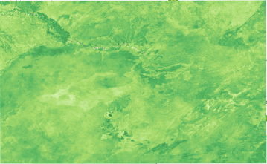
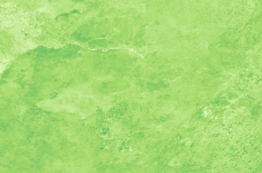
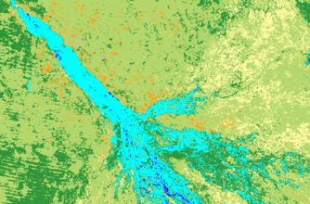
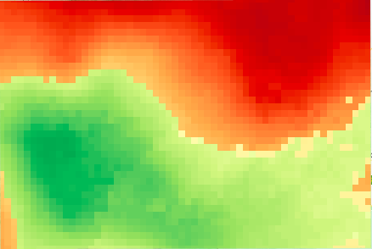
Output Layers
Image Processing
User Inputs & Data Imports
Methods: Google Earth Engine
IMAGE PROCESSING
Mask clouds
Create annual composites
Calculate indices
Random Forest classification
NDVI
SAVI
LULC
PDSI
Temperature
Precipitation
Notes:
Speaker:
The first term team developed a Google Earth Engine script that will allow our partners to replicate our methodologies in the future. The script allows the user to define the study area and date range of interest. It brings in Landsat 5 Thematic Mapper (TM) and Landsat 8 Operational Land Imager (OLI) Surface reflectance data, and TerraClimate Data. Landsat imagery is corrected to remove clouds and shadows and subsequently composite images are created for each year within the date range chosen by the user. The normalized difference vegetation index (NDVI) and soil-adjusted vegetation index (SAVI) were calculated for each year, along with changes in vegetation health between the years chosen for analysis. From TerraClimate, Palmer's drought severity index (PDSI), maximum temperature, and precipitation accumulation layers were extracted to display deviations from normal climatic conditions.
Our team modified the script to expand the date range for analysis to include all of the years between 1990 and 2020. We also added in functionality to calculate and display Land Use Land Cover Maps using a RandomForest Classifer, which we will elaborate on in the following slide.

Slide 11
Random Forest Classification
Table: Landcover Classes Used
7 Classes; Randomly Split 70/30
Class | Landcover
0 | Bare
1 | Urban
2 | Agriculture
3 | Water
4 | Wetland
5 | Woodland
6 | Grassland
Collect Training Data
Train Random Forest Classifier
Classify Imagery
Assess Accuracy
9 Bands
100 Trees
Error Matrix
Notes:
Speaker:
The RandomForest classification is a machine learning algorithm in GEE that uses the spectral responses associated with training data points to classify imagery. There were 4 main components to this process. First, the team collected training data for 8 classes, which included bare, water, urban, wetland, grassland, woodland, agriculture classes based on ocular sampling of high-resolution Planet Labs Imagery and existing Land cover maps, such as the KAZA landcover 2005 map from the WWF. Each training class was merged into one feature collection then the feature collection was randomly split to produce a training data set with 70% of the points and validation data set with the remaining 30% of points.

Slide 12
Random Forest Classification
7 Classes; Randomly Split 70/30
Collect Training Data
Train Random Forest Classifier
Classify Imagery
Assess Accuracy
Blue
Green
9 Bands
Red
NIR
SWIR
100 Trees
Temperature
SWIR2
NDVI
Elevation
Error Matrix
Notes:
Speaker:
The Random Forest classifier was trained using 9 bands from each composite image, which are displayed here. Next, the trained classifier was applied to each composite image using the training data set as guidance to produce a classified composite image with 7 land cover classes. Finally, an error matrix accuracy assessment was conducted with the remaining validation dataset to calculate the overall expected classification accuracy. We achieved validation accuracies consistently greater than 80%.

Slide 13
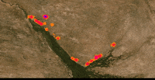
Human-elephant Conflict
0
50
100 Kilometers
HEC data: Botswana (2008-2019)
Risk assessment
Identify areas where raids are likely to occur based on historical incidence
Prioritize corridors and crop fields
Discrepancies & limitations
Risk Level
Little to None
Low
Moderate
High
Critical
Notes:
Our partners provided us with an extensive dataset on Human-Elephant Conflict events ranging from 2008 to 2019. With this data we created a series of annual density heatmaps to identify areas at most risk, as well as prioritize corridors and croplands that have historically been susceptible to elephant raiding.
Inconsistency in data collection methods is prevalent across the incidence data for all years so it was neccesary to standardize and remove null or erroneous values, reformat the data, convert coordinates, and so on. Even then, discrepancies existed that placed limitations on the type of analyses we were able to complete. For instance, among the many attributes data was collected on at every HEC event, it seems only four were consistently recorded across all years: number of elephants per raid, sex of elephant, village, and crop maturity. No data exists for the years 2011 and 2018 as well. In 2013 there were only fourteen applicable conflict events. While it may be true that mitigation efforts to thwart elephant raids on crops have improved over time, it seems unlikely they improved to that degree where as in 2008 there were over 600 HEC events recorded along the delta.
These kinds of discepancies are not uncommon in the geospatial and data sciences. To account for this, an additional decadal heat map was created merging data from all the years which was used in the corridor and agricultural risk analysis.

Slide 14
Methods: HEC Risk Analysis
Pre-processing
Import to GIS
Annual Heat Maps
Risk Assessment
Corridor Coincidence
Excel
ArcMap
ArcMap
ArcMap
ArcMap
Notes:
Appropriate pre-processing procedures (as mentioned in previous slide) were employed within excel to standardize the data and make it operable within our GIS software. GIS, or geographic information systems, is a computer system that allows us to visualize and run spatial and temporal analyses on geographical features and data. In this way we can extract information, map earth processes, and convey data in a manner that's understandable to multiple audiences. The GIS platform used for this project was ArcMap. Here, imported conflict data and created our annual heat maps using point density to create a series of rasters where each cell was assigned a value based on the number of HECs occuring within its neighborhood. We can take this output and use it visualize which areas have had the highest frequency of conflict within the last ten or so years, as well as use this information to categorize crop fields and known elephant corridors that should be a focus for land use planners and farmers so as to minimize conflict in the future.

Slide 15
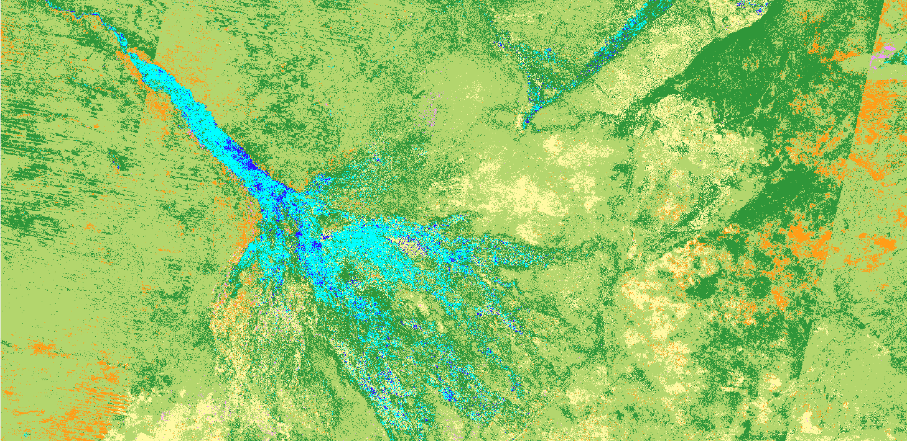
LULC Classification Results 1990
0
88
176 Kilometers
Bare
Urban
Agriculture
Water
Wetland
Woodland
Grassland
Landcover | Total Area Coverage (km²)
Bare | 10,798
Urban | 673
Agriculture | 10,626
Water | 485
Wetland | 6,103
Woodland | 253,744
Grassland | 45,429
Classification Validation Accuracy: 0.80
Notes:
Speaker:
The 1990 Classification was completed with 80% accuracy, using a composite image created using Imagery from March-July. In order to have zero cloud coverage in the composite image, a five month composite was necessary and determined based upon a cloud score. This five month period coincides with the wet season when seasonal water is more prominent. It also captures the peak crop harvest time from March-June, when most crop raiding occurs.
The five month composite was necessary to producing cloud free imagery, but is limiting in that not all of the imagery will be sampled from similar dates

Slide 16
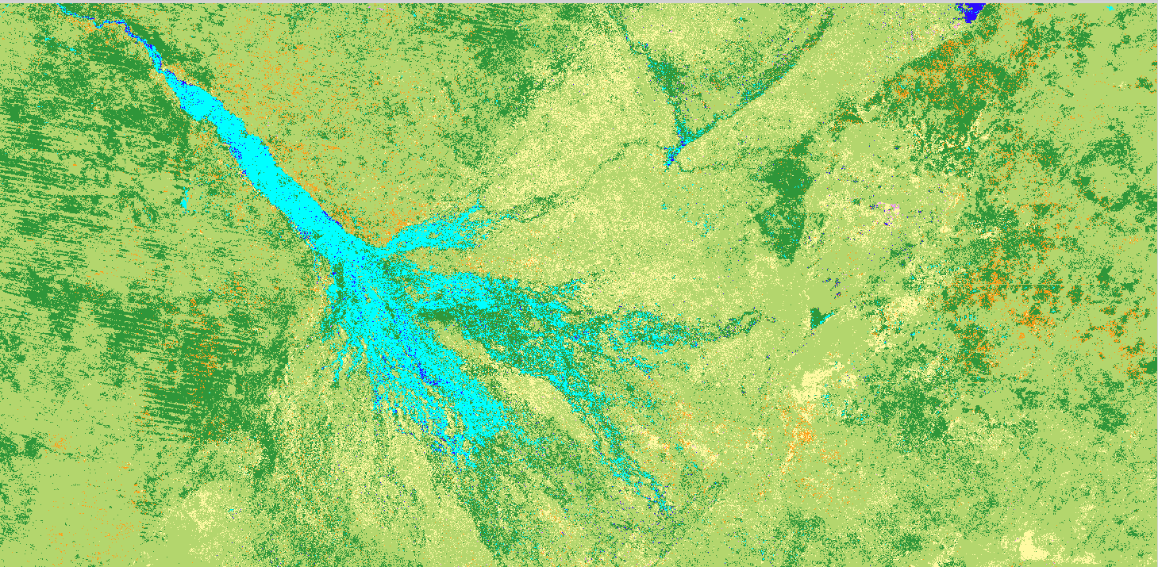
LULC Classification Results 2020
0
88
176 Kilometers
Bare
Urban
Agriculture
Water
Wetland
Woodland
Grassland
Landcover | Total Area Coverage (km²)
Bare | 12,219
Urban | 2,445
Agriculture | 10,818
Water | 1453
Wetland | 7,110
Woodland | 243,692
Grassland | 50,122
Classification Validation Accuracy: 0.85
Notes:
Speaker:
The 2020 Classification was completed with 85% accuracy. Urban land cover increased by almost 2,000 square kilometers, and agricultual lands only expanded by approximately 200 square kilometers.

Slide 17
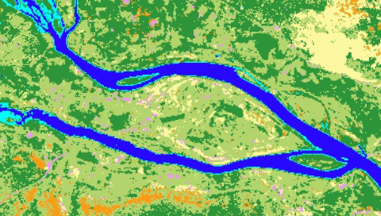
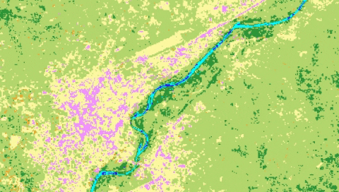
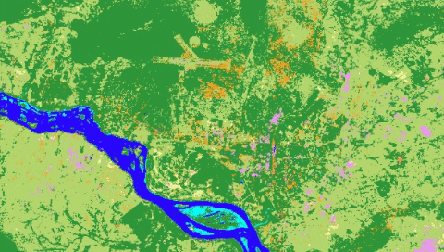
1Kilometer
Kasane
LULC Change 1990-2020
Maun
Livingstone
Urban
Agriculture
Bare
Grassland
Wetland
Woodland
Water
Notes:
Speaker:
There was significant loss in woodland cover between 1990 and 2020, coinciding with an increase in urban and agricultural areas.

Slide 18
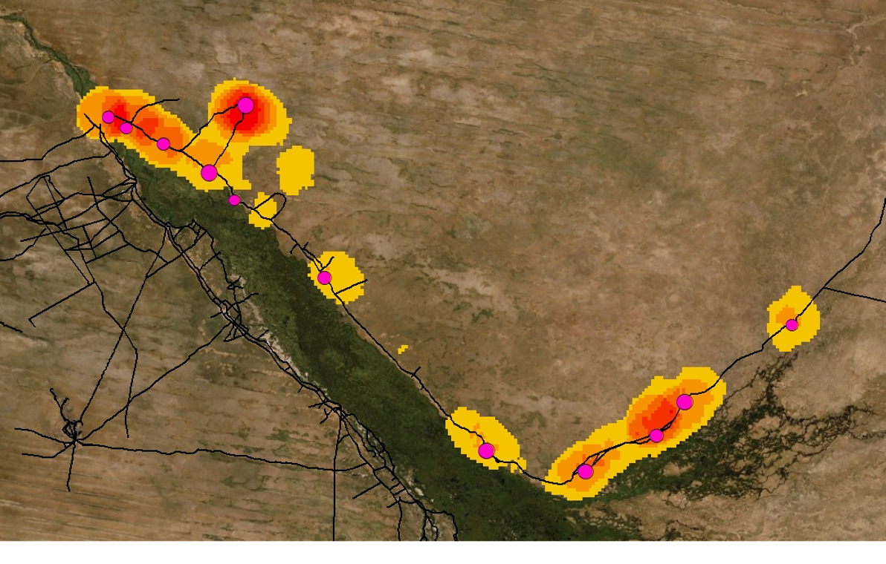
0
25
50
100 Kilometers
HEC Incidence (2008-2019) in Okavango Delta, Botswana
HECs/km^2
0 – 6
7 – 13
14 – 20
21 – 27
28 – 34
35 - 44
Villages
Roads
Notes:
Here were see the total number of human elephant conflicts per square kilometer over the last ten or so years, and areas where the highest frequency of conflicts has occurred (35-44 events) in red. The villages are symbolized proportionally with the larger pink circles representing villages that have experienced the most raids.

Slide 19
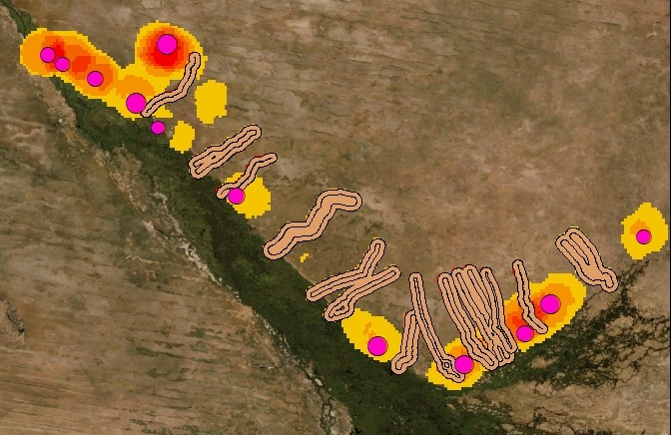
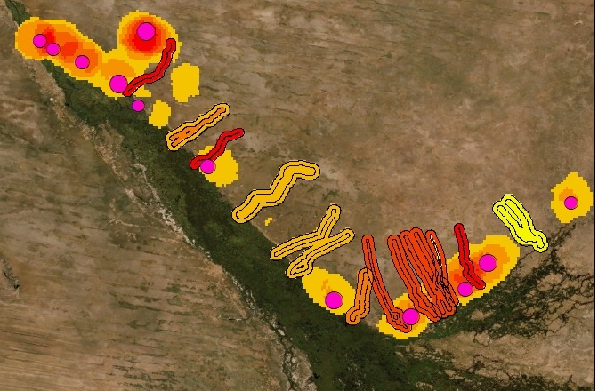
Elephant Corridor Risk Assessment
Little to None
Low
Moderate
High
Critical
0
50
100 Kilometers
Risk Level
Notes:
This map shows known elephant corridors overlaid onto the merged HEC density heat map for all years. Corridors were categorized into five levels based on conflict frequency from 2008 to 2019. We see that the corridors with the highest likelihood of human elephant conflict are those closest to at least two villages, one on each side.

Slide 20
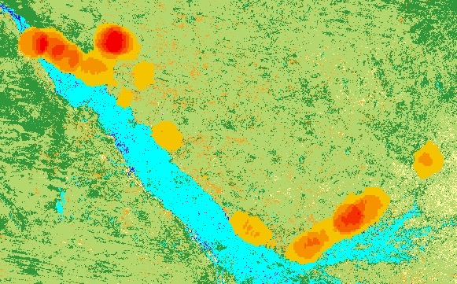
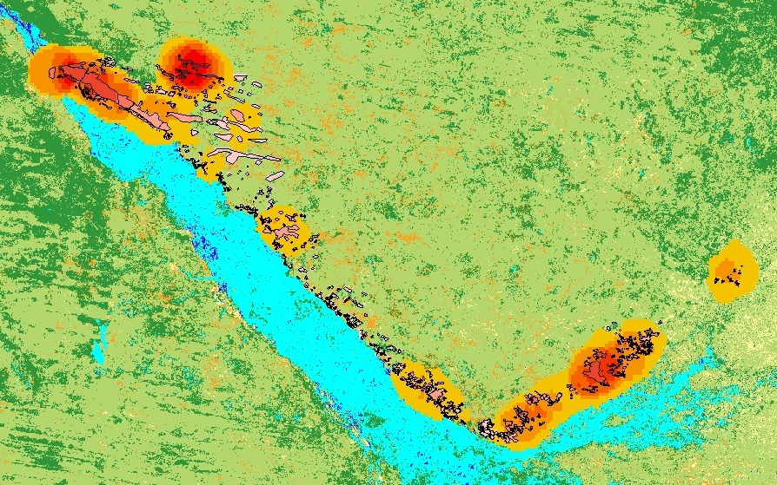
Agricultural Field Risk Assessment
0
25
50
100 Kilometers
LULC
HEC Risk Level
Grassland
Little to None
Low
Moderate
High
Critical
Bare
Urban
Agriculture
Water
Wetland
Woodland
Notes:
A similar risk assessment was done for known crop fields along the Okavango Delta where zonal statistics was employed to assign risk levels to fields that have historically had the highest incidence of human elephant conflicts based on the data from 2008-2019. In a continuation of this analysis, using remote sensing to spatially expand known agricultural areas to areas classified as agriculture by satellite imagery. The data collected by our partners is nothing short of remarkable but with more time and resources we may be able to quantify risk beyond the delta region.

Slide 21
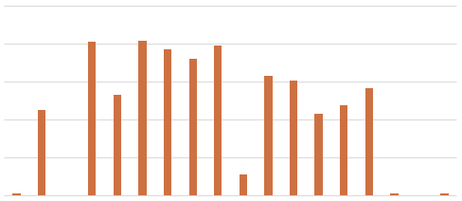
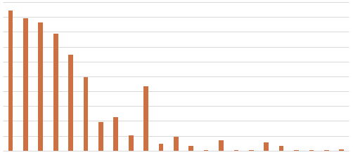
HEC Event Drivers 2008-2019
Number of HECs per Village
Number of Elephants Involved in HEC Events
250
200
200
0
Frequency
100
100
Frequency
0
Gowa
Tobera
Eretsha
Xakao
0
Kauxwi
Kyeica
1
Seronga
Beetsha
Mogotho
Gudigwa
Divava
2
3
4
5
6
7
8
9
10
11
12
13
14
15
17
18
20
22
23
29
37
59
Mohembo
Mokgacha
Ngarange
Kaputura
Modubana
Gunotsoga
Sekondomboro
Number of Elephants Involved in Raid Event
Notes:
Speaker Notes: Michael
During data exploration we compared human elephant conflict events to a variety of variables…
(1-4:LtoR,UPtoDwn)
1 Frequency of HEC per Village.
Some villages like Modubana and Divava had one HEC, whereas many as 7 other villages had upwards of 150 HEC events during the study period
2 Looked at the number of elephants participating in HEC events, and the frequency of HECs with those group counts
Tendency for elephants to frequently participate in groups of ten or less
Interesting to note that there were 2 occurrences of elephants in groups of 59
Massive HEC events are something of interest and further examination is required

Slide 22
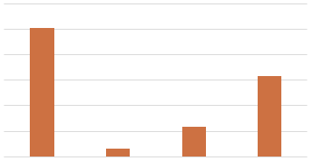
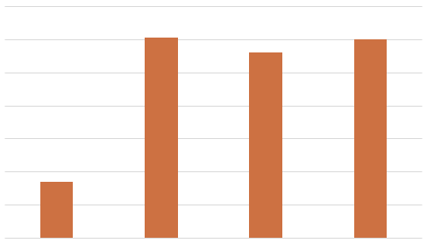
HEC Event Drivers 2008-2019
Elephant Participation in HEC by Sex
Crop Maturity During HEC Events
1200
700
500
800
Frequency
Frequency
300
400
100
0
0
Male
Female
Both
Unidentified
Seedling
Interim
Mature
NA
Notes:
Speaker Notes: Michael
During data exploration we compared human elephant conflict events to a variety of variables…
(1-4:LtoR,UPtoDwn)
1 How elephant participation in HEC events varied by sex
Expected from partner input, but largely male elephants responsible
Interesting to note that females were 10x more likely to participate in HEC events when accompanied by males
2 Crop Maturity at the time of HEC events
Large preference for older crops
large NA values indicate lack of sampling or substantial elephant participation in non crop raiding events)

Slide 23
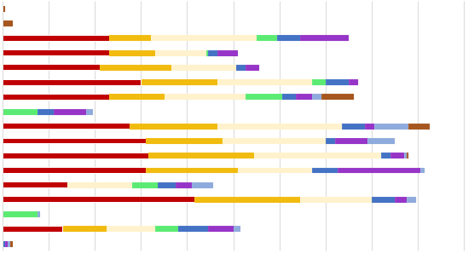
HEC Variable Changes Over Time (2008-2019)
Frequency of HEC Events per Village over Time
Divava
Kaputura
Xakao
Gudigwa
Ngarange
Eretsha
Mokgacha
Mogotho
Beetsha
Gunotsoga
Seronga
Sekondomboro
Mohembo
Tobera
Modubana
Kauxwi
Gowa
0
40
80
120
160
200
Frequency
Notes:
Speaker Notes: Michael
(1-4:LtoR,UPtoDwn)
Building off of the previous slide… The team wanted to analyze how HEC drivers varied over the study period.
1 This is a scatterplot of HEC events per village from 2008-2019
There is a general trend among villages for earlier years in the sampling period to have more frequent HEC events
Perhaps this can be explained by increases in HEC mitigation methods and efforts within the region
Beyond 2010, there is a stark decline in HEC per village for the individual years

Slide 24
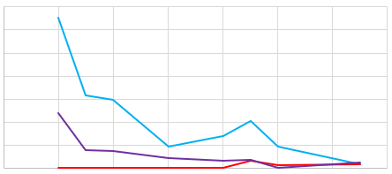
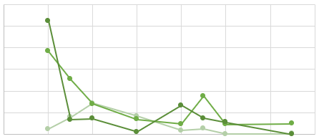
HEC Variable Changes Over Time (2008-2019)
Elephant Crop Raiding Participation by Sex
Crop Maturity During Crop Raiding Events
350
300
250
150
150
50
0
2006
2008
2010
2012
2014
2016
2018
2020
0
2006
2008
2010
2012
2014
2016
2018
2020
Male
Female
Both
Seedling
Interim
Mature
Notes:
Speaker Notes: Michael
(1-4:LtoR,UPtoDwn)
Building off of the previous slide… The team wanted to analyze how HEC drivers varied over the study period.
1 Elephant Crop raiding participation
Another negative trend in elephant participation among both sexes
There is a spike in 2015 of HEC event participation by both sexes
Interesting to note the increase in female participation in HEC 2014 onward, specifically the spike in 2015, but the general positive trend onward
It is also interesting to note how all three lines seem to merge at 2019, possibly indicating HEC participation between both sexes is equalizing
2 Looking at Crop Maturity during HEC over the years
There is a general trend for elephants to drastically prefer mature and interim crops in the first two years, however. As time passes we come to see that HEC events among all crop maturities stay below 100 events per year 2010 onward
Both graphs indicate that there was a general spike in in HEC events for 2015

Slide 25
Conclusions
Available woodland elephant habitat declined while urban and agricultural lands expanded
Available woodland elephant habitat declined while urban and agricultural lands expanded
Declines in crop-raiding after 2010 may indicate effective HEC management strategies
Image Credits: Madison Bradley
Notes:
Speaker:
Urban and agricultural expansion was observed along water sources
Available woodland elephant habitat declined by 10,000 km²
Histograms and scatterplots indicate that HEC events decreased 2010 onward
This trend may attest to the effectiveness of partner and community mitigation efforts within the region
Image Credits:
-------------------
1. Tree stand in Botswana; Madison Bradley (DEVELOP Team Member)

Slide 26
Future Work
Create high-resolution LULC maps from Planet imagery
Expand landcover classes analyzed to distinguish habitat fragmentation in riparian vegetation zones
Analyzing the role of wildfires in relation to elephant movement
Estimating vegetation composition of riverine habitats and movement corridors
Quantifying land cover change from one class to another
Image Credits: Graham McCulloch
Notes:
Speaker:
Future works should include the incorporation of higher resolution land use land cover mapping with Planet Imagery to identify critical zones of elephant habitat fragmentation at a finer scale. A higher-resolution LULC map would also be useful in increasing the number of landcover classes analyzed. For instance, being able to delineate ripariarian vegetation zones from wetlands, as well as being able to differentiate between vegetation patches resulting from varied soil gradients. Furthermore, we recommend that future works should examine the role of bushfires in driving elephant movements and resulting HEC. This could also possibly reveal more information about the role of elephants as wildfire disturbance drivers. Practices from vegetation ecology could be applied to monitor vegetation compositional changes in areas transitioning from low to high HEC risk, or vice versa. Subsequent vegetation community changes in movement corridors could be visually represented. Quantifying areal changes between land covers would allow researchers to understand the dynamic landscape at a deeper level.
(Veg Eco Future Work: referencing the transect method, in which 1 m2 plots laid out along a transect (that hopefully covers variation in vegetation structure along the transect) data can be extrapolated to give you an idea of vegetation composition for the area)
Image Credits:
-------------------
1. Elephants Aerial ; Graham McCulloch (Ecoexist Project)
2. Elephants and Dirt; Graham McCulloch (Ecoexist Project)

Slide 27
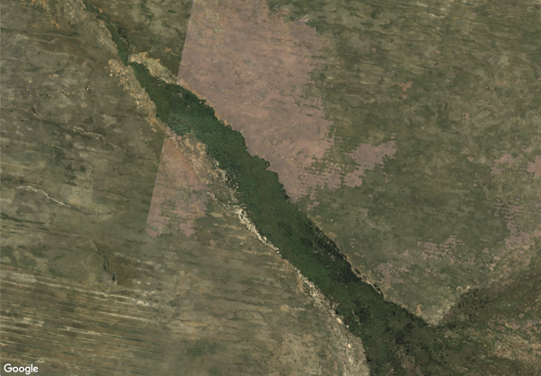
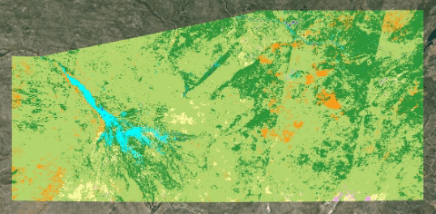
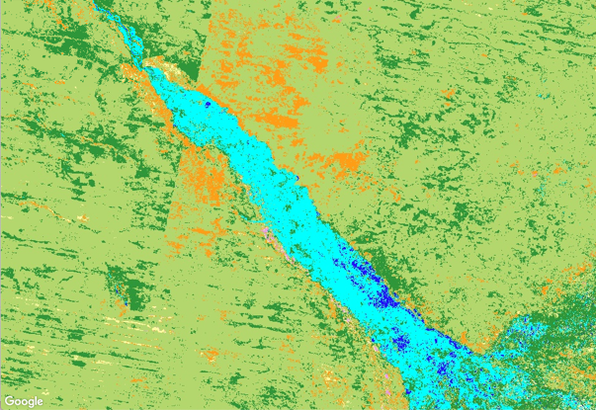
Errors and Uncertainties: LULC Change
Cloud interference
Wet season
Dry season
5-month composites
Illumination inconsistencies
Image footprints
Notes:
Speaker: As with many projects working with satellite data, one potential source of error for our project is cloud interference. In the kavango zambeze area, clouds are prevalent in the wet season, and our cloud mask that we applied before our LULC analysis eliminated pixels that were marked as cloudy. This means our LULC map may be more based on dry season pixels than intended. As a result we took 5 month composite imagery and used that as the base for the map which means....
Additionally, we can see on our LULC map some inconsistencies with the classifications that line up suspiciously well with the footprint of the landsat scenes, suggesting some inconsistenies in the classification across images. For example on the left image you can see that there are dark areas classed as forest in one image and in the immediate adjacent image classed as grassland. This may be due to illumination inconsistencies for the satellite return. However, our LULC still had a high accuracy, particularly in the areas of HEC occurrence which was the focus of the study
Images are LULC maps created in GEE

Slide 28
Project Partners:
The Ecoexist Project
Dr. Graham McCulloch, Field & Program Director
Dr. Anna Songhurst, Policy Director
Connected Conservation
Dr. Ferrell Osborn, Director
Malvern Koridozo, Senior Researcher
Science Advisors:
Dr. Marguerite Madden, University of Georgia, Department of Geography
Dr. Sergio Bernardes, University of Georgia, Department of Geography
Dr. Andrea Presotto, Salisbury University, Geography and Geosciences Department
Dr. William Langbauer, Bridgewater State University, Biology Department
Special Thanks To:
Darcy Gray, NASA DEVELOP Fellow
Katherine Markham, University of Georgia
Anastacia Makati, University of Botswana
Africa Food Security & Agriculture I Team:
Jennifer Gallucci, GA Node
Jonathan Moallem, GA Node
Erika Munshi, GA Node
Crystal Wespestad, NASA DEVELOP Fellow GA Node
Notes:
Speaker:
Finally, we would like to thank the team of researchers that made this project possible.
We will now open the floor for any questions from the audience.

Slide 29
Appendix Slides

Slide 30
LULC Change 1990-2020
Landcover | Net Change (km2)
Bare | 1,421
Urban | 1,772
Agriculture | 191
Water | 968
Wetland | 1,007
Woodland | -10,052
Grassland | 4,692
Notes:
Speaker:
There was significant loss in woodland cover between 1990 and 2020, coinciding with an increase in urban and agricultural areas.
Increases in bare and grassland area could also be tied to the dramatic loss in woodland area, possibly exemplifying the different stages of succession.

Slide 31
Methodology Overview
Google Earth Engine
NDVI, SAVI
ArcMap
HEC Risk Heat Maps
Overlay Analysis
Climate Conditions
PDSI, Temperature, Precipitation
LULC Classification
Vegetation Health
High, Medium, Low
Spatial Coincidence
Notes:
Add in notes

