Slide 1
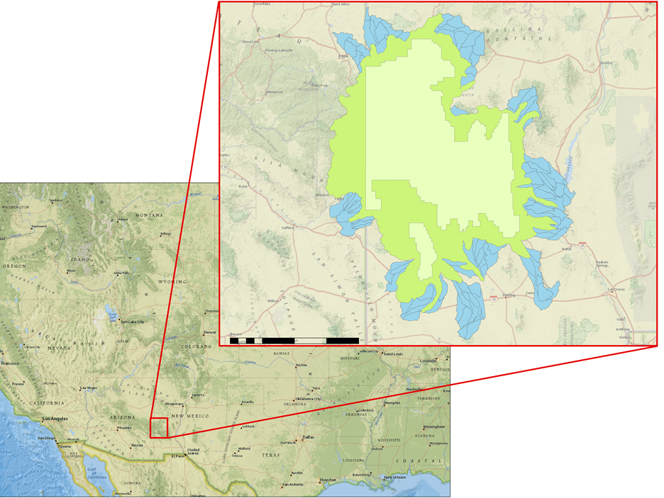
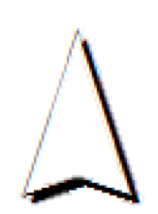
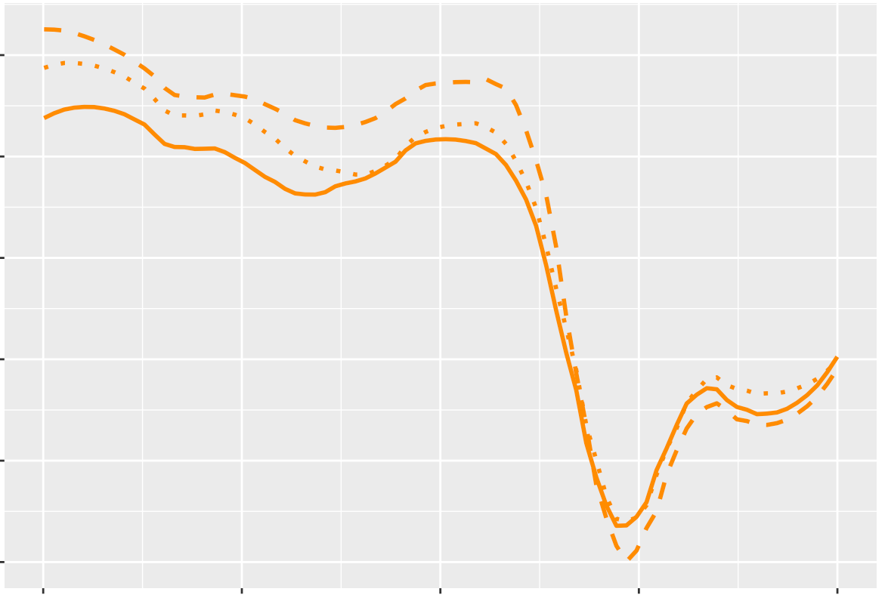
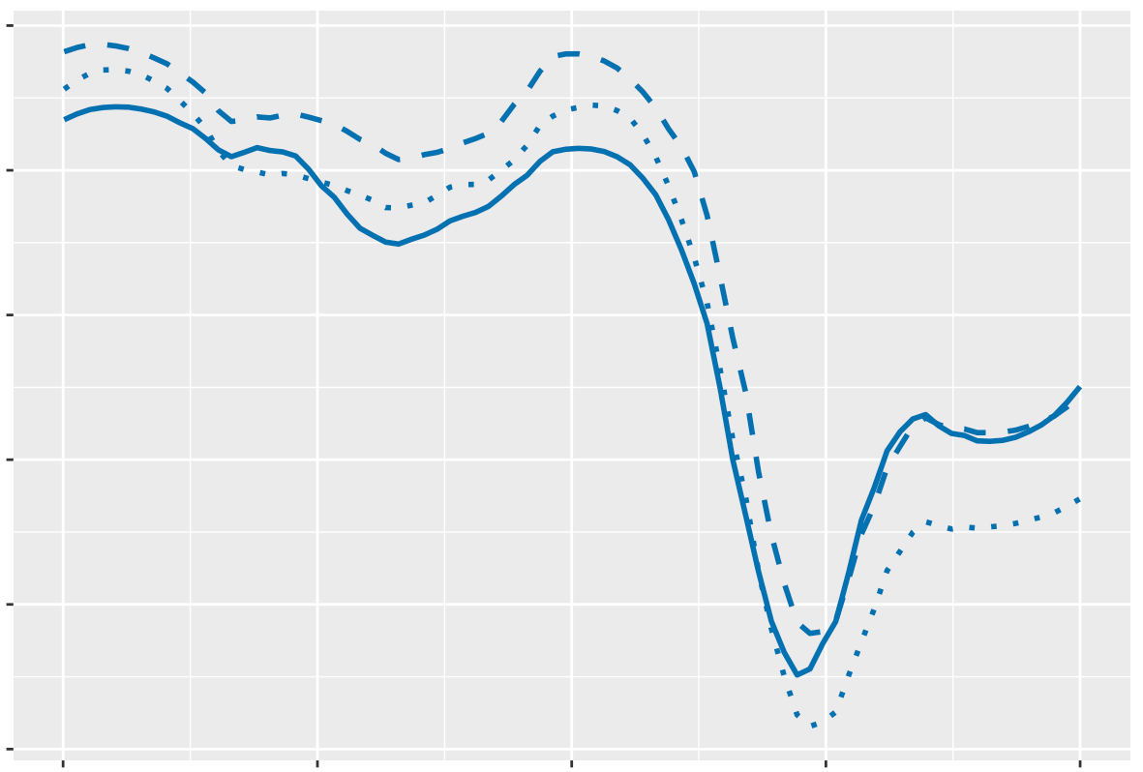
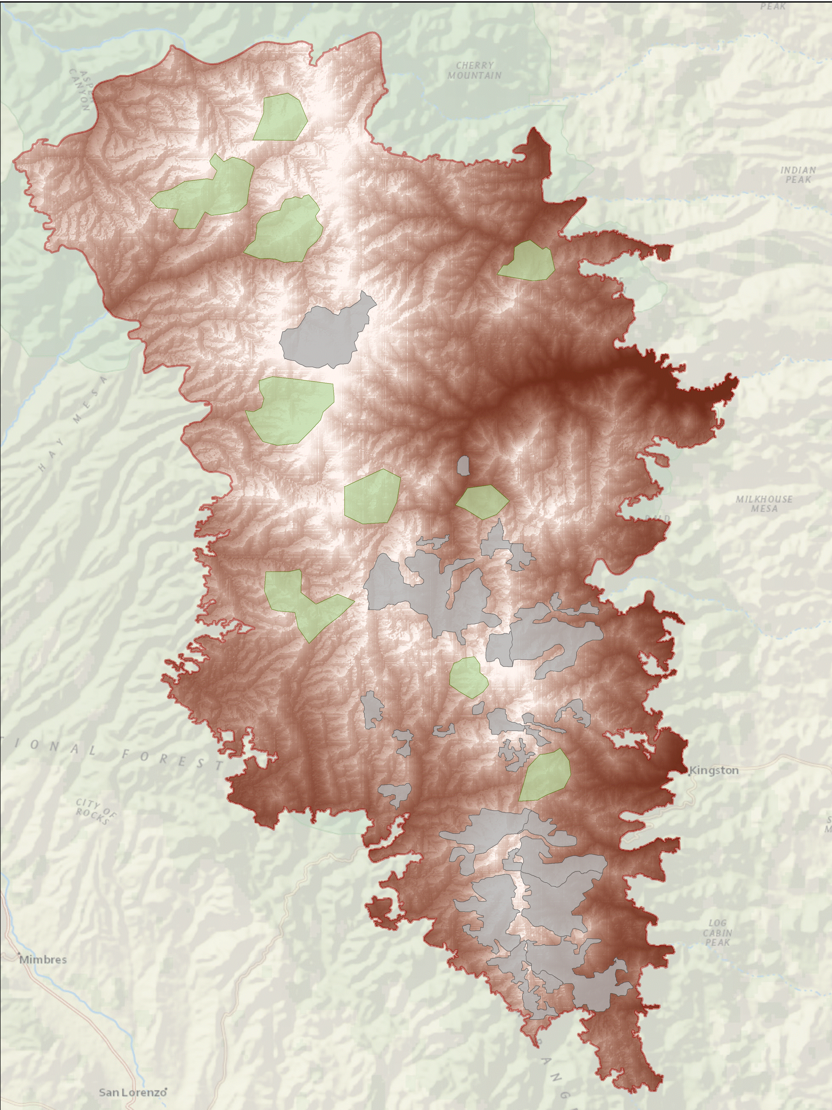
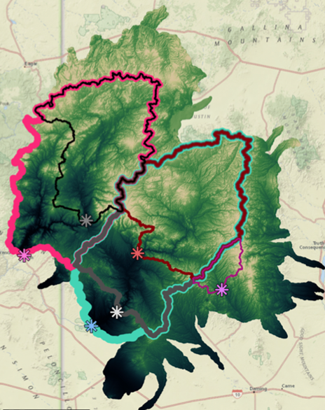
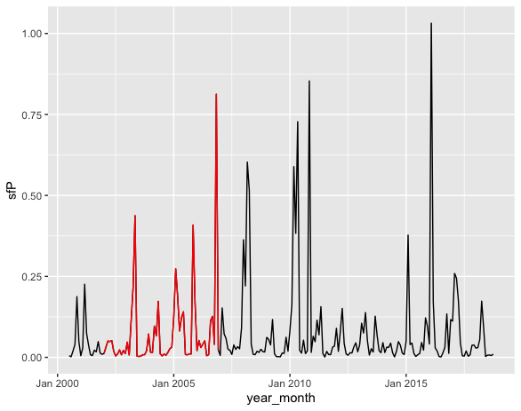
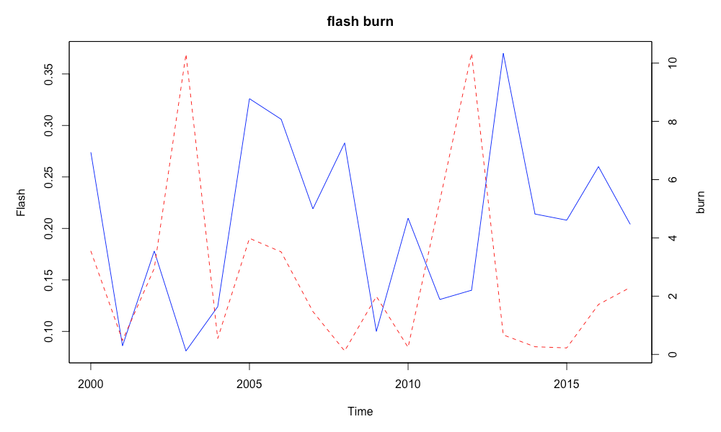
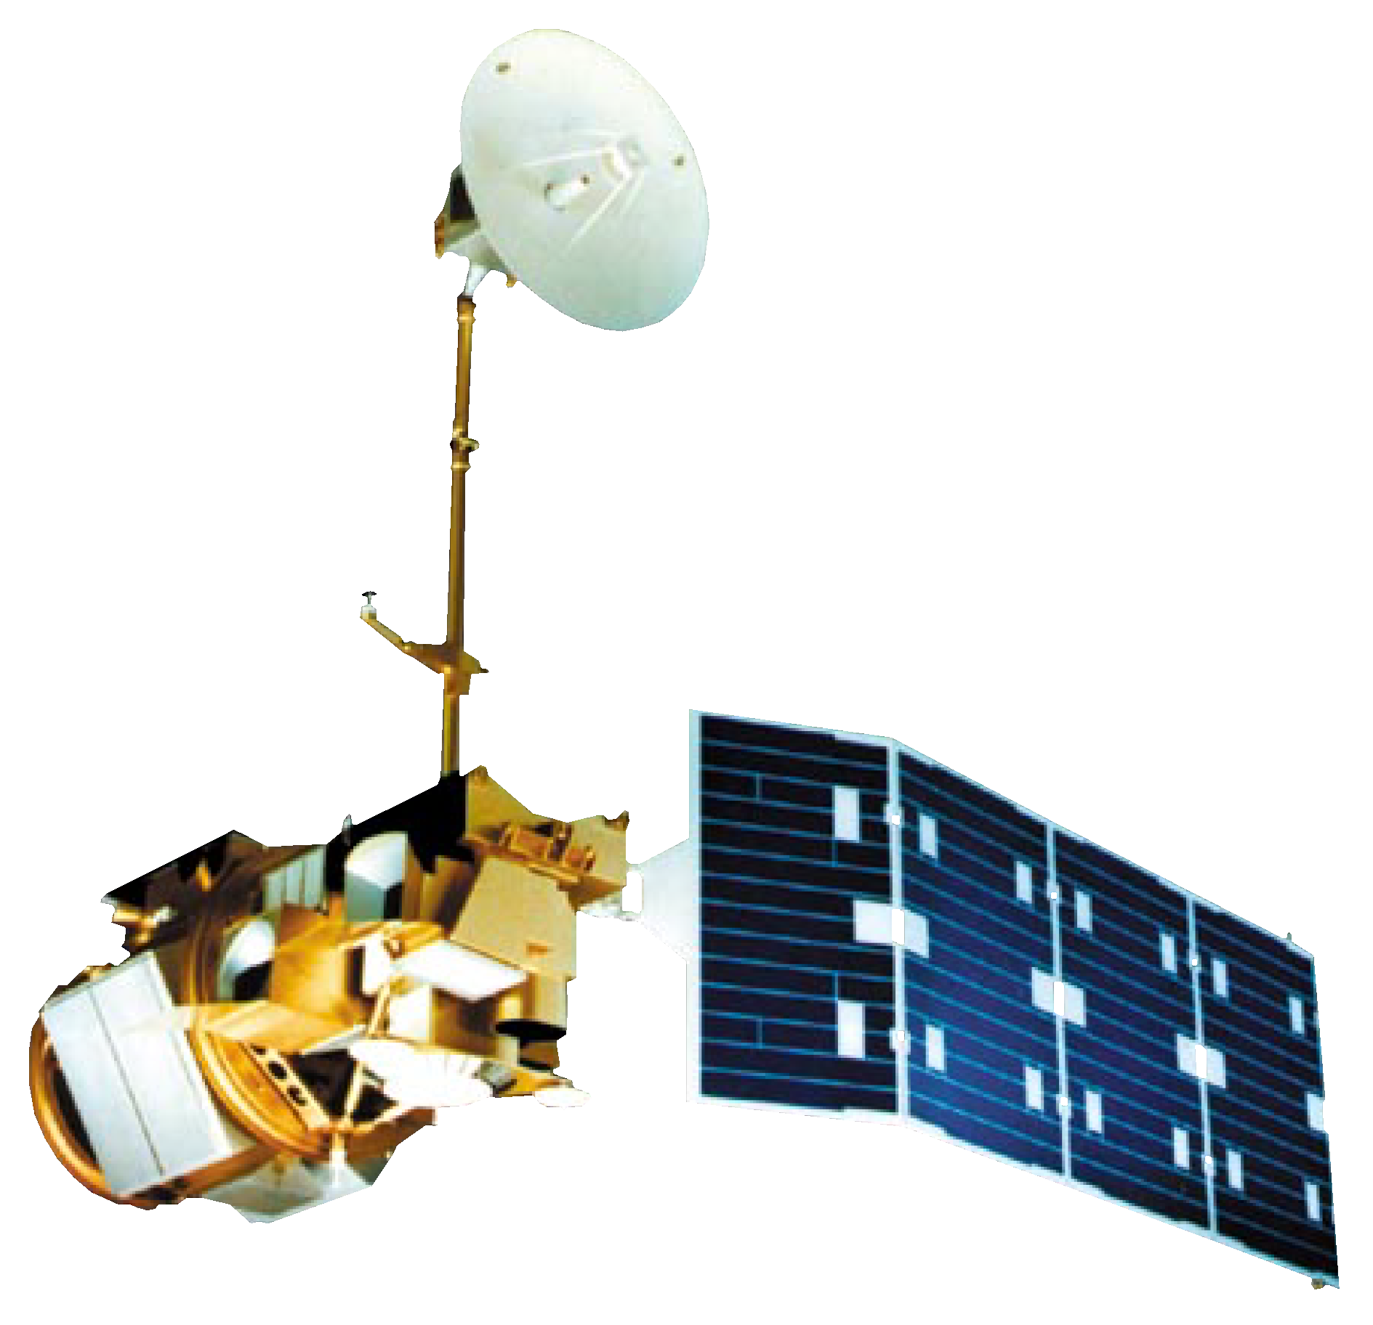
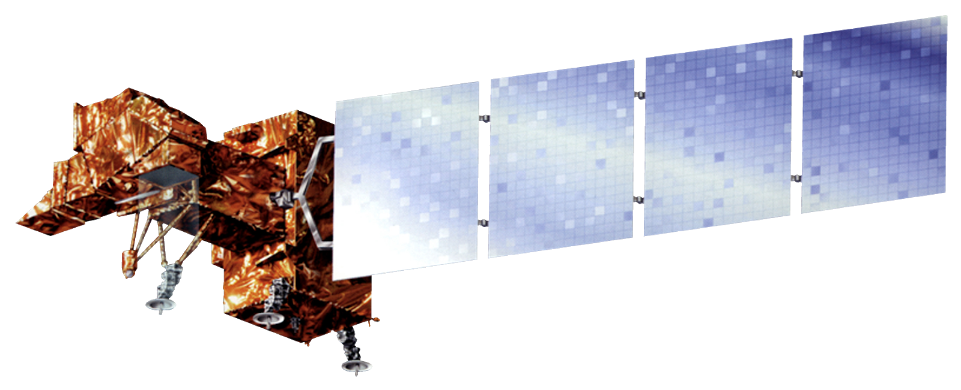
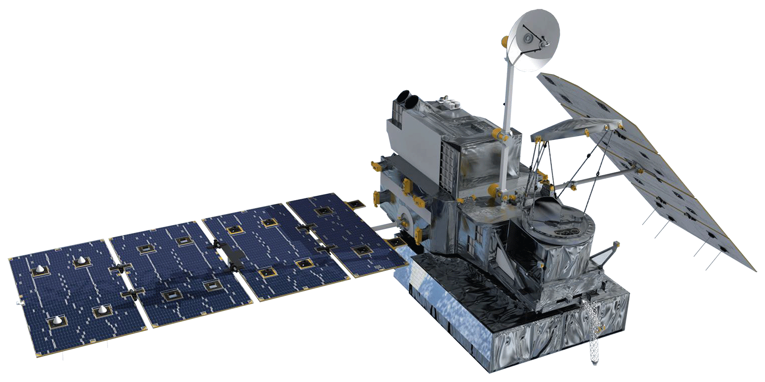
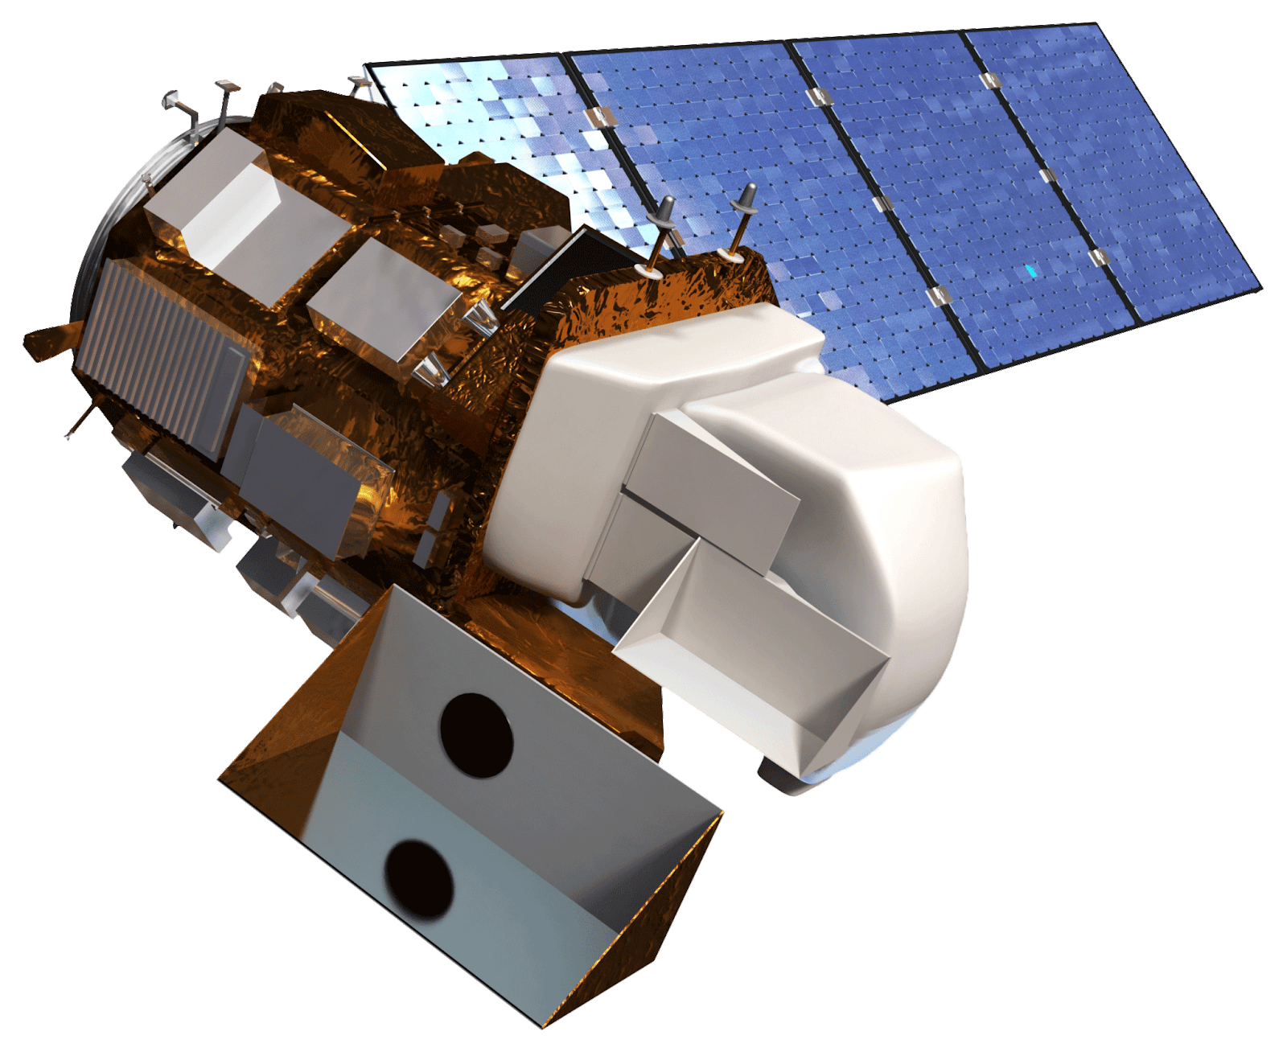
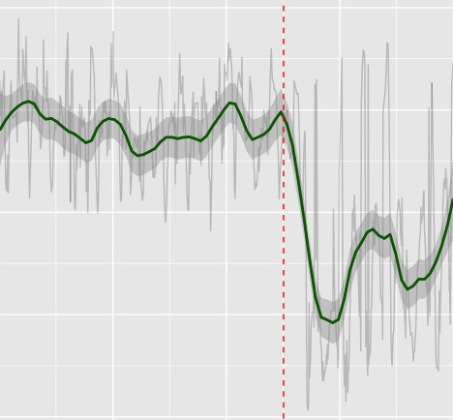
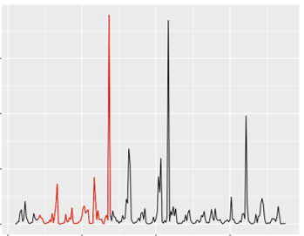
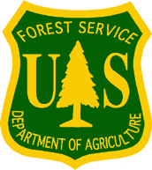
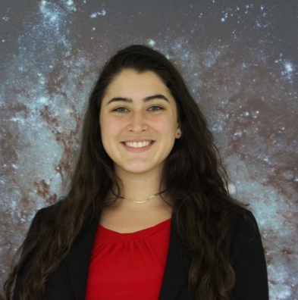
Using Earth Observations to Identify Wildfire Impacts on Hydrologic Functions and Recovery in Gila National Forest
Abstract
Study Area
New Mexico
N
Gila Water Resources II
Wildfires have the potential to cause devastating and long-lasting impacts on ecological systems. In the Gila National Forest (Gila NF), wildfire events have occurred with increasing frequency and severity over recent years. These disturbances, such as the historic Whitewater Baldy Complex Fire (2012) and Silver Fire (2013), have raised concerns over post-fire flooding, debris flows, and vegetation recovery. Understanding connections between burn events and ecological functions is crucial for developing effective land management practices within the Gila NF that ensure conservation of the watershed. The Gila Water Resources II team worked in partnership with the US Department of Agriculture (USDA) US Forest Service’s (USFS) Gila National Forest and Region 3. This project provided insight into the influence of wildfires on increased flooding events and determined if restoration efforts in the Gila NF are having a beneficial impact on vegetation regeneration. To understand recovery trends and hydrologic impact in the Gila NF between 2000-2019, this project used Landsat 5 Thematic Mapper, Landsat 7 Enhanced Thematic Mapper Plus, Landsat 8 Operational Land Imager, Global Precipitation Measurement Integrated Multi-satellite Retrievals for GPM precipitation, along with ancillary data from USGS stream gauges and data provided by USDA USFS’s Gila National Forest and Region 3. Based on these data, the team identified burn areas that received restorative treatments and compared Normalized Burn Ratio for different land cover types to better inform land management decisions. Additionally, the team analyzed the relationship between precipitation and streamflow from stream gauges to investigate the impact wildfires have on hydrology within the watershed.
Arizona
United States
0 20 40 80
Miles
Gila National Forest Study Area
Watershed Boundary
Gila National Forest Study Area
Results
Administrative Forest
Vegetation Recovery
Objectives
0.5
Mixed Conifer
0.5
Gambel Oak Shrubland
Examine the influence of restoration efforts, land cover, elevation, and burn severity on vegetation regrowth post-wildfire using Normalized Burn Ratio as a recovery metric.
Compare the efficacy of different recovery methods implemented by the USDA USFS Gila National Forest through examining treated and untreated burn areas to help inform restoration efforts.
Investigate the impacts of frequent, severe wildfires on streamflow and flash flooding (flashiness) in sub-watersheds of the Gila National Forest.
0.4
0.4
0.3
0.3
Normalized Burn Ratio (NBR)
0.2
0.2
0.1
0.1
0.0
Mixed Conifer
0.0
2000
2010
2015
2020
2000
2005
2010
2015
2020
Date
2005
Earth Observations & Methodology
Control
Seed Treatment
Seed and Mulch Treatment
Vegetation Recovery
Hydrological Response
Figure 1. Vegetation recovery for Silver fire (2013): Average NBR from 2000-2020 shown according to treatment type (control, seeded, or seeded and mulched) and the majority land cover type found for each area
Surface Flow Runoff Coefficient
Hydrological Response
Flashiness and Percent Watershed Burned
Identification of control areas for comparison against treatment areas
Stream gauge identification and sub-watershed delineation
1.00
0.35
10
0.75
0.30
8
R-B Flashiness Index
0.25
6
sf/P
% Watershed Burned
0.50
0.20
4
0.25
0.15
2
Landsat 7 Enhanced Thematic Mapper Plus (ETM+)
Global Precipitation Measurement (GPM) -Integrated Multi-satellitE Retrievals for GPM (IMERG)
0.00
2000
2005
2010
2015
2020
0.10
2000
2005
2010
2015
0
Date
Date
< 20% Watershed Burned
Annual Flashiness Index
20% Watershed Burned
Annual Percentage Burned
Landsat 8 Operational Land Imager (OLI)
Figure 2. Surface flow (sf) divided by precipitation (P) from 2000-2018; general trend of increasing sf following the period of 2002-2006 where 20% of the watershed burned
Figure 3. R-B Flashiness Index compared to percent of the watershed burned for the Gila River Near Redrock USGS stream gauge from 2000-2017
Landsat 5 Thematic Mapper
$$R−B Index=\frac{\sum_{i=1}^{n}{|q_{i}−q_{i−1}|}}{\sum_{i=1}^{n}{q_{i}}}$$
Conclusions
$$NBR=\frac{NIR−SWIR}{NIR+SWIR}$$
Flashiness Index
Methodologies were established for comparing the flashiness of a stream to the area burned within a watershed and identifying control areas as a basis of comparison for the effectiveness of post-fire restoration actions remotely using NASA Earth observations.
Areas that were targeted for post-wildfire restorative actions by USFS Gila Nation Forest have similar recovery patterns to untreated areas with comparable burn severity and land cover types.
Periods of high percentage burn in a sub-watershed are followed by peaks in annual flashiness of corresponding streams after a lag period of 1-2 years.
Vegetation Loss and Recovery
Runoff Coefficient for Sub-Watershed
0.9
0.6
3
NBR
0.3
2
Project Partners
Q/P
US Forest Service Gila National Forest
US Forest Service Region 3
0.0
1
-0.3
2000
2005
2010
2015
2020
0
2005
2015
Date
2000
2010
2020
Acknowledgements
Team Members
Date
We would like to thank Dr. John Bolten and Dr. Ibrahim Mohammed (NASA – Goddard Space Flight Center), Dr. Sebastian Martinuzzi (University of Wisconsin), Dr. Jessica Erlingis Lamers (University of Maryland), and Dr. Raha Hakimdavar (USFS) for their advising. Additional thanks to Carolyn Koury and Mike Natharius (USFS Gila National Forest), and Jack Triepke, Bart Matthews, Anna Jaramillo, and Kathleen Hawkos (USFS Region 3) for their continued support and interest. Lastly, we would like to thank our NASA DEVELOP Fellow, Darcy Gray and Gila Water Resources I team of Abigail Barenblitt, Ariege Besson, Terra Edenhart-Pepe, and Carli Merrick.
Alia Giolitti
Project Lead
Carli Merrick
Madeline Allen
Sarah Hafer
Maryland – Goddard

