Slide 1
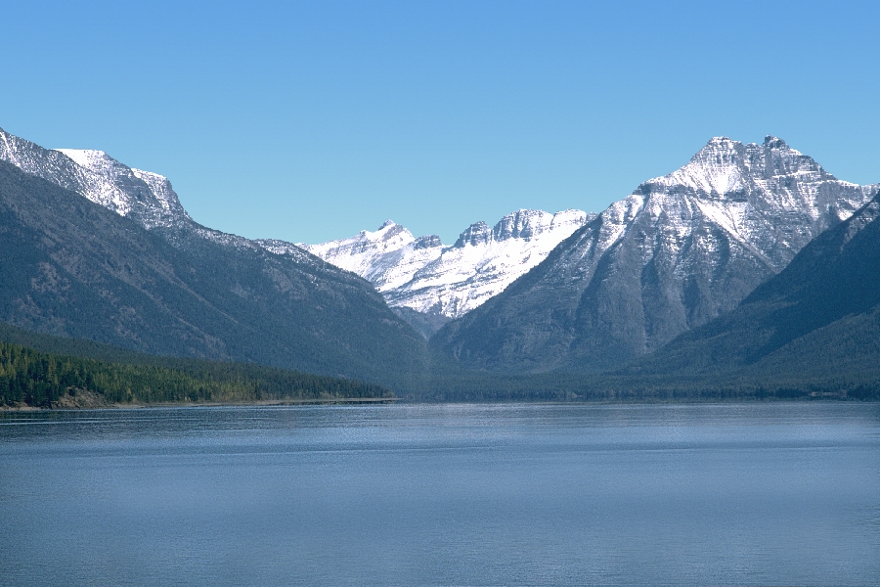
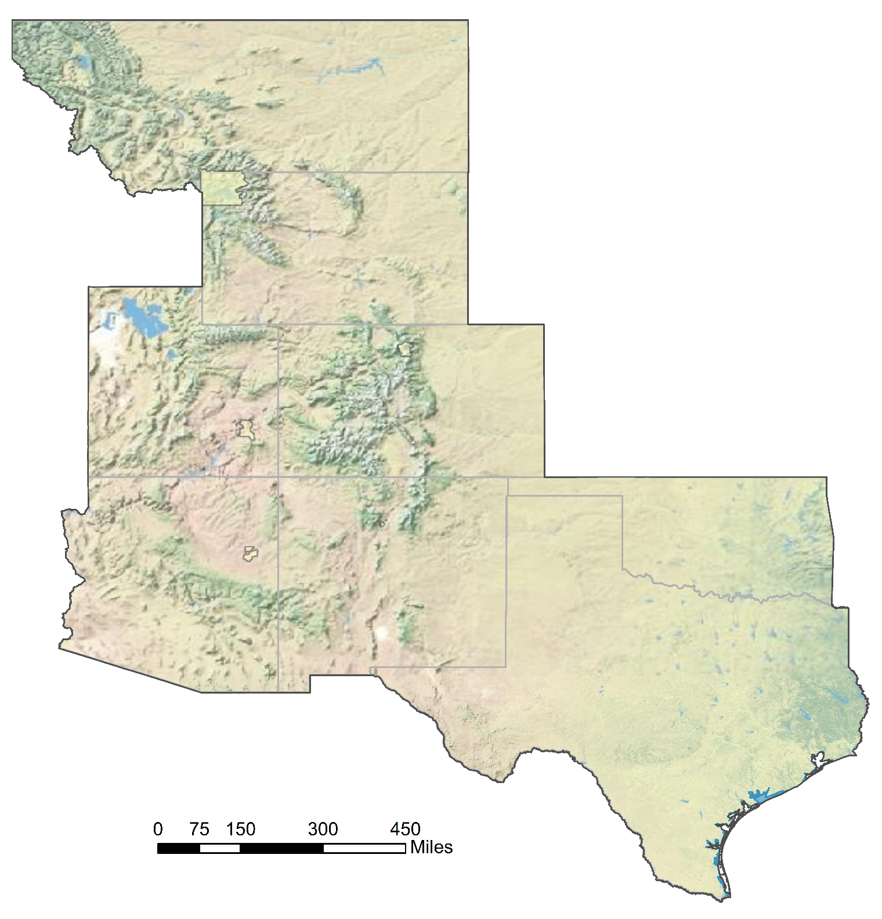
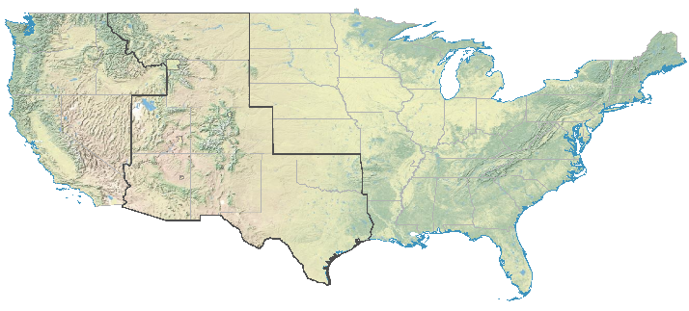
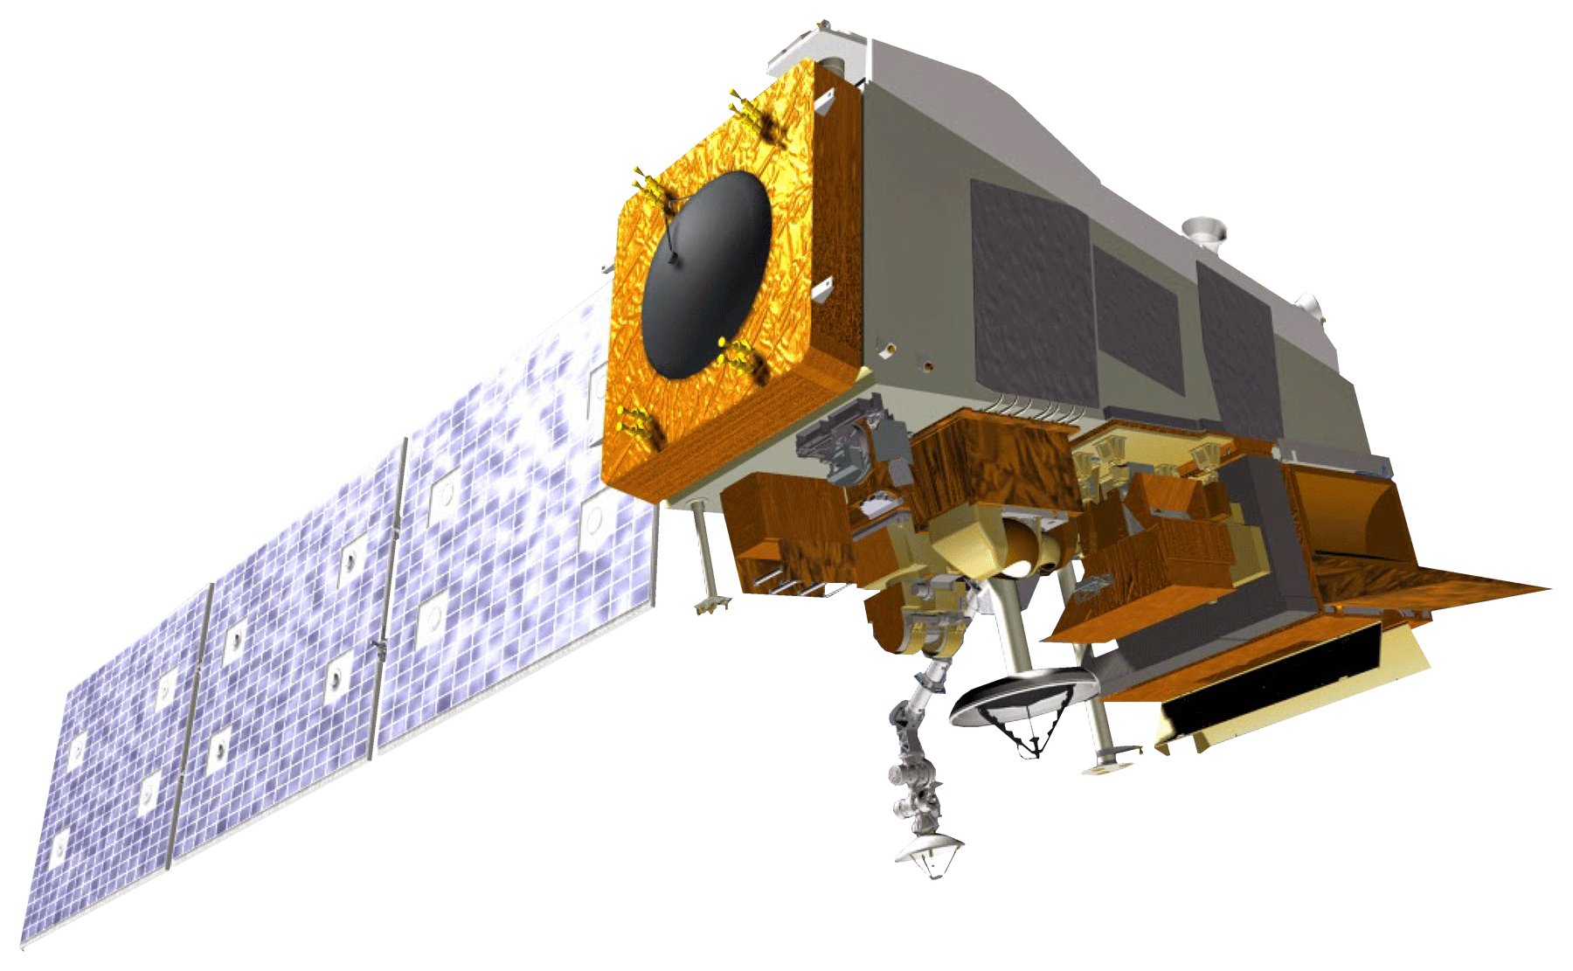
Utilizing NASA Earth Observations to Help the National Park Service Monitor and Address Visibility in Intermountain Region National Parks
Project Partner & Community Concerns
Abstract
Officials from the National Park Service are interested in understanding trends and changes in visibility across park landscapes because decreased visibility affects the experience and health of park visitors. The partner currently utilizes a limited number of in situ instruments to calculate estimates of visible range based on measured amounts of airborne particles.
The National Park Service (NPS) currently utilizes an interagency network of in situ aerosol monitoring stations to estimate light extinction and determine visibility across the public lands that it manages. With these well-defined particle masses and concentrations, the NPS makes estimates of visibility; however, their process is limited in scope because of the small number of monitoring stations and the fact that they only record measurements once every three days. This project focused on defining the empirical relationship between light extinction, calculated from these ground measurements, and satellite derived aerosol optical depth (AOD). The project team tested the feasibility of calculating visibility from Suomi National Polar-orbiting Partnership (NPP)’s Visible Infrared Imaging Radiometer Suite (VIIRS) and Aqua and Terra’s Moderate Resolution Imaging Spectroradiometer (MODIS) AOD data from 2013 to 2017. Using various regression methodologies, which also incorporated meteorological and atmospheric parameters, the team found that the MODIS data product correlates with ground truth data, giving R² values between 0.06009 and 0.3351. After applying the same methods to the VIIRS data product, R² values ranged between 0.0004629 and 0.04104. The discrepancy between the two products suggests that the VIIRS product is not suitable for this particular application; however, the underlying reason for this it not fully understood. The team applied these methods to seven NPS locations across the western United States and noted significant variability park-to-park, even when using the same data product, which is likely the result of local physiographic and meteorological factors. These findings will help the NPS expand their efforts to monitor visibility more broadly.
National Park Service
Intermountain Region
Haze formation can cause decreased visibility for the national parks, leading to visitor decreases. Aerosol pollution has harmful effects on human respiratory health and can negatively impact flora and fauna.
Varying Visibility in Glacier National Park, MT
Low Visibility Day
High Visibility Day
Objectives
Source: Federal Land Manager Environmental Database (FED)
Methodology
Provide the National Park Service with a methodology and resources to increase their understanding of visibility and atmospheric pollution
Extend monitoring capabilities beyond in situ instrumentation throughout the parks
Define empirical relationships between ground-measured light extinction and satellite-derived aerosol optical depth
Compare Suomi NPP VIIRS and Terra & Aqua MODIS data utility for the National Park Service’s monitoring needs
Suomi NPP VIIRS Data
MERRA-2
+
IMPROVE
+
gridMET
Process Imagery and Data
Calculate Polynomial Regression
Compare Regression Statistics
Analyze Outcomes
Terra & Aqua MODIS Data
Study Area & Period
Results
Intermountain West Region:
Includes 8 States: MT, WY, UT, CO, AZ, NM, OK, TX
Features 17 National Parks
ROMO
YELL
Study Period:
January 2013 through August 2017
0.0 0.2 0.4 0.6 0.8 1.0
0.0 0.2 0.4 0.6 0.8 1.0 1.2
MODIS AOD
MODIS AOD
0 50 100 150 200
0 50 100 150 200
IMPROVE B_{ext}
IMPROVE B_{ext}
0 75 150 300 450
ROMO
YELL
Miles
Frequency
Frequency
Earth Observations
0 50 100 150 200
0 50 100 150 200
IMPROVE B_{ext}
IMPROVE B_{ext}
ROMO
YELL
Suomi NPP VIIRS
Terra MODIS
Aqua MODIS
Frequency
Frequency
Acknowledgements
0.0 0.2 0.4 0.6 0.8 1.0
0.0 0.2 0.4 0.6 0.8 1.0
MODIS AOD
MODIS AOD
Conclusions
Dr. Kenton Ross, NASA Langley Research Center (Science Advisor)
Dr. Richard Ferrare, NASA Langley Research Center (Science Advisor)
William Patrick Frier, NASA DEVELOP Langley (Center Lead)
Lauren Childs-Gleason, NASA DEVELOP NPO (Operations Lead)
Debra Miller, National Park Service (Air Resource Specialist)
Anthony Prenni, National Park Service (Chemist, Air Resource Division)
Dr. Bruce Doddridge, NASA Langley Research Center (Former Science Advisor)
Chet Warren, NASA DEVELOP Langley (Former Project Lead)
Zac Peloquin, NASA DEVELOP Langley (Former Team Member)
Conclusions
MODIS can be used to model AOD and Extinction over IMPROVE sensor gaps, correlating better with in situ data than the VIIRS sensor.
Modeling is most skilled using a ln transformation, during the summer, and over dark targets.
Team Members
Kaitlyn McHenry
Project Lead
Annsley Adams
Jared Goldbach Ehmer
Intermountain Health & Air Quality II
Virginia – Langley| Fall 2018

