Slide 1
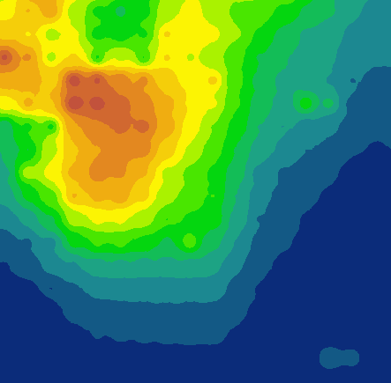
Utilizing NASA Earth Observations to Create a Precipitation Climatology of Jordan, Israel, and the West Bank to Identify Optimal Rainwater Harvesting Locations for Underserved Schools
Middle East Water Resources
Hannah Rosenblum (Project Lead)
Vishal Arya
Raghda El-Behaedi
Michael Sclater
Bradford Schroeder
Labreshia Mims
Notes:
Good morning we are the Middle East Water Resources Team.
Hi, my name is Hannah Rosenblum and I graduated from Clark University with a bachelor’s in Geography and Communications. I am currently pursuing my master’s degree in Geographic Information Science.
Hi my name is Vishal Arya and I graduated from UC Berkeley with a bachelor's in evolutionary biogeography and anthropology/GIS.
Hi my name is Didi El-Behaedi and I attend UNC Wilmington. I’m majoring in anthropology/archaeology with a minor in geospatial technologies.
Hi my name is Michael Sclater and I graduated from Virginia Tech with a bachelor's in Geography.
Hi my name is Labreshia and I graduated from Cornell University with a bachelor’s in International Policy, and I am currently a graduate student at Northeastern University studying International Relations and Economics. I am also one of the Air Force volunteers this term.

Slide 2
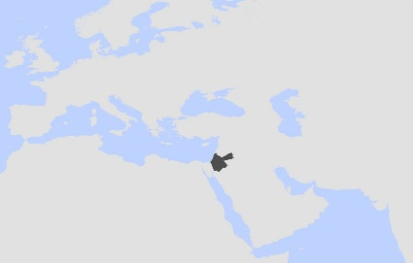
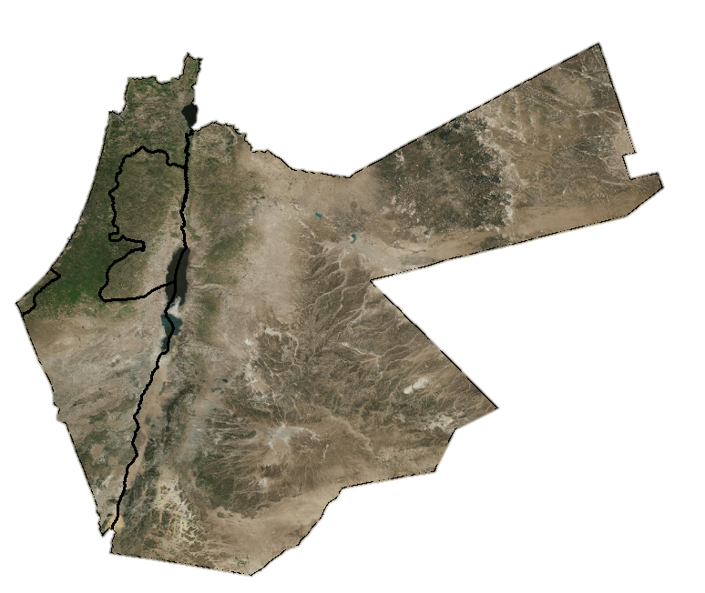
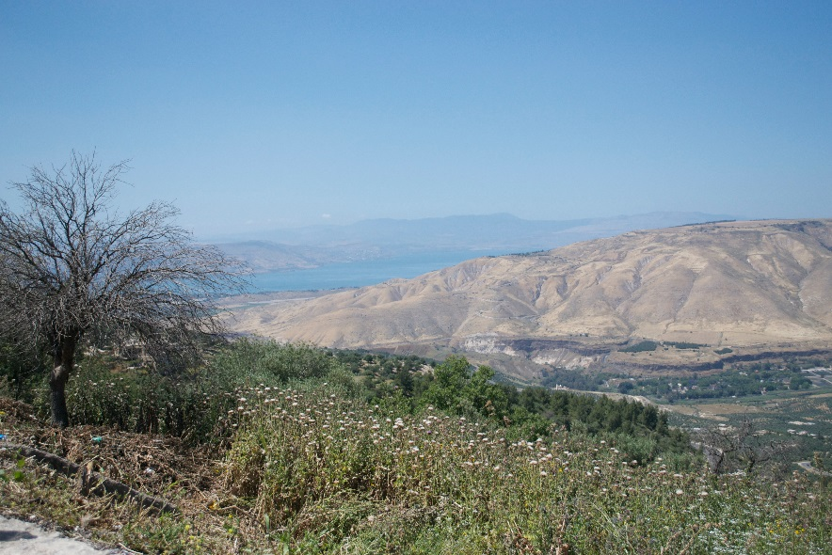
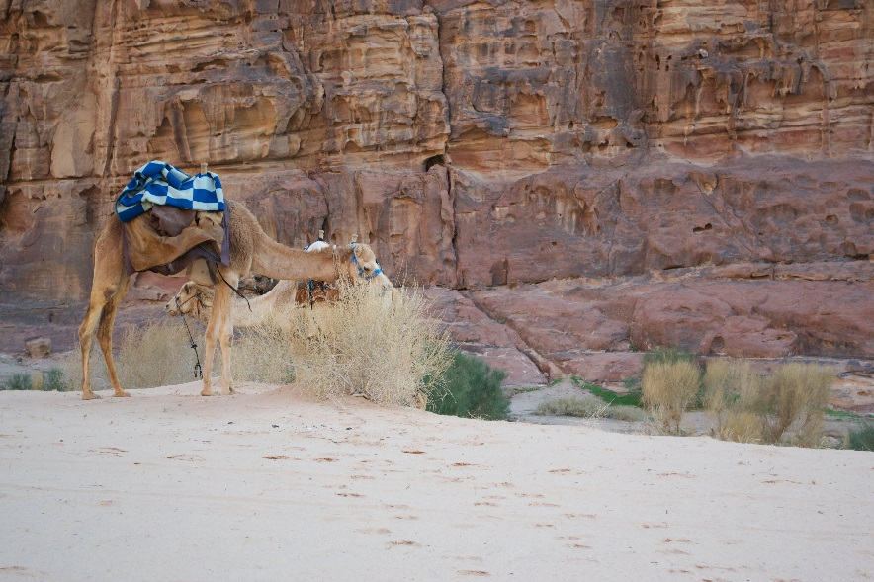
Study Area
Notes:
Our study area includes Israel, the West Bank, and Jordan, where the climate varies considerably from the north, which has a warm Mediterranean climate to, the south, which has a dry, desert climate.

Slide 3
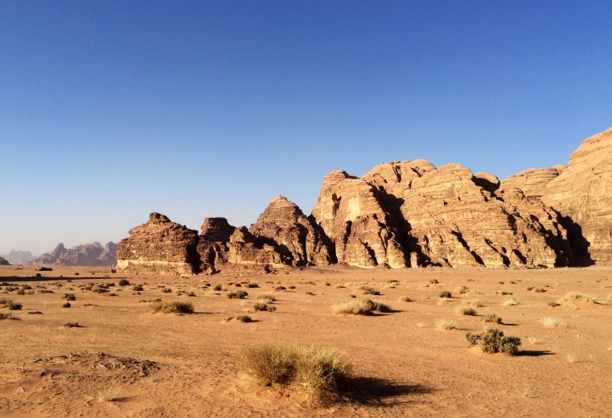
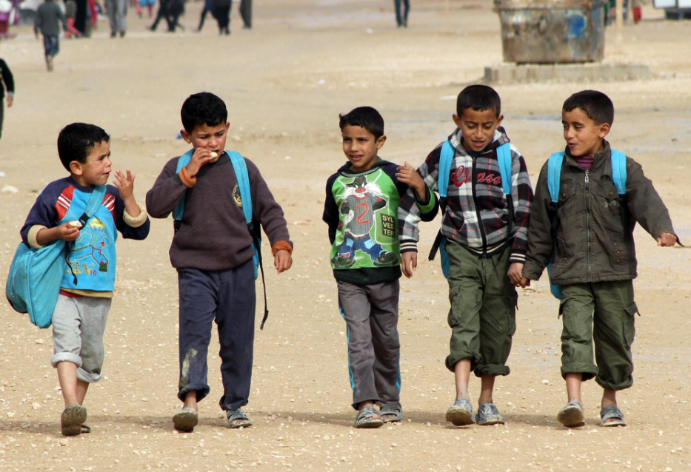
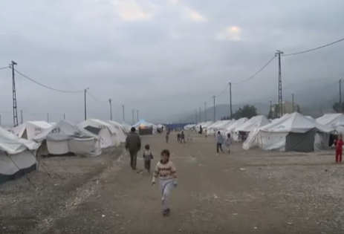
Community Concerns
Arid climate with limited surface and groundwater
Insufficient water for sanitation at schools
Predicted changes in precipitation
Image Credits: Hannah Rosenblum, Zuzana Pokrievkova, Emilie Evans
Notes:
*Click*
The combination of an arid climate with limited ground or surface water means there is very little water available in the region.
*Click*
At some schools, there has been insufficient water resources for sanitation purposes, which has forced some to close temporarily.
*Click*
Additionally, as the climate changes, it is predicted that the Levant will experience a decrease in precipitation as well as an increase of surface temperatures, which indicates further diminishment of water resources.

Slide 4
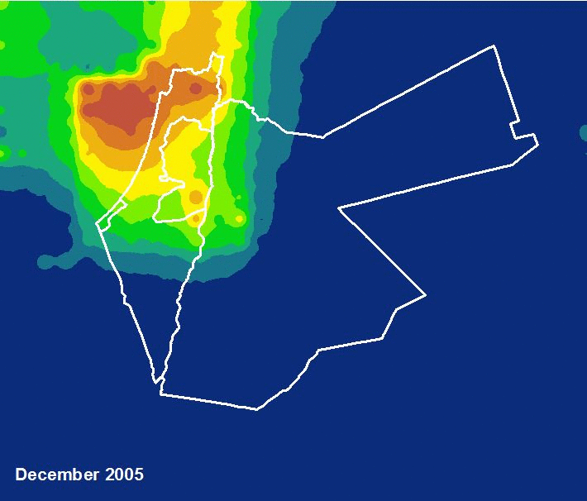
Objectives
Identify and analyze patterns in rainfall in Israel, Jordan, and the West Bank
Develop an interactive interface to enhance WRAP’s decision-making process and educational resources
Image credit: WRAP
Notes:
Our objectives were to identify and analyze patterns of rainfall in Israel, Jordan, and the West Bank, and to develop an interactive interface to enhance WRAP’s decision-making process and educational resources.

Slide 5
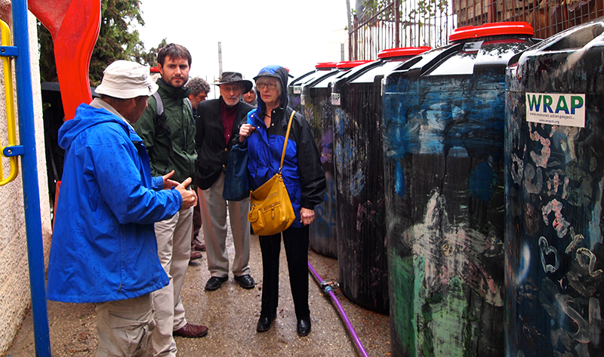
Water Resources Action Project (WRAP)
Non-profit organization
Operates in the Middle East
Provides and installs rain barrels and cisterns
Educates students on water resources
Currently, partnered with 25 schools
Image credit: WRAP
Image credit: WRAP
Image credit: WRAP
Image credit: WRAP
Notes:
The Water Resources Action Project (WRAP) is a non-profit organization that operates in the Middle East. Formed in 2007, WRAP responds to local concerns by providing rain barrels and cisterns to underserved schools in the region to increase their water resources for sanitation purposes, particularly toilet flushing.

Slide 6
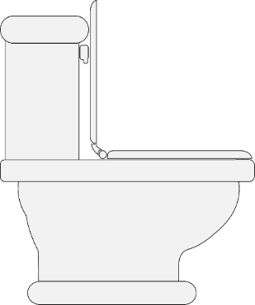
WRAP’s Rainwater Harvesting Process
مدرسة ا لافاق
ביה"ס אפאק
Notes:
*Click*
Here we see the rainwater harvesting process. The rain falls off the school’s roof into barrels or cisterns and, using a series of pipes, the water is transported to the toilets in the schools to be used for flushing.

Slide 7
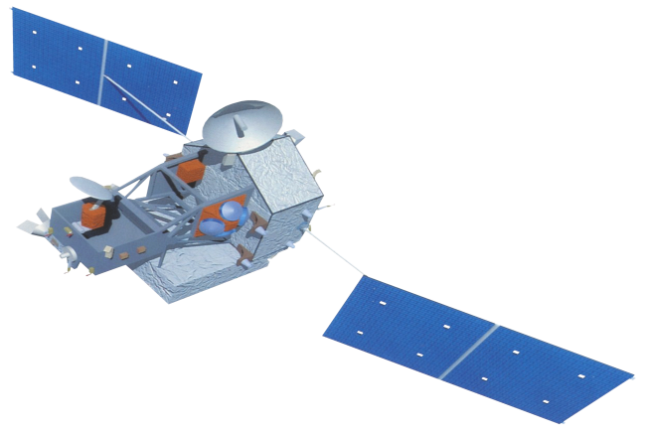
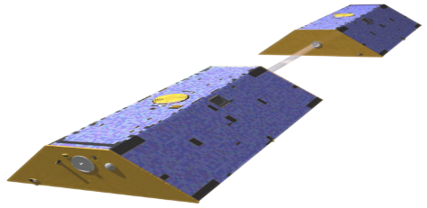
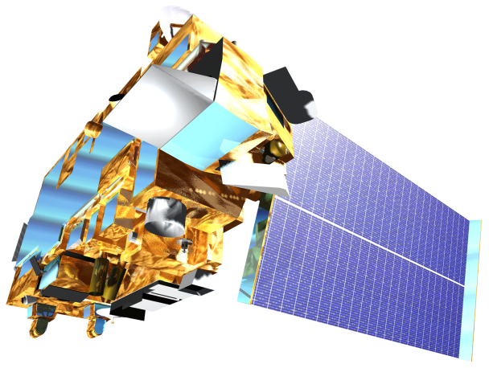
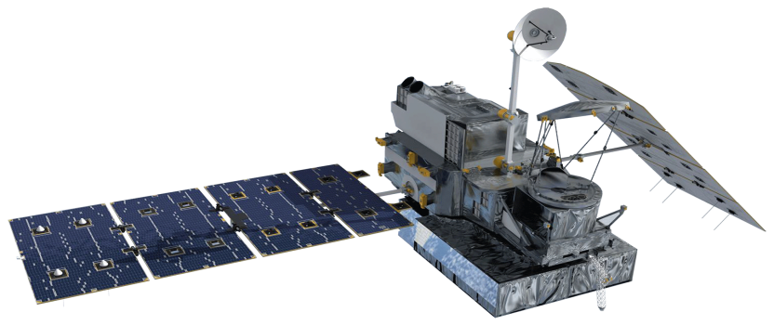
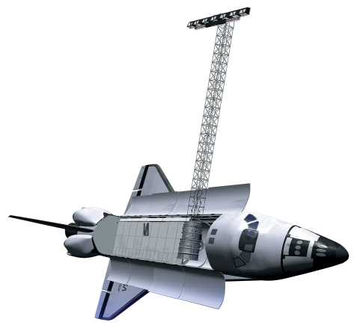
NASA Earth Observations
GRACE
Groundwater
TRMM
Precipitation
MODIS
Evapotranspiration
SRTM
Elevation
GPM
Precipitation
Image credit: Psychsearch.net
Notes:
Our interface incorporates data from several NASA Earth Observations. We retrieved precipitation data from TRMM
*Click*
and GPM (Global Precipitation Measurement)
*Click*
groundwater data from GRACE,
*Click*
evapotranspiration data from MODIS Terra,
*Click*
and elevation data from SRTM.

Slide 8
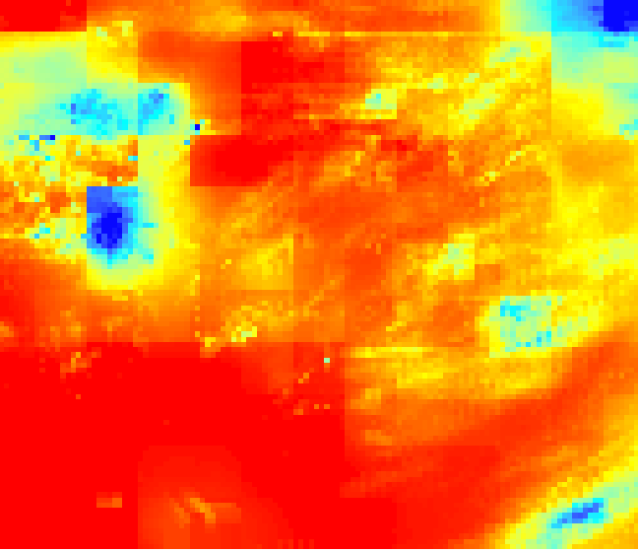
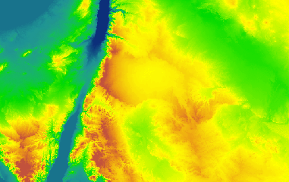
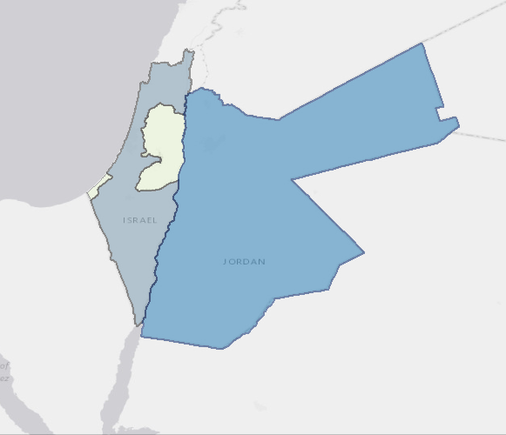
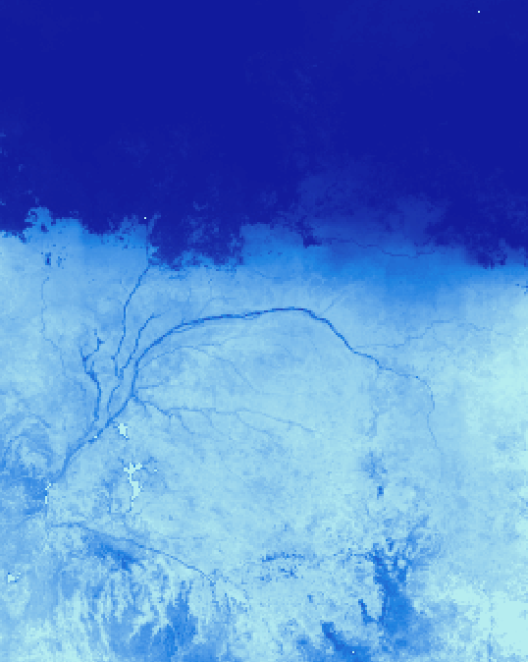
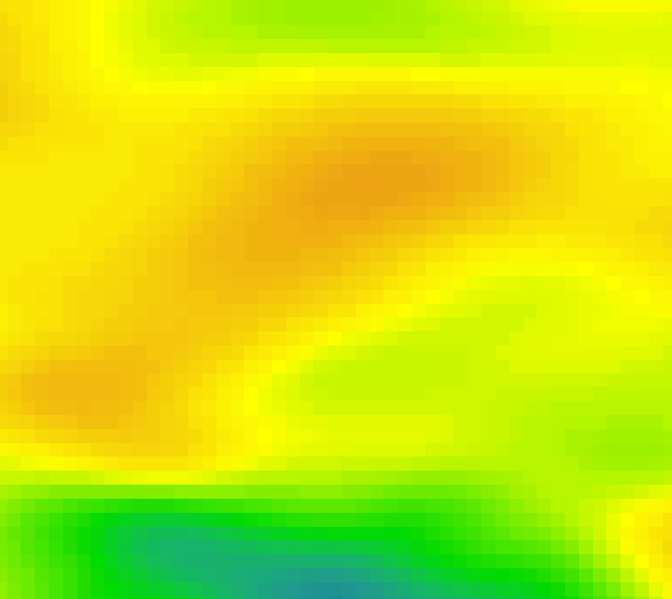
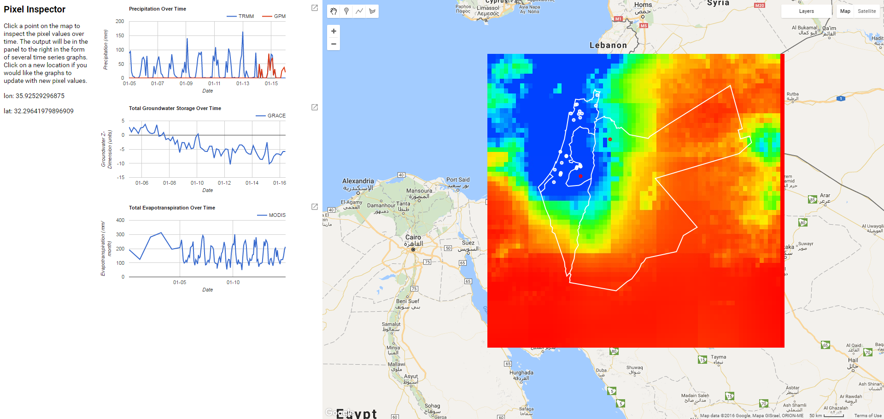
Methodology
Datasets
Data Processing
Analysis
Precipitation
1. Clip to study area extent
Validated data with NOAA NCDC rain gauge data
TRMM & GPM
Elevation
Climatology Creation
SRTM
Types of Analysis:
1. Visual comparisons
2. Statistical analysis
3. Graphical analysis
Evapotranspiration
MODIS
2. Convert precipitation layers from rates to amounts
Groundwater
GRACE
1. Create image collections
2. Code data to display
3. Assign color palettes
4. Implement chart functionality
5. Test interface
Interface Development
Notes:
We began by clipping all of our datasets to out study area extent, and for the precipitation data, we converted the rasters from precipitation rates to actual amounts
We conducted a validation of the TRMM and GPM data with NOAA rain gauge data.
To find trends in the precipitation data, we made visual comparisons and conducted statistical and graphical analyses.
At the same time, we started developing the interface, which included uploading the data, displaying it, assigning unique color palettes for the various data sets, implementing the chart functionality, and testing and perfecting the interface, which in the end comprised of over 120 lines of code in JavaScript.

Slide 9
Validation Results
Highest correlation with validation rain gauge station
Notes:
When conducting validation of GPM and TRMM, Rain station “Ben Gurion” had the highest correlation between satellite data and rain gauge data. With GPM, in particular having a very high R-squared of 0.99.

Slide 10
Validation Results
Lowest correlation with validation rain gauge station
Notes:
However, station “H4” had the lowest correlation between satellite data and rain gauge values with an R-squared value of 0.21 for TRMM and 0.0137 for GPM, which are both very low.

Slide 11
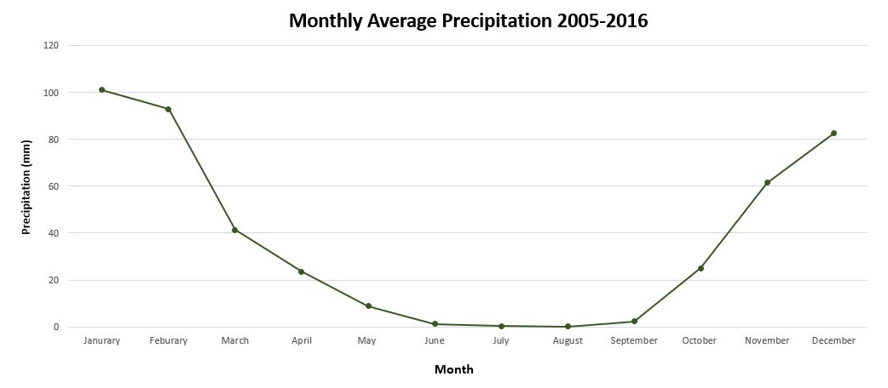
Precipitation
Notes:
Overall, the precipitation decreased from January to June and plateaued until September, where it started to increase again. This is telling of the obvious changes in rainfall from the rainy season to the dry season.

Slide 12
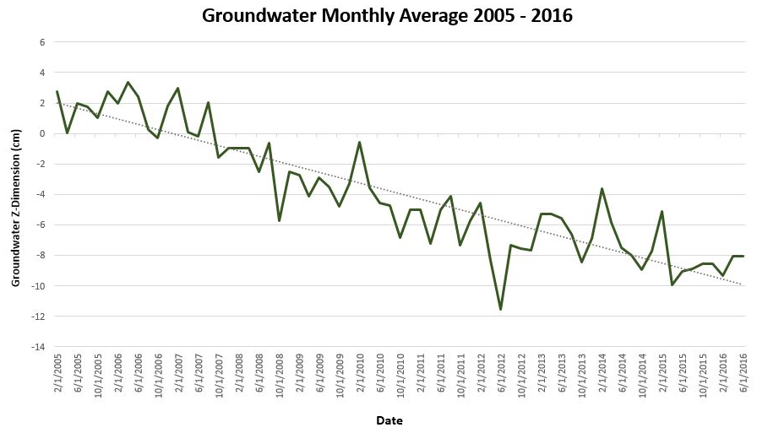
Groundwater
Notes:
The amount of groundwater in our study area is continuously decreasing, with an evident drop in June 2012, which was during a profound drought.

Slide 13
PrIME (Precipitation Interface for the Middle East)
Notes:
PrIME, the Precipitation Interface for the Middle East, can be easily accessed through a shared link. As you can see, the interface automatically loads the layers of elevation, evapotranspiration, groundwater, precipitation, school points, and a study area polygon, and it automatically centers on our region of interest. The layers can be turned on and off as the user wishes. The user can click on any point and the interface will return three charts, which show the precipitation, groundwater, and evapotranspiration at that point over the last ten years. These charts can then be exported as images or in a tabular format for further analysis.

Slide 14
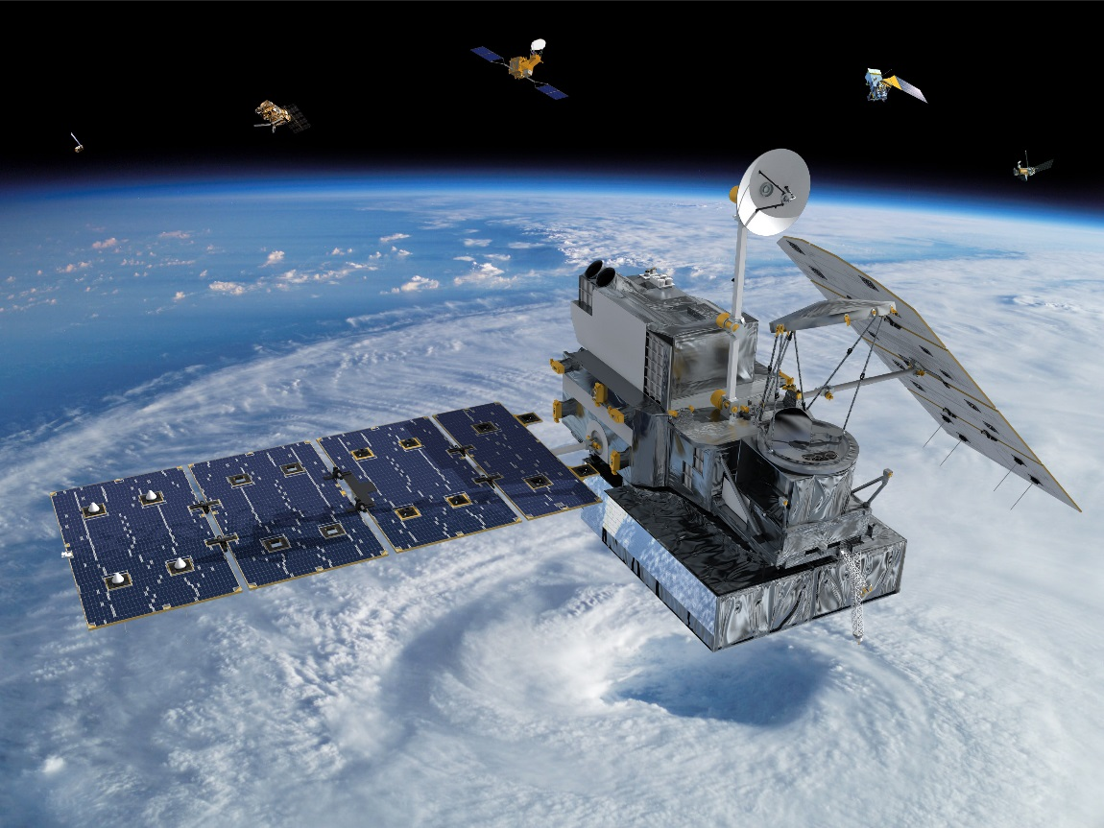
Errors and Uncertainties
TRMM and GPM are calibrated to tropical areas, are less accurate in areas with trace amounts of rainfall
Conversion from rates to amounts assumes that precipitation falls at a constant rate
Image credit: NASA
Notes:
As we mentioned before, some of the drier weather stations had a lower correlation with the remotely sensed data. This is because TRMM and GPM are both calibrated for tropical areas, therefore, they are less accurate in areas with trace amounts of rainfall such as the arid Middle East.
Additionally, the conversion from a rate to amount assumes that precipitation falls at a constant rate.

Slide 15
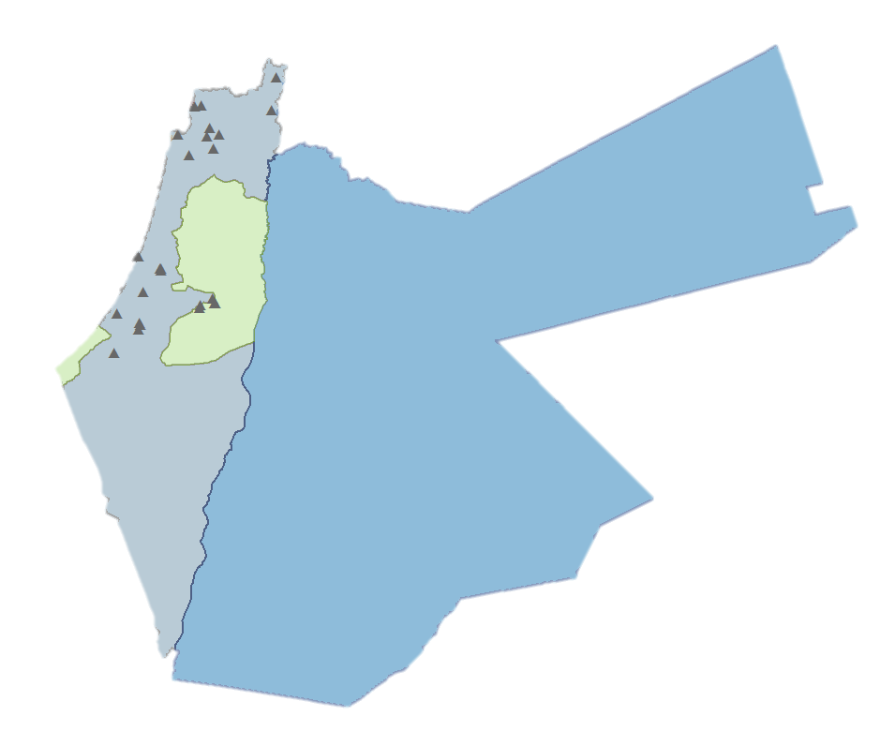
Conclusions
Ease of access and use supports decision making regarding rainwater harvesting
Allows for continuous monitoring of climatological trends in the region
Notes:
With this tool, WRAP has the capability to extract the historical precipitation at the schools they work with and potential partner schools.
Because of PrIME’s accessibility, WRAP can easily incorporate NASA Earth observations to enhance their decision-making process.
And, what is significant about this tool is that it can continue to be used in the future, as users can import data and monitor trends.

Slide 16
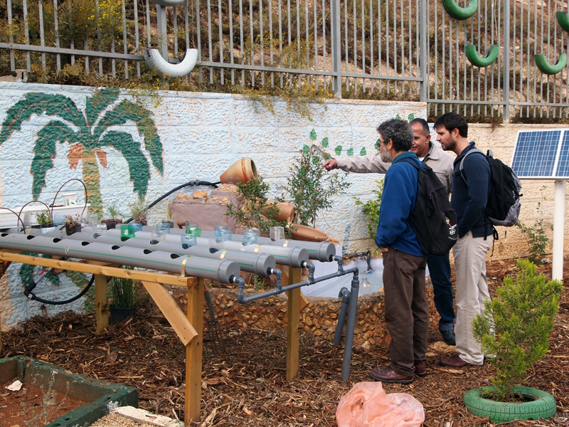
Future Work
Additional Datasets:
Teleconnections, such as North Sea Caspian Pattern
Population density
Land surface temperature
Image credit: WRAP
Image credit: WRAP
Notes:
Looking ahead, additional datasets can be added in the future: in particular, teleconnections, population density and land surface temperatures.

Slide 17
Brendan McGinnis, Water Resources Action Project (WRAP) Founder & Executive Director
Dr. Kenton Ross, NASA DEVELOP National Program Science Advisor
Mike Bender, NASA DEVELOP National Program Technical Lead
Emily Gotschalk, NASA DEVELOP LaRC Center Lead
Tyler Rhodes, NASA DEVELOP LaRC Center Lead
Kathleen Moore, NASA DEVELOP LaRC Assistant Center Lead
Jordan Vaa, NASA DEVELOP Information Technologies Fellow
Jenna Hawkins, NASA DEVELOP Graphic Design
Carrie Kelly, NASA DEVELOP Graphic Design
Notes:
Thanks to you all, to our partner Brendan McGinnis at WRAP, and to our science advisor, teammates, and support at the Langley node.

