Slide 1
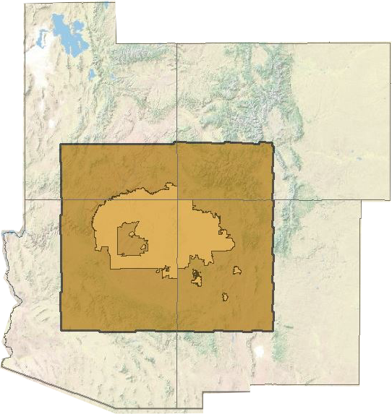
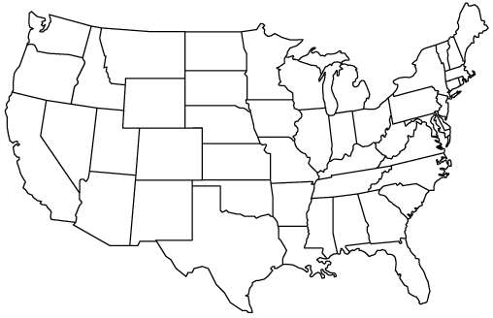
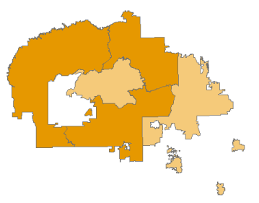
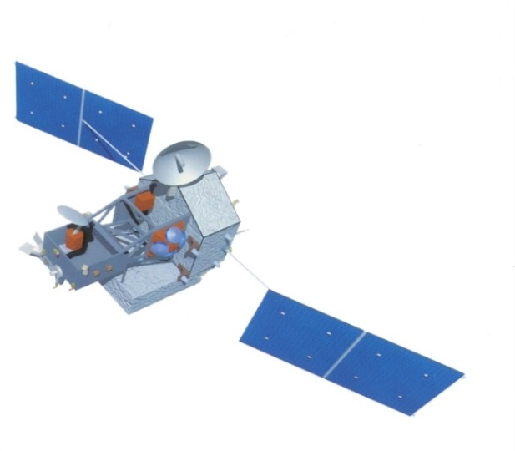
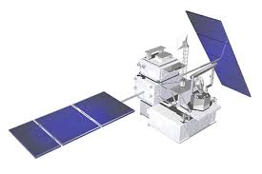
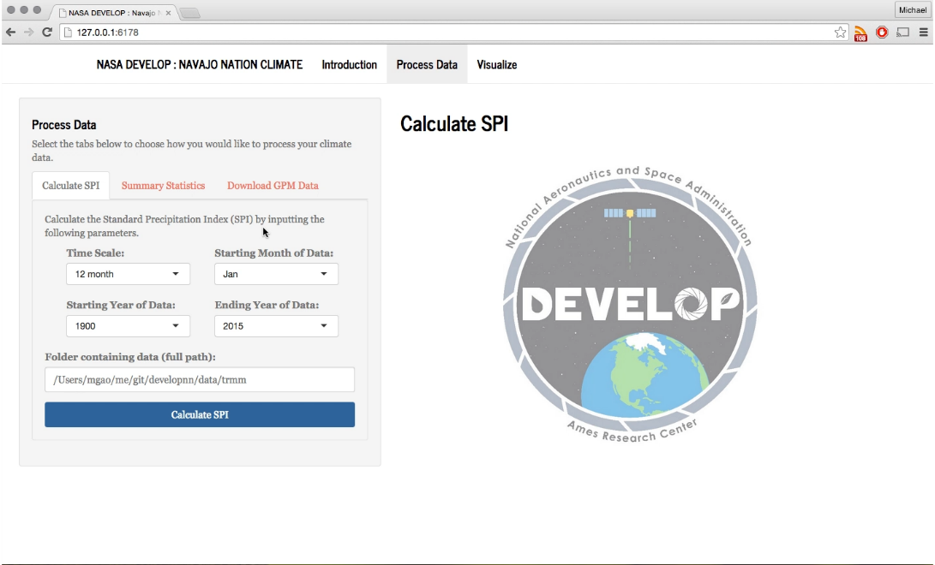
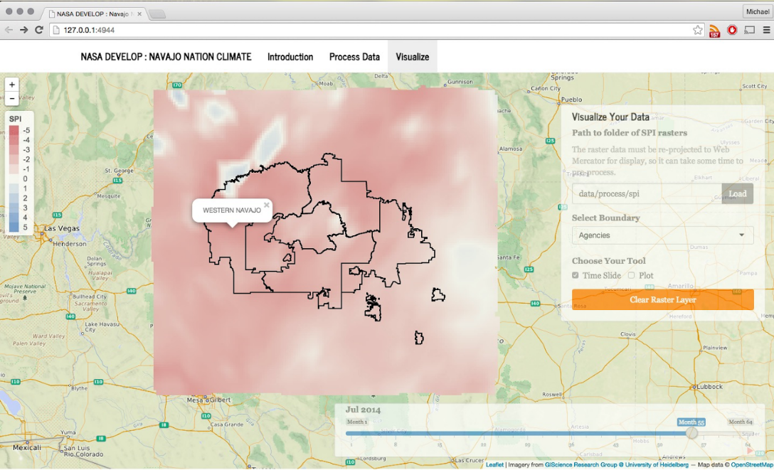
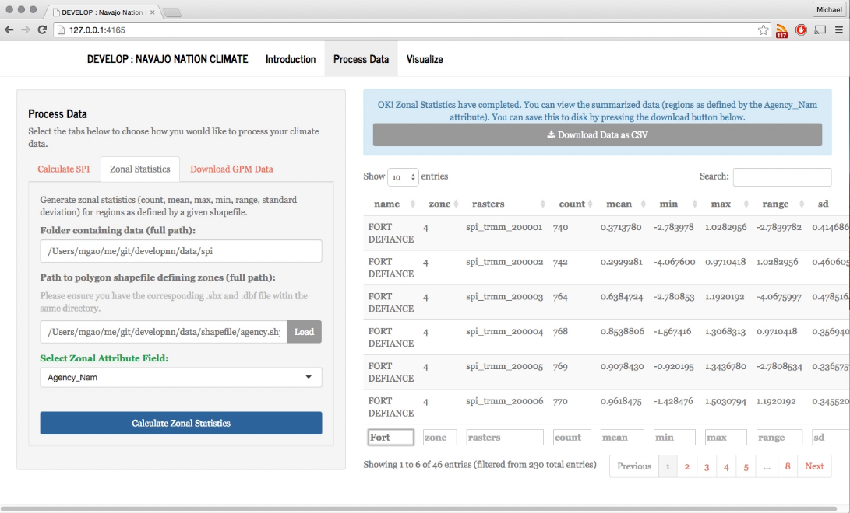
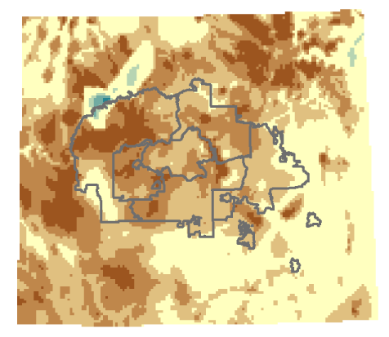
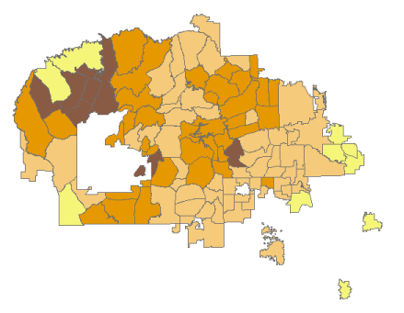
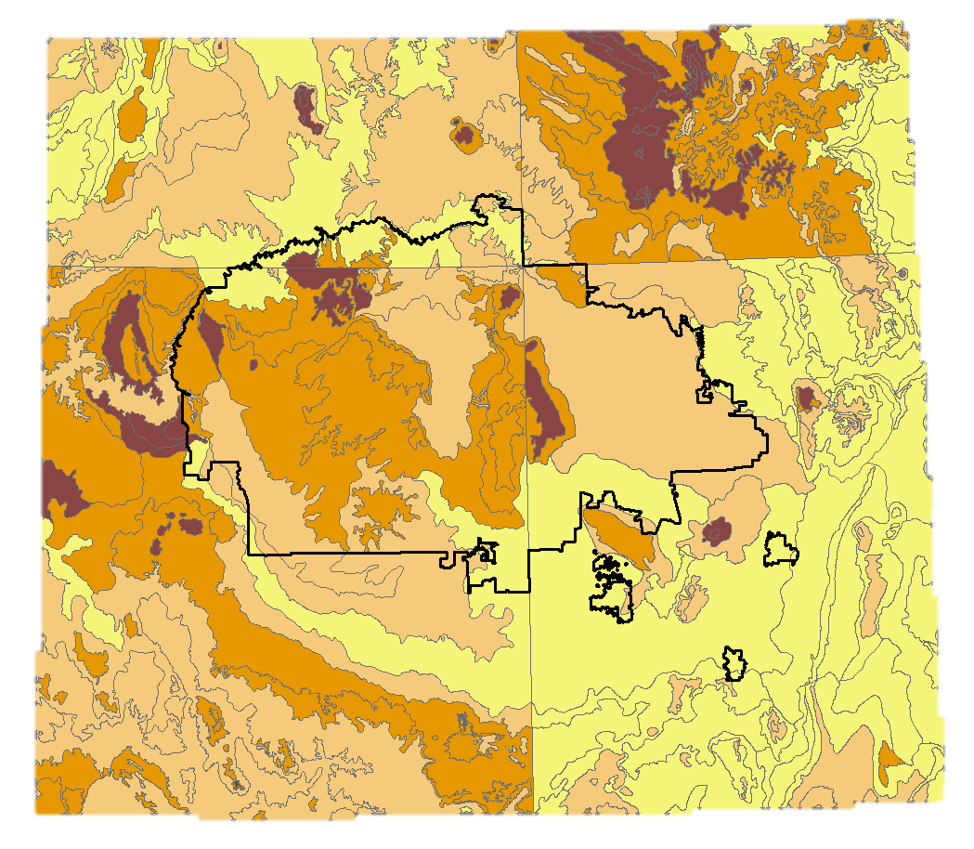
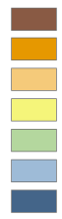

Navajo Nation Climate II
Monitoring Drought Conditions in the Navajo Nation using NASA Earth Observations
Cheryl Cary¹ (Project Lead), Michael Gao¹, Vickie Ly¹, Anton Surunis¹, Sophie Turnbull-Appell¹
¹DEVELOP National Program
Abstract
Objective
The Navajo Nation, a 65,700 km² Native American territory located in the southwestern United States, has been increasingly impacted by severe drought events and changes in climate. These events are coupled with a lack of domestic water infrastructure and economic resources, leaving approximately one-third of the population without access to potable water in their homes. Current methods of monitoring climate and drought are dependent on national-scale state-based monthly drought maps calculated by the Western Regional Climate Center. These maps do not provide the spatial resolution needed to illustrate differences in drought severity across the vast Nation. To better understand and monitor drought events and drought regime changes in the Navajo Nation, this project investigated methodologies to create a tool that calculates Standard Precipitation Index rasters for the study area, and created a geodatabase of historical climate information for use by the tool. The tool and geodatabase use Tropical Rainfall Measurement Mission and Global Precipitation Measurement observed precipitation data, and Parameter-elevation Relationships on Independent Slopes Model modeled historical precipitation data. These products allow resource managers in the Navajo Nation to utilize current and future NASA Earth observation data for increased decision-making capacity regarding future climate change impact on water resources.
Create a drought-related Decision Support Tool specific to Navajo Nation boundaries
Study Area
The Navajo Nation is a 65,700 km² Native American territory located at the intersection of Arizona, Utah, New Mexico, and Colorado.
Methodology
Drought Severity Assessment – Decision Support Tool:
Precipitation Rasters
SPI Algorithm
SPI Rasters
-1.7
-1.2
-1.5
Earth Observations
Precipitation
Pixels
SPI
Pixels
-1.8
-1.4
Tropical Rainfall Measuring Mission (TRMM)
Calculate SPI Values
Visualize Drought Severity
Calculate Summary Statistics
Global Precipitation Measurement (GPM)
Conclusions
SPI values specific to Navajo Nation boundaries will support decisions on resource allocation and drought mitigation efforts.
Built-in GPM downloading/processing allows for continued up-to-date tool and NASA Earth Observation data.
User-specified boundary input statistics allow for historical drought severity analysis, as well as modification for future interests such as watersheds within Reservation land.
Creates 6-, 12-, 18-, and 24- month SPI Rasters from a database of historical precipitation raster data.
Allows users to view SPI rasters though time.
Calculates basic SPI statistics based on user entered boundaries, as well as what percentage of a boundary is experiencing specific drought severities.
Results
Water Managers in the Navajo Nation Department of Water Resources can use the outputs from this tool to create drought maps specific to chosen boundaries to support drought mitigation, and resource allocation decisions. They can also use the tool with ecoregion boundaries for research purposes. Here is an example of such analysis for July 2014
Drought Severity / Corresponding SPI Values
Extremely Dry (SPI: ≤ -2.00)
Severely Dry (SPI: -1.99 to -1.50)
Moderately Dry (SPI: -1.49 to -1.00)
Near Normal (SPI: -0.99 to 0.99)
Moderately Wet (SPI: 1.00 to 1.49)
Severely Wet(SPI: 1.50 to 1.99)
Classified Drought Severity Raster
July 2014
Average Agency Drought Severity
July 2014
Average Chapter Drought Severity
July 2014
Average EPA Ecoregion 4
Drought Severity July 2014
Extremely Wet (SPI: ≥ 2.00)
Team Members
Project Partners
Acknowledgements
Robert Kirk, Principal Hydrologist, Navajo Nation Department of Water Resources, Water Management Branch
Teresa Showa, Principal Hydrologist, Navajo Nation Department of Water Resources, Water Management Branch
Jason John, Principal Hydrologist, Branch Director, Navajo Nation Department of Water Resources, Water Management Branch
Maurice Upshaw, GIS Supervisor, Navajo Nation Department of Water Resources, Water Management Branch
Ramsey Seweingyawma, Navajo Technical University
Clayton Sodergren, NASA DEVELOP National Program
Amber Brooks, NASA DEVELOP National Program
Dr. Jay Skiles, NASA Ames
Dr. Venkat Lakshmi, South Carolina University
Andrew Nguyen, NASA DEVELOP National Program
Chippie Kislik, NASA DEVELOP National Program
Amber Jean Kuss, Bay Area Environmental Research Institute (BAERI)
Cindy Schmidt, Bay Area Environmental Research Institute (BAERI)
Vickie Ly, Michael Gao, Anton Surunis,
Cheryl Cary (Project Lead), Sophie Turnbull-Appell
NASA Ames Research Center

