Slide 1
Great Lakes Climate II
Impact of Decreasing Lake Water Levels on Great Lakes Wetlands
Emily Adams (Project Lead)
Idamis Del Valle Martínez
Miriam Harris
Stephen Zimmerman

Slide 2
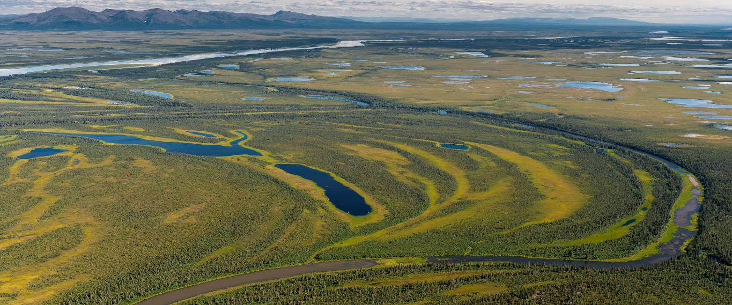
Wetlands
Link between terrestrial and aquatic ecosystems
Wetland extent decreased up to 90%
Ecological and economic benefits:
  Filtration
  Ground water recharge
  Biological diversity
  Tourism
Photo by Neal Herbert, Creative Commons by 2.0
Photo by Miriam Harris, Sandy Bottom State Park, Hampton, VA
Notes:
Wetlands are located at the interface of aquatic and terrestrial ecosystems. Globally, wetland extent has decreased up to 90% due to human activities including dredging, ditching, and filling. There are many ecological and economic benefits of wetlands including filtering water, serving as ground water recharge points, supporting diverse biota and tourism. Wetlands also serve as natural carbon sinks.

Slide 3
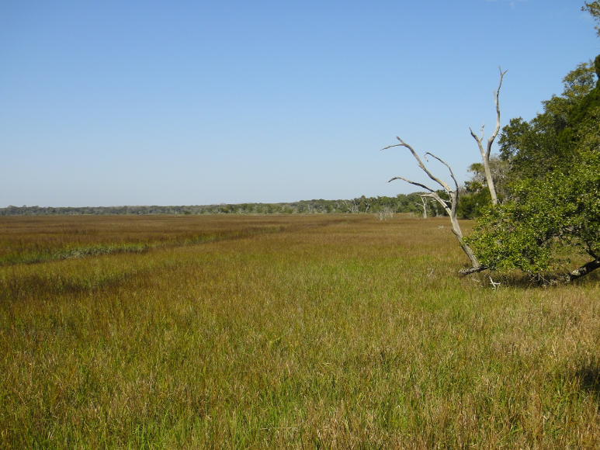
Wetlands
Link between terrestrial and aquatic ecosystems
Wetland extent decreased up to 90%
Ecological and economic benefits:
  Filtration
  Ground water recharge
  Biological diversity
  Tourism
Photo by Miriam Harris, Sandy Bottom State Park, Hampton, VA
Photo by Miriam Harris
Notes:
Wetlands are located at the interface of aquatic and terrestrial ecosystems. Globally, wetland extent has decreased up to 90% due to human activities including dredging, ditching, and filling. There are many ecological and economic benefits of wetlands including filtering water, serving as ground water recharge points, supporting diverse biota and tourism. Wetlands also serve as natural carbon sinks.

Slide 4
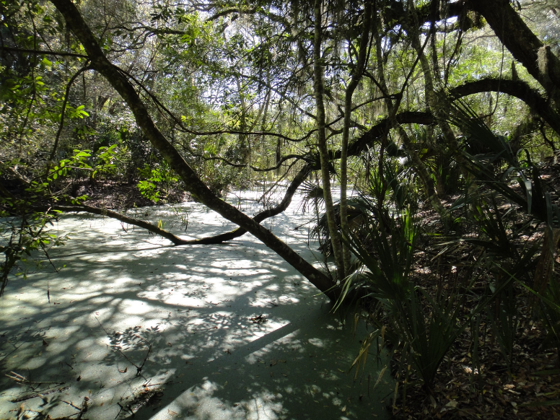
Wetlands
Link between terrestrial and aquatic ecosystems
Wetland extent decreased up to 90%
Ecological and economic benefits:
  Filtration
  Ground water recharge
  Biological diversity
  Tourism
Photo by Miriam Harris, Sandy Bottom State Park, Hampton, VA
Photo by Miriam Harris
Notes:
Wetlands are located at the interface of aquatic and terrestrial ecosystems. Globally, wetland extent has decreased up to 90% due to human activities including dredging, ditching, and filling. There are many ecological and economic benefits of wetlands including filtering water, serving as ground water recharge points, supporting diverse biota and tourism. Wetlands also serve as natural carbon sinks.

Slide 5
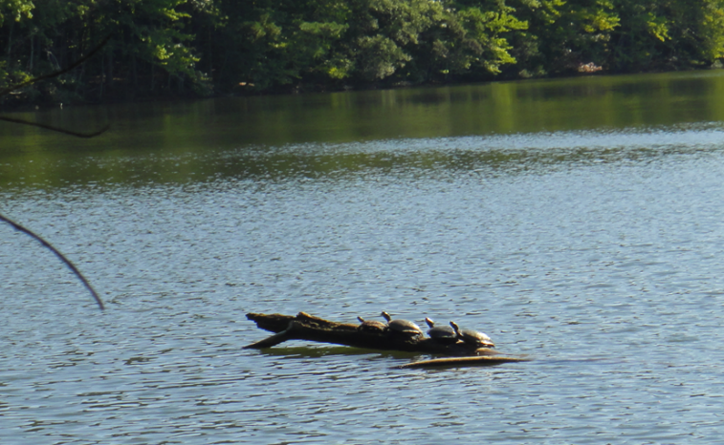
Wetlands
Link between terrestrial and aquatic ecosystems
Wetland extent decreased up to 90%
Ecological and economic benefits:
  Filtration
  Ground water recharge
  Biological diversity
  Tourism
Photo by Miriam Harris
Photo by Miriam Harris, Sandy Bottom State Park, Hampton, VA
Notes:
Wetlands are located at the interface of aquatic and terrestrial ecosystems. Globally, wetland extent has decreased up to 90% due to human activities including dredging, ditching, and filling. There are many ecological and economic benefits of wetlands including filtering water, serving as ground water recharge points, supporting diverse biota and tourism. Wetlands also serve as natural carbon sinks.

Slide 6
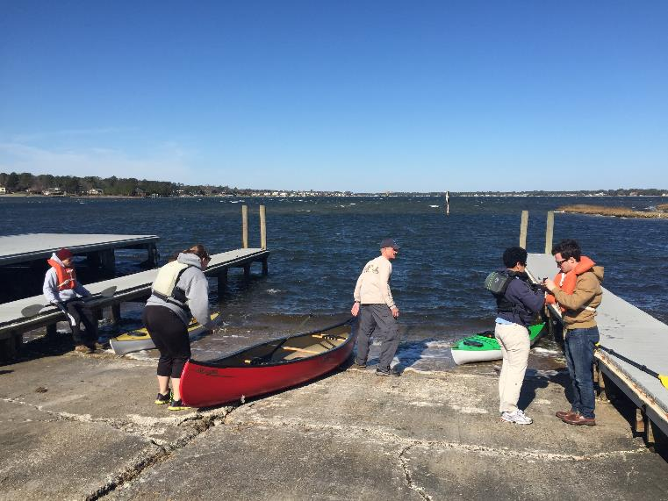
Wetlands
Link between terrestrial and aquatic ecosystems
Wetland extent decreased up to 90%
Ecological and economic benefits:
  Filtration
  Ground water recharge
  Biological diversity
  Tourism
Photo by Idamis Del Valle Martinez
Photo by Miriam Harris, Sandy Bottom State Park, Hampton, VA
Notes:
Wetlands are located at the interface of aquatic and terrestrial ecosystems. Globally, wetland extent has decreased up to 90% due to human activities including dredging, ditching, and filling. There are many ecological and economic benefits of wetlands including filtering water, serving as ground water recharge points, supporting diverse biota and tourism. Wetlands also serve as natural carbon sinks.

Slide 7
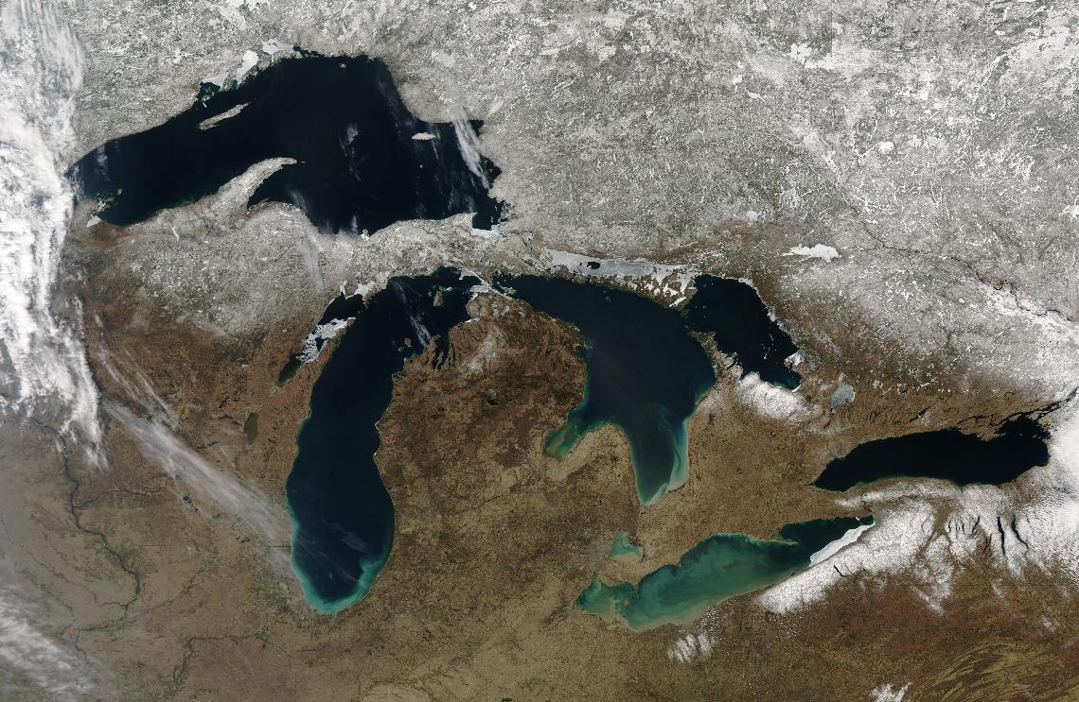
Great Lakes
Largest source of fresh water
Wetlands cover an area of 1700 km²
Lake Superior
Georgian Bay
Lake Huron
Lake Michigan
Lake Ontario
Lake Erie
Photo by Jeff Schmaltz, MODIS Rapid Response Team, NASA/GSFC
Notes:
The great lakes region is the largest freshwater resource in the world and has over 1700 square kilometers of wetlands. However climate change could be having an effect on the health and extent of wetlands

Slide 8
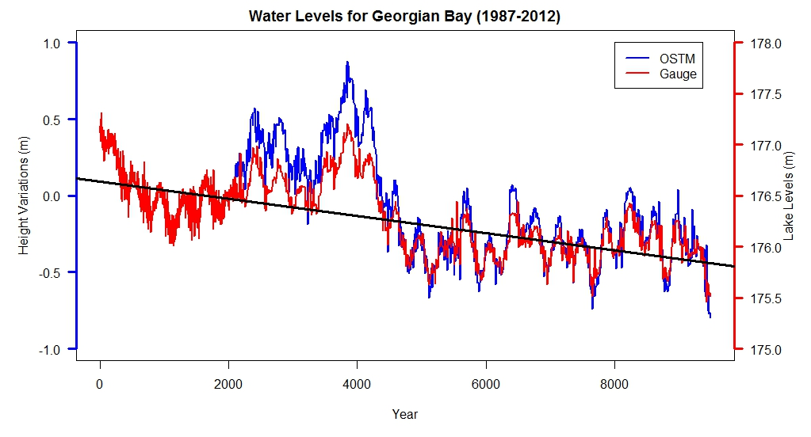
Water Levels in the Great Lakes
Fluctuations due to climate variability
  Vegetation adapts to these changes
R² = 0.95
1987
1992
1997
2003
2008
Notes:
Water level fluctuations in the Great Lakes are dictated by climate variability. Lake levels for Lake Huron typically show oscillations that the wetlands have adapted to. However, lake levels have been below the long term average since 1987. It is unknown how these changes will affect wetlands. Here, we show Jason satellite data and in situ water gauge measurements. Landsat images were then selected for Georgian Bay based on historic high and historic low water levels.

Slide 9
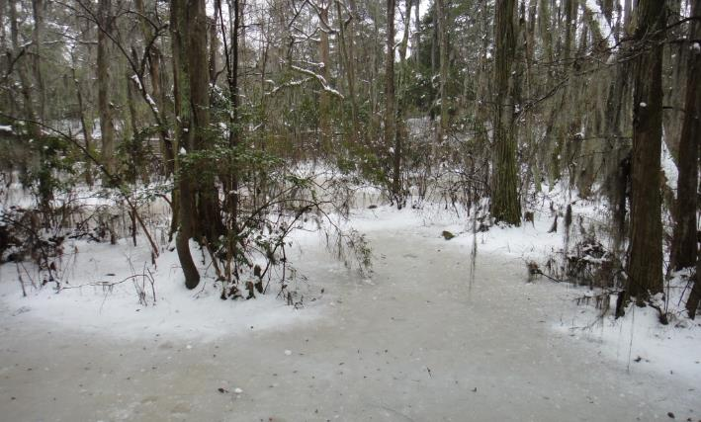
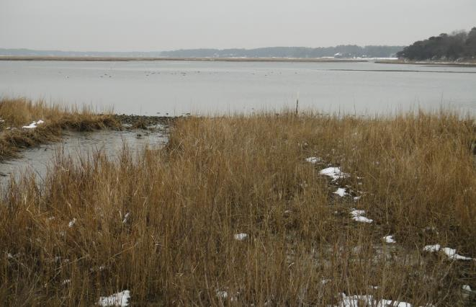
Community Concerns
Decreasing lake levels
Wetland degradation and loss
Climate change may impact wetland’s:
  Hydrologic cycle
  Biological diversity and tourism
Photo by Miriam Harris, Sandy Bottom State Park, Hampton, VA
Photo by Miriam Harris
Photo by Miriam Harris
Notes:
The decreasing lake levels, along with anthropogenic influences such as urban development, might be leading to wetland loss affecting the environmental health of the region as well as ecotourism. Furthermore, climate change models predict continuing water level decreases. Also, a changing climate will likely modify the hydrologic cycle of the Great Lakes. Therefore, understanding how wetland extent has changed over time with respect to changing water levels will help policy makers design and implement wetland protection strategies.

Slide 10
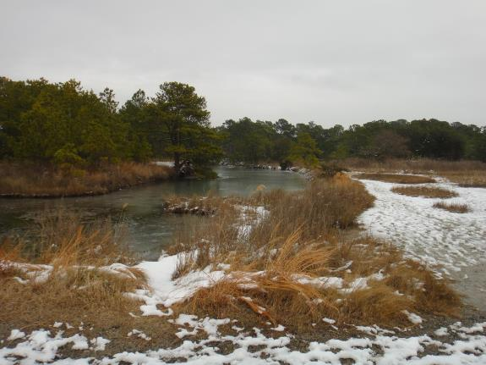
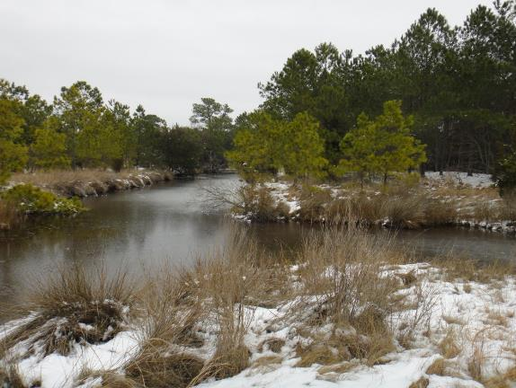
Project Partners
Photo by Miriam Harris
David Sweetnam
Executive Director
Georgian Bay Forever
David Ullrich
Executive Director
Great Lakes and St. Lawrence Cities Initiative
Mike Robertson
Imagery Project Manager
Ontario Ministry of Natural Resources
Photo by Miriam Harris
Notes:
We partnered with Georgian Bay Forever, Great Lakes and St. Lawrence Cities Initative and the Ontario Ministry of Natural Resources in order to accomplish our project objectives

Slide 11
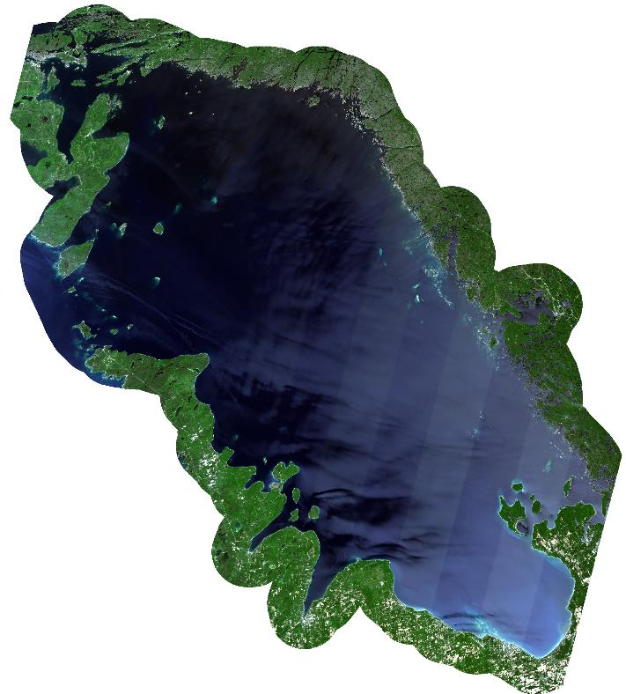
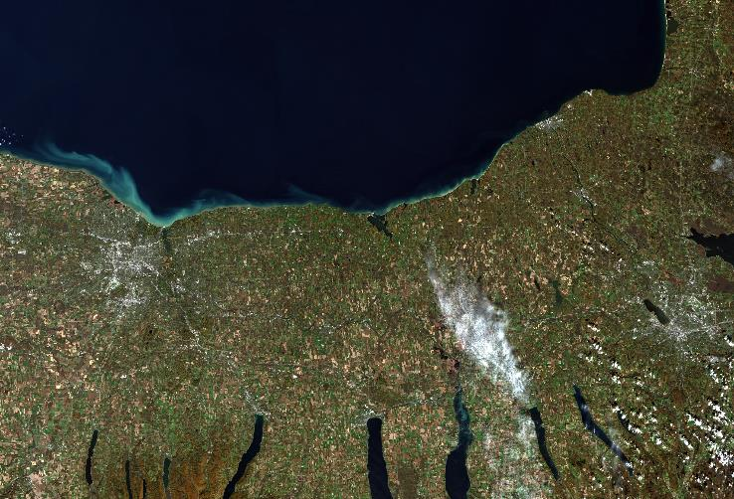
Objectives
Land cover classification maps
Wetlands extent change maps
Time series of wetland extent
Lake Ontario
Georgian Bay
Notes:
The objectives were to create land cover classification maps for Georgian Bay and the southern portion of Lake Ontario, produce wetland extent change maps, and generate time series of wetland extent.

Slide 12
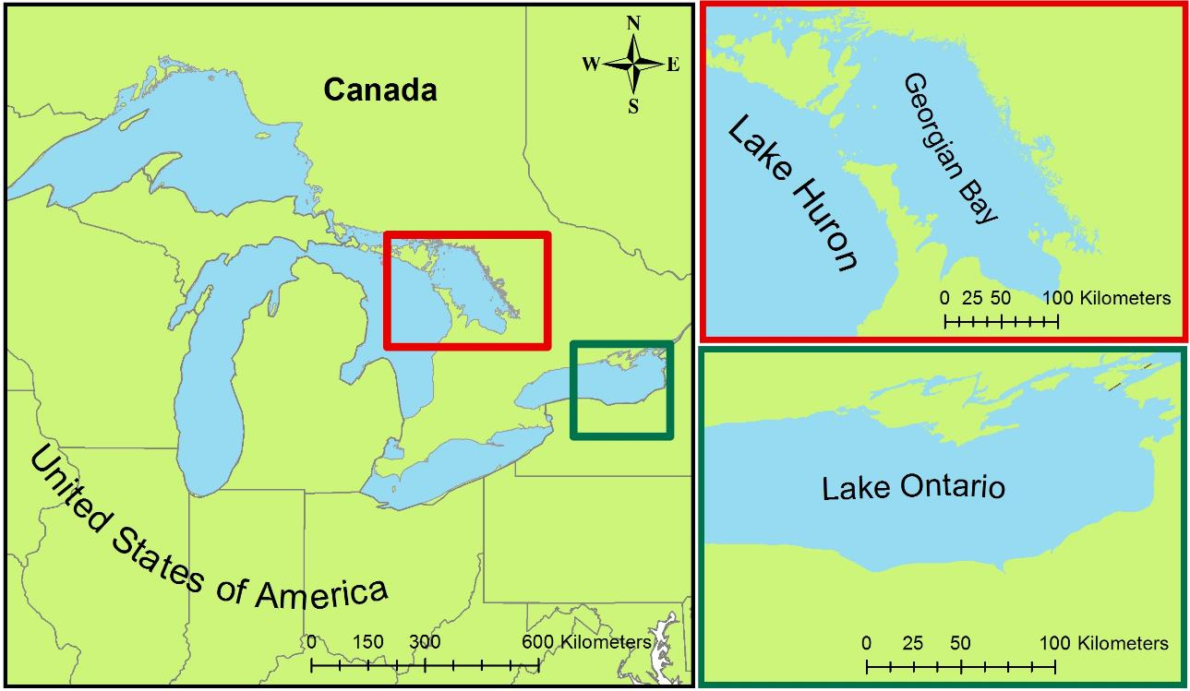
Study Area & Study Period
Georgian Bay (1987 & 2013)
Southern Lake Ontario (2007 & 2014)
Notes:
The study area included two geographical regions within the Great Lakes Basin: 1) Georgian Bay in Lake Huron for the years 1987 and 2013, representing the periods of highest and lowest water levels, and 2) the southern portion of Lake Ontario for 2007 and 2014, following the most recent classification of the NOAA Coastal Change Analysis Program.

Slide 13
Methodology
Data Acquisition
Data Processing
Data Analysis
Georgian Bay
Landsat 5 (July 1987)
Landsat 8 (June 2013)
ASTER DEM
Top of Atmosphere Corrected
Training Site Selection
Lake Ontario
Landsat 5 (August 2007)
Landsat 8(June 2014)
ASTER DEM
Mosaicked Landsat Scenes
Random Forest Land Cover Classification Script (R)
Water Levels
TOPEX/Jason-1
OSTM/Jason-2
In situ water level gauges
Study area defined by 10 km buffer around shoreline
Comparison to SOLRIS and NOAA C-CAP
Notes:
Landsat 5 Thematic Mapper (TM) and Landsat 8 Operational Land Information (OLI) imagery collected for classification. Digital Elevation Model (DEM) collected from TERRA ASTER. Georgian Bay water levels from in situ gauge measurements given to us by our project partners. Rochester in situ gauge data were downloaded from NOAA Tides and Currents, and Jason-1 and Jason-2 radar altimeters .

Slide 14
Methodology
Data Acquisition
Data Processing
Data Analysis
Georgian Bay
Landsat 5 (July 1987)
Landsat 8 (June 2013)
ASTER DEM
Top of Atmosphere Corrected
Training Site Selection
Lake Ontario
Landsat 5 (August 2007)
Landsat 8(June 2014)
ASTER DEM
Mosaicked Landsat Scenes
Random Forest Land Cover Classification Script (R)
Water Levels
TOPEX/Jason-1
OSTM/Jason-2
In situ water level gauges
Study area defined by 10 km buffer around shoreline
Comparison to SOLRIS and NOAA C-CAP
Notes:
Landsat tiles were corrected for the top of atmosphere reflectance. Two Landsat scenes for the Georgian Bay were mosaicked together to create one image. The study area was defined by a 10 km buffer from the shoreline.

Slide 15
Methodology
Data Acquisition
Data Processing
Data Analysis
Georgian Bay
Landsat 5 (July 1987)
Landsat 8 (June 2013)
ASTER DEM
Top of Atmosphere Corrected
Training Site Selection
Lake Ontario
Landsat 5 (August 2007)
Landsat 8(June 2014)
ASTER DEM
Mosaicked Landsat Scenes
Random Forest Land Cover Classification Script (R)
Water Levels
TOPEX/Jason-1
OSTM/Jason-2
In situ water level gauges
Study area defined by 10 km buffer around shoreline
Comparison to SOLRIS and NOAA C-CAP
Notes:
Training sites, or ideal pixels, were chosen for each land cover class. The GB classes were identified by the Southern Ontario Land Resource Information System, while the Southeastern Portion of Lake Ontario classes were chosen in accordance to the NOAA CCAP for easy comparison. These sites were identified using true and false color Landsat band composites. Training sites, the landsat bands, including the thermal band, the DEM and the slope were input into the Random Forest Land Cover Classification Script, run in R. The script output was a classified map. Unable to perform an accuracy assessment due to lack of ground truth data however we compared our results to existing land cover classification maps SOLRIS and NOAA C-CCAP.

Slide 16
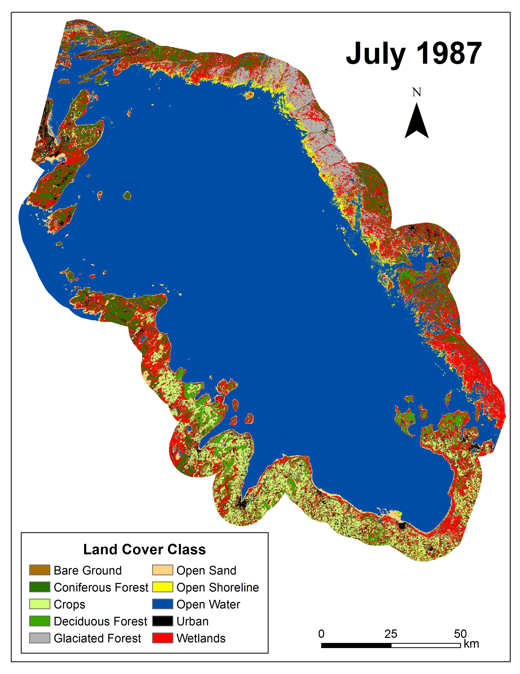
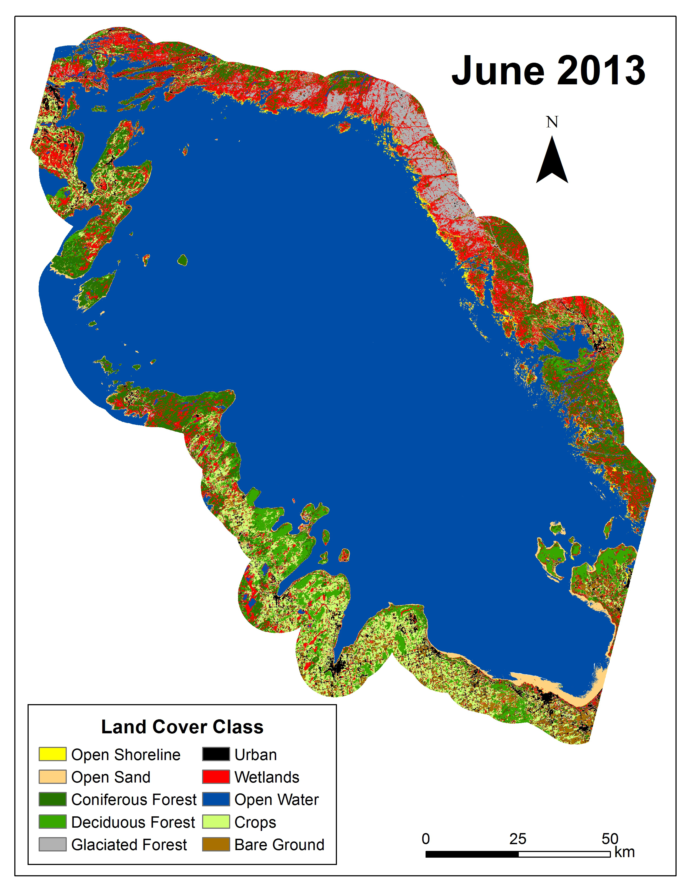
Results: Classified Maps Georgian Bay
Georgian Bay
Georgian Bay
Notes:
Here are the classified maps for the georgian bay for the years 1987 and 2013. The red color represents wetlands

Slide 17
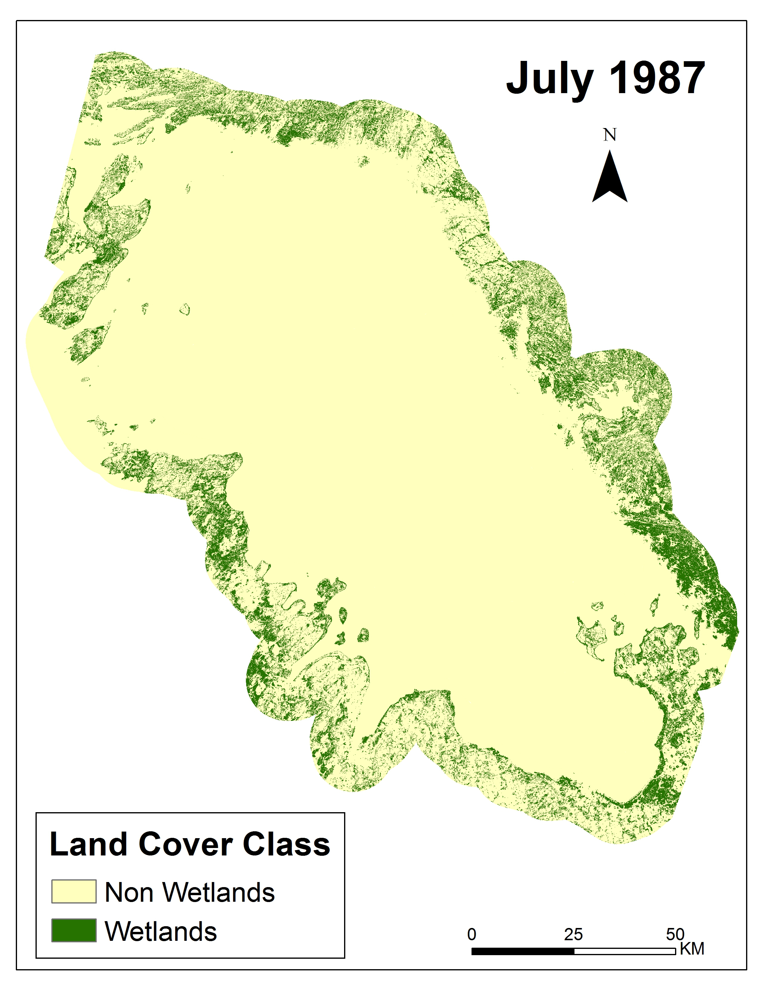
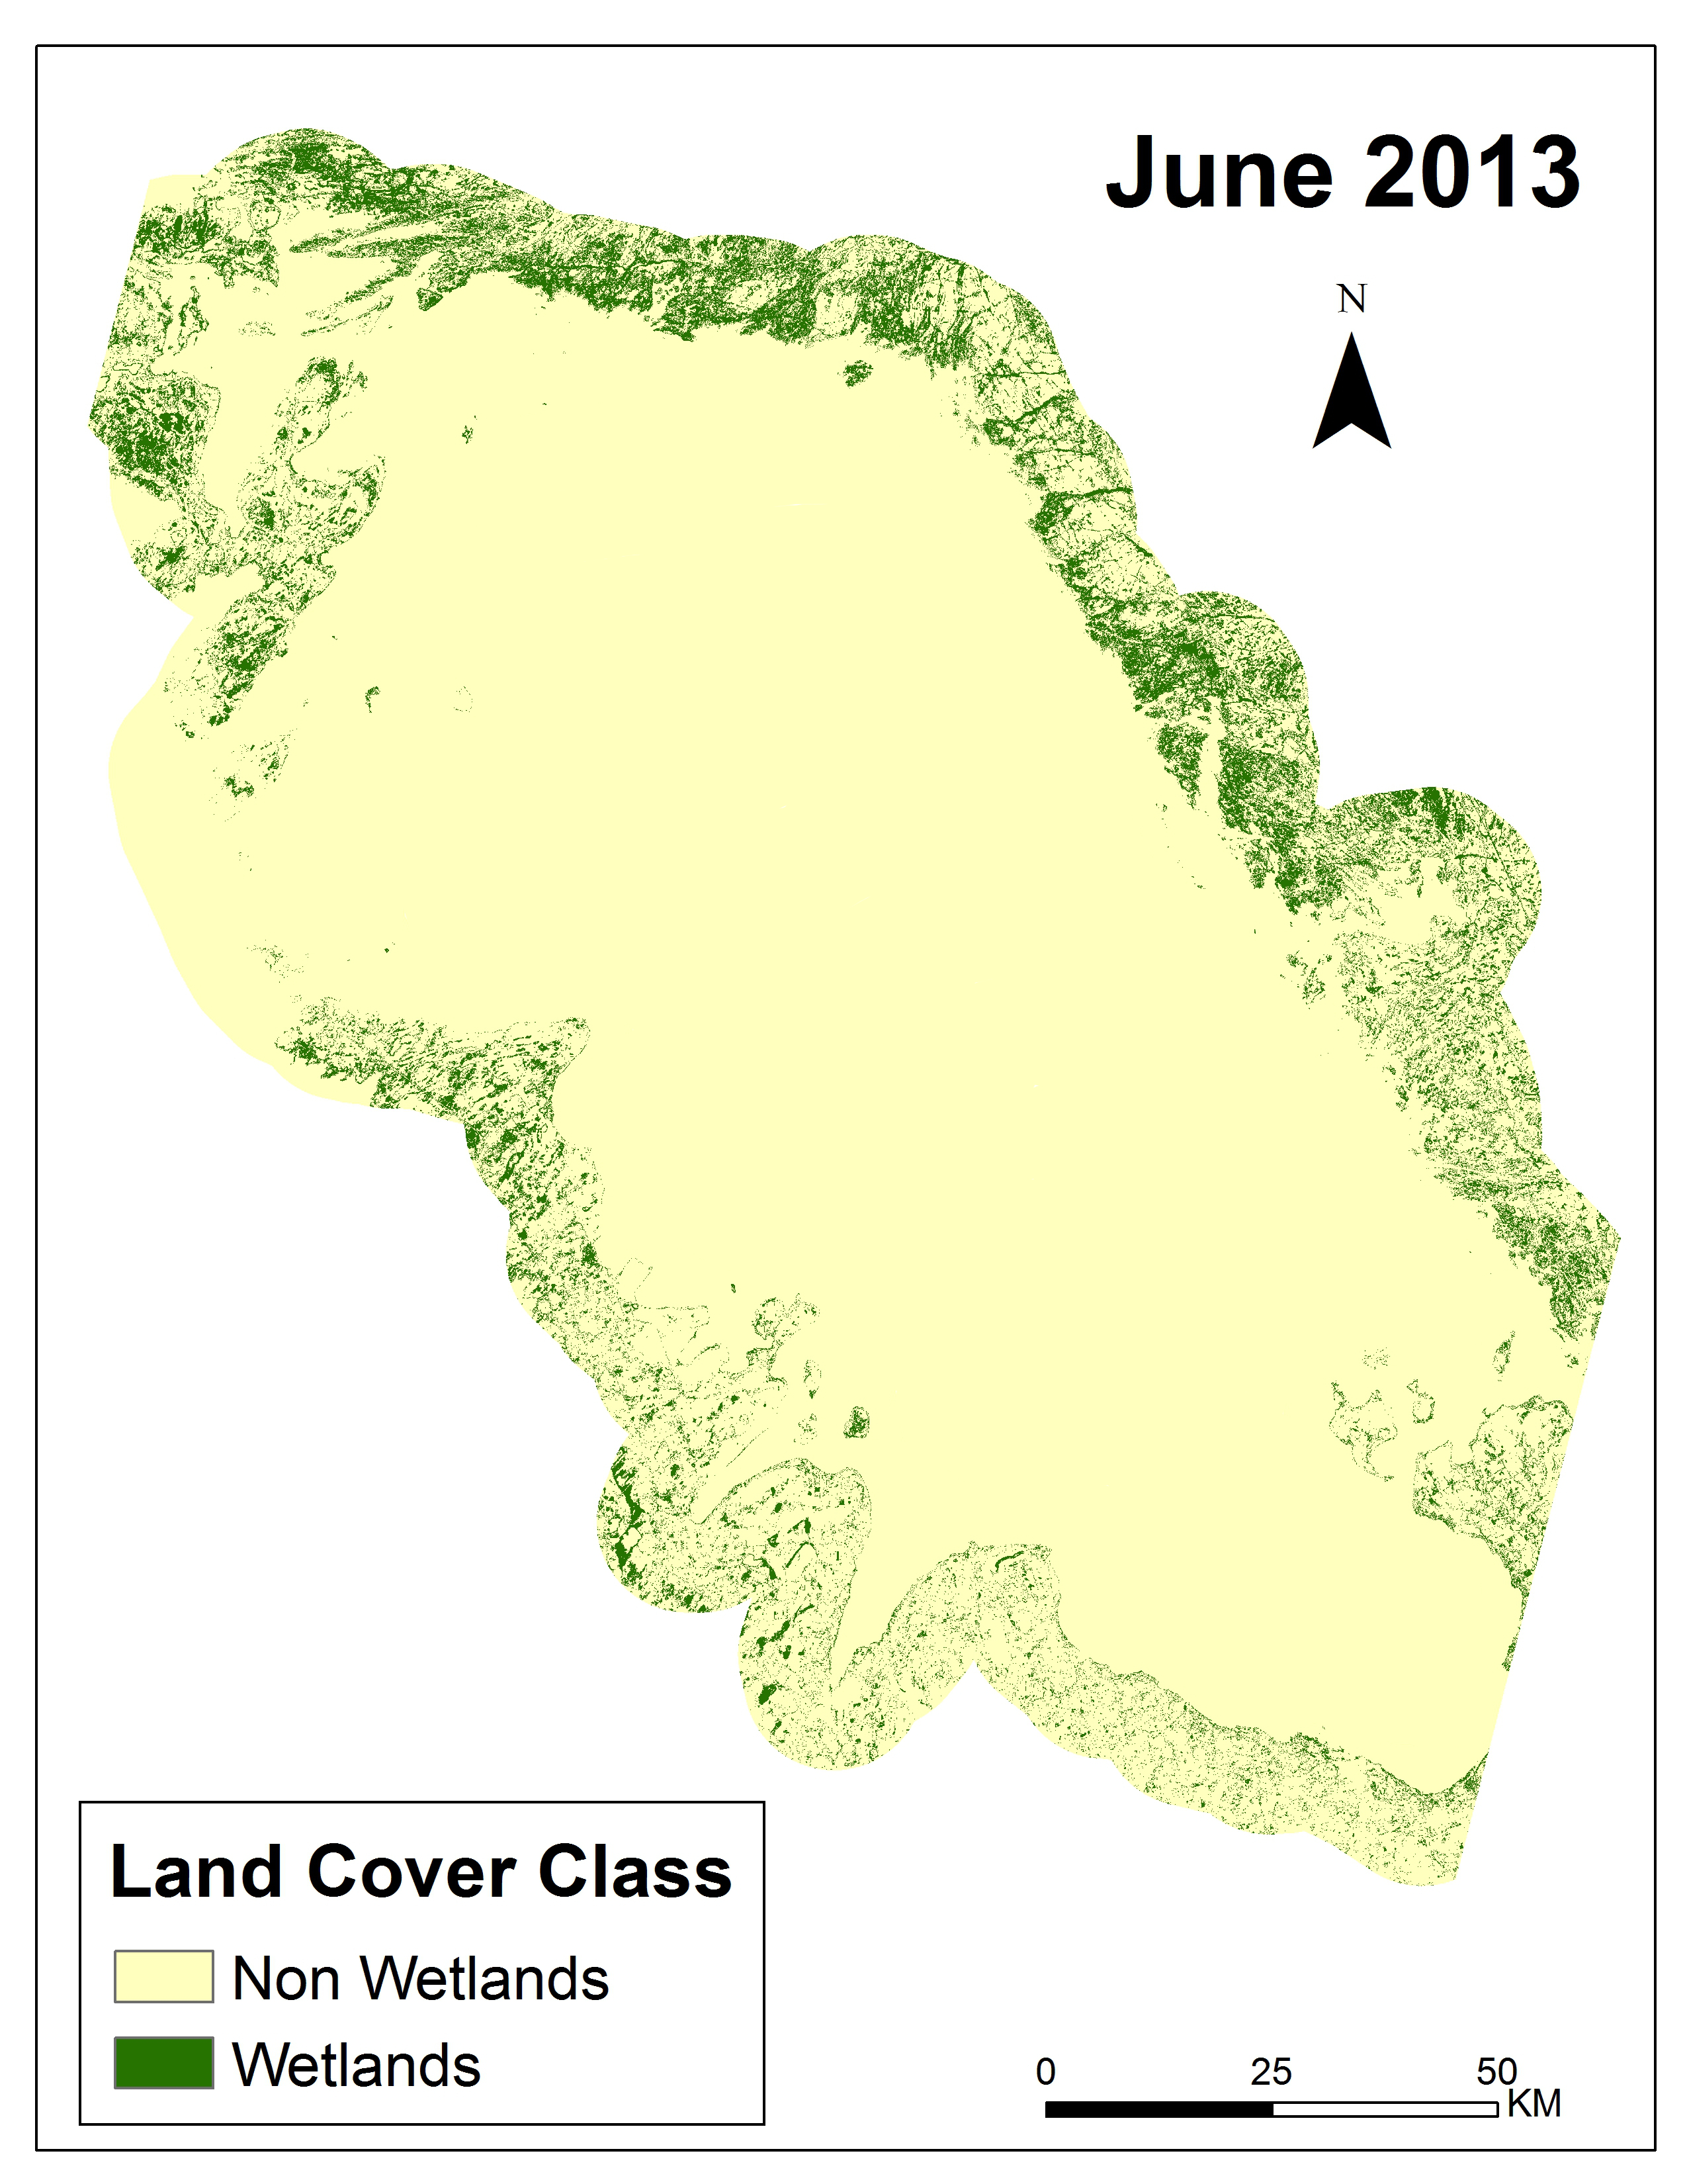
Results: Wetland vs Non-Wetland Maps
Georgian Bay
Georgian Bay
Georgian Bay
Notes:
The classified maps were reclassified into two categories, either wetland or non-wetland. Green represents wetland classes.

Slide 18
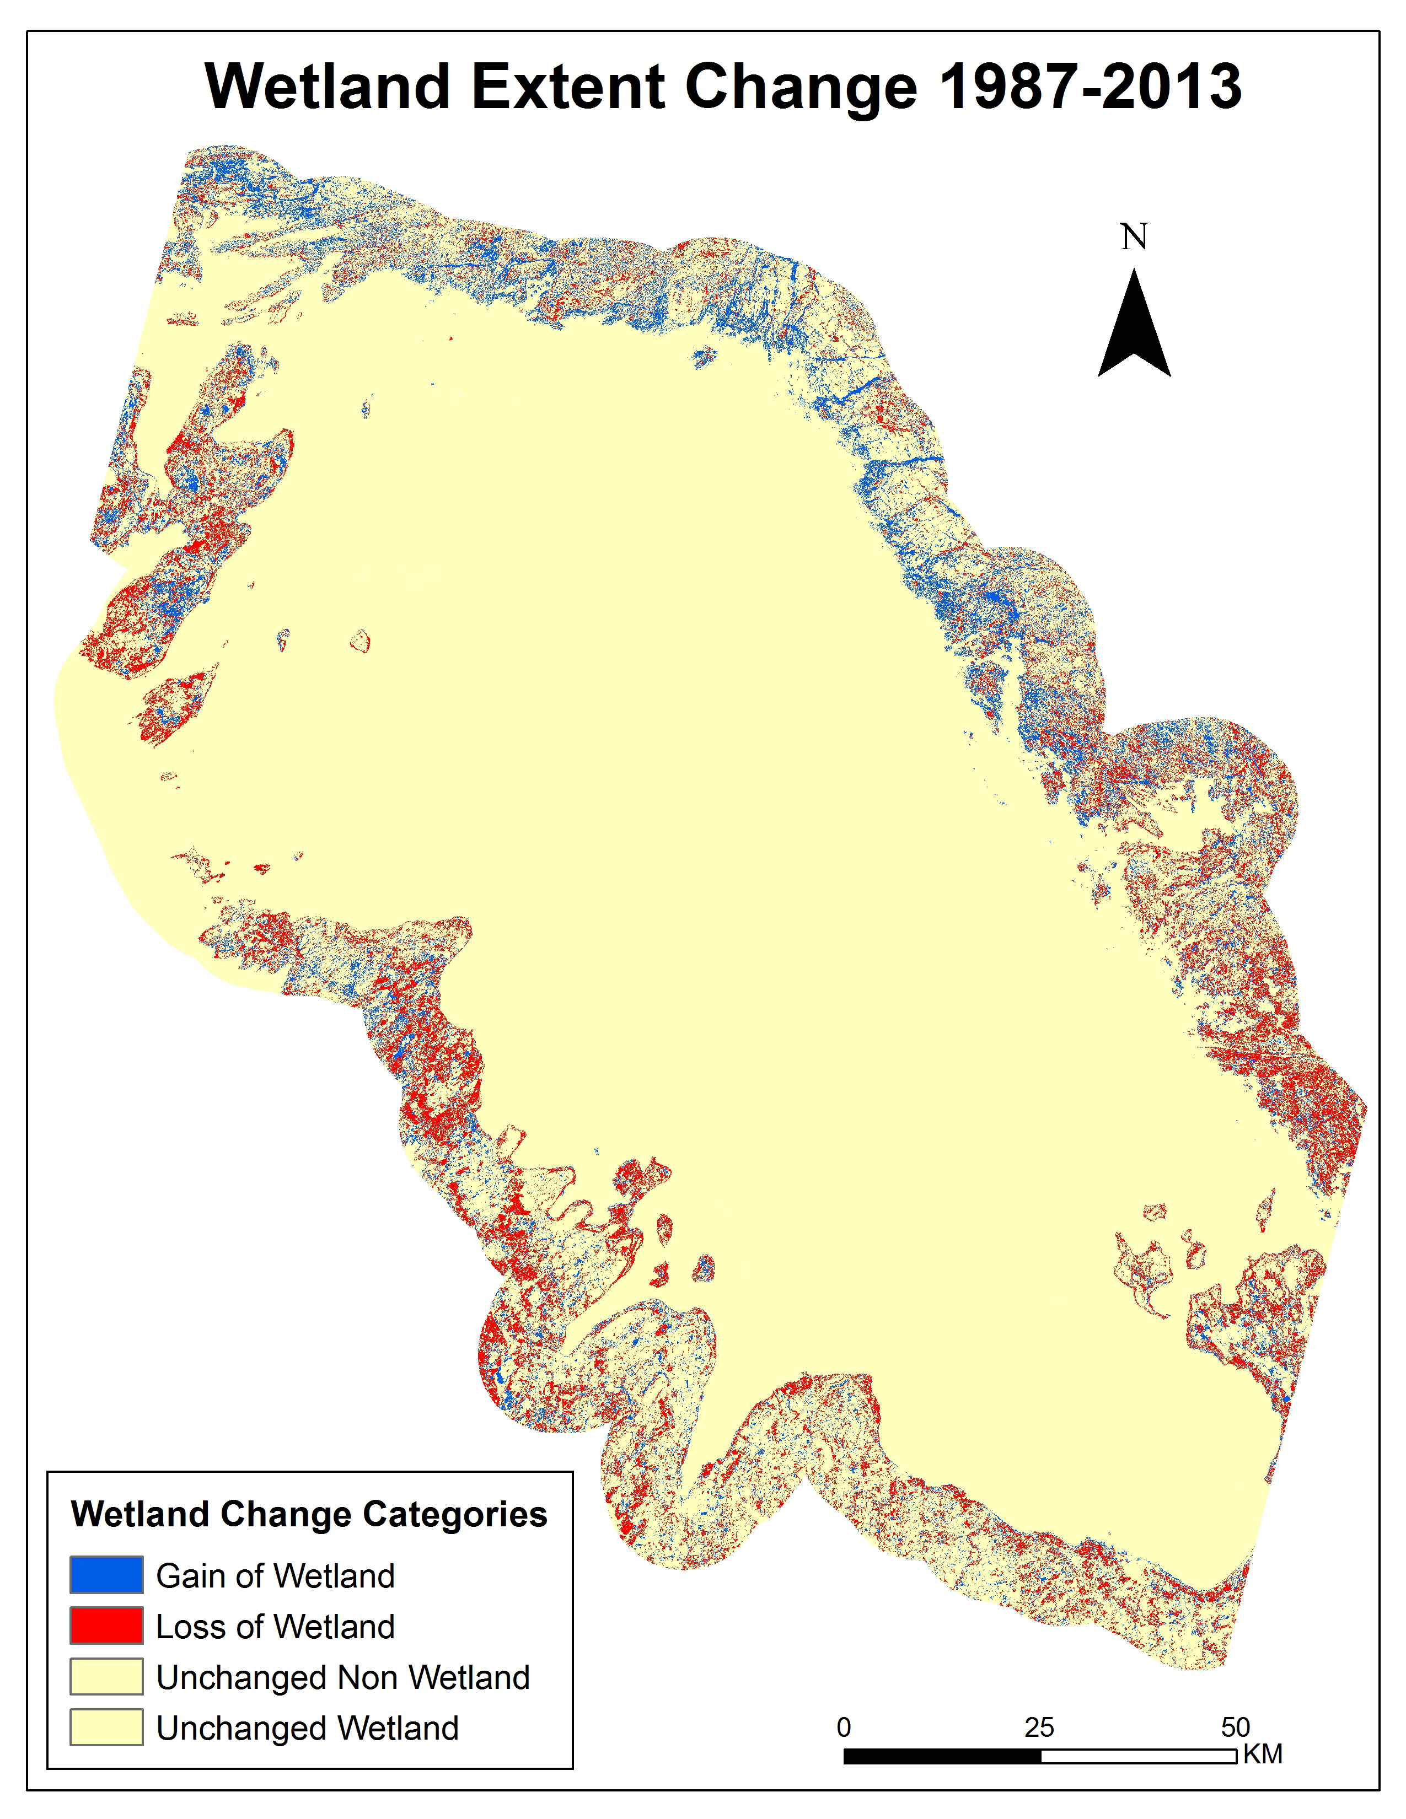
Results: Wetlands Extent Change Maps
Georgian Bay
Notes:
The wetlands/non-wetlands maps were then combined to show wetlands extent changes over time. The yellow color are areas of no change, the blue areas are increases in wetland extent, and the red color are areas of wetlands loss. This map shows a decrease in wetlands in the southern portion while the northern portion has increases in wetlands extent

Slide 19
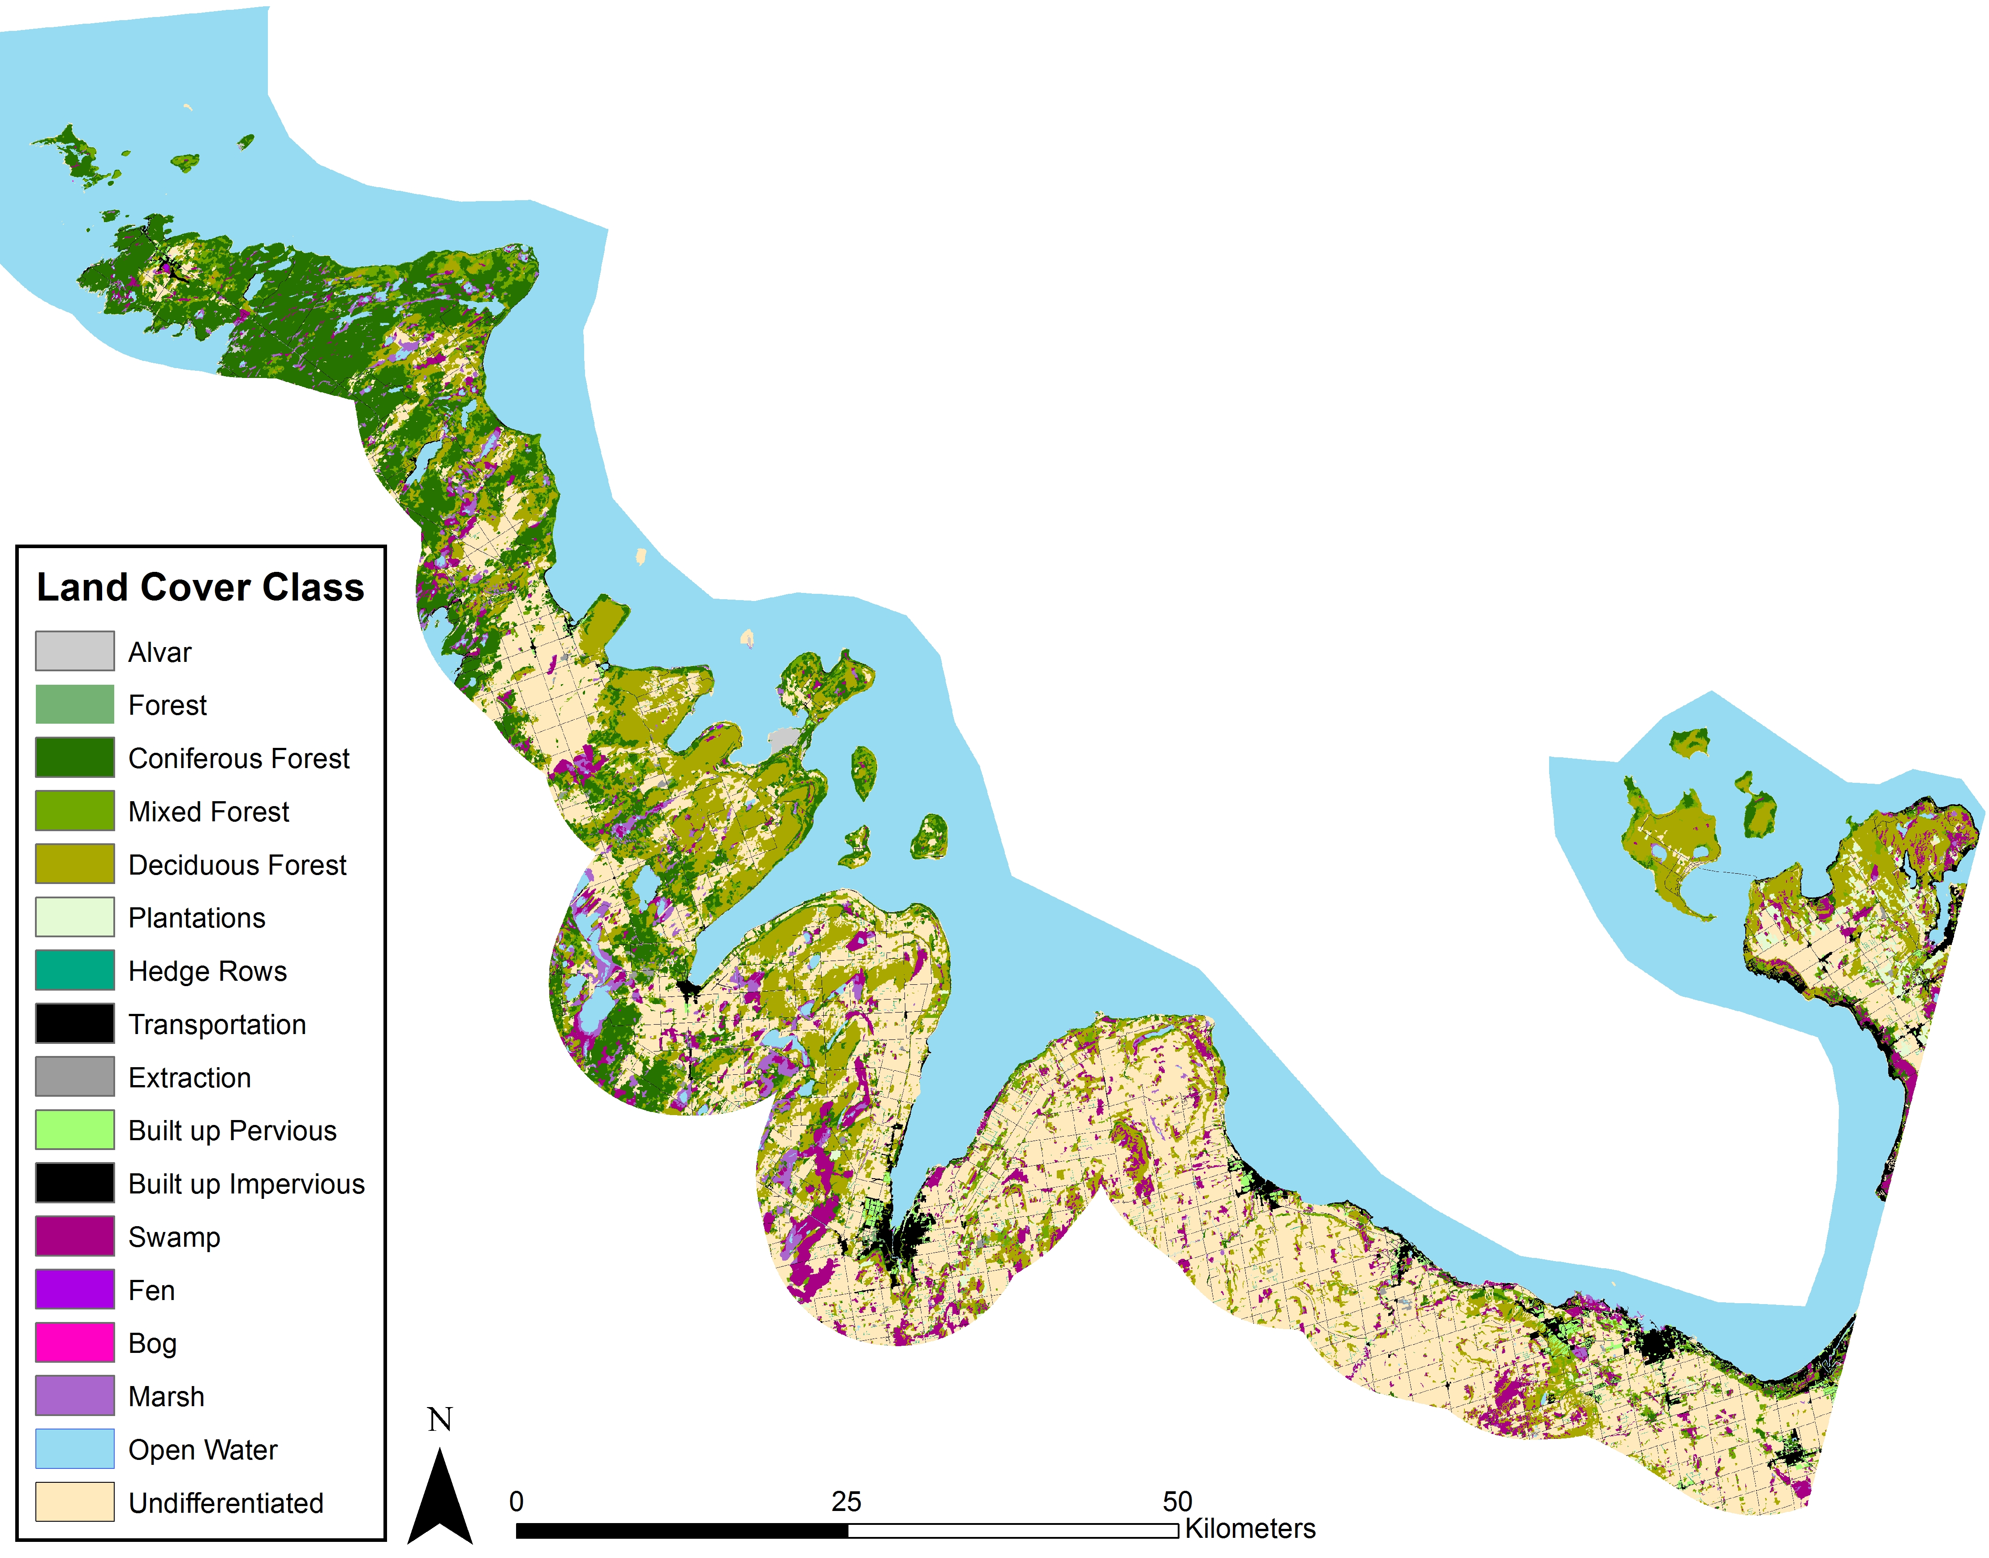
Results: Comparison with SOLRIS
South Georgian Bay
  2013 Classified map vs. 2008 SOLRIS map
Overall: 64% Similar
SOLRIS Classification
Biases
  Lower Resolution
    5000 m²
  Not time co-incident
  Also a land cover classification map
Notes:
-used the Ontario Ministry of Natural Resources and Forestry’s database called the Southern Ontario Land Resource Information System as a comparison of classifications
-200 stratified random points were generated, 100 each for the wetland and non-wetland classes
-Overall 64% similarity between classes
-Biases or impacts on comparison include using a reference map that is actually a compilation of observations over several years and that was not time-coincident with our study date, and SOLRIS has much lower resolution.

Slide 20
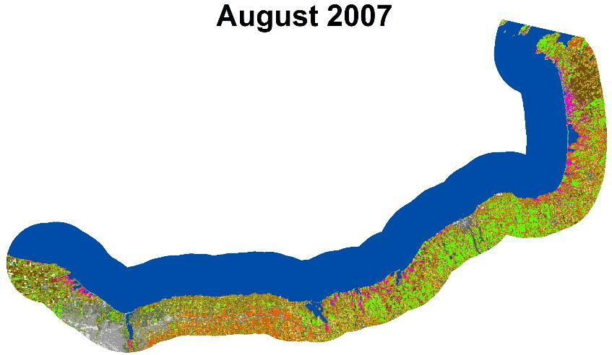
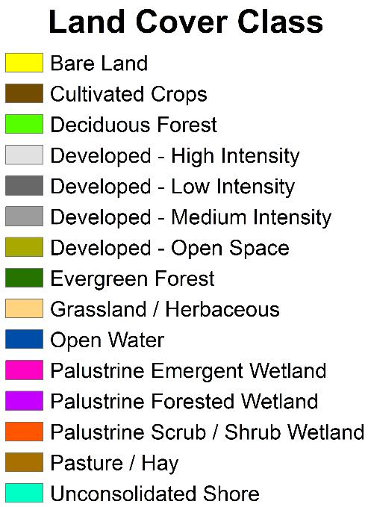
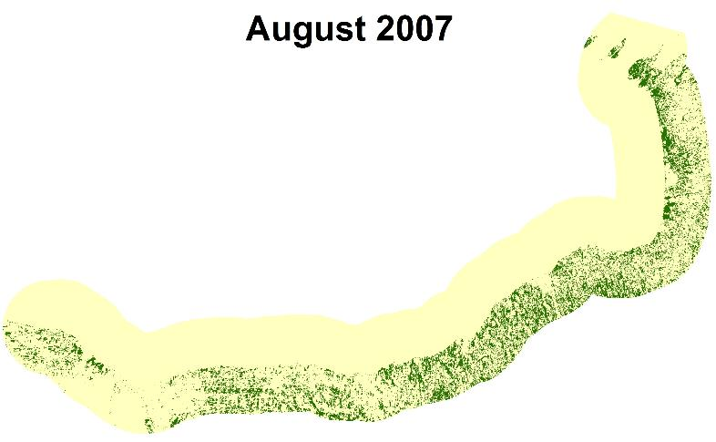
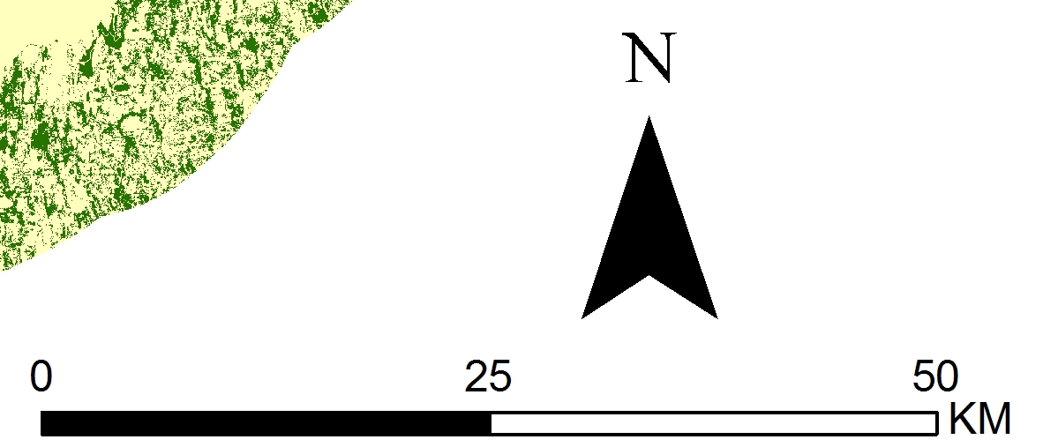
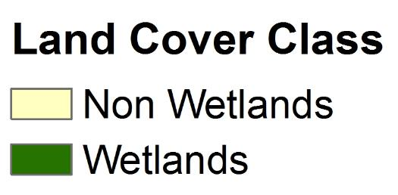
Results: Classified Maps Southern Lake Ontario
Lake Ontario
Lake Ontario
Notes:
The same methodology was used for the Southern portion of Lake Ontario. The pink, purple and red colors are wetlands

Slide 21
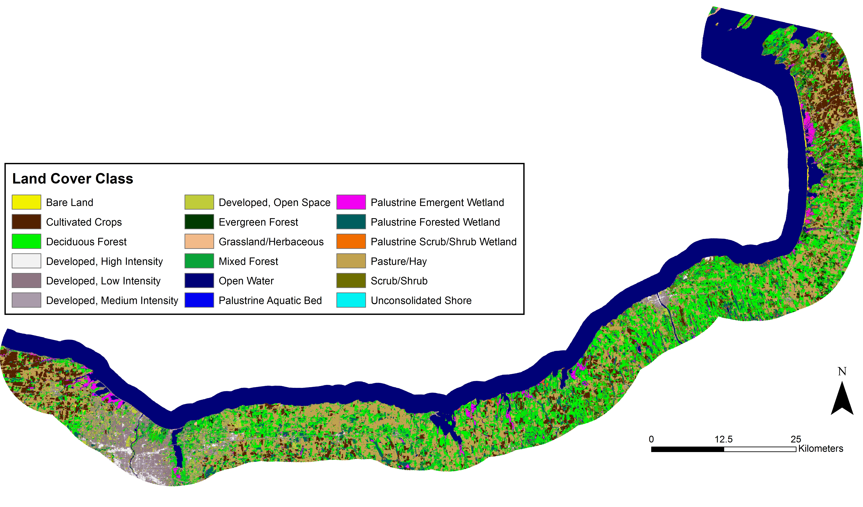
Results: Comparison
Lake Ontario Wetlands vs. Non-Wetlands
  2007 Classified map vs. CCAP 2006 map
Overall: 62% Similar
NOAA C-CAP Classification
Biases
  Not time co-incidence
  Also a land cover classification map
Notes:
-overall accuracy 62% and kappa hat statistic of 0.22
-similar biases with Georgian Bay assessments

Slide 22
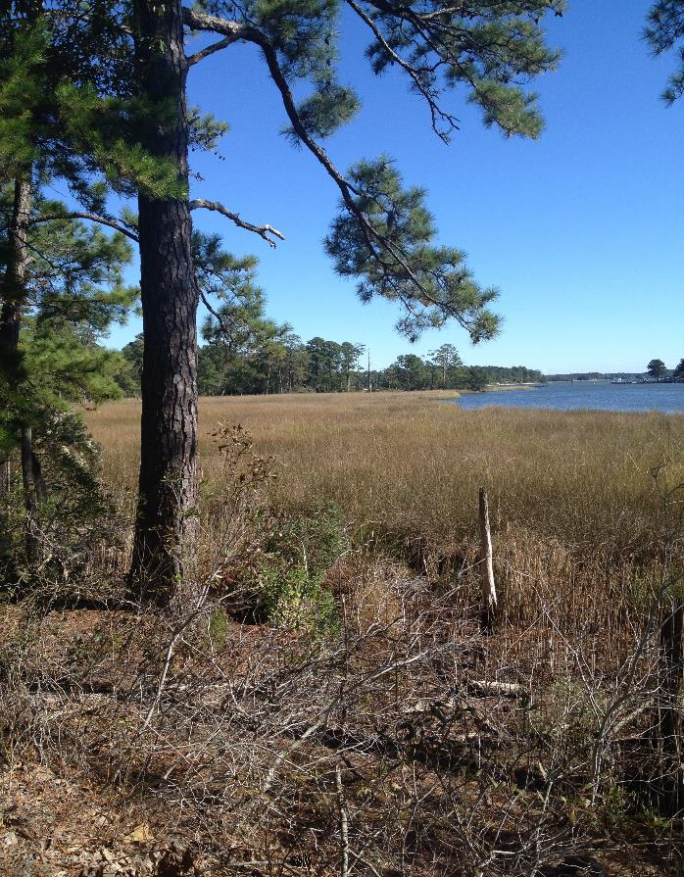
Conclusions
Rochester is preliminary
  Trainings sites need adjustment
Thermal band + DEM + Slope
  reduced random forest error rate ~ 2%
Georgian Bay: 1987-2013
  7% Wetland Gain
  10.8% Wetland Loss
Photo by Miriam Harris

Slide 23
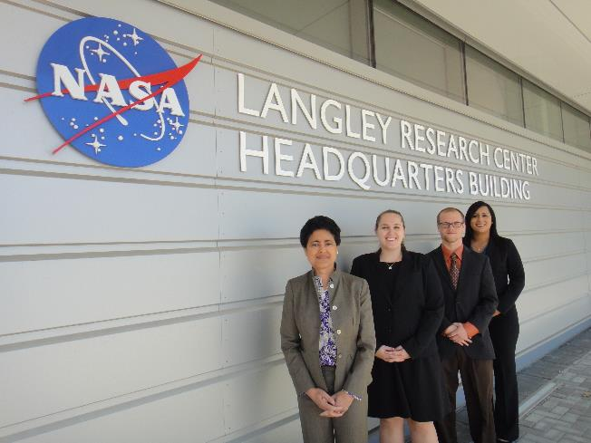
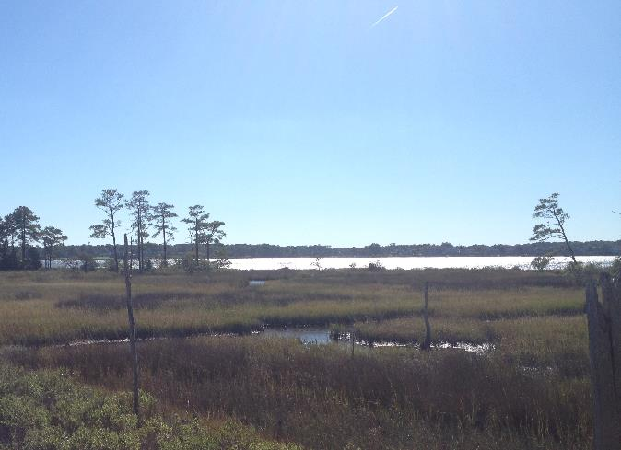
Benefits of Research
More cost effective, replicable methodology for land classification maps over large spatial scales
Facilitate comparison of wetlands extent over time
Insights on impact of changing water levels to wetlands health
Photo by Miriam Harris, First Landing State Park, Virginia Beach, VA
Photo by Miriam Harris

Slide 24
Acknowledgements
David Sweetnam
Georgian Bay Forever
David Ullrich
Great Lakes and St. Lawrence Cities Initiative
Mike Robertson
Ontario Ministry of Natural Resources
Dr. Kenton Ross
NASA DEVELOP National Program- Science Advisor
James Favors
NASA DEVELOP National Program- International Lead
Nathan Owen
NASA DEVELOP - Langley Center Lead
Fall 2014 Great Lakes Climate I
This material is based upon work supported by NASA through contract NNL11AA00B and cooperative agreement NNX14AB60A.

Slide 25
References
Assel, R. A., F. H. Quinn, and C. E. Sellinger (2004), Hydroclimatic factors of the recent record drop in Laurentian Great Lakes water levels. Bull. Amer. Meteor. Soc., 85, 1143-1151.
Breiman, L. (2001), Random forests. Mach. Learn., 45, 5-32.
Bardecki, M. J. (1991), Wetlands and climate change: a speculative review. Can. Water Resour. J., 16, 9-22.
Canada Department of Fisheries and Oceans (2014), Historical monthly and yearly mean water level graphs 1918-2013 [Available online at http://waterlevels.gc.ca/C&A/netgraphs-eng.html].
Chow-Fraser, P. (1998), A conceptual ecological model to aid restoration of Cootes Paradise Marsh, a degraded coastal wetland of Lake Ontario, Canada. Wetl. Ecol. Manag. , 6, 43-57.
Chow-Fraser, P., V. Lougheed, V. Le Thiec, B. Crosbie, L. Simser, and J. Lord (1998). Long-term response of the biotic community to fluctuating water levels and changes in water quality in Cootes Paradise Marsh, a degraded coastal wetland of Lake Ontario. Wetl. Ecol. Manag., 6, 19-42.
Cvetkovic, M., and P. Chow-Fraser (2011), Use of ecological indicators to assess the quality of Great Lakes coastal wetlands. Ecol. Indic., 11, 1609-1622.
Herdendorf, C.E. (2004), Morphometric factors in the formation of Great Lakes coastal wetlands. Aquat. Ecosyst. Health & Manage., 7, 179-197.
Keddy PA, and AA. Reznicek (1986), Great lakes vegetation dynamics: the role of fluctuating water levels and buried seeds. J. Gt. Lakes Res.,12, 25-36.
Li J., and W. Chen (2005), A rule-based method for mapping Canada’s wetlands using optical, radar and DEM data. Int. J. Remote. Sens. 26, 5051-5069.
Mcleod, E., G.L. Chmura, S. Bouillon, R. Salm, M. Bjork, C.M. Duarte, C.E. Lovelock, W.H. Schlesinger, and B.R. Silliman (2011), A blueprint for blue carbon: toward an improved understanding of the role of vegetated coastal habitats in sequestering CO2. Front. Ecol. Environ., 9, 552-560.
Midwood, J., D. Rokitnicki-Wojcik, and P. Chow-Fraser (2012), Development of an inventory of coastal wetlands for eastern Georgian Bay, Lake Huron. ISRN Ecology 2012, 1-13.
Mortsch, L.D. (1998), Assessing the impact of climate change on The Great lakes shoreline wetlands. Climatic Change, 40, 391-416.
——, and F.H. Quinn (1996), Climate change scenarios for Great Lakes Basin ecosystem studies. Limnol. Oceanogr., 41, 903-911.
——, H. Hengeveld, M. Lister, L. Wenger, B. Lofgren, F. Quinn, and M. Slivitzky (2000), Climate change impacts on the hydrology of the Great Lakes-St. Lawrence system. Can. Water Resour. J., 25, 153-179.
Sellinger, C.E., C.A. Stow, E.C Lamon, and S.S. Qian (2008), Recent water level declines in the Lake Michigan-Huron System. Environ. Sci. Technol., 42, 367-373.
Whillans, T. (1982), Changes in marsh area along the Canadian shore of Lake Ontario. J. Gt. Lakes Res., 8, 570-577.
Whillans, T. (1996), Historic and comparative perspectives on rehabilitation of marshes as habitat for fish in the lower Great Lakes basin. Can. J. Fish. Aquat. Sci., 53, 58-66.
Wilcox, D. A. and Y. Xie, (2007), Predicting wetland plant community responses to proposed water-level-regulation plans for Lake Ontario: GIS-based modeling. J. Gt. Lakes Res., 33, 751-773.

