Slide 1
BLACK ROCK
PLAYA URBAN DEVELOPMENT
A Multi-Sensor Approach to Determine the Impacts of Human Activity and Natural Surface Deformation on the Black Rock Playa, Nevada
Neda Kasraee
Dara Laczniak
Marcella Rose
Nick Rousseau
Notes:
Hi, I am Dara Laczniak.
I’m Marcella Rose.
I’m Nick Rousseau.
And I am Neda Kasraee, the team lead.
We are the Black Rock Playa Urban Development Team and we are here to talk about a multi-sensor approach to determining the impacts of human activity and natural surface deformation on the Black Rock Playa in Nevada.
--------------------------------------------
Image Source: Black Rock Playa Urban Development Team – [insert how website image was derived]

Slide 2
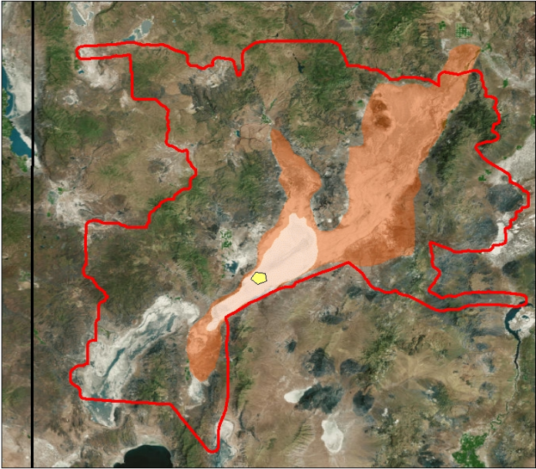
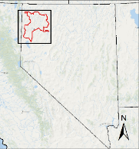
Black Rock Playa
Study Area
Black Rock Desert
Burning Man Event 2017
Black Rock Playa
Black Rock Desert
CALIFORNIA
NEVADA
NEVADA
CALIFORNIA
Notes:
Black Rock Playa is located in the northwestern corner of Nevada, within the larger Black Rock Desert Region. Since 2000, BRP has been a designated part of the Black Rock Desert-High Rock Canyon Emigrant Trails National Conservation Area. In our study area map, the extent of the playa is indicated by the tan polygon. This acts as our primary area of interest, specifically around the edge of the playa and near the Burning Man footprint.
-----------------------------------------------------------------
Sources: Esri, DigitalGlobe, GeoEye, i-cubed, USDA FSA, USGS, AEX, Getmapping, Aerogrid, IGN, IGP, swisstopo, and the GIS User Community

Slide 3
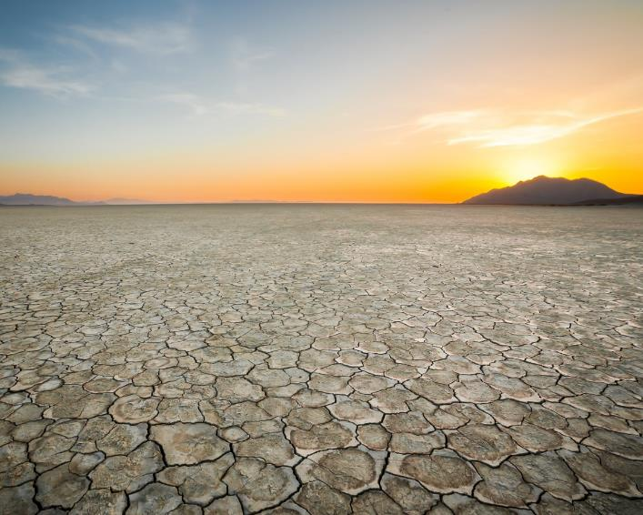
Black Rock Playa
Ephemeral, alkali lakebed
Lacks vegetation due to evaporate-rich soils
Renowned as one of the largest and flattest surfaces on Earth
Popular spot for recreational activities…
Speed racing
Rocket launches
Land sailing
Burning Man
Image Credit: Creative Commons-Flikr
Notes:
Black Rock Playa (BRP) is a dried up lakebed that experiences nearly annual flooding and drying periods and is completely void of vegetation. It is the remnant of a Lake Lahontan—an expansive Pleistocene lake. The playa is renowned as one of Earth’s largest and flattest surfaces, making it an ideal location for many recreational activities, including speed racing, rocket launches, and land sailing. However, it is most well-known for being the location of the annual Burning Man event since 1991.
-----------------------------------------
Image Source: https://www.flickr.com/photos/trevorbexon/16456760887/in/photolist-r5ecEF-qVpVD5-hXoQEE-hXpK32-hXoY9A-5qQ1E9-hXpGXR-hXoNjY-2vVkpu-ScJLs8-eBfSH7-db8wVQ-pbaffy-ef7Gps-5mszd8-cvtEo9-2G7jmy-h68Sn-5Fq1fc-67b9Gr-oHfXXc-h68Sk-d6XXc9-5FuhsG-aahRhU-dbo3Xf-qVx4n8-UaFVw6-V2pp8G-fCZeDp-VPpsid-auhGh4-hXpUyt-gzJ8Vy-hXqLiX-db8wKN-hXq7bL-SApAwt-c2qXS7-7Cv9dB-hXpRhD-R5H6Vd-aukmfE-gzJAwB-hXpPmL-dbo3BU-dbPyEn-arNCu8-E5KCtu-5mwRZf

Slide 4
Conservation
“In order to conserve, protect, and restore nationally significant landscapes that have outstanding cultural, ecological, and scientific values for the benefit of current and future generations, there is established in the Bureau of Land Management the National Landscape Conservation System.”
~ Omnibus Public Land Management Act (2009), Section 2002(a)
Image Credit: Monet
Image Credit: Creative Commons-Flikr
Notes:
Being a NCA, the 800,000 acres comprising the Black Rock Desert region must be monitored and maintained by the Bureau of Land Management
According to the National Landscape Conservation System (NCLS), the Bureau of Land Management is tasked with conserving, protecting, and restoring nationally significant landscapes that have outstanding cultural, ecological, and scientific value.
----------------------------------------------
Image Source: https://www.flickr.com/photos/patrick_nouhailler/8692378280/in/photolist-ef7He3-ef1Y9P-d6djoN-ef7HFW-ef1YB2-ef1UBZ-ef1ZaK-ef7HpE-ef7H5h-ef1WxT-ef1YhM-ef1Zng-ef7HT1-ef7Hhm-qfYWK7-r5ecEF-qVpVD5-hXoQEE-hXpK32-cvtEo9-2G7jmy-hXoY9A-hXpGXR-hXoNjY-67b9Gr-2vVkpu-ScJLs8-eBfSH7-db8wVQ-pbaffy-ef7Gps-5mszd8-h68Sn-5Fq1fc-5qQ1E9-oHfXXc-h68Sk-d6XXc9-5FuhsG-aahRhU-dbo3Xf-qVx4n8-UaFVw6-nANCv-V2pp8G-hXo3pd-fCZeDp-346Efp-VPpsid-hXqsUE

Slide 5
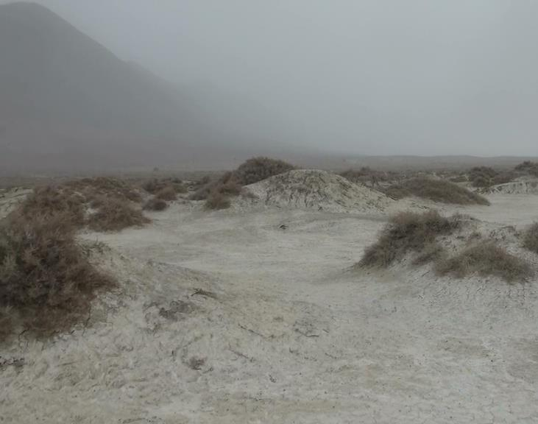
Community Concerns: Unnatural “Dunes”
In recent decades the community has noticed the formation & expansion of “dunes” along the playa shoreline
Formations are round in shape and anchored by vegetation
Image Credit: Marcella Rose
Notes:
Within the past few decades, the community surrounding BRP has brought attention to the apparent formation and expansion of “dunes” along the playa shorelines. Because these “dunes” are not part of the characteristically flat, natural landscape of the playa and are changing on short time-scales, they have generated significant concern amongst the community.
---------------------------------------------
Image Source: Marcella Rose, Black Rock Playa Urban Development, Team Member

Slide 6
Community Concerns: Unnatural “Dunes”
Indication of reduced air quality and increased dust emission
Unnatural to the playa landscape and inhibit recreational activities
Image Credit: Marcella Rose
Notes:
These concerns include: (1) the encroachment of shoreline dunes onto the playa; (2) the inhibition of typical BRP recreational activities; (3) the implications of reduced air quality resulting from increased dust emission from playa surface disturbance; and (4) the ability to properly preserve the original Black Rock Playa landscape while maintaining recreational access. Though the exact cause of the dunes is unknown, there is a general consensus that some mechanism is disturbing the hard, playa crust which generates a sediment source that can be easily transported by regional winds.
---------------------------------------------
Image Source: https://www.flickr.com/photos/blmnevada/14909811105/in/photolist-oHwFoH-ef7HWs-R5H71o-ef7He3-ef1Y9P-d6djoN-ef7HFW-ef1YB2-ef1UBZ-ef1ZaK-ef7HpE-ef7H5h-p1tx2Y-ef1WxT-ef1YhM-ef1Zng-ef7HT1-ef7Hhm-qfYWK7-r5ecEF-qVpVD5-hXoQEE-hXpK32-hXoY9A-5qQ1E9-hXpGXR-hXoNjY-2vVkpu-ScJLs8-eBfSH7-db8wVQ-pbaffy-ef7Gps-5mszd8-cvtEo9-2G7jmy-h68Sn-5Fq1fc-67b9Gr-oHfXXc-h68Sk-d6XXc9-5FuhsG-aahRhU-dbo3Xf-qVx4n8-UaFVw6-V2pp8G-fCZeDp-VPpsid

Slide 7
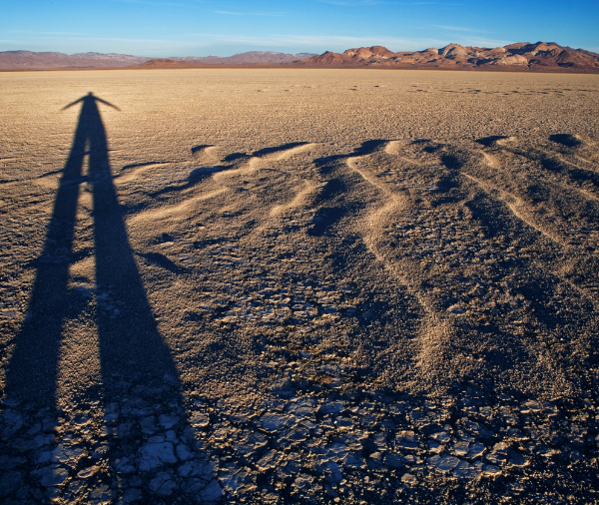
Potential Causes
Recreational Activities
Drought
Natural Geologic Processes
There is concern that the Burning Man event is accelerating the rate of dune encroachment
Image Credit: Creative Commons-Flikr
Notes:
Though the exact cause of these formations is unknown, there is a general consensus that some mechanism is disturbing the hard, playa crust which generates a sediment source that can be easily transported by regional winds. An uncertainty exists whether these mechanisms are driven by recreation, specifically the annual Burning Man event that is held on the playa, drought, other natural processes, or all of the above.
---------------------------------------------
Image Source: https://www.flickr.com/photos/blmnevada/14909811105/in/photolist-oHwFoH-ef7HWs-R5H71o-ef7He3-ef1Y9P-d6djoN-ef7HFW-ef1YB2-ef1UBZ-ef1ZaK-ef7HpE-ef7H5h-p1tx2Y-ef1WxT-ef1YhM-ef1Zng-ef7HT1-ef7Hhm-qfYWK7-r5ecEF-qVpVD5-hXoQEE-hXpK32-hXoY9A-5qQ1E9-hXpGXR-hXoNjY-2vVkpu-ScJLs8-eBfSH7-db8wVQ-pbaffy-ef7Gps-5mszd8-cvtEo9-2G7jmy-h68Sn-5Fq1fc-67b9Gr-oHfXXc-h68Sk-d6XXc9-5FuhsG-aahRhU-dbo3Xf-qVx4n8-UaFVw6-V2pp8G-fCZeDp-VPpsid

Slide 8
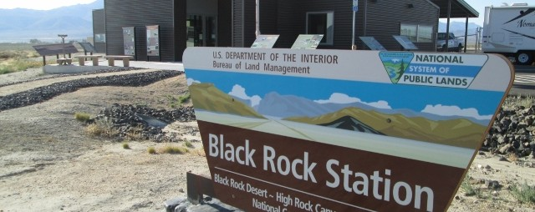
Partner
Black Rock Field Office,
Winnemucca District, Bureau of Land Management
Field Manager: Dr. Mark Hall
[Insert image of the Black Rock Field Office]
Image Credit(s): Bureau of Land Management
Notes:
With the National Landscape Conservation System mission statement in mind, our partner, Dr. Mark Hall, at BLM’s Winnemucca District Black Rock Desert Field wants to investigate the cause of the abnormal playa dunes and their change over time. Dr. Mark Hall at BLM’s Winnemucca District Black Rock Desert field office, along with fellow staff, is in charge of managing the 800,000 acres within the Black Rock Desert NCA. The staff at BLM’s Winnemucca District Black Rock Field Office, more specifically Dr. Mark Hall, is specifically tasked with preserving and managing the recreational use of the Black Rock Desert public land.
-------------------
Image Source(s): http://blackrockdesert.org/blm-black-rock-station-visitor-contact-center/

Slide 9
Objectives
Generate surface deformation maps using Synthetic Aperture Radar (SAR) imagery
Examine the morphology, spatial distribution, and temporal changes in dune formations
Analyze the relationship between temporal changes in dune formation and recreational activities, drought conditions, flooding events, and weather patterns
Assess the mechanism behind dune formation
Notes:
Through collaboration, our project aims to
Generate surface deformation maps using Synthetic Aperture Radar (SAR) imagery
Examine the morphology, spatial distribution, and temporal changes in dune formations
Analyze the relationship between temporal changes in dune formation and recreational activities, drought conditions, flooding events, and weather patterns
Assess the mechanism behind dune formation

Slide 10
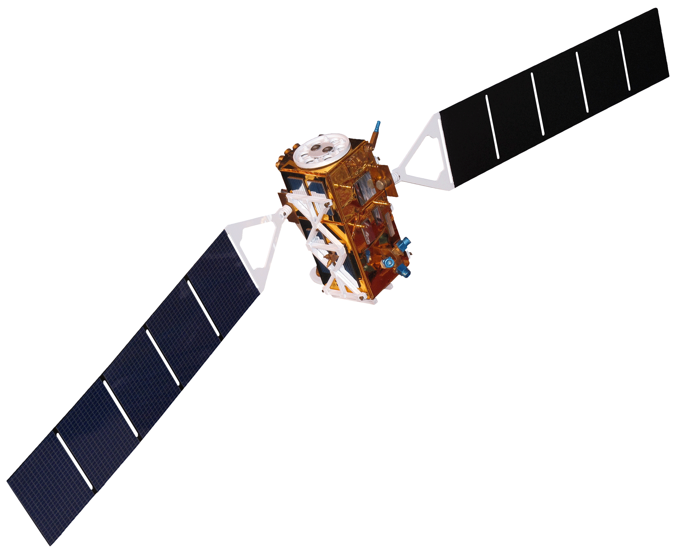
Earth Observations
Landsat 8 OLI
Landsat 5 TM
1997
2011
2013
2017
Sentinel-1 C-SAR
Image Credit: NASA
Notes:
To accomplish these goals we investigate surface deformation and dune change over the time period from 1997-2017 using both optical and radar Earth Observations. Our optical EO’s of choice include Landsat 5 Thematic Mapper and Landsat 8 OLI while radar evaluations use exclusively Sentinal-1 C-SAR data. is our only data will be used and Sentinel-1 C-SAR to evaluate our study area.
------------------------------------------------------------------
Image Source: http://www.devpedia.developexchange.com/dp/index.php?title=List_of_Satellite_Pictures

Slide 11
Methodology
(1) Download Sentinel-1 C-SAR data from 2017
Create correlation images
Identify areas with most change
Compare pre- and post-Burning Man images
Radar
Normalize images
Compare radar and optical results
(2) Download Landsat 5 & 8 and NAIP imagery from 1997-2017
Digitize Inundation Areas
Digitize dune features
Identify areas with most change
Make inferences
Optical
Notes:
We developed two separate methodologies for our radar and optical imagery.
For radar, after downloading data imagery from USGS’ Earth Explorer, we created correlation images using imagery acquired 12 days apart (including an older image and a more recent image). More of this methodology will be discussed in the next two slides
For optical, we downloaded Landsat Imagery and NAIP imagery from USGS Earth Explorer.
NAIP imagery is 1m resolution while Landsat is 30 m resolution
With the Landat imagery, we digitized inundation areas
With the NAIP imagery, we were able to draw dune boundaries.

Slide 12
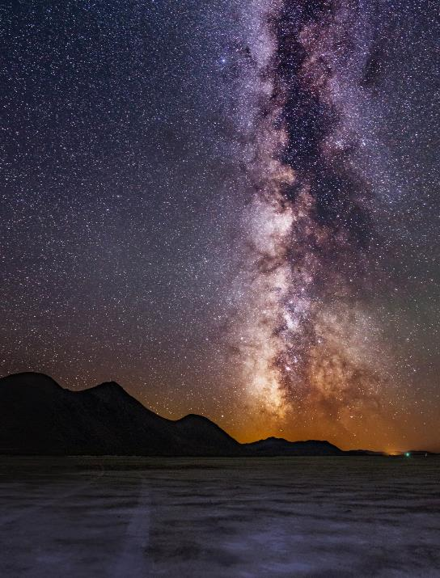
Results
Synthetic Aperture Radar (SAR)
Correlation Maps
Optical
Time Series
SAR & Optical Comparison
Image Credit: Creative Commons-Flikr
Notes:
Next, we will show everyone our results
First, we made a annotated correlation maps and also a time series with the Sentinel-1 imagery
Second, we made optical times series to show flooding events
Third, we compared the optical and SAR for the year 2017 for further analysis
-------------------------------------------------------------------------------------
Image Source: https://www.flickr.com/photos/blmnevada/19788968288/in/photolist-w9FCQq-oHwFoH-ef7HWs-R5H71o-ef7He3-ef1Y9P-d6djoN-ef7HFW-ef1YB2-ef1UBZ-ef1ZaK-ef7HpE-ef7H5h-p1tx2Y-ef1WxT-ef1YhM-ef1Zng-ef7HT1-ef7Hhm-qfYWK7-r5ecEF-qVpVD5-hXoQEE-hXpK32-hXoY9A-5qQ1E9-hXpGXR-hXoNjY-2vVkpu-ScJLs8-eBfSH7-db8wVQ-pbaffy-ef7Gps-5mszd8-cvtEo9-2G7jmy-h68Sn-5Fq1fc-67b9Gr-oHfXXc-h68Sk-d6XXc9-5FuhsG-aahRhU-dbo3Xf-qVx4n8-UaFVw6-V2pp8G-fCZeDp

Slide 13
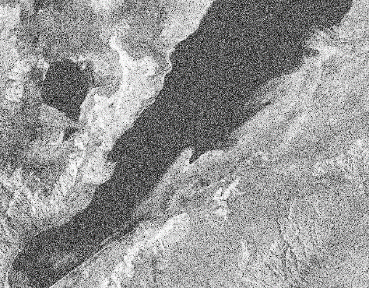
SAR Correlation Maps
0
Pixel Value
Increasing Correlation
Darker Area = Decreasing Correlation = Most Landscape Change
1
Notes:
The correlation maps we generated in ENVI are grayscale images ranging in pixel value from 0 to 255, with pixels attributed 0 being white and pixels attributed 255 being black. A pixel’s grayscale color represents its magnitude of correlation (or otherwise called decorrelation). The darker the pixel, the less correlation between the older and more recent images, and the more significant surface change that occurred.

Slide 14
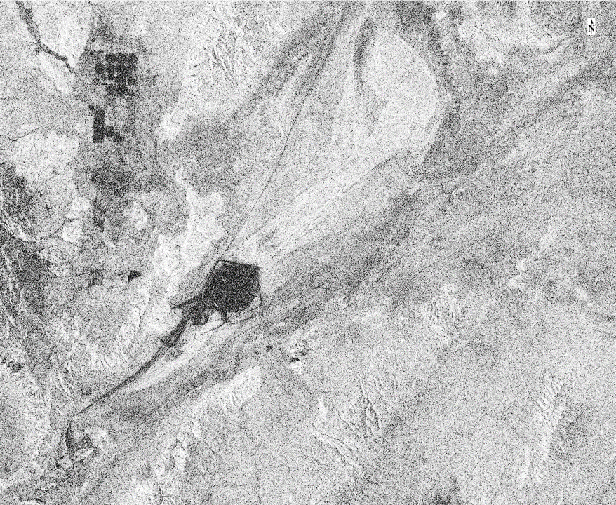
SAR Methodology
Coregister image pairs
Interferometric correlations
Deburst
Orthorectification
Coregister the stack
Normalization
Pictured: SAR intensity and coherence images from
August 25-September 6, 2017
Notes:
Discuss steps
Coregister image pairs accounts for the 12 days that pass between images and matches each pair pixel per pixel
Interferometric correlation to extract wavelength information
Deburst removes lines across image (lines are with SLC images when downloaded from ASF)
Orthorectificaton georeferences raster
Coregistering the stack matches all images pixel per pixel
Normalization accounts for outliers and makes for a more refined image, makes it easier to do analysis

Slide 15
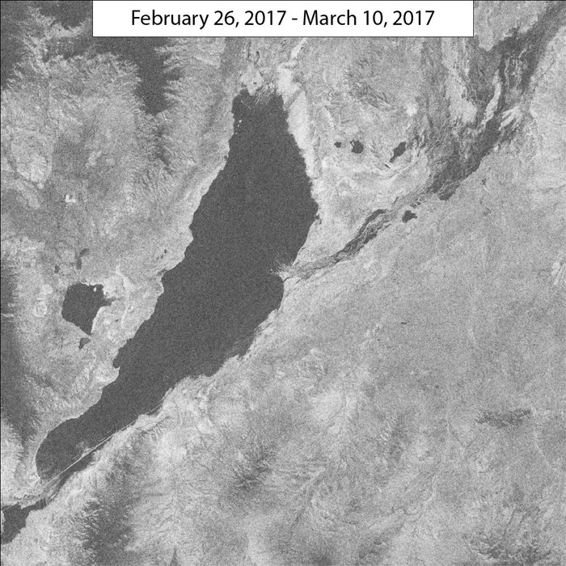
SAR Time Series
Notes:
**GIF works in presentation mode**
This is a time series for 2017 showing change in the playa. Notice the changes in color and how it relates to the time of the year.

Slide 16
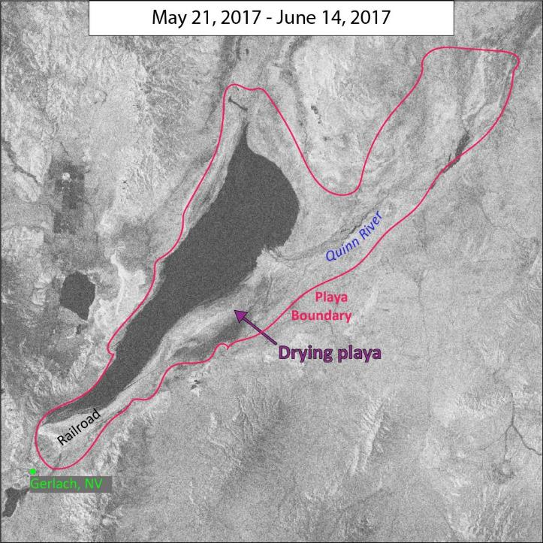
SAR Analysis
Notes:
Railroad stays consistent through all images (should be the case.. Good control)
Discuss Quinn River’s effect (makes that area darker)– it also shows where it drains into the playa
Discuss drying playa and how that affects correlation coloring
Gerlach is the closest town (it is very small and likely do not contribute to dust being kicked up)

Slide 17
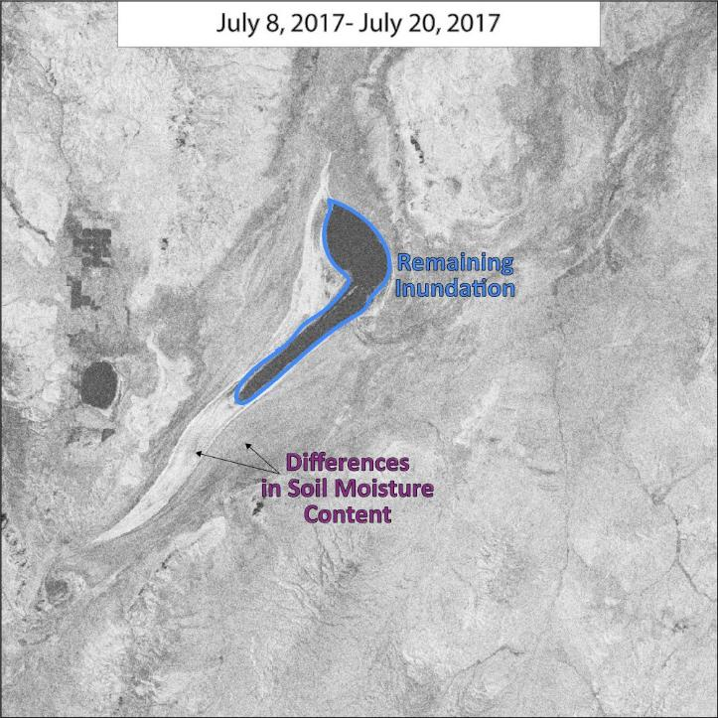
SAR Analysis
Notes:
You can clearly see the outline of the playa here and also observed where the playa dries first, and where water stays standing for a water
The dark area is not necessarily where water is standing- it could just be wet soil.
Not pointed out in the image, but the agriculture fields are standing out and remain this way during agricultural season

Slide 18
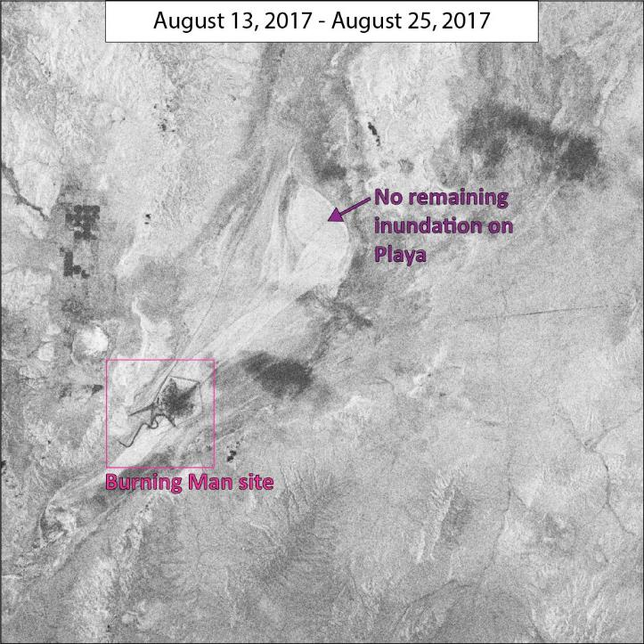
SAR Analysis
Notes:
Can still see where inundation was by the “ladle” shape
This is right before burning man starts (can only start festival when playa is dry)
Can see a potential dust storm north east of the BM site (could be dust storm from dust being kicked up from BM construction)

Slide 19
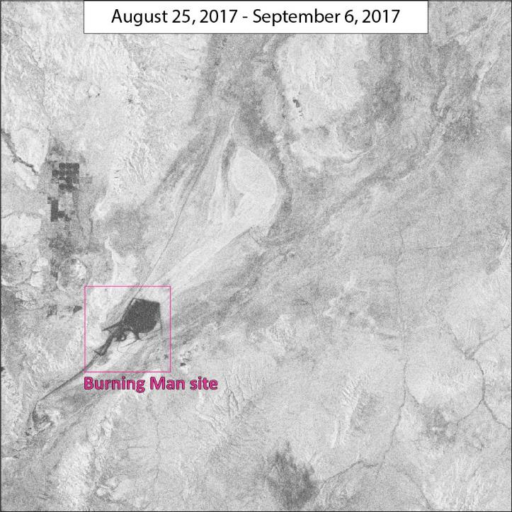
SAR Analysis
Notes:
Can clearly see Burning Man’s footprint
Interesting to see where the closure areas and also areas that have not change within the Burning Man site

Slide 20
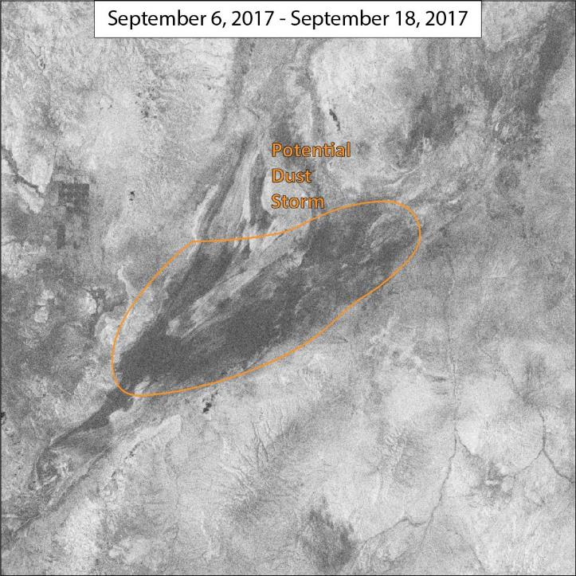
SAR Analysis
Notes:
The drastic change in color after Burning Man is important to note. It could be that after the festival goers pack up, dust is kicked up. Our partner noted that dust storms are more significant post Burning Man do to the amount of dust in the air at this time.

Slide 21
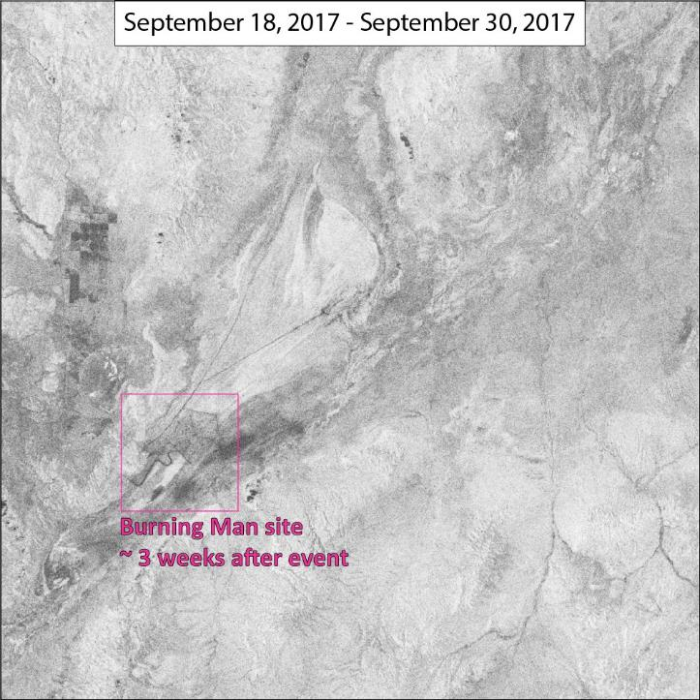
SAR Analysis
Notes:
Can still see Burning Man’s footprint 3 weeks after festival is over- the road leading to the festival is them most prominent
Notice the potential dust storm immediately south east of the festival

Slide 22
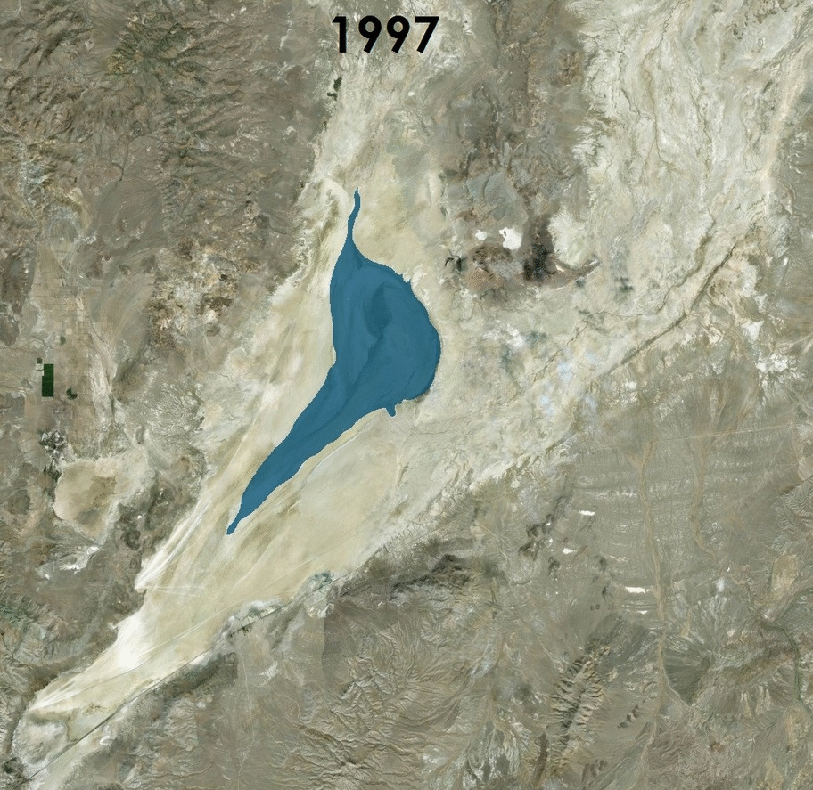
Optical Time Series
Notes:
**gif works in presentation mode**
Time series of flooding from 1997- 2017
Used Landsat 5 TM and Landsat 9 OLI

Slide 23
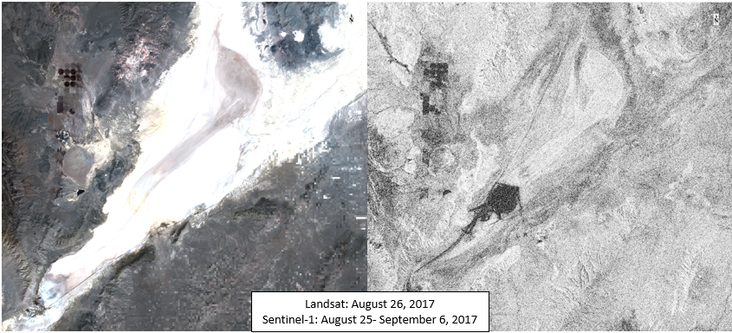
Radar & Optical Comparison
Notes:
Comparing both optical and radar helped us determine if the dark spots on the playa are from flooding or just wet soil. The SAR imagery and Landsat 8 imagery had dates that complemented each other well

Slide 24
In Conclusion
Found that the “dunes” are actually vegetation mounds
No observed mound movement
Inundation potential mitigator
Provided BLM with sound methodology for radar processing
Image Credit: Marcella Rose
Notes:
First bullet important because dunes and vegetation mounds act differently.. Good to establish correct terminology for future studies
Using NAIP, found not changes in mound location but did notice that some mounds did not have vegetation on top of them during dry months
We were limited with the NAIP imagery as even higher resolution is needed to see each individual mound and also, NAIP only has five years available. More images could help further study if inundation and mound movement are correlated.
Using ESA’s SNAP software (which is opensource so anyone can use!), we provide our partner at the BLM a foundation for future Sentinel-1 processing.
Source: Marcella Rose (team member)

Slide 25
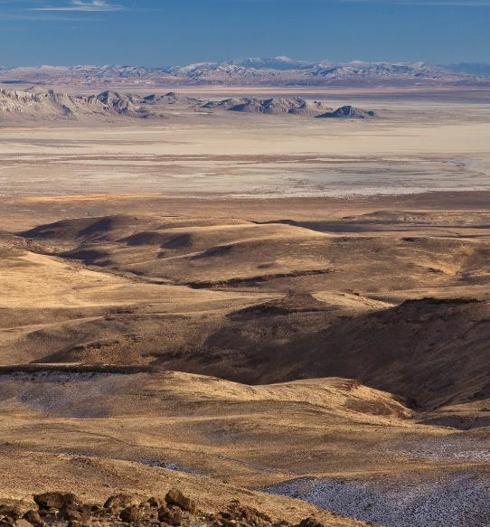
Decision Making Impact
Assess Burning Man’s request for a permit renewal & increased event attendance
Provide methodology for the BLM to evaluate impact of recreational activities
Observed that the “dunes” are actually vegetation mounds
Assist in the preservation of Black Rock Playa
Image Credit: Creative Commons-Flikr
Notes:
The end products will provide additional insight to partners at the BLM in determining the source of the dunes. The BLM needs data to assess whether the Burning Man event and its growing population, other anthropogenic activities, or the drought are the cause of the unnatural dunes and the creation of dust. The end products will be an additional resource that BLM will use to determine if a population increase in the area can be permitted. Given the spatial area and temporal scale, remote sensing is the only way to address deformation of the playa from human use.
-----------------------------------------------
Image Source: https://www.flickr.com/photos/blmnevada/24995335682/in/photolist-E5KCtu-5mwRZf-nANCv-hXo3pd-5Vtsyv-346Efp-akbosG-hXqsUE-327piS-4K6SHJ-Wfrq4i-38Me5y-TQcP1k-arNCk8-hXqxtD-TLxJbq-h68Sj-gzJ8Bs-6aFSi1-fM9dk6-faWP6L-Xtazos-5mwU5S-21bGHja-TPBuCz-EPjq2A-p9atWY-hXquKx-arRg51-gzJ81r-5pviTW-cqqqd5-hXqc5W-hXqnzk-hXpoKk-78ohfv-hXpGGS-cqqqZd-auhFvH-avLKNt-5F4uFi-arNCix-auhFAi-auhEQM-47rB7E-LtdLYy-gzJAfK-21eHQjT-gzJAov-qVz6d6

Slide 26
Acknowledgements
We want to give a big THANK YOU to our…
Science Advisors:
Dr. Bruce Chapman NASA Jet Propulsion Laboratory, California Institute of technology
Dr. Tom Farr NASA Jet Propulsion Laboratory, California Institute of Technology
Partner:
Dr. Mark Hall Bureau of Land Management, Winnemucca District, Black Rock Field Office
Image Credit: Creative Commons-Google Images
Notes:
This project could not have been completed without the help of a few very important people. We’d like to give a big thank you to our science advisors at JPL, Dr. Bruce Chapman and Dr. Tom Far) as well as our BLM Partner, Dr. Mark Hall.
Last but not least, thank you to our fellow JPL DEVELOPERs for their support, encouragement, and technical assistance.
---------------------------
Image Source(s): (1) https://www.google.com/search?site=imghp&tbm=isch&q=jpl%20logo&tbs=sur:fmc#imgrc=mjZGGqJ-Pd9CjM:&spf=1519764337770
(2) https://www.google.com/search?site=imghp&tbm=isch&q=blm%20logo&tbs=sur:fmc#imgrc=ootn6VDiICS0pM:&spf=1519759507940

Slide 27
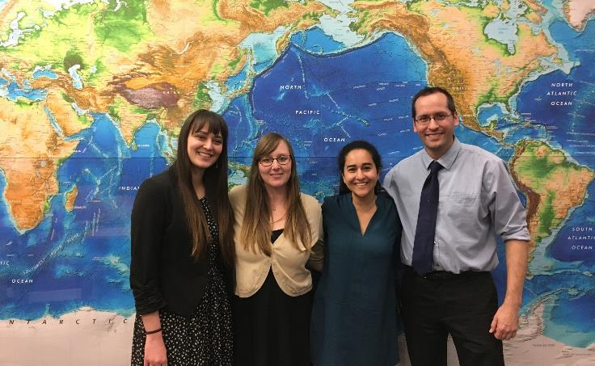
Thank you!
[Insert team photo]
Pictured(left to right): Dara Laczniak, Marcella Rose, Neda Kasraee, & Nick Rousseau
Notes:
Thank everyone for coming!

