Slide 1
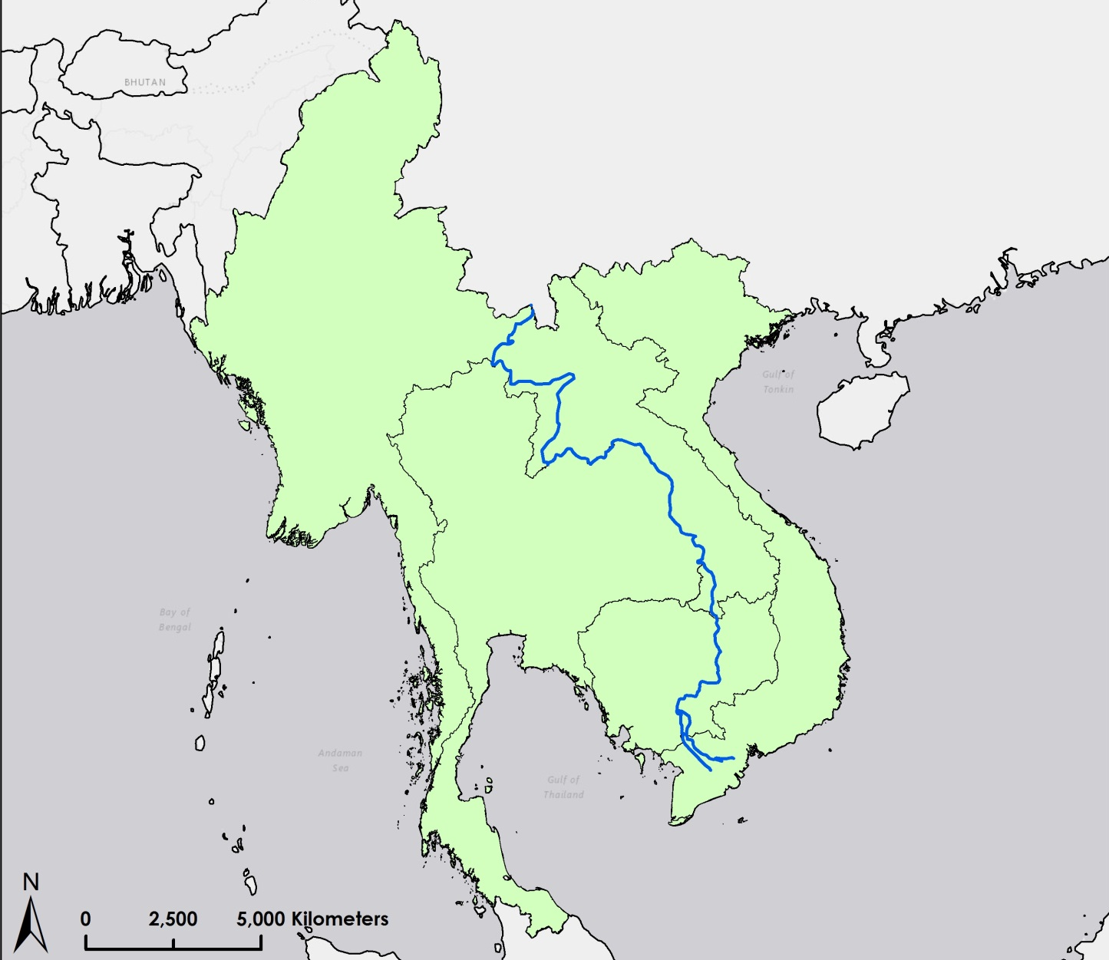
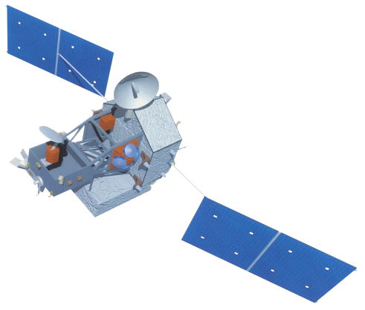
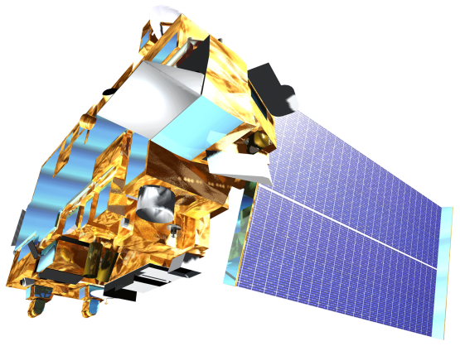
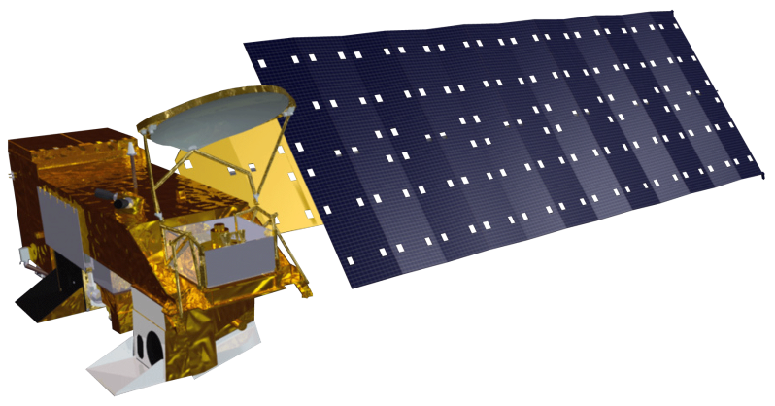
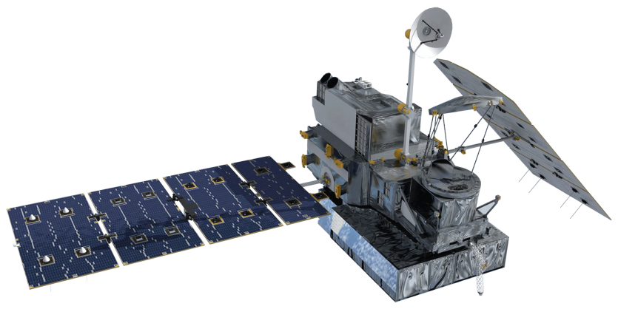
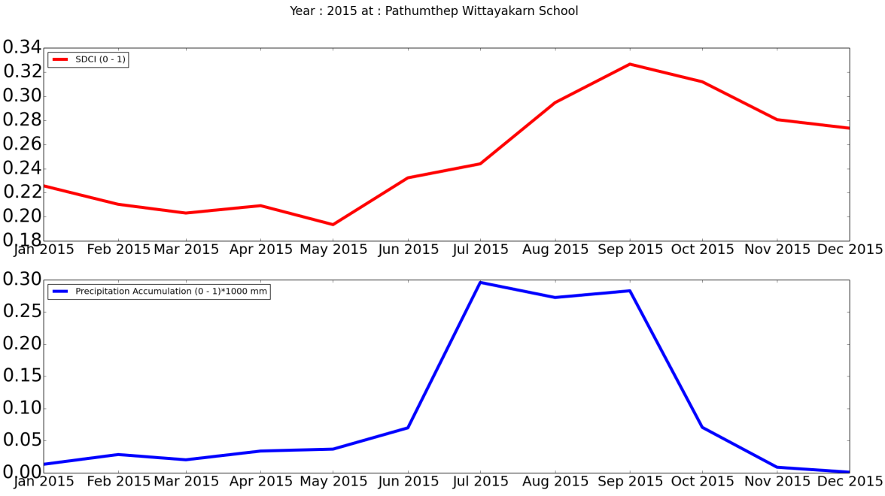
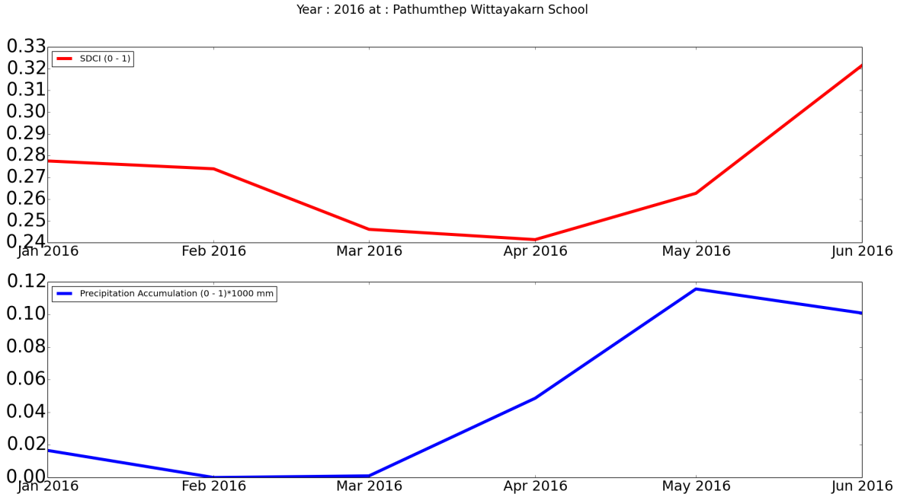
Utilizing NASA Earth Observations to Enhance Drought Management Decisions within the Mekong River Basin’s Agricultural Fields
Abstract
Objectives
The Mekong River Basin region is one of the world’s largest contributors in the global rice production market with rice paddies on over more than 10 million hectares of land. The production of these crops contributes significantly to the local economies and workforce within this region. The Mekong River Basin experiences seasonal flooding, as well as periods of drought, which affect the rice yield. The majority of the rice fields in the Mekong River Basin rely on rainwater for irrigation rather than using groundwater, which can be problematic during extended periods of drought. The NASA SERVIR Coordination Office located at the Marshall Space Flight Center (MSFC) has partnered with the Asian Disaster Preparedness Center (ADPC) through the SERVIR Mekong Hub in order to improve on climate resilience in the Mekong River Basin region. This project focused on applying the Scaled Drought Condition Index (SDCI), an index used for agricultural drought throughout Thailand, Myanmar, Laos, Vietnam, and Cambodia in the Mekong River Basin. This index was created by using precipitation data from Tropical Rainfall Measuring Mission (TRMM) and Global Precipitation Measurement (GPM), land surface temperature from the Moderate Resolution Imaging Spectroradiometer (MODIS), and Normalized Difference Vegetation Index (NDVI) data from MODIS. The SDCI was used in creating a time series and compiling a near real-time monitoring tool that aided in mitigation efforts against prolonged drought in the Mekong River Basin.
Develop the Agricultural Drought Index Monitoring Tool (ADIM) to automate data download and processing for Scaled Drought Condition Index (SDCI)
Create and examine the Scaled Drought Condition Index (SDCI) from January 2000 to May 2016
Study Area
Laos
Vietnam
Myanmar
Thailand
Methodology
Cambodia
ADIM
Near Real-Time Monitoring
Time Series
Agricultural Drought Index Monitoring Tool
Scaled Drought Condition Index
NDVI, LST, and Precipitation
User specified option
SDCI
SDCI
Scaled, Monthly Datasets
Scaled, Monthly Datasets
Earth Observations
TRMM PR
Aqua MODIS
Mekong River Basin Agriculture
Terra MODIS
GPM IMERG
Conclusions
Over time, the monthly SDCI outputs follow rain accumulation trends.
Due to the nature of the index, overall accuracy of the SDCI is difficult to calculate.
Higher resolution products will allow for a finer spatial resolution in the SDCI outputs which would better pinpoint locations experiencing agricultural drought.
The ADIM allows for faster calculation of the SDCI for both time series and near real-time analysis for arid and humid climates.
Results
Scaled Drought Condition Index, values < 0.5 indicate drought
1
April 2015
1
May 2015
1
June 2015
0
0
0
Project Partners
1
April 2016
1
May 2016
1
June 2016
SERVIR Mekong Hub – Peter Cutter
Asian Disaster Preparedness Center (ADPC) – Rishiraj Dutta
NASA SERVIR Coordination Office – Eric Anderson & Kel Markert
Royal Thai Embassy – Bunyakiat Raksaphaeng
0
0
0
Team Members
Acknowledgements
We would like to thank our science advisor, Dr. Jeffrey Luvall with NASA at NSSTC, our science mentor, Dr. Robert Griffin with UAH, Leigh Sinclair with ITSC, and Dan Irwin and Eric Anderson with SERVIR.
We would also like to thank the past contributors to the project: Sean McCartney, Nobphadon Suksangpanya, Chisaphat Supunyachotsakul, Srisunee Wuthiwongyothin, Sahakait Benyasut, Thanapat Vichienlux, Timothy Klug, Arom Boekfah, Chayanit Choomwattana, Komsan Rattanakijsuntorn, Watanyoo Suksa-ngiam, Atipat Wattanuntachai
Any opinions, findings, and conclusions or recommendations expressed in this material are those of the author(s) and do not necessarily reflect the views of the National Aeronautics and Space Administration. This material is based upon work supported by NASA through contract NNL11AA00B and cooperative agreement NNX14AB60A.
Daryl Ann Winstead
Project Lead
Allison
Daniel
Pumichat Raksaphaeng
Waritchana Rakumthong
NASA Marshall Space Flight Center – Summer 2016

