Slide 1
Louisiana Ecological Forecasting
Using UAVSAR, AVIRIS and AirSWOT to Examine Historic Trends and Model Sediment Transport within the Wax Lake Delta, Louisiana to Inform Coastal Restoration Efforts
Emily Beck(Project Lead)
Brittany Zajic
Raul Garcia

Slide 2
Introduction
Land loss due to erosion, land subsidence, and sea level rise along the Louisiana coast has amounted to 4900 km² since the 1930s
Over $200 billion in damage from hurricanes and major storms over the past 10 years
Coastal wetlands can buffer the effects of flooding and storm surge by slowing down water, reducing wave energy, and increasing water storage
Image Credit: Alexander Kolker
Notes:
Image Source: http://commons.wikimedia.org/wiki/File:Claude_Monet_-_The_Magpie_-_Google_Art_Project.jpg
There has been over 200 Billion dollars in damages from 8 hurricanes and major storms that have hit the region in the past 10 years
Research has shown that coastal wetlands can buffer the effects of flooding and storm surge by slowing down water, reducing wave energy, and increasing water storage.

Slide 3
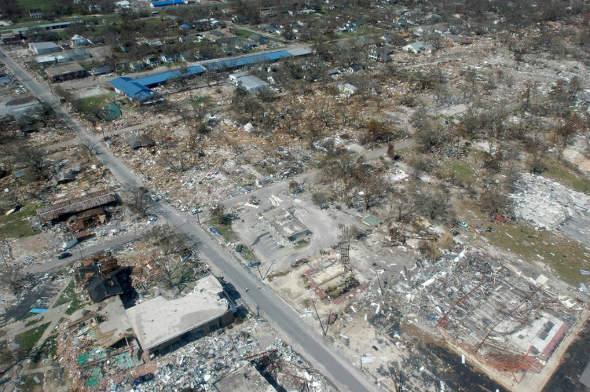
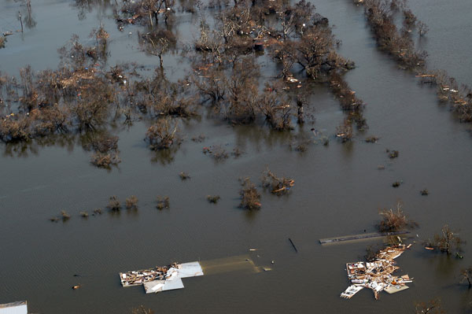
Community Concerns
Louisiana today has 40% of the wetlands found in the continental U.S. but is experiencing 80% of the losses, losing wetlands at a rate equivalent to a football field an hour
Louisiana has the potential to lose up to an additional 4500 km² over the next 50 years unless immediate efforts are taken to combat this trend
Image Credit: FEMA
Image Credit: USGS
Notes:
Image Source: http://commons.wikimedia.org/wiki/File:Claude_Monet_-_The_Magpie_-_Google_Art_Project.jpg
According to the USGS, Louisiana today has 40% of the wetlands found in the continental United States but is experiencing 80% of the losses, losing wetlands at a rate equivalent to a football field an hour.
The State of Louisiana’s Comprehensive Master Plan for a Sustainable Coast confirmed that Louisiana has the potential to lose up to an additional 4500km² over the next 50 years unless immediate efforts are taken to combat this trend.

Slide 4
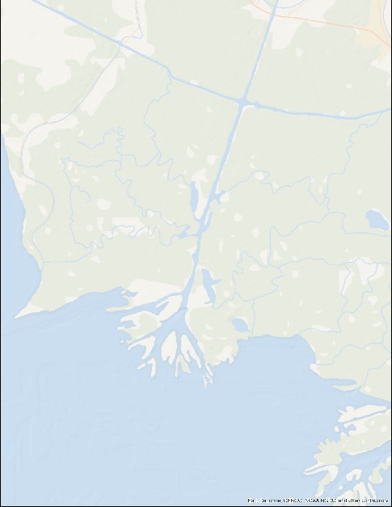
Study Area
Wax Lake Delta, Louisiana
One of two deltas that are actually growing in the U.S.
Study Period:
January 1985 - October 2015
Notes:
The Wax Lake Delta is a river delta in Louisiana that was formed by rapid deposition of sediment following the creation of a canal through Wax Lake in 1942. The Wax Lake outlet is an artificial channel that was created by the United States Army Corps of Engineers to divert 30 percent of the flow from the Atchafalaya River to the Gulf of Mexico and reduce flood stages at Morgan City, Louisiana.
It has often been in studies of deltaic formation, as it is one of only two deltas in the United States that are currently aggregating.

Slide 5
Objectives
Model water flow and sediment transport using Deltares Delft3D
Examine delta formation processes to gain a better understanding of why the Wax Lake Delta is aggregating
Observe and analyze long term delta growth patterns using Google Earth Engine API
Image Credit: NASA
Notes:
Objectives
Model water flow and sediment transport in the Wax Lake Delta using Deltares Delft3D
Examine delta formation processes to gain a better understanding of why the Wax Lake Delta is aggregating
Observe and analyze long term delta growth patterns using Google Earth Engine API

Slide 6
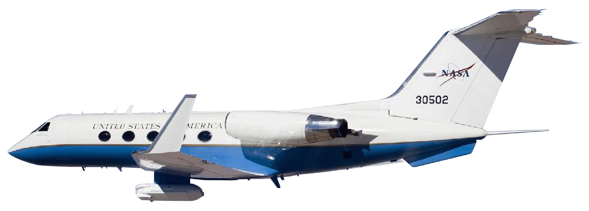
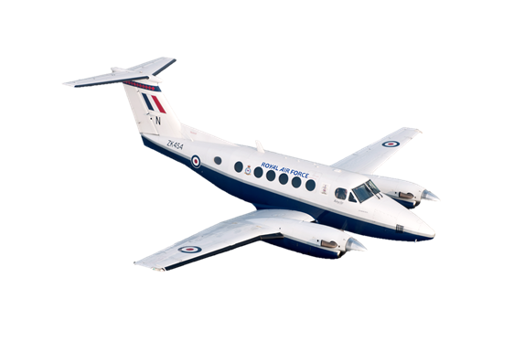
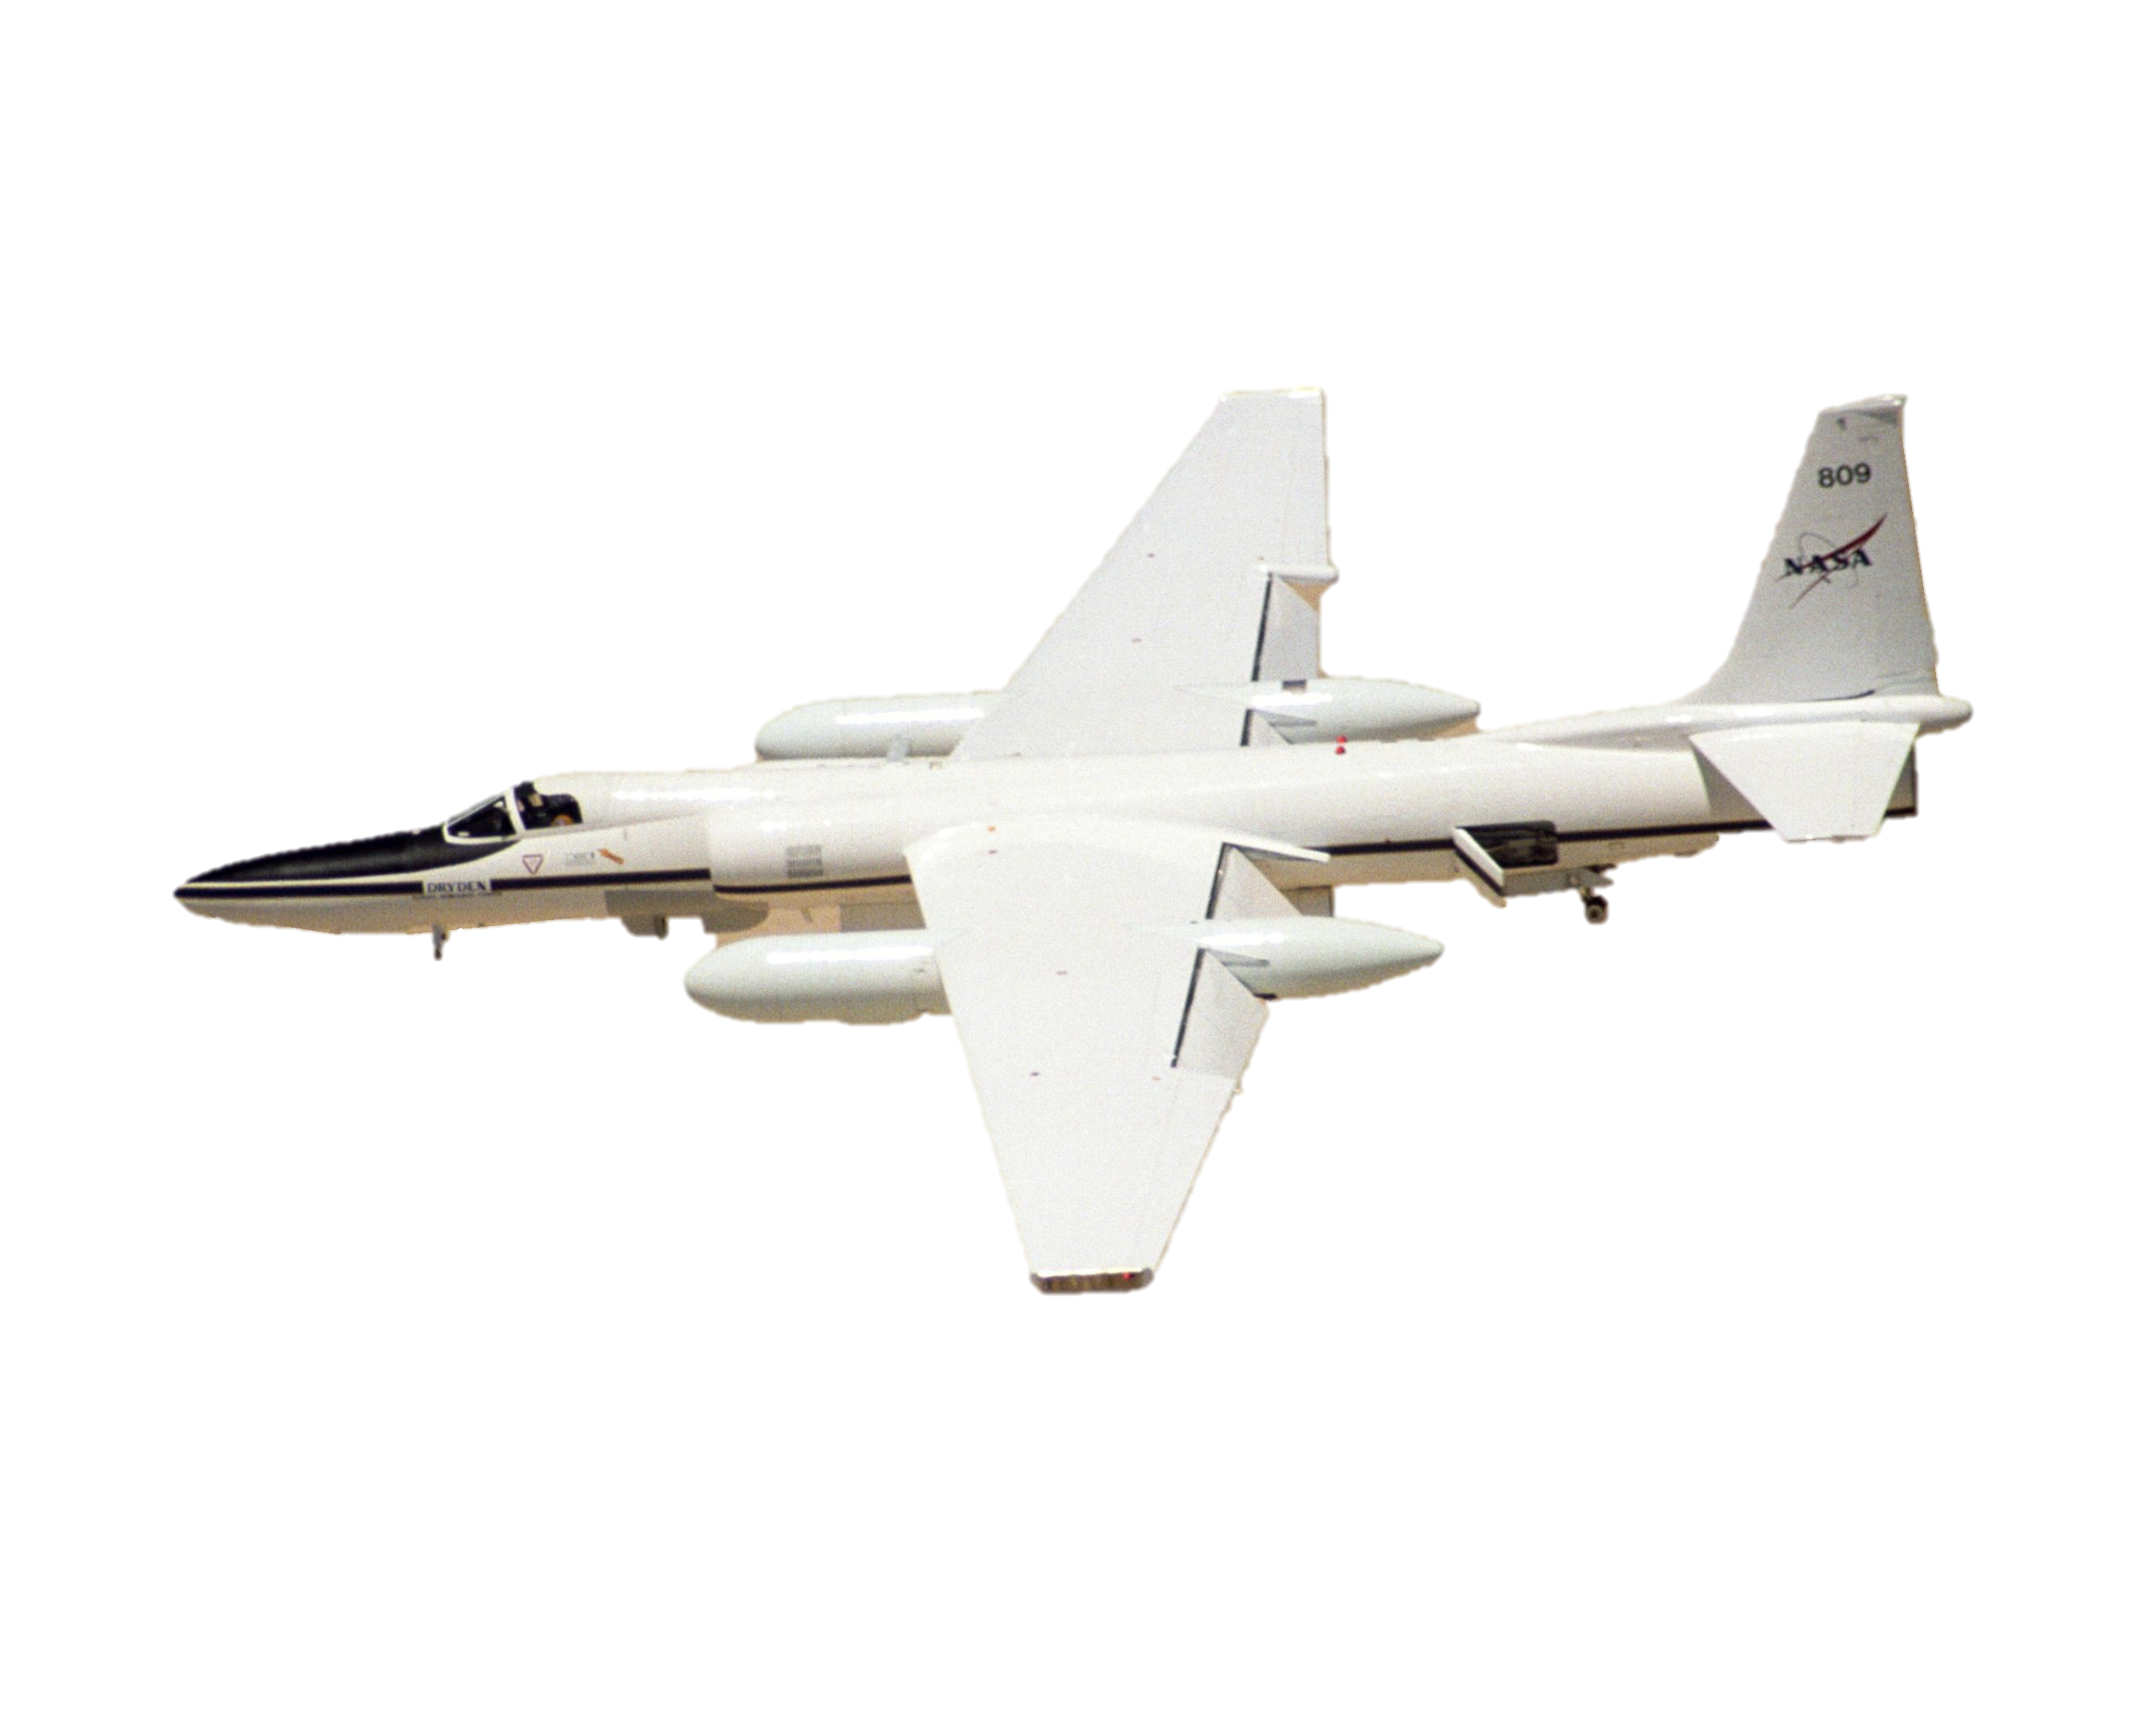
NASA Earth Observation Systems
UAVSAR
Landsat 5 TM
AirSWOT
Landsat 8 OLI
AVIRIS-NG
Image Credit: NASA
Image Credit: NASA JPL
Notes:
We used a wide array of NASA Earth Observations for this project. Landsat 5 and Landsat 8 were used to examine historic trends of the Wax Lake region. UAVSAR provides high-resolution radar data to detect shallow bathymetry. AirSWOT is the calibration/validation and science support instrument for the upcoming NASA SWOT mission, and is designed for centimeter-level detection of water surfaces and flood plains and will be used to constrain the hydrological model. And AVIRIS-NG provides high-spectral resolution to identify vegetation type, all 432 bands

Slide 7
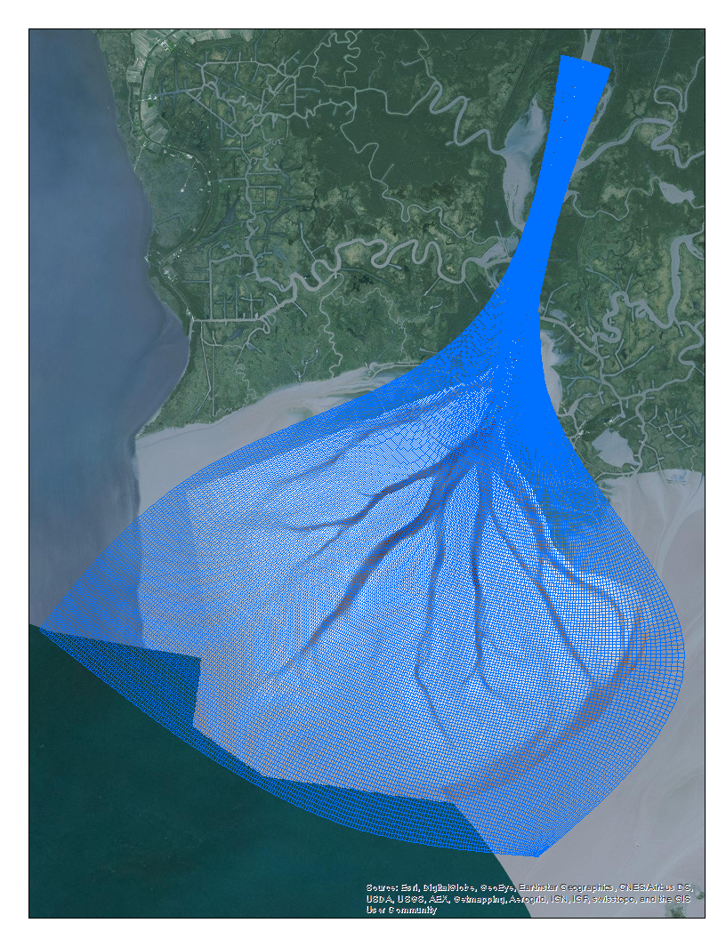
Delft3D Introduction
Created a hydrological model using Delft3D
A 2D/3D modeling suite for fluvial, estuarine and coastal environments
FLOW: a hydrodynamic simulation program that calculates transport
Capable of modeling flow, transport and morphological changes
Notes:
-We created a hydrological model of the Wax Lake Outlet and Delta using Deltares Delft3D.
-Delft3D is a multidimensional modeling suite to investigate hydrodynamics, sediment transport, and morphology and water quality for fluvial, estuarine and coastal environments.
-FLOW: a hydrodynamic simulation program that calculates flow and transport on a boundary fitted grid
-Capable of modeling flow, transport and morphological changes.

Slide 8
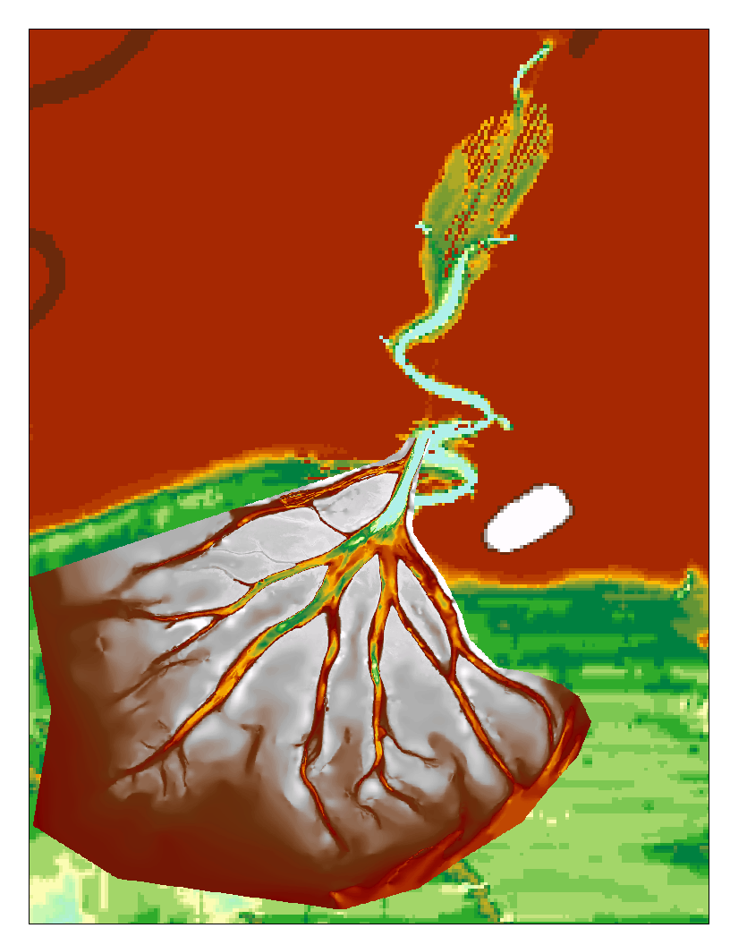
Preliminary Data Processing
Initial Outlet bathymetry contained meanders
Aerial photos and other projects show a straight channel
Channel bathymetry created using USACE data, a channel mask made from UAVSAR and ArcGIS
Notes:
-Our initial Outlet channel bathymetry layer contained meanders when aerial imagery shows a straight channel. Also, the end nearest the delta did not match up smoothly with our Delta bathymetry layer.
-Outlet channel bathymetry was created using depth transect points from the US Army Corps of Engineers 1999 Atchafalaya River Hydrographic Survey, a channel boundary mask created using UAVSAR data and interpolation tools in ArcGIS 10.3.

Slide 9
Raster Datasets of bathymetry
(ArcGIS)
Model Methodology
Modeled Sediment Transport
Vegetation Species Classification from AVIRIS
(Exelis ENVI)
Delft3D Hydrological Model
Model Calibration Using AirSWOT Data
In Situ Data:
Vegetation Species, Water Level, Flow Rate
Modeled Water Flow
Channel Boundary Mask from UAVSAR
(ArcGIS)
Notes:
Inputs for the model include the delta bathymetry raster, channel bathymetry created using the UAVSAR channel mask, and in situ data including water level and flow rates and sediment characteristics. In the future, vegetation roughness and bathymetry based on the species classification using AVIRIS will be incorporated and the model will be calibrated using AirSWOT sensor data. Results from the model include modeled surface water flow and sediment transport.

Slide 10
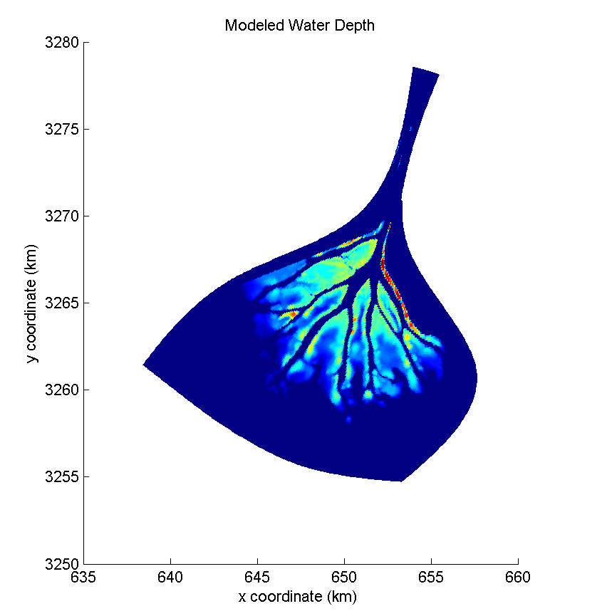
Preliminary Results
Results show modeled depth values similar to measured depth values
Preliminary and uncalibrated
Calibration needed to ensure the accuracy of model outputs
Notes:
Results show modeled depth values similar to measured depth values in the Delta. Since the model has not yet been calibrated, these results are preliminary. Calibration of the model is needed to ensure the accuracy of model results.

Slide 11
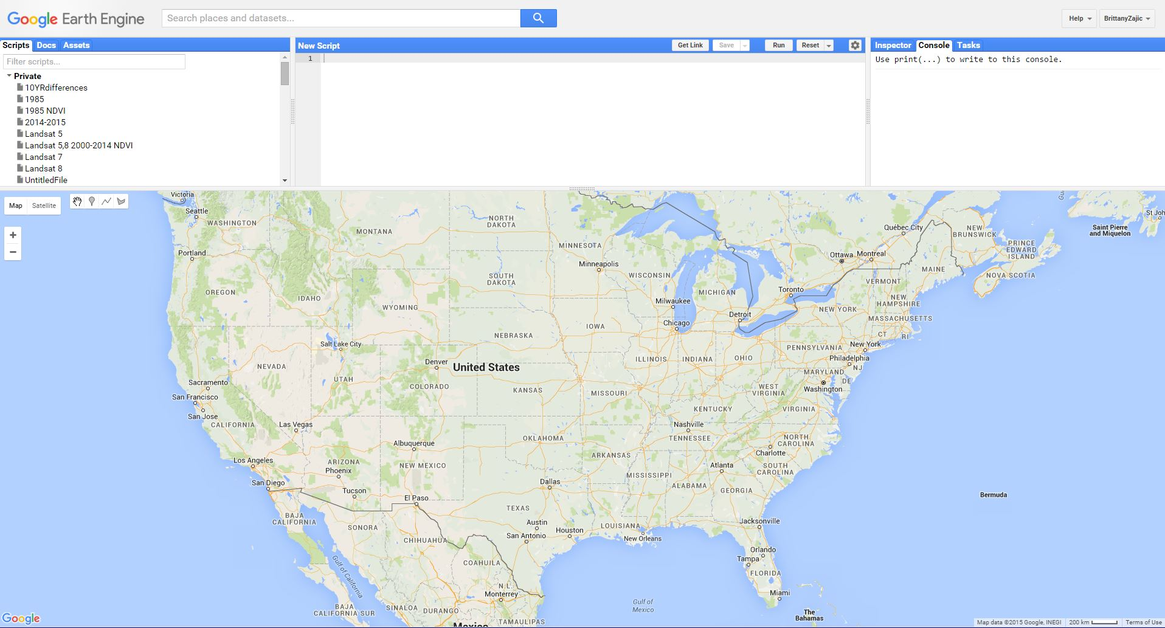
Google Earth Engine API
Image Credit: Google Earth Engine
Notes:
We were also able to incorporate the use of new technologies into our project. Google Earth Engine API is a cloud-based geospatial processing platform that allowed us to examine 30 years of Landsat imagery without having to download a single tile.

Slide 12
Landsat Time Series
Formation of Wax Lake Delta
1985 - 2014
Source: Google Earth Engine
Notes:
For visual trends of the delta formation during our study period, we created a Landsat Times series using Landsat 5 and 8 and 4 lines of code in Google Earth Engine.

Slide 13
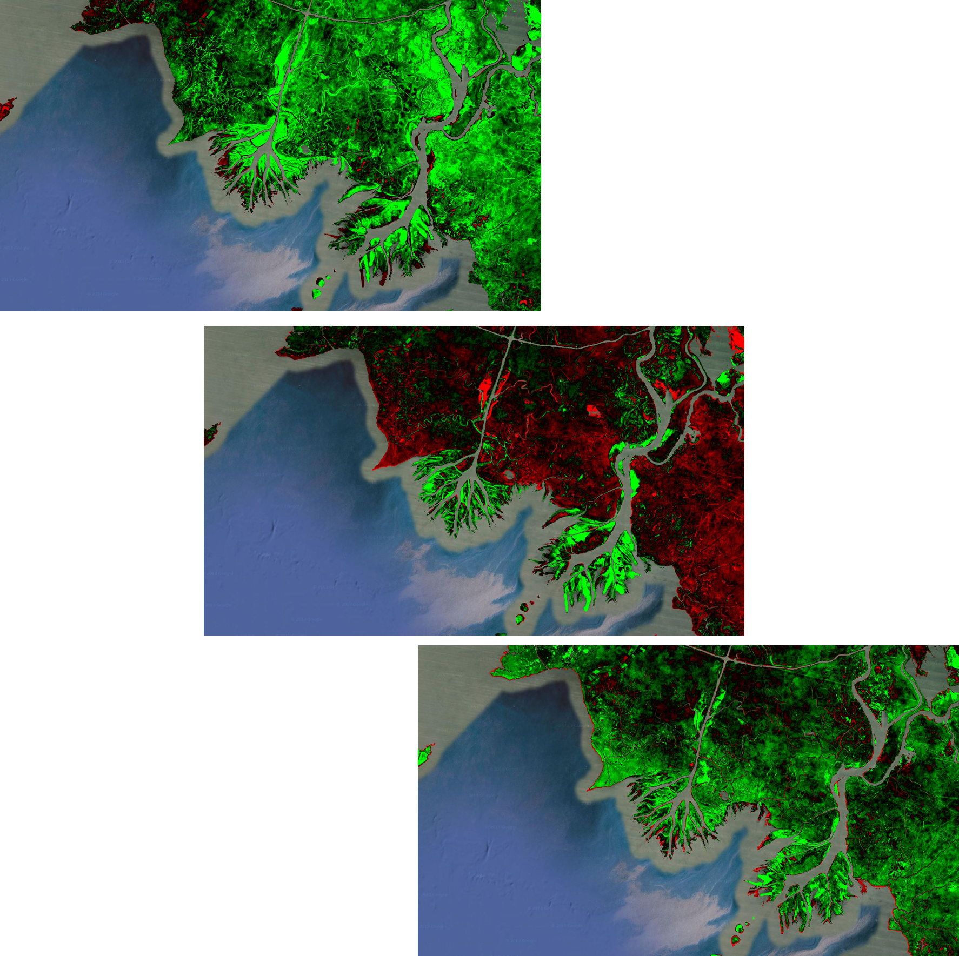
Landsat
NDVI
1985 – 1995
1995 - 2005
Methodology:
NDVI 32 Day Composites from Landsat 5 and 8
Annual mean values to create images
Subtract 10 year differences
Results:
Continued vegetation greenness/productivity across all three time periods in delta, even during 2005 high hurricane activity
2005 - 2015
Notes:
To analyze vegetation health across the same 30 year time period, we created three 10 year Normalized Difference Vegetation Index, or NDVI difference images in Google Earth Engine as well. The API provides NDVI 32 Day Composites from Landsat 5 and 8, so with annual average NDVI values we subtracted 10 year differences to create the 3 figures shown here.
1985 to 1995 and 2005 to 2015 follow initial assumptions of continued growth and vegetation productivity of the region. The 1995 to 2005 NDVI difference image shows significant decrease in vegetation in the region surrounding the delta, and preliminary analysis suggests this is due to a highly active hurricane season in 2005, with both Hurricane Katrina and Hurricane Rita causing billions of dollars in damage along Louisiana and the Gulf Coast according to NOAA.

Slide 14
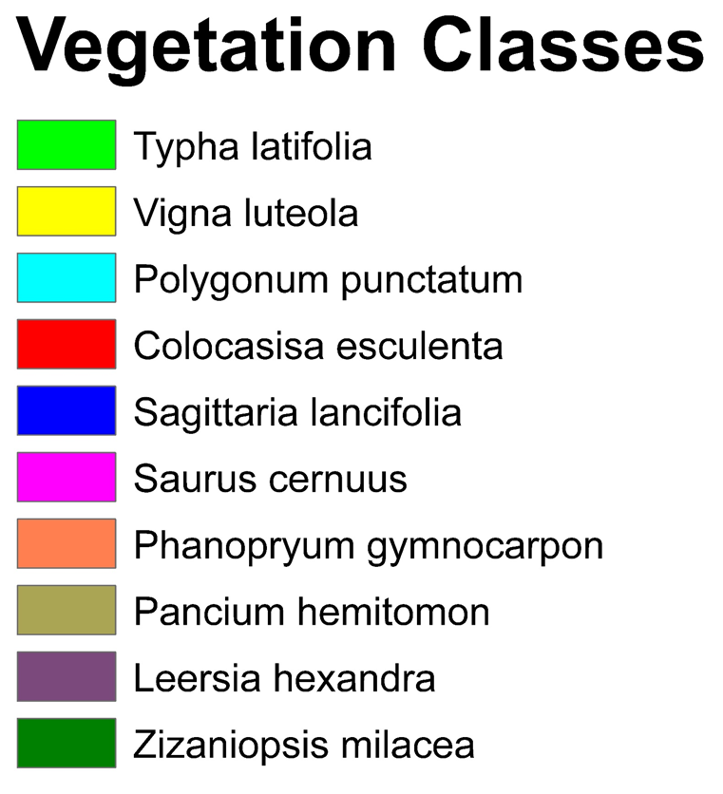
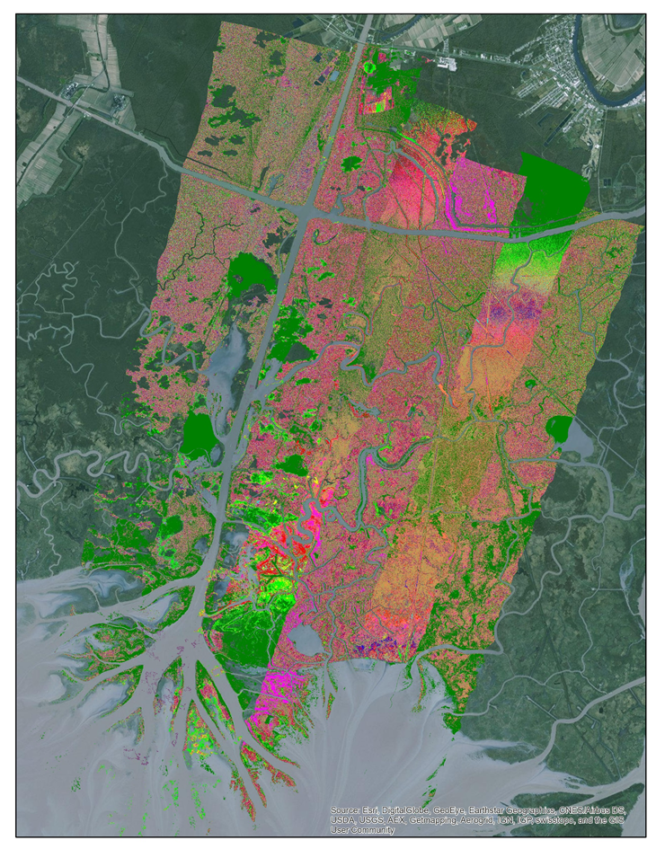
Vegetation
Classification
Methodology:
Stacked Bands
Cross-Track Illumination Correction
Parallelepiped Supervised Classification
ISODATA Unsupervised Classification
Class Merging
Mosaic
Results:
Identification of Plant Species
Notes:
AVIRIS-NG imagery was used to classify the vegetation in our study area
Methodologies
Stacked bands
Since the sensor has 432 spectral bands, the layer stacking tool was used to process only the Red, Green, Blue, and Near-Infrared Bands.
Cross-Track Illumination Correction
The Cross Track Illumination tool was used to account for a ramp in the spectral profile of the images.
Parallelepiped Supervised Classification
A parallelepiped supervised classification of the water was done to mask out all of the water bodies in the study area
ISODATA unsupervised Classification
Then an unsupervised ISODATA classification was done on all the images which included the mask
Class Merging
Ten main plant species were determined based on in situ data, so the Combine Classes tool was used to merge the original 33 classes from the ISODATA classification into 10 classes.
Mosaic
After the classes were merged, the images were mosaicked together using the Seamless Mosaic Tool
Identification of Vegetation Species
The ten different classes were then associated with vegetation species by acquiring coordinates and vegetation data from each CRMS station and Dr. Simard’s field data and applying that information to the pixel with the associated coordinates.
Pancium hemitomon, 25.2%
Zizaniopsis milacea, 23.2
The most dominant species in the study area were identified as Pancium hemitomon, occupying 25.2% of the classified pixels, followed by Zizaniopsis milacea, occupying 23.2% of the classified pixels.

Slide 15
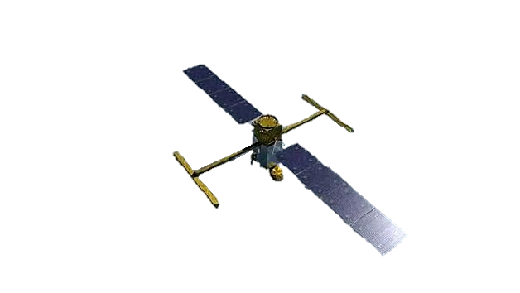
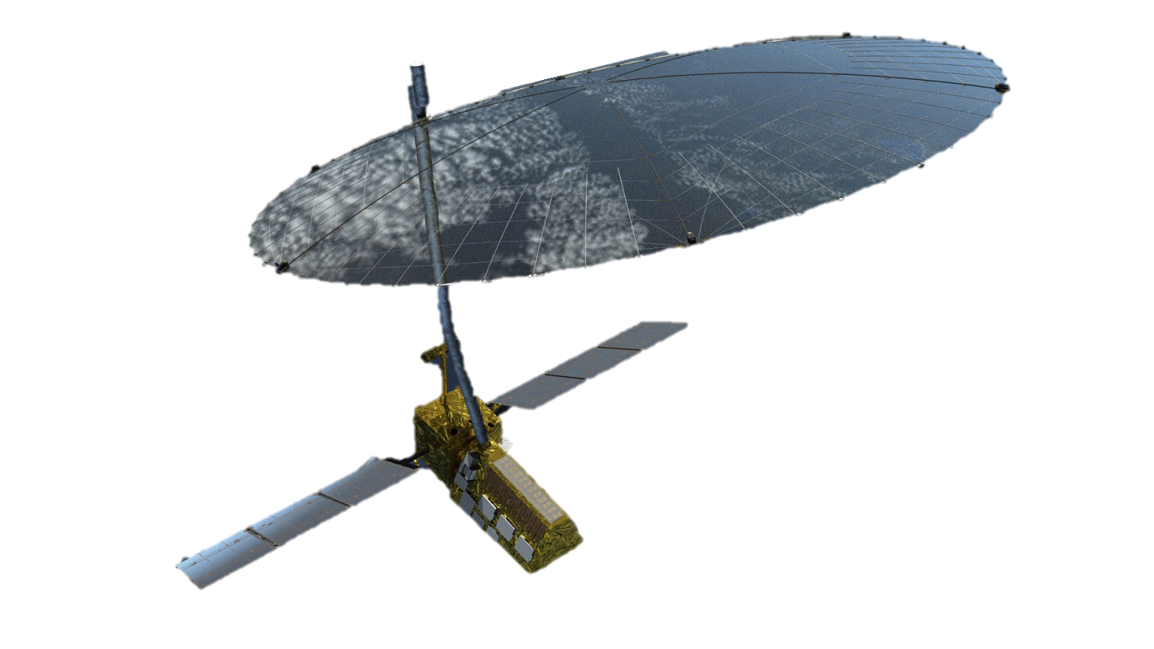
Conclusions
Constructed a preliminary hydrological model in Delft3D
Identified ten predominant plant species in the study area using unsupervised ISODATA classification from AVIRIS-NG and in situ data
Detected long term high vegetation productivity in the delta even in years where the surrounding region experienced low productivity
The work in the Wax Lake Delta simulates two space borne sensors that will be launched in 2020
SWOT
NISAR
Image Credit: NASA JPL
Notes:
-The Wax Lake Delta is an important area for research since it is building land while other areas of the coastline are eroding.
Hydrological and sediment transport modeling are particularly useful techniques because models can be easily adjusted to examine different hypothetical scenarios.
The models and outputs created for this project are the initial framework for a more robust model that will include vegetation biomass and bathymetry data from NASA AVIRIS-NG and UAVSAR sensors and be calibrated using AirSWOT.
An additional reason for the work being done in the Wax Lake Delta with AirSWOT and AVIRIS is to simulate two space borne sensors: the Surface Water Ocean Topography (SWOT) sensor, which will measure surface water height globally in oceans and large rivers; and the NASA-ISRO SAR (NISAR) sensor, which will measure ground displacement and above ground biomass.

Slide 16
Future Work
Calibrate Delft3D hydrological model using AirSWOT sensor data
Incorporate vegetation biomass and bathymetry data from AVIRIS-NG and UAVSAR
Asses the impact of vegetation on water flow using simulated plant layer in the Delft3D model
Continue exploring Google Earth Engine API capabilities with NDVI seasonality trends
Image Credit: Alexander Kolker
Notes:
Areas for future work include the calibration of the Delft3D model using AirSWOT sensor data and the incorporation of vegetation biomass and bathymetry data from AVIRIS-NG and UAVSAR. The effect of vegetation on flow could also be assessed using a simulated plant layer within the FLOW model, and we can continue exploring Google Earth Engine API capabilities by looking at NDVI seasonality trends.

Slide 17
Advisors
Dr. Cathleen Jones, NASA Jet Propulsion Laboratory
Dr. Marc Simard, NASA Jet Propulsion Laboratory
Partners
Richard Crout, Naval Research Laboratory
Dr. Alexander Kolker, Louisiana Universities Marine Consortium
Others
Gwen Miller, DEVELOP at JPL
Doug Edmonds, Delft3D
Image Credit: Alexander Kolker

Slide 18
Questions?
Image Credit: Alexander Kolker

