Slide 1
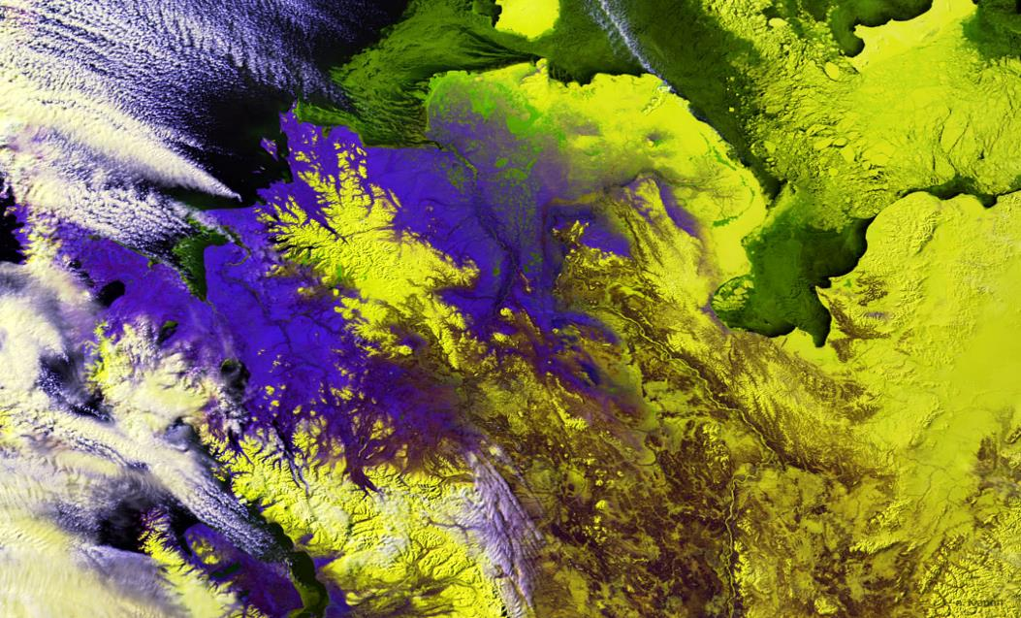
2017 Spring Preview
INTEGRATING NASA EARTH OBSERVATIONS WITH SOCIETY TO FOSTER FUTURE INNOVATION AND CULTIVATE THE PROFESSIONALS OF TOMORROW BY ADDRESSING DIVERSE ENVIRONMENTAL ISSUES TODAY.
Notes:
Your project VPS Image should be placed behind the top aperture shape. An example shape has been placed in this position for your reference. Delete the example VPS image, insert your image, right click your image and select the “Send to Back” option. Position and adjust the size of your image so that it lines up with the provided margin rulers.

Slide 2
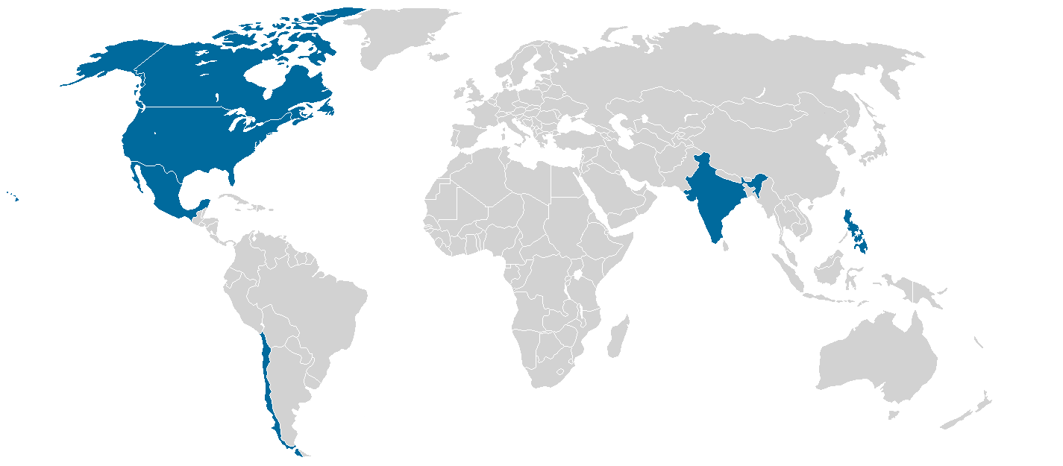
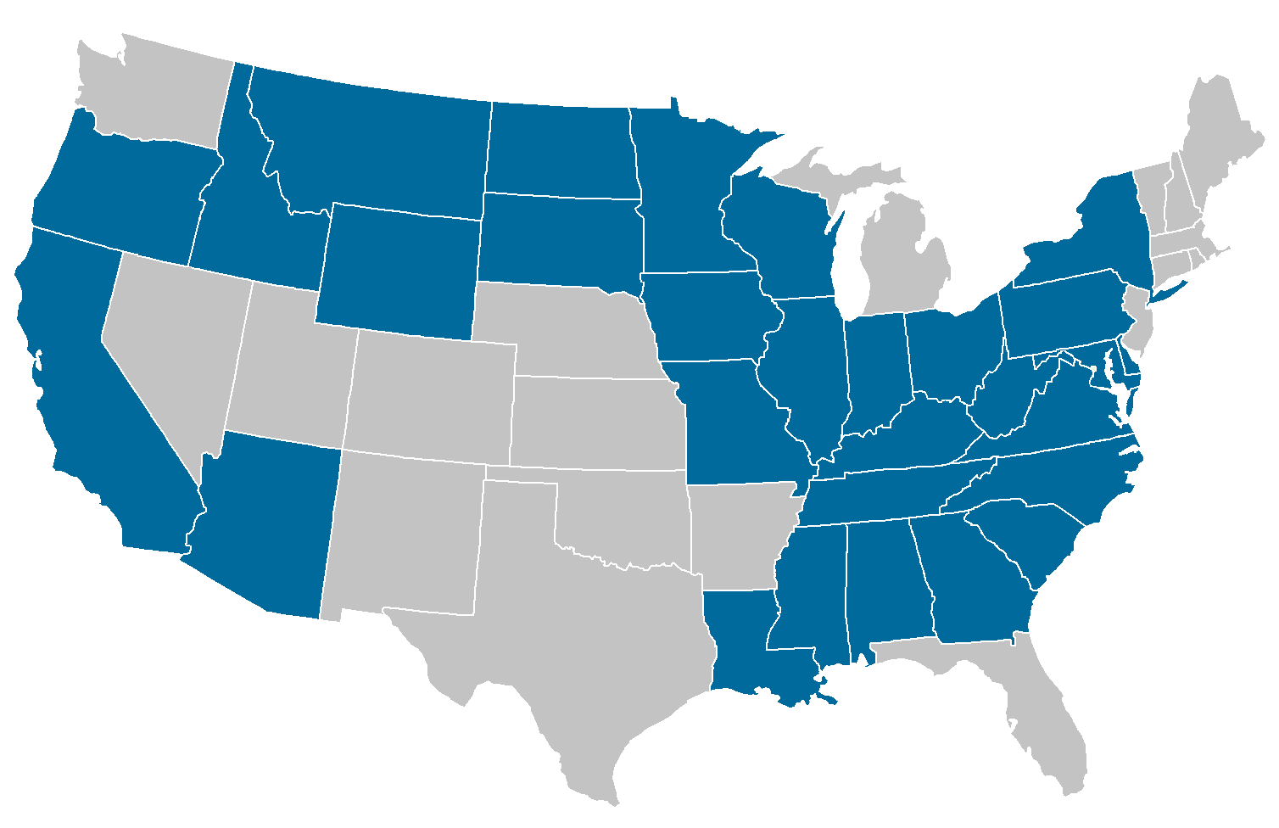
2017 Spring Portfolio
30 States & 6 Countries Impacted
23 Projects
87% Domestic 13% International
1st TERM (17)
Application Areas Addressed
Partner Total by Type
57 Partners
2nd TERM (6)

Slide 3
2017 Spring Project Preview
Alabama Agriculture
Arizona Agriculture
Chesapeake Bay Agriculture
Glacier National Park Climate II
Missouri River Climate II
Santa Monica Mountains Climate
Mississippi River Basin Disasters II
Philippines Disasters
Southern Appalachia Disasters
Eastern India Ecological Forecasting II
Intermountain West Ecological Forecasting
New York Ecological Forecasting
Yellowstone Ecological Forecasting
Nez Perce-Clearwater National Forests Energy
Phoenix Health & Air Quality
Arizona Water Resources
Chesapeake Bay Water Resources
Chile Water Resources
Lake Erie Water Resources
Mississippi Sound Water Resources
Southeastern Arizona Water Resources II
Southeastern Idaho Water Resources II
Wyoming Cross-Cutting

Slide 4
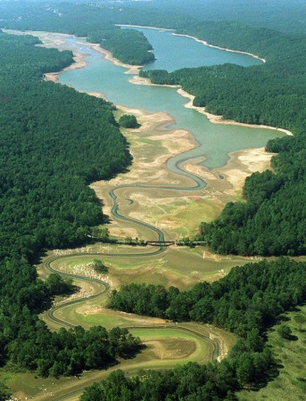
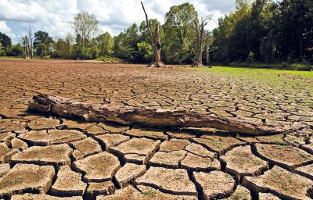
Alabama Agriculture
Community Concern: In the past 10 years, Alabama has been struck by the worst recorded droughts in its history. These droughts cause immense stress to the agricultural regions in the state.
Partners:
Alabama Office of the State Climatologist
Earth System Science Center at MSFC
Earth Observations:
Landsat 5 TM, Landsat 8 OLI, Terra and Aqua MODIS, TRMM PR, GPM IMERG, Sentinel 2 MSI
Impact & Benefit: A better understanding of drought in Alabama and the best methodologies for monitoring them will help farmers and decision makers to adjust accordingly to the changing weather conditions that have been known to severely damage crops in the area.
@ NASA Marshall Space Flight Center
Notes:
Image Source: http://commons.wikimedia.org/wiki/File:Claude_Monet_-_The_Magpie_-_Google_Art_Project.jpg

Slide 5
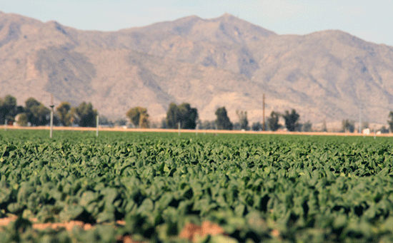
Arizona Agriculture
Community Concern: Phenotyping is used in agricultural
contexts to describe the performance of plants in a given
environment. This method allows plant breeders to identify
heat-tolerant individuals and target their management
Practices. However, it is done on an individual plant
scale which can take many years and have high costs.
Partners:
US Department of Agriculture (USDA)
Earth Observations:
Suomi-NPP VIIRS
ASTER GED
Aqua and Terra MODIS
Impact & Benefit: Working with the US Department of Agriculture (USDA) in Maricopa, AZ, this project will utilize simulated ECOSTRESS data products for remotely sensed phenotyping and identification of superior heat and drought tolerant varieties of crops. Products of this project will be utilized to increase speed and scale of the process used to identify superior heat-tolerant crop varieties. Research and decision-making on which crop varieties are appropriate in drought-prone areas can be made faster.
@ Jet Propulsion Laboratory
Notes:
Image Source: http://commons.wikimedia.org/wiki/File:Claude_Monet_-_The_Magpie_-_Google_Art_Project.jpg

Slide 6
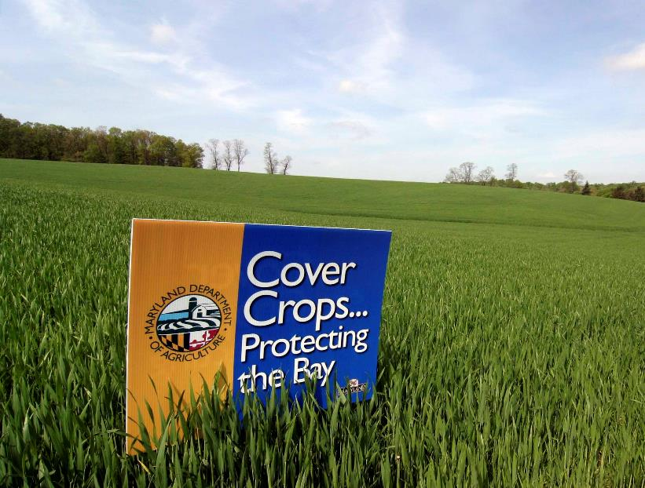
Chesapeake Bay Agriculture
Community Concern: The use of winter cover crops on agricultural fields has been identified as a key conservation management practice for reducing the loss of nitrogen and sediment from farmland. Cover crop implementation is a priority for the Chesapeake Bay Program Partnership.
Partners:
Maryland Department of Agriculture (MDA), Office of Resource Conservation
USGS Eastern Geographic Science Center
USDA-ARS Hydrology and Remote Sensing Laboratory
EPA Chesapeake Bay Program
Earth Observations:
Landsat 5 TM
Landsat 7 ETM+
Landsat 8 OLI
Sentinel 2 MSI
Image credit: MD Department of Agriculture
Impact & Benefit: Implementation of a well-calibrated, Landsat-based remote sensing technology will support analysis of cover crop outcomes and monitor progress in achieving conservation targets. Results will be used to evaluate agronomics and temporal patterns of cover crop performance, and allow for improved tracking of conservation implementation
@ Goddard Space Flight Center
Notes:
Image Source: http://commons.wikimedia.org/wiki/File:Claude_Monet_-_The_Magpie_-_Google_Art_Project.jpg

Slide 7
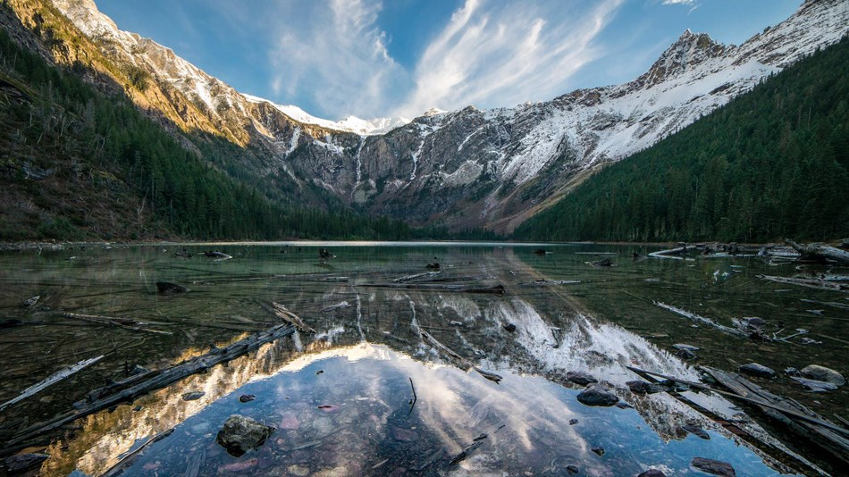
Glacier National Park Climate II
Community Concern: Glacier National Park is interested in developing a spatial database that relates landscape-level disturbances to climate-related effects across the park. By synthesizing known and unknown disturbances, the park will be able to better address and focus management resources to respond to disturbances within the park.
https://www.nps.gov/common/uploads/grid_builder/imr/crop16_9/DA3C1F02-1DD8-B71B-0BEA9E07D90D38B8.jpg?width=950&quality=90&mode=crop
Partners:
NPS, Glacier National Park
NASA Ames, Biospheric Branch
Earth Observations:
Landsat 4, 5, 7, & 8
Impact & Benefit: Disturbance detection methodology created in the first term will be automated to increase ease-of-use, and further refinement of products and tools will enhance the park’s ability to monitor and identify disturbances.
@ NASA Langley Research Center

Slide 8
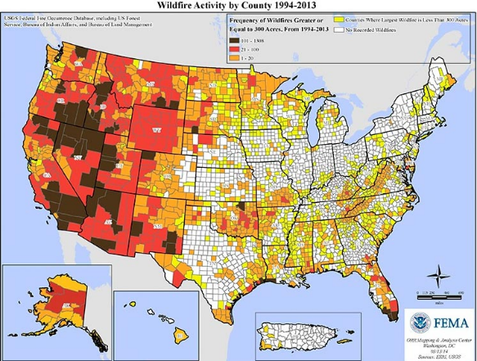
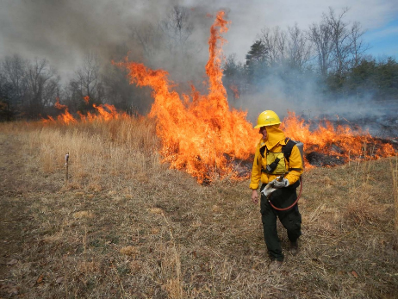
Missouri River Climate II
Community Concern: Poor grassland conditions in the Upper Missouri River Basin impact communities throughout the region by increasing the risk of wildfires and reducing the success of cattle ranches. An exceptional drought (D4 – USDM) in 2012, concentrated in the Great Plains, led to large wildfires throughout several states within the Missouri River Basin. The average wildfire size for 2012 was 1.5 times the 10-year average
Partners:
Great Plains Tribal Water Alliance
NOAA Regional Climate Services Director, Central Region
U.S. Army Corps of Engineers
Earth Observations:
PERSIANN - Precipitation
Aqua and Terra MODIS - NDVI or EVI
SMAP – Soil Moisture
Ancillary Datasets
NLDAS – Soil Moisture
U.S. Drought Monitor – Archived Drought Conditions
Impact & Benefit: The Missouri River Climate II project team will seek to provide end-users in the region with a rangeland health and wildfire vulnerability indicator that can be used to inform decision makers and community members about the potential risks. The team will also seek to combine their project results and methodology with a Great Plains Tribal Water Alliance Climate Adaptation project by building tribal capacity in South Dakota.
@ National Centers for Environmental Information
Notes:
Image Sources:
Wildfire Risk Map by county: http://s.w-x.co/fire-activity-by-county.jpg
Wildfire image: https://bernheim.org/wp-content/uploads/2013/04/3-22-13-Fire-Crew-2.jpg

Slide 9
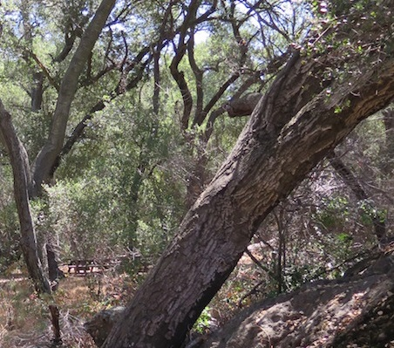
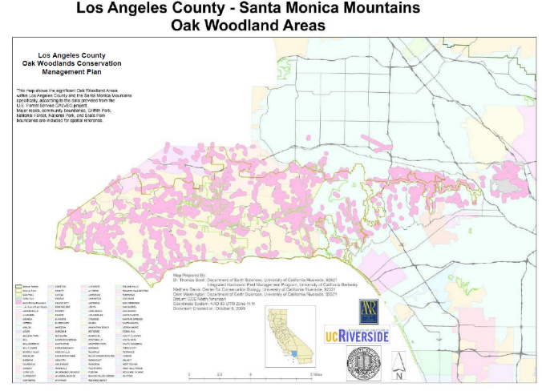
Santa Monica Mountains Climate
Community Concern: Oak woodlands and chaparral shrublands throughout the Santa Monica Mountains have recently experienced extensive tree loss and shrub dieback. Yet, as ongoing drought and the proliferation of pests and pathogens impact the Santa Monica Mountains, it is difficult to understand the exact nature and extent of increased shrub and oak mortality, and how these patterns associate with landscape and climate variables.
Partners:
Resource Conservation District (RCD) of the Santa Monica Mountains
Earth Observations:
Terra MODIS
NASA ER-2 Jet AVIRIS
NASA Gulfstream III UAVSAR
Shuttle Radar Topography Mission (SRTM)
Sentinel-2
Impact & Benefit: A baseline landscape status assessment will be produced to provide direction on ways to map spread of impacts, develop risk assessment strategies for addressing wildfire risk, and identify and prioritize potential management response strategies to make best use of limited resources.
@ Jet Propulsion Laboratory

Slide 10
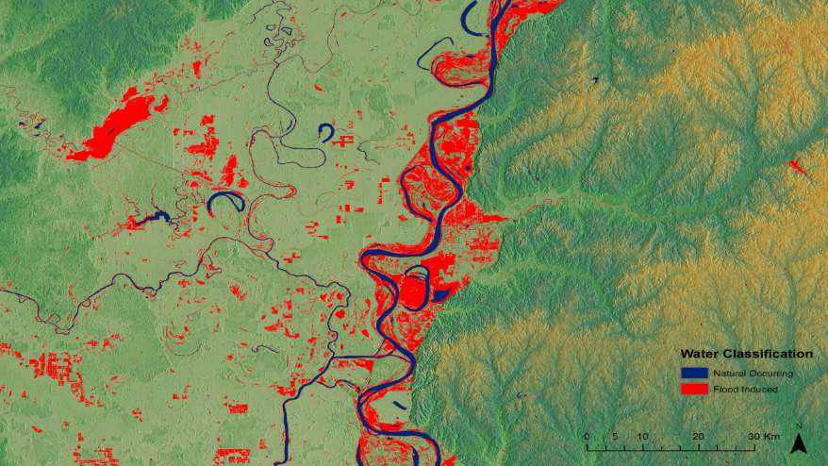
Mississippi River Basin Disasters II
Community Concern: Flooding in the Mississippi River Basin has impacted thousands of lives in the immediate area. Aid-relief organizations need more thorough mapping to identify the areas that have received the worst flooding.
Partners:
USGS Hazards Data Distribution System (HDDS)
Federal Emergency Management Agency (FEMA)
NASA Short-term Prediction Research and Transition Center (SPoRT)
Earth Observations:
Landsat 8 OLI
Sentinel 2 MSI
SRTM Version 3
Impact & Benefit: A near-real time flood model will help in the decision-making process to prioritize areas requiring aid. Additionally, these data will be instrumental in estimating damage and recovery costs, post-disaster.
@ NASA Marshall Space Flight Center

Slide 11
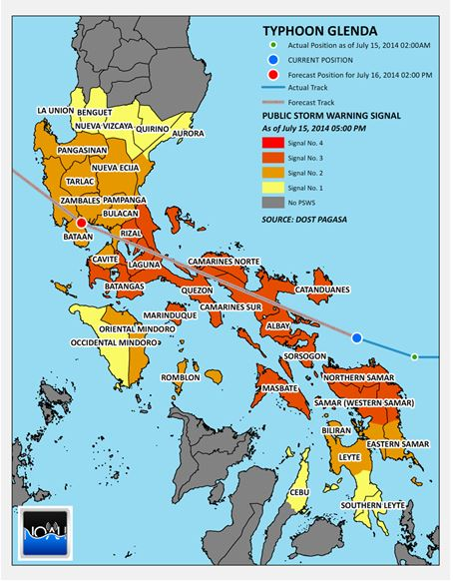
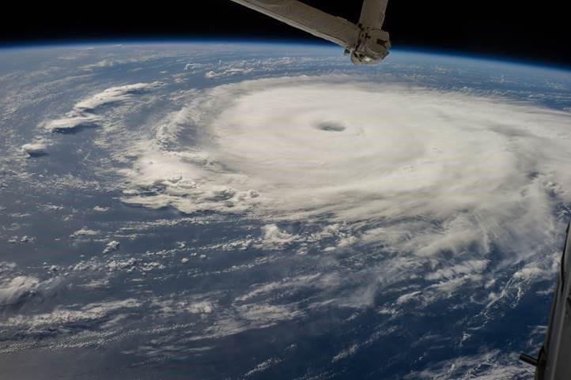
Philippines Disasters I
Community Concern: Approximately 20 tropical cyclones occur near the Philippines each year with 6-9 making landfall. The United Nations is working to address gender specific impacts to increase the efficiency and relevance of humanitarian response to hazards.
Partners:
United Nations-Office for the Coordination of Humanitarian Affairs
Visidyne, Inc.
Earth Observations:
GPM – Precipitation
PERSIANN – precipitation
ISS CyMISS – Cyclone Imagery
Ancillary Datasets
IBTrACS - Archived Cyclone Data
UN Humanitarian Data Exchange - Philippines Demographics Data
Impact & Benefit: The Philippines Disasters I Team will create a tropical cyclone climatology for the Philippines and incorporate demographics, precipitation, and impact data to create a gender risk analysis for the UN-Office for the Coordination of Humanitarian Affairs to use in future humanitarian relief efforts.
CyMISS Image from ISS
@ NOAA National Centers for Environmental Information
Notes:
Image Sources:
Typhoon Glenda Warning Assessment Map: http://blog.noah.dost.gov.ph/wp-content/uploads/2014/11/g2.jpg

Slide 12
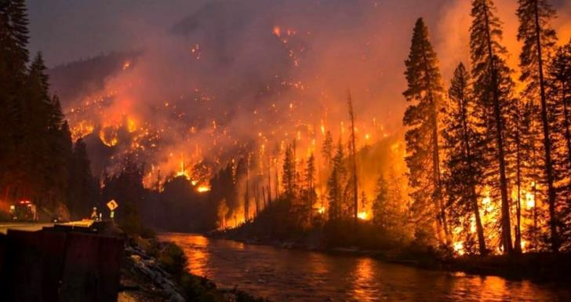
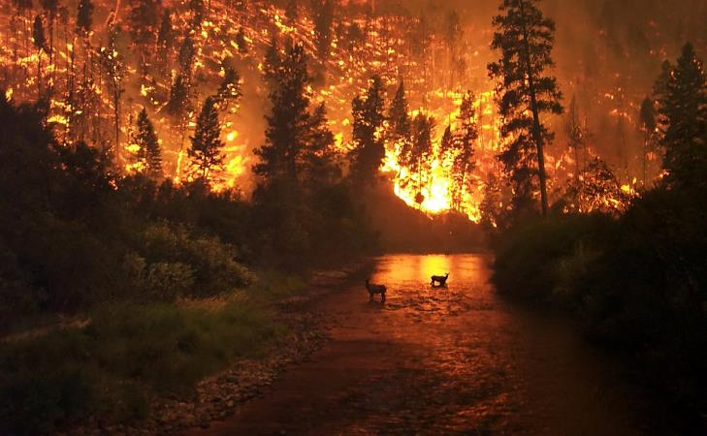
Southern Appalachia Disasters
Community Concern: Dozens of wildfires across the Southeast United States have recently burned and destroyed forests and residential areas. Over 15,000 acres within Great Smoky Mountains National Park burned due to fires spread by 80 mph winds, low humidity and drought. The wildfires damaged hundreds of buildings, caused power outages, and led to the evacuation of several populated areas.
Partners:
US Forest Service
Earth Observations:
Aqua and Terra MODIS
Landsat 8 OLI
ER-2 Aircraft
Impact & Benefit: This project will enhance the Forest Service’s management efforts in the southeastern US by demonstrating the use of NASA data for monitoring the recent drought, wildfire susceptibility, and early forest recovery.
@ The University of Georgia

Slide 13
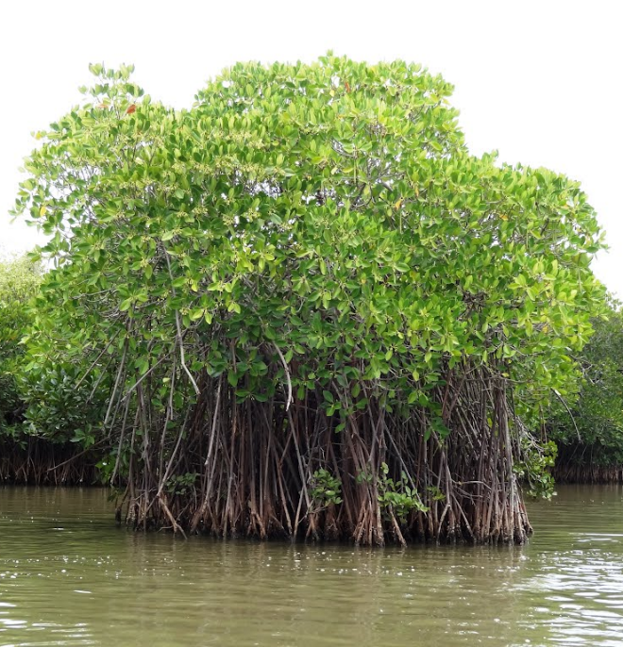
Eastern India Eco Forecasting
Community Concern: Mangroves have been overexploited or converted to other forms of land use. These forests provide valuable services such as food, raw materials, and medicinal and ornamental resources. There is growing concern for the effective management and conservation of these mangrove forests because they support families from 36 villages around the Odisha region.
Partners:
Government of Odisha; DFE; Chilika Development Authority (CDA)
Earth Observations:
Terra MODIS, ASTER
Sentinel -1A, Sentinel-2A
Landsat 4, 5, 7, 8
Impact & Benefit: CDA will receive long-term spatio-temporal estimations of mangrove physiological status. The results will allow them to identify ‘hotspots’ for early stages of mangrove degradation.
@ The University of Georgia

Slide 14
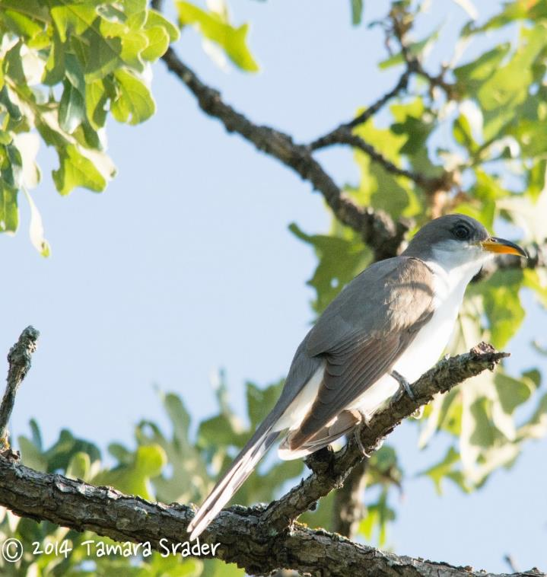
Intermountain West Eco Forecasting
Community Concern: The western yellow-billed cuckoo (YBC) (Coccyzus americanus) was once common along western streams and rivers, however, the population has declined due to habitat loss. The declining cuckoo population can act as an indicator of riparian health, and therefore points toward future water conservation.
Partners:
US Fish and Wildlife Service - ID, WY, UT
Bureau of Land Management - Pocatello Field Office
Idaho Department of Fish and Game
Earth Observations:
TRMM & GPM
MERRA
Landsat 5 TM & 8 OLI
SRTM v. 2
Impact & Benefit: It is difficult to determine the habitat extent of YBC because this avian species is secretive and only periodically visits the intermountain west region. The frequency of Earth observations, in combination with the results from this project, will provide end-users the most up to date information on current suitable habitat and also predict the future habitat extents of this species. Having this information will aid end-users when deciding where to field monitor for bird siting’s and where to concentrate conservation measures.
@ BLM at Idaho State University’s GIS TReC

Slide 15
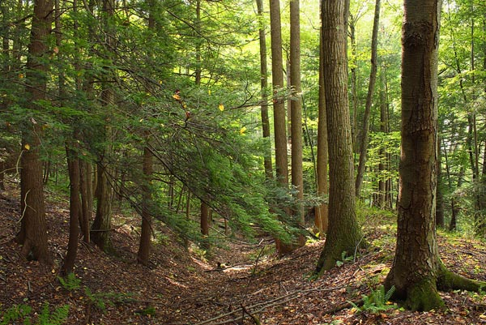
New York Eco Forecasting
Community Concern: The hemlock woolly adelgid (HWA), Adelges tsugae, is an invasive species native to East Asia. The adelgid has only recently invaded southern New England and is expanding its range northward, posing a considerable threat to New York state forests.
Partners:
Adirondack Park Invasive Plant Program (APIPP)
New York Invasive Species Research Institute at
Cornell University
Adirondack Research LLC
Earth Observations:
Terra ASTER
Landsat 7 ETM+
Landsat 8 OLI
Aqua and Terra MODIS
Suomi NPP VIIRS
Sentinel-2 MSI
SRTM
AVIRIS
Image credit: The Nature Conservancy
Impact & Benefit: Accurate hemlock distribution data is critical for early detection, to prioritize ground survey efforts, and to increase the potential for successful, cost effective management of this invasive species. Forecasted risk maps will contribute to targeted field campaigns for HWA in Adirondack Park in the future.
@ NASA Goddard Space Flight Center

Slide 16
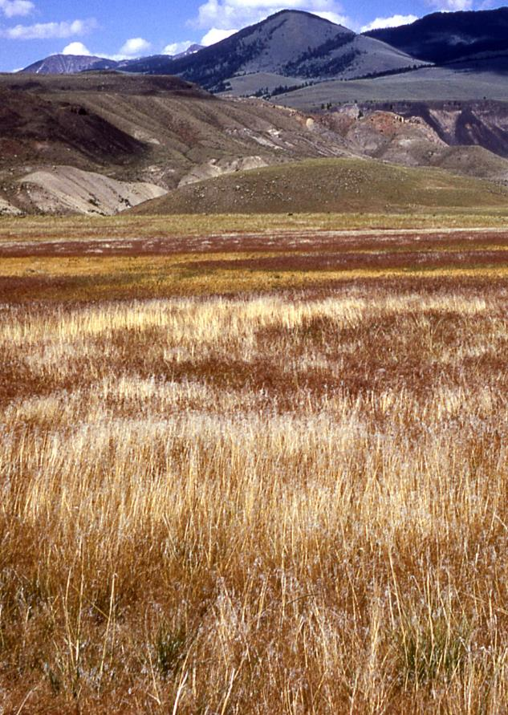
Yellowstone Eco Forecasting
Community Concern: Cheatgrass (Bromus tectorum) is an invasive grass species widely distributed across the western United States. Cheatgrass outcompetes endemic grass and forb species and quickly becomes dominant in areas of high disturbance.
Partners:
Yellowstone National Park
Earth Observations:
Landsat 5, 8
Terra MODIS - Phenology
Impact & Benefit: This project will provide the National Park Service with a better understanding of the distribution and movement patterns of cheatgrass.
Wise County Clerk of Courts

Slide 17
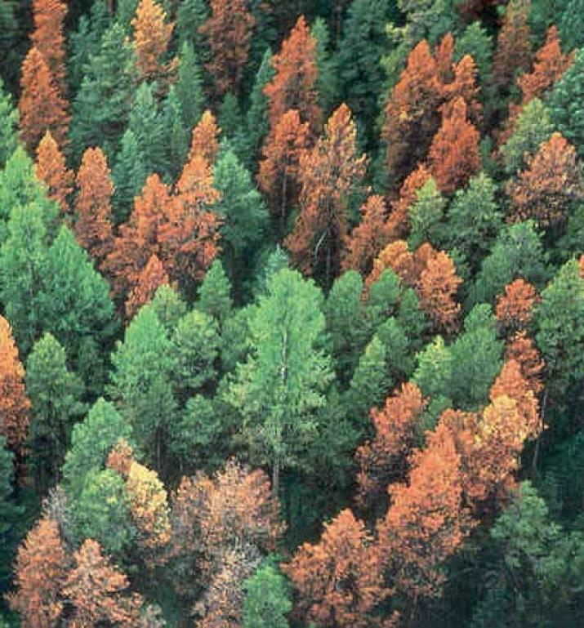
Nez Perce-Clearwater Energy
Community Concern: Bark beetle outbreaks have led to widespread tree death in coniferous forests across the Rocky Mountains, including millions of acres in Idaho. The beetle-killed wood left standing following outbreaks represents a vast bioenergy resource that requires no cultivation, but it is not currently being extracted for that purpose.
Partners:
Bioenergy Alliance Network of the Rockies
Natural Resource Ecology Laboratory, Colorado State University
Earth Observations:
Landsat 8 OLI/TIRS, Landsat 7 ETM+, Landsat 4/5 TM, Space Shuttle SRTM V2
Impact & Benefit: This project will locate and quantify beetle-killed biomass in the Nez Perce-Clearwater National Forests to help our partners assess the environmental and economic feasibility of its use as a bioenergy feedstock.
@ USGS at Colorado State University
Source: Colorado State Forest Service

Slide 18
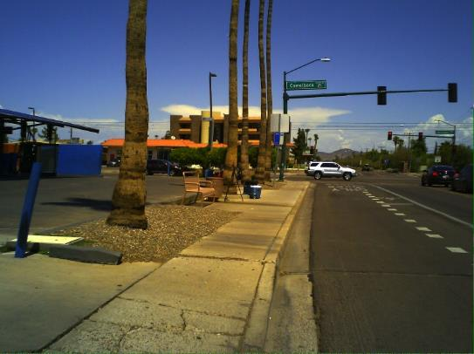
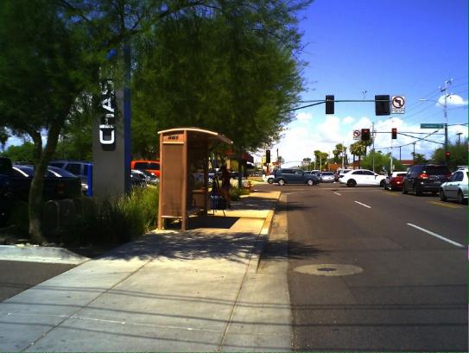
Phoenix Health & AQ
Community Concern: Over the next five years the City of Phoenix is investing $1,000,000 in the installation of shade structures at public bus stops to reduce heat exposure and thermal discomfort among transit riders.
Partners:
Phoenix Transit Department
Maricopa County Department of Public Health
Vitalyst Health Foundation
ASU Center for Policy Informatics
ASU Urban Climate Research Center
Earth Observations:
Landsat 8
Terra ASTER
Suomi NPP VIIRS
Impact & Benefit: Use NASA EO to characterize the thermal environment of the bus stops and enhance the current prioritization criteria to provide a more comprehensive assessment of the need for bus stop improvements and shading.
@ Maricopa County Department of Public Health and Arizona State University

Slide 19
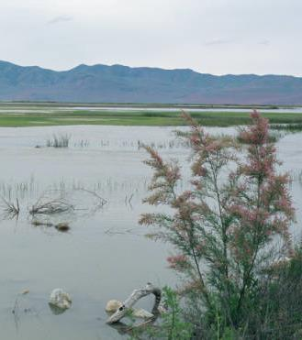
Arizona Water Resources
Community Concern: Invasive species such as tamarisk and Russian olive affect ecosystem structure and function, alter flow regimes and sediment loads, and affect evapotranspiration rates.
Partners:
Walton Family Foundation
USGS (Fort Collins Science Center & North Central Climate Science Center)
Earth Observations:
Landsat 8 OLI/TIRS, Landsat 7 ETM+, Landsat 5 TM, Space Shuttle SRTM V2, Sentinel 2a
Impact & Benefit: Project partners with the Walton Family Foundation will use map products from this project to evaluate previous management treatments and locate areas where future ecological restoration should be prioritized.
Source: USFWS
@ USGS at Colorado State University

Slide 20
Chesapeake Bay Water Resources
http://americanhistory.si.edu/onthewater/assets/graphic/full/4102.jpg
Community Concern: Submerged aquatic vegetation (SAV) is an important coastal ecosystem that provides habitat, food resources, and stabilizes near-shore sediments. However, SAV is particularly affected by water clarity, or the lack thereof. As SAV is dependent on sunlight attenuating through the water column, sediments and other particulate matter that washes into the Bay affects the growth and resiliency of SAV patches.
Partners:
Virginia Department of Environmental Quality
Earth Observations:
Landsat 5, 7, & 8
Impact & Benefit: Currently, the VADEQ does not have the resources or manpower to completely monitor the Bay annually. Thus, pursuing the feasibility of remotely sensing water clarity could increase their temporal and spatial sampling.
@ NASA Langley Research Center
http://www.habitat.noaa.gov/images/flounderineelgrass.jpg

Slide 21
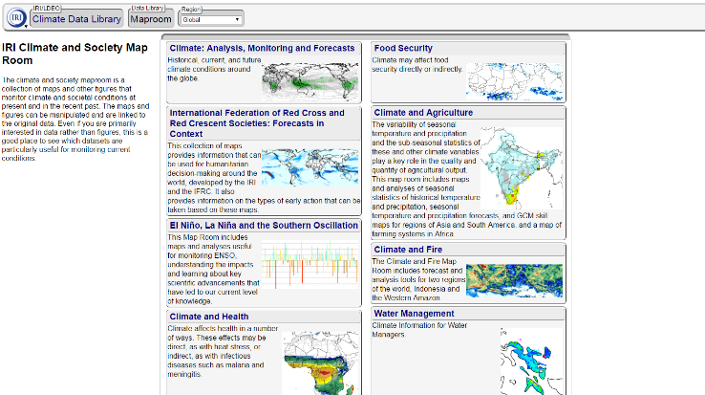
Chile Water Resources
Community Concern: Chile is vulnerable to drought and, with sub-regions of Chile relying on contrasting irrigation practices, balancing the management of supply and demand of water across the country proves a difficult task. Currently, Chile’s Ministry of Agriculture reduces vulnerability to drought and other agriculture-climate events by disseminating response information serving as early warning for decision-makers and stakeholders of the agriculture industry.
Partners:
Chile Ministry of Agriculture
Chile Embassy of the US
Earth Observations:
SMAP
Terra MODIS
Aqua AMSR-E
JAXA GCOM-W1 AMSR2
Impact & Benefit: The objective of this project is to incorporate NASA Earth observation derived soil moisture, snow cover, and snow water equivalent (SWE) data into Chile’s drought monitoring and decision-making processes using the Google Earth Engine platform.
@ NASA Ames Research Center
Credit: CDL, Google

Slide 22
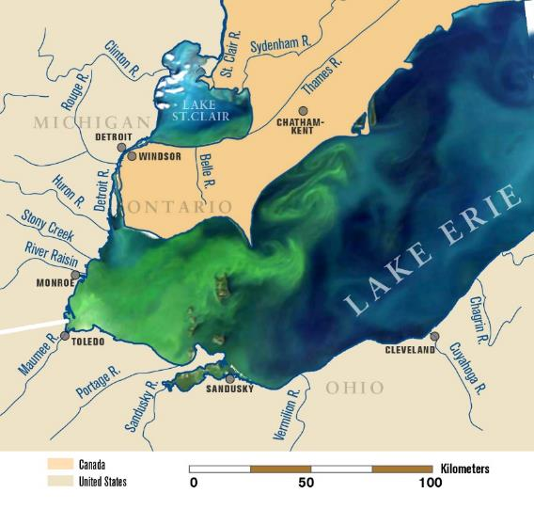
Lake Erie Water Resources
Community Concern: Harmful algal blooms (HABS), have increased in Lake Erie over the past decade, and are negatively impacting ecosystem services (drinking water supplies, fisheries), and property values in the region.
Partners:
NASA Glenn Research Center
Ohio EPA (NCWQR)
NOAA GLERL
Ohio State University Stone Lab
Earth Observations:
Landsat 8
Aqua – MODIS
Aircraft HIS – Hyperspectral Imaging (GRC)
Credit: NOAA
Impact & Benefit: These partners are interested in several objectives: determining dominant cyanobacterial groups in Lake Erie, applying FAI and NDTI to airborne imagery, and comparing Landsat satellite multispectral medium resolution imagery (30m pixel size) to hyperspectral high spatial resolution (1.2-2.4m pixel size depending on flying altitude) airborne imagery. Results of this research will be shared with the Division of Drinking and Ground Waters of the Ohio Environmental Protection Agency to enhance their decision making processes and continued monitoring of freshwater systems.
@ NASA Ames Research Center

Slide 23
Mississippi Sound Water Resources
Community Concern: Oyster reefs provide important ecological services as they filter particulates from the water column, provide habitat and food resources to other species, and can reduce wave action and storm surge. Over the past few decades, many events including changes in water quality and stochastic occurrences like Hurricane Katrina have significantly depleted and reduced the productivity of oyster reefs in the Gulf of Mexico (GoM).
Partners:
Mississippi Department of Marine Resources
Earth Observations:
Aqua MODIS
SMAP
Impact & Benefit: Understanding the environmental conditions that affect oyster health, as well as being able to predict when poor conditions are imminent, are important for the continued management of the oyster reefs in the Mississippi Sound.
Landsat 7 & 8
MUR
http://www.sunherald.com/news/local/dzs371/picture122054834/ALTERNATES/FREE_640/oysters(2)
@ NASA Langley Research Center & Jet Propulsion Laboratory

Slide 24
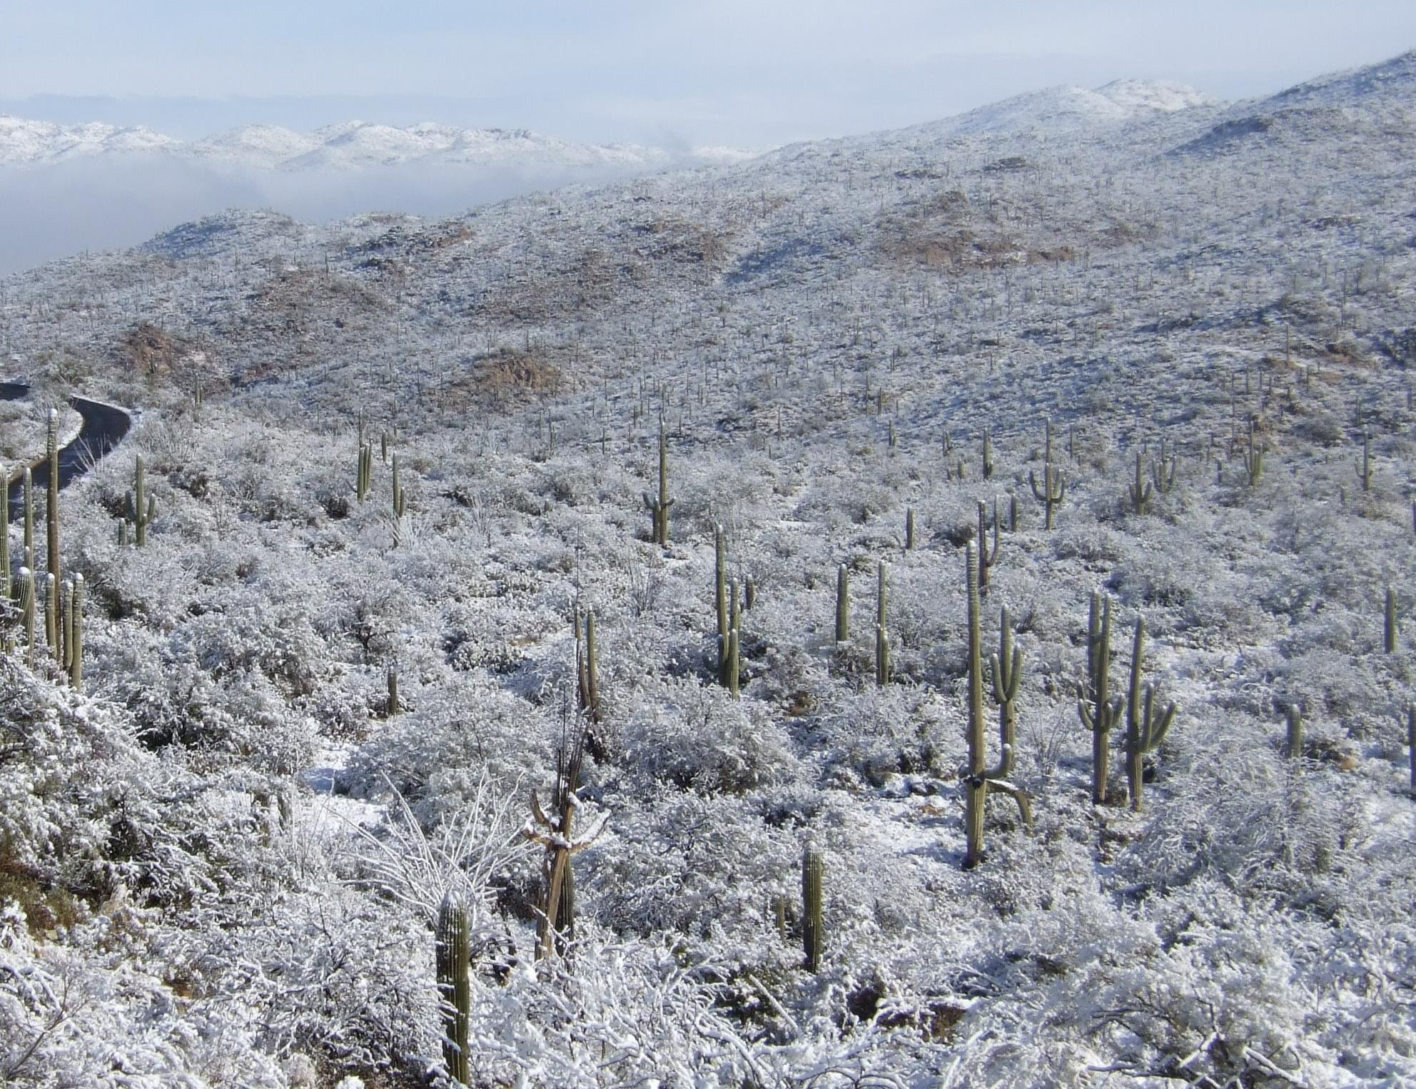
Southeastern Arizona Water Resources II
Community Concern: Within the sky island region of Southeastern Arizona, snow cover plays an important role in replenishing streams and rock fractures. Although the National Park Service (NPS)has been monitoring water presence in these streams since the mid-1990s there is a major information gap in the role that snow cover, depth, and timing play in providing water for these streams.
Partners:
National Park Service, Intermountain Region
National Park Service, Saguaro National Park
Earth Observations:
Aqua/Terra MODIS
Landsat 5 TM
Landsat 7 ETM+
Landsat 8 OLI
Sentinel-2
Impact & Benefit: The NPS does not currently have historical data for snow cover in the sky islands region. Historical maps and analysis of the role that snow plays in the sky islands, will allow park managers to better understand the overall hydrology of Saguaro National Park and the surrounding sky islands.
@ Mobile County Health Department

Slide 25
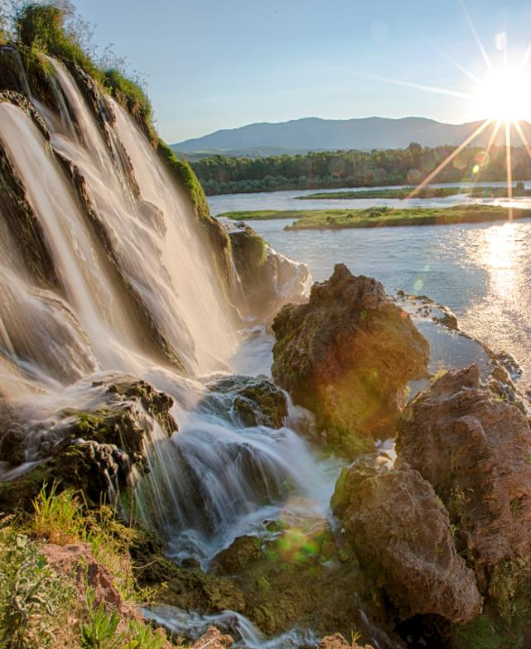
Southeastern Idaho Water Resources
Community Concern: Idaho has over 95,000 miles of rivers and streams and more than 100 lakes and reservoirs supplying the necessary water for anthropic, economic, and ecological sustenance. As a result, it is important to know the spatial extents of water sources and to understand their flow dynamics in order to improve management decisions.
Partners:
Bureau of Land Management (BLM) - Pocatello Field Office
Idaho Department of Water Resources (IDWR)
Earth Observations:
Landsat 8 OLI
MERRA
SRTM Version 2
Impact & Benefit: This tool will be user-friendly and use the most current imagery to monitor temporal changes of surface water. The resulting maps produced by the SWIM tool will create accurate datasets related to water and water availability which is important for project planning, field assignments, and allocation of resources.
BLM
@ BLM at Idaho State University’s GIS TReC

Slide 26
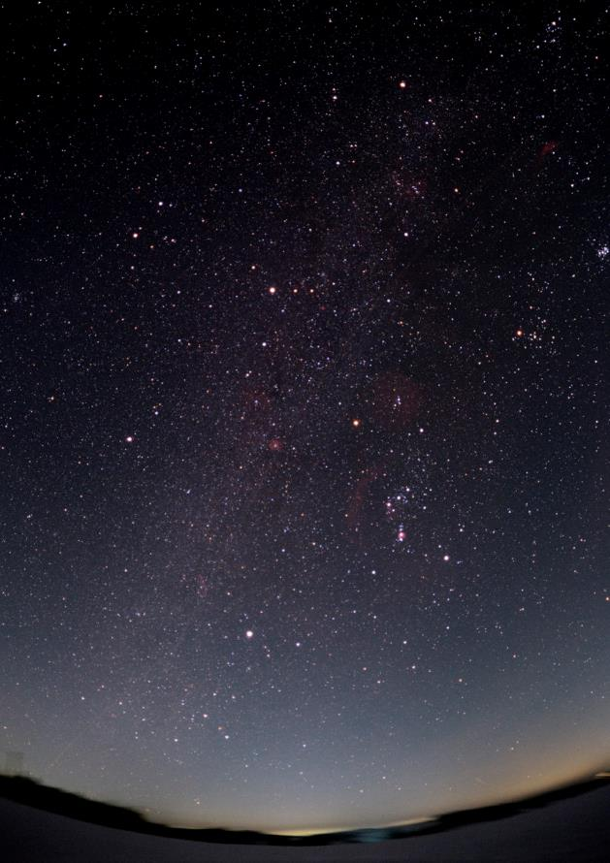
Wyoming Cross-Cutting
Community Concern: The visible disruption given off by artificial light has a detrimental effect to the reproductive, migratory, feeding, and sleep habits of wildlife. Additionally, light pollution degrades the quality in which humans view the night sky.
Partners:
National Park Service, Intermountain Region
Grand Teton National Park
International Dark-Sky Association
Earth Observations:
Suomi NPP VIIRS – DNB
Aqua and Terra – MODIS AOD
Impact & Benefit: Grand Teton National Park will use the Yearly Nighttime Radiance product to assess recent changes made to nighttime lighting in nearby communities. Additionally this product will identify areas within the park and surrounding communities that need further mitigation of artificial light.
I am a picture of something related to this project
@ Wise County Clerk of Courts

Slide 27
2017 Spring Deliverables & Deadlines
Week | Due Date | Deliverables Due
1 | 1/26 | Handbook Forms, Participant Info Sheet, Personality Assessment, Entrance Personal Growth Assessment, DEVELOPedia Participant Page, Orientation Completed
3 | 2/9 | Project Summary RD
4 | 2/16 | Tech Paper RD
5 | 2/20 | Offices Closed for President’s Day
5 | 2/23 | VPS Outline
6 | 3/2 | Poster RD, Presentation RD
6 | 3/3 | Software Release Forms (if applicable)
7 | 3/9 | Project Summary FD, Study Area Shapefiles, Website Image
8 | 3/16 | VPS Video & Transcript
8 | 3/16 | DEVELOPedia Project Page
9 | 3/23 | Poster FD, Presentation FD
9 | 3/24 | Personal Growth Assessment Part 2
10 | 3/30 | Tech Paper FD, Technical Image
10 | 3/31 | Exit Survey, Optional Deliverables

