Slide 1
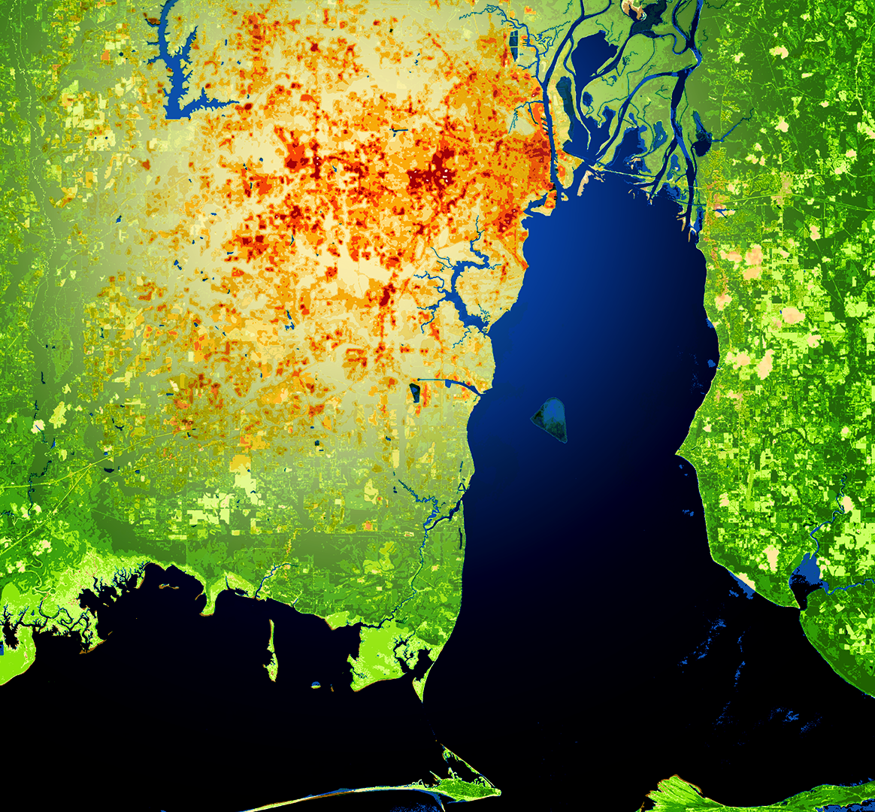
MOBILE URBAN DEVELOPMENT
Evaluating Urban Heat Islands and Flooding to Enhance Green Infrastructure Initiatives in Coastal Communities in Mobile, Alabama
Lydia Stanley
Arman Bajracharya
Filoteo Gomez-Martinez
Kelly Dunn
Alabama – Mobile| Summer 2019
Notes:
Hello, thank you all for joining us!
My name is Lydia Stanley, I graduated from the University of Alabama with a degree in Environmental Science and starting in the fall will pursue my Master’s degree in Geography. This is my first term with NASA DEVELOP.
Arman Bajracharya: I am in my senior year at St. Cloud State University studying Ecology and Field Biology. This is my first term with NASA DEVELOP.
Kelly Dunn: I graduated from the University of West Florida with my Bachelor of Science in Environmental Management. I will be continuing my education at the University of West Florida as a graduate student in the coastal management program. This is my first term with NASA DEVELOP.
Filo Gomez: I pursing my Masters Degree in Geography at the University of Oklahoma. This is my first term with NASA DEVELOP.
We are the NASA DEVELOP Urban Development team.
Image Source: ArcGIS Pro; Website Image (Created by Team)

Slide 2
Objectives
Produce risk maps of Mobile County
Identify areas with high vulnerability
Demonstrate the use of NASA Earth observations
Notes:
Our objectives were to identify and define areas that are susceptible to the negative effects of urban heat islands and flooding.
To define our vulnerability index, we focused on the 2010 U.S Bureau of Census data collected for residents of Mobile County to compare different demographics to each risk category. Vulnerability in this study is defined as the group of people that lack resources to remediate, mitigate, and recover from high-risk situations, for example, hurricanes, heat waves, and flood events.
This index would allow us to tie UHIs and flood vulnerability in with human vulnerability and improve risk management practices.

Slide 3
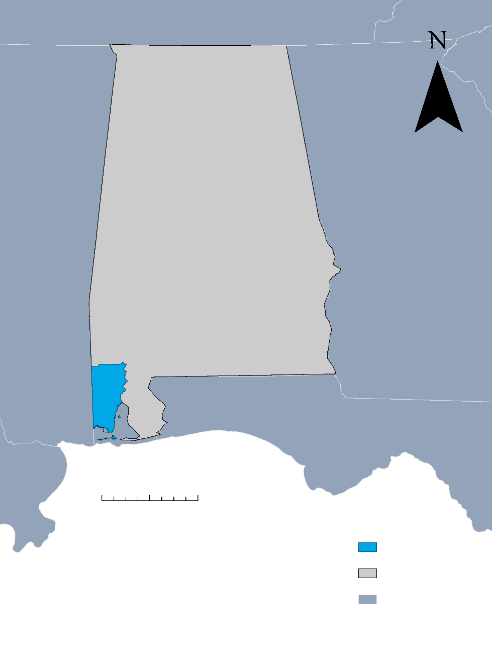
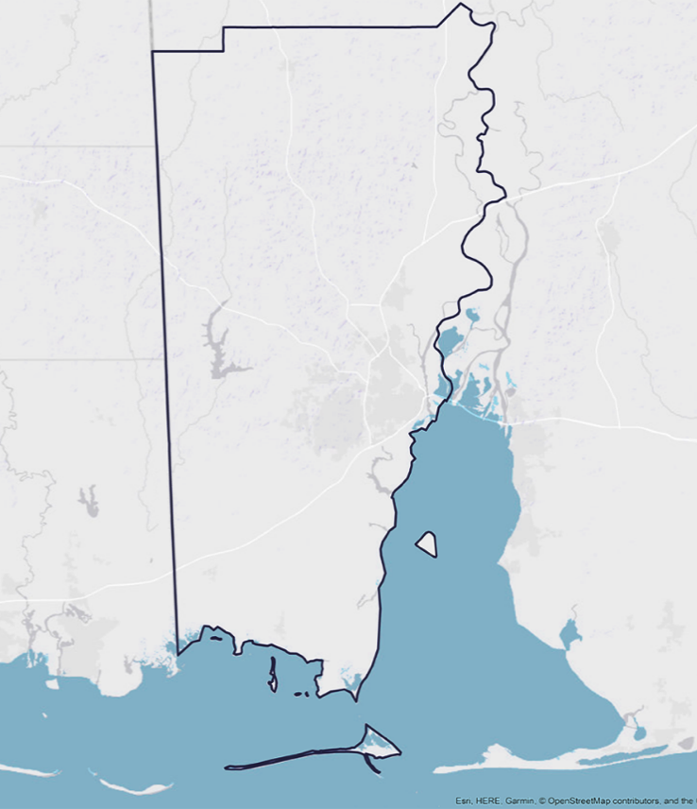



Study Area and Period
N
Mobile County, AL
April 2005 to April 2019
MS
GA
Mobile Bay
FL
0
80 Mi
Mobile County
Alabama
0
5
10 Mi
Gulf of Mexico
Notes:
The team focused on Mobile County, Alabama as the study area for this term, which is a coastal city situated on the western shore of Mobile Bay and along the Gulf of Mexico found in South Alabama. Mobile County, Alabama has a population of about 413,000. Mobile County has a mild subtropical climate with hot and humid summers consistent annual rainfall (66in.), but the wettest seasons fall between April to September. The land surface elevation ranges from 0-381 feet, or about to 0-116 meters.
The study period selected for our research is from April 2005 to April 2019.

Slide 4
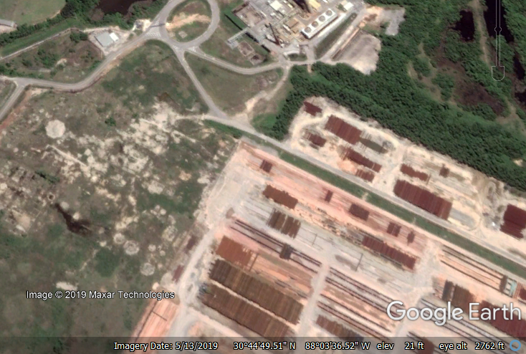
Community Concerns
Mobile, Alabama is susceptible to intense flooding and the urban heat island (UHI) effect.
Previous storm surges have impacted areas that are too small for redevelopment or within the floodplain leaving overgrown vacant lots and brownfield sites.
It is vital for local entities to be informed to plan mitigation strategies.
Image Credit: Google Earth
Notes:
Due to geographic location and low elevation Mobile, AL is susceptible to intense flooding and the urban heat island effect.
Due to a lack of previous research focusing on Mobile County for the UHI effect, it is vital for local entities to be informed of this research in order to plan for future mitigation strategies.
As a reference, the average high in the in July and August can reach up to 91°F (US climate data based on 2017). The hottest day on record in Mobile County was 105.1°F on August 30th, 2000.
Heat-related illnesses are increased in areas of high impervious surfaces and can effect certain population demographics more than others, which will be explained later.
Image source: Prichard brownfield, Google Earth, use provided with attribute

Slide 5
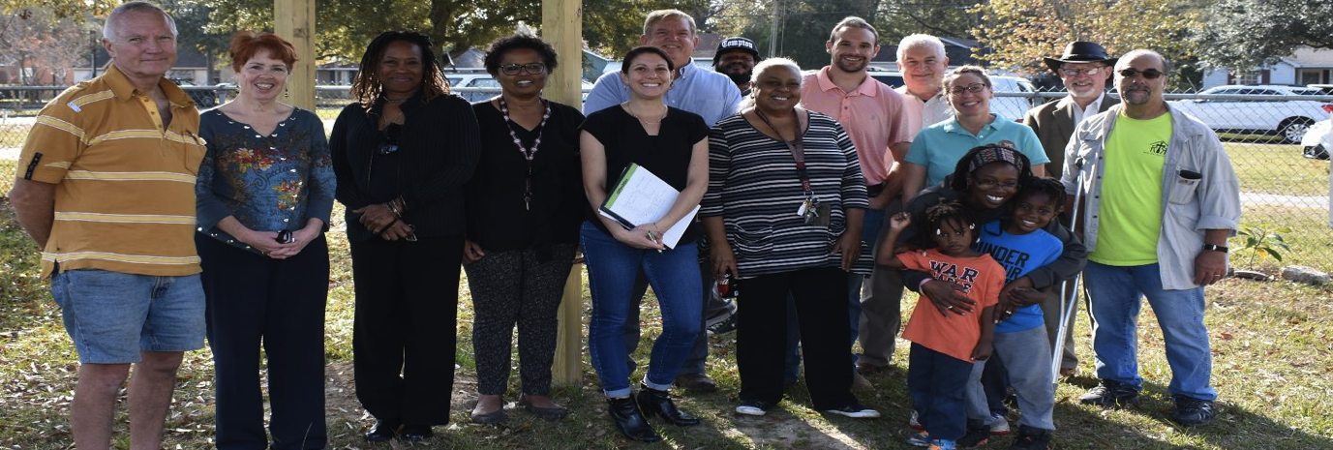
Groundwork Mobile County
GWMC aims to reduce and revitalize vacant lots throughout neighborhoods, providing healthy and safe recreational opportunities.
Image Credit: Carol Dorsey
Notes:
Groundwork Mobile County is a new trust of Groundwork USA that is out of their proposal and feasibility study phase and now implementing plans to help improve Mobile County. Their concerns rest in four areas of Mobile county: Prichard, Africatown, Northside Mobile, and Southside Mobile. They have 22 committee members from all backgrounds making this non-profit organization interdisciplinary which is important because their varying specialties will play a vital role in this community.
Now we’re going to introduce just a few members of the board whom we worked with to complete this project:
Larissa Graham is the chair of Groundwork Mobile County.
Don Blancher was the Executive Director for Groundwork New Orleans and is now an active voice for environmental efforts in Mobile.
Ray Richardson works for The City of Mobile and focuses on brownfields redevelopment.
Finally, Patricia Hall is the co-founder of Mobile Urban Growers.
Their vision is to work alongside the local community in order to revitalize vacant lots, brownfields, and dilapidated parks to create safe recreational spaces to promote education, employment, youth development and environmental stewardship training. They want to make these high vulnerability areas into a healthier environment and provide them with the tools necessary for sustainable practices. They also gear their efforts towards community involvement, primarily through summer youth capacity building programs.
Image Source: Carol Dorsey https://groundworkusa.org/road-becoming-groundwork-trust-mobile-alabama/ , Permission from partner

Slide 6
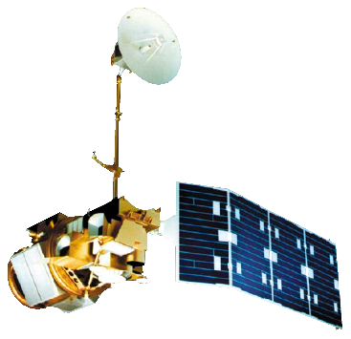
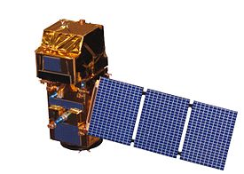
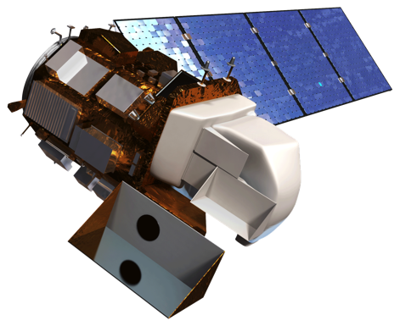
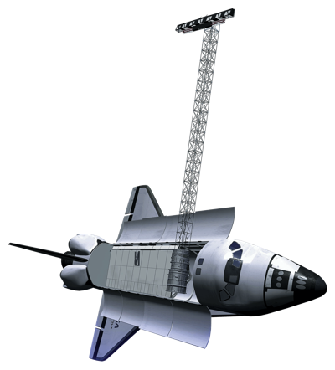
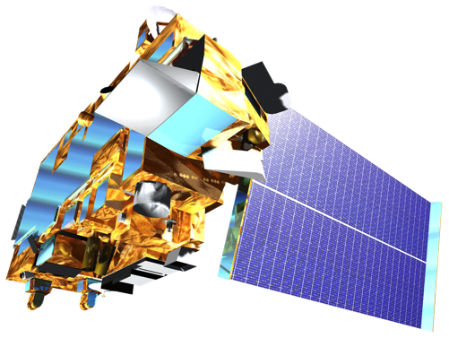
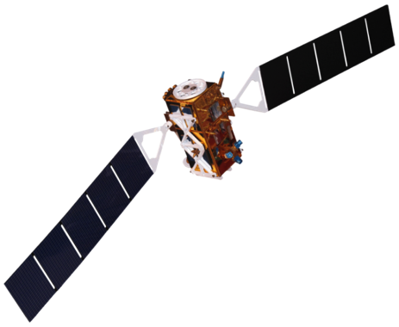
Earth Observations
Sentinel-2 MSI
Landsat 5 TM
Landsat 8 OLI & TIRS
Sentinel-1 C-SAR
Terra MODIS
SRTM
Image Credits: NASA
Notes:
Landsat 8 Operational Land Imager (OLI) and Landsat 5 Thematic Mapper (TM) were used to calculate and visualize normalized difference vegetation index (NDVI) change from 2000 to 2019. From Landsat 5 TM, Land Surface Temperature (LST) data were retrieved as Analysis Ready Data (ARD).
Landsat 8 Thermal Infrared Sensor (TIRS) was used to retrieve land surface temperature products as Analysis Ready Data (ARD) and used to identify the urban heat islands in this project.
Sentinel 1 Synthetic Aperture Radar (C-band) (C-SAR) was used to create flood maps and flash flood visualizations.
Sentinel-2 MultiSpectral Instrument (MSI) data were used to identify land use in terms of vegetation and urbanization. This product was then used to compare results from Landsat 5 TM and Landsat 8 OLI’s NDVI.
Shuttle Radar Topographic Mission (SRTM) was used to evaluate flooding through low-lying elevation levels.
Terra Moderate Resolution Imaging Spectroradiometer (MODIS) was used to spatially validate land surface temperature products.
Image Source (Landsat 5TM): https://earthobservatory.nasa.gov/images/81559/nasas-earth-science-satellite-fleet; Public domain
Image Source (Landsat 8 OLI & TIRS): (http://www.devpedia.developexchange.com/dp/images/c/c2/03_Landsat8.png; DEVELOPedia
Image source (Terra MODIS):
https://science.nasa.gov/toolkits/spacecraft-icons , Public Domain
Image Source (Sentinel-1, SRTM):
http://www.devpedia.developexchange.com/dp/index.php?title=List_of_Satellite_Pictures, Public Domain

Slide 7
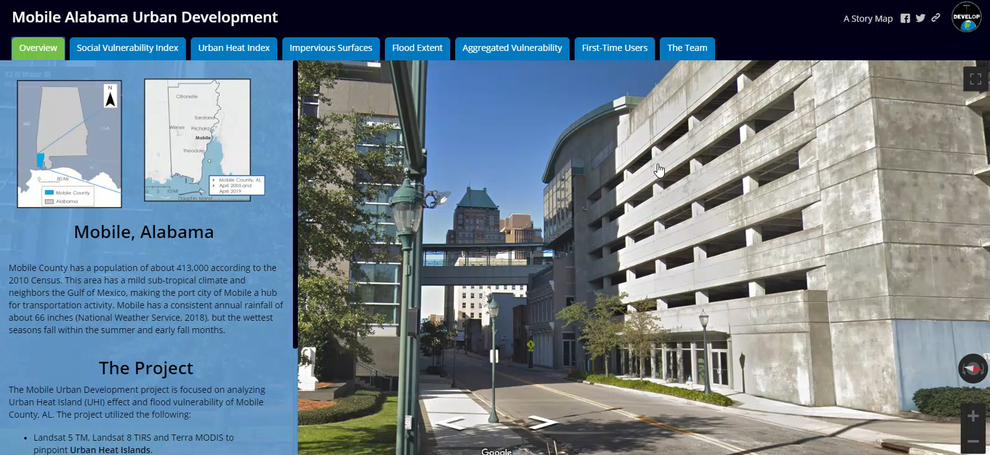
End Products
Urban Heat Assessment
Flood Extent Analysis
Socioeconomic and Demographic Risk Evaluation (SDRE)
Impervious Surface Evaluation
Notes:
The project included the following end-products:
Urban Heat Assessment
Flood Extent Analysis
Socioeconomic and Demographic Risk Evaluation
Impervious Surface Evaluation

Slide 8
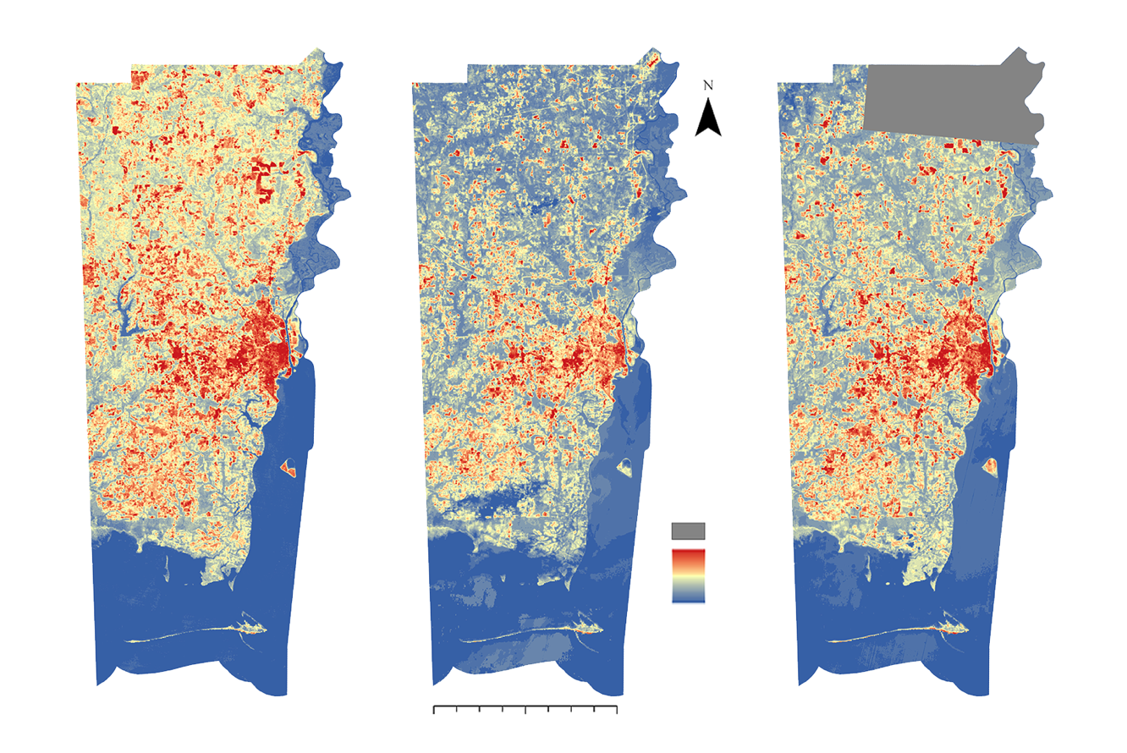



Methodology: Urban Heat Assessment
1
2
N
3
1. April 9th, 2005
2. April 21st, 2015
3. April 16th, 2019
Land Surface Temperature
95° F
70° F
No Data
0
5
10
20 Miles
Notes:
The team retrieved Landsat 5 Thematic Mapper (TM) and Landsat 8 Thermal Infrared Sensor (TIRS) Analysis Ready Data (ARD) product for the tiles horizontal 21 and 22, and vertical 15 and 16 from the 2005, 2015 and 2019 with less than 10% cloud cover.
Despite the fluctuations in average temperatures, we observe consistent hotspots throughout the time series.

Slide 9
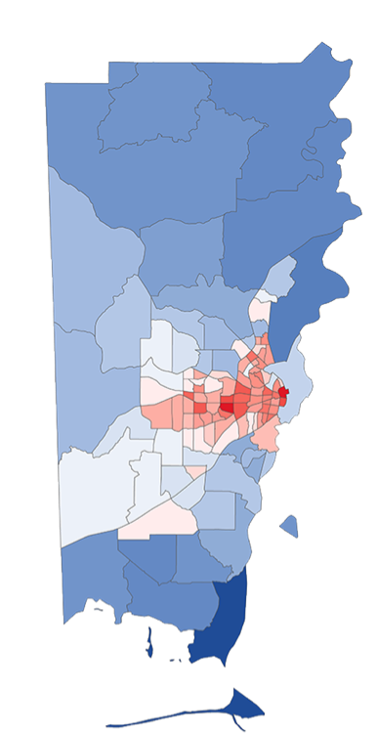


Methodology: Urban Heat Assessment
N
Land Surface Temperature (LST) obtained as Landsat 5 TM and 8 TIRS Analysis Ready Data (ARD)
Mean LST calculated per census tract and displayed
Mean Land Surface Temperature
95° F
70° F
0
5
10
20 Miles
Notes:
The Land Surface Temperature data was obtained as ARD data from USGS.
Then with the U.S census bureau tract data from 2010 we calculated the zonal temperature mean per census tract with a SoVI shapefile.
The SoVI shapefile was used for convenient comparison with social vulnerability index per tract.
By comparing the two maps, high risk census tracts can be identified and mitigation efforts can be geared towards these areas of vulnerability.
This image is based on April 21st, 2015

Slide 10
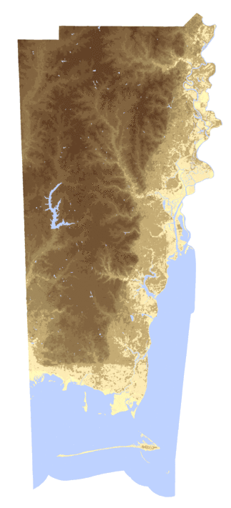
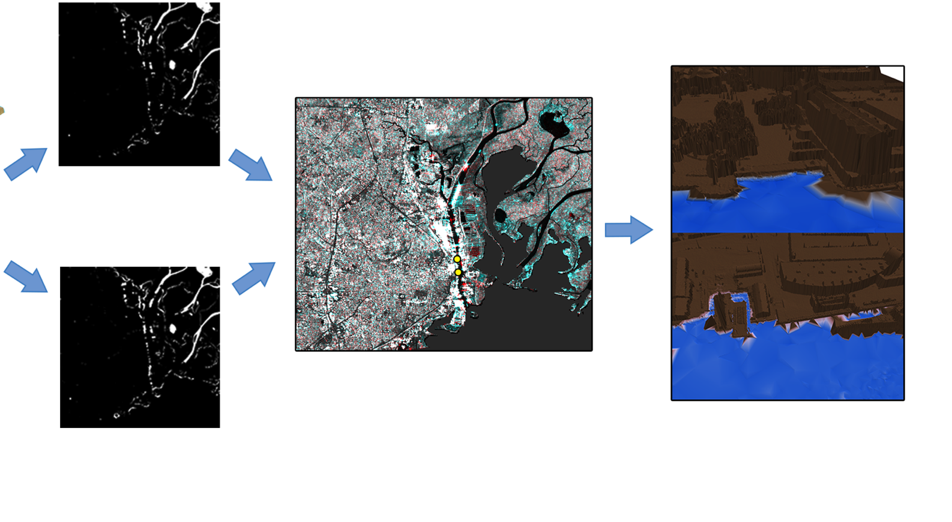
Methodology: Flood Extent Analysis
Non-flood C-SAR (20 m) image taken 6/11/2019
Before/After composite from C-SAR data for flooding, reds indicate regions where flooding has taken place. The yellow spots indicate regions observed through LiDAR
3-D visualizations created using LiDAR. The locations shown are Mobile Convention Center (top) and Port of Mobile (bottom)
Flash-flood C-SAR image taken 8/3/2018 (1 day after flood)
The SRTM DEM displays areas under the elevation of 3 meters in dark blue
Notes:
The image to the left is the SRTM (Shuttle Radar Topography Mission) acquired from EarthExplorer covers Mobile County and the purple color is the visualization of the areas that lie under the 3-meters.
To the right the two black & white are radar images of no flood and flash flood image. The flood image was taken a day after the flash flood event on August 2, 2018.
Flash flood image are localized flood areas usually within hours, therefore it is difficult to map but nevertheless changes can be observed in the RGB color map ( red band- no flood image was selected and for the Green and Blue bands the flash flood image was selected. Therefore the red color observed in the composite map is the areas the flooded during the flash flood.
The last two images are two important facilities of Mobile City: the convention center and cruise terminal

Slide 11
Methodology: Flood Extent Analysis
Raw C-SAR Image
Apply Orbit File
Thermal Noise Removal
Calibration
Speckle Filter
Terrain Correction
Processed Image for Analysis
LiDAR Point Cloud
Display as TIN based on elevation
Classified with class breaks at 1, 2 and 3 meters
Navigable 3-D visualization
Notes:
C-SAR radar data were acquired from Copernicus Open Access Hub. Preprocessing and processing were done in ESA-SNAP.
Apply-Orbit-File: used to georeferenced the Sentinel-1 data as GLONASS (Global Navigational Satellite System)
Thermal-Noise-Removal: removes the backscatter noise receiver
Calibration: Converts the digital Number (DN) of radar data to physical unit sigma naught
Speckle-Filter: reduces ‘salt and pepper’ looking texture and smooth the image
Terrain Correction: corrects the topographical (this pre-processing steps was developed by (Thomas Weiß, 2018)
LiDAR data were acquired from USGS. The LAS files point cloud data was processed in ArcMap 10.5 then Triangular Irregular Network (TIN) was created. With the TIN two 3D images of two locations in the downtown Mobile were selected for flood visualization of 1,2 and 3 meters.

Slide 12
Methodology: Socioeconomic and Demographic Risk Evaluation (SDRE)
Disability
High Level
No Vehicle
Ages 65+; Below 17
Poverty
Mobile Homes
Social Vulnerability Index
Medium Level
Minority
Crowding
Income
Low Level
Multi-structure Homes
No High School Diploma
Notes:
We selected the variables among the Census 2010 dataset that suggested higher risk during high heat events and flash floods. The high, medium, and low levels determined the weightage of these variables.
Vulnerability in this project refers to the group of people that lack the resources to remediate, mitigate, and recover from UHI and flood events.

Slide 13
Methodology: SDRE
Social Vulnerability Index
40%
Aggregated Social Vulnerability Index
Standardized mean LST
30%
Standardized Flood Vulnerability
30%
Notes:
When evaluating the social vulnerability index, it’s important to be sure that the data is weighted and standardized in a way that will read accurately on a map based on census tract data and population demographics. We converted the raw data for each section to 5-point scales based on the maximum and minimum values. Then, based on the vulnerability level, the values were multiplied, added, and converted back to a 5-point scale to obtain the social vulnerability index.
Furthermore, the mean LST and the percentage of land under 3 meters of elevation for each census tract was standardized.
The aggregated social vulnerability index was calculated with 40% of the social vulnerability index and 30% of standardized mean LST and flood vulnerability.

Slide 14
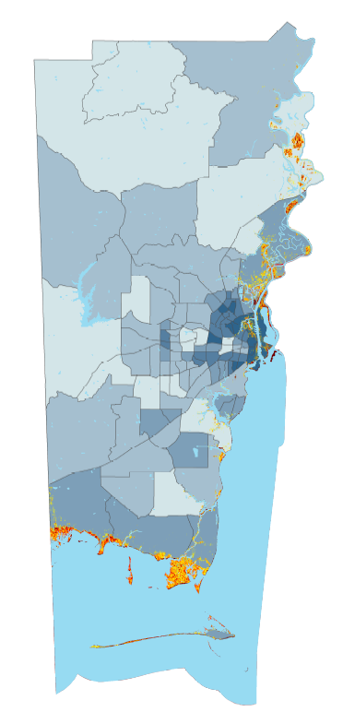
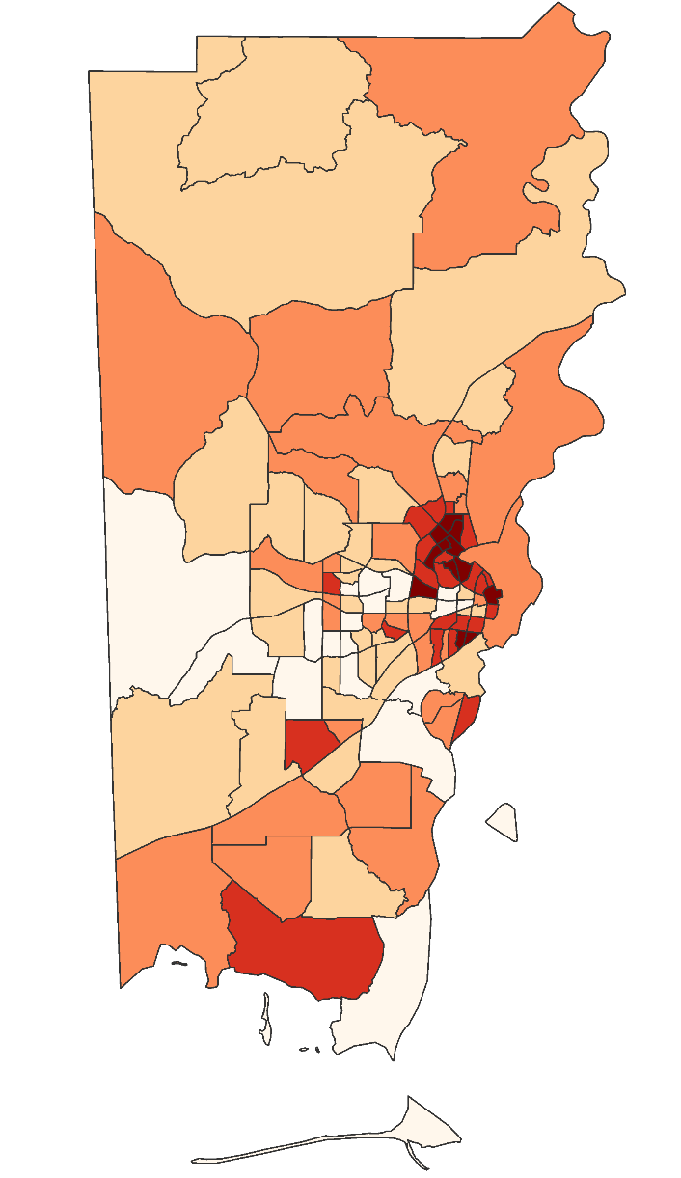


Methodology: SDRE
N
Aggregated Social Vulnerability Index
0 – 1 (Lowest Risk)
1 – 2
2 – 3
3 – 4
4 – 5 (Highest Risk)
Social Vulnerability Index
0 – 1 (Lowest Risk)
1 – 2
2 – 3
3 – 4
4 – 5 (Highest Risk)
Elevation in meters
Water Body
0
1
2
3
0
5
10
20 Miles
0
5
10
20 Miles
Notes:
To the left, we have the social vulnerability index which was derived solely from socioeconomic data. The image on the right shows the aggregated social vulnerability index with further overlay of low-lying areas under the elevation of 3 meters.

Slide 15
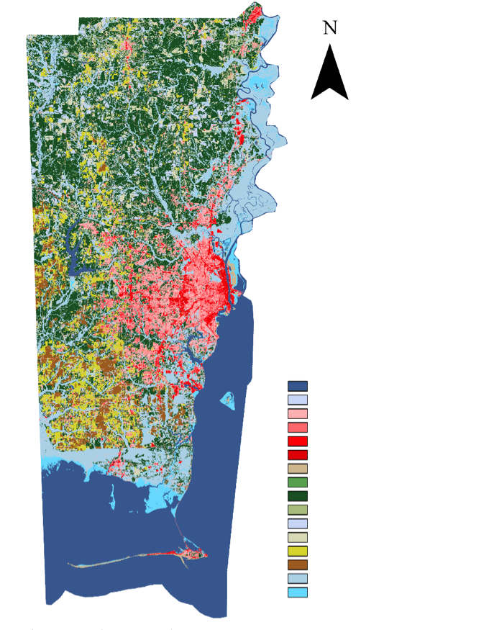
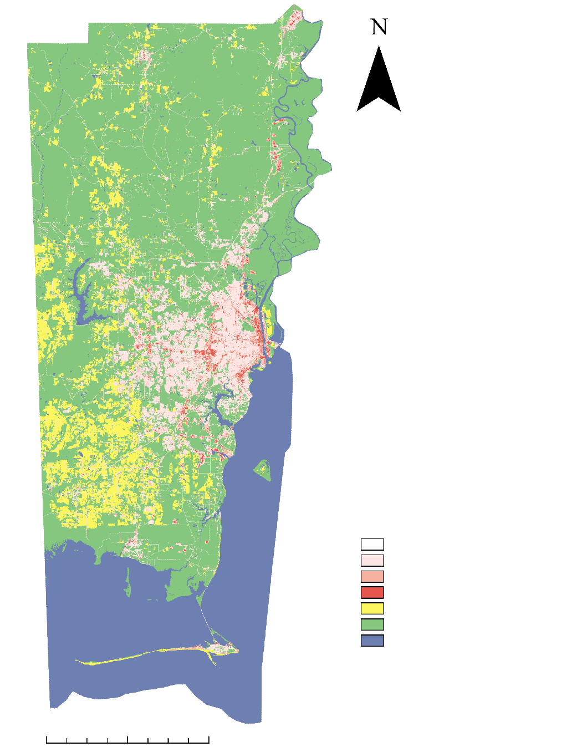

Methodology: Impervious Surface Evaluation
N
Re-classification
NLCD Classes
Open Water
Perennial Snow/Ice
Developed, Open Space
Developed, Low Intensity
Developed, Medium Intensity
Developed, High Intensity
Barren Land
Deciduous Forest
Evergreen Forest
Mixed Forest
Shrub/Scrub
Herbaceous
Hay/Pasture
Cultivated Crops
Woody Wetlands
Emergent Herbaceous Wetlands
General Land Cover
Developed, Low
Developed, Medium
Developed, High
Barren Land
Vegetation
Water
0
16 Miles
0
16 Miles
Notes:
When reclassifying our data, we reduced the National Land Cover Database data down to 6 classes. We decided to combine barren and agricultural plots of land simply because we wanted to focus on the urbanization of the study area and how much impervious surface area increased between 2001 and 2016. The maps displayed are for 2016 to show to process of classification.
Acreage was calculated for each of the 6 classes and compared between 2001 to 2016. This would give an idea of how development was growing and where it was.

Slide 16
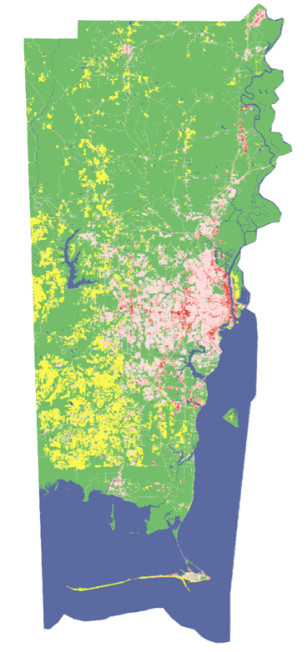
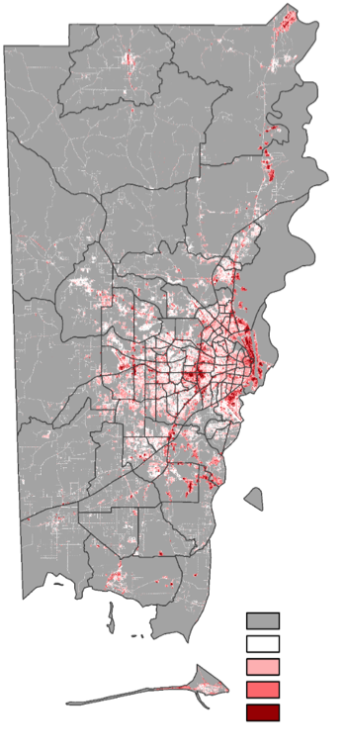
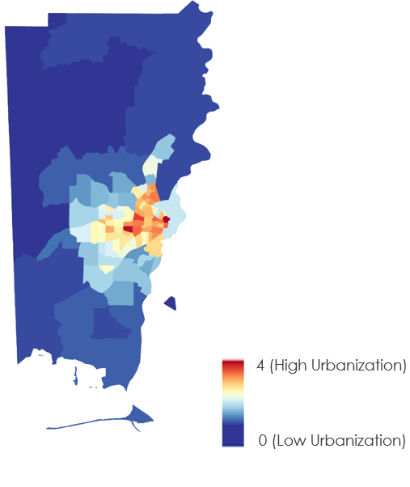

Methodology: Impervious Surface Evaluation
N
Urban Development Per Census Tract
General Land Cover
Urban Development
Developed, Low
Developed, Med
Developed, High
Barren Land
Vegetation
Water
No Development
4 (High Urban)
Open Development
Low Development
Medium Development
High Development
0 (Low Urban)
0
5
10
20 Miles
0
5
10
20 Miles
0
5
10
20 Miles
Notes:
From the reclassification process, development classes were analyzed and compared to grouped classes of vegetation. Water was later omitted for analysis purposes, but posed as an error/uncertainty for acreage in some coastal gray areas. The term gray area refers to the slim portion of land use land change that could have been classified as water instead of vegetation or vice versa.
The map in the middle shows the different degrees of development and most importantly, the impervious surface area of Mobile’s entire county. From this map, the potential of urban sprawl can be evaluated by development patterns. Urban sprawl is the uncontrolled spread and unregulated growth of a city, therefore decreasing the amount of vegetation and changing it into areas of development – ultimately alluding to the establishment of more impervious surface area.
Finally, the map on the right is the degree of urbanization per census tract. The census tracts in deep red are the ones with highest concentrations of impervious surfaces. These tracts will tie directly to high social vulnerability areas and lie primarily within Mobile City and Prichard.

Slide 17
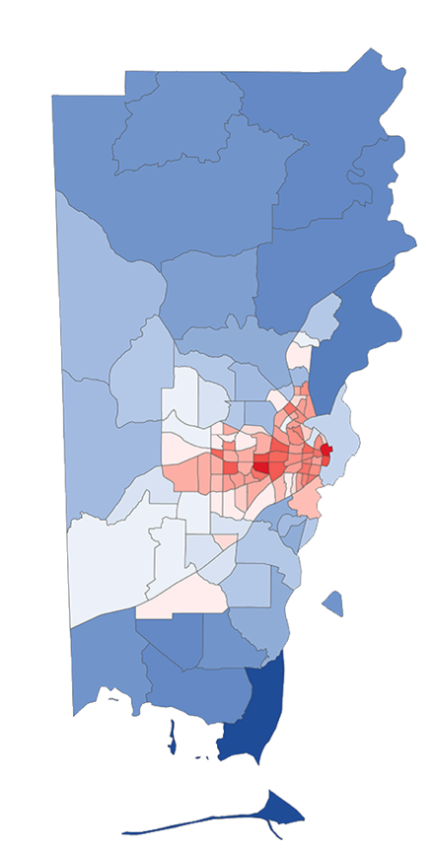
Results: Urban Heat Assessment
N
The highest LST was observed mainly in the downtown Mobile County and City of Prichard
The LST product is based on data from April 2015
Mean Land Surface Temperature
95° F
70° F
0
5
10
20 Miles
Notes:
We see that there is a distinct difference between the LST in the urban and rural areas.
Our findings resulted in measuring a 13 degree Fahrenheit temperature change between urban areas in Mobile County vs. rural areas.
The highest LST temperatures recorded in April range as high as 95 degrees in downtown Mobile and two census tracts located in the City of Prichard.
It is important to note that this extreme temperature is in April and data from June/July would be much higher.

Slide 18
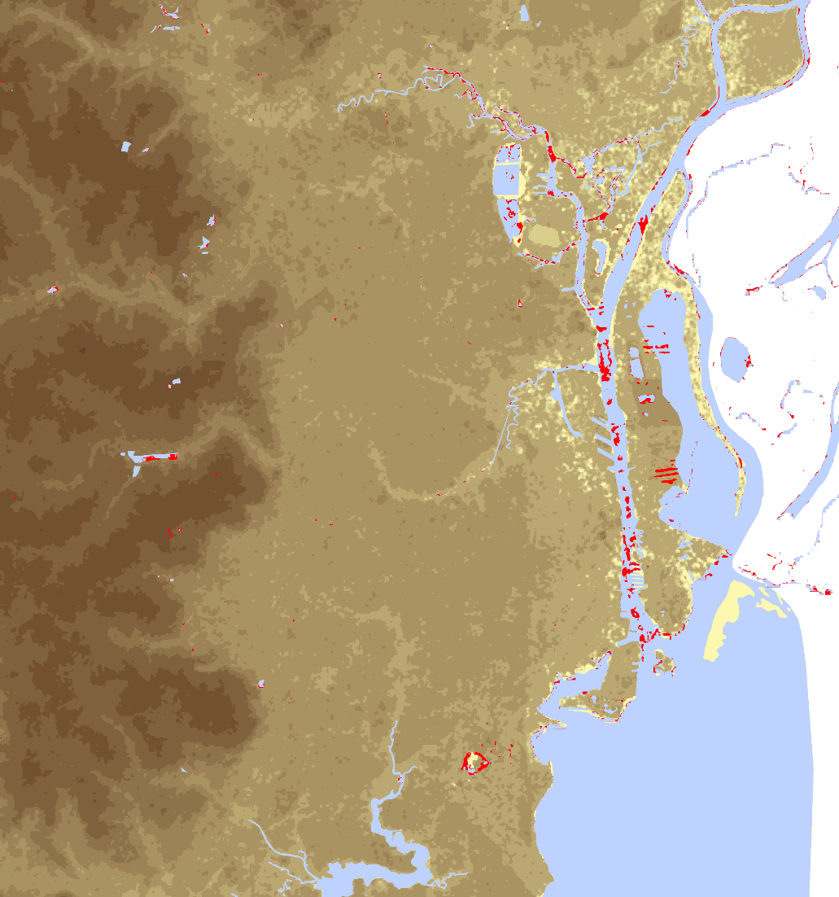



Results: Flood Extent Analysis
The flash flood mostly showed changes along the river banks
Flood potential map from project maybe more related to the effects of flooding than actual flooding
Elevation in meters
0
120
Water Body
Flash Flood areas
0
1.5
3 Miles
Notes:
The flash flood areas highlighted in red are mostly situated regions near existing water bodies such as the river banks.
While the C-SAR imagery for flood and no-flood scenarios were used to make composite image for analysis, it was found that using SRTM DEM proved to be more valuable to highlight areas of high vulnerability to flood. Hence, the results are more related to the effects of flooding than actual flooding itself.

Slide 19
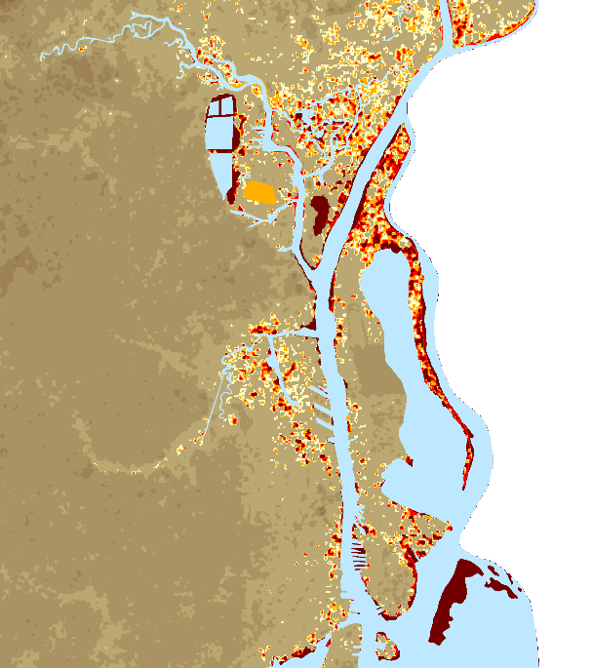
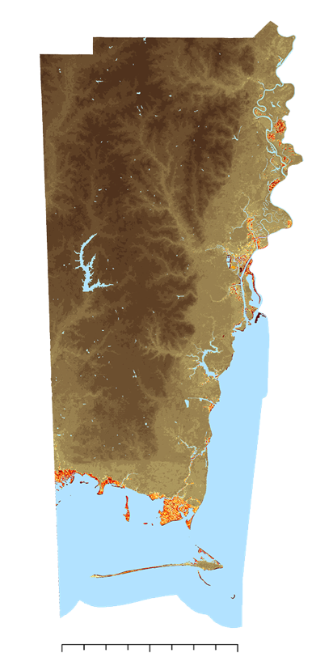

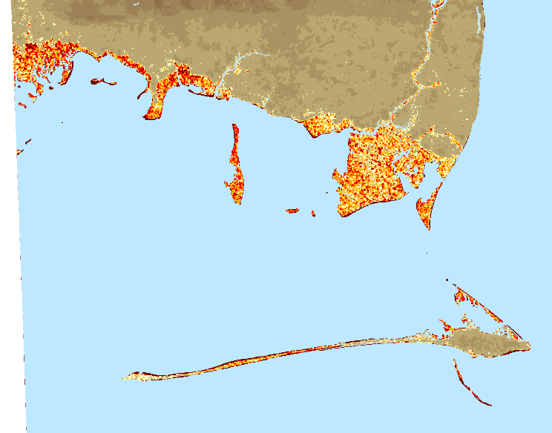
Results: Flood Extent Analysis
N
Elevation in meters
Water Body
0
1
2
3
4 – 10
11 – 20
21 – 30
31 – 40
41 – 60
61 – 80
81 – 120
0
5
10
20 Miles
Notes:
This is a visualization of 3-feet (36 inches) flood scenarios of 2 places in the Mobile County, Mobile metro area and Bayou La Batre and Dauphin Island.
Here, we see a great percentage of coastal areas that are prone to flooding based on their low elevation. Majority of the marshes located in Eastern Mobile County are around the sea level (0 elevation). Moreover, it was found that the southernmost regions of our study area had elevations under 2 meters which notably covers the Bayou La Batre region as shown in the bottom right map.

Slide 20
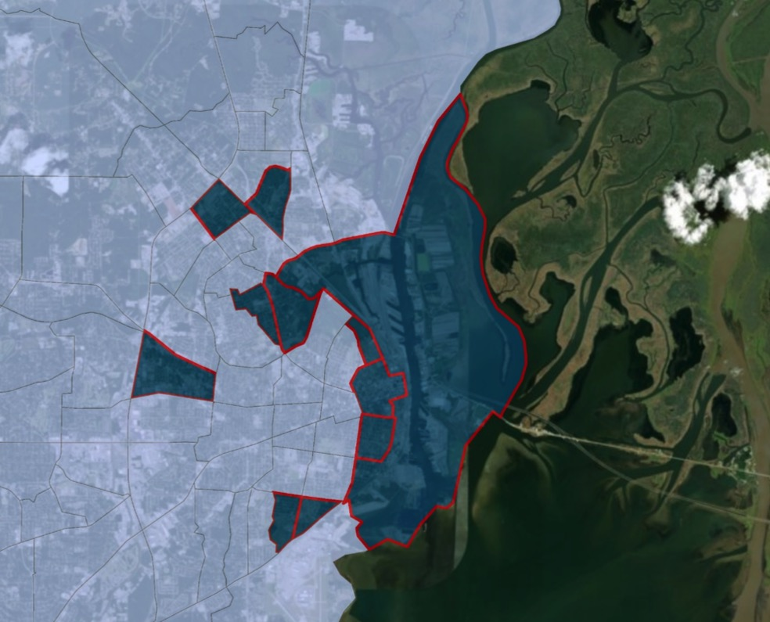
Results: SDRE
11 of the 114 census tracts were identified as regions of greatest risk based on the aggregated social vulnerability index
Census tracts that were scored 4 or more were identified as high risk
N
N
40
75
7.01
6
12
27
4.02
2
11
15.01
15.02
0
1.5
3
6 Miles
Notes:
Based on the aggregated social vulnerability index, we identified 11 census tracts that were at greatest risk. The ones selected had index scores of at least 4 out of 5).
9 of these census tracts are located in the City of Mobile, whereas the remaining 2 are located in the City of Prichard.
As the aggregated social vulnerability index is comprised of land surface temperature, socioeconomic and flood extent data, this way of highlighting the 11 census tracts is useful in a more holistic approach compared to using single index for each of the vulnerability factors.

Slide 21
Results: Impervious Surface Evaluation
N
Unchanged Development
Increased Development
Barren to Urban
Unchanged Barren
Barren to Vegetation
Water Cover
Vegetation to Urban
Vegetation to Barren
Unchanged Veg
Percent change shown above is in relation to the original acreage of a given land cover type
0
5
10
20 Miles
Notes:
Just to reiterate, focusing on the areas of development and land use change is important because it shows how a city is developing and if urban sprawl is occurring, which ultimately affects the health of a city. If a city begins the process of urban sprawl, vegetation lands are cleared and developed.
Impervious surfaces retain heat and resist the filtration of water back into the ground. This non-porous material will heighten flood volumes, making urbanized areas vulnerable to flash floods. And since large areas of concrete also retain heat, then more heat will be absorbed during the day and less will be emitted back into the atmosphere at night therefore keeping these high-density areas warmer than those in rural areas. Residents living in areas of high impervious surfaces are more at risk during flood and heat wave events.
These rural areas are notably cooler than within Mobile City. This is because of the high amounts of vegetation. Vegetation reflectance and evapotranspiration assist in cooling down the environment. The areas of purple that are on the outskirts of unchanged development indicate that there is a reduction in vegetation and an increase in urbanization, alluding to this theme of urban sprawl.
From 2001 to 2016, a total of 10166.6 acres of vegetation and barren land were lost to urbanization. The percentage change is visualized in the chart to the right of the slide.

Slide 22
Conclusions
11 of the 114 census tracts is at high risk of both UHI and flood potential.
A total of 10,503 acres (1% of Mobile County by area) of vegetation and barren land were lost to urban development from 2001 to 2016.
The digital elevation model showed several low-lying areas at risk of flooding within Mobile County, AL and the C-SAR data was used to show flash flooding effects.
  Social Vulnerability Index
  Impervious Surface Evaluation
  Flood Vulnerability
Notes:
By utilizing and analyzing the NASA Earth observation data, we found risk vulnerability were highest in areas of high development, impervious surface area, and UHIs. The highest surface temperatures found were located within Mobile City and Prichard limits and with an increase in urbanization densities, the potential for urban sprawl and more UHIs increase. In comparison, areas of high vegetation would have significantly lower temperature readings because of vegetation reflectance and albedo.
Green space initiatives aid in creating microclimates that increases evaporation, infiltration, and evapotranspiration while also decreasing CO2 emissions, pollution, and stormwater volumes. Since green space areas positively impact flood potential as well, it is important to note that both UHIs and Flood vulnerability are affected by high volumes of impervious surfaces. These impervious surface areas can be found in high densities within Mobile City limits and increase water and air pollution, CO2 emissions from increased energy demand by use of air conditioning technology, and peak flow volumes from lack of infiltration into the ground.

Slide 23
Errors and Uncertainties
By using only one date per year for the LST, there was noticeable difference across the products.
LULC error when calculating acreage between vegetation, barren land and water.
Limited availability of the radar data for the flood extent analysis.
Notes:
When analyzing LULC data, an uncertainty with acreage change from 2001 to 2016 would occur because of a gray area between coastal areas. On the east end of Mobile county, areas of water are heavily vegetated and could be interpreted different from land classifications, therefore skewing the acreage change. True amounts of acreage change remains an uncertainty.
One of the challenges when gathering data finding a radar image that coincided with the flash flood date event in Mobile, AL. Sentinel 1A & B the repeat cycle is of every 6-days. Each have 12-day repeat but since they orbit in the same orbit plane with a 180°. Also, sentinel-1A & 1B were launched 2014 and 2016 respectively, as a consequence they are relatively recent earth observations. The team wanted to observed flood analysis based from the true flood event, the closest proximity of flood data was August, 3rd which is was a day after the flood actually happened.

Slide 24
Future Work
Ground-truthing for LULC accuracy
Use 2020 Census Bureau data for a new social vulnerability index
Assess the combined use of NDVI and NLCD for LULC mapping
Notes:
Future work stems from the areas that there were uncertainties and error in methodology. These areas of potential for future work to implement will improve accuracy and provide a more specific evaluation rather than the generalizations that were made throughout the project.
By using multiple imagery for the LST, we can get more reliable data.
When evaluating areas that are socially vulnerable and how land use has changed over a 15-year time span, these factors would improve greatly with a ground truthing process.
For social vulnerability, a few groups of people were excluded from the vulnerability analysis and the number of homeless people in Mobile County is missing from the evaluation as well.
A better understanding of how sparse resources are in the mentioned vulnerable areas can be obtained through a business inventory and an analysis of management practices in Prichard and the City of Mobile.
Due to the temporal resolution of the C-SAR data, the flood vulnerability analysis did not reach full data potential. However, using data from multiple sources can be useful in future flood extent analyses.

Slide 25
Joseph Spruce, Science Advisor, Science Systems and Applications, Inc.
Dr. Kenton Ross, Science Advisor, NASA Langley Research Center
Danielle Quick, Impact Analysis Senior Fellow, NASA Langley Research Center
Madison Murphy, Center Lead, NASA DEVELOP Alabama – Mobile & Marshall Nodes
Bernard H. Eichold II, M.D., Dr. P.H., Mentor, Mobile County Health Department
Larissa Graham, Project Lead, Groundwork Mobile County
Eldon Blancher, PhD, BCES, Groundwork Mobile County
Ray Richardson, Groundwork Mobile County
This material contains modified Copernicus Sentinel data (2019), processed by ESA.

