Slide 1

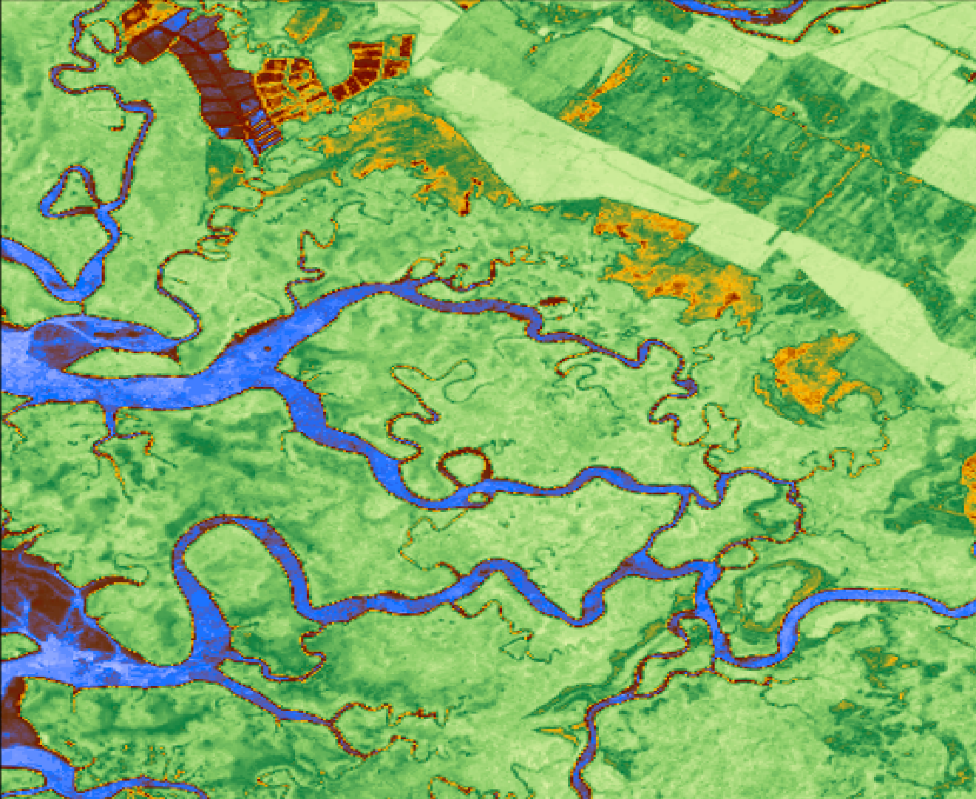

2018 Summer | GA – Athens
OSA PENINSULA WATER RESOURCES II
Utilizing NASA Earth observations to Evaluate Effects of Land Use Change on Watershed Health and Carbon Sequestration in the
Osa Peninsula, Costa Rica
Suravi Shrestha
Tanner Johnson
John Langstaff
Taufiq Rashid
Notes:
For this project, the Osa Peninsula Water Resources II Team utilized NASA Earth observations to Evaluate Effects of Land Use Change on Watershed Health and Carbon Sequestration in the Osa Peninsula, Costa Rica

Slide 2
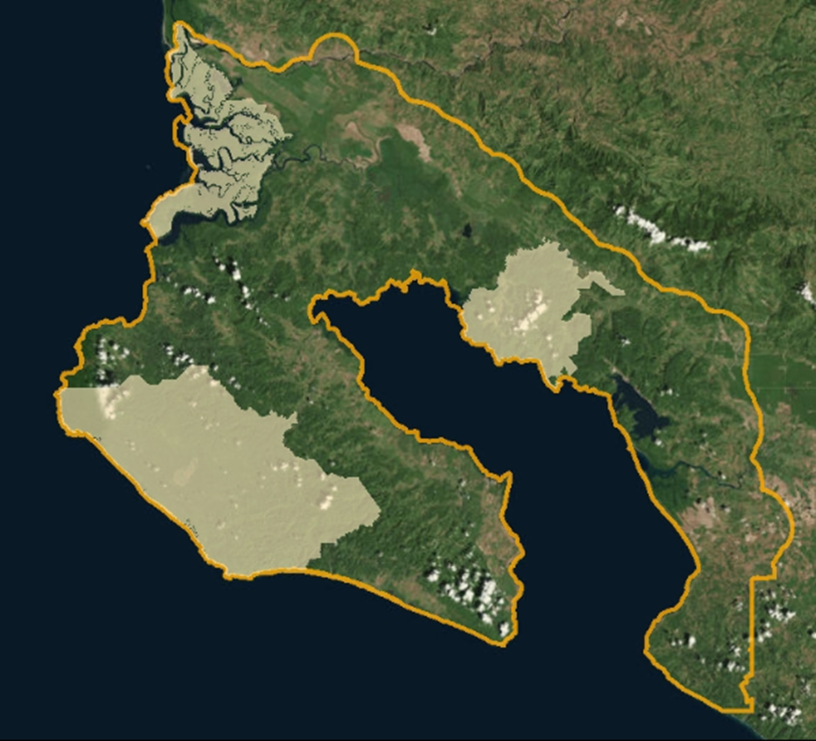
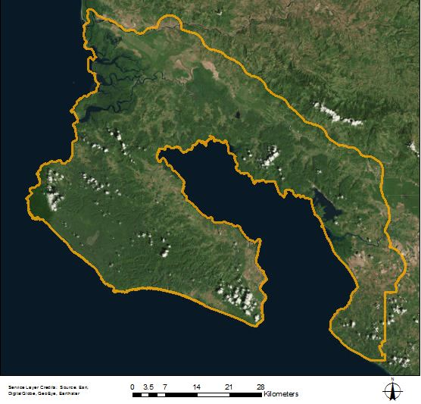
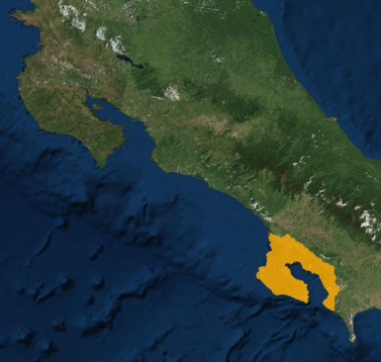
Study Area
Osa Peninsula, Costa Rica
Covers ~1800 km² and home to 2.5% of the Earth’s biodiversity
“The most biologically intense place on Earth”– National Geographic
Three National Parks
  Corcovado
  Piedras Blancas
  Terraba Sierpe
Case Studies around the Peninsula
Costa
Rica
Costa Rica
Terraba Sierpe
Piedras Blancas
Corcovado
Notes:
Photo Credit: http://osaconservation.org/
For this project, we focused on the Osa Peninsula in Costa Rica. The peninsula is located on the southern end of Costa Rica’s Pacific Coast, and is roughly the double the size of New York City. This region has 2.5% of the world’s biodiversity. This means that this one region on Earth contains many different species of plants and animals. National Geographic has also called it “the most biologically intense place on Earth”. The peninsula is home to three national parks that are the main locations for this biodiversity: Corcovado, Piedras Blancas, and Terraba Sierpe. The protected areas are connected by vital biological corridors. Additionally, we conducted a small scale case study in one of our partner’s river restoration study sites in the southern portion of the Osa Peninsula.
For more details on the biodiversity in the Osa Peninsula, please check: http://osaconservation.org/about-the-osa-peninsula/

Slide 3
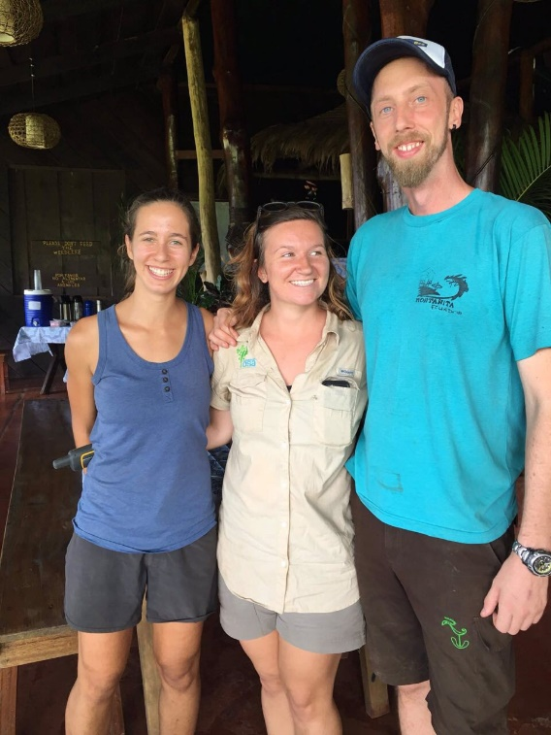
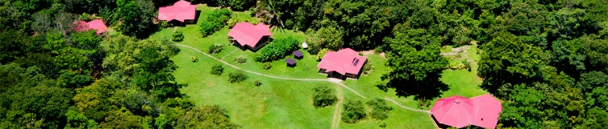
Partner
Osa Conservation
  Dedicated to protecting the biodiversity of the Osa Peninsula
  Hilary Brumberg and Dr. Andy Whitworth
Credit: Hilary Brumberg
Credit: Osa Conservation
Notes:
Photo Credit: http://osaconservation.org/
Our partner for this project was Osa Conservation. This is an NGO headquartered in the Osa Peninsula of Costa Rica, and their focus is on protecting the biodiversity of the Osa Peninsula. They also educate local landowners and the general public about threats to biodiversity and encourage landowners to practice restoration and sustainable farming practices.
We have had the privilege of working with Hilary Brumberg and Dr. Andy Whitworth from Osa Conservation. They assisted us in every aspect of this project, from getting us land cover data to video footage of the Osa Peninsula.

Slide 4
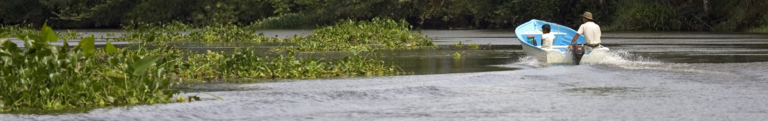
Community Concerns
Human Impact: Deforestation and the extensive use of pesticides and fertilizers have led to water pollution and a loss of biodiversity, specifically increasing the need to protect biological corridors
Economic Importance: Ecosystem health and biodiversity in the area hold major economic importance to residents
Watershed Health: It is vital to understand watershed degradation impacts. Specifically, sedimentation and pollution are threatening the biodiversity and stability of the region’s wetland ecosystems
Public Outreach: There is a need for data on land use change in the Osa Peninsula to inform local conservation strategies, environmental policy, and public education
Credit: Osa Conservation
Notes:
Photo Credit: http://osaconservation.org/
Many of the community concerns ultimately stem from the impacts of human activities on the region. Two activities in particular that are raising concerns are deforestation and plantation agriculture. Both have been very extensive during the latter half of the 20th Century. Deforestation has led to habitat loss and habitat fragmentation, and agriculture has led to the extensive use of pesticides and fertilizers that eventually run off into bodies of water. Both activities have contributed to water pollution and biodiversity loss in the Osa Peninsula. This ultimately can negatively impact humans, as decreased water quality makes it difficult for humans to live in the region.
Mangroves are important to maintaining these ecosystems. Because of human activity, they could be negatively impacted.
Our project partners need information about environmental degradation and biodiversity loss so that they can build outreach materials. They want to reach out to local landowners and educate them about these negative impacts so they can encourage them to practice reforestation and other activities that will help to restore biodiversity.
A final concern relates to the economy. High biodiversity means that many people are going to the Osa Peninsula specifically to see these ecosystems and the natural landscapes. Destroying these ecosystems could be detrimental to the economy, which could also negatively affect humans.
For more details: http://osaconservation.org/about-the-osa-peninsula/conservation-challenges/

Slide 5
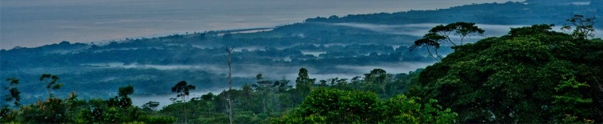
Objectives
Refine time series maps of land use and land cover change in the Osa Peninsula for the years 1987, 1997 and 2017
Evaluate land use and land cover change pre- and post-1996 Forest Law 7575
  1996 Forest Law: Protected riparian zones and established the current Payment for Environmental Services program (PES)
Assess and predict watershed impacts in the Osa Peninsula region incorporating land cover and terrain data
Create accessible public outreach materials to inform the local community on land use change and water quality impacts within the region
Credit: Osa Conservation
Notes:
Credit: http://osaconservation.org/
Our first objective was to produce refine the time series land cover classification maps of the Osa Peninsula between the years 1987, 1997 and 2017.
These maps were used to quantify the effectiveness of the 1996 Forestry Law 7575 that aimed to curb deforestation and erosion in riparian zones.
Our second objective was to assess and predict the watershed impacts in the region by incorporating land cover and terrain data This is a type of environment suffering the most from habitat degradation, so being able to quantify how it has been affected will help to educate the public about sustainable practices.
Our final objective in this project was to create Outreach Materials that are accessible by the public. These public outreach materials will be used by Osa Conservation to inform the local community on how to implement sustainable practices.

Slide 6



Data Acquisition
NASA Satellites/Sensors
Planet Scope Data
  3 meter spatial resolution
  Daily image collection
INOGO
  Land cover data produced by Stanford University and the University of Florida in 2012
Atlas CR 2014
  River and watershed shapefiles
  SWAT Model Data
  FAO - Global soil dataset
  CFSR- Long term global weather estimates
  In situ water quality data from Osa Conservation
Ancillary Data
Land cover
Landsat 8 OLI
Landsat 5 TM
Elevation & Gross Primary Productivity
Terra ASTER
Terra MODIS
Notes:
Satellite data from Landsat 5 and 8 were used to assess land cover.
Elevation data was obtained from the Terra ASTER satellite.
GPP data was obtained using Terra MODIS satellite
[If time permits, mention the following. If not, then mention something like, “these are the ancillary data we used”]
In addition, we also have ancillary data that helped us during our study. PlanetScope Data provided high resolution imagery that helped us to validate our land cover maps.
Additionally, land cover data through INOGO - produced by Standford university and Univ. of Florida provided a basis for our land cover maps.
River and watershed shapefiles were obtained from the Atlas CR 2014 dataset
Finally for SWAT model, we used:
Food and Agriculture Organization (FAO) for soil data
Climate Forecast System Reanalysis (CFSR) for long term global weather estimates
In Situ Data from Osa Conservation

Slide 7
Methodology
Data Collection
Terra MODIS
Terra ASTER
Landsat 5 TM
PlanetScope
DEM:
Elevation Data
Landsat 8 OLI
2016
2017
Gross Primary Productivity
1987
1997
2017
Google Earth Engine API
FAO soils data
Slope
Streams & Watersheds
Weather Data
Carbon Sequestration Time Series
Land Cover Time Series
High Resolution NDVI Map
(2016-2017)
ArcSWAT
Predictive Hydrologic
Model
Notes:
Here is the overall methodology for our project. We created land cover time series maps using GEE, which we incorporated into our hydrologic model to predict water quality. We also calculated GPP to produce Carbon sequestration maps.

Slide 8
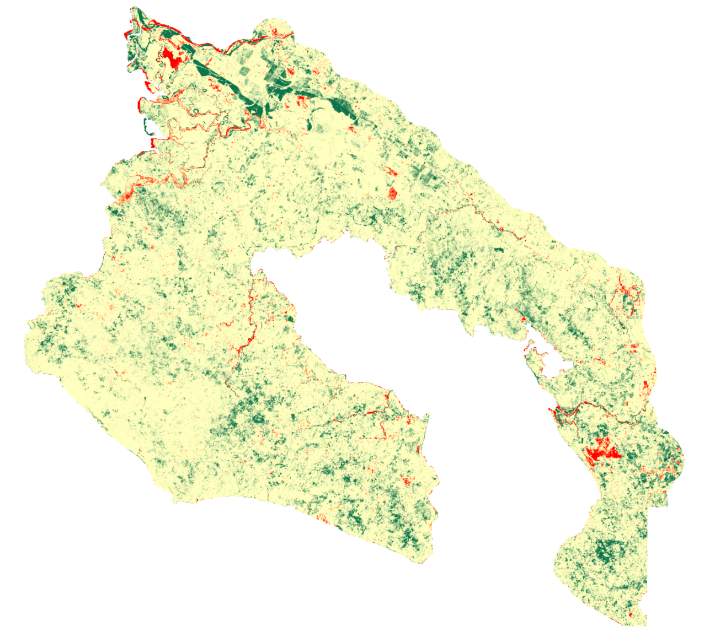


Results
Normalized Difference Vegetation Index (NDVI) between 1987 and 2017
Decrease
in NDVI
No
Change
Increase
in NDVI
Notes:
We calculated the difference in NDVI between 1987 and 2017 to see the change in vegetation for Osa in the last 20 years. This result shows that there has been significant increase in NDVI near Corcovado National park and Piedras Blancas National Park. Increases in NDVI can be attributed to secondary forest growth in old grasslands or palm plantations. NDVI was helpful in separating out the vegetative land cover classes.

Slide 9
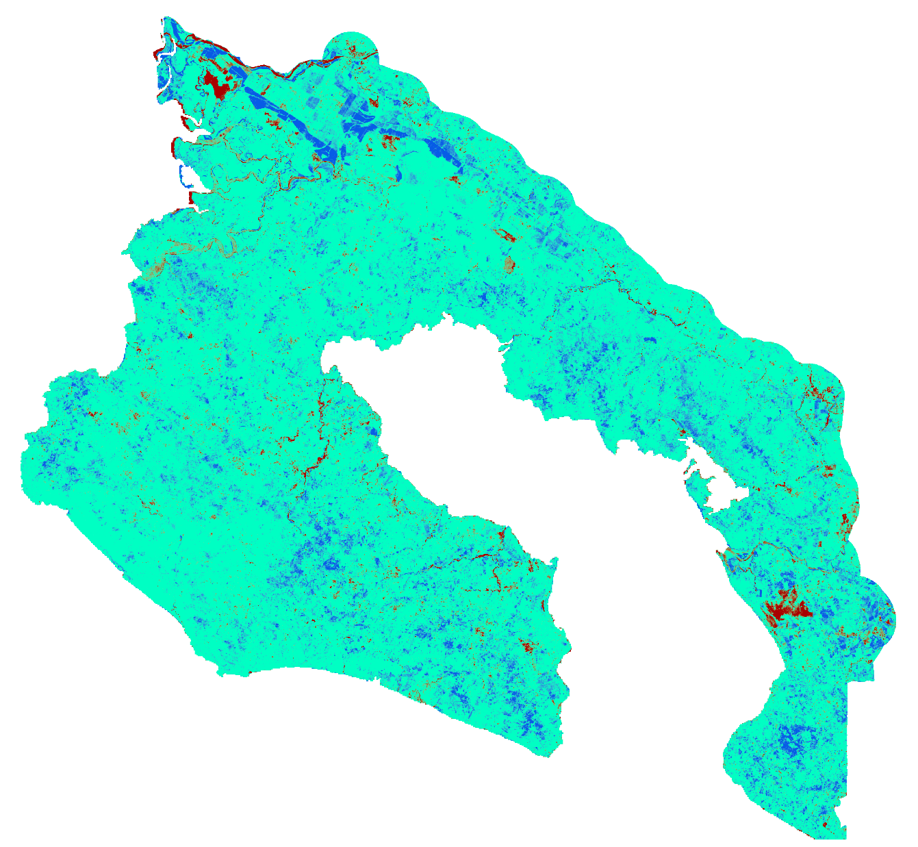

Results
Change in Enhanced Vegetation Index (EVI) between 1987 and 2017
Decrease
in EVI
No
Change
Increase
in EVI
Notes:
Additionally, we also calculated the difference in EVI for our study area between 1987 and 2017. EVI is more sensitive to differences in heavily vegetated areas, and better corrects for atmospheric haze as well as the land surface beneath the vegetation. Therefore, we calculated EVI along with NDVI.
The EVI result is very similar to the NDVI result supporting the conclusion that there has been a increase in forested areas in Osa in last 20 years.

Slide 10
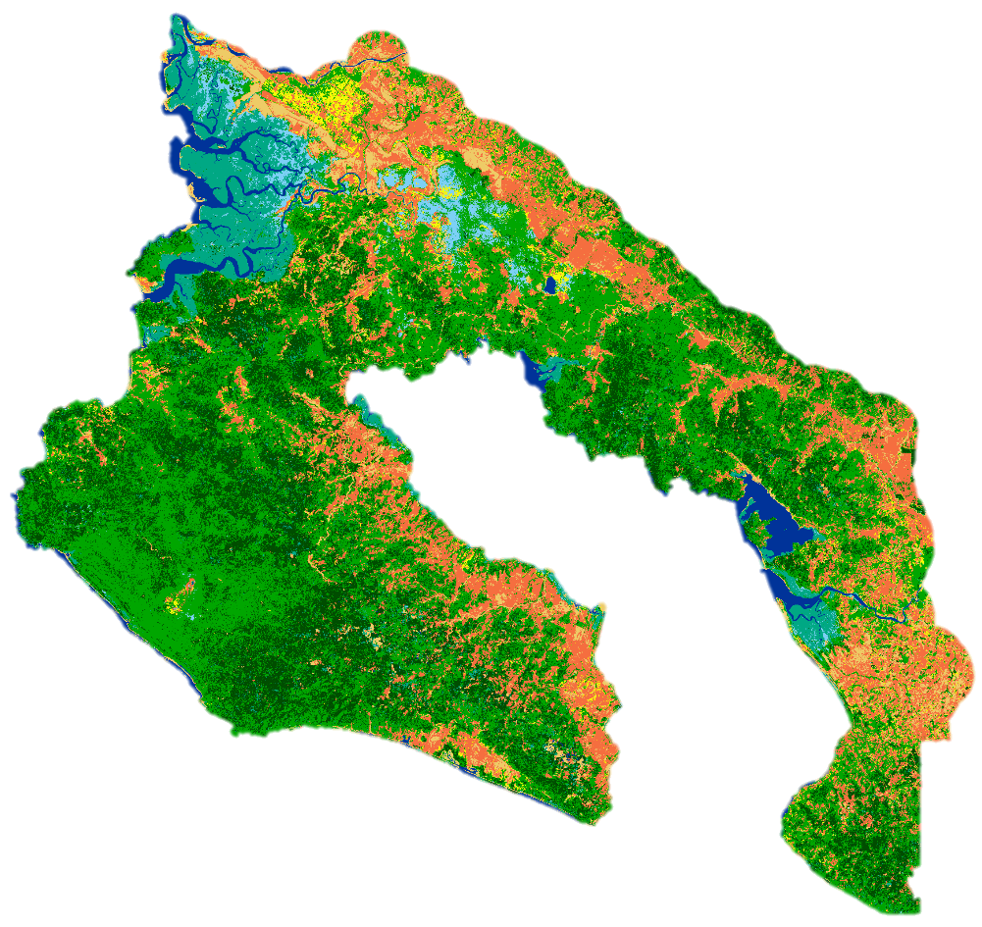
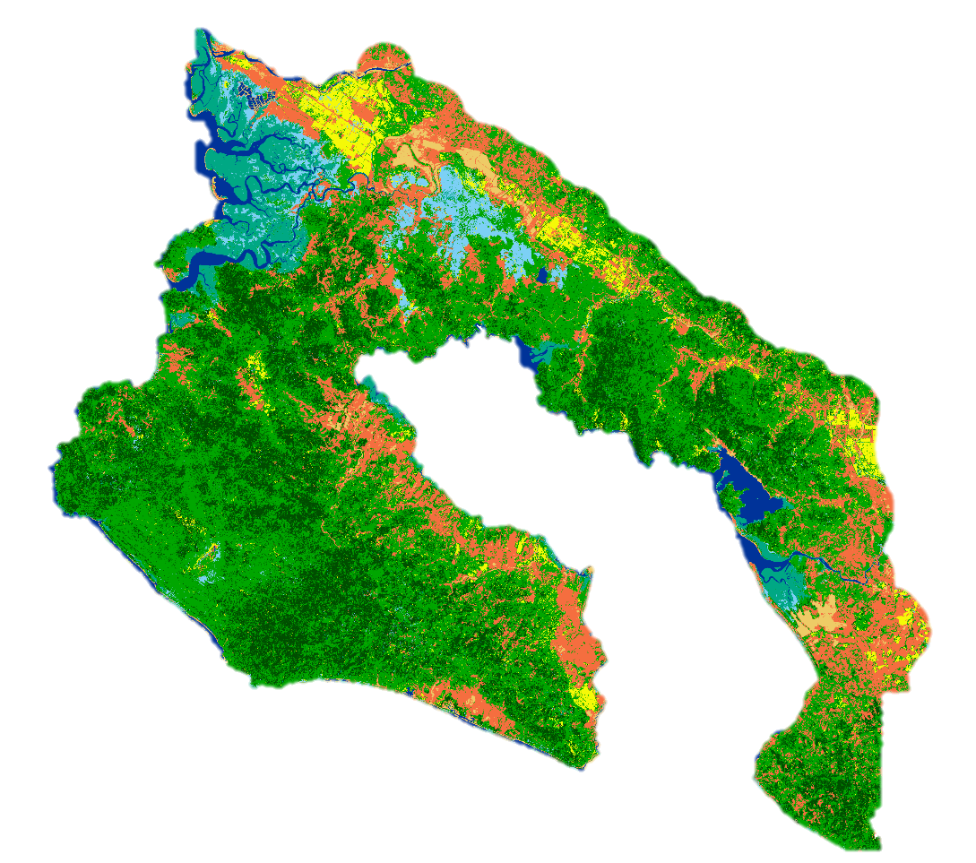
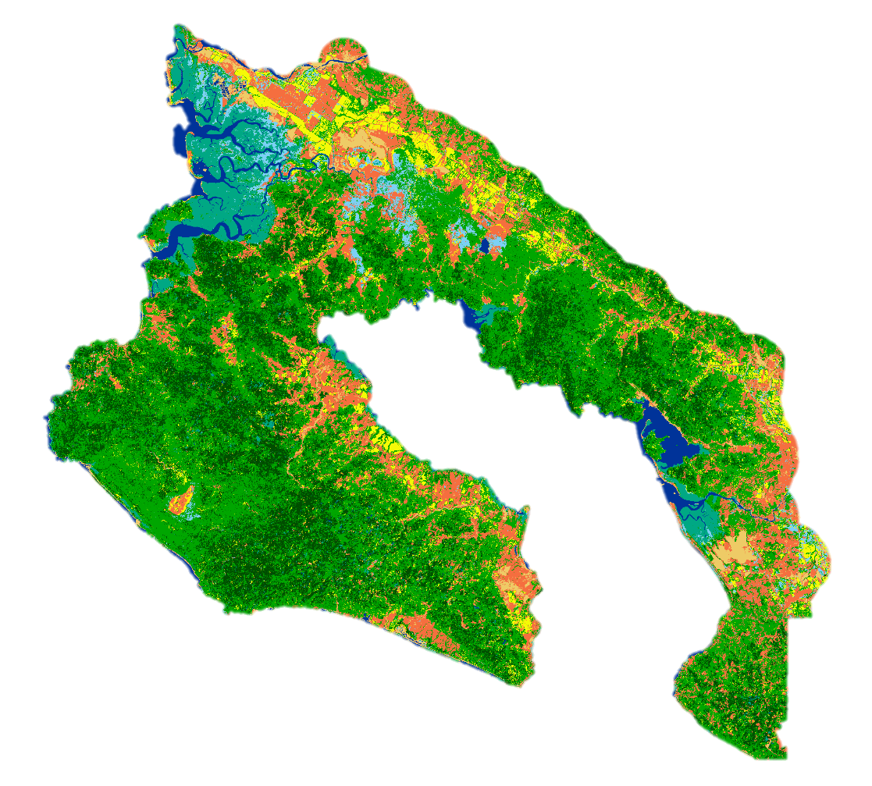

Land Cover Maps
1987
1997
2017
Land Cover Types
No Data
Exposed Soil/ Urban
Wetland
Mangrove
Primary Forest
Palm Plantation
Secondary Forest
Pasture/Grassland
Water
Notes:
We created land cover maps for three years, which were chosen to highlight the effects of the 1996 Forest Conservation law. For 1987 and ‘97 we used landsat 5, and landsat 8 for 2017.
We needed to create cloud free composites over multiple months, as cloud free images of the peninsula are rare.
Google Earth Engine was perfect for our project, since it makes it very easy to collect and composite images over a year or more.
A primary goal of our classification was to separate primary and secondary forest based on ground truth data provided by our partner. To help with this, we added indices to our image such as NDVI, EVI, and tasseled cap for vegetation, NDMI and NDWI for moisture, and slope from Terra ASTER. We used the randomforest algorithm to achieve our result.

Slide 11
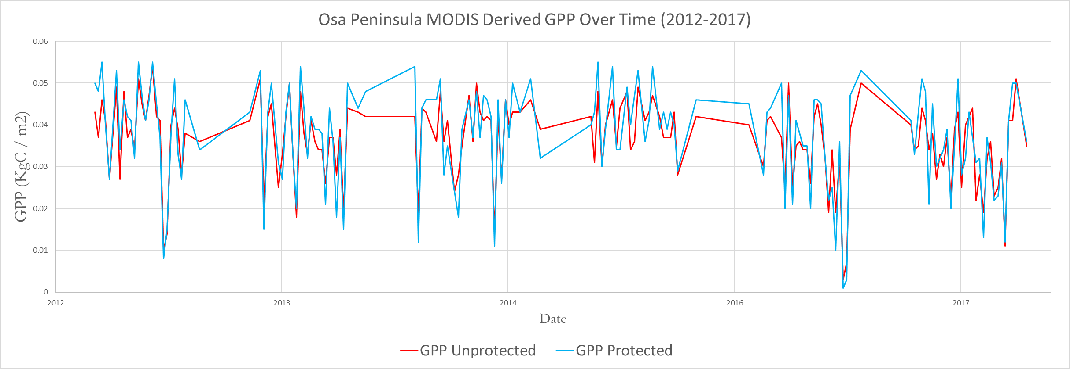
Carbon Sequestration
MODIS Derived GPP Over Time (2012 -2017)
Protected Areas
Unprotected Areas
Notes:
In addition to Landsat, we used the MODIS GPP product to evaluate carbon sequestration in Osa. Protected areas are known to store much more carbon than areas that are open to development. The GPP for Osa during 2012-2017 shows that protected areas usually have higher GPP than the unprotected areas. It means that the protected areas are contributing more in conserving the environment through carbon sequestration.

Slide 12
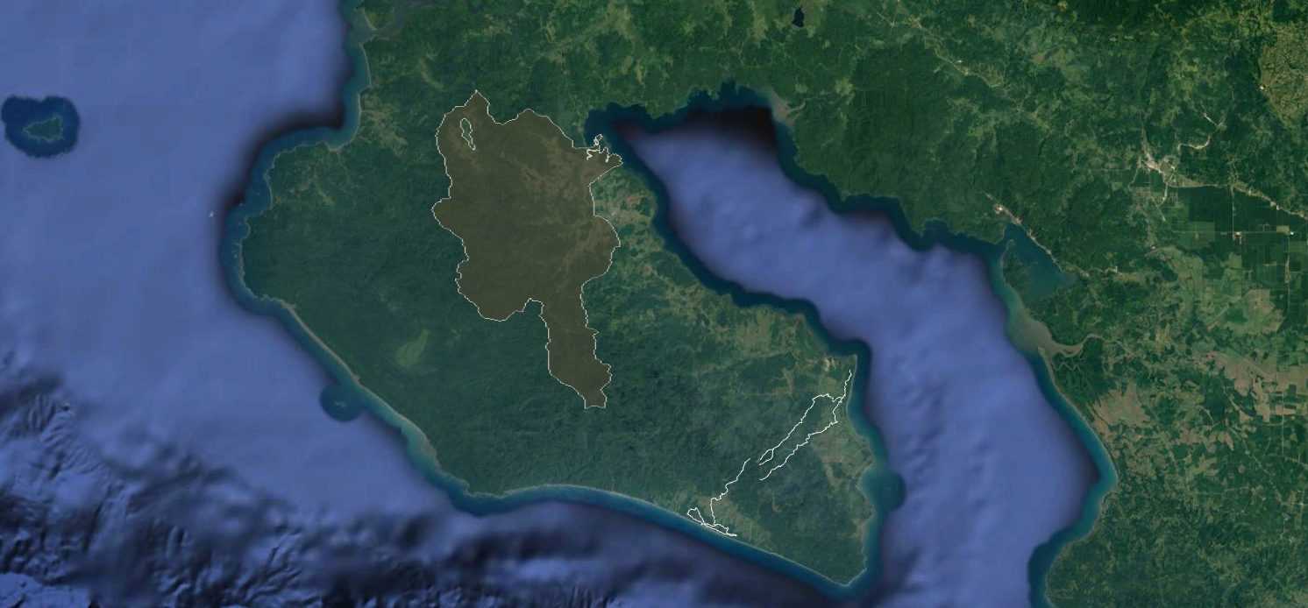
SWAT Case Study Areas
Rincon Watershed
Rio Corzal and Plantares
Rio Pejeperro
Notes:
These are areas that Osa conservation is interested in restoring with 15m forest buffers. By modelling the effect of different land uses in these areas with SWAT, our project will serve as a decision making tool to prioritize watersheds for restoration.

Slide 13
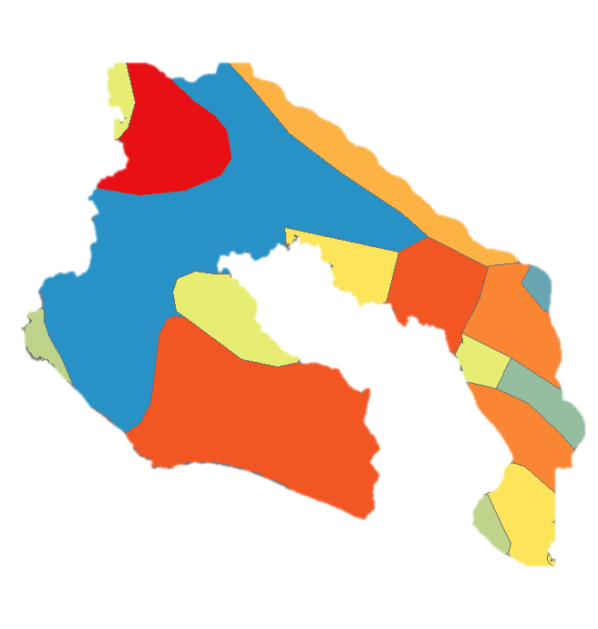
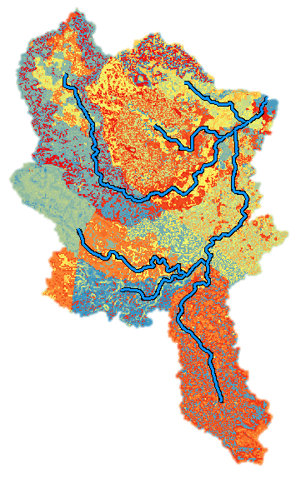
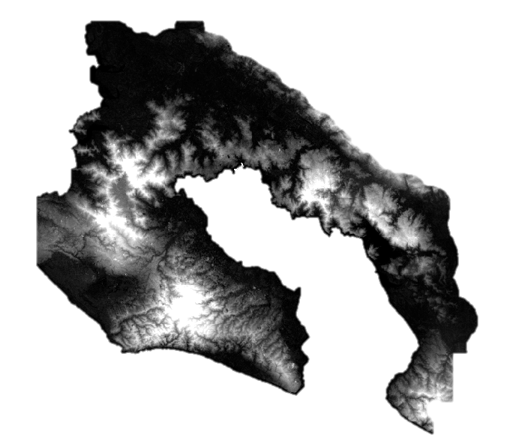
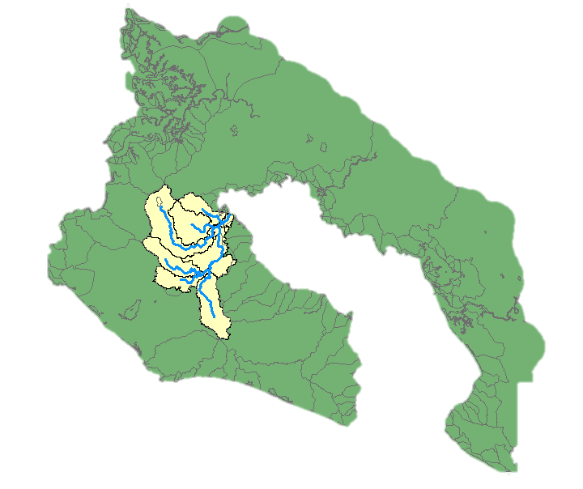
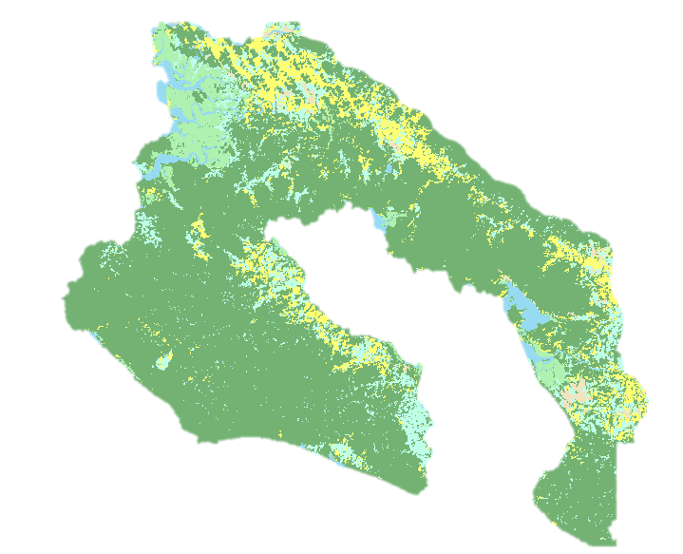
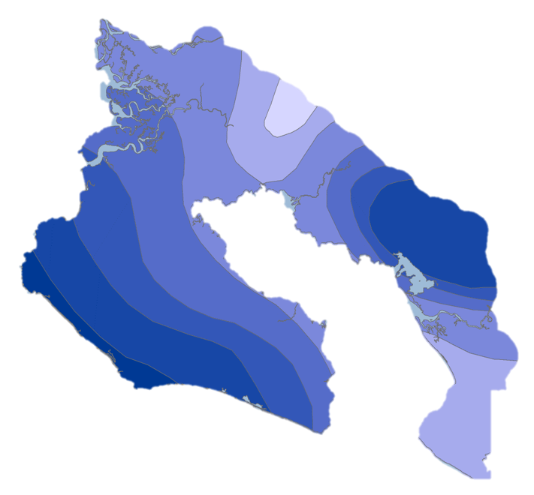
SWAT Model Methodology
Soil, Elevation, Weather and
Land Use Data
Watersheds and
Sub-basins
Hydrologic
model
Notes:
SWAT creates a model which tells how water will behave if it lands on or flows over a certain spot based on the vegetation, soils, and slope in this location. We started by creating streams and watersheds based on elevation data. Then we added land use and soil data. Finally, we simulated weather data for our study period, which was based on real historical data.

Slide 14
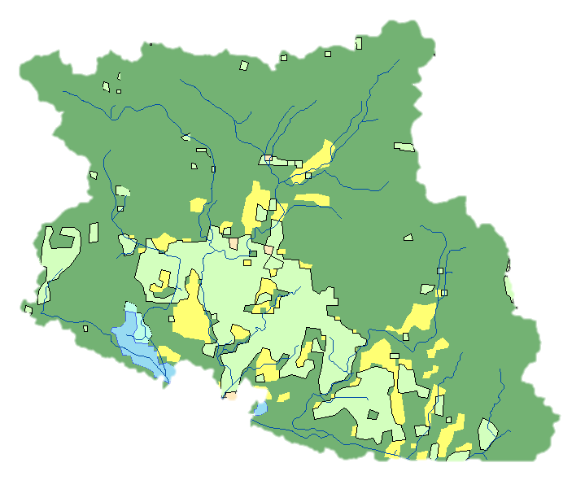

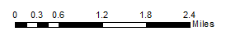
SWAT Model Methodology
Land Cover Types
Forest
No buffer
15 m buffer around riparian areas
Grassland
Oil Palm
Wetland
Water
Notes:
After running the model with the current land use data, we created modified land use scenarios to include 15 meter forest buffers around streams in the restoration areas.
15 meter forest buffers are a common restoration practice on the Osa peninsula, and are required by law for newly deforested areas.

Slide 15
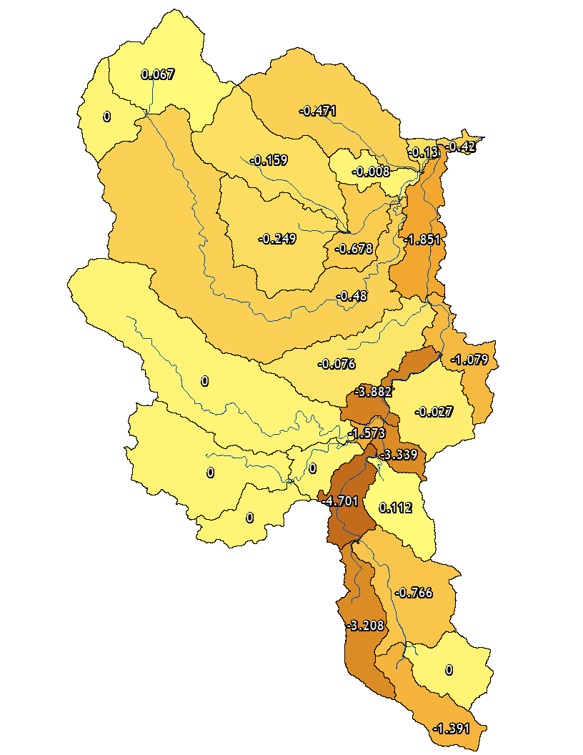
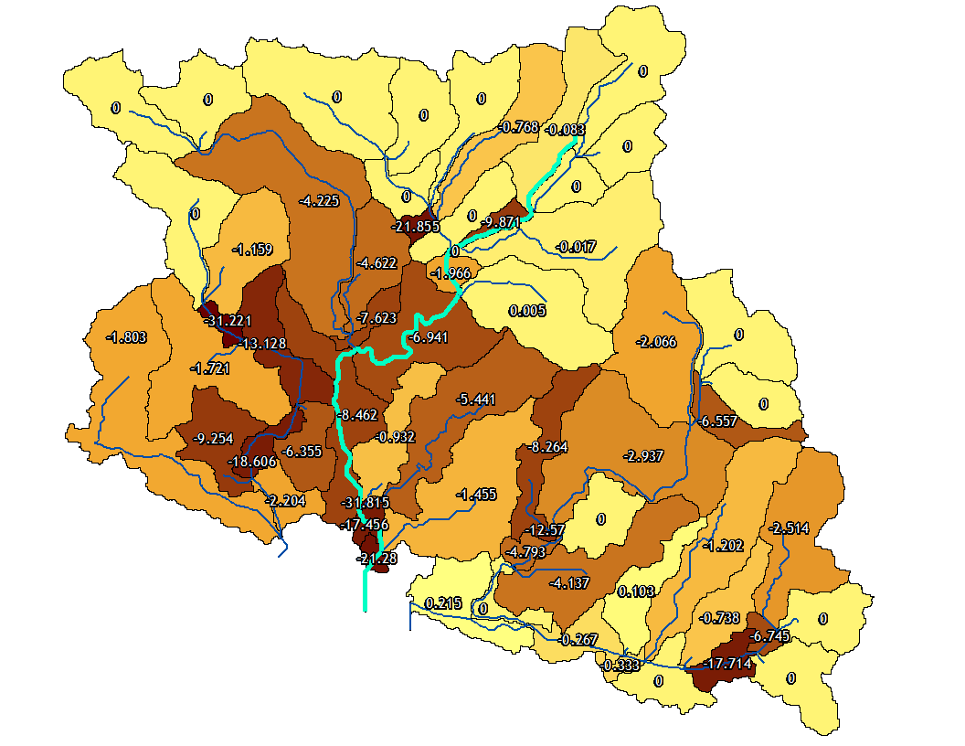
Results
Rincon Watershed
Rio Pejeperro (Highlighted)
% Decrease in Daily Sediment yield with 15 m Forest Buffer
31.221%
-0.215%
Watershed outlet
Notes:
Our model predicts that 15 meter forest buffers will cause significant decreases in daily sediment loads, along with nitrate and phosphorus concentrations (which are not shown here). It will also help our partner decide which stretches of river to restore in order to have the greatest impact on water quality.

Slide 16
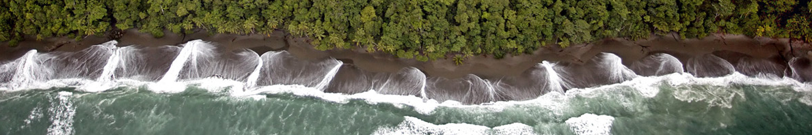
Conclusions
The NDVI and EVI maps indicate an overall growth in vegetation between 1987 and 2017
Land cover change between 1987 and 2017:
  Palm plantations doubled in area – from ~100 sq. km to ~200 sq. km
  Secondary forests increased by 10.4%
    Majority of the forest regeneration is taking place on grassland (64.15%)
The GPP for protected areas is 3.06% higher than the unprotected areas between 2012 and 2017
Credit: Osa Conservation
Credit: Osa Conservation
Notes:
Overall, our NDVI and EVI maps indicate an increase in vegetation over the study period from 1987 to 2017.
In addition, the land cover maps also indicated that palm plantations doubled in area between 1987 and 2017. Similarly, we observed increase in secondary forests by 10.4%. Of this increase, ~ 64% of the forest regeneration took place on grasslands.
Similarly, the GPP for protected areas are higher than unprotected areas between 2012 and 2017 by 3.06%.

Slide 17
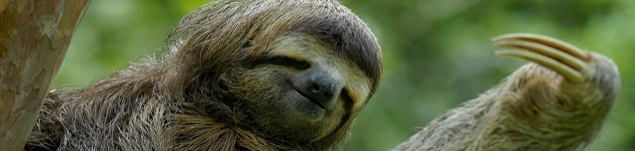
Limitations
Cloud cover in early Landsat 5 scenes
Lack of ground truth data for land cover classification
Lack of river gauge and chemical data for SWAT
Credit: Osa Conservation
Notes:
During our research, there were some issues when it came to cloud coverage in the satellite images. Since it is a tropical area, cloud coverage in the region is much heavier than compared to other parts of the world, some years were too cloudy to obtain an acceptable image.
The SWAT model was only valid for comparing between watersheds, due to our lack of data for calibration and validation.

Slide 18
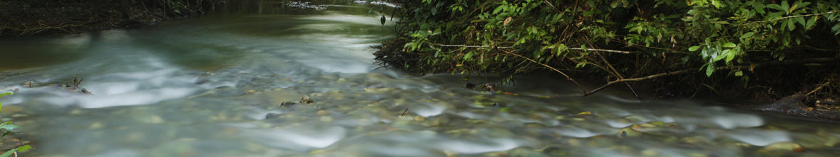
Future Work
Forecast future land use in the study region
Compare the erosion rate of ten most degraded and ten most pristine rivers in the study region
Calculate rates of mangrove deforestation and reforestation since 1980s
Identify how land use change and river water quality affect mangrove health
Credit: Osa Conservation
Notes:
Our partner has been very helpful in providing us with key questions and discussion points that they hope to achieve through their collaboration with NASA DEVELOP.
We based our work in accordance to the partner’s need and we hope to continue this project as a third term project to forecast future land use trends in the peninsula, compare erosion rate of degraded and pristine rivers, calculate rates of mangrove deforestation and reforestation since the 1980s and finally identify how land use change and river water quality affect mangrove health.

Slide 19
End Products
Land Cover Time Series
High Resolution Land Cover Map
NDVI Analysis
Term I
1987
1999
2017
2016
2017
ArcMap (Landsat)
ArcMap (PlanetScope)
Refined
Land Cover Time Series
Watershed Health Maps
Carbon Sequestration Time Series
Outreach Materials
Term II
GEE
SWAT model
GEE
ArcGIS Story Map
In-situ water quality data
Notes:
This slide shows all the end products that have been produced in the past two terms.
These end products will help Osa Conservation in their efforts to conserve and maintain the biodiversity of the Osa Peninsula. With an intended third-term in the Fall, we hope to further collaborate with our project partner to produce tools and products that would help further their outreach efforts.

Slide 20
Acknowledgments
Science Advisor
Dr. Marguerite Madden, Director for Center for Geospatial Research, University of Georgia
Project Partner – Osa Conservation
Hilary Brumberg, Rios Saludables Program Coordinator,
Dr. Andy Whitworth, Director of Ecological Restoration and Biodiversity Conservation
NASA DEVELOP GA-Athens Node
Caren Remillard, Center Lead
Austin Stone, Communications Fellow
Past Members and Contributors
Dr. Sergio Bernades, Associate Director for Geospatial Research, University of Georgia
Marie Bouffard
Candice Lee
Emily Pauline
Sam Tingle
Notes:
We would like to thank our science advisor, Dr. Marguerite Madden for her support and guidance throughout this project. She was a crucial resource in figuring out certain methodologies and techniques while working with our data and classification.
We would like to thank our project partners from Osa Conservation, Hilary Brumberg and Dr. Andy Whitworth, for their feedback and for providing us with a variety of materials used to complete this project, like valuable datasets and visual imagery.
We would like to acknowledge our past project members and advisors who have contributed during the initial phase of this term.
Finally, we would like to thank the DEVELOP leadership at the Athens node, Center Lead Caren Remillard and Communications Fellow Austin Stone for their support, feedback, and helpful input throughout the entire term.

