Slide 1
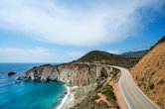
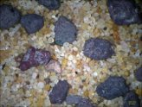
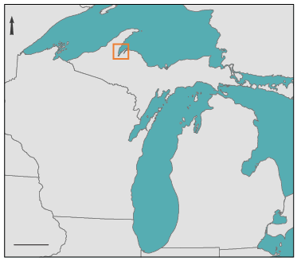
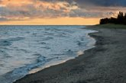
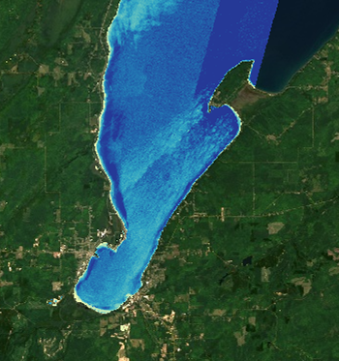
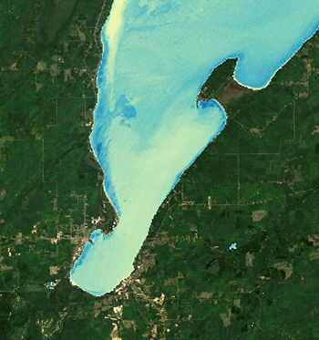
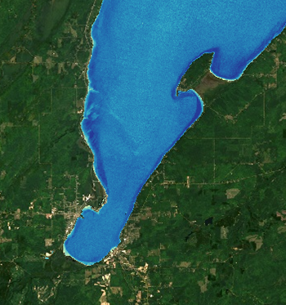
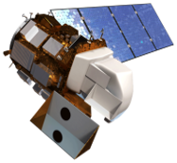
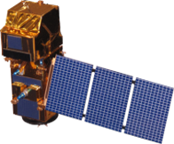
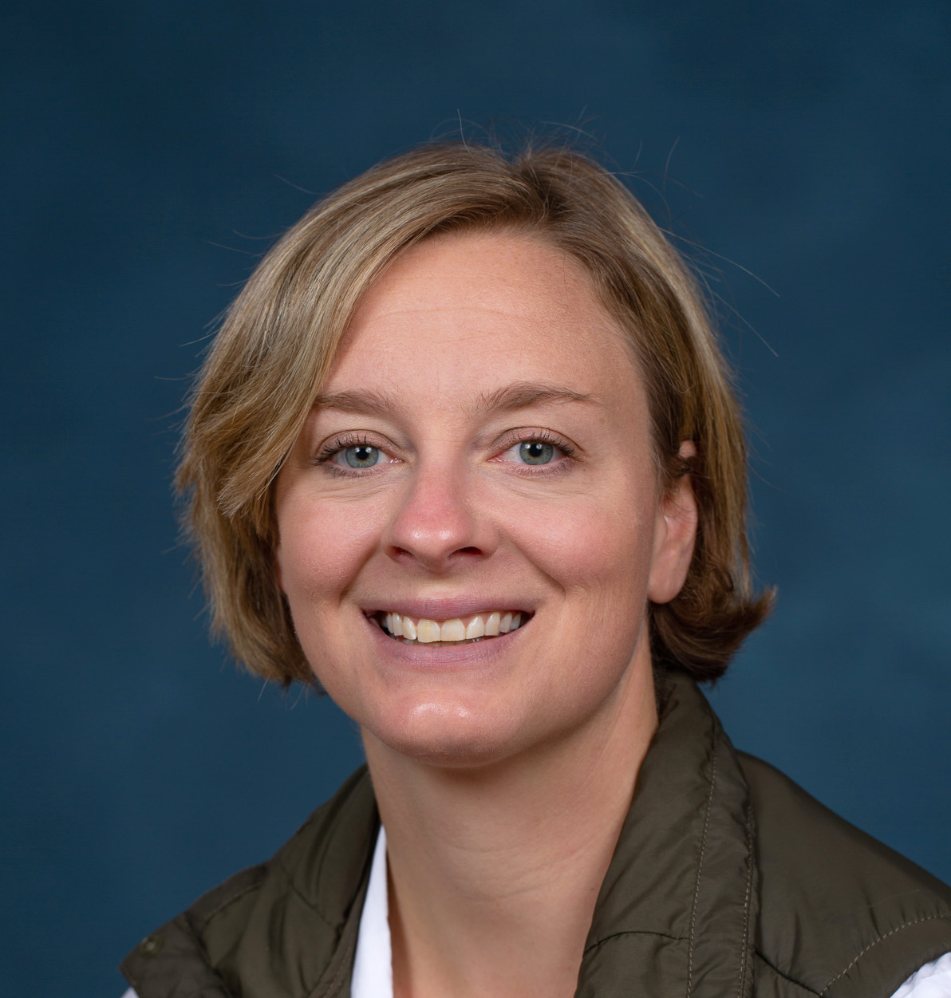
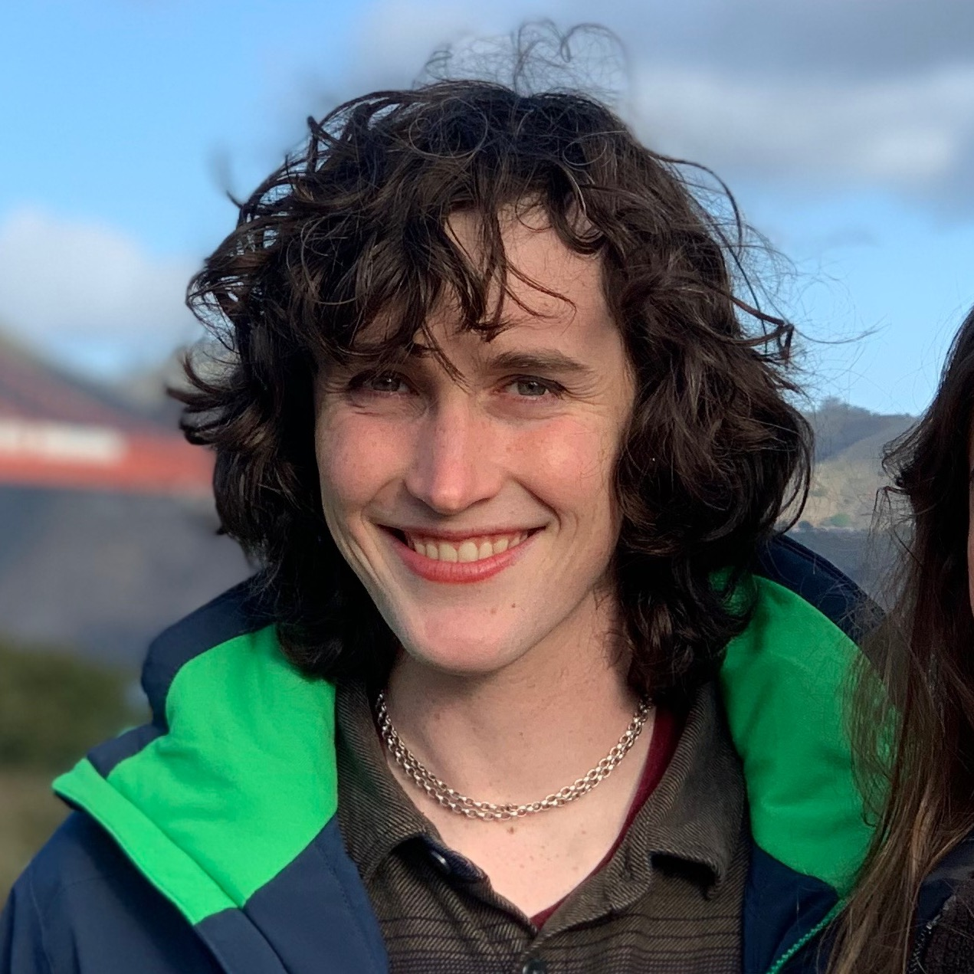
Turbidity Data Decision Support for Shoreline Assessment and Management in Lake Superior's Keweenaw Bay
Keweenaw Bay: What's in the Water?
Keweenaw Bay Water Resources
Between 1850 and 1929, the Keweenaw Peninsula region was the second largest copper producer in the world. Waste from these mines including fine gravels enriched in heavy metals, called "stamp sands," were deposited on the Lake Superior shoreline and shift with rising lake levels and natural coastal processes. An influx of water into the bay from snowmelt or heavy precipitation can mobilize these stamp sands and loft them into the water column, creating turbid water. Such sediments threaten wetland restoration projects, critical habitats for the fish and flora that serve as traditional food sources for the community.
Impacts to coastal highways and infrastructure
Loss of public beaches and shoreline
Redistribution of stamp sands
N
Lake Superior
Canada
What is Turbidity?
Turbidity is a measure of water clarity, or how much light is scattered as it passes through water. The higher the intensity of scattered light, the higher the turbidity. Turbidity is caused by particulates in the water, such as coastal sediment derived from erosion.
Wisconsin
Michigan
100 km
Snowmelt Season
(~early-mid Spring)
Rain-Dominated Season
(~early-mid Summer)
Drier Season
(~late Summer-early Fall)
A proxy for turbidity mapped for each season.
Darker blues = less turbidity. Lighter blues to yellow = more turbidity.
Earth observations used to analyze turbidity
Turbidity is greatest during the rain-dominated season.
Turbidity is apparent during snowmelt season, but the signature
is weaker compared to the rain-dominated season.
Turbidity is least apparent during the dry season.
Landsat 8 OLI
Sentinel – 2 MSI
The team thanks everyone who made this project possible:
Keweenaw Bay Indian Community (KBIC) Partners: Evelyn Ravindran, Natural Resources Department Director; Erin Johnston, Wildlife Program Lead; Dione Price, Environmental Specialist; Luis Verissimo, Geospatial Specialist
Environmental Protection Agency Partners: Abby Hall, Senior Advisor on Local and Regional Planning; Sarah Gruza, Environmental Protection Specialist; Jennifer Manville, Michigan Tribal Contact
Langley Research Center (LaRC)Advisors: Dr. Kenton Ross, Science Advisor; Lauren Childs-Gleason, Science Advisor; Olivia Landry, Fellow; Cecil Byles, Senior Fellow
Image credits: NASA,ESA, Jason Chaytor, USGS; Wesley Ballinger, GLIGWC; ,csbonawitz; PowerPoint stock image, ESA/NASA (Public Domain)
Team Members
Khaim Syed-Raza
Project Lead
Lisa Siewert
Nora Whitelaw-McDonald
Sofia Vakhutinsky
Langley

