Slide 1
POWDER RIVER BASIN
Water Resources
Mapping Russian Olive in the Powder River Basin to Inform Invasive Species Management
Catherine Buczek, Carly Andrews, Karissa Courtney, Dahlia Shahin, & Amy Tian
Colorado – Fort Collins

Slide 2
Introduction and
Background
Notes:
Transition slide between topics.

Slide 3
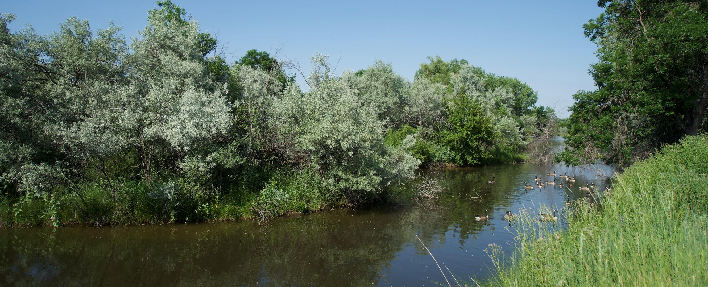
RIPARIAN ZONES
Riparian buffer zones are the "most diverse, dynamic, and complex" terrestrial habitat.
(Naiman et al. 1993)
Image by Karissa Courtney
Riparian ecosystems, though delicate, provide important ecosystem services:
Improve Water Quality and Quantity
Mitigate Flood Impacts
Provide Habitat
Provide Food Source
Notes:
Image Credit: Karissa Courtney – DEVELOP participant
Speaker Notes: Riparian ecosystems are an extremely important blend of aquatic systems as they transition to land. They perform various ecosystem services such as improving water quality, quantity, and can help mitigate flood impacts.
Riparian zones have unique plant communities that offer food sources and habitat for aquatic and terrestrial organisms and are the “most diverse, dynamic, and complex” terrestrial habitats. So, when invasive species enter riparian zones, they are not only threatening biodiversity, food sources, and habitat for many species, but can also impact local hydrology.
Bullet citation 1-2 : Ocampo et al. 2006
Bullet citation 3-4: Gregory et al. 1991)
Quote citation: Naiman et al. 1993

Slide 4
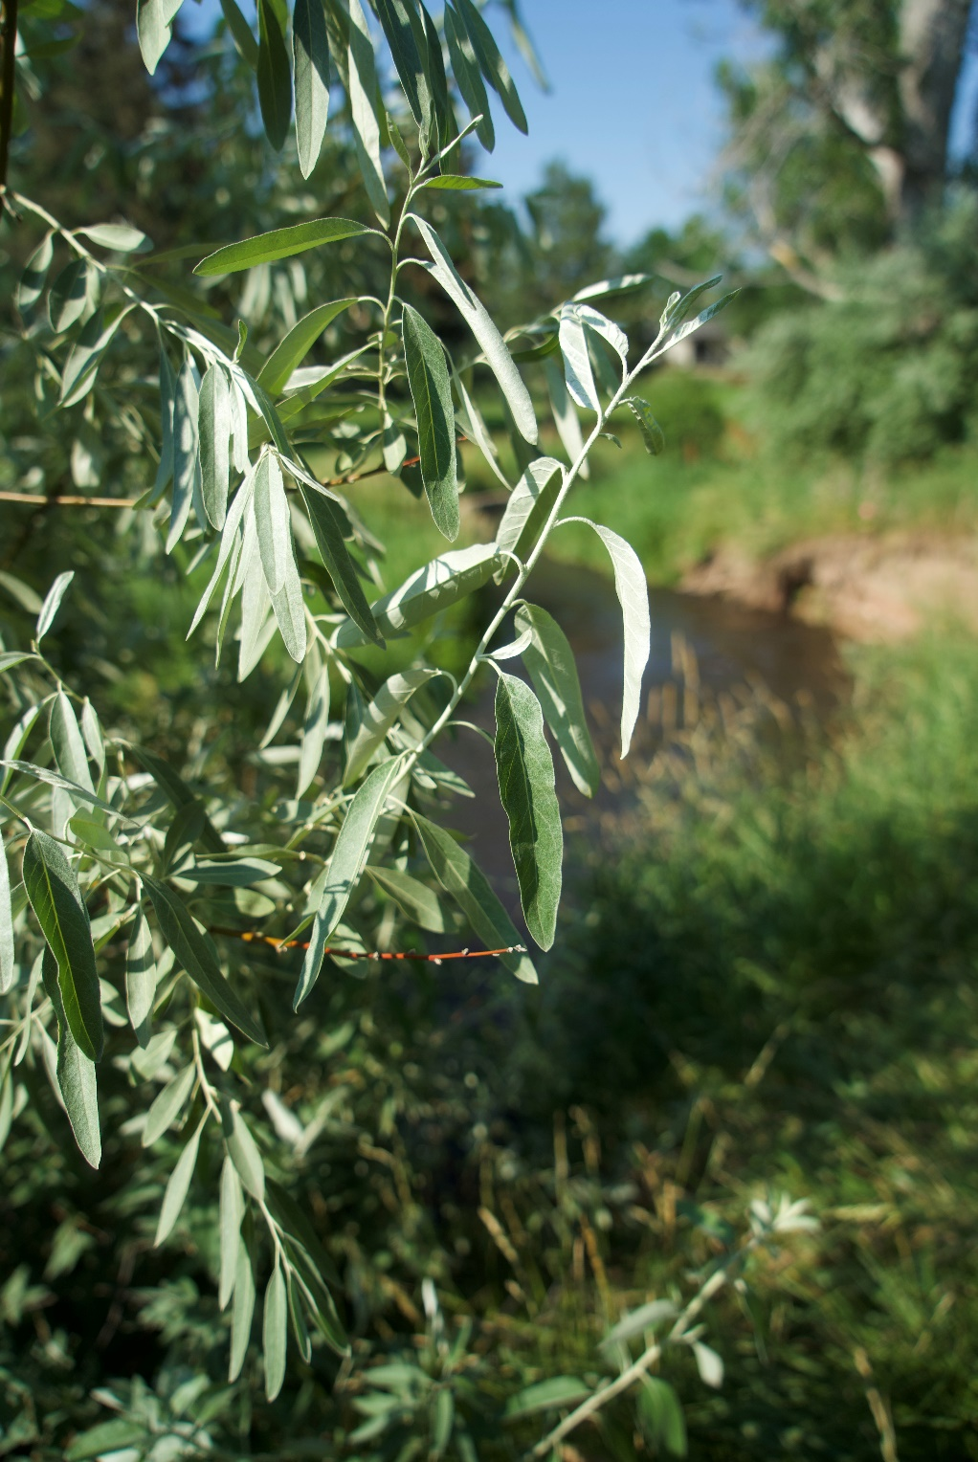
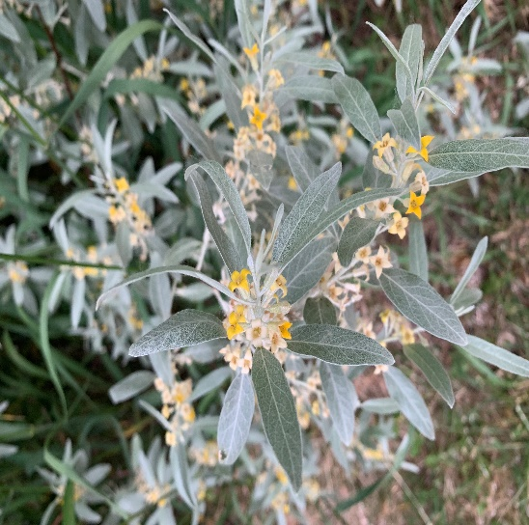
RUSSIAN OLIVE
Elaeagnus angustifolia
Deciduous, woody tree/shrub
Native to Europe and Asia
Introduced to the US in the 1800s
Often out-competes native vegetation
Dispersed by animal vectors and short-term flooding
Nitrogen fixing
Images by Karissa Courtney
Notes:
Image Credit: Karissa Courtney – DEVELOP participant (both)
Speaker Notes:
Russian olive (Elaeagnus angustifolia) is the species of interest for this project. It is a deciduous, woody tree/shrub that can grow very large. It is originally native to Europe and Asia, but was brought over to the US in the 1800s as an ornamental and a wind break for farmers. Russian olive often out-competes native vegetation in riparian areas. It primarily disperses its large seeds by animal vectors and shorter-term flooding (1.5 to 5-year floods). Finally, Russian olive is also a nitrogen fixer, which some studies have found can affect water quality when found near agricultural sites.
Bullet one-four citation: (Katz and Shafroth 2003)
Bullet five citation: (West et al. 2020)
Bullet six citation: (Mineau et al. 2011)

Slide 5
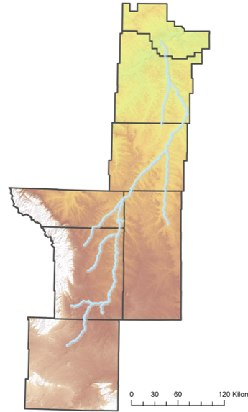
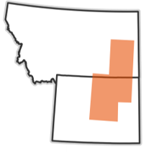
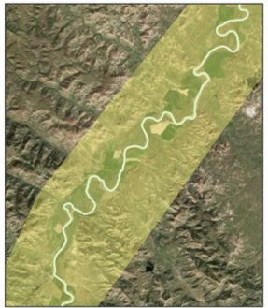
STUDY AREA
State Boundaries
County Boundaries
Powder River
Elevation (0-4020 meters)
Study Area Extent
Montana & Wyoming
Basin covers 31,080 km²
Semi-arid climate
Major water source for agricultural irrigation and ranching
0
30
60
120 km
Notes:
Speaker Notes: Our study area falls within the Powder River Basin, located in southeast Montana and northeast Wyoming. The study area extent was originally going to be the entire basin but was further refined to a riparian buffer zone following the Powder River (shown in the bottom left image). ​
​
The Powder River is a tributary of the Yellowstone River in Wyoming and Montana (Pizzuto 1994). The basin covers 31,080 km2 and is surrounded by the Laramie, Casper, and Bighorn Mountains (Bergquist 2007). The region is considered to have a semi-arid climate with annual precipitation of 30 – 41 cm a year (BLM 2003). The Powder River provides much of the irrigation water for agriculture and ranching in the region (Bergquist 2007). The river serves as a critical water source for farms, ranches, municipalities, and promotes biodiversity (BLM 2003).​

Slide 6
Russian olive Detection Map
Optical imagery, field data, and a digital elevation model
Analyze current distribution and percent cover to inform local decision-making
Geomorphology time series
Optical imagery from 1984-2021
Detect stream channel change and its relation to Russian olive
OBJECTIVES
Notes:
Transcript (Catherine):
Our project was broken up into two primary portions. Our partners wanted to better understand the current distribution patterns of Russian olive and the percent cover of Russian olive along the Powder River. Additionally, our partners wanted to understand the impact of Russian olive on stream channel change. Both objectives served to inform our partners and local stakeholders on the impacts of the local Russian olive invasion.
For the Powder River riparian zone in Wyoming and Montana:
1. a Random Forest Model was created to detect Russian olive. The model was built using 2020 Landsat 8 OLI imagery, 2020 Sentinel-2 MSI imagery, 2019 NAIP imagery, Lidar data, field data, and SRTM elevation data. From the RFM, we created a Russian olive distribution map and a percent cover map to inform local stakeholders of its presence.
2. For the second portion of our project, we created a geomorphology time series of the Powder River. In other words, we captured changes to the stream channel shape, size, and location over time. To do this, we used optical imagery from Landsat 8 OLI, Landsat 7 ETM+, and Landsat 5 TM with the temporal resolution of this portion of the project being from 1984 to present (2021). The goal of the time series was to inform local stakeholders of Russian olives impact on stream channel morphology, as the Powder River serves as a primary water resource for the region.

Slide 7
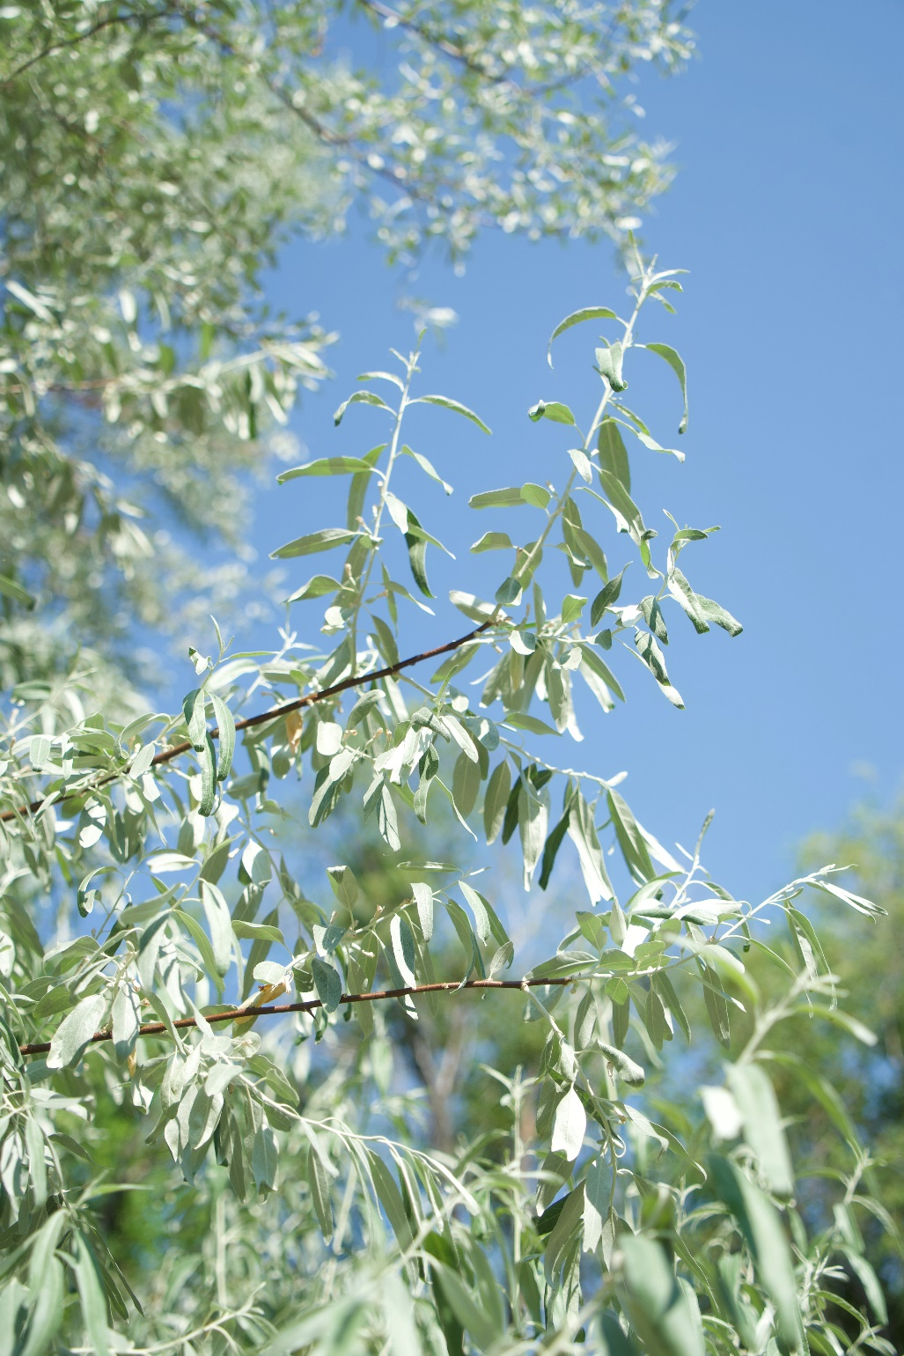
PARTNERS
Powder River County Weed Board (End user)
Tammy Van Tine, Weed Coordinator
Gay Ranch (End user)
Glenn Gay, Rancher
University of Northern Colorado (Collaborator)
Dr. Sharon Bywater-Reyes, Assistant Professor
Dr. Scott Franklin, Assistant Professor
USGS, Boulder, CO Office (Collaborator)
John Moody, Hydrologist
Image by Karissa Courtney
Notes:
Image Credit: Karissa Courtney – DEVELOP Participant
Speaker notes: Dr. Sharon Bywater-Reyes and Dr. Scott Franklin from the University of Northern Colorado collected and sent to the team Russian olive field data. The data were collected during May and June 2021. From the USGS Boulder Colorado Office, John Moody was helpful in providing expert knowledge of the Powder River—providing us with cross-sectional data and historical information such as flooding along the Powder River. Our end products will be used by Tammy Van Tine with the Powder River County Weed Board and by Glenn Gay from Gay Ranch. The results of our research will help inform decision making at the Powder River County Weed Board and at Gay Ranch.

Slide 8
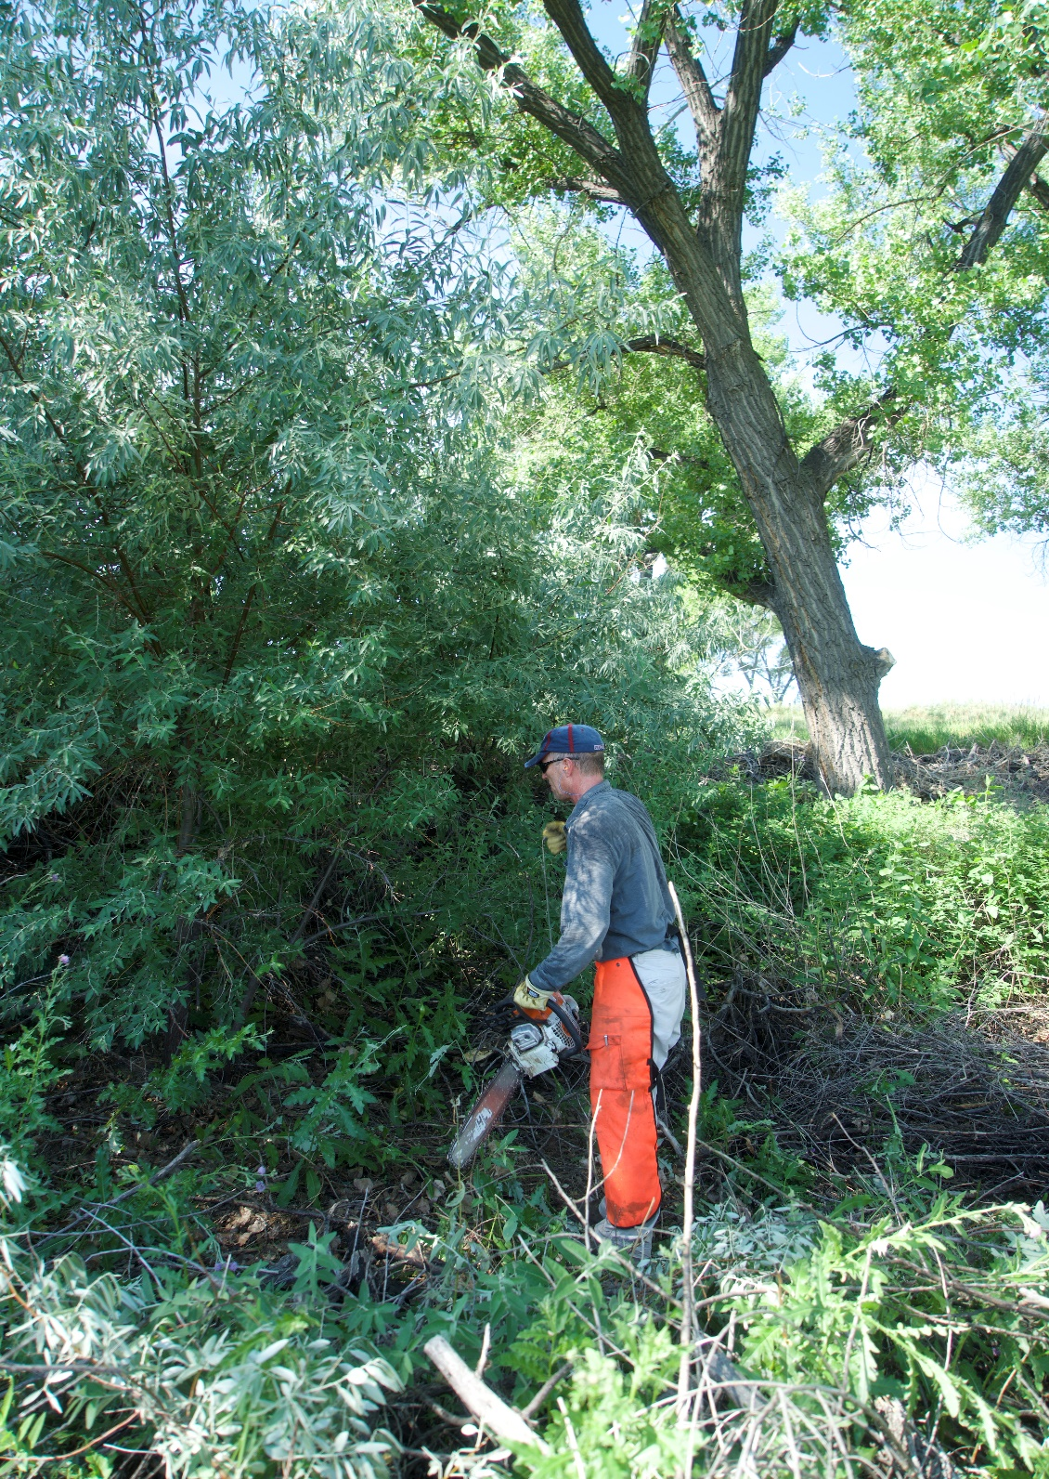
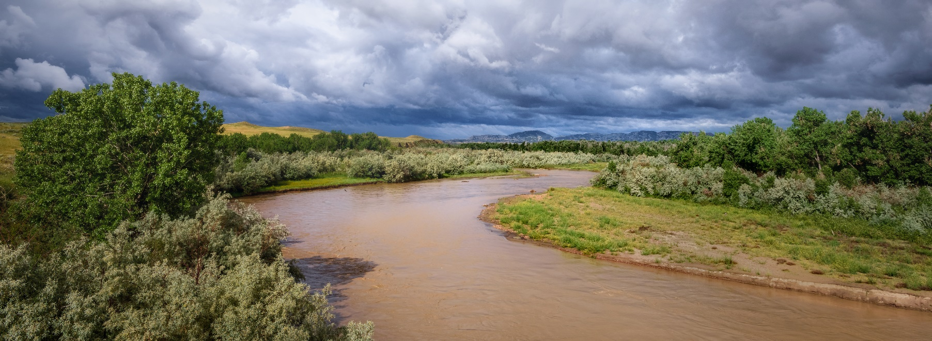
COMMUNITY CONCERNS
Critical water source
Accounts for a large portion of regional biodiversity
Impacts to local hydrology
Russian olive may impact stream channel dynamics
Image by Diana Robinson
Image by Karissa Courtney
Notes:
Image credit: Karissa Courtney – DEVELOP Participant
Image credit: Diana Robinson. (2017). Clouds over the Powder River near Broadus, Montana. CC By-NC-ND 2.0. Retrieved from https://www.flickr.com/photos/62501682@N00/35263274961
Speaker notes (Amy):
The presence of Russian olive has important implications for the Powder River community and local ecosystem. The Powder river basin is an important area to assess because it is a critical water source for many farms, ranches, and municipalities in the region. In addition, its riparian zone accounts for a large portion of regional biodiversity. With the presence of Russian olive, this invasive plant may impact the region by influencing stream channel dynamics, soil water availability, evapotranspiration, streamflow, sediment regimes, and ecosystem functions.

Slide 9
Data and Methodology
Notes:
Transitional slide
Speaker notes: Moving into the methodology section, we will first begin by discussing the remotely sensed data used in both parts of this project and later we will discuss briefly the methodology for each part of the project.

Slide 10
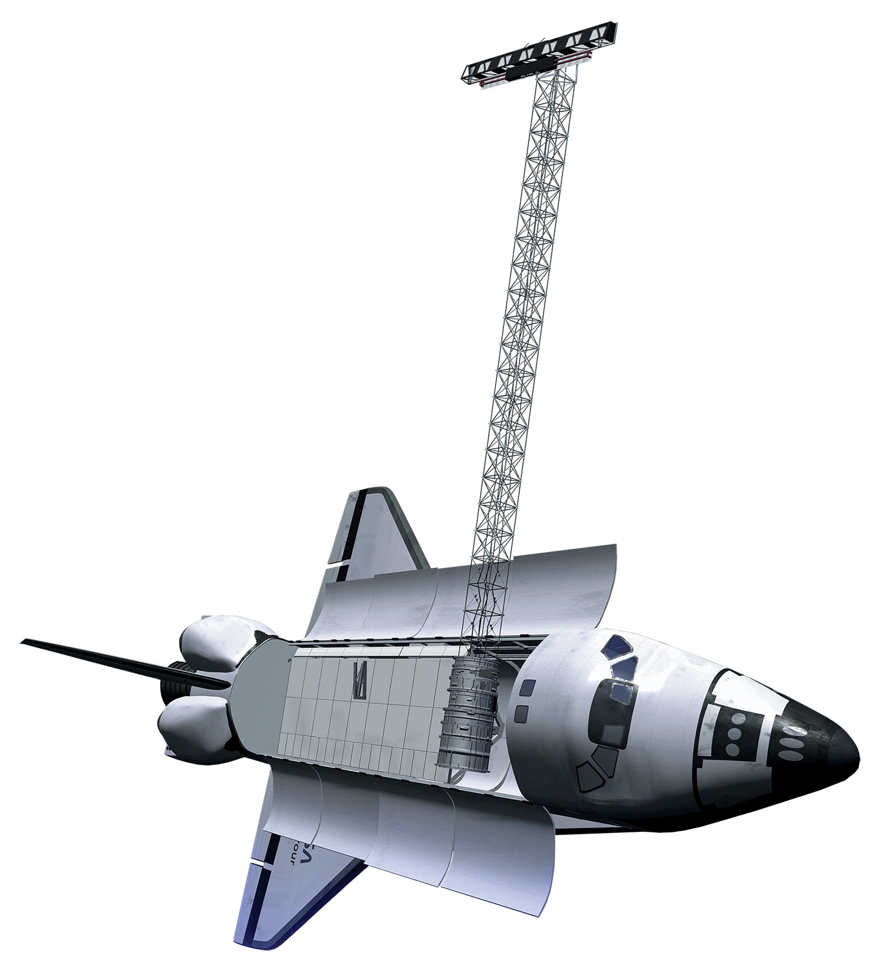
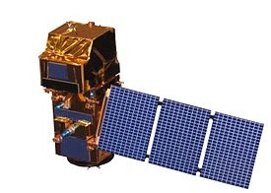
SATELLITES & SENSORS – RFM
Sentinel-2 MSI
Optical Imagery
SRTM
Elevation Data
NAIP
Visible Imagery
LiDAR
Canopy height
Landsat 8 OLI
Optical Imagery
Images by NASA, ESA
Notes:
Image Credit: USDA
Image credit: NASA, ESA (https://www.devpedia.developexchange.com/dp/index.php?title=List_of_Satellite_Pictures)
Speaker notes: For the random forest model, we started with National Agriculture Imagery Programs (NAIP) optical imagery from 2019 to train our model. Next, we collected recent Sentinel-2 MSI and Landsat 8 OLI optical imagery, from which we produced results from our random forest model. Finally, SRTM elevation data and LiDAR data were included as canopy height and topographical inputs.

Slide 11
SATELLITES & SENSORS – Geomorphology
Landsat 5 TM
Optical Imagery
Landsat 7 ETM+
Optical Imagery
Landsat 8 OLI
Optical Imagery
Images by NASA
Notes:
Image credit: NASA, all from DEVELOPedia (https://www.devpedia.developexchange.com/dp/index.php?title=List_of_Satellite_Pictures)
For the geomorphology portion of our project, we used visible imagery from the landsat 5, 7, and 8 missions. We collected data from 1984, the start of the Landsat 5 mission, to 2020 to represent the current state of the Powder River. To correct fro Landsat 7 ETM+ Scan Line Corrector failure, we simply omitted the year/did not use that year as part of our analysis.

Slide 12
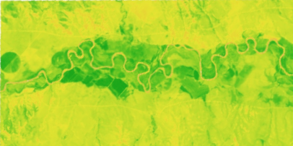
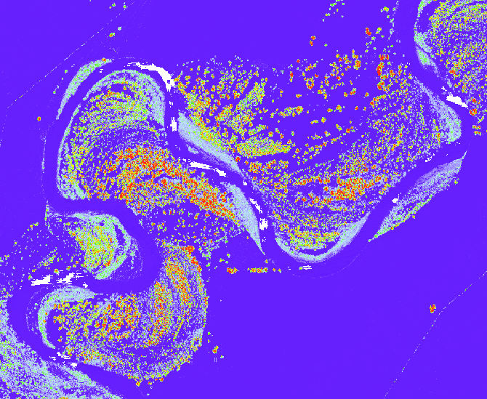
METHODOLOGY – DATA ANALYSIS
Russian Olive Distribution
Process satellite data
Collected Landsat 8 and Sentinel-2 in Google Earth Engine (GEE)
Collect ocular samples
Created sampling procedure in GEE
Run Random Forest model
Used predictor variables from literature review
Evaluate model result
Evaluated different predictor variables in R. Calculated summary statistics
Notes:
Speaker notes (Amy):
The first product we aimed to create was a Russian Olive distribution map that will display presence/absence of RO across our study area. To do so, we first processed the satellite data from Landsat 8 and Sentinel-2 in Google Earth Engine for input training of the Random Forest model. Then, we collected ocular samples of this satellite data and ran a Random Forest model in Google Earth Engine and R. We tested several predictor variables as inputs for the model based on a literature review. Next, we validated the model using field data collected by the University of Northern Colorado. Lastly, we calculated the percent coverage of Russian olive in the study area and ran a regression on the predictor variables we used in R.
The top image is a canopy height model, and the bottom image is false color composite of the Powder River using Landsat 8 OLI.

Slide 13
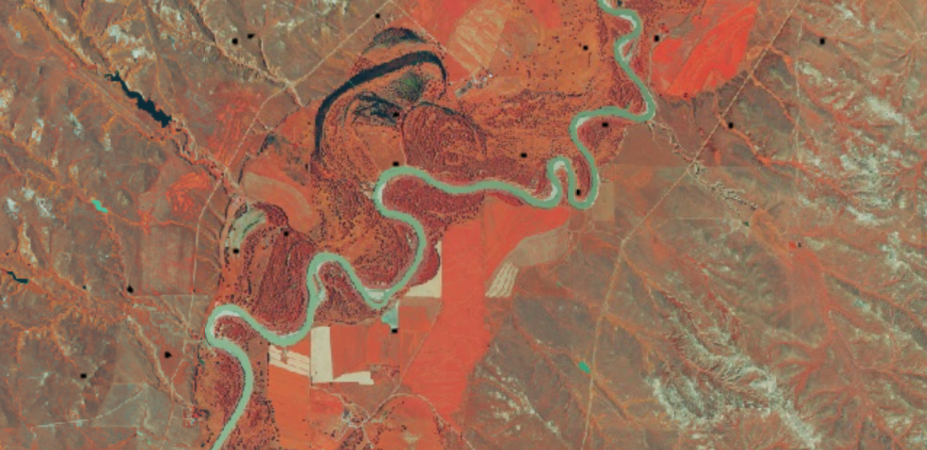
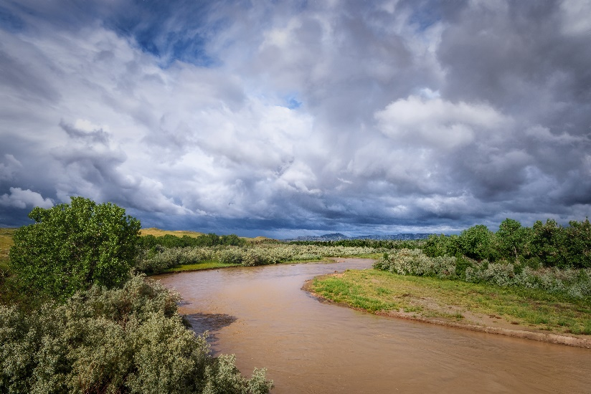
METHODOLOGY – DATA ANALYSIS
Stream Channel Time Series
Process satellite data
Collected Landsat 5, 7, 8
from 1984-2020
Track flow of Powder River
Utilized toolkits in Google Earth Engine and spectral indices
River geomorphology change
Visualized historical decadal changes in river to understand change over time
Image by Diana Robinson
Notes:
Image 2-- Diana Robinson. (2017). Clouds over the Powder River near Broadus, Montana. CC By-NC-ND 2.0. Retrieved from https://www.flickr.com/photos/62501682@N00/35263274961
Speaker notes: Amy
The second product we aimed to create was a stream channel time series to examine how the geomorphology of the Powder River is changing over time. Because Russian olive has the potential to influence hydrology and stream channel dynamics, we looked at the interactions between the physical shapes of the river and how its water and sediment processes are changing over time. To create the time series, we first processed the satellite data using Landsat 5, 7, and 8 from 1984-2020. The study period began in 1984 because Landsat 5 with the 30m resolution we are collecting for goes back to this date. Next, we used toolkits in Google Earth Engine and spectral indices to track the flow of the Powder River. Some indices used included MNDWI, NDWI, NDVI. Lastly, we created a time series animation that visualizes the historical decadal changes in the Powder River to demonstrate how it is changing over time.

Slide 14
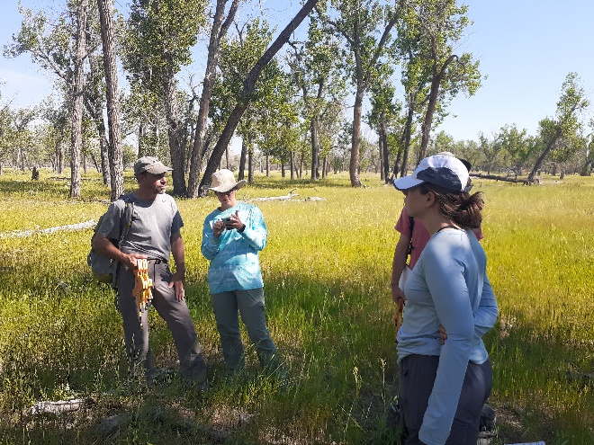
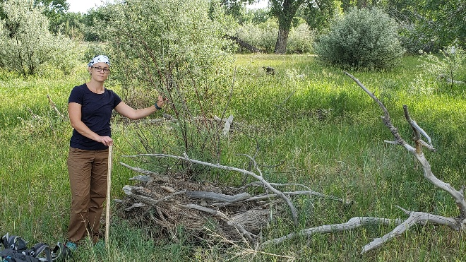
DATA COLLECTION – Field Data
Source | Data Product | Acquisition Method | Extent | Collection Date
University of Northern Colorado | % Cover of Russian olive | Ground sampling | 10m plots | June 2021
University of Northern Colorado | Canopy height | Ground sampling | 10m plots | June 2021
2021 Powder River Basin DEVELOP Team | % Cover of Russian olive (additional points) | GEE ocular sampling | 10m plots | June-July 2021
Images by Dr. Sharon Bywater-Reyes
Notes:
Image Credit: Sharon Bywater-Reyes, University of Northern Colorado (Partner Image)
Speaker notes: Our partner at UNC collected Russian olive % cover data in summer of 2021. UNC also collected LIDAR imagery which was used to develop our canopy height model. Our team also gathered data by ocularly sampling throughout the study area using Google Earth Engine.

Slide 15
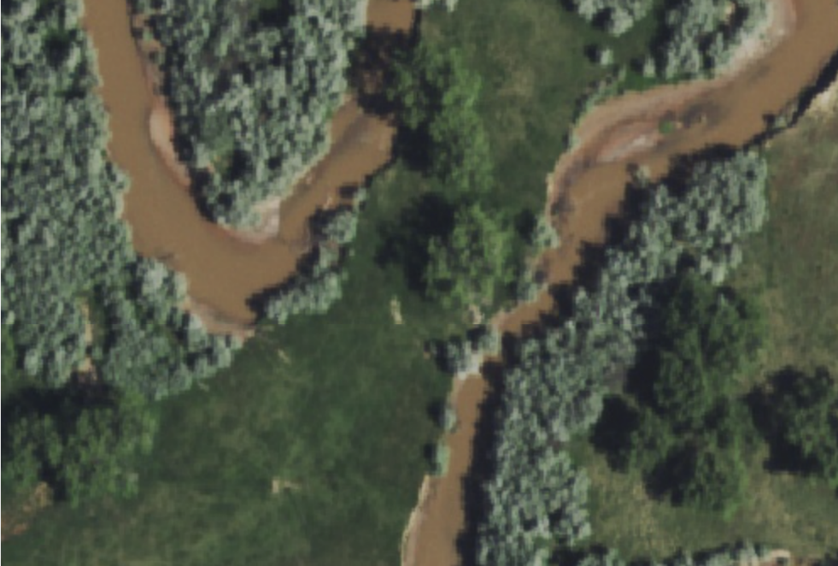
DATA COLLECTION – Ocular Sampling
Powder River
Russian olive
Grass or other small herbaceous plant
Cottonwood
Notes:
Image Credit: 2021 Powder River Basin DEVELOP Team; GEE, NAIP true imagery 2019
Speaker notes: The satellite image shown here is NAIP 2019 imagery showing an aerial view of part of our study area. This shows our ocular sampling methodology. In this photo there is Russian olive, cottonwood, and grass/other small, herbaceous plants. The ocular sampling data, along with the % cover data from UNC, was used as training data to build our random forest model.

Slide 16
Results and Conclusions
Notes:
Transition slide between topics.
Speaker notes: now moving into the results and conclusions section, we will first begin by discussing the results from our Russian olive detection map and will discuss the results of the geomorphology section after. Later we will discuss errors and uncertainties and suggested future work.

Slide 17
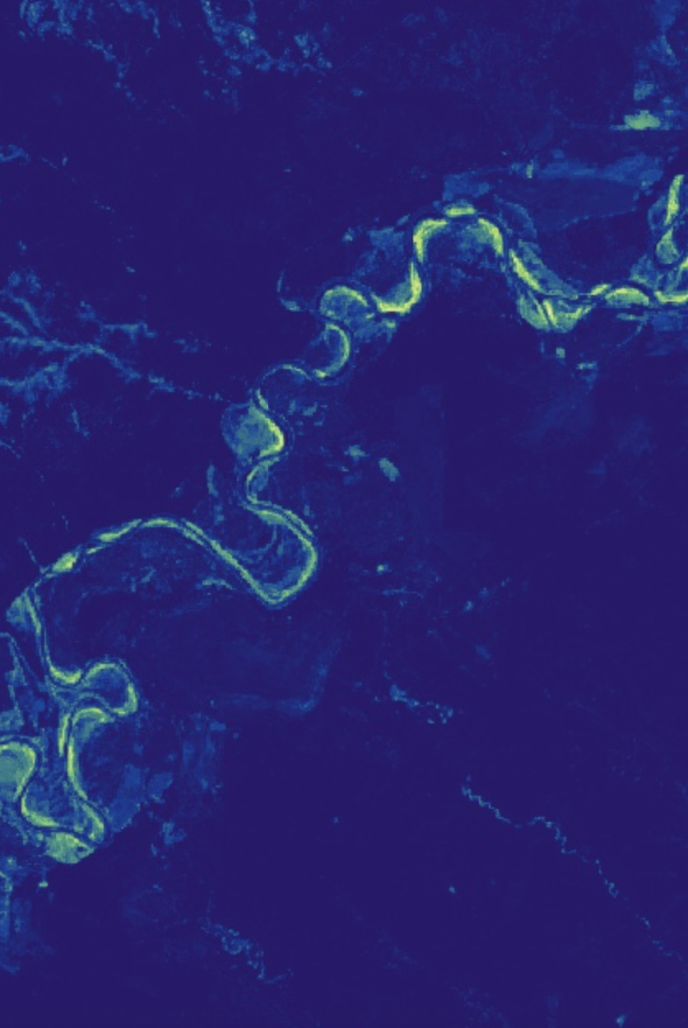
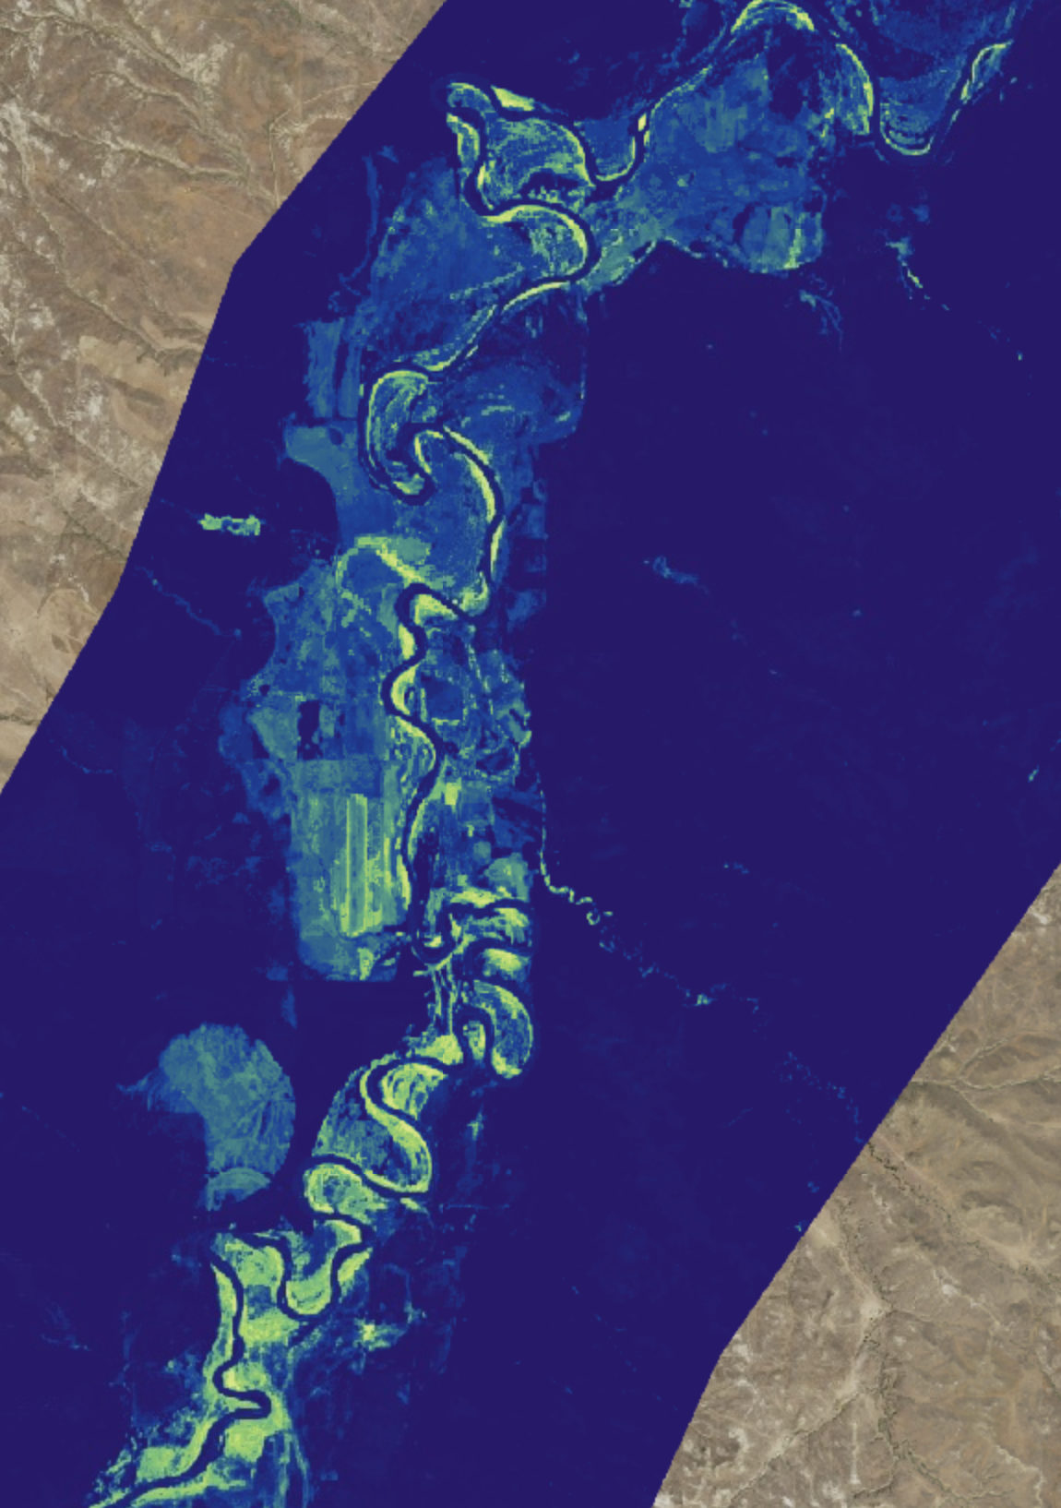
RESULTS – Percent Cover
Successfully differentiated Russian olive
Russian olive is more prevalent in the Montana portion of the study area than in Wyoming
Placeholder for an image of model output
% Russian Olive
100%
0%
Notes:
Image Credit: Random Forest Model Output, GEE – DEVELOP Team
We successfully used Sentinel-2 imagery and Random Forest modeling to differentiate Russian olive from other species, including Cottonwood, Sage, and grass species. This was the primary goal of our project and resulted in valuable information about Russian olive distribution across the Powder River study area.
This distribution information has yielded some insights on Russian olive presence in the Powder River basin. We found that Russian olive is far more prevalent in the northern part of the study area. The model showed that Russian olive is well established along large sections of the Powder River in Montana, but in Wyoming, there are far fewer areas where Russian olive is dominant.

Slide 18
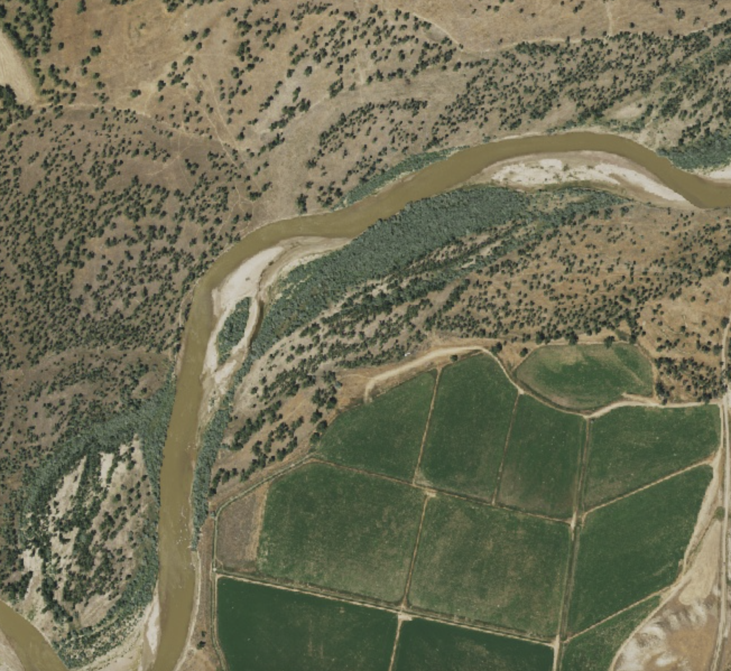
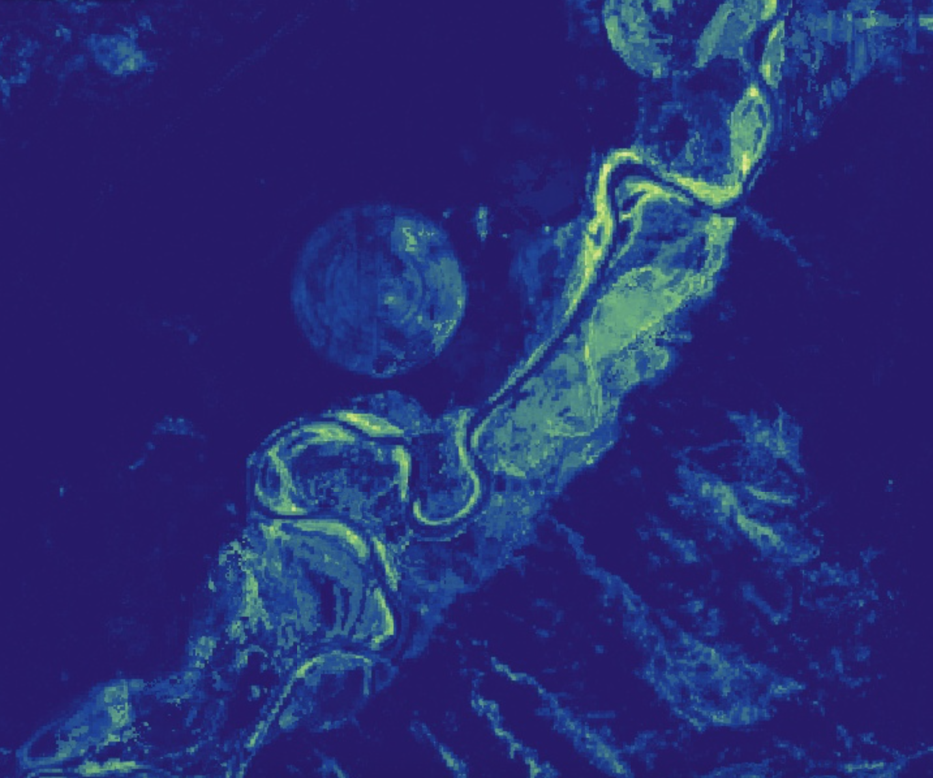
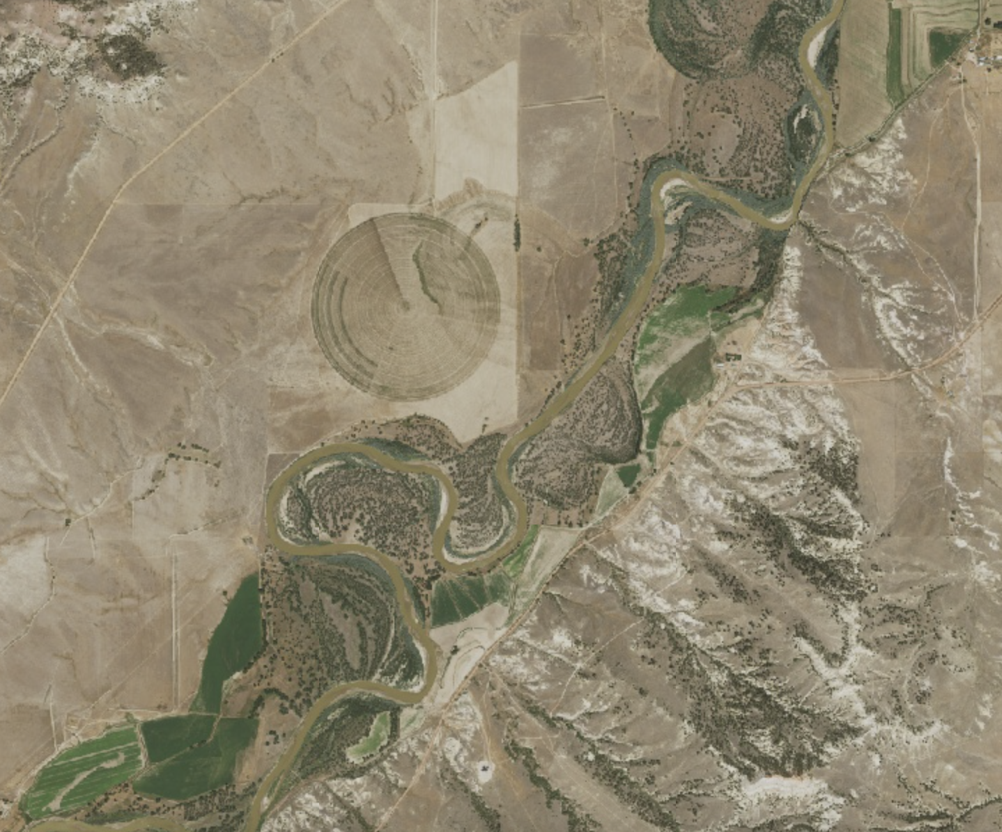
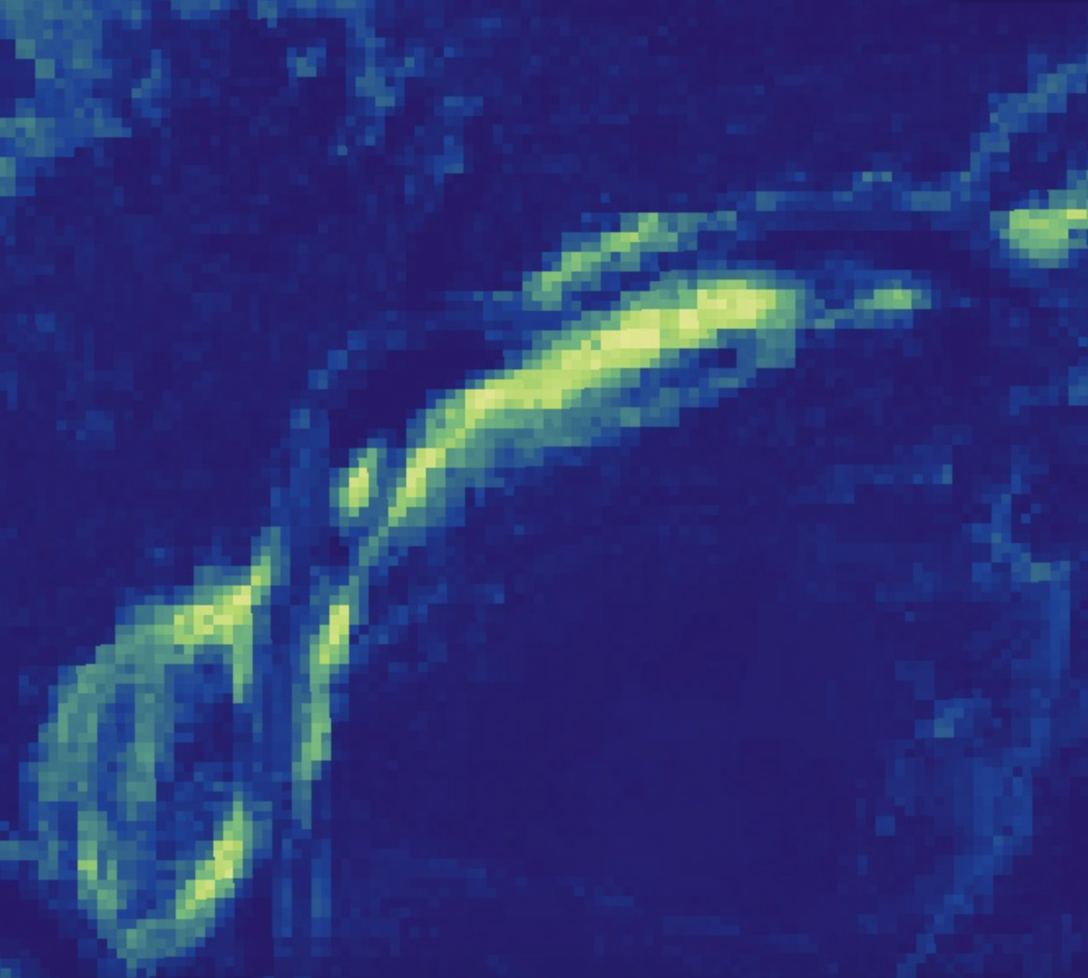
RESULTS – Percent Cover
100%
0%
Notes:
Photo credits: 1) NAIP 2019 imagery collected in GEE by DEVELOP Team, 2) Model output results in GEE derived from Landsat-2 by DEVELOP Team
On the left you can you can see where we know Russian olive to be present. It's distinctive color and texture is clear from this image. On the right is our model output. Dark blue is 0% Russian olive and yellow is 100% Russian olive. As you can see, the model successfully picked up the Russian olive in this area.
(once animated photos come in) : Our model runs well in most areas, but there are still some areas where it isn't performing well. Again, on the left is the NAIP imagery and on the right is our model output. Here, you can see a crop circle and a field, and the model is picking up Russian olive in those areas, which is incorrect.

Slide 19
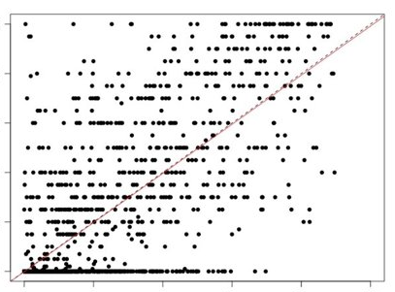
RESULTS – Percent Cover
Random forest model has R² value of 0.63 and RMSE value of 15.44 % cover
Chose to use RMSE as classification threshold
Tasseled cap brightness between the summer and spring
Fall tasseled cap greenness
100
Russian olive Predicted vs. Actual
Fall tasseled cap brightness
80
Fall normalized difference vegetation index
60
Actual
Spring narrow near-infrared
40
Spring tasseled cap wetness
20
0
0
20
40
60
80
100
45
55
65
75
Predicted
%IncMSE
Notes:
Random forest is a good algorithm for both classification and regression problems and generates an internal unbiased estimate of the generalization error as the model building progresses. Our final model produced an r-squared value of 0.63 or 62.72% and a root mean squared error value of 15.44 % cover.
There are many ways to choose a classification threshold, and we decided to use the RMSE. This means that anything below 15.44 is considered Russian olive absence. The graph on the right indicates the increase of the Mean Squared Error, or how much our model accuracy decreases if we leave out that variable.
Our top predictors included difference in tasseled cap brightness between the summer and spring (SMmSP_TCB_difference), fall tasseled cap greenness (FA_TCG), fall tasseled cap brightness (FA_TCB), fall normalized difference vegetation index (FA_NDVI), spring narrow near-infrared band (SP_NarrowNIR), and spring tasseled cap wetness (SP_TCW).

Slide 20
RESULTS – Percent Cover
Partial Dependency Plots
0 10 20 30 40 50
0 10 20 30 40 50
0 10 20 30 40 50
Partial Dependence
-1000
0
1000
2000
3000
4000
3000
4000
5000
6000
7000
8000
9000
-4000
-3000
-2000
-3000
0
Fall tasseled cap greenness
Fall tasseled cap brightness
Spring tasseled cap wetness
0 10 20 30 40 50
0 10 20 30 40 50
0 10 20 30 40 50
Partial Dependence
-3000
-2000
-1000
0
1000
2000
3000
1000
2000
3000
4000
0.0
0.2
0.4
0.6
0.8
Tasseled cap brightness between the summer and spring
Spring narrow near-infrared
Fall normalized difference vegetation index
Notes:
Plots from model output in RStudio
[[Notes: Friedman’s partial dependence plots are based on the following idea: consider an arbitrary model obtained by fitting a particular structure (e.g., random forest, support vector machine, or linear regression model) to a given dataset D.]]
Partial dependency functions can tell us how the value of a variable influences the model predictions after the influence of all other variables has been "averaged out".
These figures present plots of partial dependence functions for the variables SMmSP_TCB_difference, FA_TCG, FA_NDVI, FA_TCB, SP_NarrowNIR, and SP_TCW. The plots show that all variables influence the model where regression is increasing and have no influence/less influence where regression is flat-lining. Overall, our predictor variables performed very well.
Partial dependence is on the y
Index name is on the bottom

Slide 21
RESULTS – Percent Cover
Percent cover based on different classifications
Classification | RMSE (15.44) | 20 | 30 | 40
Present | 7.39% | 5.40% | 2.45% | 1.20%
Absent | 92.61% | 94.60% | 97.55% | 98.80%
Notes:
Table of percent Russian olive presence and absence based on different levels of classification from our RMSE (about 15.44) to 40. What this means is we calculated the percent of RO by assuming that anything less than the classification number was zero percent Russian olive cover. So, any presence of Russian olive that was less than 40%, 30%, 20% and 15.44%, for example, was essentially taken out and assumed to be zero.

Slide 22
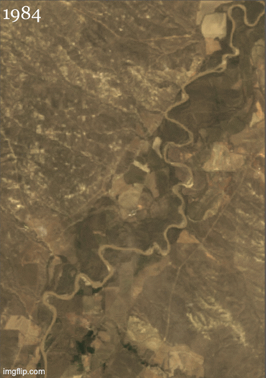
RESULTS – Geomorphology
Stream channel did not change much in most locations
Notable change in image to the right
Change could be due to multiple factors such as flooding, human-induced water diversions, flood events, presence of ice, and human development along the river
Causes are outside the scope of this project
Stream channel change just north of Broadus, MT.
Notes:
GIF credit: Landsat 5,7, 8 imagery from GEE. GIF by Karissa Courtney made on imgflip.com
The stream geomorphology aspect of our project revealed how the Powder River has changed over time from 1984-2019. Change in the stream channel was constant on an annual scale but is accelerated or reduced in some years. The change observed in the stream channel is influenced by a range of factors, including the presence of winter ice, human development, water diversions, and flooding, but we can't say for certain that Russian olive helped to prevent channel change where it's been long established.
Citations for causes of river change: (Wang et al., 2008), (Hajdukiewicz et al., 2016), (Best et al. 2018), (Gregory et al., 1992).

Slide 23
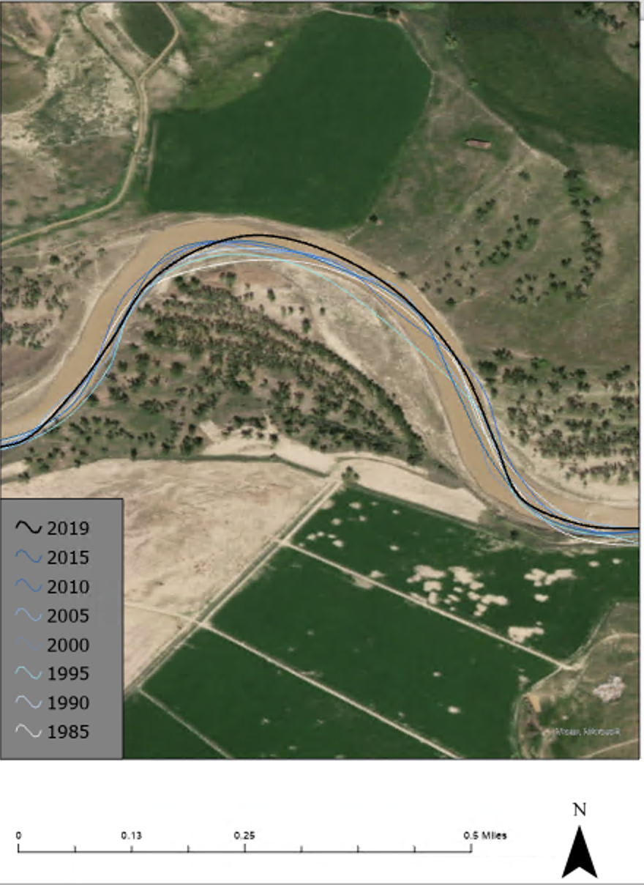
RESULTS – Geomorphology
Notes:
Figure by DEVELOP Team using ArcPro
Here is part of the study area zoomed in, along the Gay Ranch in-between Moorehead and Broadus, MT. Each line represents a different year for where the river was flowing derived from Landsat active binary images. An active masked binary layer is a combination of a wetted channel mask and alluvial deposit mask.
As you can see there wasn't much change over the 34-year time-period in this area of the river.

Slide 24
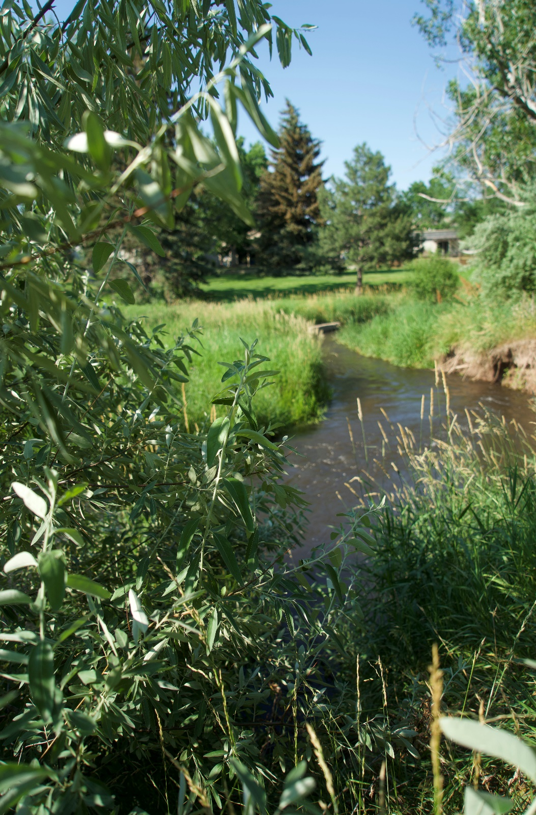
CONCLUSIONS
Frequent flooding is associated with Russian olive establishment
Future removal treatments: Wyoming, areas of frequent flooding
Russian olive does not appear to have an influence on stream channel morphology
Russian olive likely decreased stream channel change
Image by Karissa Courtney
Notes:
Photo Credit: Karissa Courtney – DEVELOP Participant
One of our biggest goals was to broadly understand the distribution of Russian Olive on the Powder River, and what factors have influenced that distribution. This information will help our partners understand where Russian olive currently is along the Powder River and where it may be spreading in the future. Our results agree with prior work which suggests that frequent floods are associated with a higher chance of Russian olive establishment (West et al. 2020). This is likely because flooding acts as a dispersal vector for Russian Olive.
Our partners have done work to remove Russian olive in the past, with varying degrees of success. Our work has shown that removal treatments should be focused on Wyoming. This is because there is less Russian olive present, making removal more feasible and reducing the chance that removal could negatively impact the native bird community. Any areas along the Powder River in Wyoming which also frequently flood should be areas of focus, as they will be most susceptible to rapid Russian olive invasion.
Our examination of stream geomorphology at the Powder River revealed that flooding most influenced stream channel change. However, we did find that Russian olive presence may have decreased stream channel change in some areas. This is likely due to the dense, woody thickets Russian olive is known to produce. These areas of concentrated woody vegetation have the affect of anchoring the stream bed and preventing shifts in the stream channel. This effect could become more exaggerated as Russian olive establishment continues.

Slide 25
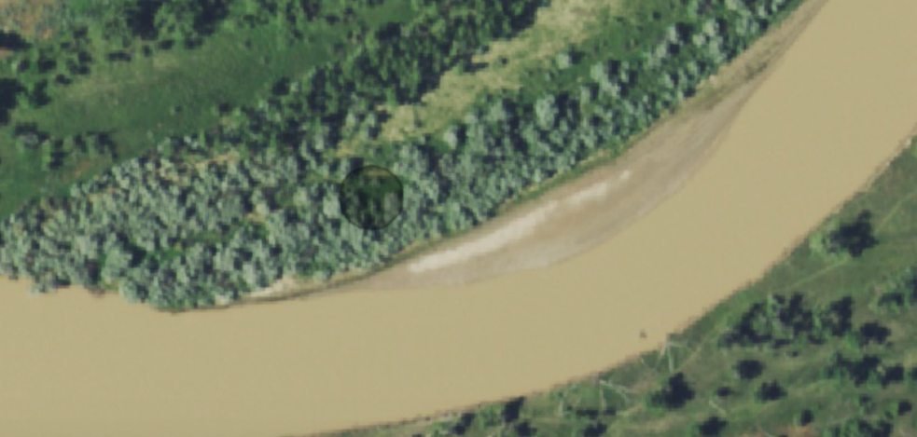
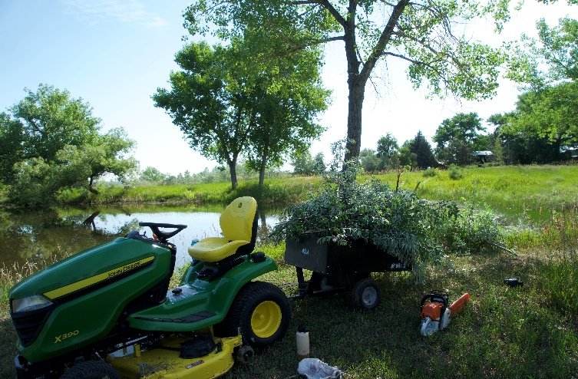
ERRORS & UNCERTAINTIES
Russian olive under larger tree canopies cannot be detected by most sensors
Field data was only collected in a small part of the study area
Human errors introduced by ocular sampling
Limited by available spatial resolution of sensors
Image by Dr. Sharon Bywater-Reyes
Image by Karissa Courtney
Notes:
Left: Image by project partner, Sharon Bywater-Reyes, Right: Image by Karissa Courtney – DEVELOP participant
Some uncertainties introduced include Russian olive percent cover under larger tree canopy such as cottonwood, which can't be detected by most sensors. Additionally, field data used to train our model were collected in a small area while the model was applied to a large area. Human error was introduced by ocular sampling and assessing presence of Russian olive. There are also limitations to this project due to available spatial resolution of sensors used. Furthermore, our model used data derived from Sentinel-2 MultiSpectral Instrument (MSI) imagery, which provided us with a spatial resolution of 20 meters.

Slide 26
Advisors:
Dr. Paul Evangelista
Dr Catherine Jarnevich
Dr. Anthony Vorster
Peder Engelstad
Nicholas Young
Brian Woodward
Partners
Dr. Sharon Bywater-Reyes
Dr. Scott Franklin
John Moody
Glenn Gay
Tammy Van Tine
Scott Cunningham, Colorado DEVELOP Fellow
This material contains modified Copernicus Sentinel data (2020), processed by ESA.

Slide 27
REFERENCES
Best, H., McNamara, J.P., and Liberty, L. (2018). Association of ice and river channel morphology determined using ground-penetrating radar in the Kuparuk River, Alaska. Arctic, Antarctic, and Alpine Research 37(2), 157-162. https://doi:10.1657/1523-0430(2005)037[0157:aoiarc]2.0.co;2
Gregory, S.V., Swanson, F.J., McKee, W.A., and Cummins, K. (1991). An ecosystem perspective of riparian zones. BioScience 41(8), 540-551. https://doi:10.2307/1311607
Gregory, K.J., Davis, R.J., and Downs, P.W. (1992). Identification of river channel change due to urbanization. Applied Geography 12, 299-318. https://doi:10.1016/0143-6228(92)90011-b
Hajdukiewicz, H., Wyzga, B., Mikus, P., Zawiejska, J., and Radecki-Pawlik, A. (2016). Impact of large flood on mountain river habitats, channel morphology, and valley infrastructure. Geomorphology 272(1), 55-67. https://doi.org/10.1016/j.geomorph.2015.09.003
Katz, G.L. and Shafroth, P.B. (2003). Biology, ecology, and management of Elaeagnus angustifolia L. (Russian olive) in western North America. Wetlands 23(4), 763-777. https://doi.org/10.1672/0277-5212(2003)023[0763:BEAMOE]2.0.CO;2
Mineau, M.M., Baxter, C.V., and Marcarelli, A.M. (2011). A non-native riparian tree (Elaeagnus angustifolia) changes nutrient dynamics in streams. Ecosystems 14, 353-365. https://doi.org/10.1007/s10021-011-9415-0
Naiman, R.J., Decamps, H., Pollock, M. (1993). The role of riparian corridors in maintaining regional biodiversity. Ecological Applications 3(2), 209-212. https://doi:10.2307/1941822
Ocampo, C. J., Sivapalan, M., Oldham, C. (2006). Hydrological connectivity of upland-riparian zones in agricultural catchments: Implications for runoff generation and nitrate transport. Journal of Hydrology. Volume 331, Issues 3–4, 643-658, ISSN 0022-1694. https://doi.org/10.1016/j.jhydrol.2006.06.010.
Wang, Z., Wang, Z., and de Vriend, H.J. (2008). Impact of water diversion on the morphological development of the Lower Yellow River. International Journal of Sediment Research 23, 13-27. https://doi:10.1016/s1001-6279(08)60002-5
West, N.M., Reinhold, A.M., Poole, G.C., and Espeland, E.K. (2020). Flood dynamics dictate distributions of Elaeagnus angustifolia L. (Russian olive) on a riverine floodplain. Biological Invasions 22, 3493-3499. https://doi.org/10.1007/s10530-020-02352-z

