Slide 1
Technical Imagery 2018 Summer
Project Short Title here
Node Name here

Slide 2
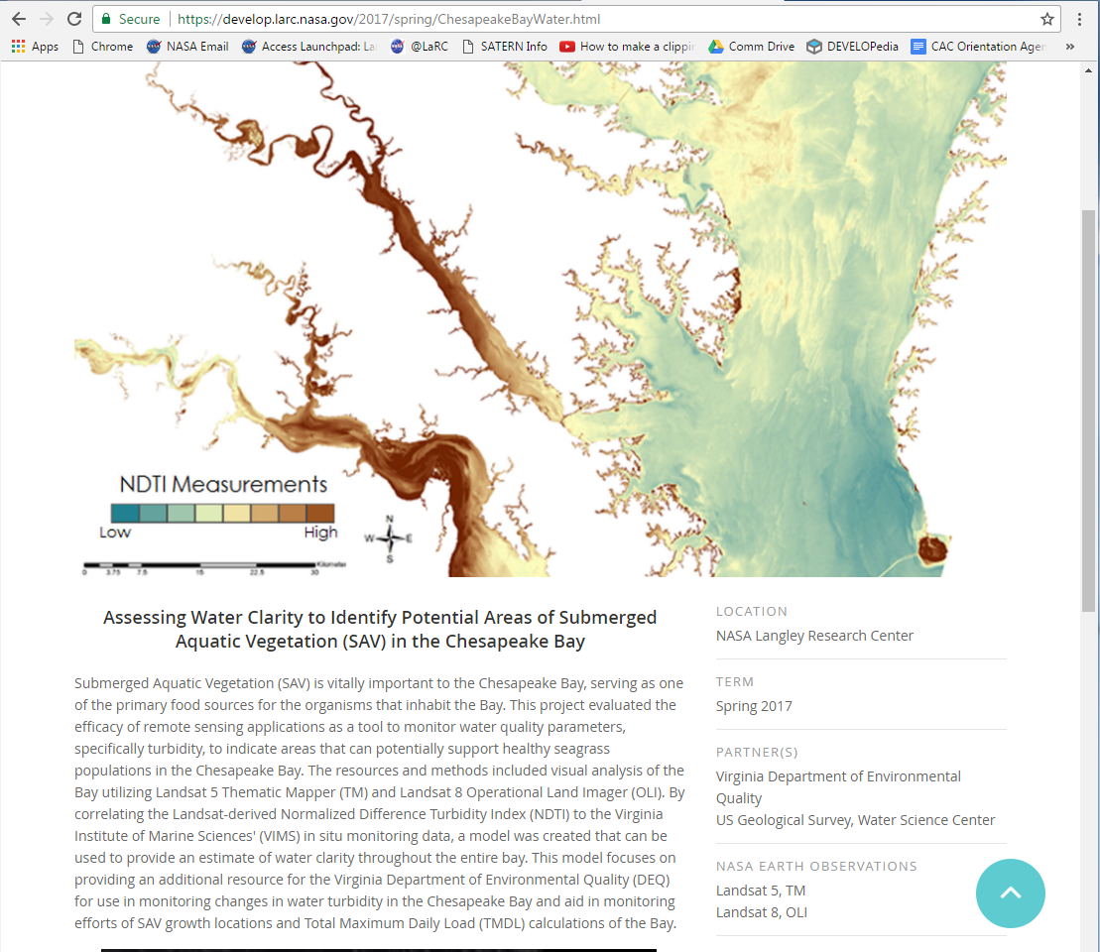
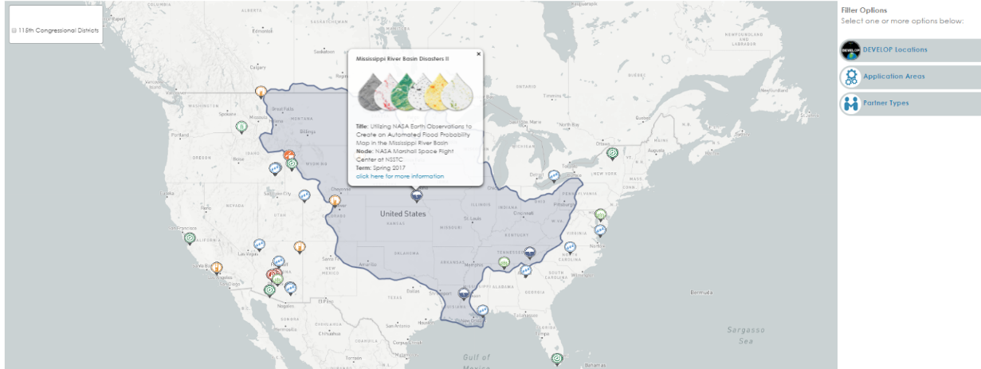
Purpose & Overview
This image should be composed of attractive, processed imagery of your study area that displays and explains your project results. This image will be used on your project’s page of the DEVELOP website, interactive mapper pop-up, and any future purposes that visual results are needed. This image is your opportunity to explain the science of your project. Be sure to include a scale bar, north arrow, and a legend that can stand alone. Meaning if you were to read the legend without the visual map you would still understand what information it is providing.
Project page on DEVELOP website
DEVELOP Interactive Mapper pop-up
Delete this slide before submission
Notes:
These notes should be thorough enough for someone not familiar with the project to clearly present the material.
NOTE: For every image on the slide include an image source in the speaker notes (ex. URL; Name, Affiliation, etc.)
Image Source: http://commons.wikimedia.org/wiki/File:Claude_Monet_-_The_Magpie_-_Google_Art_Project.jpg

Slide 3
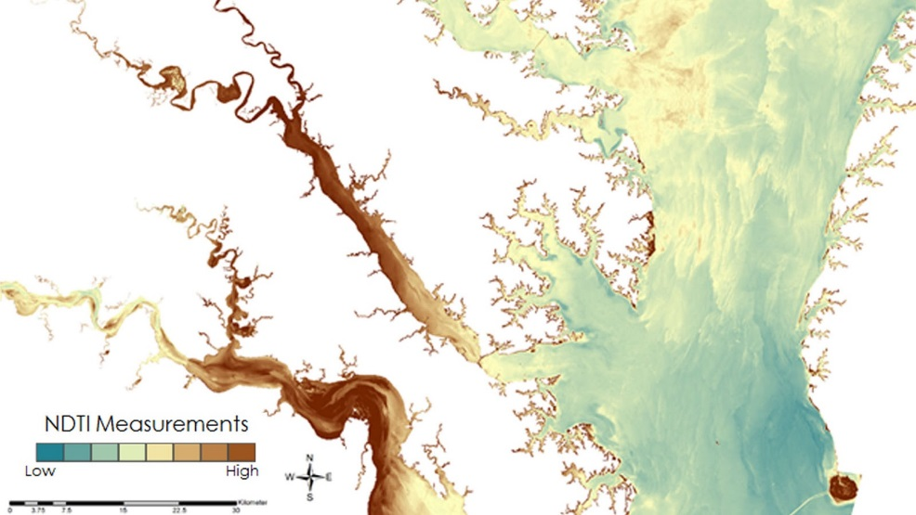
Technical Image Checklist: Requirements
High-resolution 1920 x 1080 (over 300 dpi) – landscape orientation
White background
Saved as a JPEG or PNG
Map resources available on DEVELOPedia
Image is derived from NASA sensor data
Not from an outside source
Not a photograph of the team or landscape
Exception: NCEI projects using CDRs
Why? DEVELOP is a NASA-funded program that is focused on highlighting NASA data applications. These images are used by NASA in a variety of communication materials.
1920 px
1080 px
At least one image provided is derived from recent data (2017-2018)
Text is separate from image and typed in PowerPoint (no exported text images)
Some kind of processing has taken place
Not just a raw satellite image or simple re-order of spectral bands (false color composite)
The team actually created the image
There can be NO outside content included (what we mean by this is something some non-DEVELOP person processed/created/picture they took) – including non-NASA data along with NASA data in the creation of your image is fine, but you can’t take a map or diagram someone else made and include it.
Delete this slide before submission
Notes:
These notes should be thorough enough for someone not familiar with the project to clearly present the material.
NOTE: For every image on the slide include an image source in the speaker notes (ex. URL; Name, Affiliation, etc.)
Image Source: http://commons.wikimedia.org/wiki/File:Claude_Monet_-_The_Magpie_-_Google_Art_Project.jpg

Slide 4
Technical Image Guidelines
Do not…
Title your legend “Legend”
Be sloppy with labels overlapping or misspellings
Include metadata (datasets, who made the map, what the projection is, etc.)
Import text as a photo
Do…
Make sure if you decide to include text that it is legible and you type it into the slide. (No imported text)
Consider the scale/shape of the image – feel free to zoom in to a particularly interesting part of the study area that fits the dimensions listed above
Pick your symbology wisely
Be thoughtful with color schemes (remember color blind people and be kind to viewers eyes as some colors
should not be next to each other!)
Coloration: Sequential and qualitative are great, diverging should be used carefully
Have multiple people look at the imagery with a critical eye
Be careful about scale bars. You can put the bar part in the image, however the numbers and units text must be typed in PowerPoint
Use descriptive legends
You can…
Include text and legends as long as they are legible, or include no text if you prefer. All text must be typed as separate objects in PowerPoint. (No imported text)
Exclude the North arrow if North is directly up
Include insets to give a greater context of where in the US or world you are zoomed in
If your study area shape is inherently portrait-style, get creative how to make your image in landscape – duplicate the image to make a time series, zoom in on one specific area, etc.
Delete this slide before submission
Notes:
These notes should be thorough enough for someone not familiar with the project to clearly present the material.
NOTE: For every image on the slide include an image source in the speaker notes (ex. URL; Name, Affiliation, etc.)
Image Source: http://commons.wikimedia.org/wiki/File:Claude_Monet_-_The_Magpie_-_Google_Art_Project.jpg

Slide 5
Delete this box and place image here
In the case you’d like to submit more than one, duplicate this slide
Project Short Title Here
Caption: Make sure to include what NASA satellite and sensor the image is derived from and the date the data were collected by the satellite. Also include what the image is (ex. NDVI, etc.), and how it can be used for decision making. 25 word limit.
Metadata Tags: List any keywords, or project participant names that you would like included in the photo’s metadata.

