Slide 1
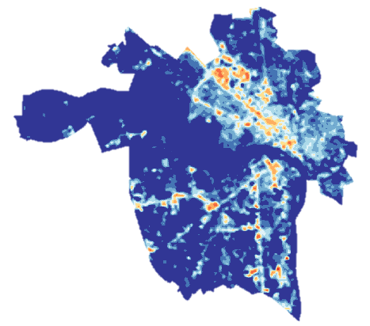
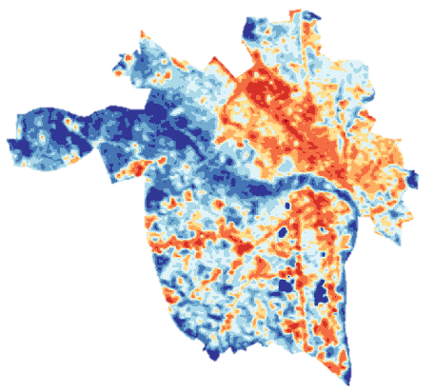
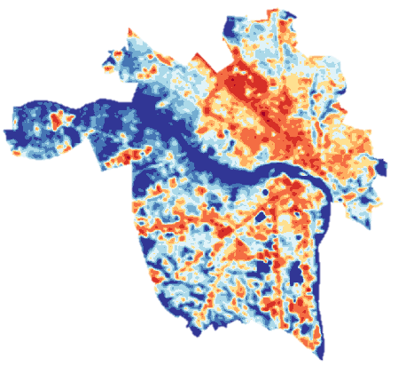
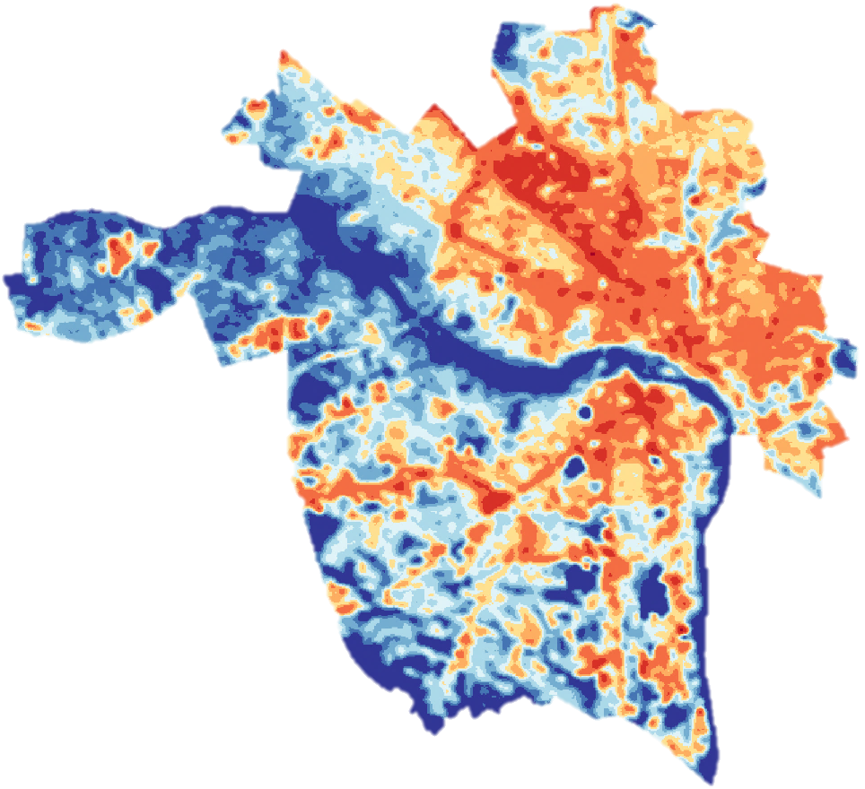
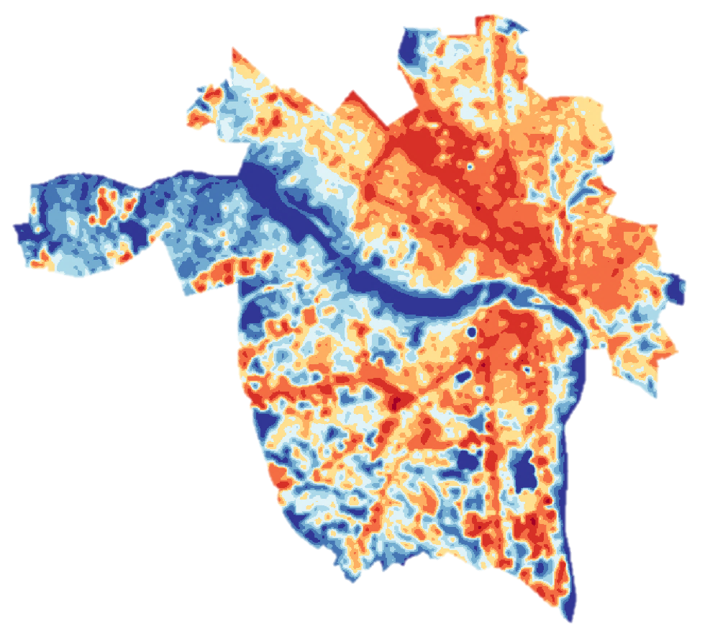
Synthesizing Temperature, Reflectance, and Land Change to Provide Spatial and Temporal Temperature Analyses in Richmond, Virginia
Abstract
Methodology
Cities around the world are adopting adaptation and mitigation strategies for extreme heat events, which are projected to increase in upcoming years. As Richmond, Virginia continues to grow, its residents are more likely to experience more extreme temperatures resulting from the urban heat island effect. An increase in impervious surfaces such as asphalt and concrete, which retain more heat energy than the natural environment, drive this effect. Efforts to alleviate these problems include supporting interventions by local non-profits, including Groundwork RVA, and working with the Richmond City Planning Office to prioritize increased tree cover in the area. In this project, we used Landsat 5 Thematic Mapper (TM), Landsat 8 Operational Land Imager (OLI) and Thermal Infrared Sensor (TIRS), and Terra Advanced Spaceborne Thermal Emission and Reflection (ASTER) data to analyze these patterns in land surface temperature. To inform these patterns, we also examined the significance of the city’s infrastructure and land use choices. Land cover was assessed for selected years using data from the Virginia GIS Clearinghouse and the National Agriculture Imagery Program. Heat vulnerability indicators and land cover data were synthesized using US Census and health records and Centers for Disease Control (CDC) Social Vulnerability Indicators. These indicators depict the sensitivity of the population to extreme heat and identify where vulnerable demographics reside. Along with identifying these areas of concern, our results indicated that the urban heat profile of Richmond has dramatically increased and expanded in the last twenty years. Groundwork RVA can use temperature assessment maps along with these heat vulnerability indicators to establish, carry out, and prioritize green infrastructure projects in the city.
Brightness Temperature
Land Surface Temperature
LST time series
Level 1 Imagery
Path 15
Row 34
(1994 – 2017)
NDVI Calculation
Land Cover
Aggregate & join to census tracts
Identify Social Variables
Data from CDC and US Census Bureau
Percentile Rank Data to create Index
Areas of heat & social vulnerability
Project Partners
Groundwork USA, Groundwork RVA
Results
1994
2001
2006
Objectives
Acquire Landsat 5 TM & Landsat 8 OLI/TIRS imagery from USGS Earth Explorer
Utilize a cloud mask to process images containing significant cloud cover
Calculate Land Surface Temperature (LST) from satellite imagery
Classify urban land cover using Virginia GIS Clearinghouse data and NAIP imagery
Observe change in summer heat intensity in Richmond over the past two decades, using Terra ASTER imagery to validate our findings
Create a Heat Vulnerability Index to identify populations most affected by increased urbanization and heat
Land Surface Temperature (°F)
2010
2017
37 – 75.2
75.2 - 77
77 – 78.8
78.8 – 80.6
80.6 – 82.4
82.4 – 84.2
Study Area
84.2 - 86
86 – 89.6
89.6 – 96.8
Richmond, Virginia
96.8 – 104
Water
Impervious Surface
0
50
100
Miles
0
2
4
Tree Cover
Heat Vulnerability Index
Earth Observations
Miles
Turf/Grass/Shrub
Socioeconomic
Status
Health
Low Vulnerability
0 – 0.18
0.18 – 0.38
0.38 – 0.58
0.58 – 0.78
Age
Minority Status
0.78 - 1
High Vulnerability
Conclusions
Landsat 8 Operational Land
Imager /Thermal Infrared Sensor (OLI/TIRS)
Landsat 5 Thematic Mapper (TM)
Terra Advanced Spaceborne Thermal Emission and Reflection Radiometer (ASTER)
Increased urbanization has led to a higher prevalence of impervious surfaces in the city of Richmond, VA, since 1994.
Concurrently, summer heat intensity has also increased measurably in this region over time; particularly in areas with high impervious surface cover.
The highest temperature increases often coincide with census tracts that are home to some of Richmond’s most vulnerable populations.
Team Members
EXAMPLE
Acknowledgements
Giles Harnsberger, Executive Director, Groundwork RVA
Dr. Jeremy Hoffman, Science Museum of Virginia
Dr. Kenton Ross, Science Advisor, NASA Langley Research Center
Jonathan O’Brien, LaRC Center Lead, DEVELOP National Program
Washoe County Urban Development Team – Summer 2018 DEVELOP AZ Node
Meg Fredericks
Project Lead
Simeon Brown
Patricia Abduragimova
Josh Turner
Richmond Health & Air Quality
Virginia – Langley| Summer 2018

