Slide 1
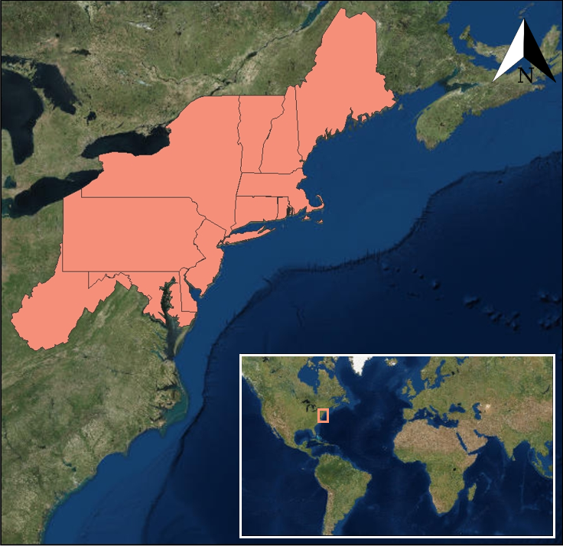
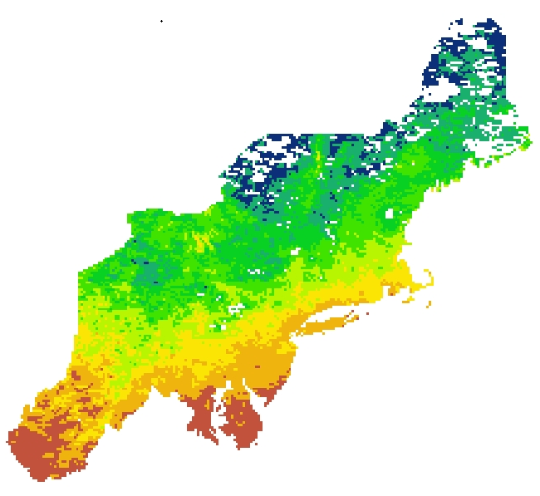
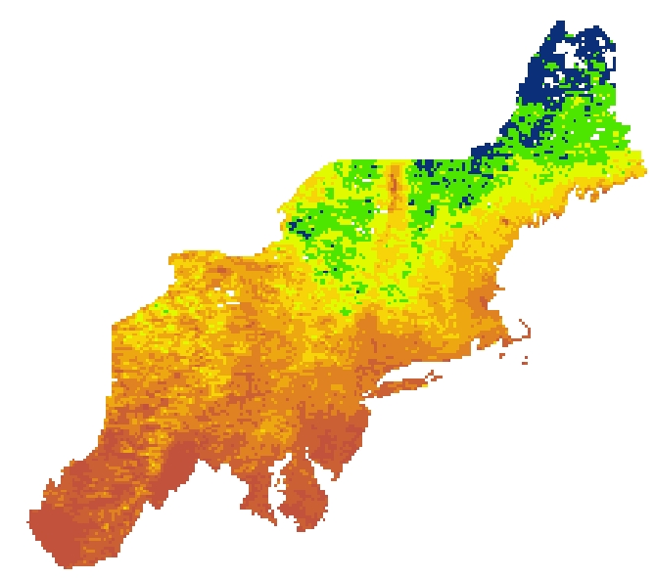
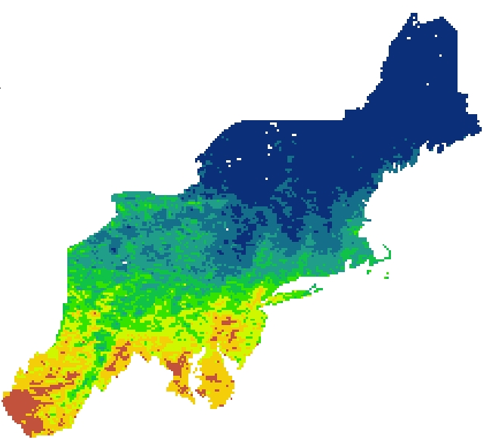
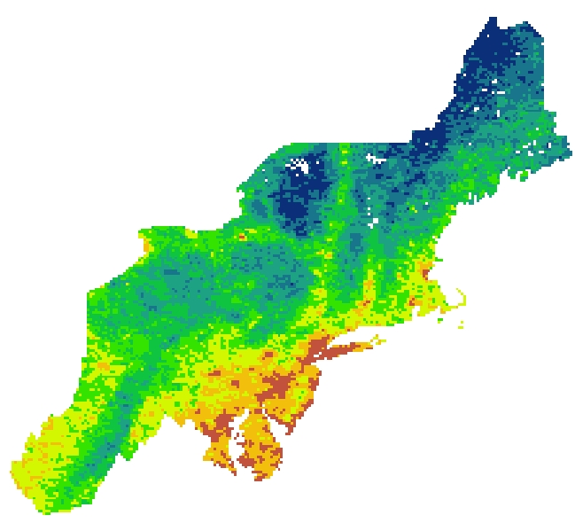
Developing Annual, Seasonal, and Monthly Temperature Indices over the Northeast United States to Represent Temperature Trends Using NASA and NOAA Datasets
Abstract
Study Area
Objectives
Since 1977, every year has been in the top ten warmest years on record when first ranked, reflecting the upward progression of annual global temperatures. However, some years within this time frame, such as 2012, are significantly cooler than surrounding years like 2010 or 2013. The variability of yearly rankings makes it difficult to differentiate the relative warmth or coolness of individual years from the secular trend. This project consists of two parts. First, the team devised a simple algorithm to create monthly, seasonal, and annual temperature scores regionally, within the Northeast US, and globally for the time periods ranging from 1975 to 2016 and 1880 to 2016. The temperature score product allows users to differentiate the relative coolness or warmth of a particular year in regard to the warmth or coolness of surrounding years from the overall temperature rankings. The algorithm also provides context for the temperatures in the Northeast Region, accounting for recent year-to-year fluctuations with respect to longer term trends. Secondly, this project utilized daily Aqua and Terra MODIS Land Surface Temperature (LST) data to provide useful, high-resolution temperature-based metrics to the energy and agriculture industries. This consisted of producing heating, cooling and growing degree days (for energy and agriculture industries respectively) for the Northeast US using satellite derived data. The results from this study, which give users the ability to visualize maps of monthly degree days at a higher spatial resolution than indices previously available, are expected to be distributed to various clients by project partners.
Provide a multitude of end users with an easily digestible perspective of how temperature trends have changed over the last few decades by utilizing information from NASA and NOAA temperature data and satellite datasets
Develop a temperature index specific to the Northeastern United States with a higher spatial resolution than other indices currently being utilized
Compute heating and cooling degree days using daily LST data and insitu temperature data
Create a product for the end users that has the potential to expand to a diverse set of end-users to utilize the data
Project Partners
Ellen Mecray, Director, NOAA Regional Climate Services
Karin Gleason, Meteorologist, NOAA National Center for Environmental Information, Climate Monitoring Branch
Earth Observations
TERRA MODIS
AQUA MODIS
Methodology
Results
Data Acquisition
NASA GISTEMP
NOAA nClimgrid
Data Analysis
Process temperature score algorithm through IDL
End Product
Temperature scores and graphs
Northeast US Cross-Cutting
Data Acquisition
NASA Terra & Aqua MODIS
Climate Reference Network
Data Analysis
Run MODIS through algorithm to extract LST values
End Product
Maps of heating, cooling, and growing degree days
Heating Degree Days January 2003
Heating Degree Days January 2017
1865
1865
Conclusions
1058
1058
Recent Northeast temperature trends as characterized by the running ranks and temperature scores have exhibited a great degree of oscillation between two extreme readings rather than clustering near the median
Land Surface Temperature data from MODIS is capable of providing higher spatial resolution temperature information
End users will use temperature scores for context and future state of the climate reports. Degree days will also be operationalized within the agriculture and energy sectors
Growing Degree Days March 2017
Growing Degree Days August 2017
396
1257
Team Members
9
869
Acknowledgements
We would like to thank our science advisors, Anthony Arguez and Anand Inamdar, as well as our center leads, Alec Courtright and Jonathan O’Brien for their help and guidance in this project. We would also like to acknowledge all of the NCEI employees, our partners, and fellows who helped us along the way.
Lilian Yang
Team Lead
Laurel Mahoney
Shannan Hurley
North Carolina – NCEI
2017

