Slide 1
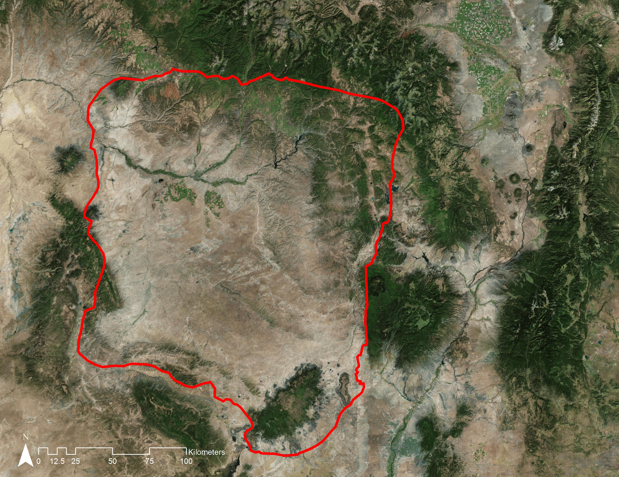
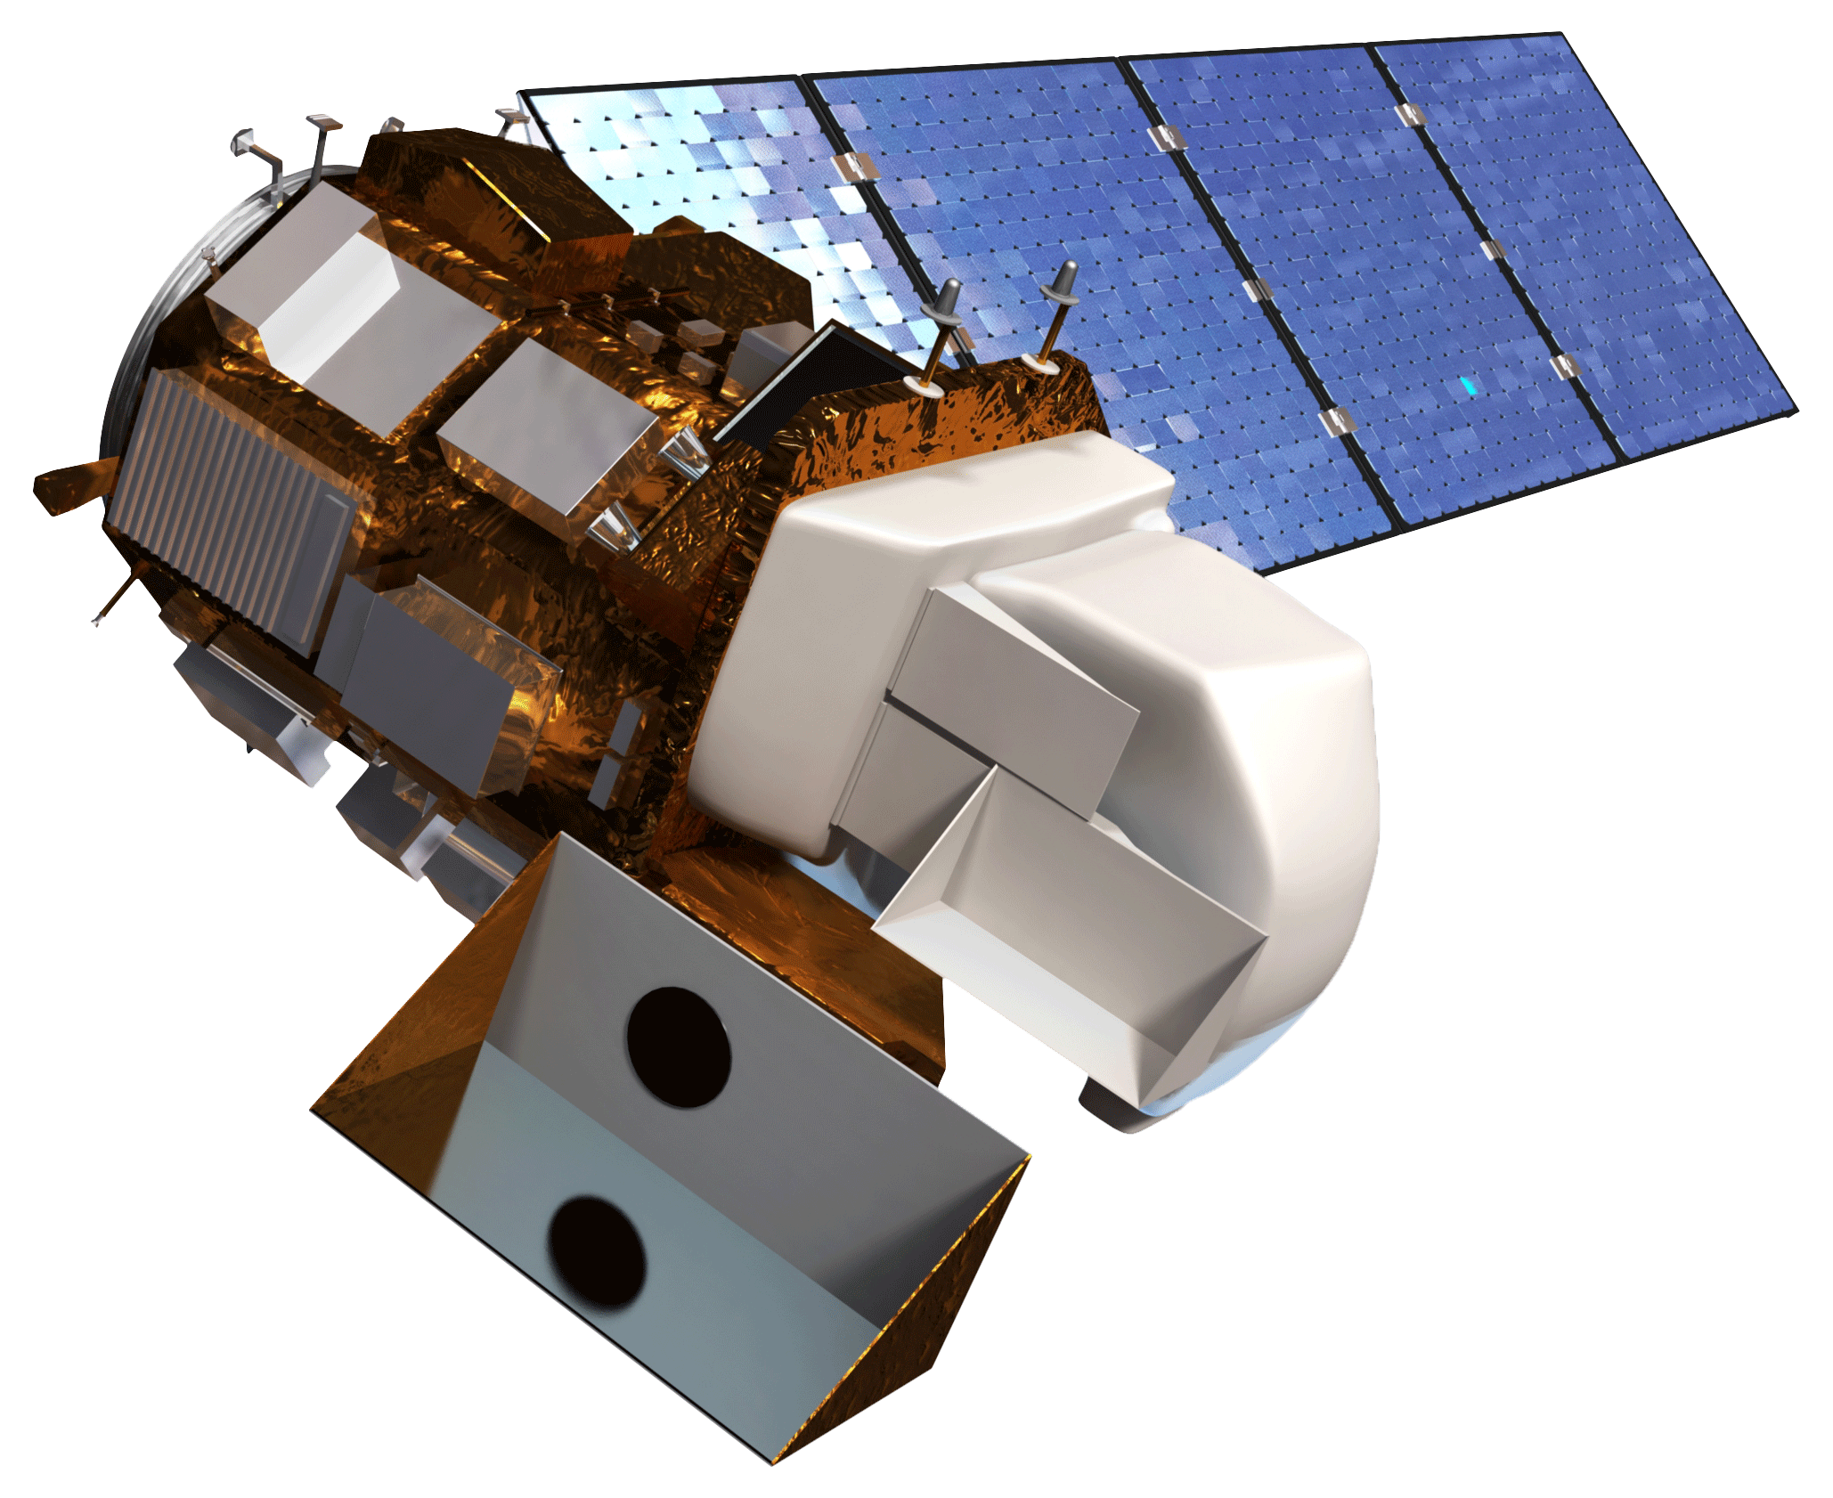
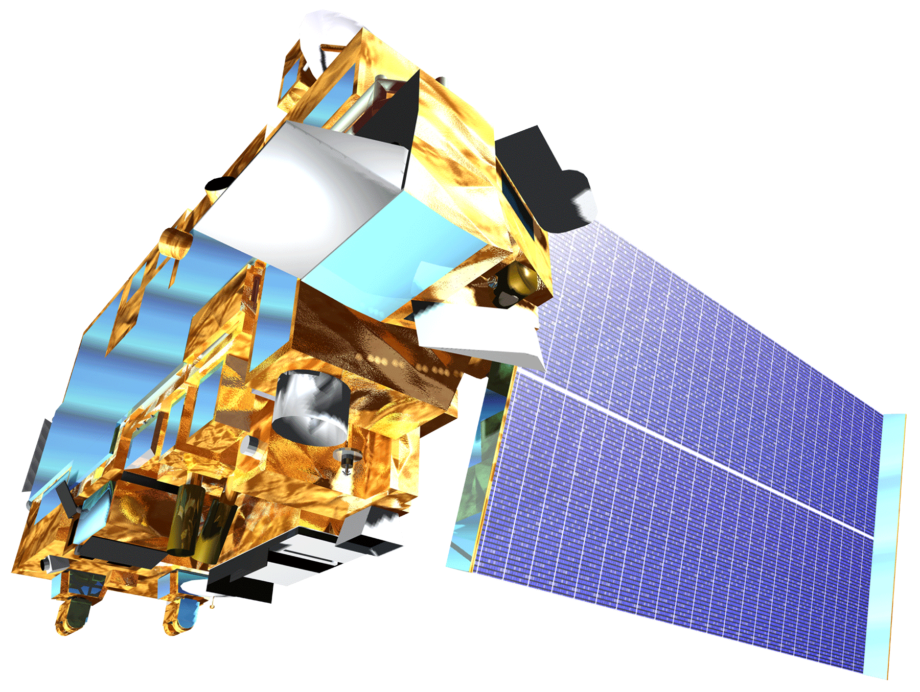
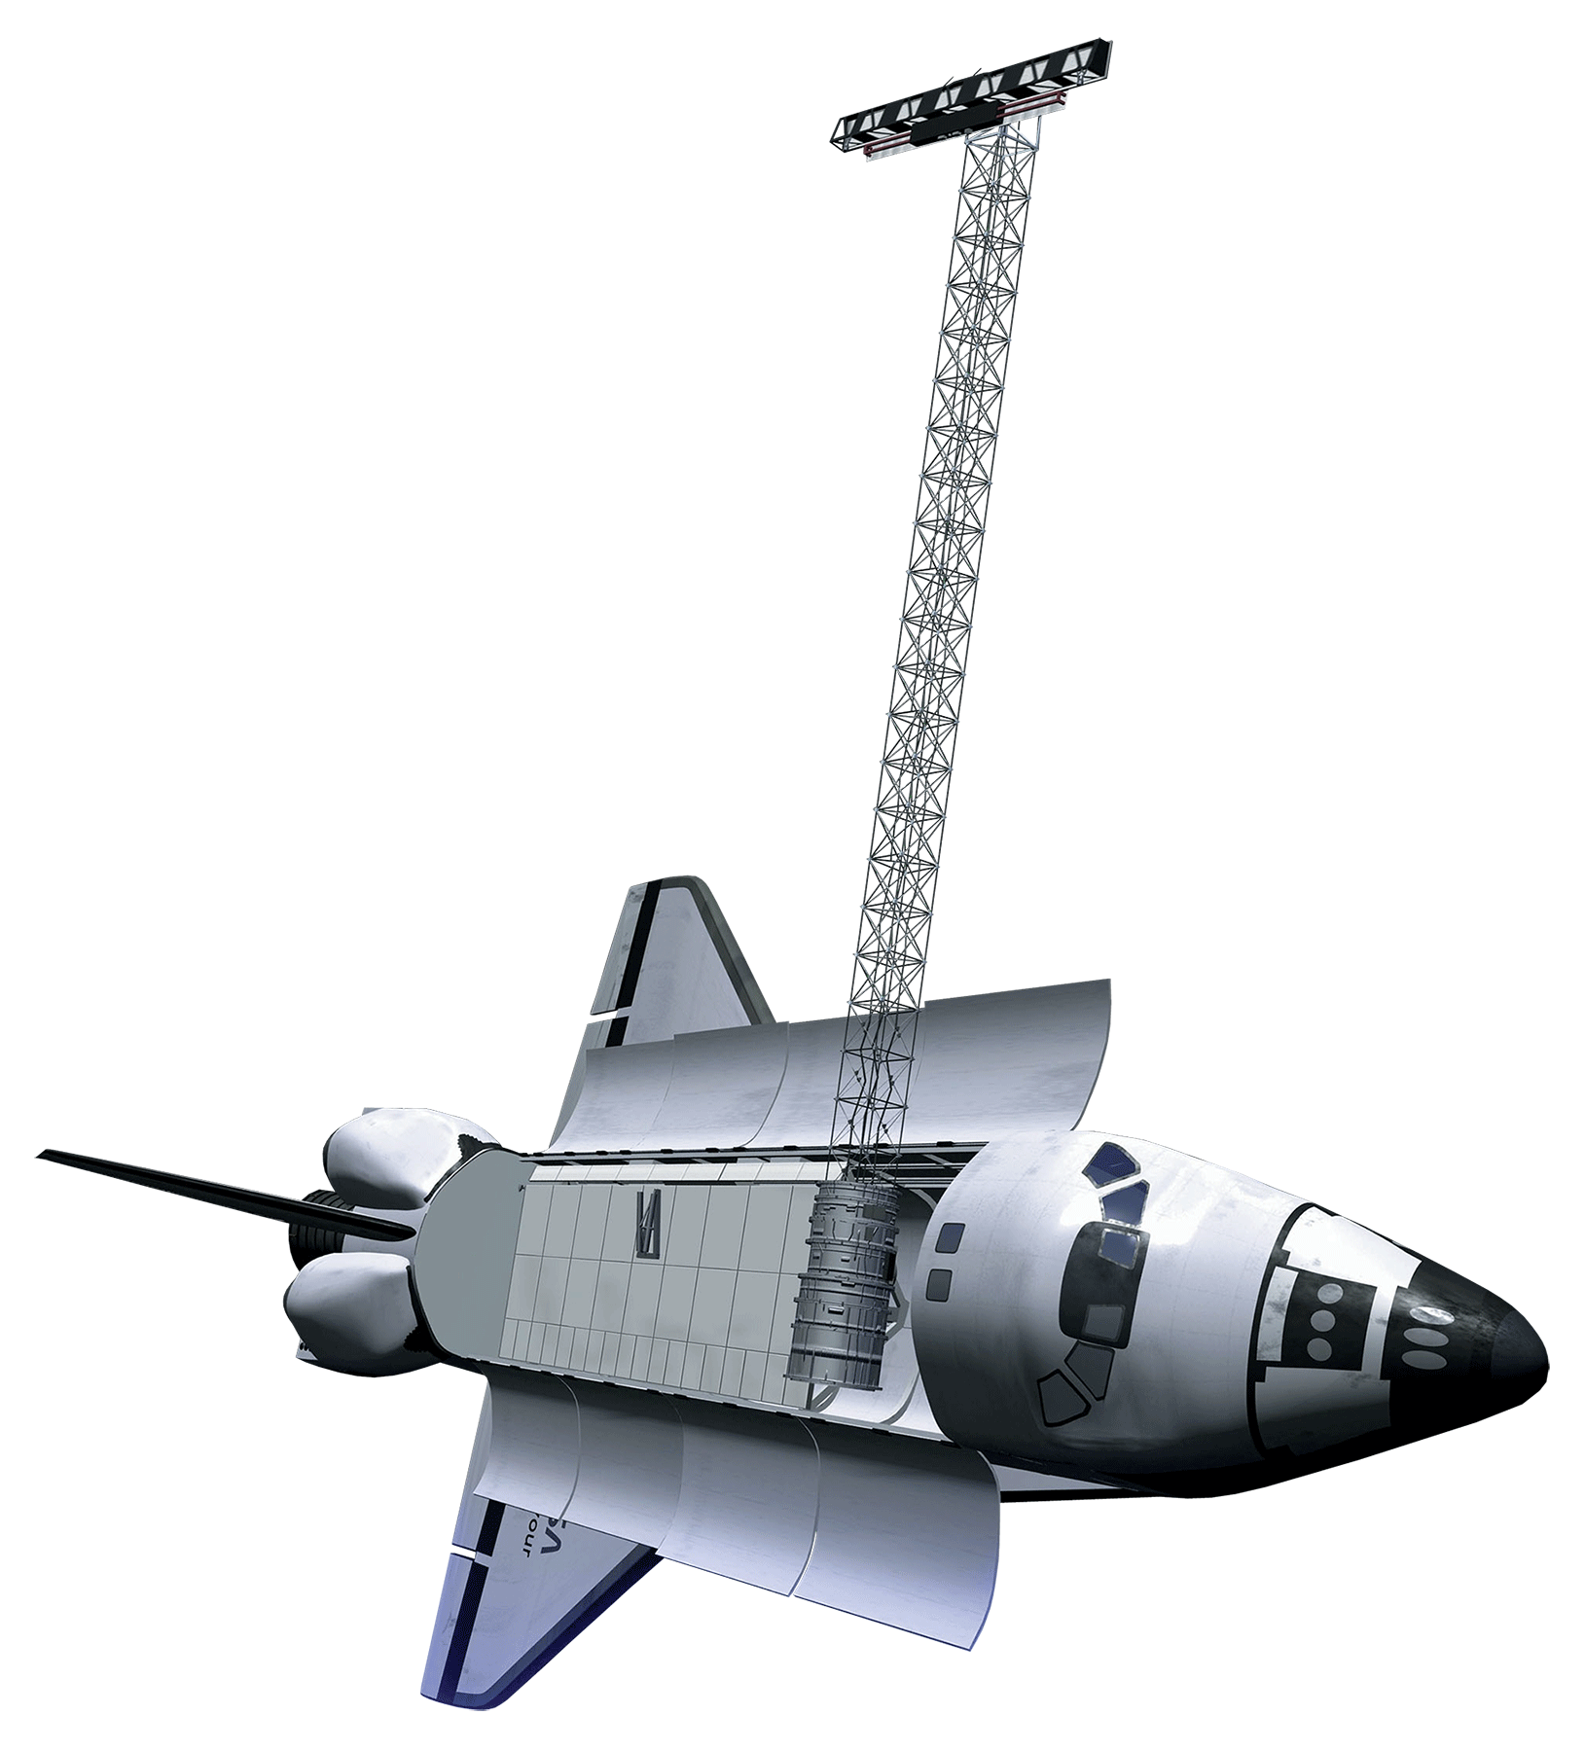

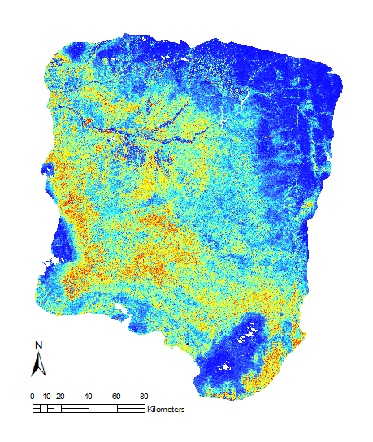

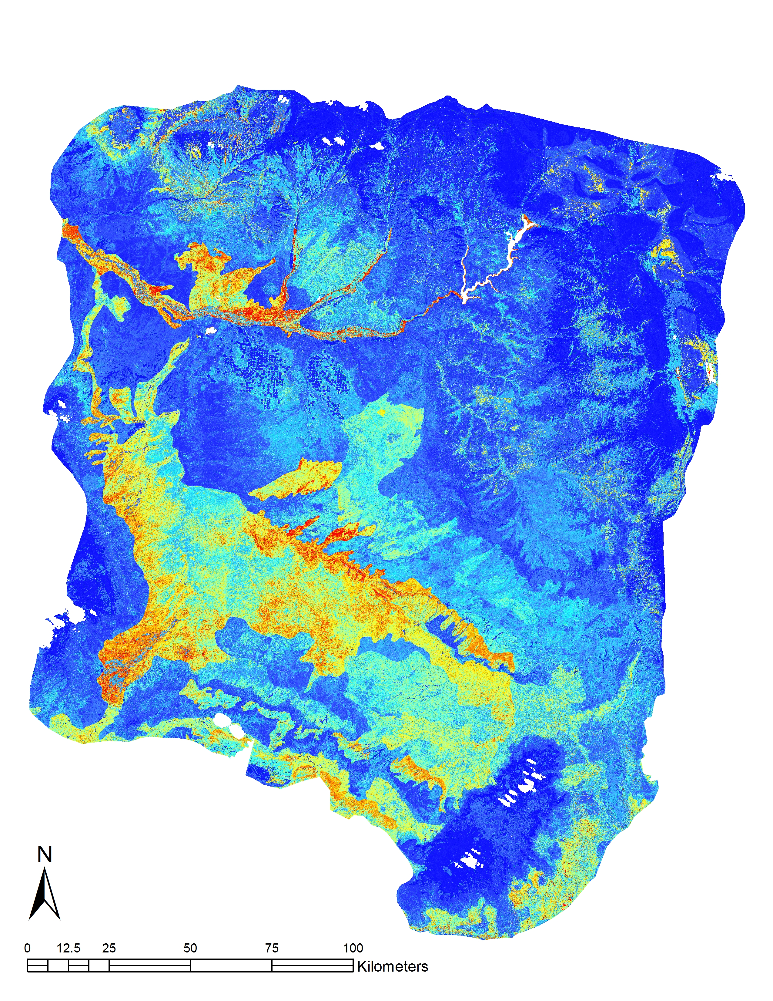
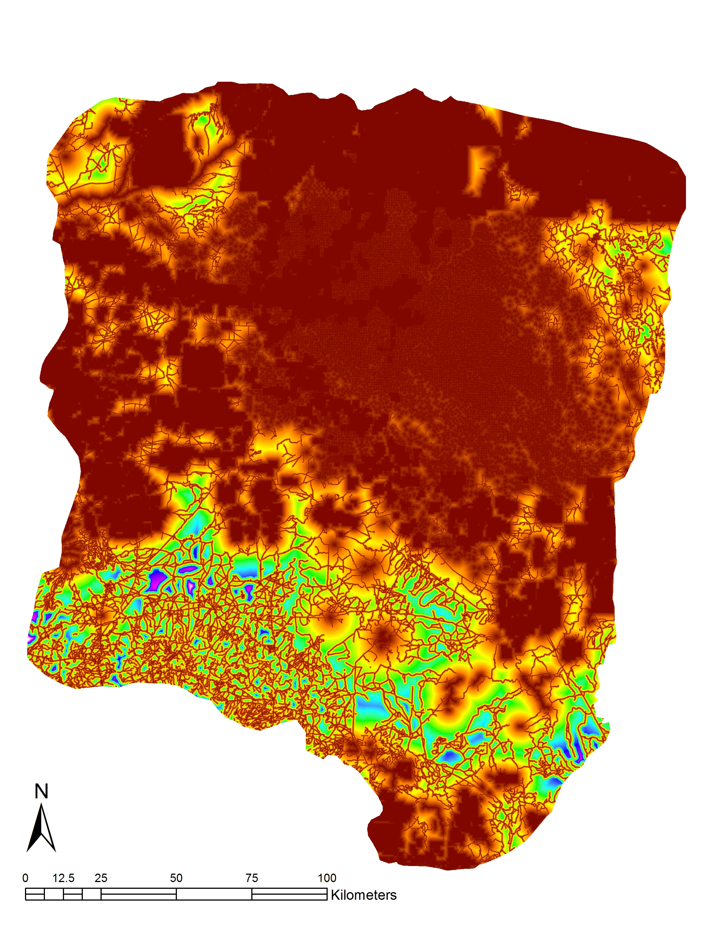
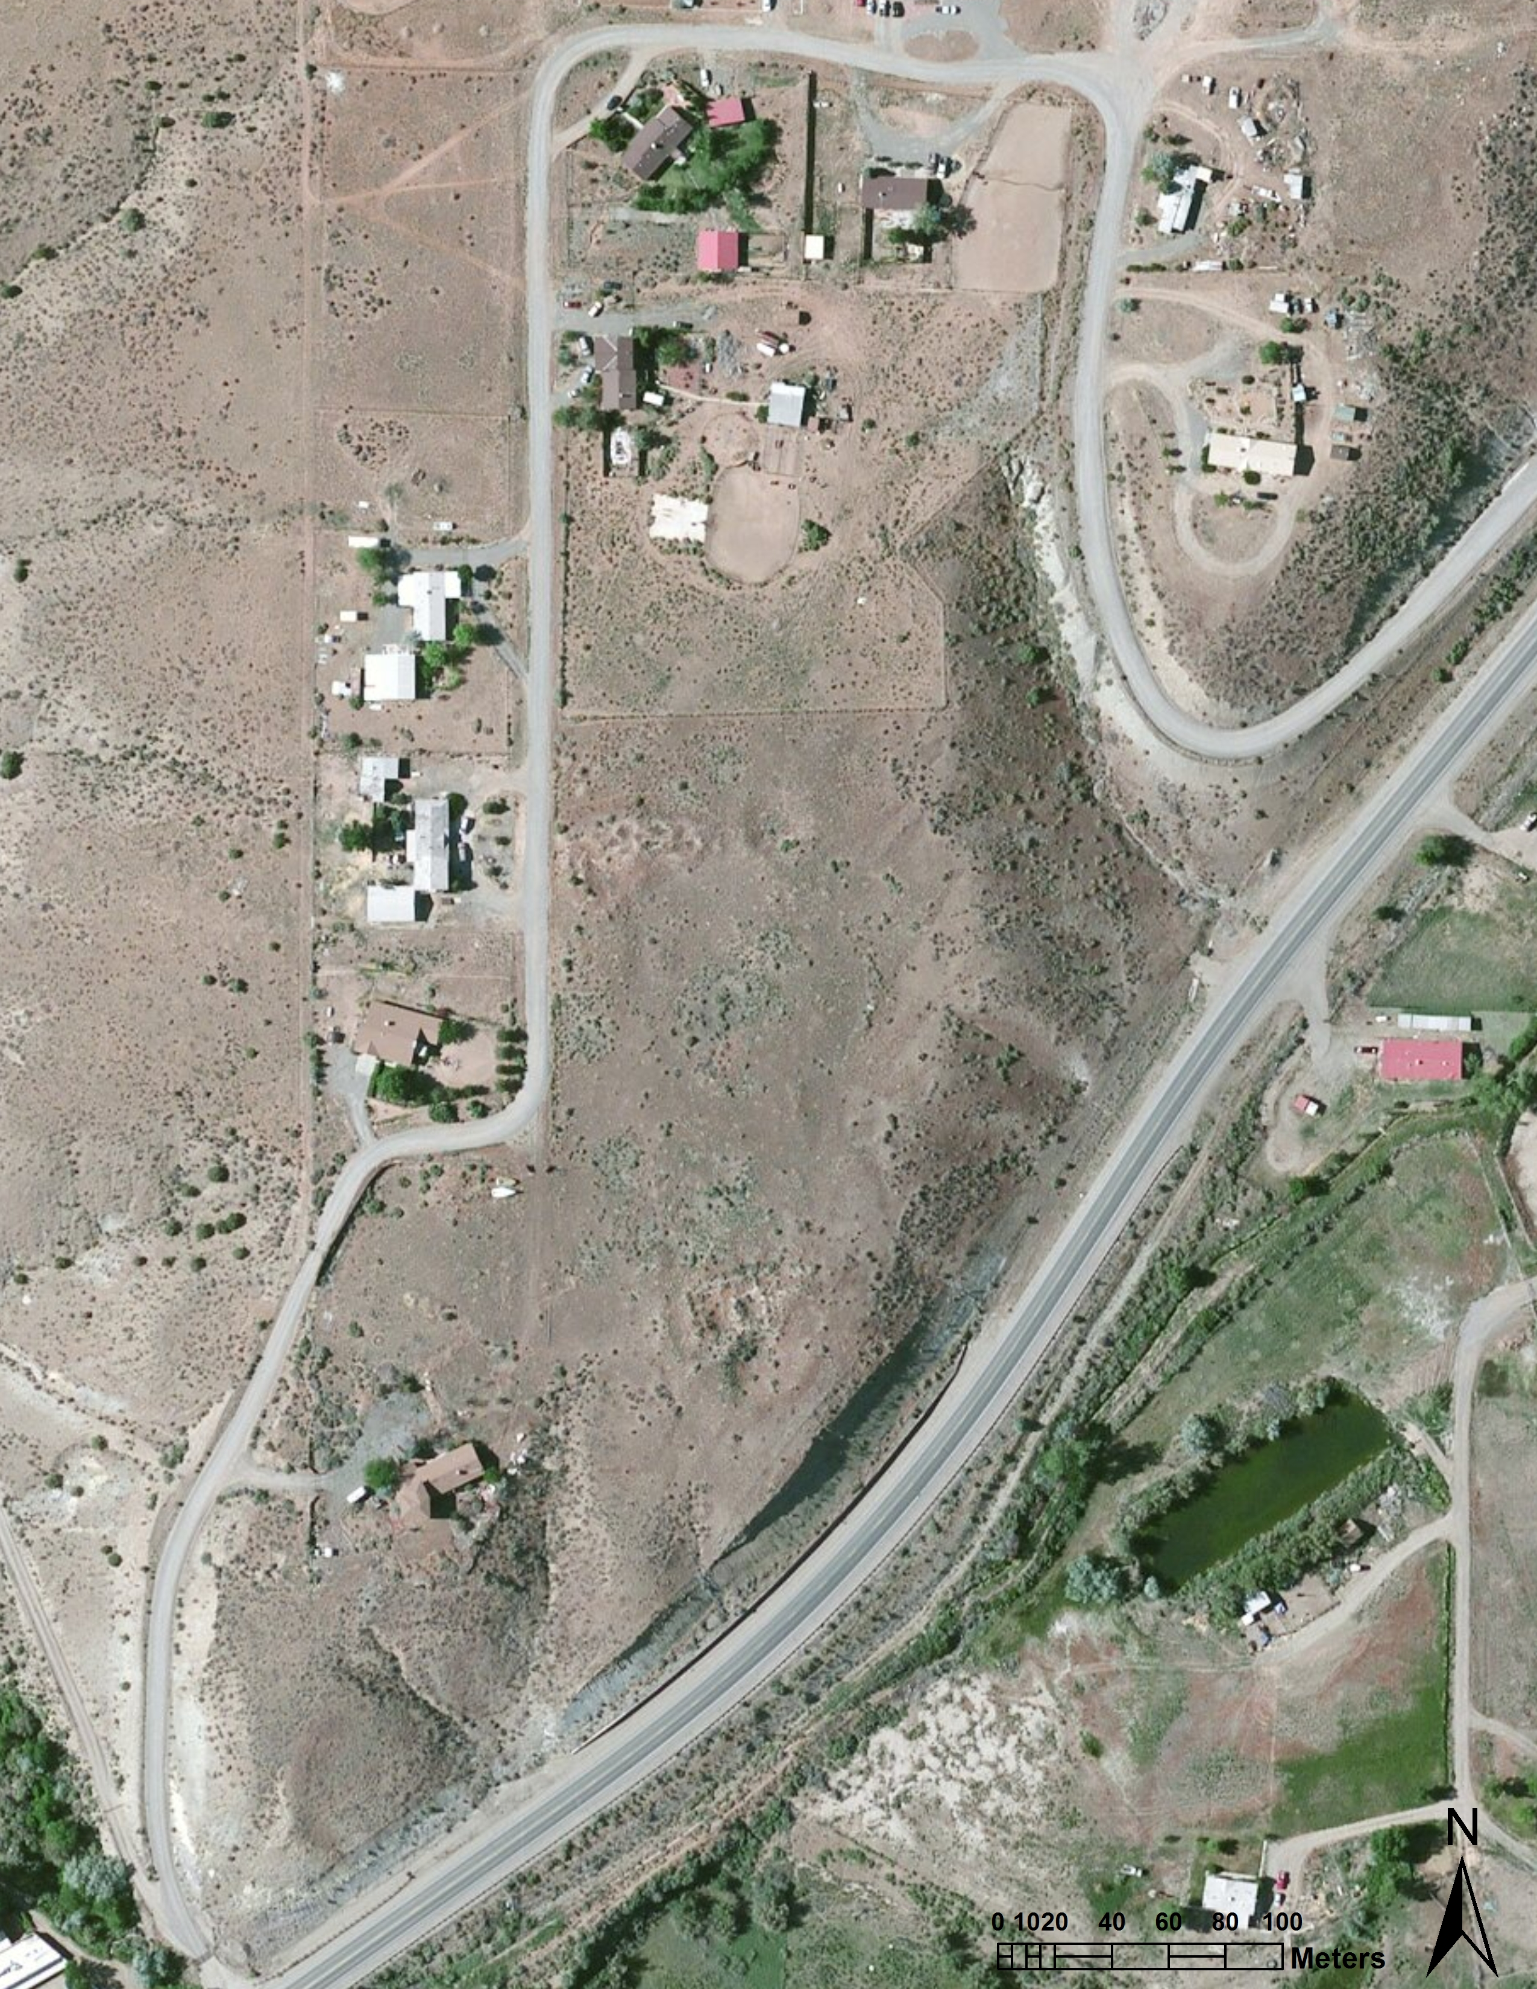
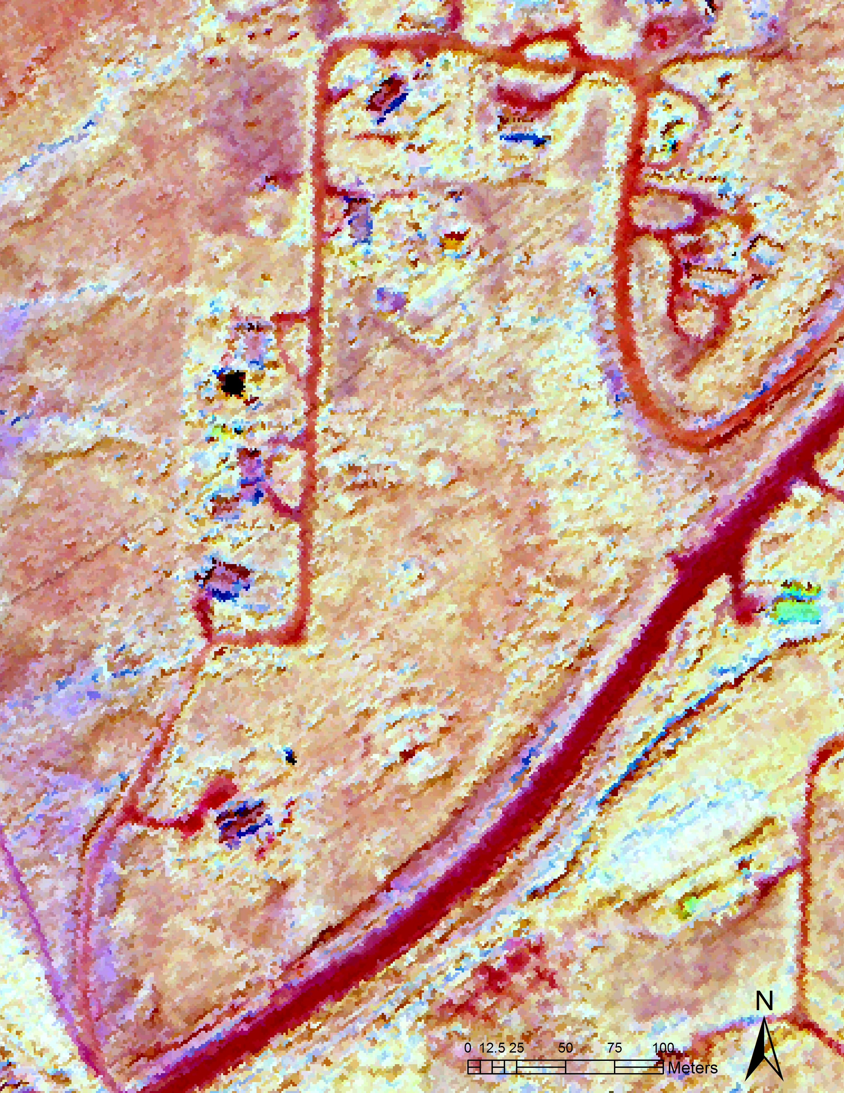
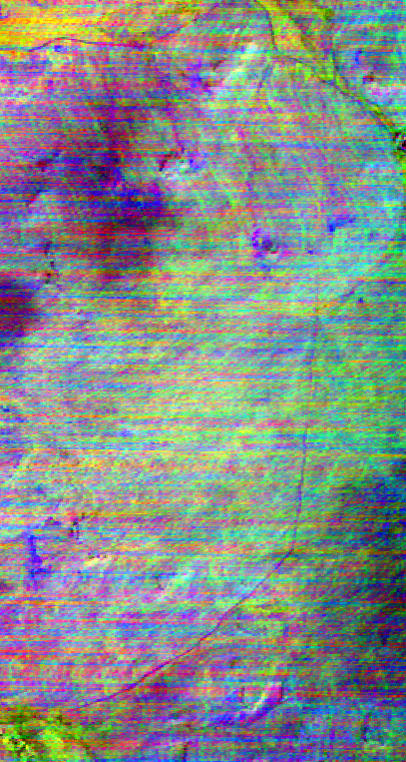
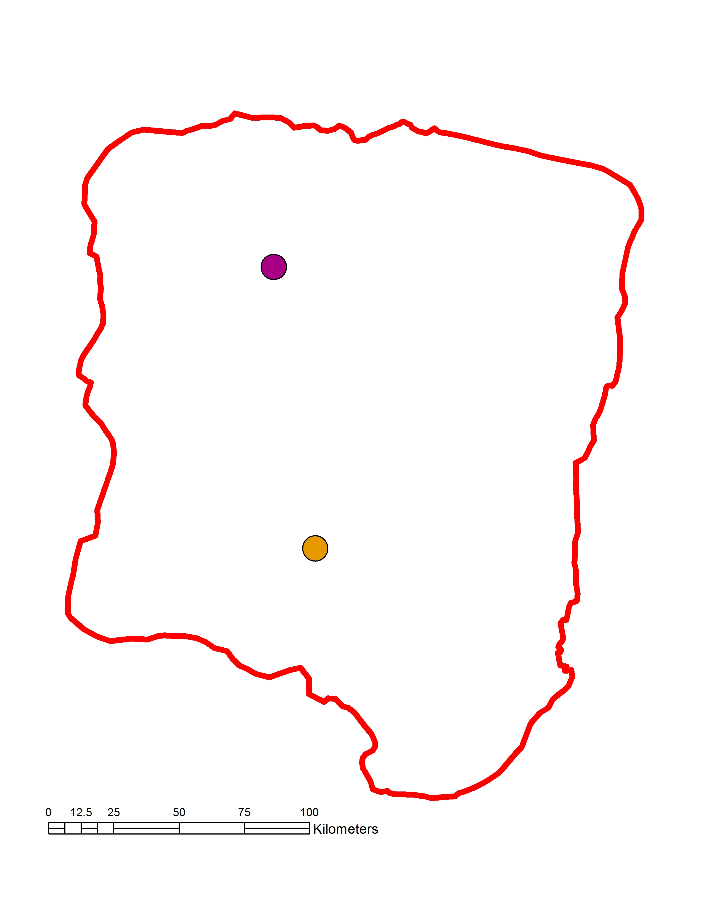

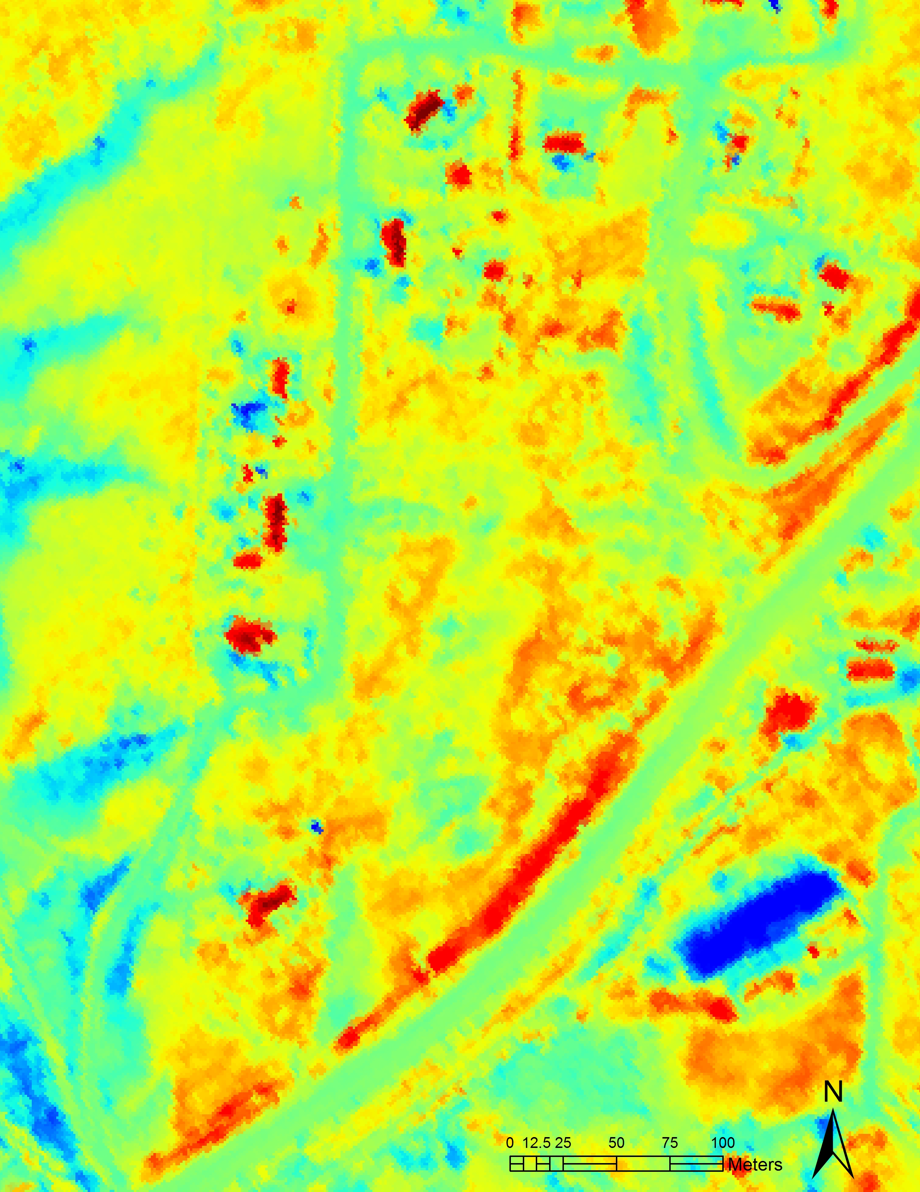

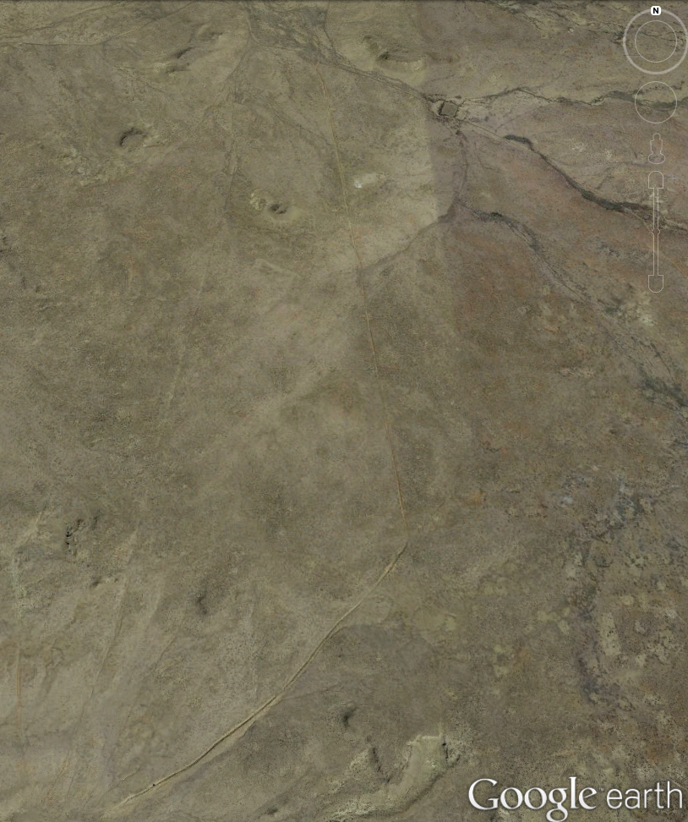





Utilizing NASA Earth Observations to Identify Chacoan Community Signature Profiles throughout the San Juan Basin to Assist with Preservation and Protection Strategies
Abstract
The Chacoan people flourished in northwest New Mexico between 850 and 1150 AD. Today, remnants of their monumental architecture draw over 40,000 visitors a year to Chaco Canyon National Park to experience the natural grandeur of the area and to learn about Native American history throughout the San Juan Basin. However, many Chacoan roads and communities are located outside the boundaries of the National Park. These unprotected sites are threatened by encroaching infrastructure associated with resource extraction, such as drill pads with requisite access roads and pipelines. Currently, the National Park Service (NPS), Binghamton University, the University of Nebraska-Lincoln, and the University of Colorado Boulder rely on expensive and time-consuming ground surveys, imagery from Google Earth, and the Landsat series to identify the extent of Chacoan roads and houses. This project utilized Landsat 8 Operational Land Imager (OLI) surface reflectance, Shuttle Radar Topography Mission Version 2 (SRTM-v2) digital elevation models (DEMs), Terra Advanced Spaceborne Thermal Emission and Reflectance Radiometer (ASTER) emissivity data, Thermal Infrared Multispectral Scanner (TIMS) data, and Hyperspectral Thermal Emission Spectrometer (HyTES) data to identify highly probable locations of unknown Chacoan sites, to determine sites at risk from infrastructure development, and to identify the spectral signatures of these ancient communities. Documenting Chacoan community signature profiles and determining which areas are at risk of being affected by encroaching development will help the project partners to better understand the Chacoan landscape, as well as to better protect and preserve these ancient sites.
Objectives
Study Area
Earth Observations
Identify areas that are likely locations of unknown Chacoan communities and roads
Identify areas with known Chacoan communities and roads that are at risk from developing infrastructure
Delineate Chacoan communities and roads using NASA Earth observations
Chaco Canyon Cross-Cutting Project Study Area:
San Juan Basin, New Mexico and Colorado
Methodology
Landsat 8 OLI
Terra ASTER
Data Acquisition
Landsat 8 OLI
Surface Reflectance
Image Processing
SRTM-v2
Digital Elevation Model
NDVI
SRTM-v2
LANDFIRE
Land Cover
Slope
Aspect
Results
Results
Chacoan Site & Road Locations
Site Suitability Map
Chacoan Site Suitability Map
Chacoan Site Risk Map
USDA Soil Survey
Soil map
Analysis
SEDAC
Population
MaxEnt Model
National Hydrography Dataset
Perennial Water Bodies
Site Risk Map
Chaco Canyon Cross-Cutting
Fuzzy Logic
OpenStreetMap
Road locations
Site Delineation
Oil and gas drill locations
Site and Road Delineation
Terra ASTER
Thermal Band Radiance
a..
b..
e..
TIMS
HyTES
Project Partners
National Park Service (NPS) Intermountain Region - Tom Lincoln
Binghamton University - Dr. Ruth Van Dyke
University of Nebraska-Lincoln - Dr. Carrie Heitman
University of Colorado Boulder - Dr. Steve Lekson
c..
d..
f..
TIMS
Conclusions
Many known Chacoan sites and roads are at risk for destruction from developing infrastructure.
Moderate resolution imagery from Terra ASTER and Landsat 8 are not as useful for identifying Chacoan sites and roads as higher resolution imagery from TIMS and HyTES.
Future projects could increase the robustness of the risk map by obtaining the locations of destroyed sites, more full coverage TIMS and HyTES imagery, and very high resolution imagery.
Figures a through d are of the Morris 39 site. Figure a is NAIP aerial imagery. Figure b is HyTES emissivity. Figure c is HyTES land surface temperature. Figure d is ASTER 1LT thermal radiance. The black arrows indicate known archaeological features at the Morris 39 site. The grey arrow in figure c is a potentially unknown feature. Figures e and f are of a segment of Road 77. Figure e is TIMS imagery with band combination 1,3,6 and a decorrelation stretch. Figure f is Google Earth aerial imagery. The black arrows indicate known segments of Road 77.
Team Members
Acknowledgements
The Chaco Canyon Cross-Cutting Project would like to thank Dr. Tom Sever (The University of Alabama in Huntsville), Dr. Jeffrey Luvall (NASA NSSTC), Dr. Robert Griffin (The University of Alabama in Huntsville), Richard Friedman (The Solstice Project), Paul Neville (The University of New Mexico), Evan O’Keefe (San Juan County), Leigh Sinclair (NASA DEVELOP), and Daryl Ann Winstead (NASA DEVELOP).
Any opinions, findings, and conclusions or recommendations expressed in this material are those of the author(s) and do not necessarily reflect the views of the National Aeronautics and Space Administration. This material is based upon work supported by NASA through contract NNL11AA00B and cooperative agreement NNX14AB60A.
Kelsey Herndon
Project Lead
Dashiell Cruz
Sydney Neeley
Ryan Schick
NASA Marshall Space Flight Center – Summer 2016

