Slide 1
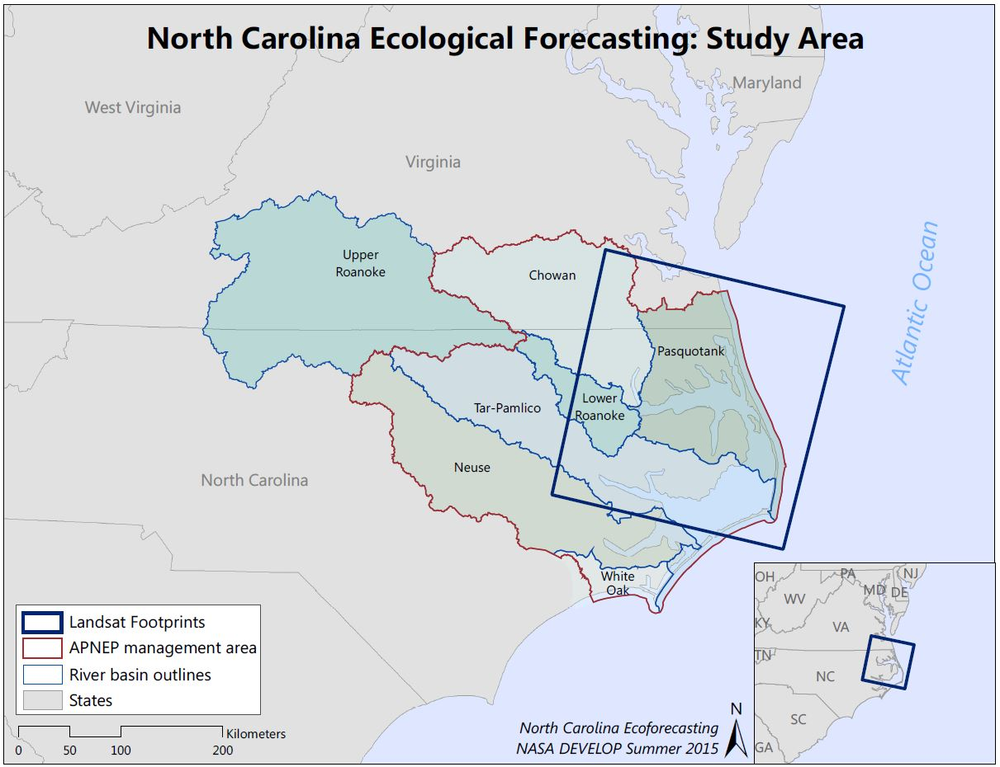
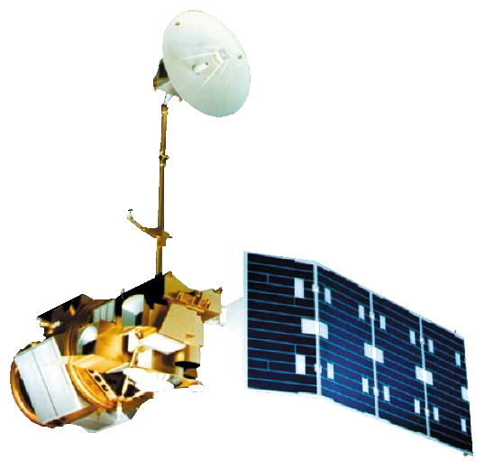
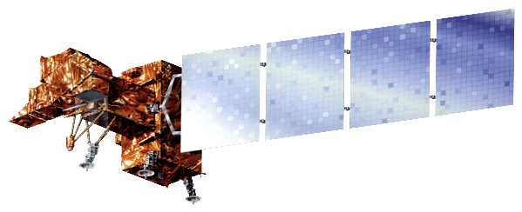
NORTH CAROLINA ECOLOGICAL FORECASTING
Evaluating the Application of NASA Earth Observations to Rapidly Detect
Change in Wetland Types at a Regional Scale
Zand Bakhtiari (Project Lead), Stephen Zimmerman, Kayla Patel, Brad Gregory (USAF)
Abstract
Objectives
As a result of their sensitivity to sea level rise, wetlands are considered one of the most vulnerable ecosystems to climate change. In addition, wetland extents have diminished over time due to population increases and associated land change patterns. This project, partnered with the Albemarle-Pamlico National Estuary Partnership (APNEP), sought to delimitate wetland extent within the Albemarle-Pamlico watershed from 2000 to 2015 using NASA’s Landsat 5 Thematic mapper(TM), 7 Enhanced Thematic mapper(ETM+), and 8 Operational Land Imager(OLI). Four images (representing spring, summer, fall, and winter) were collected for each year from 2000 to 2015. Multiple images were used for each year to account for tidal changes and to minimize the noise produced by cloudy imagery. After pre-processing the images, indices that measure water extent and wetland health were calculated for each image. From these indices’ wetland extent and relative health were measured more rapidly than contemporary classification methods. A tutorial was provided to APNEP to support the organization in implementing policies toward wetland monitoring, protection, and restoration.
This project looked at wetland extent in the Albemarle-Pamlico estuary over time.
Using a dense time-stacking of Landsat Imagery, wetland extent were mapped throughout Albemarle Pamlico watershed between the years 2000 – 2015.
Two indices were used, the first measured change in water extent over the years and the other measured the relative health of the wetlands themselves.
This two pronged approach sought to capture both natural and anthropogenic effects on the Albemarle Pamlico estuary system.
Methodology
Study Area
Landsat -5, 7, and 8 scenes(path 15, row, 35)
Four season acquisition
Python used for pre-processing and two band indices
Earth Observations
Landsat 7 ETM+
Results
Landsat 8 OLI
Use images.
Make sure that it has some sort of flow, that it makes sense. Show your results in a logical order.
No bullets.
Landsat 5 TM
Conclusions
Use bullets.
Use complete sentences with periods.
Team Members
Project Partners
Acknowledgements
Use a professional-looking photo.
Individual headshots are ok, if they aren’t pixelated and are all the same size.
Include a caption that states the team members’ names.
Albemarle-Pamlico National Estuary Partnership (APNEP)
Include anyone who has helped you with the project.
If this is a continuation project, credit the previous team members and contributors.
If you are including affiliations, use DEVELOP as the affiliation for a DEVELOPer or former DEVELOPer—not their school or former school.
NASA Langley Research Center

