Slide 1
Himalayan Disasters II
Automating a Landslide Identification Product and a Hazard Assessment Model for Enhanced Landslide Detection
Justin Roberts – Pierel (Project Lead)
Aakash Ahamed
Jessica Fayne
Binu Maharjan
Kanti Sen Ojha
Amanda Schochet
Ang Dawa Sherpa

Slide 2
Study Area: Nepal
Location: Nepal and Himalaya Region
Area: 147,181 km²
Climate: Tropical, Suptropical Temperate, Subalpine, Alpine, Permanent Snow, Cold Desert.
Precipitation: 160 mm – 5,000 mm
Notes:
Location:
Nepal is a landlocked, mountainous East Asian country that is slightly larger than the state of Arkansas.
Area:
The country basin is 147,181 square kilometers in size.
Climate: 8 Climatic zones across the country due to large gradients in altitude and precipitation.
Image Source:
Aakash Ahamed
Image Data sources: ICIMOD
Content source: Wikipedia

Slide 3
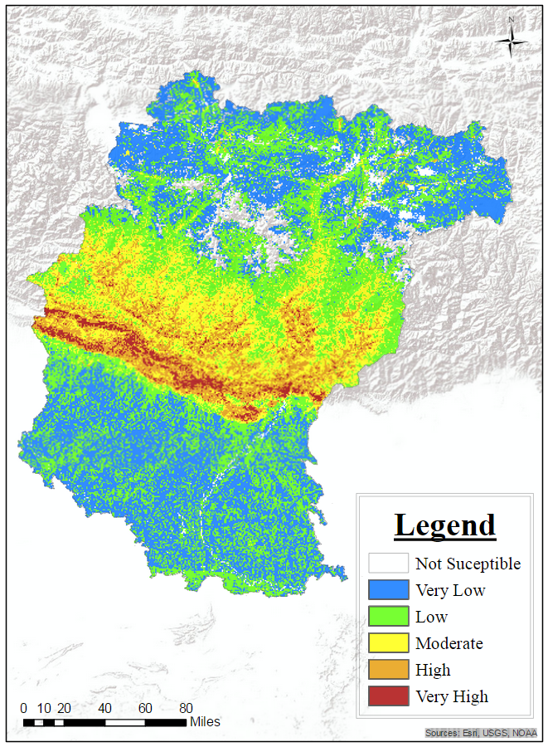
Study Objectives
Develop a near real time automatic landslide detection product for the Nepal and Himalaya region.
Add landslide events to the Global Landslide Catalog (GLC) database.
Develop a near real time precipitation monitoring product for the Nepal and Himalaya region.
Notes:
Image Source:
Amanda Rumsey
Speaker notes being developed

Slide 4
Community Concerns
Landslides cause hundreds of fatalities and millions of dollars of losses in the Nepal and Himalaya region annually.
In the wake of the M7.8 Gorkha earthquake, landslides emerged as a significant induced hazard that are likely to increase in frequency and severity during the upcoming monsoon season.
With current underestimation of landslide impacts and the increasing trend in frequency and intensity of landslide events due to anthropogenic factors, this work is critical even outside the scope of the earthquake.
Placeholder for ICIMOD Landslide/Earthquake Photographs
Notes:
Sources: Dahal and Hasegawa (2007)
Speaker notes being developed

Slide 5

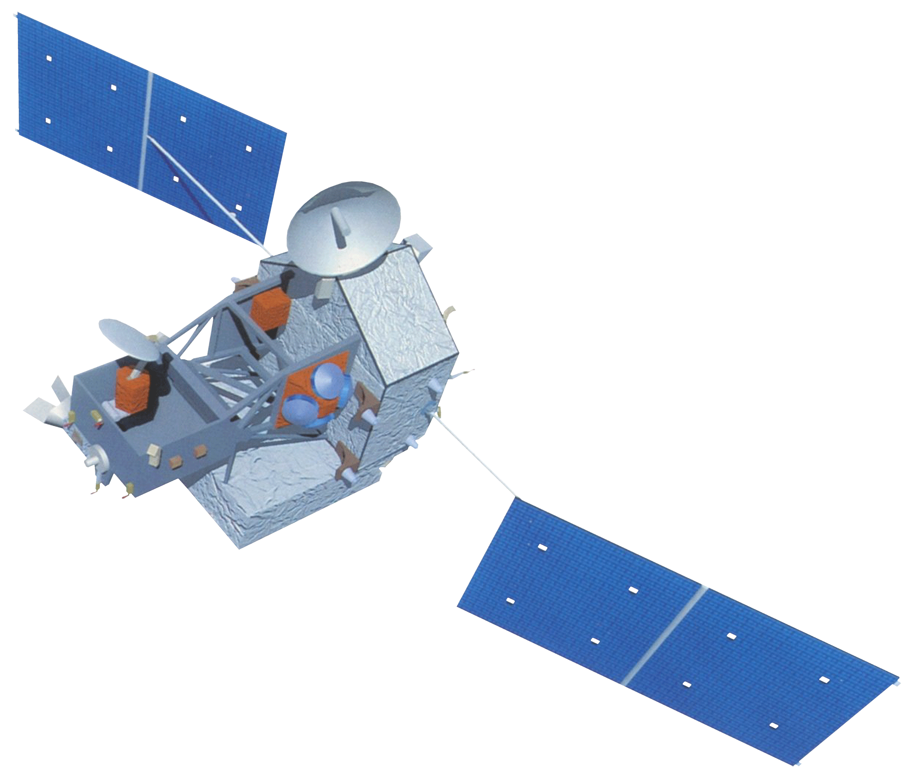
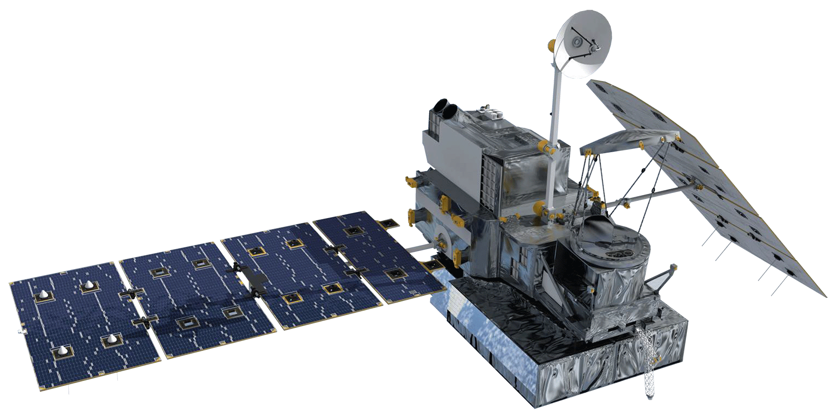

NASA Satellites / Sensors Used
TRMM
Landsat 8
GPM
Terra
Notes:
Image: Justin Roberts-Pierel
Speaker notes being developed

Slide 6
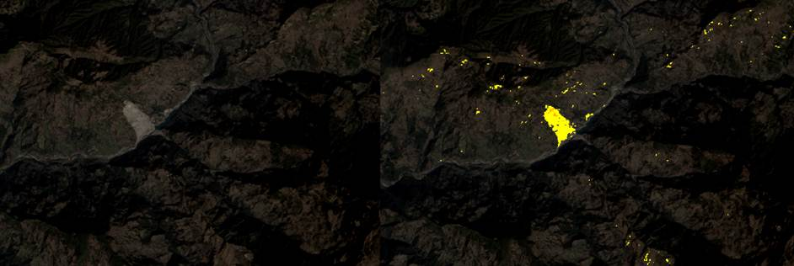
Methodology (SLIP)
Data Collection
Collect Landsat scenes and extract R, IR,SWIR and QA bands
Cloud Mask
Use the QA Band to Remove Clouds from the R, IR, and SWIR images
Red Increase
Calculate percent change between two Red images
Remove pixels with slopes lower than 15%
Remove Flat Terrain
Moisture Index
Calculate areas that become moist using the IR and SWIR bands, comparing two images
Notes:
Image: Jessica Fayne
Speaker notes being developed

Slide 7
Methodology (SLIP)
Notes:
Video: Jessica Fayne
Speaker notes being developed

Slide 8
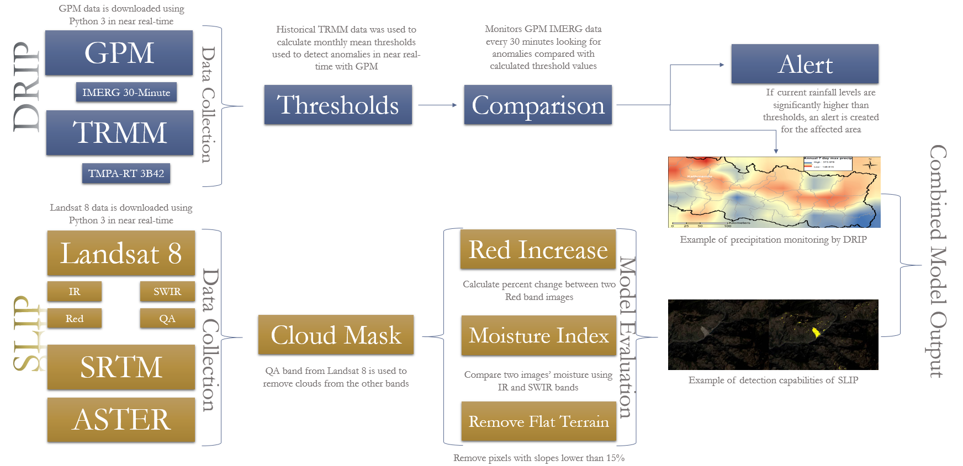
Methodology (Overview)
Notes:
Image Source: Justin Roberts-Pierel
Make text bigger, make boxes selectable and editable in final version. This is a placeholder
Speaker notes being developed

Slide 9
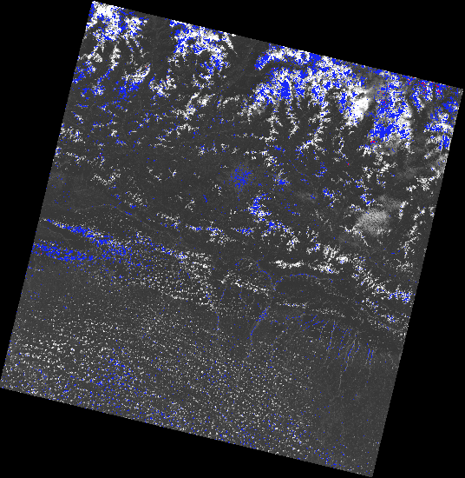
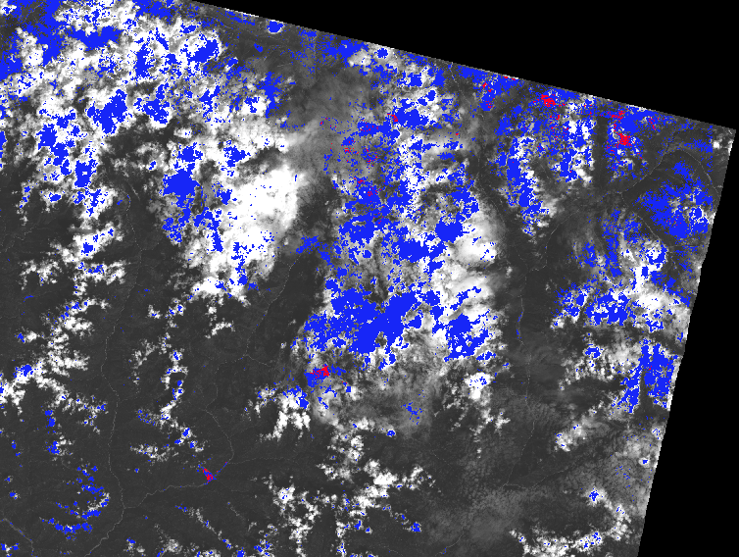
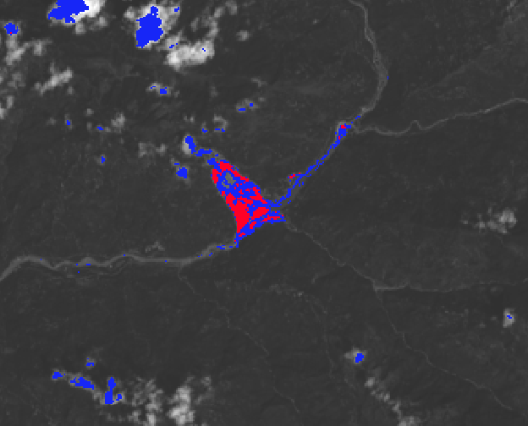
Results (SLIP)
Blue areas match either the moisture or the red increase criteria, the red areas match both.
This example is from an non-cloud masked image…
More to come!
Notes:
Image Source: Jessica Fayne
Speaker notes being developed

Slide 10
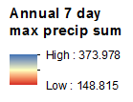
Results (DRIP)
Notes:
Image Source:
Aakash Ahamed
Speaker notes being developed

Slide 11
Results (Other)
TBD

Slide 12
Conclusions
TBD
Notes:
Speaker notes being developed

Slide 13
Errors and Uncertainties
TBD
Notes:
Speaker notes being developed

Slide 14
Future Work
TBD
Notes:
Web tool
Speaker notes being developed

Slide 15
Advisors
Dr. Dalia B. Kirschbaum, NASA Goddard Space Flight Center (Science Advisor )
Dr. John D. Bolten, NASA Goddard Space Flight Center (Science Advisor)
Thomas A. Stanley, NASA Goddard Space Flight Center (Science Advisor)
Sebastian Wesselman, ICIMOD (Science Advisor)
Partners
International Centre for Integrated Mountain Development (ICIMOD)
Former Teammates
Amanda Rumsey
Jamie Shiplet
Notes:
Speaker notes being developed

