Slide 1
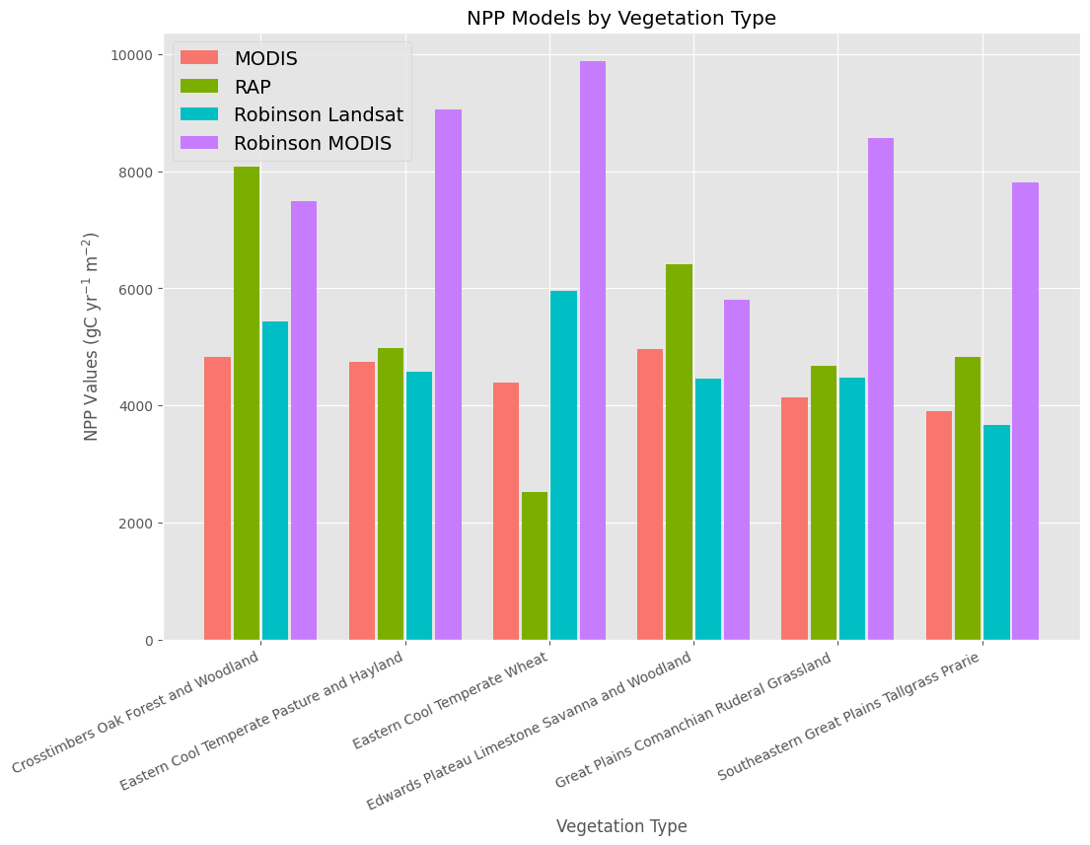
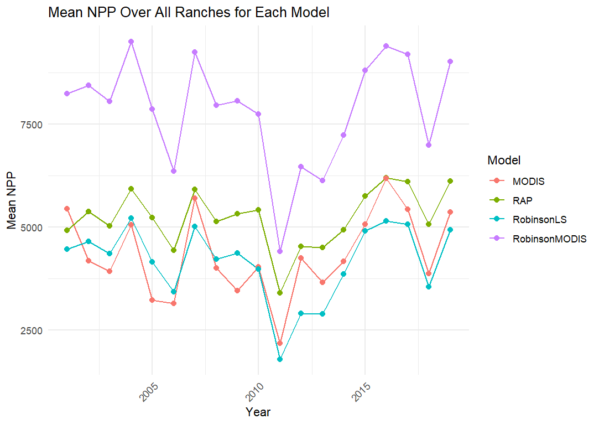
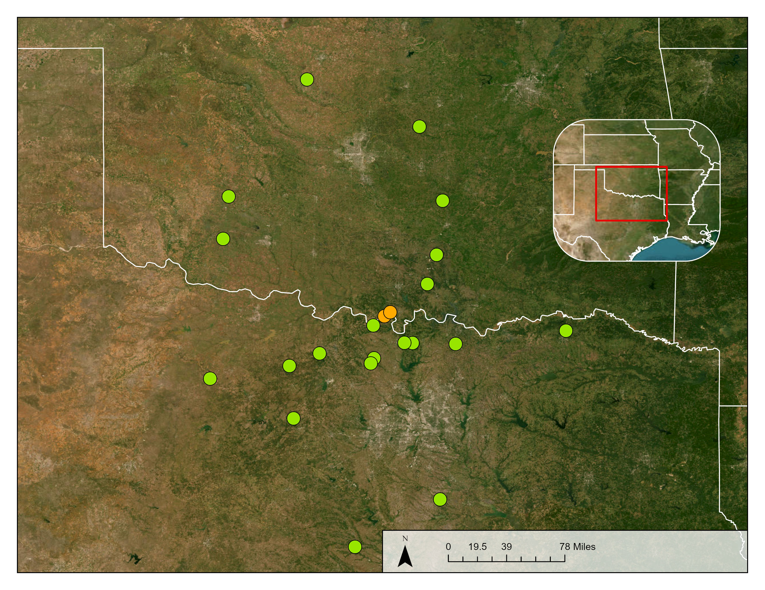
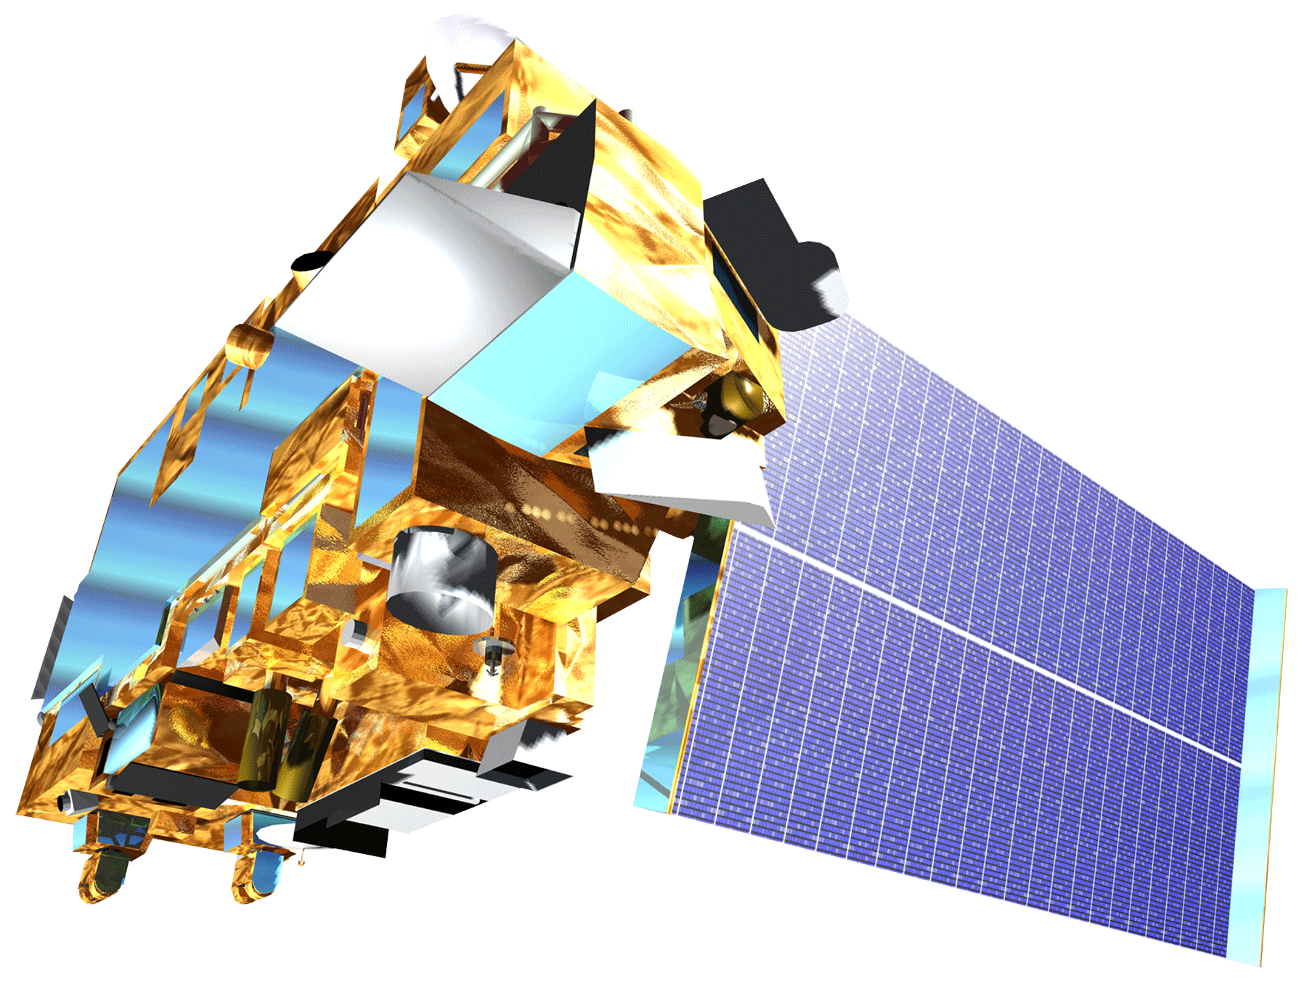
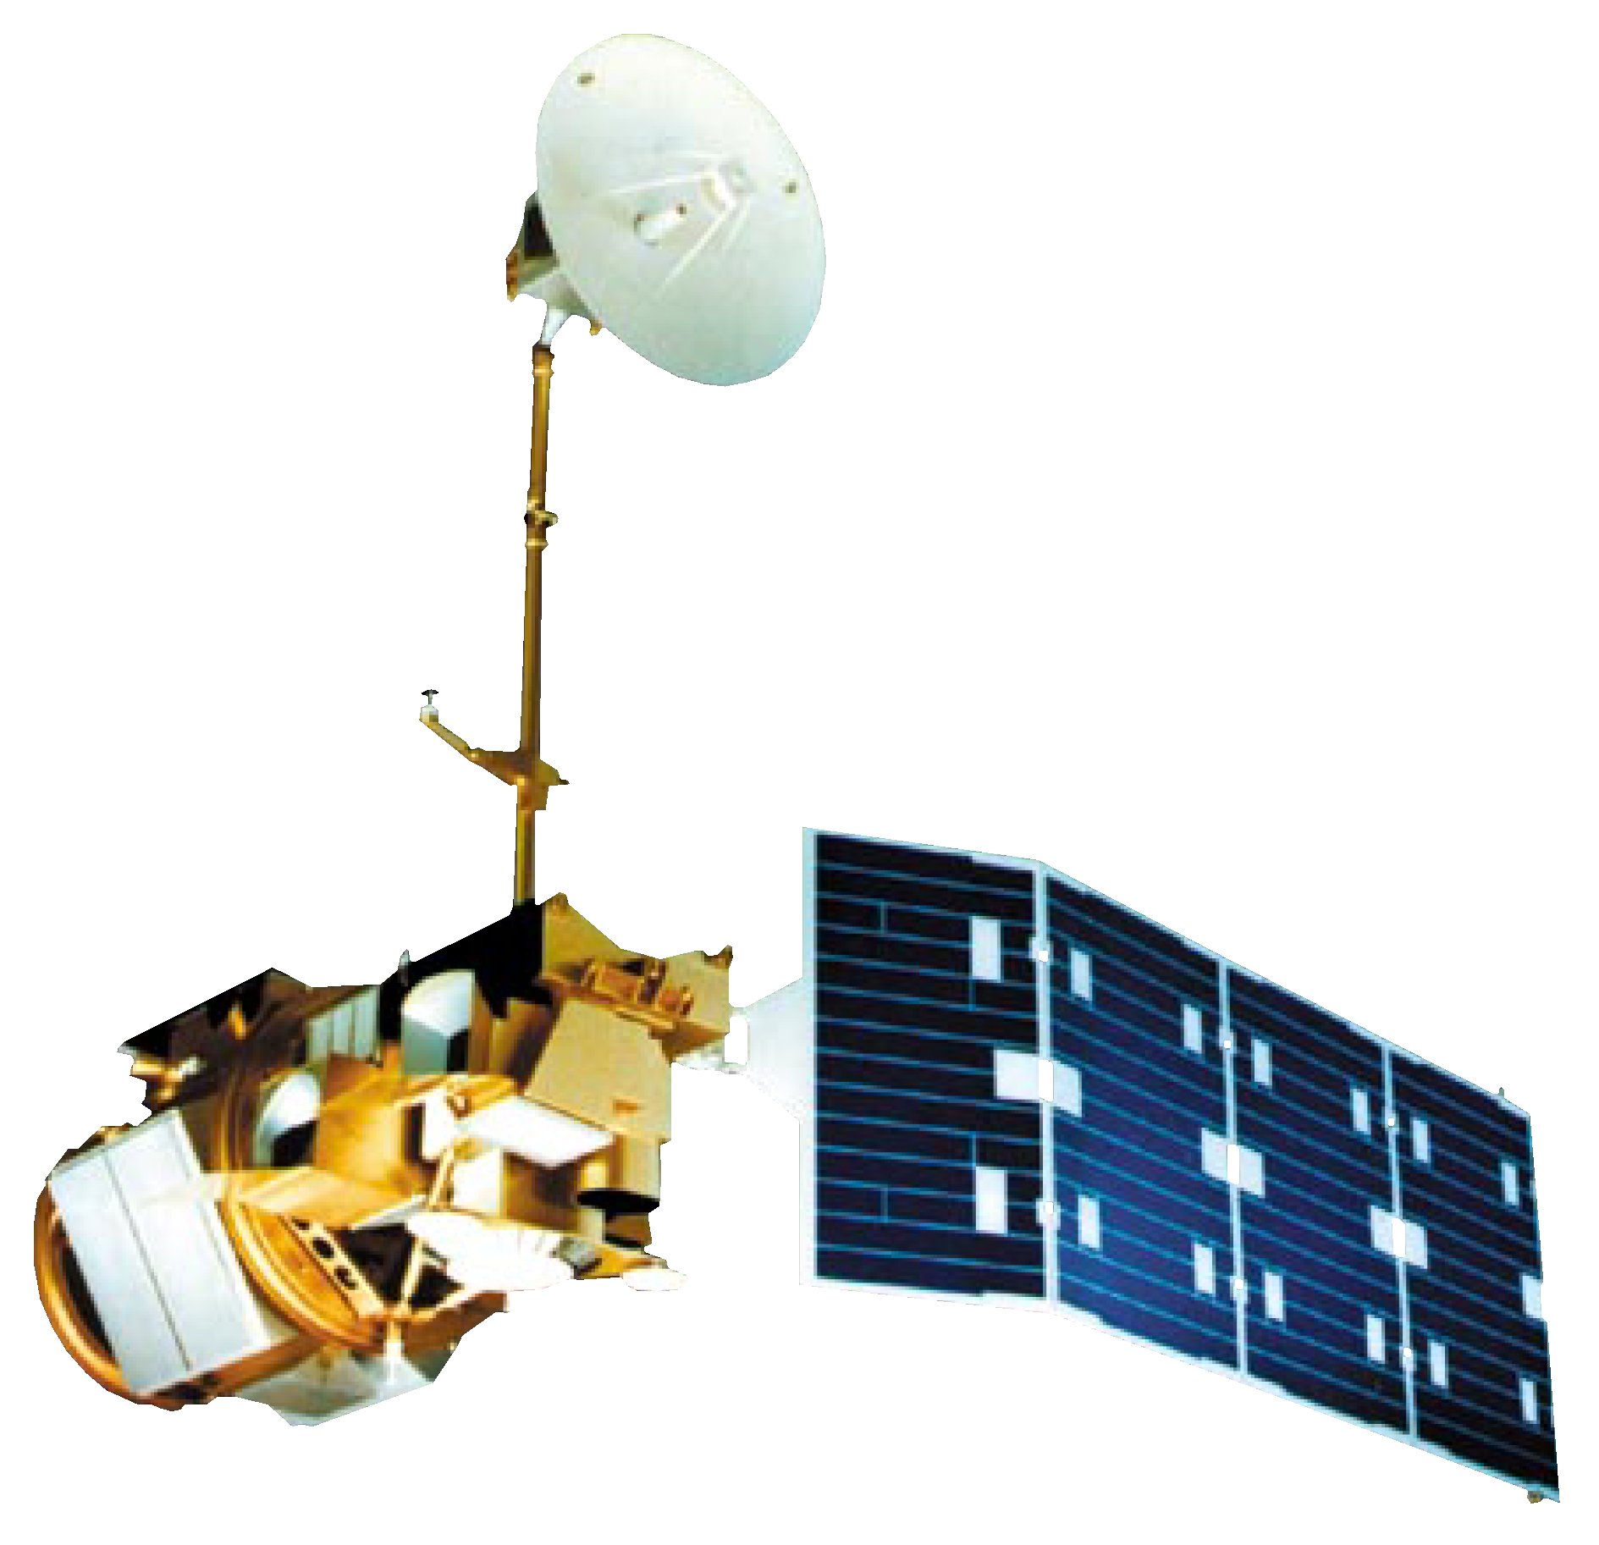
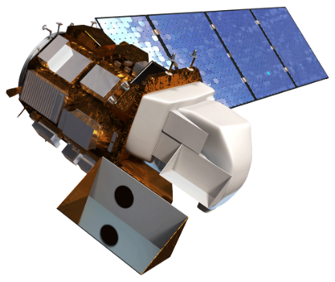
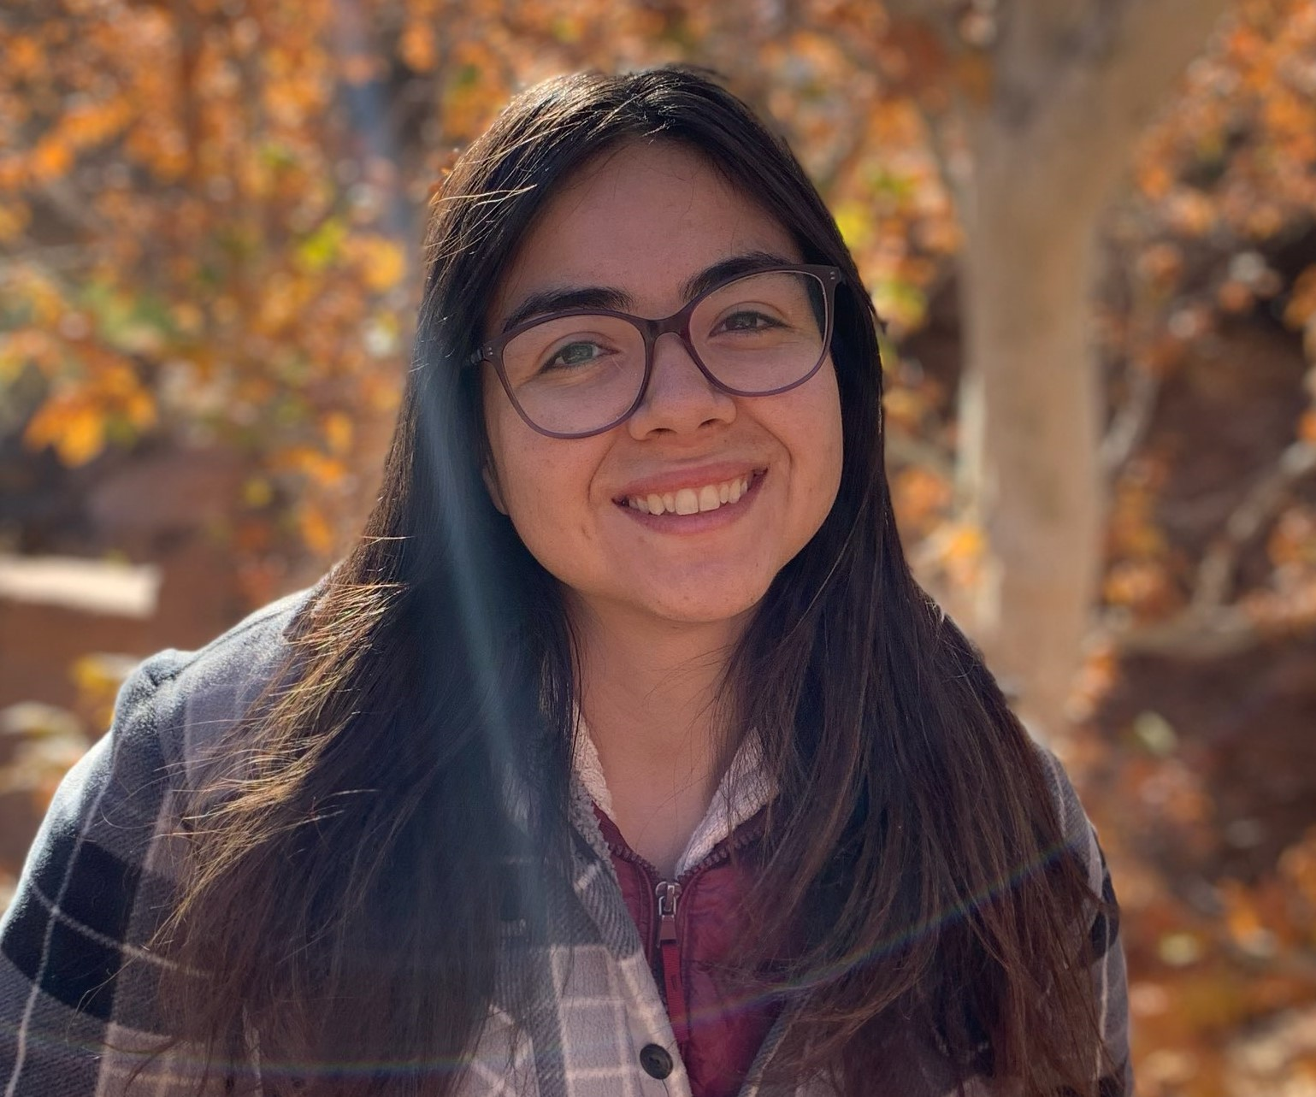
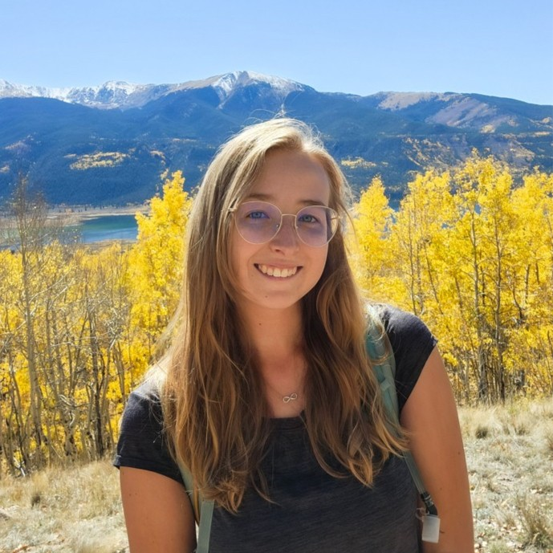
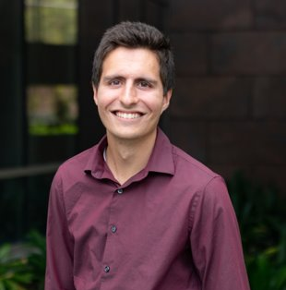
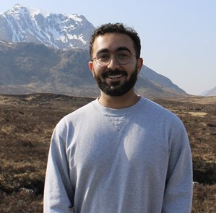
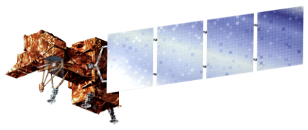
OKLAHOMA & TEXAS AGRICULTURE
Mapping Grassland Productivity on South Central Oklahoma and Texas Ranch Lands to Evaluate Management and Quantify Soil Carbon Fluxes
Project Synopsis
Project Partners
Rangelands are vital ecosystems that serve important ecological and economic functions for both humans and livestock. Composed primarily of grasses, shrubs and dispersed trees, rangelands encompass about 30% of terrestrial carbon stocks. The balance of the carbon cycle on these ecosystems is highly dynamic and exhibits the largest variability in aboveground net primary productivity (NPP) of biomes in North America. Given their broad spatial distribution and their influence on the global terrestrial carbon cycle, there is an urgent need for effective rangeland monitoring and management strategies to sustain rangeland ecosystem health and function. To better assess NPP in rangelands, the team compared several remote sensing derived NPP models, including MOD17, Robinson Landsat NPP_{L30}, Robinson MODIS NPP₂₅₀, and Rangeland Analysis Platform (RAP). This included assessing their influence by vegetation composition to understand how these products are impacted by diverse ranches. Additionally, this project also evaluated the accuracy of RAP's Biomass product using field biomass data as ground truth.
The NASA DEVELOP team partnered with the Noble Research Institute, a non-profit that focuses on guiding farmers and ranchers in applying regenerative principles in agriculture. Other notable partners include Colorado State University and the USDA – ARS.
Results
Mean NPP of Each Model For All Producer Ranches Over Time
10000
MODIS
NPP Models by Vegetation Type (2001-2019)
RAP
Robinson Landsat
8000
Robinson MODIS
Objectives
7500
6000
MODEL
Mean NPP (gC yr ⁻¹ m⁻²)
Compare four existing annual NPP products by spatial scale and vegetation composition to each other between 2001 - 2019
Evaluate Rangeland Analysis Platform (RAP) biomass data to field measured biomass clippings for two Noble Research Institute ranches for 2022-2023
Mean NPP (gC/m²/yr)
MODIS
4000
RAP
5000
Robinson LS
2000
Robinson MODIS
0
2500
Crosstimbers Oak Forest and Woodland
Eastern Cool Temperate Wheat
Great Plains Comanchian Ruderal Grassland
Eastern Cool Temperate Pasture and Hayland
Southeastern Great Plains Tallgrass Prairie
Study Area
2001
2005
2010
2015
2019
Edwards Plateau Limestone Savana & Woodland
Oklahoma and Texas Field Sites
Year
Correlation Analysis of RAP Biomass vs. Field Clipping Data
2022
Corr: 0.16
4000
2023
Corr: 0.43
Oklahoma
3000
3000
2000
RAP Biomass (lbs/acre)
2000
1000
1000
1000
2000
3000
1000
2000
3000
Texas
Field Biomass (lbs/acre)
Ranches:
Noble Sites
Producer Sites
Conclusions
Earthstar Geographics
Robinson MODIS was significantly different from the other models across all years and during wet and dry periods.
Map data ©2015 Google, U.S. Census, 2022, TIGER/Line Shapefile [ESRI Shapefile] Figure 1. General study area map displaying where the Oklahoma and Texas Noble and producer ranch sites are located.
This project takes place within 17 counties throughout Texas and Oklahoma, encompassing 20 partner locations and two Noble Research Institute managed ranches.
Vegetation type proved to be an important factor when comparing these models.
Methodology
RAP Biomass correlated well in 2023 but not in 2022, warranting further investigation to determine the role of drought
RAP
Spatial: 30m Temporal: 16d
LANDFIRE
ArcGIS Pro
ANOVA
Correlation Analysis
MOD17
Spatial: 500m Temporal: 365d
Statistical Comparison
Acknowledgements
Robinson (MODIS)
Spatial: 250m Temporal: 365d
Google Earth Engine
R
The team would like to thank everyone who made this project possible:
Lead: Truman Anarella
Advisors: Dr. Anthony Vorster (Colorado State University); Nicholas Young (Colorado State University)
Robinson (LANDSAT 5, 7, 8)
Spatial: 30m Temporal: 365d
Noble Research Institute
Transect Clipping Data
Biomass and LAI readings from 2 points per transect
Temporal: 28d
RAP Biomass
Spatial: 30m Temporal: 16d
Forage biomass data (pre and post grazing)
Team Members
Earth Observations
Terra MODIS
Landsat 5 TM
Landsat 7 ETM+
Landsat 8 OLI
Ashley Bañuelos
Project Lead
Alyssa Spencer
Joseph Dale
Yezzen Khazindar
Colorado - Fort Collins | Spring 2024
Yezzen Khazindar

